Slide 1
HEARTS P1 Review Meeting
25 September 2024
https://indico.cern.ch/event/1411185/
Thomas Brent / WP2

Slide 2
Outline
Work package two consists of three tasks:
Establish effective communication and data exchange between the partners within the project
Communicate the results of the project to external interested parties
Disseminate the results of the R&D achieved within the project and the knowledge transfer activities to open up the possibility of collaborations with external parties

Slide 3
The outlook of the WP in P1
During RP1, strong progress was made on achieving the objectives of WP2.
Highlight achievements:
Creation of a well-organised website
CERN article on the HEARTS project
Project representation at various in-person events
Creation of a LinkedIn page and regular posting

Slide 4

Deliverables and Milestones in P1
Deliverables
D2.1 Communication and dissemination plan
D2.2 Exploitation and management plan
Milestones
M09. Project website launched (with update and maintenance plan)
M10. Project social media launched

Slide 5
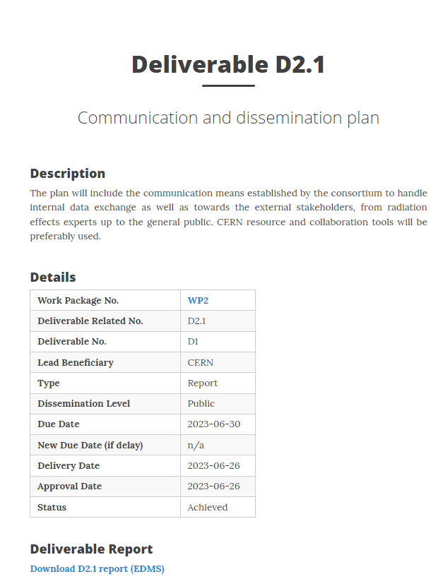
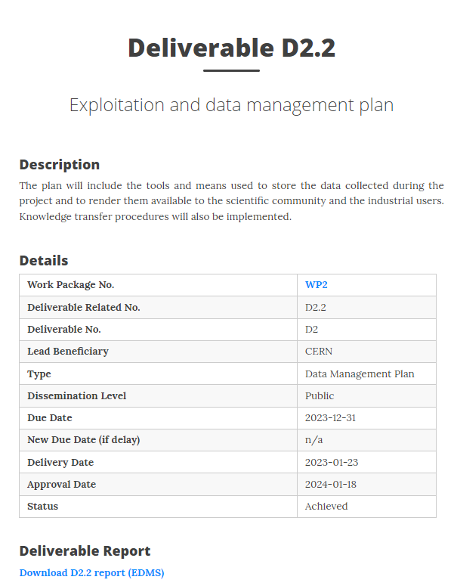
Deliverables in P1
The achieved deliverables are available on HEARTS website page:
https://hearts-project.eu/project/deliverables/

Slide 6
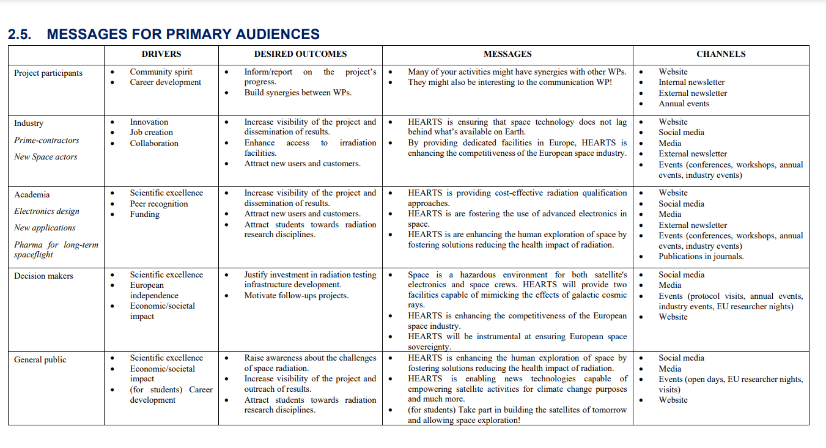
Deliverables in P1 – D2.1

Slide 7
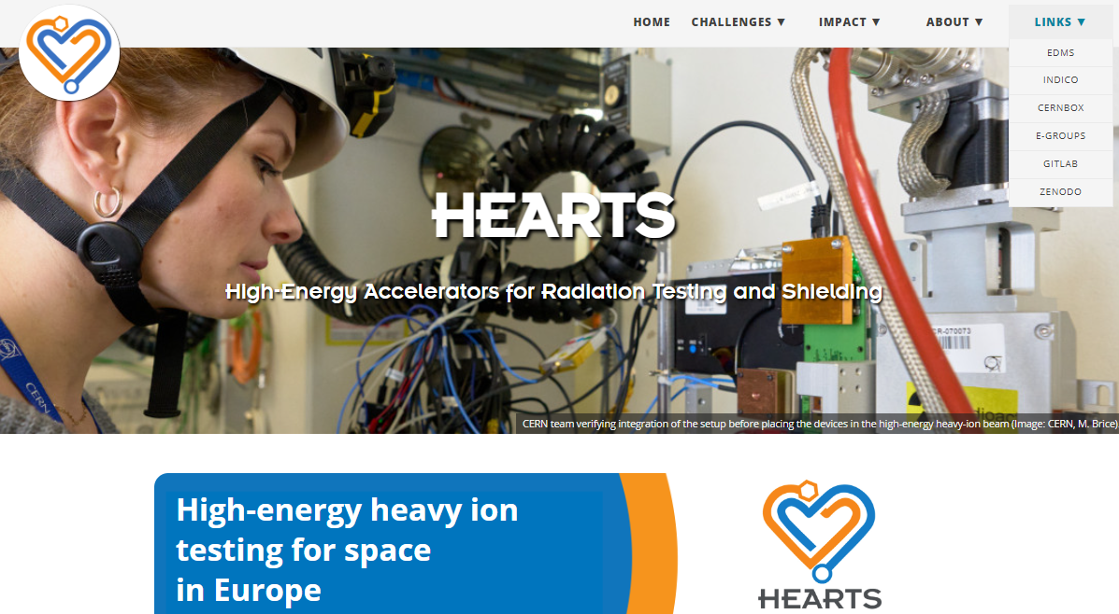
Milestones in P1 - Website

Slide 8
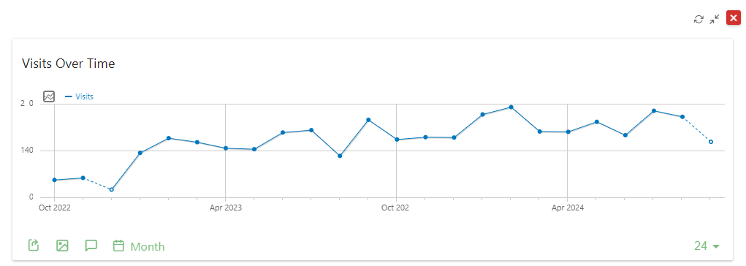
Milestones in P1 - Website

Slide 9
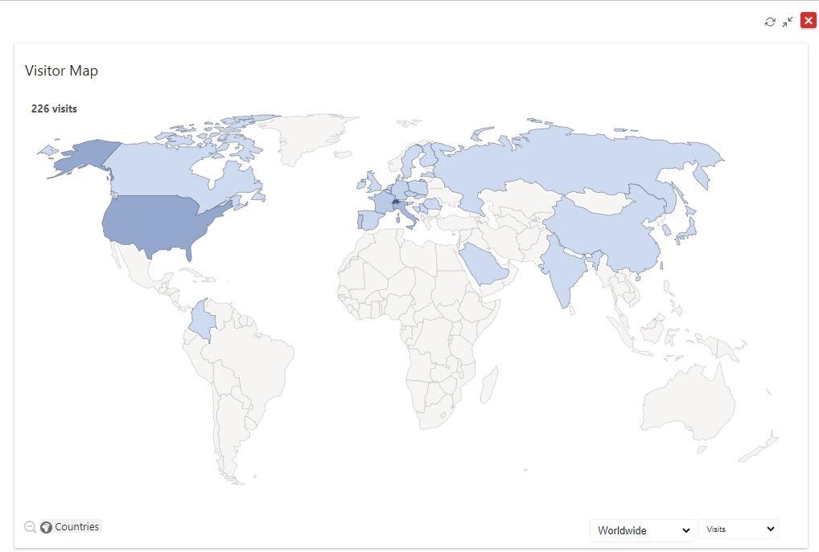
Milestones in P1 - Website

Slide 10
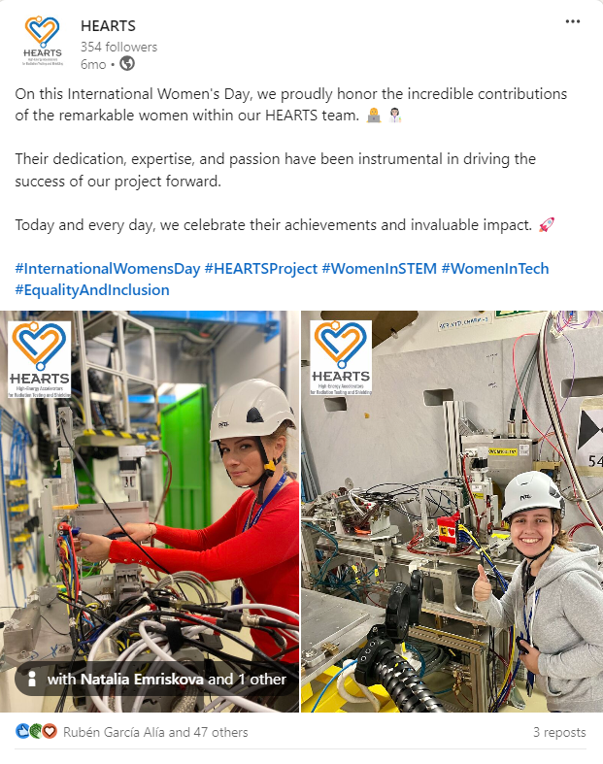
Social media (LinkedIn)
354 followers
13 posts
1000+ page views
441 unique visitors

Slide 11
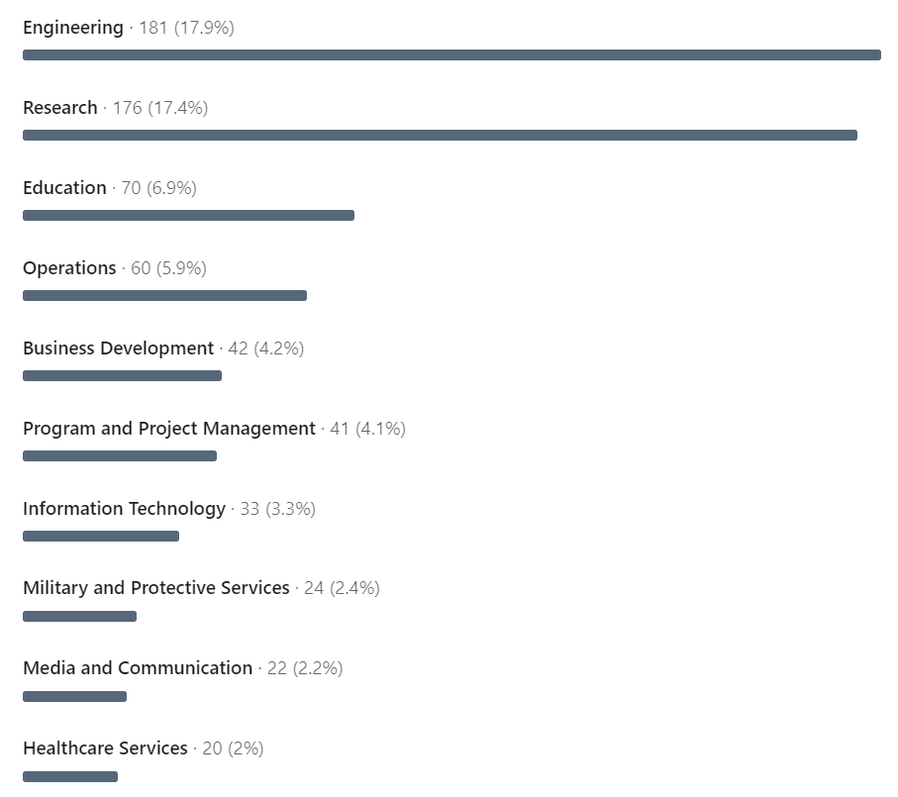
Milestones in P1 – LinkedIn

Slide 12
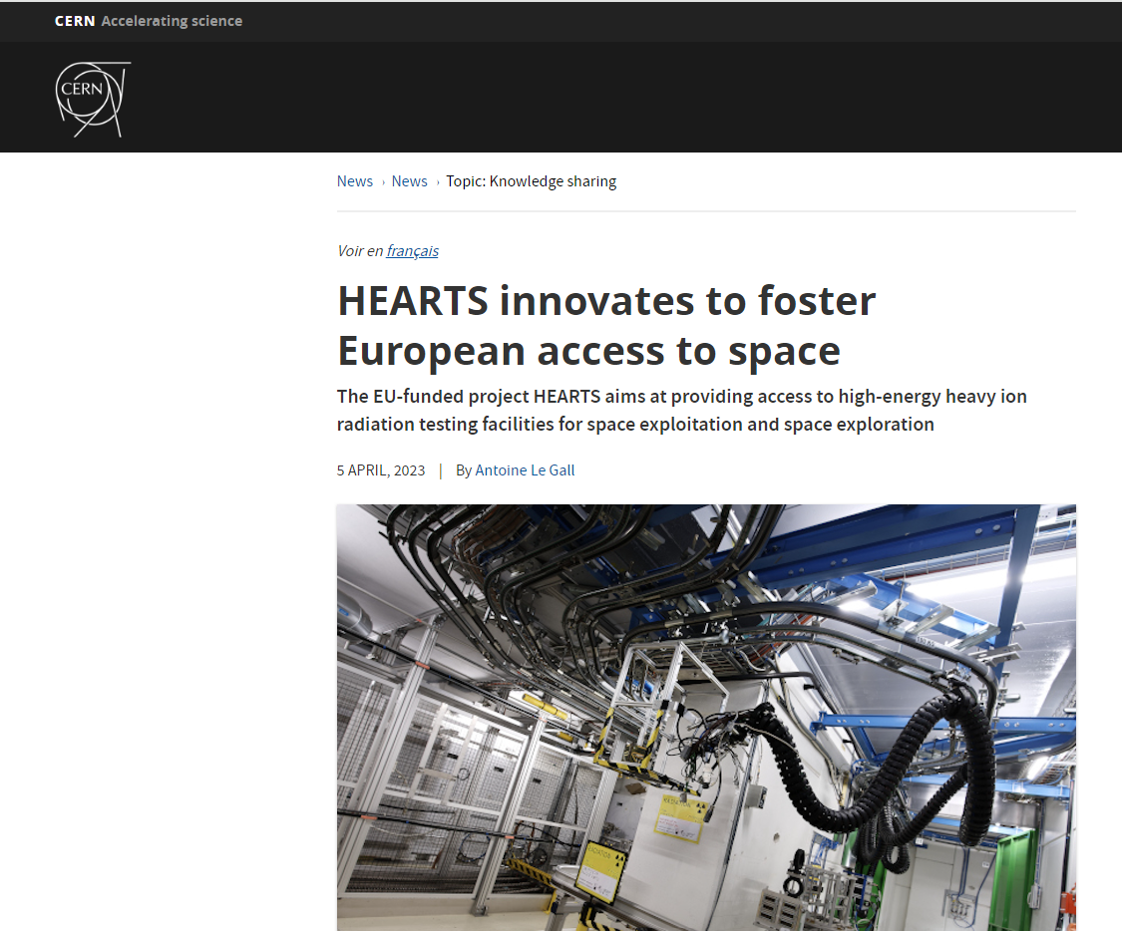
Communications
CERN
Accelerating News

Slide 13
Upcoming Deliverables & Milestones
Deliv. No. | Deliverable name | Due date | Status
D2.3 | Knowledge transfer turnover report | 2025-12-31 | Pending
D2.4 | Final report on communication, dissemination, outreach and exploitation | 2026-12-31 | Pending

Slide 14
Goals moving forwards
Increase LinkedIn visibility
Attract more media attention
Foster future knowledge transfer activities through dissemination of project results

Slide 15
Conclusion
P1 saw the successful achievement of both deliverables and milestones
The HEARTS website serves as external visibility for the project as well as an internal navigation tool
Need to increase number of LinkedIn followers and website visitors

Slide 16
Thank you for your attention.
Questions?

