Slide 1
HEARTS P1 Review Meeting
25 September 2024
https://indico.cern.ch/event/1411185
L.S. Esposito, A. Waets / CERN
on behalf of all WP3 members and contributors

Slide 2
WP3 members
CERN
  Luigi Salvatore Esposito
  Rubén Garcia Alia
  Karolina Klimek
  David Lucsanyi
  Andreas Waets
GSI
  Christoph Schuy
UNIPD
  Marta Bagatin
  Simone Gerardin
  Alessandro Paccagnella
TAS
  Luca Bocchini
  Claudio Cipriani

Slide 3
Outline
W3 timeline
Upcoming Deliverables & Milestones
Task status and progress
Risk assessment
Follow-up of recommendations from previous review
Conclusions

Slide 4
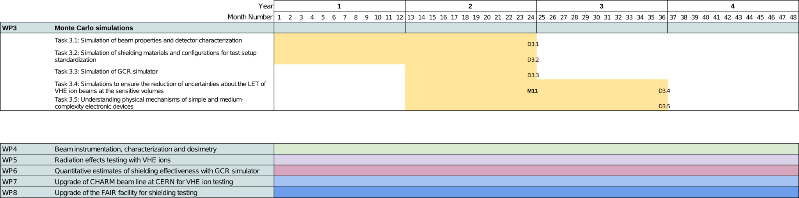
WP3 timeline
Activities in WP3 span over the first 3 years (M1 - M36) of the project
Transversal work package providing support and deliverables to WP4-8
  Characterization of beam conditions, feeding into instrumentation choice, setup standardization
Instrumentation choice
PIN diode characterization
Setup standardization
Simulation of setup
Setup standardization
Beam line simulation
Comparison to
experiments
Comparison
to device
response

Slide 5
Upcoming Deliverables & Milestones
Deliv. No. | Deliverable name | Due date | Status
D3.1 | Numerical characterization of the CHARM beamline and of detector response | 2024-12-31 | Pending
D3.2 | Modelling of shielding materials and configurations for test setup standardisation | 2024-12-31 | Pending
D3.3 | GCR/SPE simulator optimizer software | 2024-12-31 | Pending
D3.4 | Demonstration of LET uncertainty reduction from simulations as a complement to experimental measurements | 2025-12-31 | Pending
D3.5 | Modelling of medium-complexity devices and response to different ion beams | 2025-12-31 | Pending
Milest.No. | Milestone name | Due date | Status
M11 | Release of G4SEE VHE ion tool | 2024-12-31 | Pending
No deliverables or milestones were due in P1

Slide 6
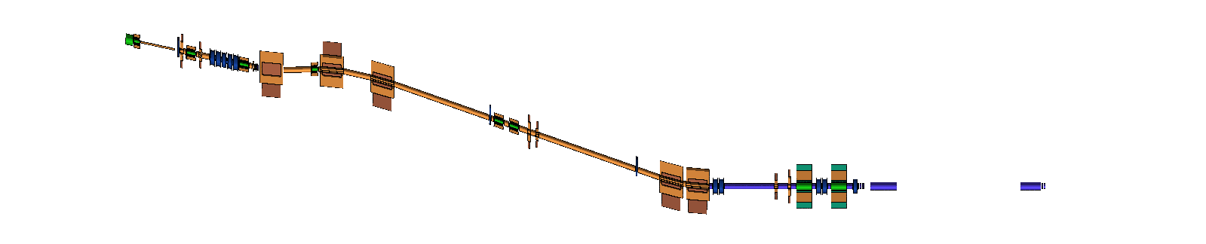
Task 3.1: Simulation of beam properties and detector characterization (CERN)
Detailed Monte Carlo simulations of the VHE ion beam transport through the T08 beam line at CERN were carried out
A dedicated geometry of the T08 beam line was constructed relying on the optics settings used during operation, dimensions from technical drawings and in-person inspections
Using FLUKA, a more fundamental and in-depth description of the beam and radiation environment was obtained and multiple configurations and related optimizations in parallel could be explored (directly feeding into WP7)
The properties determining the beam quality are:
  beam line transmission
  beam profile
  beam energy and spread of energy distribution
  LET and spread of LET distribution

Slide 7
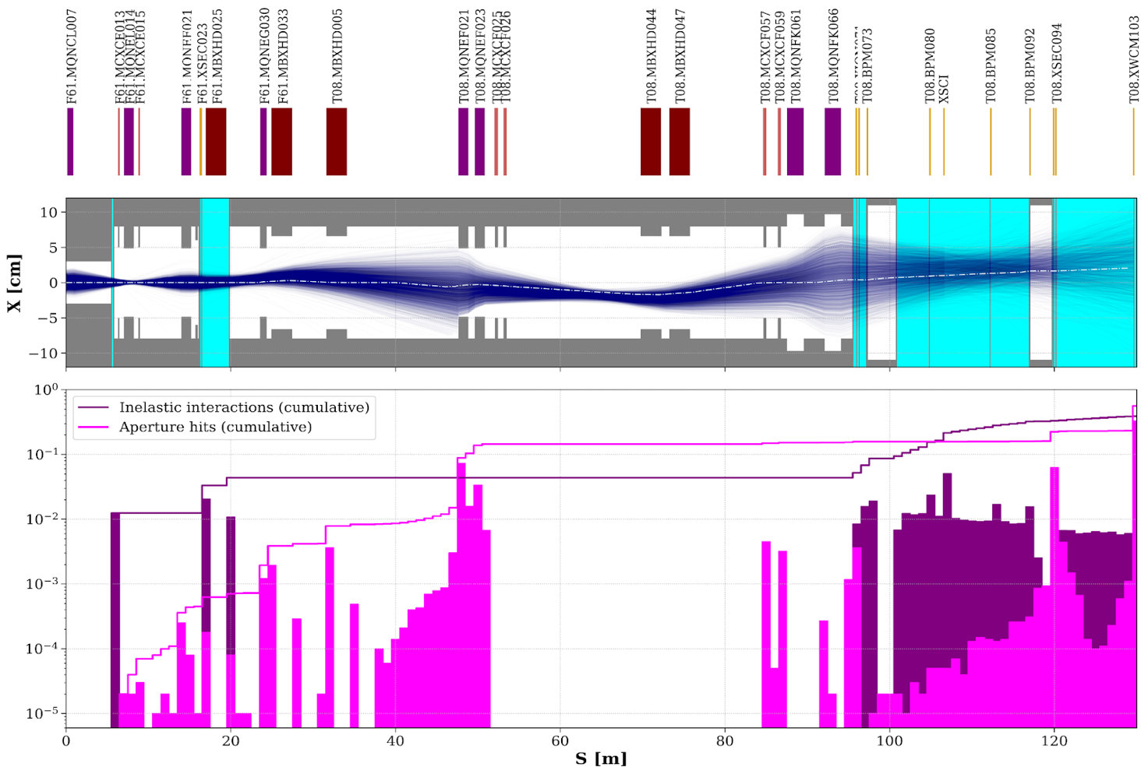
Task 3.1: Simulation of beam properties and detector characterization (CERN)
“Loss maps” give insight into the physical processes that determine the resulting radiation field at the DUT
Aperture hits are prevalent where:
  the beam is defocused by the quadrupole magnets
  non-vacuum sectors (scattering)
Inelastic interactions causing the primary beam to fragment and generate lower-LET ions and other secondary particles:
  Non-vacuum sectors (including beam instrumentation and vacuum windows)

Slide 8
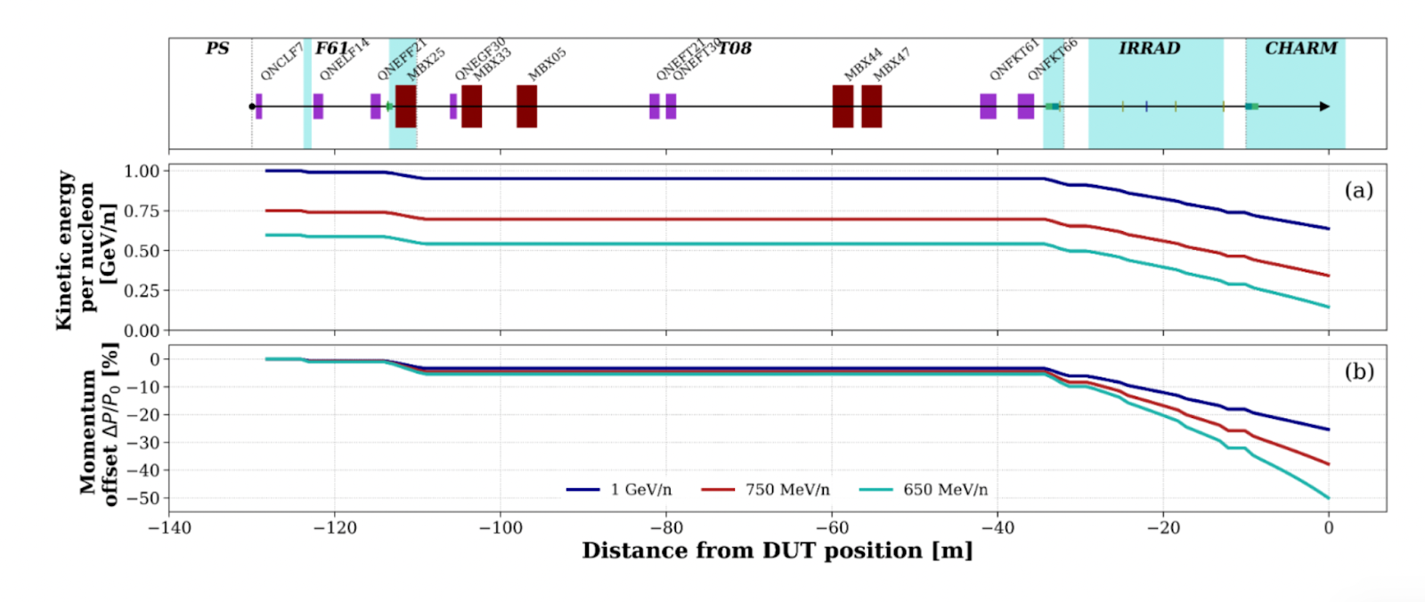
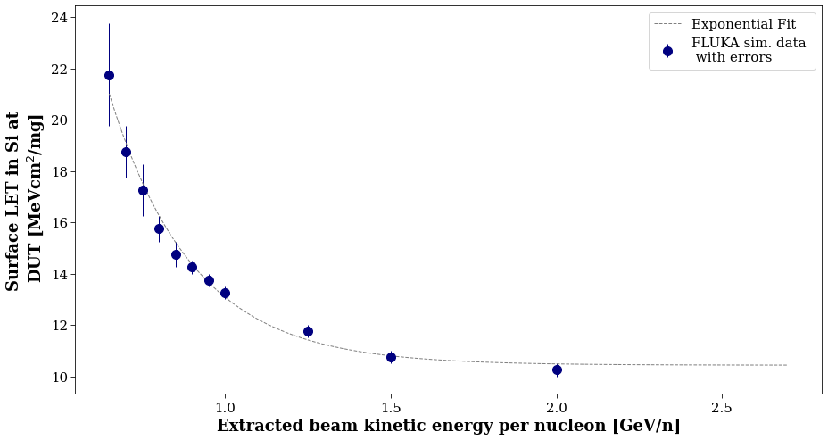
Task 3.1: Simulation of beam properties and detector characterization (CERN)
Material budget in the beam line causes a significant amount of energy straggling: the beam extracted from the Proton Synchrotron at a certain energy will arrive at the DUT position at a significantly reduced energy
Minimum energy limit for extraction and transport to CHARM set to 650 MeV/n

Slide 9
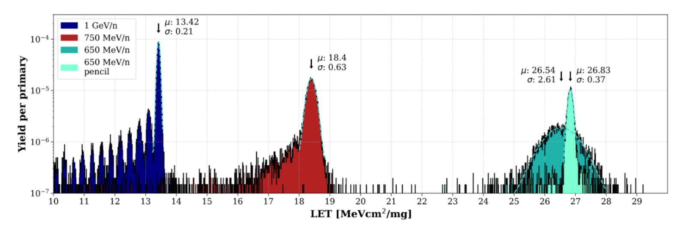
Task 3.1: Simulation of beam properties and detector characterization (CERN)
Spread of the primary beam LET distribution is an important dosimetric information for the users who are generally used to a single LET value in standard energy heavy ion facilities
Deviations from the desired LET value of the DUT radiation field result from ion fragments and other secondary particles present in the beam

Slide 10
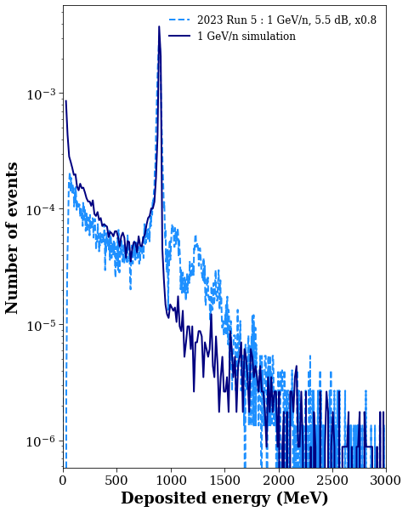
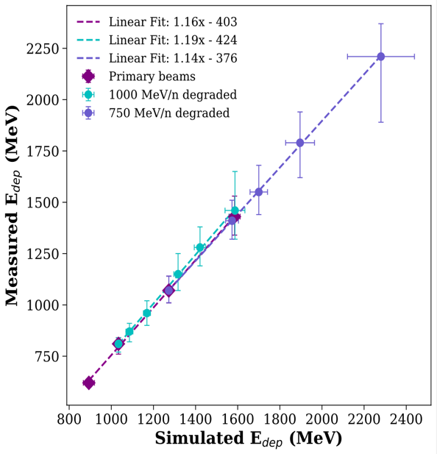
Task 3.1: Simulation of beam properties and detector characterization (CERN)
A good agreement between the simulated and measured energy deposition spectra is observed
Energy deposition only offers an indirect indication of the beam LET, However, this agreement offers sufficient confidence that the silicon diode in combination with FLUKA simulations can determine the LET as one of the key dosimetric quantities
Comparison between simulated and measured peak energy deposition values show an excellent agreement. This correlation also serves as a calibration of the instrument

Slide 11
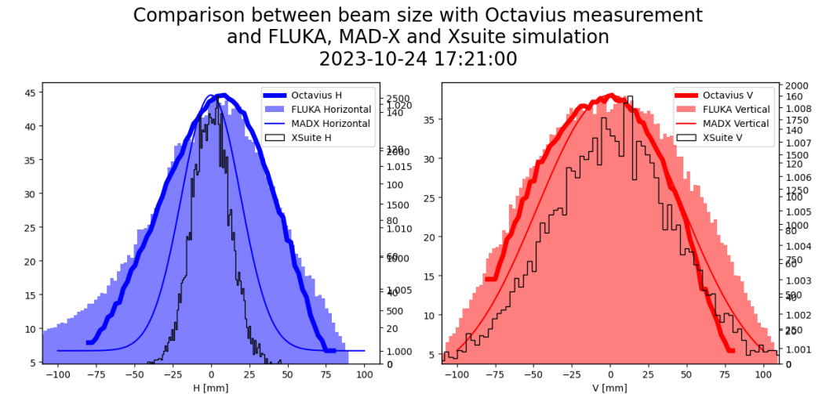
Task 3.1: Simulation of beam properties and detector characterization (CERN)
Excellent agreement between
  FLUKA
  PTW Octavius array
  Multi-Wire Proportional Chamber
In conclusion, the FLUKA simulation model and workflow has been shown to be an excellent tool for the numerical characterization of the beam line

Slide 12
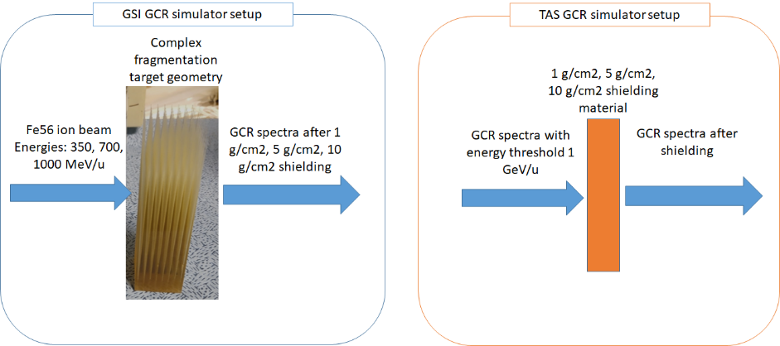
Task 3.2: Simulation of Shielding Materials (TAS-I)
GRAS and Geant4 Monte Carlo preliminary simulations have been performed to:
identify a suitable set of relevant parameters to be considered in the standardized setup definition for shielding materials testing
prepare a simulation setup to include the GPS source provided by GSI, representative of the GCR simulator
Simulation cases summary

Slide 13
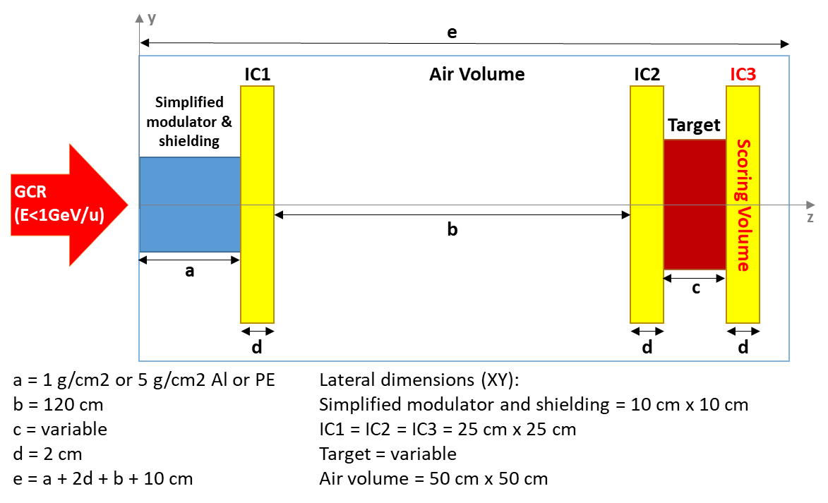
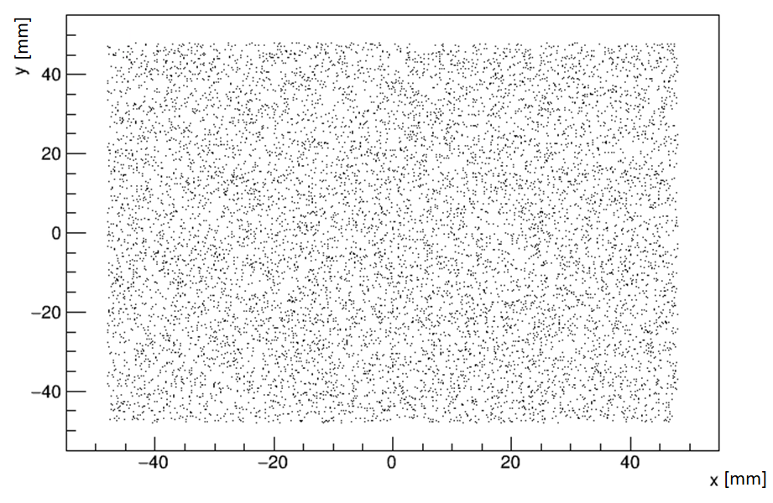
Task 3.2: Simulation of Shielding Materials – Geometry (TAS-I)
Simplified simulation setup used in TAS-I simulations
Source Sampling Geometry

Slide 14
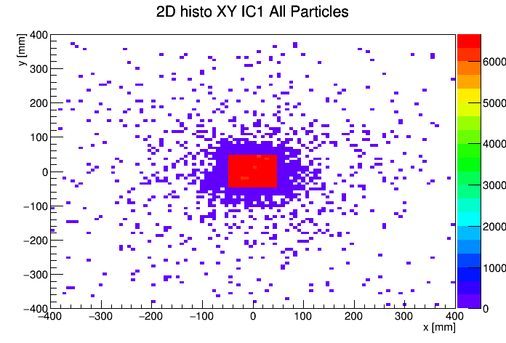
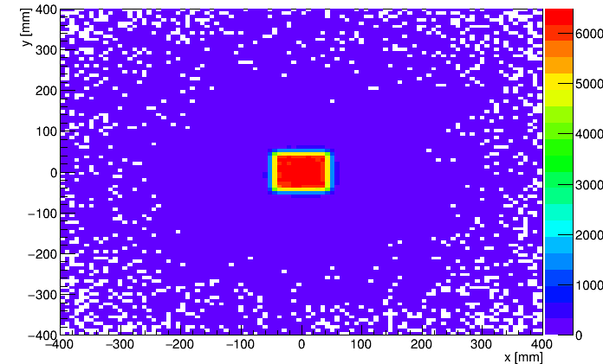
Task 3.2: Simulation of Shielding Materials – Setup (TAS-I)
Upstream and downstream ionization chambers particle distribution
GCR spectra
  CREME96 model as particle source
  Energy <=1 GeV/n (imposed by the GSI accelerator facility)
  All particle species from H to Fe56 simulated
Results evaluation parameter
  To evaluate the lateral scattering induced by the target dimensions and modulator thickness and material, the RMS of the particle position distribution has been calculated (results briefly summarized in the following charts)

Slide 15
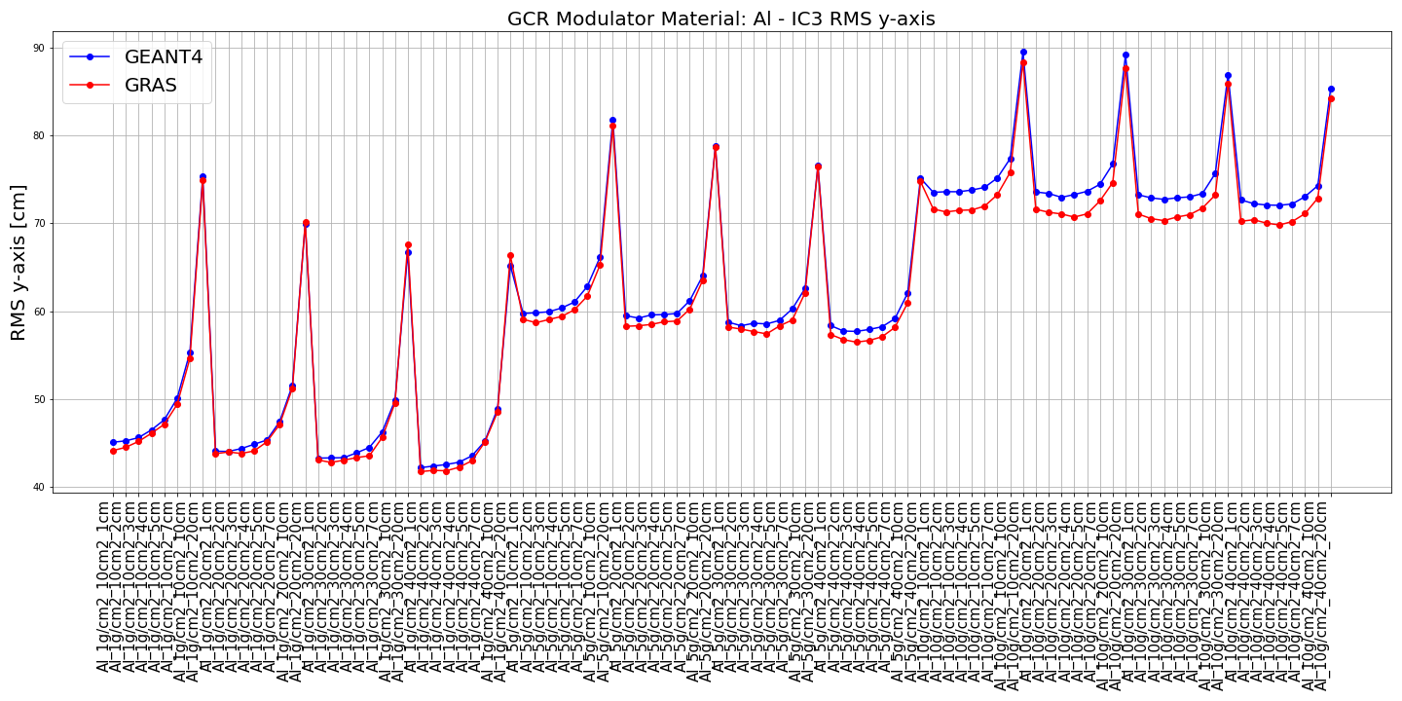
Task 3.2: Simulation of Shielding Materials – Results & Future Work (TAS-I)
10 g/cm2 mod
QBBC_EMY Physics list is used
The Geant4 (v4.10.05p01) and GRAS (v3.3) results show good agreement
Similar results are obtained for PE modulator
Upcoming activities
Benchmark simplified TAS-I setup vs GSI GPS (phase space file), done in close collaboration with GSI
Preliminary dose reduction simulations of selected shielding/spacecraft materials in a simplified setup
Modelling of realistic experimental setup to establish a representative standardization approach, in close collaboration with GSI
5 g/cm2 mod
1 g/cm2 mod
20cm x 20 cm
10cm x 10 cm
30cm x 30 cm
40cm x 40 cm

Slide 16
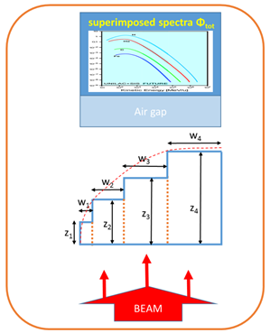
Task 3.3: Simulation of GCR/SPE simulator (GSI)
Objective:
  Enhance simulation capabilities of the GCR/SPE simulator, which aims to find material weights for given material thickness to reproduce target function
Key Focus Areas:
  Development of templates and standards for modulator base data and full setup geometry simulations
  Simplified simulation strategies like providing a GSI-GCR phase space
  Standardized interaction with GSI's HPC cluster
  New Python-based optimization tool (instead of the original approach based on C++ and ROOT)
Material weights
Material thickness

Slide 17
Task 3.3: Simulation of GCR/SPE simulator (GSI)
Optimization Tool Benefits:
  Ease of use (no compilation, Jupyter notebook compatibility)
  Access to external libraries for agile development
  Broader potential contributor base due to Python usage
Next Activities:
  Test, finalize and evaluate new tools
  Open internal development Git repositories to the external users (wherever possible and reasonable)
Material weights
Material thickness

Slide 18
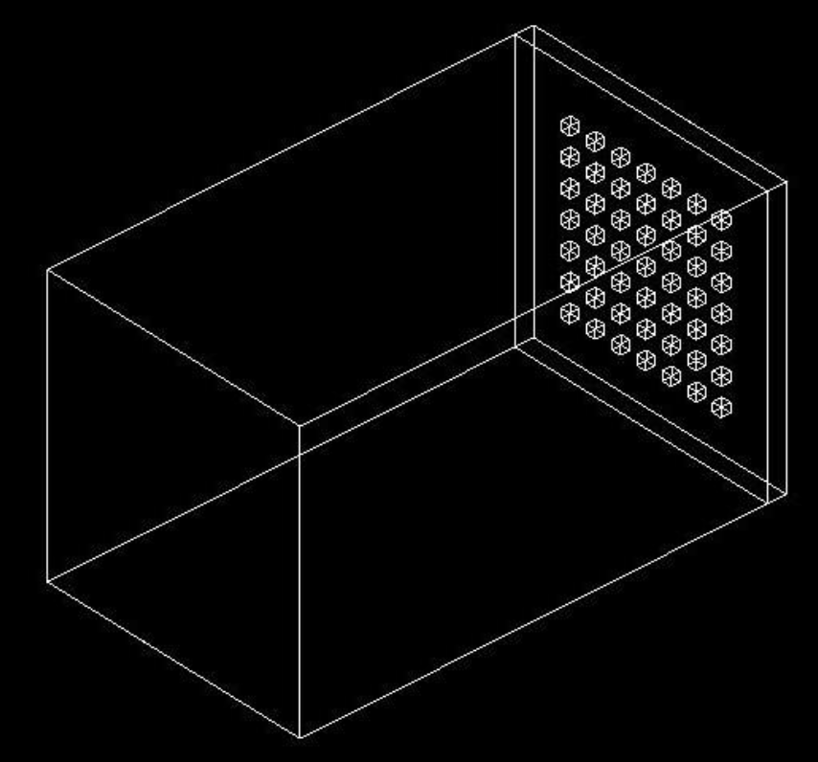
Task 3.4: Simulations to Reduce LET Uncertainties (UniPD)
Objective: Study uncertainties in energy deposition and LET for VHE ions impacting small sensitive volumes
Model: UniPD has developed a simple but effective model using Geant4
Key Features:
  Array of small silicon cubes representing sensitive volumes (reversed-biased –n junctions,
  Configurable parameters (size, pitch, overlayer material and thickness)
  GDML description for easy import into Geant4 codes

Slide 19
Task 3.4: Simulations to Reduce LET Uncertainties (UniPD)
Current Focus:
  Simulations to compare energy deposition and LET uncertainties between VHE ions and particles from commonly used accelerators and HEARTS
Future Work:
  Analyse simulation results to gain insights into LET uncertainties
  Develop strategies to reduce these uncertainties for VHE ion testing
  Explore synergies with G4SEE

Slide 20
Task 3.5: Understanding physical mechanisms of simple and medium-complexity electronic device (UNIPD)
Objective: Elucidate physical mechanisms underlying the response of electronic devices to VHE heavy ions
Test devices:
  pin (p-intrinsic-n) diode (simple) and 3D NAND Flash memories (medium complexity)
  Physical devices are or will be available for a direct comparison with experimental data
Models:
  TCAD model of a pin diode (developed using Synopsys Sentaurus device simulator) is currently being calibrated
  GDML descriptions of pin diode and 3D NAND Flash memories for Geant4 simulations

Slide 21
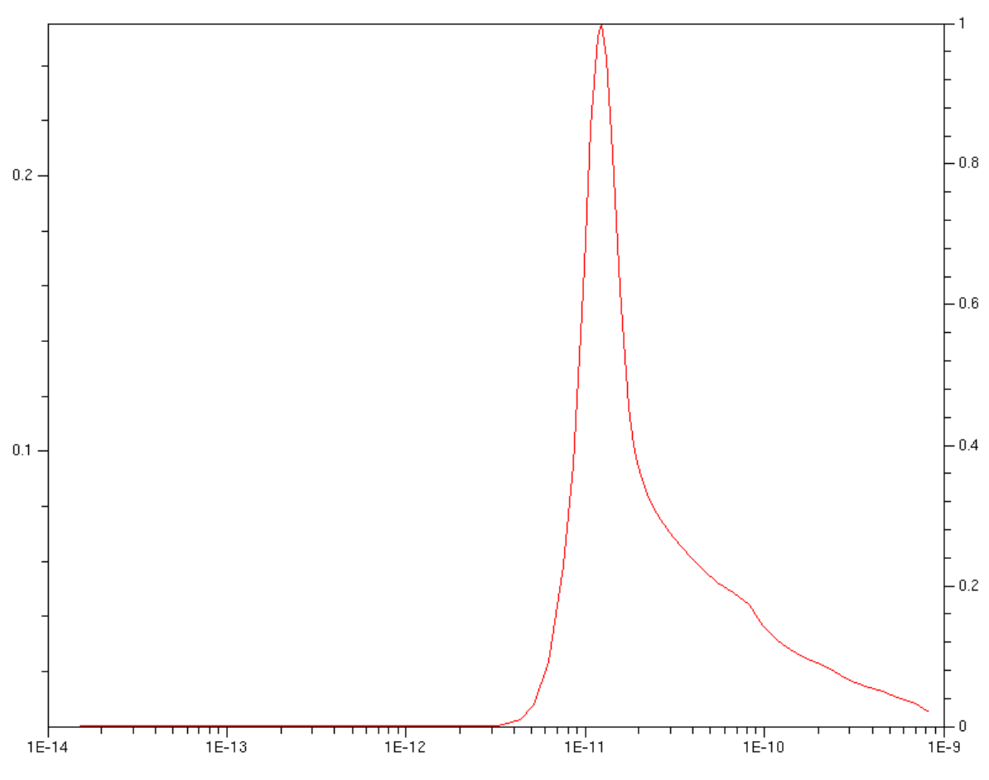
Task 3.5: Understanding physical mechanisms of simple and medium-complexity electronic device (UNIPD)
Current Focus:
  Preliminary transient simulations of pin diode at various biases, akin to Mirion pin diodes (to be tested at CERN and GSI)
  Development of Python script to change dimensions and materials in 3D NAND Flash memory models
Future Work:
  Compare simulation results with experimental data from CERN and GSI campaigns
  Investigate variability in measured energy deposition and charge losses
  Gain insights into the physical mechanisms influencing device responses to VHE ions
Transient waveform simulated with TCAD software in a pin diode
Normalized current
Time [s]

Slide 22
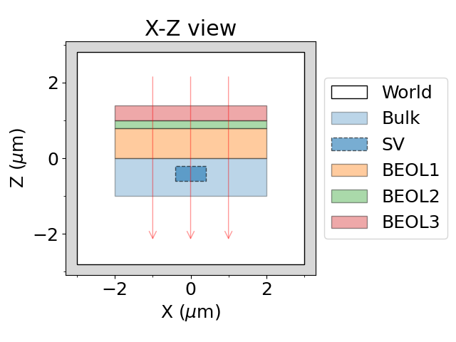
Milestone 11: G4SEE VHE Ion Tool
Achievement: Successful development of G4SEE, a Geant4-based Single Event Effect simulation toolkit
Motivation: Lack of open-source SEE simulation tools and limited access to proprietary tools
Key Features:
  Physics-based Monte Carlo particle transport in microscopic volumes
  Dedicated event-by-event energy deposition scoring
  Released as free and open-source code
Multi-layer, micro-metric geometry used in a G4SEE simulation to obtain energy deposition in Sensitive Volume (SV) inside Bulk and below Back End Of Line (BEOL) layers

Slide 23
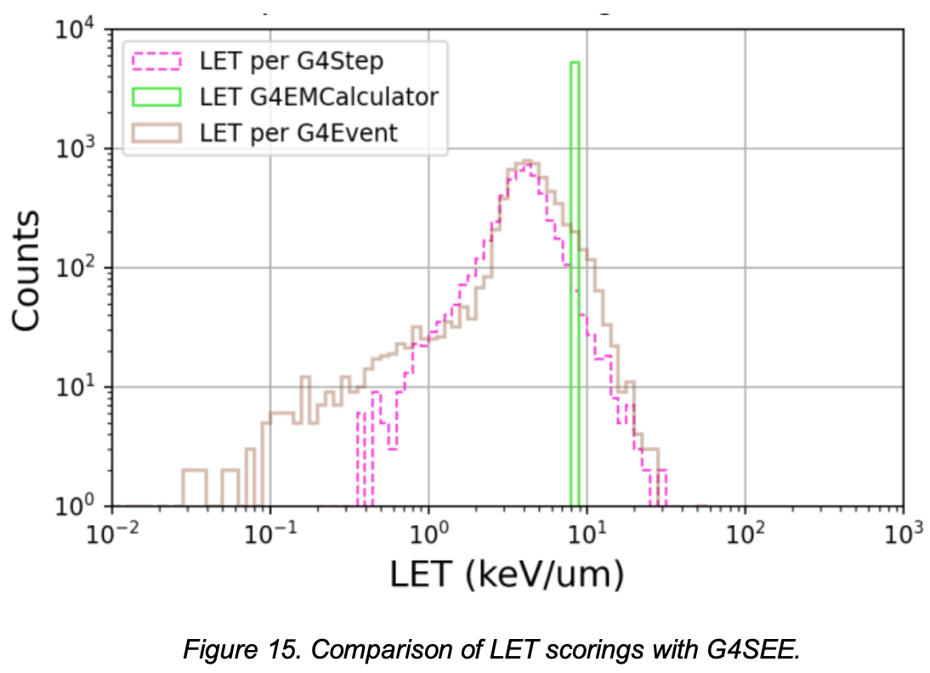
Milestone 11: G4SEE VHE Ion Tool
New Features for HEARTS and VHE Ion Simulations:
  LET scoring of individual particles
  Energy deposition per nuclear reaction scoring
  Capability to run non-analog Monte Carlo simulations for heavy ions
Upcoming Release:
  G4SEE VHE ion tool to be released in December 2024
  Includes all new features, updated documentation, and simulation examples/tutorials
  Will be publicly available on the G4SEE repository
G4SEE website:​ cern.ch/g4see
Open-source repository: gitlab.cern.ch/g4see
Open-access publication: 10.1109/TNS.2022.3149989
User forum: g4see-forum.web.cern.ch

Slide 24
Risk Assessment
No Delays: All tasks are progressing as planned, with no anticipated delays in achieving the deliverables and milestones.
No Critical Risks Materialized: The identified critical risks in the Grant Agreement have not materialized during P1.

Slide 25
Follow-up of recommendations from previous review
Development of a user-friendly tool for calculating the incident LET based on the component’s material composition and beam path
Progress:
  Development of a dedicated HEARTS tool has been initiated
  Thanks to the collaboration with NSRL, they have now incorporated lead as a primary ion in their stack-up tool (released on 9th August 2024)

Slide 26
Conclusion
Significant progress has been made all tasks in developing and validating simulation models and tools for beam characterization, shielding material assessment, and understanding the effects of VHE ions on electronic devices.
Deliverables 3.1, 3.2 and 3.3, and Milestone 11 are on track to be completed in due time (31.12.2024)

Slide 27
Thank you for your attention.
Questions?

