Slide 1
HEARTS P1 Review Meeting: WP4
25 September 2024
https://indico.cern.ch/event/1411185/
Tim Wagner
Uli Weber
GSI

Slide 2
Outline
Reminder about WP4 Tasks
Status of WP4 Tasks
WP4 Deliverables and Milestones
Plans for the future
Conclusion

Slide 3
Tasks & Objectives
Task 4.1: Knowledge transfer between CERN and GSI (CERN & GSI, M1 – M12)
  Exchange on beam instrumentation and characterization methods
  Visit of CERN colleagues to GSI to see beam instrumentation in Cave A
  Discussion with related experts
Task 4.2: Calibration of beam instrumentation for VHE ion beam extraction (CERN, M1 – M24)
  Calibration and exploitation of existing beam instrumentation
  Identification and installation of new beam instruments and detectors
  Closely linked to Task 3.1 and Task 7.2
Task 4.3: Beam delivery monitoring (GSI, M12 – M36)
  Define necessary beamline instrumentation for beam monitoring during space radiation testing
  Platform should handle both high intensities (10⁸ – 10¹⁰ ions/s) for shielding measurements and low intensities (10² – 10⁵ ions/s) for SEE cross-section measurements
  Dedicated set of dosimeters, thin gas ionization chambers and plastic scintillators

Slide 4
Tasks & Objectives
Task 4.4: Target Station (GSI, M12 – M36)
  Optimization of GSI sample handling to increase TRL
  Remotely controlled holder for microelectronics with input from industrial partners
  Automatic placement and removal of material for shielding measurements
  Standardization between GSI and CERN device under test (DUT) holder
Task 4.5: GCR/SPE simulator dosimetry (GSI, M24 – M36)
  Definition and standardization of Dosimetry-on-target
  Explore possibility of microdeosimetry behind shielding to characterize the quality factor Q of the mixed field
  Dedicated measurements for the GCR/SPE simulator measuring the LET spectrum and charge composition of the mixed field
Task 4.6: Intercomparison between CERN and GSI (CERN & GSI, M24 – M48)
  Transfer of experience between CERN and GSI
  Dedicated comparison measurement between the facilities (e.g. with the same beam instruments and reference electronics)

Slide 5

Status Task 4.1: Knowledge transfer between CERN and GSI (CERN & GSI) [1/2]
Knowledge Transfer Meeting at GSI on 20.04.2023
  Participants from GSI, CERN and Univ. Oldenburg
Discussions about:
  The challenges at each of the two facilities
  Dosimetry detectors used for beam characterization and monitoring
  Plans for a comparison measurement between the standard detectors available CERN and GSI
  → Beamtime October 2023 @ CERN (see Task 4.6)
Picture by: A. Waets, CERN

Slide 6
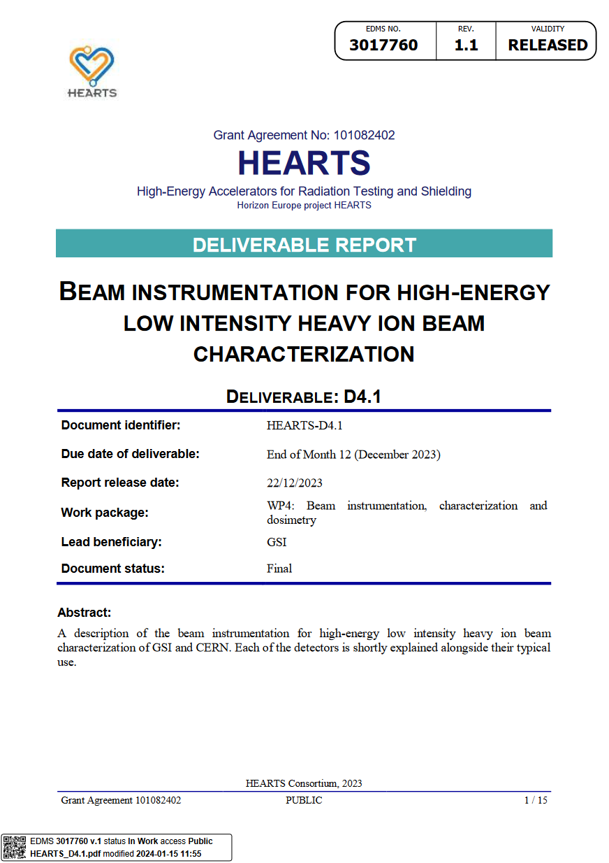
Status Task 4.1: Knowledge transfer between CERN and GSI (CERN & GSI) [2/2]
Deliverable D4.1: Beam instrumentation for high-energy low intensity heavy ion beam characterization
Reporting on the different detectors used for characterization and monitoring used at CERN and GSI
  Examples GSI: Parallel Plate Ionization Chamber; Scintillators; various standard dosimetry detectors (Farmer Chambers, etc.); Octavius detector; and more
  Examples CERN: Silicon diode; Secondary emission chambers (XSEC, XION); Multi Wire Proportional Chamber

Slide 7
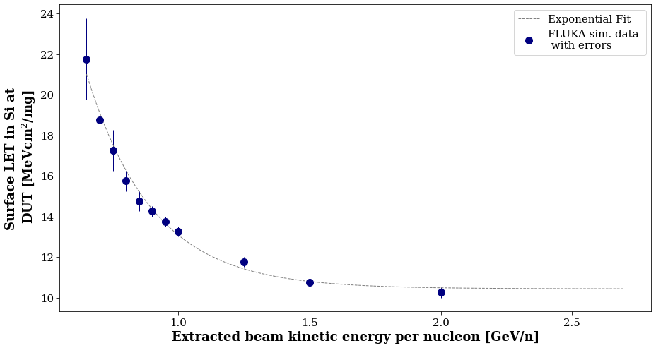
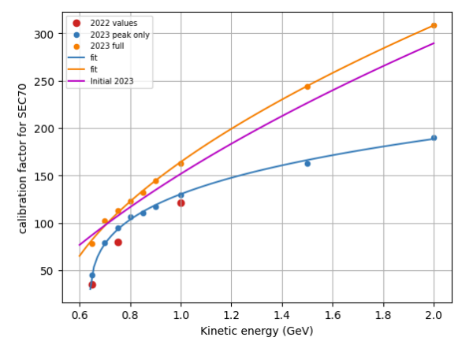
Status Task 4.2: Calibration of beam instrumentation for VHE ion beam extraction (CERN) [1/2]
CERN approach: accurate provision of LET and flux/fluence as dosimetric quantities for users as function of extracted beam energy.
Energy/LET and flux/fluence calibration achieved after Oct. 2023 test campaign (further detailed in WP7)
Calibration using energy deposition measurements using Si diode at DUT + beam line simulations in FLUKA to extract LET
Calibration of relative beam monitor signal (emission chambers), provided by Si detector at DUT
LET
Flux/fluence

Slide 8
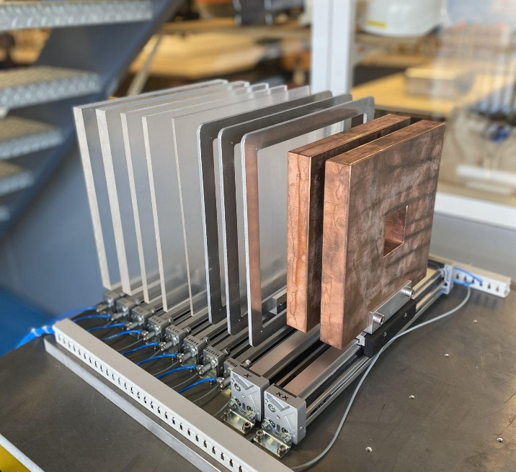
Status Task 4.2: Calibration of beam instrumentation for VHE ion beam extraction (CERN) [2/2]
PMMA degraders
  24 * 24 cm² area with thicknesses between 0.5 mm and 40 mm
  Used to reduce the beam energy to increase the available LET range
Two copper collimators / collimators
  20 * 20 cm² area and 3 cm thick
  Square cutouts in the center to cut off the tails of a broad Gaussian beam and achieve a uniform irradiation area
Full list of PMMA degrader thicknesses:
0.5 mm, 1 mm, 2 mm, 4 mm, 8 mm, 10 mm, 20 mm & 40 mm
Picture by: CERN

Slide 9
Status Task 4.3: Beam delivery monitoring (GSI)
Standard GSI beam monitoring detectors:
  Parallel Plate Ionization Chambers (Used for medium to high intensities)
  Scintillators (Used for low intensities, as single particles are counted)
Calibration detectors:
  Farmer Chamber
  Octavius detector array
  Various other absolute dosimetry detectors, e.g., Pinpoint, Markus Chamber, etc.
All of the above detectors are described in D4.1 in detail
Exploration of addition of a position sensitive detector to the beamline instrumentation of Cave A
  Possibility to always monitor the beam position during the irradiation
  Possible options: multi-wire proportional chamber (MWPC) or silicon strip detector
Exploration of the addition of microdosimetric spectra as part of the standard dosimetry for Cave A

Slide 10
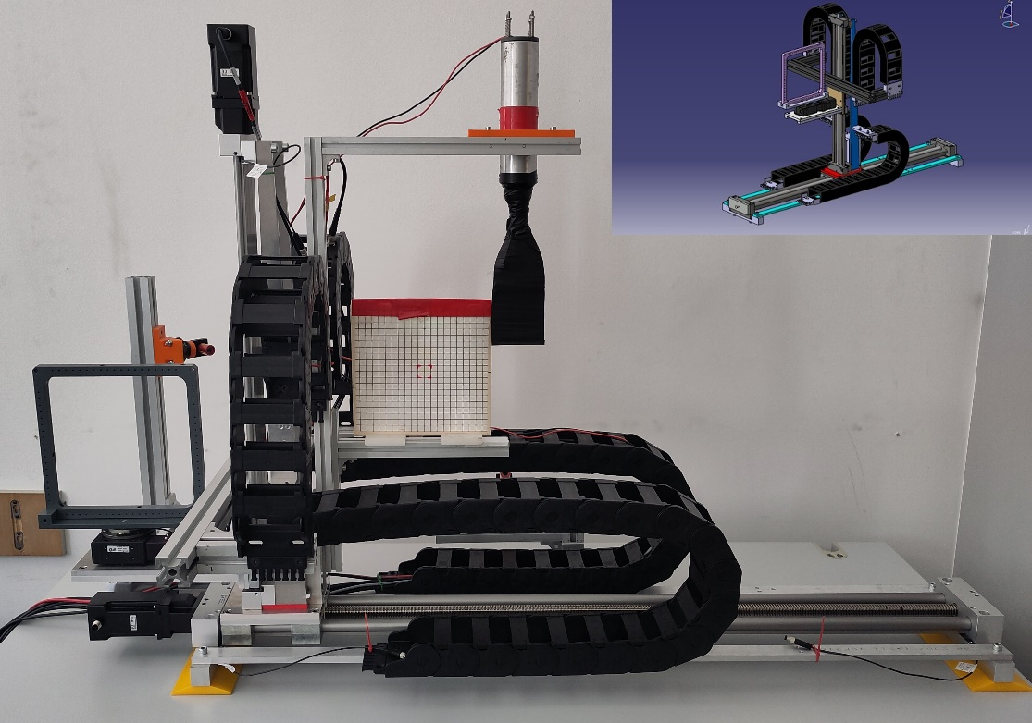
Status Task 4.4: Target station (GSI) [1/4]
Movement in 2 dimensions + 1d rotation possible
  2d movement for the positioning of the sample
  1d rotation for irradiation with grazing angles, if desired by the use
Compatible with the “ESA standard frame” (according to the recommendation of D5.1)
  “ESA standard frame” allows users familiar with other electronics irradiation facilities to mount their samples quicker and easier
Beam diagnostics mounted to target station
  Allows beam calibration at the DUT position
Already used in February, April and June 2024
Picture by: C. Schuy & A. Gera, GSI

Slide 11
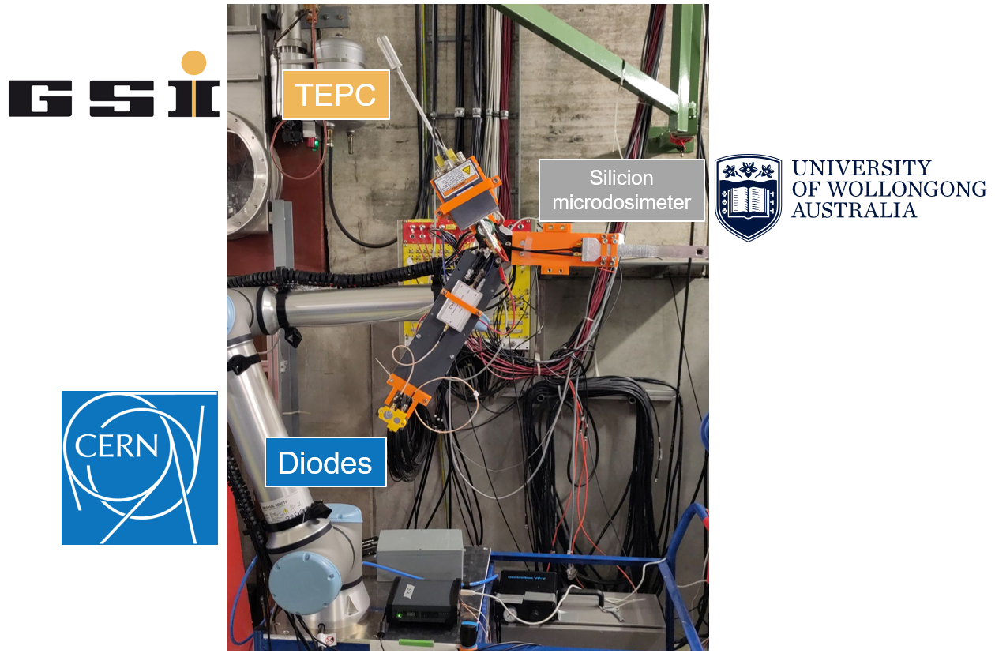
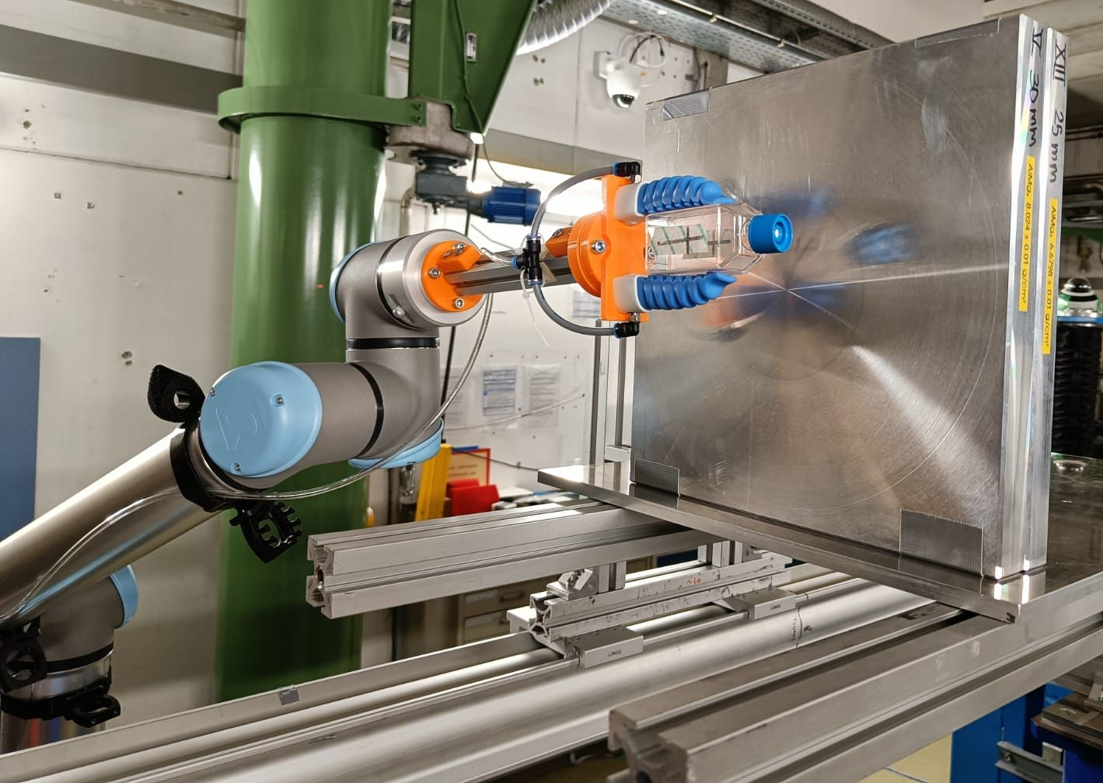
Status Task 4.4: Target station (GSI) [2/4]
Robotic arm UR10e with a reach of 1300 mm and a payload of 12,5 kg
Confirmed operation in an environment with ionizing radiation (December 2023)
Has been used in April 2024 to position detectors and biological samples into the beam (more details in WP6)
Picture by: C. Schuy, GSI
Picture by: C. Schuy, GSI

Slide 12
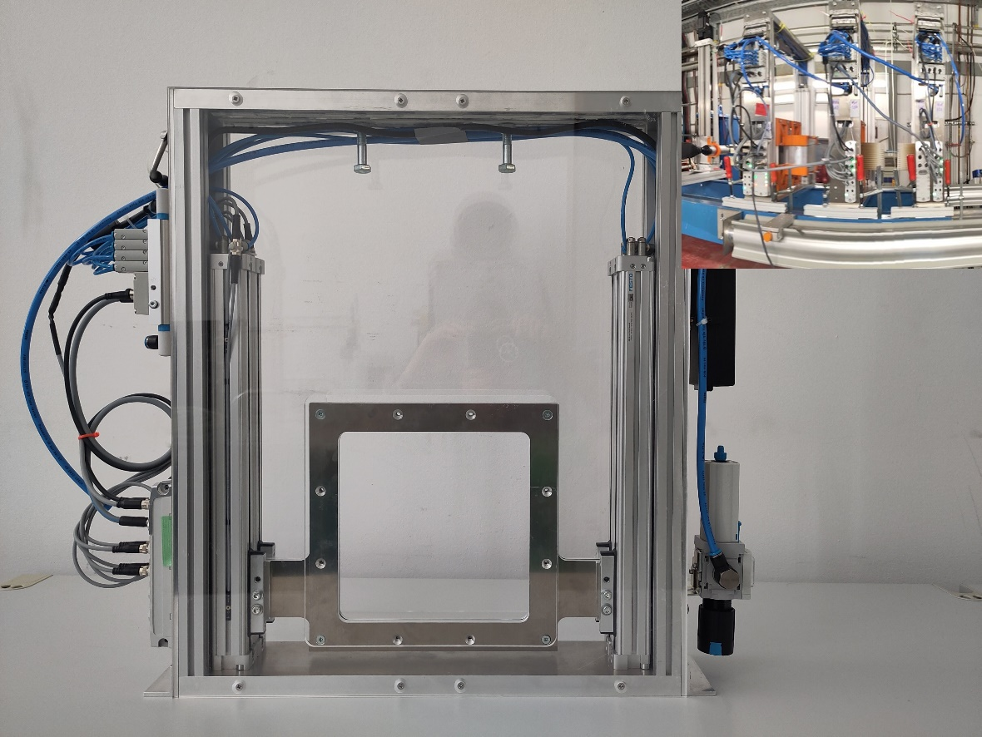
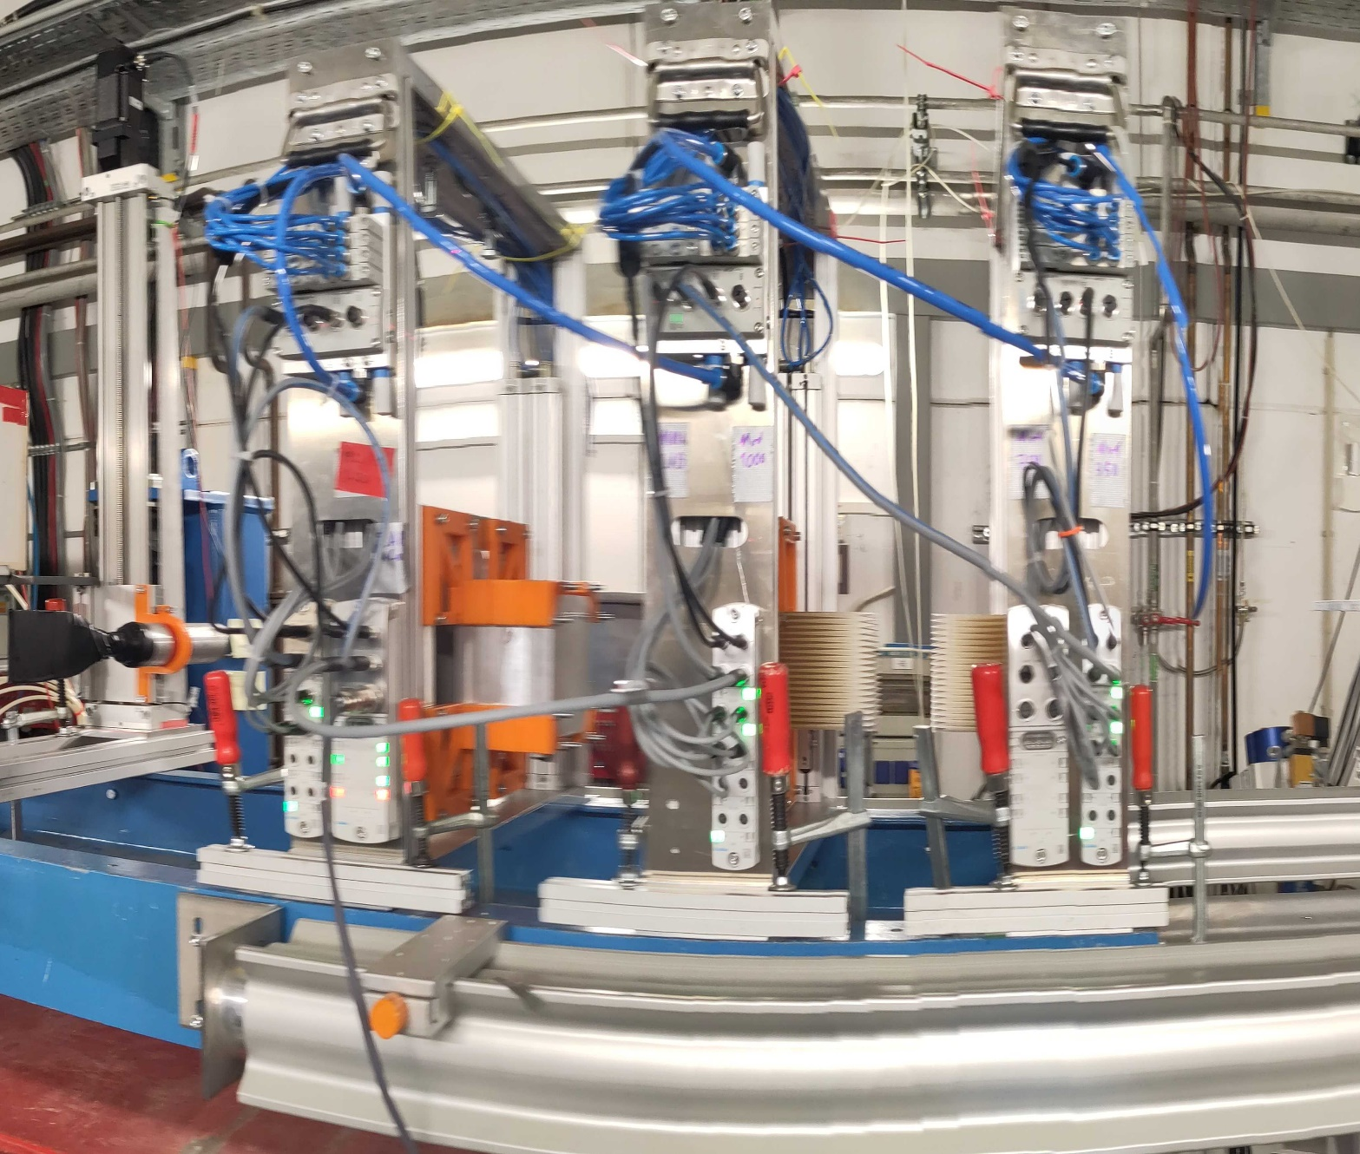
Status Task 4.4: Target station (GSI) [3/4]
New modular range shifters for positioning of shielding material
Two plates / elements can be mounted to each of them
  Three modular range shifters for a total of 6 plates / elements
Distance between the individual range shifters can be varied for a more diverse application
Have already been used in the April 2024 for the GCR simulator
(more details in WP6)
Picture by: C. Schuy, GSI

Slide 13
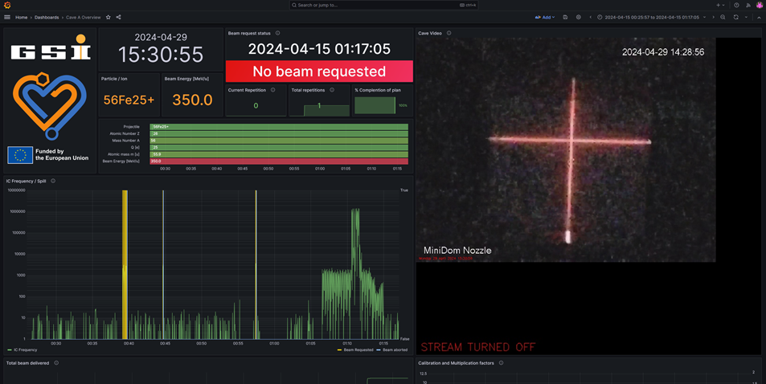
Status Task 4.4: Target station (GSI) [4/4]
User dashboard for easy access to information
Shows irradiation modalities and hardware settings
General design follows the recommendations from D5.1 (Sec. 2.2; Req. 2.2h)
Still work in progress, as some data is not displayed yet and it will be improved
Picture by: T. Wagner, GSI

Slide 14
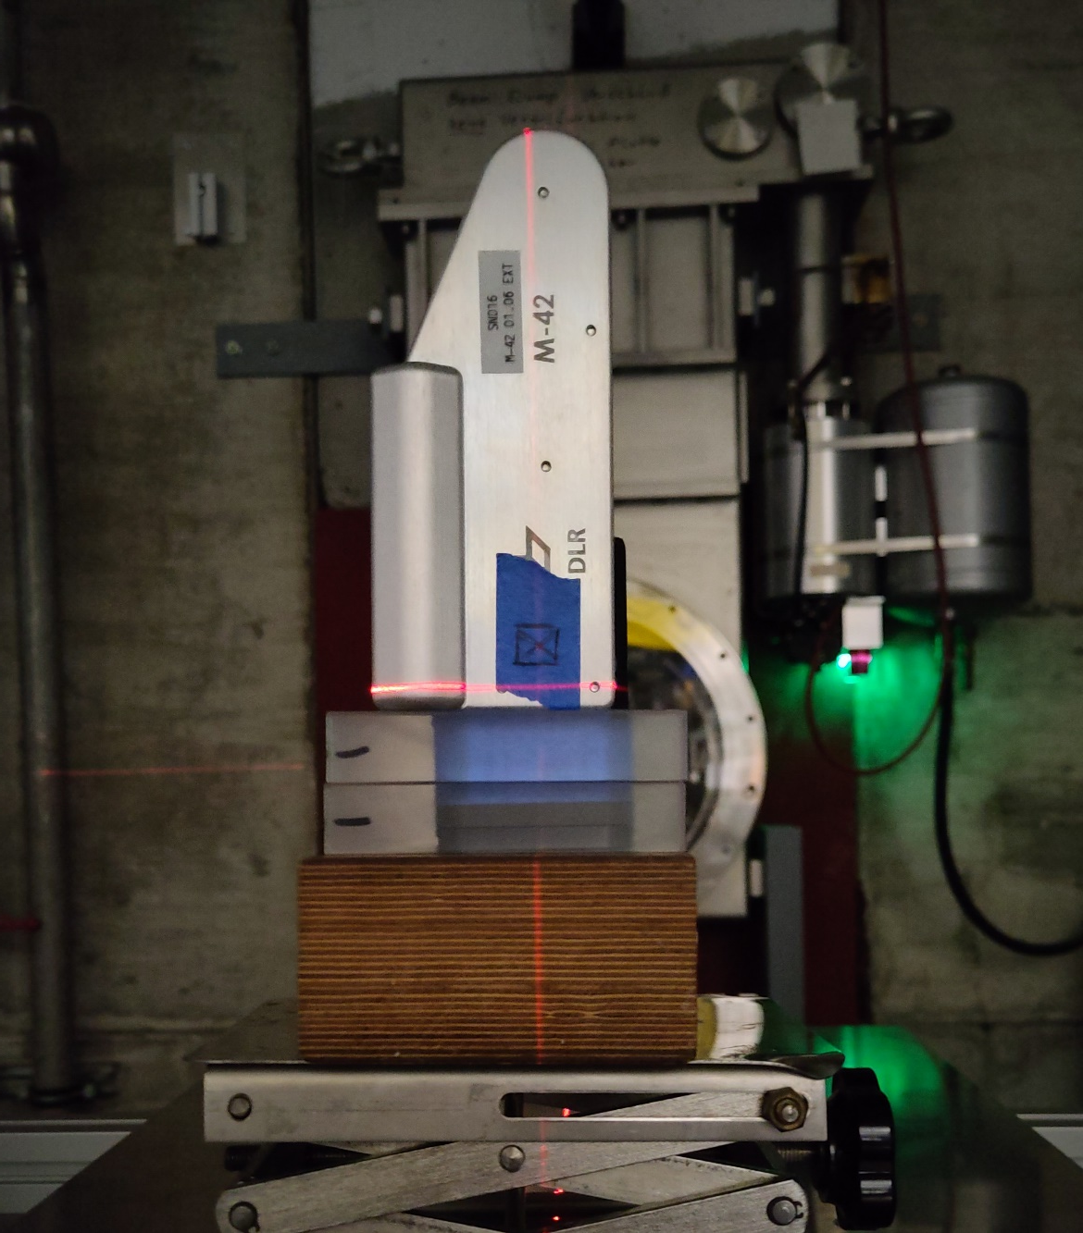
Status Task 4.5: GCR simulator dosimetry (GSI) [1/3]
Detailed characterization of the GCR Simulator for Cave A done in April 2024
Used various different detectors:
  Standard dosimetry detectors
  Microdosimetry detectors
    Tissue Equivalent Proporitional Counter (TPEC)
    Silicon microdosimeter (courtesy of University of Wollongong)
  Dosimeters by DLR, which have been to space already
  etc.
Aimed lower than the marked (sensitive) area on the DLR detector on purpose, as the GCR field is large and the top part of the detector should be spared (electronics).
Picture by: C. Schuy, GSI
Picture by: C. Schuy, GSI

Slide 15
Status Task 4.5: GCR simulator dosimetry (GSI) [2/3]
GCR field produced with six different configurations of modulators, slab targets and energies (more details see WP6)
Estimates how to combine the six irradiation modalities based on simulators (see WP3, Task 3.3)
Each configuration measured by the TPEC to obtain the LET spectrum
Most of the measurements are still under analysis
Measurements still pending:
  Charge composition of the mixed field
  Microdosimetry after shielding

Slide 16
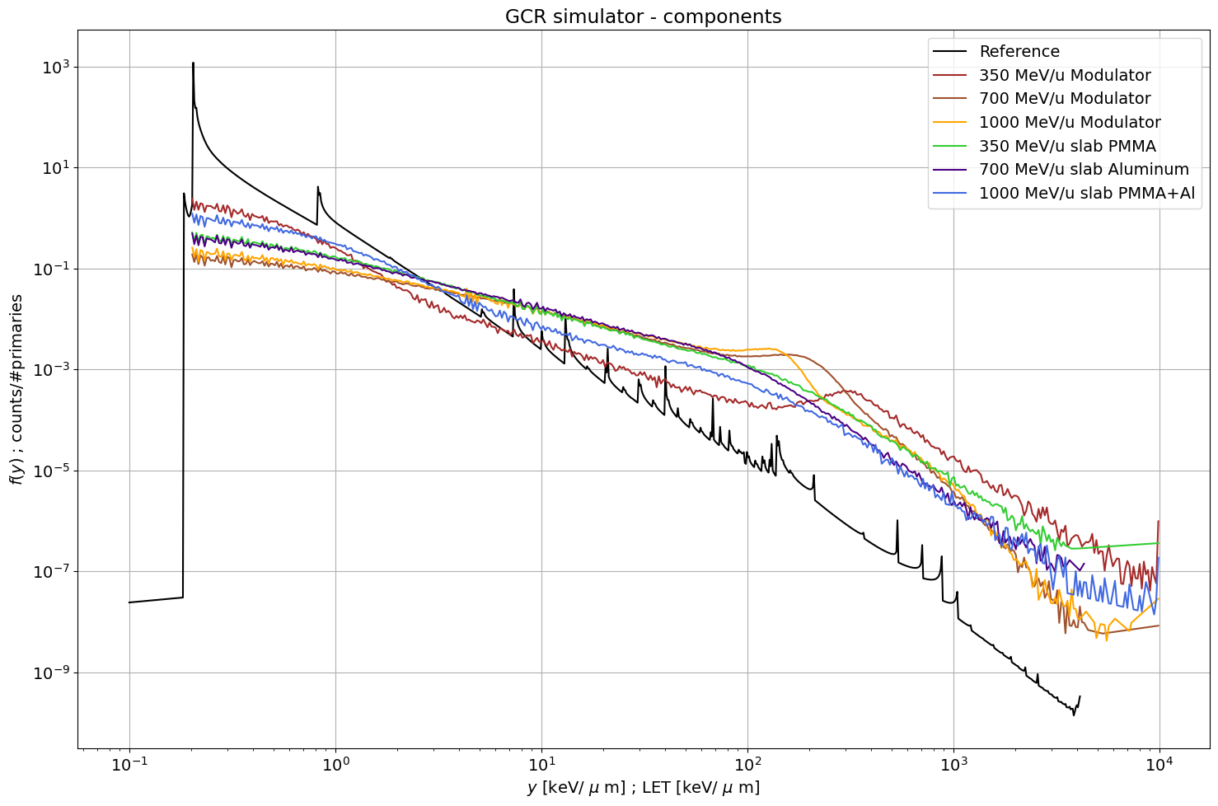
Status Task 4.5: GCR simulator dosimetry (GSI) [3/3]

Slide 17
Status Task 4.6: Intercomparison between CERN and GSI (CERN & GSI) [1/3]
Cross comparison of GSI and CERN detectors during a beamtime in October 2023 @ CERN
Analysis of data still ongoing → Will be reported on in D4.6
  Some spill fluctuations (possible energy shift?) complicate the analysis of the data
Detector 1 | Detector 2 | Reason
Parallel Plate Ionization Chamber (GSI) | Farmer Chamber (GSI) | Calibration of IC with an absolute detector and Cross-check of RF-gain intensity adjustments
Parallel Plate Ionization Chamber (GSI) | Silicon Diode (CERN) | Comparison between standard GSI and CERN detectors
Thin plastic Scintillator (GSI) | Silicon Diode (CERN) | Comparison between standard GSI and CERN detectors (for lower intensities)
Thin plastic Scintillator (GSI) | Barium Fluoride Scintillator (GSI) | Measurement of beam spectra and Characterization of the fragments
The CERN emission chambers (XSEC and XION) were always placed in the beam.

Slide 18
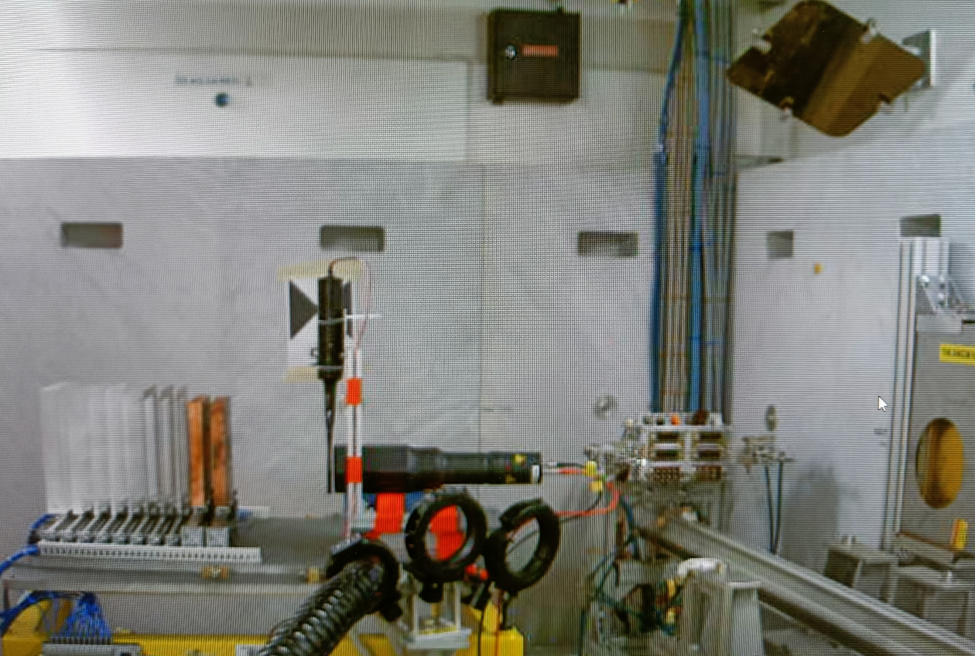
Status Task 4.6: Intercomparison between CERN and GSI (CERN & GSI) [2/3]
Thin plastic Scintillator
CERN Degraders and Collimators
CERN MWPC
Barium Fluoride Scintillator
Beam direction
Experimental setup for the measurement of the thin plastic scintillator vs the Barium Fluoride scintillator in October 2023 at CERN.
Picture by:
T. Wagner, GSI

Slide 19
Status Task 4.6: Intercomparison between CERN and GSI (CERN & GSI) [3/3]
Measurements with CERN‘s Silicon Diodes
  Pure Iron beam at different energies
  Some of the GCR irradiation conditions
“Automatic” comparison with GSI’s Parallel Plate Ionization Chamber
→ Will be reported on in D4.6
Picture by: C. Schuy, GSI

Slide 20
Deliverables and Milestones in P1
Deliv. No. | Deliverable name | Due date | Status | Summary
D4.1 | Beam instrumentation for high-energy low intensity heavy ion beam characterization | 2023-12-31 | Achieved | A description of the beam instrumentation for high-energy low intensity heavy ion beam characterization of GSI and CERN. Each of the detectors is shortly explained alongside their typical use.
Milest. No. | Milestone name | Due date | Status | Summary
- | - | - | - | -
No milestones were due in P1 for WP4
The achieved deliverables and milestones are available on the HEARTS website:
https://hearts-project.eu/project/deliverables/ and https://hearts-project.eu/project/milestones/

Slide 21
Upcoming Deliverables & Milestones
Deliv. No. | Deliverable name | Due date | Status
D4.2 | Calibrated CERN beam instrumentation documented and installed in the accelerator | 2024-12-31 | Pending
D4.3 | Experimental measurements on GSI beam instrumentation and dosimetry | 2025-12-31 | Pending
D4.4 | Documentation on the target station construction and use | 2025-12-31 | Pending
D4.5 | Report on microdosimetry for GCR simulator calibration | 2025-12-31 | Pending
D4.6 | Intercomparison between CERN and GSI instrumentation and standardisation | 2026-12-31 | Pending
Milest. No. | Milestone name | Due date | Status
M12 | CERN beam instrumentation and dosimetry installed and running | 2024-12-31 | Pending
M13 | GSI beam instrumentation and dosimetry installed and running | 2025-21-31 | Pending

Slide 22
Plans for the future
Task 4.1: Knowledge transfer between CERN and GSI (CERN & GSI)
  Completed with D4.1 ✔
Task 4.2: Calibration of beam instrumentation for VHE ion beam extraction (CERN)
  Verification of the calibration in the beamtime end of 2024
  Report on the calibration → Deliverable D4.2
Task 4.3: Beam delivery monitoring (GSI)
  Exploration of the addition of microdosimetric spectra as part of the standard dosimetry for Cave A
  Exploration of the addition of position sensitive detector to the beamline instrumentation

Slide 23
Plans for the future
Task 4.4: Target Station (GSI)
  Improve laser alignment by adding remote controlled adjustment
  Detailed report on the GSI target station → Deliverable D4.4
Task 4.5: GCR simulator dosimetry (GSI)
  Analysis of all the collected data
  Comparison of the results from the different detectors
  Further measurements, e.g., behind extra shielding
Task 4.6: Intercomparison between CERN and GSI (CERN & GSI)
  Analysis of measured data from October 2023 @ CERN
  Analysis of measured data from April 2024 @ GSI
  Detailed report about the comparison measurements → Deliverable D4.6

Slide 24
Conclusion
Work Package progressing as planned
Several Tasks started ahead of time
  Task 4.5: GCR simulator dosimetry (GSI, M24 – M36)
  Task 4.6: Intercomparison between CERN and GSI (CERN & GSI, M24 – M48)
Some tasks progress ahead of schedule
  Task 4.4: Target Station (GSI, M12 – M36)

Slide 25
Thank you for your attention.
Questions?

