Slide 1
HEARTS P1 Review
Meeting
25 September 2024
https://indico.cern.ch/event/1411185/
S. Gerardin - UniPD

Slide 2

Tasks & Objectives
Project goal is to provide >100 MeV/n heavy ion beams to space users, to mimic the effects of Galactic Cosmic Rays (GCR) at ground level
  penetration levels large enough to enable electronics testing in air, without the need of special preparation and at board and box level
  essential for the exploitation of high-end microelectronics technology in space, for e.g. onboard Artificial Intelligence or Big Data processing applications
Purpose of WP5: study of radiation effects induced by VHE heavy ions on a set of technologies representative of current state-of-the-art COTS electronics
  Comparison with standard-energy heavy ions.
  A hierarchical approach, based on three levels of complexity, will highlight different levels of details
2
2

Slide 3
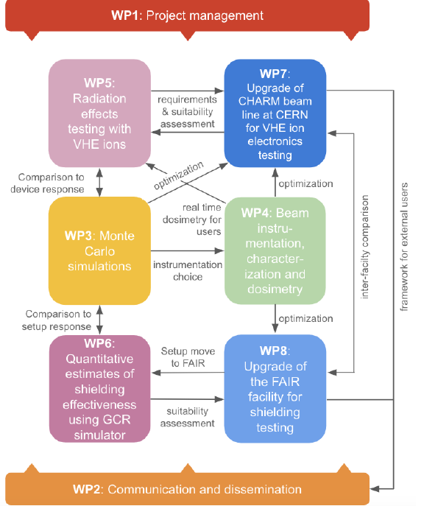
WP5 in the Project
WP5 is strongly interconnected with the other work packages
  WP3: comparison with simulation results
  WP4: beam dosimetry
  WP7: facility development
2
3

Slide 4
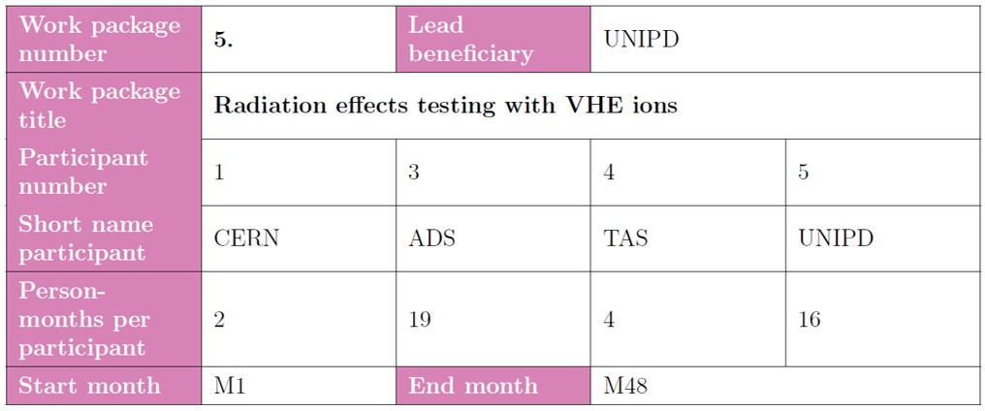
WP5 Key Personnel
Airbus DS/TESAT:
  R. Mangeret, M. Rostewitz
TAS:
  R. Mancini, S. Francola
UniPD:
  M.Bagatin, UniPD project leader
  S. Gerardin, WP5 leader
CERN:
  M. Sacristan Barbero
2
4

Slide 5
WP5 Tasks
5.1 Final review of VHE ion beam requirements for SEE testing COMPLETED 
5.2 Analysis of ionization response in a PIN diode for beam quality assessments IN PROGRESS
From 1st year
    5.3 Suitability of the proposed VHE ion beams for 3D integrated device structures IN PROGRESS
    5.4 Validation of the VHE ion beams for industrial use with TRL 6-7 achievement IN PROGRESS
From 2nd year
        5.5 Qualification of high-complexity devices IN PROGRESS
        5.6 Board-level testing
From 3rd year
2
5

Slide 6
WP5 Timeline
2
6

Slide 7
Task 5.1 - Final review of VHE Ion Beam Requirements for SEE Testing: Description of Work
Partners: UNIPD, ADS, TAS, CERN M1-6
Academic and industrial partners will review the goals in terms of VHE ion beam parameters to be reached with the CHARM and GSI-FAIR upgrade (WP7-8)
Other than parameters such as ion type, energy, LET and and range (and related accuracy), beam time availability (facility usable/bookable with reasonable delays) and commercial conditions of access (competitive with respect to European standard-energy ion facilities) will be included. Optimal trade-offs will be identified and submitted to the facilities
DELIVERED
D5.1 (M6) Beam Requirements
2
7

Slide 8
Deliverable 5.1: Structure
D5.1 FINALISED LIST OF BEAM PARAMETER REQUIREMENTS CONCURRING TO ESTABLISH A TRL 6-7 FOR THE HEARTS FACILITIES
2. SOURCE
  2.1. HEAVY-ION BEAMS
  2.2. BEAM FLUX, FLUENCES AND TEMPORAL STRUCTURE
  2.3. BEAM SIZE AND SPATIAL UNIFORMITY
  2.4. SAMPLE HOLDER AND USER SETUP
3. CONDITIONS FOR ACCESS
The document is organized as a set of requirements and reflects users’ perspective!
2
8

Slide 9
Deliverable 5.1: Beam Requirements
D5.1 FINALISED LIST OF BEAM PARAMETER REQUIREMENTS CONCURRING TO ESTABLISH A TRL 6-7 FOR THE HEARTS FACILITIES
SOURCE
Req. 2.1.a: the LETs of the available beams shall range from ~ 0.1 to >= 60 MeV ∙ mg⁻¹ ∙ cm²
[…] Low-LET beams are very important, because the long range of very-high energy heavy-ion facilities will be used to test advanced components with low LET threshold, and because of the abundance of low-LET particles in space.
Req. 2.1.d: the particle range shall exceed 500 μm in Silicon for the full LET range. In addition, several use cases require significantly longer ranges [heat spreader > 3 mm].
Req. 2.2.a: the heavy ion accelerator shall be capable of delivering ions with variable flux ranging from a few (10) ions/cm²/s to at least 10⁶ ions/cm²/s on the device under test.
2
9

Slide 10
Deliverable 5.1: Access Requirements
D5.1 FINALISED LIST OF BEAM PARAMETER REQUIREMENTS CONCURRING TO ESTABLISH A TRL 6-7 FOR THE HEARTS FACILITIES
CONDITIONS FOR ACCESS
Req. 3.a: a schedule with weeks of beam time availability should be ready 6 months before the first testing period. The user should have the possibility of giving the final confirmation 3 weeks in advance.
Req. 3.b: the cost for beam should be less than 3000€ per hour. The invoiced time should include only hours that can be effectively used (beam preparation should not be included, but ion energy changes should be).
2
10

Slide 11
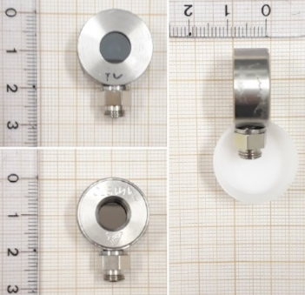
Task 5.2 - Analysis of Ionization Response in a PIN diode for Beam Quality Assessments: Description of Work
Partners: UNIPD, M1-24
PiN diode: simple and effective structure to study heavy ion beams. It provides precise measurements of energy deposition in semiconductor materials. Diagnostic tool to assess the quality of the provided beam in terms of purity and energy straggling (e.g. with degraders)
D5.2 (M24) Beam Quality
D5.5 (M48) Impact of beam energy in SEE testing
2
11

Slide 12
Task 5.2 - Analysis of Ionization Response in a PIN diode for Beam Quality Assessments: Status and Plans
UniPD has defined the experimental setup and procured the material
  ESA involvement is no longer foreseen
  Mirion diodes, CAEN charge amplifier and multi-channel analyzer have been procured
  Measurements in second half November 2024
Large experimental data set is available with standard energy heavy ion beams, mostly collected with the ESA experimental setup
  Monte Carlo model of the diode is available (see also WP3)
TCAD simulations using Sentaurus are being carried out by UniPD to study the transient currents induced by the heavy ions (see also WP3)
D5.2 (M24) Beam Quality
D5.5 (M48) Impact of beam energy in SEE testing
2
12

Slide 13
Task 5.2 - Analysis of Ionization Response in a PIN diode for Beam Quality Assessments: Status and Plans
UniPD experimental setup: currently being tested and debugged in the lab
D5.2 (M24) Beam Quality
D5.5 (M48) Impact of beam energy in SEE testing
2
13

Slide 14
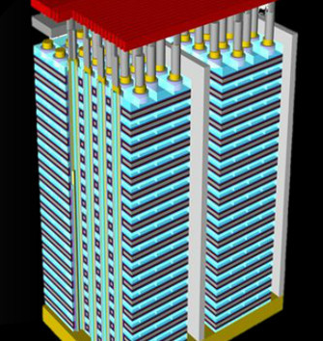
Task 5.3 - Suitability of the Proposed VHE Ion Beams for 3D Integrated Device Structures: Description of Work
Partners: UNIPD, M12-36
3D NAND Flash memories, the first and most successful example of 3D integration in the semiconductor industry, are an ideal test vehicle
Devices with hundreds of layers are now available and increasing, reaching tens of microns of thicknesss.
VHE heavy ions are extremely useful for these technologies
D5.3 (M36) Beam suitability for 3D structures
D5.6 (M48) SEE qualification guidelines for high complexity devices and board level testing
D5.5 (M48) Impact of beam energy in SEE testing
2
14

Slide 15
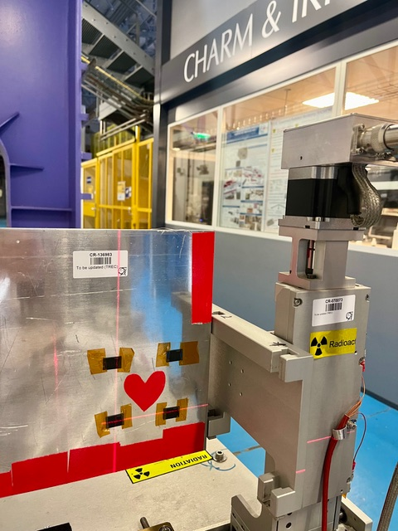
Task 5.3 - Suitability of the Proposed VHE Ion Beams for 3D Integrated Device Structures: Status
Four 3D NAND FG devices have been irradiated at CERN in October/November 2023
  Exposure in passive mode, possible thanks to the non-volatility of the memories
Device S/N | Energy | LET [MeV/(mg/cm²)] | Fluence [ions/cm²]
MS33 | 2GeV/n | 11 | 5E6
MS34 | 2GeV/n | 11 | 1E7
MS35 | 750 MeV/n + 15 mm PMMA degradation | 30 | 5E6
MS36 | 750 MeV/n + 15 mm PMMA degradation | 30 | 1E7
2
15

Slide 16
Task 5.3 - Suitability of the Proposed VHE Ion Beams for 3D Integrated Device Structures: Status
Four 3D NAND FG devices have been irradiated at CERN in October/November 2023
  Cross section consistent with previous measurements
  Good linearity with fluence (errors bars smaller than symbols)
2
16

Slide 17
Task 5.3 - Suitability of the Proposed VHE Ion Beams for 3D Integrated Device Structures: Status (2)
Four 3D NAND FG devices have been irradiated at CERN in October/November 2023
  Large clusters are visible and secondaries information extracted. Monte Carlo simulation of secondaries for calibration/comparison ongoing.
2
17

Slide 18
Task 5.3 - Suitability of the Proposed VHE Ion Beams for 3D Integrated Device Structures: Plans
Next steps
Complete analysis on irradiated FG 3D NAND devices and compare experimental results with simulations (see WP3)
Carry out a full irradiation campaign in second half of November 2024
  3D NAND Devices with Floating gate and Replacement Gate Technologies will be used
  Both passive and active irradiations
  Exposure to different LETs
2
18

Slide 19
Task 5.4 - Validation of the VHE Ion Beams for Industrial use with TRL 6-7 Achievement: Description of work
Partners: Airbus DS/TESAT, CERN, M-12-36
VHE SEE testing on devices which have already been characterized by the ADS or CERN at standard-energy heavy ion test facilities (e.g., UCL, RADEF)
Previous tests carried out according to ESCC 25100 (package lid removal)
Broad range of technologies have been tested or will be tested:
  Benchmark SRAMs
  High power diodes (Silicon or SiC)
  High power MOSFETs (Silicon or SiC)
  A stacked memory
    all the dies will be tested as opposed to only the top die as customary with standard energy ions
  High-complexity device
D5.4 (M36) Verification of beam parameter requirements
D5.5 (M48) Impact of beam energy in SEE testing
D5.6 (M48) SEE qualification guidelines for high complexity devices and board level testing
2
19

Slide 20
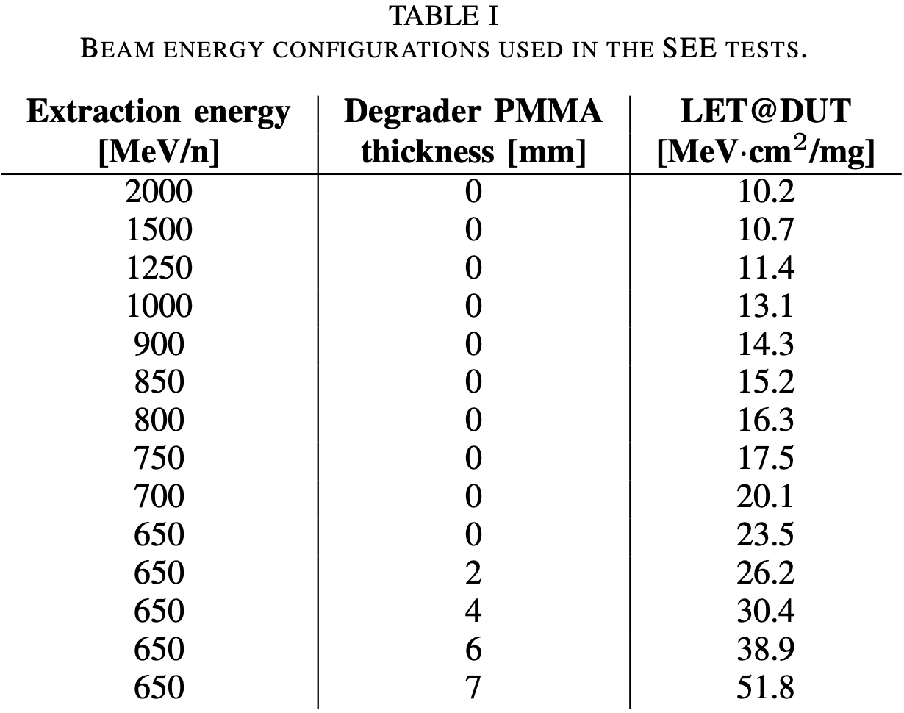
Task 5.4 - Validation of the VHE Ion Beams for Industrial use with TRL 6-7 Achievement : Status and Plans
CERN used a wide range of energies/LETs by means of the continuous tunability of the beam extraction energy and the LET booster (PMMA degrader).
Primary LETs from 10 to 24 MeV·cm²/mg and enhanced LETs up to 52 MeV·cm²/mg.
Contribution to NSREC 2024 Data Workshop with the SEE measurements (SEU, SEL, SEB).

Slide 21
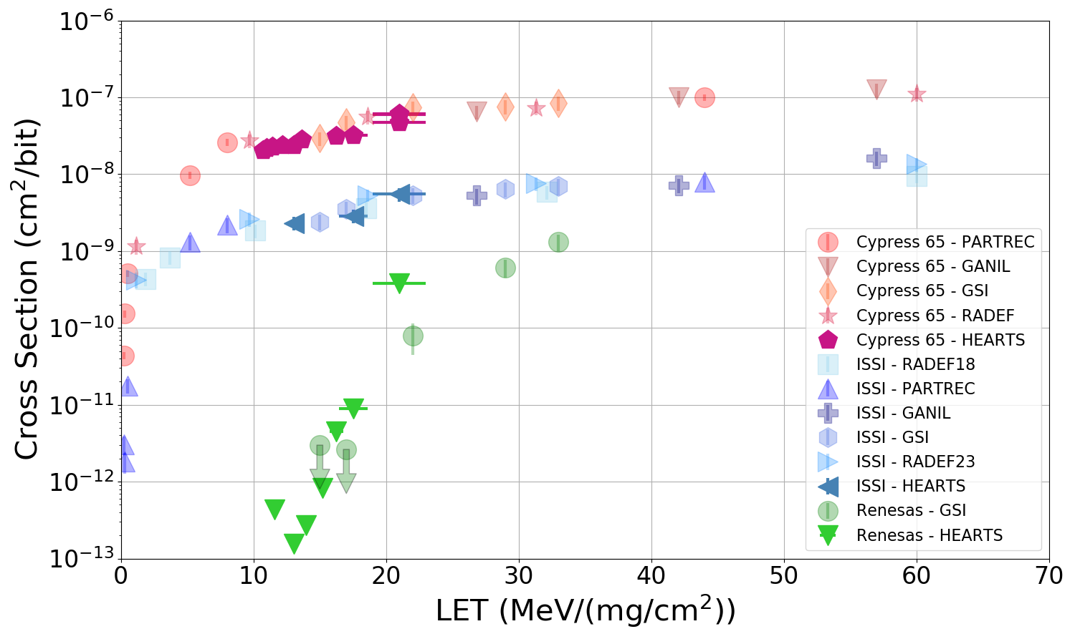
Task 5.4 - Validation of the VHE Ion Beams for Industrial use with TRL 6-7 Achievement : Status and Plans
CERN measured the SEU cross section of three benchmark SRAMs from Cypress, ISSI, and Renesas during the October 2023 run
A large amount of experimental data at other facilities is available for these samples
The data taken at HEARTS include only primary beam energies and no degradation runs.
2
21

Slide 22
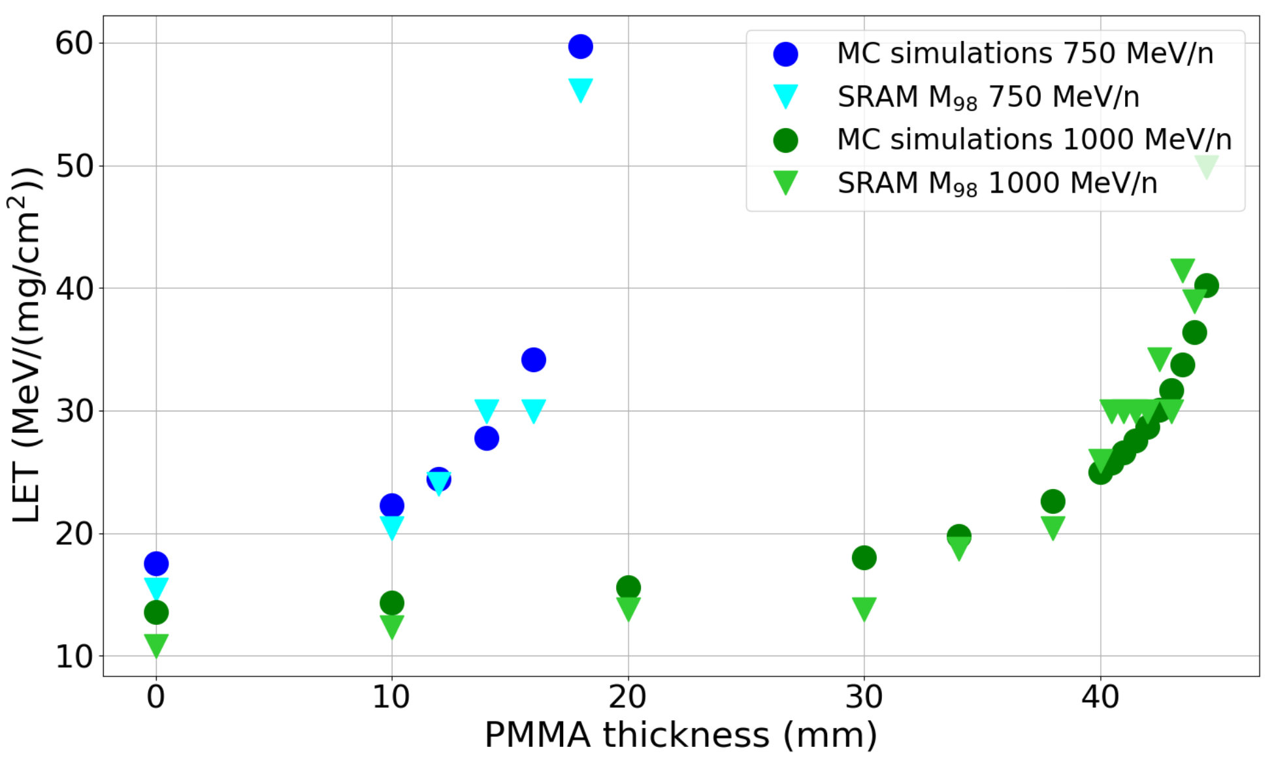
Task 5.4 - Validation of the VHE Ion Beams for Industrial use with TRL 6-7 Achievement : Status and Plans
MCU clustering algorithms allow correlating multiplicity distribution and beam LET.
Good correlation between degraded LETs obtained via MCU multiplicity study and FLUKA MonteCarlo simulations.
Contribution for RADECS 2024.

Slide 23
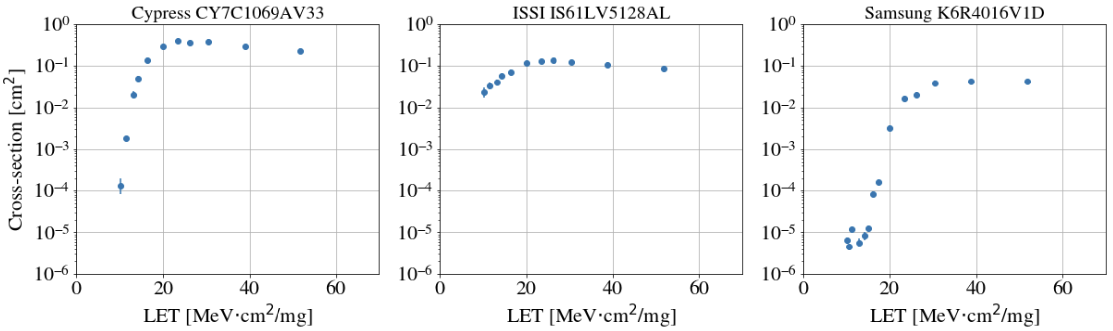
Task 5.4 - Validation of the VHE Ion Beams for Industrial use with TRL 6-7 Achievement : Status and Plans
Single Event Latchup has been measured as well for three 3 SRAMs (Cypress, ISSI and Samsung) during the same test campaign
2
23

Slide 24
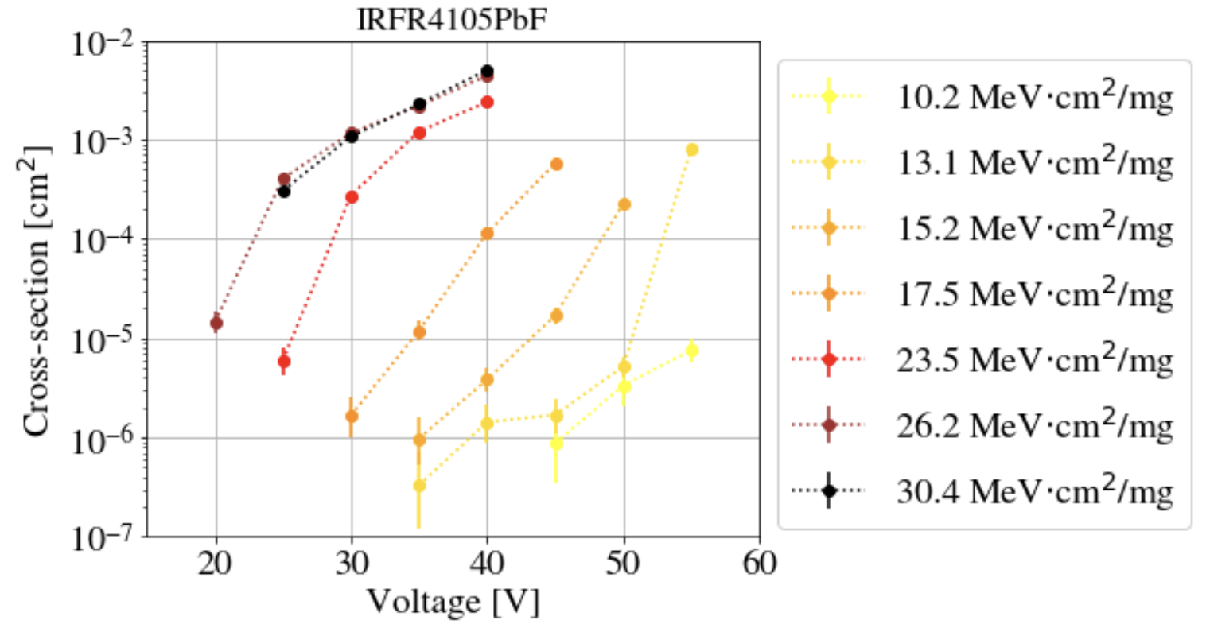
Task 5.4 - Validation of the VHE Ion Beams for Industrial use with TRL 6-7 Achievement : Status and Plans
Single Event Burnout of power MOSFETs (Infineon IRFR4105PbF 55V max.).
Increasing SEB cross-section as a function of LET and drain voltage.
Higher LET features lower voltage SEB onset.

Slide 25
Task 5.4 - Validation of the VHE Ion Beams for Industrial use with TRL 6-7 Achievement : Status and Plans
Device types are to be selected according to HEARTS objectives, and, both heritage testing and device stock availability at Airbus DS and TESAT.
Device type selection aims at
  Covering different families, different Single Event Effect natures and different potential issues
  Allowing test results comparison between high energy and traditional SEE test facilities
  Allowing testing of “untestable” device reference
  Supporting test analysis guideline
Multiple test campaigns will be needed
D5.4 (M36) Verification of beam parameter requirements
D5.5 (M48) Impact of beam energy in SEE testing
D5.6 (M48) SEE qualification guidelines for high complexity devices and board level testing
2
25

Slide 26
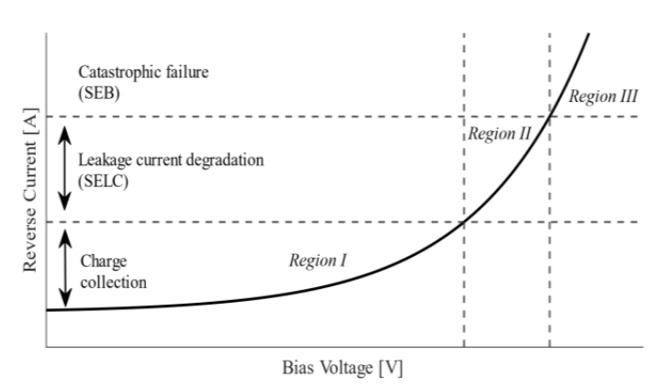
Task 5.4 - Validation of the VHE Ion Beams for Industrial use with TRL 6-7 Achievement : Status and Plans
First “family” will address power devices and SEB/SEGR
  Two different power device types and SEE mechanisms are planned to be tested
    SiC Diode (e.g. SiC Schottky C3D02060E from Wolfspeed)
    Si/SiC Power Mosfet
  SiC diode is of particular interest
  since exhibiting a very specific
  behavior under HI exposure
D5.4 (M36) Verification of beam parameter requirements
D5.5 (M48) Impact of beam energy in SEE testing
D5.6 (M48) SEE qualification guidelines for high complexity devices and board level testing
2
26

Slide 27
Task 5.4 - Validation of the VHE Ion Beams for Industrial use with TRL 6-7 Achievement : Status and Plans
Second “family” is memory
NAND flash MT29F256G08AUCAB
Different type of SEE to be investigated since those devices exhibit sensitivity to multiple SEE
  SEL, SEU, MBU, row event, column event, SEFIs, stuck/weak bits
D5.4 (M36) Verification of beam parameter requirements
D5.5 (M48) Impact of beam energy in SEE testing
D5.6 (M48) SEE qualification guidelines for high complexity devices and board level testing
2
27

Slide 28
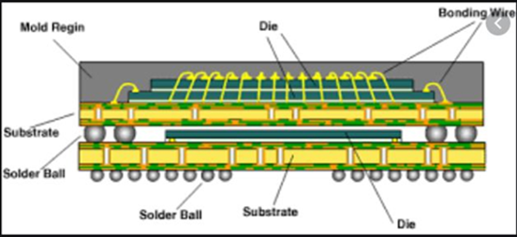
Task 5.4 - Validation of the VHE Ion Beams for Industrial use with TRL 6-7 Achievement : Status and Plans
Third “family” prone to a different approach
Device type will be selected according to the Airbus DS project needs (and stock availability)
  Device won’t necessarily benefit of previous SEE testing
  Device selection of interest w.r.t. beam specificities
D5.4 (M36) Verification of beam parameter requirements
D5.5 (M48) Impact of beam energy in SEE testing
D5.6 (M48) SEE qualification guidelines for high complexity devices and board level testing
2
28

Slide 29
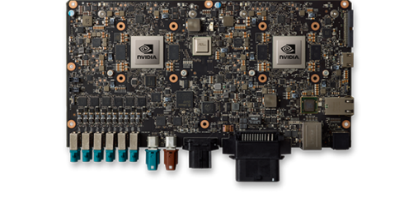
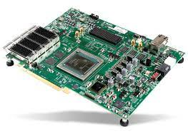
Task 5.5 - Qualification of High-complexity Devices: Description of Work
Partners: UNIPD, TAS, M24-48
Graphical Processing Units (GPUs) and Field Programmable Gate Arrays (FPGAs) are two key enablers for on-board artificial intelligence
Heavy-ion SEE qualification is very complex because of the very high power-consumption (standard energy ions require in-vacuum irradiations) -> in air irradiation is key
UNIPD will perform a test campaign on a GPU
TAS will perform a test campaign on a FPGA
The results will be used together to compile recommendations and guidelines about SEE testing with very high energy ion beams
D5.5 (M48) Impact of beam energy in SEE testing
D5.6 (M48) SEE qualification guidelines for high complexity devices and board level testing
2
29

Slide 30
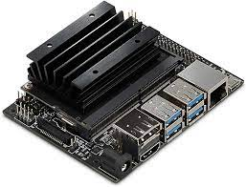
Task 5.5 - Qualification of High-complexity Devices: Status and Plans
UNIPD has selecting a suitable platform and has performed preliminary test campaigns (using neutrons)
  NVIDIA Jetson line of AI accelerators appears as the most promising candidate
    CPU + GPU in one chip, with full framework for AI computing
  Preliminary tests carried out at ChipIr (UK) on some Jetson Nano boards
D5.5 (M48) Impact of beam energy in SEE testing
Jetson Nano board
D5.6 (M48) SEE qualification guidelines for high complexity devices and board level testing
2
30

Slide 31
Task 5.5 - Qualification of High-complexity Devices: Status and Plans
Device is to be chosen according to the need and availability of TAS projects.
Trade-off is between:
  High performance System-On-Chip (backside irradiation with fan-based cooling system).
  Optoelectronics that cannot be «opened» in the traditional way to be tested.
Device will be chosen during the next months
D5.5 (M48) Impact of beam energy in SEE testing
D5.6 (M48) SEE qualification guidelines for high complexity devices and board level testing
2
31

Slide 32
Task 5.6 - Board-level testing: Description of Work
Partners: TAS, M24-48
Board-level testing can enable the qualification of several devices by irradiating them simultaneously under the same beam.
In some cases, and thanks to the properties of VHE ion beams, it can even be envisaged to test more complex systems that are made of a few electronic boards stacked on top of one another.
The task will consist of testing electronic boards enabling power conditioning functionalities, which may be particularly sensitive to radiation.
The objective of the task will be that of defining a methodology for testing these kinds of boards with a VHE ion beam that will be integrated in the guideline.
D5.6 (M48) SEE qualification guidelines for high complexity devices and board level testing
2
32

Slide 33
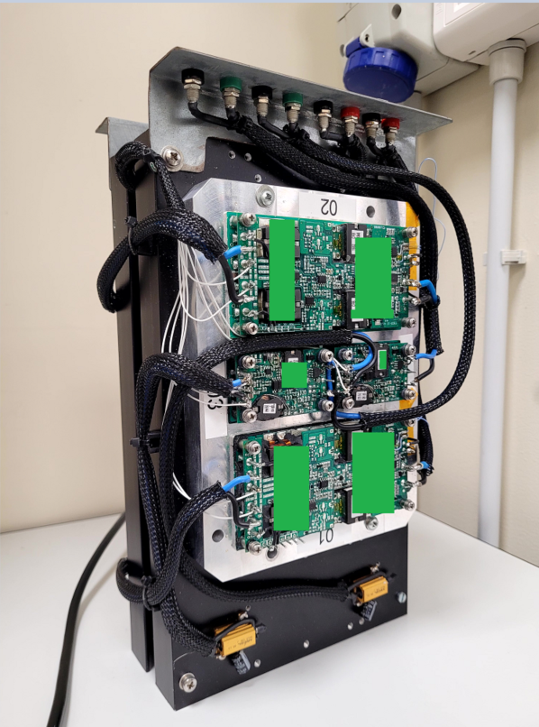
Task 5.6 - Board-level testing: Status and Plans
Device under trade-off for testing are DC/DC converters.
DC/DC converter with high power density w.r.t. footprint are not so common in the space market.
On the other hand they are a need in payload architecture where the same module type is implemented recursively to build large structures (like SAR for earth observation).
The first choice for this application are commercial DC/DC converters available in TAS.
D5.6 (M48) SEE qualification guidelines for high complexity devices and board level testing
2
33

Slide 34
Conclusions
Task | Status
5.1: Final review of VHE ion beam requirements for SEE testing | Beam requirements have been discussed. Task has been completed with deliverable D5.1.
5.2: Analysis of Ionization Response in a PIN diode for Beam Quality Assessment | In progress.PIN diode setup has been defined.
5.3: Suitability of the Proposed VHE Ion Beams for 3D Integrated Device Structures | In progress. First set of high-energy heavy ion experiments on 3D NAND Flash have been carried out.
5.4: Validation of the VHE Ion Beams for Industrial use with TRL 6-7 Achievement | In progress. Experiments have been carried out with benchmark SRAM devices and power devices. Additional experiments have been planned and are being prepared for the next campaigns.
5.5: Qualification of High-complexity Devices | Initial study and experiments on GPUs using wide spectrum neutrons.
5.6: Board-level testing | Will start later as planned
2
34

