Slide 1
HEARTS P1 Review Meeting: WP8
25 September 2024
https://indico.cern.ch/event/1411185/
Tim Wagner
GSI

Slide 2
Outline
Reminder about WP8 Tasks
Status of WP8 Tasks
WP8 Deliverables and Milestones
Plans for the future
Conclusion

Slide 3
Tasks & Objectives
Task 8.1: Framework for user access (GSI, M1 – M48)
  Development of the framework and procedure to make the facility available to external users for VHE irradiation testing
  The framework will be developed through the experience of accommodating external users for testing at GSI/SIS18 and Cave A
Task 8.2: GCR simulator installation in APPA cave or CBM vault (GSI, M36 – M48)
  Installing the GCR simulator in the CBM vault
  Transferring the dosimetry system from Cave A and making it adequate for shielding, radiobiology and microelectronics testing
  Will start already before the opening of the SIS100, so that the GCR/SPE simulator will be ready on FAIR-day-1
Task 8.3: Test of the GCR simulator (GSI, M47 – M48)
  On FAIR-day-1, one of the first experiments will be the testing of the GCR simulator using Fe-ions at 10 GeV/n in the CBM vault
  Extend to a higher cutoff, around 3 GeV/n in a first test, before reaching the final goal of 10 GeV/n
  Focus on dosimetry and on a first biological measurement to be compared to the result in Task 6.4

Slide 4
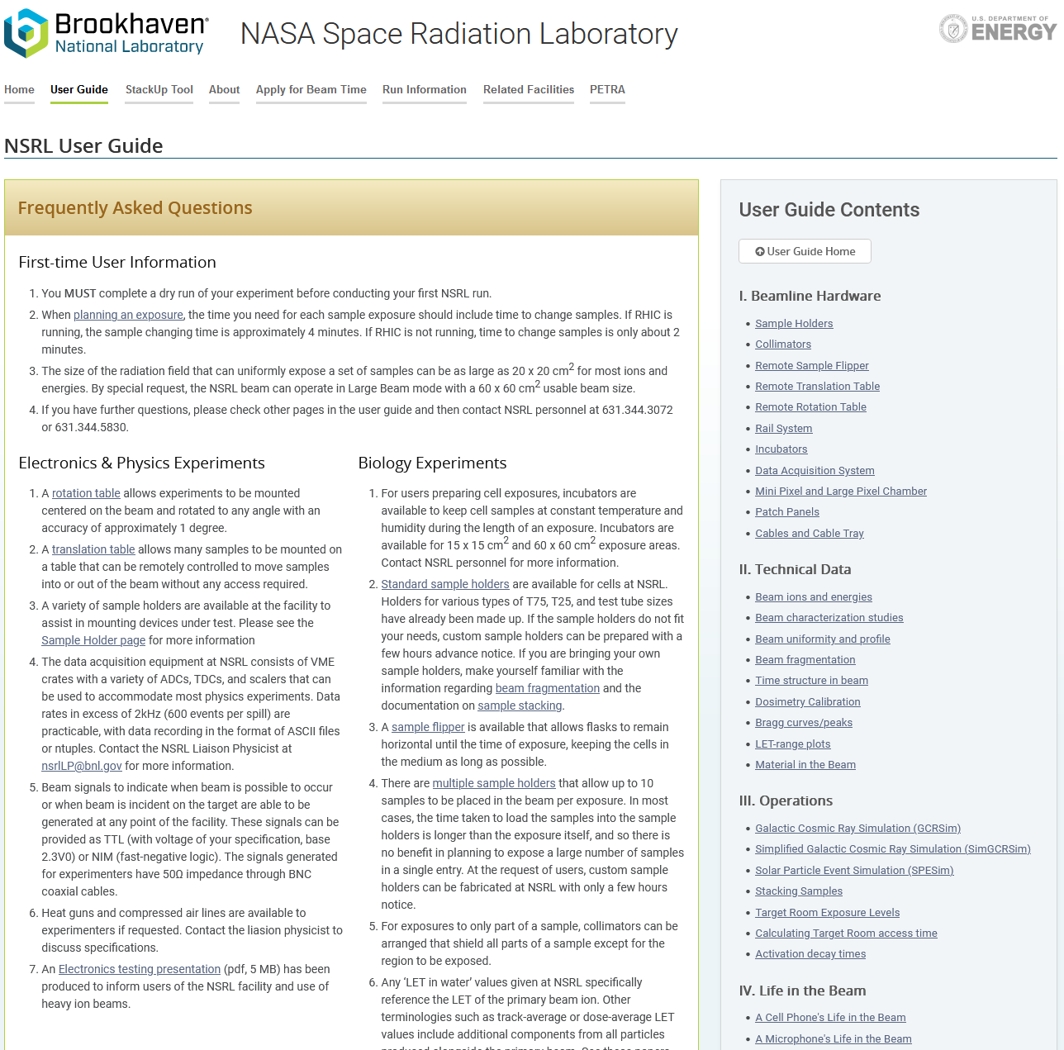
Status Task 8.1: Framework for user access (GSI) [1/3]
User experience
Started the process to make accessing and understanding the facility easier for users
User Guide webpage
  Inspired by the NSRL User Guide
  Idea: Make an easy to understand guide for the users, both for GSI and CERN
    Highlight similarities and differences between the facilities
  Draft available, shared with the CERN team
https://www.bnl.gov/nsrl/userguide/

Slide 5
Status Task 8.1: Framework for user access (GSI) [2/3]
User experience
Short introduction to LISE++ for simple calculations
Development of Geant4-based template simulation
  Quick calculation of more complicated scenarios without requiring full knowledge and experience in Monte Carlo (MC) codes
Development of standardized user manuals and face-to-face user interaction
  Facilitate campus access
  Clarify general and radiation safety related topics
→ Developments partially in use since beginning of 2024 and being refined based on user feedback

Slide 6
Status Task 8.1: Framework for user access (GSI) [3/3]
Access to beams
Started development of a potential business model via the “GSI/FAIR Innovationsfond”
Major discussion points:
  Determination of long-term cost of running GSI/FAIR including overhead and how to fund it
  Handling of short-term scheduling of multiple exposure opportunities per year within the long-term beamtime scheduling of GSI/FAIR

Slide 7
Status Task 8.2:
GCR simulator installation in the CBM vault (GSI) [1/4]
PhD student (Luca Lunati) working on the design of the high energy GCR simulator
Still a hybrid design for CBM, but differs from Cave A (or APPA) design
  No beam scanning available in the CBM vault
  Complex, rotating modulator
  Scanning with the target, e.g. with a robotic arm
  Has to be compatible with other equipment by other experiments in the CBM vault
  → Many design constraints
Plans and designs made how to integrate GCR Experiments into the CBM vault
Memorandum of Understanding signed with the CBM collaboration for the installation of the GCR simulator

Slide 8
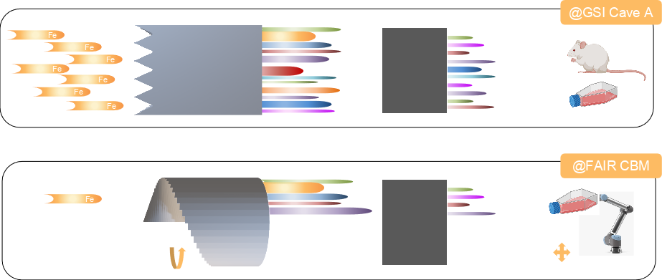
Status Task 8.2:
GCR simulator installation in the CBM vault (GSI) [2/4]
Visualization of the main differences between the GSI Cave A and future FAIR GCR simulator concept.

Slide 9
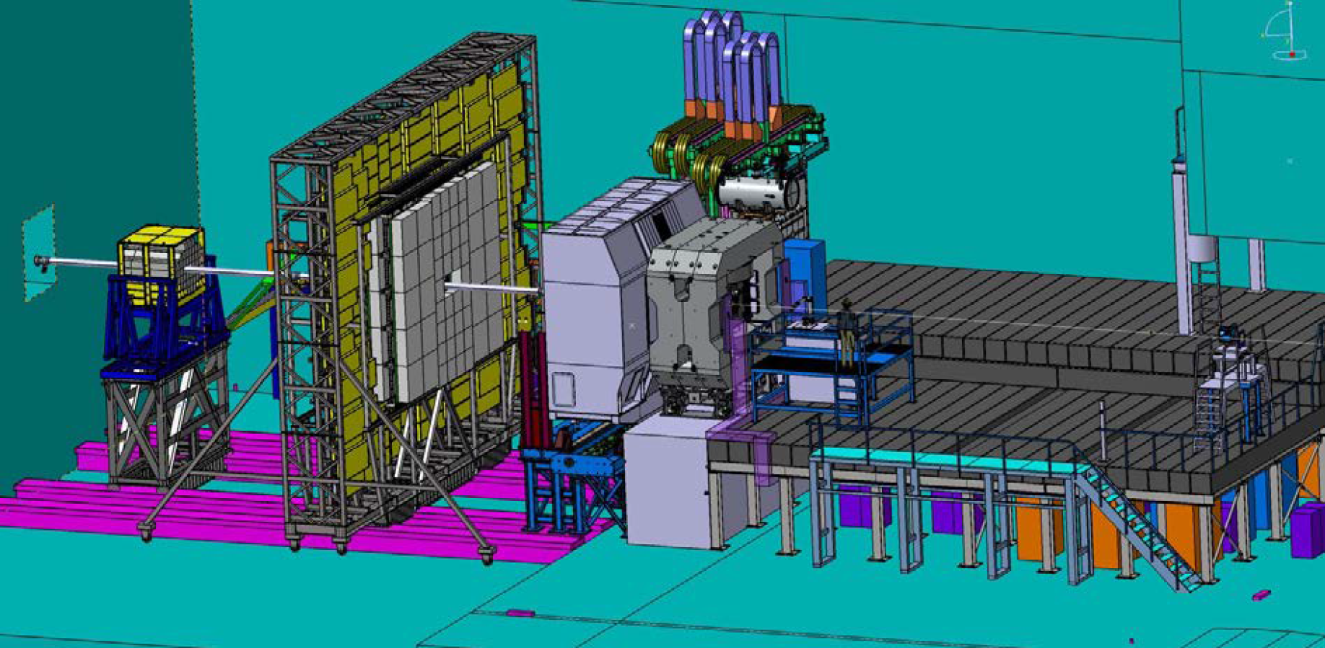
Status Task 8.2:
GCR simulator installation in the CBM vault (GSI) [3/4]
CBM vault
Target Station
GCR Simulator
~10m
Reference: One Person
Technical Design Report: BIOMAT in CBM

Slide 10
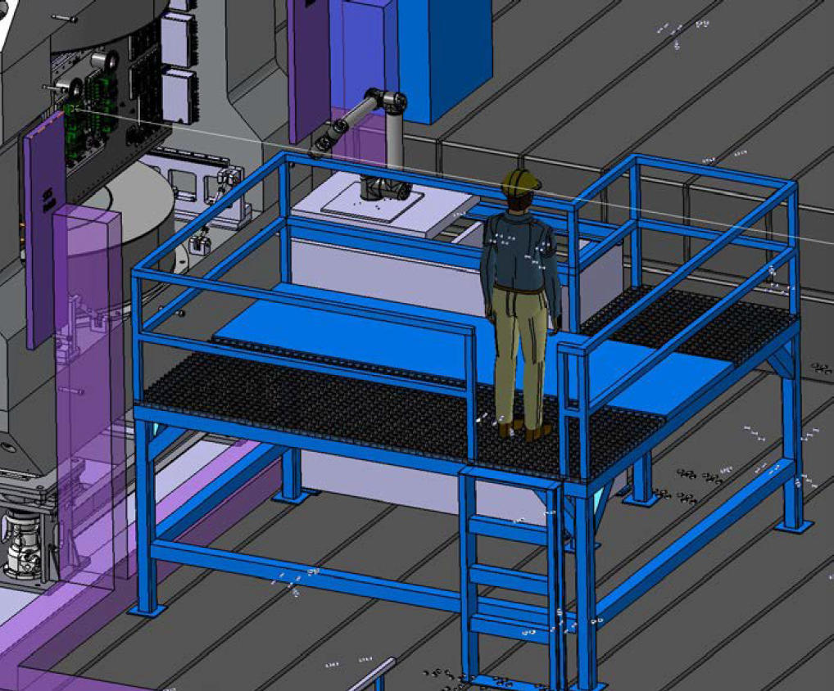
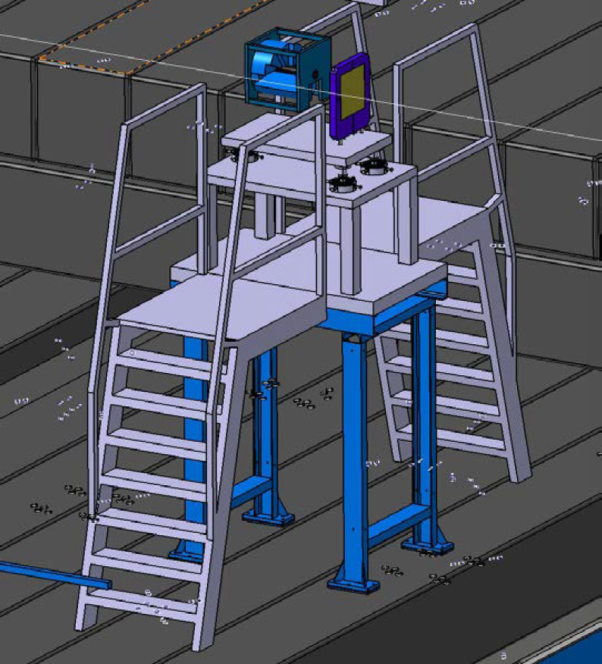
Status Task 8.2:
GCR simulator installation in the CBM vault (GSI) [4/4]
GCR Simulator
Target Station with Robotic arm
Monitor IC
Technical Design Report: BIOMAT in CBM

Slide 11
Status Task 8.3: Test of the GCR simulator (GSI)
No progress yet, as FAIR is still under construction and Task 8.2 is a requirement for this Task

Slide 12
Deliverables and Milestones in P1
Deliv. No. | Deliverable name | Due date | Status | Summary
- | - | - | - | -
Milest. No. | Milestone name | Due date | Status | Summary
- | - | - | - | -
No deliverables or milestones were due in P1 for WP8
The achieved deliverables and milestones are available on the HEARTS website:
https://hearts-project.eu/project/deliverables/ and https://hearts-project.eu/project/milestones/

Slide 13
Upcoming Deliverables & Milestones
Deliv. No. | Deliverable name | Due date | Status
D8.1 | Established framework for user access to the GCR simulator | 2026-12-31 | Pending
D8.2 | Installation of the GCR simulator in APPA cave or CBM vault | 2026-12-31 | Pending
D8.3 | First measurements with GCR simulator with and without shielding in APPA Cave or CBM vault at 10 GeV/n cutoff | 2026-12-31 | Pending
Milest. No. | Milestone name | Due date | Status
M22 | Routine access for external users at FAIR GCR simulator | 2026-12-31 | Pending
M23 | First test at FAIR GCR simulator | 2026-12-31 | Pending

Slide 14
Plans for the (near) future
Task 8.1: Framework for user access (GSI, M1 – M48)
  Continue writing the User Guide including any new instrumentation developed during the HEARTS project (e.g. Task 4.4 Target Station)
Task 8.2: GCR simulator installation in the CBM vault (GSI, M36 – M48)
  Continue development of the new GCR Simulator design for the CBM vault
  Perform simulations verifying new designs
Task 8.3: Test of the GCR simulator (GSI, M47 – M48)
  Wait for completion of Task 8.2

Slide 15
Conclusion
Work Package progressing as planned

Slide 16
Thank you for your attention.
Questions?

