Slide 1
HEARTS P1 Review Meeting
25 September 2024
https://indico.cern.ch/event/1411185/
Miha Vitorovič
HEARTS
COSYLAB

Slide 2
Outline
The outlook of the WP in P1
Deliverables and Milestones in P1
Upcoming Deliverables & Milestones
Critical Risks & Mitigation Measures in P1
Identification of new risks

Slide 3
The outlook of the WP in P1
Task 9.2: User interface tool for experimentation
  Obtain access to CERN infrastructure
  Test connection to IRRAD/CHARM T8 beamline
  Discuss user requirements and use-cases
  Check means of accessing various FESA properties programmatically
  Preparation of the development environment
  Tool selection – which libraries and frameworks to use
  Proof-of-concept to test the tool selection
Task 9.3: User experiment lifecycle interface
  Not started
  Starts in Sept. 2025

Slide 4
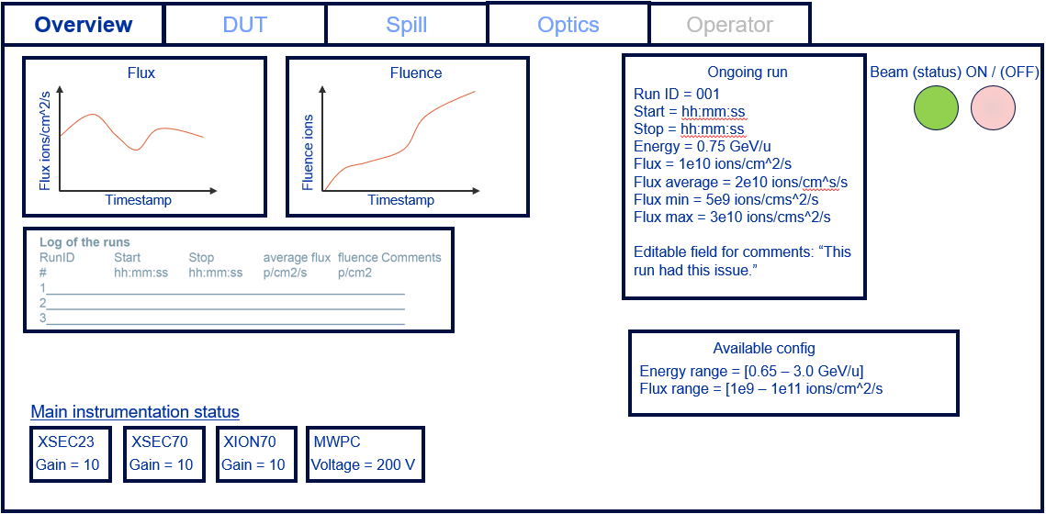
UI Mock-ups – Overview screen

Slide 5
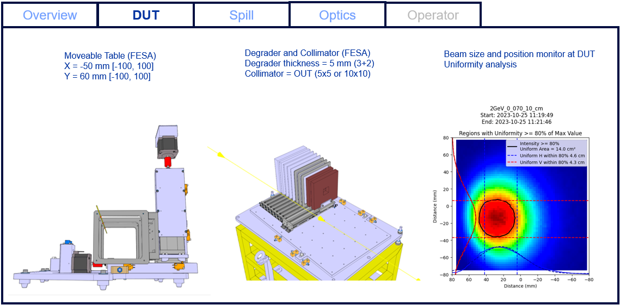
UI Mock-ups – DUT screen

Slide 6
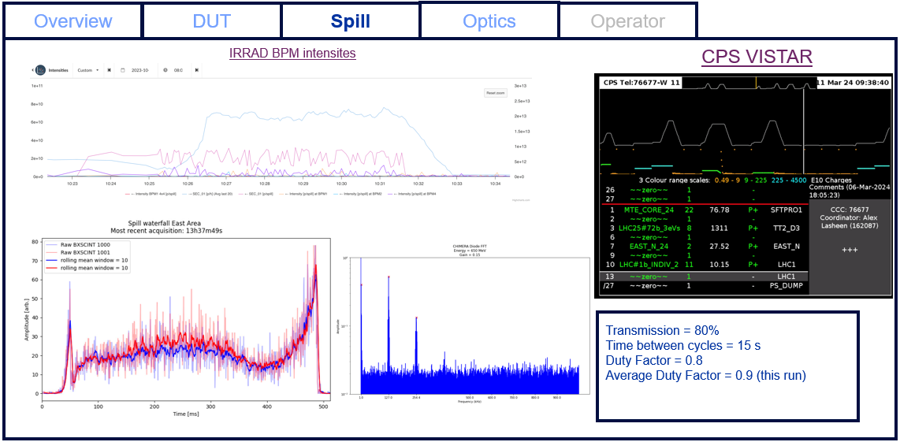
UI Mock-ups – Spill screen

Slide 7
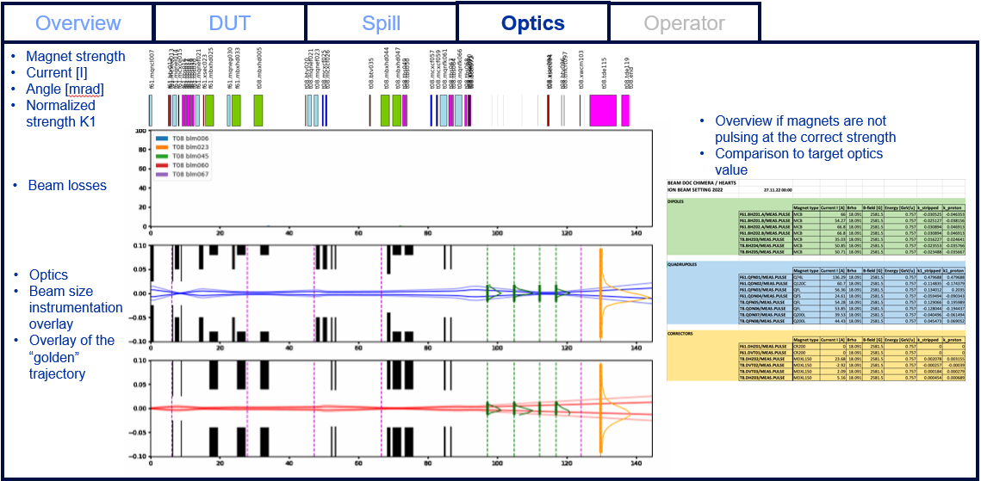
UI Mock-ups – Optics screen

Slide 8
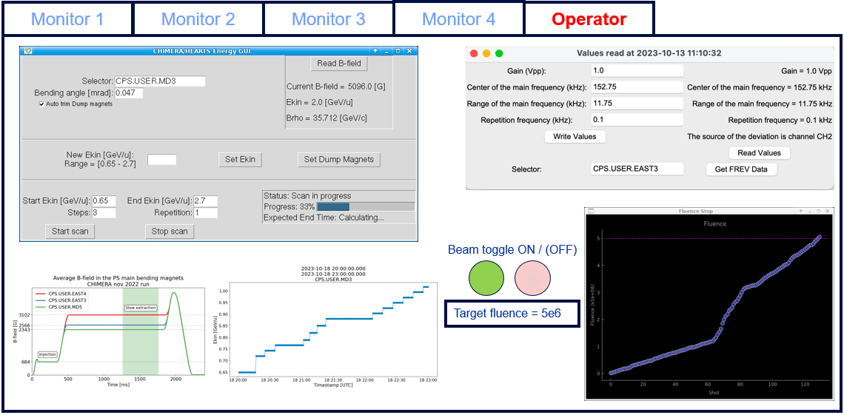
UI Mock-ups – Operator screen

Slide 9
Deliverables and Milestones in P1
WP9 had no deliverables in P1
There were no milestones affecting WP9 in P1

Slide 10
Upcoming Deliverables & Milestones
Deliv. No. | Deliverable name | Due date | Status
D9.1 | User interface tool for beam experimentation | 2026-05-31 | Pending
D9.2 | User experiment lifecycle interface deployment | 2026-12-31 | Pending
Milest. No. | Milestone name | Due date | Status
MS14 | Achievement of TRL6-7 for electronics testing at the CHARM facility | 2026-05-31 | Pending
MS15 | Achievement of TRL6-7 for electronics testing at GSI | 2026-05-31 | Pending
MS19 | Achievement of TRL6-7 for the SIS18 GCR/SPE simulator | 2026-05-31 | Pending

Slide 11
Critical Risks & Mitigation Measures in P1
No critical risks affecting WP9 have materialised in P1

Slide 12
Identification of new risks
No new risks have been identified

Slide 13
Conclusion
WP9 tasks are proceeding according to plan
We’re still on track for end-of-year prototype testing

Slide 14
Thank you for your attention.
Questions?

