Slide 1
1
FCC study plans following MTR
Michael Benedikt, Jean-Paul Burnet, Frank Zimmermann
TE FCC workshop, 16 May 2024

Slide 2

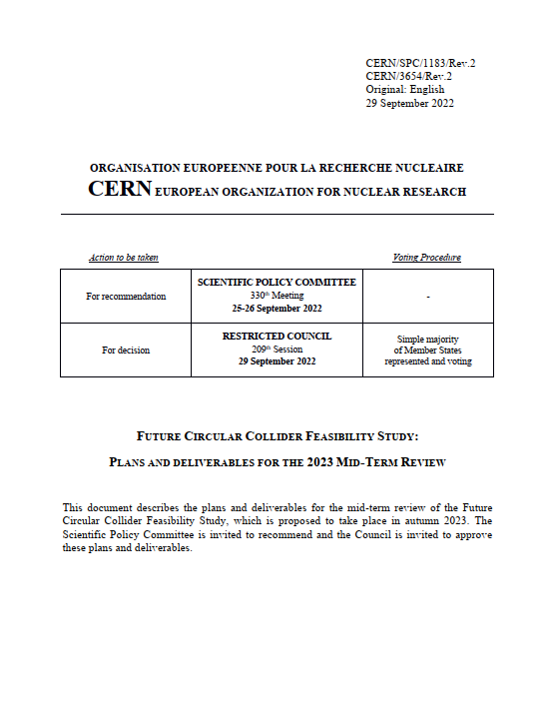
FCC FS Mid-Term Review concluded in February 2024
The goal of the FCC FS mid-term review is to assess the progress of the Study towards the final report.
Deliverables approved by the Council in September 2022:
https://indico.cern.ch/event/1197445/contributions/5034859/attachments/2510649/4315140/spc-e-1183-Rev2-c-e-3654-Rev2_FCC_Mid_Term_Review.pdf
Deliverables:
D1 : Definition of the baseline scenario
D2 : Civil engineering
D3 : Processes and implementation studies with the Host States
D4 : Technical infrastructure
D5 : FCC-ee accelerator
D6: FCC-hh accelerator
D7: Project cost and financial feasibility
D8: Physics, experiments and detectors
Many thanks to the Host States
for their strong support!
Documents:
Mid-term report (all deliverables except D7)
Executive Summary of mid-term report
Updated cost assessment (D7)
Funding model (D7)
Review process:
Oct 2023: Scientific Advisory Committee (scientific and technical aspects)
and Cost Review Panel (ad hoc committee; cost and financial aspects)
Nov 2023: SPC and FC
2 Feb 2024: Council
Many thanks to the SAC, CRP, SPC, FC and the Council for the very useful reviews!

Slide 3
FCC key dates
Date | Deliverable | Achievement | Target
End 2024 | Completion of technical work for Feasibility Study
March 2025 | Feasibility Study Report - complete draft ready for submission to ESPPU
End 2025 | Systems description for entire project
2027 | Technical pre-design for entire project 2027 → requirements and specifications to enable CE tender design
2031/32 | Start of CE construction ; TDR to enable prototyping, industrialization towards component production for TI and accelerator

Slide 4
Main goals for 2024/begin 2025
Completion of technical work for Feasibility Study until end 2024
  Implementation of recommendations of the mid-term review
  Focus on “feasibility items” and items with important impact on cost/performance
  Develop a risk register
  Update cost estimate to reach cat 3 level on cost uncertainty.
  Further develop the funding model based on discussions with the Council
  Complete FS by March 2025 as input for ESPP update.
  In parallel, continue work with host states on project definition and responsibilities, authorization procedures, excavation material strategy and regional implementation development.

Slide 5
Pre-TDR phase from April 2025 until end 2027
Main goal is to provide all information to Council to allow taking a decision on the project at the end of 2027 or mid-2028
  further develop the civil engineering and the technical design all major components, so as to provide a more detailed cost estimate with reduced uncertainties
  Continuation ot technical R&D activities.
  Continuation of site investigations and perform an overall integration study to specify requirements of technical infrastructure, accelerators and detectors for subsequent civil engineering design in case the project goes ahead.
  Launch of environmental impact study in 2026
  Work with host states on regional implementation development and authorization procedures.

Slide 6
Analysis of mid-term review recommendations
from SAC, CRP, SPC, FC and Council (i)
Analysis of recommendations and planning for implementation, F. Gianotti and M. Benedikt, presented to Council in March 25.
Until/for Feasibility Study March 2025:
Increase resources of FCC FS team (SAC, FC, SPC)
Establish pre-project team to significantly improve confidence in design and cost estimate (CRP)
Ramp-up accelerator R&D and design (CRP)
Decision on FCC-ee injector system (SAC, SPC) and cost (CRP)
Baseline on FCC-hh injector system (SAC, SPC)
Avoid different RF systems for Z and W/H (SAC)
Clarify logistic (safety) for a 10km-long 5.5m-diameter tunnel (CRP)
Perform safety risk analysis with external consultant (SPC)
Emphasize system integration and interfaces between work packages (CRP)
Provide FCC-hh cost (although with less precision than for FCC-E) (FC, SPC)
State cost of FCC-ee due to preparation for FCC-hh (FC)
Identify opportunities for heat recovery to the benefit of local use (SAC)
Procedures for conservation of He (SAC)

Slide 7
Analysis of mid-term review recommendations
from SAC, CRP, SPC, FC and Council (ii)
Until/for Feasibility Study March 2025:
Clarify LHC role in the FCC-ee era (FC)
Financial implications of the various operational sequences and e.g. running at H peak (FC, SPC)
For final report provide well-defined baseline layout for all aspects of the FCC ee machine (SPC)
Provide well-understood and prioritized R&D plan for FCC-hh in the final FS report (SPC)
Develop roadmaps for LTS & HTS magnets for FCC-hh and include report on HFM about FCC-hh feasibility (SPC)
Provide more detailed construction schedule for tunnel and accelerator (SPC)
Provide more info on the reliability of the simulation of transport and logistics for installation phase (SPC)
Workshop to further define accelerator scope, define interfaces, identify missing scope/cost (CRP)
Include FTEs needed for R&D, design and construction phases (SPC)

Slide 8
Analysis of mid-term review recommendations
from SAC, CRP, SPC, FC and Council (iii)
For 2027-2028, project approval, start of CE design contract:
CO2 footprint over full project lifecycle (SAC, SPC, Council)
Environmental impact and sustainability (FC, Council)
Discuss sustainability issues for FCC-hh (SPC)
SCRF performance improvement (Q and gradient) (SAC)
R&D on NEG coating to reduce risks (SPC)
Sensitivity to commodity prices (SAC)
Continue to develop benchmarks as reference for FCC-ee cost (CRP)
Revisit CERN’s procurement policies and learn for other big facilities to ensure balanced industrial return without increasing cost (FC)
Risks of not achieving FCC-ee luminosity (SPC)
Heat recovery to the benefit of local use technical implementation (SAC)
FCC-hh magnet R&D (SAC)
Evaluate pros/cons of commercial vs in-house systems for controls (SPC)

Slide 9
Further aspects to be taken into account
Mid-term recommendations do not give the full picture. Many areas deserve attention and require collaborative transverse setups, e.g.
  synchrotron radiation management & shielding concept
  arc mock-up studies and integration optimisation
Importance of design optimisation towards industrial production, maintenance, reliability, etc.
Importance of parallel cost optimisation (CAPEX/OPEX) and cost CONTROL with respect to mid-term estimate
Importance of international support for project approval
Need for collaboration and integration of partners, also in view of low-risk management of potential in-kind contributions

Slide 10
FCC-ee Accelerator organisation 2024 (preliminary)
Accelerators FCC-ee F. Zimmermann, T. Raubenheimer /SLAC
Accelerator Technical Implementation
JP. Burnet, T. Raubenheimer
Beam transfer systems
Beam instrumentations
Beam Intercepting Devices
Magnets
Vacuum
Power converters
Radiation & shielding
Radio Frequency
Survey & alignment
Integration
Radiation WG
MDI WG
Arc mock-up WG
System engineering and interface management
Accelerator Design
C. Carli, F. Zimmermann
Parameters & performance, C. Carli & F. Zimmermann
Optics design, K. Oide/UNIGE
Correction & tuning, R. Tomas, J. Keintzel
Alignment, J. Wenninger
Energy calibration and polarisation, J. Keintzel & G. Wilkinson / Oxford
Beam-beam, X. Buffat
Impedance & collective effects, M. Migliorati / Sapienza & C. Zannini
Electron cloud and ion effects, L. Mether
Collimation & machine protection, R. Bruce & J. Uythoven
MDI, M. Boscolo/INFN-LNF
Booster, A. Chance
Booster design WG
EPOL WG
Machine protection WG
Transfer Lines Design
W. Bartmann
Optics
Machine protection
Interfaces
Injector and TLs
P. Craievich/PSI, A. Grudiev
e-/e+ sources
Linacs
Damping ring
all Accelerator Design activities should have indico meeting sites inside the FCC indico structure !

Slide 11

FCC Feasibility Study
EU Projects
NN
Study Support Unit
IT: Sylvain Girod
Procurement: Adam Horridge
Quality management: Beatriz Arias
Resources: Sylvie Prodon
Secretariat: Julie Hadre
Collaboration building
Emmanuel Tsesmelis
Study Support and Coordination
Study Leader: Michael Benedikt
Deputy Study Leader: Frank Zimmermann
Communications
Panagiotis Charitos, Arnaud Marsollier
Physics, Experiments and Detectors
Patrick Janot, Christophe Grojean
Physics programme
Matthew McCullough, Frank Simon
Accelerators
Tor Raubenheimer
Frank Zimmermann
Project organisation model
NN
Technical Infrastructures
Jean-Paul Burnet Klaus Hanke
Host State processes and civil engineering
Timothy Watson
Organisation and financing models
Florian Sonnemann
FCC-ee accelerator design
Christian Carli, Frank Zimmermann
FCC-ee technical implementation
Jean-Paul Burnet, Tor Raubenheimer
FCC-ee injector
Paolo Craievich, Alexej Grudiev
FCC transfer lines
Wolfgang Bartmann
FCC-hh design
Massimo Giovannozzi
Integration
Jean-Pierre Corso
Geodesy & survey
Hélène Mainaud Durand
Electricity and energy management
Jean-Paul Burnet
Cooling and ventilation
Guillermo Peon
Cryogenics systems
Laurent Delprat
Computing and controls infrastructure, communication and network
Pablo Saiz
Safety
Thomas Otto
Operation, maintenance, availability, reliability
Jesper Nielsen
Transport, installation concepts
Roberto Rinaldesi
Administrative processes
Friedemann Eder
Placement studies
Johannes Gutleber
Environmental evaluation
Johannes Gutleber
Tunnel, subsurface design
John Osborne
Surface sites layout, access and building design A. Mayoux
Detector concept
Mogens Dam, ???
Physics performance
Patrizia Azzi, Emmanuel Perez
Software and computing
Gerardo Ganis, NN
Financing model
Florian Sonnemann
Procurement strategy and rules
Anders Unnervik
In-kind contributions
Anders Unnervik
Operation model
Verena Kain

Slide 12
FCC Feasibility Study – summary and outlook
The first part of the FCC Feasibility Study has been completed with the mid-term review
  placement & layout was defined, and entire project adapted to the new geometry
  dialogue with local-regional actors and stakeholders for implementation established and ongoing
  all deliverables met, list of recommendations from committees towards final Feasibility Study
Next milestone is completion of the FCC Feasibility Study by March 2025 to enable advancing project decision and project start date.
By 2027-2028, possible project approval, possible start of CE design contract
By 2031-32, possible start of CE construction:
  CE groundbreaking
  TDR to enable prototyping, industrialization towards component production
Challenging period ahead but hopefully significant resources from MTP 2024
Many thanks for TE support and contributions!

