Slide 1


FCC cryogenic SYSTEM
FCC-ee Layout and Implementation
(incl. compatibility with FCC-hh)
This project has received funding from the European Union's Horizon 2020 research and innovation programme under grant agreement No 951754.
Boyan Naydenov
on behalf of CERN TE/CRG
16th of May, 2024

Slide 2

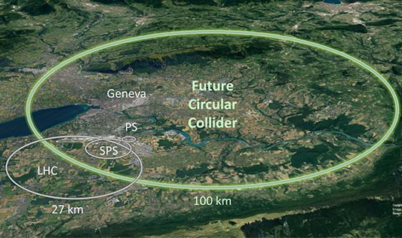
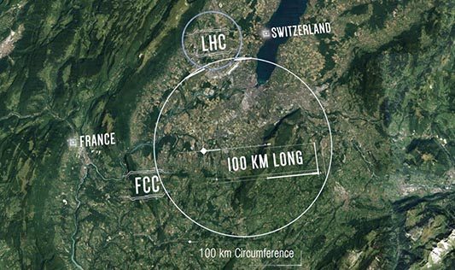
Table of contents
B. Naydenov | FCC Cryogenic System
Introduction & status
FCC-ee
  Cryogenic cooling users
  SRF heat loads
  Cryoplants layout
  Helium inventory
  Electrical power needs
  Operation modes
  Cost estimate and challenges
FCC-hh compatibility
Conclusions

Slide 3
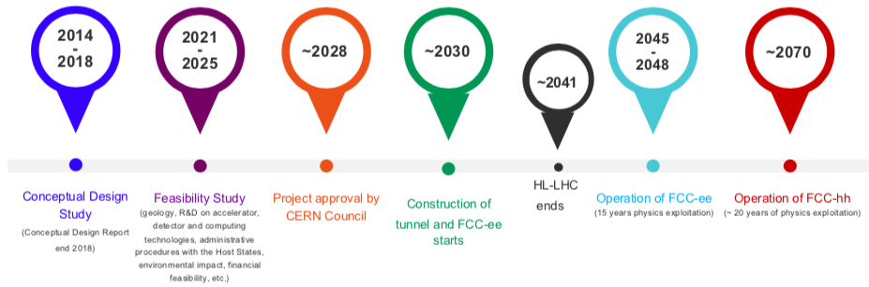
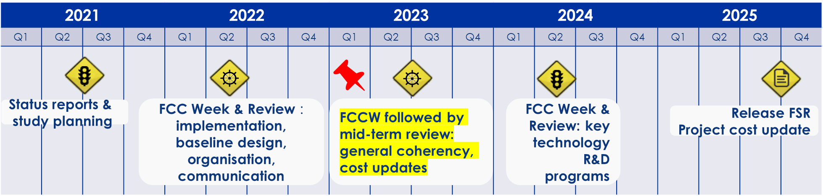

Status
B. Naydenov | FCC Cryogenic System
FCC Full schedule
F. Gianotti
FCC Feasibility status:
  Started in ‘21.
  Mid-term review completed in ‘24
  Feasibility Report => May’25
M. Benedikt
Focus:
Cryomodules Helium inventory refinement.
Updated static loads for 4.5 K cryomodules.
New layout at point L – becomes symmetric again.
FCC-hh layout adjusted with integration constraints (PH, PB and tunnel diameter).
  Utilities needs are also being adjusted.
Point L – RF Booster
4 IPs
Point H – RF Collider
Status | Heat loads | Cryo layout | Helium/EL needs | Op. modes | Cost Estimate | FCC-ee challenges | FCC-hh compatibility | Upcoming steps

Slide 4
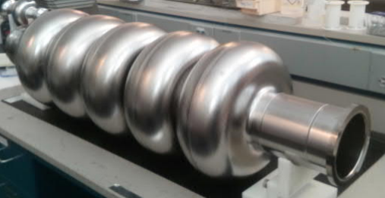
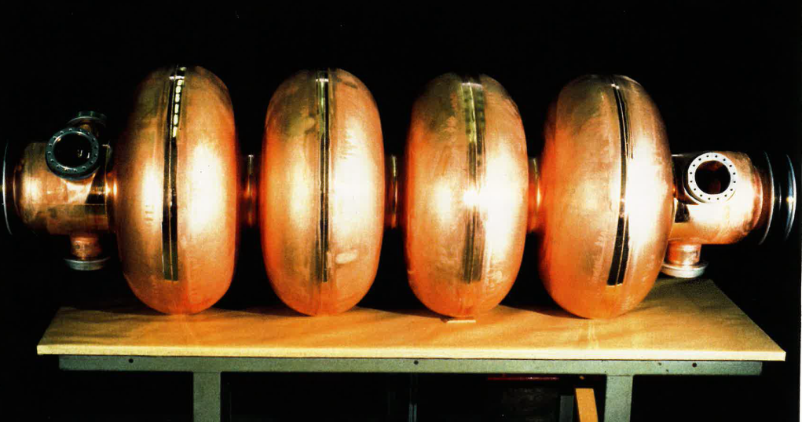
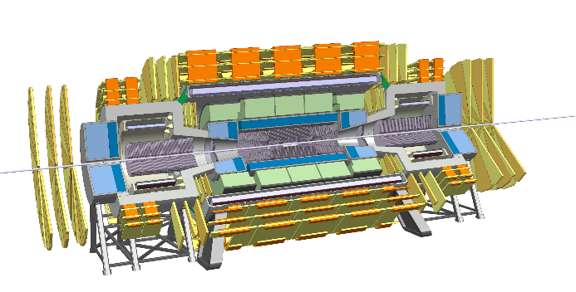
FCC-ee cryogenic cooling users
B. Naydenov | FCC Cryogenic System
RF booster cavities
PA
PL
PB
2 K
Detector solenoids and MDI magnets
PJ
PD
4.5 K
RF collider cavities
PH
PF
2 K
PG
Status | Heat loads | Cryo layout | Helium/EL needs | Op. modes | Cost Estimate | FCC-ee challenges | FCC-hh compatibility | Upcoming steps

Slide 5
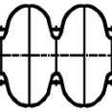












FCC-ee SRF dynamic and static heat loads
B. Naydenov | FCC Cryogenic System
String of 1950 m
Point H - Collider
Point L
Point L - Booster
String of 1300 m
Strong dynamic/static ratio
Strong transient heat loads
Point H
4y
Z
x28 ${CM}_{400MHz}$– 8.7 kW at 4.5 K
x6 ${CM}_{800MHz}$– 0.3 kW at 2 K
➔
Assumptions
2y
W
400 MHz cavities : $Q_{installed}$ = 2.7E+9
x66 ${CM}_{400MHz}$– 64 kW at 4.5 K
x14${ CM}_{800MHz}$– 0.9 kW at 2 K
➔
800 MHz cavities : $Q_{installed}$ = 3.0E+10
3y
H
➔
x66 ${CM}_{400MHz}$– 64 kW at 4.5 K
50 % margin on heat loads, today
x27${ CM}_{800MHz}$– 1.9 kW at 2 K
Similar total equivalent cooling power to LHC cryogenics.
x66 ${CM}_{400MHz}$– 64 kW at 4.5 K
ttbar
5y
x150 ${CM}_{800MHz}$– 9.9 kW at 2 K
x122 ${CM}_{800MHz}$– 22.7 kW at 2 K
Status | Heat loads | Cryo layout | Helium/EL needs | Op. modes | Cost Estimate | FCC-ee challenges | FCC-hh compatibility | Upcoming steps

Slide 6
FCC-ee 3-stages cryoplants layout
B. Naydenov | FCC Cryogenic System
RF Points cryogenics
Stage | Point H - Collider | Point L - Booster
Z | 1 x 9 kW eq @ 4.5 K | 1 x 1 kW eq @ 4.5 K (97% @ 2K)
W&H | 2 x 35 kW eq @ 4.5 K | 1 x 6 kW eq @ 4.5 K (97% @ 2K)
tt | 2 x 67 kW eq @ 4.5 K (55% @ 2K) | 2 x 15.5 kW eq @ 4.5 K (97% @ 2K)
PA
PL
RF Booster point
PB
PJ
PD
Experiment points cryogenics
RF Collider point
Detector solenoid :
Number of experiments and their heat loads have not been defined yet.
Option 1 (baseline):
  4 “CMS-like” cryoplants, one of which has a LAr calorimeter.
Option 2:
  2 “CMS-like” cryoplants, one of which has a LAr calorimeter.
PH
PF
→ Technical Point
→ Sector RF Cryoplant
→ IR Cryoplant
→ Experiment Point
→ Experiment Cryoplant
→ Experiment Cryoplant + LAr Calorimeter
PG
Insertion Region magnets:
Unknown heat loads.
Not covered!
ttbar stage is the driver for surface needs, shaft and tunnel integration.
Status | Heat loads | Cryo layout | Helium/EL needs | Op. modes | Cost Estimate | FCC-ee challenges | FCC-hh compatibility | Upcoming steps

Slide 7
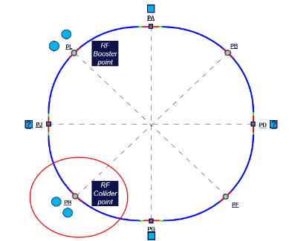
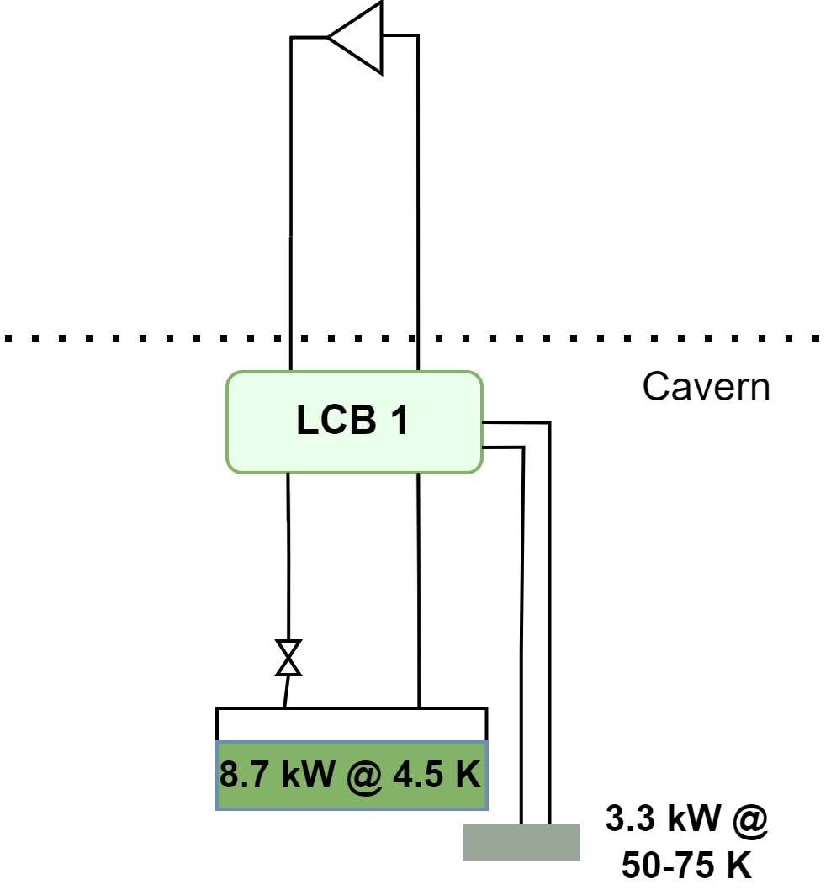
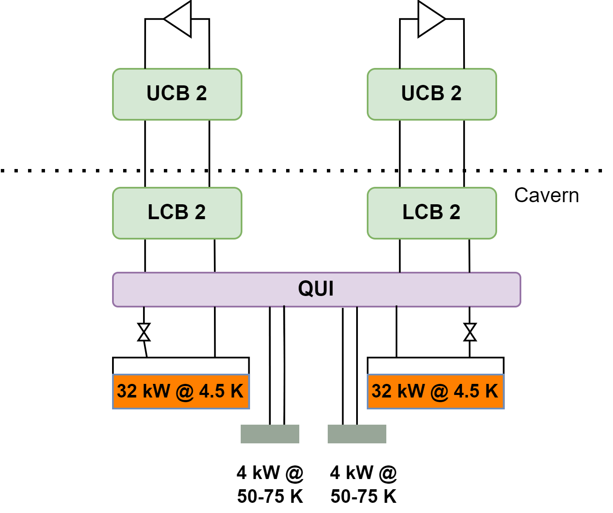
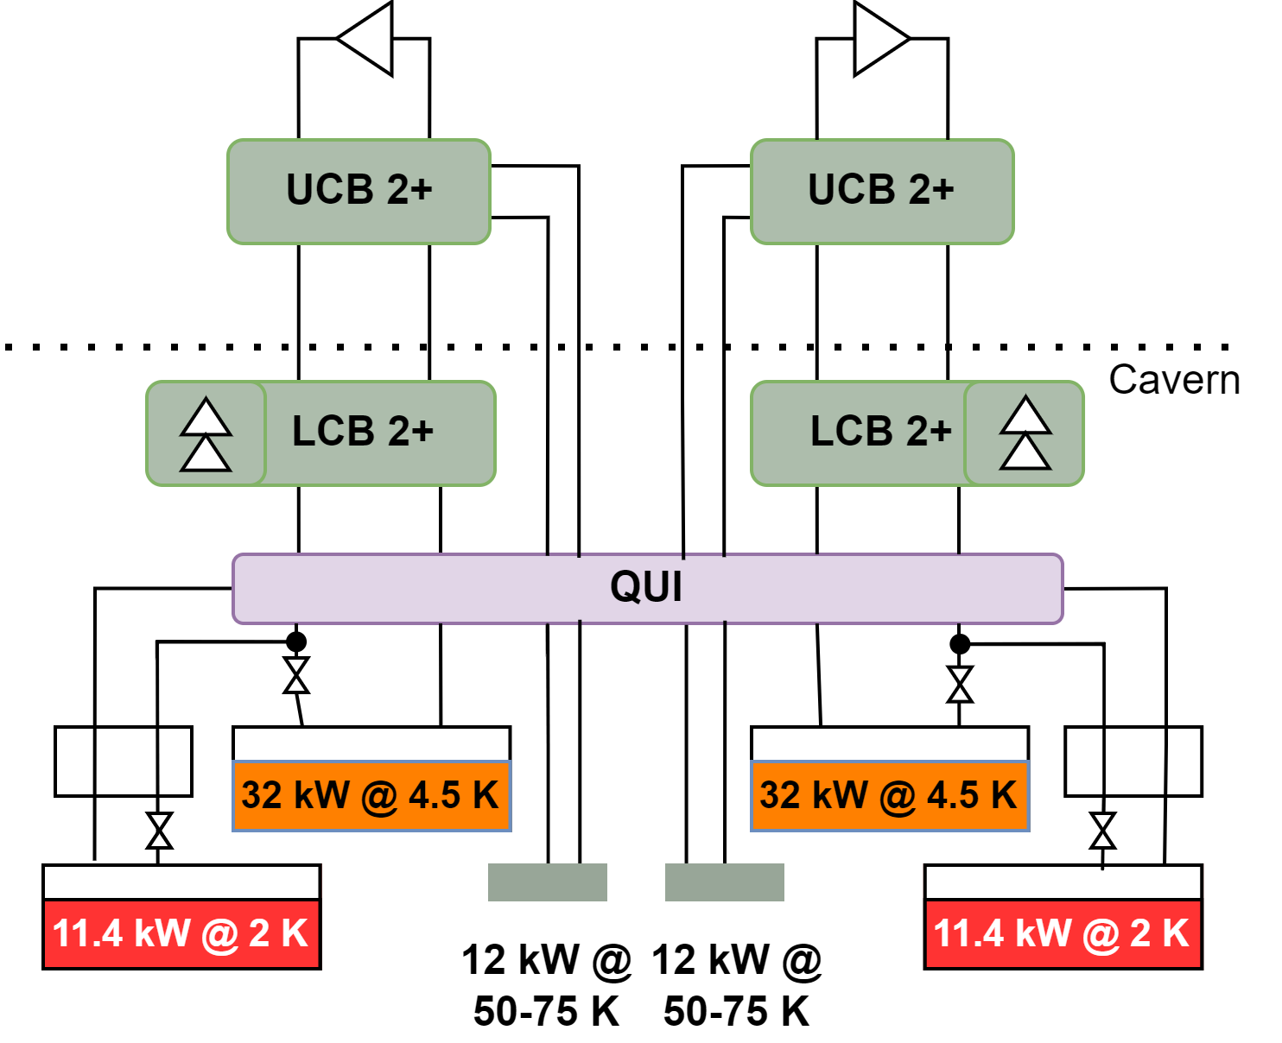
FCC-ee cryoplants at point H - staging
B. Naydenov | FCC Cryogenic System
Staging at point H
    Increased staging complexity.
$Q_{{800MHz}_{Installed}}=3.0E+10$ //$Q_{{400MHz}_{Installed}}=2.7E+9$
Z
➔
W
&
H
➔
ttbar
Ref. ~9 kW eq @ 4.5 K
Ref. ~67 kW eq @ 4.5 K
Ref. ~67 kW eq @ 4.5 K
Ref. ~35 kW eq @ 4.5 K
Ref. ~35 kW eq @ 4.5 K
12 kW @ 2 K included
12 kW @ 2 K
included
Status | Heat loads | Cryo layout | Helium/EL needs | Op. modes | Cost Estimate | FCC-ee challenges | FCC-hh compatibility | Upcoming steps

Slide 8
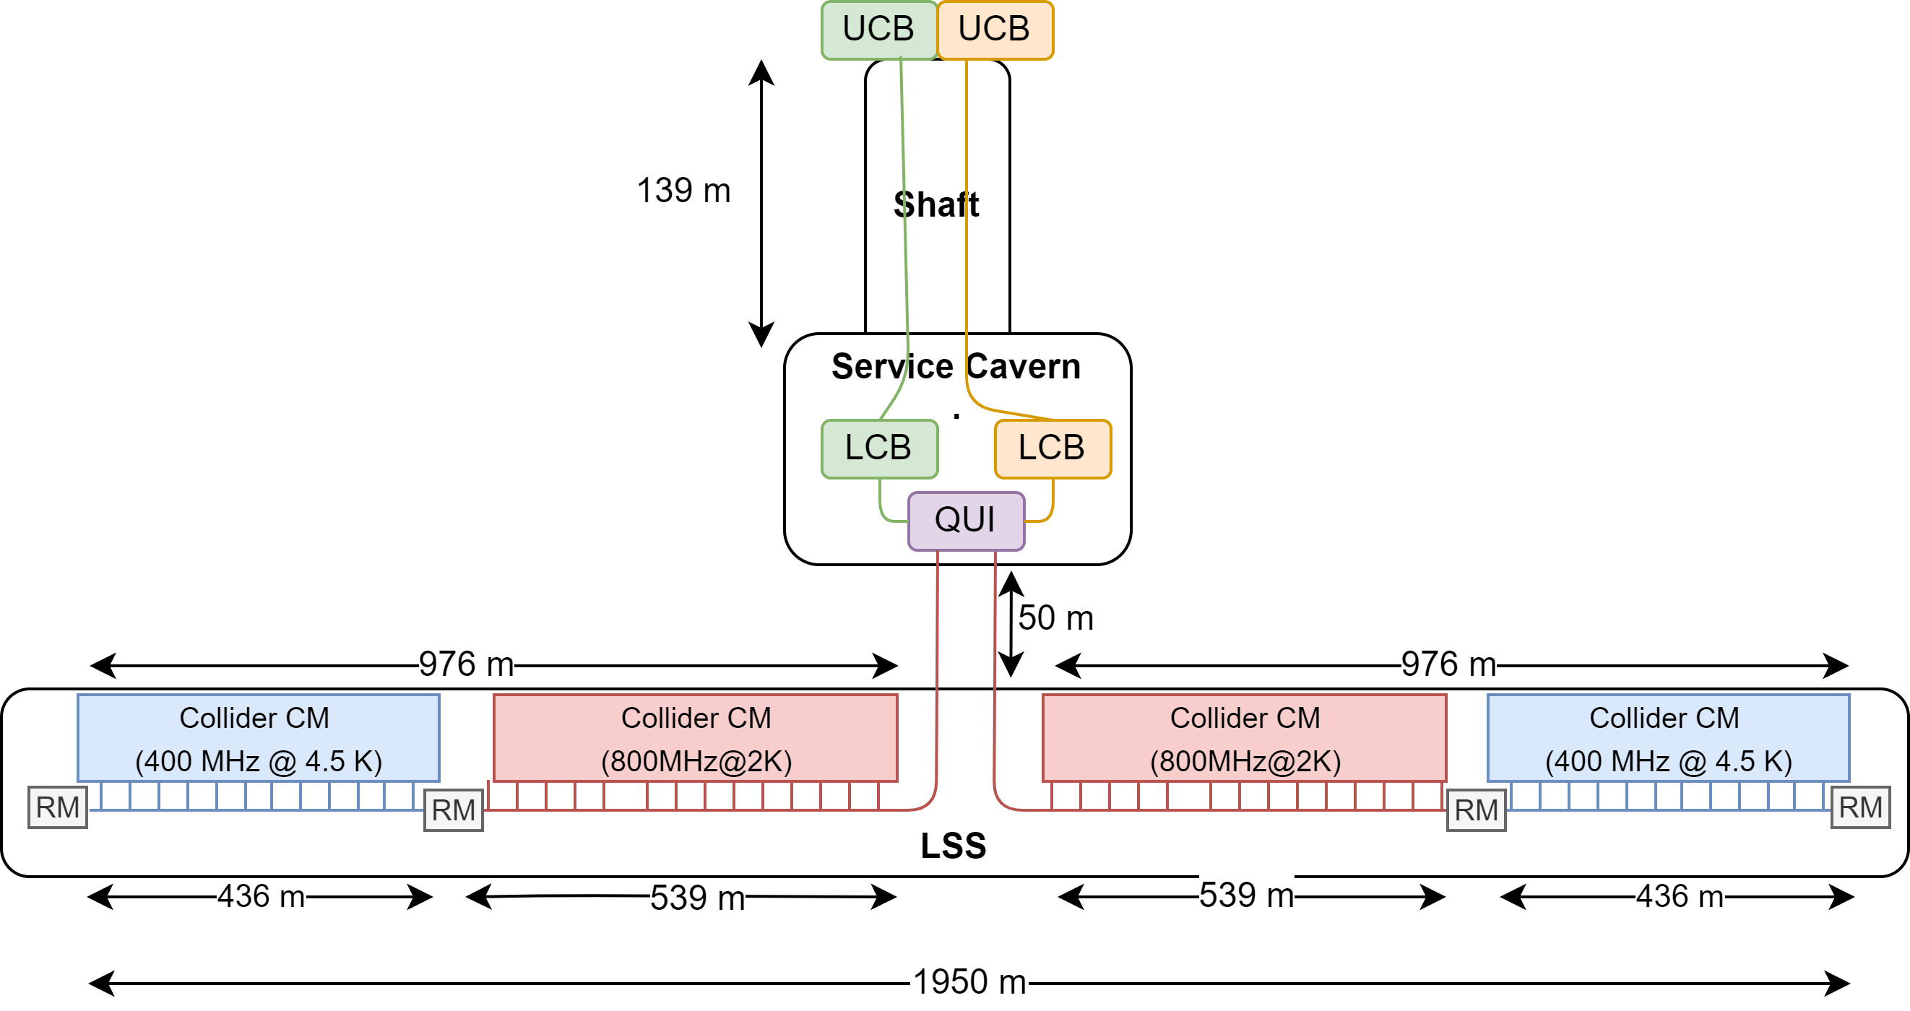
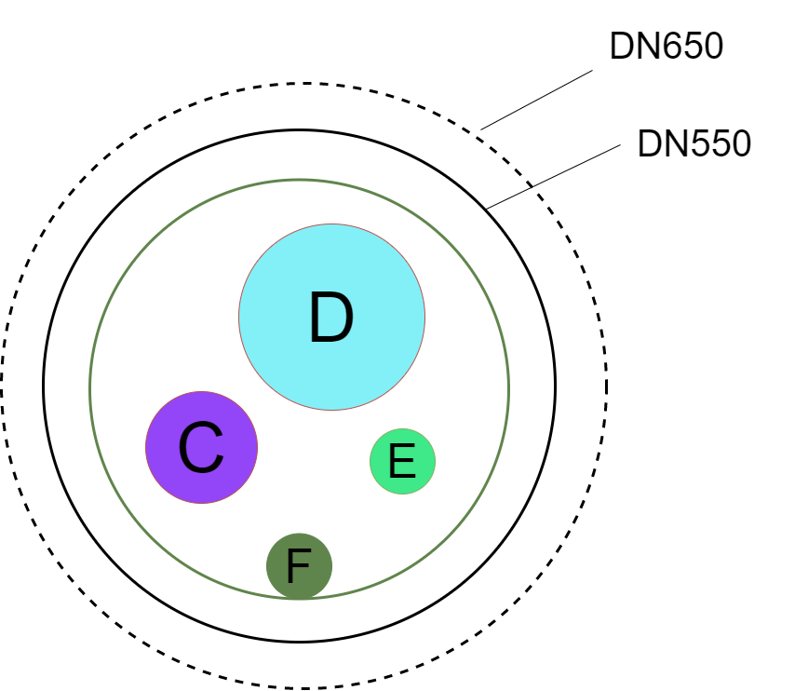
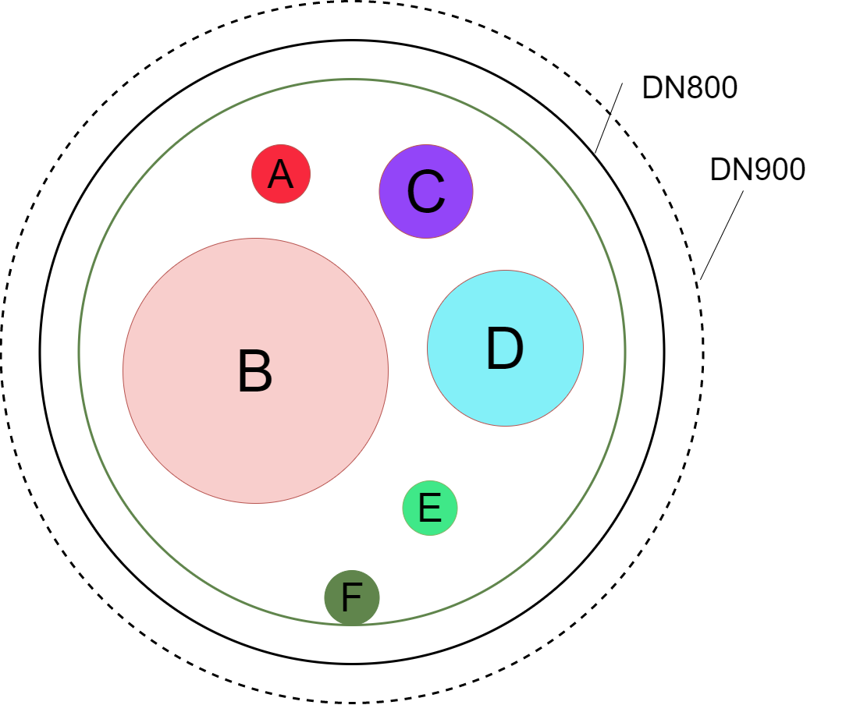
FCC-ee cryo layout at point H (ttbar)
B. Naydenov | FCC Cryogenic System
Service cavern & LSS
center are aligned
CMs are shared
symmetrically
CMs organized to
optimize QRL
LSS total length is of 2032 m
QRL Header & Process values | Diameter (mm)
A : 1.3 bar , 2.2 K (∆P=25 mbar) | 75
B : 30 mbar , 2 K (∆P=2 mbar) | 340
C: 3 bar, 4.6 K (∆P=130 mbar) | 120
D: 1.3 bar, 4.5 K (∆P=70 mbar) | 200
E: 20 bar, 50 K (∆P=10 mbar) | 80
F: 18 bar, 75 K (∆P=15 mbar) | 80
Vacuum jacket (400MHz) | 550*
Vacuum jacket (800 MHz) | 800*
* +100 mm for bellows and flanges
DN650
DN900
DN900
DN650
Status | Heat loads | Cryo layout | Helium/EL needs | Op. modes | Cost Estimate | FCC-ee challenges | FCC-hh compatibility | Upcoming steps

Slide 9
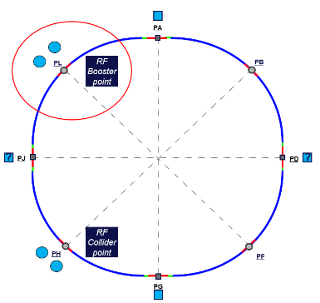
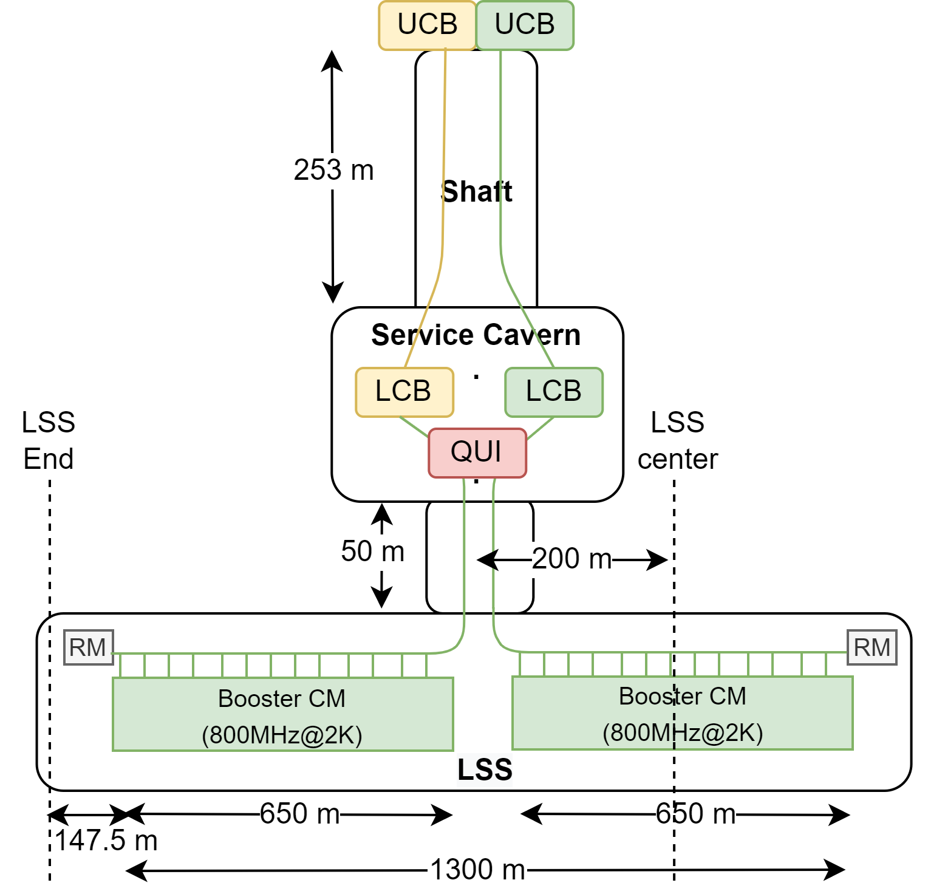
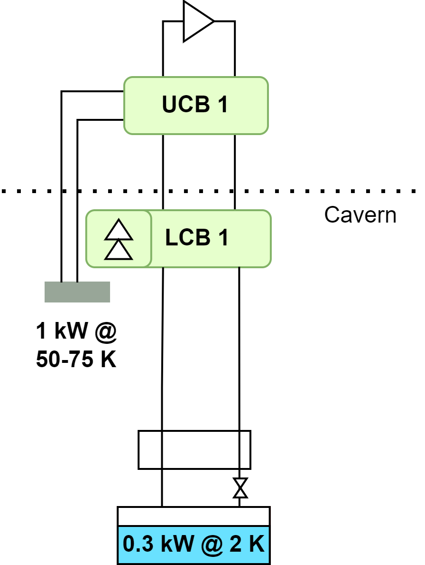
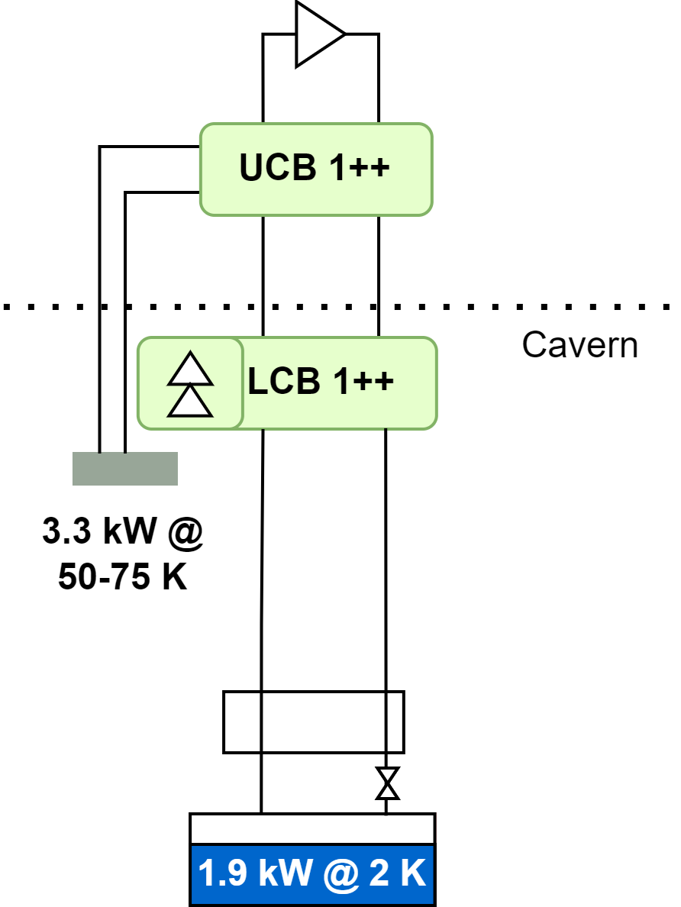
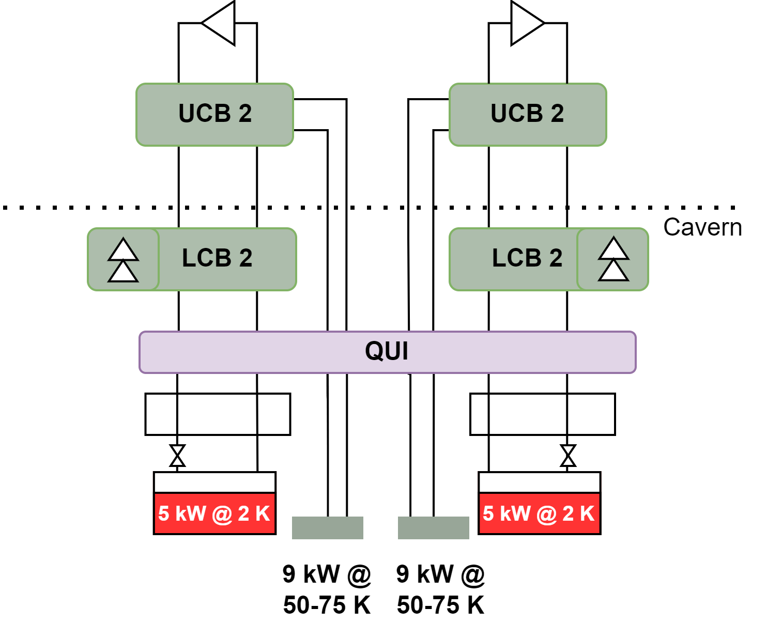
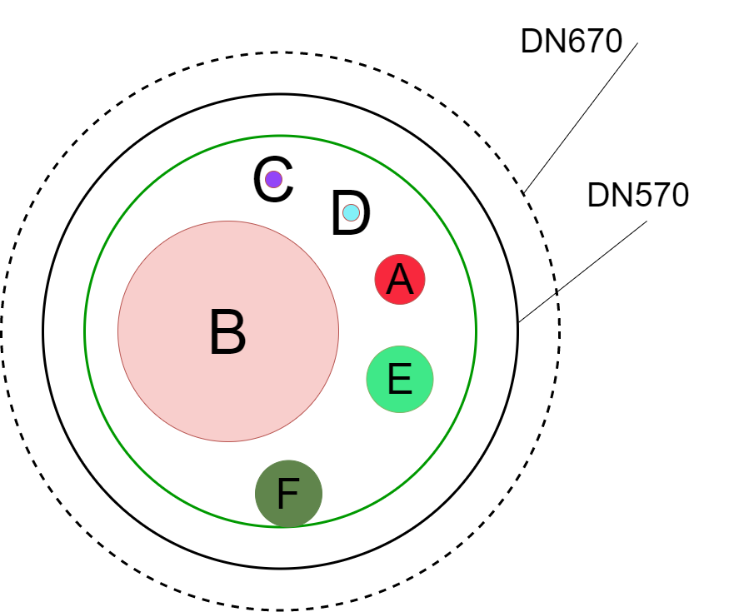

FCC-ee cryoplants at point L: staging
B. Naydenov | FCC Cryogenic System
@ ttbar
Z
➔
W
&
H
➔
ttbar
Ref. 2 K (~0.5 kW)
Ref. 2 K (~2 kW)
Ref. 2 K (~5 kW)
Ref. 2 K (~5 kW)
$$Q_{{800MHz}_{Installed}}=3.0E+10$$
Line A – 1.3 bar / 2.2 K: 60 mm
Line B – 30 mbar/ 2 K: 265 mm
Line E – 20 bar / 50 K: 80 mm
Line F – 18 bar / 75 K: 80 mm
DN670
Status | Heat loads | Cryo layout | Helium/EL needs | Op. modes | Cost Estimate | FCC-ee challenges | FCC-hh compatibility | Upcoming steps

Slide 10

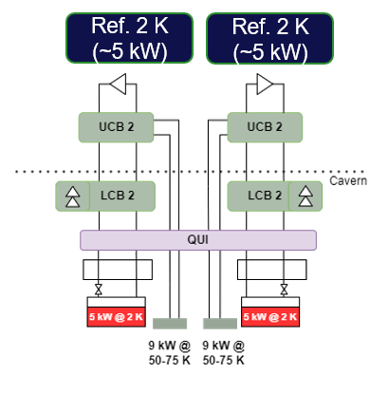
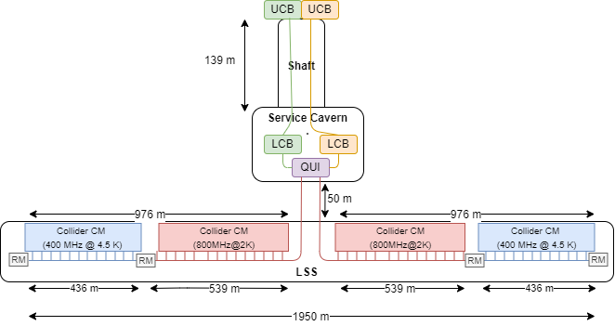
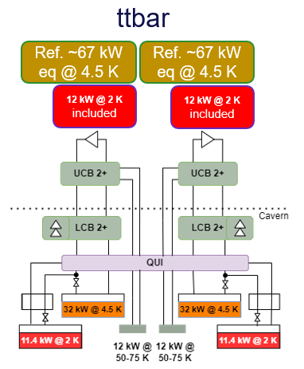
FCC-ee SRF cryogenic system layout summary @ ttbar
B. Naydenov | FCC Cryogenic System
PA
PL
PB
Point L
DN670
Point H
PJ
PD
DN900
PH
PF
PG
Status | Heat loads | Cryo layout | Helium/EL needs | Op. modes | Cost Estimate | FCC-ee challenges | FCC-hh compatibility | Upcoming steps

Slide 11


FCC-ee SRF points H and L - Helium inventory
B. Naydenov | FCC Cryogenic System
Updated CM inventories:
$$116 kg LHe per CM @ 4.5 K$$
$$55 kg LHe per CM @ 2 K$$
Point L | Z | W | H | ttbar
Cryomodules | 0.4 ton | 0.8 ton | 1.5 ton | 8.3 ton
Distribution (QRL) | 1 ton | 1 ton | 1 ton | 1 ton
Cryoplants | 0.1 ton | 0.2 ton | 0.2 ton | 1.1 ton
Total | 1.5 ton | 2 ton | 2.7 ton | 10.4 ton
Point H | Z | W | H | ttbar
Cryomodules | 3.2 ton | 7.7 ton | 7.7 ton | 14.4 ton
Distribution (QRL) | 2.4 ton | 2.4 ton | 2.4 ton | 4.9 ton
Cryoplants | 0.3 ton | 2.4 ton | 2.4 ton | 4.7 ton
Total | 5.9 ton | 12.5 ton | 12.5 ton | 24 ton
Total helium inventory for technical points at FCC-ee (ttbar) ~ 35 ton
Status | Heat loads | Cryo layout | Helium/EL needs | Op. modes | Cost Estimate | FCC-ee challenges | FCC-hh compatibility | Upcoming steps
Notes:
- LHC ~16t per sector

Slide 12

FCC-ee SRF points H and L – Installed EL power
B. Naydenov | FCC Cryogenic System
Three scenarios are considered:
  Conservative: 230 Wel/W or 28.8 % of Carnot efficiency (LHC-like – CDR values) the baseline!
  Intermediate: 210 Wel/W or 31.5 % of Carnot efficiency (With an optimized process) appears not achievable
  Optimistic: 170 Wel/W or 39 % of Carnot efficiency (With centrifugal compressors) strong R&D effort needed
 | PH [MW] | PL [MW] | Total (PH+PL) [MW]
Z | 2.1 / 1.9 / 1.5 | 0.23 / 0.21 / 0.17 | 2.3 / 2.1 / 1.7
W | 16.1 / 14.7 / 1.5 | 1.4 / 1.3 / 1.0 | 17.5 / 16 / 13
H | 16.1 / 14.7 / 1.5 | 1.4 / 1.3 / 1.0 | 17.5 / 16 / 13
ttbar | 30.8 / 28.1 / 22.8 | 7.1 / 6.5 / 5.3 | 38 / 35 / 28
In “high” mode
-26% of consumption with centrifugal compressors - R&D needed.
Status | Heat loads | Cryo layout | Helium/EL needs | Op. modes | Cost Estimate | FCC-ee challenges | FCC-hh compatibility | Upcoming steps

Slide 13
FCC operation Modes – typical year
B. Naydenov | FCC Cryogenic System
Source: CDS 2645151
Phases in a typical year – 365 days
  Shutdown phase – 120 days (33%)
    The machine is stopped and open for upgrade works, maintenance and repairs.
  Operation phase – 245 days (67%)
    Hardware and beam commissioning – 30 days
      All systems are restarted and tested before operation.
    Physics operation – 185 days
      Beam is stable and collides for experiments.
    Technical stops – 10 days
      Planned stops during operation to perform maintenance and repairs.
    Machine development – 20 days
      Planned activities with beam operation to improve beam performance.
Availability target – 80 % of physics operation
The modes will impact the design of the cryoplants and their energy consumption (30% estimated savings with ECO mode)
Cryo in ECO mode
Cryo in ECO mode
A total of 14 years of expected life-cycle:
4 years in Z stage
2 years in W stage
3 years in H stage
5 years in ttbar stage
Status | Heat loads | Cryo layout | Helium/EL needs | Op. modes | Cost Estimate | FCC-ee challenges | FCC-hh compatibility | Upcoming steps
Notes:
More: https://indico.cern.ch/event/1258795/contributions/5287427/attachments/2602506/4494119/FCC_energy_operation-model_SAC_28-02-23.pdf

Slide 14
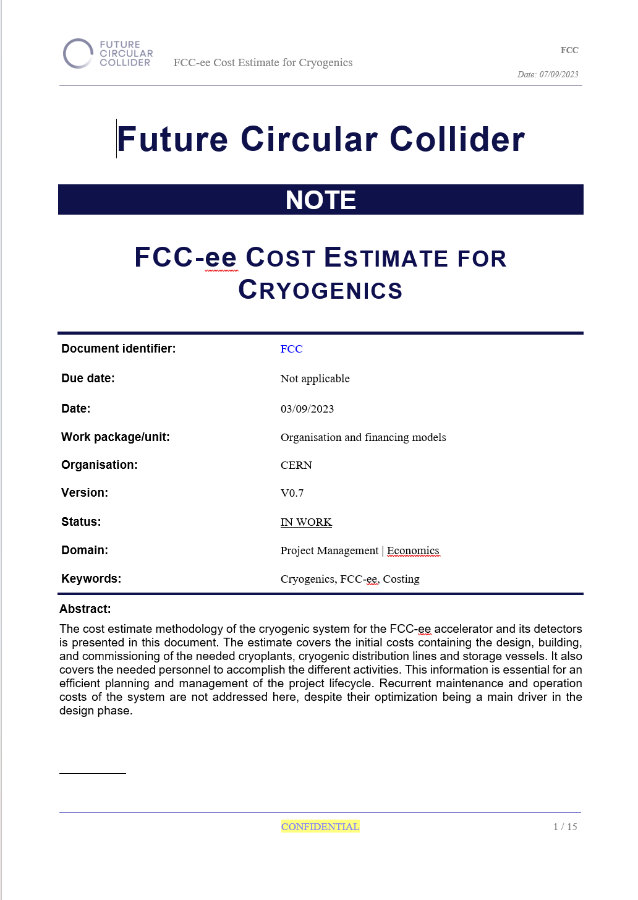
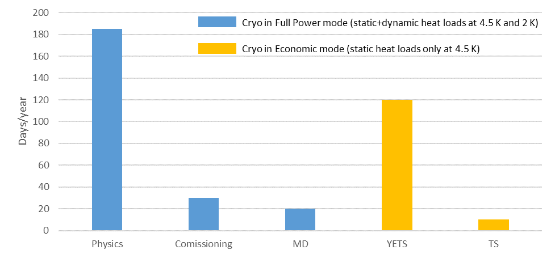
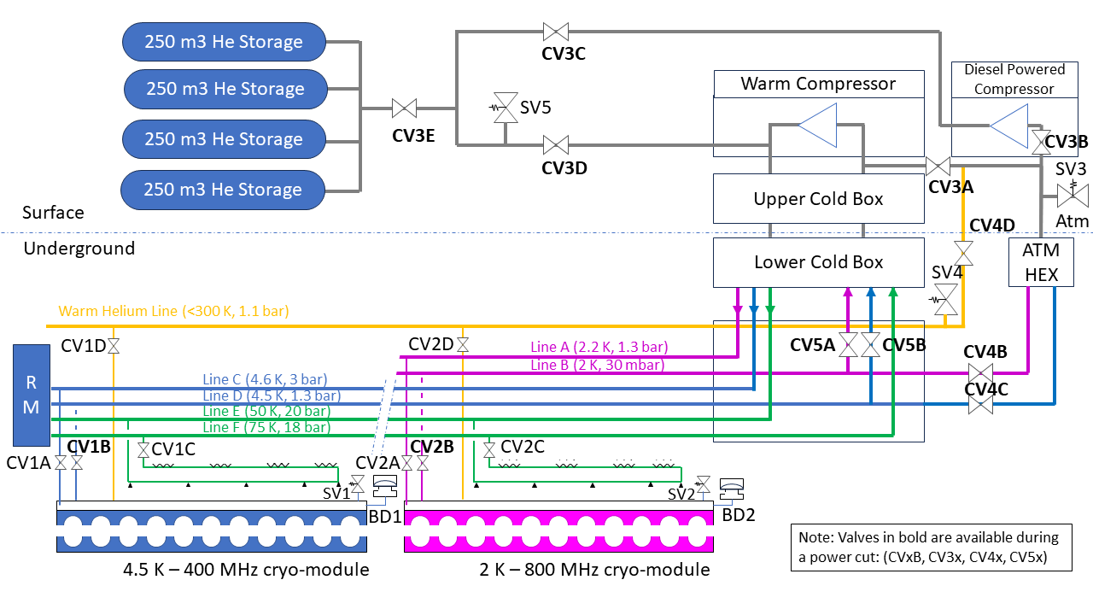
FCC-ee cryogenic system cost estimate
B. Naydenov | FCC Cryogenic System
Class 4 Cost estimate has been delivered for the Mid-Term Review
  Includes SRF cryoplants and 4 detector CMS-like cryoplants.
  MDI region needs are not accounted!
  Needs to be updated to include last heat loads and inventory.
An FTE estimate has been added.
A CAPEX-OPEX optimisation is currently addressed:
  Cryoplant ECO mode to be included from design stage
    Current assumption is that all cavities are kept at 4.5 K, without dynamic loads, during the TS and YETS.
  A Helium Recovery system is proposed for the RF points
    Addresses a power outage scenario as well as an isolated CM situation.
EDMS document (confidential)
Status | Heat loads | Cryo layout | Helium/EL needs | Op. modes | Cost Estimate | FCC-ee challenges | FCC-hh compatibility | Upcoming steps

Slide 15
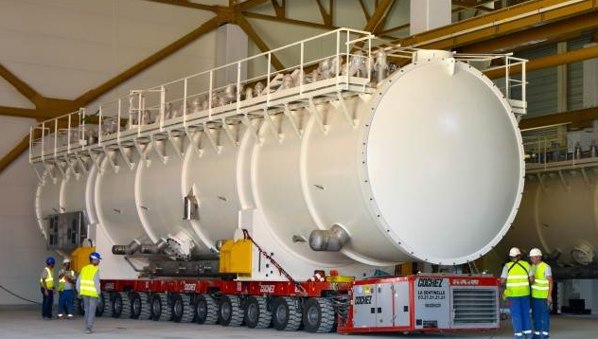


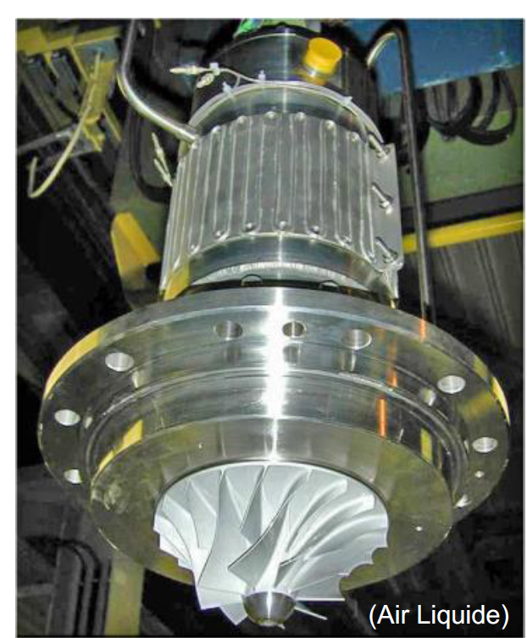
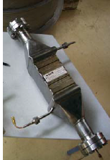
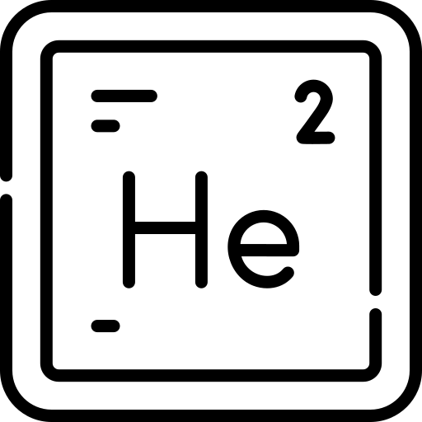


FCC-ee SRF cryogenics challenges
B. Naydenov | FCC Cryogenic System
Cryoplants size. Very large cryoplants needed to optimise for availability. Factor 3 wrt to state-of-the-art units (ITER). Big industrial challenge.
Heat loads density. Similar cryogenic cooling power to LHC, concentrated at point H.
Dynamic / static heat loads ratio. Colliders SRF system requires 4 times more dynamic heat loads than static (with current assumptions). LHC dynamic to static ratio is closer to 0.5.
Transient heat loads management. Booster is operated in a pulsed manner and has different modes: filling from scratch and top up. Impacts cryoplant operation and cryomodules pressure stability.
Fast cooldown requirements of the cavities between certain temperatures imposes operational constraints and affects the distribution line sizing.
2 K system - 500 g/s for the collider at 30 mbar. R&D needed as factor 2 wrt to current state-of-the-art (HEX + cold compressor).
Helium dependency needs to be reduced for future projects. Being addressed with a cryomodule and distribution line optimization, together with a Helium recovery system.
Sustainability. An optimised cryoplant ECO mode design and operation is required in order to reduce energy consumption. Centrifugal compressors R&D could have a very positive effect too.
Installation. The cryogenic distribution line should be installed to cover from Z to ttbar. Complex optimization and integration in the tunnel. Moreover, the cryoplant size doubles between H and ttbar, leading to a challenging staging in a tight schedule.
Status | Heat loads | Cryo layout | Helium/EL needs | Op. modes | Cost Estimate | FCC-ee challenges | FCC-hh compatibility | Upcoming steps

Slide 16
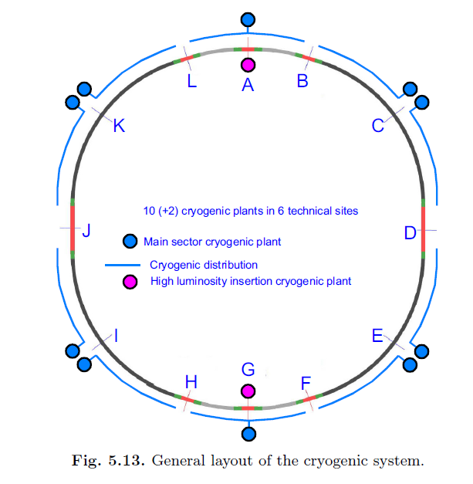
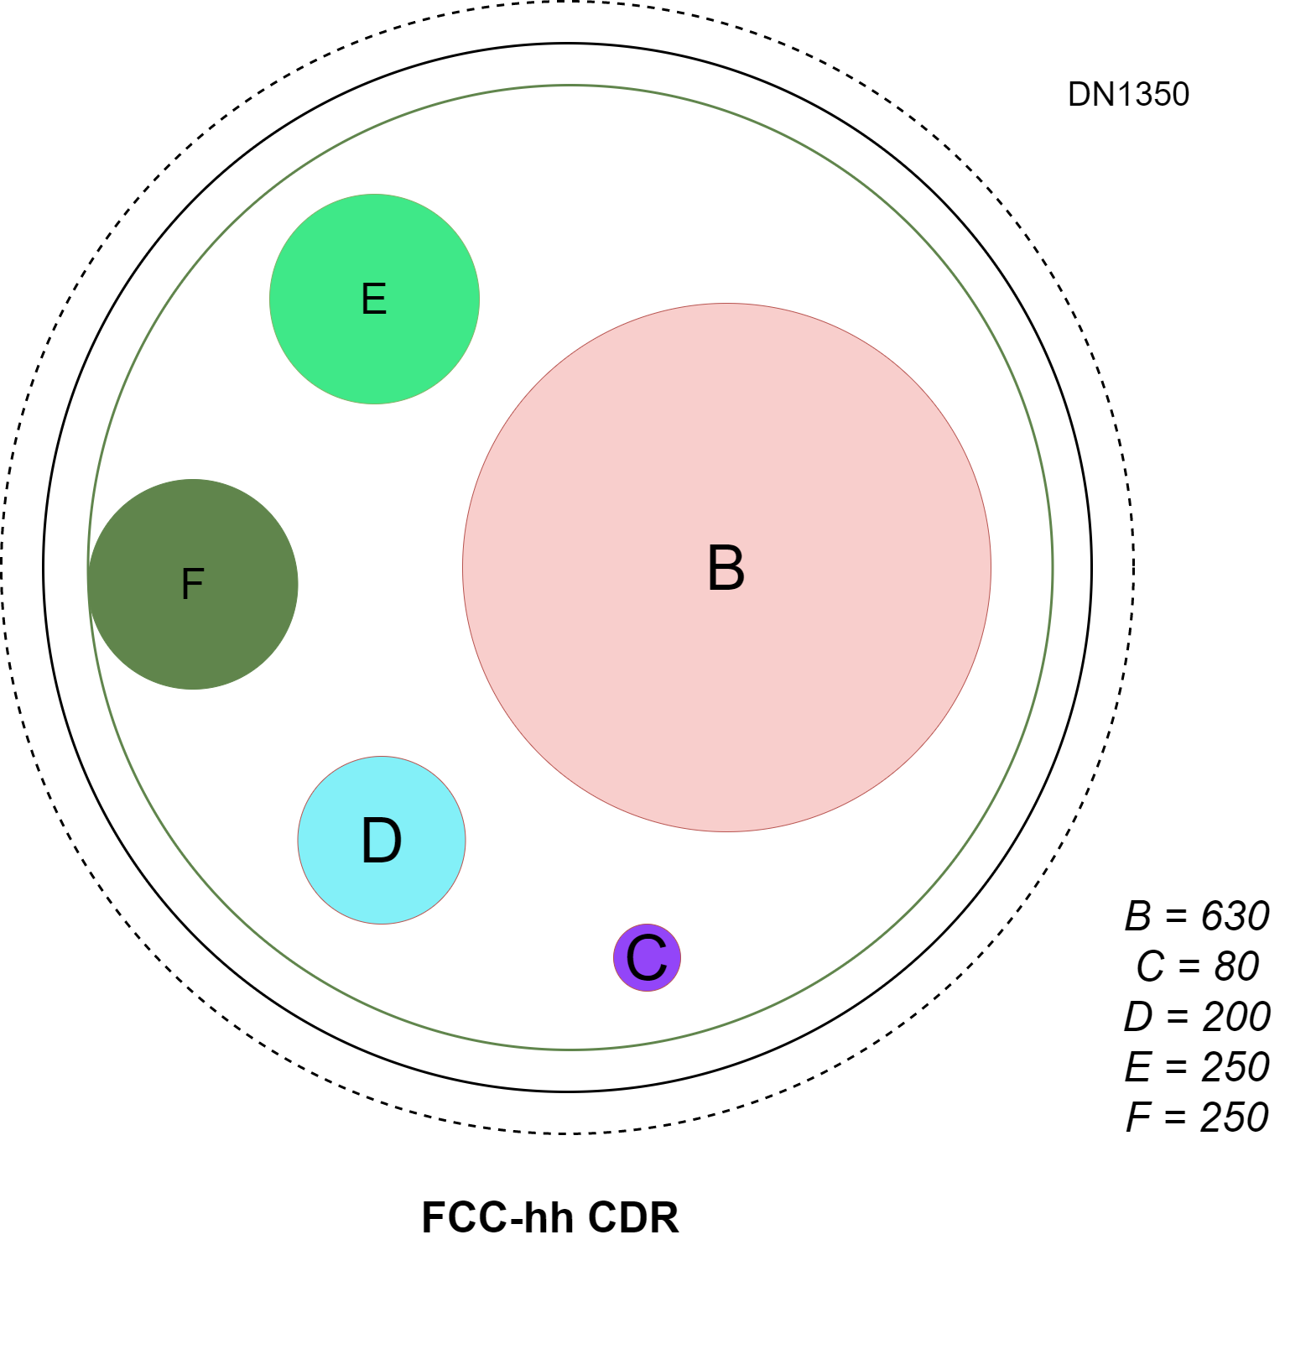
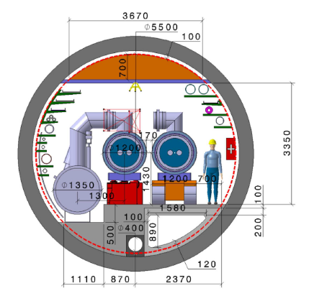
FCC-hh compatibility – CDR cryogenic layout
B. Naydenov | FCC Cryogenic System
Cryogenic distribution line
DN1350
Circumference: 97.75 km
Sectors: 10
Sector length: 9.8 km
Cryo cooling length: 8.4 km
Cryoplants: 12
10 sector cryoplants ~ 110 kW @ 4.5 Keq each.
2 insertion cryoplants ~ 41 kW @ 4.5 Keq each
Heat loads:
  1.4 W/m @ 1.9 K
  70 W/m @ 40-60 K
QRL diameter: 1350 mm
He Inventory: ~880 ton
DN1350
Status | Heat loads | Cryo layout | Helium/EL needs | Op. modes | Cost Estimate | FCC-ee challenges | FCC-hh compatibility | Upcoming steps
Notes:
LHC total inventory is some 150 t.

Slide 17
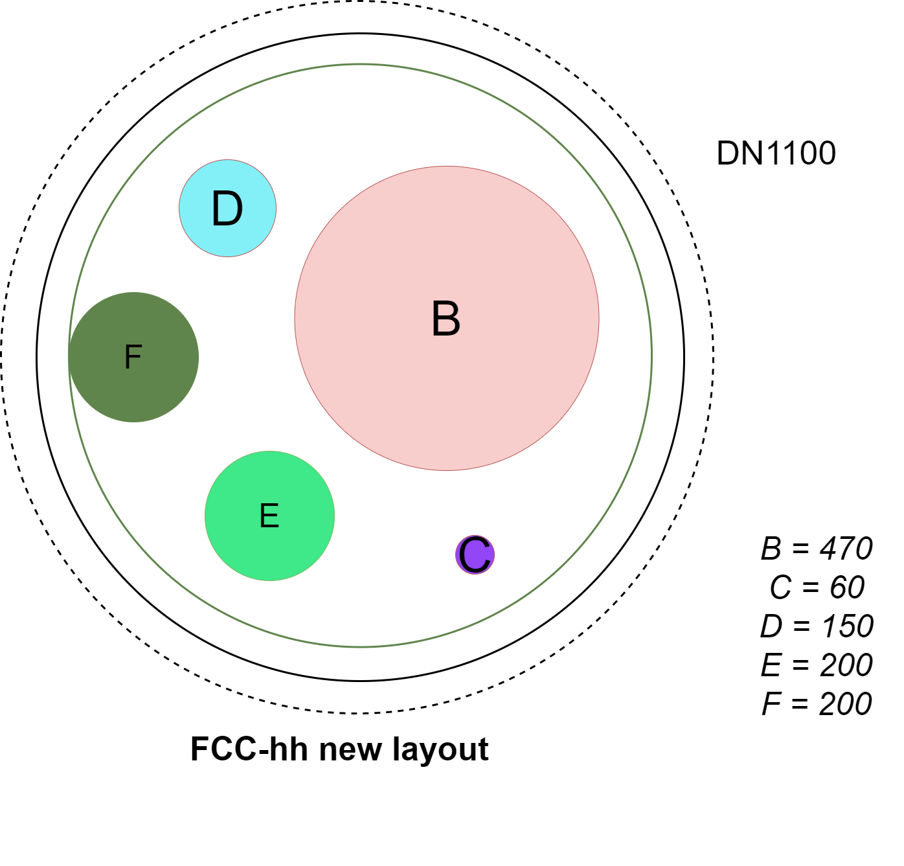
FCC-hh cryogenic system updated layout – Nb3Sn @ 1.9 K
B. Naydenov | FCC Cryogenic System
PA
Cryogenic distribution line
PL
PB
DN1100
Circumference: 91 km
Sectors: 8
Sector length: 11.4 km
Cryo cooling length: 5 km per side
Cryo-islands: 8
6 sector cryo-islands ~125 kW @ 4.5 Keq each.
2 insertion cryo-islands ~176 kW @ 4.5 Keq each.
Heat loads (CDR):
  1.4 W/m @ 1.9 K
  70 W/m @ 40-60 K
QRL diameter: 1100 mm
He Inventory: ~820 ton
PJ
PD
DN1100
→ Technical Point
→ Normal sector cryo-island
PH
PF
→ Insertion sector cryo-island
PG
Status | Heat loads | Cryo layout | Helium/EL needs | Op. modes | Cost Estimate | FCC-ee challenges | FCC-hh compatibility | Upcoming steps

Slide 18
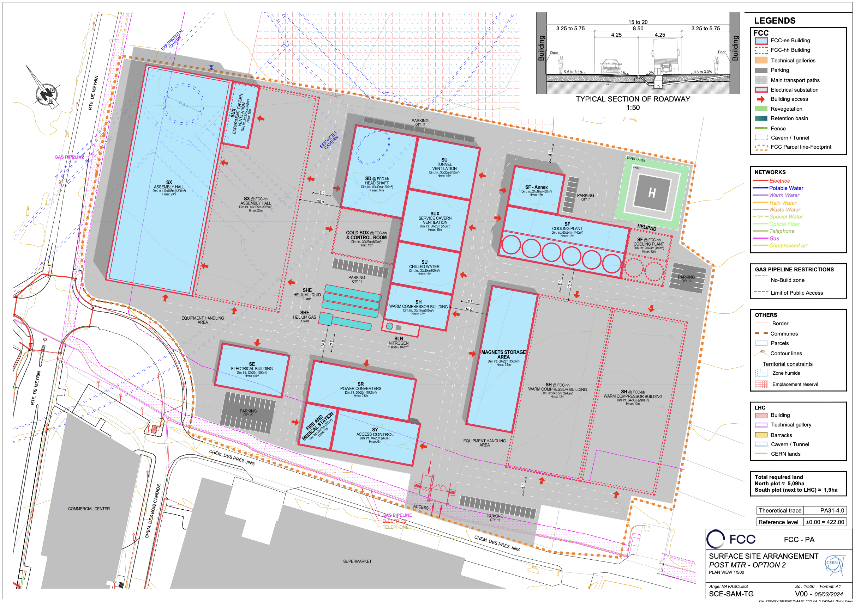
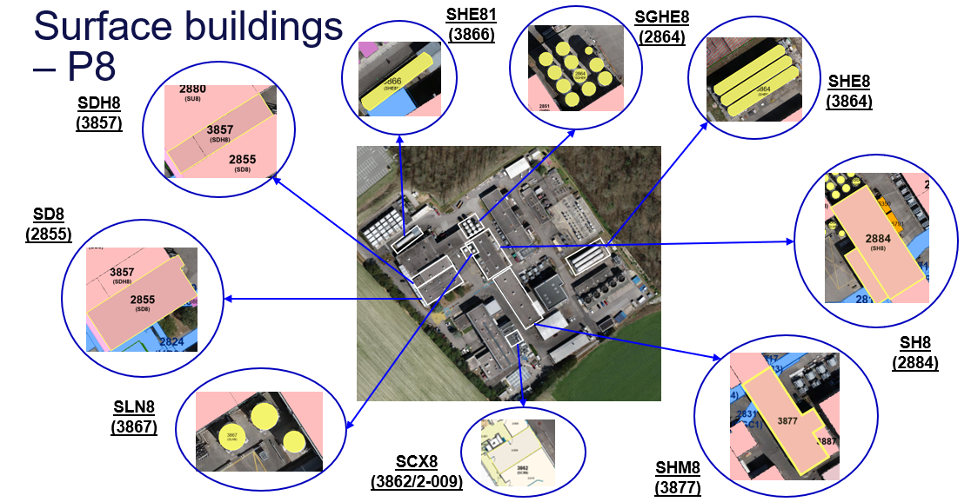
B. Naydenov | FCC Cryogenic System
Surface requirements for FCC cryogenics
Aboveground surface needs per point:
Estimations based on industrial studies for FCC-hh @ CDR baseline and LHC experience.
 |  | Point A & G |  | Point B & F |  | Point D & J |  | Point H |  | Point L
 |  | ee (ttbar) | hh | ee (ttbar) | hh | ee (ttbar) | hh | ee (ttbar) | hh | ee (ttbar) | hh
Surface in m2 | Compressor station building | 430 | 5870 | x | 3200 | 430 | 4270 | 4300 | 3200 | 2140 | 3200
 | Cold box building | x | 600 | x | 400 | x | 400 | 800 | 400 | 400 | 400
 | LN2 storage | 302 | 102 | x | 102 | 102 | 102 | 102 | 102 | 102 | 102
 | GHe storage | 405 | 3240 | x | 1215 | 405 | 2430 | 2430 | 1215 | 1215 | 1215
 | LHe storage | X | 2880 | x | 1440 | x | 1440 | X | 1440 | x | 1440
 | Total aboveground | 1207 | 12762 | x | 6427 | 1007 | 8712 | 7632 | 6427 | 3857 | 6427
70 m2 control room is included in all points!
LHe Storage
GHe Storage
FCC surface site arrangement in point A
LHC P8 total cryo area of about 4600 m2 (as a comparison)
Cold box
building
CV and EL surface needs also depend on cryo needs.
LN2 Storage
Compressor stations
Control Room
CERN SCE Dept
Status | Heat loads | Cryo layout | Helium/EL needs | Op. modes | Cost Estimate | FCC-ee challenges | FCC-hh compatibility | Upcoming steps

Slide 19
FCC-hh cryogenic system updated layout – Nb3Sn @ 4.5 K
B. Naydenov | FCC Cryogenic System
PA
See P. Borges de Sousa talk
Cryogenic distribution line
PL
PB
Line B disappears.
Line D size expected to increase.
Circumference: 91 km
Sectors: 8
Sector length: 11.4 km
Cryo cooling length: 5 km per side
Cryo-islands: 8
  6 sector cryo-islands
  2 insertion cryo-islands
Heat loads:
  ?? W/m @ 4.5 K
  ?? W/m @ 40-60 K
QRL diameter: ↘ mm
He Inventory: ↓↓ ton
PJ
PD
DN↘
→ Technical Point
→ Normal sector cryo-island
PH
PF
→ Insertion sector cryo-island
PG
Status | Heat loads | Cryo layout | Helium/EL needs | Op. modes | Cost Estimate | FCC-ee challenges | FCC-hh compatibility | Upcoming steps

Slide 20
FCC-hh cryogenic system updated layout – HTS @ 20 K
B. Naydenov | FCC Cryogenic System
PA
See P. Borges de Sousa talk
Cryogenic distribution line
PL
PB
Many unknowns at this stage.
Circumference: 91 km
Sectors: 8
Sector length: 11.4 km
Cryo cooling length: 5 km per side
Cryo-islands: 8
  6 sector cryo-islands
  2 insertion cryo-islands
Heat loads:
  ?? W/m @ 20 K
  ?? W/m @ 40-60 K
QRL diameter: ≤ 1.1 m
He Inventory: ↓↓ ton
?
PJ
PD
DN ≤ 1.1 m
→ Technical Point
→ Normal sector cryo-island
PH
PF
→ Insertion sector cryo-island
PG
Status | Heat loads | Cryo layout | Helium/EL needs | Op. modes | Cost Estimate | FCC-ee challenges | FCC-hh compatibility | Upcoming steps

Slide 21
Conclusions and upcoming activities
B. Naydenov | FCC Cryogenic System
Progress on preliminary cryomodule design led to updates on heat loads and He inventory.
Service cavern location at point L changed, making the point symmetric again.
FCC-ee cryogenics study is on track in collaboration with different stakeholders
  SCE team regularly updated with surface needs – current focus on land reservation.
  EN/EL and EN/CV updated with cryogenic needs.
  Integration: regular iterations to optimize FCC-ee layout to fit in a 5.5 m tunnel.
Cryo for detectors under study with user inputs to be transmitted to cryogenics for further development of the associated design. Detectors are accounted for land reservation only. MDI is not accounted anywhere from cryo side.
Mid-Term Review Cost and FTE estimation has been delivered (Class 4) – EDMS document (confidential)
  CAPEX-OPEX topics currently being addressed: ECO mode and He recovery system.
FCC-hh compatibility needs to be ensured in terms of land reservation and tunnel integration. Work in progress. In all configurations (1.9 K, 4.5 K and 20 K), QRL diameter is equal or less than baseline. However, transients (ramping losses) for 20 K to be confirmed.
Impact on the cryogenic system sizing, layout and staging. Updated values were presented here.
Status | Heat loads | Cryo layout | Helium/EL needs | Op. modes | Cost Estimate | FCC-ee challenges | FCC-hh compatibility | Upcoming steps

Slide 22
Thank you for your attention

