Slide 1
Circuit protection for FCC
1. Recap of FCC-hh circuit protection
2. Conditions for FCC-ee circuit protection
Arjan Verweij, CERN-TE-MPE
Arjan Verweij, TE-MPE-PE, TE FCC Workshop 2024

Slide 2
1. Recap of FCC-hh circuit protection
Studies have been performed in 2015-2020 mainly by M. Prioli and me, with input from: B. Auchmann, L. Bortot, M. Maciejewski, T. Salmi, R. Schmidt, A. Siemko.
Outcome of the studies has been presented at various occasions, especially at FCC week in Rome in 2016 and FCC week in Brussels in 2019.
Since 2020, we have stopped working on the topic due to low priority, and since no major changes in the designs of the FCC layout and SC magnets were introduced.
Arjan Verweij, TE-MPE-PE, TE FCC Workshop 2024

Slide 3
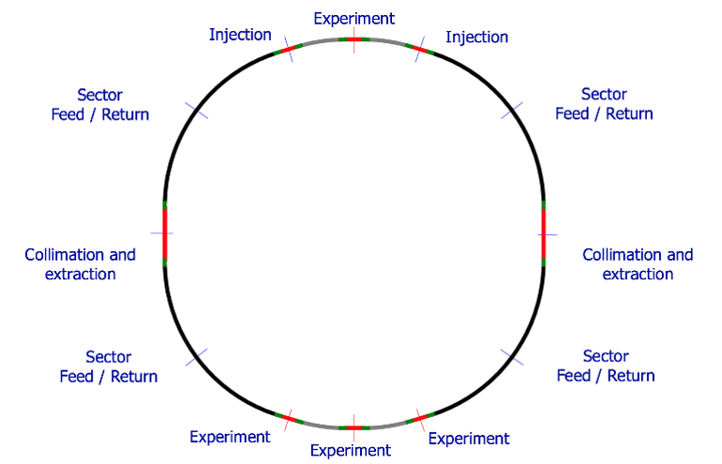

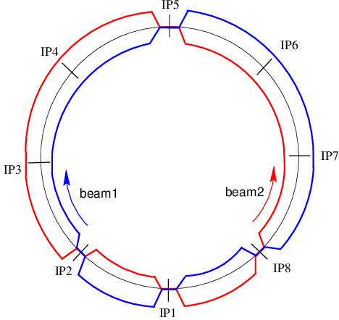
Intro
 | LHC | FCC
Number of arcs | 8 | 8
Length arc | 3 km | 8 km
Number of dipoles per arc | 154 | 438
Nominal current of the dipoles | 11.9 kA | 10-18 kA
Stored energy per arc | 1.1 GJ | 16-20 GJ
Number of mini-arcs | - | 4
Length mini-arc | - | 3.2 km
Number of dipoles per mini-arc | - | 180
Stored energy per mini-arc | - | 7-8 GJ
Total stored energy in the dipoles | 8.8 GJ | 108-176 GJ
FCC (2019 layout)
Dipole locations
8 km Arc
3.2 km Mini-arc
LHC
11’500-10’000 trucks of 20 ton at 110 km/hr
Arjan Verweij, TE-MPE-PE, TE FCC Workshop 2024

Slide 4
Magnet protection
The individual magnet protection is based on a similar concept as the LHC:
Quench detection based on differential voltage;
Quench heaters;
Cold bypass diodes.
Four different FCC magnet designs (LTS, LHe) were considered, varying significantly in terms of inductance and current. HTS designs were not yet considered
The ‘allowed’ internal quench voltage U_{q,max} was about 1.2 kV.
 | Cosθ (baseline) | Block | Common Coil | CCT
L [H] | 0.591 | 0.745 | 0.339 | 0.284
I [A] | 11390 | 10100 | 16100 | 18000
E [MJ] | 38 | 38 | 44 | 46
Arjan Verweij, TE-MPE-PE, TE FCC Workshop 2024

Slide 5
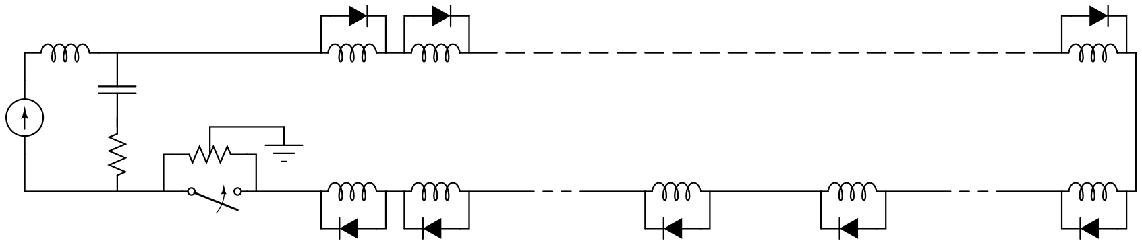
Circuit protection
The circuit powering and protection is based on a similar concept as the LHC:
Series connection of magnets to limit the number of power converters and current leads;
Warm Energy Extraction Systems (EES). LHC uses two passive EES per circuit (expon. decay). For the FCC we consider one active EES per circuit (lin. decay to reduce the MIIts for the same maximum circuit voltage).
Grounding of the circuit in the centre of the EE resistance to reduce maximum voltage to ground. Max. circuit voltage U_{circ,max} at FPA was set to 1.3 kV.
L_{circ}=N_{mag}L_{mag}
R_{EE}
L_{mag}
Arjan Verweij, TE-MPE-PE, TE FCC Workshop 2024

Slide 6
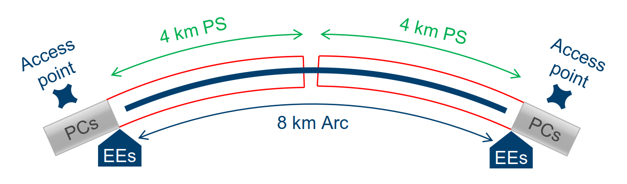
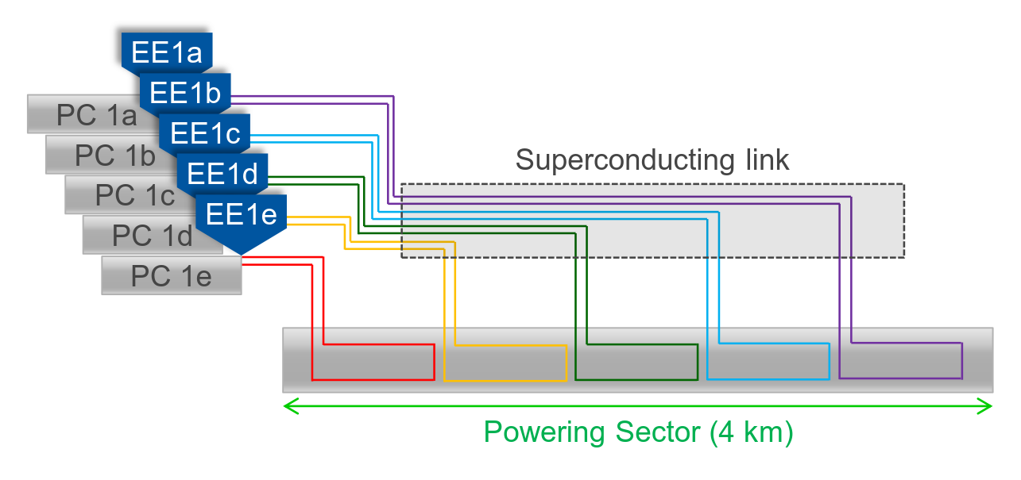
Circuit topology
Power converters (PC) and energy extraction systems (EES) close to the 12 access points
  Space optimization and easier maintenance
Power each 8 km long Arc from two sides, obtaining in total 16 powering sectors (PS) of 4 km
Power each 3.2 km long Mini-arc from one side, obtaining in total 4 mini powering sectors (PS_{mini}) of 3.2 km
Subdivide each PS in N circuits (16N circuits in total)
Subdivide each PS_{mini} in N_{mini} circuits (4N_{mini} circuits in total)
Equip each circuit with one PC and one EES
Power the circuits through superconducting links
Example for N=5
Arjan Verweij, TE-MPE-PE, TE FCC Workshop 2024

Slide 7
Circuit design targets
Design target | N, N_{mini} | I_{magnet}
Minimize the Voltage Withstand Level; VWL+f *(U_{Q,max}+U_{circ,max}) | ↑ | ↑
Minimize the discharge time during a Fast Power Abort and hence cross-section of the busbars; t=L_{circ}/R_{EE,0} | ↑ | ↑
Minimize the stored energy in a circuit (risk scenario’s) | ↑
Minimize the number of SC links | ↓
Minimize the thermal heat inleak | ↓ | ↓
Reduce number of EES and current rating EES | ↓ | ↓
Minimize ramp time and the required peak voltage and power of the PC | ↓ | ↑
Minimize the time needed for HWC & training campaign | ↑
This circuit topology is very flexible. Optimum values for N and N_{mini} have to be defined depending on type of magnet and various design targets, resulting in about 80-120 powering circuits (see Annex)
Arjan Verweij, TE-MPE-PE, TE FCC Workshop 2024

Slide 8
Conclusion
Studies for the protection of the main dipole circuit (based on Nb₃Sn) for the FCC-hh have been made in 2015-2020. Depending on the magnet design, the baseline is to power all dipoles in about 80-120 circuits, each with one power converter and one active EE system.
The converters and EE systems will be located in the access points, hence an additional cryogenic distribution line, separate or incorporated in the magnets cryostats, is needed to house the SC links that feed the current to all the circuits.
Protection and powering of HTS magnets is very different w.r.t. Nb₃Sn magnets. FCC-hh based on HTS is in my opinion a very promising option. Should we not quickly increase much more the R&D on HTS tapes/cables/magnets?
The circuit powering and protection for the quads and all other circuit types is much simpler but of course has to follow somehow the dipole circuit topology, which will impact the complexity and size of the SC link and current leads.
Arjan Verweij, TE-MPE-PE, TE FCC Workshop 2024

Slide 9
Further studies (to name a few)
Study quench detection & protection of HTS magnets/circuits through modelling and experimental work.
Increase performance and reliability of the protection (use of CLIQ or variants of it, new EES concepts, …). Note that CLIQ units are large and have to be placed next to each magnet.
Optimize availability (minimize probability of spurious triggering of the QDS, …)
Reduce probability and consequences of failures (fail-safe design, …)
Reduce quench recovery time (quench stoppers, …)
Optimize the SC link (incorporated/separate, LTS/HTS/MgB₂, …)
Arjan Verweij, TE-MPE-PE, TE FCC Workshop 2024

Slide 10
2. Conditions for FCC-ee circuit protection
Warm magnets will be protected by the WIC.
I am not aware of the design of any SC magnet or circuit for the collider part of the FCC-ee. I am not considering the final focus Nb-Ti magnets that are positioned at 2.2 m from the IR.
Hence, we have not performed any study for the SC magnet/circuit protection.
In case the FCC-ee will comprise SC magnets/circuits, then MPE should be involved from the beginning in the magnet design and circuit layout, so that both magnet and circuit are protectable in an effective and reliable way.
Arjan Verweij, TE-MPE-PE, TE FCC Workshop 2024

Slide 11
Annex
Arjan Verweij, TE-MPE-PE, TE FCC Workshop 2024

Slide 12
Circuit topology
Setting t_{decay}=120 s, and requiring U_{circ,max}<1.3 kV, gives:
 |  | Cosθ | Block | Common Coil | CCT
 | L [H] | 0.591 | 0.745 | 0.339 | 0.284
 | I [A] | 11390 | 10100 | 16100 | 18000
 | E [MJ] | 38 | 38 | 44 | 46
Arc | Nr of circuits N | 5 | 6 | 4 | 4
 | U_{circ,max} [V] | 1230 | 1140 | 1250 | 1170
Mini-arc | Nr of circuits N_{mini} | 4 | 5 | 4 | 3
 | U_{circ,max} [V] | 1260 | 1130 | 1020 | 1280
Total | Total nr of circuits | 96 | 116 | 80 | 76
Arjan Verweij, TE-MPE-PE, TE FCC Workshop 2024

Slide 13
Circuit topology
Setting t_{ramp}=1200 s, constant ramp rate, gives:
 |  | Cosθ | Block | Common Coil | CCT
 | L [H] | 0.591 | 0.745 | 0.339 | 0.284
 | I [A] | 11390 | 10100 | 16100 | 18000
 | E [MJ] | 38 | 38 | 44 | 46
 | U_{M,ramp} [s] | 5.6 | 6.3 | 4.5 | 4.3
Arc | Nr of circuits N | 5 | 6 | 4 | 4
 | U_{Circ,ramp} [V] | 246 | 229 | 249 | 233
 | Max P_{PC} [MW] | 2.8 | 2.3 | 4.0 | 4.2
Mini-arc | Nr of circuits N_{mini} | 4 | 5 | 4 | 3
 | U_{ramp} [V] | 252 | 226 | 205 | 256
 | Max P_{PC} [MW] | 2.9 | 2.3 | 3.3 | 4.6
Arjan Verweij, TE-MPE-PE, TE FCC Workshop 2024

