Slide 2
Assumptions on FCC-hh magnets outer dimensions and cooling needs
E. Todesco
Thanks to D. Schoerling, B. Auchmann, S. Izquierdo Bermudez, L. Bottura,
A. Verveij, A. Milanese
FCC-ee TE-workshop, May 2024

Slide 3
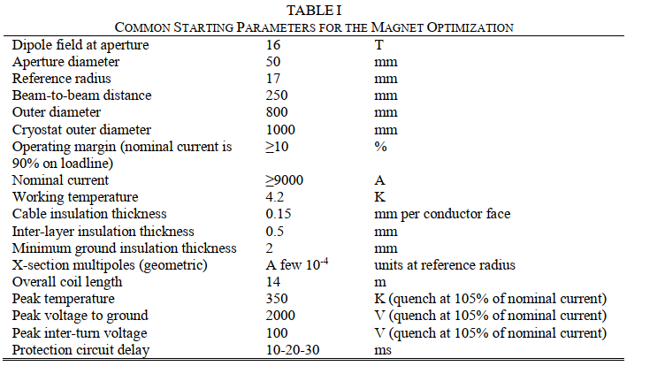
Arc magnet dimensions historical
Recall of values for outer diameter cold mass
  LHC main dipole : 570 mm
  MQXF HL-LHC quadrupole : 630 mm
  Hypothesis considered for FCC-hh: 600 mm to 800 mm
Magnet dimensions are related to three factors
  Tolerable fringe field, requiring some space for iron to act as a shield
  Space needed to allocate aperture, coil width, beam separation, mechanical structure
  Tolerable b₂ arising from cross-talk of two apertures due to iron asymmetry
    This can be negotiated with beam optics
Studies in the framework of EuroCirCol network
initially considered 800 mm for a 16 T operational field
magnet, with 250 mm beam separation
800 mm is the RMM diameter (16 T magnet)
  (but with single aperture and very large coil width)
F. Toral, et al “16 T Dipole design options:
Input Parameters and Evaluation Criteria”
EuroCirCol-P2-WP5 (2015)

Slide 4
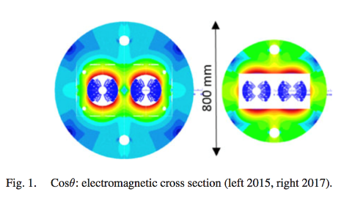
Arc magnet dimensions historical
In 2017, beam separation reduced to 204 mm, acceptable fringe field increased to 200 mT, and magnet diameter was reduced to 600 mm
  This was done to have the same 16 T dipole for FCC-hh installable in the LHC tunnel for HE-LHC
In 2019, the parameters are fixed to 800 mm outer dimension, with a fringe field of 100 mT and a beam separation of 250 mm [D. Schoerling, et al, IEEE TAS 29 (2019) 4003109]
  These are the numbers that are in the CDR [Europhys. J. 228 (2019), page 836]
D. Tommasini, et al, IEEE TAS 28 (2018) 4001305

Slide 5
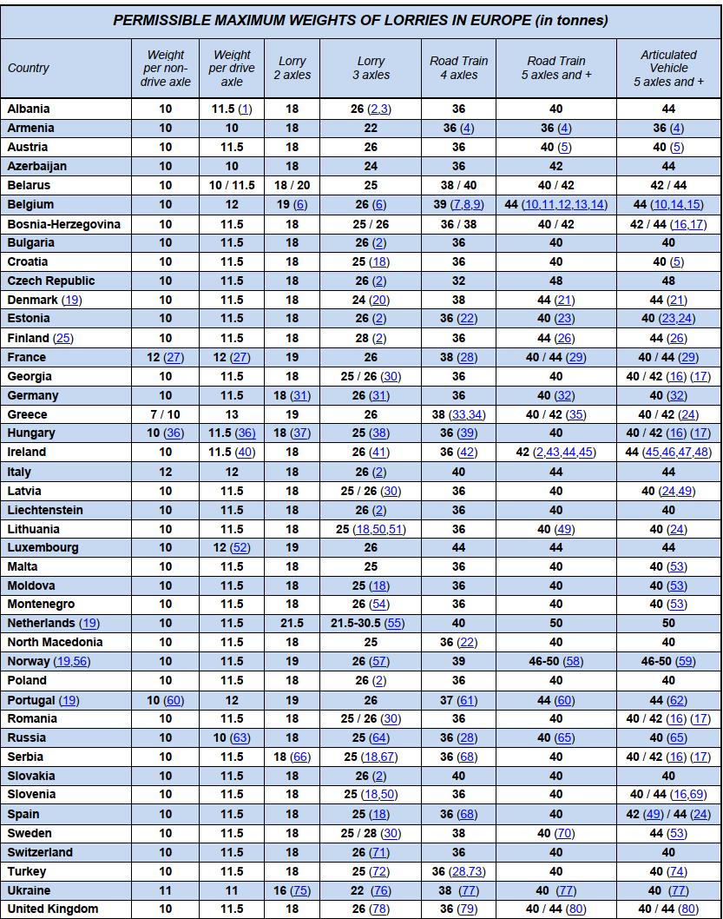

Arc magnet dimensions: logistics
There is an additional argument that should be taken into account: weight and logistics
  Note that for a 800 mm diameter, a 14.5 m long cold mass weight is 55 tons, plus 6 of cryostat (see CDR, page 836 table 3.1)
  A 55 tons cold mass is problematic in terms of transport – not clear to me how this is possible
  (FCC in the Netherlands?)
  Having 10 m long dipole would fit the 40 tons, but would reduce the filling factor and the energy of the accelerator, and increase the manufacturing costs
S. Spielberg, et al, “Duel” Universal Television (1971)

Slide 6
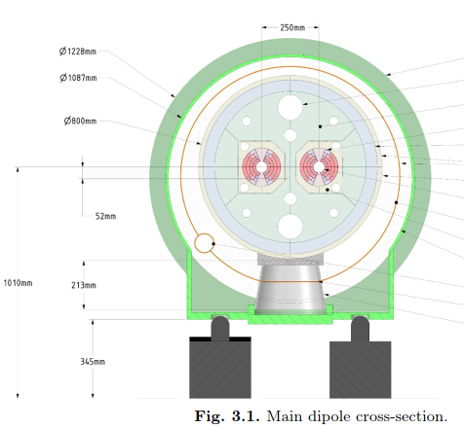
Arc magnet dimensions: the new targets for Nb₃Sn
In the past four years, the indication of lowering the operational field of the FCC-hh dipole has become more and more evident
  US-MDP considered 15 T as a target field for FNAL program
  12 T magnet was introduced in the HFM program
  The last few tesla are very expensive in terms of conductor, see [D. Schoerling, et al, IEEE TAS 27 (2017) 4003105]
Since 2024 the HFM mandate explicitly includes a target of 14 T for Nb₃Sn operational field (see https://indico.cern.ch/event/1377966/ )
  Since 800 mm diameter were proposed for
  the 16 T case, it will be fine 14 T (weight issue still
  to be clarified, maybe 700 mm would be more appropriate
  For 800 mm diameter cold mass, 1220 mm diameter cryostat
  was proposed [FCC-hh CDR, Europhys. J. 228 (2019), page 835 Fig 3.1]
On the other hand, I would exclude magnet diameters larger than 800 mm (and this is the information that is needed today)
  The issue of the weight for 1000 mm diameter cold mass would become too challenging

Slide 7
Cooling
The main components of the cooling requirements are
  Static losses due to cryostat (in the cold mass and in the beam screen)
  Hysteresis losses, ramp rate losses in the superconductor (in the magnet cold mass)
  Hysteresis losses, ramp rate losses in the yoke (in the magnet cold mass) – much smaller
  Synchrotron radiation and beam losses (mainly intercepted by the beam screen at higher temperature than the cold mass)
    Remember that synchrotron radiation is not negligible in FCC-hh , and scales with E⁴, therefore 20% energy reduction from 100 to 80 TeV means halving the heat load due to synchrotron radiation

Slide 8
Cooling targets for Nb₃Sn
Targets for cooling considered operational temperature of 1.9 K, and are given in [D. Schoerling, et al, IEEE TAS 29 (2019) 4003109]
  Static losses are estimated at 0.5 W/m at 1.9 K and 10 W/m at 50 K
  A target has been set at 5 kJ/m per ramp (total 140 kJ per cycle for a 14 m long magnet) – source is [S. Izquierdo Bermudez, November 2017, presentation at EuroCirCol https://indico.cern.ch/event/679654/ ] – see following slides

Slide 9
Hysteresis losses for Nb₃Sn
Hysteresis losses in the superconductor are the dominating source
  For Nb₃Sn, they mainly depend on the filament size – with present HL-LHC technology (diameter of 50 μm) losses are order of 20 kJ/m per cycle (10 kJ/m per ramp, i.e. twice the target)
  To be compared to 0.5 kJ/m in the LHC dipoles
  Hysteresis losses are found to weakly depend on magnet design
Coil geometry |  | Cos-theta | Block | Common Coil
Deff | µm | 50 | 50 | 50
Xi | -- | 1 | 1 | 1
I1 | Inom (50 TeV) | 11060 | 10465 | 16100
I2 | Ireset | 100 | 100 | 100
I3 | Iinj (3.3 TeV) | 729.96 | 690.69 | 1062.6
I4 | Inom (50 TeV) | 11060 | 10465 | 16100
AC-loss (2 Ap) | J/m | 18330 | 19603 | 23489
AC-loss/Asc | J/m₃ | 4728455 | 4633384 | 4776274
  Talk given by S. Izquierdo Bermudez, November 2017, EuroCirCol meeting https://indico.cern.ch/event/679654/

Slide 10
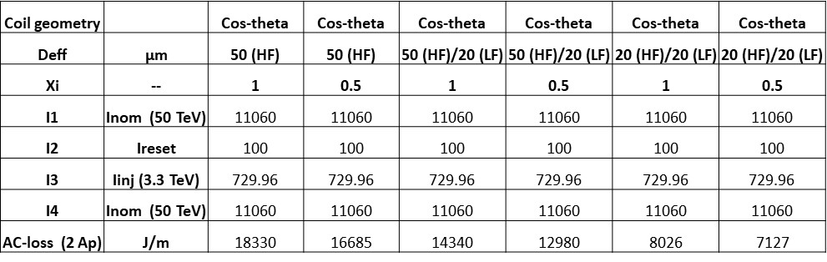
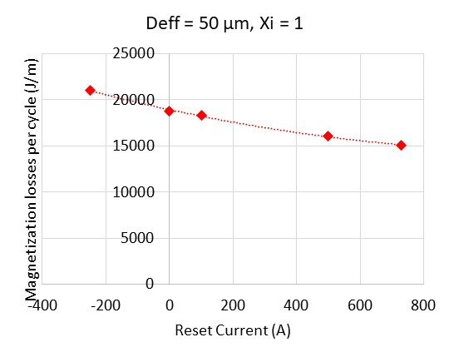
Hysteresis losses for Nb₃Sn
The main dependence of hysteresis losses is on filament size
  A reduction of D_{eff} from 50 µm to 20 µm
  can halve these losses – this is the reason
  for setting a target of 5 kJ/m for ramp
  Pinning with internal oxidation also
    allows to reduce magnetization
Hysteresis losses depend on energy range since they dominate at low fields
  In particular they depend on the reset current – this is another argument that makes a injection at 1.3 rather than 3 TeV much more challenging
  Talk given by S. Izquierdo Bermudez, November 2017, EuroCirCol meeting https://indico.cern.ch/event/679654/

Slide 11
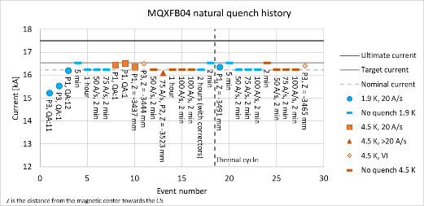
Cooling options
In the CDR of FCC-hh, 16 T magnets operate at 1.9 K at 86%
The new target for the Nb₃Sn dipole of FCC-hh of 14 T is set both at 1.9 K and at 4.5 K
  This is achieved by setting a larger loadline margin (80%) at 1.9 K
  Following the HL-LHC experience, where all MQXF are also able to operate at 4.5 K and nominal current
Operating at 4.5 K allows to considerably save on the cooling power needed for hysteresis losses, that are in the magnet coil
  Hysteresis losses at 4.5 K and at 1.9 K are similar, due to flux jumps, but heat is extracted at higher temperature
Quench performance of MQXFB04 at 1.9 K and at 4.5 K [F. Mangiarotti, S. Izquierdo Bermudez,et al.]

Slide 12
The HTS case
Magnet dimension
  For the HTS case, the target is 20 T – this relies on the possibility of significantly increasing the current density and keeping the coil mass limited (both for magnet size and for cost), and using stress management
  Yoke size, mechanical structure, to be studied
Cooling: Whereas for Nb₃Sn models to estimate the hysteresis losses are well established, for HTS the modeling is much less advanced and much more complicated
  For HTS the anisotropy introduces a dependence on the magnet design
  For HTS the contribution of hysteresis losses is much larger than in Nb₃Sn and could wipe out part or all the beneficial effects of operating at 20 K with present status of technology (not developed specifically for accelerator magnets)
  Use of striated and twisted tapes could reduce it, but it would greatly increase the coil size
  Physical dimension of QRL at 20 K also to be studied
  Maximum acceptable Δt should be fixed by magnet design

Slide 13
Conclusions
A maximum diameter of 800 mm can be confirmed, considering that
  Target field for Nb₃Sn magnet has been reduced from 16 T to 14 T
  800 mm magnet diameter for a 14 m long magnet is already above the 40 tons
Cooling hypothesis of the CDR of the 2019 are the latest stage of the work
  However, the new target of 14 T at 80% at 1.9 K opens the possibility of operating the cold mass at 4.5 K
  This would allow reducing the cooling related to hysteresis losses that is a significant part
  Note that the present target of today for hysteresis losses (5 kJ/m per ramp) requires a technology beyond HL-LHC, i.e. smaller filaments – with HL-LHC conductor we have twice
For HTS, many elements are still missing to draw conclusions
  Building, testing, modelling …

