Slide 1

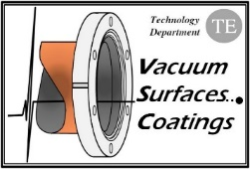
Synchrotron Radiation in FCC-ee: Simulation, Absorption, and Related Issues
R. Kersevan, reporting for TE-VSC
TE FCC-ee workshop, CERN, 16 May 2024

Slide 2
OUTLINE
FCC study program (2013-today)
FCC-ee: relevant machine and vacuum parameters
Vacuum chamber cross section
Synchrotron radiation spectra
SR absorbers: yes or no?
Pumping solutions
Pressure profiles
The MDI region
Synchrotron radiation ray-tracing
Pressure profiles
Conclusions and future work
Acknowledgments

Slide 3
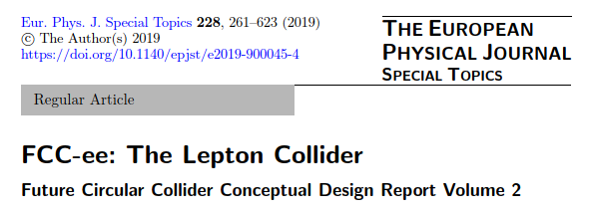
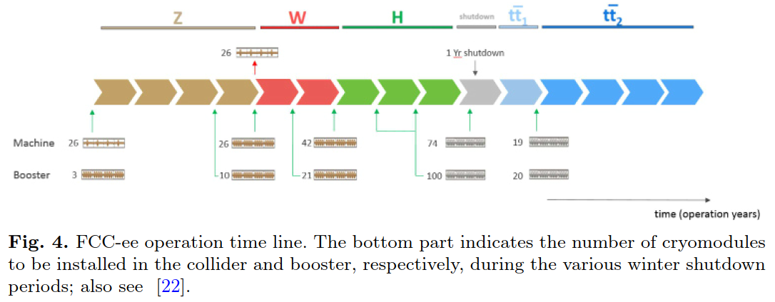
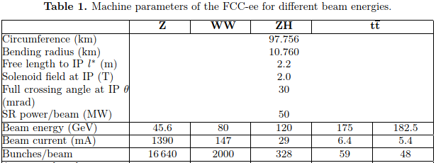
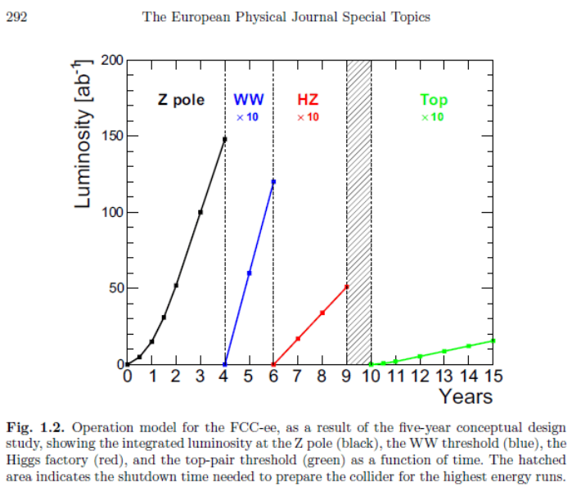
FCC study program; Relevant machine and vacuum parameters (pre-2019)
Big variation of nominal current vs beam energy, since all machine versions are limited to 50 MW of synchrotron radiation per beam
P (W) = 88.46 · E⁴(GeV) · I(mA) / ρ(m)
F (ph/s) = 8.08·10¹⁷ · E(GeV) · I(mA)
We aim at an average pressure giving a beam-gas scattering lifetime large enough not to be detrimental to the integrated luminosity, say in the low 10⁻⁹ mbar range, or better, with a gas composition of 80~90% hydrogen, and no molecular masses above 44 (CO₂).
We also aim at reducing/eliminating the e-cloud and ion-trapping effects and related beam instabilities and losses
Typically, we assume a residual gas composition of 80~90% H₂, 10~20% CO+CO₂, traces of CH₄

Slide 4
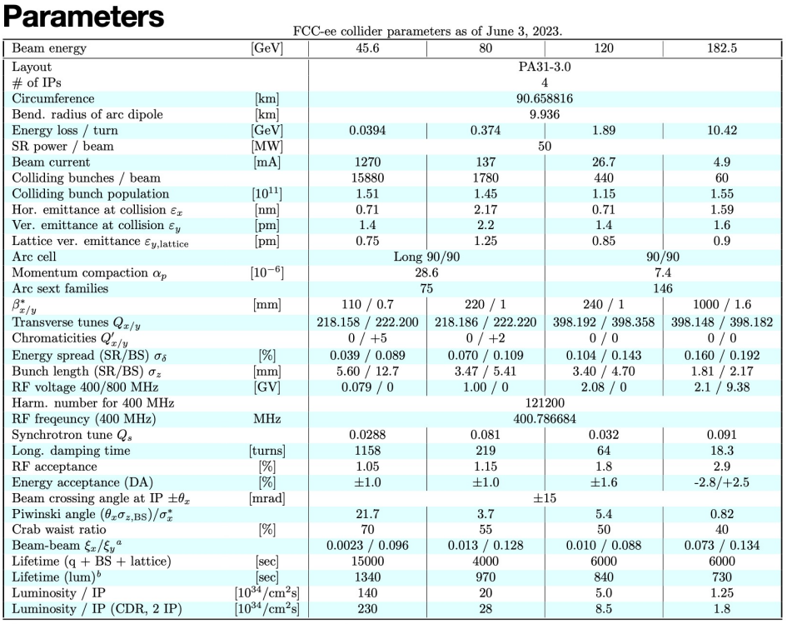
New parameter table (90.7 km rings)
Consequence of 50 MW/beam MAX
P (W) = 88.46 · E⁴(GeV) · I(mA) / ρ(m)
F (ph/s) = 8.08·10¹⁷ · E(GeV) · I(mA)
The beam currents at the various energies scale as the reciprocal of the 4th power of the beam energy:
The beam current at ttbar is only (45.6/182.5)⁴ = 1/4⁴=1/256 that of the Z-pole
High current (B-factory level) for Z energy
The beam currents at the various energies scale as the reciprocal of the 4th power of the beam energy
The beam current at ttbar is only (45.6/182.5)⁴ = 1/4⁴=1/256 that of the Z-pole
Starting the machine not at the Z energy prevents having a fast vacuum conditioning

Slide 5
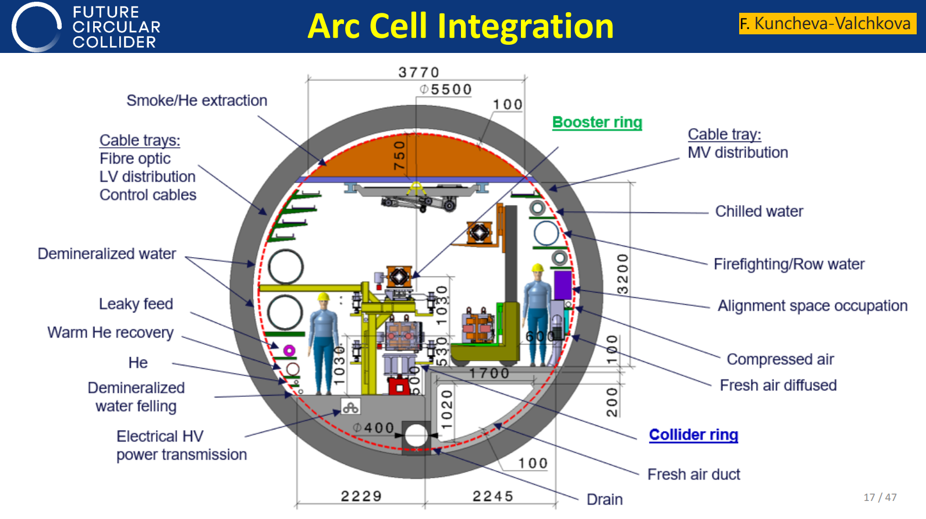
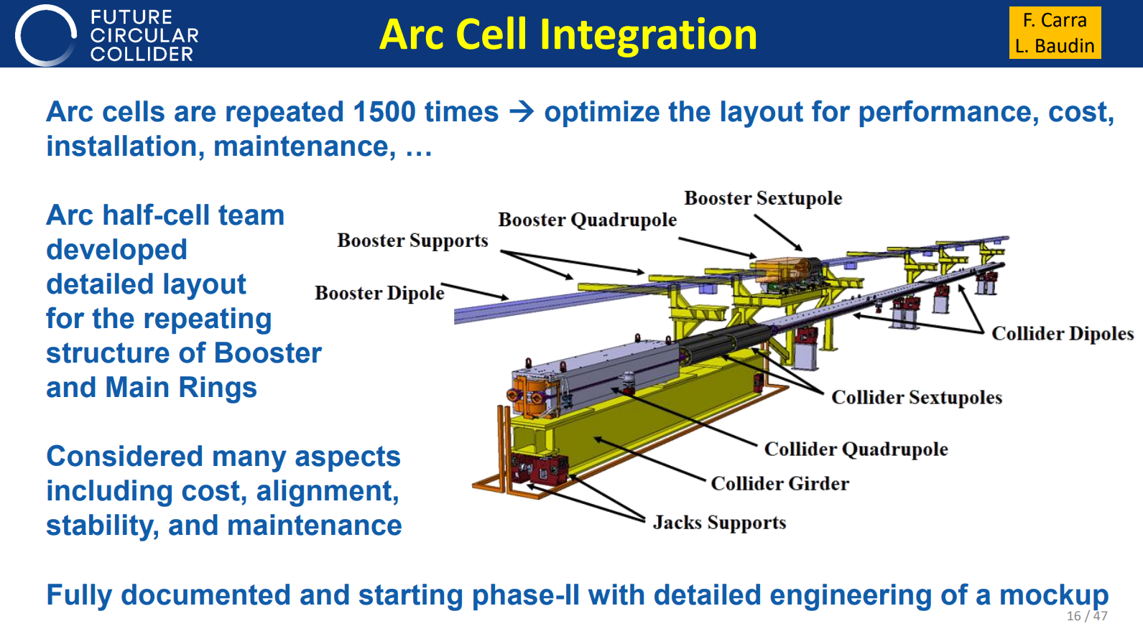
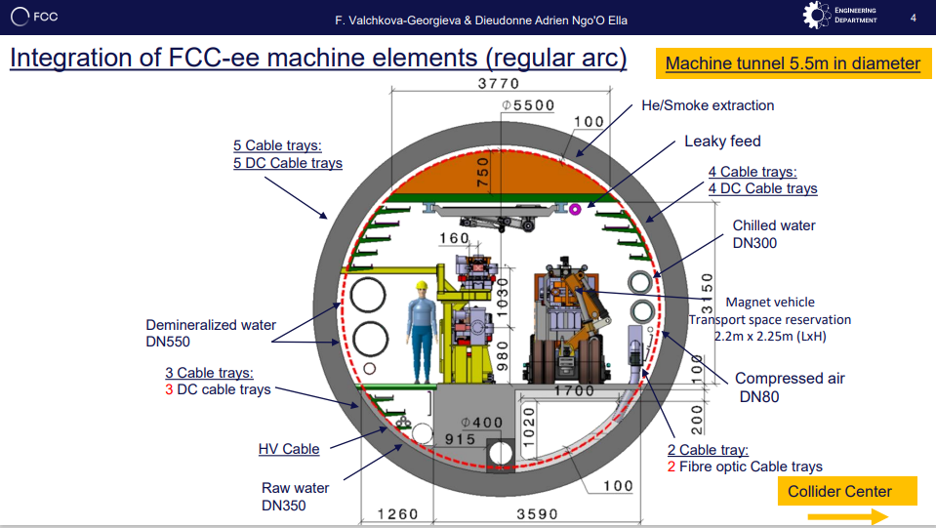
The tunnel along the arcs has a typical cross-section as shown below (left)
There are about 3x 91 km ring vacuum system, plus additional (many) km of TRANSFER LINES (TLs) from booster to collider rings, and also other TLs from other accelerators in the chain (pre-booster chain has different options under study)
Standardization and easy-to-transfer to industry design and technology must be implemented

Slide 6
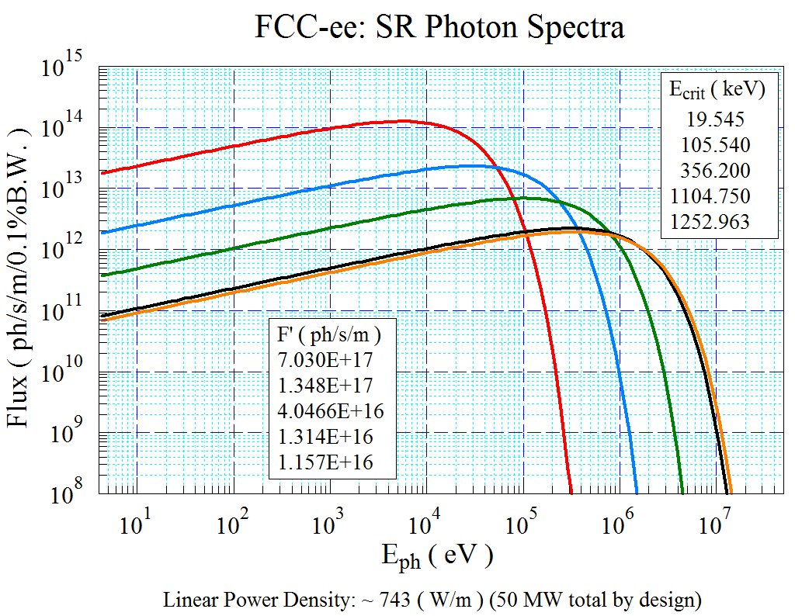
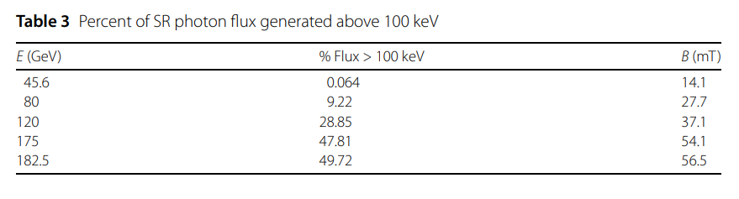
Synchrotron Radiation Spectra
90.7 km machine
Z-Pole: very high photon flux (→ large outgassing load);
Z-pole: compliance with scheduled operation (integrated luminosity first 2 years), requires quick commissioning to I_{NOM}=1270 mA;
T-pole (182.5): extremely large and penetrating radiation, critical energy 1.36 MeV;
T-pole (and also W and H): need design which minimizes activation of tunnel and machine components (→ FLUKA);
W, H-pole: intermediate between Z and T; still E_{crit} > Compton edge (~100 keV (Al), ~200 keV (Cu))
Critical energy: ε_{c} = 2218·E³ (GeV) / ρ(m)
97.8 km machine
21.2
114.3
385.7
1196.4
1356.9
Z
W
H
T
T
https://doi.org/10.1140/epjti/s40485-022-00087-w

Slide 7
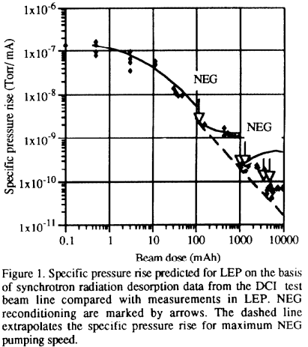
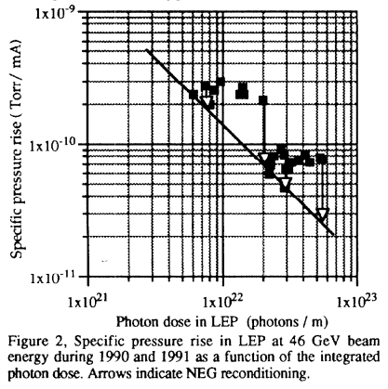
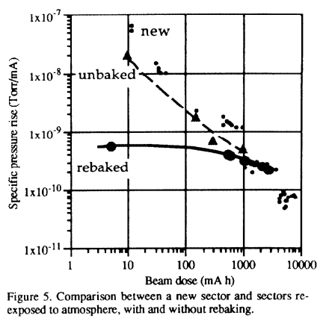
Synchrotron Radiation-Induced Desorption
When photons with energy above the work function of the vacuum chamber (VC) material hit the surface they can generate PSD molecular outgassing, mediated by PE emission
The PSD yield η (molecules/photon) is characterized by a conditioning curve which, in a log-log scale vs accumulated photon dose D (photons/m) resembles a power law η=η_{o}·D^{-α} , with 0.3<α<1
“Experience with the Operation of the LEP Vacuum System and its Performance for LEP200”, O. Gröbner et al., EPAC’92

Slide 8
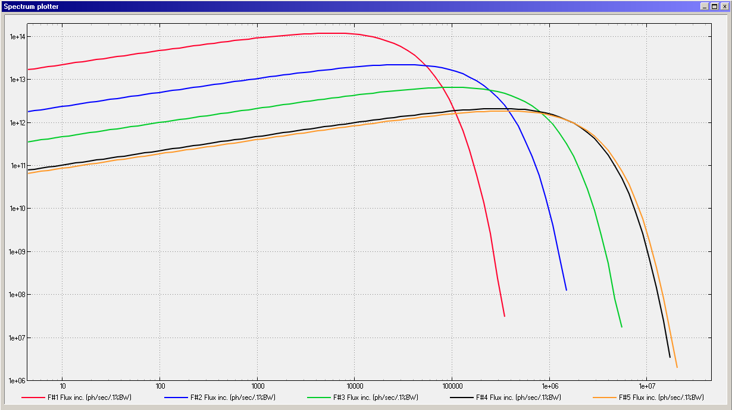
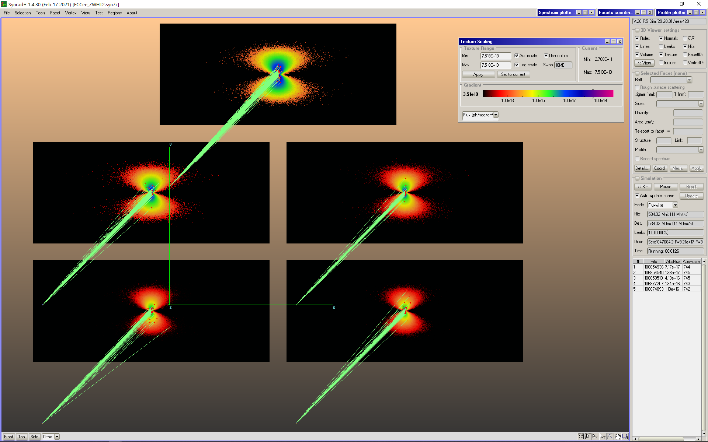
Synchrotron radiation spectrum, flux, power
Typical vertical opening angle SR: 1/γ; γ(ttbar)=357,143; 1/γ=2.8 μrad → @50 m = 0.14 mm
SR Spectra computed with SYNRAD+
Radiation projected onto
five 14x6 cm² screens;
1 cm-long dipole arc trajectories;
Flux distribution shown here,
Logarithmic scale for textures,
6 orders of magnitude displayed;
45.6 GeV
80 GeV
120 GeV
175 GeV
182.5 GeV
Beam Energy E(GeV) | Beam Current I(mA) | Critical Energy (keV) | Photon Flux F’(ph/s/m) | PSD Outgassing Load (mbar·l/s/m) @ 1·10⁻⁶(mol/ph)
45.6 | 1390 | 19.5 | 7.17·10¹⁷ | 2.90·10⁻⁸
80 | 147 | 105.5 | 1.38·10¹⁷ | 5.58·10⁻⁹
120 | 29 | 356.2 | 4.13·10¹⁶ | 1.67·10⁻⁹
182.5 | 5.4 | 1253.1 | 1.18·10¹⁶ | 4.78·10⁻¹⁰
45.6
Z
W
80
120
H
T
175
182.5
50 m
Units: Vertical: photons/s/(0.1% bandwidth)/m; Range [10⁶ - 2·10¹⁴]
Horizontal eV; Range [4 - 5·10⁷]

Slide 9
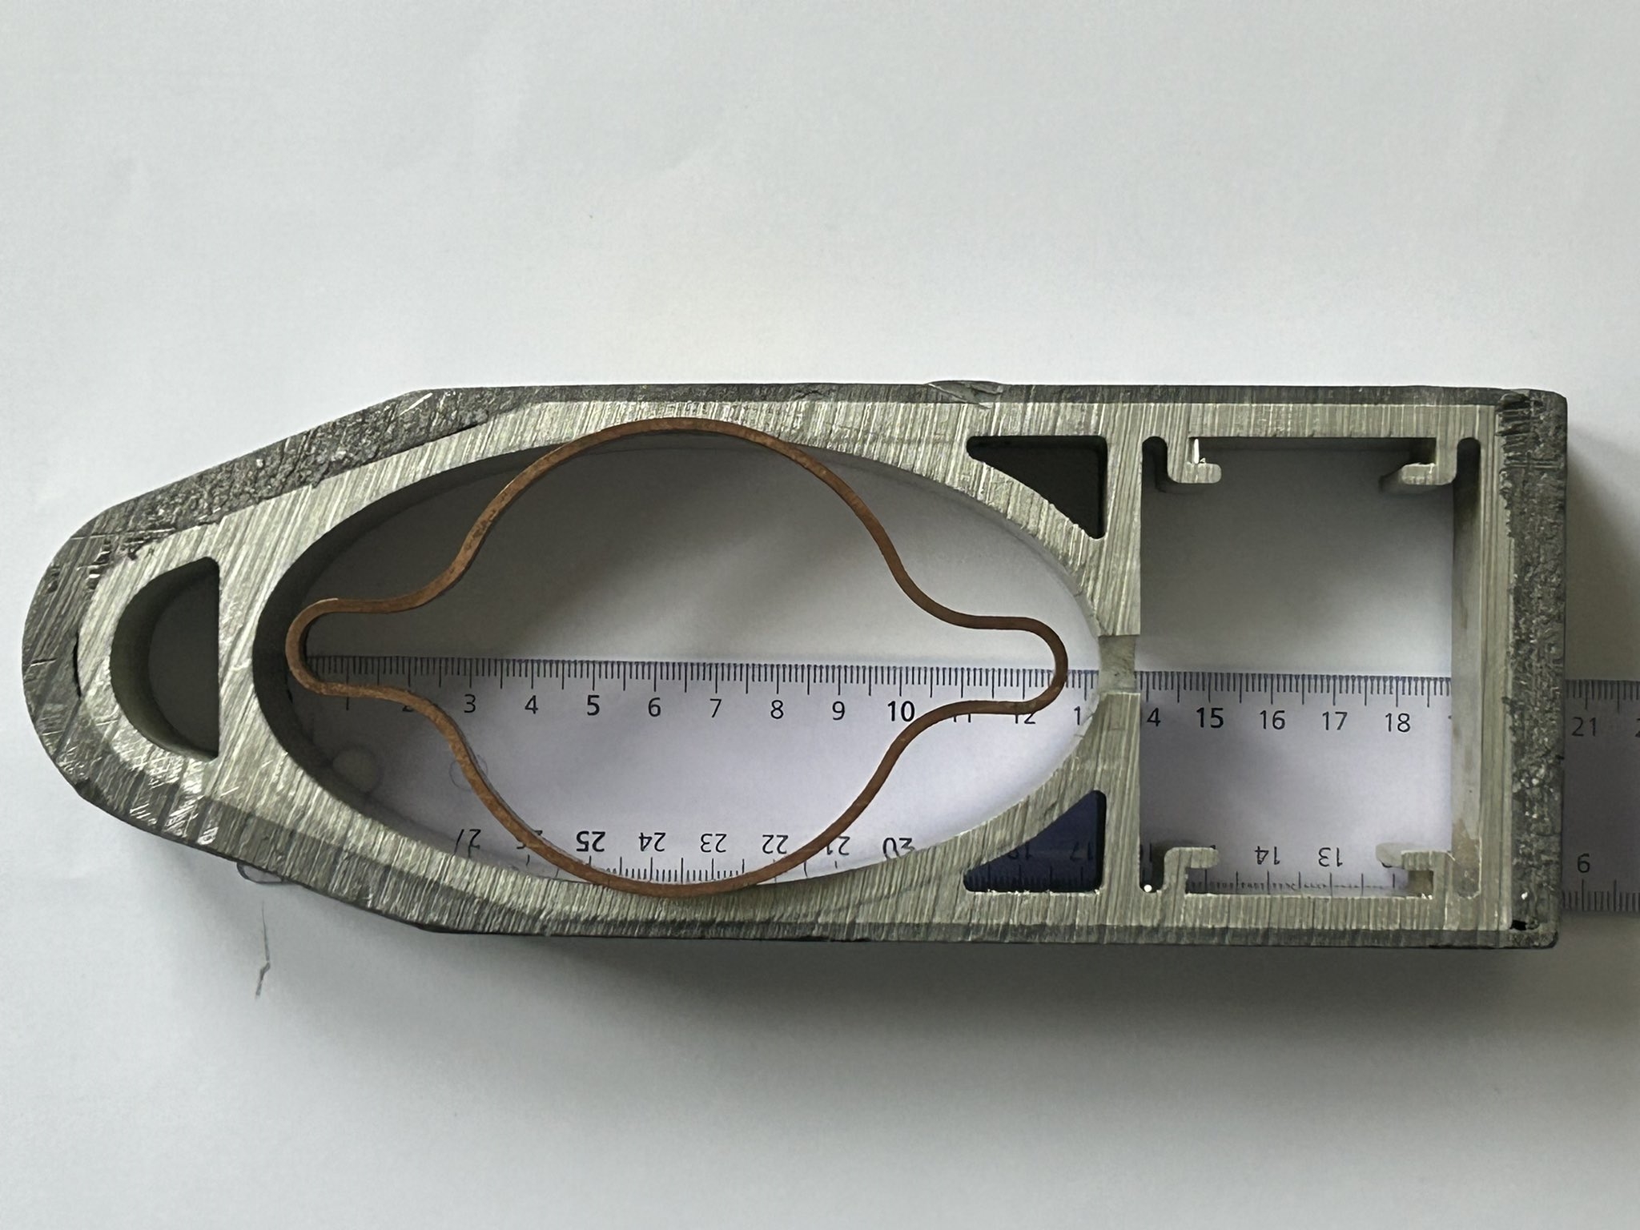
Comparison of LEP extruded cross-section (dipole chambers) with FCC-ee’s (70 mm ID version)
Pumping slots
Antechamber for NEG strip
Lead shielding
LEP:
ellipse 131x70 mm²
FCC-ee:
115 mm wide, 70 mm ID
The specific conductance of FCC-ee is ~1/2 that of LEP, i.e. ~50 l·m/s
The new baseline 60 mm ID version for FCC-ee would have a 37% additional conductance decrease, i.e. only ~1/3 that of LEP

Slide 10
We therefore have (Machine/Optics design and desiderata):
High SR photon flux generating high photon-stimulated desorption (PSD) gas load
Rather low specific conductance of the vacuum chamber (dictated by the size of the quadrupole/sext opening)
Requirement of a fast vacuum conditioning so that a large integrated luminosity can be achieved
Need for a vacuum system which minimizes e-cloud (e+ beam) and ion-trapping (e- beam) (to preserve the quality of the beam)
This leads to (Requirements):
Efficient removal of the 50 MW/beam SR power load
Vacuum surfaces (materials, thin-films, treatments) having a low PSD yield, minimizing gas-beam interactions
Efficient pumping, both in cost and in performance
Minimization of the high-energy component of the Compton-scattered primary SR fan (for energies W, H, T), as per FLUKA simulations/results
We can satisfy these requirement if we design a vacuum system based on:
NEG-coating (thin, ~200 nm, to reduce resistive-wall impedance contribution)
Primary SR fans intercepted by localized SR absorbers, rather than a LEP-like configuration where the SR fans are distributed more or less uniformly along the external side of the vacuum chamber
The next slides will summarize the modelling exercise showing that a NEG-coated, localized SR absorber configuration meets the requirements

Slide 11
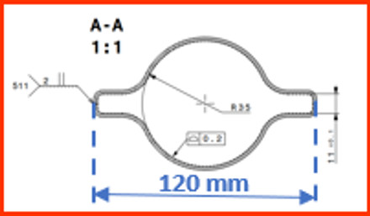
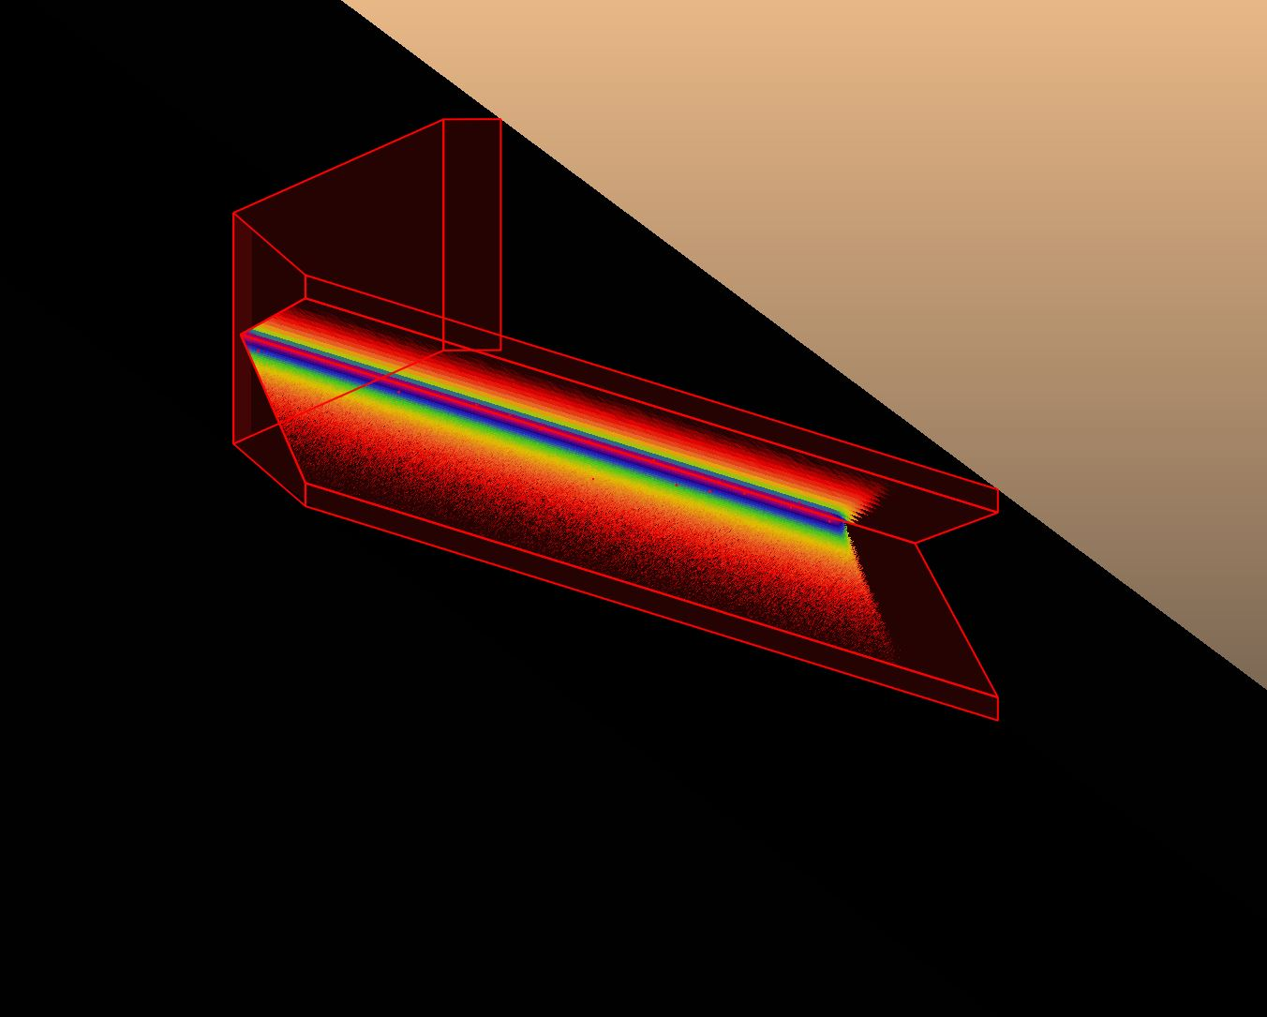
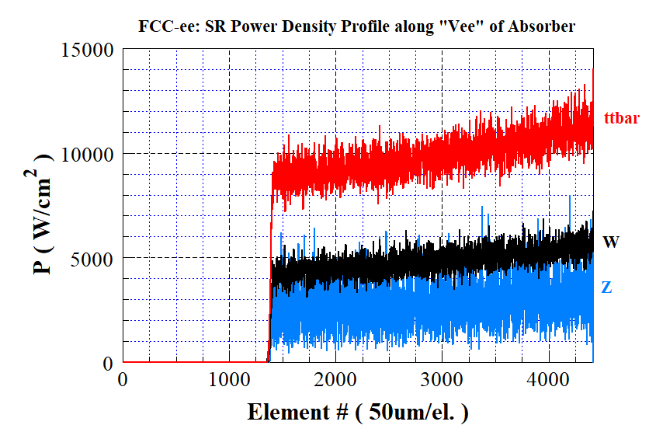
Initial geometry of the SR photon absorber, now superseded by 3D-printed one (next slide)
B
300 mm
18 mm
A
175 mm
A
B

Slide 12
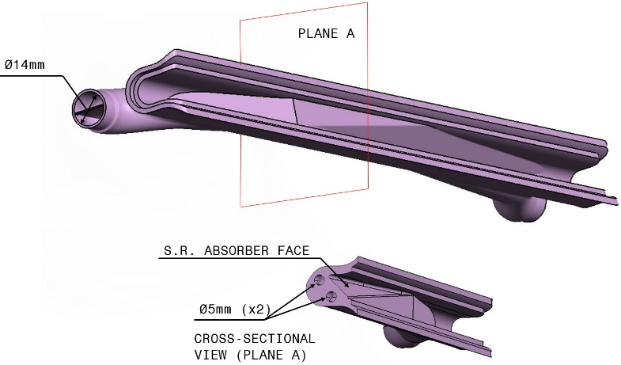
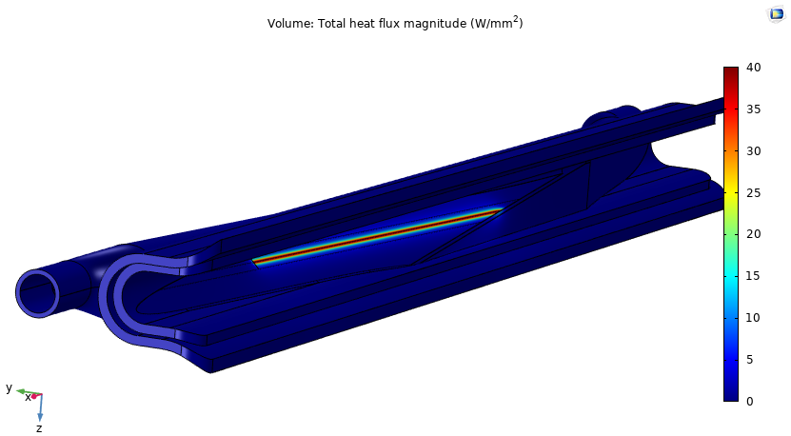
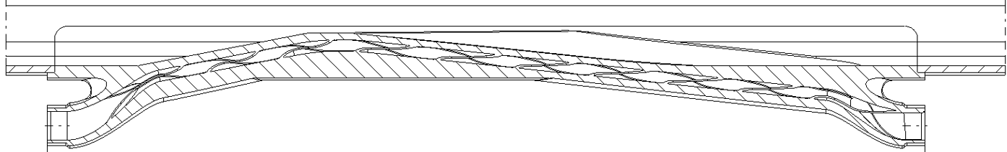
Current design: 3D-PRINTED SR ABSORBER, with INTEGRATED COOLING CIRCUIT AND SWIRL TAPE TO IMPROVE HEAT EXCHANGE

Slide 13
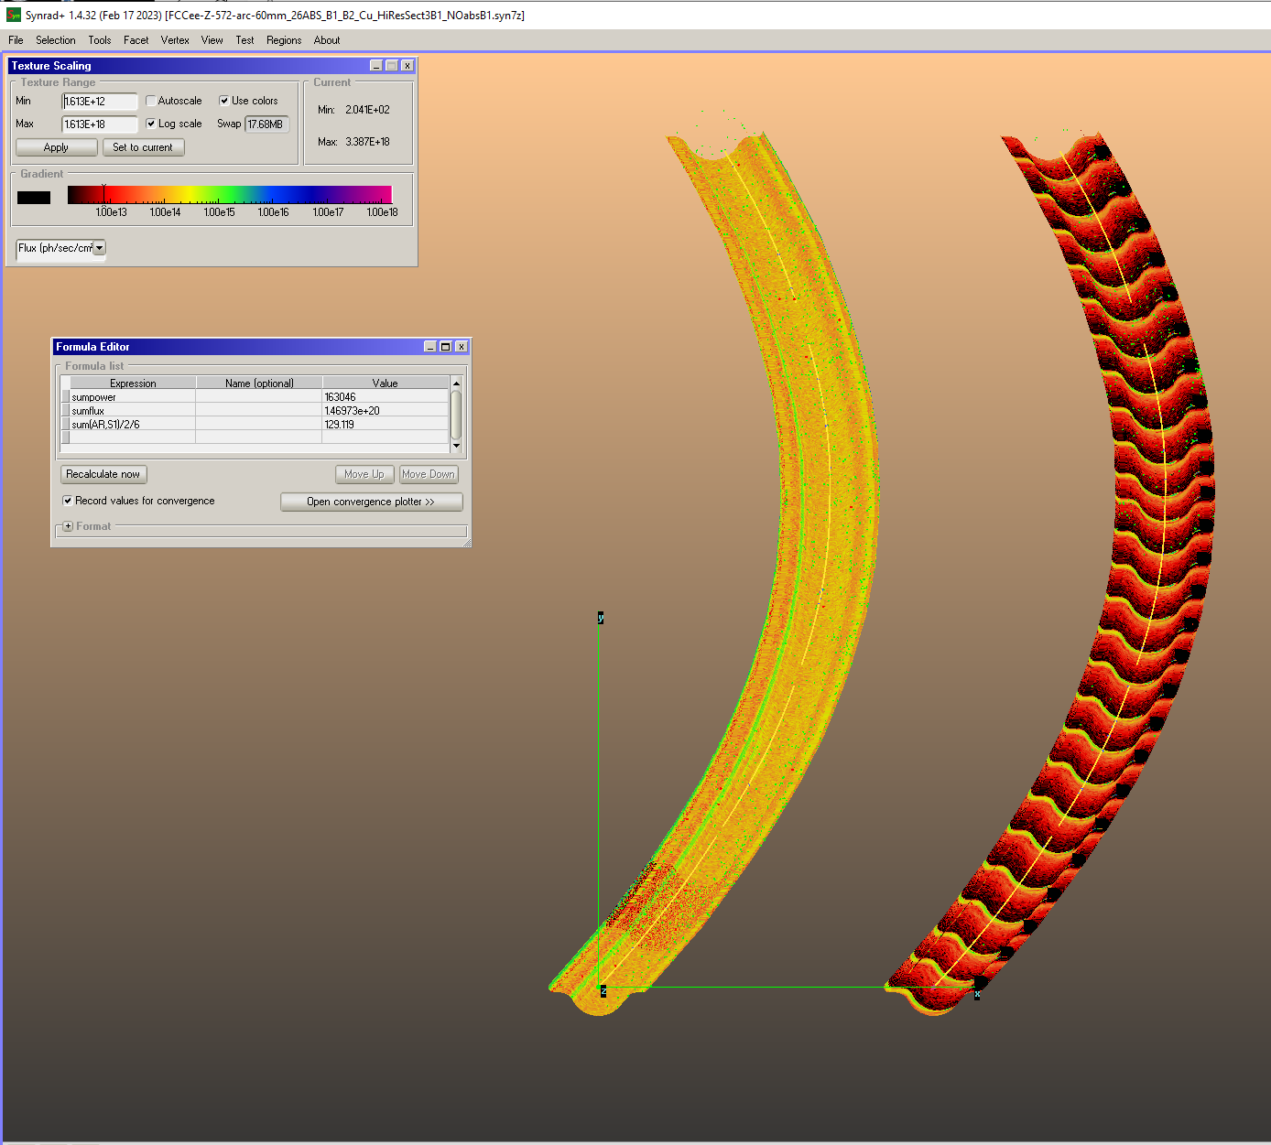
Pumping solutions (new baseline 60 mm ID chamber)
These 2 models represent a section of the arcs (132.4 m long)
We have used Molflow+ to calculate the PSD pressure rise at different beam doses, using the photon irradiation maps calculated by SYNRAD+
A sample 132.4 m-long section of an arc has been considered, with the two beams side by side: 4 dipoles and 4 quadrupoles as sources of SR
The orbits along 4 dipoles interleaved with 4 quadrupoles are simulated, importing the lattice files from MADX into SYNRAD+
The 3D model for B2 has 26 absorbers placed at ~ 5.0 m average spacing (avoiding quadrupoles and sextupoles which have tight coils), while B1 has no absorbers, and the SR fan is let impinge onto the bottom of the external winglet
The MDI region adopts the same philosophy: lumped absorbers covering ~100%† of the primary SR photon fans
~12% MORE ABSORBERS as compared to the 70 mm ID chamber and different lattice!
B2
B1
† To be precise, ~0.6% of the generated photons miss the absorbers, being generated at a large vertical angle. Average distance for first hit is 33.8 m

Slide 14
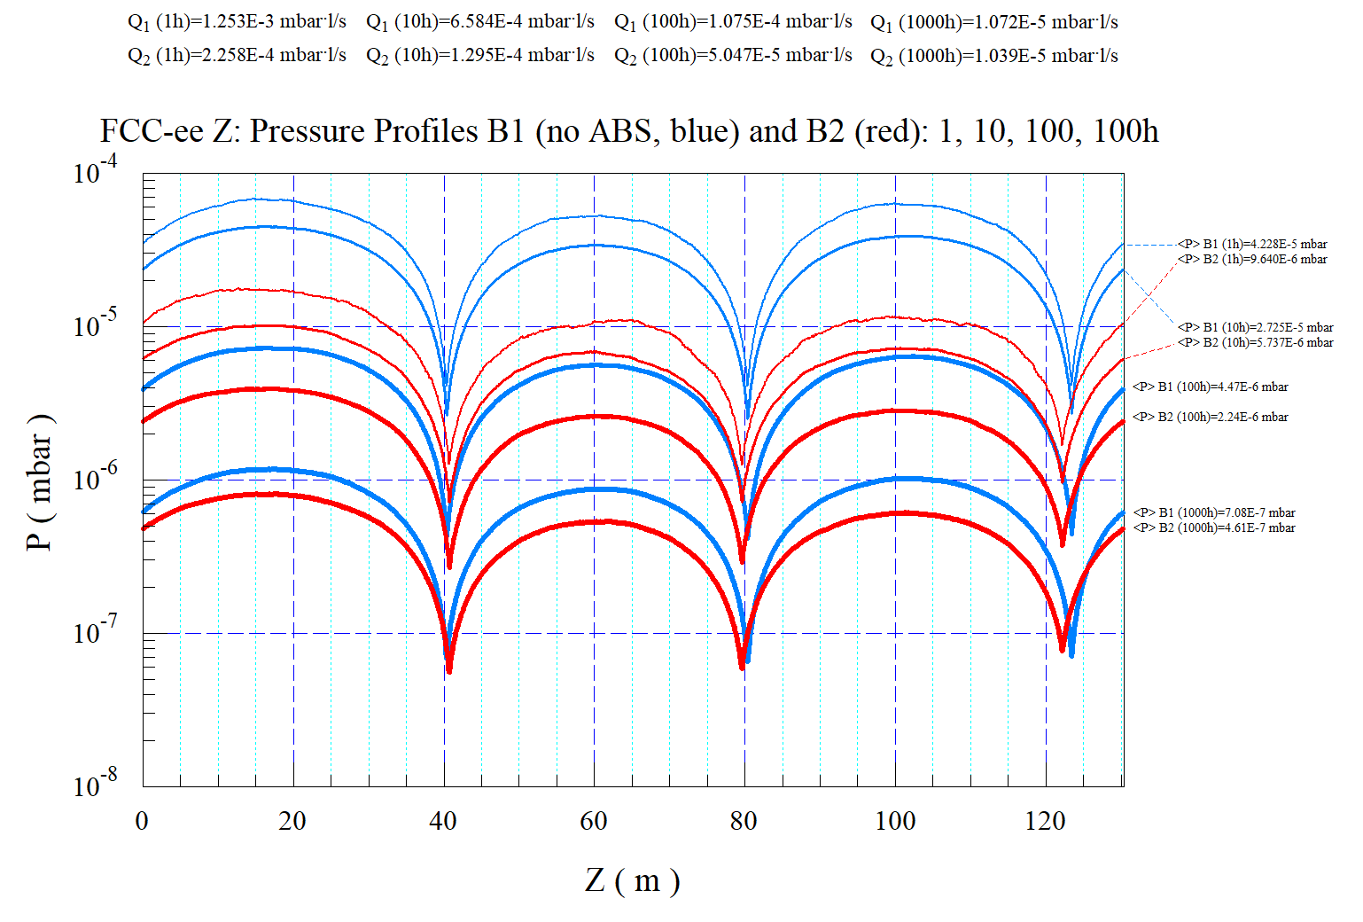
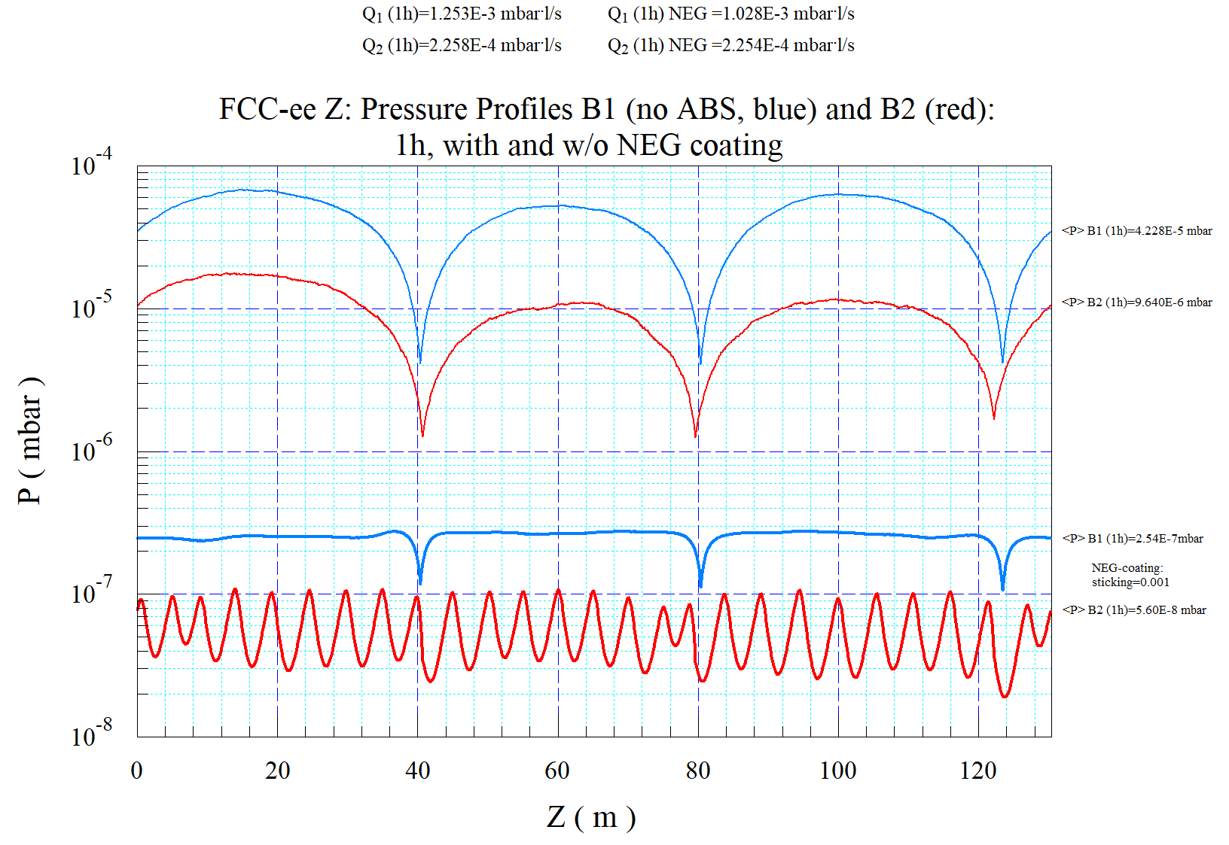
We have calculated the PSD pressure profiles for 4 different beam doses, corresponding to times of 1 h, 10 h, 100 h, 1000 h at nominal current (1270 mA); Simulated gas: CO
On the left the case with 3x 100 (l/s) lumped pumps/beam, and no NEG-coating
On the right, the case with NEG-coating with some residual sticking (s=0.001) for 1h case
Pressure profiles
1000 h
NO NEG
~1/170

Slide 15
Conclusions and open issues
The synchrotron radiation flux in the FCC-ee is particularly large for the Z energy, creating the largest SR-induced gas load
The higher energies are characterized by much lower beam currents but there is an additional contribution to the SR-induced gas load coming from the back-scattered Compton showers, with increasing intensity as the beam energy increases
The advantage of both having SRAs and distributed NEG-coating are clear: we should pursue these two technologies in order to speed up the vacuum conditioning of the machine, especially if the FCC-ee is not started at the Z energy
The design of the SR photon absorbers (SRAs) has been optimized, prototypes have been ordered and received; TO DO: define the welding parameters
TO DO: try to minimize the fraction of primary SR photons reflected by the SRAs, tentatively introducing a sawtooth profile on the photon intercepting facet of the SRAs
Not shown here: some work has been carried out on the MDI region too, and the full-energy booster as well; TO DO: make detailed design of vacuum components, for both MDI and booster
BOOSTER: our original proposal was to have a fully bakeable ring with NEG-coating: the cost review team has asked us to backtrack to a simpler and less expensive version with NO bake out, NO NEG-coating, and NO RF contact fingers
A booster as defined above, would need a very long time to be vacuum conditioned to the low 10⁻⁹ mbar level: TO DO, a re-appraisal of this issue
Comments: 1. Collaboration with other groups/departments is functioning rather well: machine physics, radiation losses and R2E, tunnel integration, project costing, etc…; 2. If we want to go to a deeper level of details, human/financial resources are needed

