Slide 1
T8 - CHARM beam steering joint activities
Salvatore Fiore
BE-CEM-EPR

Slide 2
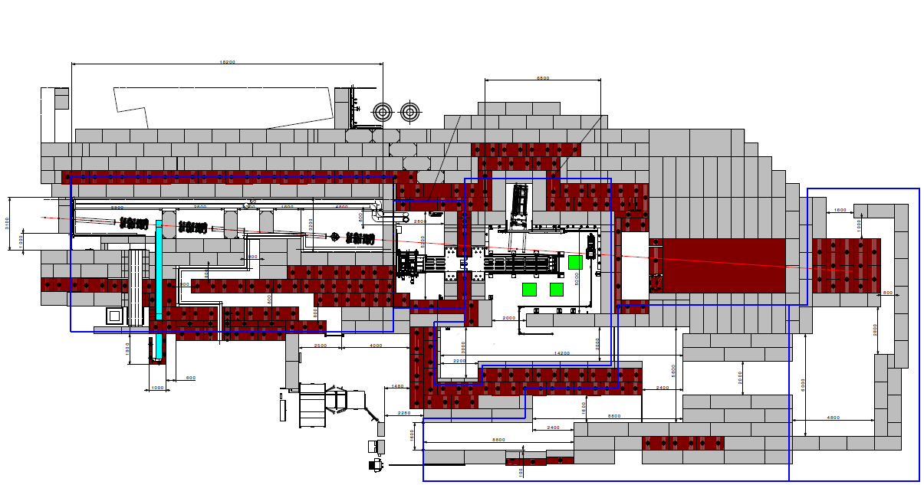
East Area Irradiation Facilites
  Primary beam line from PS (T08): 24 GeV/c proton beam
  CHARM irradiation area is placed downstream to IRRAD on the T8 line
PS p+
24 GeV/c
~400ms spill
DUMP
IRRAD
ENTRANCE
CHARM

Slide 3
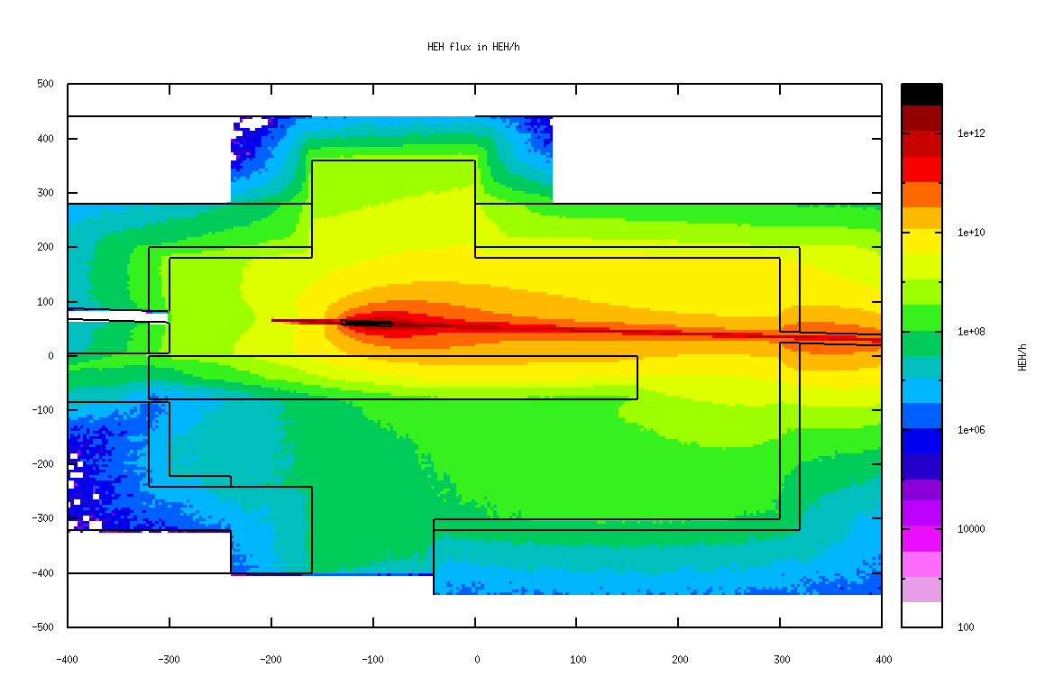
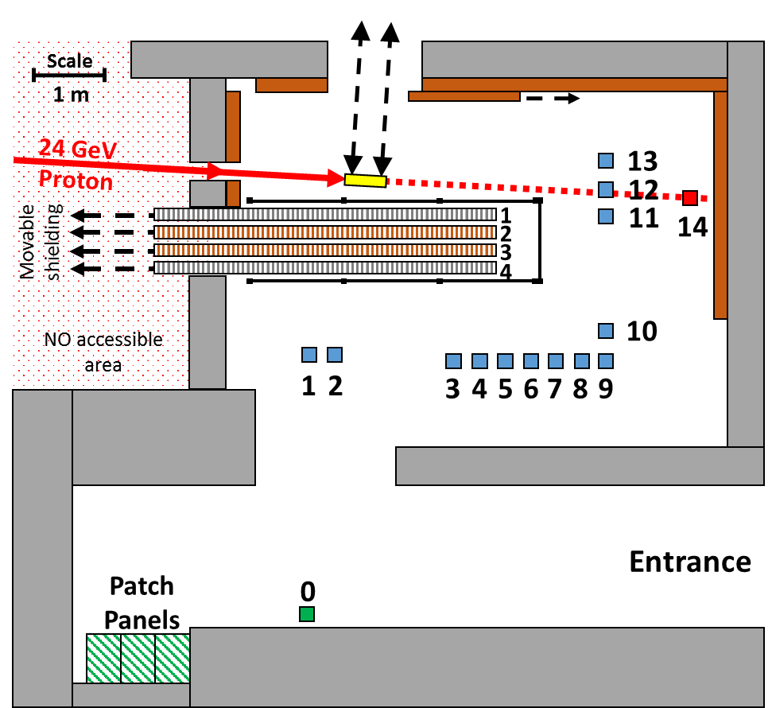
Irradiation Room
PRIMARY PROTONS IMPINGE THE TARGET: A SECONDARY RADIATION FIELD IS CREATED
3 KEY ELEMENTS:
Target
Movable Shielding
Positions
Target
Concrete
5mt
Iron
6mt
Conveyer
Montrac

Slide 4
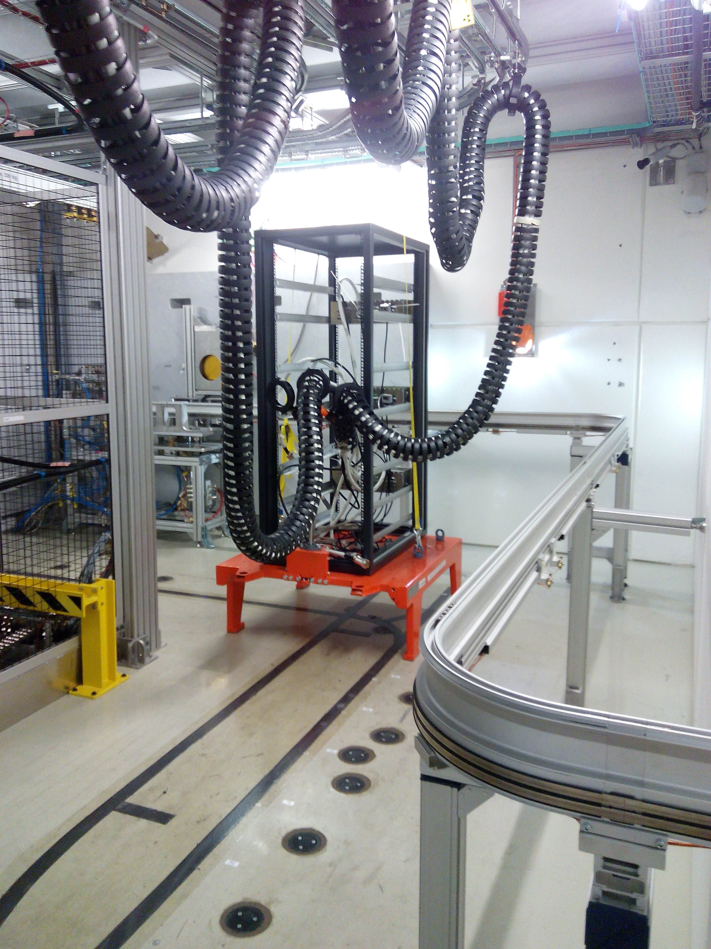
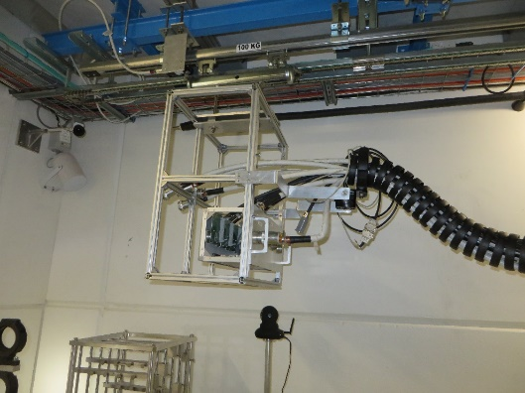
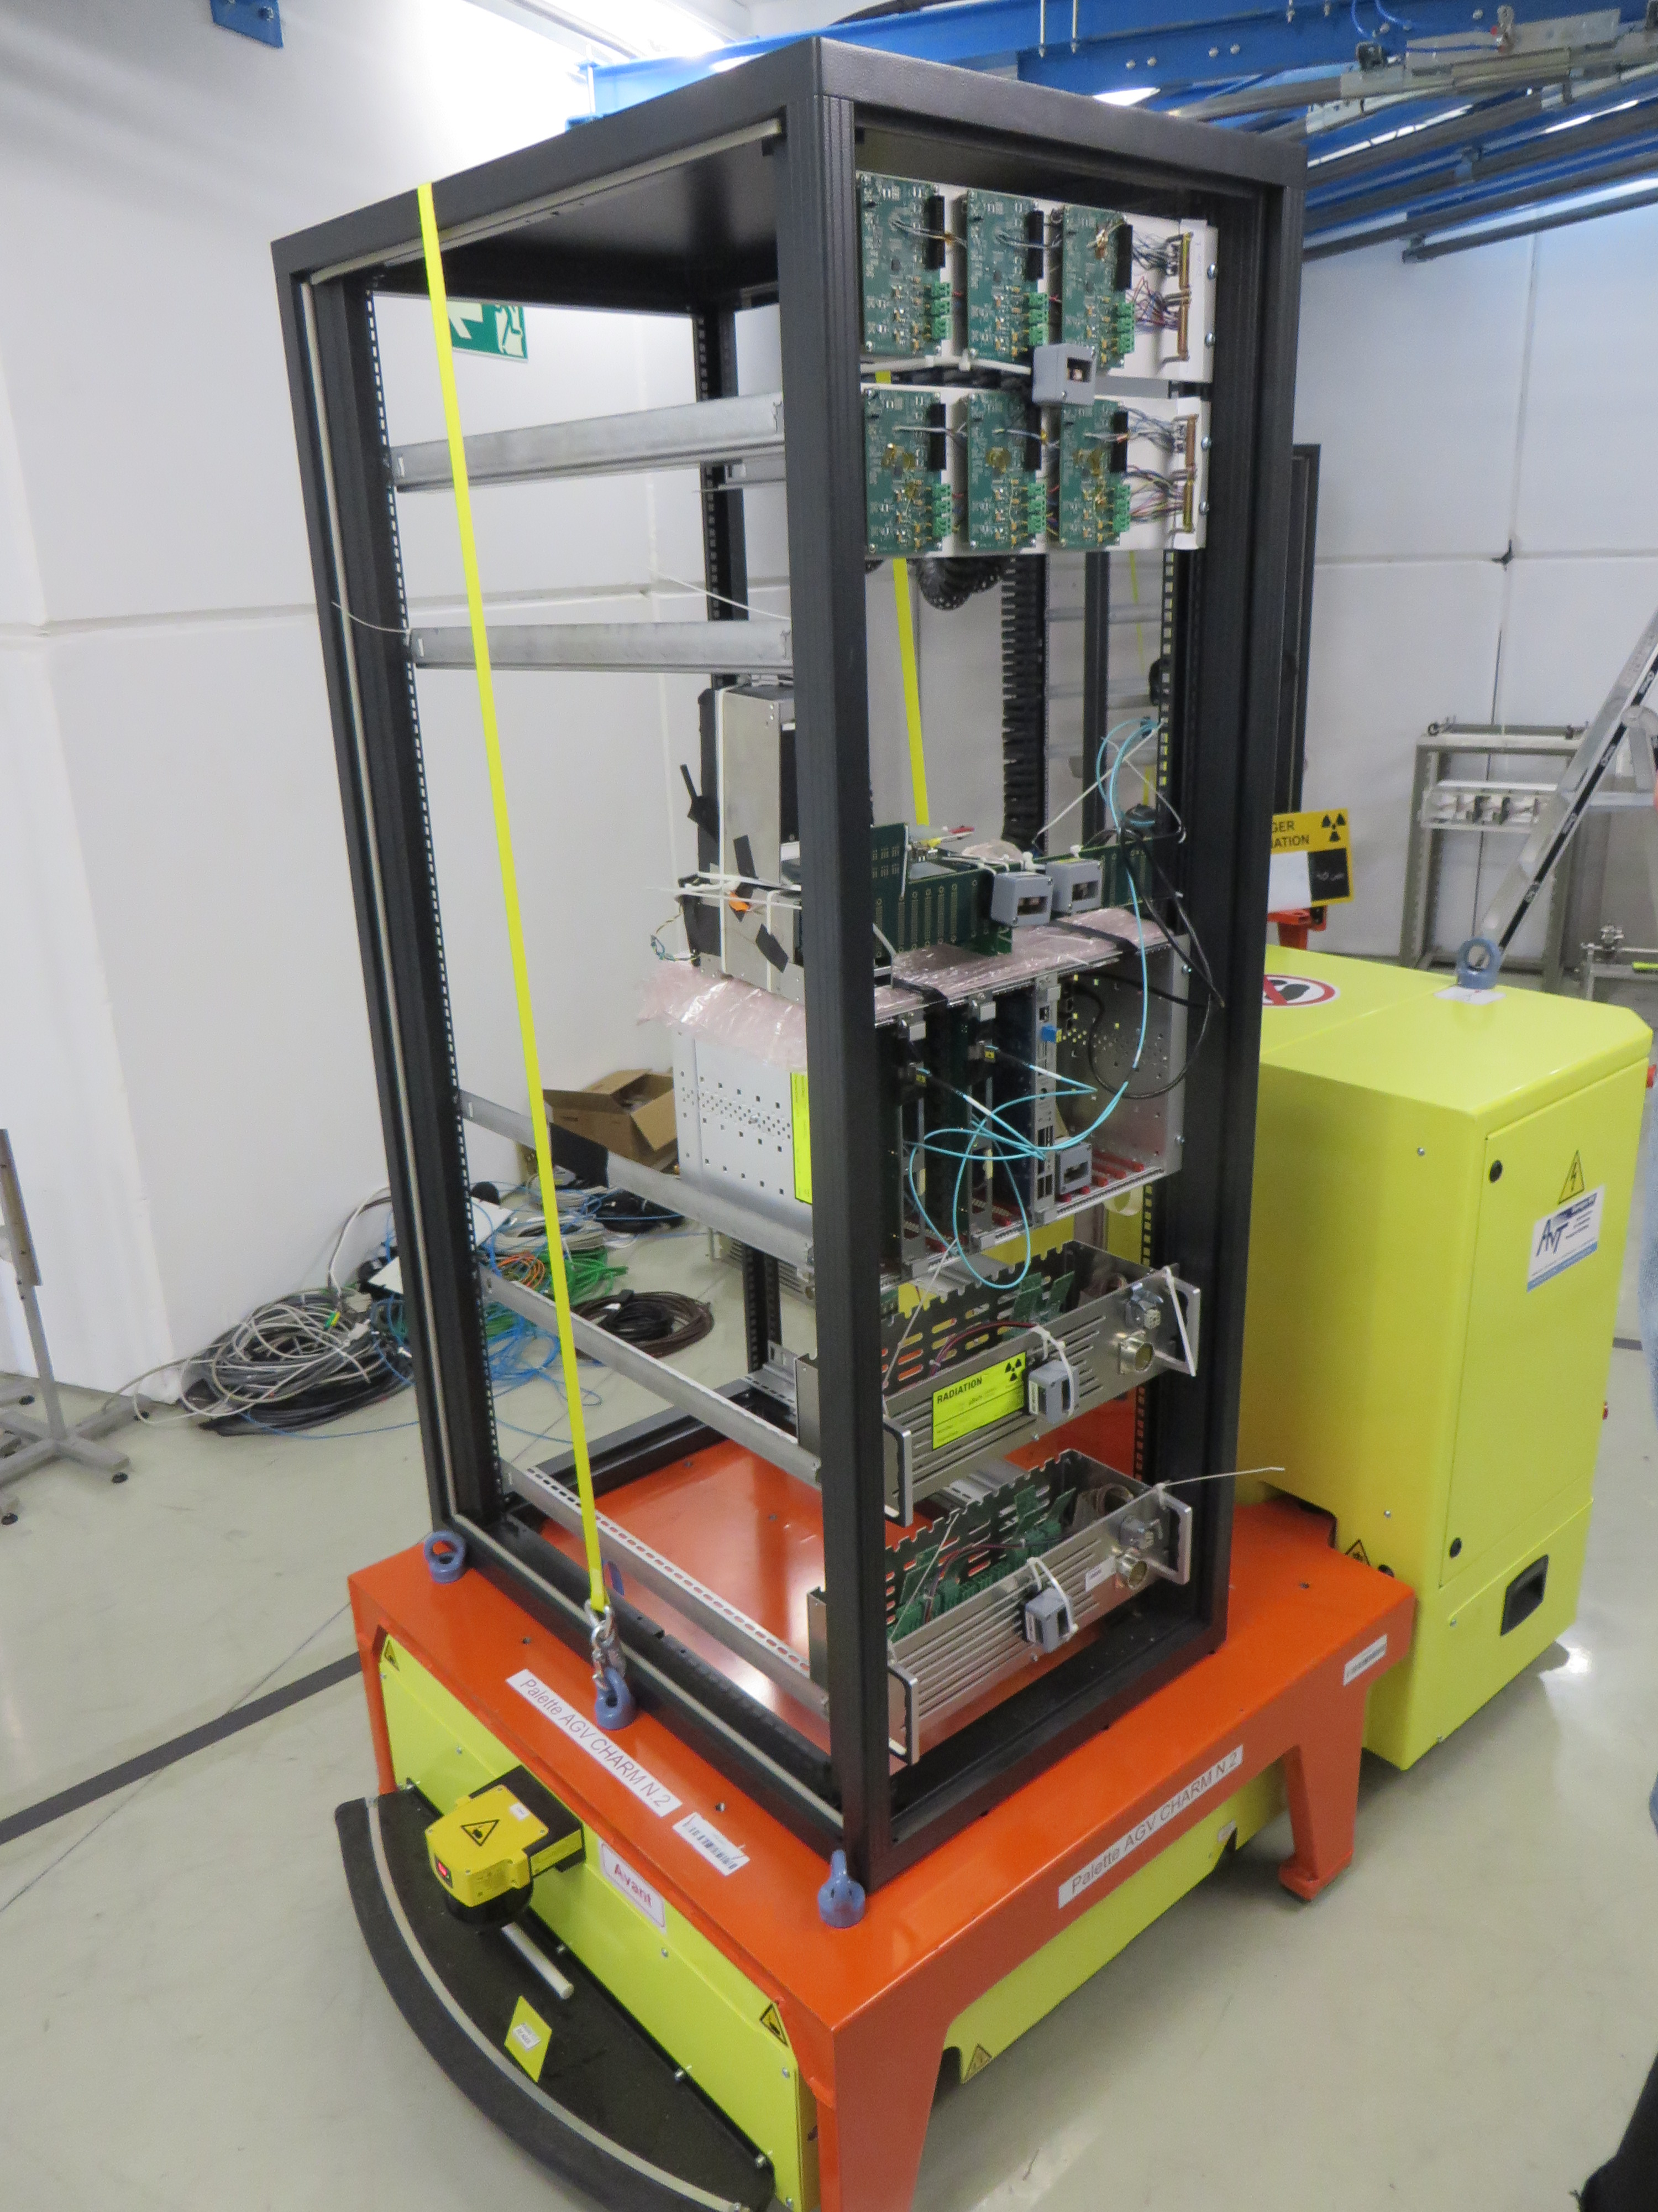
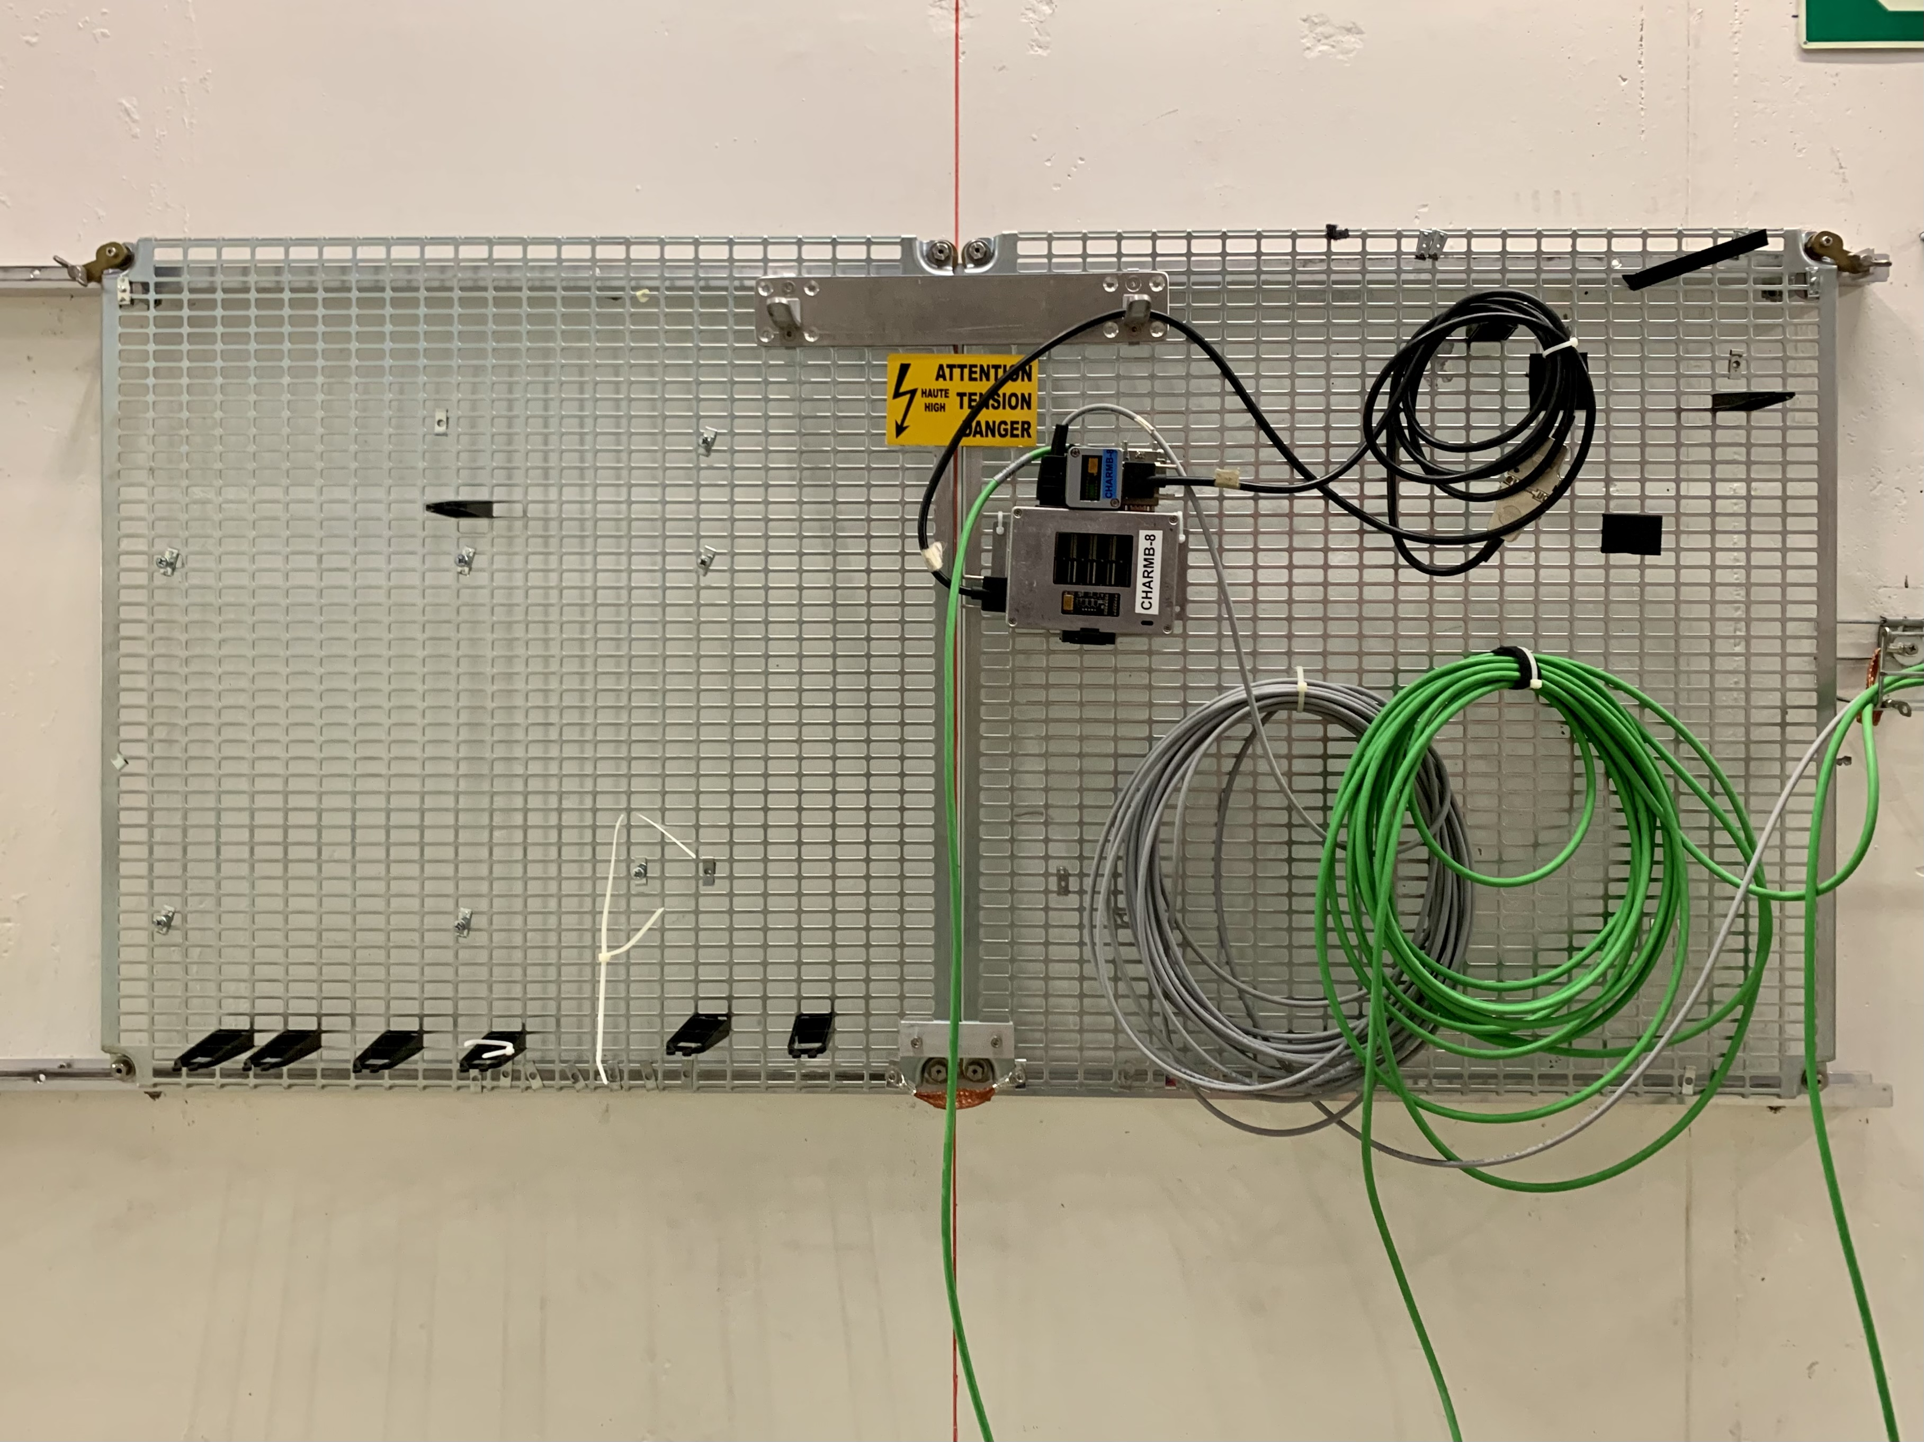
Irradiation Room
OVERHEAD
BLM MOV
RACK
BLM 102
BLM 101
RACK
G0
G0

Slide 5
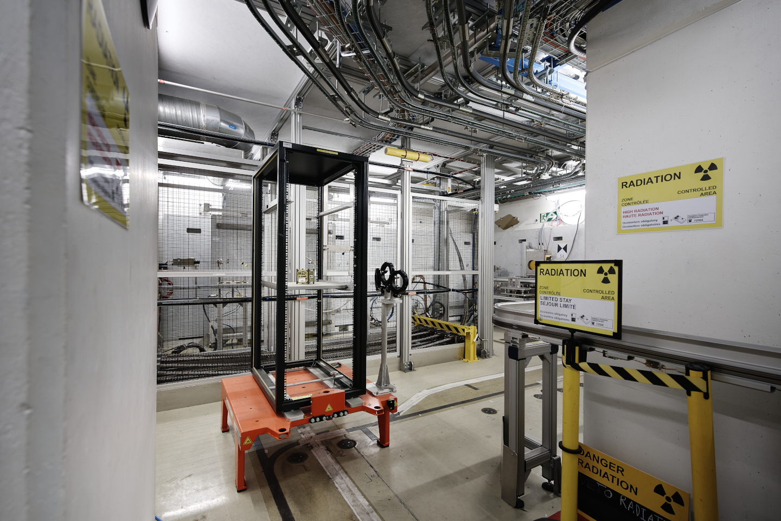
CHARM irradiation zone

Slide 6
Testing procedure
On 18/3/2024, starting 13h30:
T8 beam extracted with nominal intensity (8E11) and slow extraction
Marc in CCC changed beam extraction parameters, monitoring the extracted beam by the scintillator placed along the line
Salvatore and Roberta monitored the effect on the secondary field emitted by the CHARM target, by the BLMs located on top and on the side of the target
BLM were seeing a ~orthogonal-to-the-beam radiation, on top of the target, plus a BLM at beam height on the left of the beam line, downstream the target

Slide 7
Spill shape change
Change of beam shape at extraction
→ we see the enhanced head or tail of the time profile on the CHARM BLMs

Slide 8
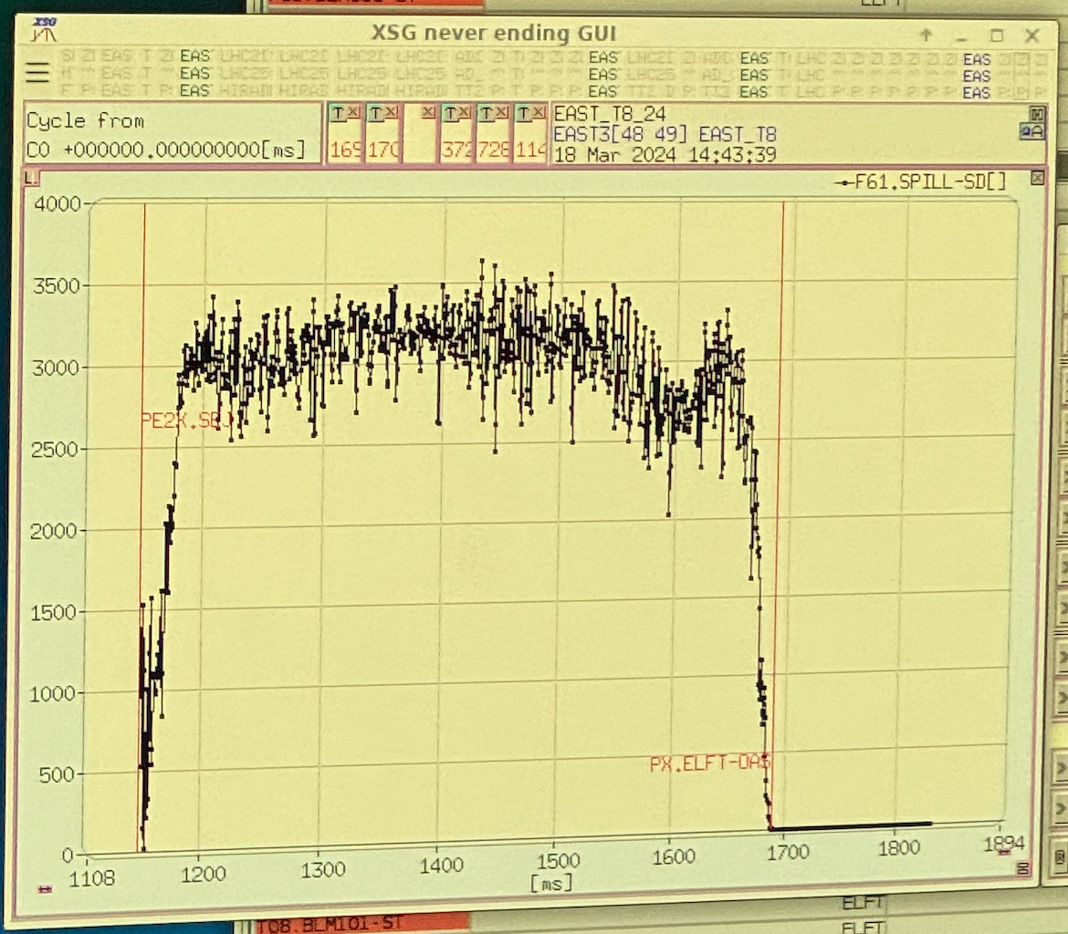
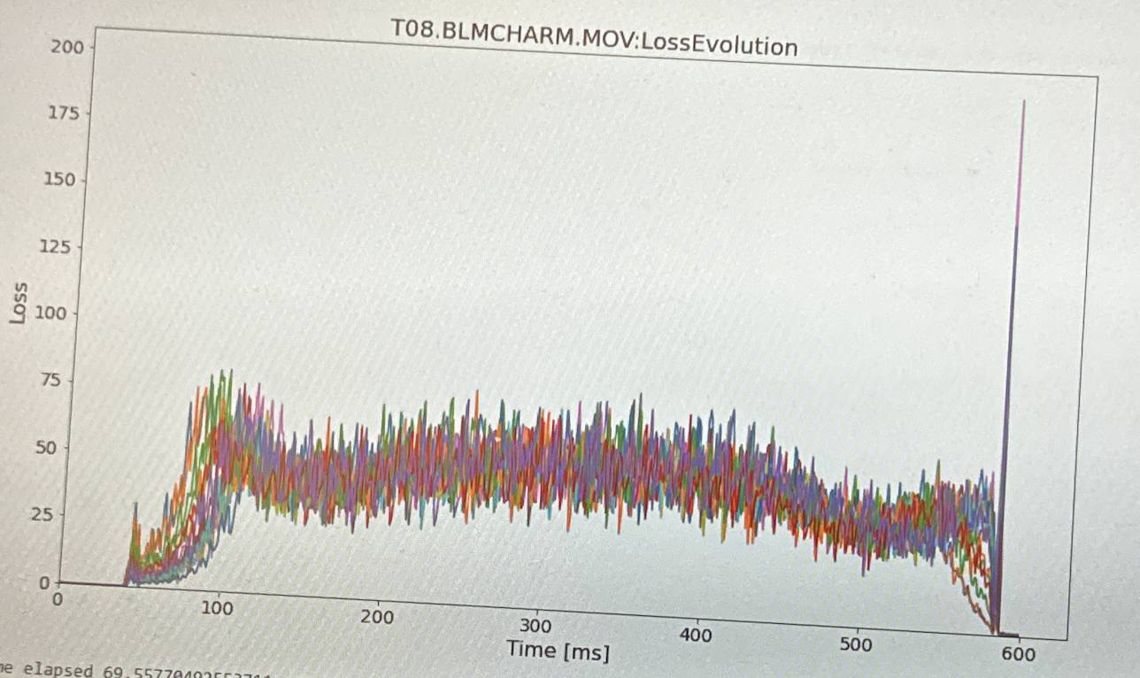
Spill “overflow”
T8 line activation (kickers and magnets) lasts 540 ms
If the spill extraction is not centered in this window, head and/or tail are mis-steered
Extraction shift was intentionally provoked
We saw spikes in the radiated field by the target

Slide 9
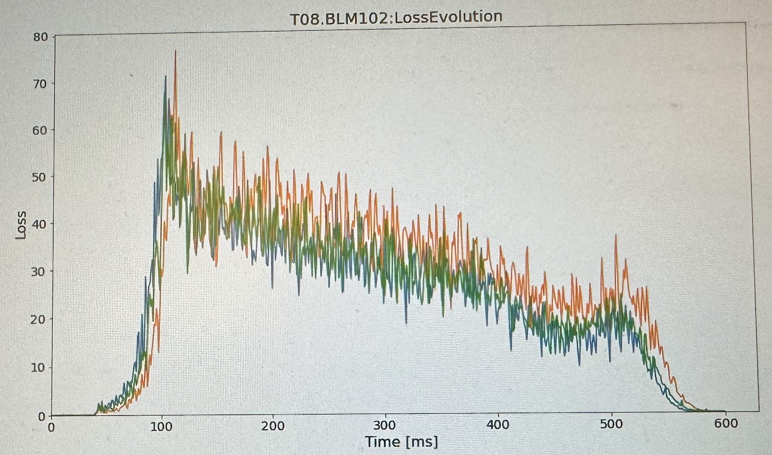
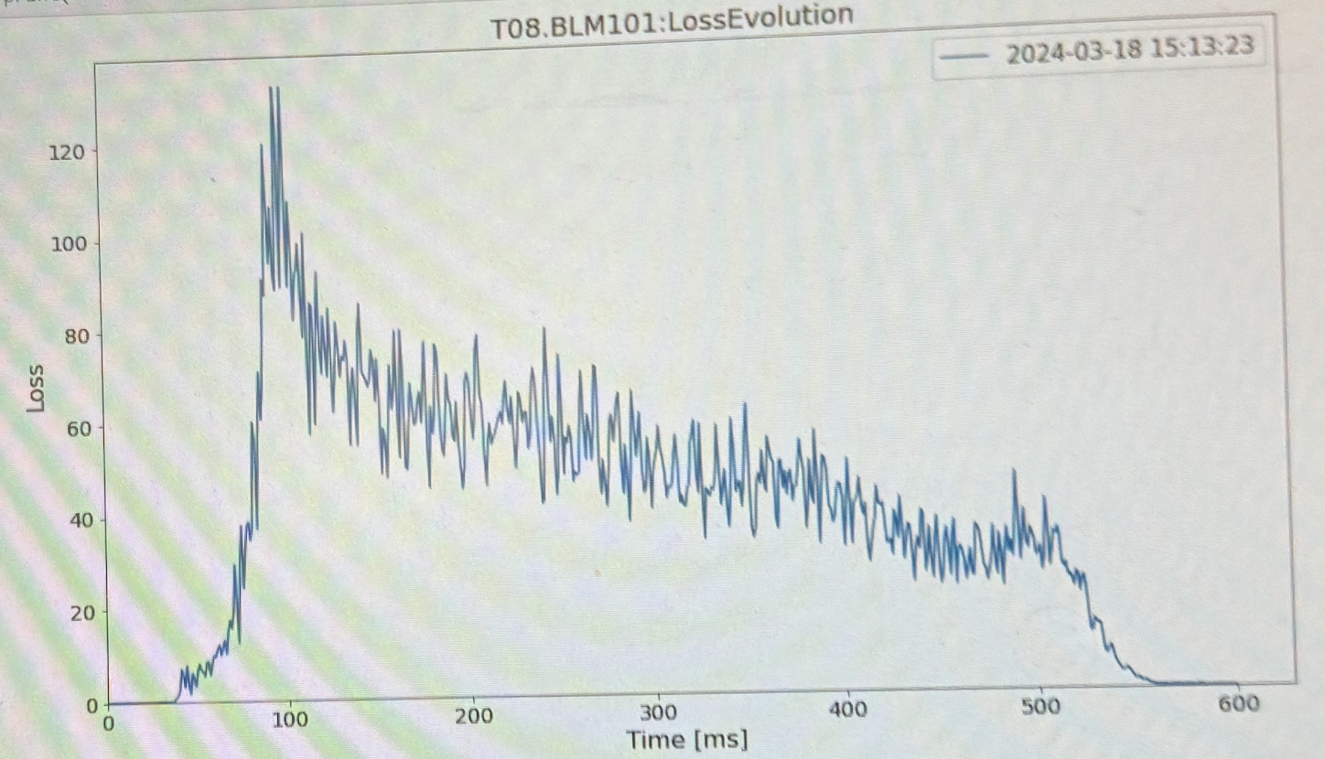
Steering out of CHARM target
Spill was intentionally steered steadily out of target in horizontal plane
40 mm sx 20 mm dx
Effect is not clear, a distorted time profile is present but similar in two cases
Hp: intrinsic momentum spread plus displacement may cause dynamic effect due to parasitic dipole effect of quads

Slide 10
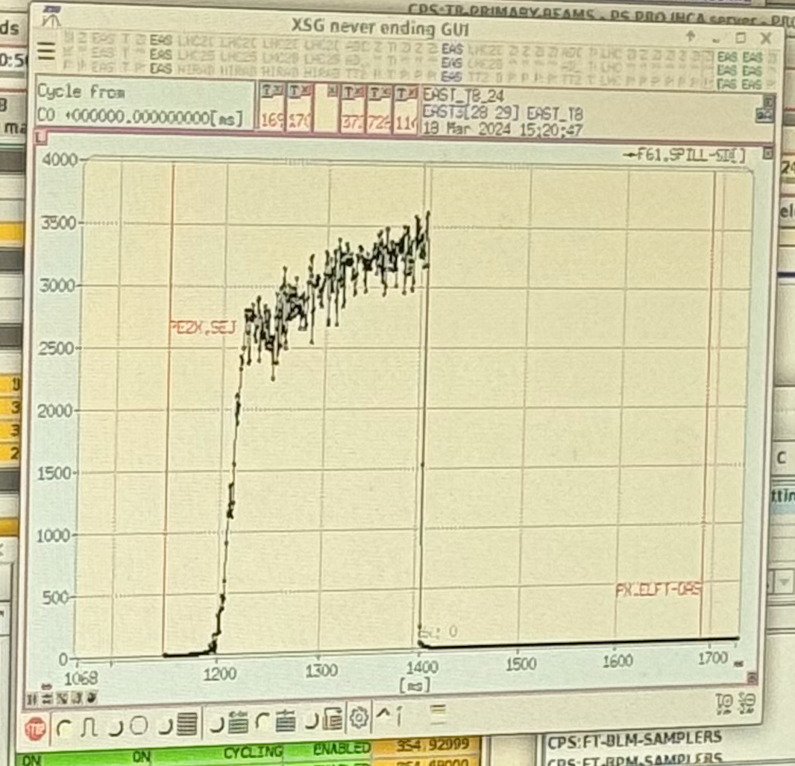
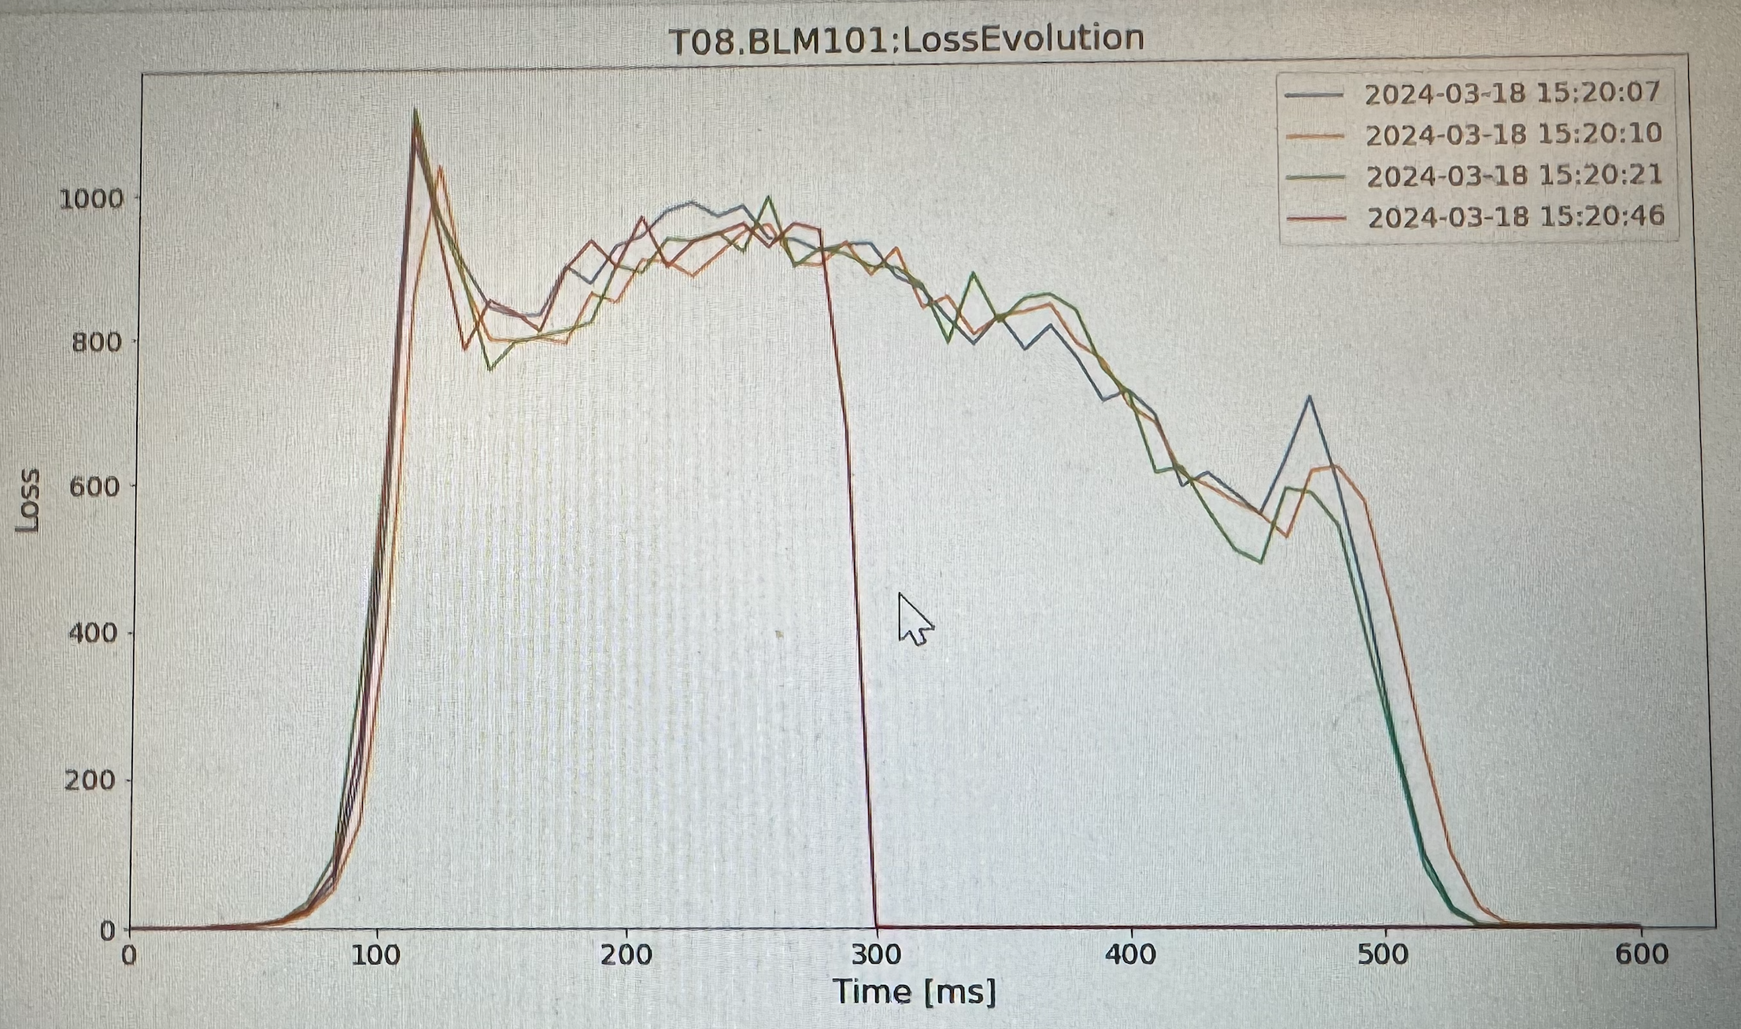
Spill shortening
Spill cut with internal dumps Reproduced in CHARM field

Slide 11
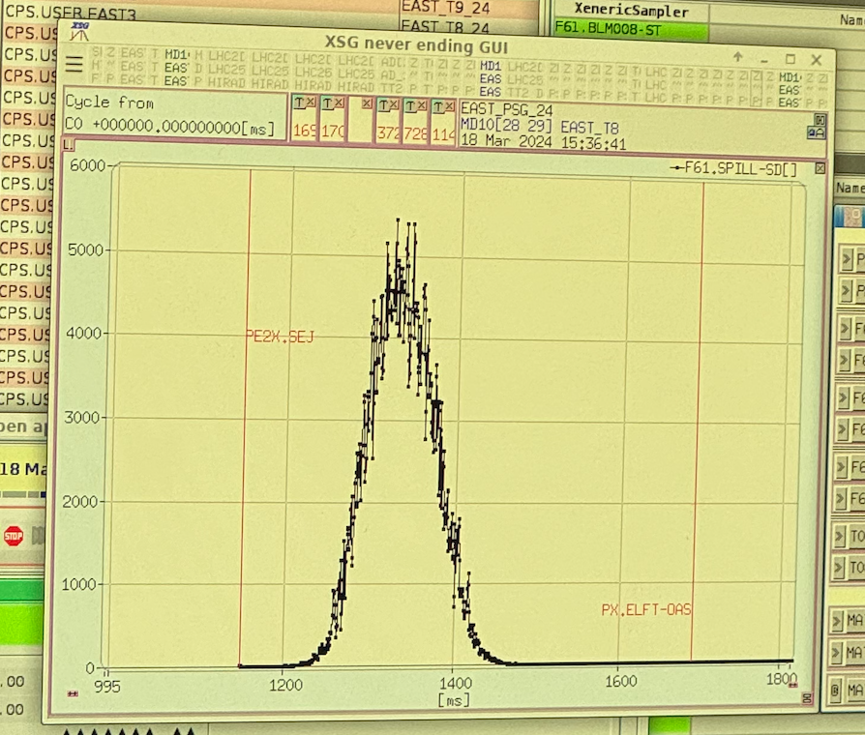
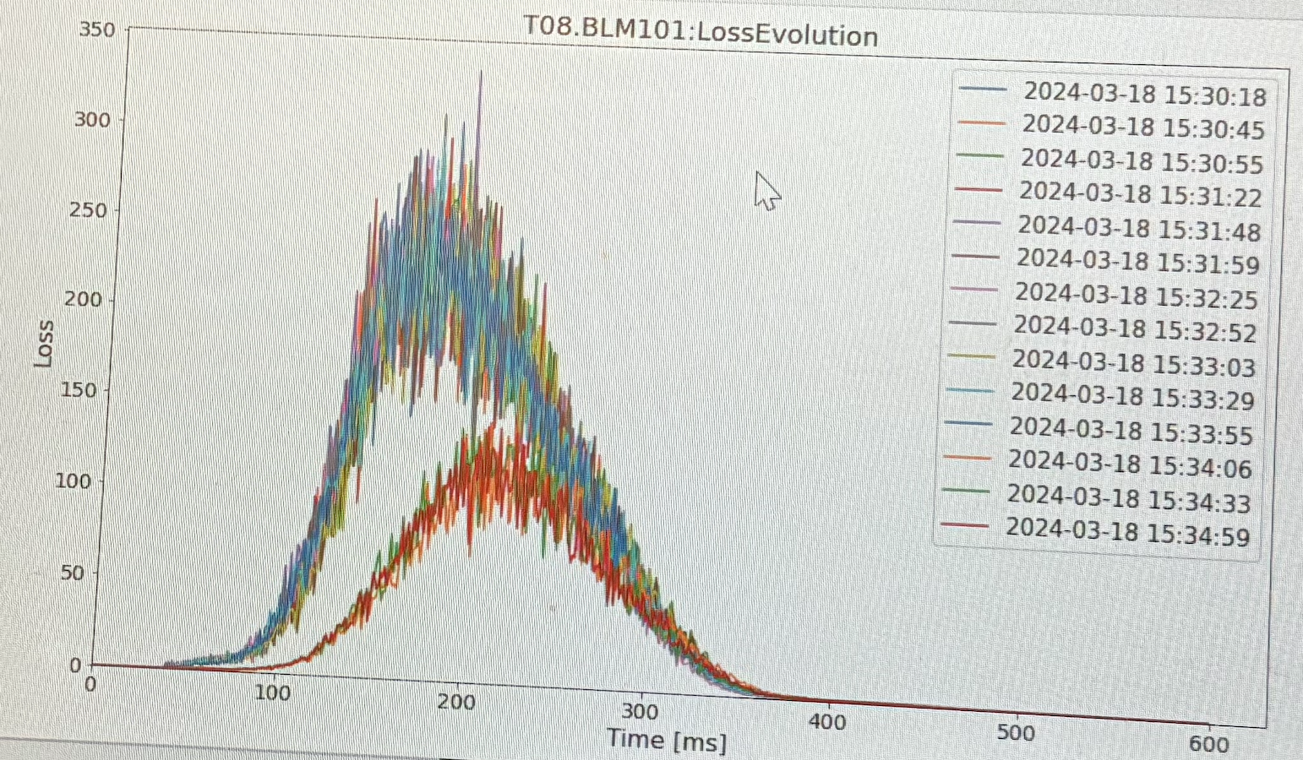
Short gaussian spill
Extracted and reproduced in CHARM field

Slide 12
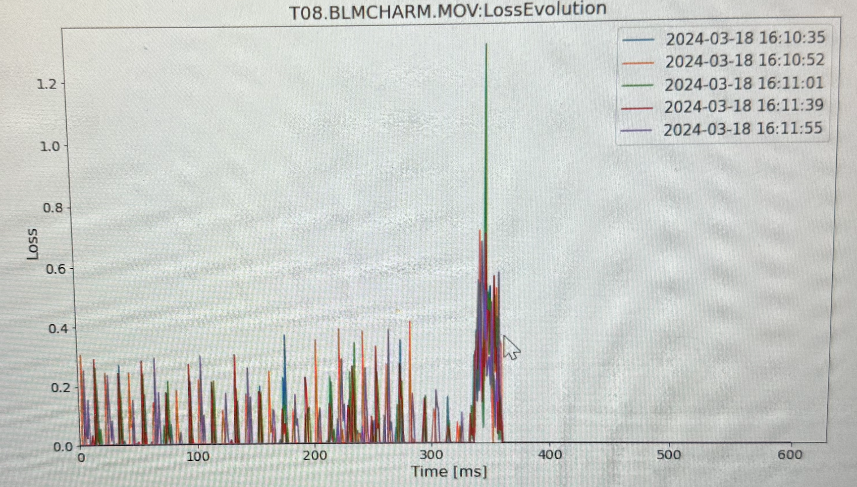
Fast extraction
Extracted as fast, seen in CHARM as single peak anticipated by smaller ones. BLM resolution does not allow for such time resolution

Slide 13
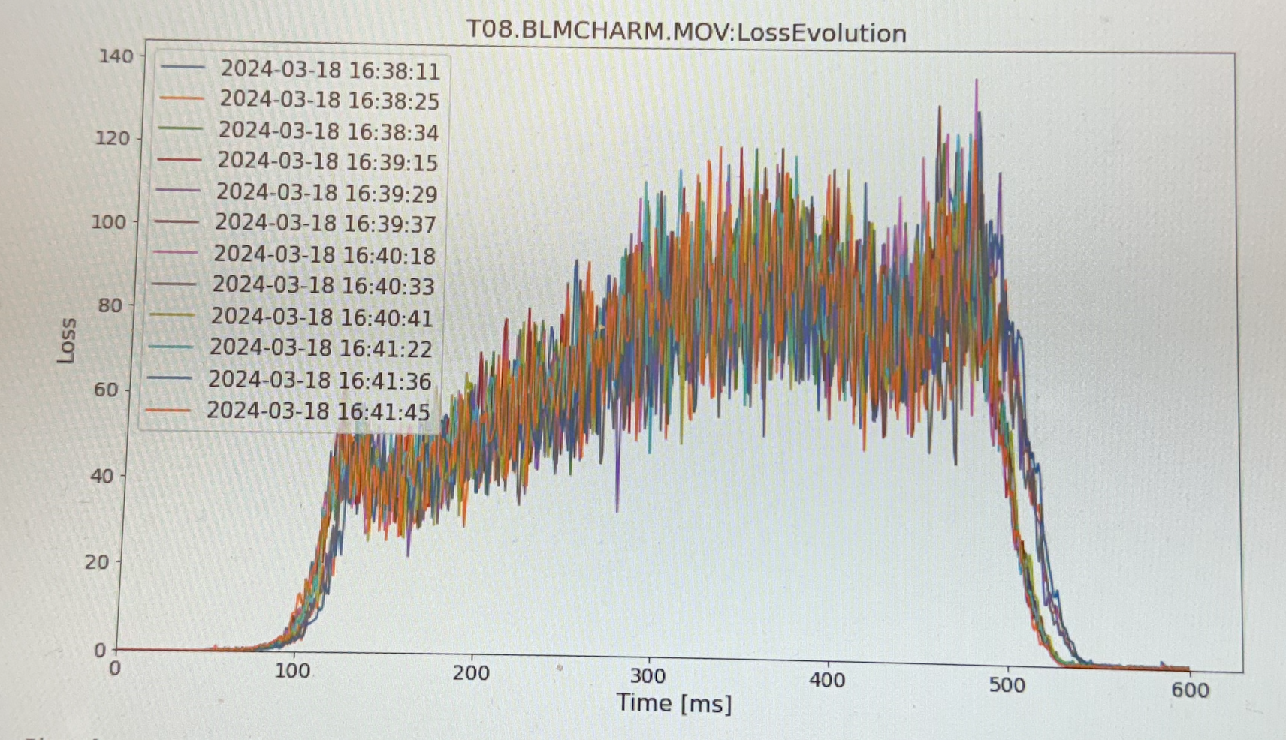
Spill steering during extraction
A sweep along X horizontal axis has been attempted (exploiting momentum spread plus a dipole sweep)
Effect in CHARM is unclear, we see deformation but difficult to connect to a position sweep

Slide 14
First conclusions
If the spill has non-geometric variations, that induce displacement on CHARM target due to e.g. beam momentum spread and parasitic dipole effect in quads, this is not seen at extraction but seen in CHARM
If the spill has time profile properties at extraction, these are seen both at extraction and in CHARM
Steering on CHARM target, either static or dynamic during extraction, is seen as deformation in CHARM but not directly reconducible to specific direction

Slide 15
Next actions
By exploiting the results we got, repeat the exercise done in March with:
More detailed plan of beam variations,
Acquisition of relevant beam setting parameters
Acquisition of relevant BLM spectra
Acquisition with new fast BPM in IRRAD to follow sweeps and record beam spot

Slide 16
Thank you for your attention!

