Slide 2
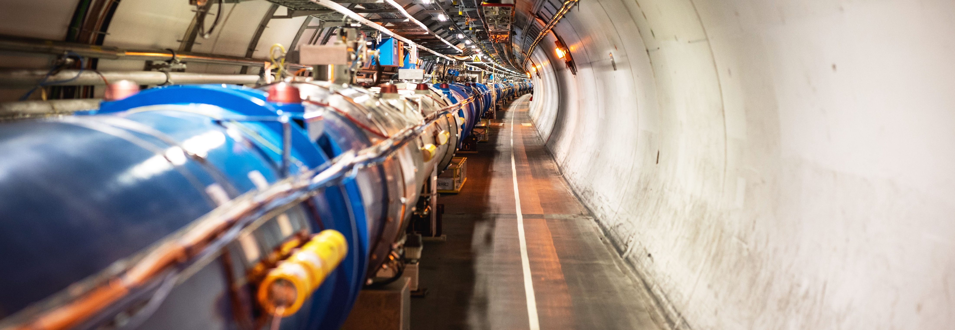
Accelerating Innovation: How CERN Technology Makes its Way into Society
Giovanni Anelli, Head of Knowledge Transfer Group, CERN

Slide 3
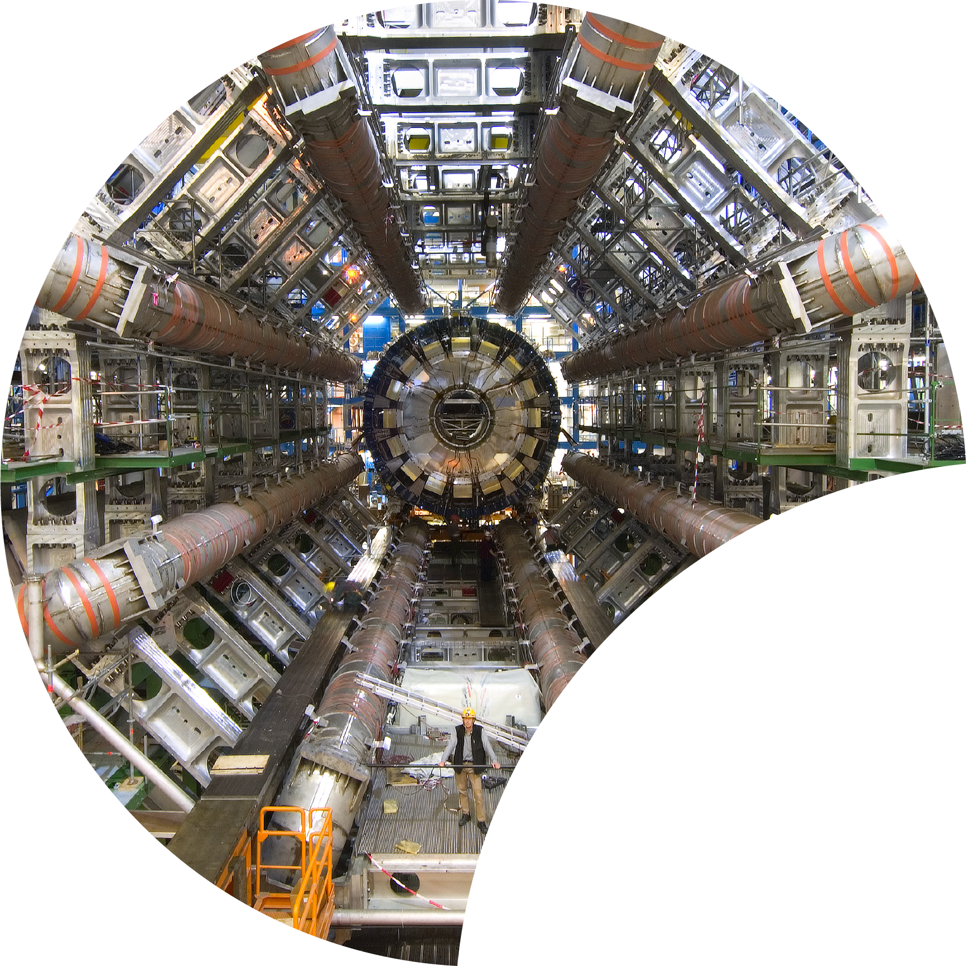
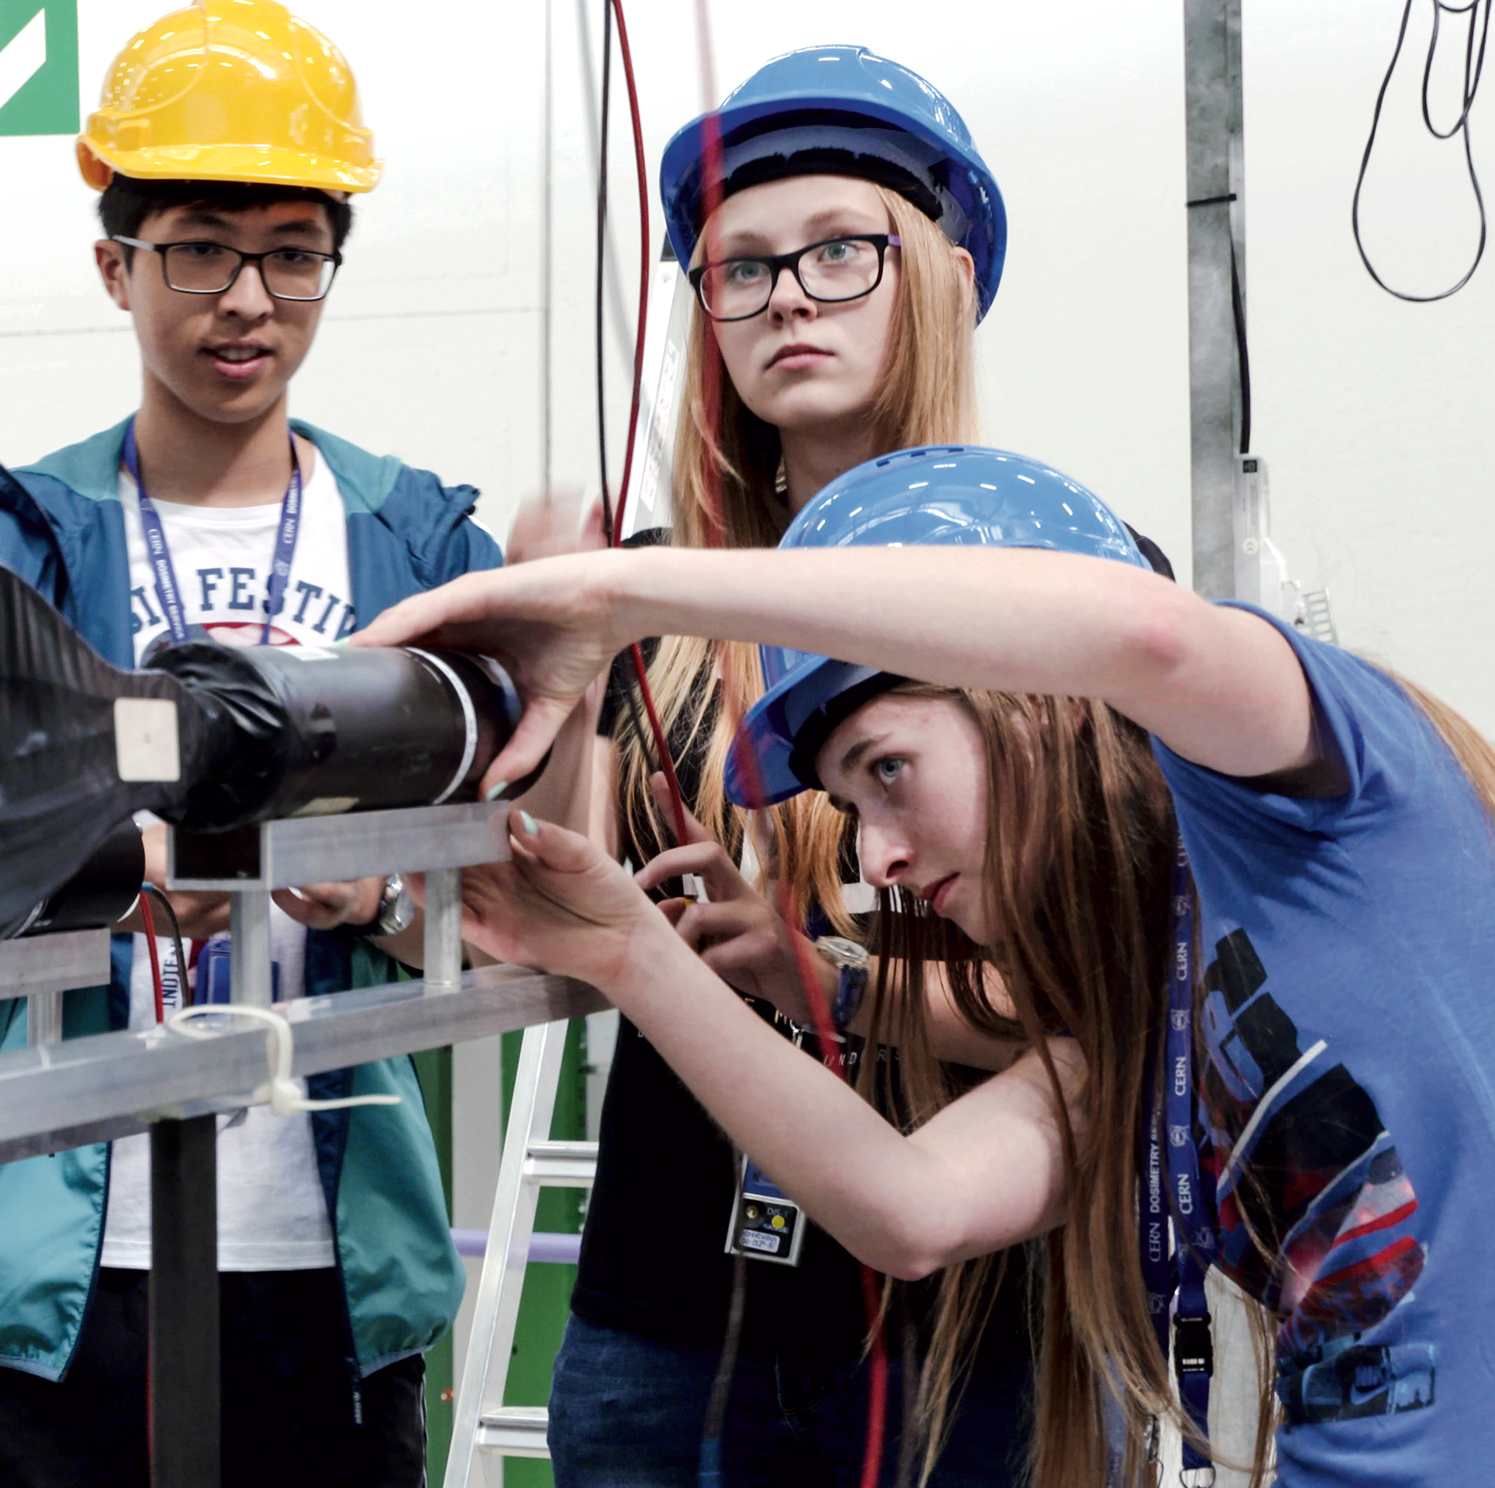
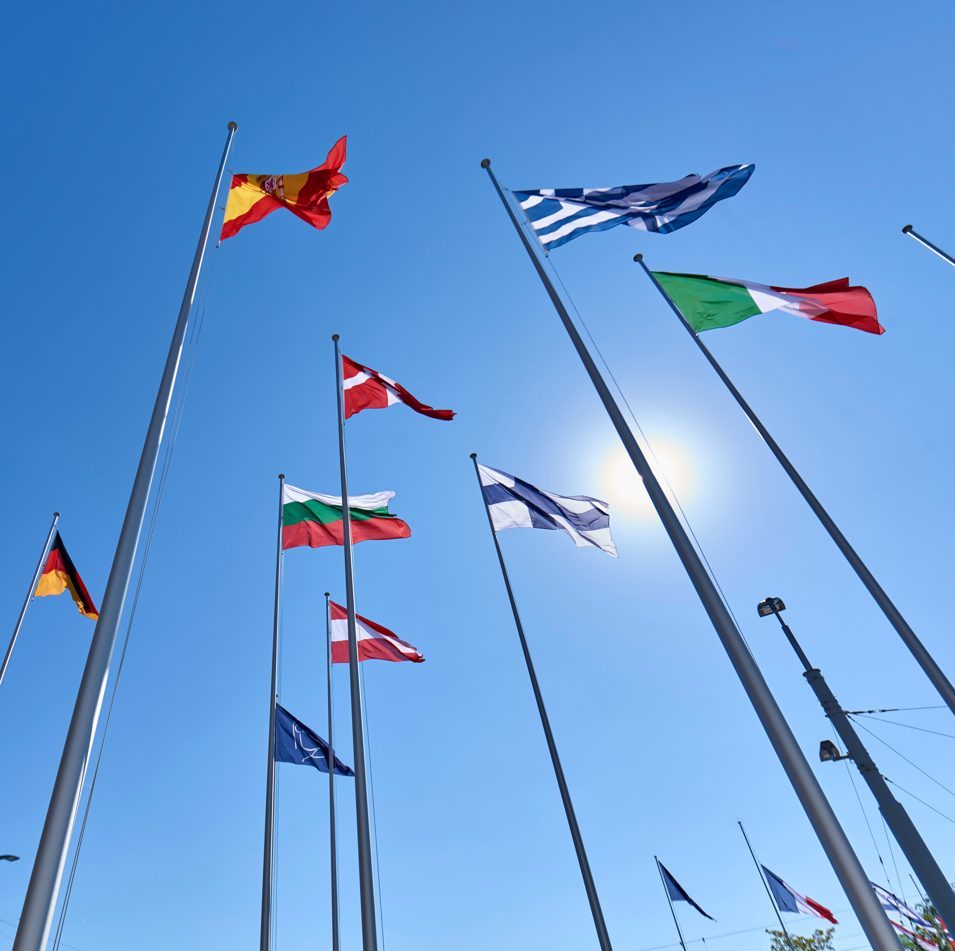
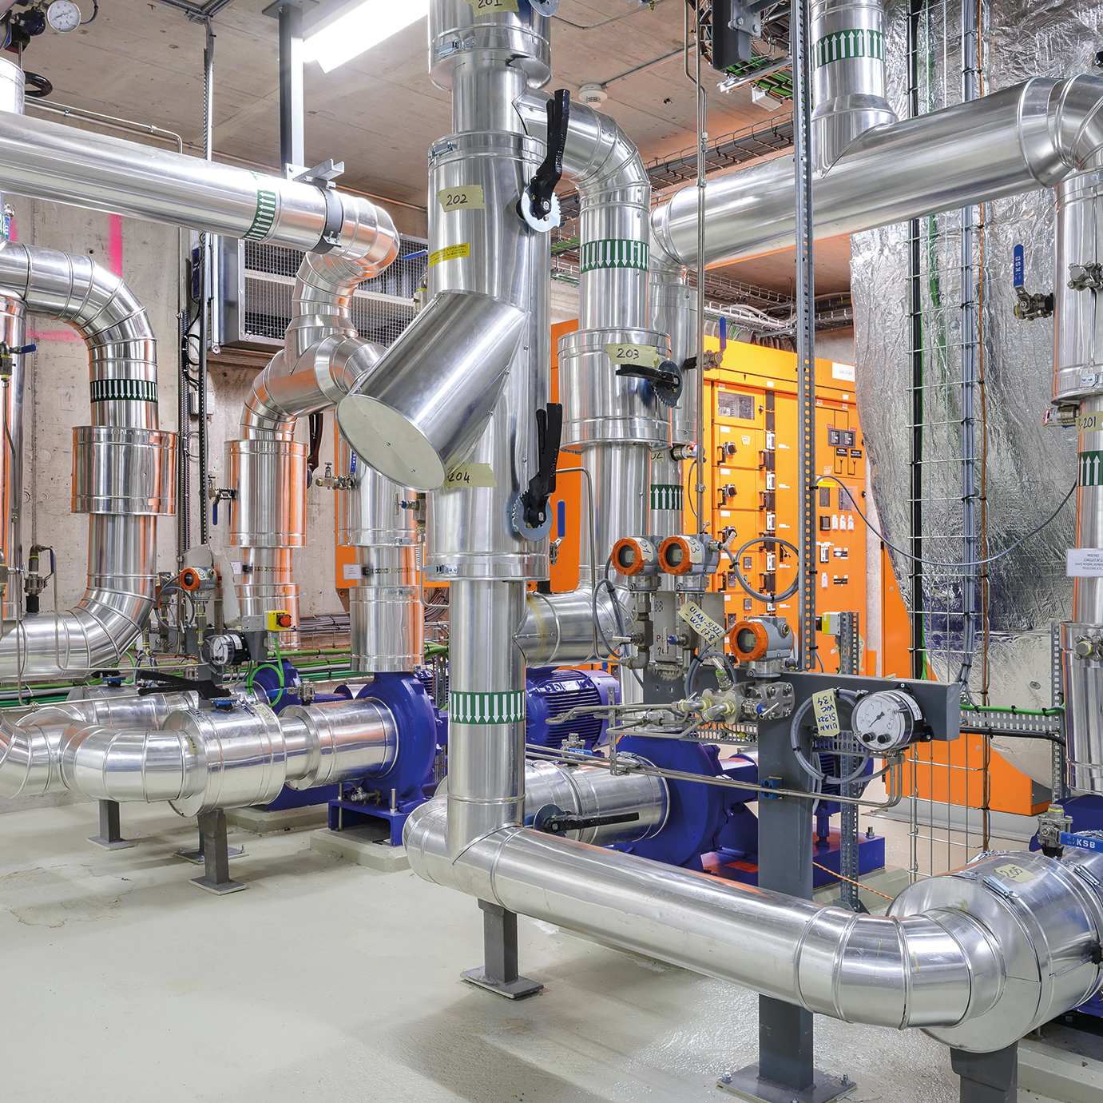

Four pillars underpin CERN’s mission
RESEARCH
EDUCATION
& TRAINING
COLLABORATION
TECHNOLOGY
& INNOVATION

Slide 4
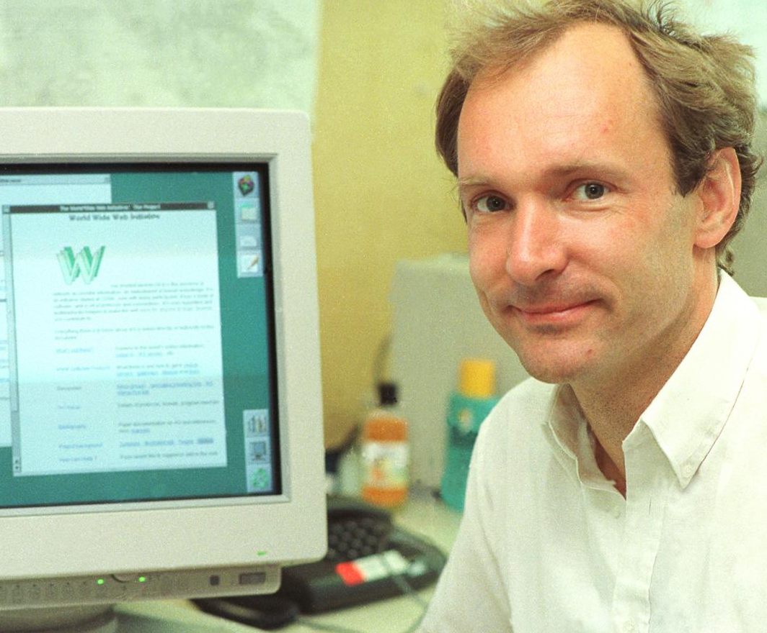
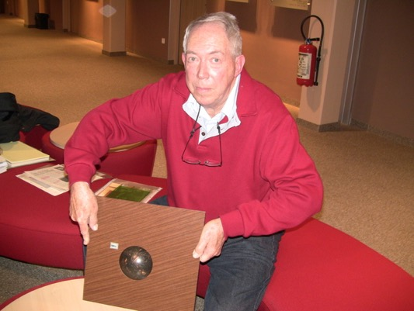
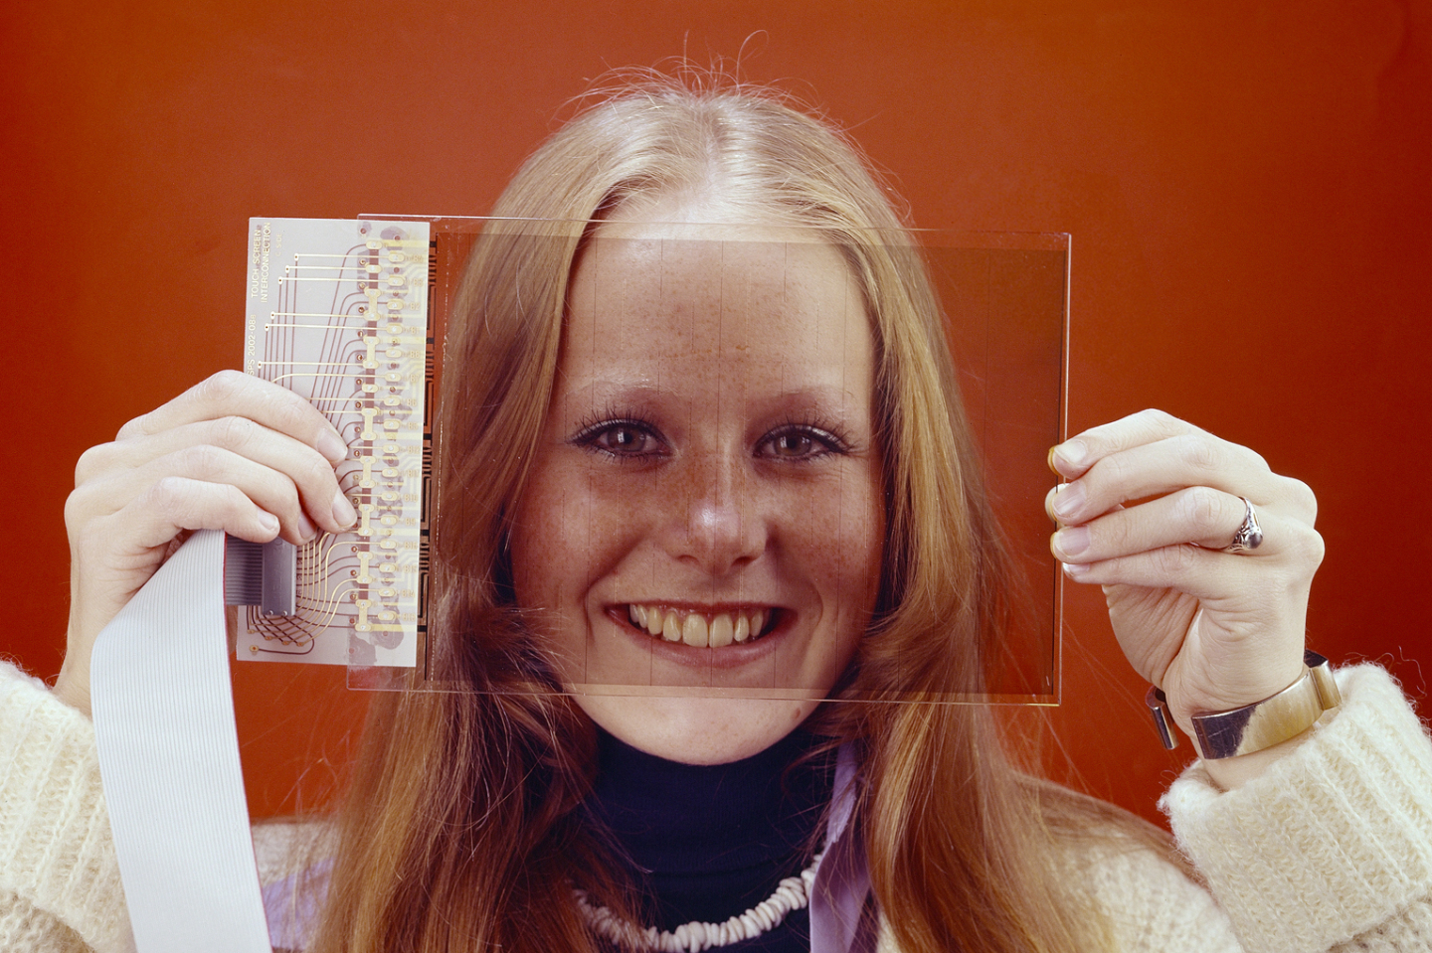
Some historic examples
WWW
TRACKERBALL
TOUCHSCREEN

Slide 5
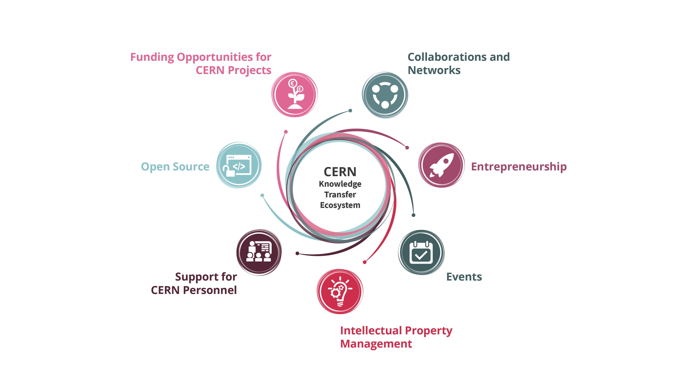
Our toolbox to accelerate innovation

Slide 6
Hybrid strategy: tech push & market pull
Scout for technologies
Search unmet needs
Mobilize tech experts
Mobilize innovation partners
Create tech and IP dossiers
Create value propositions

Slide 7

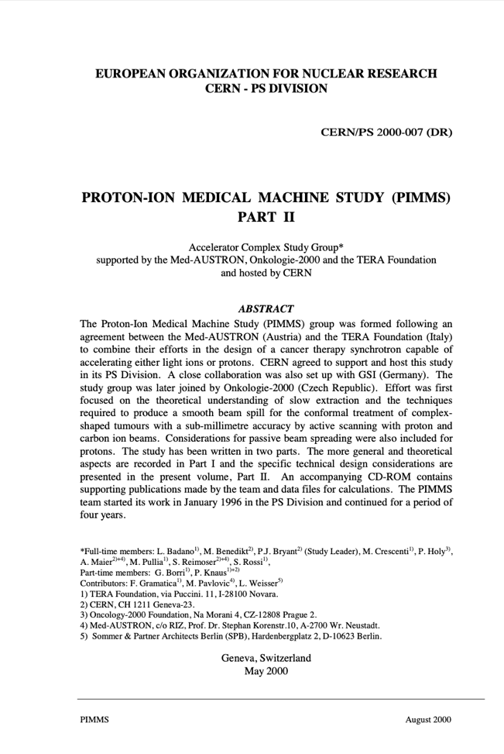
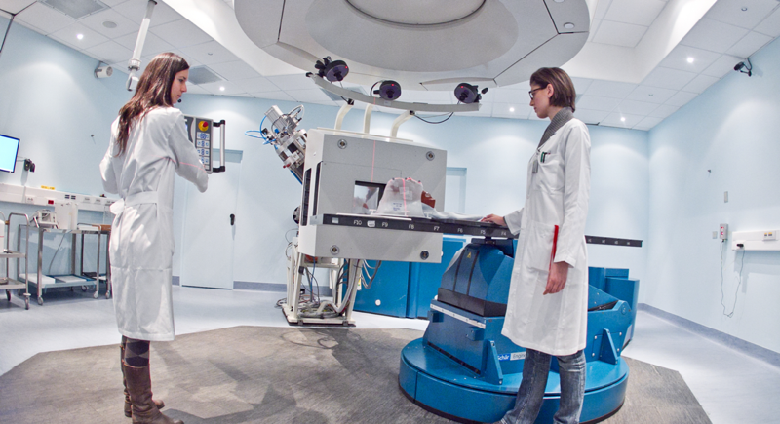

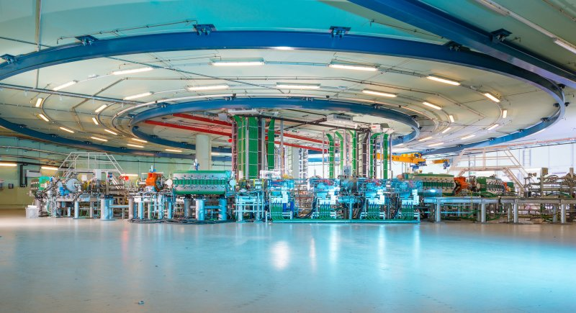

From the
PIMMS Study @

Slide 8
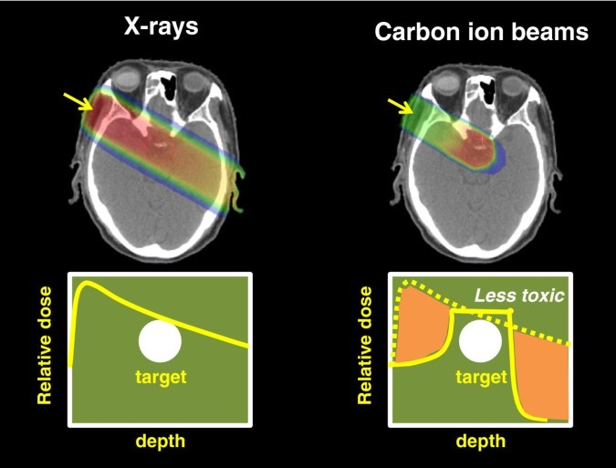
https://link.springer.com/article/10.1186/1878-5085-4-9
Notes:
Use of protons first proposed by Robert Wilson, 1946

Slide 9
Construction of a compact, transportable accelerator based on the HF-RFQ developed at CERN
In collaboration with INFN-CHNet (Cultural Heritage Network)
MACHINA
Movable Accelerator for Cultural Heritage In-situ Non-destructive Analysis
Photo: INFN

Slide 10
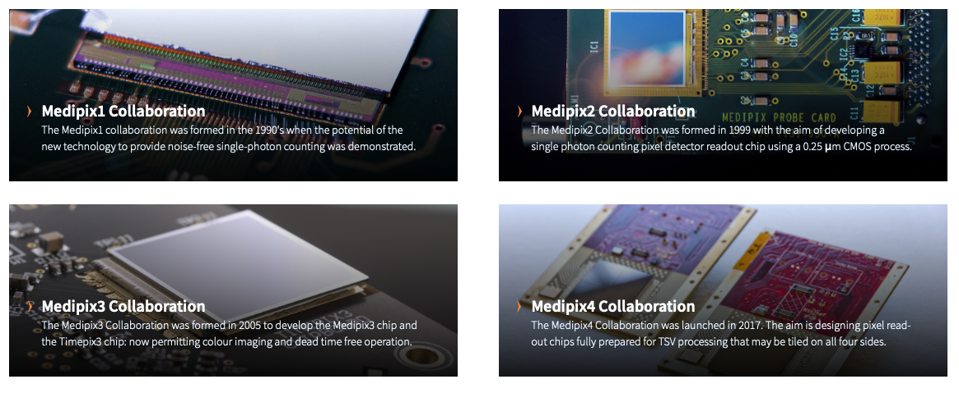
Medipix
A family of pixel detector read-out chips for particle imaging and detection developed by the Medipix Collaborations
Michael Campbell (CERN)

Slide 11

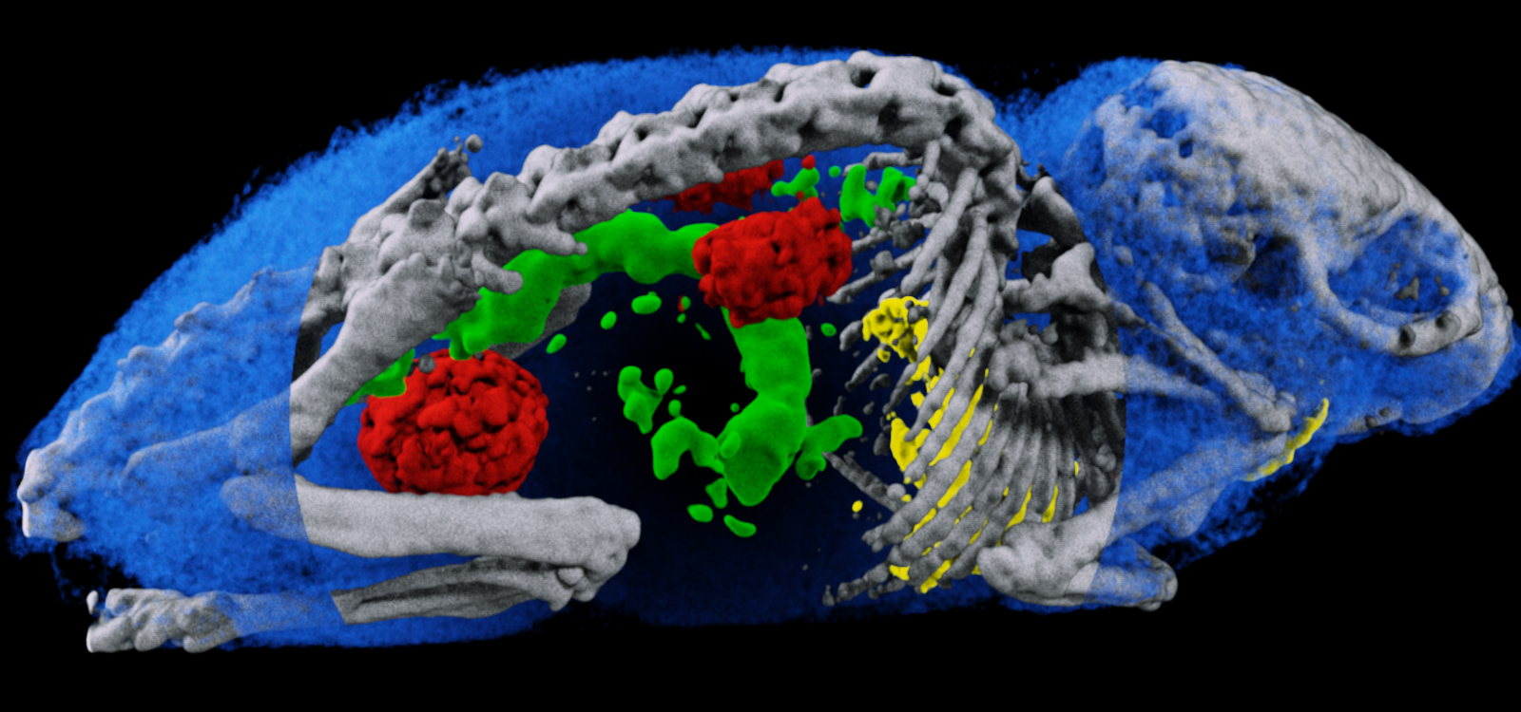
Spectroscopic information permits material separation
Images presented and the European Congress of Radiology, Vienna, March 2017.
A. Butler, University of Canterbury

Slide 12
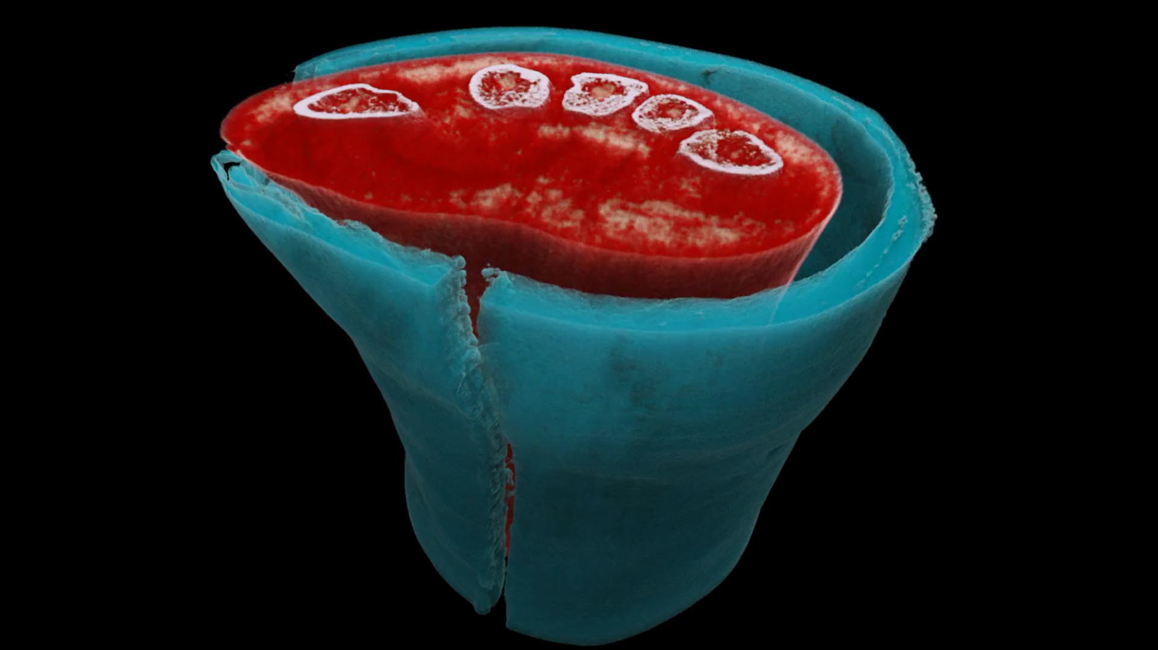


Slide 13

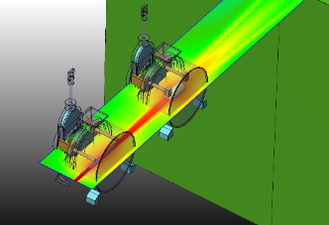
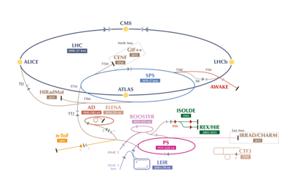
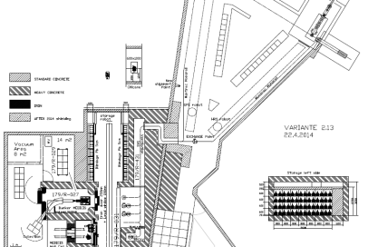
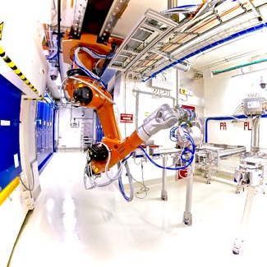
CERN-MEDICIS
Non-conventional isotopes collected by mass separation for new medical applications
MEDICIS Target Irradiation
MEDICIS
1.4 GeV protons
ISOLDE
“Free” proton beam
(otherwise lost in the dump)
Rail
Conveyor
System
MEDICIS Laboratory

Slide 14
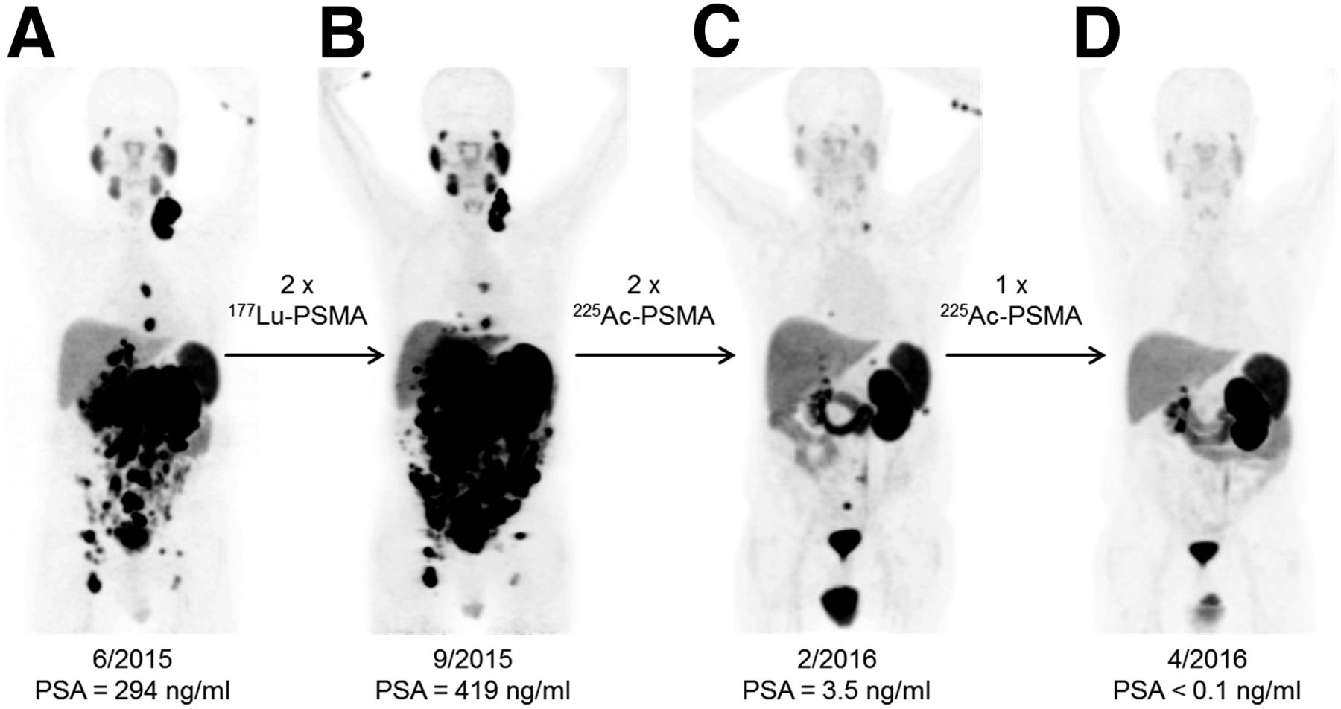

68Ga-PSMA-11 PET/CT scans of patient B. In comparison to initial tumor spread (A), restaging after 2 cycles of β-emitting 177Lu-PSMA-617 presented progression (B).
Clemens Kratochwil et al. J Nucl Med 2016;57:1941-1944
Notes:
Why you need new radioisotopes

Slide 15
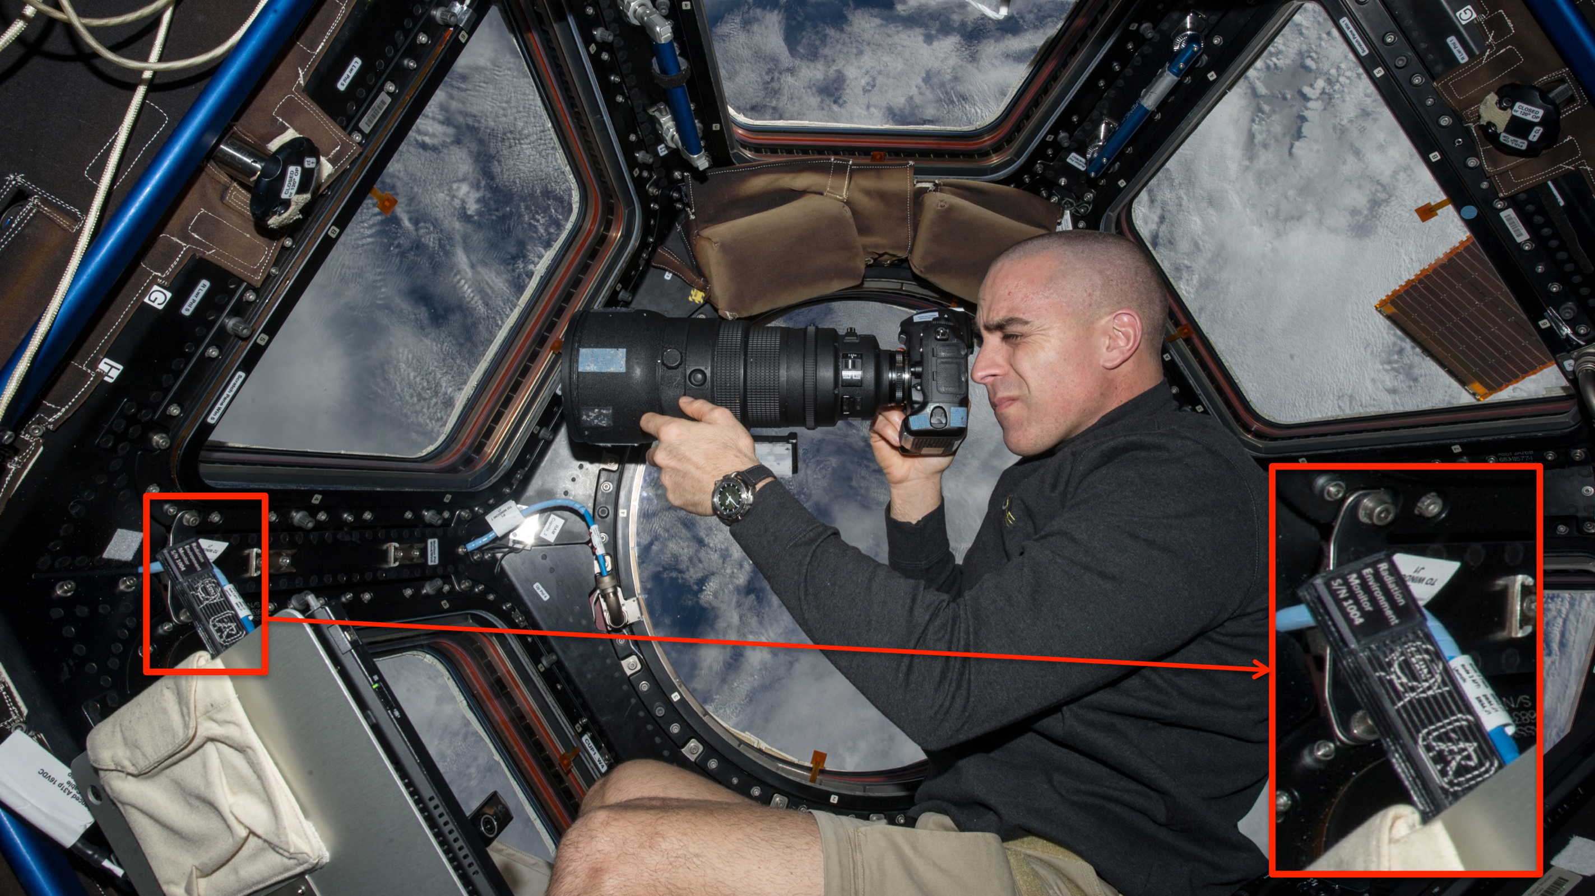
Timepix on the ISS
Courtesy of NASA, photo ref. no. iss036e006175

Slide 16
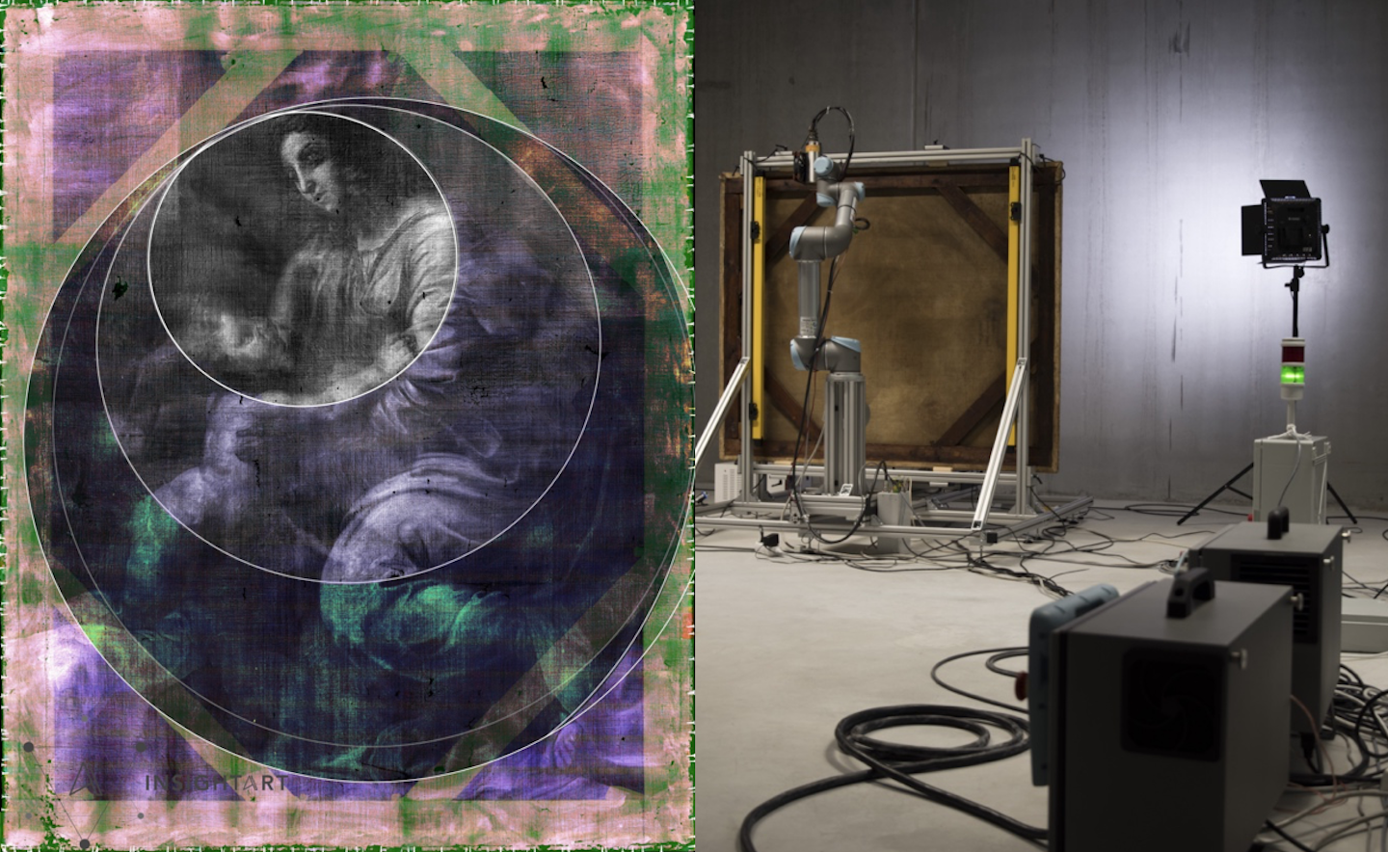
InsightArt
Start-up using Medipix
X-ray eyes for cultural heritage
Notes:
For a long time, it was thought that The Madonna and Child, a painting on canvas from a private collection, was not created directly by the master himself. Property of Popes and later part of Napoleon's war treasure, the painting changed hands several times before arriving in Prague during the 1930’s. Due to its history and numerous inconclusive examinations, its authenticity was questioned for a long time. It has now been attributed to Raphael by a group of independent experts. One of the technologies that provided them with key information, was a robotic x-ray scanner using CERN-designed chips.

Slide 17
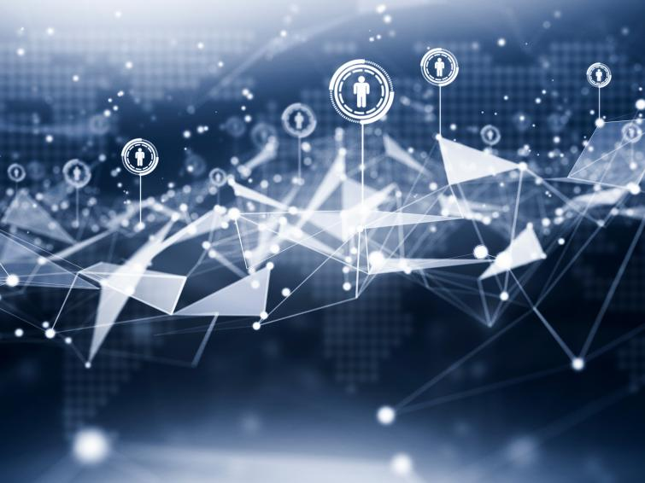
Bundesdruckerei (Berlin) works with CERN on next generation ideas for identity management and cryptography and data handling.
Consultancy

Slide 18
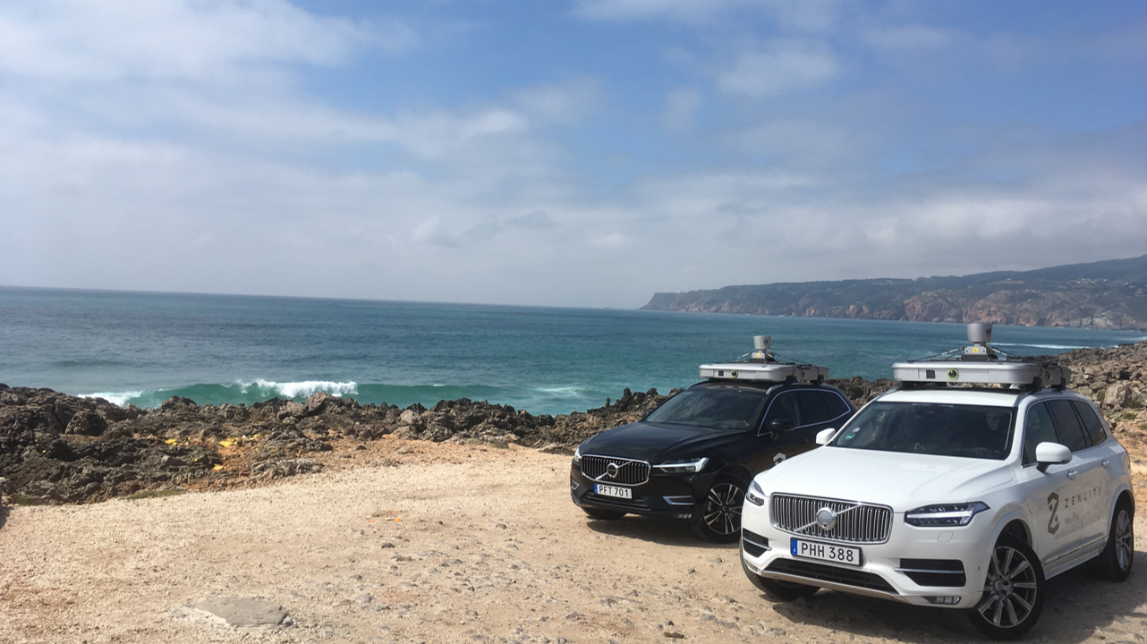
ZENSEACT (Volvo Cars Company) teams up with CERN on extremely fast machine learning using FPGAs.
Collaborative R&D

Slide 19
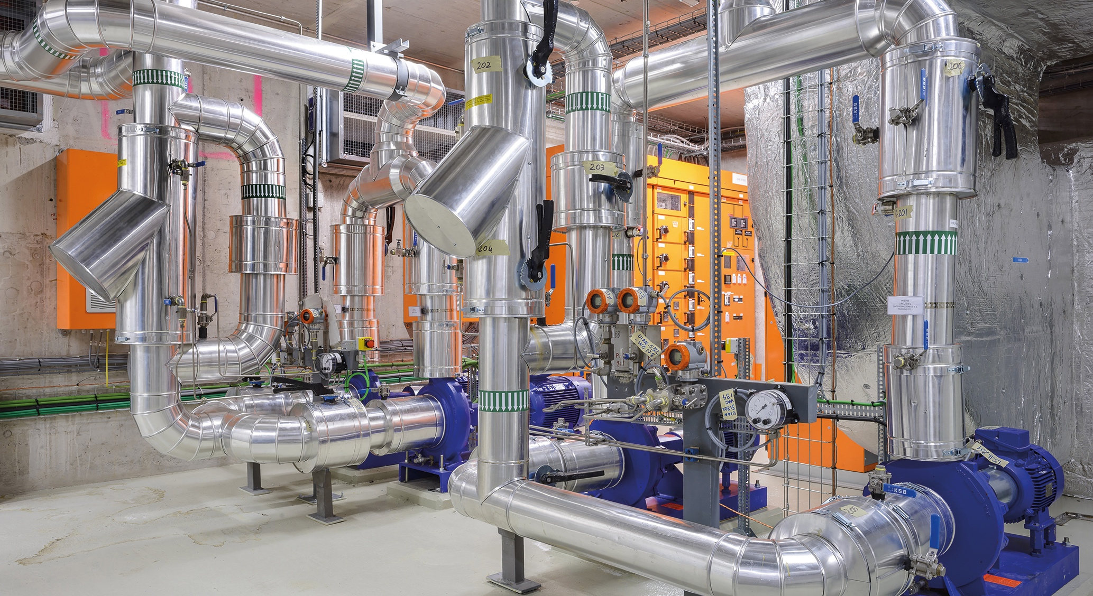
ZENSEACT (Volvo Cars Company) teams up with CERN on fast machine learning using FPGAs.
Collaborative R&D
Collaborative R&D
CERN and ABB team up on reducing electricity in cooling and ventilation.

Slide 20

Collaborative R&D
Collaboration with CORMEC and WUR to support national banks and regulators to detect trading anomalies in stock market.

Slide 21
Thank you!

