Slide 1
L1T Upgrade Update #6
Brock Ewing
4.30.2024

Slide 2
Project Recap
Upgrade the L1T system to look for new Higgs signatures in background HL-LHC data
Analyze and select events from simulated data to train an NN for implementation onto the HL-LHC hardware
Create NN and generate accuracy and efficiency graphs, ROC graphs to show the ability of our NN.
Use Qkeras and hls4ml to reduce the size of our NN and transfer it onto FPGA hardware.

Slide 3
Progress
Tested out different NN architectures and compared their performances on further preprocessed data.

Slide 4
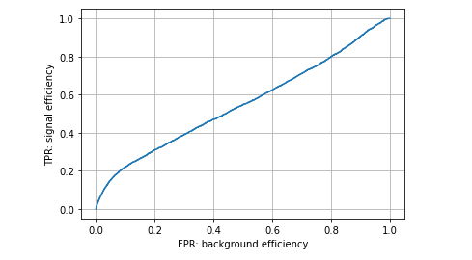
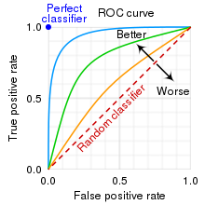
Initial ROC Curve

Slide 5
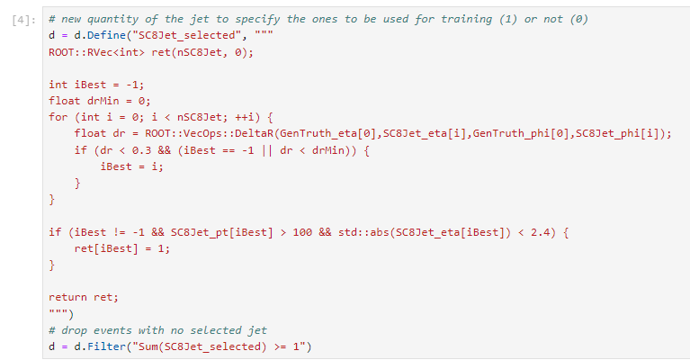
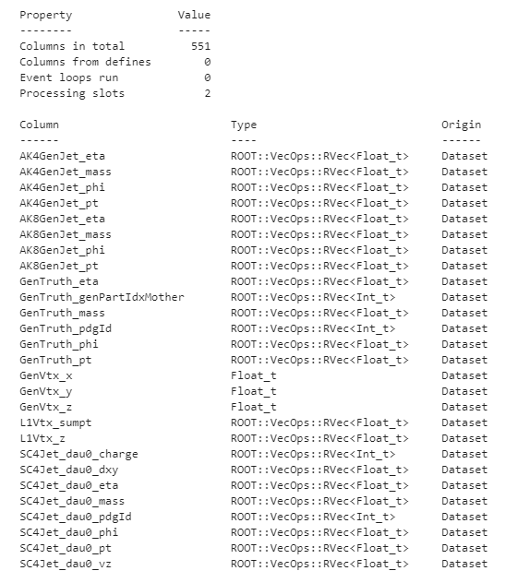
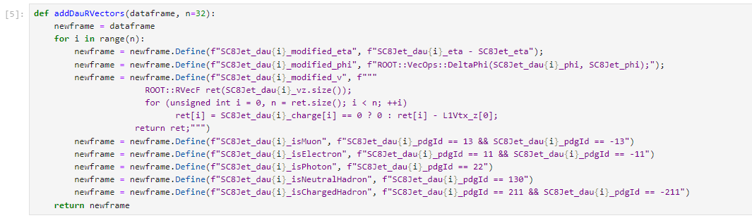
Preprocessing data
deltaR filter
Data Structure
Jet-aligned and daughter type columns

Slide 6
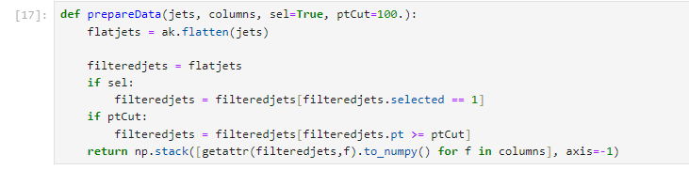
Preprocessing data
Cuts on Jets:
Only >100GeV
deltaR within .3
Filter for daughter types

Slide 7
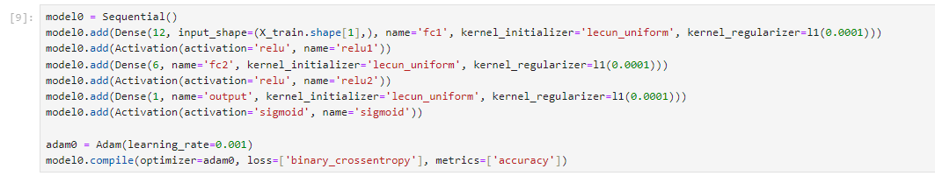

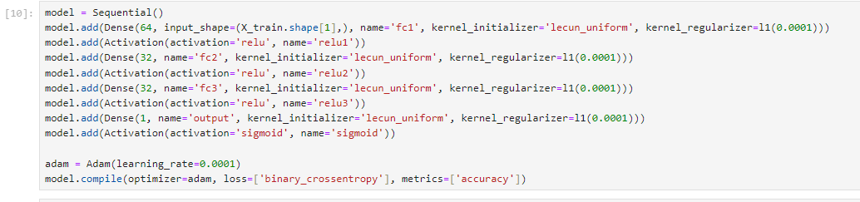
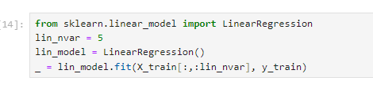
Neural Network models
Simple NN
Boosted Decision Tree
More complex sequential NN
Linear Regression

Slide 8
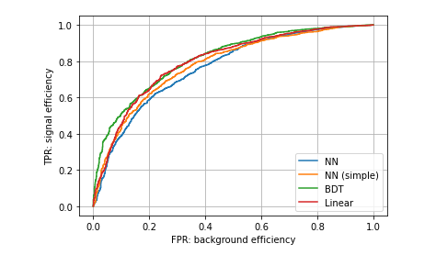
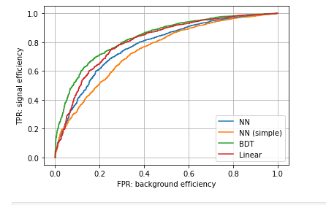
ROC Curves
Pre
Post

Slide 9
Next Steps
Try Deep Sets architecture
Process data more/add larger sample size

