Slide 1


ᑐ ᑌ ᑎ ᕮ
Supernova Pointing
Harry Akins 16/04/2024

Slide 2

Recap
Still transitioning between 2 related projects
  Background radiation study/energy interpolation
  Main Track identifier optimization

Slide 3
Fitting
Using all background distributions to interpolate between ADC and MeV
Use endpoints of background beta decay specutrums
Two simulated background radiation datasets
  Realistic background rates
  More uniform rates for all backgrounds (to help with fit, among other things)

Slide 4
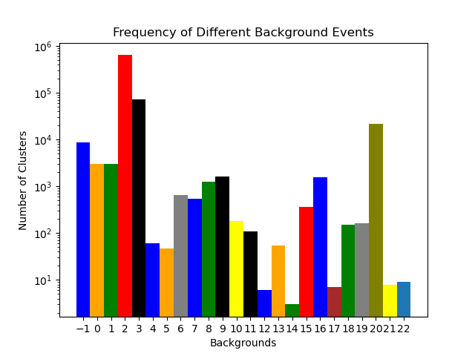
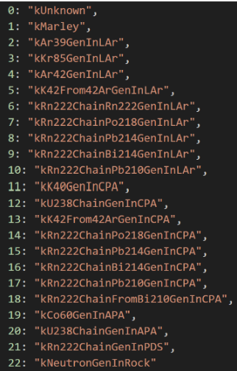
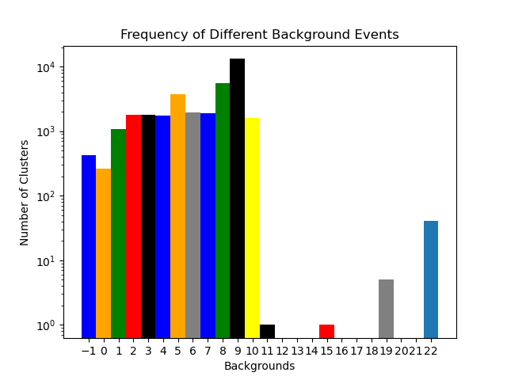

Slide 5
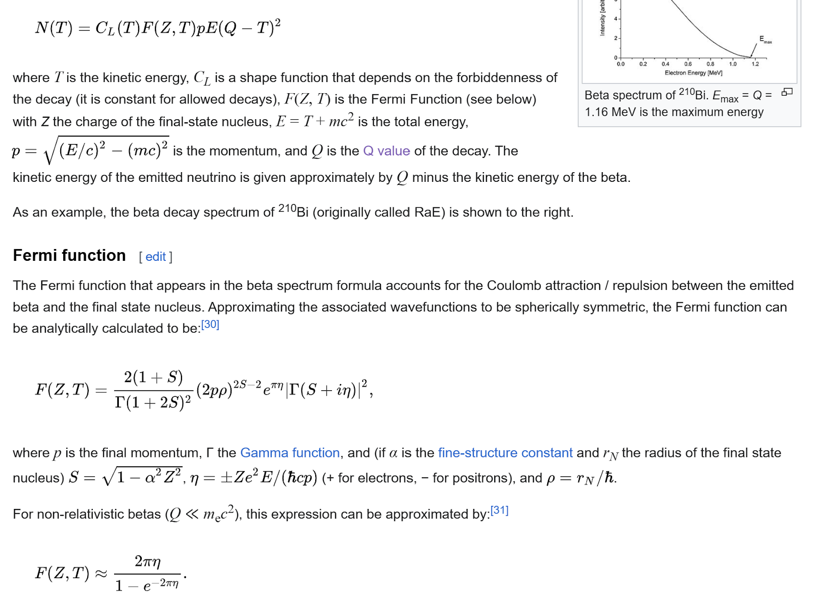
Fit Using Fermi Function

Slide 6
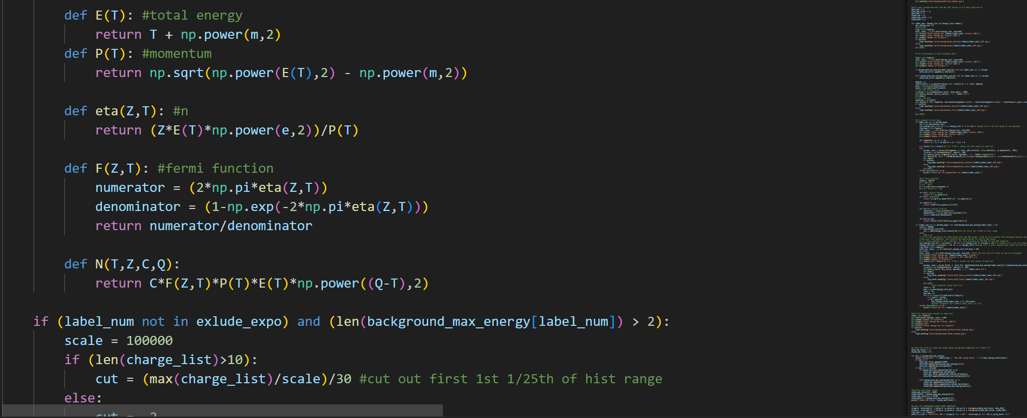
Implementation
Fit function (N) to histograms, plug in the fit parameters and find the endpoints for each background

Slide 7
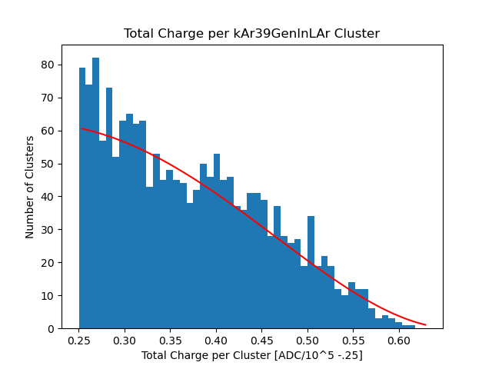
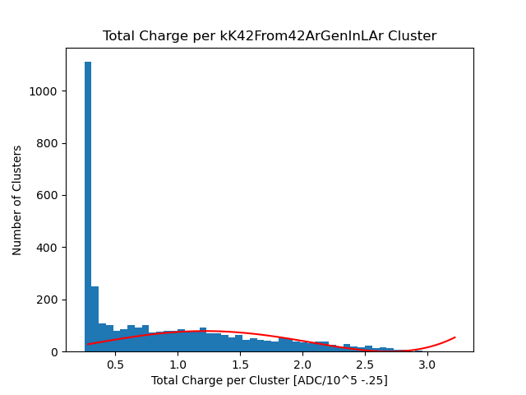
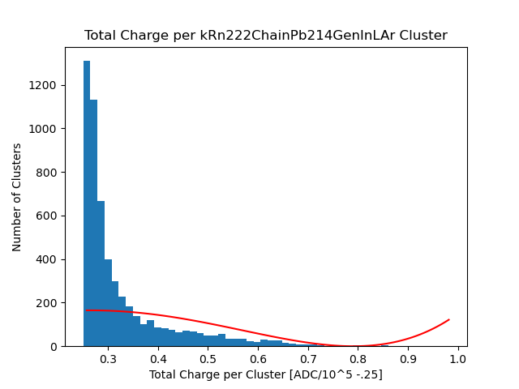
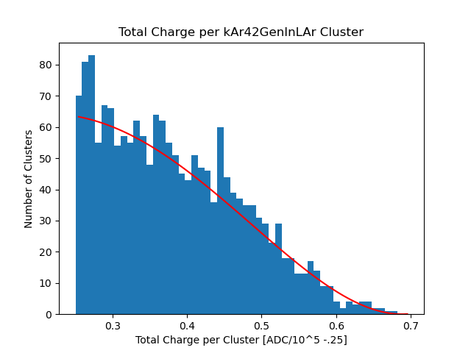
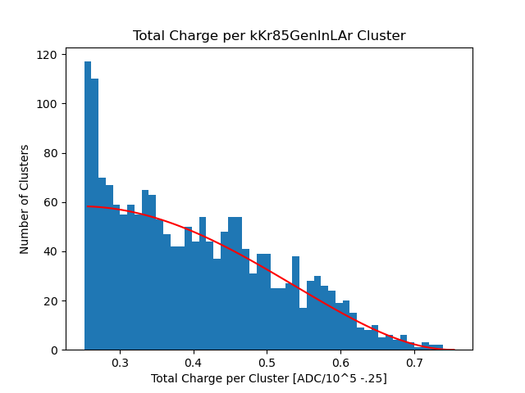
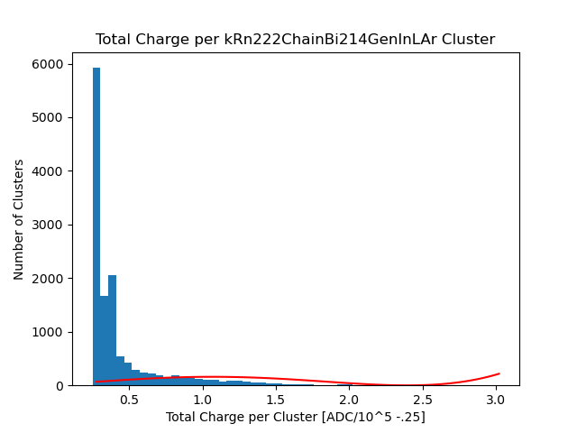
Fit with ADC cut to ignore spike at low energy

Slide 8
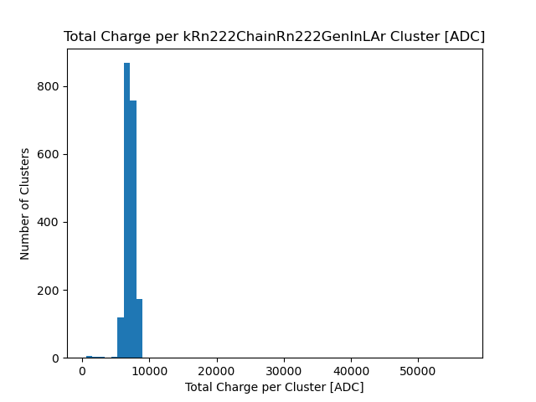
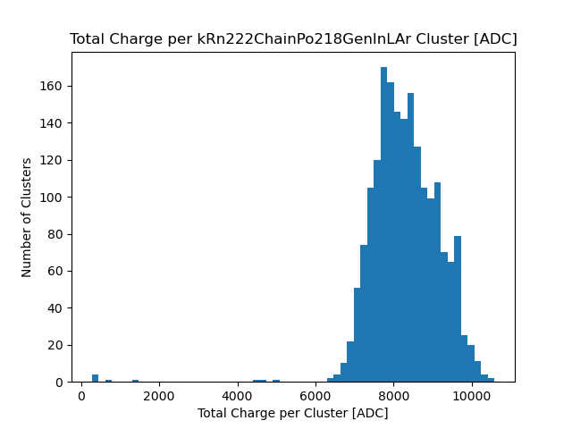
Doesn’t work for Alpha decay
Very few alpha decay, so can just manually find endpoints

Slide 9
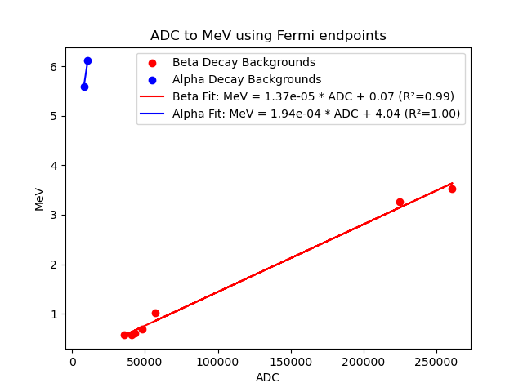
Adding Uncertainties
Need to add uncertainty in each point
Sample many different fit parameters and make histogram of all minimums, use STD as error
Uniform Backgrounds

Slide 10
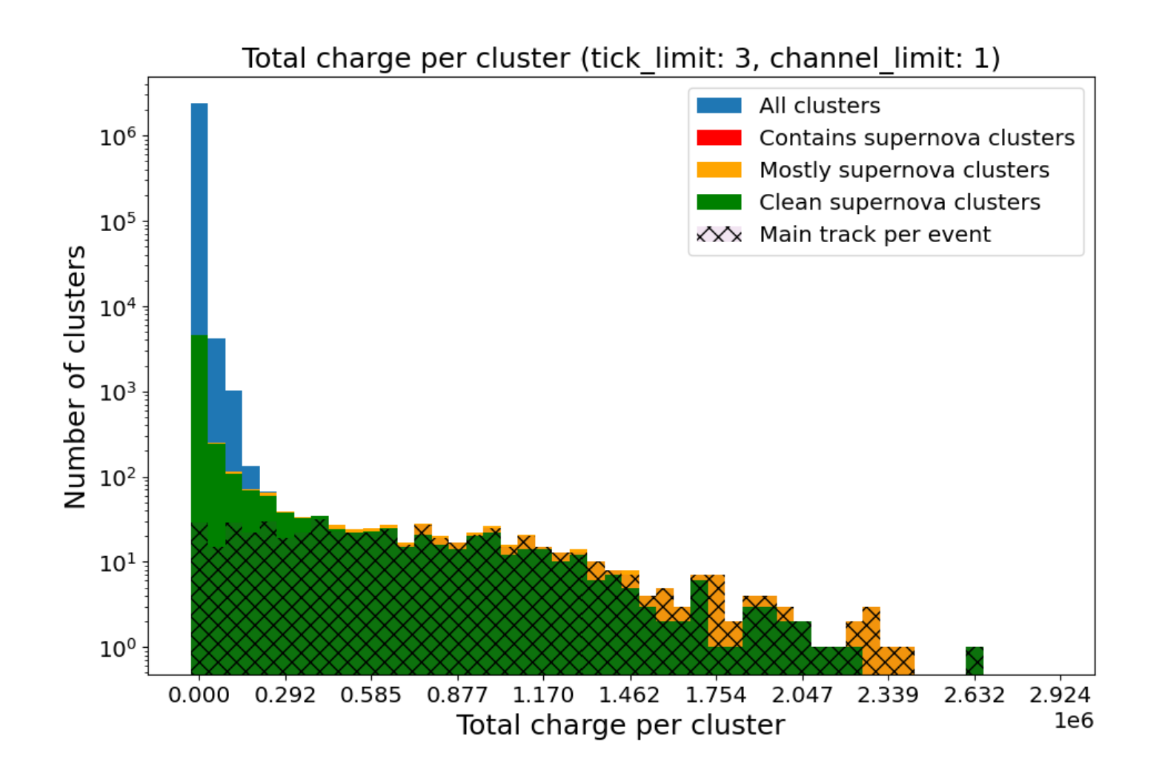
Main Track Identifier
Testing SN Main track identifier using different background cuts
  Goal: Classify events as Main Track or other ---> Significantly reduce number of events to analyse so a more complex algorithm can be applied to remaining events for identification (ML)

Slide 11
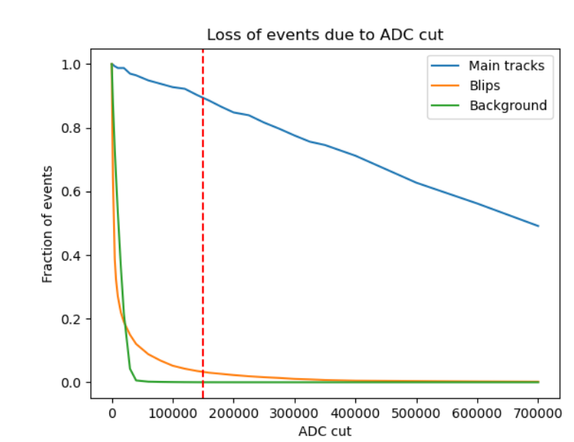
Where to Cut?
We can cut at very high ADC and eliminate most backgrounds, but we are not sure how many MTs we need for pointing yet
Accepting only higher energy main tracks may affect performance of ES-CC neural net as well
My task:
  Create new models at different cuts and test performance. Find best cut
  Test ES-CC classifier with this cut as well

Slide 12
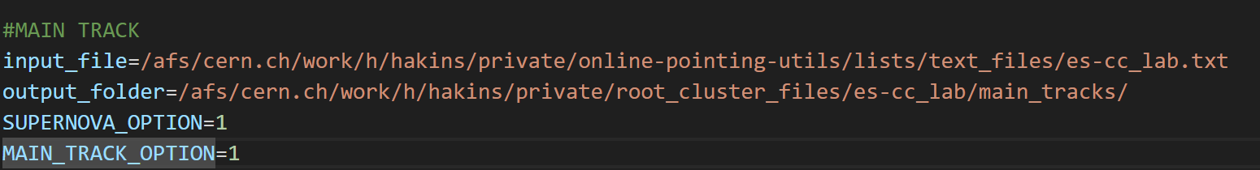
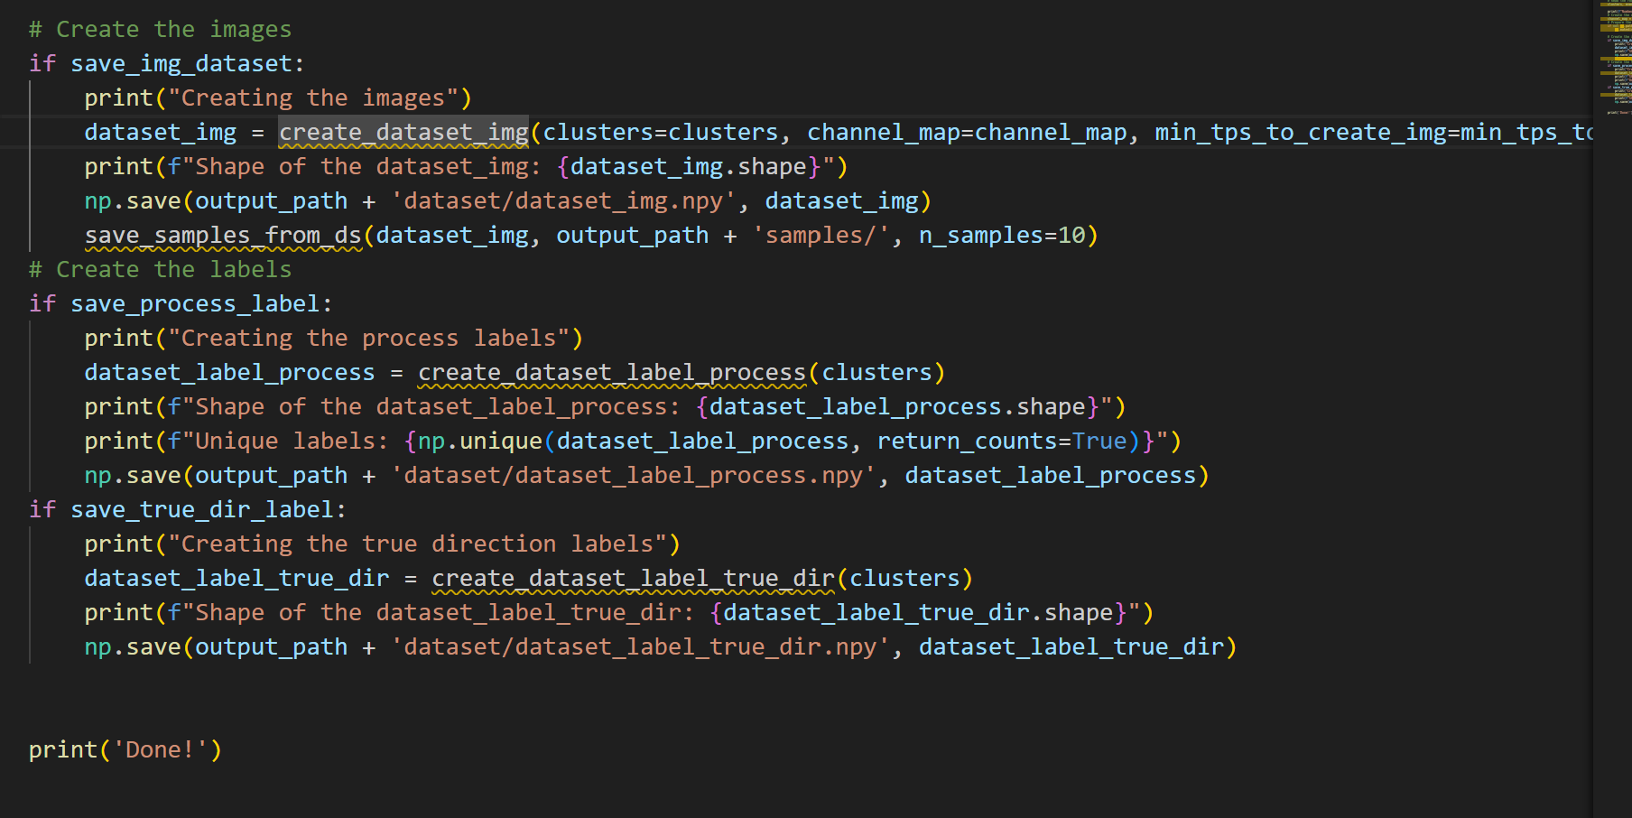
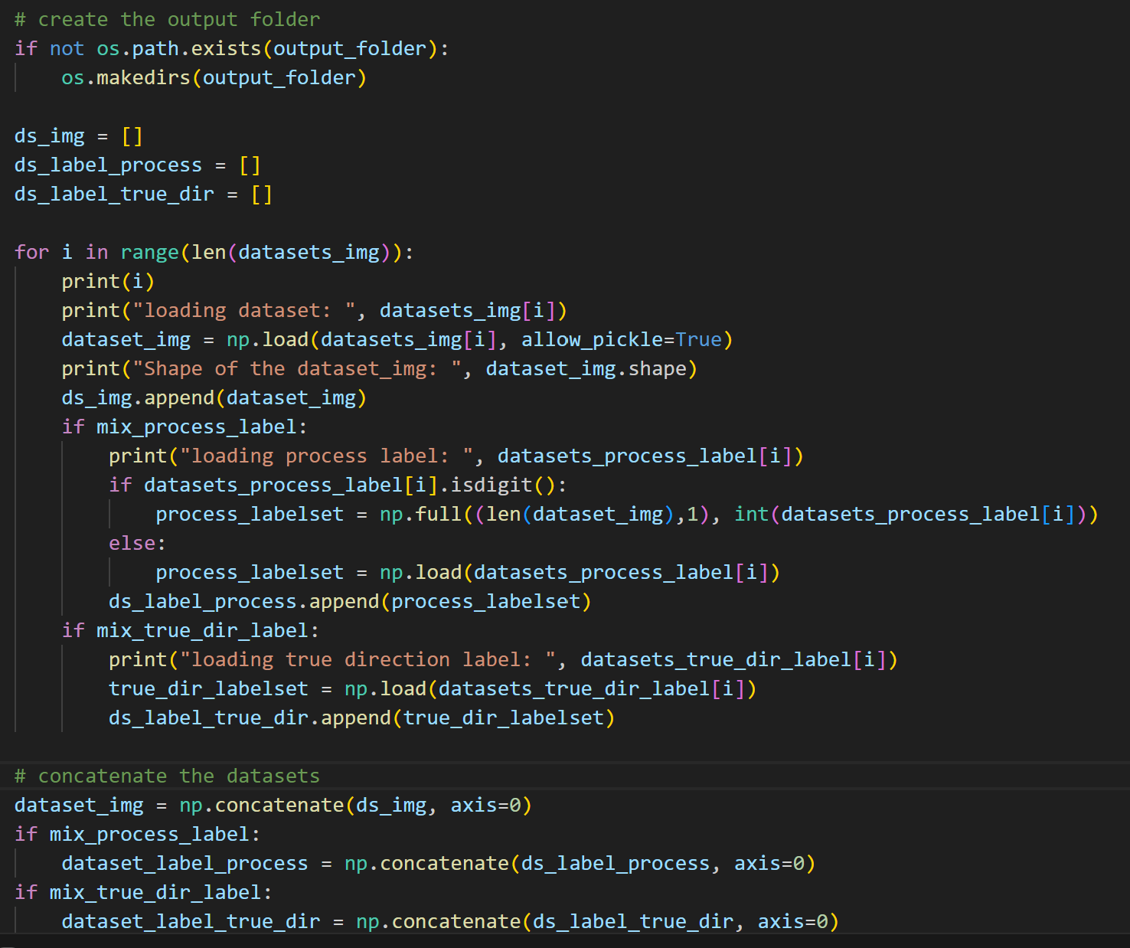
Step 1: Create Training Data
Create Cut Clusters
2. Clusters to numpy datasets
3. Mix Datasets

Slide 13
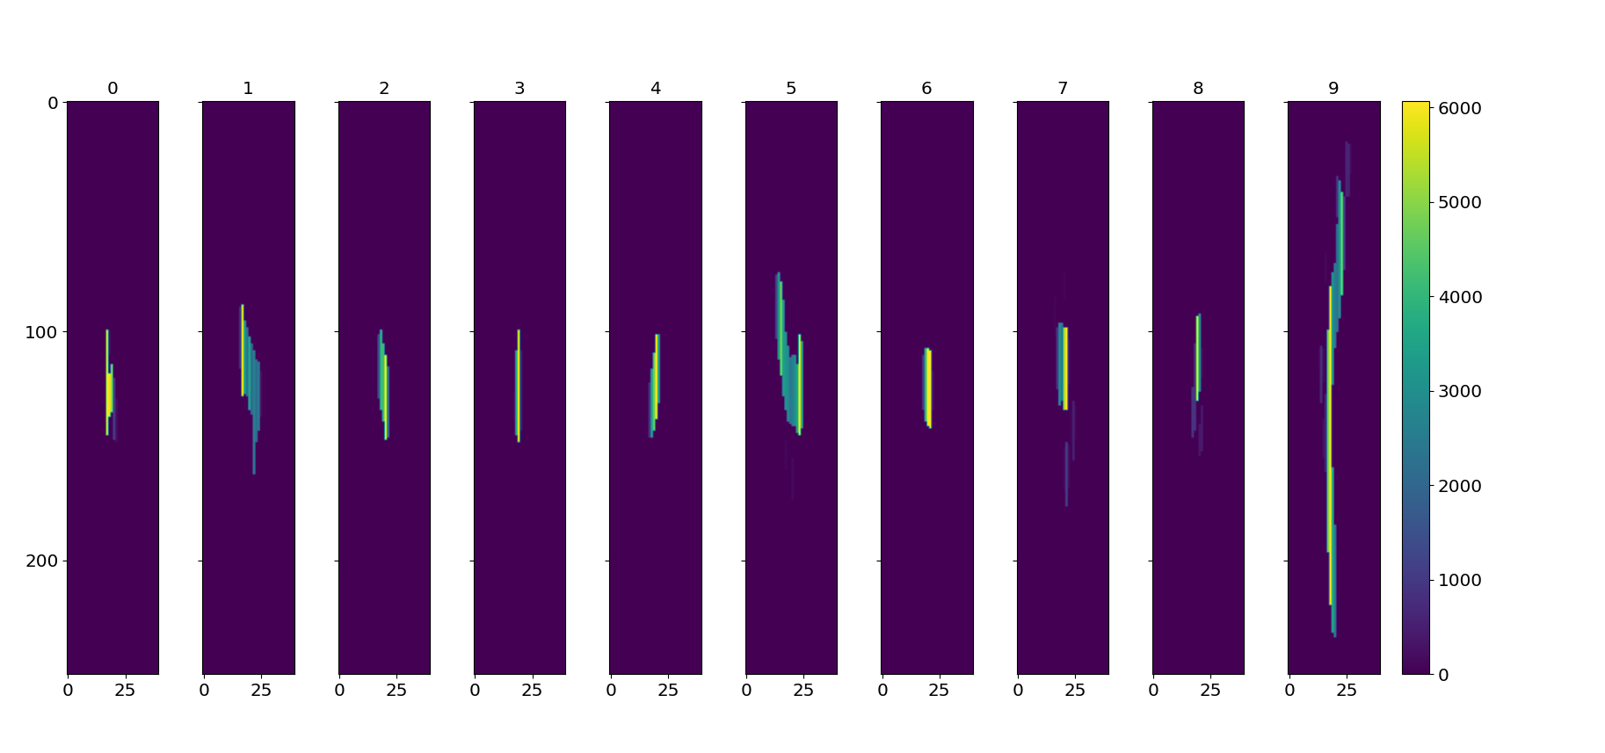
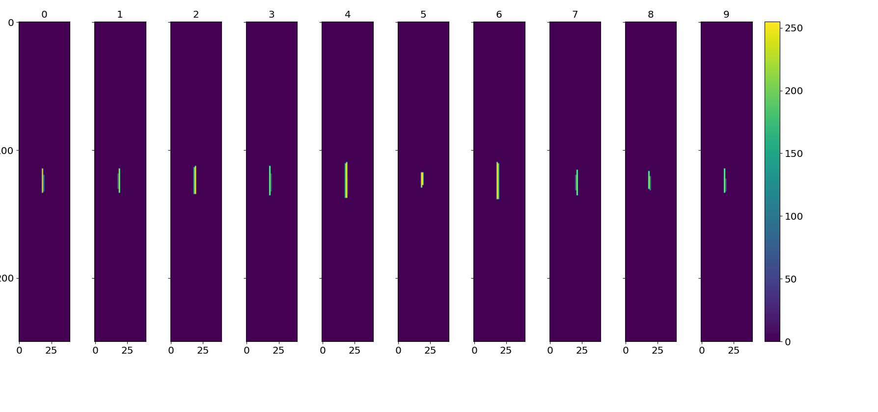
Train Model
Main Track Samples
Images created from TPs, model is trained on them
Using 2D CNN
  Good for images, picks up different patterns across different convolution layers
Background Samples

Slide 14
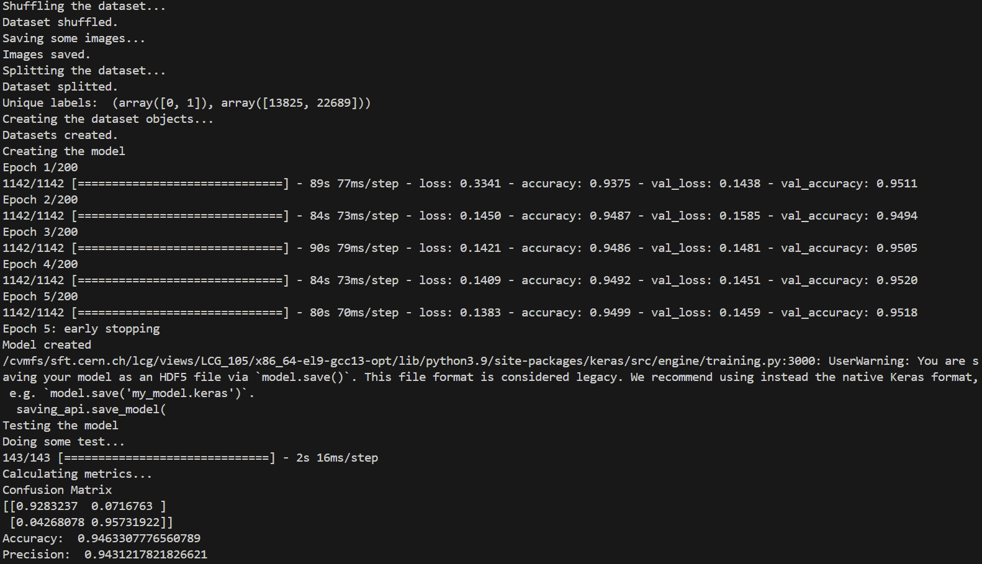

Slide 15
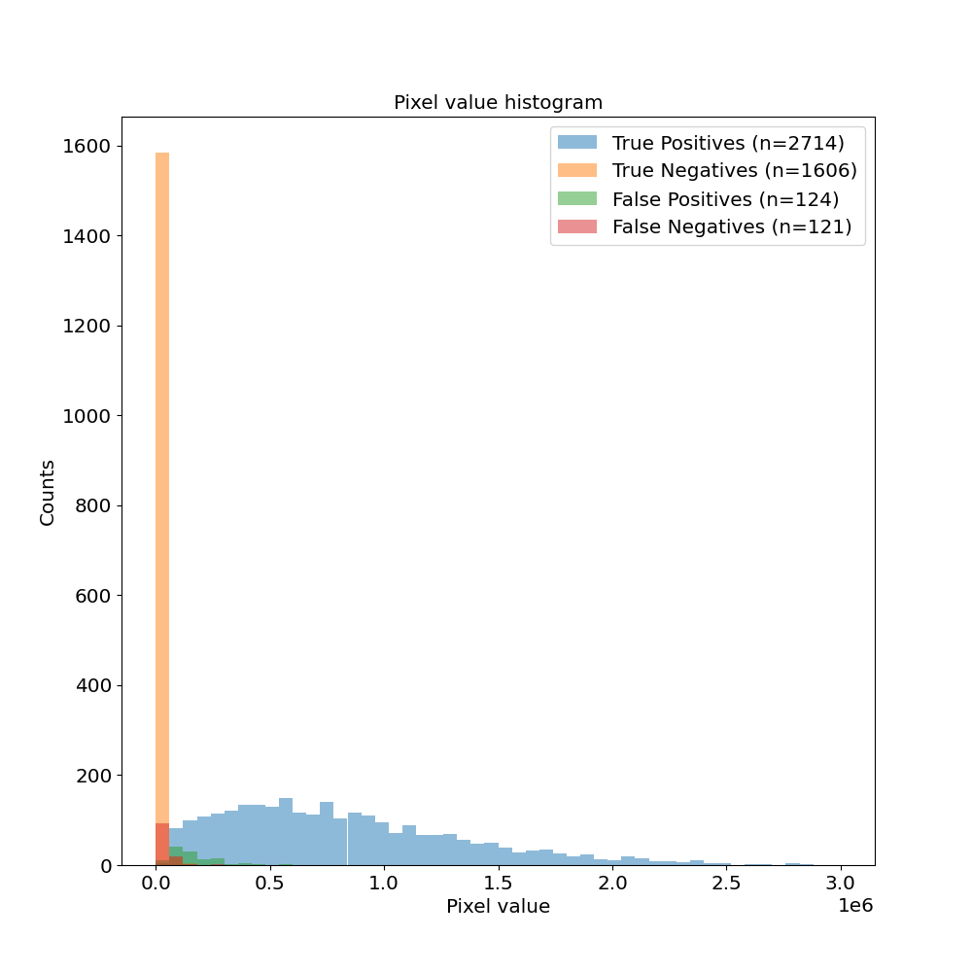
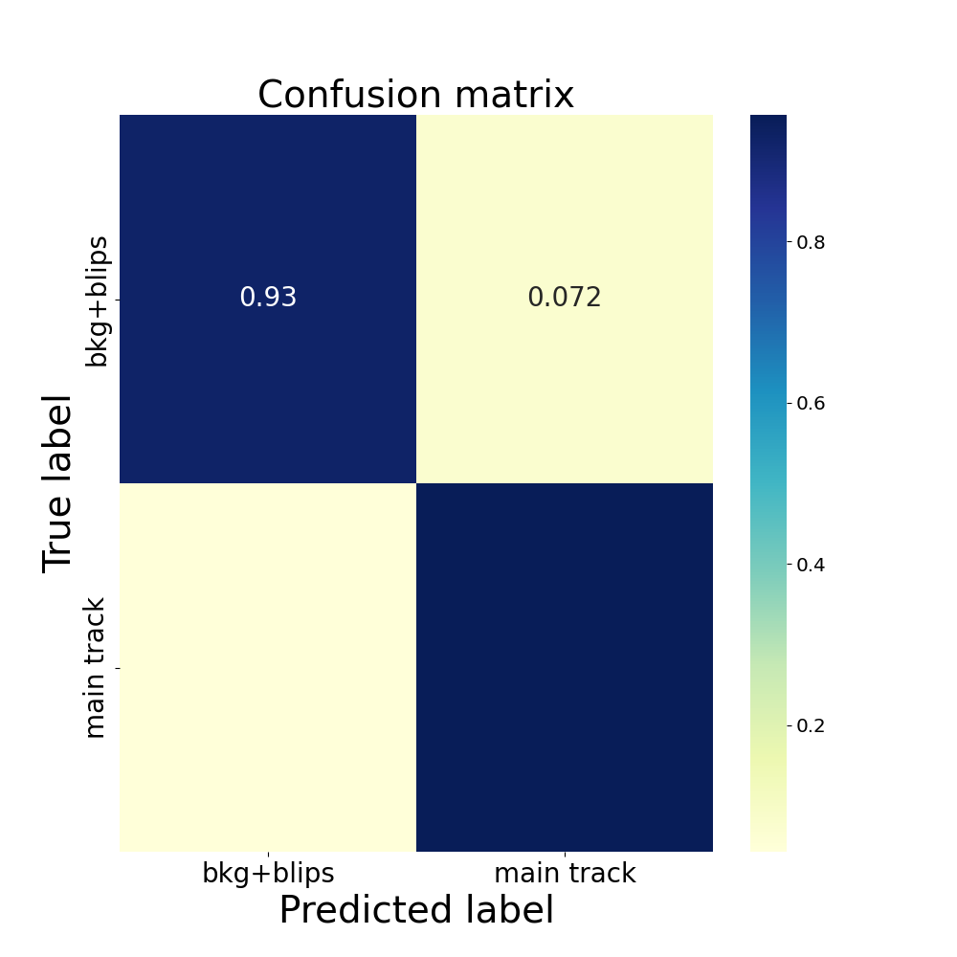
No ADC Cut
0.04
0.96

Slide 16
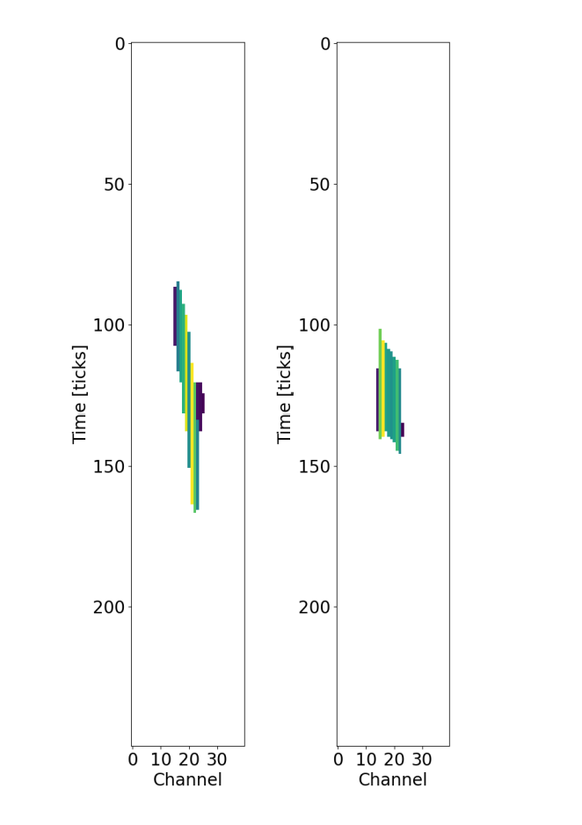
Next Steps
Plot Uncertainties in ADC to MeV
Make around 6 more models with different ADC cuts
  Compare performance of models

Slide 17
Ideas for Better Performance:
Create more sophisticated images
  Pixel value(color) is ADC Integral/TOT
  Create triangle instead of rectangle using start and end time
  Include peak value
Use a transformer instead of CNN
  Better for more sparse images (mostly 0s)

