Slide 1

KISTI-GSDC Report
Geonmo Ryu, Sangwook Bae
On behalf of KISTI-GSDC
2-4 September 2024 @ ATCF8

Slide 2

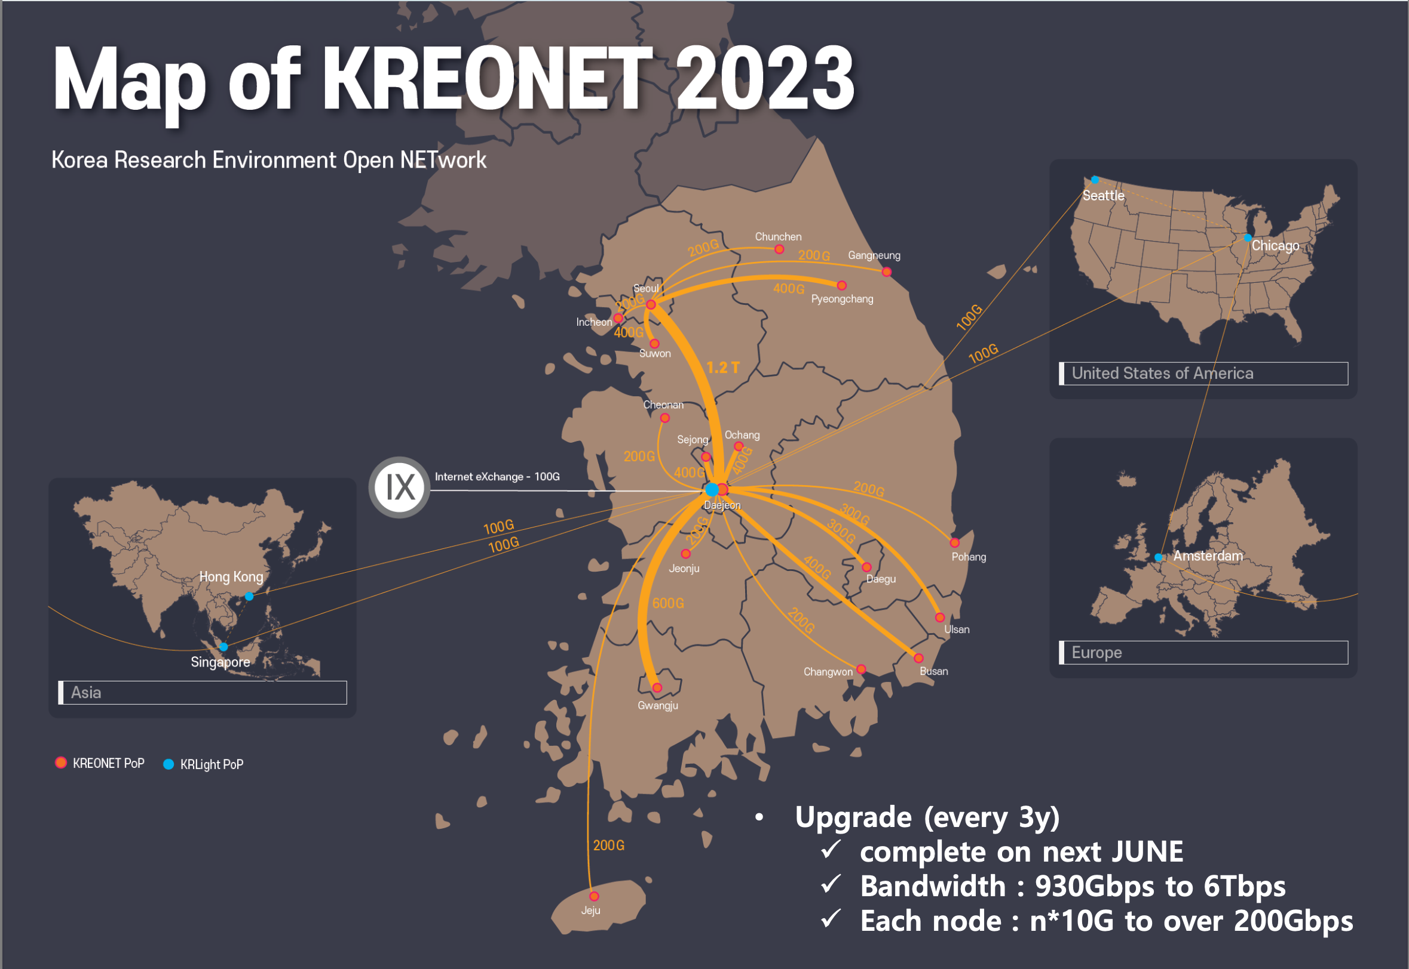
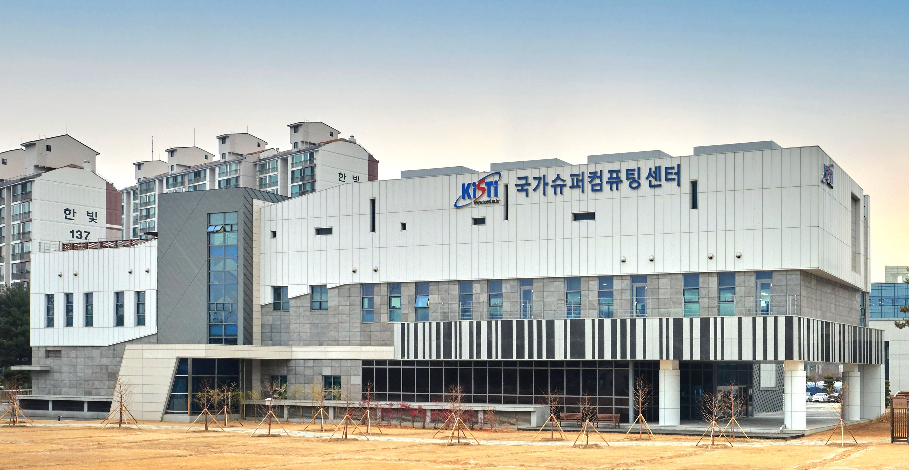
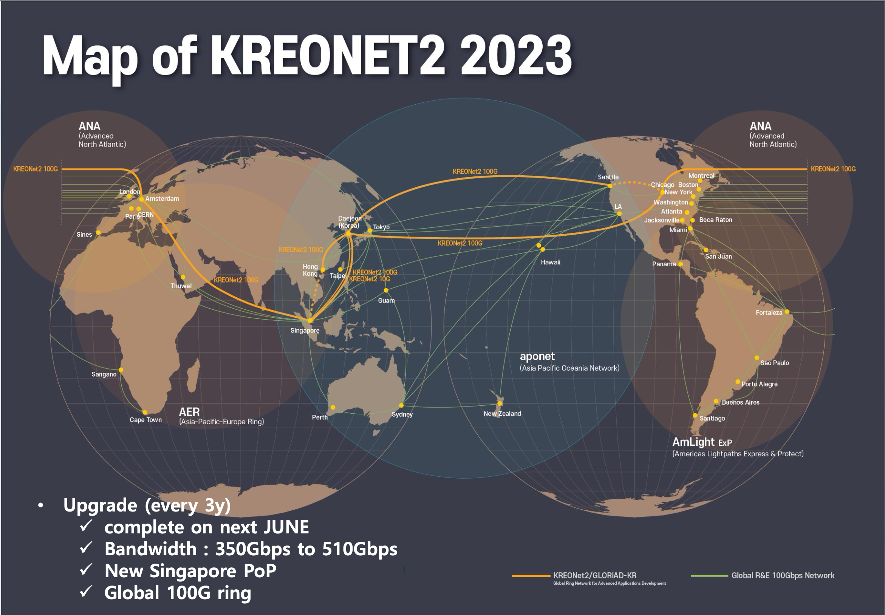
KISTI
Korea Institute of Science and Technology Information
Government-funded research institute founded in 1961 for national information services and supercomputing
National Supercomputing Center
  Nurion - Cray CS500 system
    25.7 PFlops at peak, ranked 11th of Top500 (2018) ⇨ 46th (Nov 2022)
  Neuron - GPU system, 1.24 PFlops
  KREONet/KREONet2 - National/International R&E network
2

Slide 3







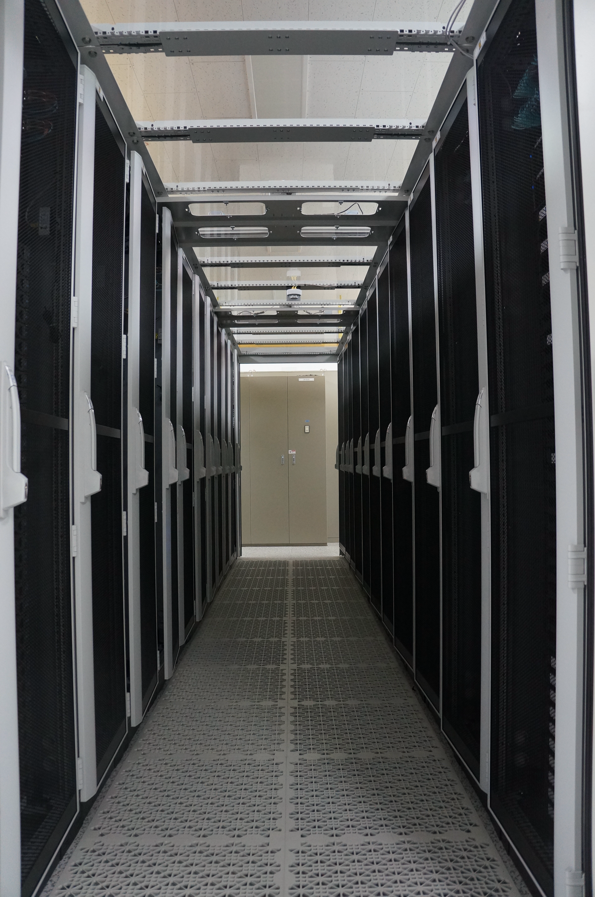
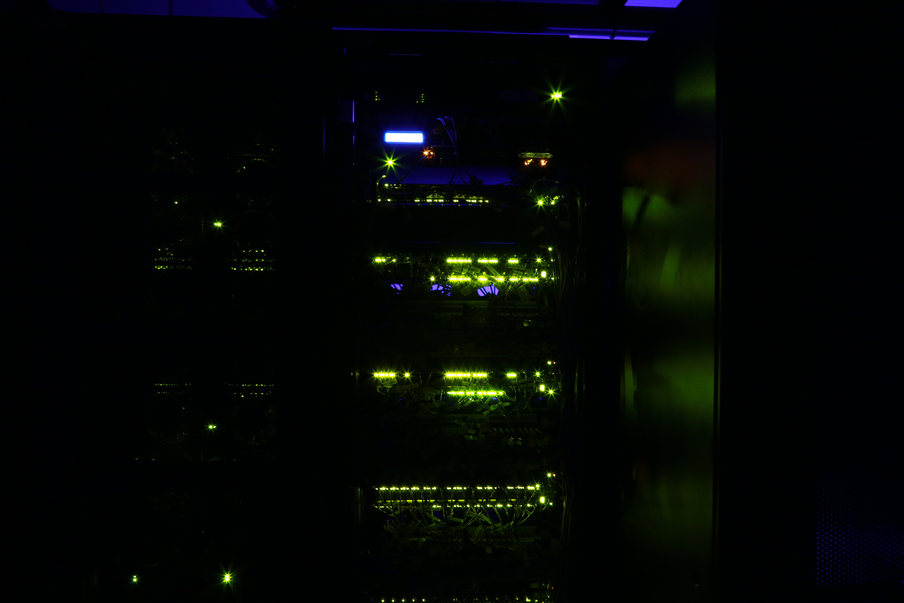
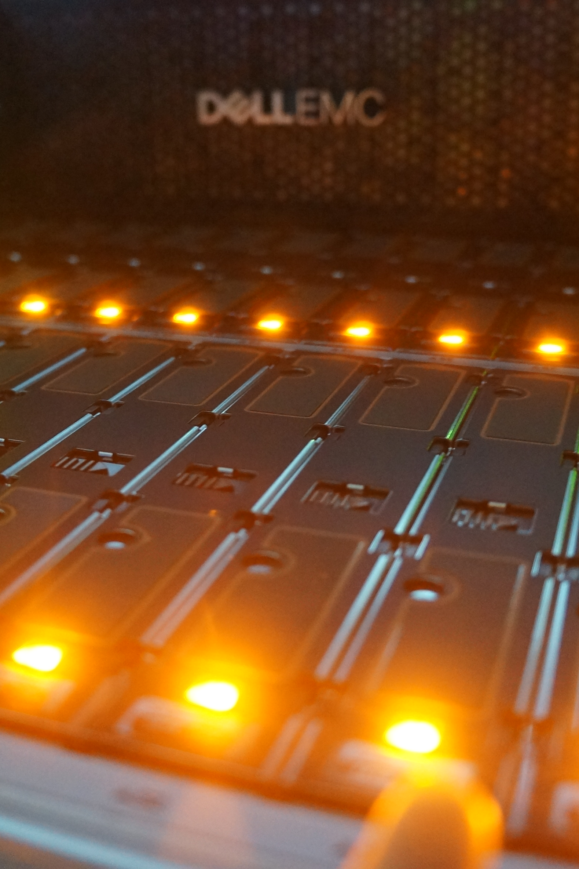
GSDC
Global Science experimental Data hub Center
Government-funded project, started in 2009 to promote Korean fundamental research through providing computing power and data storage
Datacenter for data-intensive fundamental research
  Preserving data from domestic or overseas large and complex scientific instruments as well as simulation-R&D activities
  Providing services based on technology development: distributed computing structure, high availability storage system, infra integrated management, disk-based custodial storage
Server
Network
Storage

Slide 4


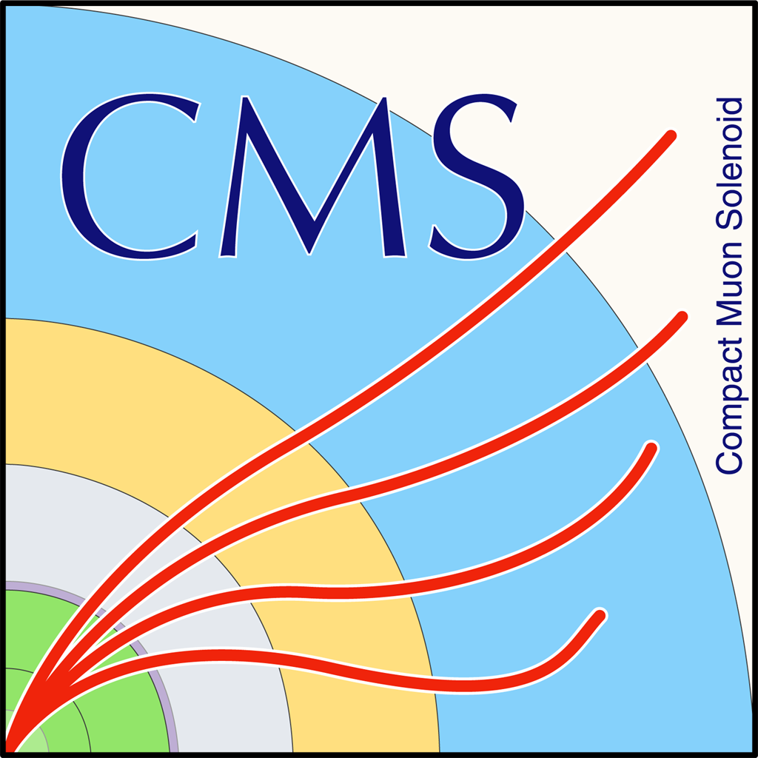






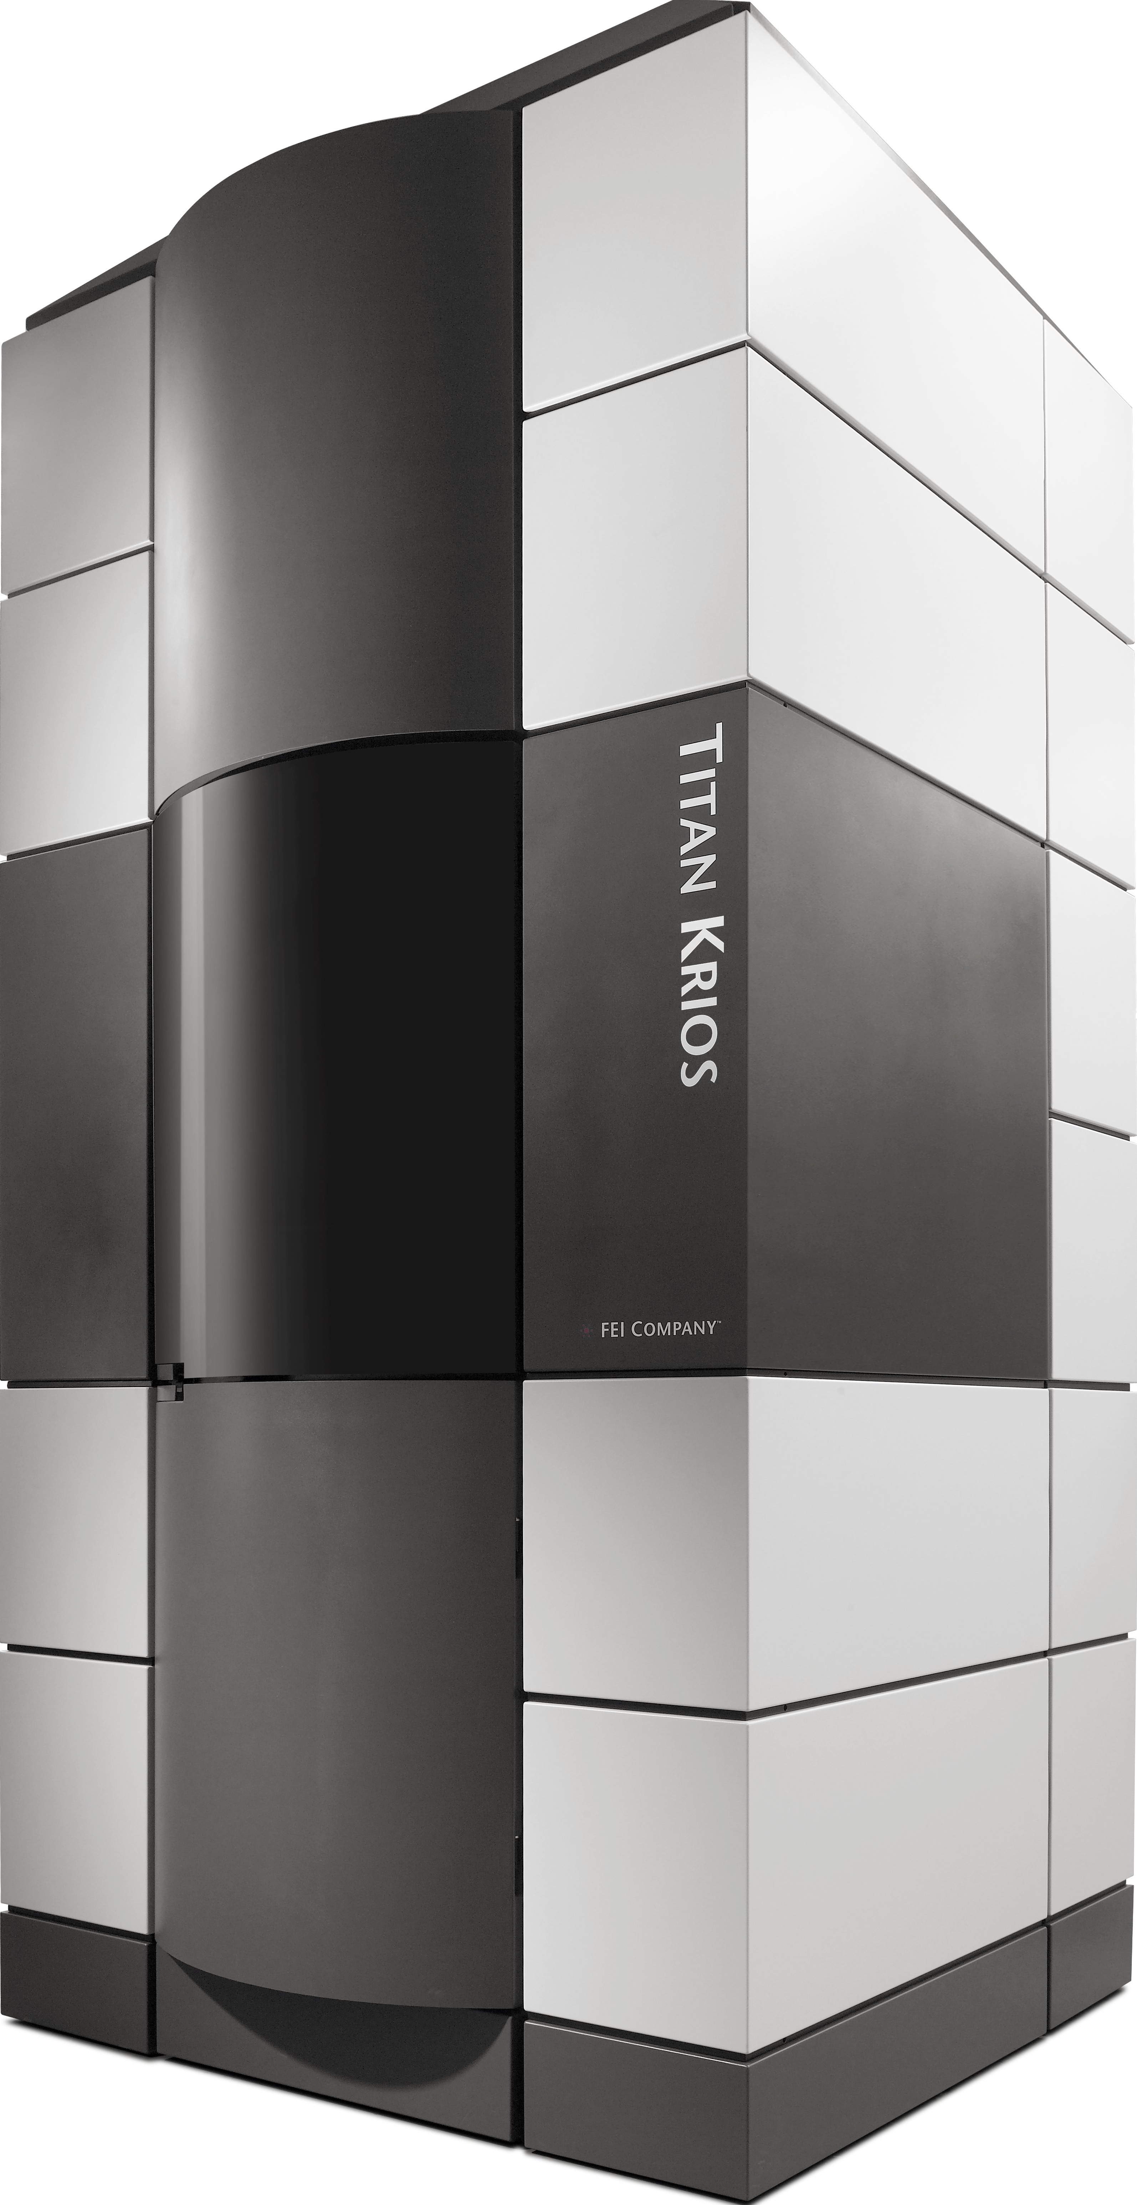
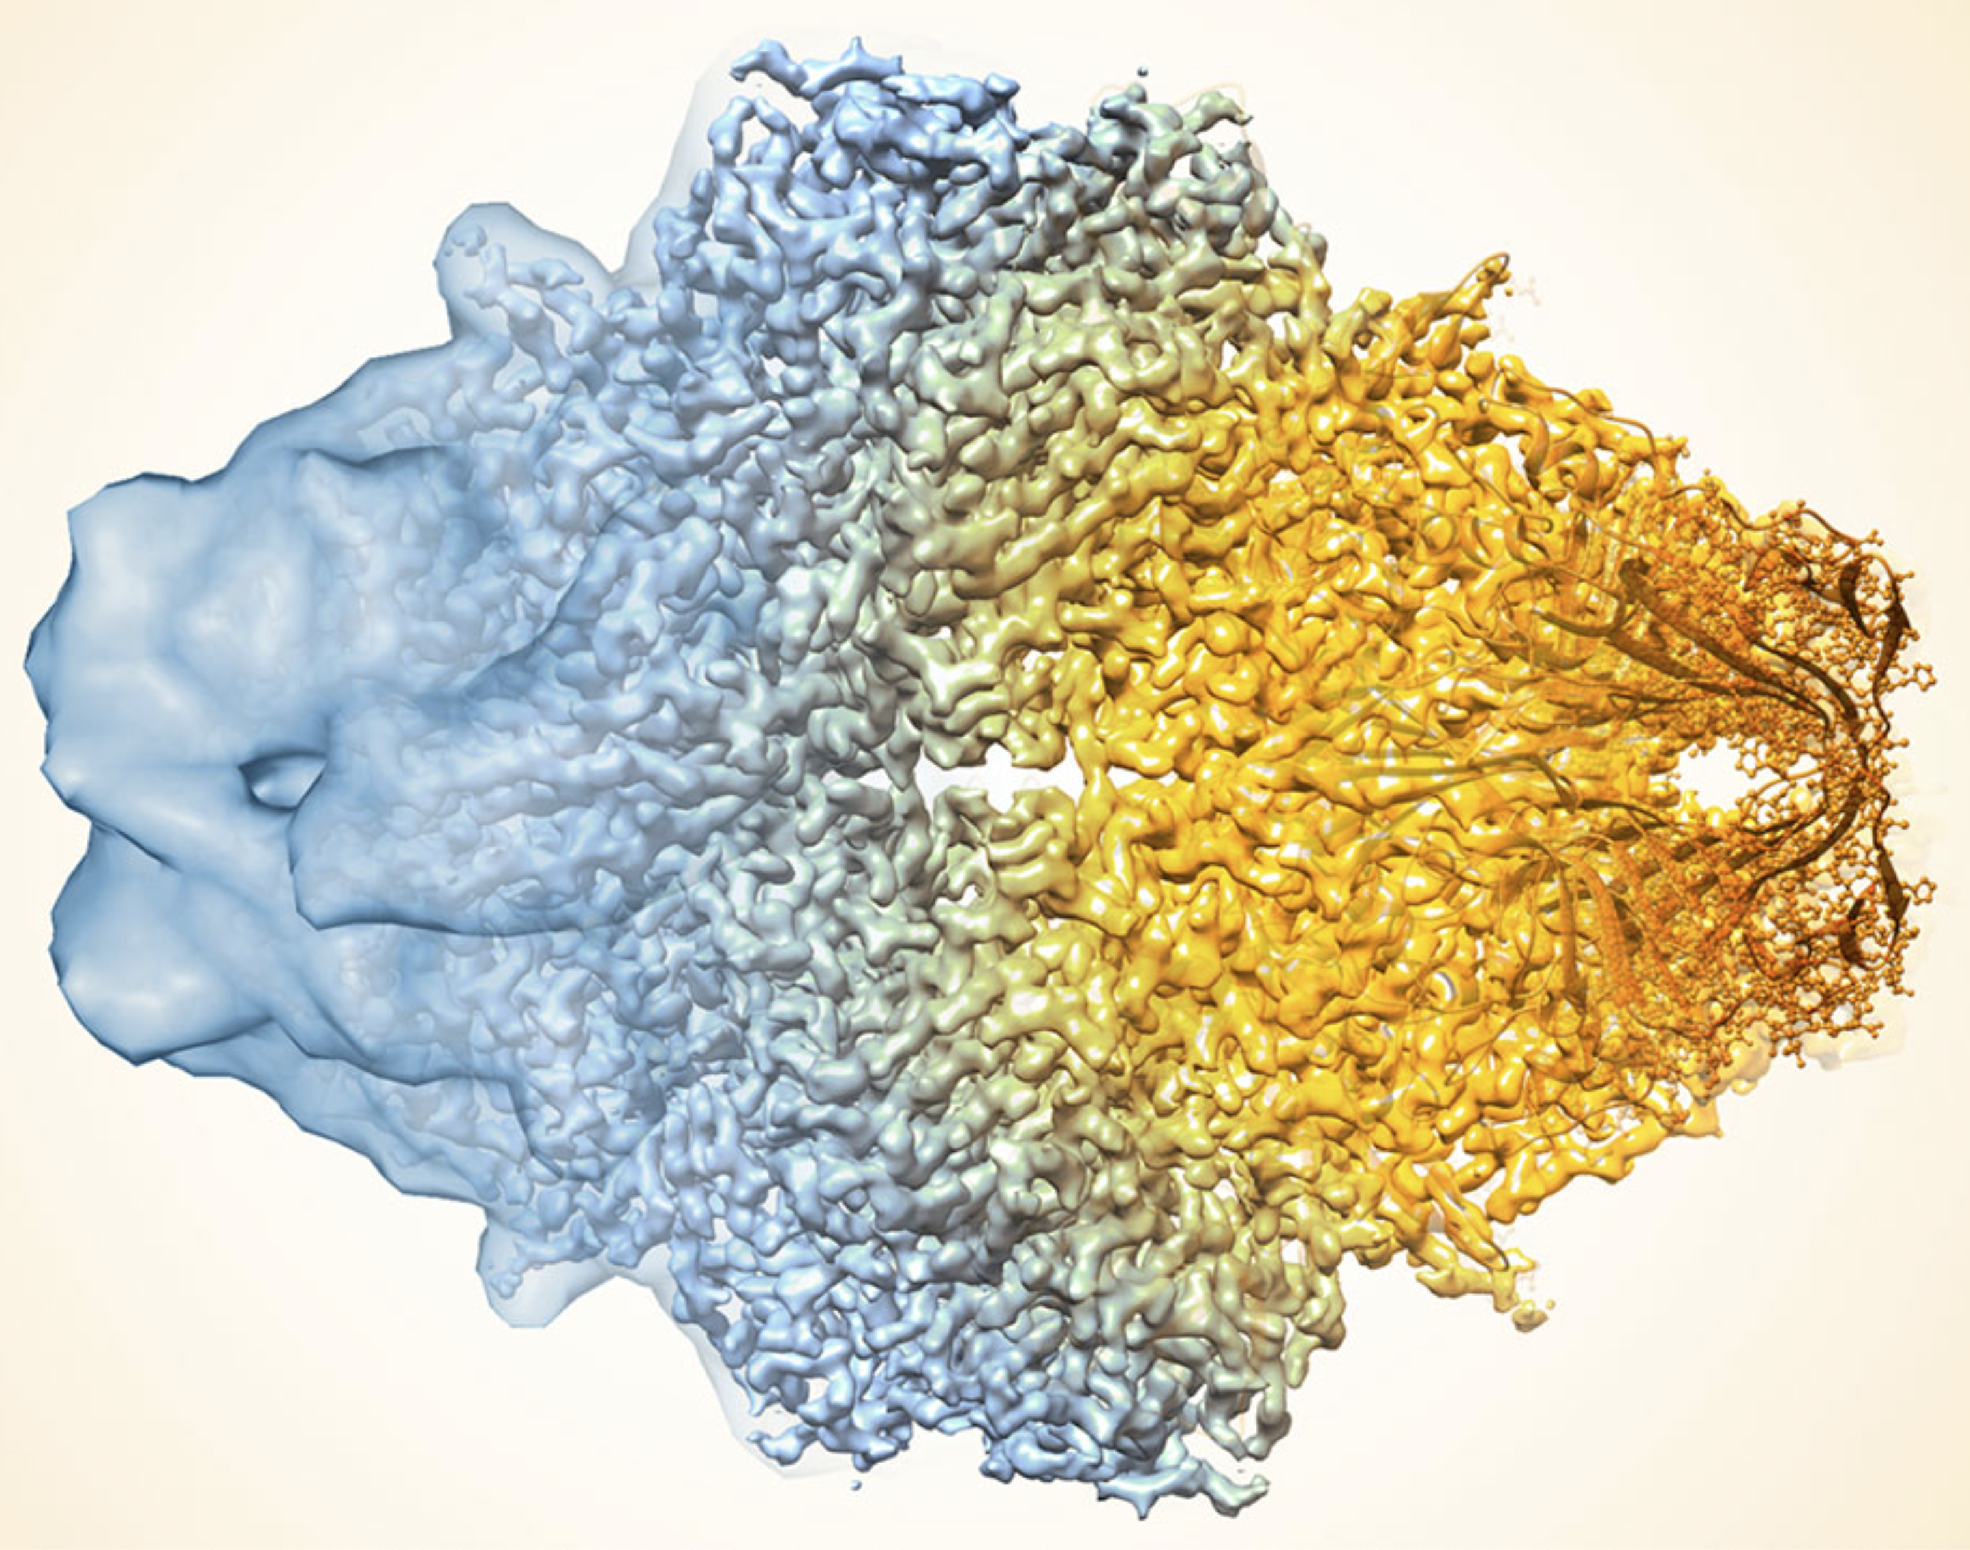

Supporting Experiments
Heavy-Ion Physics
WLCG Tier-1 (2014)
Elementary Particle Physics
WLCG Tier-2 (2018)
Elementary Particle Physics
B2G Tier-2 (TBD)
Astrophysics
LDG Tier-2 (2019)
Neutrino Physics
RAW Storage
Medical Science
ICGC-ARGO Center
Structural Biology using Cryo-EM/XFEL
Data Storage & Analysis Pipeline

Slide 5
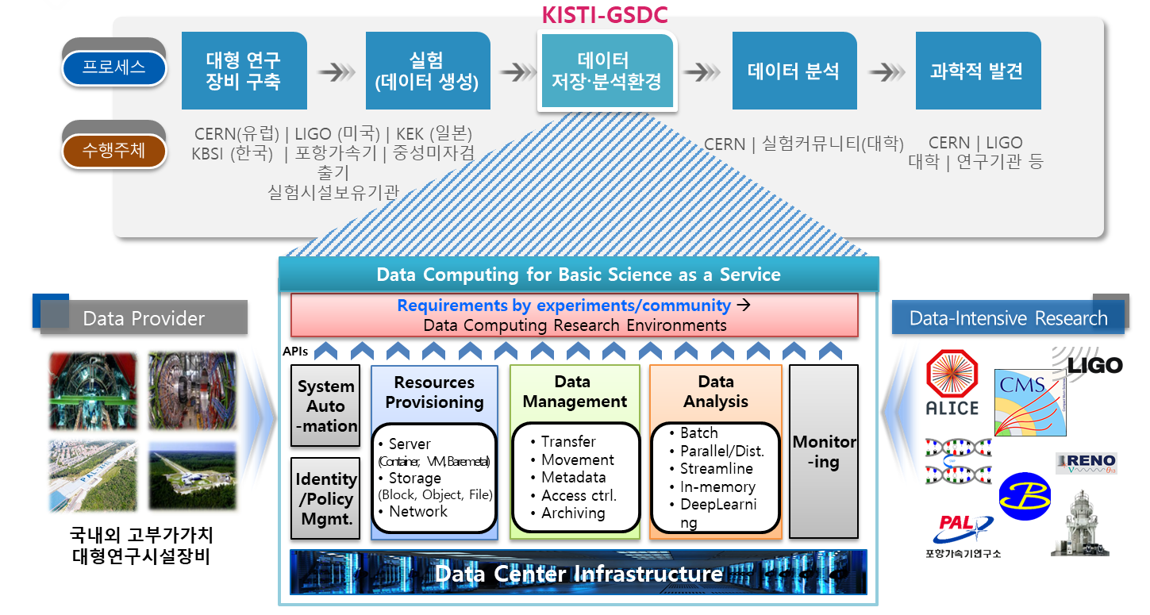
Role of GSDC for Data-intensive Research
Process
Constructing
Facility
Conducting
Experiment
Data
Comp. Env.
Analyzing
Data
Scientific
Achievement
CERN(EU) | LIGO (US) | KEK (JP)
KBSI (KR) | PAL | RENO
Large-scale Facilities
Users | User Groups
Research Community
Subject
Domestic | Overseas
Large-scale Facility

Slide 6
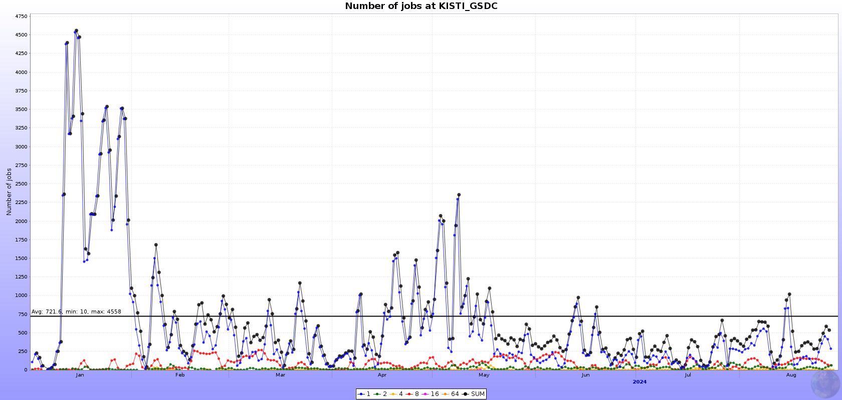
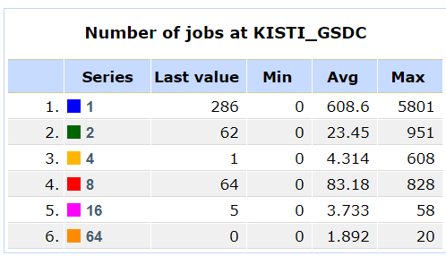
WLCG Tier-1 @ KISTI-GSDC
Flagship Service for Data-intensive Computing
A WLCG Tier-1 in Asia for the ALICE experiment
  Contributing about 10% of T1 resource requirements of ALICE
    More than 2% of total (T0+T1+T2+AFs) resource requirements of ALICE
CE
  HTCondor-based, whole-node submission enabled (for N-core jobs)
SE
  XRootD/EOS based disk storage
  Archival SE : CDS, the disk-based one powered by EOS
Networking
  LHCOPN : 20G dedicated link between Daejeon (KR) and Geneva (CH)
  LHCONE : 100G provisioned by KREONet connecting to EU, US and Asia (SG/HK)

Slide 7
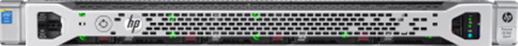
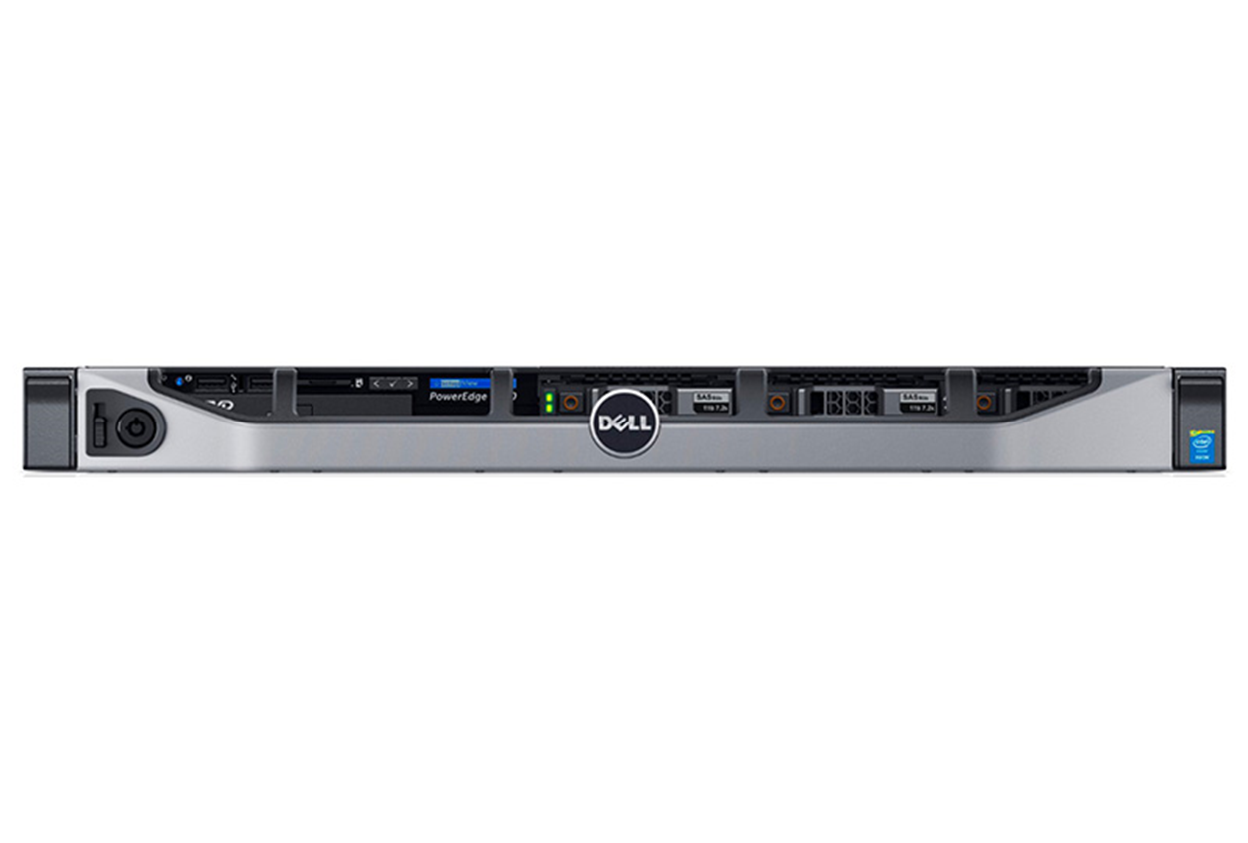
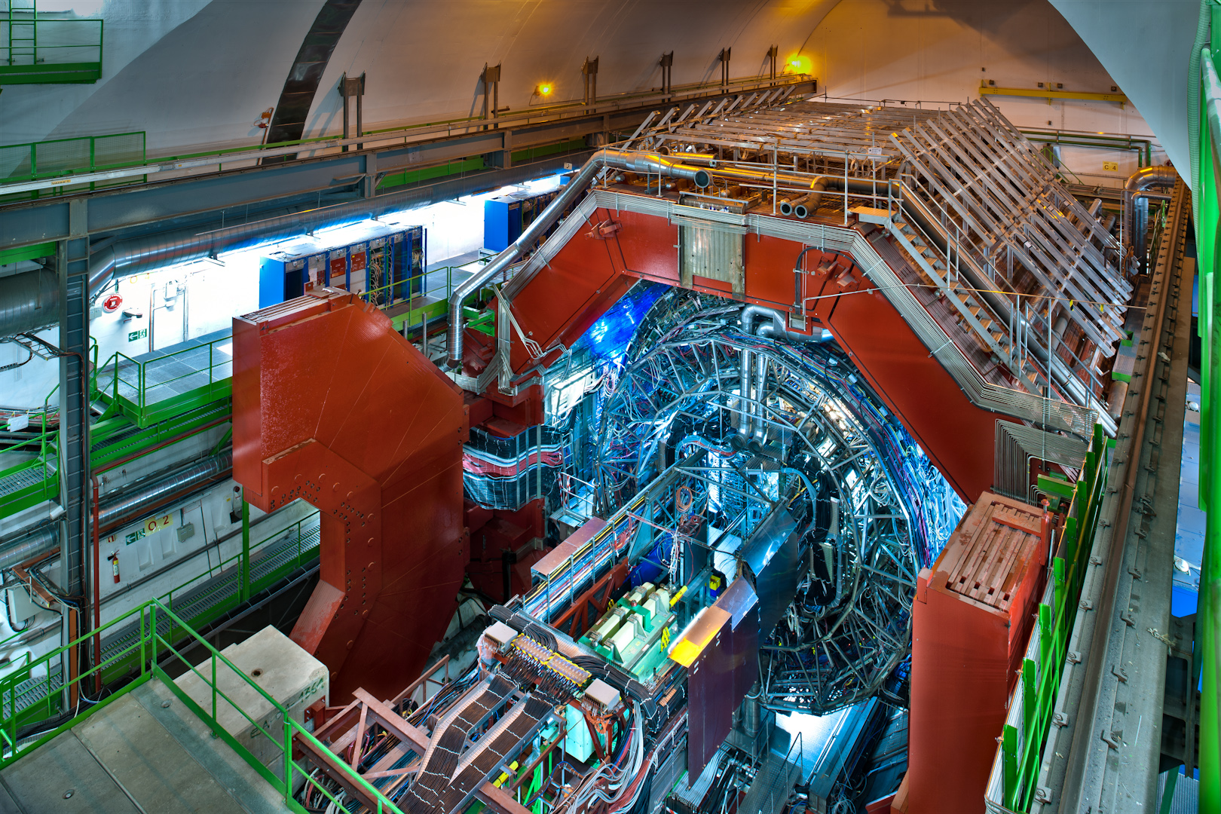
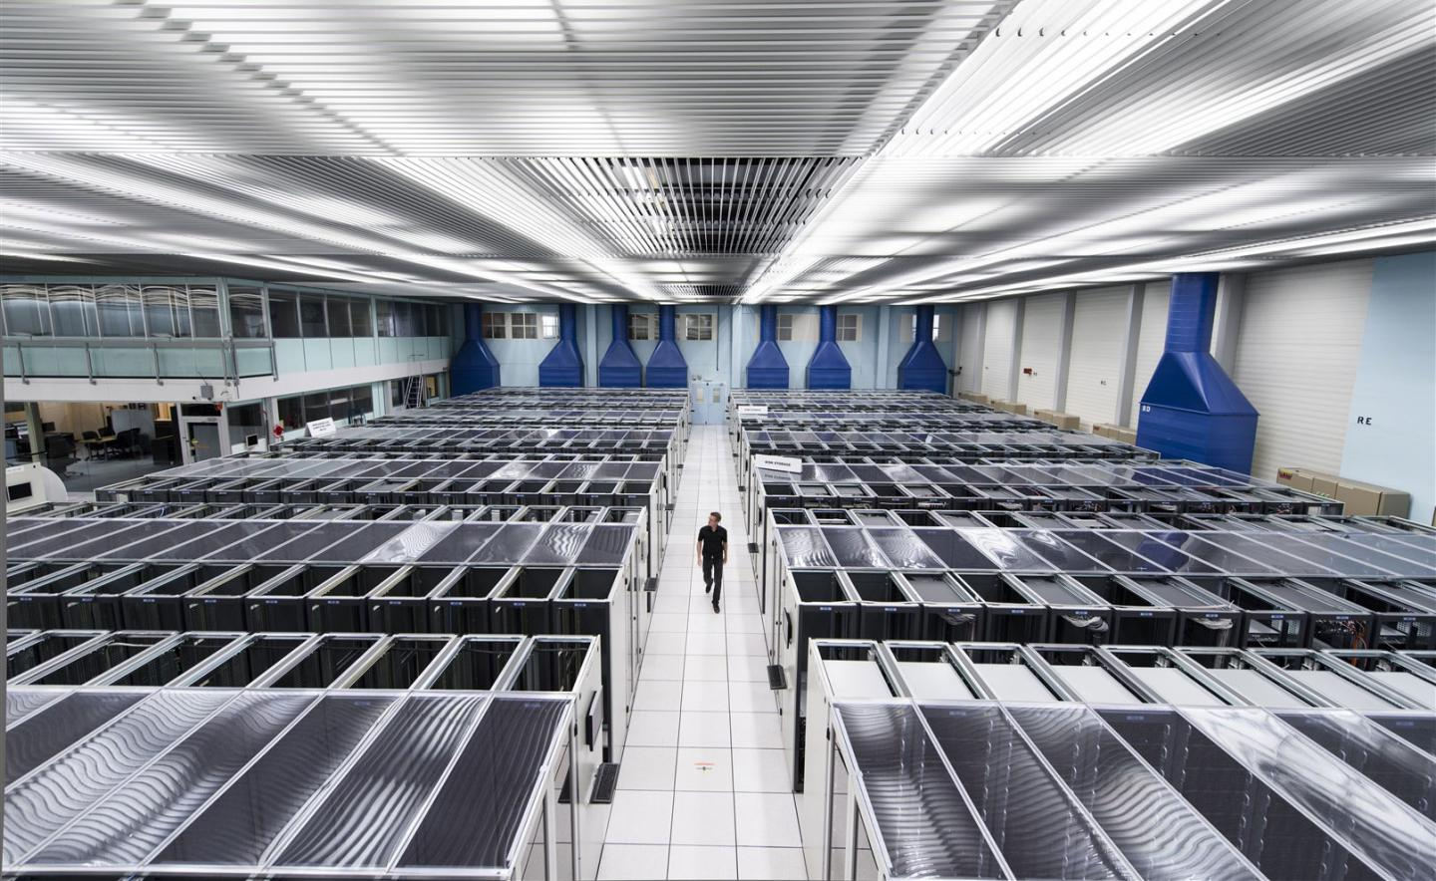
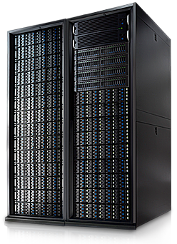
KISTI ALICE T1 Structure Overview
WLCG CRIC
publish
Accounting
Job
APEL
HTCondor
Data
Simulation
Organised Analysis
3,880 Core
statistics
CERN
Reconstruction
User Analysis
Job
Queue
HTCondor-CE
Job Broker
allocation
VO-Box
submission
CE
scheduling
Batch Cluster
HTCondor
query
collect
AuthN/AuthZ
BDII/Argus
read only
data i/o
80 PB
collect
collect
Erasure-Coded storage
Archival
Storage
Disk Storage
Detector
ALICE O2
O2 Buffer
real-time data transfer (> 25Gb/s required)
raw
processed
80PB/yr
archive
KISTI-CERN 20Gbps
~ 1EB
CDS
EOS EC Storage
EOS
T0
Usable = 12 PB
RAW = 18 PB
4.12 PB
3.8 PB
Tape Library decommissioned
Nov. 2021
100Gpbs became a standard
Will be added on October

Slide 8
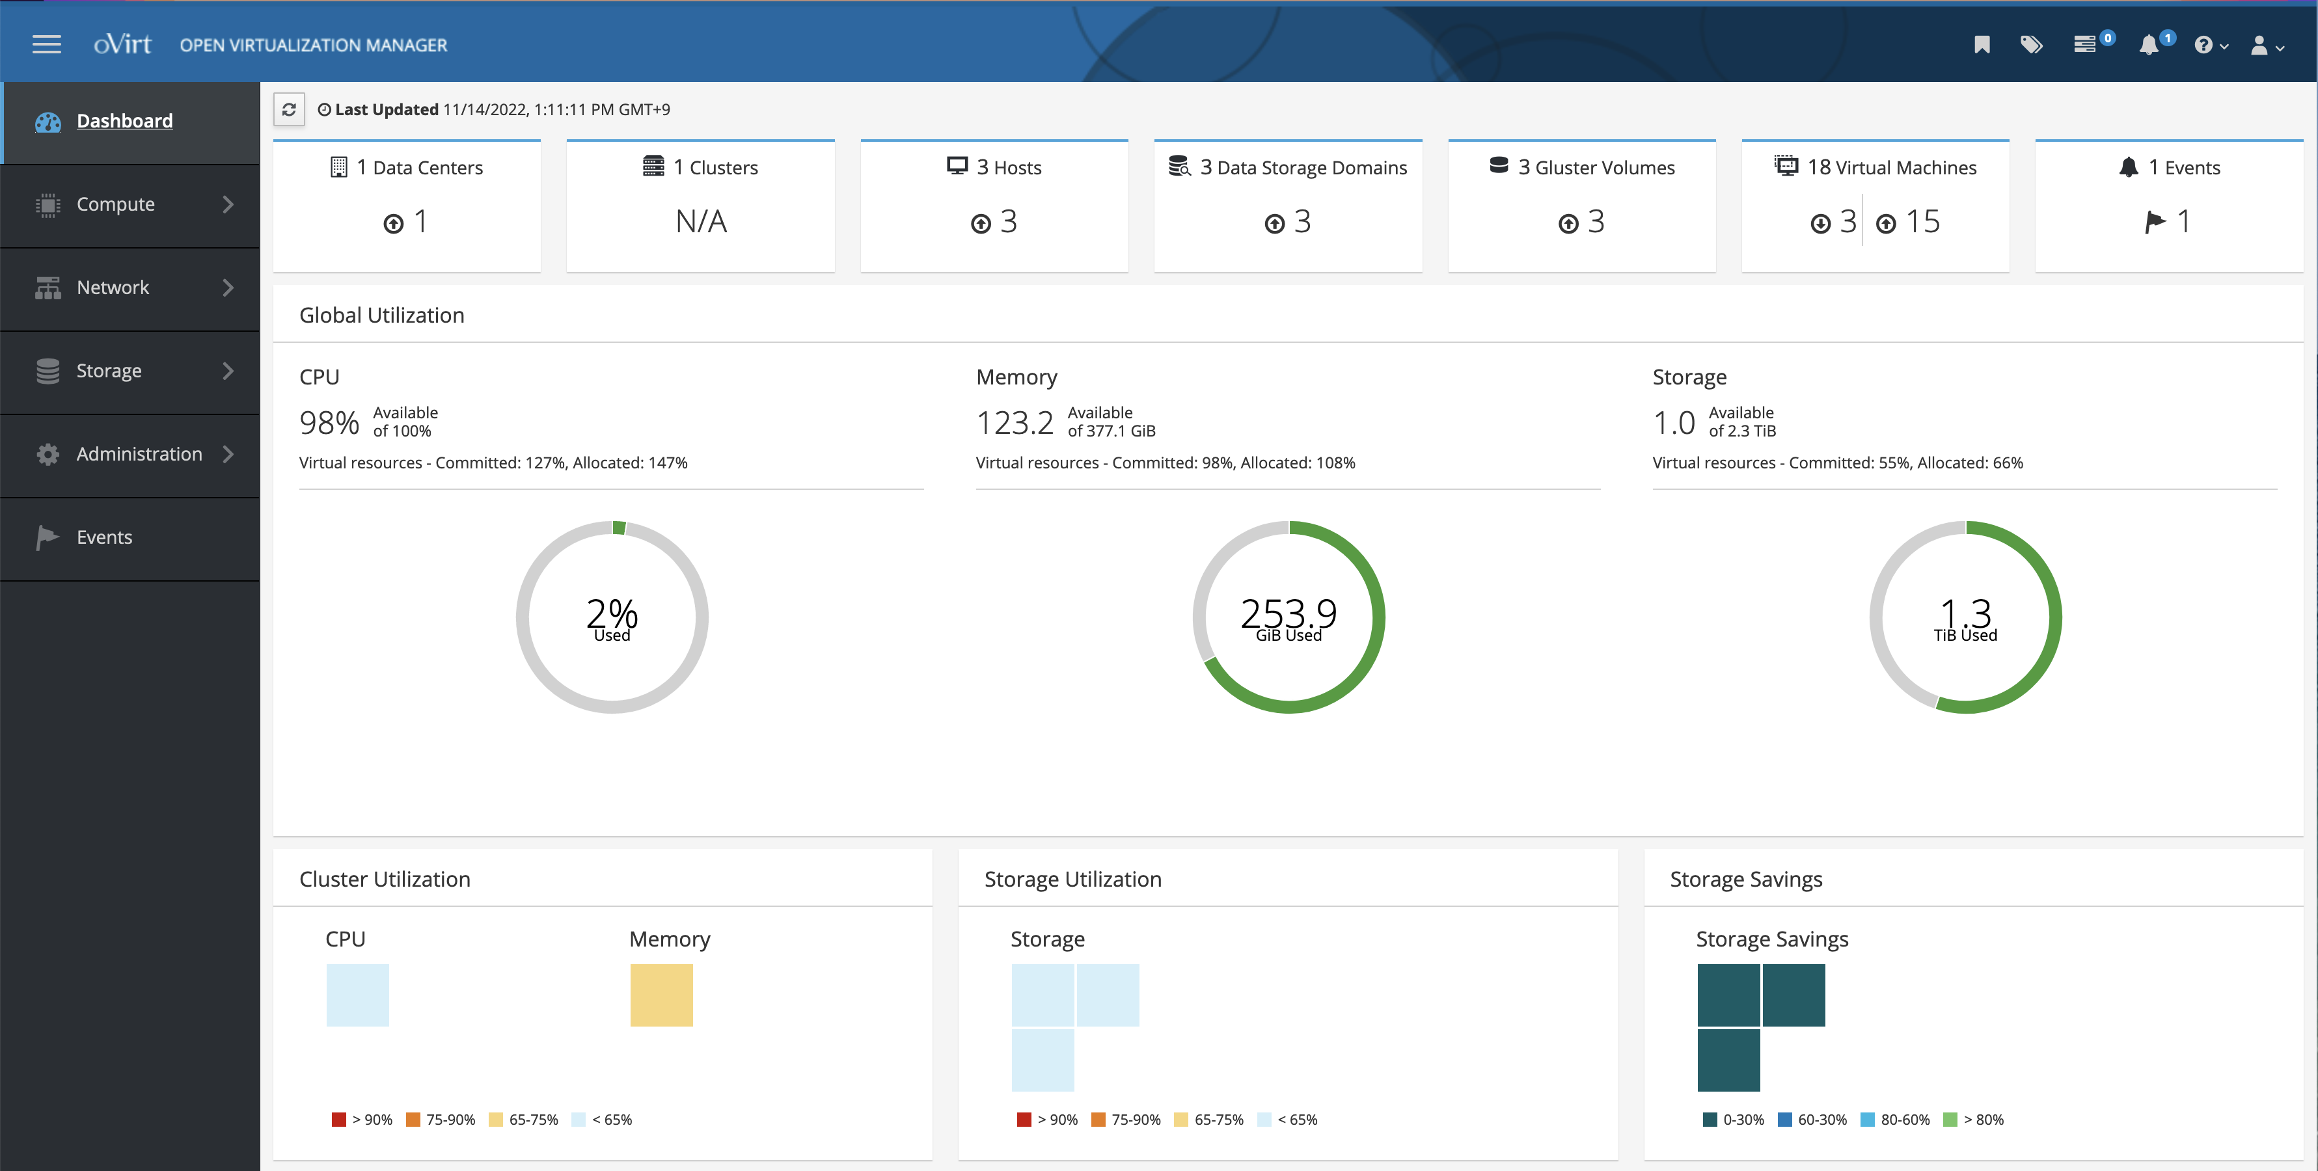
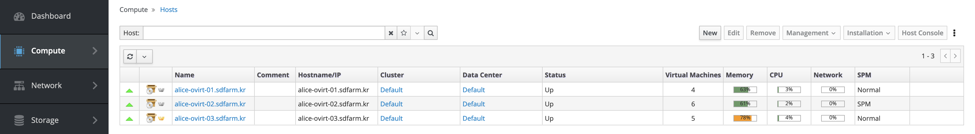
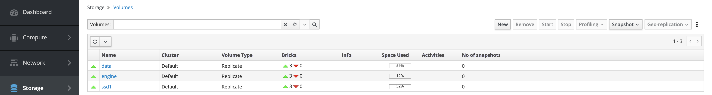
T1 Grid Services
Site Status
Many grid services running on VMs provided by oVirt cluster
  oVirt 4.3.8 + GlusterFS 6.10
  3 oVirt hosts with 384 GB of RAM and 2.3 TB of Gluster Storage
  (1.5 TB HDDs, 0.8 TB SSDs)
  Live migration & load-balancing
VMs for Grid services
  VOBOX for job submission
  Site-BDII & Argus (AuthN & AuthZ)
  3 Squid caches for CernVM-FS (Application provisioning,
  e.g. AliRoot, ROOT, GEANT4, etc.)
  APEL (WLCG Accounting)
  3 HTCondor-CEs (CE & Condor 23.0.8-1)

Slide 9
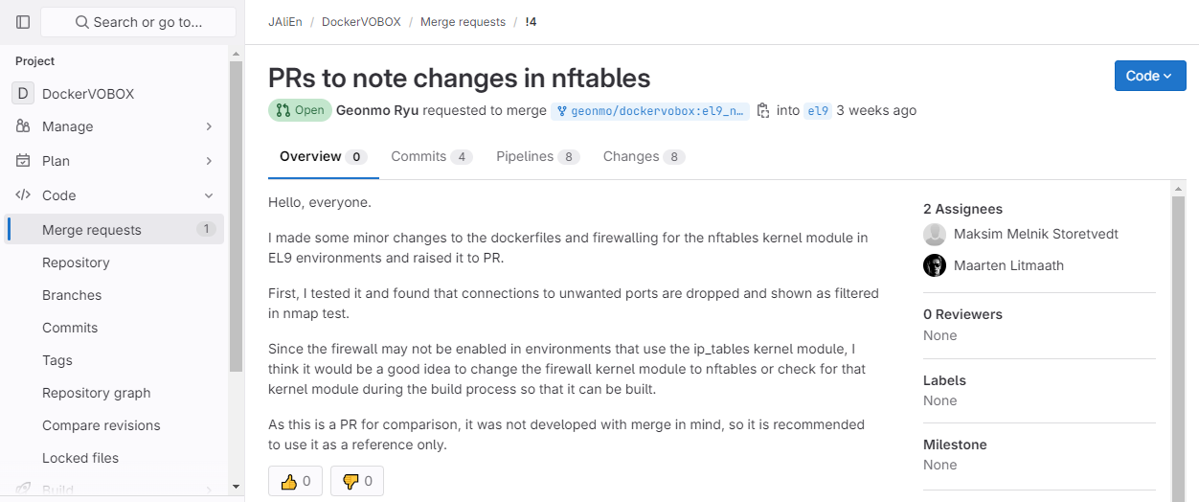
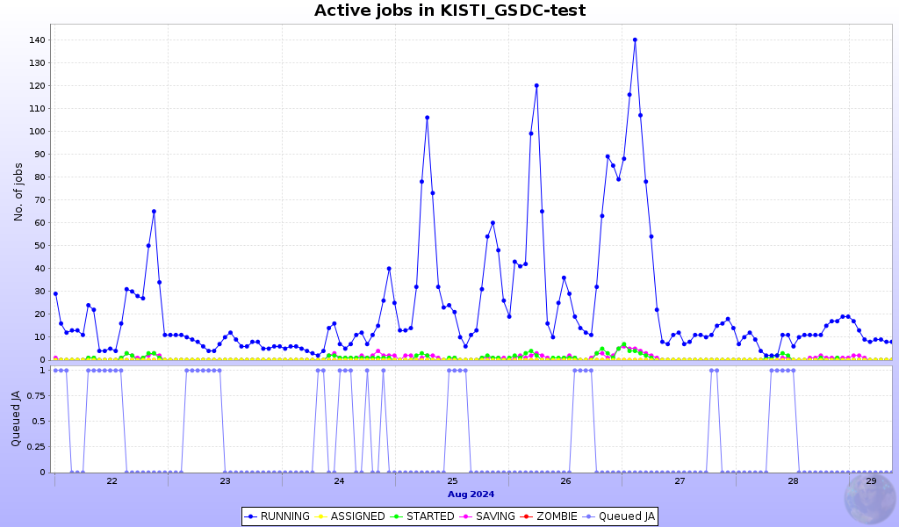
Computing Elements
JAliEn CE and Monalisa is working on VOBOX machine
  To submit alice jobs to our CEs using site-bdii information
  To collect resource information from CE and SE
A VOBOX container is testing on a Almalinux 9 VM to replace old vobox machine (with nftables kernel module)
    Maarten and Maksim are helping to make the test a success
Computing Resource
  alice-t1-ce04.sdfarm.kr: WN 38EA / 13,528 HS06
  alice-t1-ce05.sdfarm.kr: WN 45EA / 55,036 HS06
  alice-t1-ce06.sdfarm.kr: WN 50EA / 16,700 HS06
Total: 85 kHS06 / Newer than 2015 : 52.7 kHS06
Pledge: 63 kHS23 (2024) / 69 kHS23 (2025)
Status: OS upgrading to AlmaLinux 9
Plan
  14 kHS06 to be added later in this year and replace old WNs
    Removed WNs will move to other services

Slide 10
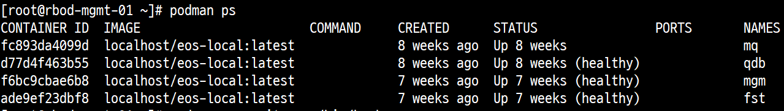
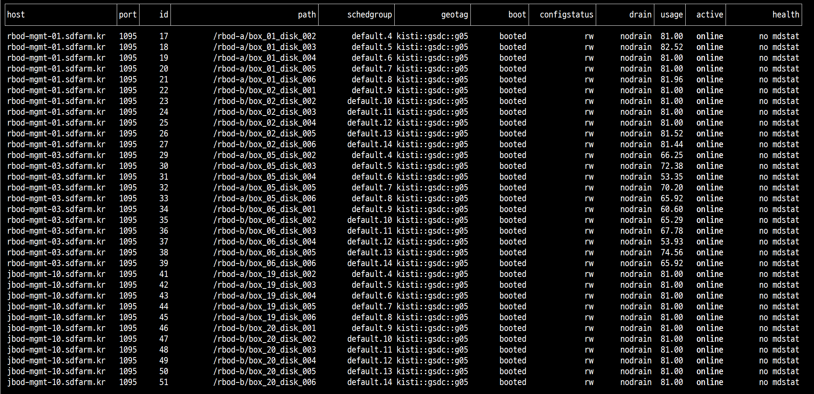
EOS Disk Status
Structure
  Running a container-based EOS server directly with podman
    Container Image: AlmaLinux 9.3
    3 EOS servers (v5.2.21)
      2x (MQ + MGM + QDB + FST) + 1x (QDB+FST)
      MGM DNS Round robin (eos-disk.sdfarm.kr)
Status
  Total : 4.12 PB (=3.65PiB)
  Used : 3.13 PB (75.81%)
Plan
  SE2(XRootD cluster for ALICE) will be deprecated
  Will be added more space on October
    + 3.8 PB = 7.9PB (2025 Pledge)

Slide 11
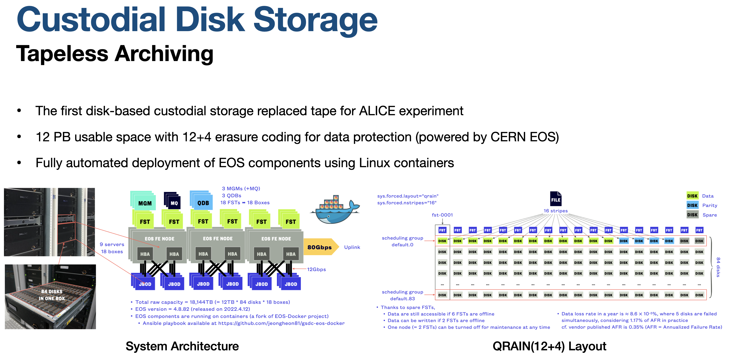
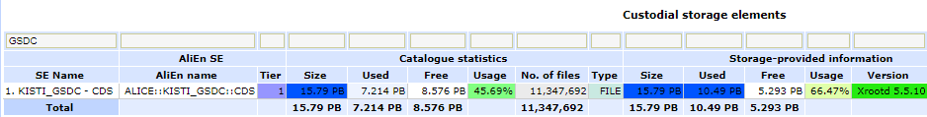
CDS Archving Storage
Structure
  Running a container-based EOS server directly with docker and podman on CentOS7 hosts
  (Will be updated)
    Container Image: AlmaLinux 9.4
    9 EOS servers
    (v5.1.22/MGM,QDB + v5.1.28/FST)
      3x ( MGM+MG+FST ) + 3x ( QDB+FST )
      + 3x( FST )
    MGM DNS Round robin (eos-archive.sdfarm.kr)
Status
  Total : 17.77 PB (=15.79PiB)
  Used : 11.81 PB (=10.49PiB / 66.46%)
Detail
  Will talk on CDS session

Slide 12
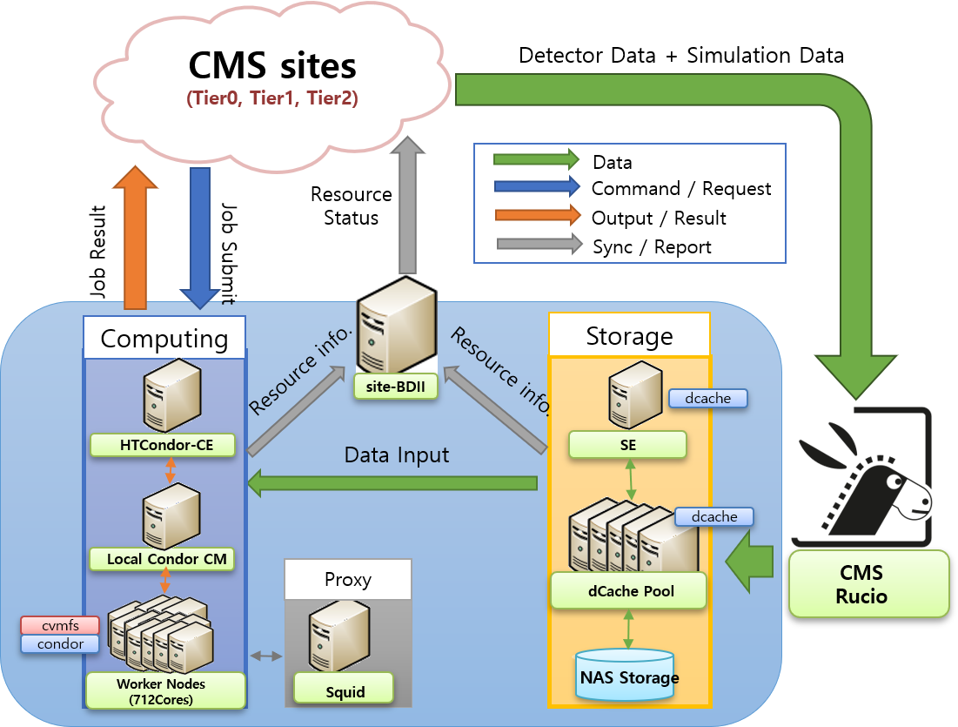
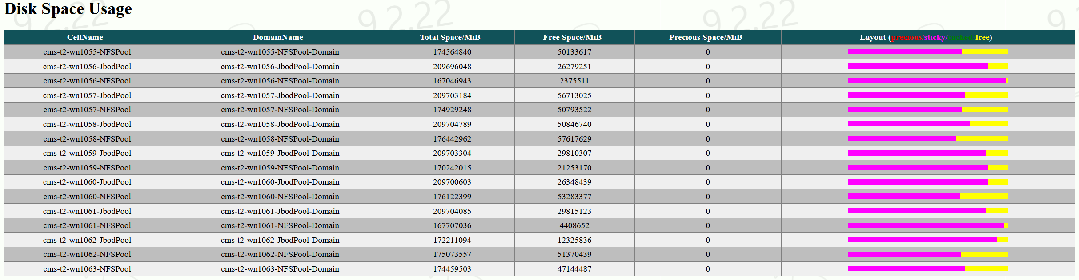
CMS Tier-2 @KISTI
Services run on baremetal servers
  OS installation by Foreman
  Provisioning with Ansible
    Ansible Roles : https://github.com/orgs/gsdc/repositories?q=visibility%3Apublic+archived%3Afalse
Main Component
  Middleware : WLCG repo (will be changed when UMD5 is available)
  CE : HTCondor-CE 23.0.14
  LRMS : HTCondor
    45 WNs / 1,392 logical cores / 14.6 kHS06 (except one failure node)
    RAM 2,000MB per core
  SE : dCache v9.2 + XRootD PSS server for CMS AAA
    9 x dCache Pool Server (10Gbps)
      8 JBOD + 9 NFS Pools / 2819TiB (=3100TB)
    Protocol : XRootD (RO), WebDAV (RW)
  Report: Site-BDII (will be deprecated), APEL
  Cache : 2x Frontier-Squids
Network: LHCONE

Slide 13
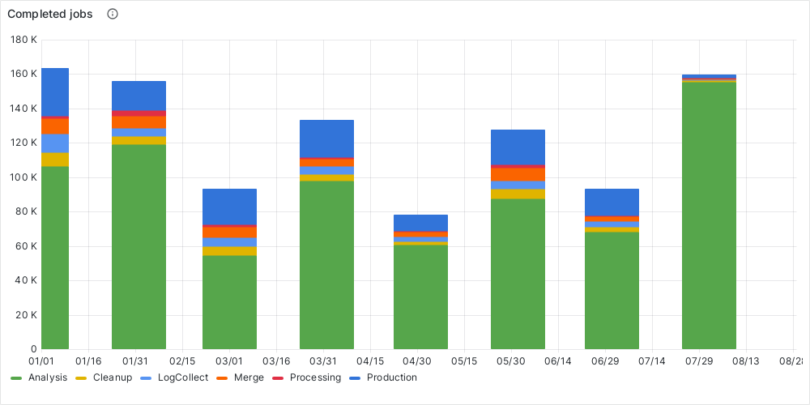
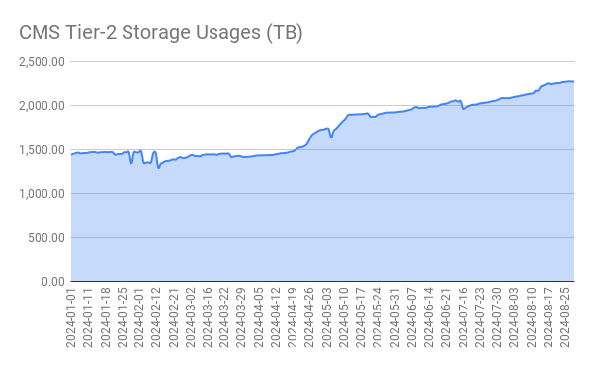
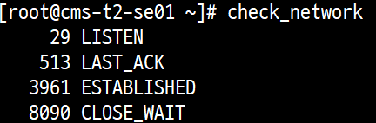
T2_KR_KISTI Site Report
Site Status
  OS migration is finished except dCache pool servers
  Computing Resource: 14.6kHS06
    1,005,543 jobs Completed
  Storage: 2,276/2,819TiB (80.73%) [24-08-29]
Site issues
  After an OS upgrade, there was a bug in OpenSSL 3 library(used by voms_api) on PSS server where transfer requests would cause an explosion of CLOSE_WAIT sockets and spike CPU utilization (almost 2,500~3,000%)
    Downgrading the OS to Almalinux8 is a known workaround
    Now, we is testing xrootd pss with OpenSSL v3.2.3-dev branch

Slide 14
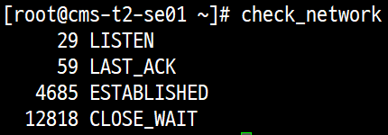
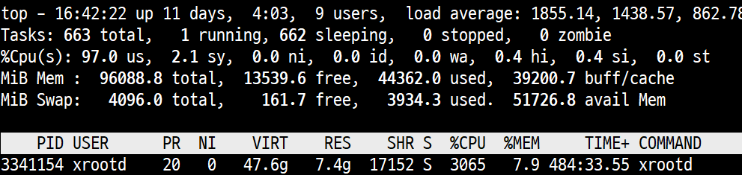
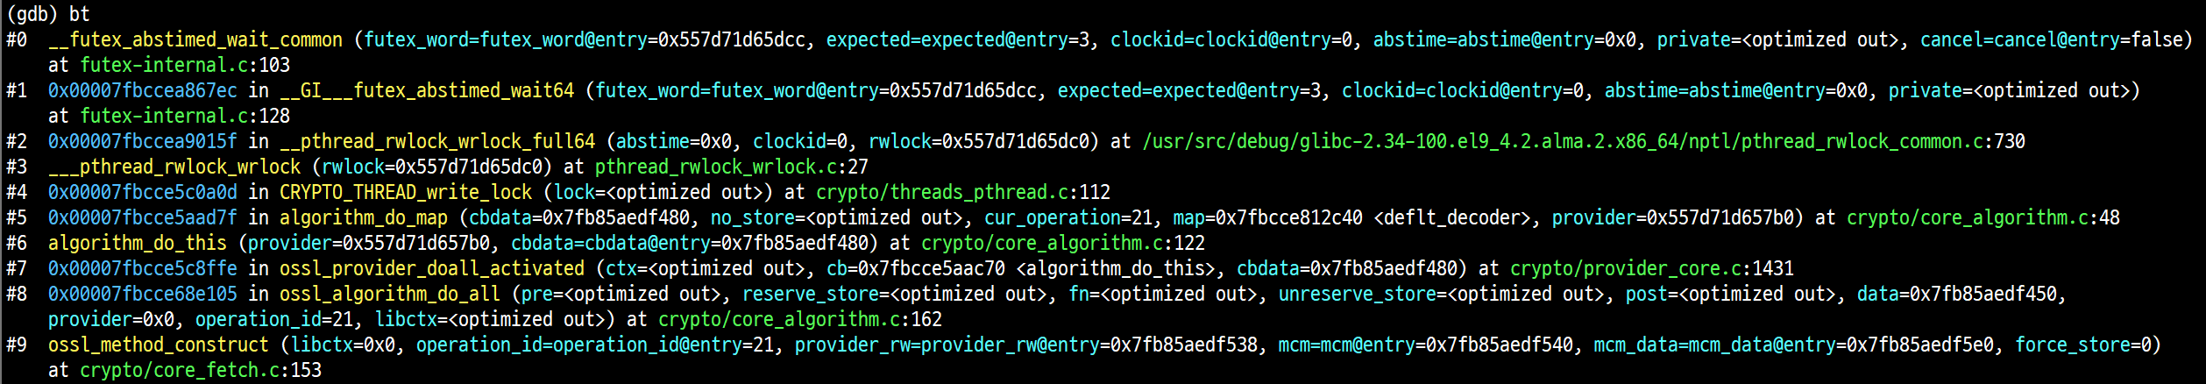
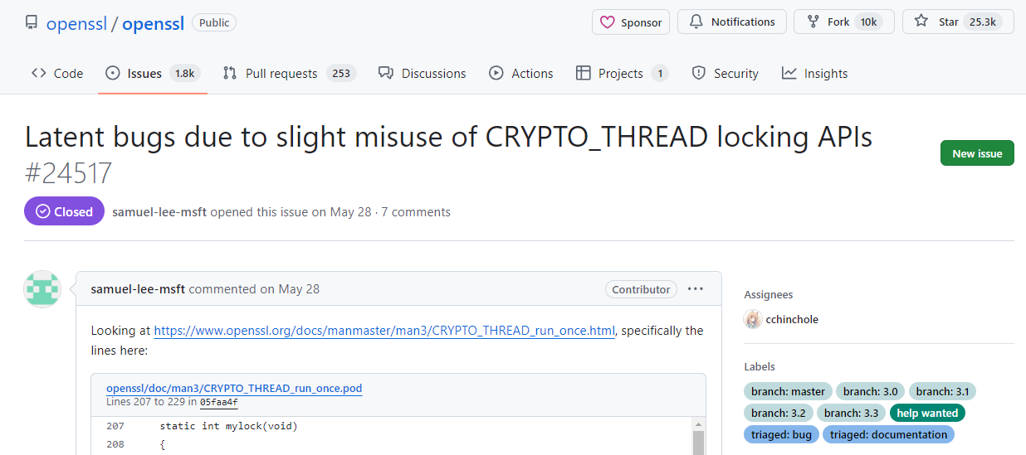

Slide 15


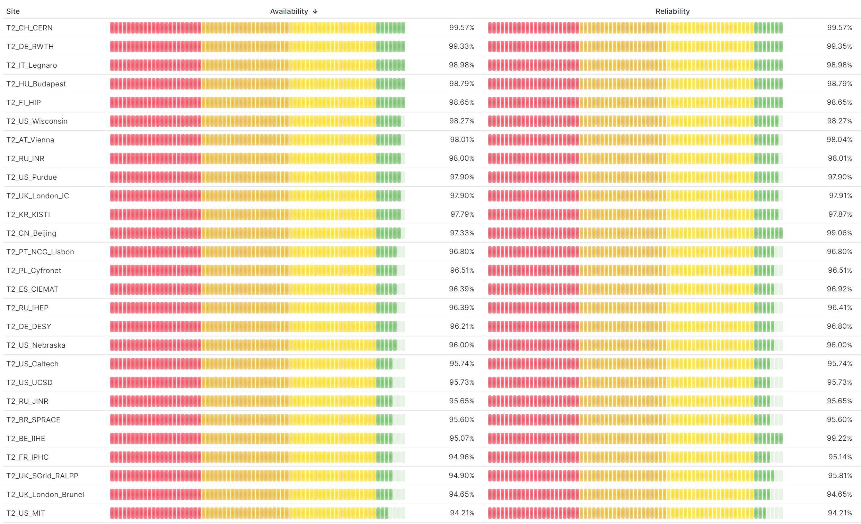
WLCG Tier-2 Service Availability / Reliability
 | Reliability | Availability
 | Overall in 2024 | Overall in 2024
CMS | 97.79% | 97.87%
Monthly target of WLCG : 95%
CMS Tier-2 Availability/Reliability
Dr. Ryu, Geonmo

Slide 16
GSDC-LDG
GSDC-LDG (LIGO Data Grid), a gravitational wave data analysis computing environment at the request of the Korea Gravitational Wave Research Foundation (KGWG) in 2010.
In 2019, the International Gravitational-Wave Observatory Network (IGWN) computing environment was established.
Currently, the GSDC-LDG system operates as an integrated system that can be used simultaneously by global and domestic users.
Dr. Bae, Sangwook

Slide 17
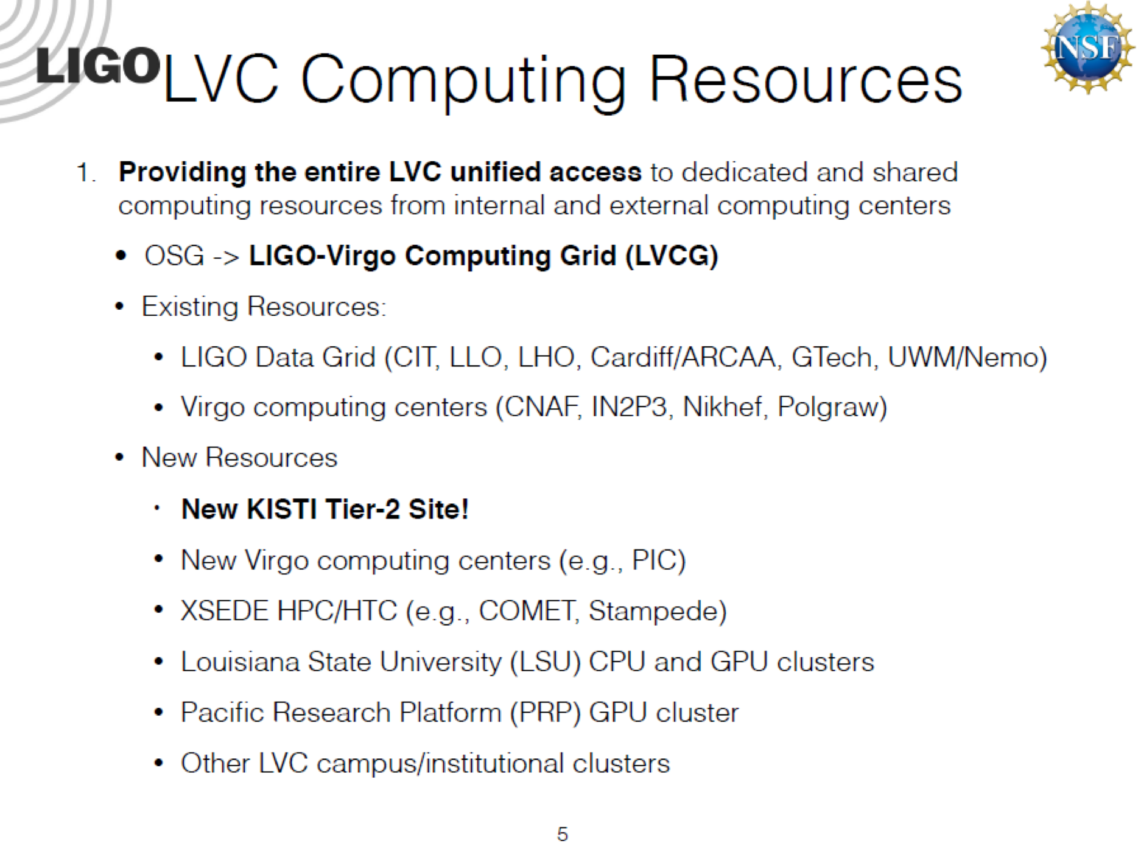

History
2010
2011
GSDC-LDG
Service Start
2012
200 core, 100TB
HTCondor
24 core, 5TB
HTCondor
80 core, 5TB
PBS
2013
420 core, 150TB
HTCondor
2016
2015
2014
420 core, 150TB
HTCondor
864 core, 550TB
HTCondor
2017
864 core, 340TB
HTCondor
636 core, 150TB
HTCondor
Puppet, forman
996 core, 550TB
HTCondor
Added RAM (minimum 72GB)
2018
2020
2021
2019
996 core, 550TB
Enabled Tier2 Service
HTCondor, HTCondor CE
Added 3 GPU Server (with P40 3 GPU Cards)
2019 LVC Meeting
996 core, 550TB
HTCondor
Added 3 GPU cards
996 core, 550TB
HTCondor
Dr. Bae, Sangwook

Slide 18
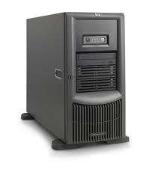





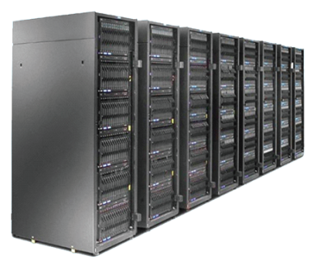

GSDC-LDG Overview
Login Node
Tier3 Job
ldg-ui.sdfarm.kr
ldg-ui01.sdfarm.kr (HTCondor)
User
ldg-t2-ce.sdfarm.kr
ldg-ce.sdfarm.kr
(HTCondor-CE, HTCondor)
LIGO Data
Grid Job
550TB
996cores
KAGRA Data
Storage
Cluster
Dr. Bae, Sangwook

Slide 19
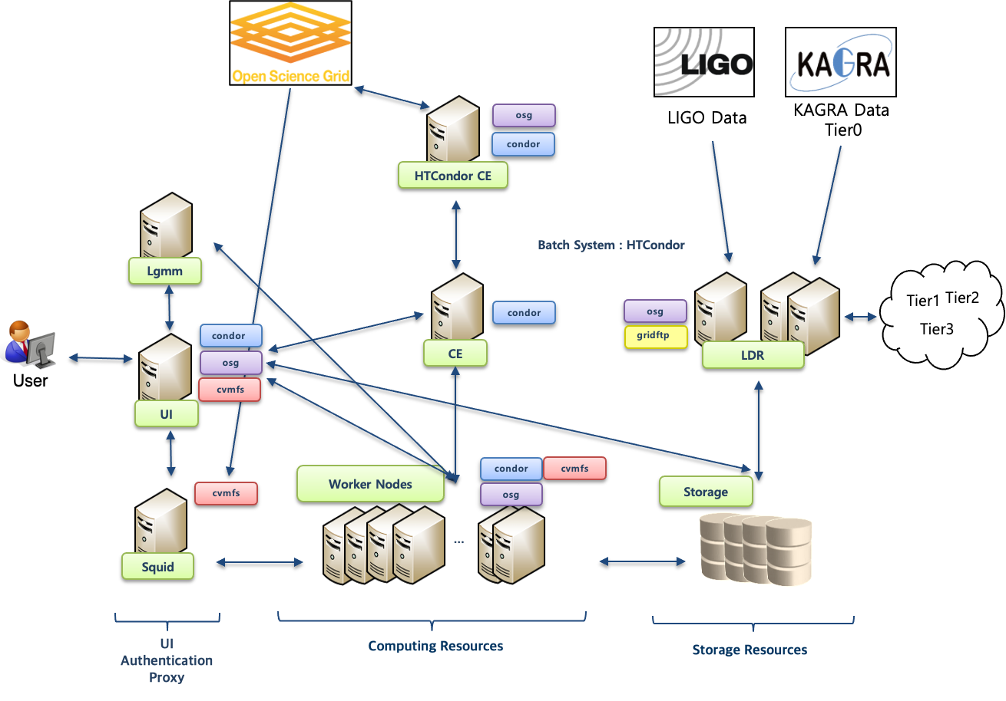
Status of GSDC-LDG
Dr. Bae, Sangwook

Slide 20
Resources
Computation Resource
Storage Resources
 | Physical Core | Memory
Work Node | 996 (66 servers) | 72GB X 27 96 GB X 33 384 GB X 6
UI,CE,LGM,LDAS,LDR | 60 (5 servers) | 24GB X 5
Total | 1056 | 7416
Work Node (GPU) | 3 Servers | 6 GPU Cards (P40)
Mount on
Size
Used
Avail
Use
Total
LIGO
/data/ligo/
400T
252T
149T
63%
Lustre
KAGRA
/data/kagra/
150T
114T
37T
76%
Lustre
Dr. Bae, Sangwook

Slide 21
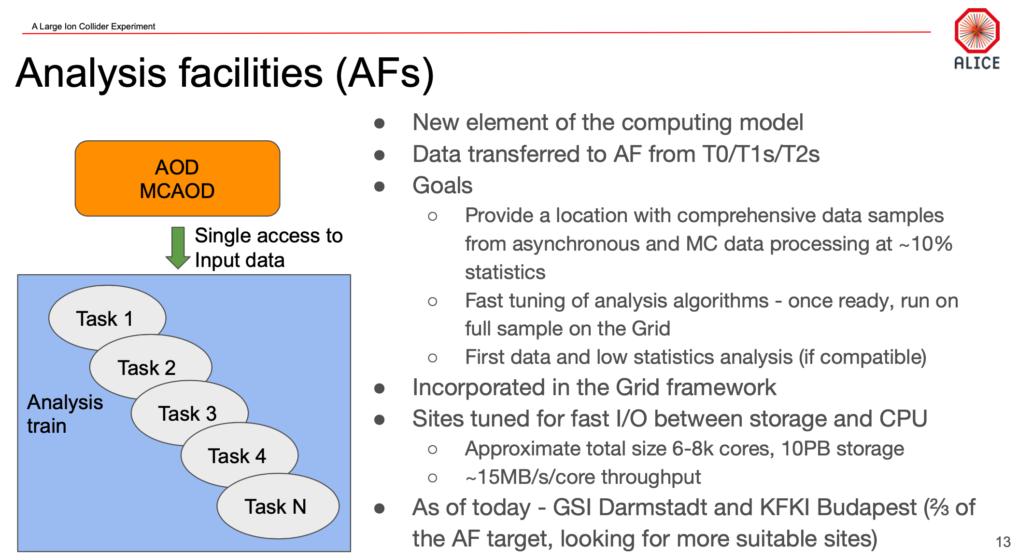
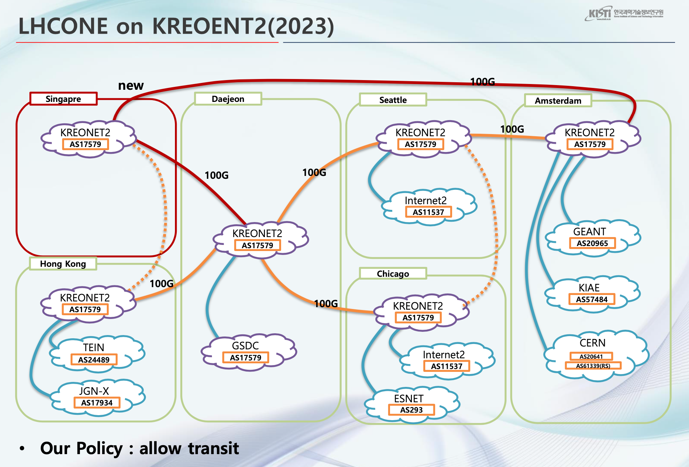
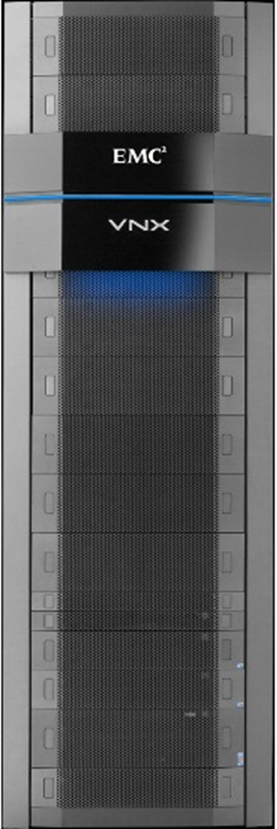
KISTI Tier-3
≠
For Domestic Researchers
Unified HTCondor Clusters provided for different experiments
Quota and groups are managed by HTCondor Negotiator
Application distributed by CernVM-FS
Compute
Storage
Dataset staging
UIs
resource allocation via
match-making
condor CM
job submission
LHCONE
subscription
resource advertising
/{alice,cms,bio}/home
/{alice,cms,bio}/data
/{alice,cms,bio}/scratch
Lustre
Cray Lustre
3.2 PB
Workers
shared
ALICE T3
CMS T3
BIO
GLORIAD
76 Workers
5.2k Core
/cvmfs
http
squid-proxy
cvmfs
stratum-0
Squid-Proxy shared with KISTI T1 & T2
Applications
Total 5.2k logical cores

Slide 22
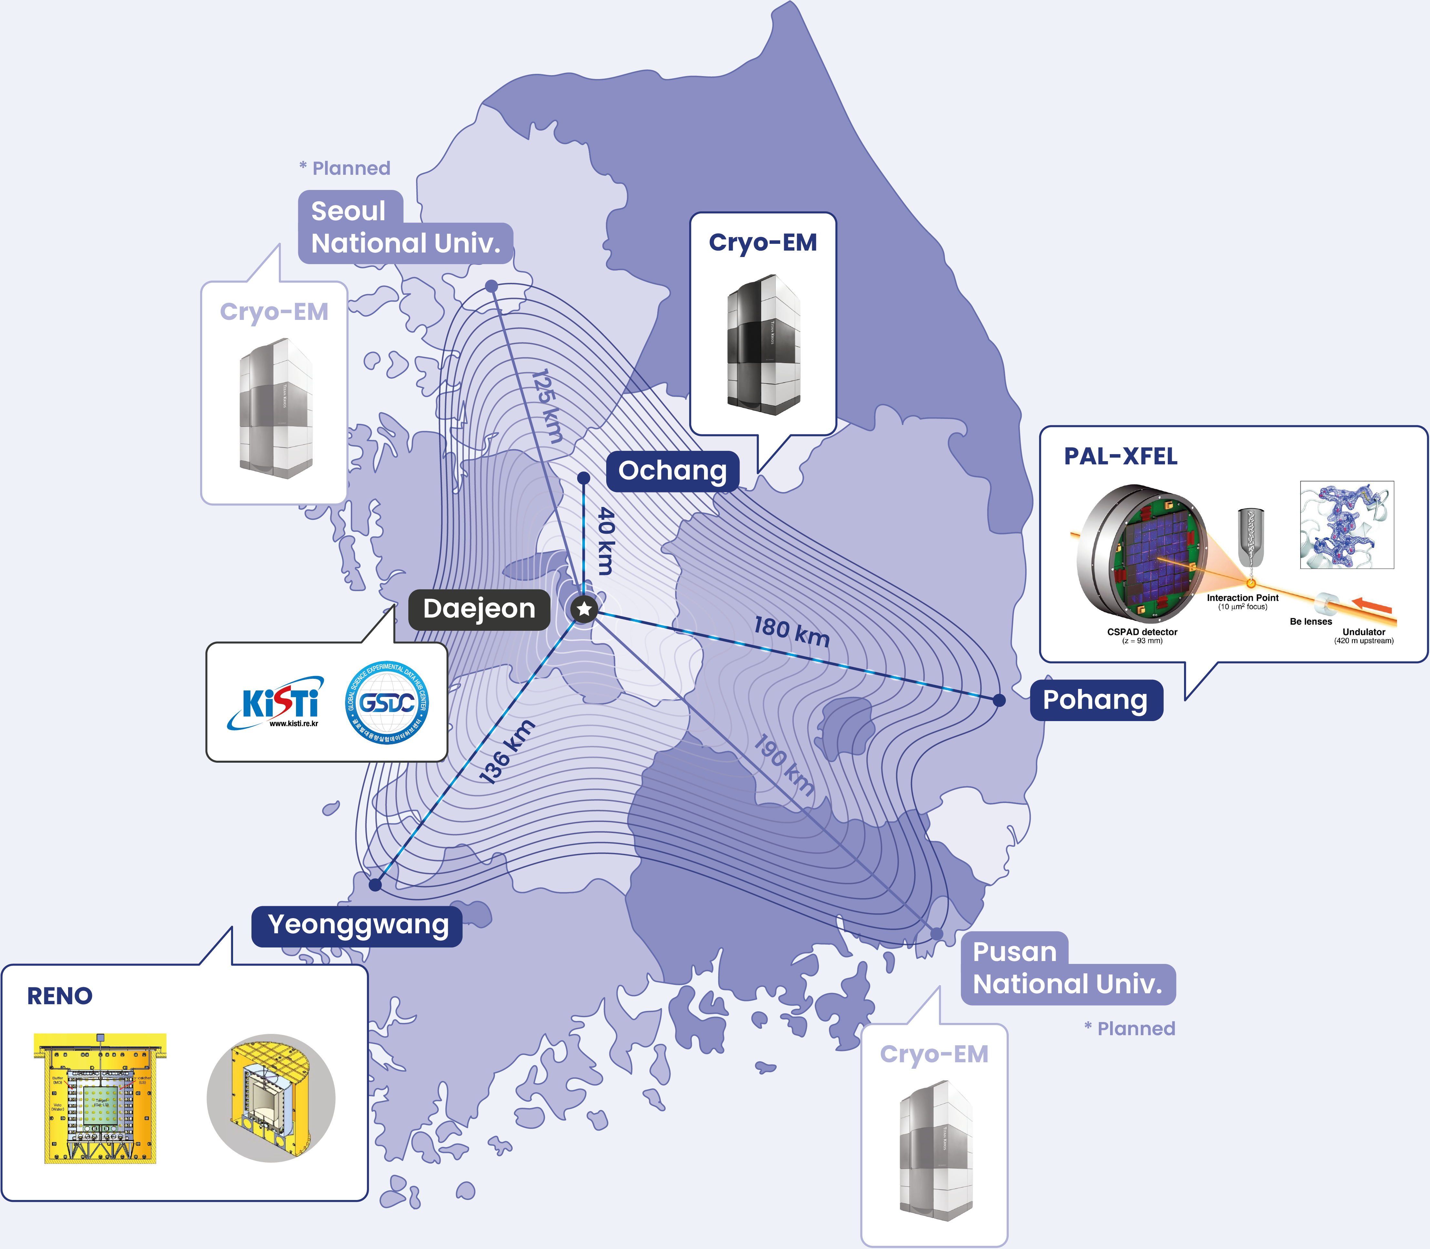


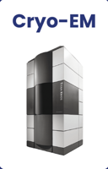
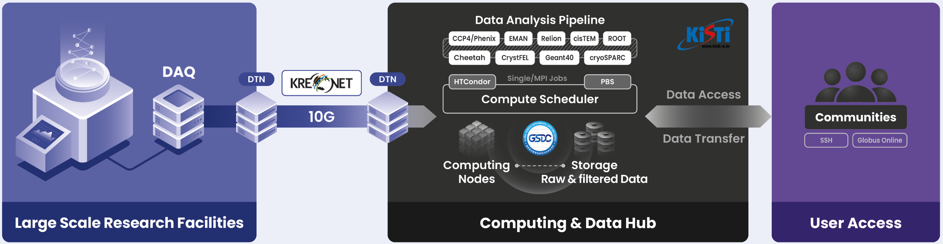

Supporting Domestic Research
Providing data storage, analysis pipeline and access
Adapting the knowledge learned from operating Grid facilities to domestic region
Dedicated optical links provided by KREONet for efficient data transfer and sharing
  No need to move data by using external drives and overseas delivery
Data analysis pipeline running on compute clusters
  No need to own and maintain private cluster at individual labs
User access to data and analysis pipeline without geographical constraints
Significant reduction of time in research activities

Slide 23
Thank you

Slide 24
Backup

Slide 25
