Slide 2
Residual radiation at hadron & ion accelerators
C. Theis, H. Vincke
RADMEP Workshop 2024
December 2024, CERN

Slide 3
Contents
Illustration of residual vs. prompt radiation at hadron/ion accelerators
Residual dose and its (analytical) calculation
(Analytical) shielding assessments with respect to residual radiation
Measurement of residual radiation at high energy hadron/ion facilities such as CERN

Slide 4
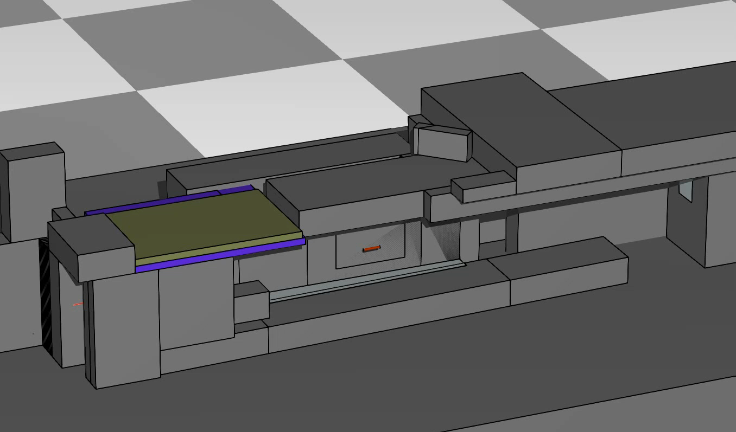
What is residual radiation?
Proton
Neutron
Pion+
Pion-
Electron
Positron
Photon
CERF irradiation facility
Protons with 120 GeV/c
Cu target (50 cm length)
First let’s have a look at the
“prompt” hadronic radiation

Slide 5
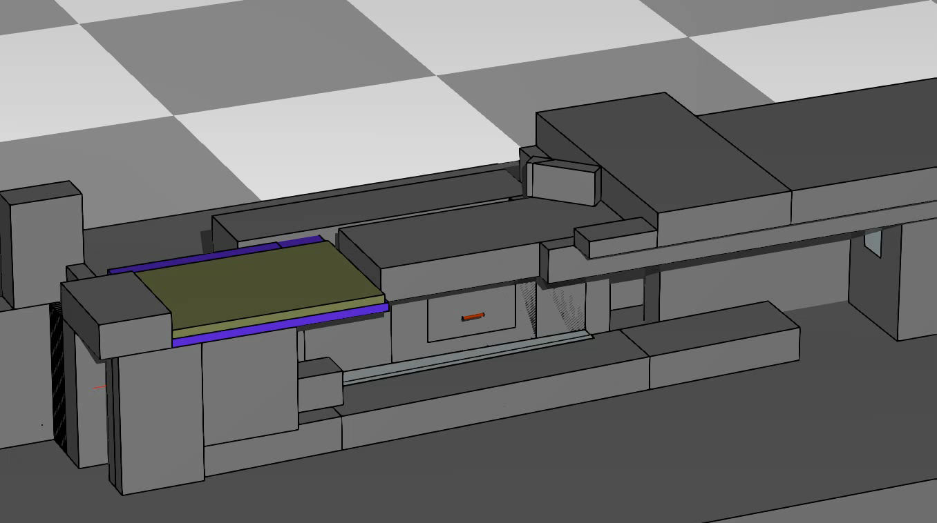
What is residual radiation?
Proton
Neutron
Pion+
Pion-
Electron
Positron
Photon
CERF irradiation facility
Protons with 120 GeV/c
Cu target (50 cm length)
First let’s have a look at the
complete cascade

Slide 6
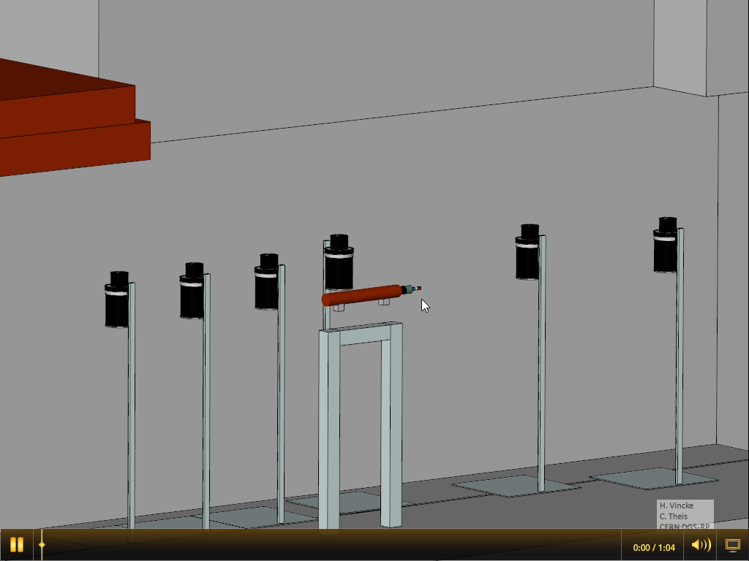
What is residual radiation?
CERF irradiation facility
Protons with 120 GeV/c
Cu target (50 cm length)
Several shots
Keep looking out for the photons /!\

Slide 7
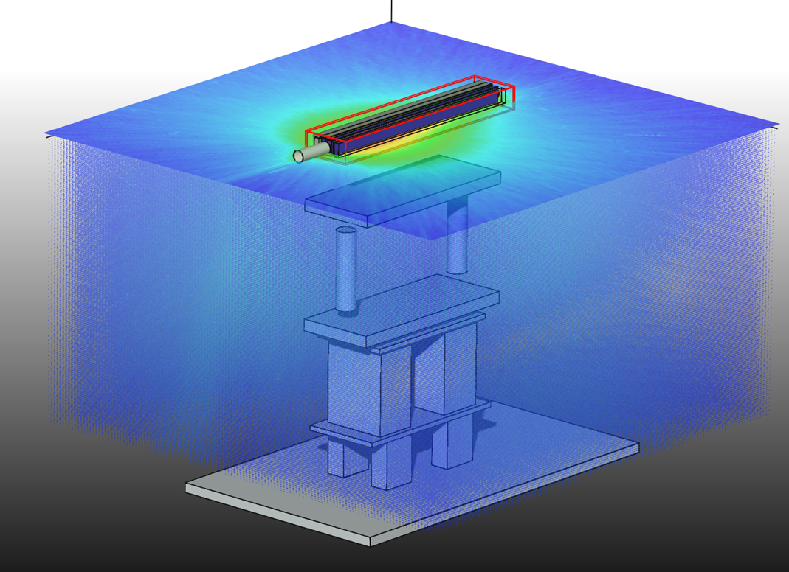
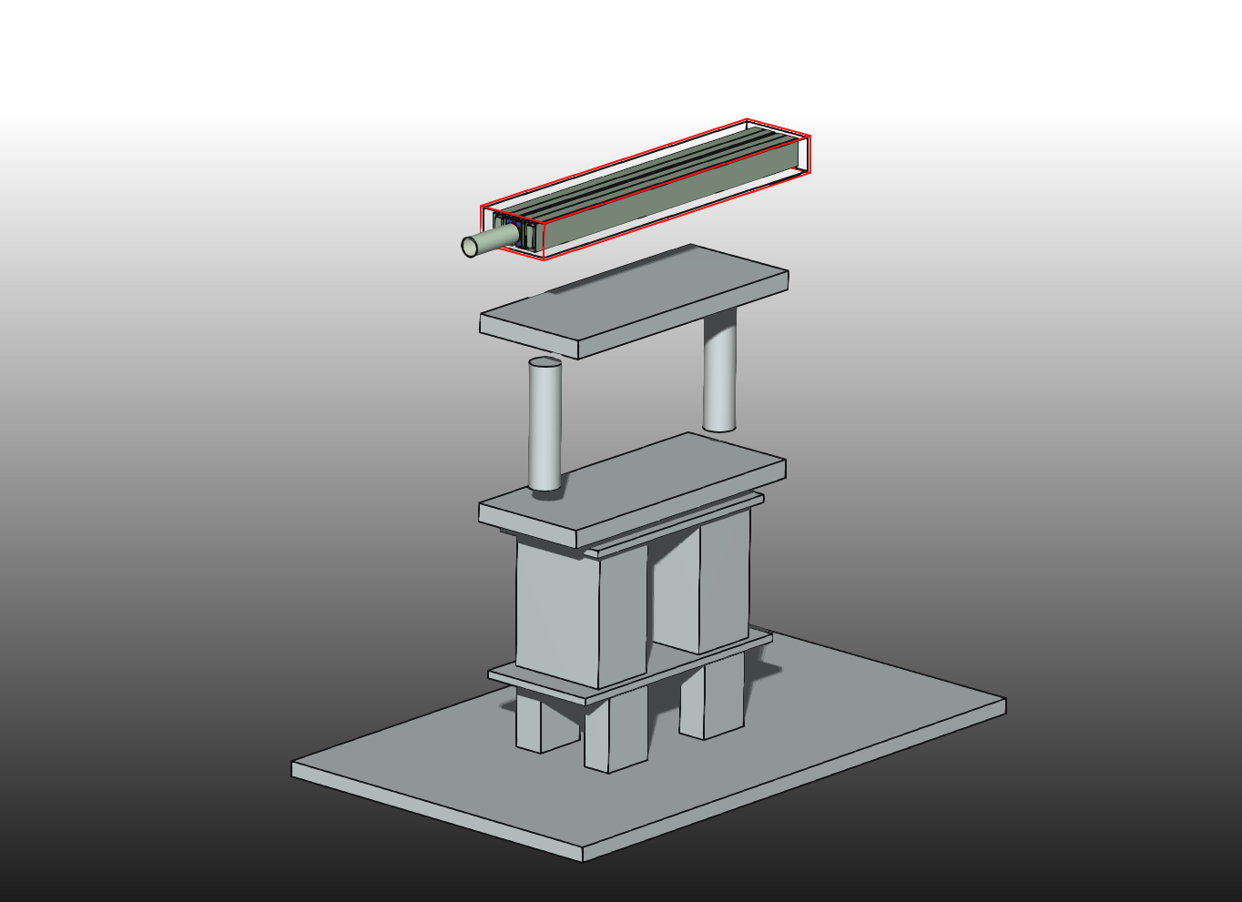
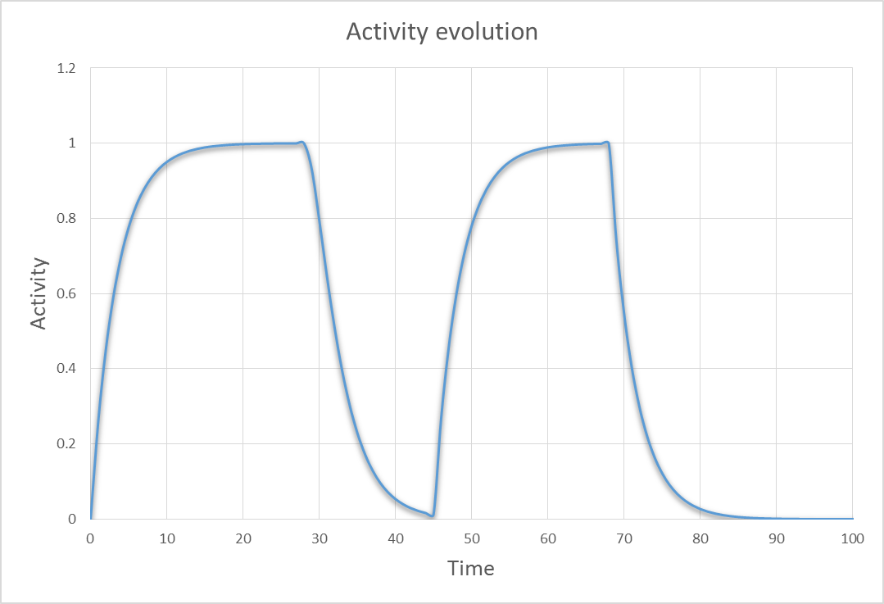
What is residual radiation?
Residual radiation
Source: radioisotopes
created in material
Intensity: decreases
secondary particles
beam
Decay
Isotope production &
build-up

Slide 8
Characteristics of residual radiation
Radioisotopes in activated material (= “nuclide inventory”) are at the origin of residual radiation
Type of created radioisotopes depends on:
  chemical composition of target material
  incident particle type
  incident particle energy
  irradiation & cooling time
Emitted radiation types:
  γ radiation (mainly < 2.76 MeV*)
  e+ and e-
  alpha
*Na-24

Slide 9
Creation of radioisotopes
At high-energy accelerators primary particles interact with matter. The primary particle itself or secondary particles interacting with nuclei can produce radioactive isotopes. Main production channels of activation at hadron and ion high-energy accelerators are:
  Spallation and other inelastic hadronic interactions ( (n,n’γ), (n,2n), (n,p), (n,α) …)
Hadron/ion accelerators generally
show much higher activation levels
than electron/positron machines with
identical energies & beam intensities.
  Particle capture (mainly neutrons)
  (γ,n)-reactions (of lower relevance at hadron/ion accelerators)
proton
neutron

Slide 10

Creation of radioisotopes
A minimum threshold energy needs to be exceeded to see nuclear reactions induced by ions that will produce activation and thus, residual radiation:
$$E_{th}= \frac{m+M}{M} |Q_{v}|$$
m … mass of incident projectile
M … mass of the target atom
Q_{v} … amount of energy absorbed during the reaction
Rule of thumb:
Protons or other ions require > 10 MeV to create important amounts of radioisotopes, though the onset can be
observed at lower energies of a few MeV.
Negative pions can already have important contributions at a few MeV as they are not repelled by the
Coulomb barrier.
Neutrons can enter the nucleus at any energy (no Coulomb barrier)

Slide 11
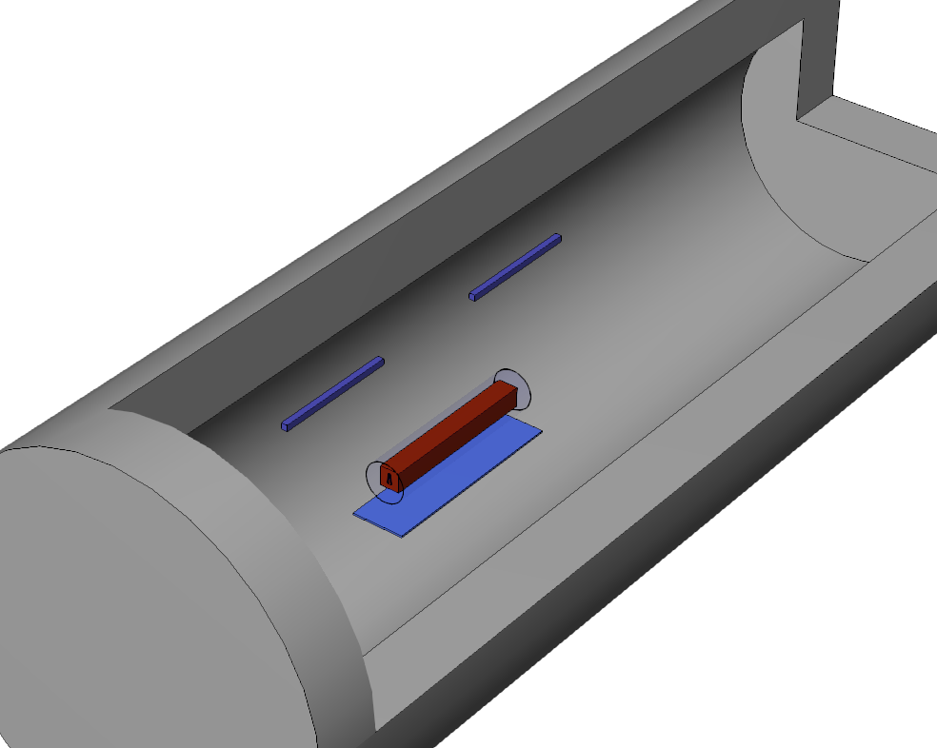
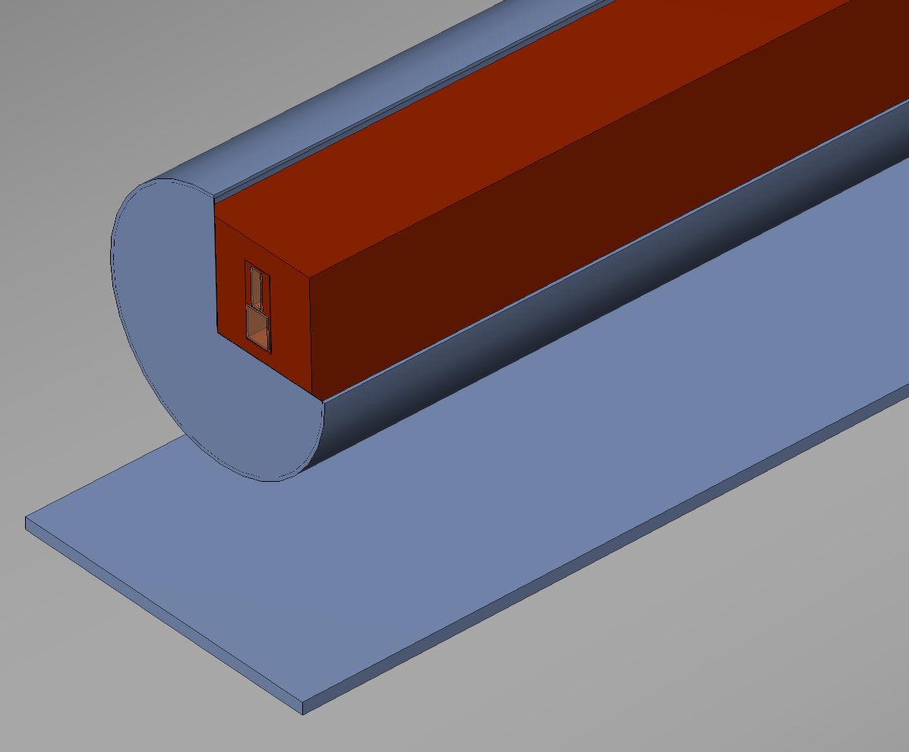
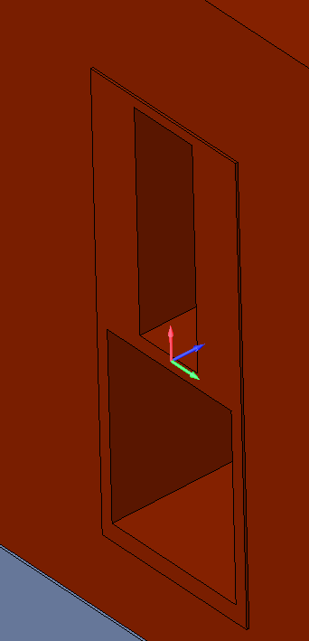
Example – prompt vs. residual radiation
FLUKA studies: TCSC collimator (simplified version)
Protons @ 400 GeV/c
Beam parameters: pencil proton beam @ 400 GeV/c
Irradiation periods: 10 years of operation with 5E17 protons impacting over 365 days
+ by 200 days with 5E17 protons equally distributed within these 200 days

Slide 12
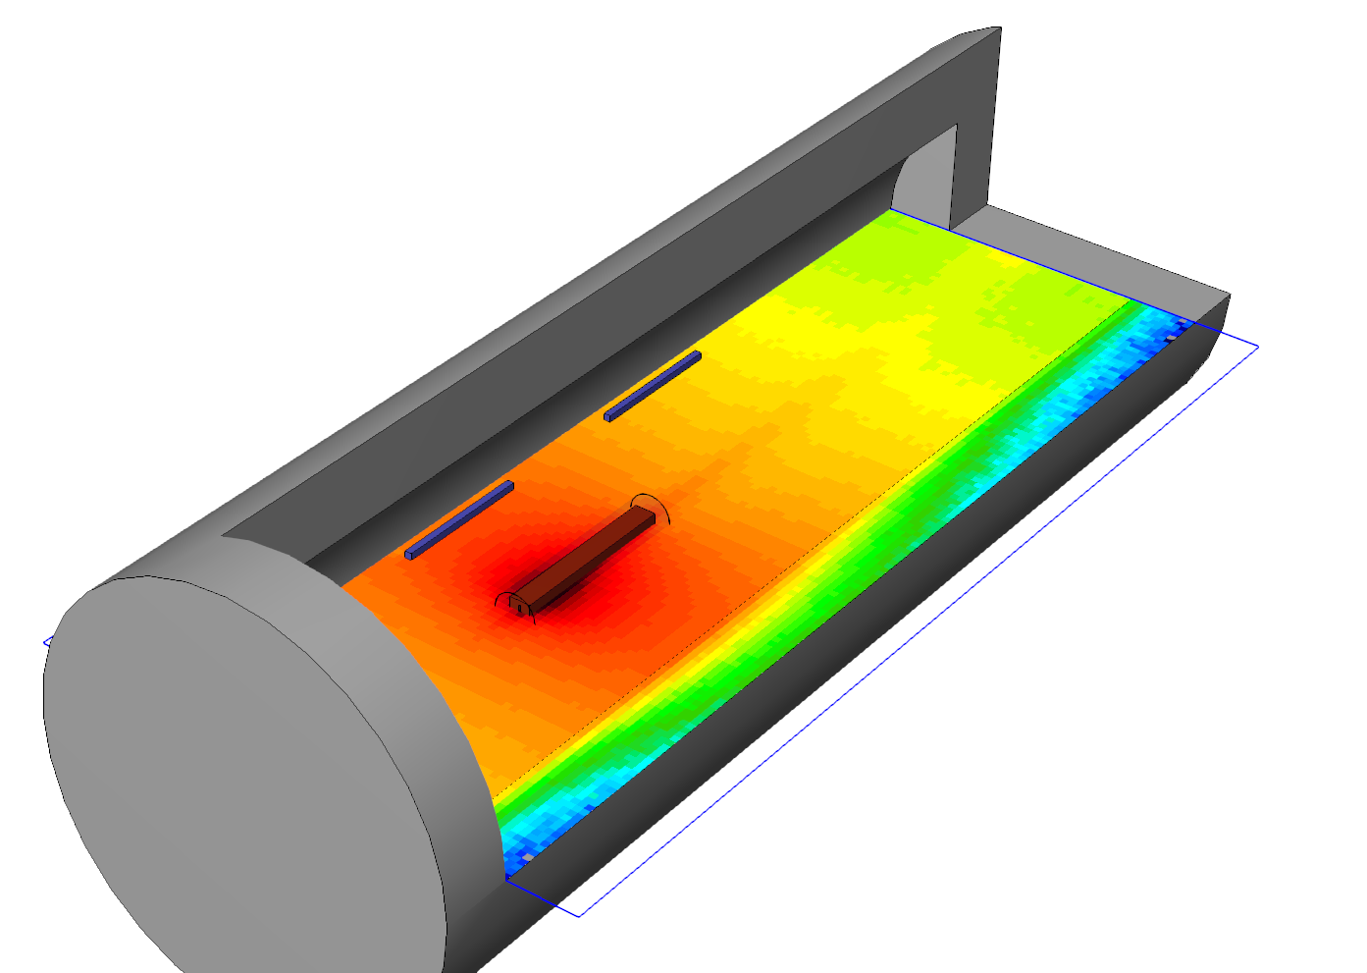
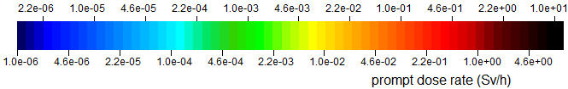
Example – prompt vs. residual radiation
Prompt dose rate in Sv/s considering a proton beam impact of 2.9E10 p/s@400 GeV/c
(=5E17 per 200 days)
Prompt dose rate (Sv/s)

Slide 13
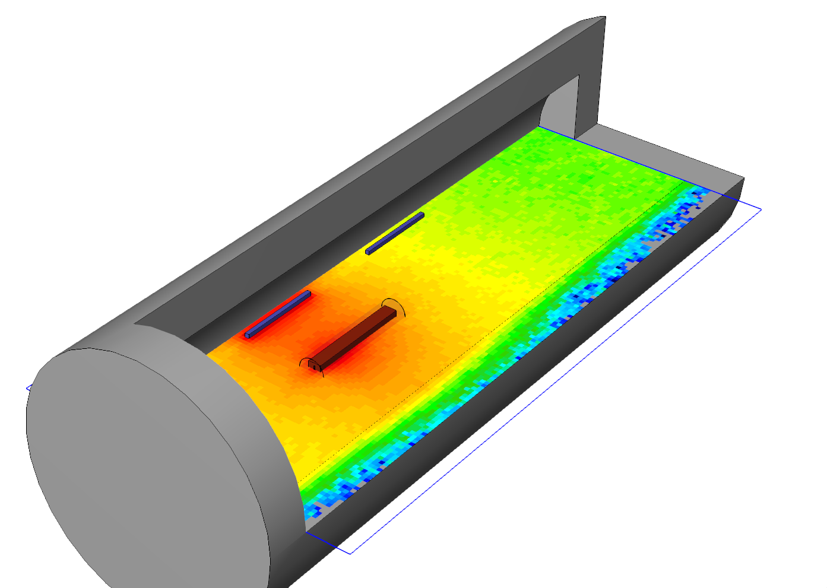
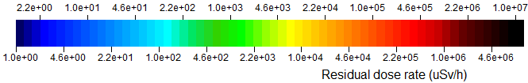
Example – prompt vs. residual radiation
Co bar,
added for illustration purposes
Residual dose rate in uSv/h after a cool down of 1 day

Slide 14
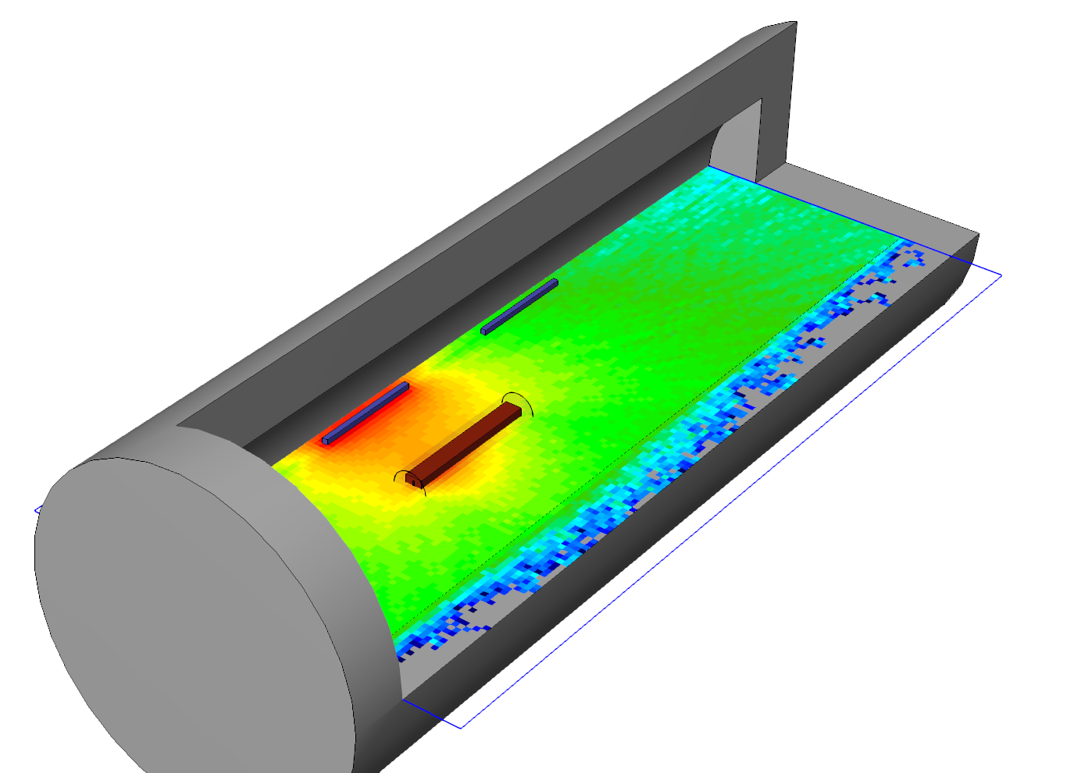
Example – prompt vs. residual radiation
Co bar,
added for illustration purposes
Residual dose rate in uSv/h after a cool down of 2 years

Slide 15
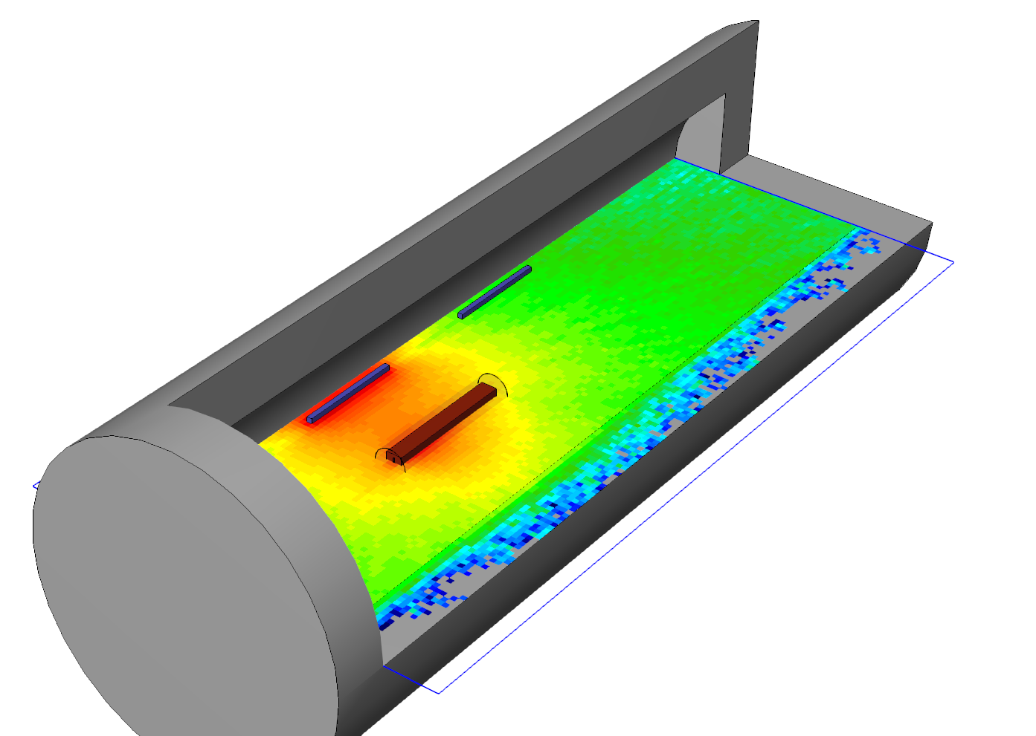
Prompt dose rate in Sv/s considering a proton beam impact of 2.9E10 p/s@400 GeV/c
Residual dose rate in uSv/h after a cool down of 4 months
Prompt dose rate (Sv/s)

Slide 16
Residual dose rates
Interventions in activated environments pose a risk due to the exposure to residual radiation
As a rule of thumb one can say that it will be mostly gamma exposure with a (very rough /!\) average energy of ~0.8 MeV*
To plan and optimize interventions one must calculate the dose rate
* A. H. Sullivan, A guide to radiation & radioactivity levels near high energy particle accelerators, Nuclear Technology Publishing 1992

Slide 17
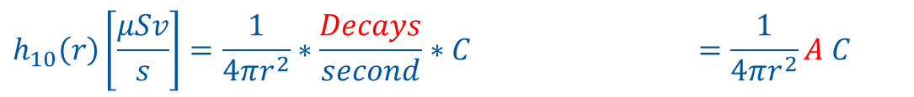
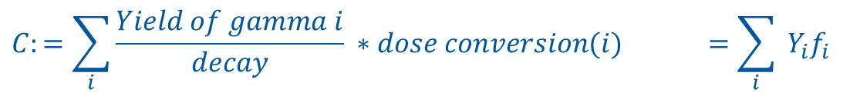
Residual dose rate calculation
Uncollided* gamma dose rate of one gamma emitting isotope:
$$h_{10}\left(r\right)\left[\frac{μSv}{s}\right]=\frac{1}{4πr^{2}}∗\frac{Decays}{second}∗C =\frac{1}{4πr^{2}}A C$$
$$C:=\sum_{i}{\frac{Yield of gamma i}{decay} ∗dose conversion(i)} =\sum_{i}{ Y_{i}f_{i}}$$
A … source strength (Bq)
r … distance (cm)
Y_{i} … yield of i^{th} gamma line per decay
f_{i} … dose conversion coefficient for the i^{th} gamma line (μSv cm²)
*Note: This formula ignores any attenuation & scattering
for the time being

Slide 18
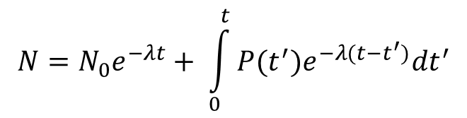
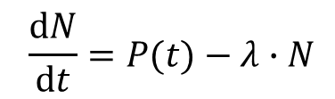
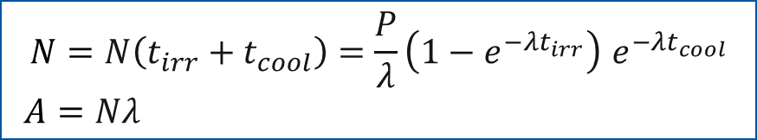
Calculation of activity
$$N=N_{0}e^{−λt}+ \int_{0}^{t}{P(t^{′}){e^{−λ(t−t^{′})}dt}^{′}}$$
$$\frac{dN}{dt}=P(t)−λ∙N$$
→
N … number of nuclides
t … time
N₀ … number of nuclides at t = 0
P … production rate
… decay constant
If we assume P = constant & N₀ = 0
$$N=N\left(t_{irr}+t_{cool}\right)=\frac{P}{λ}\left(1−e^{−λt_{irr}}\right) e^{−λt_{cool}}$$
$A=Nλ$
A … activity
t_{irr} … time of irradiation
t_{cool} … time of cooling

Slide 19




Calculation of activity
Real life is often more complicated ☹ - at a high energy accelerator one meets isotopes which decay in chains
^{110m}Ag
¹¹⁰Ag
¹¹⁰Pd
¹¹⁰Cd
¹¹⁰Cd
decay-chains with branching

Slide 20
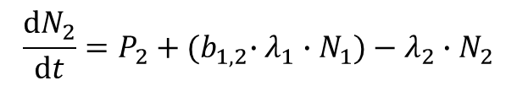
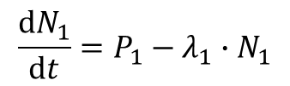

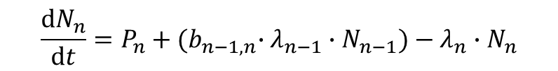
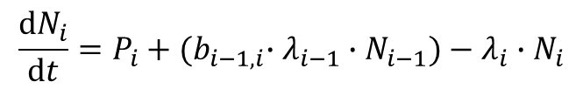
Calculation of activity – decay chains
Production & decay described via Bateman equations:
$$\frac{dN_{1}}{dt}=P_{1}−λ_{1}∙N_{1}$$
$$\frac{dN_{2}}{dt}=P_{2}+{{(b}_{1,2}∙λ}_{1}∙N_{1})−λ_{2}∙N_{2}$$
N_{n} … Number of nuclides of isotope n
P_{n} … Production rate of isotope n
l_{n …} Decay constant of isotope n
b_{n} … Branching ratio from isotope n-1 into n
…
…
$$\frac{dN_{i}}{dt}=P_{i}+{{(b}_{i−1,i}∙λ}_{i−1}∙N_{i−1})−λ_{i}∙N_{i}$$
…
…
$$\frac{dN_{n}}{dt}=P_{n}+{{(b}_{n−1,n}∙λ}_{n−1}∙N_{n−1})−λ_{n}∙N_{n}$$
build-up
decay
written with a matrix A
(ignoring production in a first simplification)
$$\dot{N}=AN with N\left(0\right)= N_{0}$$

Slide 21
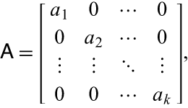
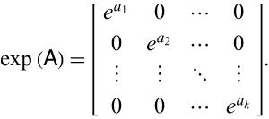


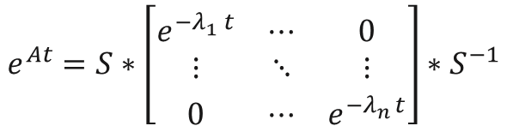



Calculation of activity – decay chains
$$\dot{N}=AN$$
can be solved via matrix exponential method
$$N(t)=e^{At}N_{0}$$
where
$$e^{At}$$
is the so-called matrix exponential
Matrix exponential e^{A} is unfortunately not the exp() of each matrix element but an algebraic mapping.
exp() of each matrix element only works for diagonalized matrices:
→ Eigendecomposition (if matrix is not defective)
$$e^{At}=S∗\left[\begin{matrix}e^{{−λ}_{1}^{}t} & ⋯ & 0 \\ ⋮ & ⋱ & ⋮ \\ 0 & ⋯ & e^{{−λ}_{n}^{}t}\end{matrix}\right]∗S^{−1}$$
$$S=\left[\begin{matrix}↑ & ↑ & ↑ \\ v_{1} & … & v_{n} \\ ↓ & ↓ & ↓\end{matrix}\right]$$
Matrix of eigenvectors v
$$λ_{1},…,λ_{n}$$
Eigenvalues λ

Slide 22
Calculation of activity – decay chains
Numerically robust solution depends on the scale of the period t and the decay
constants of the involved isotopes
Mixture of short & long lived isotopes typically introduce an arbitrarily large span of Eigenvalues λ →
condition number (~”difficulty to solve the Eigenwert problem”) is the ratio of λ_{max}/ λ_{min}
Not every matrix can be diagonalized ☹ → e.g. approximation via a series (Sylvester’s theorem) or other
numerical methods
does not (yet) include external production (requires additional integral term to be solved):
Notes:
Mathematically the problem is that the notion of “zero” is very different when looking at large and at small numbers. For example, for 6e23 adding 1e7 (remember that on a computer double precision accuracy is ~1e-16) still gives 6e23 → thus 1e7 can be considered as 0. However, for a small number like 1e-23 this would result to 1e-39 as being considered as 0. Mixing numbers of largely varying orders of magnitude in one expression, will numerically cause havoc and very quickly make your matrices quasi-impossible to solve.
When looking at a matrix equation A*b = c small changes/algorithmic errors on the left-hand side are amplified by the mapping represented by A. This amplification is given by the ratio of the Eigenvalues of A. Looking at long-lived and short-lived isotopes in the same chains will result in largely different Eigenvalues and thus, small algorithmic or numerical precision errors can be amplified enormously which quickly brings the solvers into the region of numerical instability! → requires introduction of preconditioning (e.g. Cholesky factorization)

Slide 23

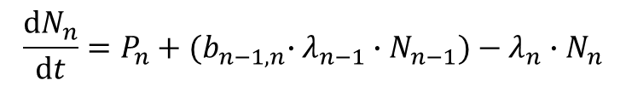
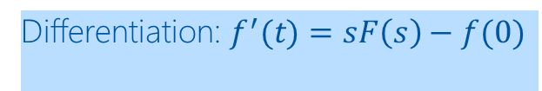

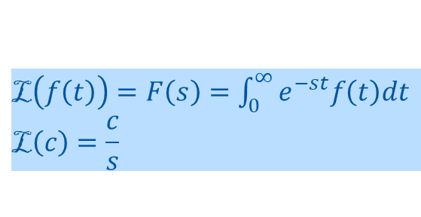
Calculation of activity – decay chains
$$\frac{dN_{n}}{dt}=P_{n}+{{(b}_{n−1,n}∙λ}_{n−1}∙N_{n−1})−λ_{n}∙N_{n}$$
$\text{L}\left(f\left(t\right)\right)=F\left(s\right)=\int_{0}^{∞}{e^{−st}f\left(t\right)dt}$
$$\text{L}\left(c\right)=\frac{c}{s}$$
Laplace transform
Linearity: $af\left(t\right)+bg\left(t\right)=aF\left(s\right)+bG(s)$
Differentiation: $f^{′}(t)=sF\left(s\right)−f(0)$
$$s∙F_{n} \left(s\right)−N_{n}(t=0) =\frac{P_{n}}{s}+{b_{n−1,n}∙λ}_{n−1}∙F_{n−1}(s)−λ_{n}∙F_{n}(s)$$
Retransform
$$\text{L}{\left(F\left(s\right)\right)}^{−1}=N(t)$$
Fully analytical solution without numerical
approximations & boundary condition
constraints
k … index of irradiation/cooling cycle
i … generation in the decay chain
decay
build-up

Slide 24
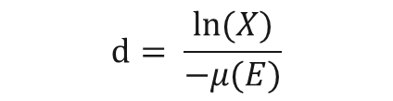

Shielding of residual radiation
Important for optimization of interventions & transport
For a given distance between source & point of interest the attenuation of the unshielded dose D₀
of a mono-energetic source behind a shielding of thickness d can be calculated using the attenuation
coefficient μ(E) :
$$D\left(d\right)={D_{0} e}^{−μ\left(E\right)d}$$
$$X:=\frac{D(d)}{D_{0}}$$
In practice the desired relative attenuation X is defined and the thickness d
is to be calculated → trivial:
$$d= \frac{ln⁡(X)}{−μ(E)}$$

Slide 25
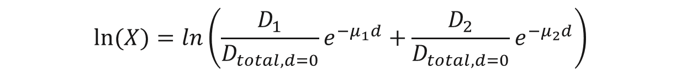
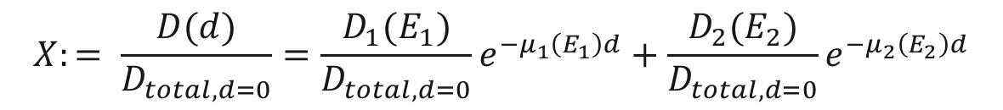

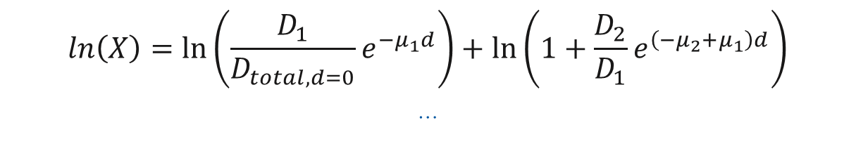
Shielding of residual radiation
Let’s look at a radioisotope which has two dominant energies, e.g. Co-60, which both contribute
to the dose :
$$D_{total}(d)={D_{1}\left(E_{1}\right)e}^{−μ_{1} \left(E_{1}\right)d}+{D_{2}\left(E_{2}\right)e}^{−μ_{2} \left(E_{2}\right)d}$$
D_{i} (E_{i}) … dose contribution of gamma line with energy E_{i}
$μ_{i}\left(E_{i}\right)$ … attenuation coeff. of gamma line with energy E_{i}
$$X:= \frac{D(d)}{D_{total,d=0}}={\frac{D_{1}(E_{1})}{D_{total,d=0}}e}^{−μ_{1}\left(E_{1}\right)d}+{\frac{D_{2}(E_{2})}{D_{total,d=0}}e}^{−μ_{2}\left(E_{2}\right)d}$$
So we need to solve for d:
$$ln⁡(X)=ln\left(\frac{D_{1}}{D_{total,d=0}}e^{−μ_{1}d}+\frac{D_{2}}{D_{total,d=0}}e^{−μ_{2}d}\right)$$
/ $ln\left(x+y\right)=\ln\left(x\right)+\ln\left(1+\frac{y}{x}\right)$
$$\ln\left(X\right)=\ln\left(\frac{D_{1}}{D_{total,d=0}}e^{−μ_{1}d}\right)+\ln\left(1+\frac{D_{2}}{D_{1}}e^{\left(−μ_{2}+μ_{1}\right)d}\right)$$
…
…even for seemingly simple cases this gets complicated to solve for d due to the logarithm of a sum….

Slide 26
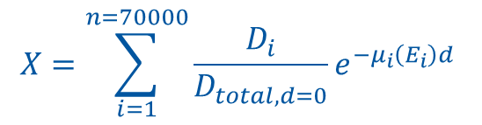
Shielding of residual radiation
The gamma energies found in an activated electronic circuit board coming
from the LHC (~70.000):
Solve for d to find the shielding thickness w.r.t. desired
relative attenuation X:
$$X=\sum_{i=1}^{n=70000}{\frac{D_{i}}{D_{total, d=0}}e^{−μ_{i}\left(E_{i}\right)d} }$$
….good luck ☺

Slide 27


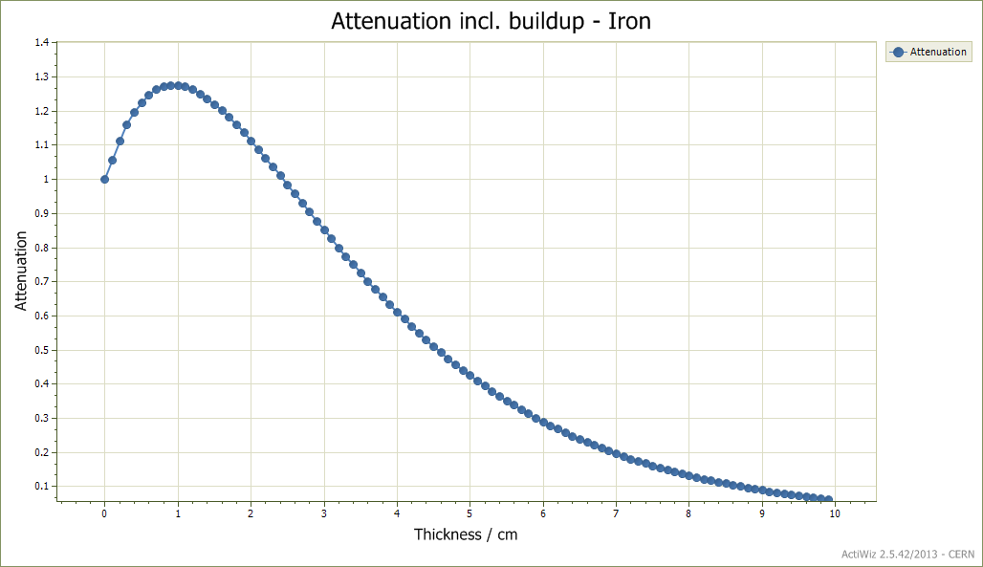
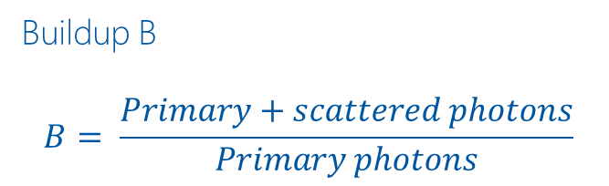
Shielding of residual radiation - buildup
Buildup B
$$B= \frac{Primary+scattered photons}{Primary photons}$$

Slide 28
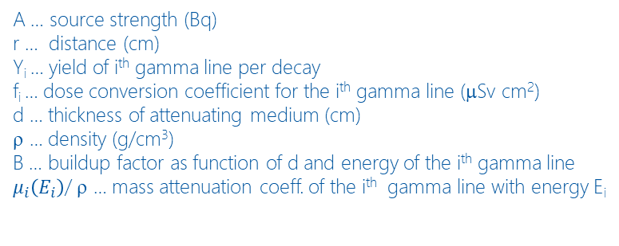
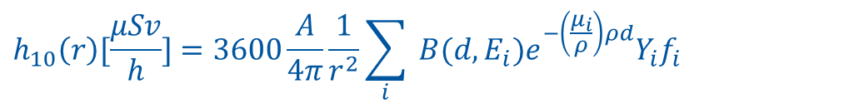
Shielding of residual radiation
Buildup factors can be found in literature for different materials and shielding thicknesses d
Putting it all together one finds for the dose rate from one isotropic point source:
$$h_{10}\left(r\right)[\frac{μSv}{h}]=3600\frac{A}{4π}\frac{1}{r^{2}}\sum_{i}{ B(d,E_{i})e^{−\left(\frac{μ_{i}}{ρ}\right)ρd}Y_{i}f_{i}}$$
A … source strength (Bq)
r … distance (cm)
Y_{i} … yield of i^{th} gamma line per decay
f_{i} … dose conversion coefficient for the i^{th} gamma line (μSv cm²)
d … thickness of attenuating medium (cm)
ρ … density (g/cm³)
B … buildup factor as function of d and energy of the i^{th} gamma line
$μ_{i}\left(E_{i}\right)$/ ρ … mass attenuation coeff. of the i^{th} gamma line with energy E_{i}
At hadron/ion beam energies of >1 GeV we can easily create many hundreds of different isotopes within the different
materials → dose rate calculation becomes very heavy → Monte Carlo is an extremely elegant and powerful solution

Slide 29
Measurement of residual radiation
Prompt ionizing radiation
beam on
Ionizing Radiation due to induced radioactivity
beam off
Whole particle zoo with E up to initial beam energy
α, β-, γ-radiation,
Main γ energies: < 2.76 MeV

Slide 30
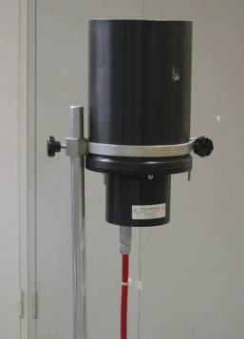
Measurement of residual radiation
In the tunnel we use so called IAM (induced activity monitoring) detectors
PE wall (4mm) / inside graphite coated
Wall composition: C-H₂
Active volume
Filling gas: air atmospheric pressure
Anode: PE / graphite coated
Active volume: 3l
Voltage: ~460 V
Various connectors

Slide 31
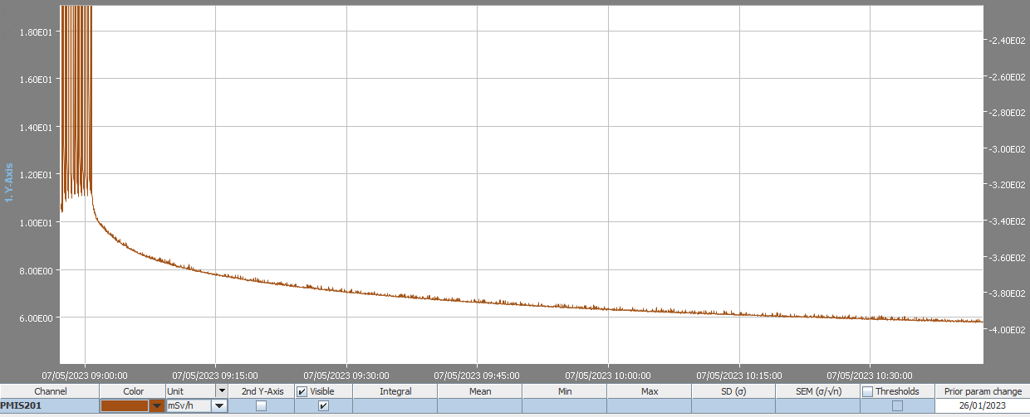
Measurement of residual radiation
Beam on
Manufactured by PTW Freiburg;
Measuring range : 5 µSv/h to >10 Sv/h
Min. energy : 50 keV
Measuring time : from 1 to 3600 s
Typical value 60 s
Typical graph used to plan interventions
(Work and dose planning)
Beam off

Slide 32
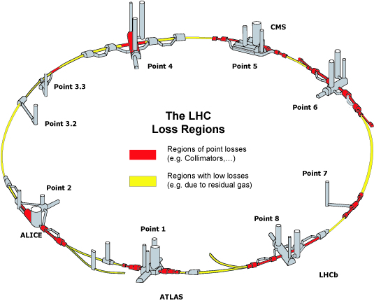
Measurement of residual radiation
IAM are installed in high loss regions (red) around the LHC. Especially in the two beam cleaning regions (Points 3 and 7) and the dump caverns (point 6).
156 IAM installed at LHC
(33 in experimental caverns)
Courtesy of D. Perrin

Slide 33
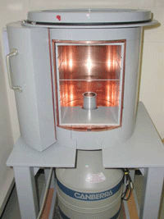
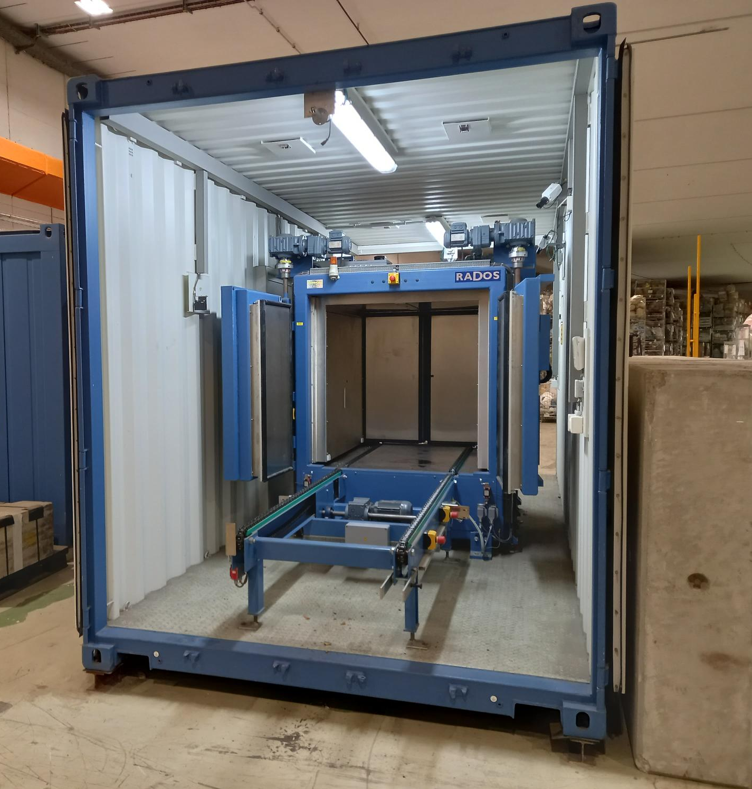
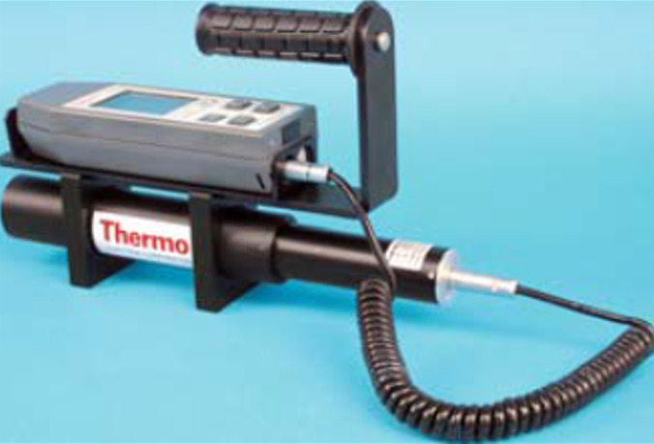
Measurement of residual radiation
To measure residual radiation from equipment/waste:
Handheld BGO counters
(Bismuth Germanate scintillators)
g-spectrometry samples
Total gamma counters
yields information on
nuclide inventory
agnostic to nuclide inventory
→ appropriate calibration is important
agnostic to nuclide inventory
→ appropriate calibration is important

Slide 34
Thank you for your attention
Acknowledgements: all members of the HSE-RP group who all contributed in one way or the other to this material

