Slide 1
Timepix3 Radiation Monitor applications
Daniel Prelipcean
RADMEP Workshop 2024
https://indico.cern.ch/event/1412225
2024.12.09

Slide 2
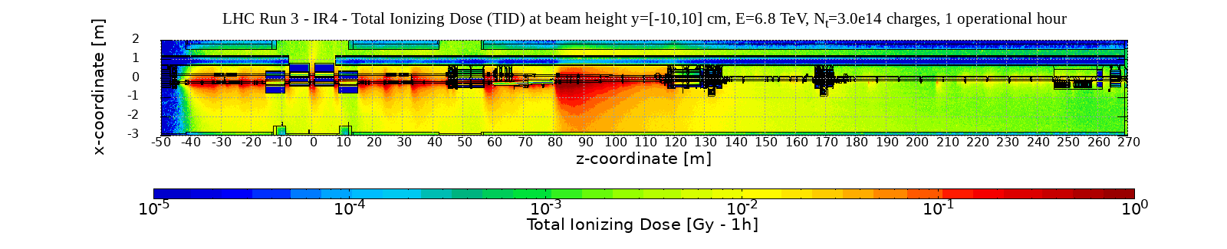
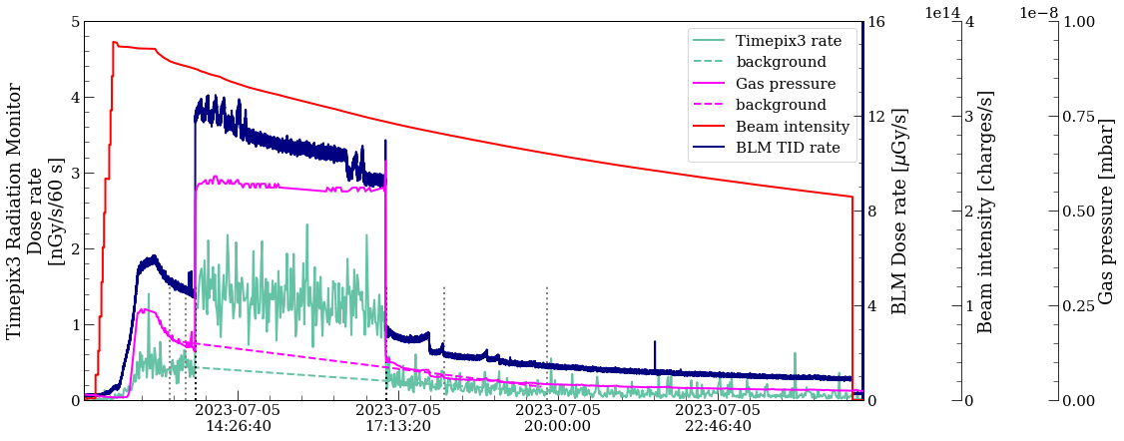
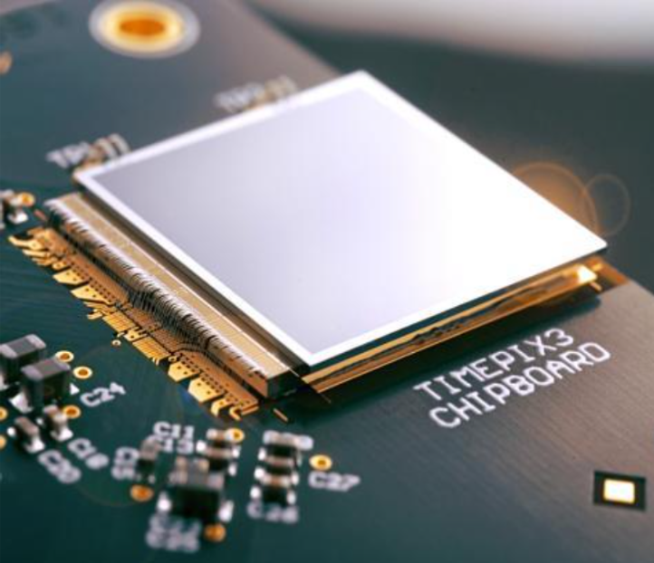
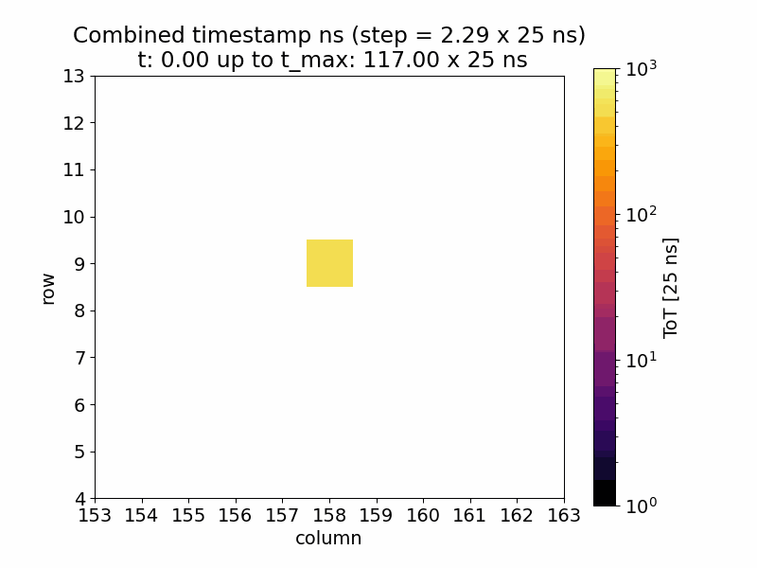
Table of Contents
Prospects
1. The Timepix3 Radiation Monitor
2. LHC IR4 radiation environment
3. Timepix3 Radiation Monitor measurements at LHC IR4

Slide 3
1. Timepix3 Radiation Monitor

Slide 4
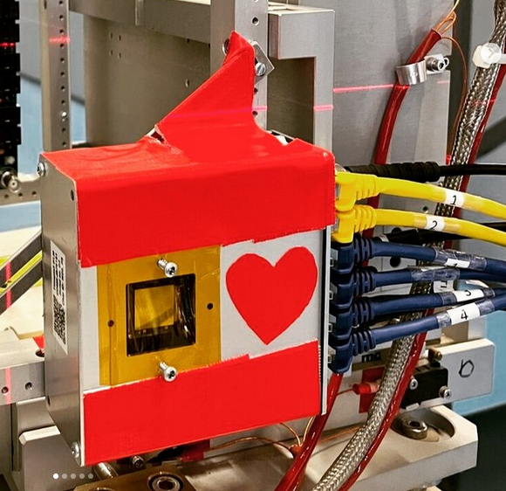
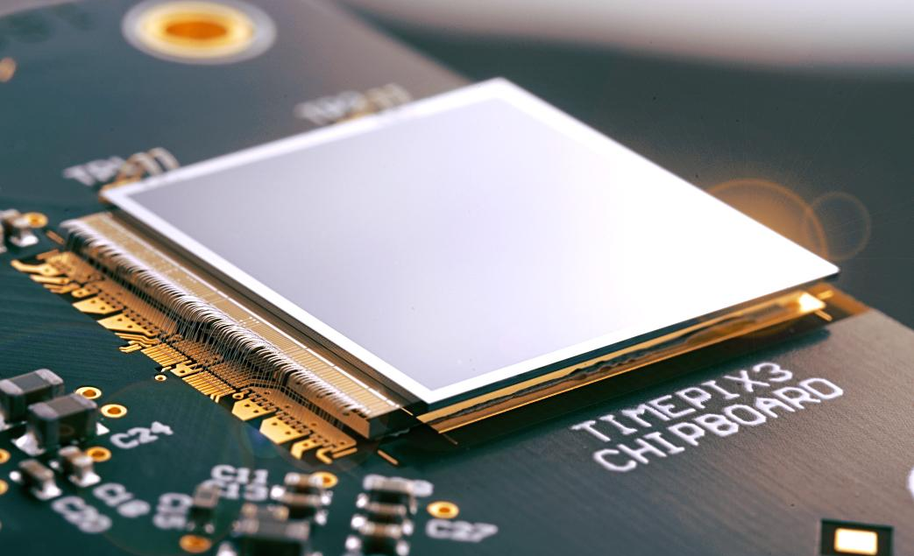
Timepix3 Radiation Monitor
p-in-n Silicon detector, composed of 256 x 256 pixels with a pixel pitch of 55 um.
operated at a partial bias voltage (50 V), leading to a depletion layer thickness of 250 um.
Measures:
Time-over-Threshold (ToT) and Time-of-Arrival (ToA) in units of 25 ns (40 MHz).
fast Time-of-Arrival (fToA) in units of 1.56 ns.
Timepix3 Radiation Monitor during HEARTS@2023
Source: Levasseur S., Development of a Hybrid Pixel Detector Based Transverse Profile Monitor for the CERN Proton Synchrotron, PhD thesis

Slide 5
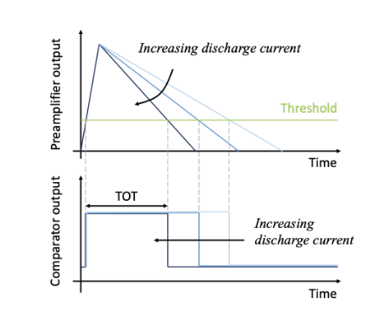
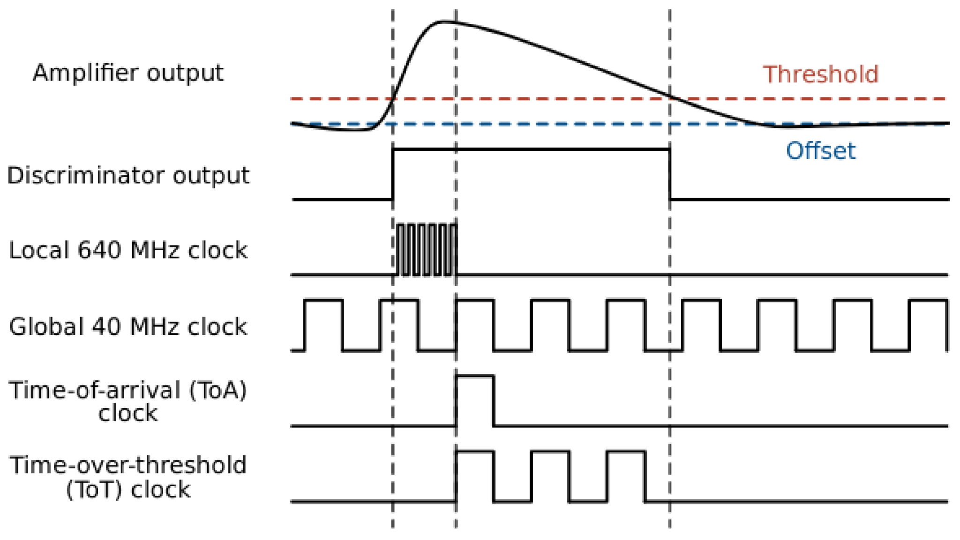
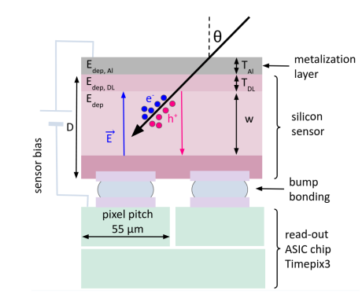
The ToT principle
1. D. Prelipcean et al,
Towards a Timepix3 Radiation Monitor for the Accelerator Mixed Radiation Field: Characterisation with Protons and Alphas from 0.6 MeV to 5.6 MeV.
in Applied Sciences 14, no. 2: 624, January 2024. DOI: 10.3390/app14020624.

Slide 6
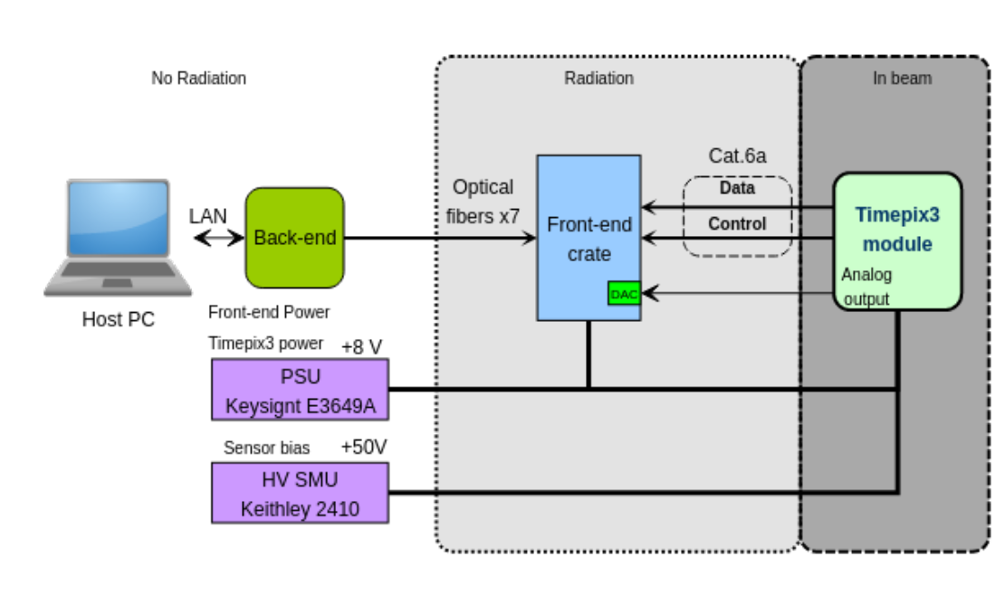
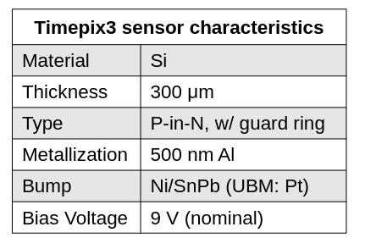
BGI Pixel setup: block diagram
Setup developed by CERN SY/BI group
‹#›

Slide 7
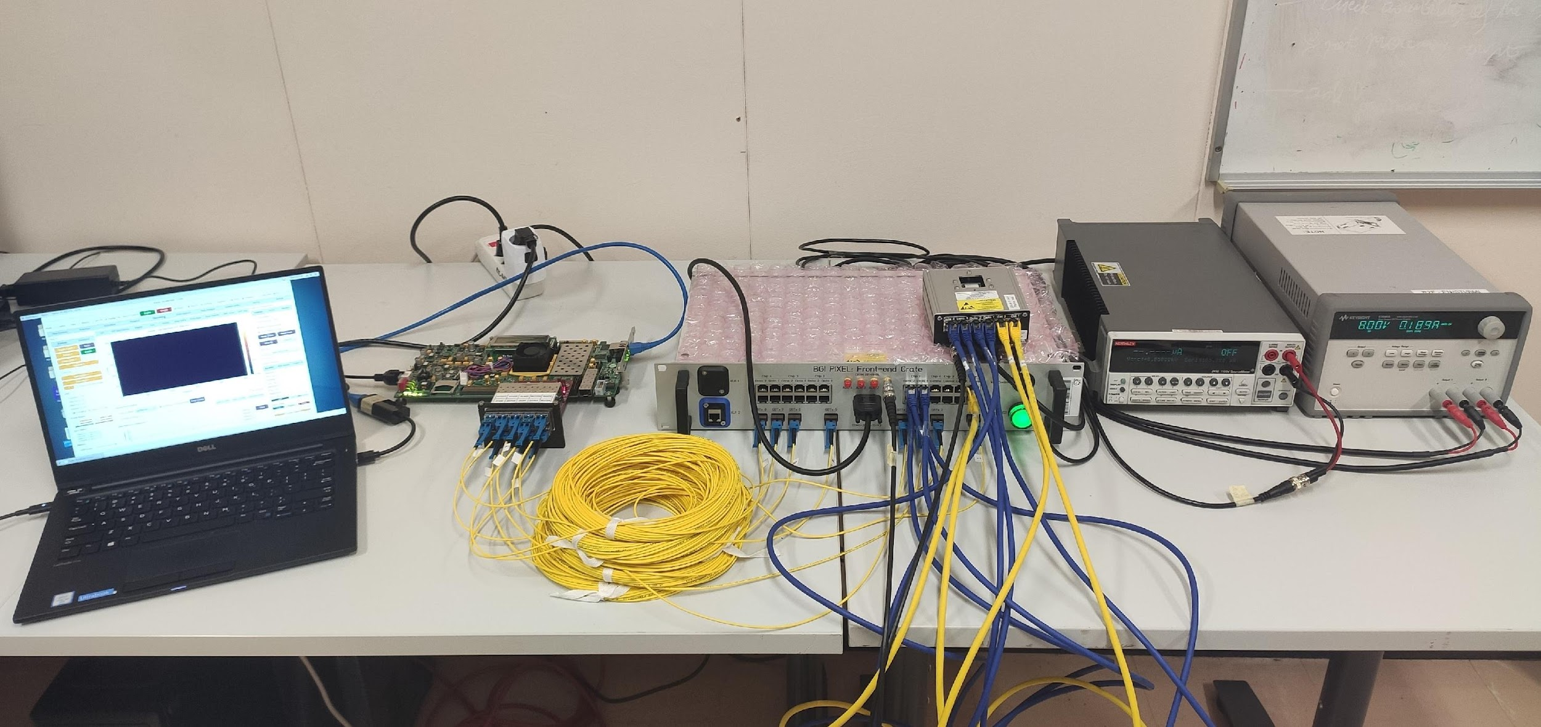
BGI Pixel setup
Back-end electronics
Front-end electronics
Timepix3 module
Laptop with
BIPXL
software
running
Timepix3 + frontend crate power supply (2 x 8V)
Timepix3 detector power supply (+50V)
‹#›

Slide 8
Analysis Status for the R2E Timepix3 test campaigns
Year | Month | Device | Test Campaign | Particles | Purpose | analysis status | info/ references
2021 | 02 | T-Rex | ILL | cold neutrons (peaked @6.67 meV) | calibration | finalized | first tests with neutrons
 | 07 | T-Rex | CALLAB - radioactive sources | alphas @ 4.7 MeV | calibration | finalized | first tests with charged particles
 |  |  |  | gammas @1.17 and 1.13 MeV
2022 | 02 | T-Rex | CALLAB - AmBe | neutrons (up to 10 MeV) | calibration | finalized | to be submitted to RADECS
 | 05 | T-Rex | CNA | protons from 0.6 to 6 MeV | calibration | finalized | published in [1]
 |  |  |  | alphas from 1 to 8.4 MeV
 | 11 | T-Rex | NorthArea | heavy ions (Pb @ 450 GeV/n) | beam characterisation | in progress | parly published in [2]
 | 11 | T-Rex | IR8 - CODEX | muon (peaked @ 120 MeV) | accelerator | finalized | presented at [3]
2023 | 03 to 10 | T-Rex | IR4 - BGC | charged hadrons (muons and protons) and neutrons | accelerator | finalized | presented at [4]
 | 10 | T-Rex | HEARTS | heavy ions (Pb @ 0.6 to 2.7 GeV/n) | calibration | in progress
2024 | 03 to 06 | T-Rex | IR1 - SND | muons | accelerator | finalized | presented at [5]
 | 06 to date | T-Rex | IR4 - BGC | charged hadrons (muons and protons) and neutrons | accelerator | finalized
 | 07 | Katherine | ISIS ChipIr | neutrons (atmospheric, up to 300 MeV) | beam characterisation | in progress
 | 10 | Trident | IR2 - QPS failures | accelerator mixed field | accelerator | in progress
 | 11 | Katherine | HEARTS | heavy ions (Pb @ 0.6 to 2.7 GeV/n) | beam characterisation | in progress
2025 | 2 | T-Rex/Katherine | CNA | protons up to 1 MeV | calibration | planned
 |  |  |  | Ni @ 25 MeV | calibration
1. D. Prelipcean et al,
Towards a Timepix3 Radiation Monitor for the Accelerator Mixed Radiation Field: Characterisation with Protons and Alphas from 0.6 MeV to 5.6 MeV.
in Applied Sciences 14, no. 2: 624, January 2024. DOI: 10.3390/app14020624.
2. M. S. Barbero et al,
Characterization of Fragmented Ultra-high Energy Heavy Ion Beam and its Effects on Electronics Single Event Effect Testing.
in IEEE Transactions on Nuclear Science, January 2024. DOI: 10.1109/TNS.2024.3396737.
3. D. Prelipcean et al,
Radiation Monitoring in the D1 area
in 1st CODEX-b week.
https://indico.cern.ch/event/1239064/contributions/5439527/
4. D. Prelipcean, et al,
Study of the radiation background and of new monitoring tools at the LHC for Run 3 and the HL-LHC, in 26th Gentner Day. https://indico.cern.ch/event/1393957/
5. E. Revani et al,
Measurement of the muon rate background at the SND experiment with the Timepix3 Radiation Monitor
in Summer student reporting
https://indico.cern.ch/event/1443723/

Slide 9
2022-03 CNA
Monoenergetic charged particles
0.6 to 8.4 MeV

Slide 10
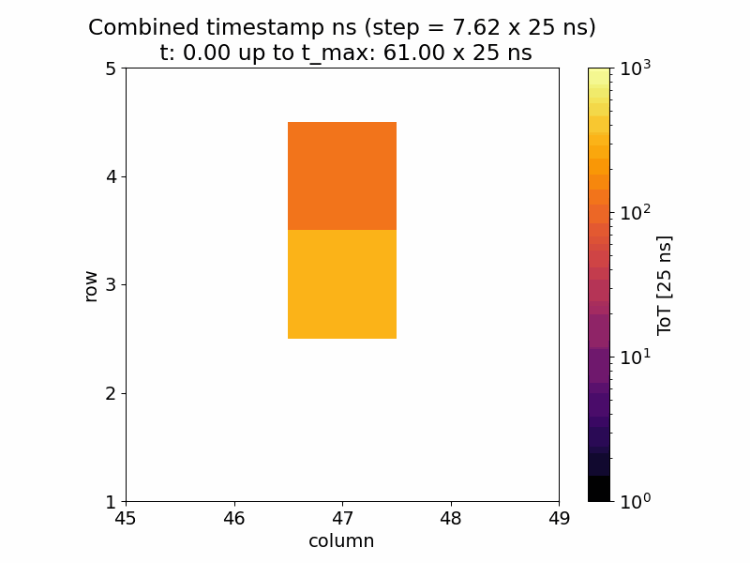
Seeing the Timepix3 Radiation Monitor blossom
0.6 MeV proton
8.405 MeV alpha

Slide 11
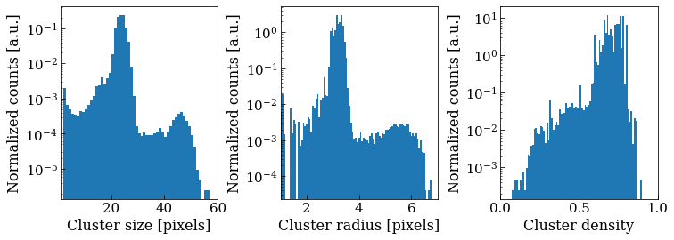
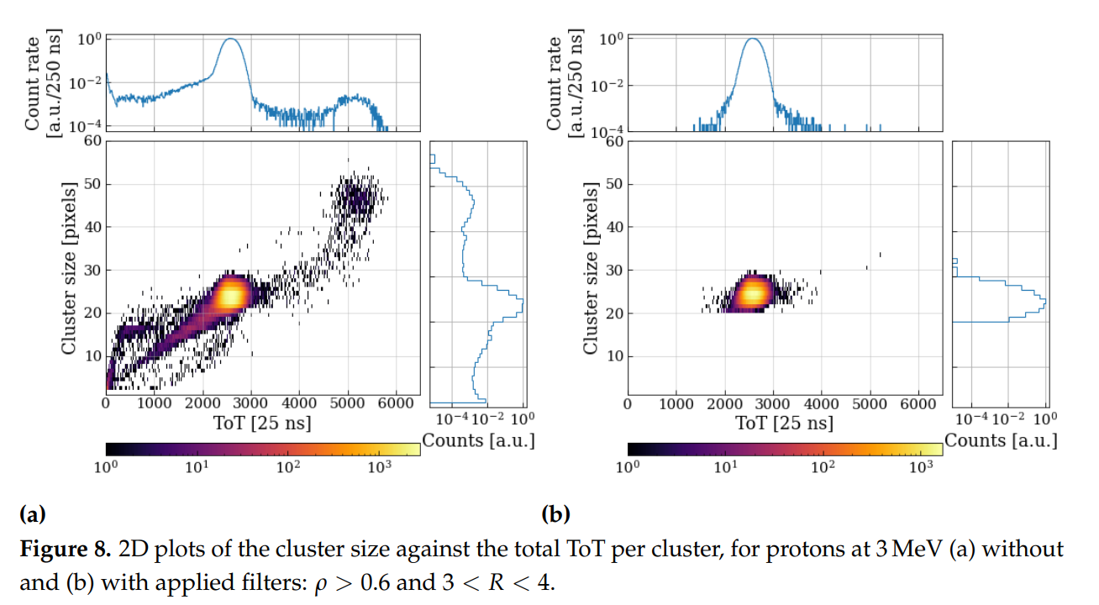
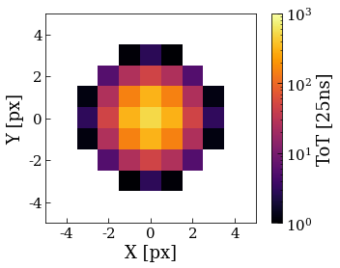
Event selection
Define cluster parameters:
  cluster volume, size, radius, density
Hadrons leave circular blobs (with high density)
Cluster size (and radius) increasing with energy.

Slide 12
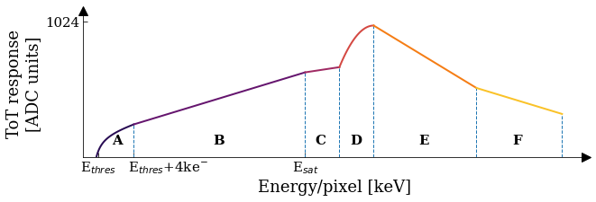
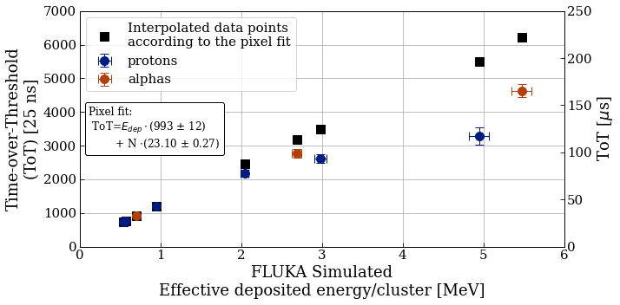
ToT-Energy calibration
Linear only up to a saturation threshold E_{sat} (around 1 MeV/pixel).
Followed by highly non-trivial and multiple-valued dependencies.
For the CNA test campaign, barely probing region C.
Further saturation effects (e.g. volcano) can be expected for even higher energy depositions.

Slide 13
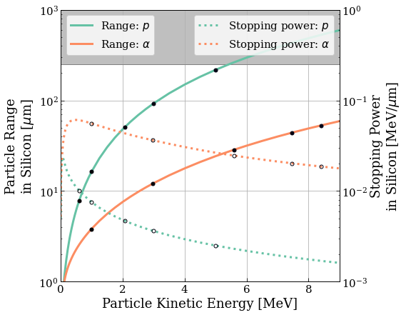
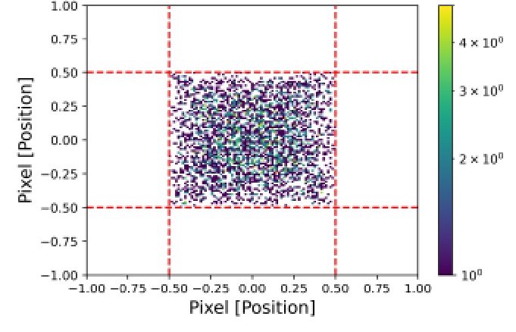
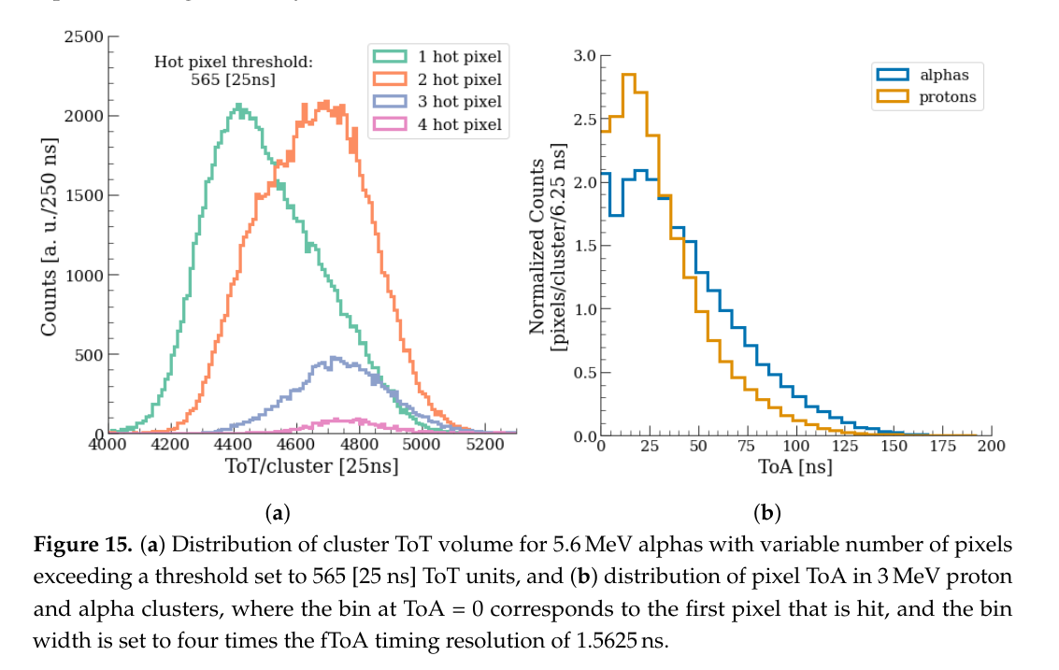
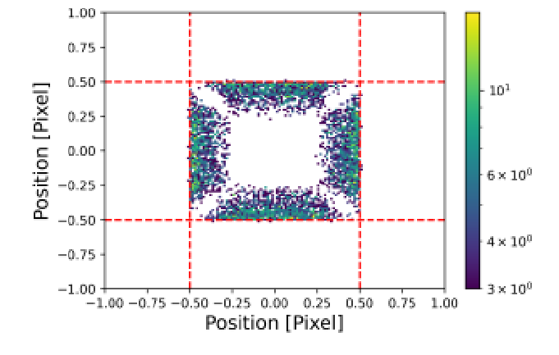
And many more features
1 hot pixel
2 hot pixel
Different stopping power translates into different energy deposition depth that that takes more/less time to be collected at the corresponding electrode.
P. Christodoulou et al, Probability distribution maps of deposited energy with sub-pixel resolution for Timepix3 detectors
in Journal of Instrumentation, Volume 19, January 2024. DOI: 10.1088/1748-0221/19/01/C01026

Slide 14
2022-11 North Area - Heavy Ions

Slide 15
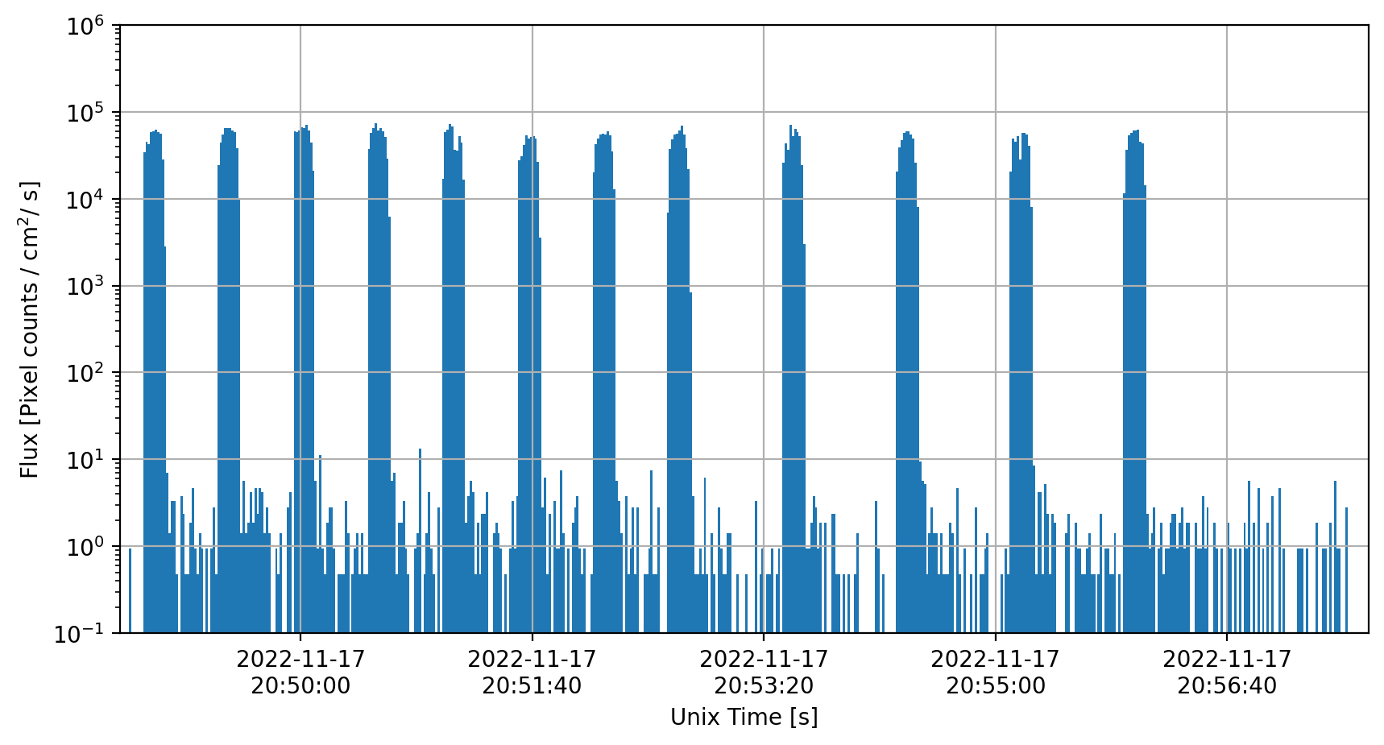
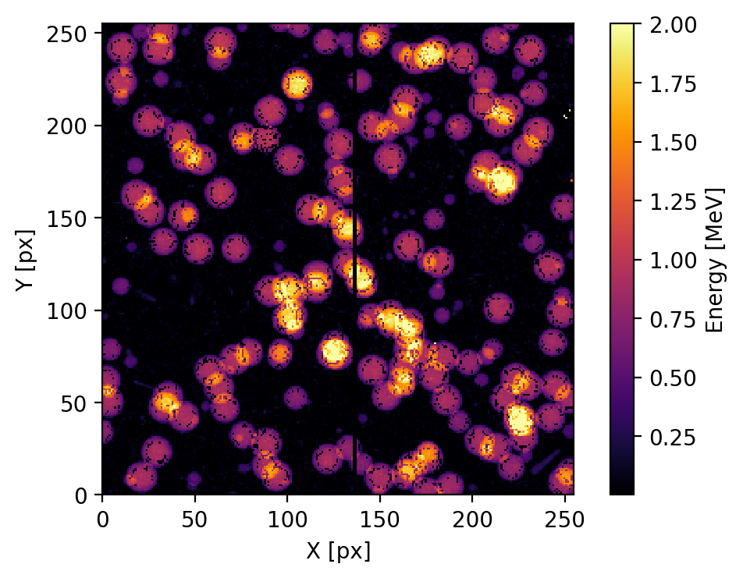
2022-11 North Area - Heavy Ions
Flux in Pixel Hits
Beam shape / Alignment / Decomposition

Slide 16
2022-11 IR8 - CODEXb

Slide 17
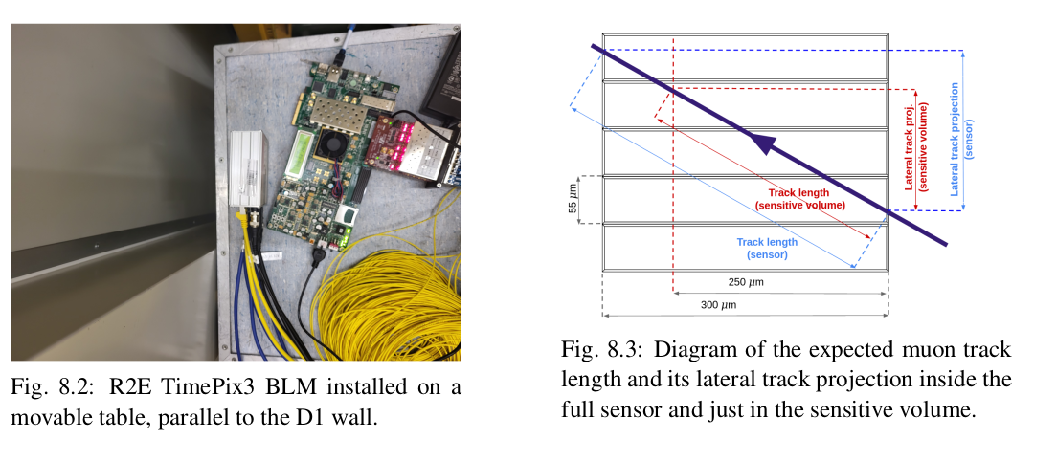
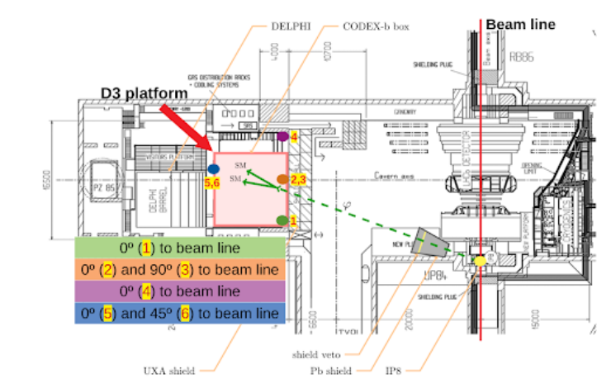
Scope
Quantify if the muon flux is higher during luminosity production at LHCb/IP8 as compared to the background at LHCb in the D1 shielded area, the foreseen location of the CODEX-b experiment.
Detector installed at the same level with the IP, at a 15 deg angle wrt. the perpendicular to the beamline.

Slide 18
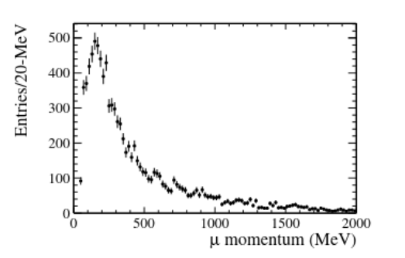
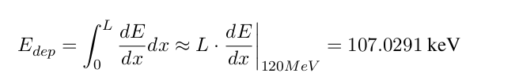
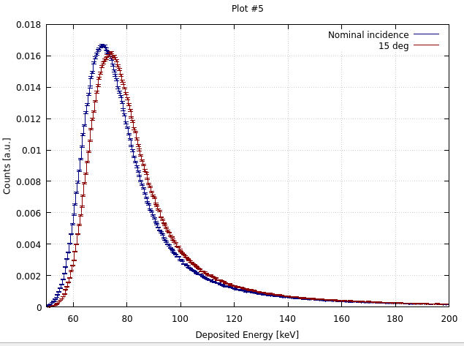
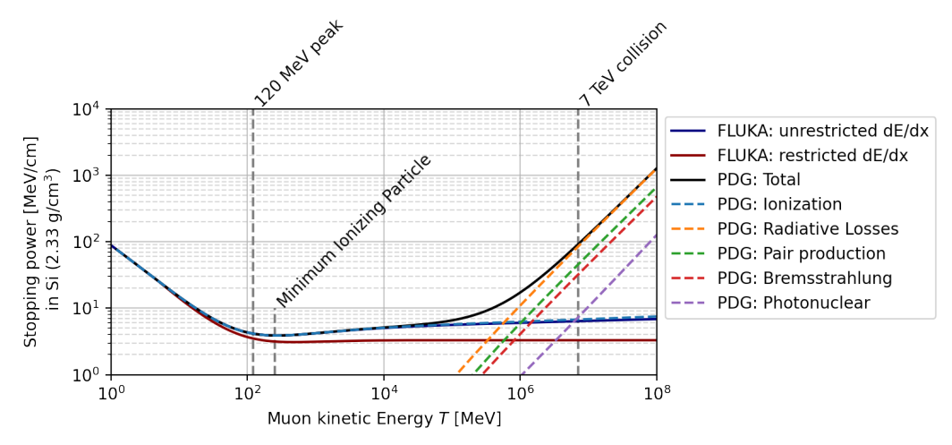
Expected signal
Muon flux peaks at ~120 MeV kinetic energy, corresponding to a Minimum Ionizing Particle regime.

Slide 19
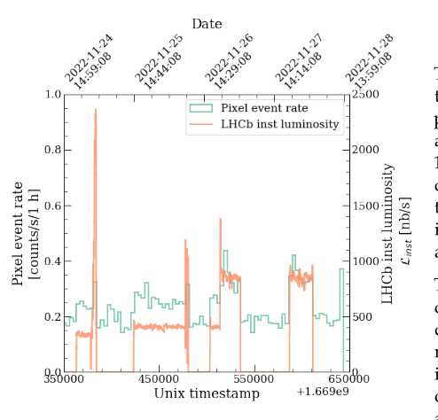
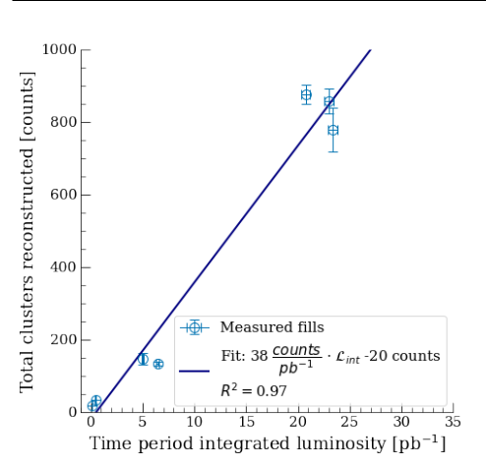
Flux measurements

Slide 20
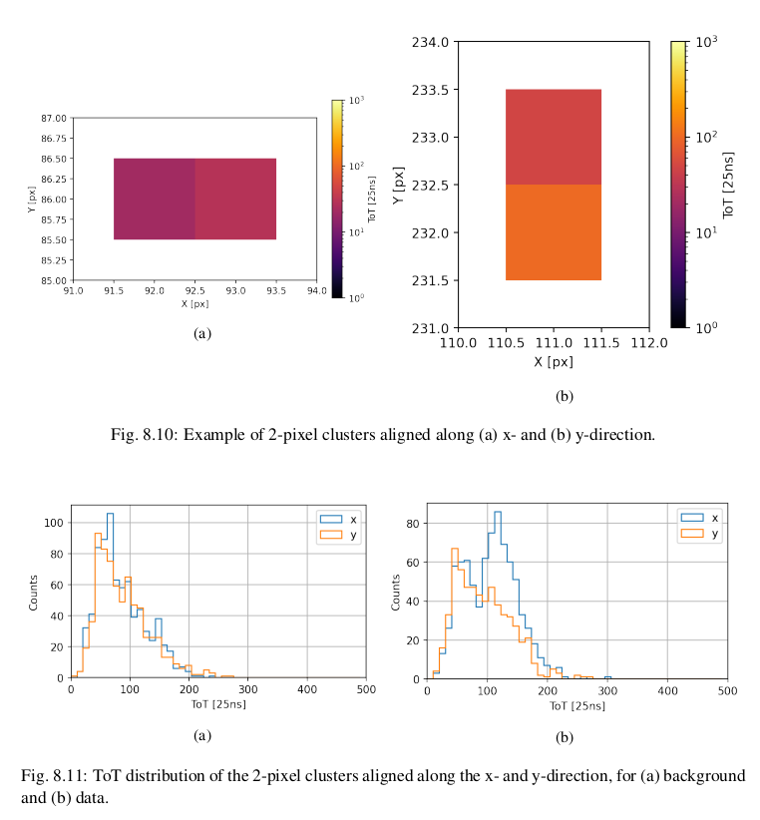
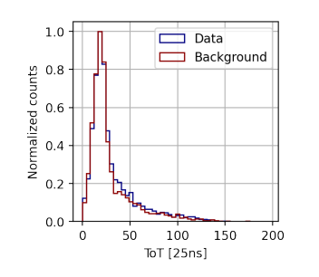
Signal selection
Assign direction to clusters:
  1 pixel -> not possible (however, signal indistinguishable from background)
  2 pixel -> straightforward
  3 pixel -> only if all 3 pixels aligned along either x or y
  4 pixels and more -> if Nx > Ny, then x

Slide 21
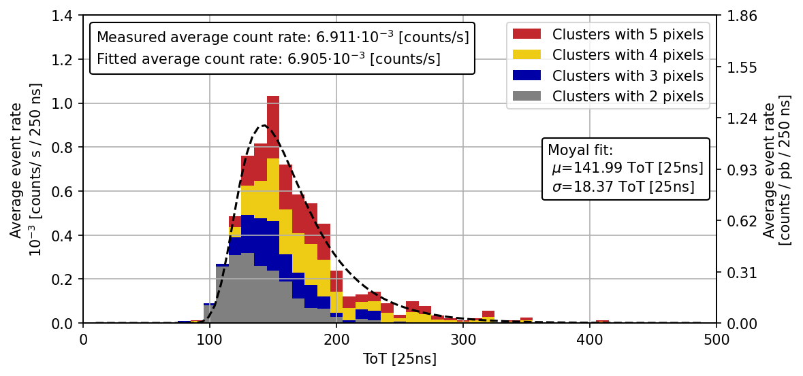
Timepix3 BLM results
Full signal is reconstructed from clusters with 2, 3, 4 and 5 pixels (from 6 and above, the signal is indistinguishable from background, consistent with geometrical expectations).
Total Timepix3 measured count rate: 6.91 milicounts/s.
  Value to be renormalized to the nominal Run 2 luminosity rate of 0.45 Hz/nb to compare with previous measurements and FLUKA simulations.
Full signal

Slide 22
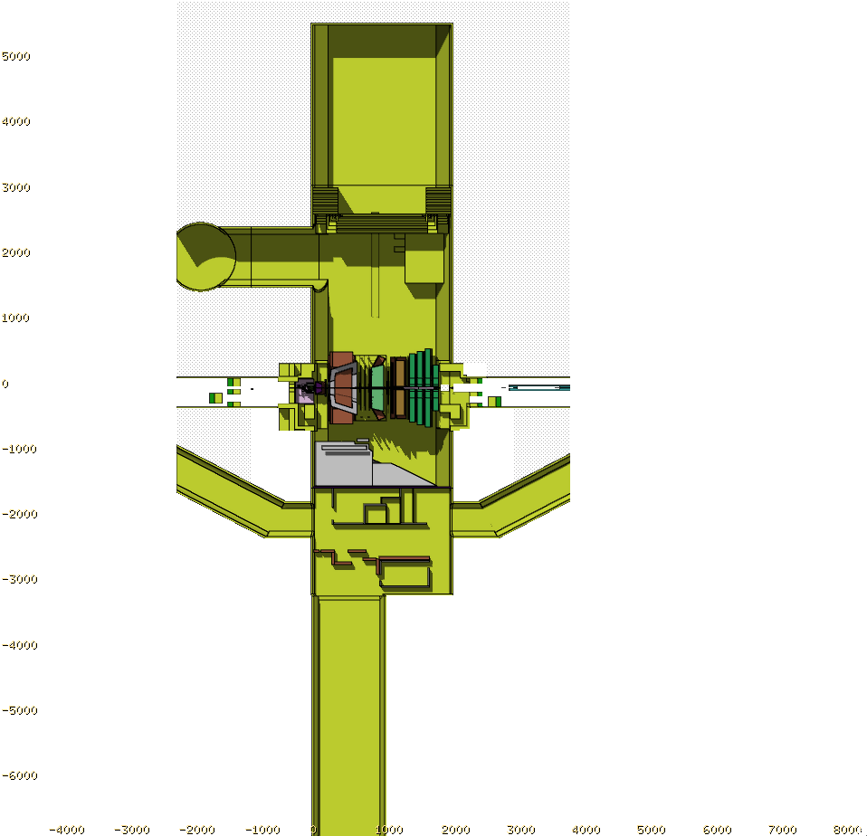
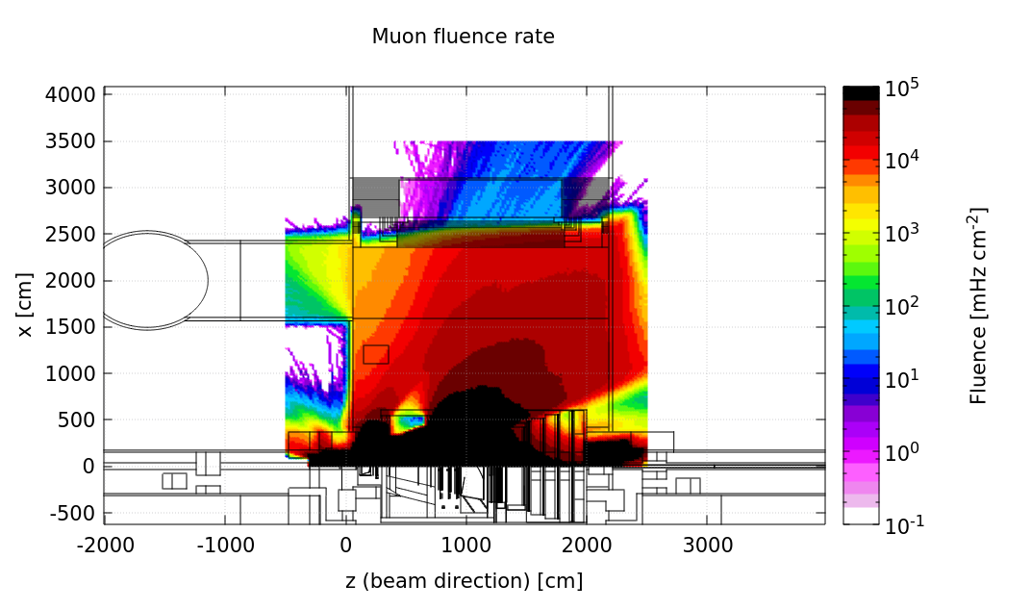
Muon fluence rate simulation
FLUKA simulations of the LHCb collisions and the muon rate inside the UXA-85.
Normalized to 0.45 Hz/nb.

Slide 23
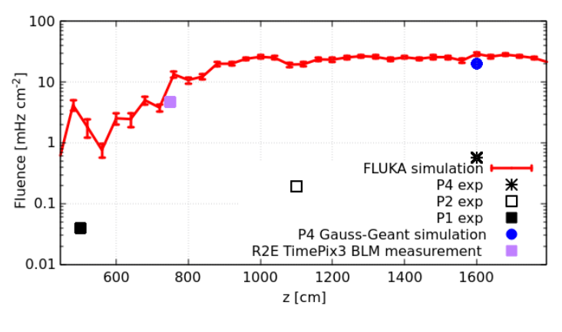
Muon fluence rate simulation and comparison
Previous measurements: Table 1 from Ref. 1
[1] Biplab Dey et al, Background studies for the CODEX-b experiment: measurements and simulation, https://arxiv.org/abs/1912.03846
The TimePix3 adds the purple data point agreeing well with the simulation.
Possible reason for disagreement of previous data - faulty trigger?

Slide 24
2023 - RP CALLAB
AmBe source neutrons up to 10 MeV

Slide 25
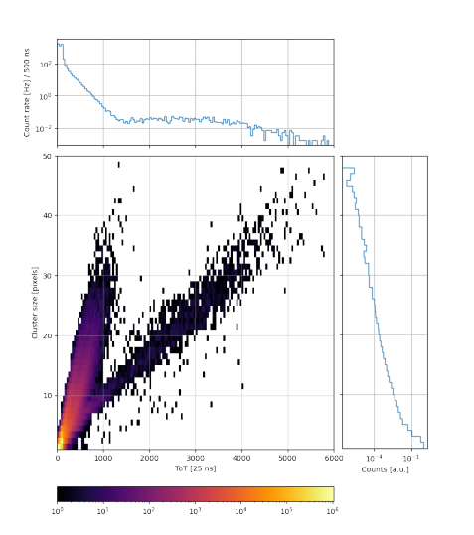
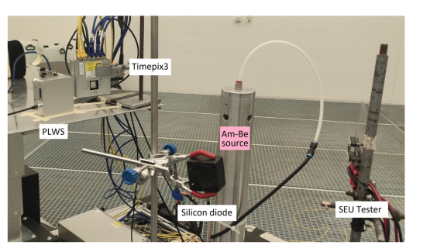
Neutron interactions
Elastic interactions - lower energy
Inelastic - can go up to beam energy

Slide 26
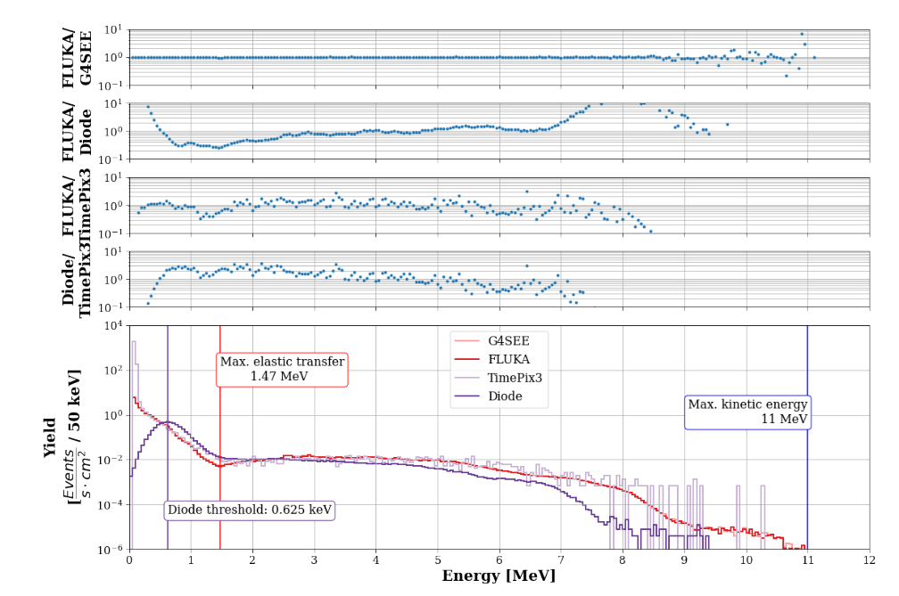
Comparison with other detectors and
Monte Carlo codes
Low measurement statistics at the higher energies
(above 7 MeV)
Very good agreement at intermediate energies
(7 MeV to detection thresholds)
Overshoot for Timepix3 at very low energies (no filter was applied to exclude background particles)
[1] Mario Sacristan Barbero
FLUKA and G4SEE point-wise neutron treatment study in a silicon detector.
https://edms.cern.ch/ui/file/2781372/1.0/FLUKA_and_G4SEE_point_wise_neutron_treatment_study_in_a_silicon_detector_v1.pdf

Slide 27
2. LHC IR4 radiation environment

Slide 28
LHC IR4 radiation environment
Discuss the radiation levels in Insertion Region 4 (IR4), an area of the Large Hadron Collider (LHC) which was previously not systematically studied, caused by Beam Instrumentation (BI) elements operation:
  Beam Gas Vertex (BGV) - presented at the High Luminosity (HL-)LHC Technical Coordination Comittee (TCC) [1] and at International Particle Accelerator Conference (IPAC) [2].
  Beam Gas Curtain (BGC) - presented at the HL-LHC TCC [3], BGC collaboration meetings [4,5]
  and IPAC [6].
  Beam Gas Ionization (BGI) - previous work based on Run 2 [7,8].
D. Prelipcean, BGV Beam gas collisions at IR4 and related radiation levels and heat loads,
in 150th HL-LHC TCC, https://indico.cern.ch/event/1129683/
D. Prelipcean et al, Radiation levels produced by the operation of the Beam Gas Vertex monitor in the LHC tunnel at IR4,
in 14th International Particle Accelerator Conference, https://accelconf.web.cern.ch/ipac2023/pdf/THPL082.pdf
D. Prelipcean, Update of radiation level specifications in IR4 (from beam gas collisions),
in 193rd HL-LHC TCC,https://indico.cern.ch/event/1397881/
D. Prelipcean, Radiation levels from BGC operation,
in the 9th BGC collaboration meeting, https://indico.cern.ch/event/1281084/
D. Prelipcean, BGC radiation hard background simulation and camera protection,
in the 10th BGC collaboration meeting, https://indico.cern.ch/event/1350731/
D. Prelipcean et al, Radiation levels from a beam gas curtain instrument at the LHC at CERN,
in 15th International Particle Accelerator Conference, https://www.jacow.org/ipac2024/pdf/THPG58.pdf
C. B. Soerensen, Measuring abort gap population with beam-gas interactions in the BGI
in https://indico.cern.ch/event/1097265/contributions/4617018/attachments/2353783/
O. Stein, MD456: Monitoring of abort gap population with diamond particle detectors at the BGI in IP 4,
in https://cds.cern.ch/record/2131864/files/CERN-ACC-2016-0011.pdf

Slide 29
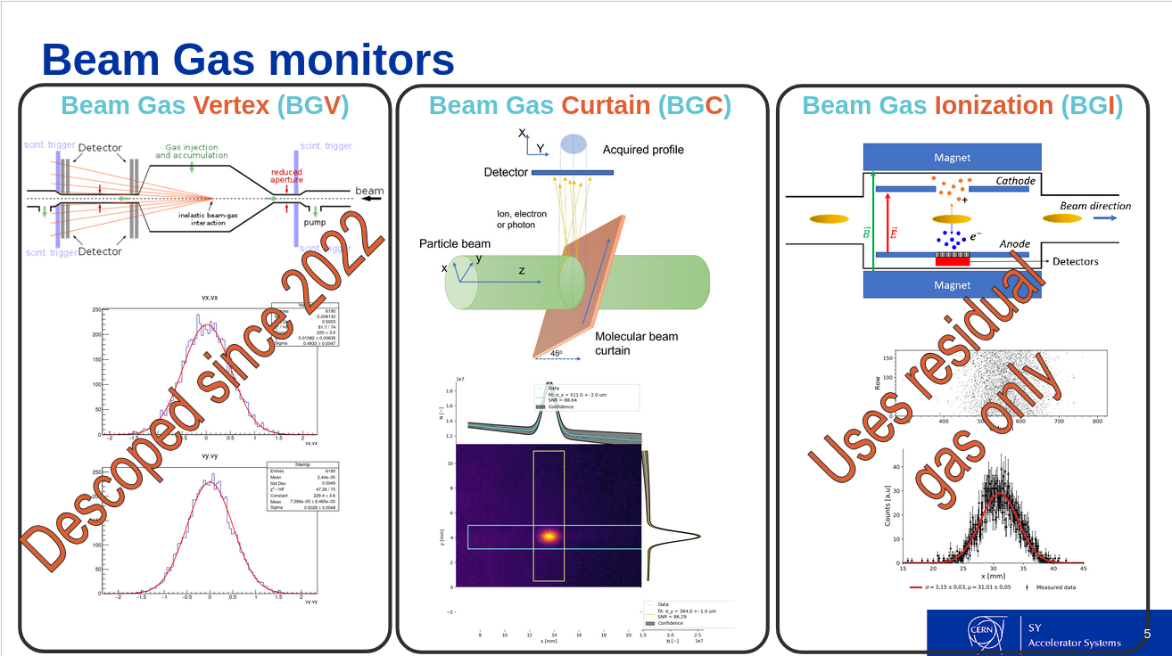

Slide 30
Methods and tools
Main objective is to determine whether the operation of these devices can lead to:
  Radiation to Electronics (R2E) issues
  excessive heat loads on the cryogenic magnets or other systems.
Key ingredients of the analysis:
  Measurements:
    from LHC Run 2 (2015-2018) with the BGV demonstrator.
    from LHC Run 3 (2022-to date) with the BGC demonstrator.
  FLUKA simulations of beam gas interactions for LHC Run 2, 3 and HL-LHC scenarios.
Strategy:
  a benchmark [1, 2] is performed between:
    the FLUKA simulation
    the existing Beam Loss Monitor (BLM) measurements
  the accuracy of the simulation is thus estimated.
  predictions are made based on the FLUKA simulations scaled to the HL-LHC operation scenario.
A. Lechner et al, Validation of energy deposition simulations for proton and heavy ion losses in the CERN Large Hadron Collider,
in Physical Review Accelerator and Beams 22, 071003 (2019), https://journals.aps.org/prab/pdf/10.1103/PhysRevAccelBeams.22.071003
D. Prelipcean et al, Benchmark between measured and simulated radiation level data at the mixed-field CHARM facility at CERN.
in IEEE Transactions on Nuclear Science, Vol. 69, No. 7, July 2022. DOI: 10.1109/TNS.2022.3169756.

Slide 31
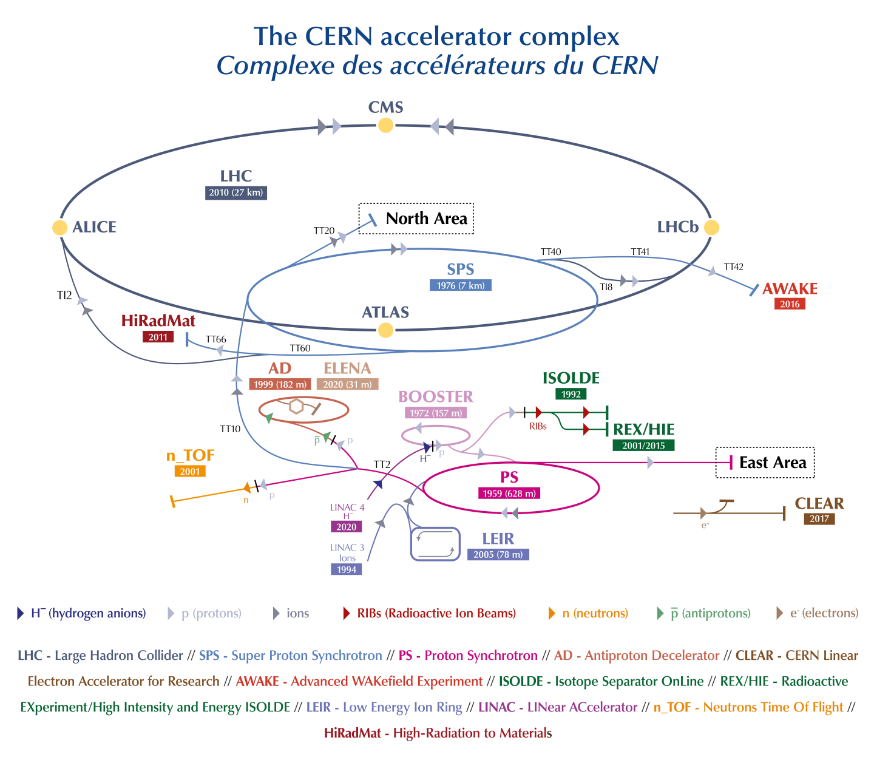
The CERN Accelerator Complex
Long sequence of accelerators and transfer lines to reach the LHC, for proton and ion operation.
Energy increase by a factor ≈30 at each step.
The four LHC interaction points (IPs) are:
ATLAS (IP1), CMS (IP5),
ALICE (IP2) and LHCb (IP8).
Many experiments and facilities
e.g. CHARM test facility,
which you are visiting later!
Figure from: cds.cern.ch/record/2684277

Slide 32
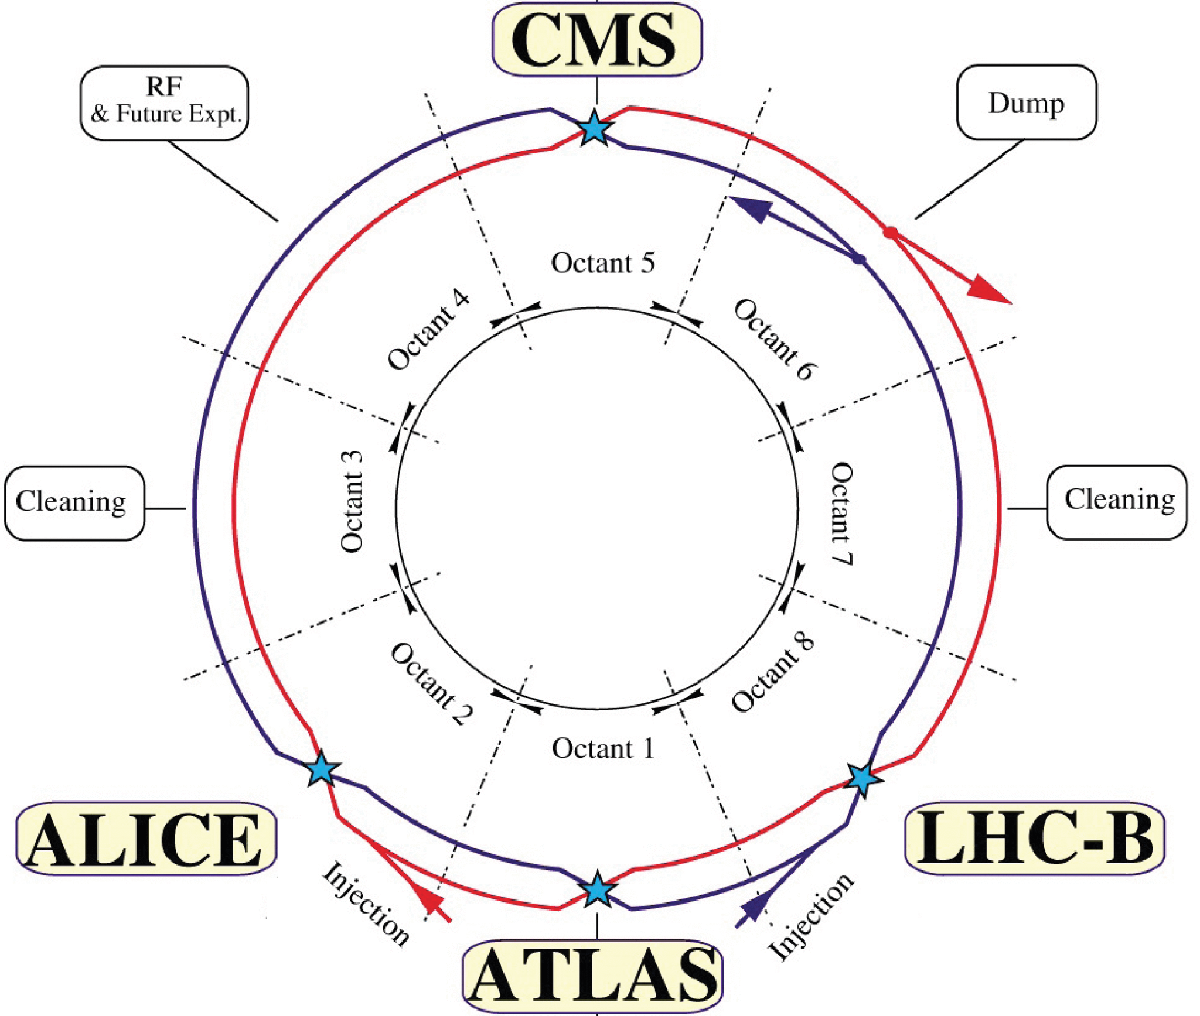
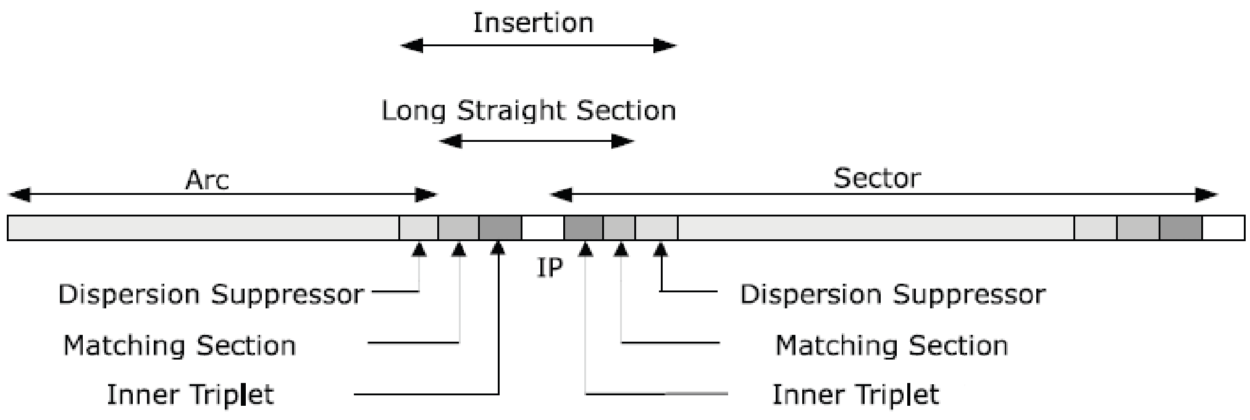
LHC layout
The LHC radiation levels depend on the location. The layout consists of eight octants with left/right sides of 34 cells.
Long straight section (LSS), cells 1-7: key LHC elements (Interaction Points, collimators, etc.).
Arc, cells 14-34: curved section with sequence of dipole and quadrupole magnets.
Dispersion suppressor (DS), cells 8-13: curved section connecting LSS and arc.
Figures from: home.cern/science/accelerators/large-hadron-collider

Slide 33
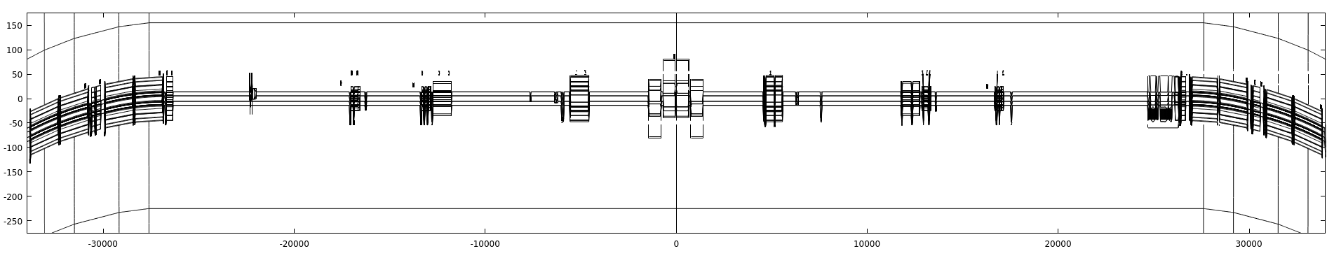
LHC IR4 layout
Radio Frequency cavities
Beam Gas Vertex (BGV) monitor
at -220 m on
beam 2
Beam Gas Curtain (BGC) monitor
at -42 m on
beam 1
Two bending dipoles to increase beam separation from 9.7 to 21 cm
Two quadrupoles for (de)focusing
Beam 2
Beam 1

Slide 34
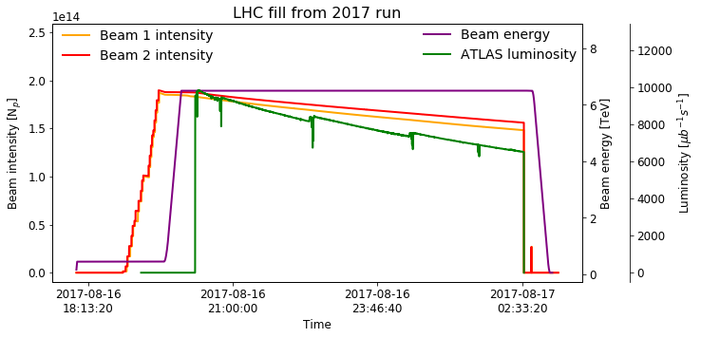
Focusing on the LHC: a typical cycle (fill)
LHC cycles are designed to deliver collisions to the experiments.
Goal: maximize time-integrated luminosity.
Radiation to electronics (R2E) failures in critical systems can lead to premature (undesired) beam dumps.
Beam injection at low energy from SPS at 450 GeV
Energy ramp from 450 GeV to 6.5 TeV
Stable beams in collisions mode for 10-20h.
Beam dump, either scheduled or accidental.

Slide 35


Radiation to electronics @CERN
The radiation to electronics (R2E) project has the main responsibility to mitigate the issue of premature beam dumps due to electronics failures caused by radiation.
Mitigation techniques can consist of:
i) (re)placement of shieldings and repositioning of equipment;
ii) now switching to prevention measures, e.g. a foreseen radiation hardness assurance (RHA) procedure for new electronics systems.
The monitoring and calculation Working Group (MCWG) in the R2E context characterizes the radiation environment by means of analysing data from different radiation monitors and of FLUKA simulations.

Slide 36
Radiation Monitors (also) used for R2E purposes
Beam loss monitors (BLMs) [1]
2. Radiation monitors (RadMONs) [2-4]
- approximately 4 000 detectors placed along the accelerator.
- radiation detectors (ionisation chambers), that detect particle showers caused by the beam losses.
- capable of measuring dose rates with good time resolution of 40 𝜇s.
- roughly 400 RadMONs, placed in strategic locations around the LHC tunnel and alcoves.
-monitor the radiation field relevant to radiation induced failures in LHC electronics.
- capable of measuring:
- cumulated dose
- high energy hadron fluence
Direct
3. Distributed Optical Fibre for Radiation Sensing (DOFRS) [5]
4. Radio-Photo-Luminescence (RPL)
Dosimeter [6,7]
- deployed in PSB, PS, SPS and LHC: dispersion suppressor (IP1, IP5 and IP7).
- well adapted to be employed in long accelerators, running parallel to the beamline.
- provides a linear map of the cummulated radiation dose with a spatial resolution of 1 m.
- used for high level dosimetry (HLD):
Dose range: 1 Gy – 100kGy.
- passive measurements.
- deployed on request

Slide 37
Radiation monitor references
E. B. Holzer et al., Beam loss monitoring system for the LHC,
in: IEEE Nuclear Science Symposium 2, October 2005
G. Spiezia et al., The LHC radiation monitoring system - RadMon,
in: Proceedings of Science 143 (2011), pp. 1–12, DOI: 10.22323/1.143.0024.
G. Spiezia et al., A New RadMon Version for the LHC and its Injection Lines,
in: IEEE Trans. Nucl. Sci. 61.6 (2014), pp. 3424–3431, DOI: 10.1109/TNS.2014.2365046.
S. Danzeca et al., Wireless IoT in Particle Accelerators: A Proof of Concept with the IoT Radiation Monitor at CERN,
in: JACoW IPAC 2022 (2022), pp. 772–775, DOI: 10.18429/JACoW-IPAC2022-TUOXGD2.
D. Di Francesca et al., Qualification and Calibration of Single-Mode Phosphosilicate Optical Fiber for Dosimetry at CERN,
in: Journal of Lightwave Technology 37.18 (2019), pp. 4643–4649.
D. Pramberger et al., Characterization of Radio-Photo-Luminescence (RPL) Dosimeters as Radiation Monitors in the CERN Accelerator Complex,
in: IEEE Trans. Nucl. Sci. 69.7 (2022), pp. 1618–1624, DOI: 10.1109/TNS.2022.3174784.
Y. Aguiar, Overview of the RPL research activities at CERN,
in URL: https://indico.cern.ch/event/1363429/contributions/5738870/attachments/2790643/4866523/Overview_RPL.pdf

Slide 38
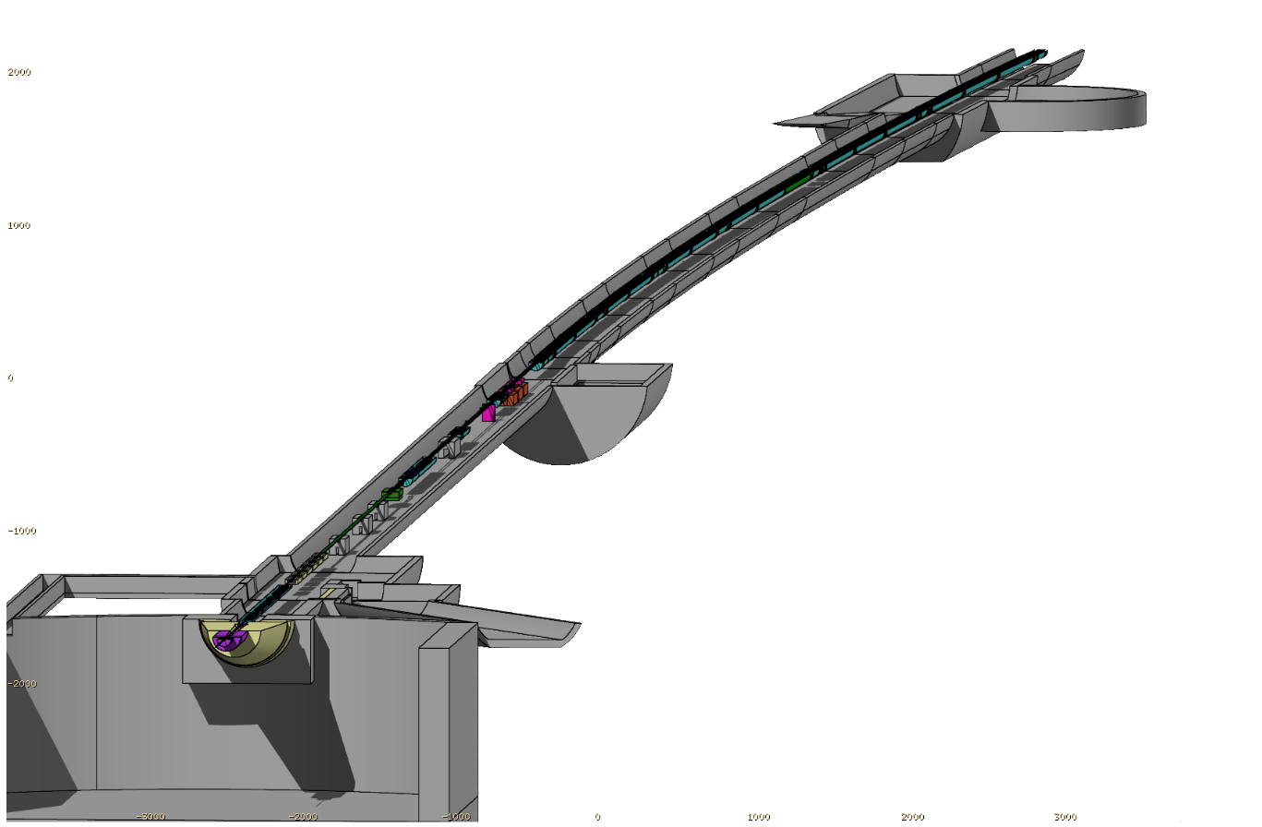
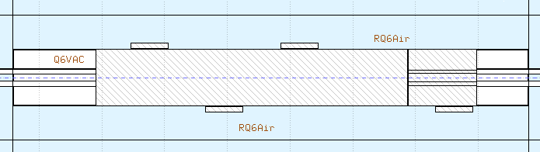
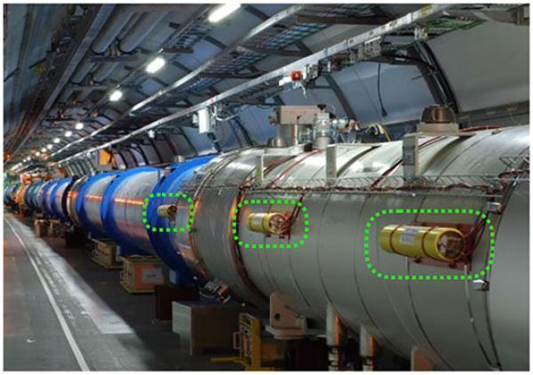


Radiation monitors (in FLUKA)
RPL
Size ~grain of rice
-> too small for identical modelling.
Replaced by a cube of AIR ~RadMon
BLM
explicitly modelled in FLUKA
TID deposited in their active volume
DOFRS
Actual fibre is 150 μm in diameter -> too small for identical modelling.
A compromise for an OF made out of SiO₂ with radius of 1 cm has been reached.
RadMon
Not explicitly modelled due to their small sensitive volume (order of mm³)
Replaced by a cube of AIR with side length 20/50/100 cm (depending on statistics)

Slide 39


Radiation sources from the collision debris and off-momentum protons
Beam-machine interactions
Before reaching the tunnel, LHC particles typically interact with machine elements, e.g. collimators, absorbers, magnets.
This is true both for collision products (e.g. IR1-IR5) and in IRs where no collisions are produced, where beam-machine interactions can be seen as the primary source of radiation.
Beam-gas interactions
Despite the vacuum system, the beam pipes are not empty → the beams can interact with residual gas molecules.
Sub-dominant effect compared to other sources. Relevant in the arcs, where it can cause R2E issues in distributed systems with many units.

Slide 40


Radiation source: beam gas collisions
Any residual gas will lead to beam-gas interactions causing local radiation showers.
Beam Gas elements in IR4: inject gas (typically Ne) to increase the local density and measure the secondaries for beam profile reconstruction.
Drawback: Higher radiation levels possibly impacting the other elements along the beamline.
Assumption: radiation level rates scale as follows:
Instrument operation
(HL-)LHC operation
Injected gas
density profile
Interaction cross section - Gas species (Neon)
Beam
energy
LHC revolution frequency
Beam
intensity
BLM TID
rate
Pressure Gauge
reading
Beam Current Transformer (BCT) Instrument

Slide 41

Measured data
TID rate and pressure gauge reading increase at the beginning of the fill
BGC gas injection leads an increase the TID rates of the BLMs downstream of the BGC.
BLM TID increases unevenly for different BLMS

Slide 42

Measured data
Fit for both the BLM TID rate and the pressure measurements:
- an exponential decay curve (based on beam intensity)
- otherwise, constant function
In order to isolate just the BGC contribution. Define:
- signal time period based on gas injection
- background time periods (before and after, ideally)

Slide 43

Instantaneous correlations
Each data point corresponds to one timestamp in the pressure gauge measurement.
This procedure has been applied to all:
  BLMs downstream of the BGC -> only for some, a good linear correlation can be extracted.

Slide 44

Instantaneous correlations
Each data point corresponds to one timestamp in the pressure gauge measurement.
This procedure has been applied to all:
  BLMs downstream of the BGC -> only for some, a good linear correlation can be extracted.
  all gas injection fills -> only some had clean signal/background time periods to extract just the BGC contribution.
  two available pressure gauges:
  up(443)- and down(368)-stream of the BGC.

Slide 45
Simulated radiation level data (v122)
FLUKA is capable of simulating the radiation shower caused by the beam-gas interactions at the BGC, using a simulated input gas pressure profile provided by SY-BI.
The shower extends longitudinally over several tens of meter.
Radiation level patterns/regions:
BGC vicinity
RadioFrequency cavities
First bending dipole (reducing the beam separation from 21 to 9.7 cm)
Second bending dipole (makes the beams parallel, separated at 9.7 cm) and first quadrupole

Slide 46

BLM Benchmark
The shape of the BLM profile is well reproduced, with an agreement level generally within a factor of 2 and decreasing with distance from the source.
Usually what we can achieve in a well controlled situation is a few ten percent agreement level [1, 2].
A. Lechner et al, Validation of energy deposition simulations for proton and heavy ion losses in the CERN Large Hadron Collider,
in Physical Review Accelerator and Beams 22, 071003 (2019), https://journals.aps.org/prab/pdf/10.1103/PhysRevAccelBeams.22.071003
D. Prelipcean et al, Benchmark between measured and simulated radiation level data at the mixed-field CHARM facility at CERN.
in IEEE Transactions on Nuclear Science, Vol. 69, No. 7, July 2022. DOI: 10.1109/TNS.2022.3169756.

Slide 47

Power deposition in the coils of the magnets
Heat loads:
  Max Power Density Distribution in the inner coils.
  Total Power Dissipated on the entire magnet and TID (in backup slides).
No risk of quenching in the magnets for:
  with the assumed gas profile,
  max HL-LHC beam intensity.
Quench limits [1, 2, 3]:
Nb₃Sn quadrupole
@ 40 mW/cm³
NbTi D1 dipole and correctors
@ 13 mW/cm³
N. V. Mokhov et al, Energy deposition studies for the high-luminosity Large Hadron Collider inner triplet magnets,
in Phys. Rev. ST Accel. Beams 18, 051001 (2015)
A. V. Zlobin et al, Large-aperture Nb3Sn quadrupoles for 2nd generation LHC IRs,
in Proceedings of the 8th European Particle Accelerator Conference, Paris, 2002 (EPS-IGA and CERN, Geneva, 2002), MOPLE017, pp. 2451–2453.
I. Novitski and A. V. Zlobin, Thermal analysis of SC quadrupoles in accelerator interaction regions,
in IEEE Trans. Appl. Supercond. 17, 1059 (2007).

Slide 48
3. Timepix3 Radiation Monitor
measurements at LHC IR4

Slide 49
3. Timepix3 Radiation Monitor
measurements at LHC IR4
Use the Timepix3 detector as a complementary radiation monitor to the existing ones:
  BLMs can measure Total Ionizing Dose (TID)
  Standard Radiation Monitor (RadMons) can measure, additionally, High Energy Hadron Fluences (HEHeq)
Timepix3 could do both, with better timing resolution and lower detection threshold:
  TID - e.g. by simply summing all the deposited energy (uncorrected)
  Fluence Monitor - counting the number of clusters/particle hits
  And further capabilities could include:
    Cluster classification/Particle IDentification (PID) to distinguish between:
      hadrons (nuclear vs elastic interactions)
      electrons/positrons
      gammas
    Directionality/Origin of radiation.

Slide 50

Location
2
Installed in location:
2, inside shielded alcove.
Placed at two angles with respect to the beam:
10 deg
40 deg
1

Slide 51

Nominal LHC cycle
Timepix3 cluster (hit) rate follows the expected behaviour, similar to the BLM dose rate:
  minor increase during INJECTION
  significant increase during RAMP
  exponential decrease following the beam intensity during FLATTOP/STABLE beams
Fill number 9063

Slide 52



Nominal LHC cycle
Each data point corresponds to 1 min of (averaged) measured data.
INJECTION
E_{beam}= 450 GeV
RAMP
E_{beam}= 0.45 to 6.8 TeV
STABLE BEAMS
E_{beam}= 6.8 TeV
Natural cosmic background ± standard deviation

Slide 53


Timepix3 measured radiation levels from BGC operation in 2023
Main interest: radiation levels induced by the BGC (to define operational constraints).
Secondary interest: radiation levels from accelerator operation (background, unavoidable).
only 4 gas injection in the BGC in 2023:
  2 during STABLE BEAMS
  2 during RAMP UP
Signal to background Ratio: ~3 to 6
Redeployed in 2024 TS1 (June 6th)
to acquire more statistics until
EYETS 24/25.

Slide 54


Slide 55


Timepix3 new capabilities
Linear Energy Transfer (LET)
Radiation source locator
Disentangle the radiation field into several components.
Based on the angle of incidence on the detector plane.

Slide 56




Prospects
Ion run analysis of IR4
2. BGC profiler
Perform the same benchmark analysis (BLMs vs. FLUKA) for the ion operation of LHC.
Change the modus operandi of the BGC signal detection from a fluorescence signal to a radiation-based measurement.
3. IP2 QPS monitoring
4. HEARTS
Due to a significant number of failures in the LHC Quench Protection System (QPS) during ion run, a timepix3 telescope has been deployed during 2024 TS2.
Use the Timepix3 detector as a beamline monitor device at the High-Energy Accelerators for Radiation Testing and Shielding (HEARTS) project at CERN and GSI.

Slide 57
Conclusions
The operation of the Beam Gas instruments at IR4 was benchmarked successfully for:
  The Beam Gas Vertex (BGV) demonstrator in Run 2 (2015-2018)
  The Beam Gas Curtain (BGC) demonstrator in Run 3 (2022-to date)
revealing no concerns in terms of quench or TID lifetime degradation for the magnets, but other equipment (e.g. electronics) could suffer radiation damage.
The Timepix3 Radiation Monitor was successfully calibrated in several test campaign and deployed across the CERN accelerator complex, in particular at LHC IR4, confirming its operation as standard radiation monitor with lower detection threshold.
Amongst the possible new capabilities for the detector are:
  Linear Energy Transfer (LET) detector -> Particle IDentification (PID).
  Radiation source locator.

Slide 58



Slide 60
Backup slides

Slide 61

 |  |  | LHC | HL- LHC
Magnets | d IP [m] | d BGC [m] | Total Power [mW]
MBRS 5L4 | -56.7 | -14.2 | 0 | 0
ACSCA 2 5L4 | -15.4 | 27.1 | 27.5 | 60.2
ACSCA 1 5L4 | -7.6 | 34.9 | 56.6 | 121.9
ACSCA 1 5R4 | 0.7 | 43.2 | 60.9 | 133.1
ACSCA 2 5R4 | 8.7 | 51.2 | 30.6 | 68.4
MBRS 5R4 | 56.7 | 99.2 | 248.4 | 542.8
MBRB 5R4 | 118.8 | 161.3 | 172.8 | 336.1
QY 5R4 | 130.8 | 173.3 | 4.4 | 15.4
QY 6R4 | 167.8 | 210.3 | 15.8 | 16.1
QM 7R4 | 264.6 | 307.1 | 24.7 | 69.2
MBA 8R4 | 270.4 | 312.9 | 11.8 | 32.3

Slide 62


How far is the BGC relevant in terms of radiation levels?
Compute correlation parameter R² from the linear regression.
Only those BLMs with R² > 0.3 are considered for comparison
with FLUKA.
Example of a BLM with poor correlation with the BGC gas pressure reading.

Slide 63

BLM TID: HL-LHC - background vs. BGC operation
HL-LHC reference run: 2016 run (without BGC), scaled to HL-LHC parameters.
The HL-LHC BGC contribution to the radiation levels would be the dominant.
(locally even up to 2 orders of magnitude more than the background)
G. Lerner et al, Radiation level specifications for HL-LHC,
in https://edms.cern.ch/ui/#!master/navigator/document?D:101588884:101588884:subDocs

Slide 64



2. The Timepix3 Radiation Monitor
Characterise the Timepix3 sensor received from Beam Instrumentation (BI), to be used as a radiation monitor across the CERN accelerator complex, in particular:
  modus operandi (practical limitations of the setup)
  detector calibration and data analysis
R2E Timepix3 Sensor
Material | Si
Type | P-in-N
Sensor [um] | 300
Dead layer [nm] | 300
Al metalization [nm] | 500
Bias voltage [V] | 80
Source: Levasseur S., Development of a Hybrid Pixel Detector Based Transverse Profile Monitor for the CERN Proton Synchrotron, PhD thesis
Source: Llopart X., The TimePix Chip Family, presentation, 20th Anniversary Symposium on Medipix and Timepix, 18 September 2019

Slide 65



Timepix3 detector
The Timepix detector family [1], designed by the Medipix collaboration [2], is a multi-purpose readout Application Specific Integrated Circuit (ASIC) for hybrid pixel detectors, designed as a:
  timing measurement chip
  capable as well of determining the deposited charge, using the Time over Threshold (ToT) technique
The Timepix3 [3] upgrade adds
the functionality of simultaneous
Time of Arrival (ToA) measurement
with the ToT.
Co-60 2.1 kBq (3982RP) 1.17 MeV, 1.33 MeV γ
Am-241 39 kBq (4276RP) 5.49 MeV, 5.44 MeV α
Distance from the detector: 100 mm (300 sec)
Distance from the detector: 20 mm (60 sec)
X. Llopart et al. “Timepix, a 65k programmable pixel readout chip for arrival time, energy and/or photon counting measurements”.
in: Nucl. Instrum. Meth. A 581 (2007). Ed. by Josef Hrubec et al. [Erratum: Nucl.Instrum.Meth.A 585, 106–108 (2008)], pp. 485–494. DOI : 10.1016/j.nima. 2007.08.079.
Medipix Collaboration. URL : https://medipix.web.cern.ch/home (visited on 02/09/2023).
T. Poikela et al. “Timepix3: a 65K channel hybrid pixel readout chip with simultaneous ToA/ToT and sparse readout”
in: Journal of Instrumentation 9.05 (May 2014), pp. C05013–C05013. DOI : 10.1088/1748-0221/9/05/c05013. URL : https://doi.org/10.1088/1748-0221/9/05/c05013.

Slide 66

Proton and alpha range/stopping power in Si
The R2E Timepix3 sensor has a thickness of 300 um, but partially biased to just 250 um.
The longest expected range is for protons at 5 MeV (~210 um), hence we expected a priori to see full energy deposition.
Data from : physics.nist.gov/PhysRefData/Star/Text/PSTAR.html

Slide 67

Fresh from the (LHC) oven
Preferred orientation along y axis, due to the geometry of the detector deployment, and the radiation source being the beam-gas collisions in the accelerator tunnel.
Particle zoo:
  longer/straighter tracks: light charged hadrons (protons, muons, etc.)
  wiggly thin tracks: electrons/positrons
  bigger blobs: heavier particles, or inelastic interactions (if round)
100 s of acquisition time
Full intensity beam
(3.2e14 charges per beam)

Slide 68






Beam Gas monitors
Beam Gas Vertex (BGV)
Beam Gas Curtain (BGC)
Beam Gas Ionization (BGI)
Uses residual
gas only
Descoped since 2022

