Slide 1
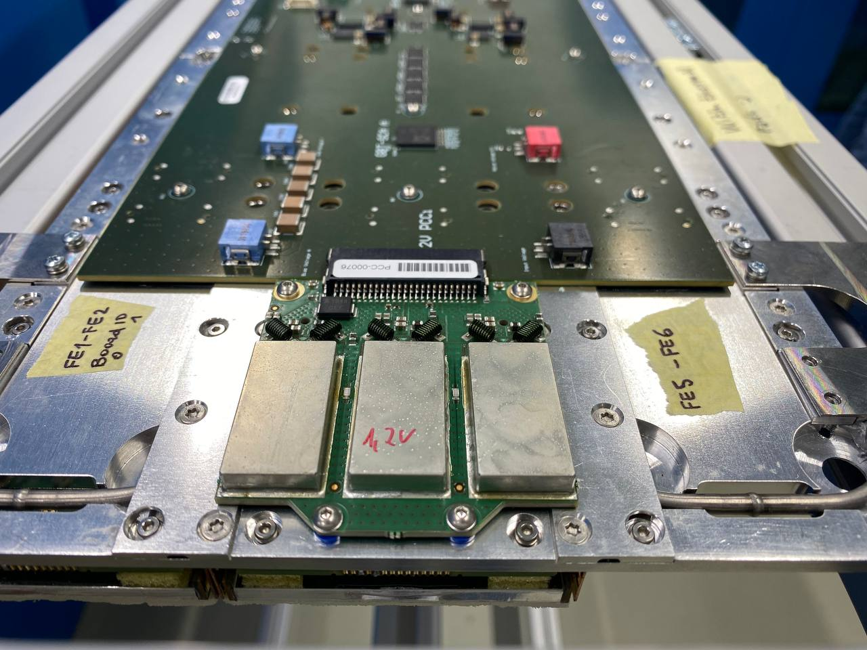
My work in CERN
(in pictures)
Iryna Kapran
Mentor: Chris Neu
Team: Braden Allmond, Giulia Sorrentino

Slide 2
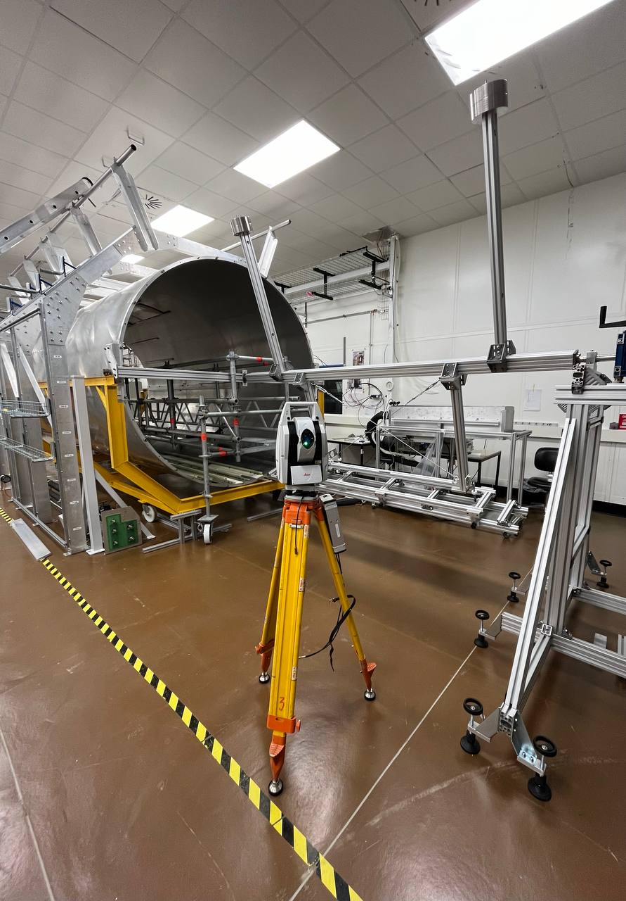
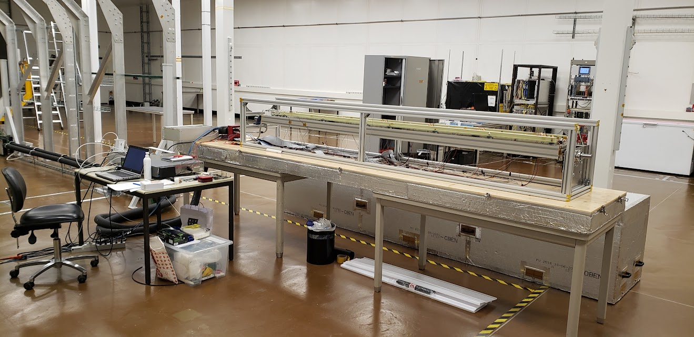
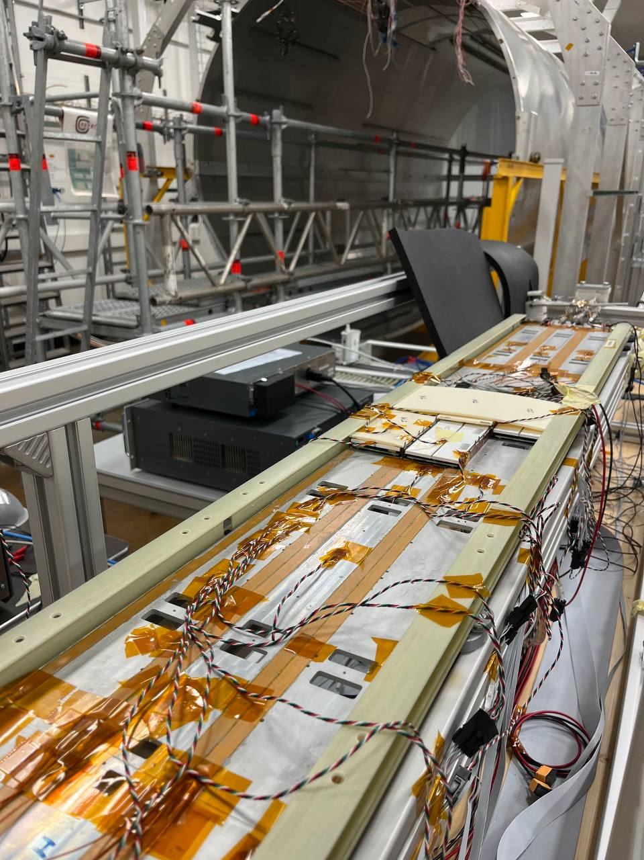
BTL
2

Slide 3
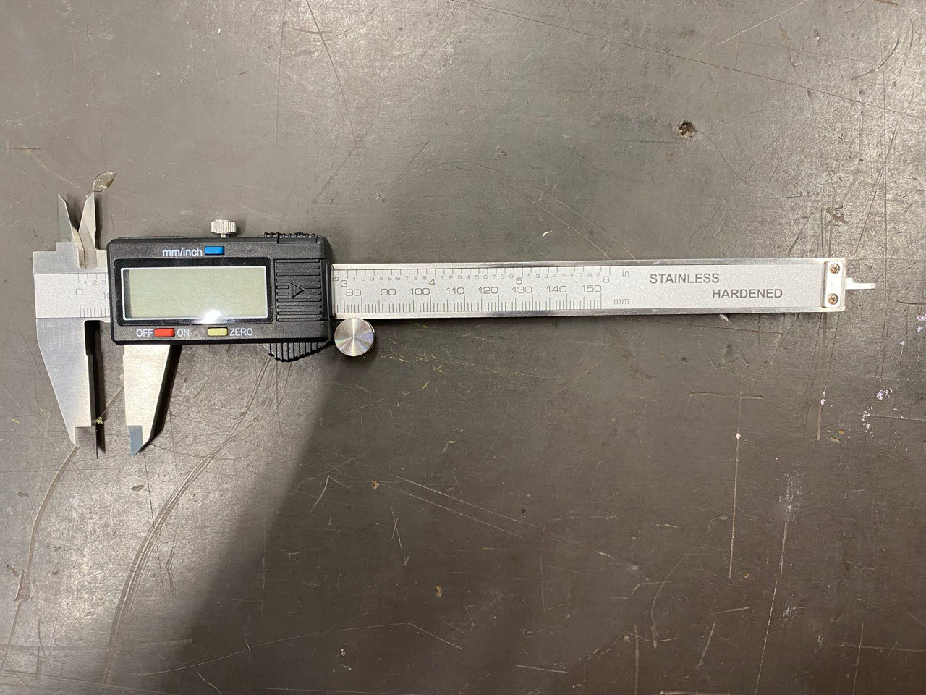
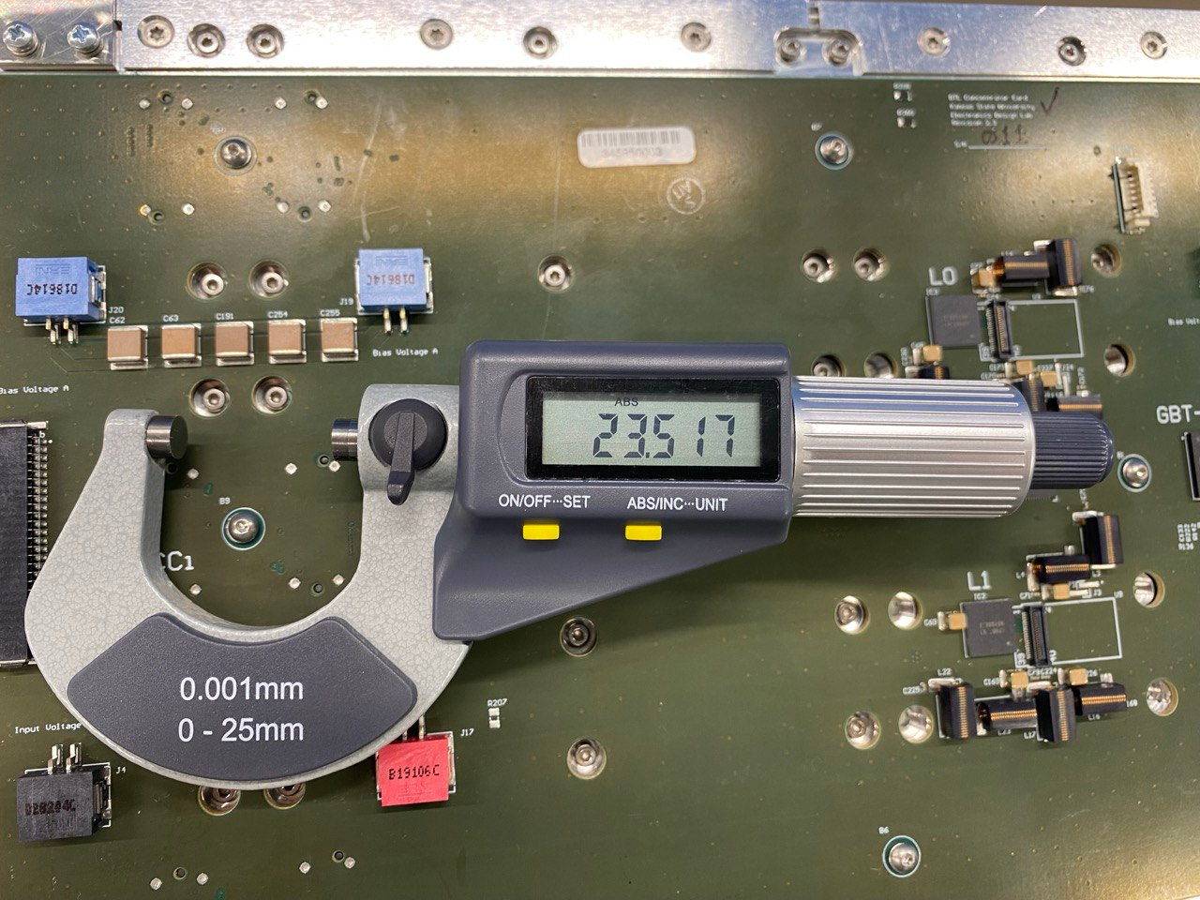
Measuring instruments
Caliper
Micrometer
3

Slide 4
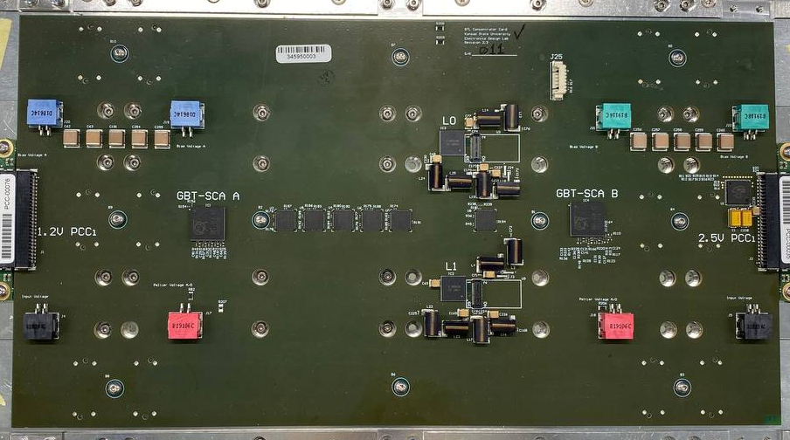
CC Measurements
CC Length Left
CC central screw
CC Length Right
CC Width
CC Width = (149,99 ± 0,01) mm
CC Total Length = (279,90 ± 0,06) mm
4
CC Total Length

Slide 5
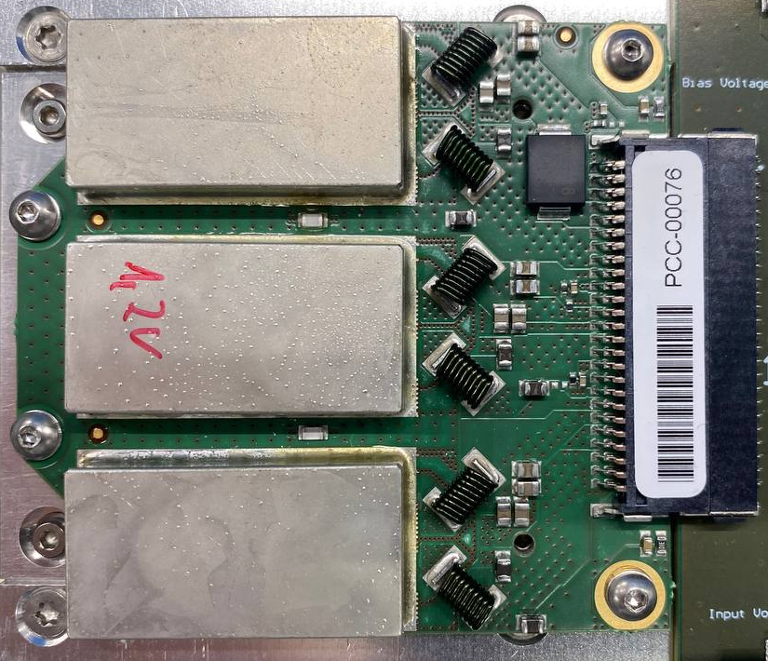
PCC Measurement
PCC width = (58,96 ± 0,01) mm
PCC width
5

Slide 6
PCC-CC-PCC Measurements
СС height + space
Height with PCC
Height without PCC
Height of metal plate
Caliper:
СС height + space = (2,77 ± 0,04) mm
Height without PCC = (17,37 ± 0,05) mm
Height with PCC = (26,17 ± 0,03) mm
Height of metal plate = (4,32 ± 0,02) mm
Micrometer:
СС height = (1,771 ± 0,009) mm
Height without PCC = (17,229 ± 0,075) mm
Height with PCC = (24,587 ± 0,188) mm
Height of metal plate = (4,026 ± 0,001) mm
6

Slide 7
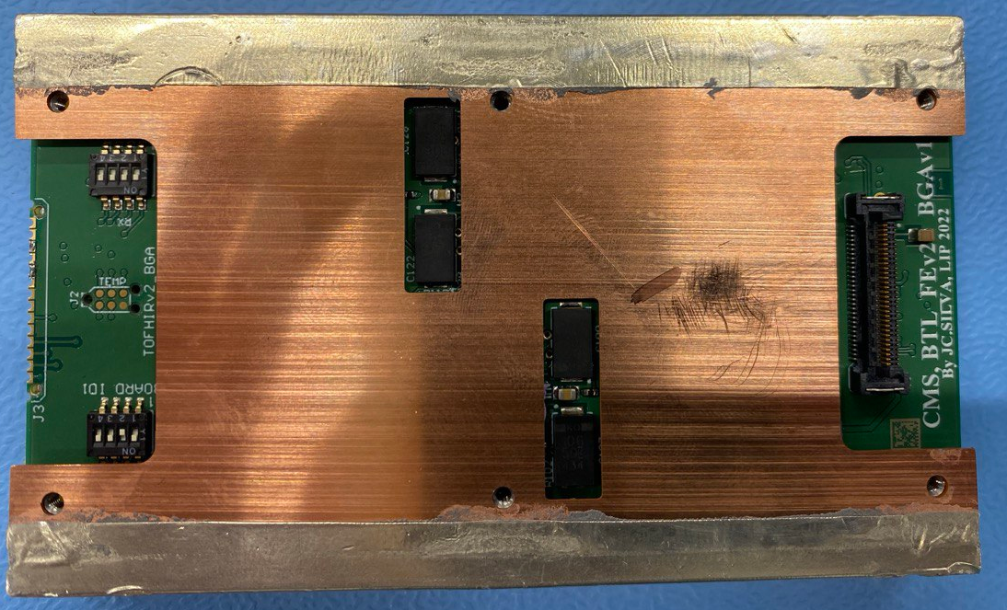
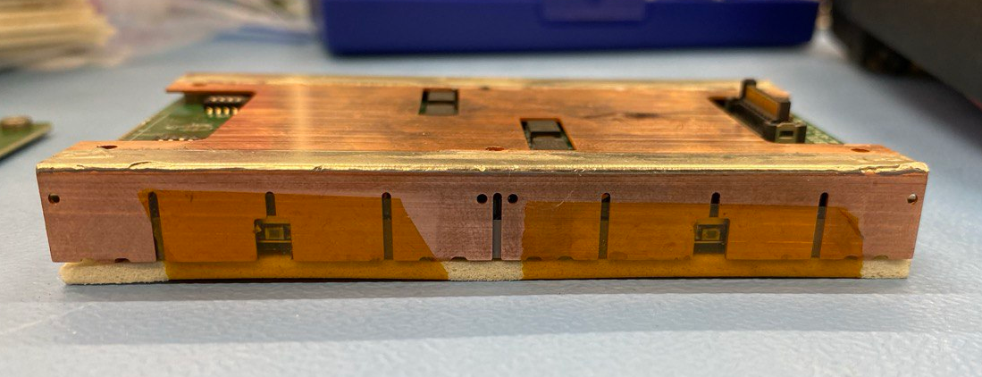
PCC-CC-PCC Measurements
Caliper:
Copper Housing center = (0,51 ± 0,04) mm
All in one = (13,86 ± 0,11) mm
Micrometer:
Copper Housing center = (0,551 ± 0,018) mm
All in one = (13,134 ± 0,079) mm
7

Slide 8
CC repeated measurements
CC Length Left
CC central screw
CC Length Right
CC Width
8
CC Width = (149,95 ± 0,05) mm
CC Total Length = (279,92 ± 0,01) mm
CC Total Length

Slide 9
PCC repeated measurements
PCC width = (58,97 ± 0,01) mm
PCC width
9

Slide 10
PCC-CC-PCC repeated measurements
СС height + space
Height with PCC
Height without PCC
Height of metal plate
Caliper:
СС height + space = (2,80 ± 0,01) mm
Height without PCC = (17,27 ± 0,01) mm
Height with PCC = (26,02 ± 0,02) mm
Height of metal plate = (4,31 ± 0,01) mm
Micrometer:
СС height = (1,765 ± 0,002) mm
Height without PCC = (17,278 ± 0,011) mm
Height with PCC = (24,724 ± 0,076) mm
Height of metal plate = (4,080 ± 0,018) mm
10

Slide 11
PCC-CC-PCC repeated measurements
Caliper:
Copper Housing center = (0,51 ± 0,01) mm
All in one = (13,11 ± 0,06) mm
Micrometer:
Copper Housing center = (0,547 ± 0,008) mm
All in one = (13,230 ± 0,050) mm
11

Slide 12
PCC-CC-PCC Measurements
Mass [g]
Front End Card = (28 ± 2) g
Front End Card w Thermal Pads = (29 ± 2) g
Copper Housing = (32 ± 2) g
Airex Pad with Size of Front End Card = (1,15 ± 0,15) g
All in one = (221 ± 2) g
LYSO c25-2-T1 = (77 ± 2) g
LYSO c30-3-T2 = (62 ± 2) g
LYSO c25-2-T3 = (51 ± 2) g
LYSO Hpk-2-30 = (64 ± 2) g
CC = (215 ± 2) g
12

Slide 13
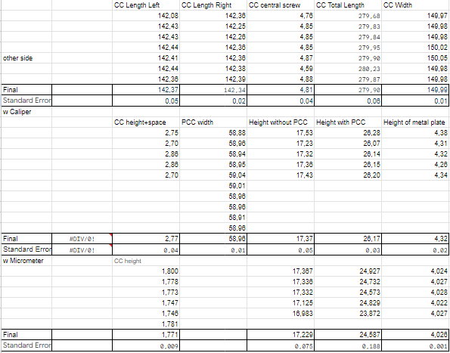
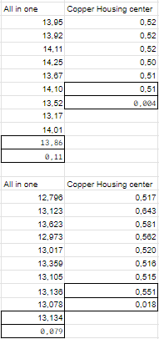
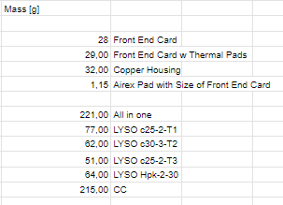
PCC-CC-PCC Measurements
13

Slide 14
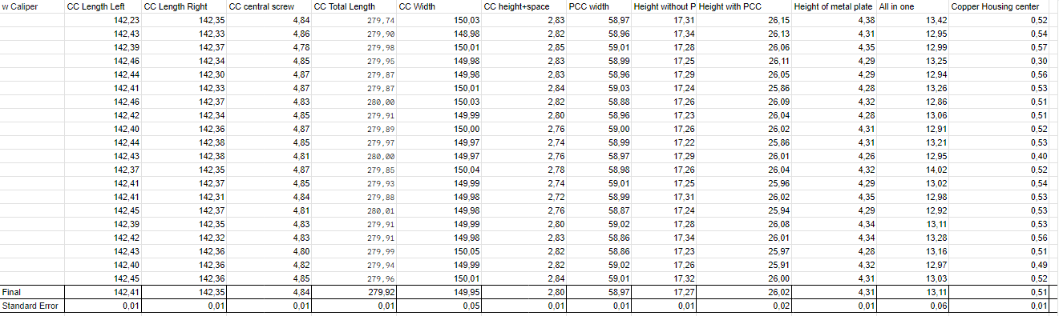
PCC-CC-PCC repeated measurements
14

Slide 15
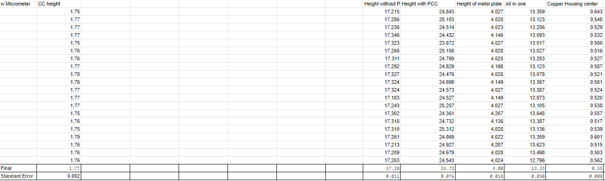
PCC-CC-PCC repeated measurements
15

Slide 16
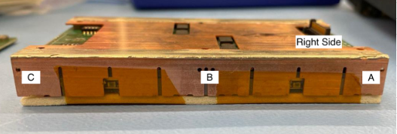
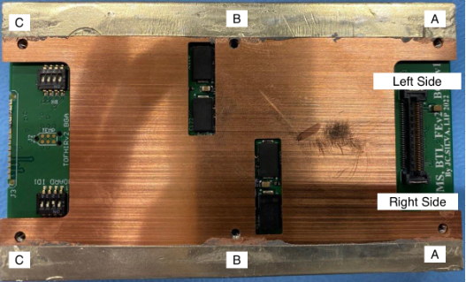
Module measurements
Height = (14,06 ± 0,34) mm
Width = (61,18 ± 0,03) mm
Length = (103,20 ± 0,02) mm
16

Slide 17
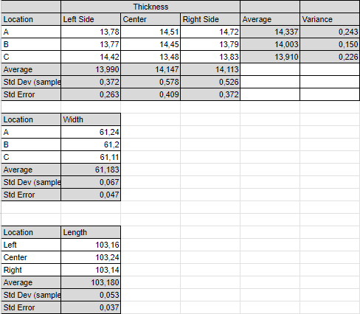
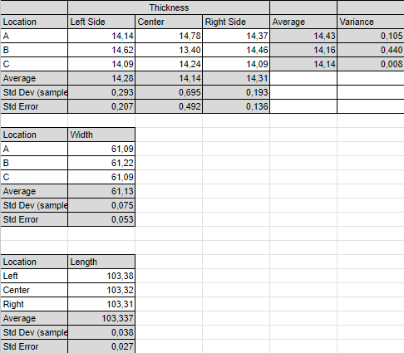
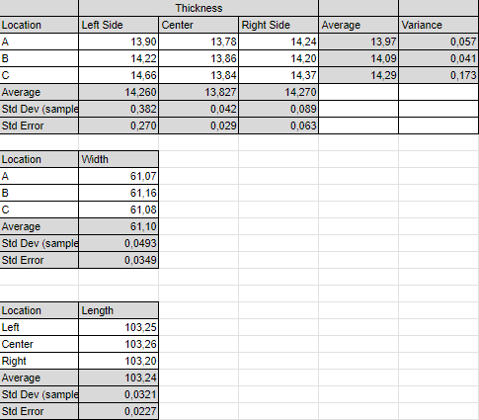
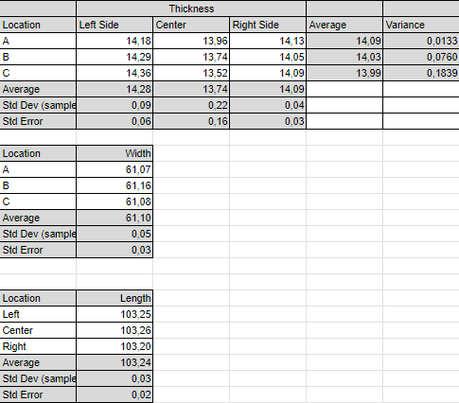
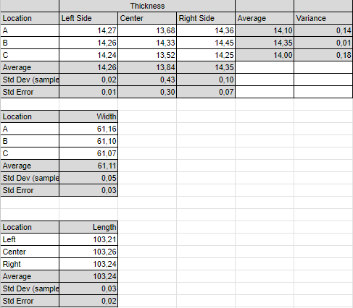
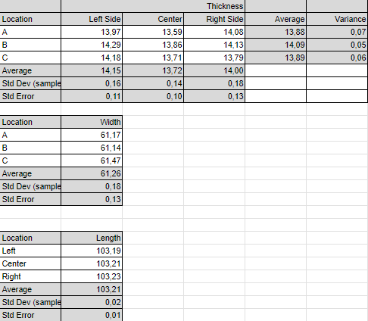
Module measurements
17

Slide 18
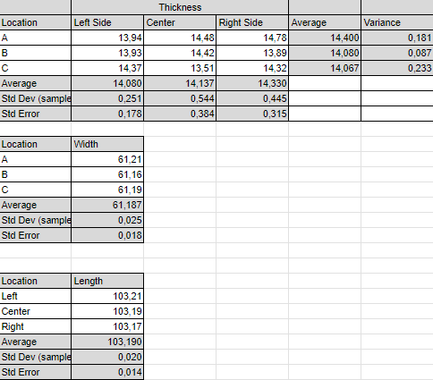
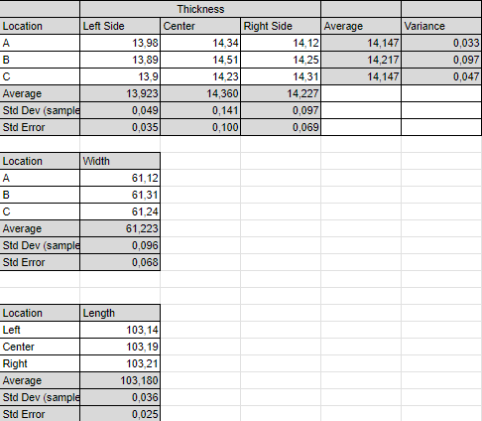
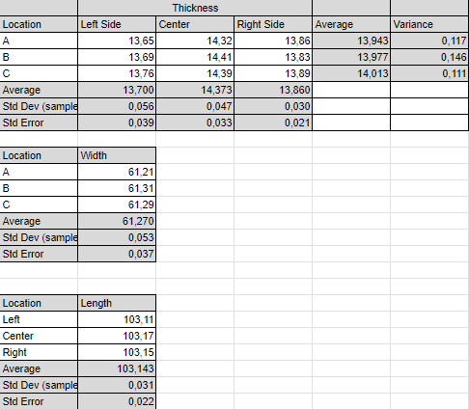
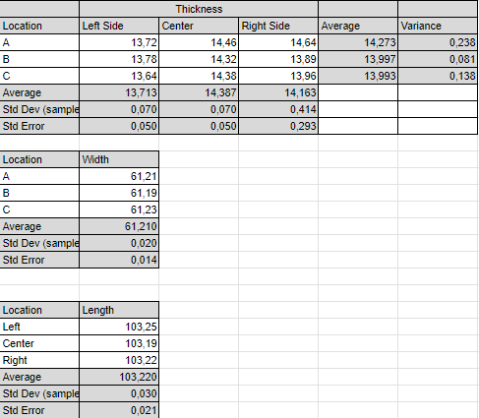
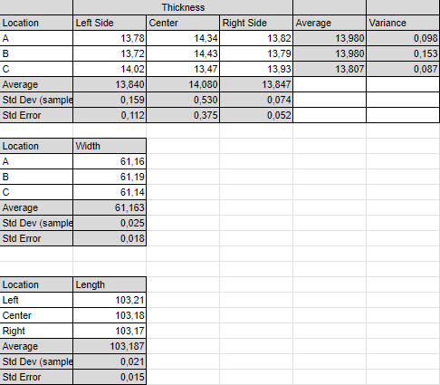
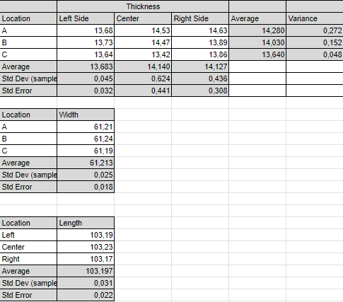
Module measurements
18

Slide 19

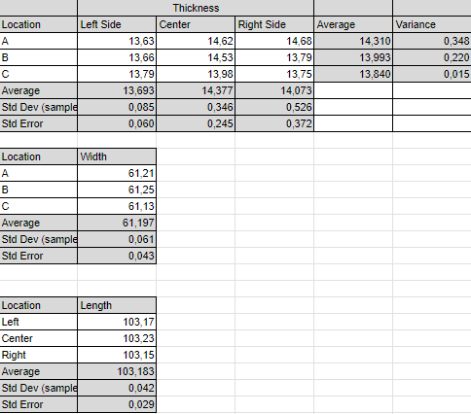
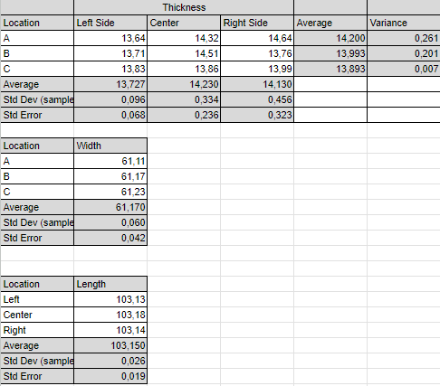
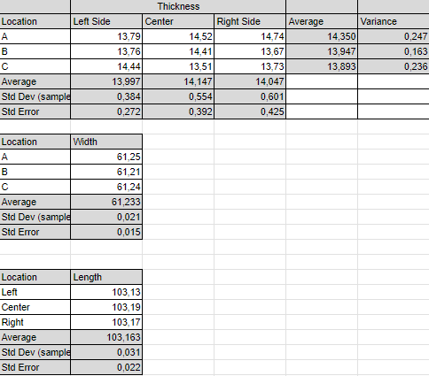
Module measurements
19

Slide 20
Сonclusions
During the first measurements, we took an average of 6-7 data per value. The small number of experiments and the human factor influenced the fact that the results of caliber and microment measurements differ in some places. Next, we took twenty data per value. As a result, the final data has less divergence. We have big differences in the Height with PCC measurement. This is due to the Airex Pad, because it is quite soft and this distorts the results. All other data is quite accurate, which is confirmed by our final calculations.
20

Slide 21
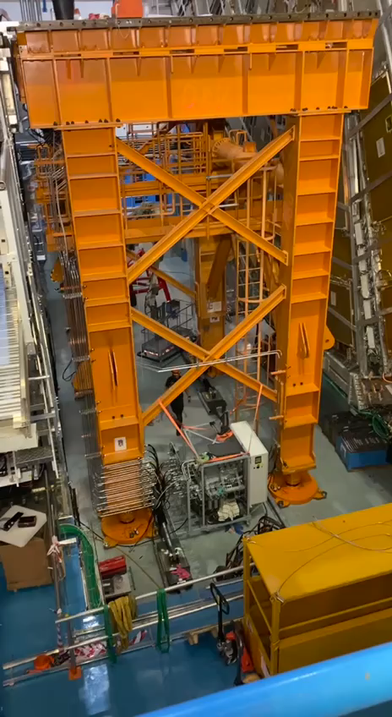
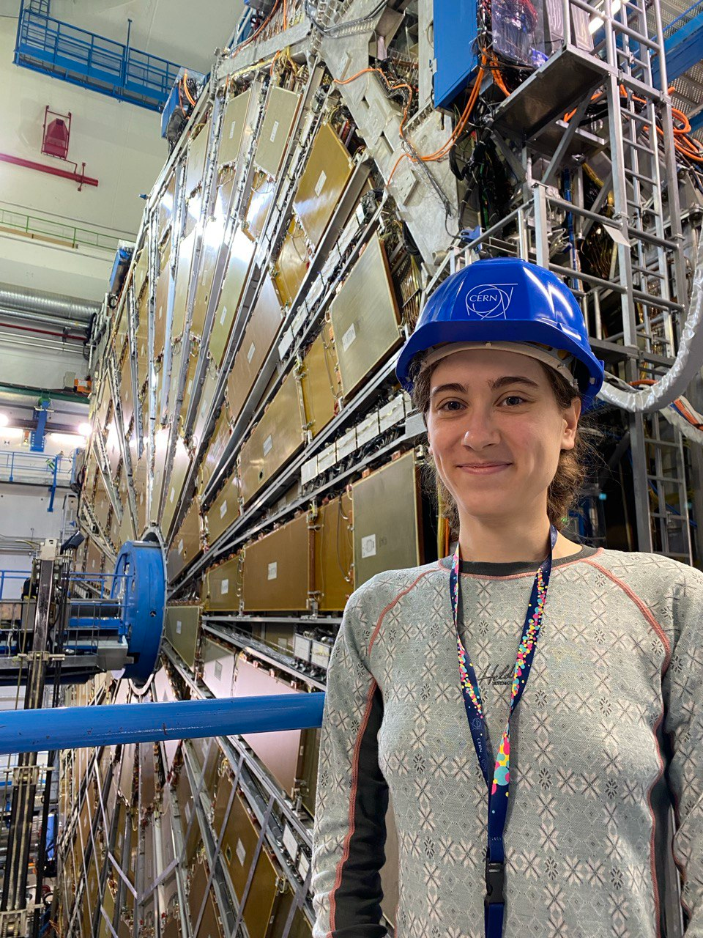
Thank you for your attention

Slide 22
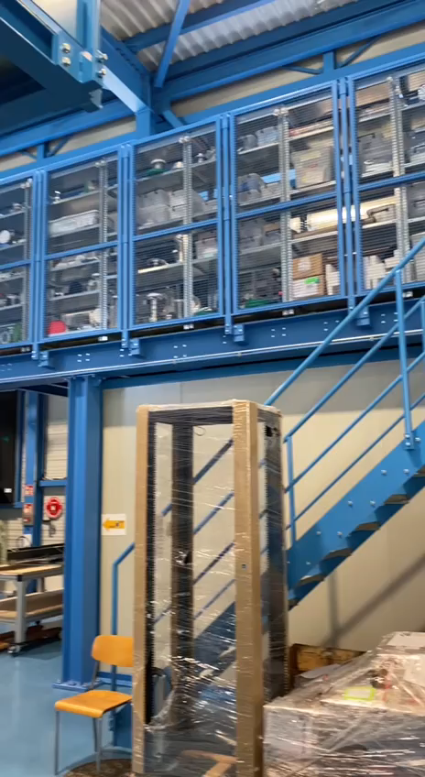
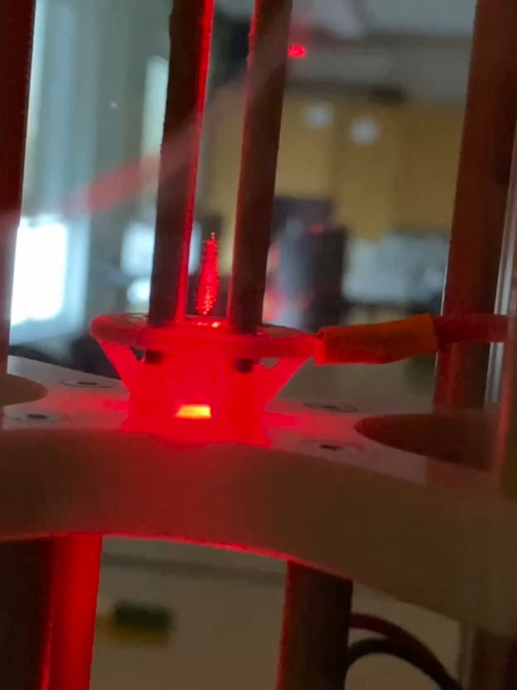
Thank you for your attention

Slide 23
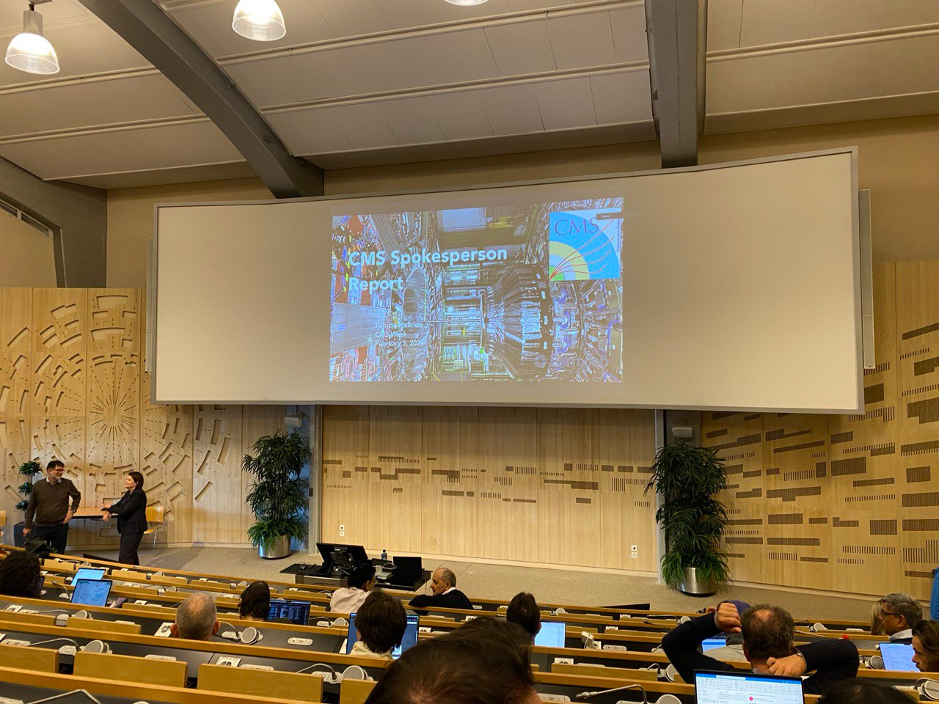
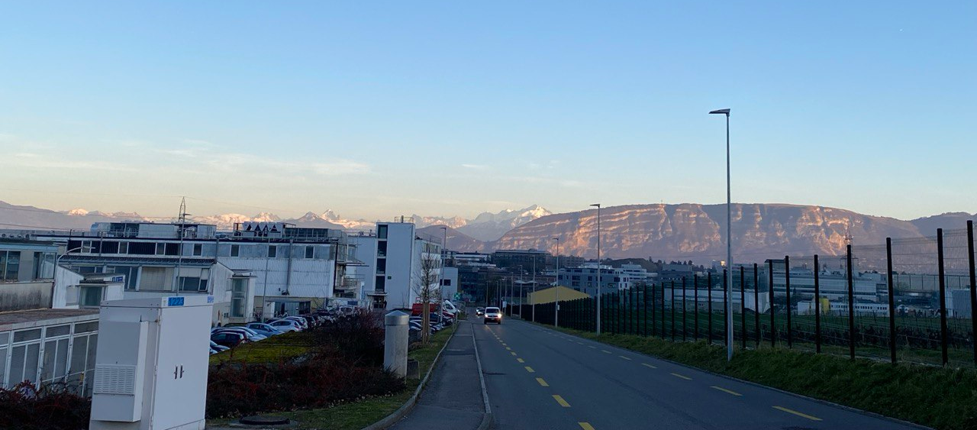
Thank you for your attention

