Slide 1
Education & Public Outreach
Past & Future
Mark Richardson
Manager for Education & Public Outreach

Slide 2
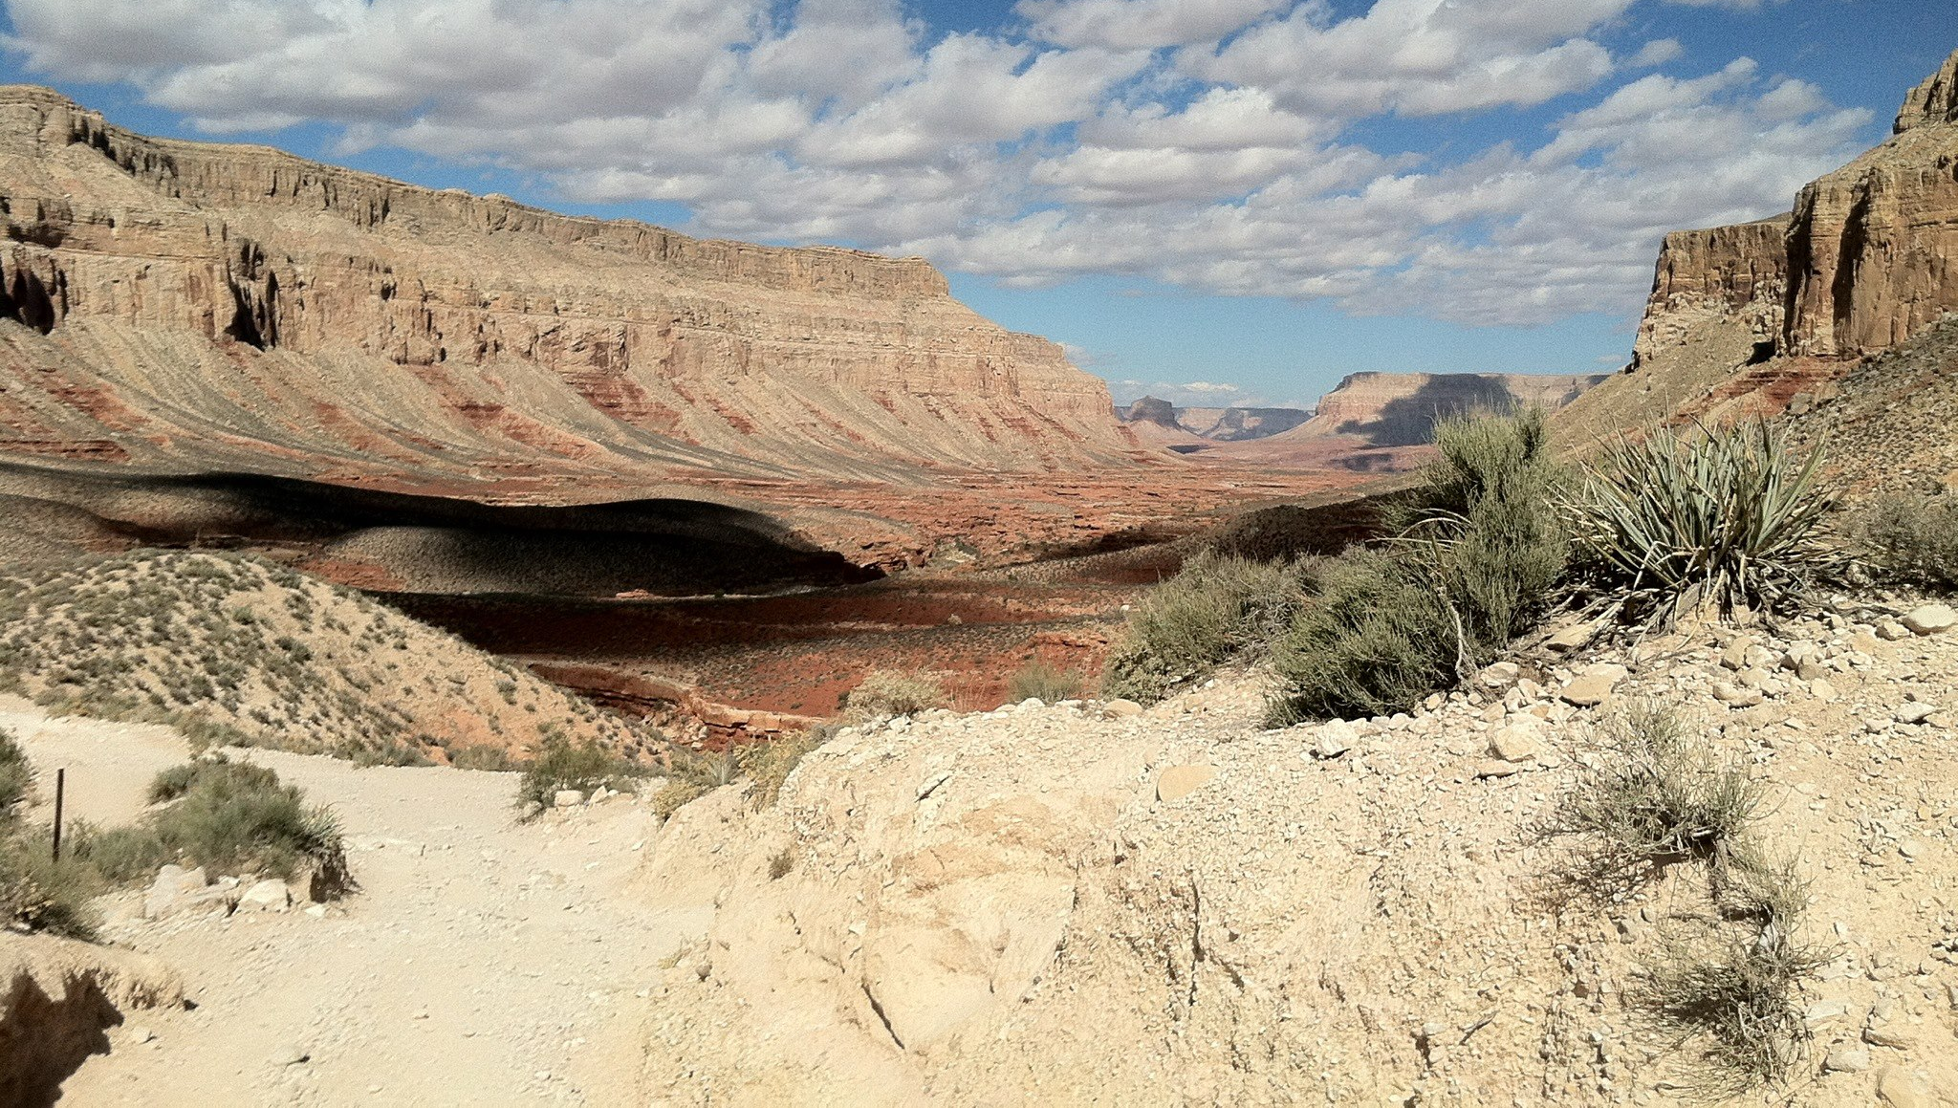
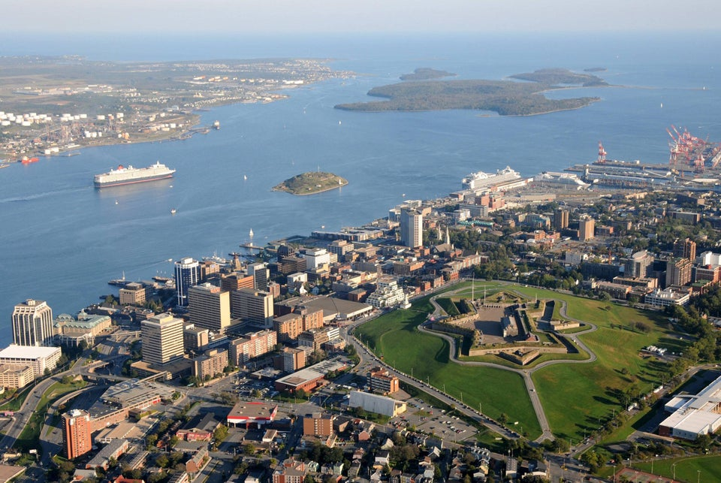
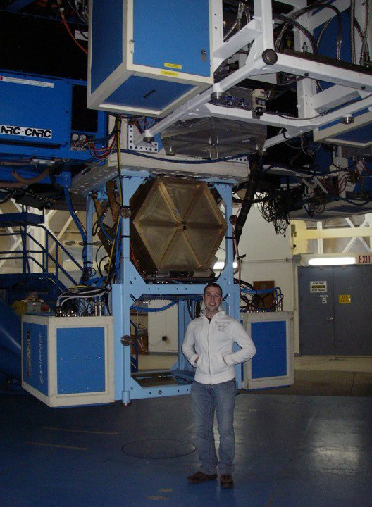
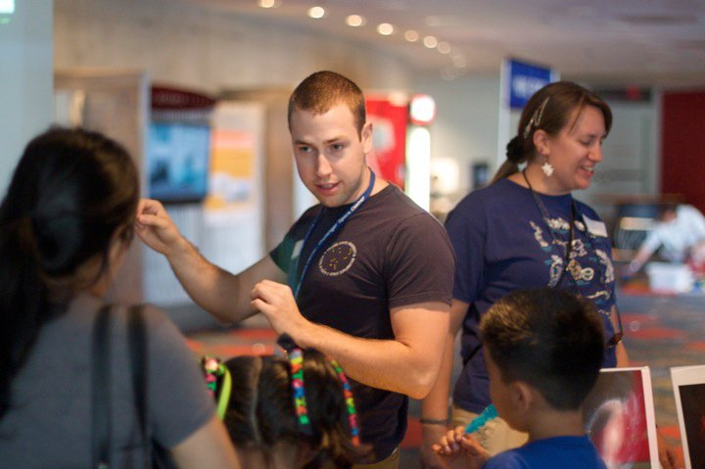
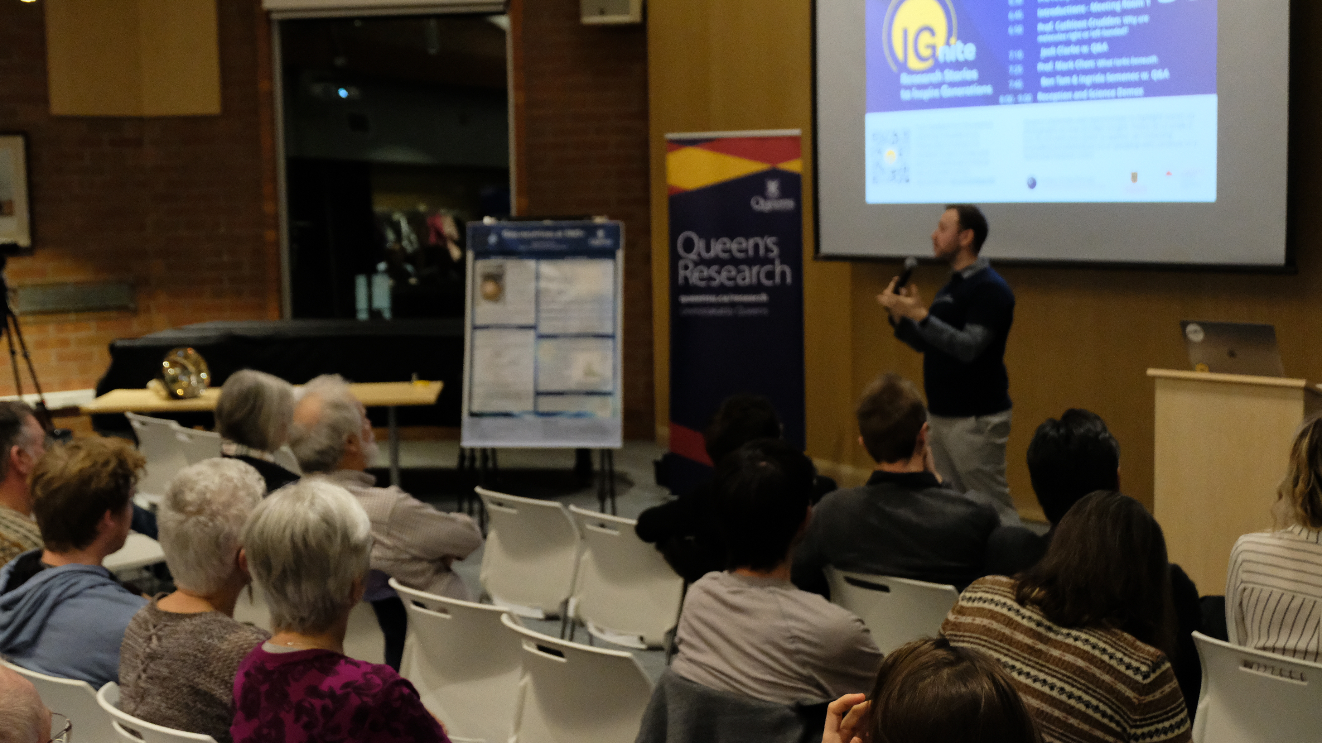
Dr. Mark Richardson (he/him)
Settler from Halifax (Eski’kewaq district of the Mi’kmaq), and all my family is there. Studied Astrophysics at Saint Mary’s University in Halifax.
PhD at Arizona State 2009-2014.
Had research positions at Oxford and the AMNH in NYC before joining Queen’s in 2018.
I am Manager for Education & Public Outreach Officer.
My job relies on connecting you with the public.

Slide 3

Including those in Canada in our achievements
Astroparticle
Physics
The Public
The Next Generation of Scientists

Slide 4











Our approach: Relationship building

Slide 5











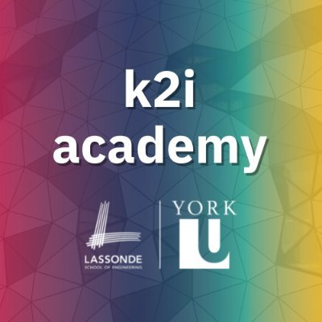
Working with partners with established expertise

Slide 6
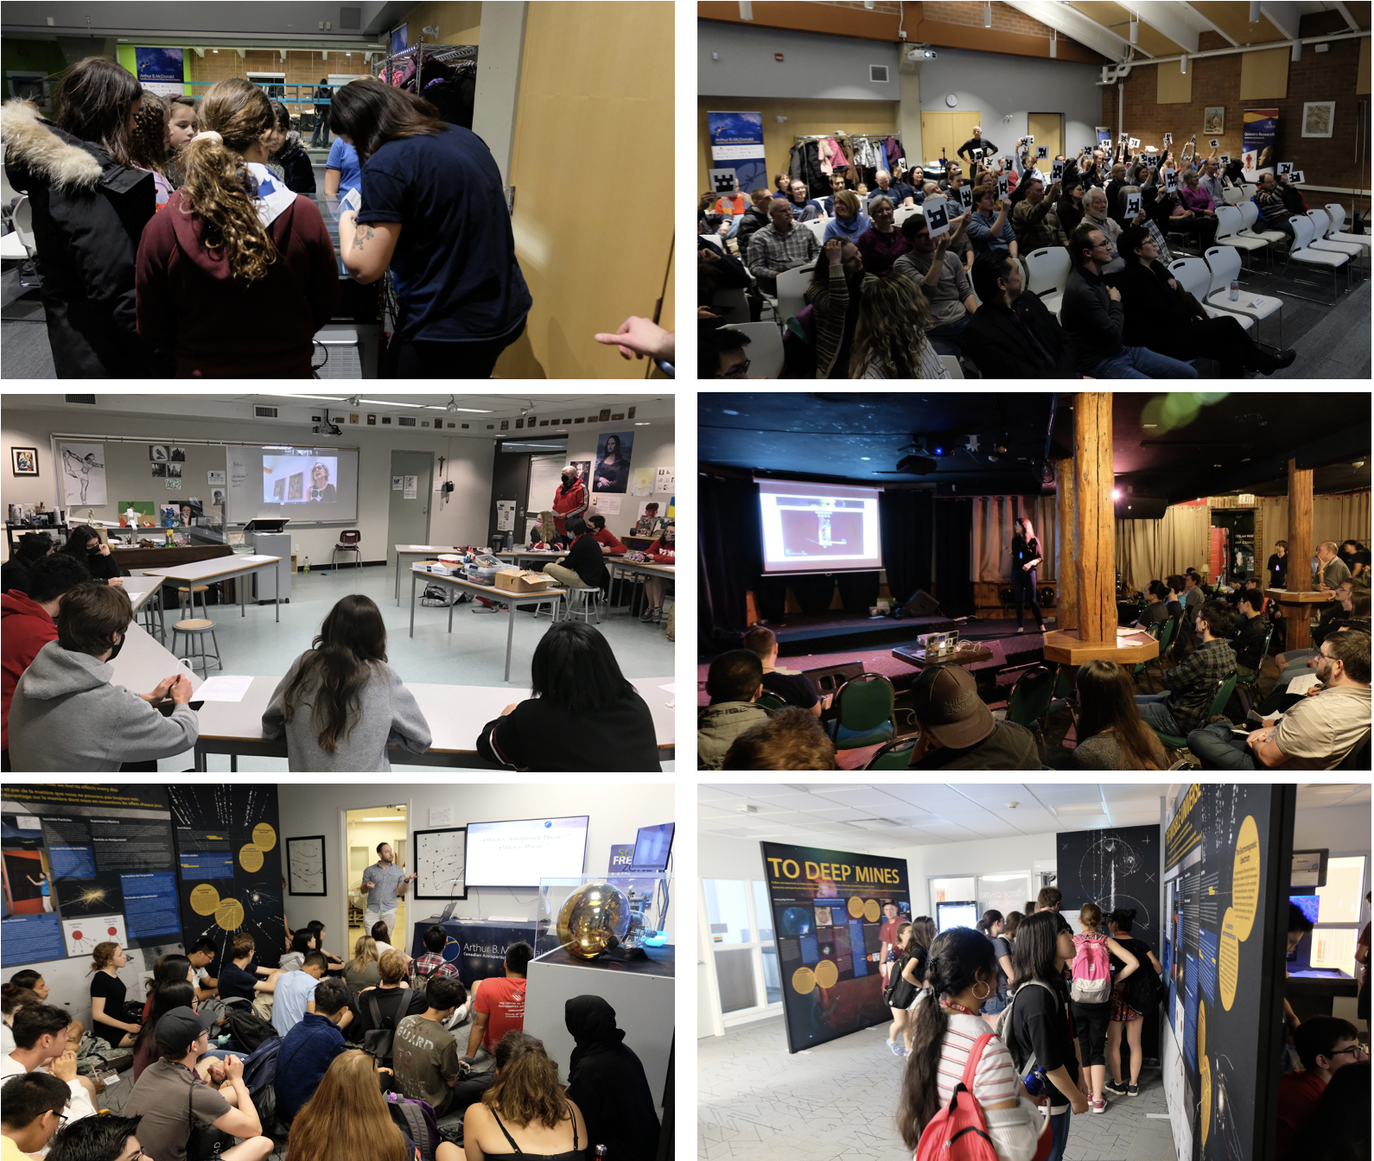
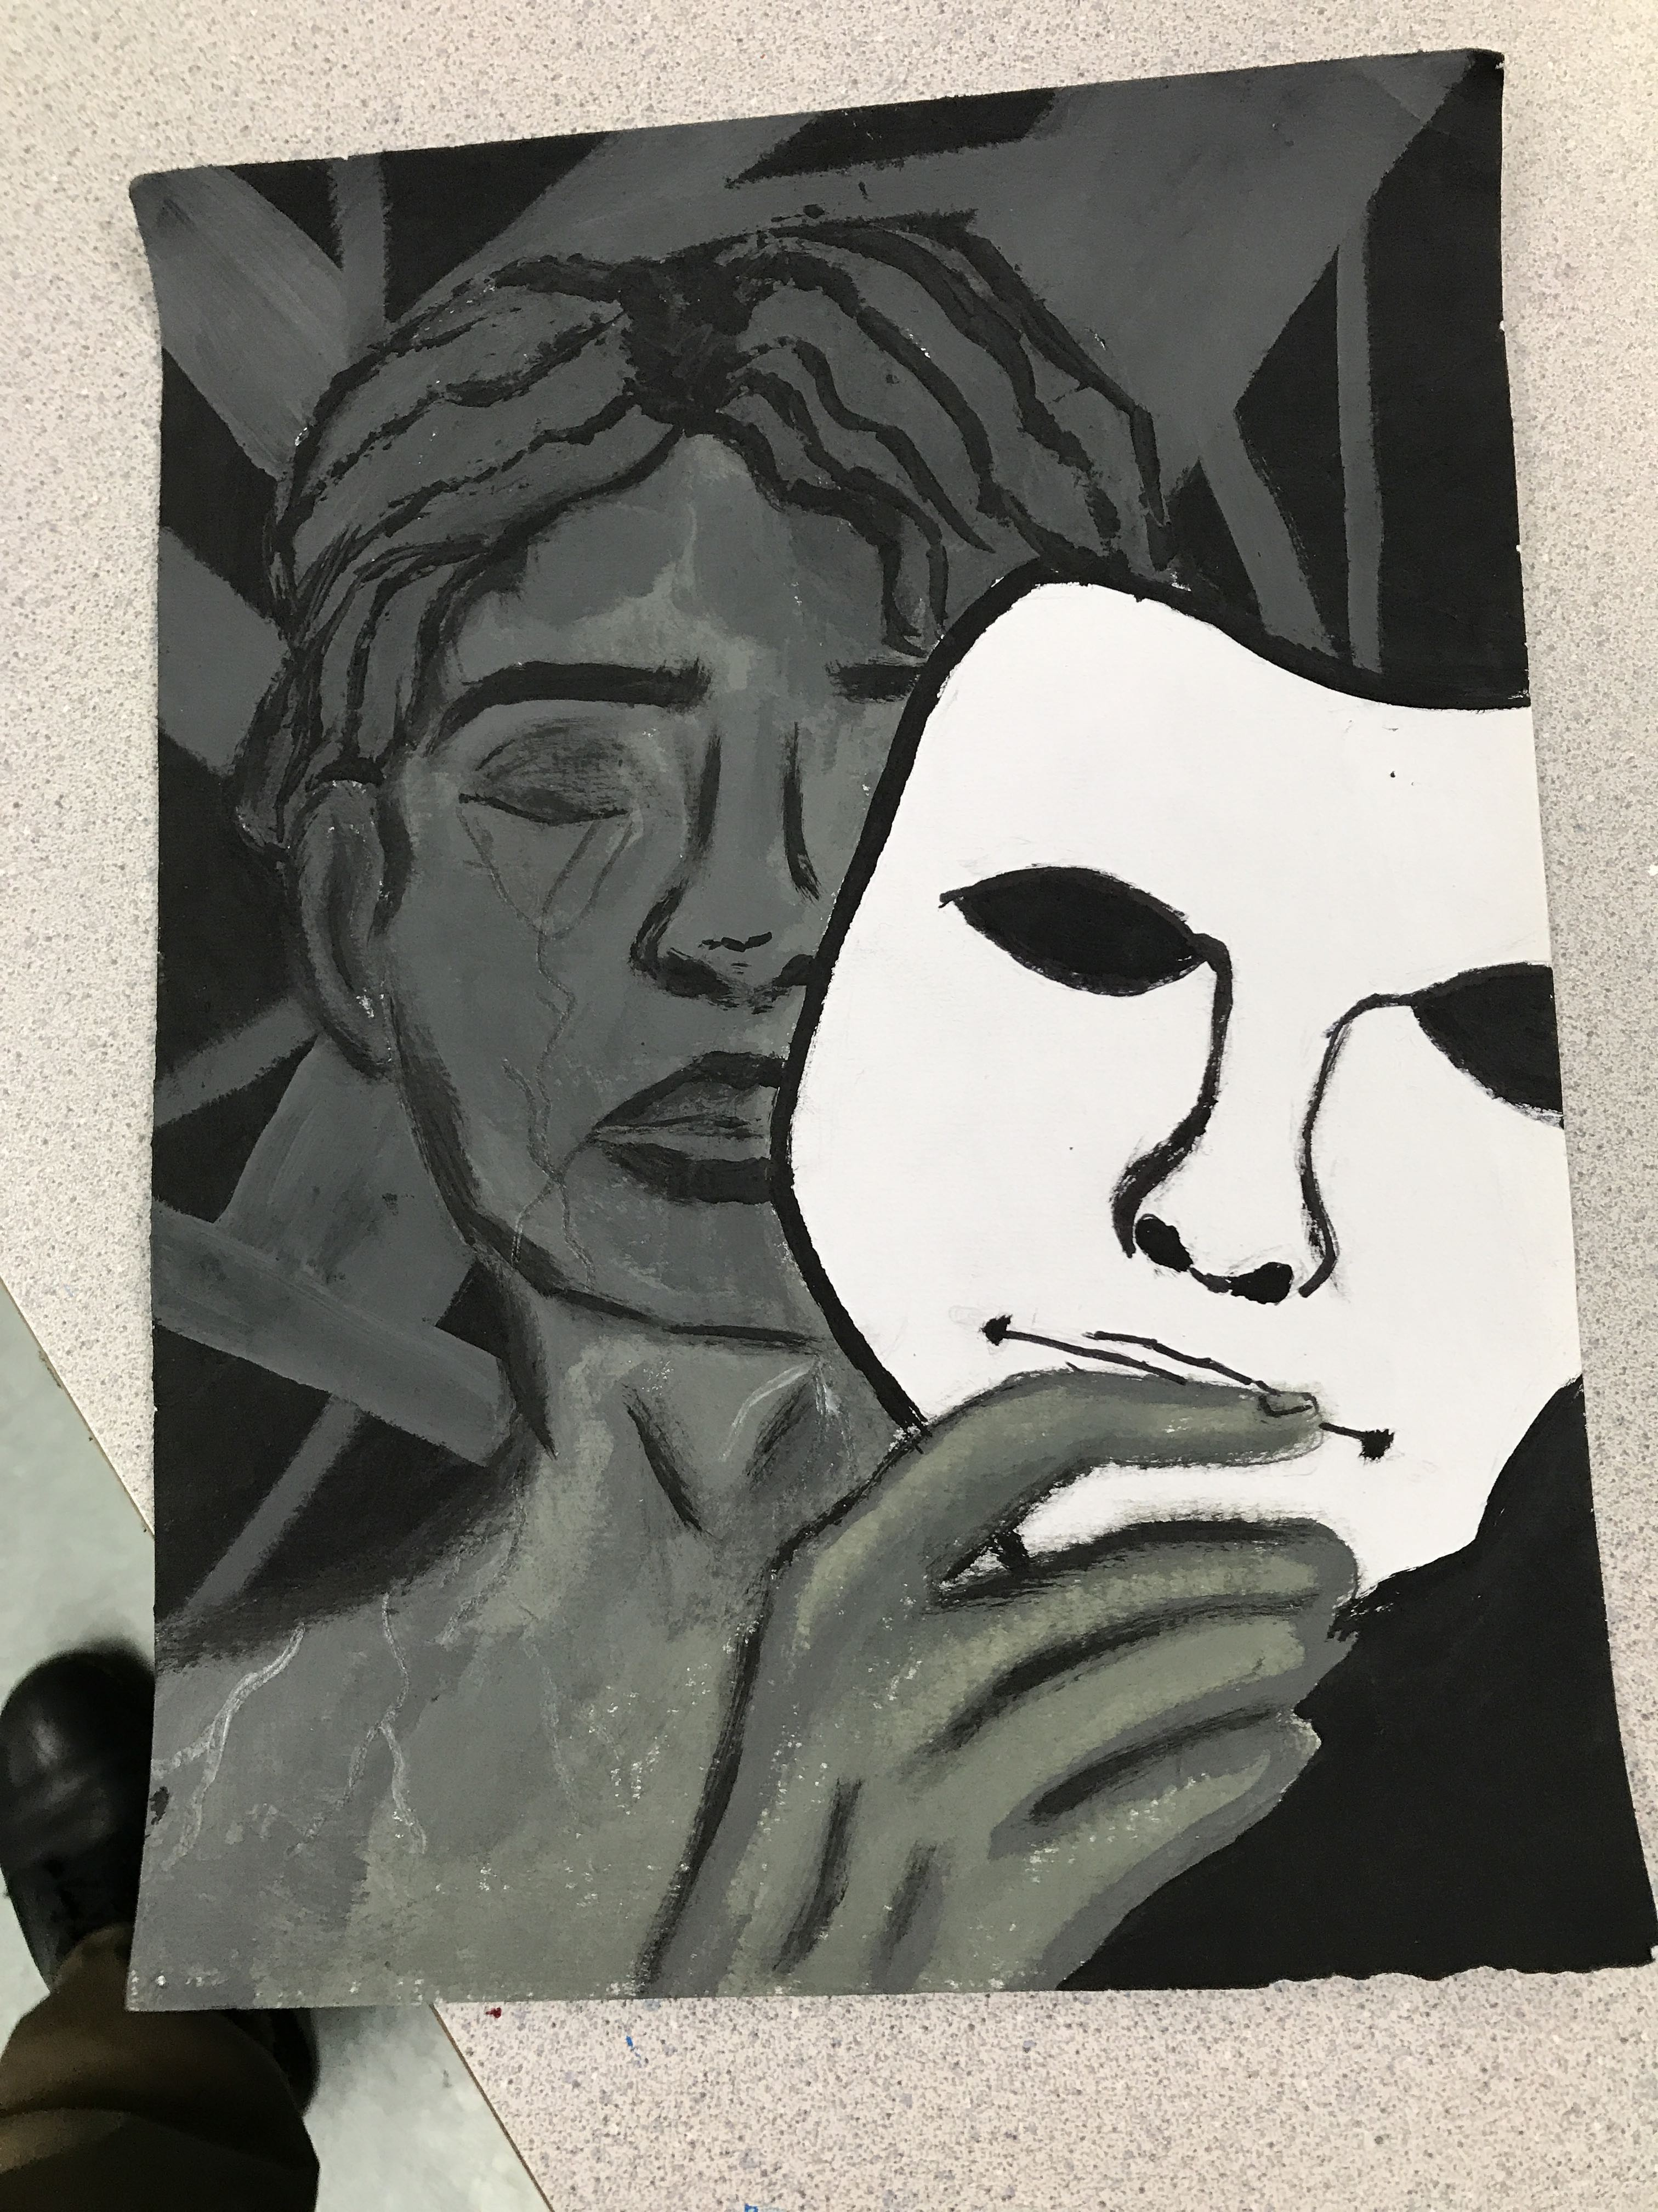
Relationships have taken time, but lead to organic, broader reach
Notes:
60+ outreach events, with over 3,000 attendees pre-covid, and now over 3,000 since Covid.
More people attending events now than before, getting more audiences involved due to word of mouth and and building of relationships.

Slide 7
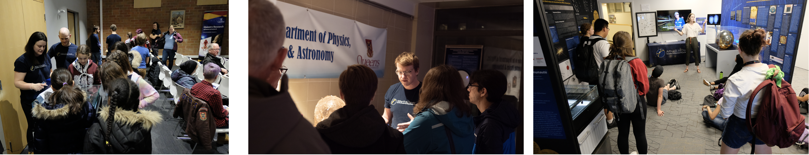
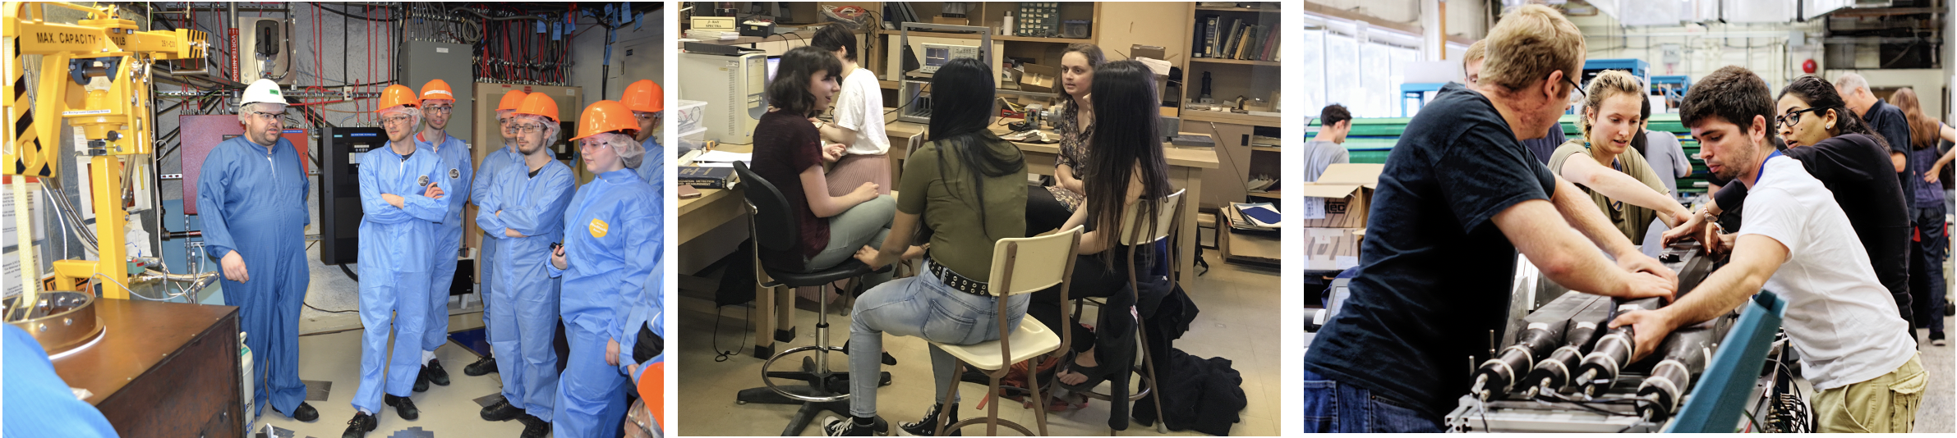
Outreach incorporates our highly qualified personnel.
Provides them communication experience and training
And we have other programs training them in science as well.

Slide 8
Successes
Huge community engagement. The McDonald Institute is becoming a known entity … in Kingston.
Through virtual tools, able to connect with other communities for hybrid events (Drift, DMD), and bring in students from other communities to our events and programs. We are getting some international household recognition.

Slide 9
Obstacles
Challenges in supporting making the McDonald Institute a known name beyond Kingston in Canada.
Challenges sharing our lessons learned and being a resource for our community.
Challenges in getting HQP engaged while balancing their own research and training.

Slide 10
To the future: 2024 - 2029

Slide 11
Through Education
More teacher resources via teacher in residence, expanding/developing education resources, and teacher workshops that will grow a teacher network.
Work with existing partner education frameworks (e.g., Perimeter).
More classroom engagement through various provincial and board groups.

Slide 12
Public Outreach
Offering support to partner institutes to run local outreach events
Partner for joint outreach events.
Offer financial support to run barrier-free outreach events across Canada in APP.

Slide 13
Visitor Centre
Adding new interactive exhibits.
Updating content, representing new experiments (nEXO, SBC, P-ONE, etc.) and theory.
Showcase more of our community, our stories, and our interests.
Other ideas?

