Slide 1
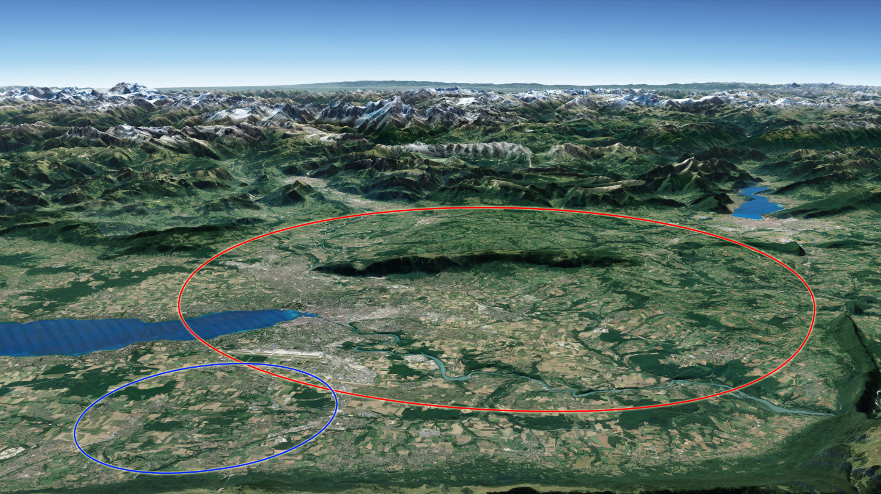




Xsuite and Circulant Matrix Model simulations for FCC-ee beam-beam and wakefield effects.
FCC week 2024 - DATE
Roxana SOOS, Xavier BUFFAT, Angeles FAUS-GOLFE, FCC-ee collective effects study group

Slide 2
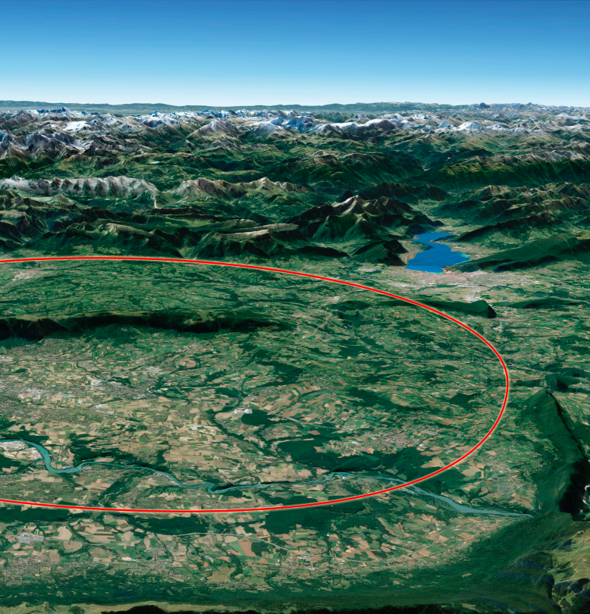
Summary
Introduction
  Study context for FCC-ee
  Xsuite and parameter sets for simulations
Simulation tools
  Circulant matrix model
  Xsuite versus mode analysis algorithm
Simulation of Beam-Beam
  Intensity scans – coherent instability
  Tune scans – study of different characteristics
Simulation of wakefields
  Circulant matrix model for wakefields
  Transverse mode coupling instability simulations
Summary
  Summary and outlook
Xsuite and Circulant Matrix Model simulations for FCC-ee beam-beam and wakefield effects.
FCC week 2024 - DATE
Roxana SOOS, Xavier BUFFAT, Angeles FAUS-GOLFE, FCC-ee collective effects study group.

Slide 3
Xsuite and Circulant Matrix Model simulations for FCC-ee beam-beam and wakefield effects.
3
Roxana SOOS
12/06/24
Introduction
Study context for the FCC-ee
Context:
Interplay between impedance (wakefields) and beam-beam has a growing interest for building new accelerators [1]
BimBim (CMM) and Xsuite showed agreement with LHC and VEPP measurements [2], [3]
[1] Y. Zhang, et al., Phys. Rev. Accel. Beams 26, 064401 (2023)
[2] S. White, et al., Phys. Rev. ST Accel. Beams 17, 041002 (2014)
[3] E. A. Perevedentsev and A. A. Valishev, Phys. Rev. ST Accel. Beams 4, 024403 (2001)

Slide 4
Xsuite and BimBim simulation tools for beam-beam and impedance studies
4
Roxana SOOS
12/06/24
Introduction
Study context for the FCC-ee
Context:
Interplay between impedance (wakefields) and beam-beam has a growing interest for building new accelerators [1]
BimBim (CMM) and Xsuite showed agreement with LHC and VEPP measurements [2], [3]
https://indico.cern.ch/event/1202105/
https://indico.cern.ch/event/1326738/
https://indico.cern.ch/event/1326738/
[1] Y. Zhang, et al., Phys. Rev. Accel. Beams 26, 064401 (2023)
[2] S. White, et al., Phys. Rev. ST Accel. Beams 17, 041002 (2014)
[3] E. A. Perevedentsev and A. A. Valishev, Phys. Rev. ST Accel. Beams 4, 024403 (2001)

Slide 5
Xsuite and BimBim simulation tools for beam-beam and impedance studies
5
Roxana SOOS
12/06/24
Introduction
Study context for the FCC-ee
Context:
Interplay between impedance (wakefields) and beam-beam has a growing interest for building new accelerators [1]
BimBim (CMM) and Xsuite showed agreement with LHC and VEPP measurements [2], [3]
https://indico.cern.ch/event/1202105/
https://indico.cern.ch/event/1326738/
https://indico.cern.ch/event/1326738/
Goal:
Understand the different effects due to the contribution of beam-beam and impedance and the dependence on different parameters.
As announced in [1] and other literature, it is difficult to find a stable tune area when the two effects are considered.
[1] Y. Zhang, et al., Phys. Rev. Accel. Beams 26, 064401 (2023)
[2] S. White, et al., Phys. Rev. ST Accel. Beams 17, 041002 (2014)
[3] E. A. Perevedentsev and A. A. Valishev, Phys. Rev. ST Accel. Beams 4, 024403 (2001)

Slide 6
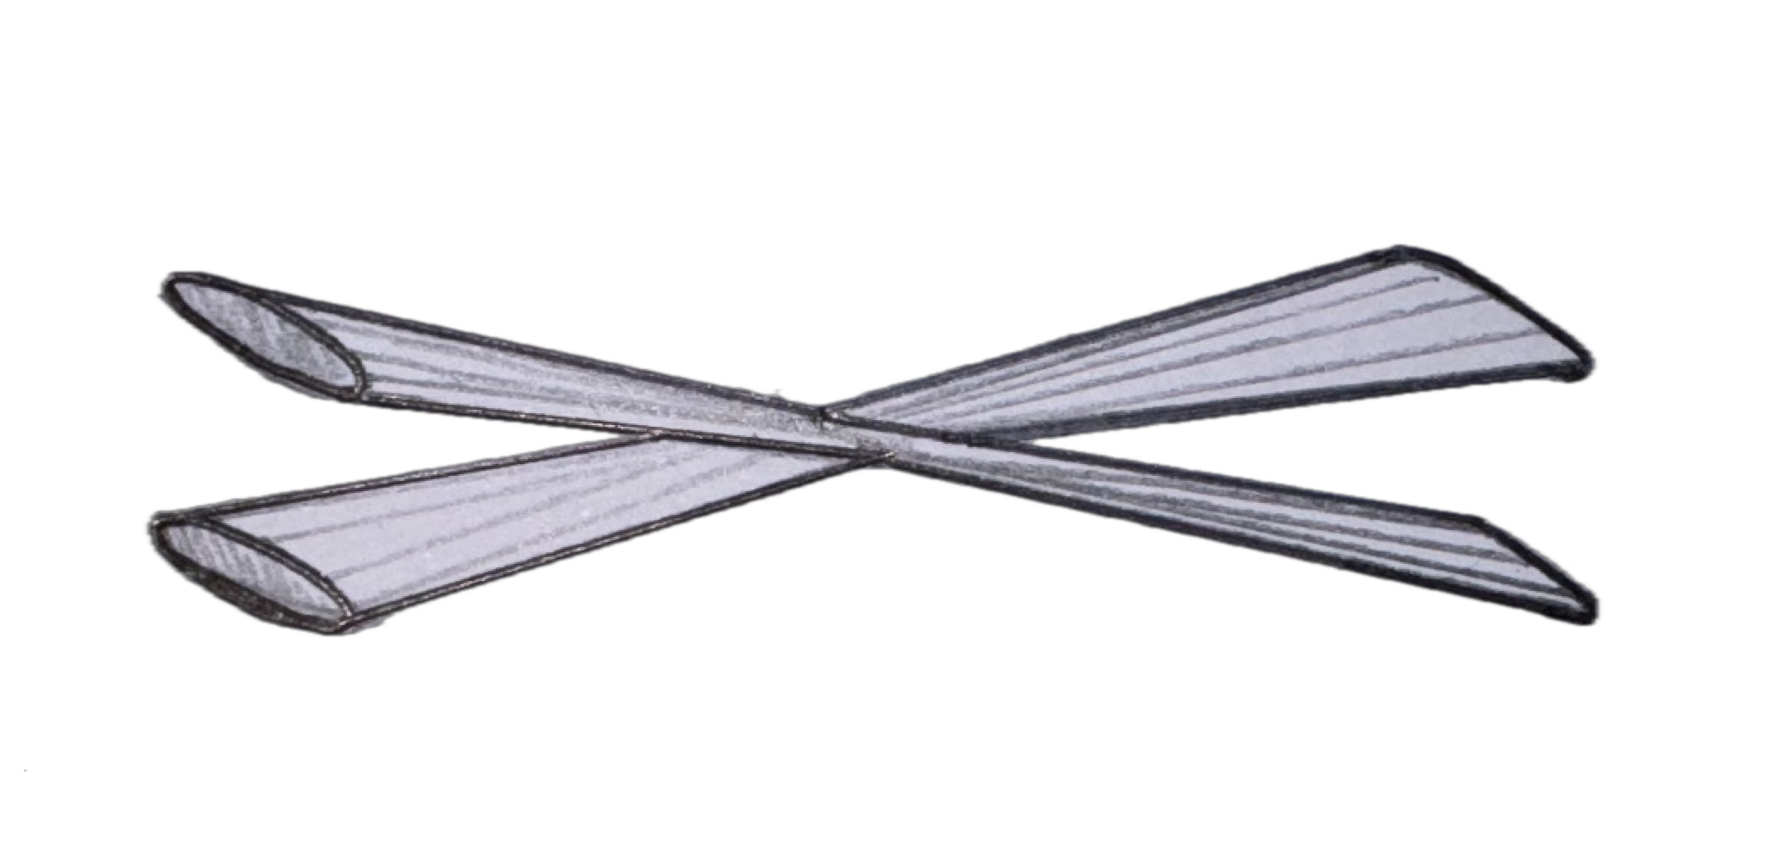
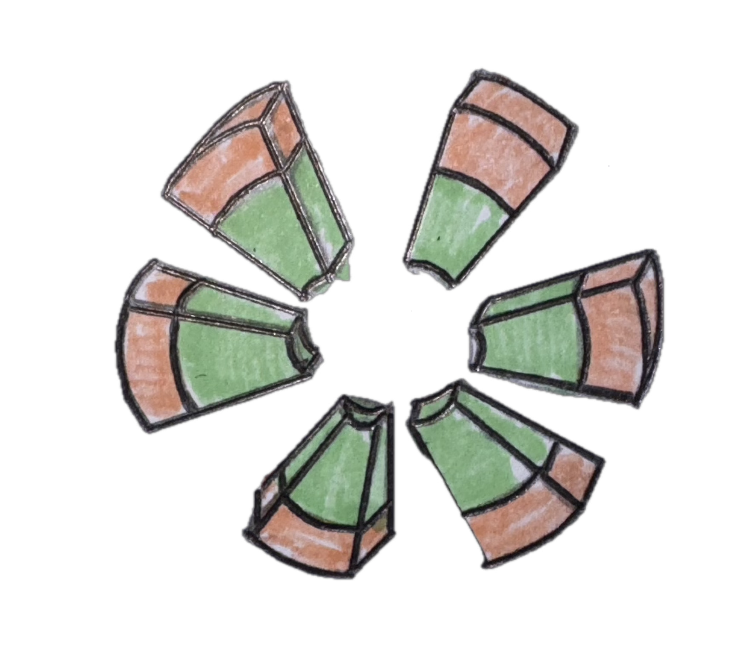
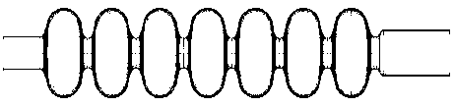
Xsuite and Circulant Matrix Model simulations for FCC-ee beam-beam and wakefield effects.
6
Roxana SOOS
12/06/24
Introduction
Simulation tools
Xsuite and parameter sets for simulation
Turn by turn tracking of particles, calculating nonlinear forces around the specified accelerator components.
FCC-ee (Z) approximated model:
Why:
Limits the numerous complicated non studied effects.
Faster simulations.
What:
FCC-ee (Z) parameters table (bunch lengths/sizes, RF power, crossing angle, …)
Synchrotron radiation (SR) + Radio frequency cavities (RF)
Single beam-beam interaction point + Beamstrahlung (BS)
Crab sextupoles (when crossing angle)
Longitudinal + Transverse wakefields (2023 - M. MIGLIORATI)
SEXTUPOLE
SEXTUPOLE
BEAM BEAM INTERACTION
SYNCHROTRON RADIATION
WAKEFIELDS
RF CAVITIES

Slide 7
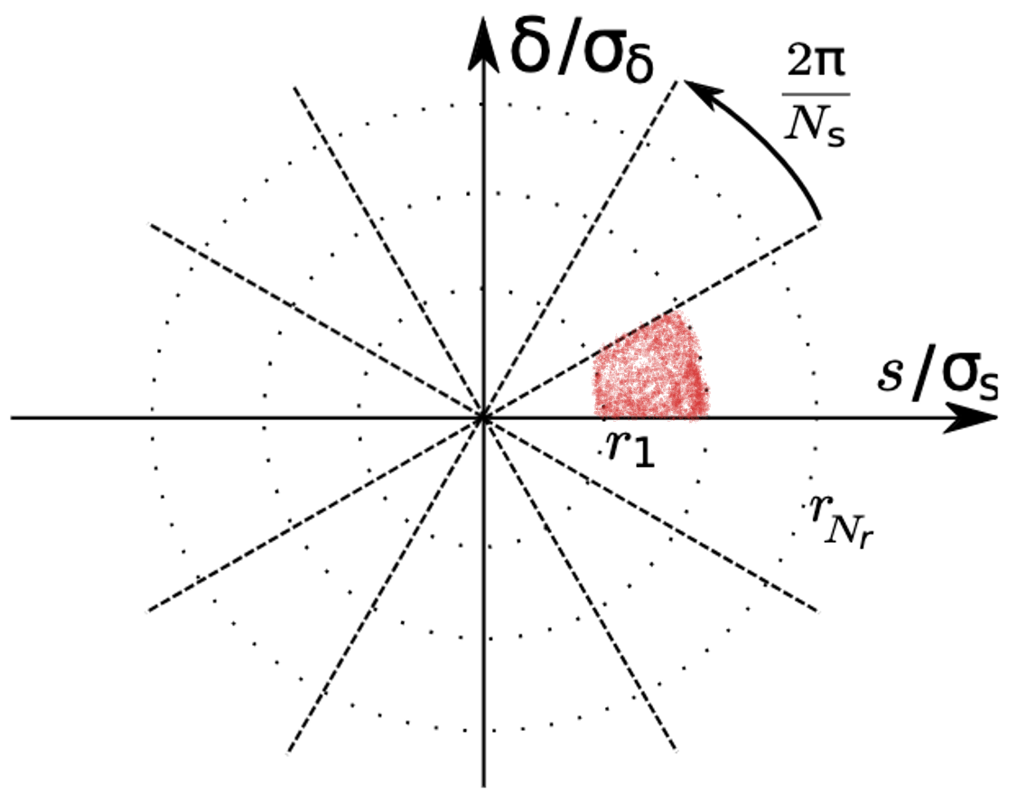
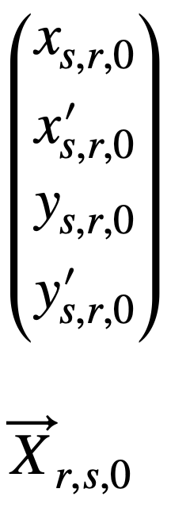
Xsuite and Circulant Matrix Model simulations for FCC-ee beam-beam and wakefield effects.
7
Roxana SOOS
12/06/24
Introduction
Simulation tools
Circulant Matrix Model (CMM)
Use linear algebra on a one turn matrix that represents a system, applied on discretized longitudinal phase space
Polar longitudinal phase space
Slicing structure
=

Slide 8
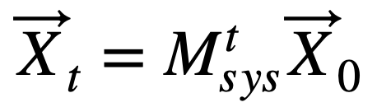
Xsuite and Circulant Matrix Model simulations for FCC-ee beam-beam and wakefield effects.
8
Roxana SOOS
12/06/24
Introduction
Simulation tools
Circulant Matrix Model (CMM)
Use linear algebra on a one turn matrix that represents a system, applied on discretized longitudinal phase space
Polar longitudinal phase space
1 turn system matrix
Slicing structure
Circulant matrix
Real part = oscillation modes
Imaginary part = growth rate
Diagonalize to get eigenvalues
Linear beam-beam perturbation
=
Synchrotron (permutation)
+
betatron motion
Wakefield perturbation

Slide 9
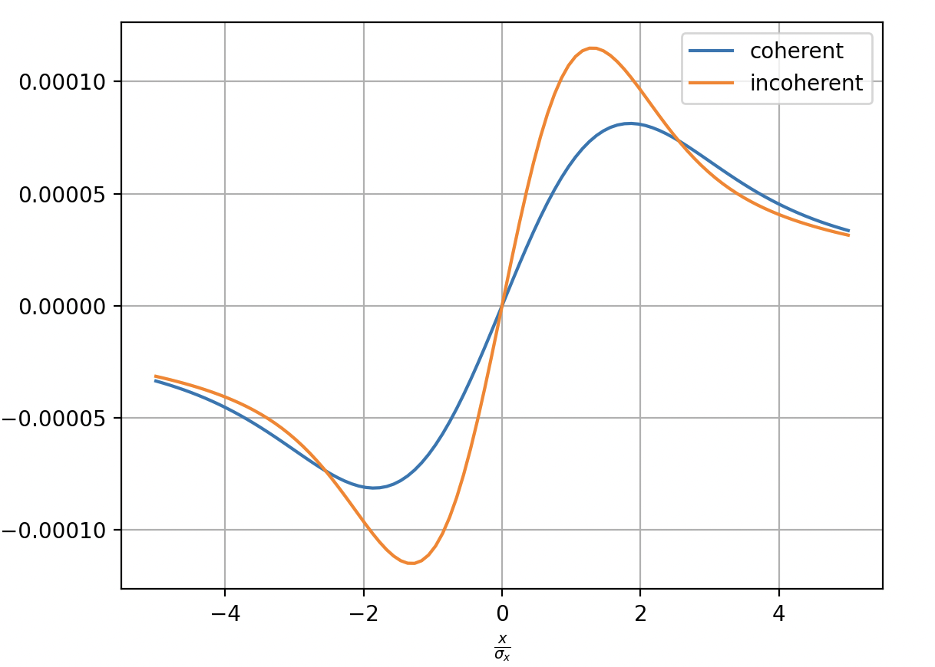
Xsuite and Circulant Matrix Model simulations for FCC-ee beam-beam and wakefield effects.
9
Roxana SOOS
12/06/24
Introduction
Simulation tools
Circulant Matrix Model (CMM)
Use linear algebra on a one turn matrix that represents a system, applied on discretized longitudinal phase space
Linearized coherent flat beam-beam kick
(from Bassetti – Erskine formula)
Transverse beam-beam kicks reprensentation
(Given by Bassetti – Erskine formula)
Matrix elements example
Coherent = over all particle
Beam-beam kick
Incoherent = single particle

Slide 10
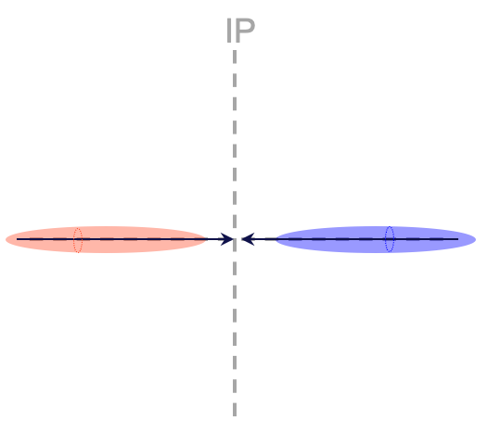
Xsuite and Circulant Matrix Model simulations for FCC-ee beam-beam and wakefield effects.
10
Roxana SOOS
12/06/24
Introduction
Simulation tools
Circulant Matrix Model (CMM)
Use linear algebra on a one turn matrix that represents a system, applied on discretized longitudinal phase space
Linearized coherent flat beam-beam kick
(from Bassetti – Erskine formula)
Transverse beam-beam kicks reprensentation
(Given by Bassetti – Erskine formula)
Matrix elements example
What is in the beam-beam model?
Flat beams
Crossing angle
Drifts (IP -> CP -> IP)
Hourglass effect
Coherent = over all particle
Beam-beam kick
Incoherent = single particle

Slide 11
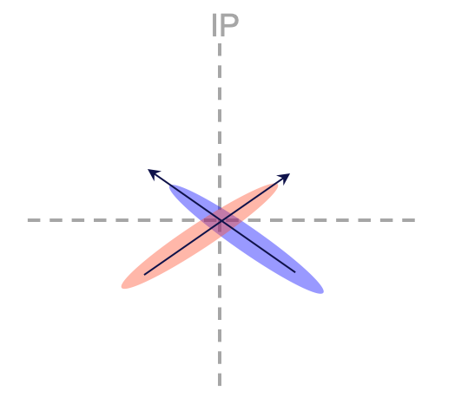
Xsuite and Circulant Matrix Model simulations for FCC-ee beam-beam and wakefield effects.
11
Roxana SOOS
12/06/24
Introduction
Simulation tools
Circulant Matrix Model (CMM)
Use linear algebra on a one turn matrix that represents a system, applied on discretized longitudinal phase space
Linearized coherent flat beam-beam kick
(from Bassetti – Erskine formula)
Transverse beam-beam kicks reprensentation
(Given by Bassetti – Erskine formula)
Matrix elements example
What is in the beam-beam model?
Flat beams
Crossing angle
Drifts (IP -> CP -> IP)
Hourglass effect
Coherent = over all particle
Beam-beam kick
Incoherent = single particle

Slide 12
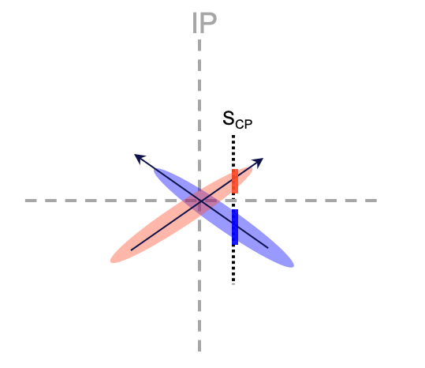
Xsuite and Circulant Matrix Model simulations for FCC-ee beam-beam and wakefield effects.
12
Roxana SOOS
12/06/24
Introduction
Simulation tools
Circulant Matrix Model (CMM)
Use linear algebra on a one turn matrix that represents a system, applied on discretized longitudinal phase space
Linearized coherent flat beam-beam kick
(from Bassetti – Erskine formula)
Transverse beam-beam kicks reprensentation
(Given by Bassetti – Erskine formula)
Matrix elements example
What is in the beam-beam model?
Flat beams
Crossing angle
Drifts (IP -> CP -> IP)
Hourglass effect
Coherent = over all particle
Beam-beam kick
Incoherent = single particle

Slide 13
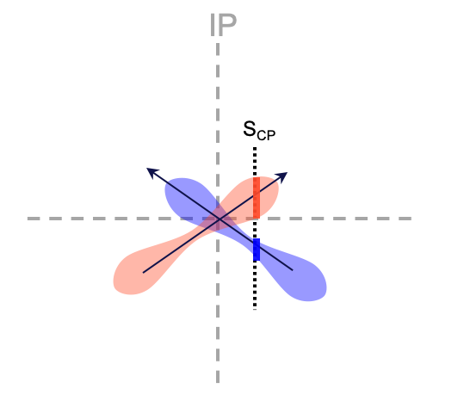
Xsuite and Circulant Matrix Model simulations for FCC-ee beam-beam and wakefield effects.
13
Roxana SOOS
12/06/24
Introduction
Introduction
Simulation tools
Circulant Matrix Model (CMM)
Use linear algebra on a one turn matrix that represents a system, applied on discretized longitudinal phase space
Linearized coherent flat beam-beam kick
(from Bassetti – Erskine formula)
Transverse beam-beam kicks reprensentation
(Given by Bassetti – Erskine formula)
Matrix elements example
What is in the beam-beam model?
Flat beams
Crossing angle
Drifts (IP -> CP -> IP)
Hourglass effect
Coherent = over all particle
Beam-beam kick
Incoherent = single particle
Disclaimer: schematic not 100% accurate representation.

Slide 14
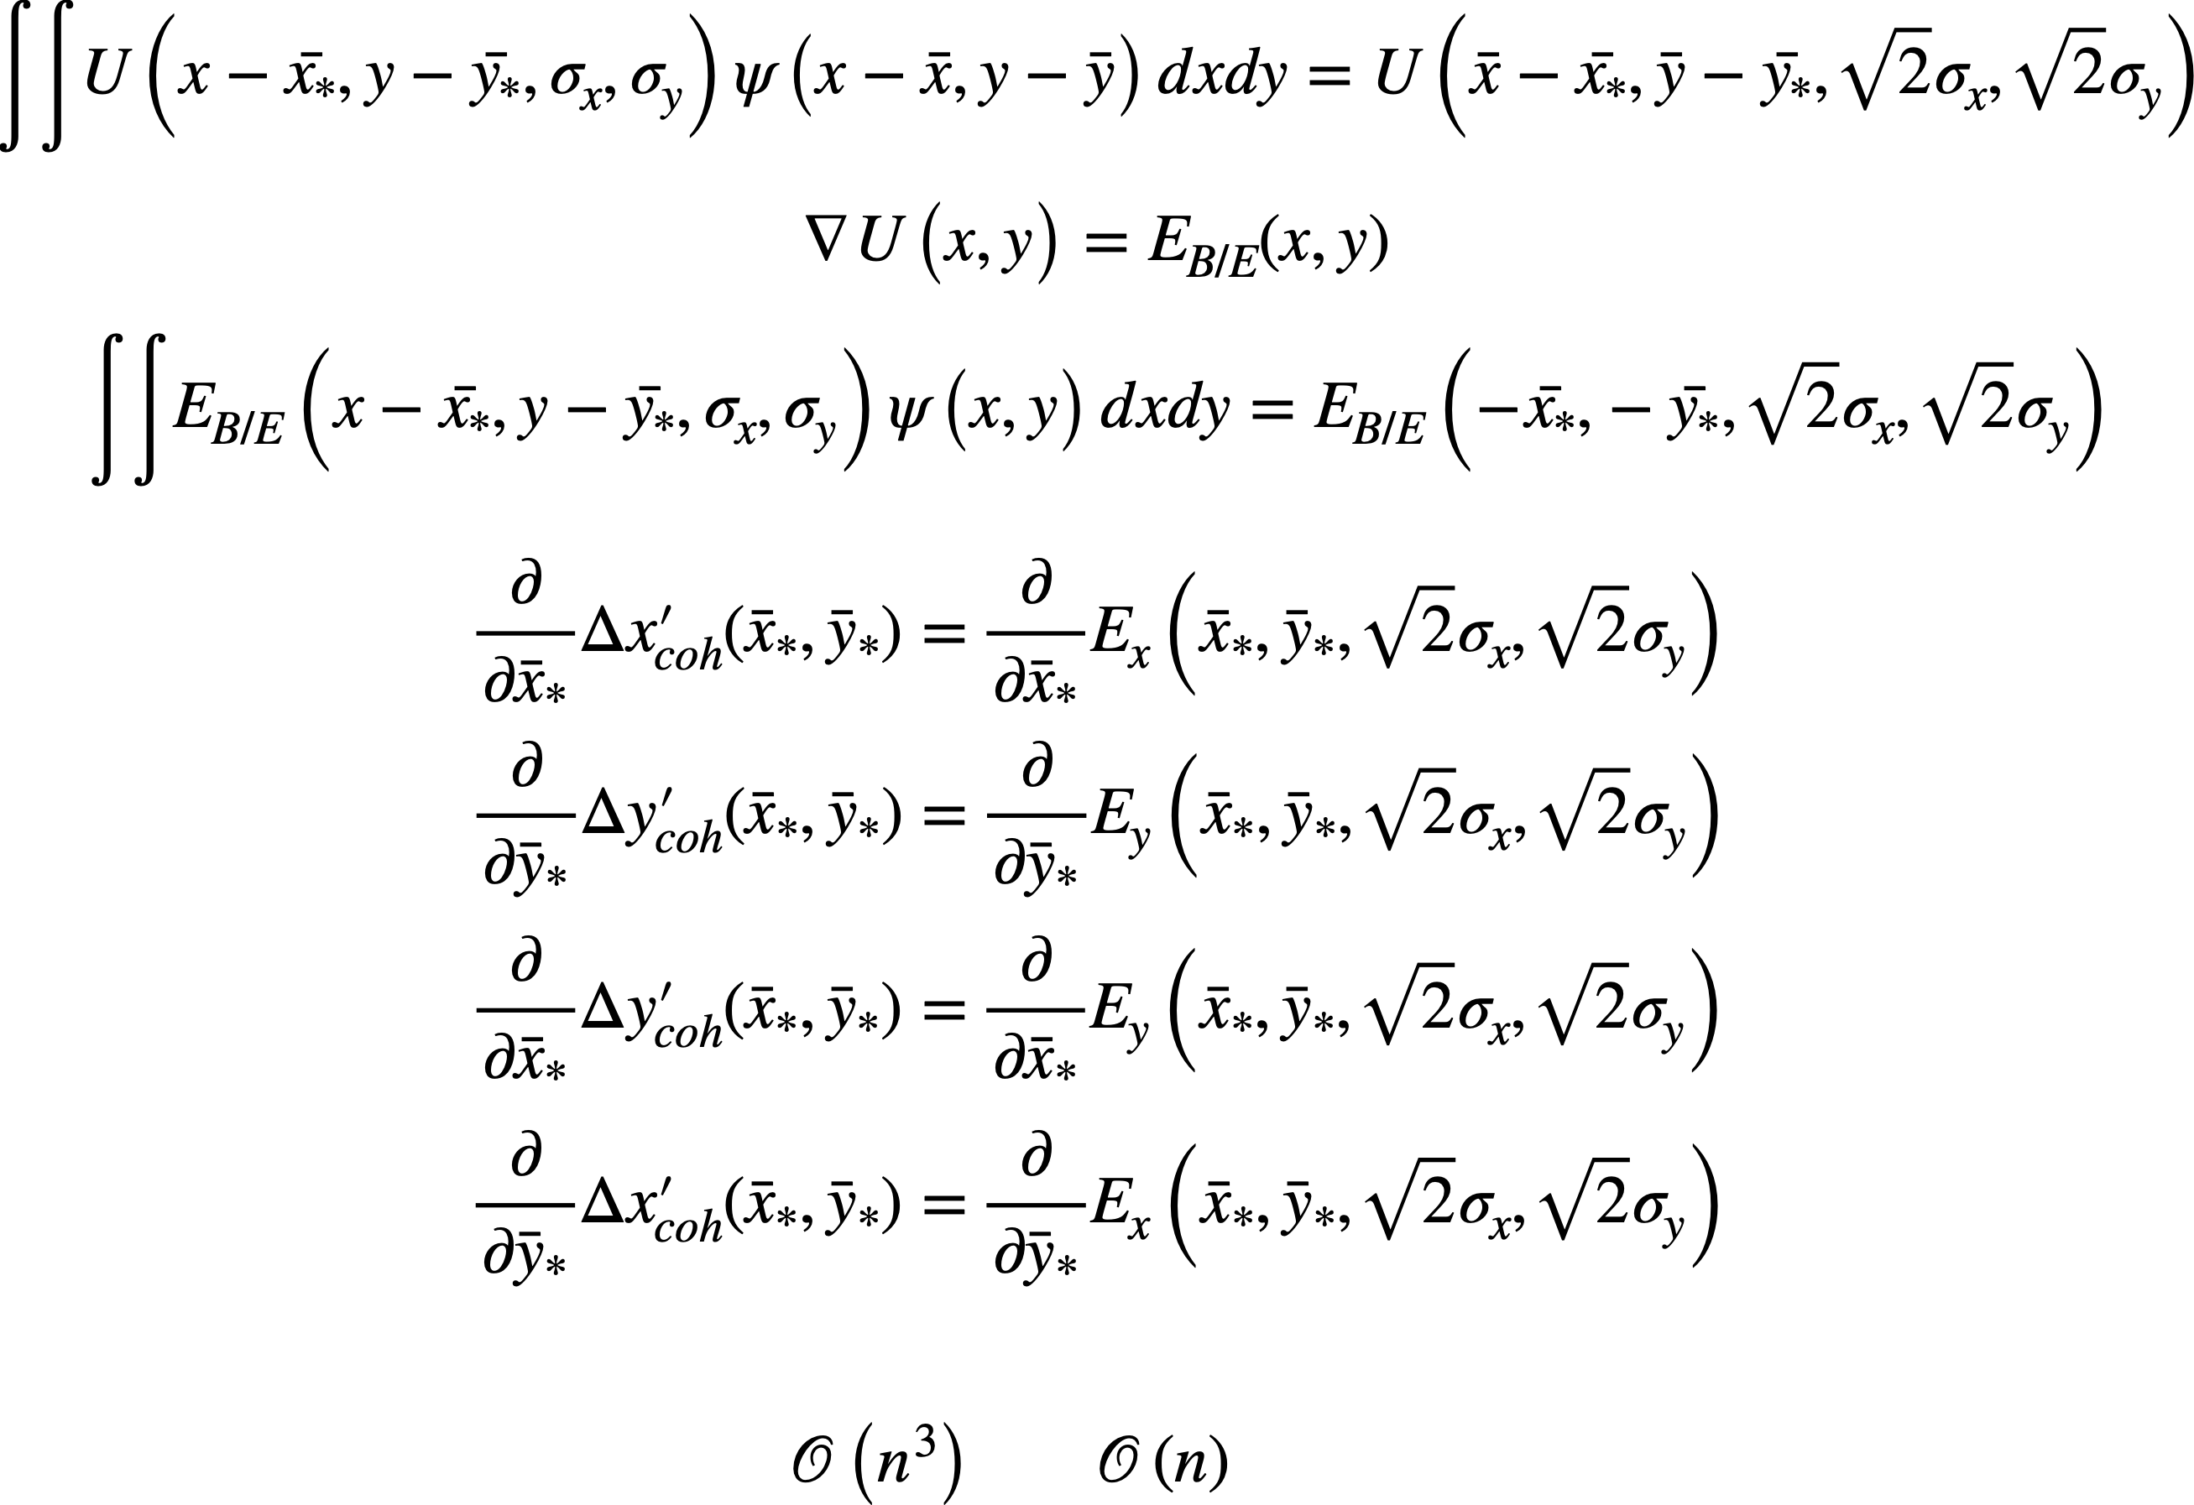
Xsuite and Circulant Matrix Model simulations for FCC-ee beam-beam and wakefield effects.
14
Roxana SOOS
12/06/24
Introduction
Introduction
Simulation tools
Circulant Matrix Model (CMM)
Use linear algebra on a one turn matrix that represents a system, applied on discretized longitudinal phase space
Linearized coherent flat beam-beam kick
(from Bassetti – Erskine formula)
[4]
Transverse beam-beam kicks reprensentation
(Given by Bassetti – Erskine formula)
Matrix elements example
Coherent force
Bassetti – Erskine formula
Coherent = over all particle
Normal forces
Beam-beam kick
Incoherent = single particle
Coupled forces
[4] K. HIRATA, Nuclear Instruments and Methods in Physics Research A269, 7-22 (1988)

Slide 15
Xsuite and Circulant Matrix Model simulations for FCC-ee beam-beam and wakefield effects.
15
Roxana SOOS
12/06/24
Introduction
Introduction
Simulation tools
Circulant Matrix Model (CMM)
Use linear algebra on a one turn matrix that represents a system, applied on discretized longitudinal phase space
Linearized coherent flat beam-beam kick
(from Bassetti – Erskine formula)
[4]
Matrix elements example
Coherent force
Bassetti – Erskine formula
[4]
Normal forces
Coupled forces
[4] K. HIRATA, Nuclear Instruments and Methods in Physics Research A269, 7-22 (1988)

Slide 16
Xsuite and Circulant Matrix Model simulations for FCC-ee beam-beam and wakefield effects.
16
Roxana SOOS
12/06/24
Introduction
Introduction
Simulation tools
Circulant Matrix Model (CMM)
Use linear algebra on a one turn matrix that represents a system, applied on discretized longitudinal phase space
Linearized coherent flat beam-beam kick
(from Bassetti – Erskine formula)
Simple case with the beam beam kick only applied to the horizontal space
Matrix elements example
BEAM 1
BEAM 2
This can be generalized to the vertical space and for $N_{slice}$x $N_{ring}$ mesh elements.
[4] K. HIRATA, Nuclear Instruments and Methods in Physics Research A269, 7-22 (1988)

Slide 17
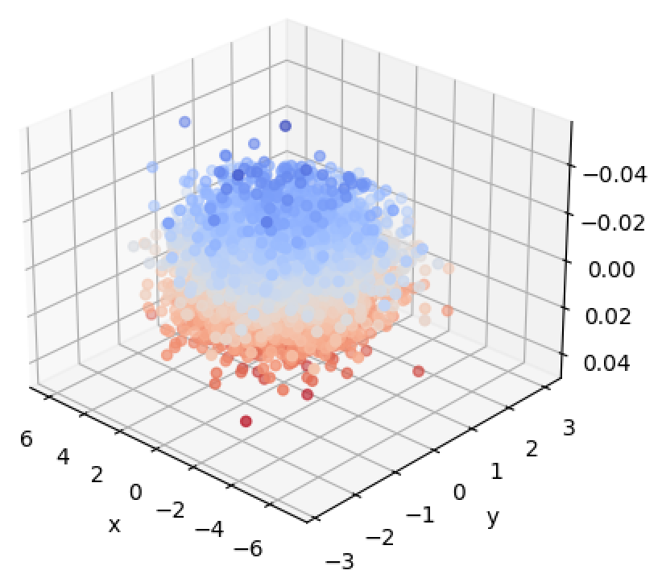
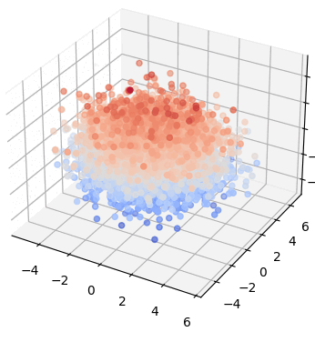
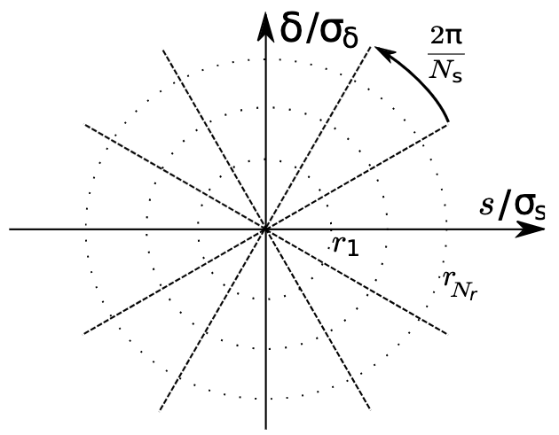
Xsuite and Circulant Matrix Model simulations for FCC-ee beam-beam and wakefield effects.
17
Roxana SOOS
12/06/24
Introduction
Simulation tools
XSuite versus mode analysis algorithm
Xsuite
CMM*
Output:
Turn by turn parameters of the particles in the beam
Output:
Eigenvalues
⬄
tunes and growth rates
Study of BOTH wakefields and
beam-beam interactions possible
Advantages:
We can see all oscillation modes and the growth rates quickly
Advantages:
Closer to reality, non-linear models,
Landau damping,…
Drawbacks:
Difficult to interpret results, slower
Drawbacks:
Linear model, cannot show non-linear effects
^{*Circulant Matrix Model}

Slide 18
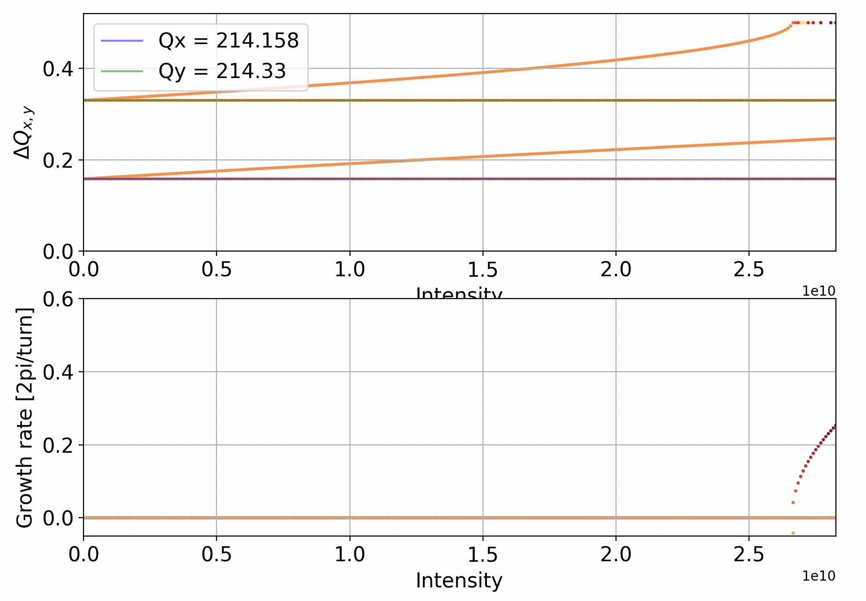
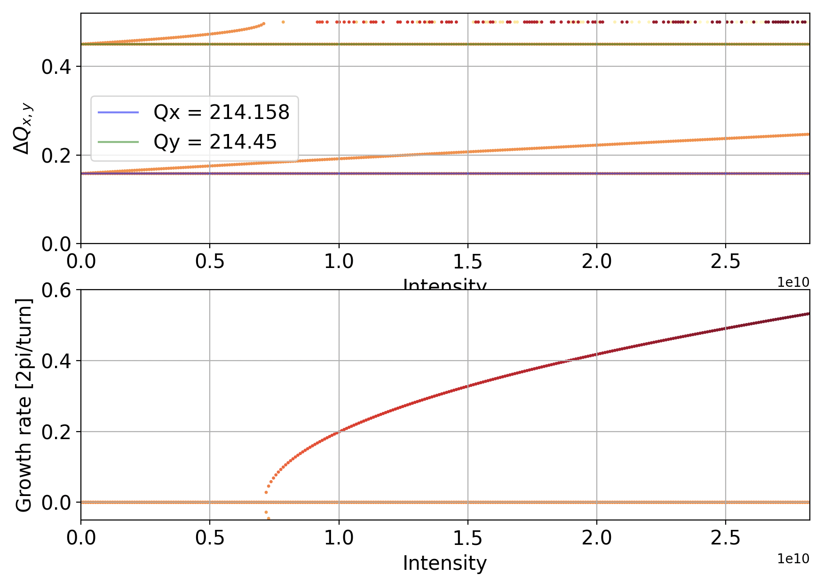





Xsuite and Circulant Matrix Model simulations for FCC-ee beam-beam and wakefield effects.
18
Roxana SOOS
12/06/24
Introduction
Simulation tools
Simulations of beam-beam
Intensity scans – coherent instability
The intensity scan is a simulation where we study growth rates of the instabilities and modes of oscillation, varying the intensity. The CMM outputs are modes of oscillation and growth rates.
Smaller vertical tune: farther from 0.5 resonance
Higher vertical tune: closer to 0.5 resonance
$$Q_{π,y}$$
$$Q_{σ,y}$$
$$ξ_{y}(I)$$
$$Q_{π,x}$$
$$Q_{σ,x}$$
0.5 resonance hit
=
Coherent instability
Simple case: Only beam-beam, with circular beam, no hourglass, low intensity, to demonstrate ‘simple’ intensity scan
FCC-ee (Z) base parameters with $β_{x}= β_{y}$ = 0.15 m, $ε_{x}=ε_{y}$ = 7.1e-10m, $θ$ = 0 mrad
[5] A. CHAO, Coherent Beam-Beam Effects (1991)

Slide 19
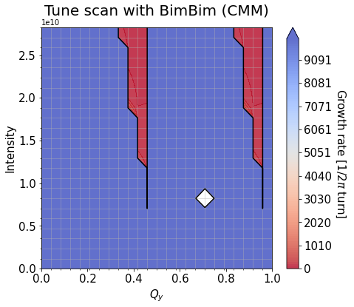
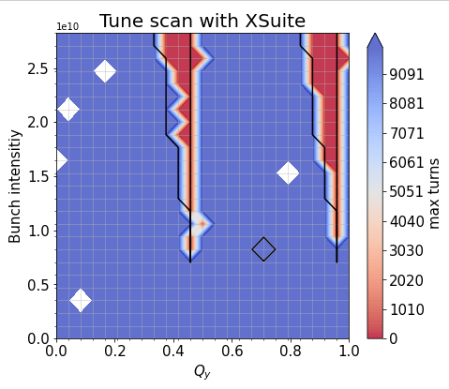

Xsuite and Circulant Matrix Model simulations for FCC-ee beam-beam and wakefield effects.
19
Roxana SOOS
12/06/24
Introduction
Simulation tools
Simulations of beam-beam
Tune scans – study of different characteristics
The tune scan is a simulation where we study the growth rate of the instabilities in a bunch, varying the intensity and/or the tune(s).
Simple case: Only beam-beam, with circular beam, no hourglass, low intensity, to demonstrate ‘simple’ tune scan
FCC-ee (Z) base parameters with $β_{x}= β_{y}$ = 0.15 m, $ε_{x}=ε_{y}$ = 7.1e-10m, $θ$ = 0 mrad
[5] A. CHAO, Coherent Beam-Beam Effects (1991)
Notes:
/eos/project/f/fcc-ee-bbeam-wake-studies/rosoos/beambeamStudies/intyVStune/tune_scan_0/

Slide 20
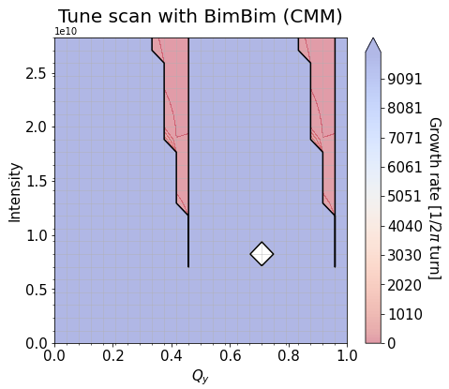
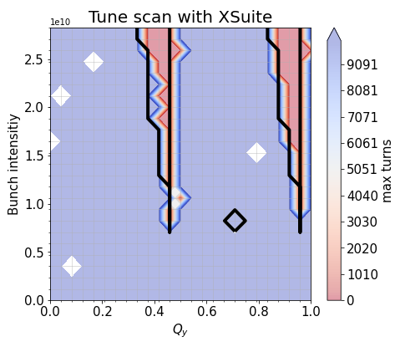
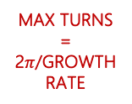
Xsuite and Circulant Matrix Model simulations for FCC-ee beam-beam and wakefield effects.
20
Roxana SOOS
12/06/24
Introduction
Simulation tools
Simulations of beam-beam
Tune scans – study of different characteristics
The tune scan is a simulation where we study the growth rate of the instabilities in a bunch, varying the intensity and/or the tune(s).
UNSTABLE
UNSTABLE
UNSTABLE
UNSTABLE
[5]
Missing data points
MAX TURNS = 2$π$/GROWTH RATE
Missing data points
STABLE
STABLE
Simple case: Only beam-beam, with circular beam, no hourglass, low intensity, to demonstrate ‘simple’ tune scan
FCC-ee (Z) base parameters with $β_{x}= β_{y}$ = 0.15 m, $ε_{x}=ε_{y}$ = 7.1e-10m, $θ$ = 0 mrad
[5] A. CHAO, Coherent Beam-Beam Effects (1991)
Notes:
/eos/project/f/fcc-ee-bbeam-wake-studies/rosoos/beambeamStudies/intyVStune/tune_scan_0/

Slide 21
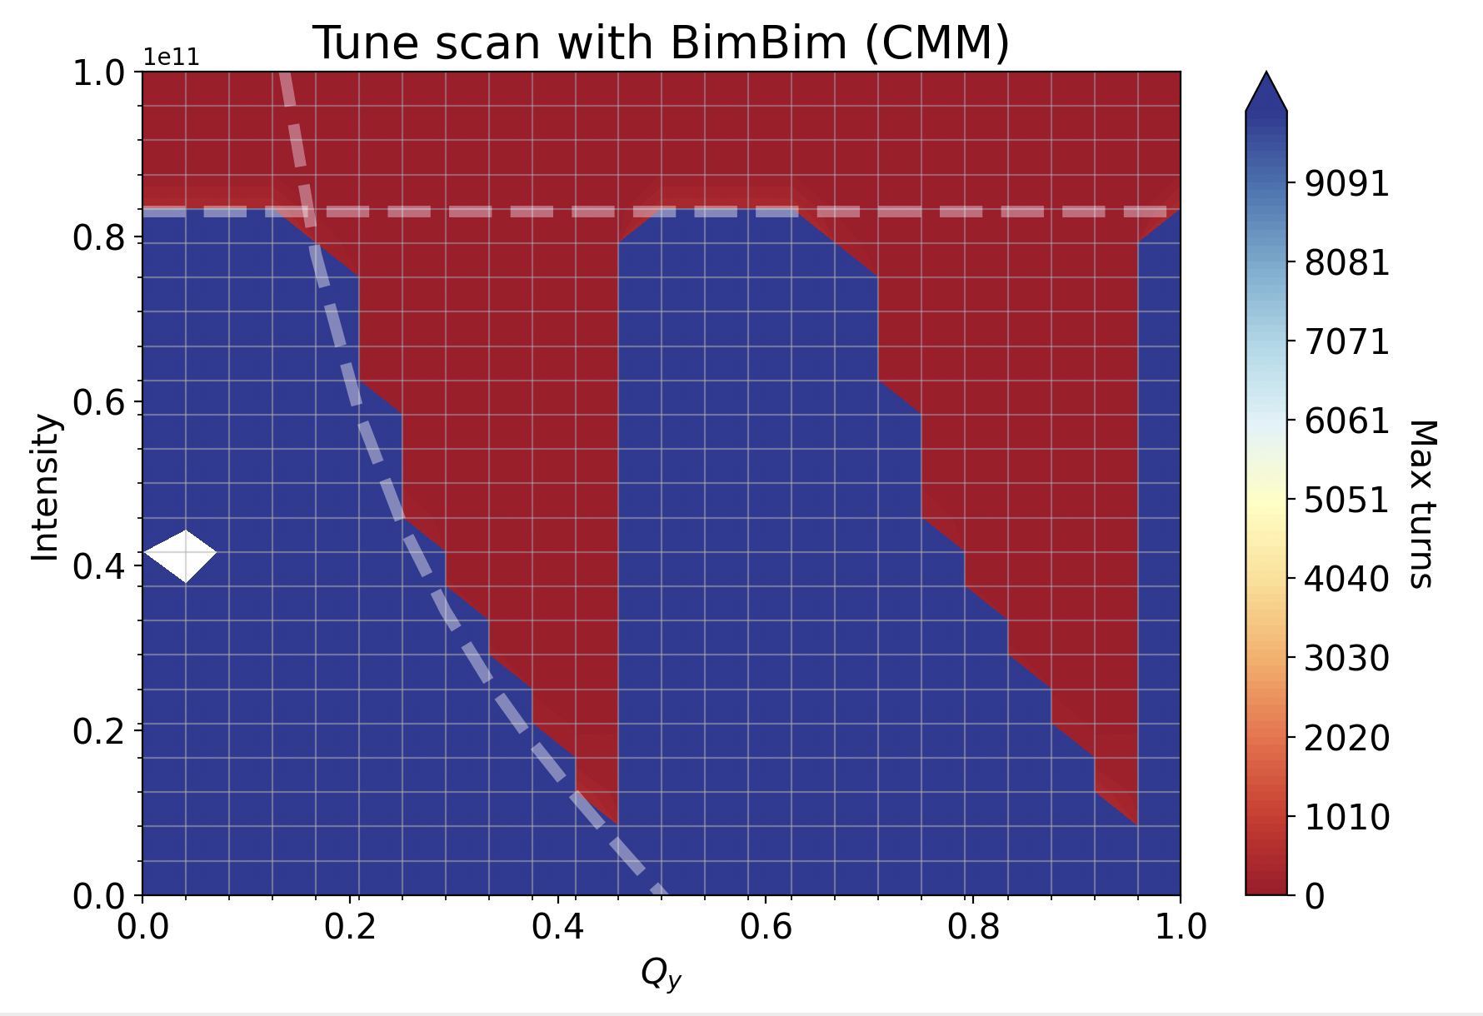
Xsuite and Circulant Matrix Model simulations for FCC-ee beam-beam and wakefield effects.
21
Roxana SOOS
12/06/24
Introduction
Simulation tools
Simulations of beam-beam
Tune scans – study of different characteristics
The tune scan is a simulation where we study the growth rate of the instabilities in a bunch, varying the intensity and/or the tune(s).
UNSTABLE
UNSTABLE
UNSTABLE
UNSTABLE
[5]
MAX TURNS = 2$π$/GROWTH RATE
STABLE
STABLE
Simple case: Only beam-beam, with circular beam, no hourglass, low intensity, to demonstrate ‘simple’ tune scan
FCC-ee (Z) base parameters with $β_{x}= β_{y}$ = 0.15 m, $ε_{x}=ε_{y}$ = 7.1e-10m, $θ$ = 0 mrad
[5] A. CHAO, Coherent Beam-Beam Effects (1991)
Notes:
/eos/project/f/fcc-ee-bbeam-wake-studies/rosoos/beambeamStudies/intyVStune/tune_scan_0/

Slide 22
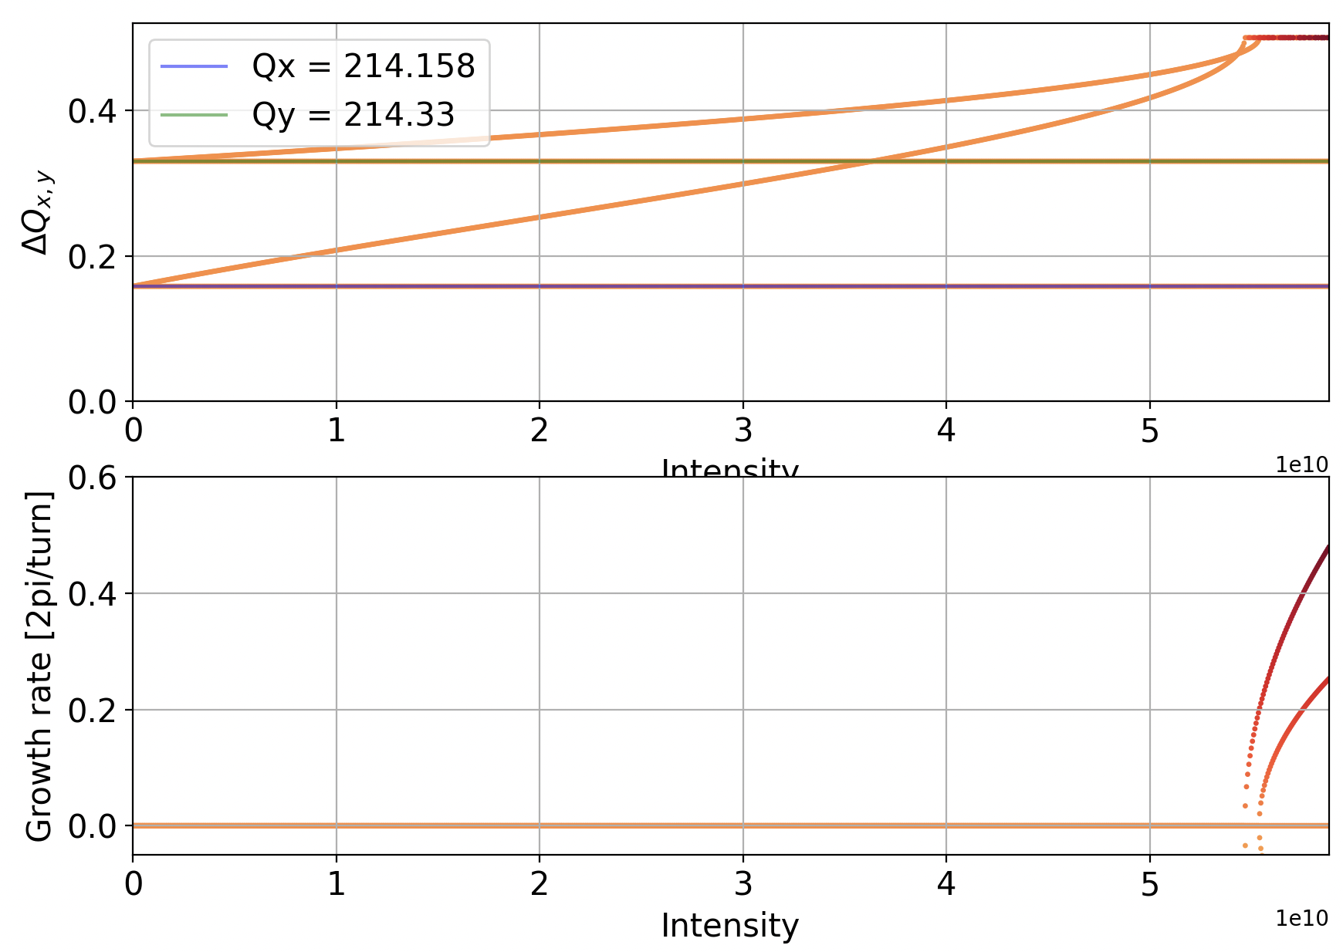
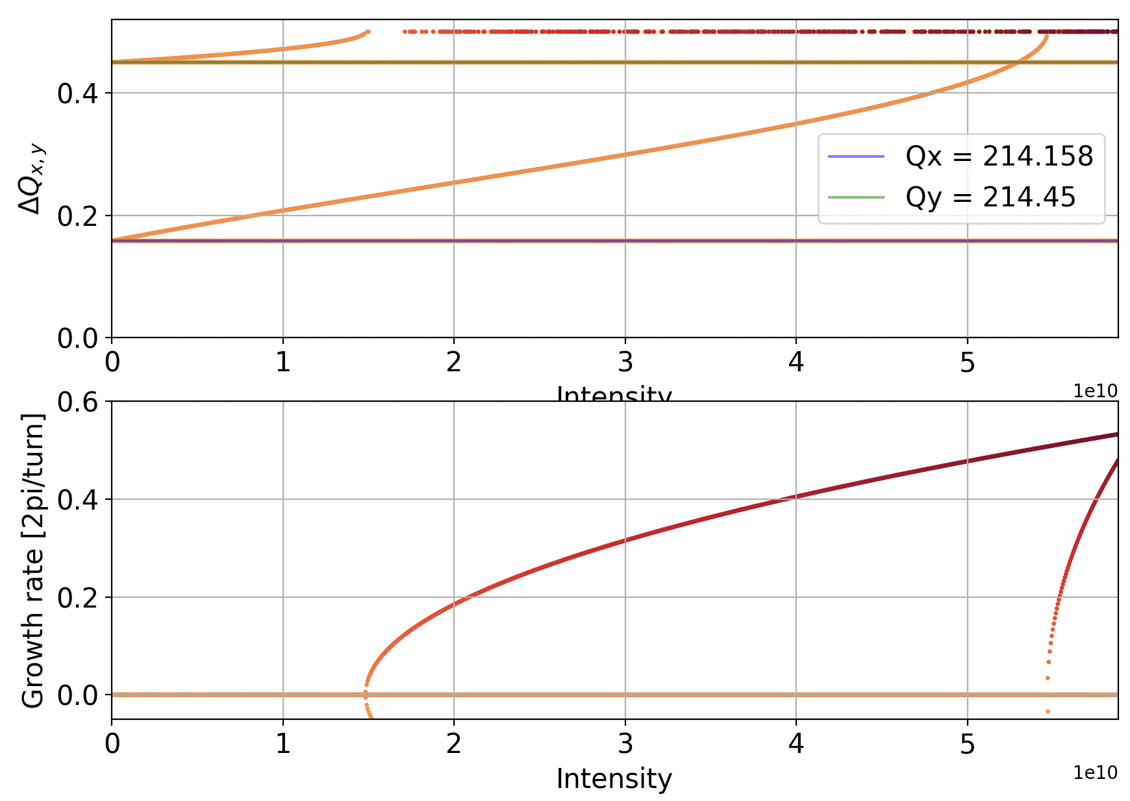


Xsuite and Circulant Matrix Model simulations for FCC-ee beam-beam and wakefield effects.
22
Roxana SOOS
12/06/24
Introduction
Simulation tools
Simulations of beam-beam
Intensity scans – coherent instability
The intensity scan is a simulation where we study growth rates of the instabilities and modes of oscillation, varying the intensity. The CMM outputs are modes of oscillation and growth rates.
Smaller vertical tune: farther from 0.5 resonance
Higher vertical tune: closer to 0.5 resonance
$$Q_{π,y}$$
$$Q_{π,x}$$
$$Q_{σ,y}$$
$$Q_{σ,x}$$
0.5 resonance hit
=
Coherent instability
Simple case: Only beam-beam, with flat beam, no hourglass, low intensity, to demonstrate ‘simple’ intensity scan
FCC-ee (Z) base parameters with $β_{x}\text{= }\text{1} \text{m}{, β}_{y}$ = 0.1 m, $ε_{x}=ε_{y}$ = 7.1e-10m, $θ$ = 0 mrad

Slide 23
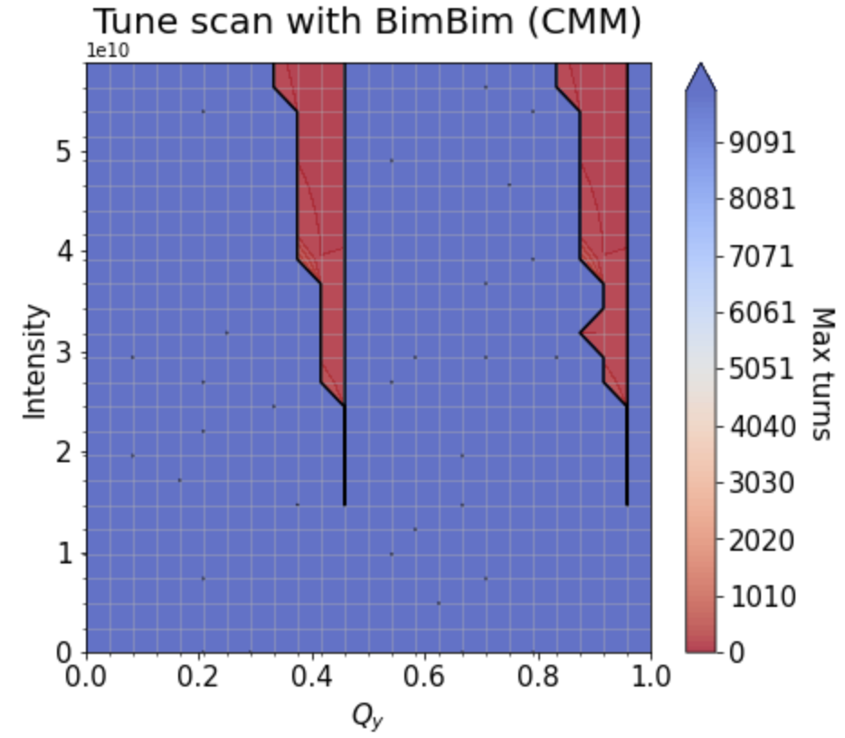
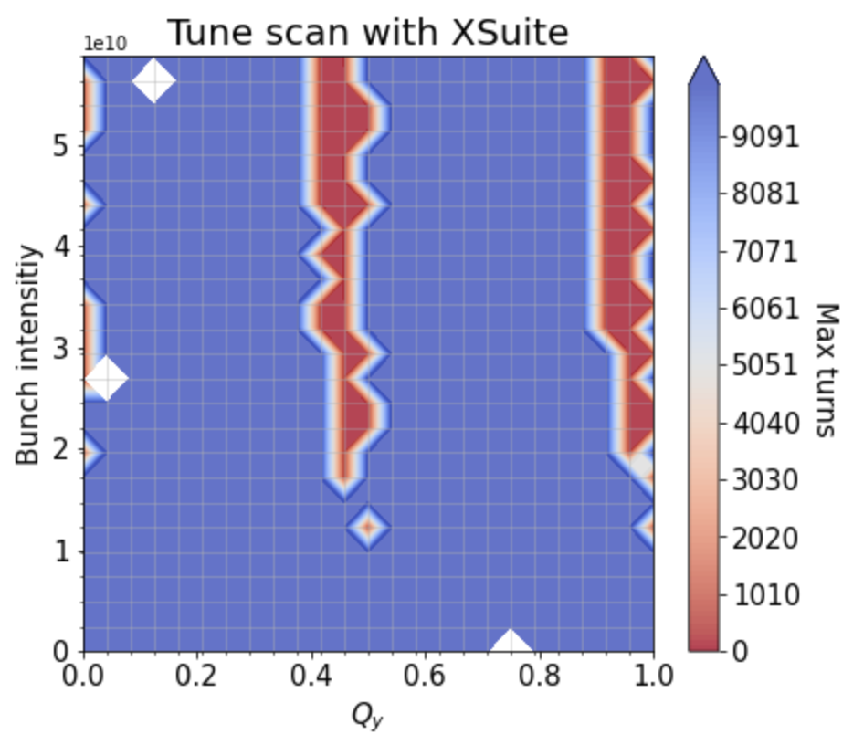
Xsuite and Circulant Matrix Model simulations for FCC-ee beam-beam and wakefield effects.
23
Roxana SOOS
12/06/24
Introduction
Simulation tools
Simulations of beam-beam
Tune scans – study of different characteristics
The tune scan is a simulation where we study the growth rate of the instabilities in a bunch, varying the intensity and/or the tune(s).
Y PLANE RESONNANCES
Y PLANE RESONNANCES
Y PLANE RESONNANCES
Y PLANE RESONNANCES
Simple case 2: Only beam-beam, with flat beam, no hourglass, low intensity, ONLY Y PLANE.
FCC-ee (Z) base parameters with $β_{x}\text{= }\text{1} \text{m}{, β}_{y}$ = 0.1 m, $ε_{x}=ε_{y}$ = 7.1e-10m, $θ$ = 0 mrad
Notes:
/eos/project/f/fcc-ee-bbeam-wake-studies/rosoos/beambeamStudies/intyVStune/tune_scan_13/

Slide 24
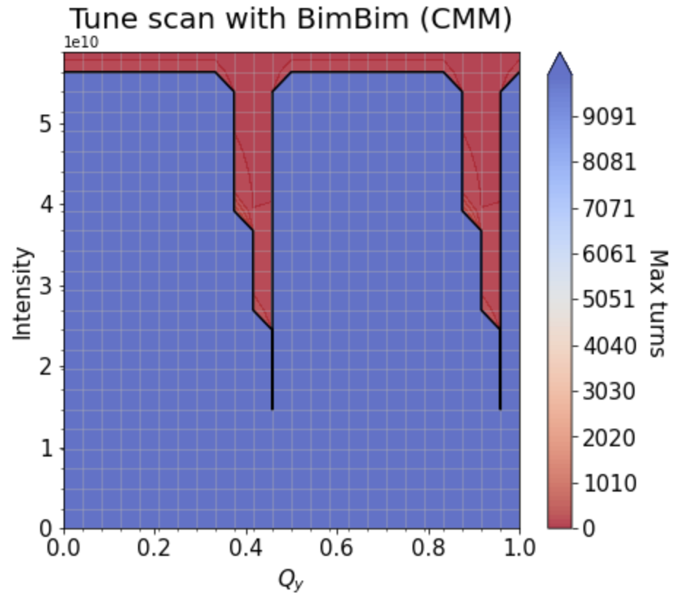
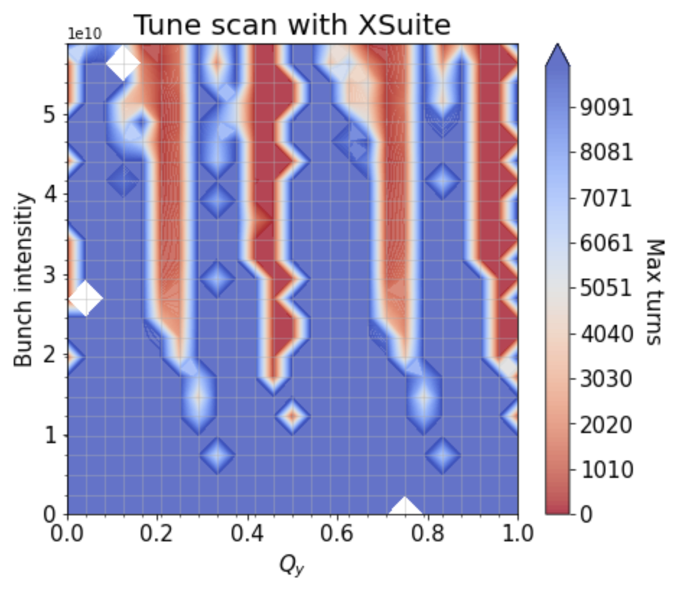
Xsuite and Circulant Matrix Model simulations for FCC-ee beam-beam and wakefield effects.
24
Roxana SOOS
12/06/24
Introduction
Simulation tools
Simulations of beam-beam
Tune scans – study of different characteristics
The tune scan is a simulation where we study the growth rate of the instabilities in a bunch, varying the intensity and/or the tune(s).
X PLANE RESONNANCE
Simple case 2: Only beam-beam, with flat beam, no hourglass, low intensity, Y AND X PLANES.
FCC-ee (Z) base parameters with $β_{x}\text{= }\text{1} \text{m}{, β}_{y}$ = 0.1 m, $ε_{x}=ε_{y}$ = 7.1e-10m, $θ$ = 0 mrad
Notes:
/eos/project/f/fcc-ee-bbeam-wake-studies/rosoos/beambeamStudies/intyVStune/tune_scan_13/

Slide 25
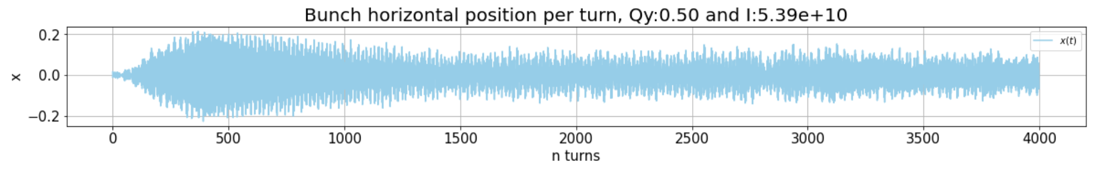
Xsuite and Circulant Matrix Model simulations for FCC-ee beam-beam and wakefield effects.
25
Roxana SOOS
12/06/24
Introduction
Simulation tools
Simulations of beam-beam
Tune scans – study of different characteristics
The tune scan is a simulation where we study the growth rate of the instabilities in a bunch, varying the intensity and/or the tune(s).
LANDAU DAMPING?
Simple case 2: Only beam-beam, with flat beam, no hourglass, low intensity, Y AND X PLANES.
FCC-ee (Z) base parameters with $β_{x}\text{= }\text{1} \text{m}{, β}_{y}$ = 0.1 m, $ε_{x}=ε_{y}$ = 7.1e-10m, $θ$ = 0 mrad
Notes:
/eos/project/f/fcc-ee-bbeam-wake-studies/rosoos/beambeamStudies/intyVStune/tune_scan_13/

Slide 26
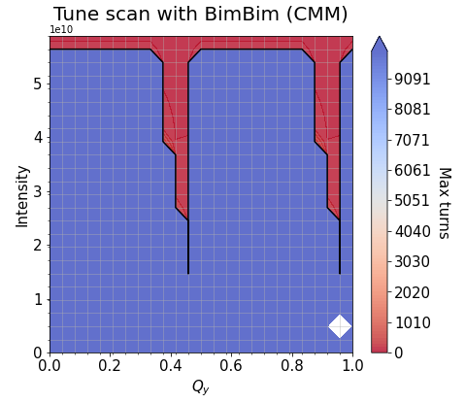
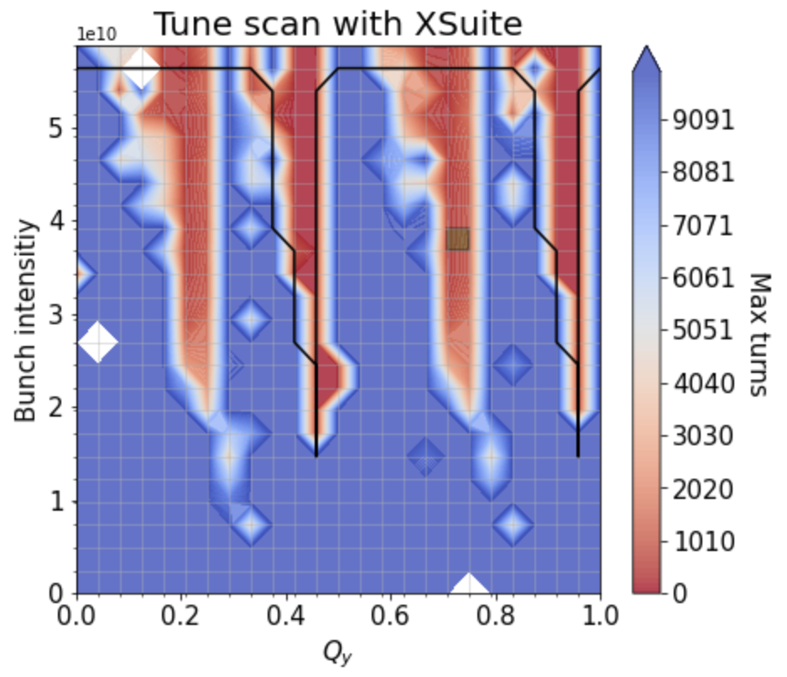
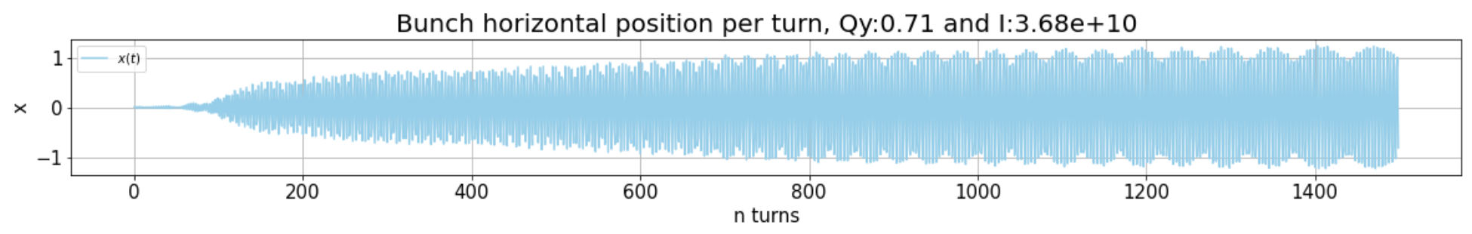
Xsuite and Circulant Matrix Model simulations for FCC-ee beam-beam and wakefield effects.
26
Roxana SOOS
12/06/24
Introduction
Simulation tools
Simulations of beam-beam
Tune scans – study of different characteristics
The tune scan is a simulation where we study the growth rate of the instabilities in a bunch, varying the intensity and/or the tune(s).
HIGHER ORDER COHERENT INSTABILITY?
Simple case 2: Only beam-beam, with flat beam, no hourglass, low intensity, Y AND X PLANES.
FCC-ee (Z) base parameters with $β_{x}\text{= }\text{1} \text{m}{, β}_{y}$ = 0.1 m, $ε_{x}=ε_{y}$ = 7.1e-10m, $θ$ = 0 mrad
Notes:
/eos/project/f/fcc-ee-bbeam-wake-studies/rosoos/beambeamStudies/intyVStune/tune_scan_13/. (0.7,2) sigma

Slide 27

Xsuite and Circulant Matrix Model simulations for FCC-ee beam-beam and wakefield effects.
27
Roxana SOOS
12/06/24
Introduction
Simulation tools
Simulations of beam-beam
Simulations of wakefields
Circulant Matrix Model (CMM) for wakefields
Use linear algebra on a one turn matrix that represents a system, applied on discretized longitudinal phase space
Transverse wake kick
x
Matrix elements example
x₁
x₂
$$∆s$$
s
X. BUFFAT CERN– EPFL Thesis 2015

Slide 28
Xsuite and Circulant Matrix Model simulations for FCC-ee beam-beam and wakefield effects.
28
Roxana SOOS
12/06/24
Introduction
Simulation tools
Simulations of beam-beam
Simulations of wakefields
Circulant Matrix Model (CMM) for wakefields
Use linear algebra on a one turn matrix that represents a system, applied on discretized longitudinal phase space
Transverse wake kick
x
Matrix elements example
x₁
x₂
$$∆s$$
s
X. BUFFAT CERN– EPFL Thesis 2015

Slide 29
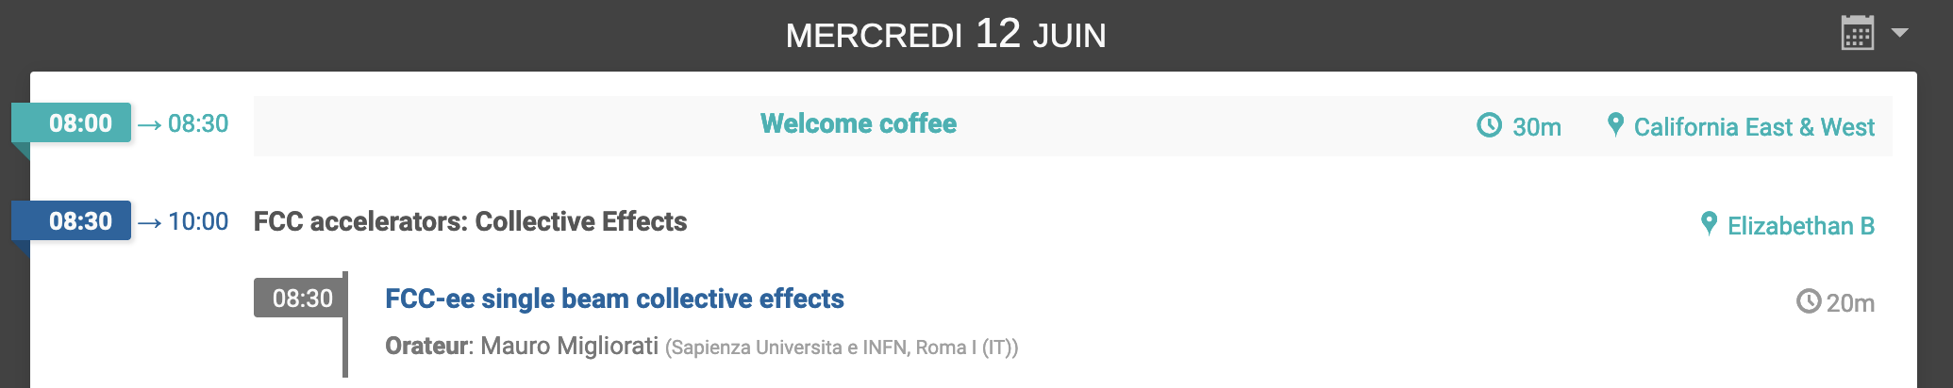

Xsuite and Circulant Matrix Model simulations for FCC-ee beam-beam and wakefield effects.
29
Roxana SOOS
12/06/24
Introduction
Simulation tools
Simulations of beam-beam
Simulations of wakefields
Circulant Matrix Model (CMM) for wakefields
Talk earlier this morning on the effects of wakefields in FCC-ee, and mitigation techniques.

Slide 30
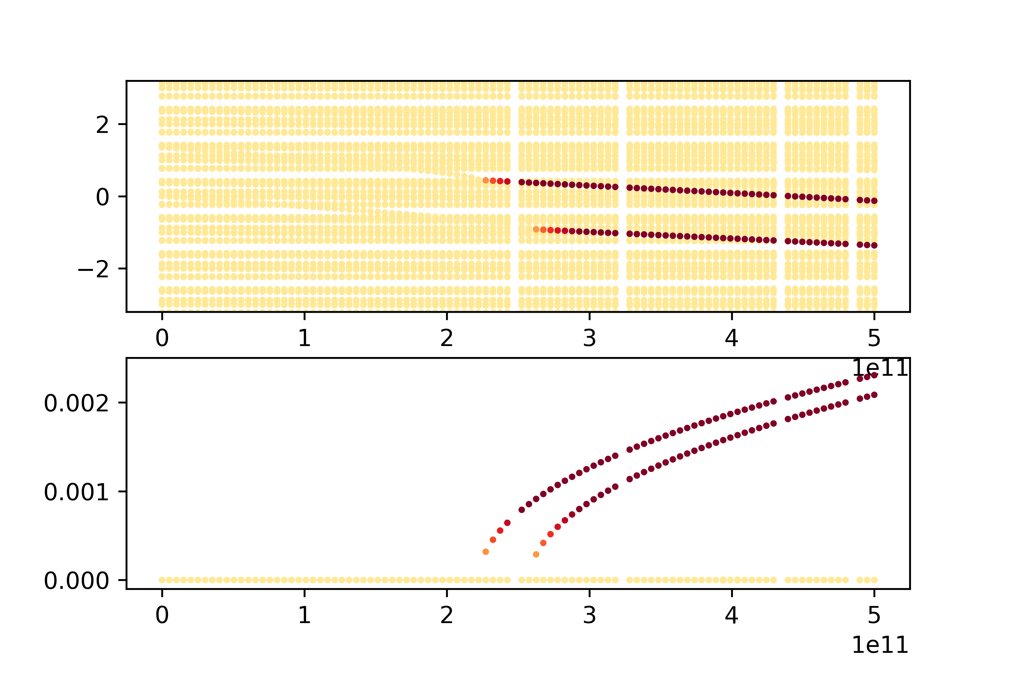
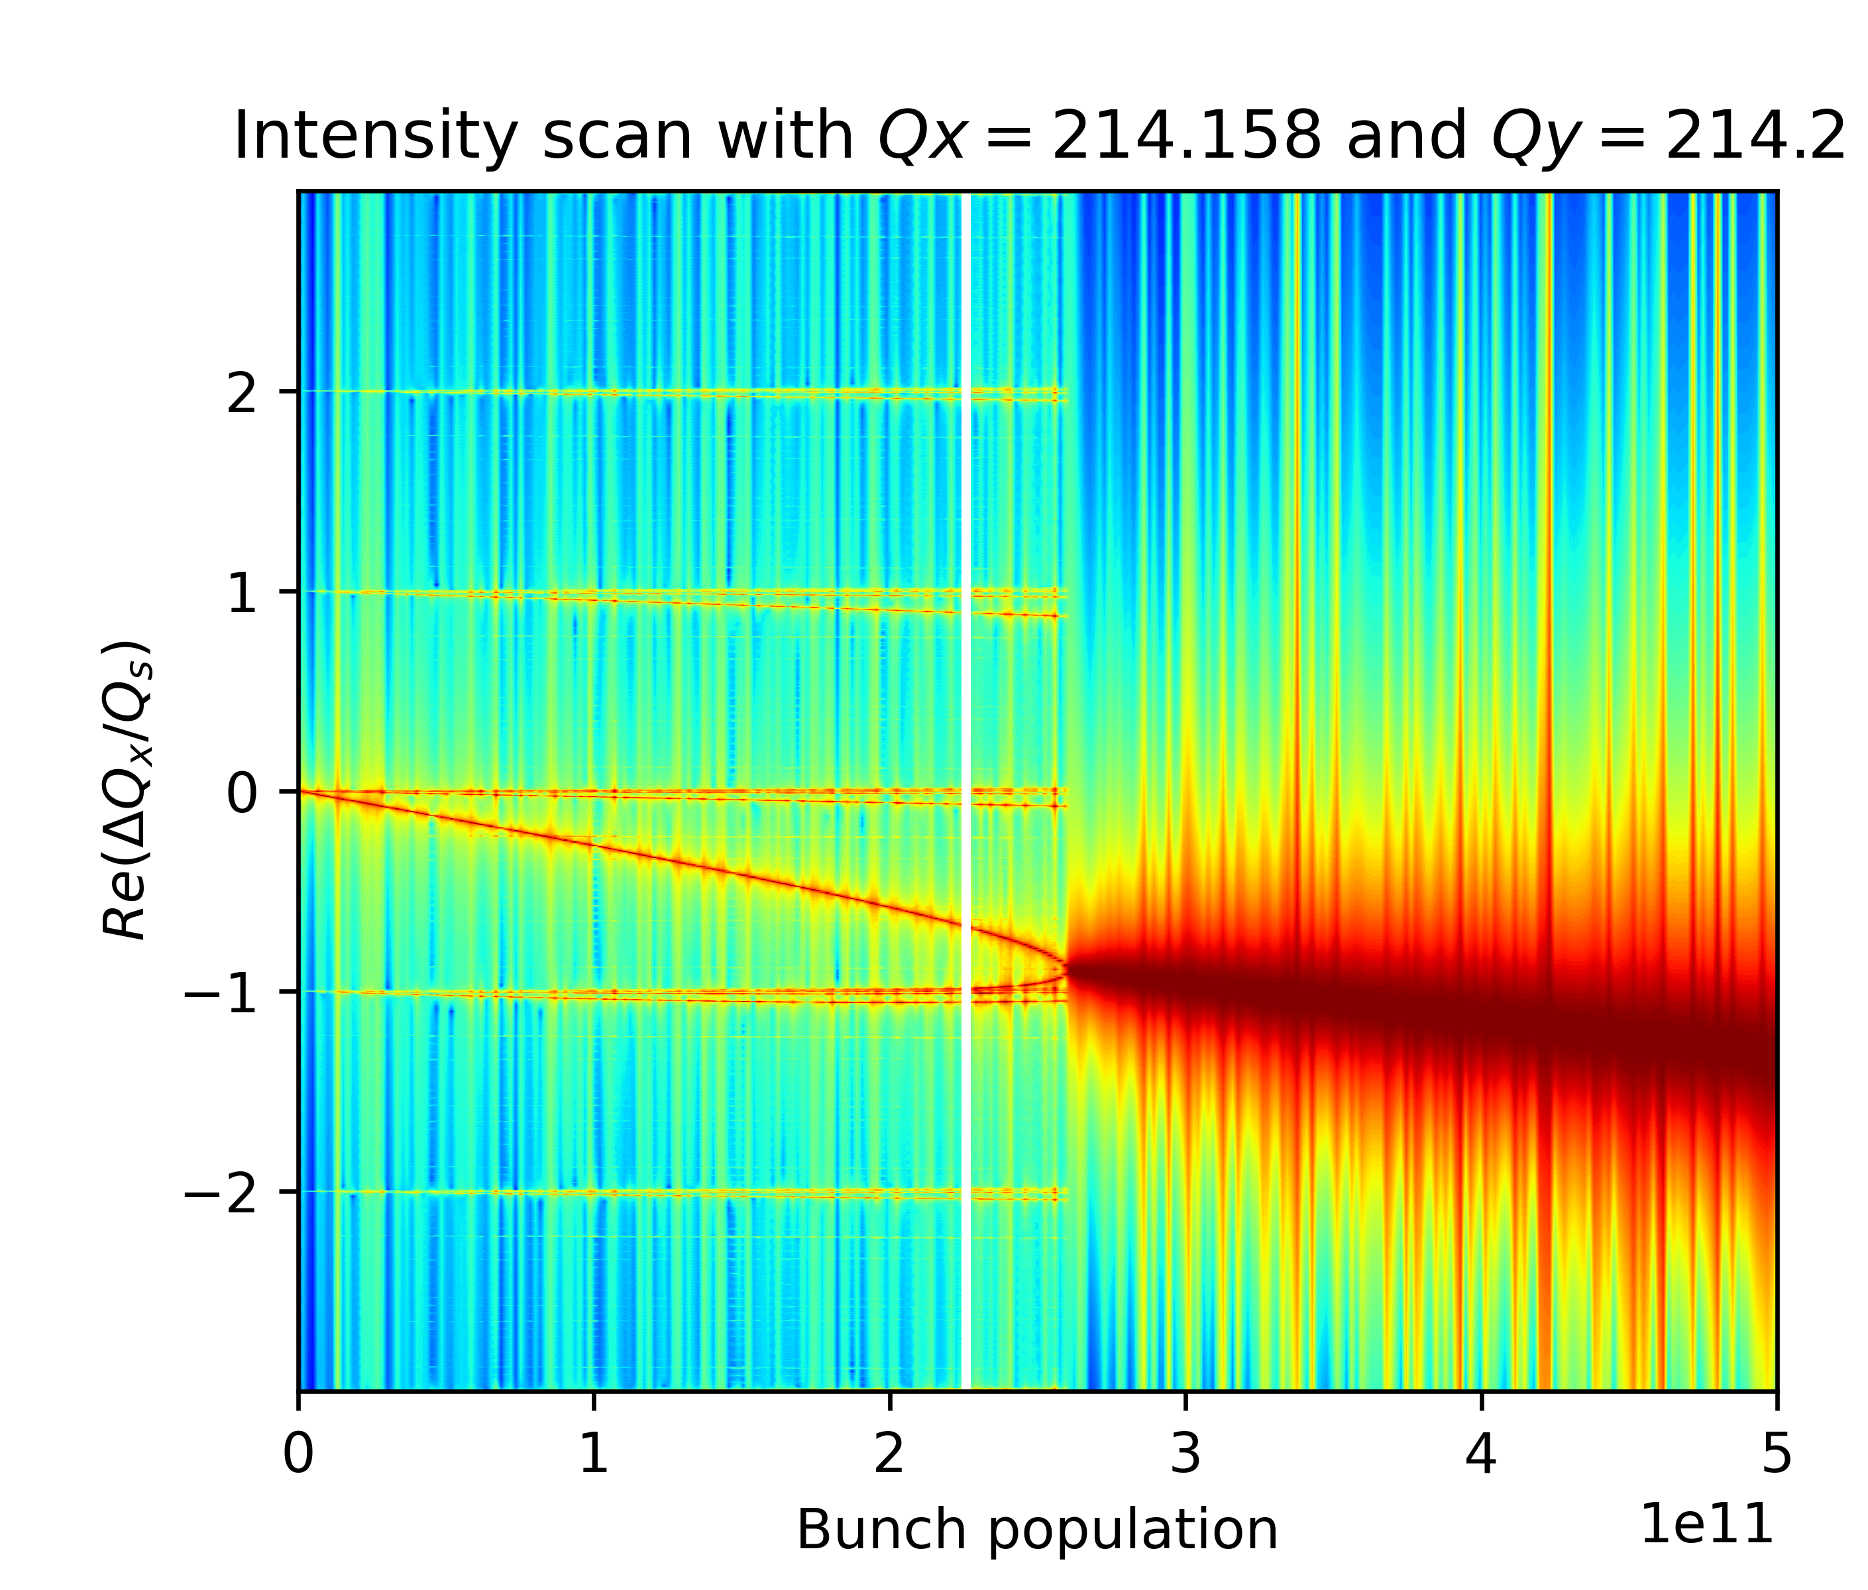
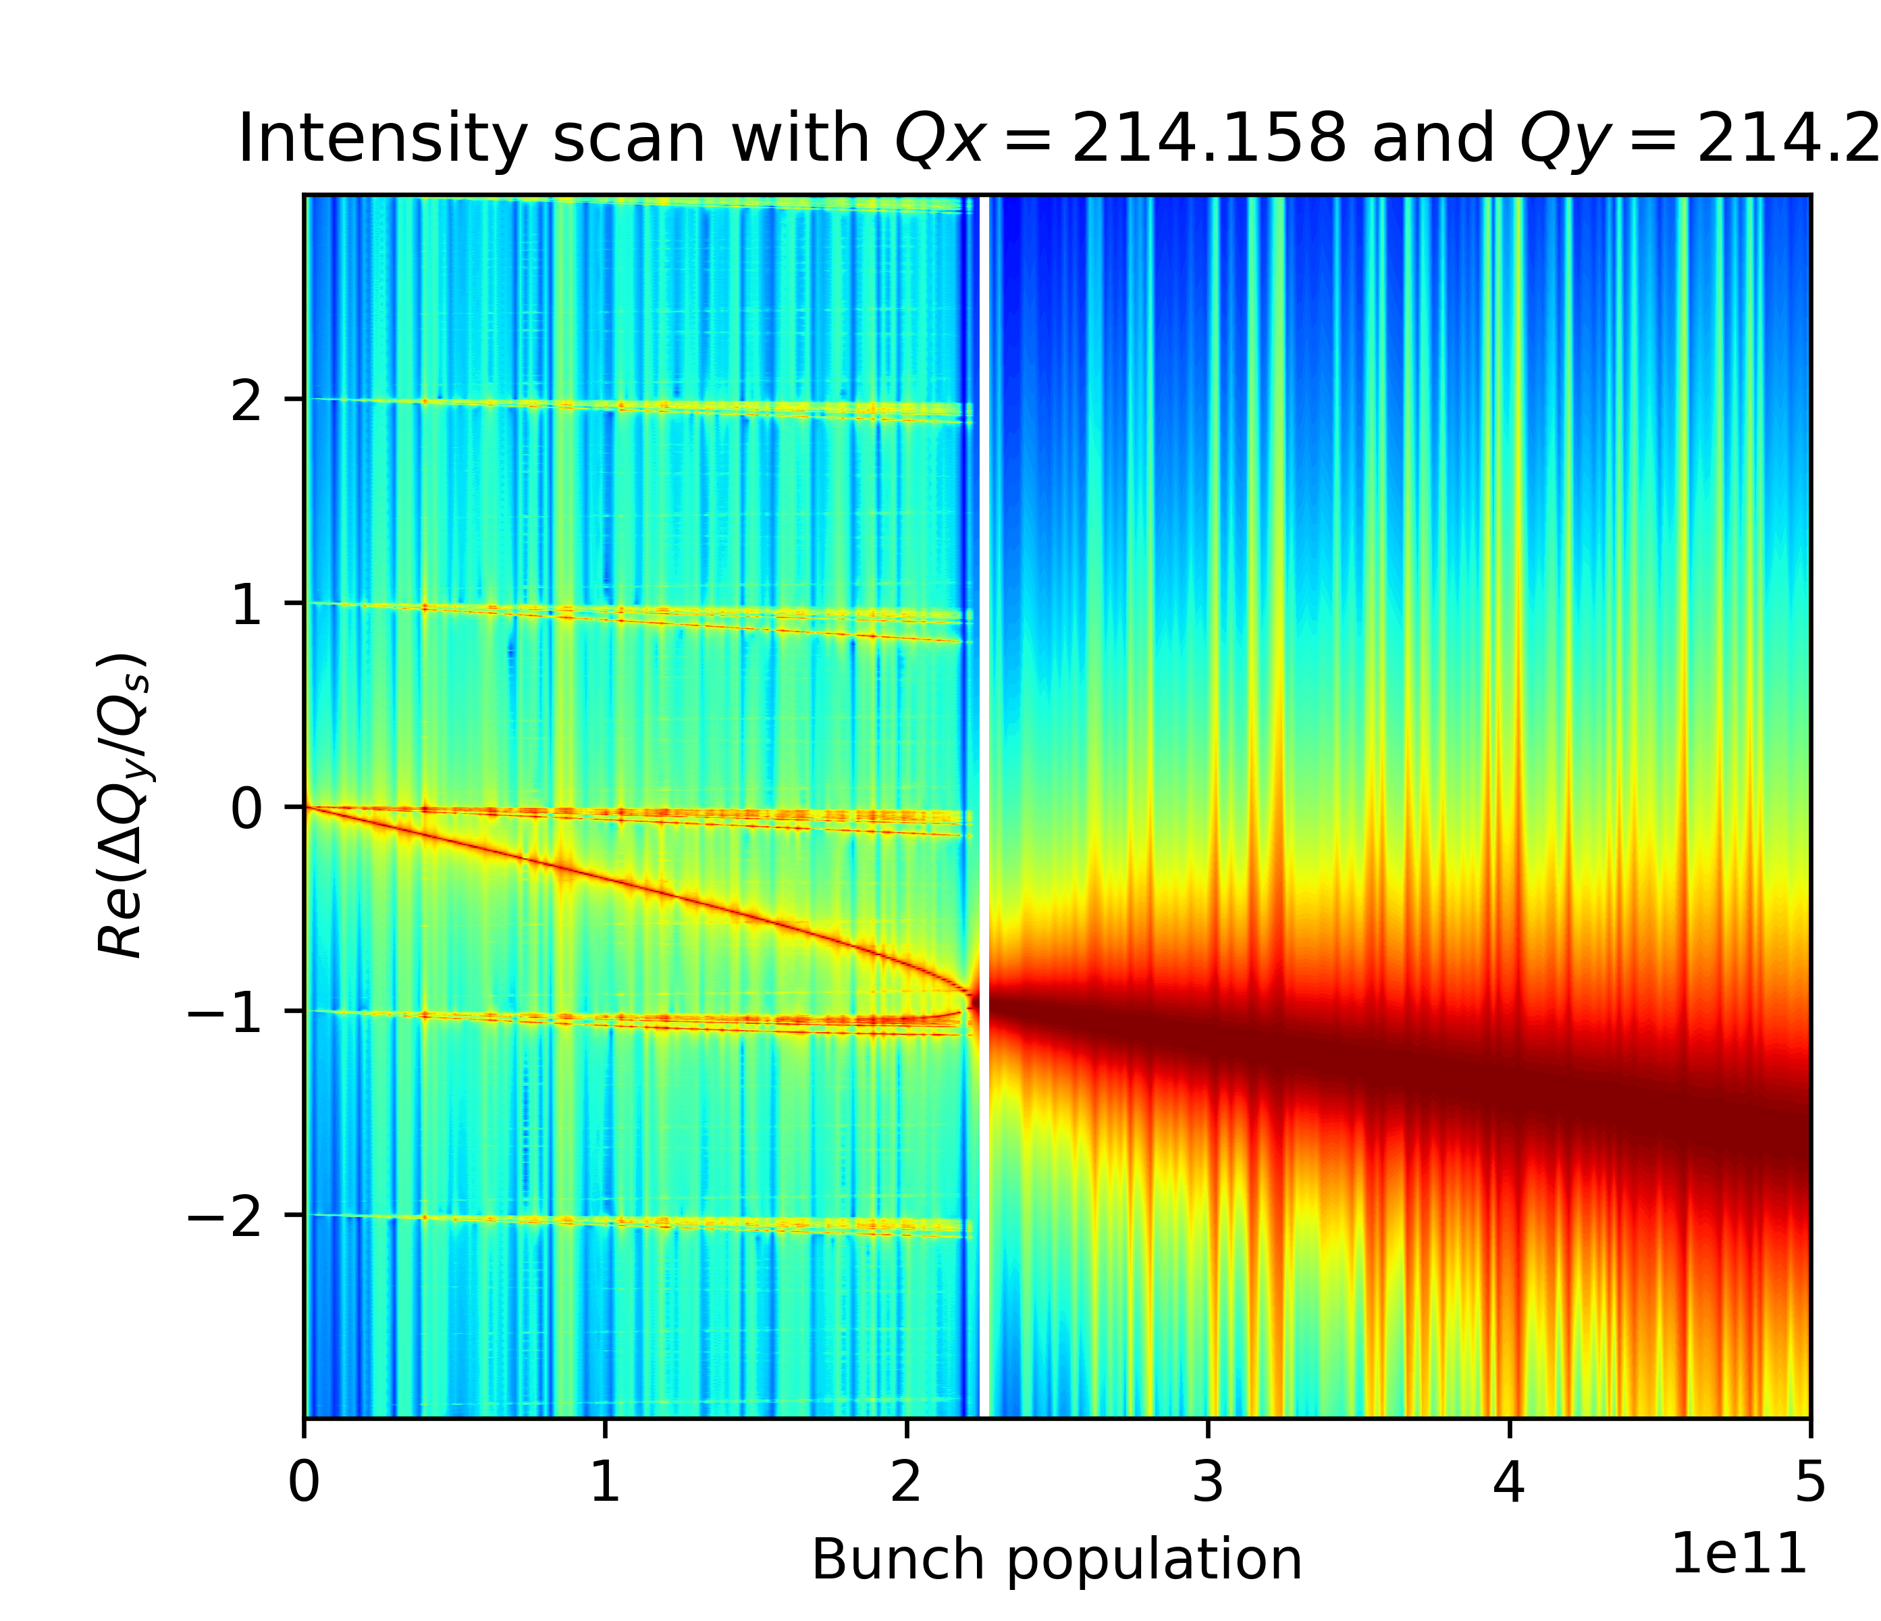
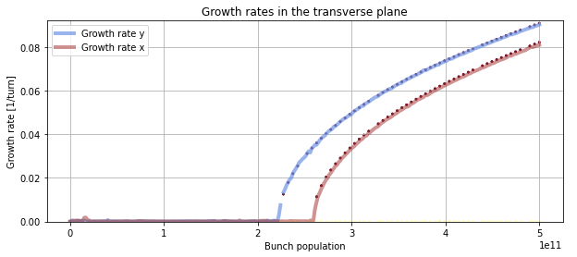

Xsuite and Circulant Matrix Model simulations for FCC-ee beam-beam and wakefield effects.
30
Roxana SOOS
12/06/24
Introduction
Simulation tools
Simulations of beam-beam
Simulations of wakefields
Transverse mode coupling instability simulations
Transverse wakefields for FCC-ee at Z energy; perfect agreement!
Intensity scan with CMM
Intensity scan with Xsuite - PyHT
Re($Q−Q_{x,0}$)/$Q_{s}$
2,3.10¹¹
2,6.10¹¹
Growth rate [2pi/trun]
Growth rate [1/trun]
2,3.10¹¹
2,6.10¹¹
Bunch population
Bunch population
Bunch length without beamstrahlung (5.2mm), L = 90.66 km , linearized RF, no longitudinal wakes.

Slide 31
Summary and outlook
Xsuite and Circulant Matrix Model simulations for FCC-ee beam-beam and wakefield effects.
31
Roxana SOOS
12/06/24
Introduction
Simulation tools
Simulations of beam-beam
Simulations of wakefields
Summary
The circulant matrix model (CMM) has successfully been tested for simple cases of flat beam collisions, x and y planes can be studied separately, but coupled forces can also be calculated.
Another method should be applied to predict higher order collective resonances.
CMM has shown perfect agreement for simulations involving transverse wakefields.
Further development should allow longitudinal wakefields to be considered.
Studies with a crossing angle and Crab waist are ongoing, with both the CMM and Xsuite, a correct setup is yet to be done with strong-strong simulations
Once the setup is totally controlled, reliable simulation with both beam beam and wakefields can be obtained with both Xsuite and CMM

Slide 32
Thank you!

Slide 33
Thank you!

Slide 34
Xsuite simulations of beam-beam effects with impedance contribution
TITRE
DATE
Roxana SOOS
34
Introduction
Simulation tools
XSuite versus mode analysis algorithms
Backup slide on the coupled forces benchmark,
On the slice analysis
The precise calculation of the force
The matrices in the CMM, basically what I did with HIRATA
On SR?

Slide 35



FCC-ee collective effects:
wakefileds and beam-beam interactions
TITRE
04/06/2024
Roxana SOOS
35
Introduction
Simulation tools
Circulant Matrix Model (CMM)
Use linear algebra on a one turn matrix that represents a system, applied on discretized longitudinal phase space
Linearized coherent flat beam-beam kick
(from Bassetti – Erskine formula)
[4]
Matrix elements example
Bassetti – Erskine formula
transverse beam-beam kicks,
main frequencies = coherent kick
Normal forces
Computational cost
Fully numerical method
Fully analytical model
1000 pts ~6h
Dependent on numerical values
~ 5$μ$s
Independent of numerical values
Coupled forces
$$x/σ_{x}$$
[4] K. HIRATA, Nuclear Instruments and Methods in Physics Research A269, 7-22 (1988)

Slide 36
FCC-ee collective effects:
wakefileds and beam-beam interactions
TITRE
04/06/2024
Roxana SOOS
36
Introduction
Simulation tools
Circulant Matrix Model (CMM)
Use linear algebra on a one turn matrix that represents a system, applied on discretized longitudinal phase space
Linearized coherent flat beam-beam kick
(from Bassetti – Erskine formula)
Linearized coherent kick benchmark
Matrix elements example
transverse beam-beam kicks,
main frequencies = coherent kick
Computational cost
Fully numerical method
Fully analytical model
1000 pts ~6h
Dependent on numerical values
~ 5$μ$s
Independent of numerical values
$$x/σ_{x}$$
[4] K. HIRATA, Nuclear Instruments and Methods in Physics Research A269, 7-22 (1988)

Slide 37
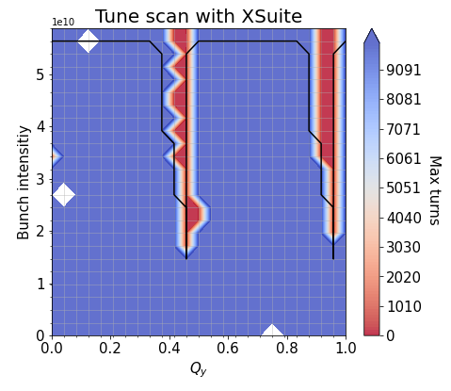
FCC-ee collective effects:
wakefileds and beam-beam interactions
TITRE
DATE
04/06/2024
Roxana SOOS
37
Introduction
Simulation tools
Tune scans
Tune scans – study of different characteristics
The tune scan is a simulation where we study the growth rate of the instabilities in a bunch, varying the intensity and/or the tune(s).
Simple case 2: Only beam-beam, with flat beam, no hourglass, low intensity, to understand some effects of having a flat beam.
FCC-ee (Z) base parameters with $β_{x}\text{= }\text{1} \text{m}{, β}_{y}$ = 0.1 m, $ε_{x}=ε_{y}$ = 7.1e-10m, $θ$ = 0 mrad
Notes:
/eos/project/f/fcc-ee-bbeam-wake-studies/rosoos/beambeamStudies/intyVStune/tune_scan_13/

Slide 38
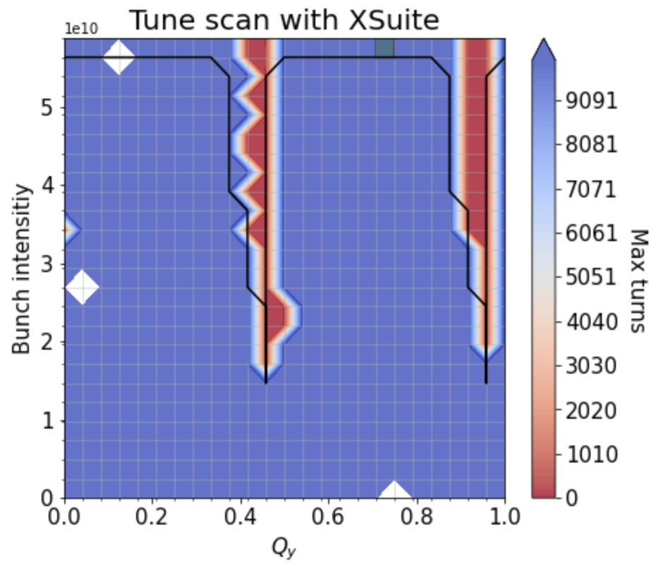
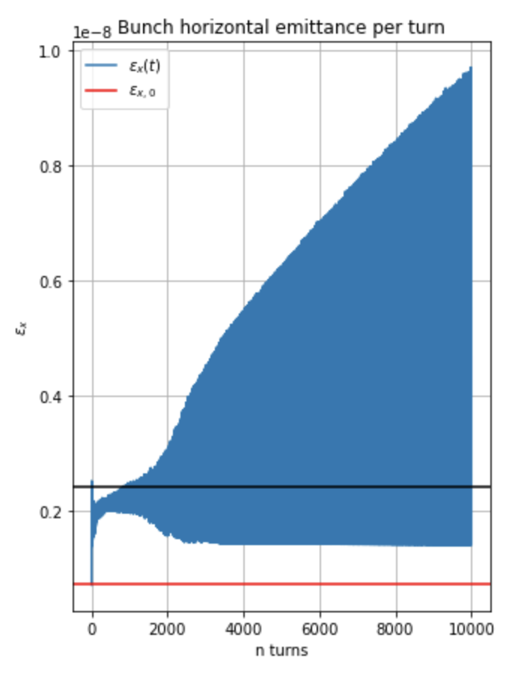
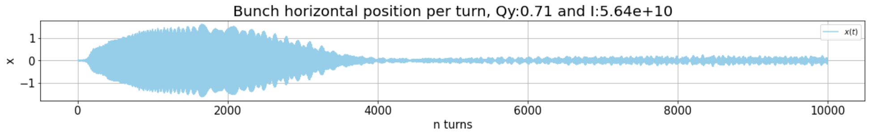
FCC-ee collective effects:
wakefileds and beam-beam interactions
TITRE
DATE
04/06/2024
Roxana SOOS
38
Introduction
Simulation tools
Tune scans
Tune scans – study of different characteristics
The tune scan is a simulation where we study the growth rate of the instabilities in a bunch, varying the intensity and/or the tune(s).
LANDAU DAMPING?
Simple case 2: Only beam-beam, with flat beam, no hourglass, low intensity, to understand some effects of having a flat beam.
FCC-ee (Z) base parameters with $β_{x}\text{= }\text{1} \text{m}{, β}_{y}$ = 0.1 m, $ε_{x}=ε_{y}$ = 7.1e-10m, $θ$ = 0 mrad
Notes:
/eos/project/f/fcc-ee-bbeam-wake-studies/rosoos/beambeamStudies/intyVStune/tune_scan_13/ (2,2) sigma

Slide 39
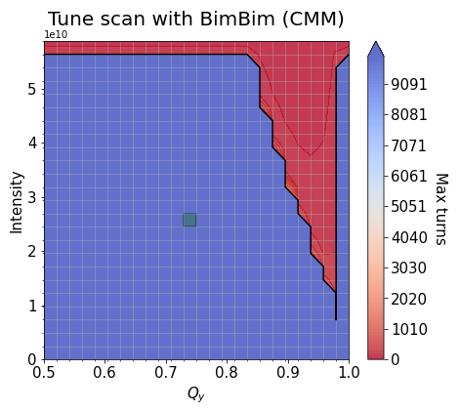
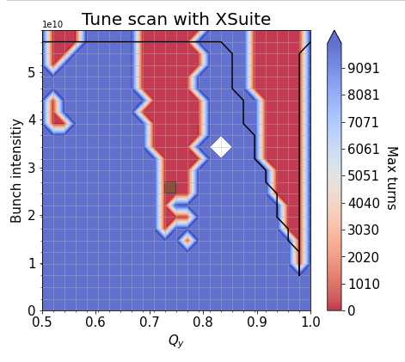
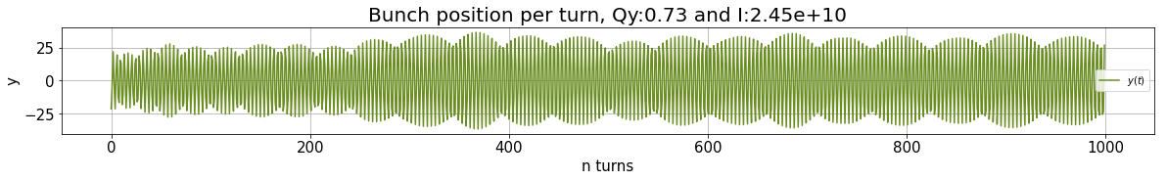
FCC-ee collective effects:
wakefileds and beam-beam interactions
TITRE
DATE
04/06/2024
Roxana SOOS
39
Introduction
Simulation tools
Tune scans
Tune scans – study of different characteristics
The tune scan is a simulation where we study the growth rate of the instabilities in a bunch, varying the intensity and/or the tune(s).
HIGHER COHERENT INSTABILITY ?
Case 2 bis: Only beam-beam, with flat beam, hourglass, low intensity, kick beams by a fraction of sigma to see some coupled modes.
FCC-ee (Z) base parameters with $β_{x}\text{= }\text{1} \text{m}{, β}_{y}$ = 0.1 m, $ε_{x}=ε_{y}$ = 7.1e-10m, $θ$ = 0 mrad $x_{off}=y_{off}$= 0.3 sigmas
Notes:
/eos/project/f/fcc-ee-bbeam-wake-studies/rosoos/beambeamStudies/intyVStune/tune_scan_16/. (10,25 sigma)

Slide 40
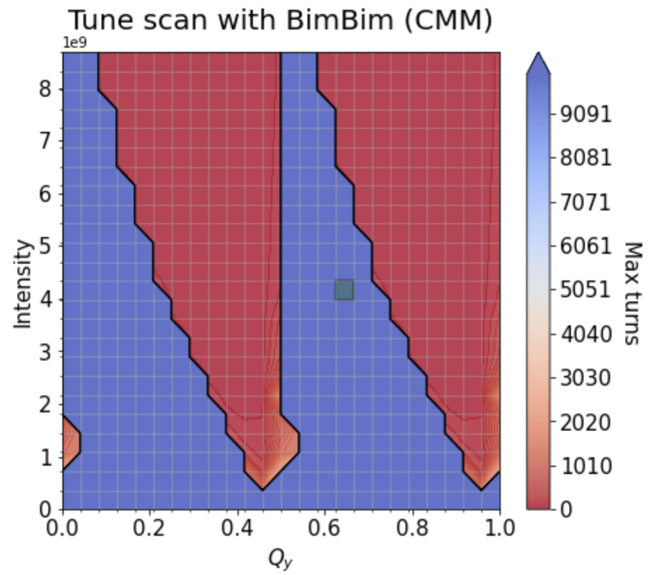
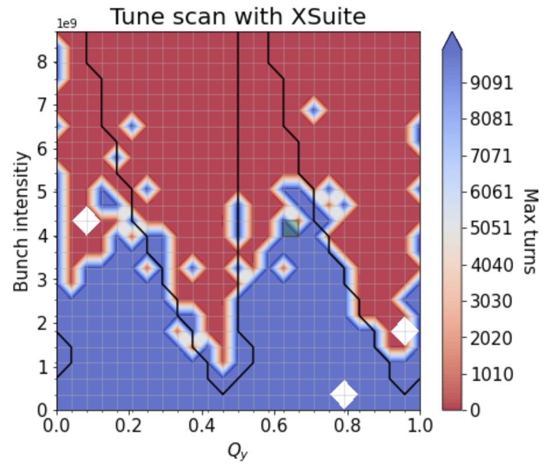
FCC-ee collective effects:
wakefileds and beam-beam interactions
TITRE
DATE
04/06/2024
Roxana SOOS
40
Introduction
Simulation tools
Tune scans
Tune scans – study of different characteristics
The tune scan is a simulation where we study the growth rate of the instabilities in a bunch, varying the intensity and/or the tune(s).
Case 3: Only beam-beam, with flat beam, hourglass, low intensity, to understand some effects of having a flat beam.
FCC-ee (Z) base parameters with $β_{x}\text{= }\text{0.0008} \text{m}{, β}_{y}$ = 0.15 m, $ε_{x}\text{= 7.1}\text{e}\text{−10}\text{m}, ε_{y}$ = 1.42e-12m, $θ$ = 0 mrad
Notes:
/eos/project/f/fcc-ee-bbeam-wake-studies/rosoos/beambeamStudies/intyVStune/tune_scan_1/

Slide 41
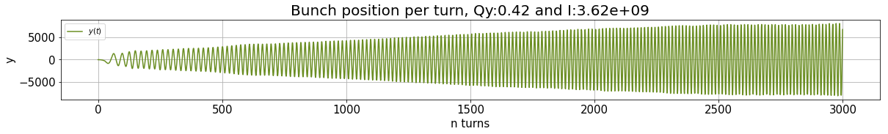


FCC-ee collective effects:
wakefileds and beam-beam interactions
TITRE
DATE
04/06/2024
Roxana SOOS
41
Introduction
Simulation tools
Tune scans
Tune scans – study of different characteristics
The tune scan is a simulation where we study the growth rate of the instabilities in a bunch, varying the intensity and/or the tune(s).
COHERENT INSTABILITY
NON-COHERENT INSTABILITY
Case 3: Only beam-beam, with flat beam, hourglass, low intensity, to understand some effects of having a flat beam.
FCC-ee (Z) base parameters with $β_{x}\text{= }\text{0.0008} \text{m}{, β}_{y}$ = 0.15 m, $ε_{x}\text{= 7.1}\text{e}\text{−10}\text{m}, ε_{y}$ = 1.42e-12m, $θ$ = 0 mrad
Notes:
/eos/project/f/fcc-ee-bbeam-wake-studies/rosoos/beambeamStudies/intyVStune/tune_scan_1/

Slide 42




FCC-ee collective effects:
wakefileds and beam-beam interactions
TITRE
04/06/2024
Roxana SOOS
42
Introduction
Simulation of impedance
TITRE
Xsuite - PyHT
PyHEADTAIL
Simulation executed by M. Migliorati
Simulation executed by M. Migliorati
Perfect agreement (Radio frequency cavities and synchrotron radiation + wakes for FCC-ee Z).
Sum of the Fourier transforms of the higher order momentas.
Momentum of order k at a turn t
Horizontal positions
Average on the macroparticles
Longitudinal positions relative to the bunch

Slide 43


FCC-ee collective effects:
wakefileds and beam-beam interactions
04/06/2024
Roxana SOOS
43
Introduction
Circulant Matrix Model (CMM)
Use linear algebra on a one turn matrix that represents a system, applied on discretized longitudinal phase space
Linearized coherent flat beam-beam kick
(from Bassetti – Erskine formula)
BETTER PLOT OF THIS IN THE BACKUP SLIDES
+
ANALYTIC FORCE
Matrix elements example
NEXT PUT THE WEIRD COIUPLING THAT COULD BE SECOND ORDER AND SEE WITH HIRATA MAYBE
[4] K. HIRATA, Nuclear Instruments and Methods in Physics Research A269, 7-22 (1988)

Slide 44










FCC-ee collective effects:
wakefileds and beam-beam interactions
44
Roxana SOOS
Introduction
Overview
SLIDE ON SLICE ANALYSIS WHEN HTC SUPPORT FIXES THE SERVICE
Transverse wakefields
Longitudinal wakefields
Synchrotron radiation
Slice Analysis
Beam-beam interactions with wakefield contributions
Round beam collision
Flat beam w/o hourglass
Flat beam w hourglass
Crossing angle

Slide 45
FCC-ee collective effects:
wakefileds and beam-beam interactions
04/06/2024
Roxana SOOS
45
Introduction
Simulation of impedance
elements = [arc, wake_field]
142
What is in the arc?
What is in the wake fields?
Synchrotron radiation
Transverse wakes /
Energy loss
Damping rates
Equilibrium emittances
Longitudinal wakes
NO geometrical contribution of the collimators
RF Cavities
Resisitive wall ( Beam pipe + collimator RW)
Nonlinear RF forces
Energy compensation
RF Cavities
Beam Position Monitors (BPM)
Bellows

Slide 46

FCC-ee collective effects:
wakefileds and beam-beam interactions
04/06/2024
Roxana SOOS
46
Introduction
Simulation of impedance
LineSegmentMap already benchmarked; add synchrotron radiation
Test damping times
Linear map, SR ( ), no wakes, same inital distribution

Slide 47

FCC-ee collective effects:
wakefileds and beam-beam interactions
04/06/2024
Roxana SOOS
47
Introduction
Simulation of impedance
LineSegmentMap already benchmarked; add synchrotron radiation
Test damping times
Test equilibrium emittances
Linear map, SR ( ), no wakes, same inital distribution
Linear map, SR ( ), no wakes, same inital distribution
8%
8%
SYSTEMATIC DISCREPENCY
PERFECT OVERLAP / EXPECTED VALUES
8%

Slide 48
FCC-ee collective effects:
wakefileds and beam-beam interactions
04/06/2024
Roxana SOOS
48
Introduction
Simulation of impedance
Different synchrotron radiation models (in both longitudinal and transverse planes)
Xsuite - PyHT
PyHEADTAIL
damping
eq emittance
eq emittance
damping
damping
eq emittance
R = damping time
n = random number
Implemented flag in LineSegmentMap with partition ratio.
Full matrix? "From the beam envelope matrix to synchrotron radiation integrals",
Kazuhito Ohmi, Kohji Hirata, Katsunobu Oide, in Phys.Rev.E 49 (1994) 751-765
Xtrack/xtrack/beam_elements/elements.py in class LineSegmentMap l.1955 to l.1966 and Xtrack/xtrack/beam_elements/elements_src/linesegmentmap.h l.281 to l.290 and l.337 to l.350

Slide 49
FCC-ee collective effects:
wakefileds and beam-beam interactions
04/06/2024
Roxana SOOS
49
Introduction
Simulation of impedance
Different synchrotron radiation models (in both longitudinal and transverse planes)
162
arc = xt.LineSegmentMap(
sync_ratio = 1,
)
162
arc = xt.LineSegmentMap(
sync_ratio = 0.5,
)
163
163
164
164
Perfect agreement when the same model is used.

Slide 50

FCC-ee collective effects:
wakefileds and beam-beam interactions
04/06/2024
Roxana SOOS
50
Introduction
Simulation of impedance
Simulation of beam-beam
Benchmark Xsuite
Aspect ratio versus form factors
Scan on aspect ratio versus $π$ mode tune shift
Arbitrary tunes used for simulation to reduce numerical noise.
Xsuite results show a 20% error with respect to Yokoya (self-consistent)
Errors improve to only 5% when compared to Yokoya (soft-gaussian) -> Due to an artificial transverse kick

