Slide 1
GP using GP GPU
my experience with OpenCL
Future computing in particle physics
15. Jun. 2011

Slide 2


Long time ago …
1935 – Carl Friedrich von Weizsäcker SEMF
Liquid drop model – Gamow, Borh, Wheeler
Nucleons interactions:
Strong force
Electromagnetic

Slide 3
Long time ago …
Weizsäcker Semi-Empirical Mass Formula
Volume
Surface
Coulomb
Asymmetry
Pairing
Magic numbers:
2, 8, 20, 28, 50, 82, 126

Slide 4
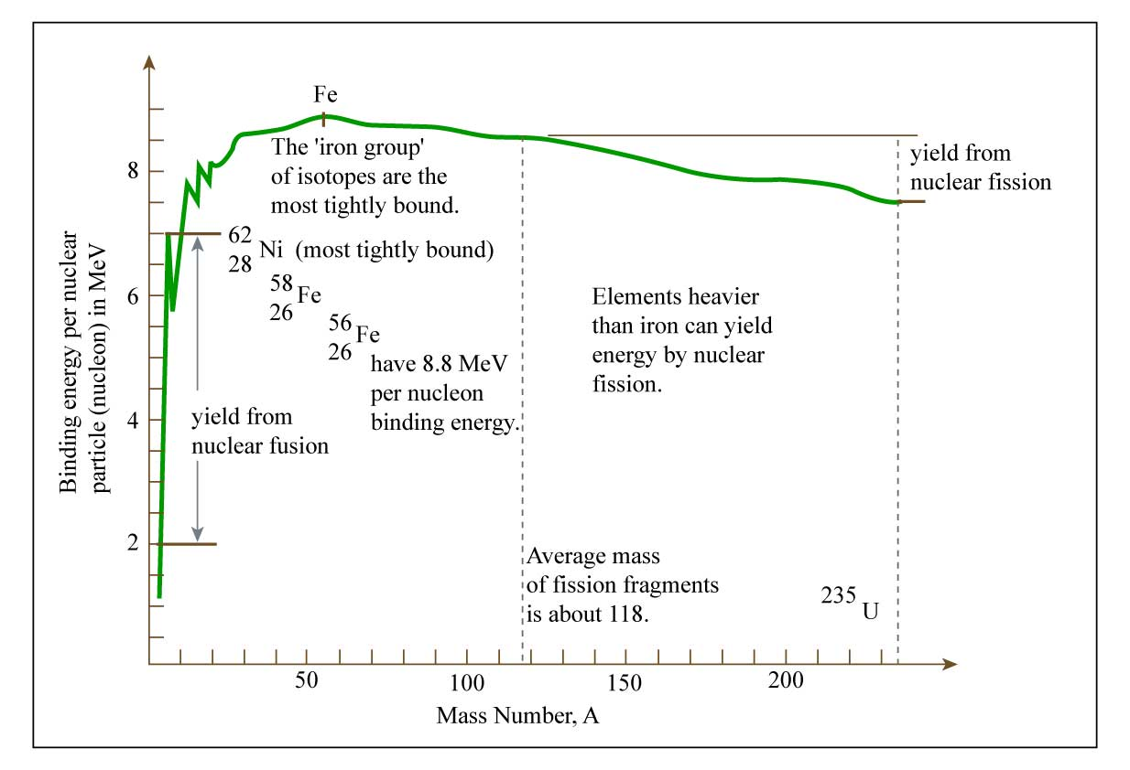
Long time ago...

Slide 5
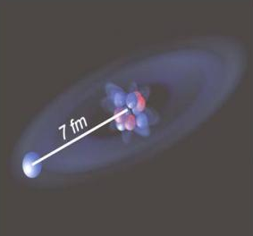
These days
Nuclei don’t look like you imagine them
Diameter 1.75 – 15fm
37 different models* – from 3 to hundreds of parameters.
2009 - Be11 GSI - ISOLDA
*N.D. Cook (2010). Models of the Atomic Nucleus (2nd ed.) Springer

Slide 6
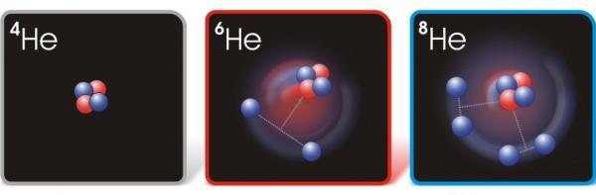
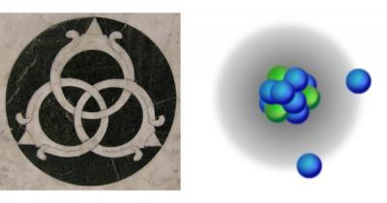
These days
2008 – Argon - GANIL
2010 – Borromean –RIKEN Tokio C22

Slide 7
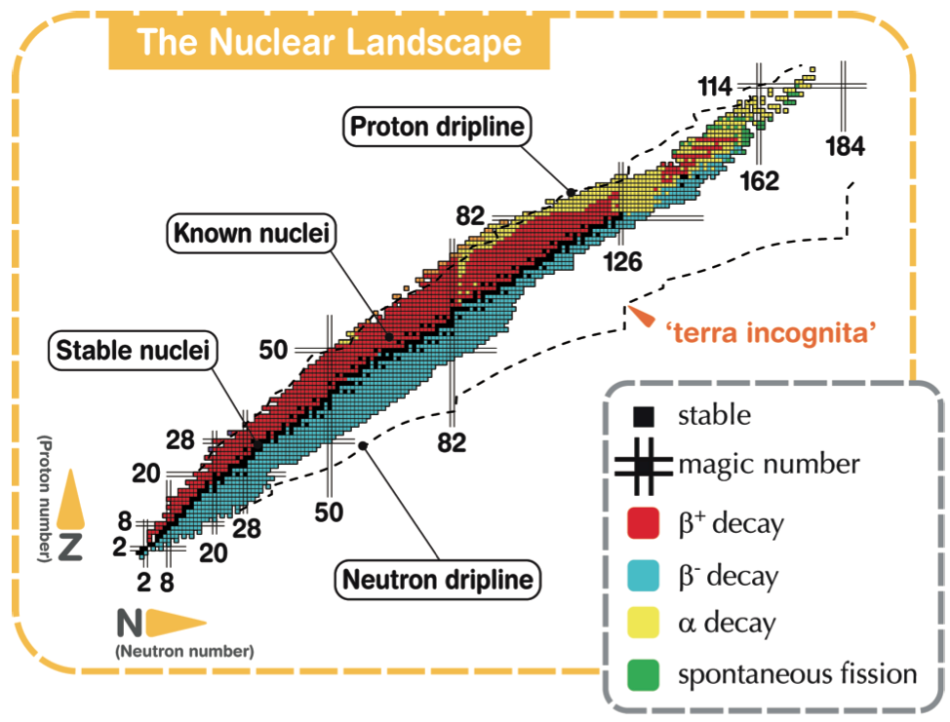
These days

Slide 8
Why?
Goals
Test bounds
Nuclear Structure
Phases of Nuclear Matter
Quantum Chromodynamics
Nuclei in the Universe
Fundamental Interactions
Applications
Experiments
CERN ISOLDA
FAIR – GSI
EURISOL
Spiral2 GANIL – Caen
Riken – Japan
MSU, ISAAC – USA

Slide 9
Genetic Algorithm
Def. heuristic based on rules of natural evolution.
Used for difficult optimization or search problems.
Ingredients
Genes
Individuals
Population
initialization
Example 1
evaluation
Example 2
Example 3
selection
Operations
Selection
Crossover
Mutation
cross-over
mutation

Slide 10
Genetic Algorithm
Deceptively simple
Infinite number of ways to set it up*.
Important decisions:
  Representation (binary, real, multiple sexes…)
  Crossover (single, two point, continuous,…)
  Selection (elitist strategy, weighted,… )
  Tunings: number of populations, population size, mutation rate, …
Only some aspects are theoretically explained.
Only experience will help you get optimal algorithm.
* There are even Human based Genetic algorithms

Slide 11
Genetic Algorithm
Pros
Applicability
Speed
Embarrassingly parallel
robust to local minima
Cons
Needs full understanding of both problem and method
Needs tuning for optimal performance
Speed (in case of very expensive fitness function)

Slide 12
Genetic programming
Usually a genetic algorithm evolving a computer program optimal for a given task.
Recent breakthroughs in theoretical explanations
Important results in last few years (electronic design, game playing, evolvable hardware)
Even more complex to set up
Very computationally intensive
Usually done in Lisp. Gens are often assembler commands.

Slide 13

Genetic programming
Example:
+
+
/
+
/
+
1
sin
y
mod
1
sin
y
mod
x
z
y
x
z
y
+
+
/
+
/
+
1
sin
y
sin
1
mod
y
mod
x
x
z
y
z
y

Slide 14
GenetiX
Requirements
Any platform
Use all CPU’s and GPU’s
As simple as possible
As extensible as possible

Slide 15
Real work
Started with having ARTS in mind
  4 servers – 16 cores + 4 nVidia GPUs
  Unfortunately of compute capability 1.0
Decide on OpenCL
  A bit more complex to use than CUDA
  Similar performance expected
All the genetic operations on CPU only
Graphics based on Qt (with qwt)

Slide 16
OpenCl part 1
Usage rather simple
  clGetDeviceIDs
  clCreateContext
  clCreateCommandQueue
  clCreateBuffer
  clEnqueueWriteBuffer/clEnqueueMapBuffer
  clCreateProgramWithSource
  clBuildProgram
  clCreateKernel
  clGetKernelWorkGroupInfo
  clSetKernelArg
  clEnqueueNDRangeKernel
  clFinish
  clEnqueueReadBuffer

Slide 17
OpenCl part 2
Usage rather simple but good performance complex
  Need new tools to measure performance
  Need to know hardware in details
    Even differences between 1.0 and 1.3 cards are huge
  Need parallel algorithms

Slide 18
Real work part 2
First idea: let OpenCl parse the equation string.
  Fast to build for CPU. 100x slower for GPU even without aggressive optimization.
__kernel void FF( __global float* A, __global float* B, __global float* R){
int i = get_global_id(0);
R[i]=A[i]+B[i] * sin(A[i]) / pow(A[i],B[i]);}
Solution:
  equation in postfix format
  operations as separate kernels uploaded once
  parsed by myself
__kernel void ADD( __global float* A, __global float* B, __global float* C){
int i = get_global_id(0);
C[i]=A[i]+B[i];}
__kernel void DIV( __global float* A, __global float* B, __global float* C){
int i = get_global_id(0);
C[i]=native_divide(A[i],B[i]);}

Slide 19
Real work part 3
Idea: Sum elements of fitness function on CPU
Getting results back is way too expensive
Solution:
Do parallel reduction on the GPU
Optimal reduction quite complex
Non-power-of-2 size problems are greatly penalized
Do one transfer per population and not per individual
Use page-locked (pinned) memory

Slide 20
Performance
MacBookPro
CPU
  I5 M520
  2.40 GHz
  2 cores/4 threads
  L2 256kB
  L3 3MB
GPU
  GeForce GT 330M
  Cuda 1.2
  6 multiprocessors * 8 cores
  MAX_WORK_GROUP_SIZE: 512
  MAX_CLOCK_FREQUENCY: 1100
MacPro
CPU
  Quad-Core Xeon
  2.26 GHz
  2 processors/8 cores/16 threads
  L2 256kB
  L3 8MB (per processor)
GPU
  GeForce GT 120
  Cuda 1.1
  30 cores
  MAX_WORK_GROUP_SIZE: 512
  MAX_CLOCK_FREQUENCY: 550

Slide 21
Performance
MacBook Pro
Equation calculations/s

Slide 22
Performance
MacPro
Doing very bad job on this CPU!
Equation calculations/s

Slide 23
Problems
Compute profiler on Mac not well supported by nVidia
On laptops need to warm up GPU
Even in simple cases there is no analytical way to pre-calculate optimal localWorkSize (there is an excel spreadsheet …)
Difficult to estimate influence of non ECC memory

Slide 24
OpenCL experience
For current CPU’s (4 cores) more than factor 2-5 can’t be obtained with compute capability 1.2 cards
And that only with very optimal problem (code)
Problems smaller than 64k elements shouldn’t be considered
Problems with large I/O
Problems with unpredictable branching

Slide 25
To do
Move project storage to cloud (Google)
Add OpenMPI
Move from qwt to ROOT
Add symbolic reduction
Add free fit parameters
Fine GA tuning
Move from tree to node representation (?)
“Discover” better description of inter-nucleon interactions.

Slide 26
Disclaimer
No physicist will loose job because of this or any other similar system.
Physics laws are expressed by equations but further advancement is made by humans making mental picture of what that equation means.
Still, having equation would greatly help.

Slide 27
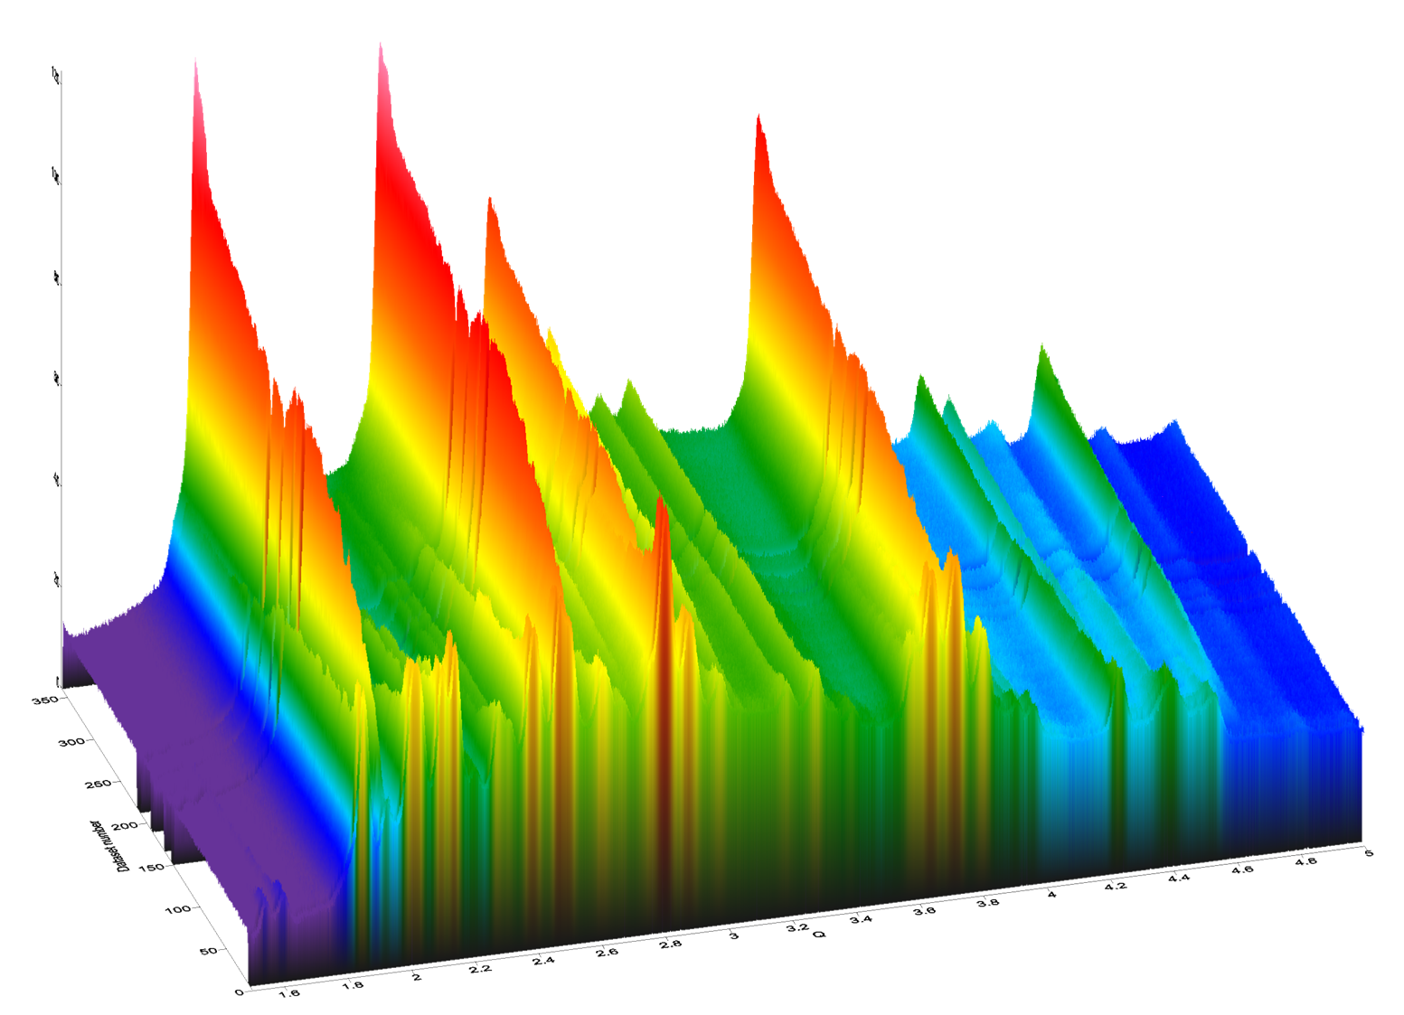
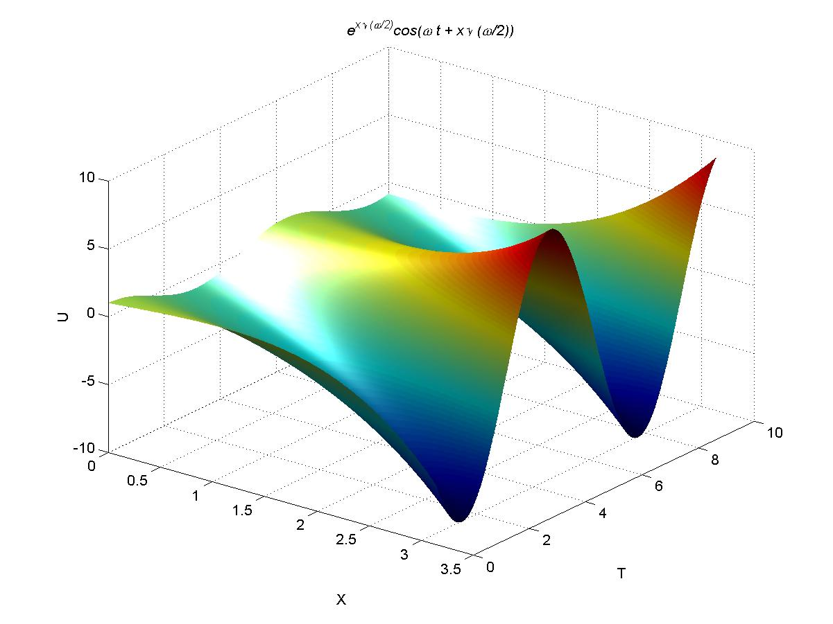
Simple search
Blind kangaroos
looking for Mount Everest
Simulated annealing
Hill climbing
Gen: 64 bit number in gray representation
Individual: two genes connected 128 bits
Mutation: toggle of one random bit
Crossover: with 20% probability take bit from other individual
Y
X
back

Slide 28
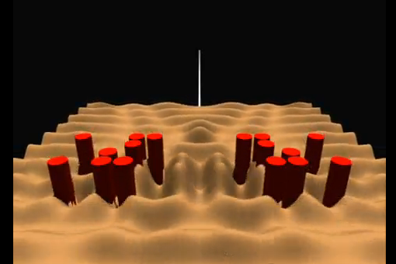
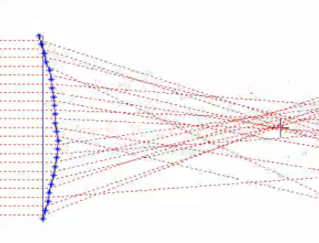
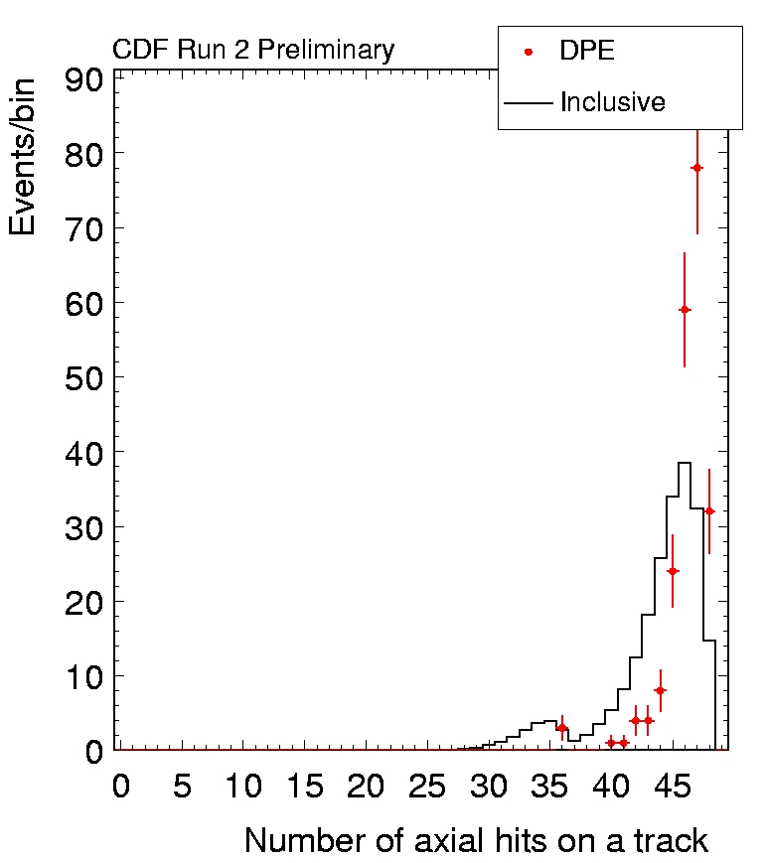
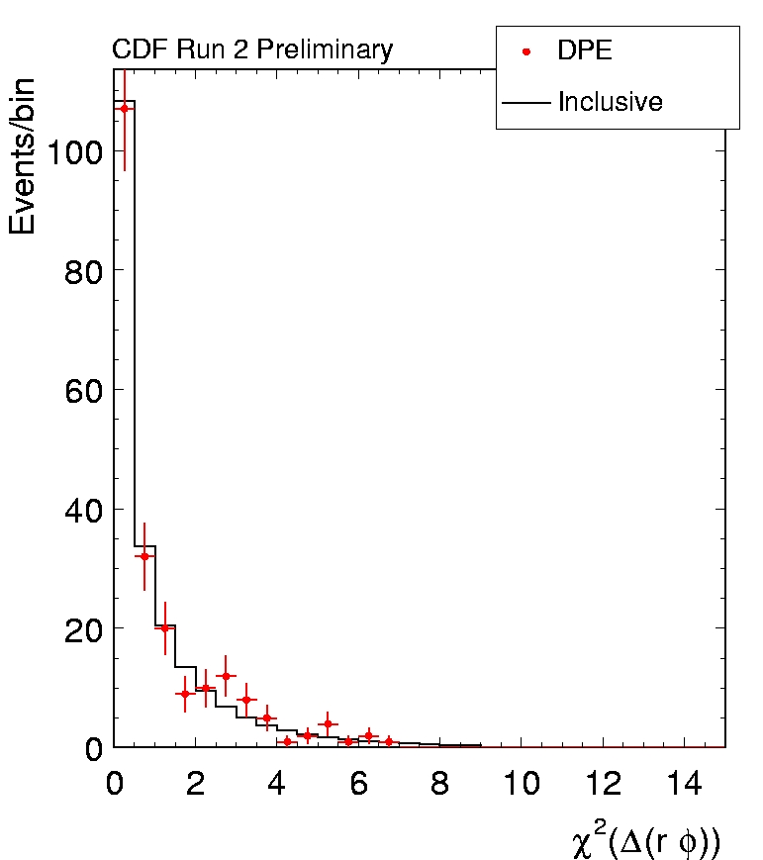
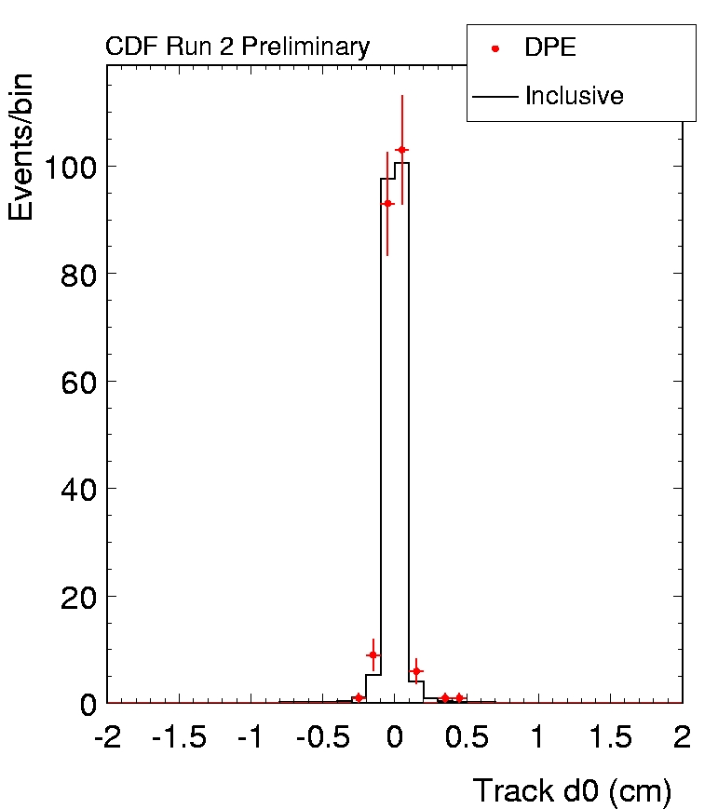
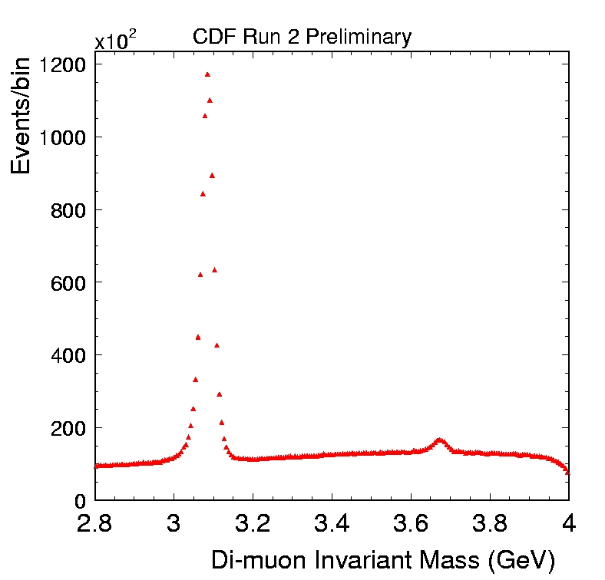
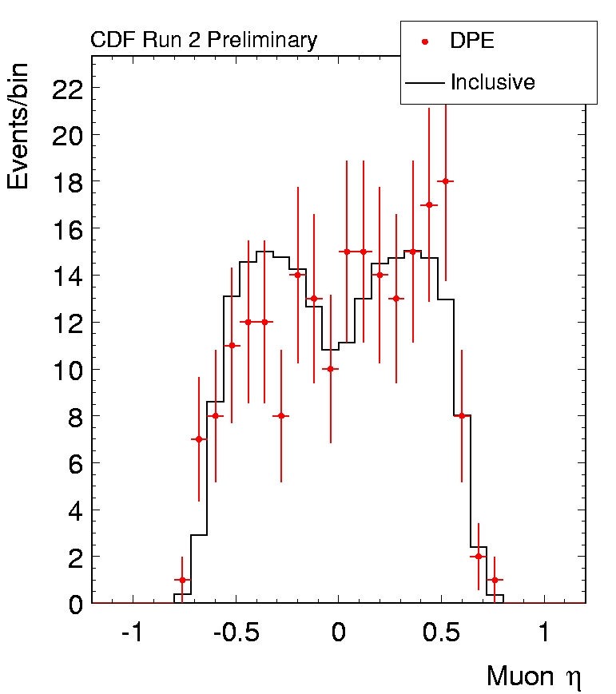
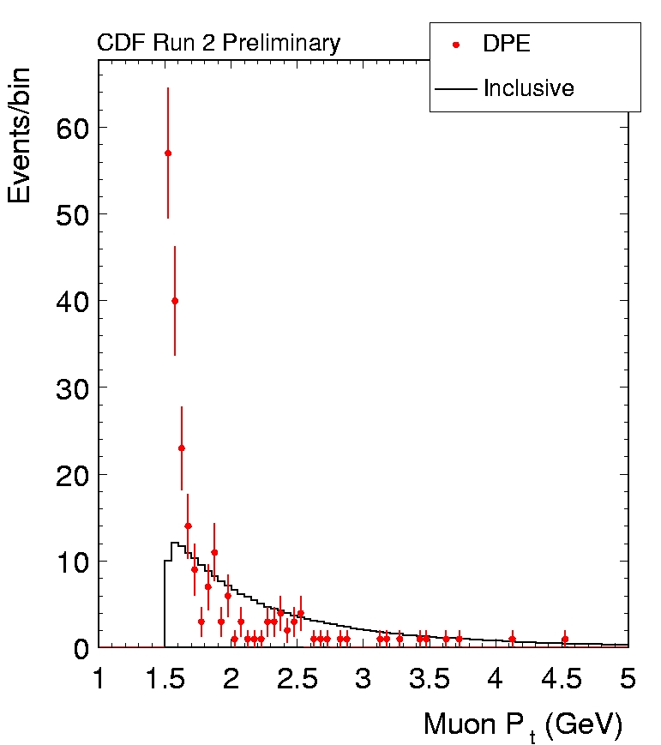
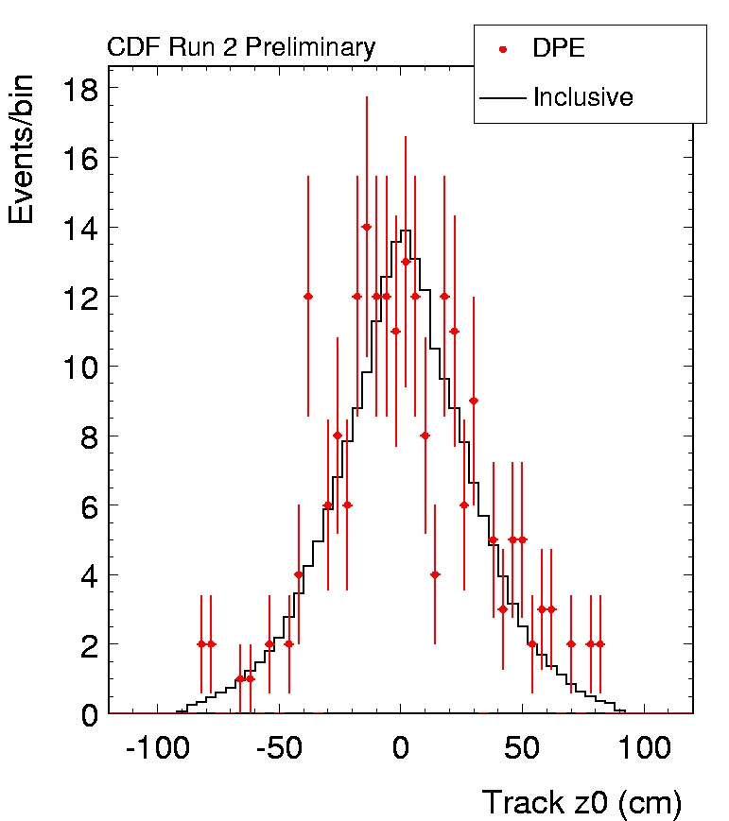
Physics systems
HEP analysis cut optimization
back

Slide 29
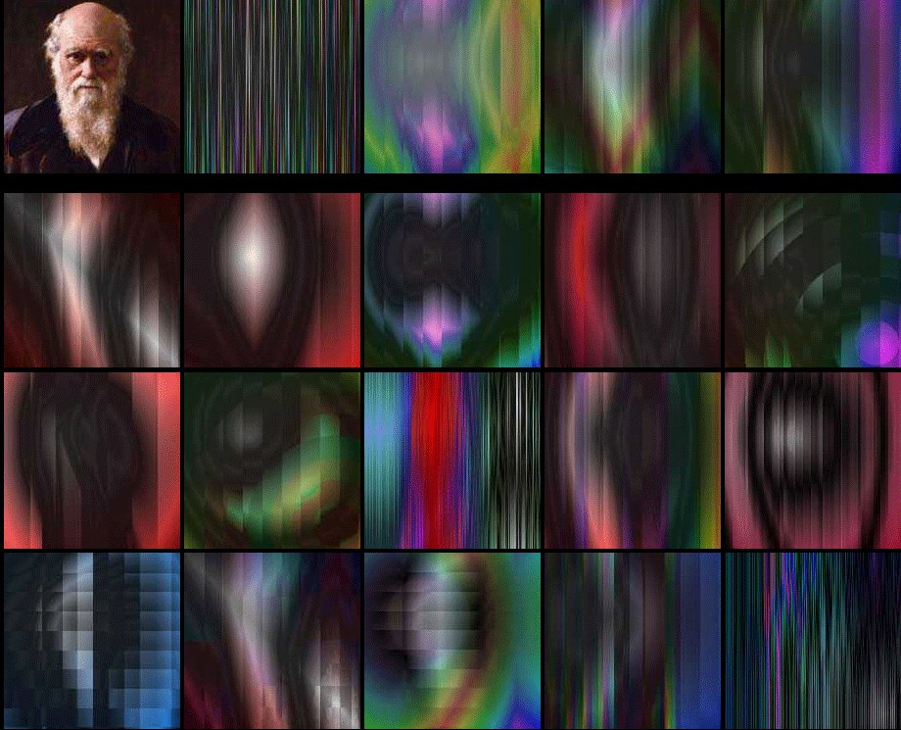
Music & Art industry
back

