Slide 1
Project Report 6
Investigating Four-Top Production with ATLAS
Dean A. Reiter
Advisor: Nedaa-Alexandra Asbah
May 7, 2024

Slide 2
Status Update
Validated n-tuple processing code
Wrote and tested simple hadronic top reconstruction algo
  Optimizing for accuracy

Slide 3

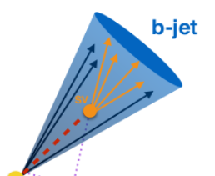
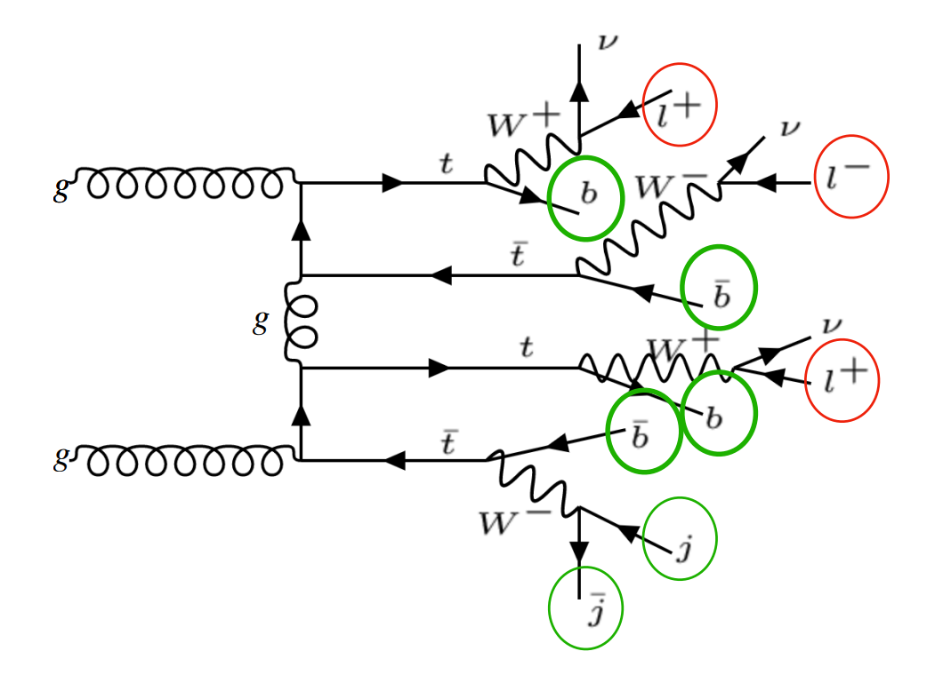
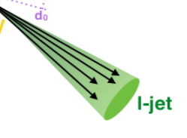



Recap: Top Quark Reconstruction in tttt
Leptonic Tops
p_{T}^{miss}
Hadronic Tops
Ex: 3-lepton (3L) channel
Neutrinos

Slide 4
Recap: Top Quark Reconstruction in tttt
Hadronic top quarks
  0-2 hadronic tops in 2LSS, 3L, 4L channels we are searching
  Difficult because of compute time
Leptonic top quarks
  Almost impossible because of multiple missing neutrinos
  Partial reconstruction can still tell us useful kinematic variables

Slide 5
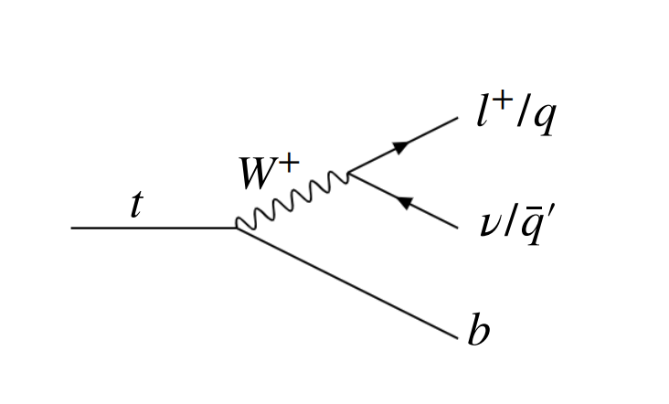
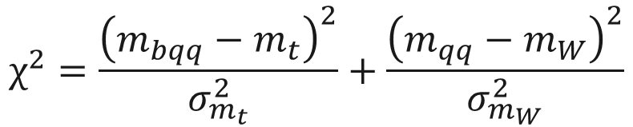
Hadronic Top Reconstruction
Chi-Squared Method
  Test every possible permutation of jets
      Permutations of 3 jets (including 1 b-jet) among all 6+, 8+ jets
  Compares combined mass of jets to known masses of W boson and top quark
      Real top quark decay products should have lowest chi-squared value
$$χ^{2}=\frac{{\left(m_{bqq}−m_{t}\right)}^{2}}{σ_{m_{t}}^{2}}+\frac{{\left(m_{qq}−m_{W}\right)}^{2}}{σ_{m_{W}}^{2}}$$
Suffers from combinatorial explosion problem – too many combinations of jets

Slide 6
Initial Tests
Using simulated tttt data sample
  Every event contains the decay of four top quarks
  Data is from Monte Carlo – contains truth data
      Kinematics of original particles, decay information, etc.
Goals
  Determine whether chi-squared method works
  Determine accuracy and efficiency

Slide 7
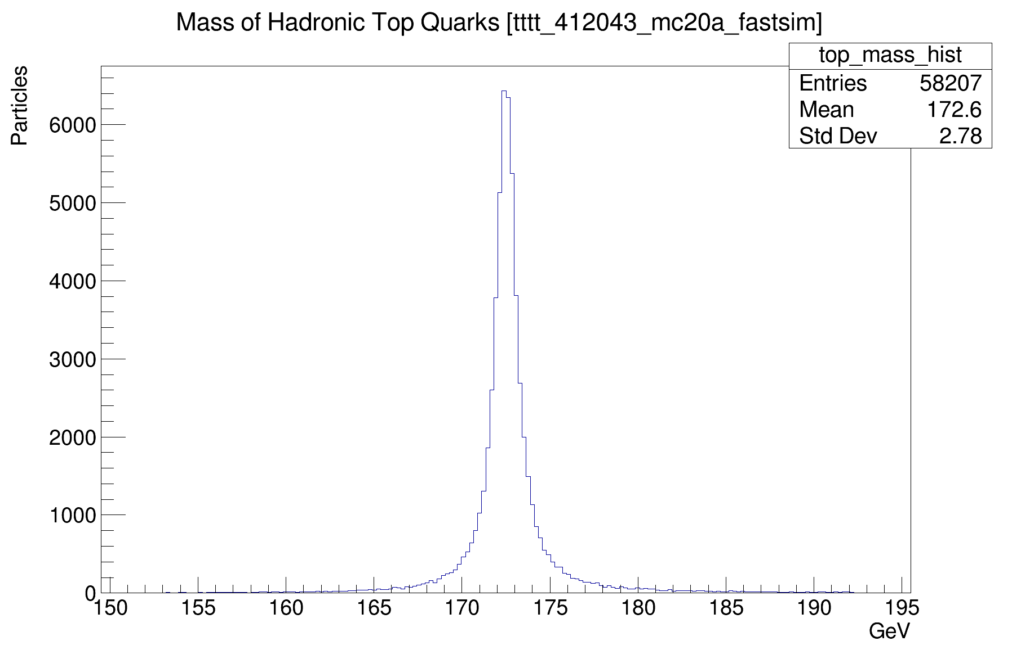
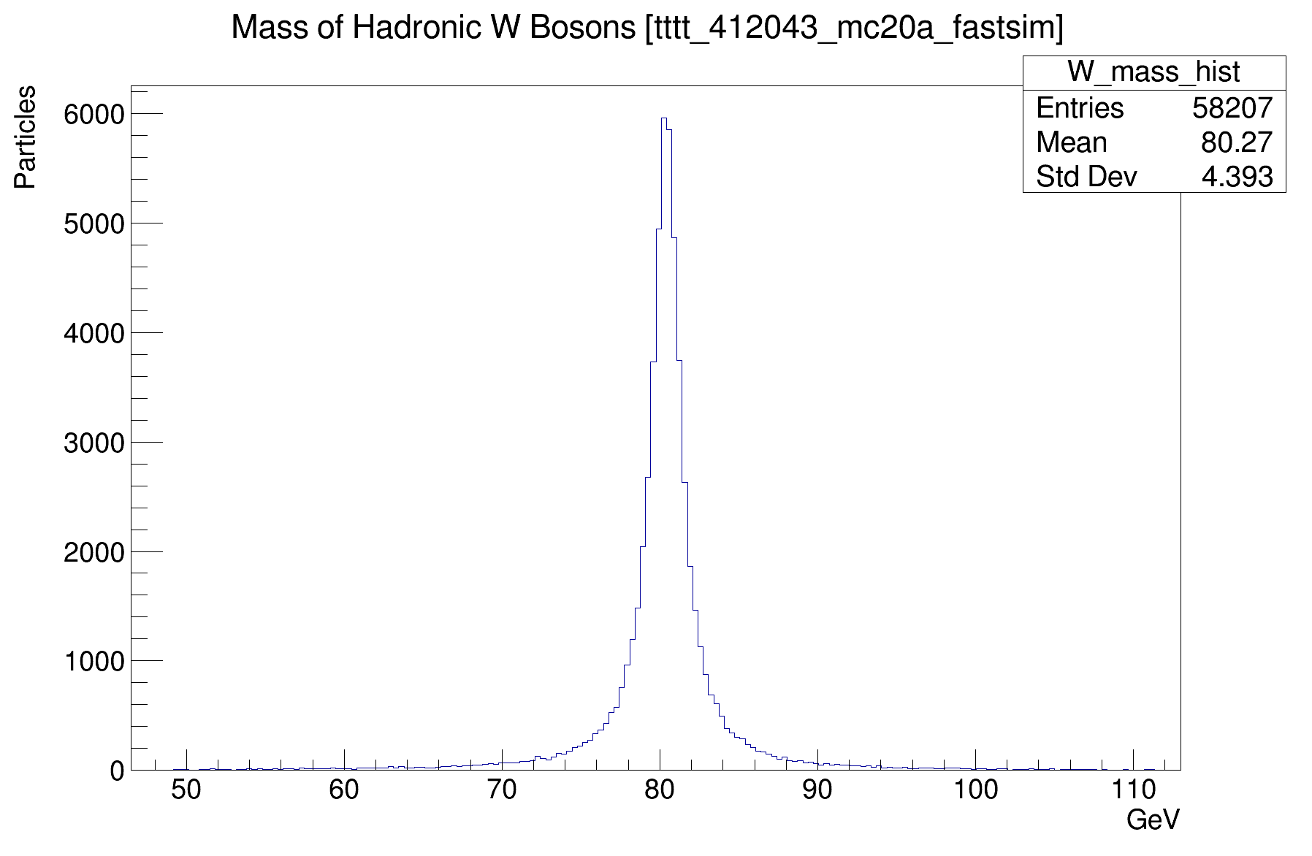
Determining Known Masses of t and W
Mass distributions of all hadronic top quarks and W bosons in sample
Means and standard deviations used to calculate chi-squared

Slide 8
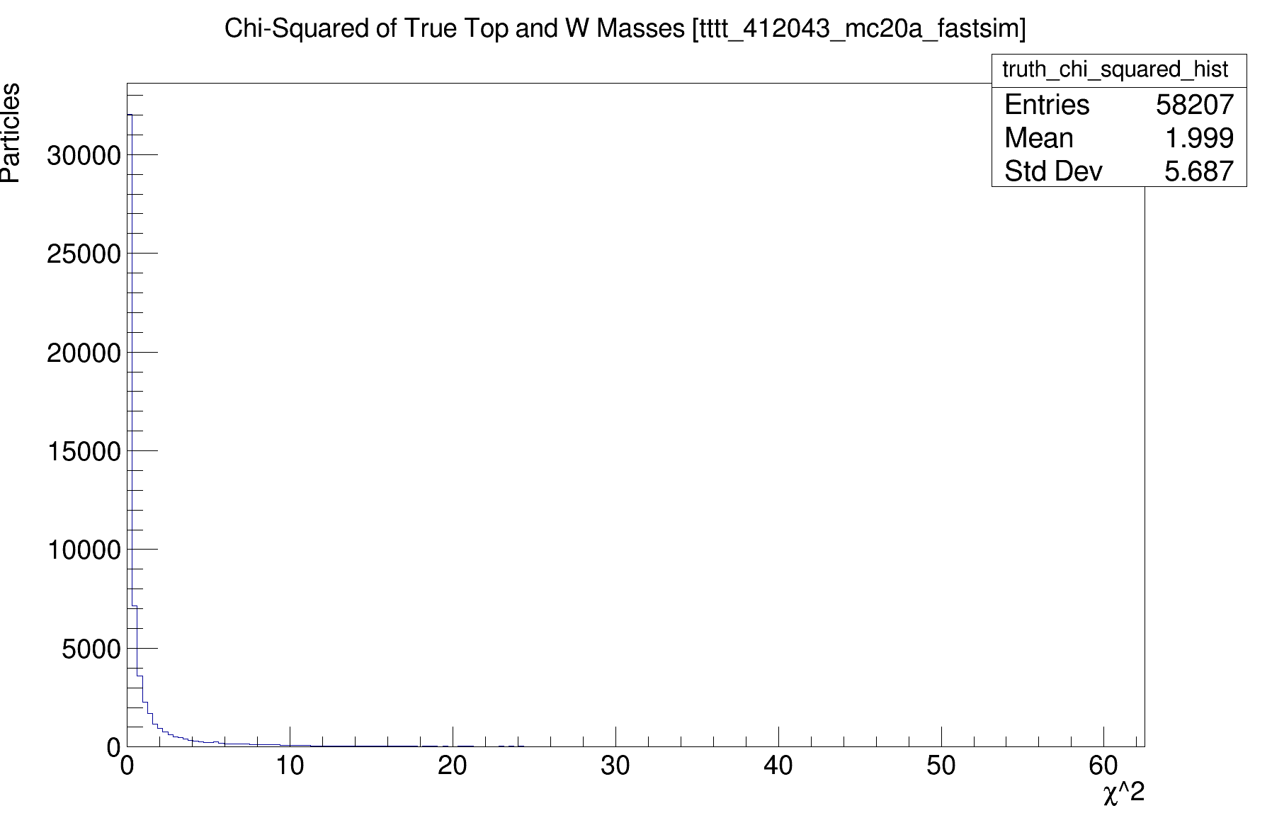
What is a good chi-squared?
Comparing mass distributions of known top quarks and W bosons to their means
Sanity check
Most top quark decay products (jets) should have chi-squared < 10

Slide 9
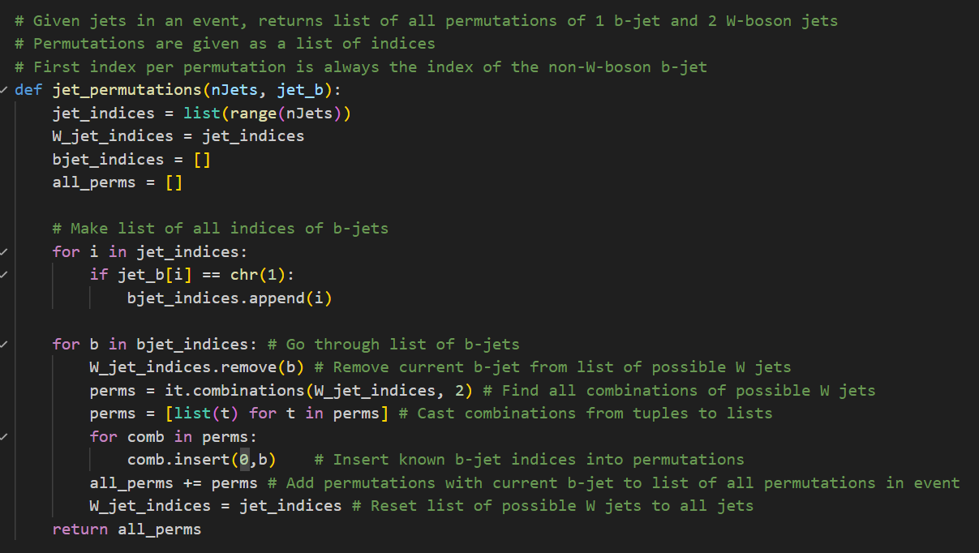
Finding all combinations of jets that might be from a top quark
Example: if b-jet indices are 0, 2 and other jet indices are 1, 3
then this returns [ (0, 1, 2), (0, 1, 3), (0, 2, 3), (2, 0, 1), (2, 0, 3), (2, 1, 3) ]

Slide 10
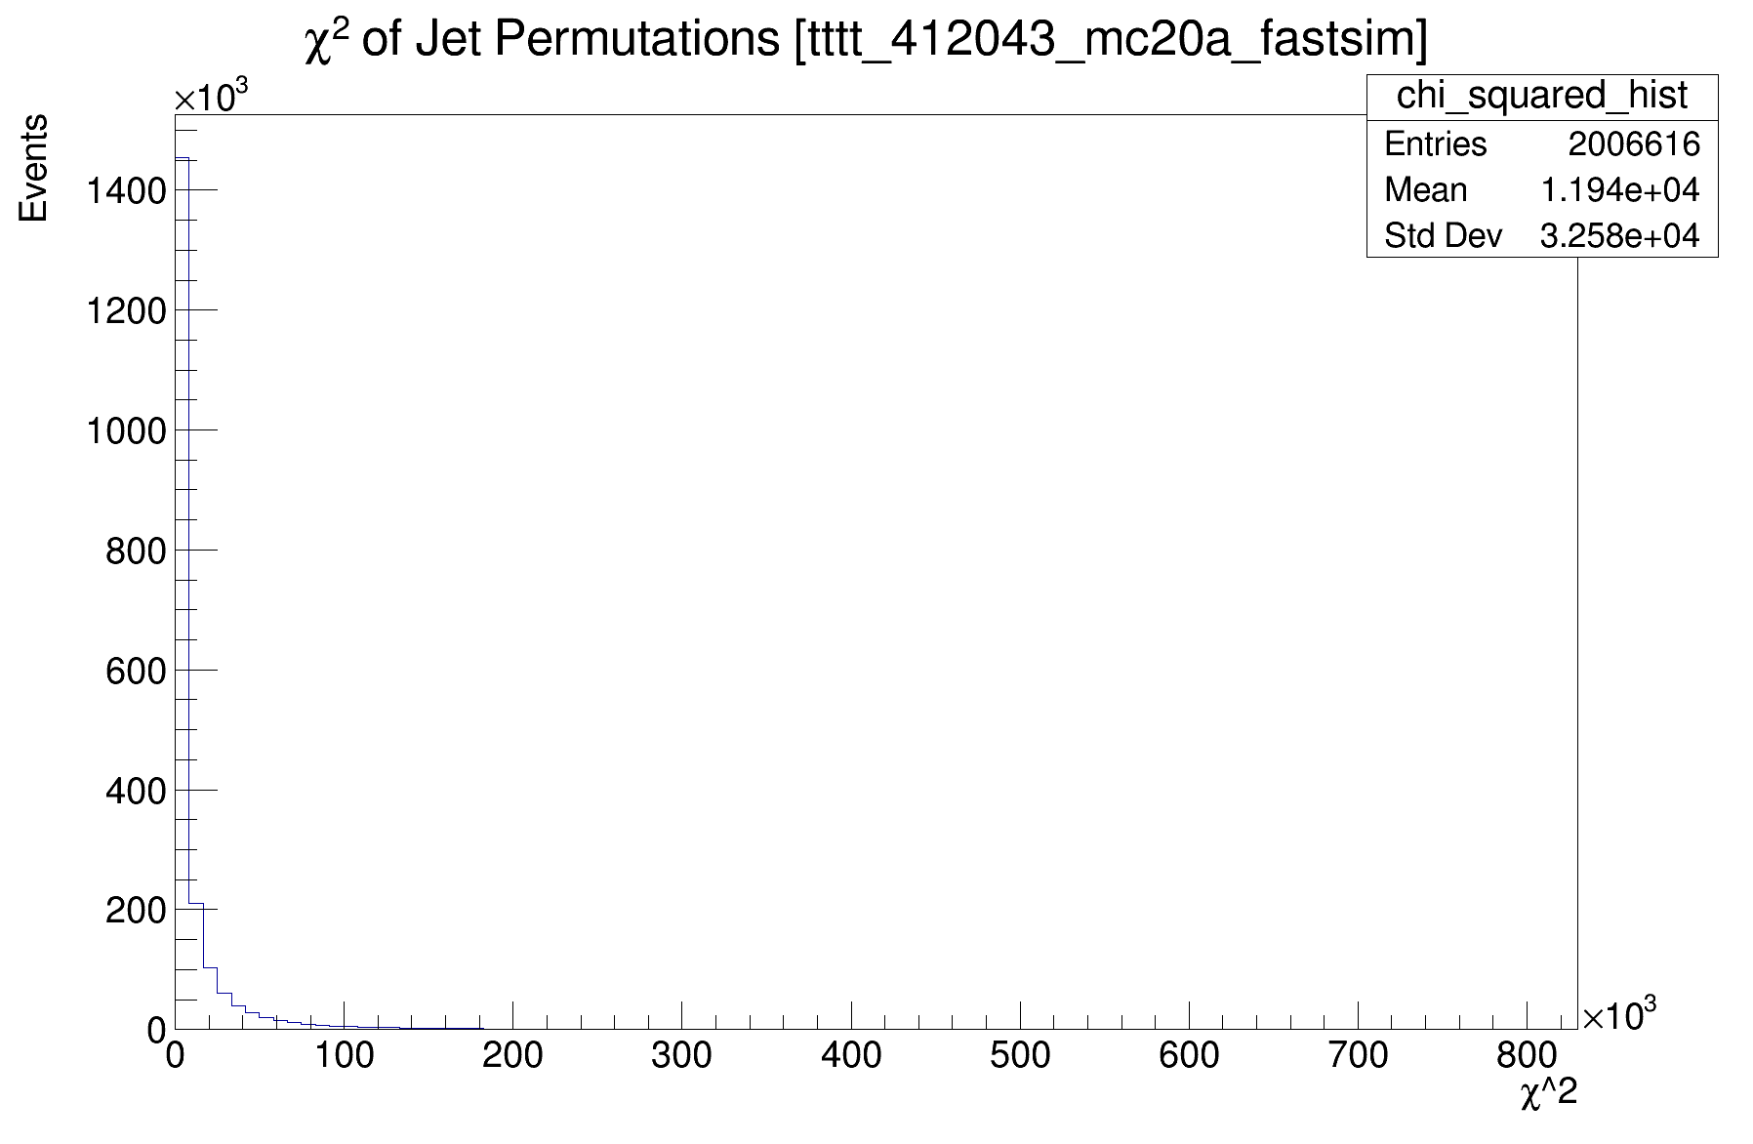
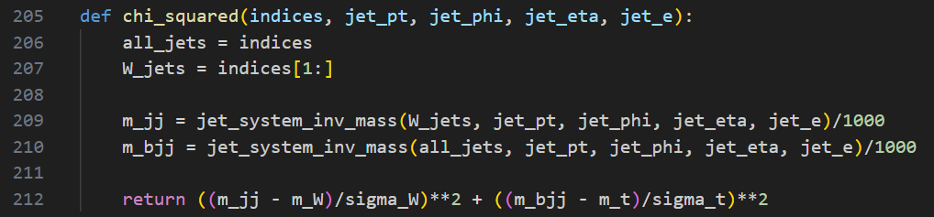
Calculating chi-squared of jet systems
Many jet combinations have chi-squared over 1000 and up to 200,000
  These can be easily ruled out
Some have low chi-squared by coincidence
  Can be misidentified as top quarks

Slide 11
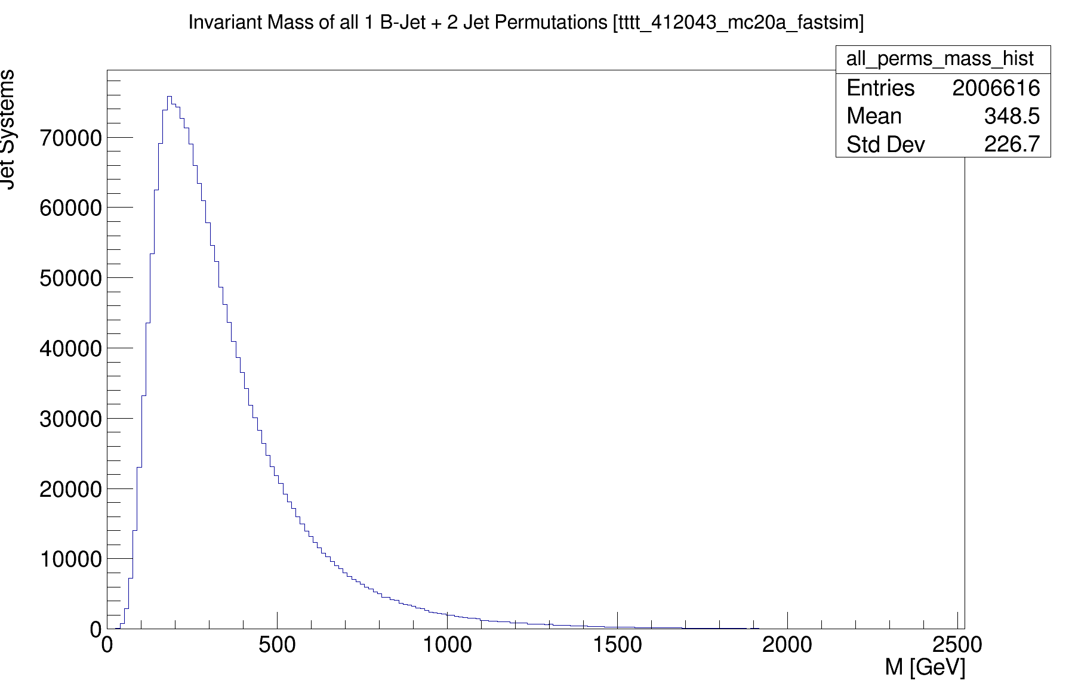
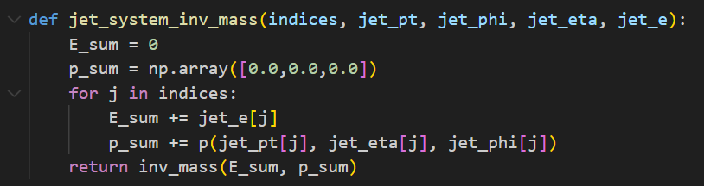
Calculating the mass of all jet system combinations
Peaks around 250 GeV which makes it somewhat difficult to extract real top quarks

Slide 12
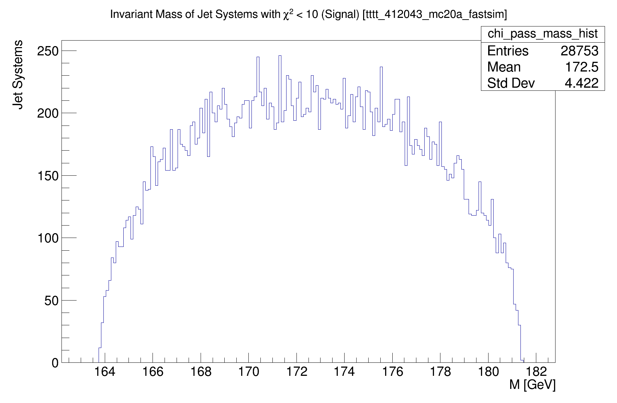
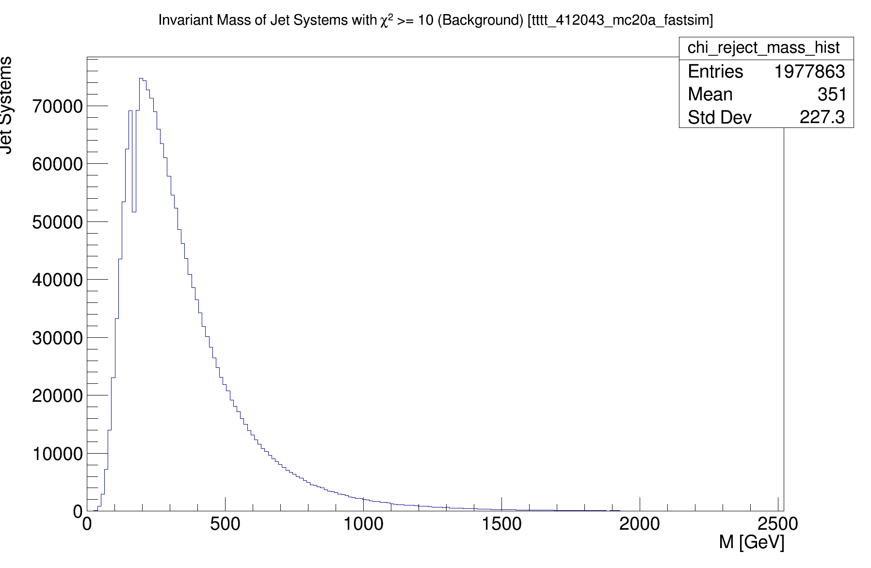
Selecting jet permutations with low chi-squared
Passed χ² < 10
Failed χ² < 10
Algorithm only finds about 35% of top quarks (estimate)

Slide 13
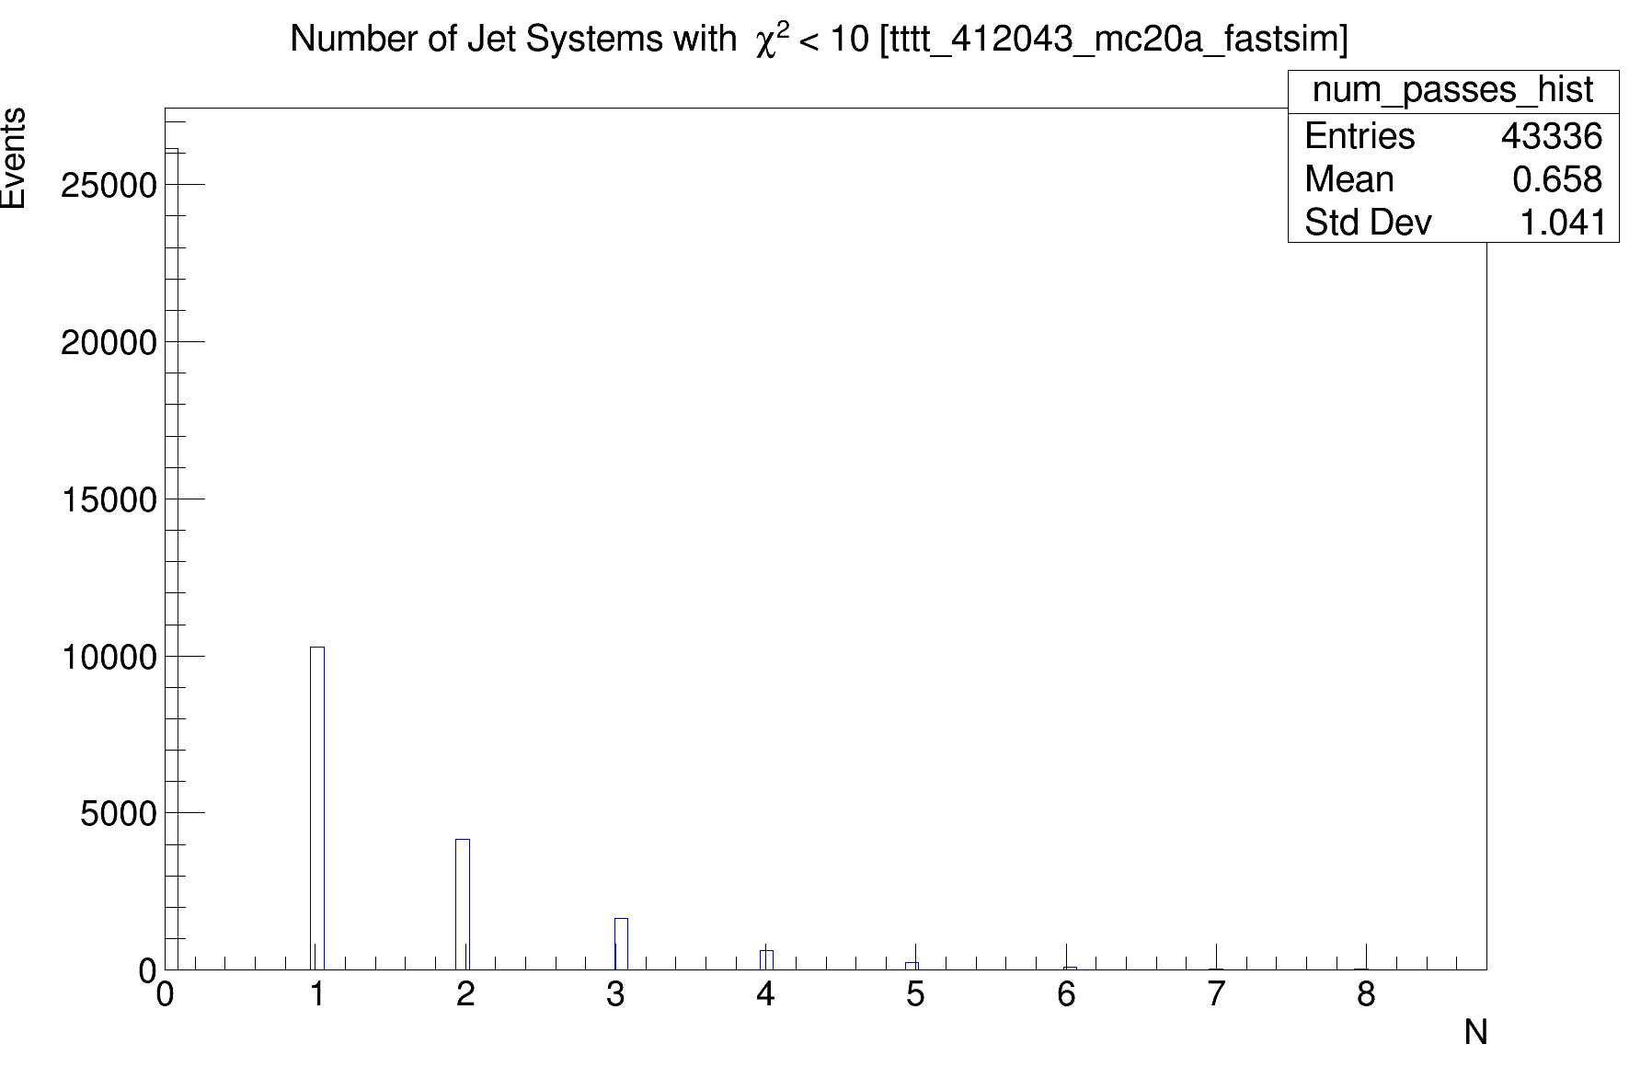
There are at most 2 hadronic tops per event…
The algorithm misidentifies some jet combinations

Slide 14
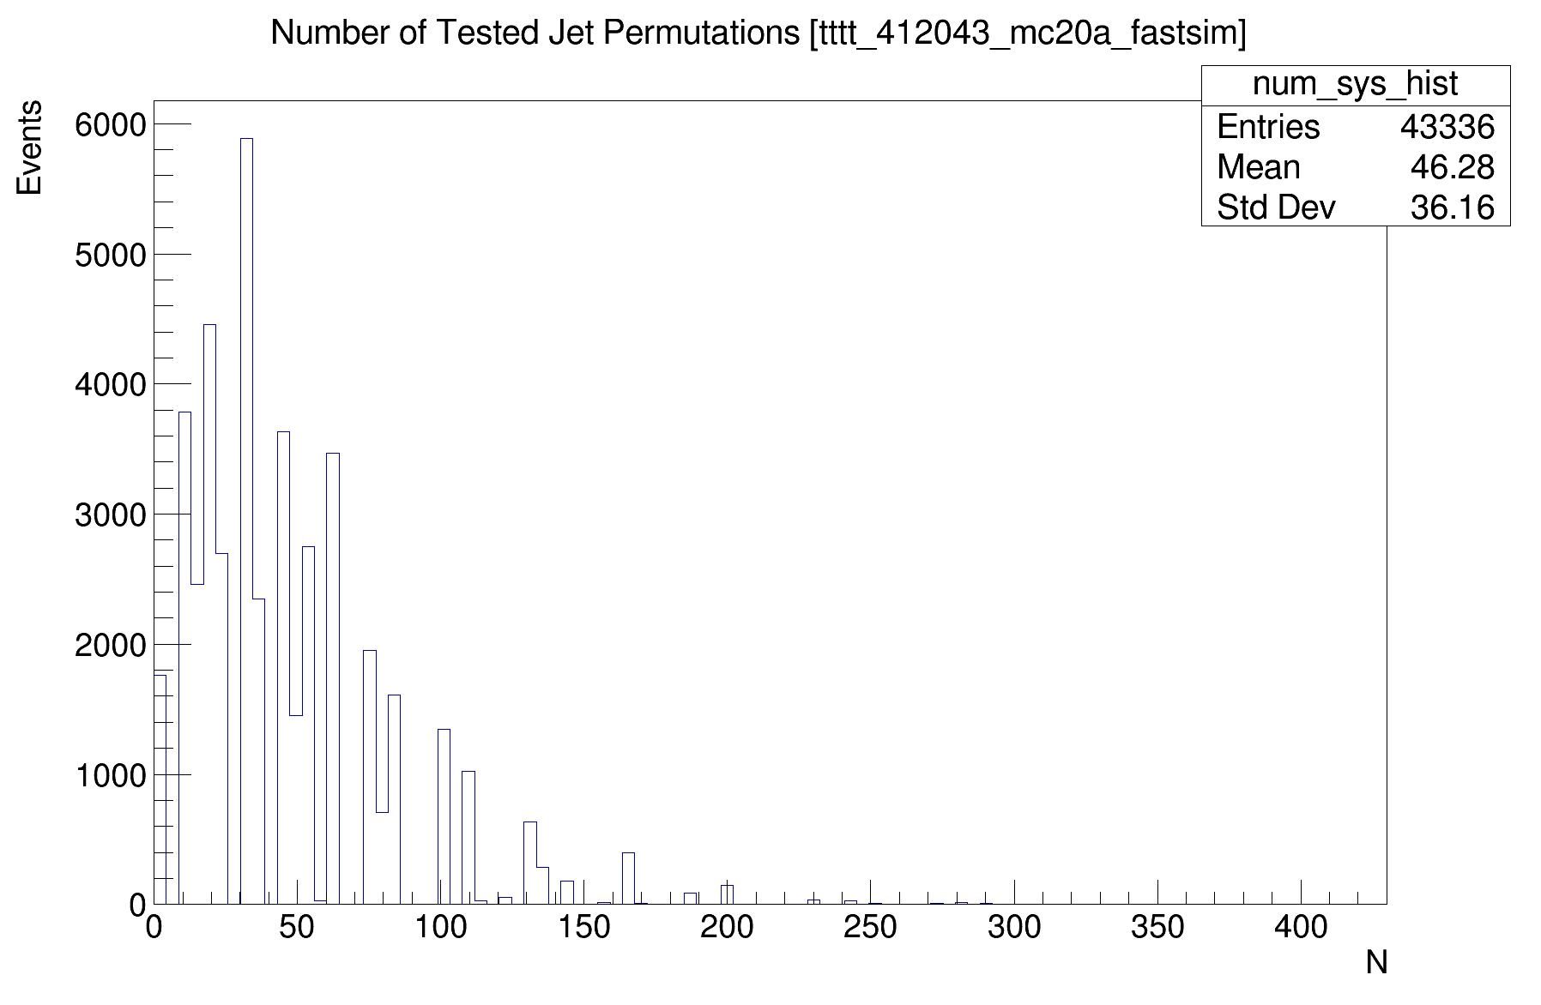
Combinatorial explosion
47,757 events
2,006,616 total combinations
On average 46 combinations checked per event

Slide 15
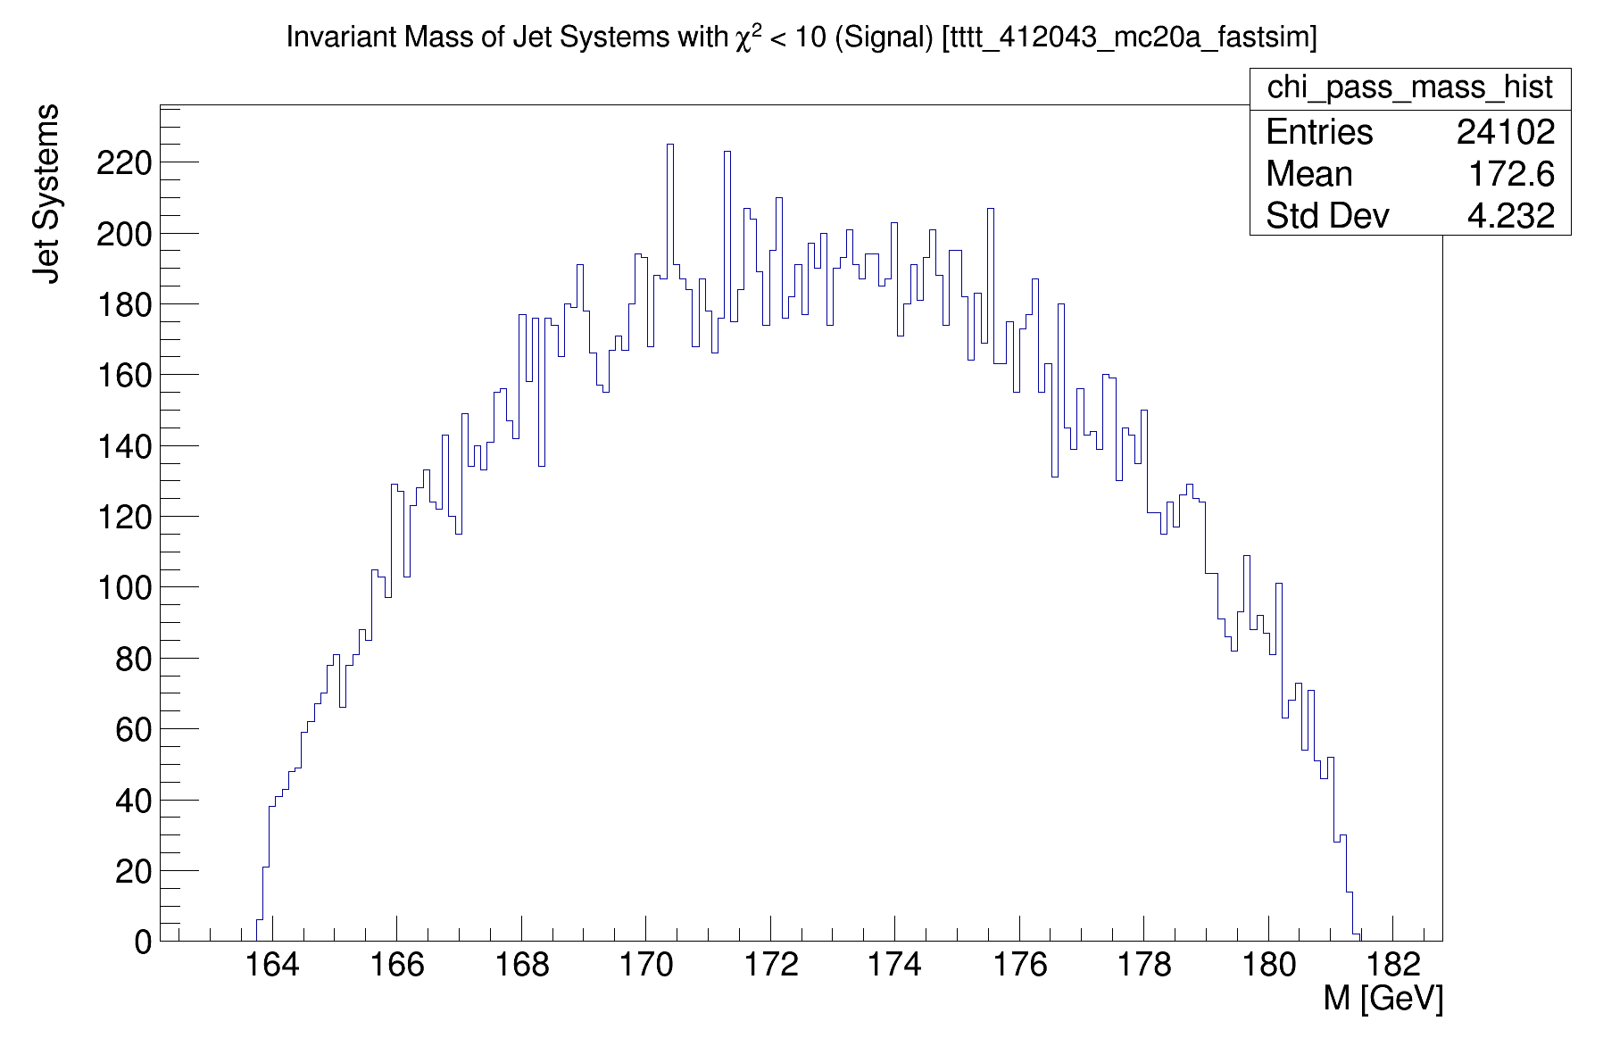
What if we select only the two lowest scoring combinations?
Reduces standard deviation in mass distribution from 4.4 to 4.2
Reduces number of false top quarks

Slide 16
Next Steps
Work on hadronic top reco algorithm
  Optimize chi-squared cut-off for best accuracy
      Use truth data to determine which reconstructions are correct
  Look at angular separation between jets
      Can factor into chi-squared calculation
  Look at computational efficiency
  Test on realistic dataset
  Compare results to more advanced (ML) algorithms
  Present at meeting next week
Research leptonically decaying top reconstruction
Speak with other groups working on four top reconstruction

Slide 17
Questions?

Slide 18
Backup Slides

Slide 19
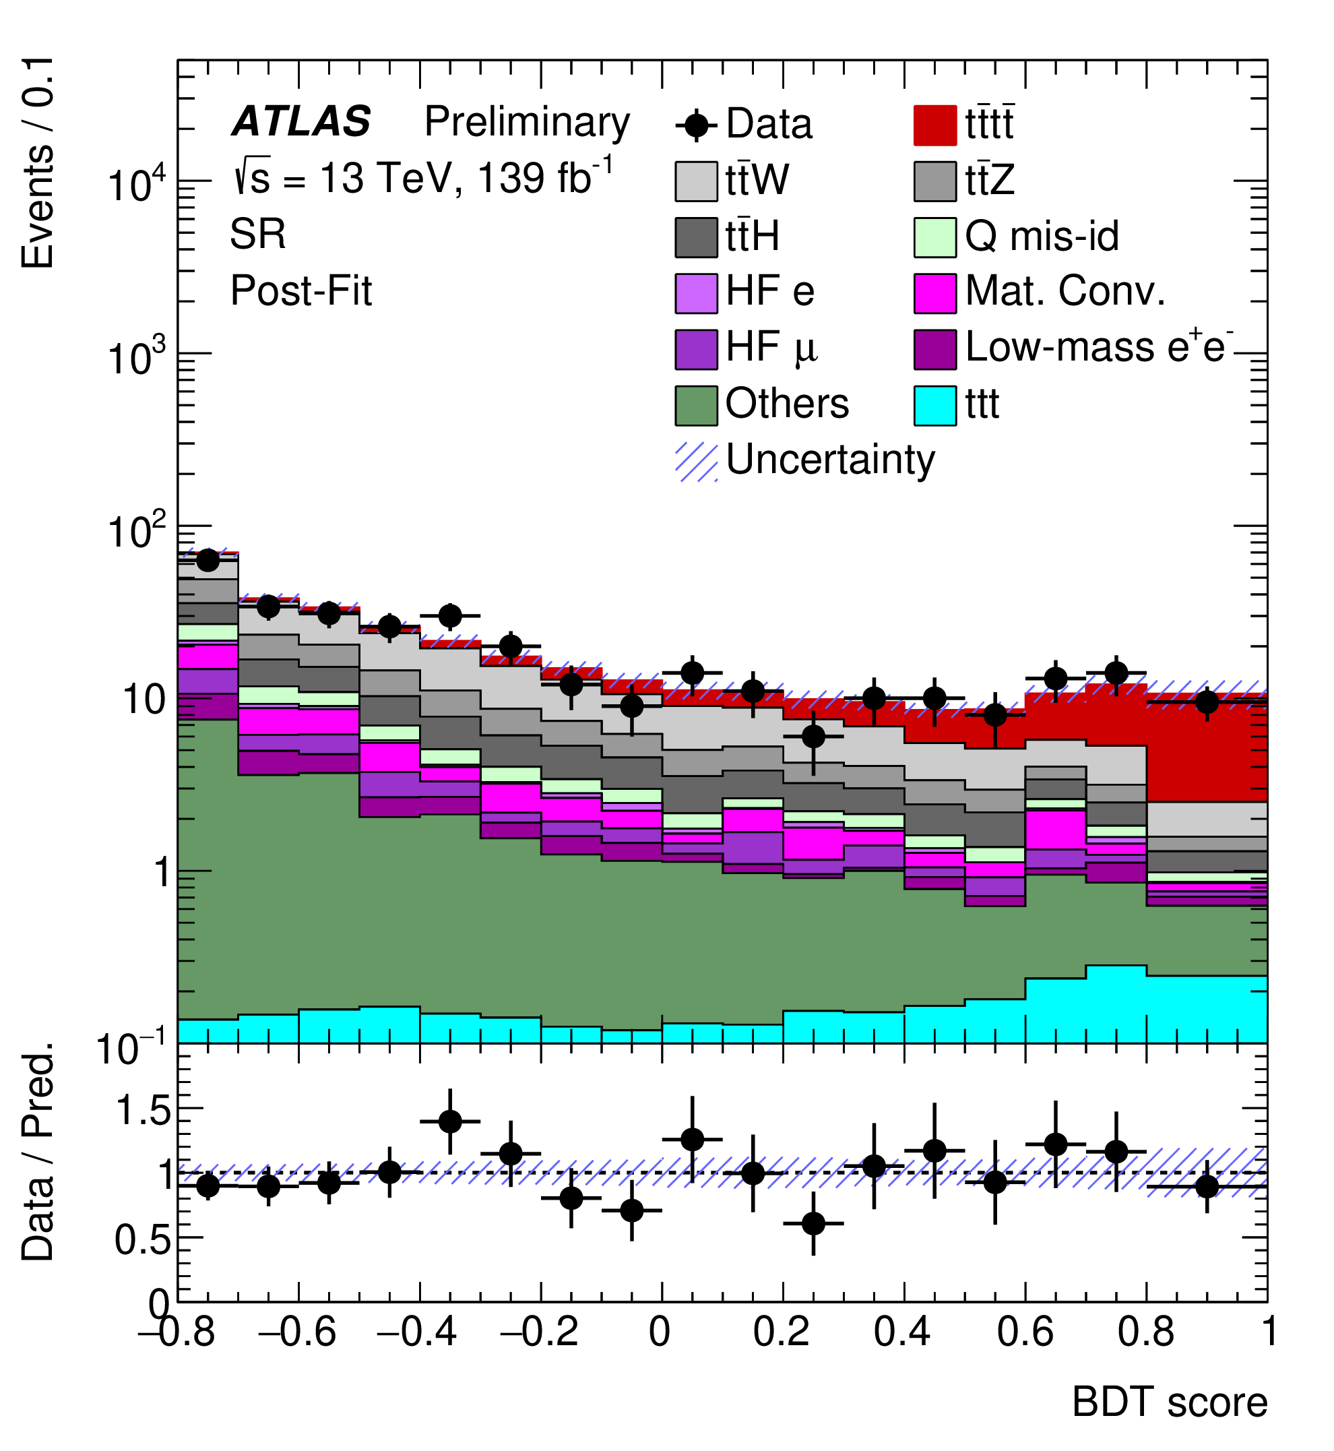
Past Observation of 4 Tops
2020/2023 Papers
Used Run 2 Data @13 TeV
Observed 4 Tops with ~ 6 sigma
Now looking at Run 3 Data @13.6 TeV
Need to update analysis framework and code
  Also helps prepare for HL-LHC

Slide 20
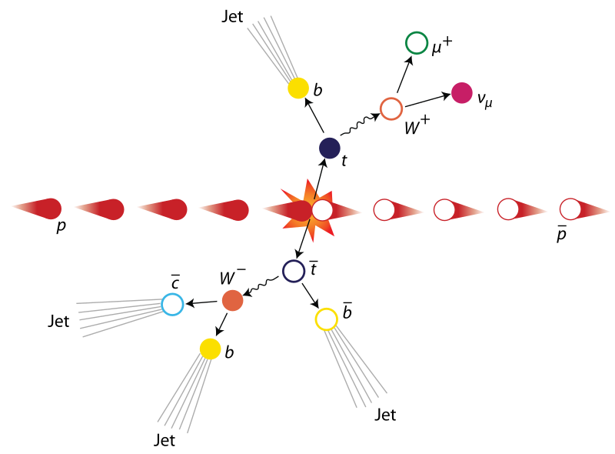

Example: $t\overline{t}$ Production

Slide 21
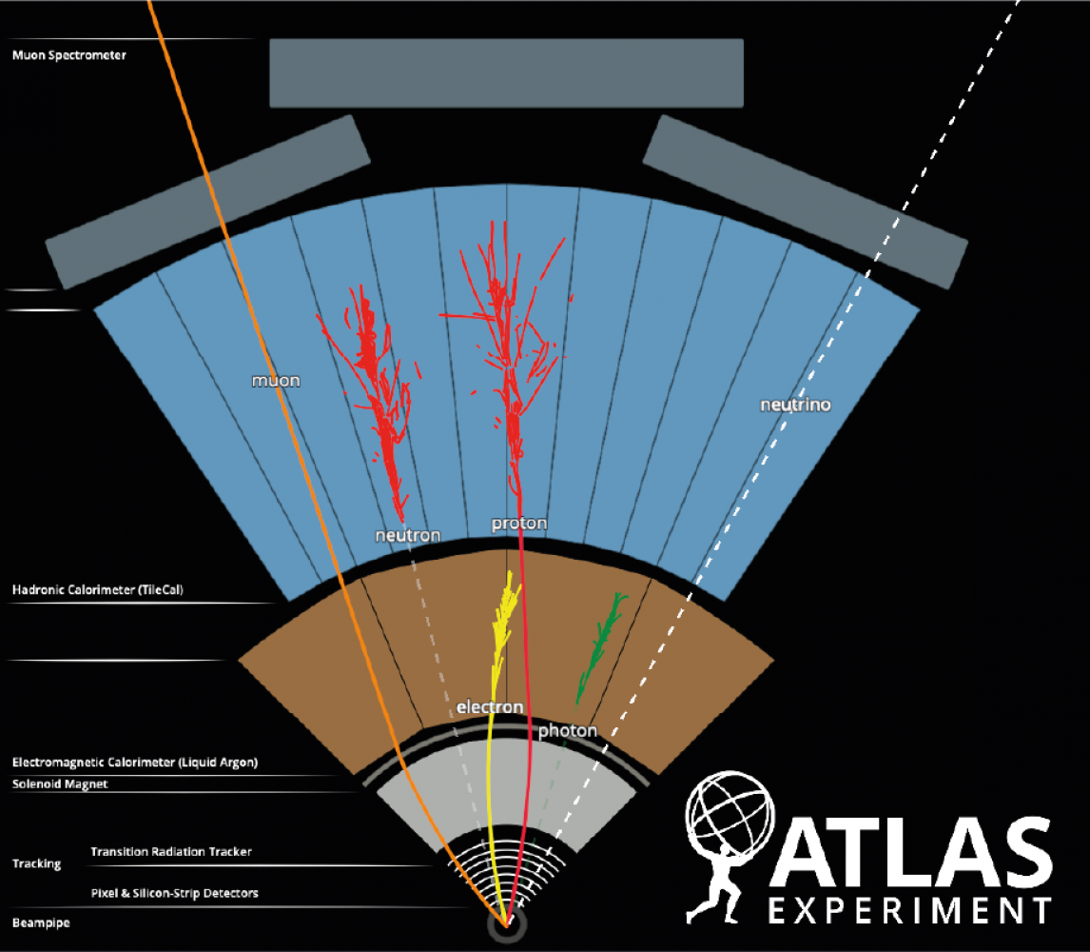
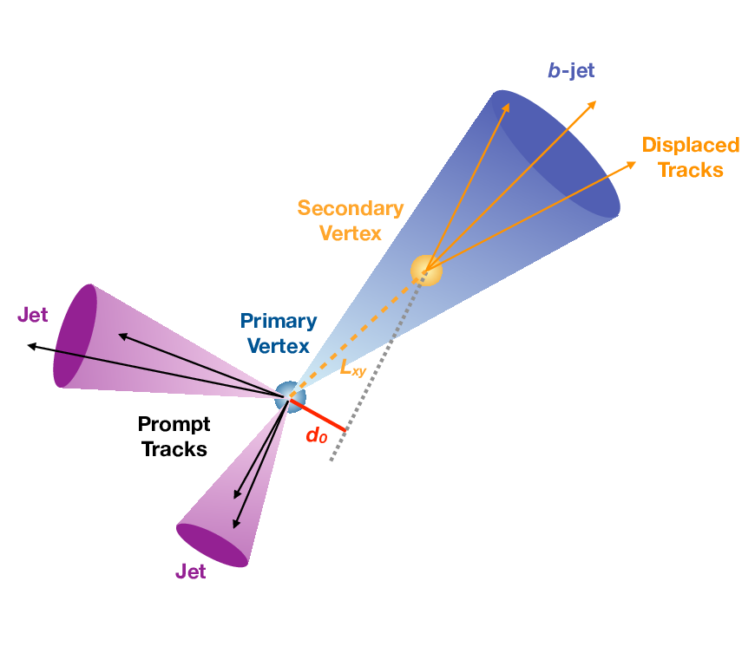
B-Jet Tagging vs Leptons

Slide 22
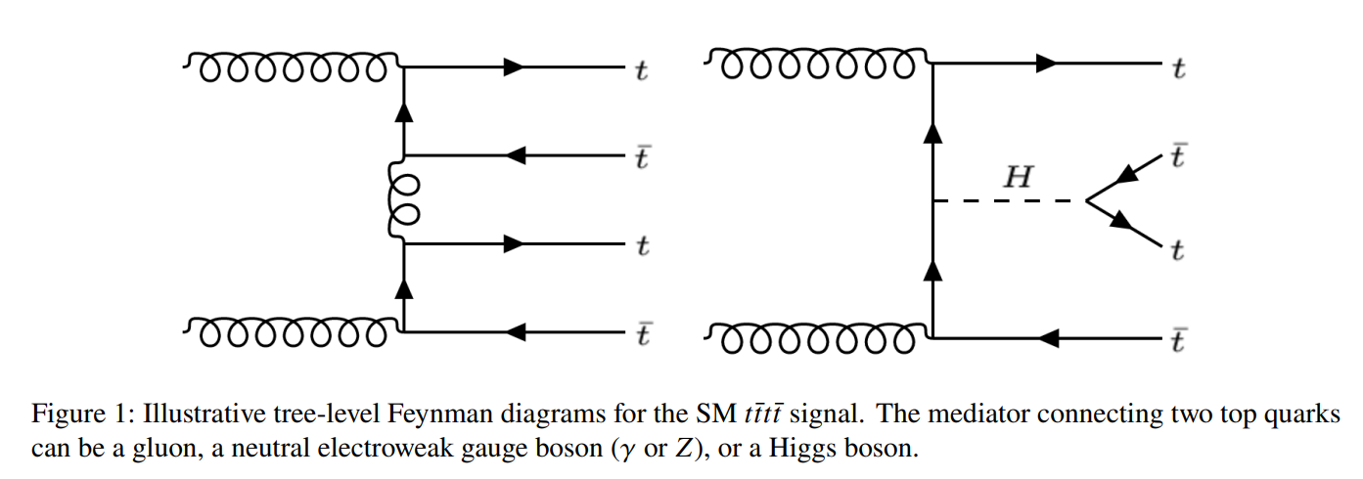
Four Tops

Slide 23
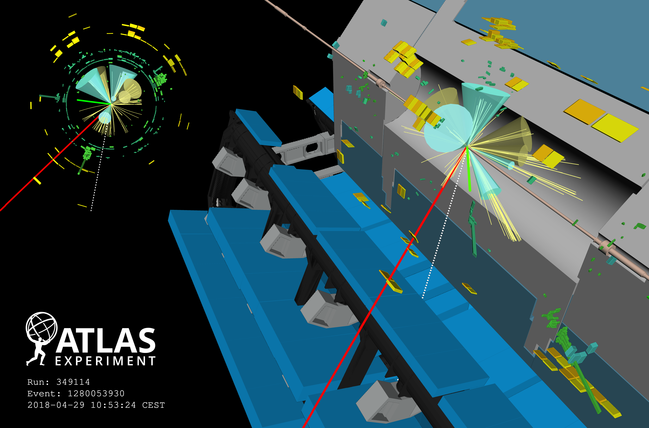
Notes:
Four-top candidate from 2018. Event display of a candidate four-top-quark event (Run 349114, Event 1280053930) with seven jets (four of them are b-tagged); two of the top quarks decay leptonically (one with a resulting muon, shown in red, and one with an electron, shown in green), and two top quarks decay hadronically. Green rectangles correspond to energy deposits in cells of the electromagnetic calorimeter, while yellow rectangles correspond to energy deposits in cells of the hadron calorimeter. The jets (b-tagged jets) are shown as yellow (blue) cones. The direction of the missing transverse momentum is indicated by a dotted line.

Slide 24
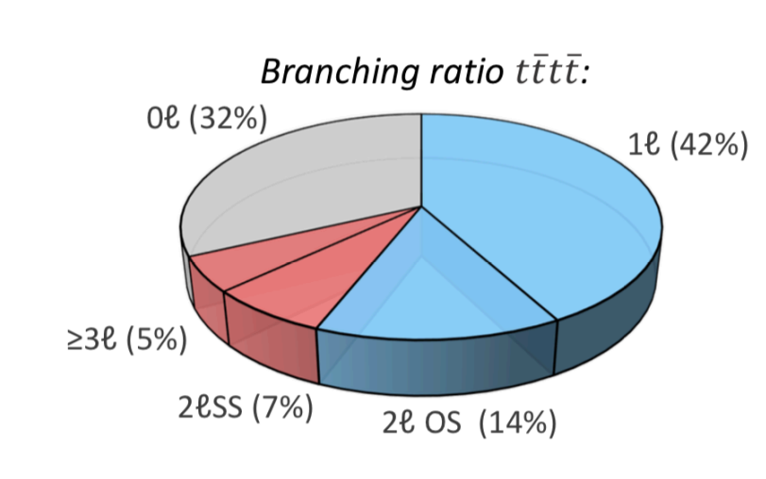
Branching ratios
Most 4 Tops decay into all hadrons
2 and 3 lepton channels (3l, 2lss) are cleanest

Slide 25
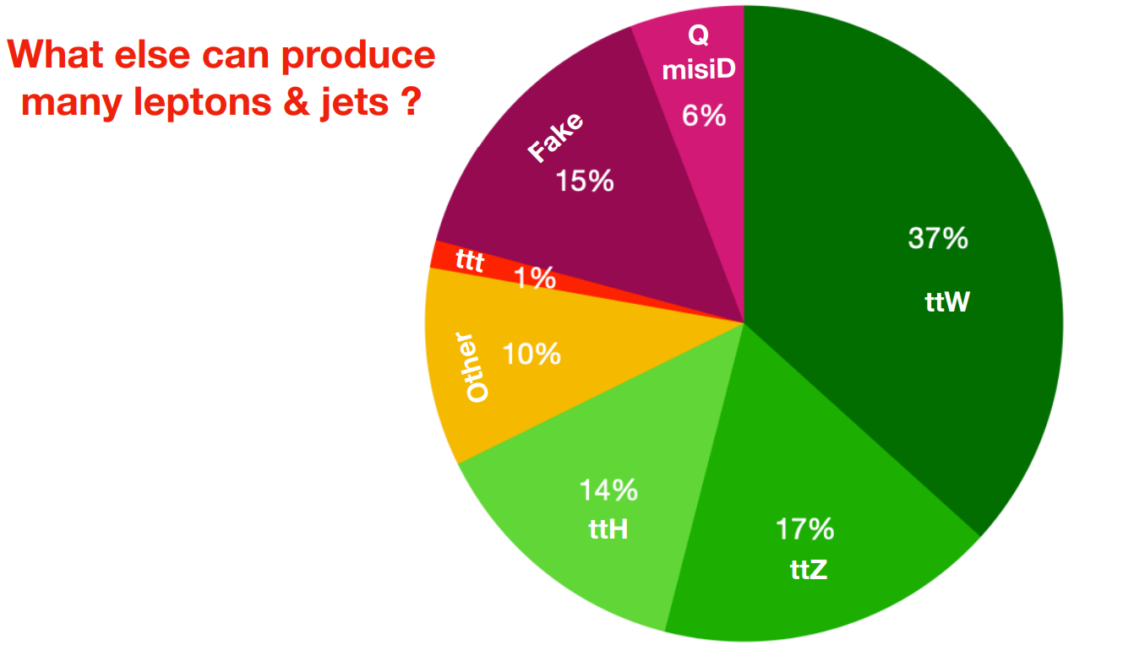
Backgrounds

Slide 26
Example of 3L Channel Signal

Slide 27
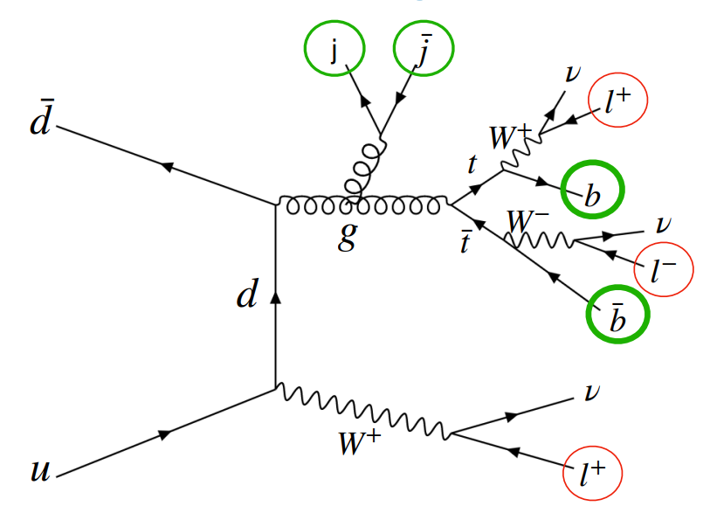
Example of 3L Background

Slide 28
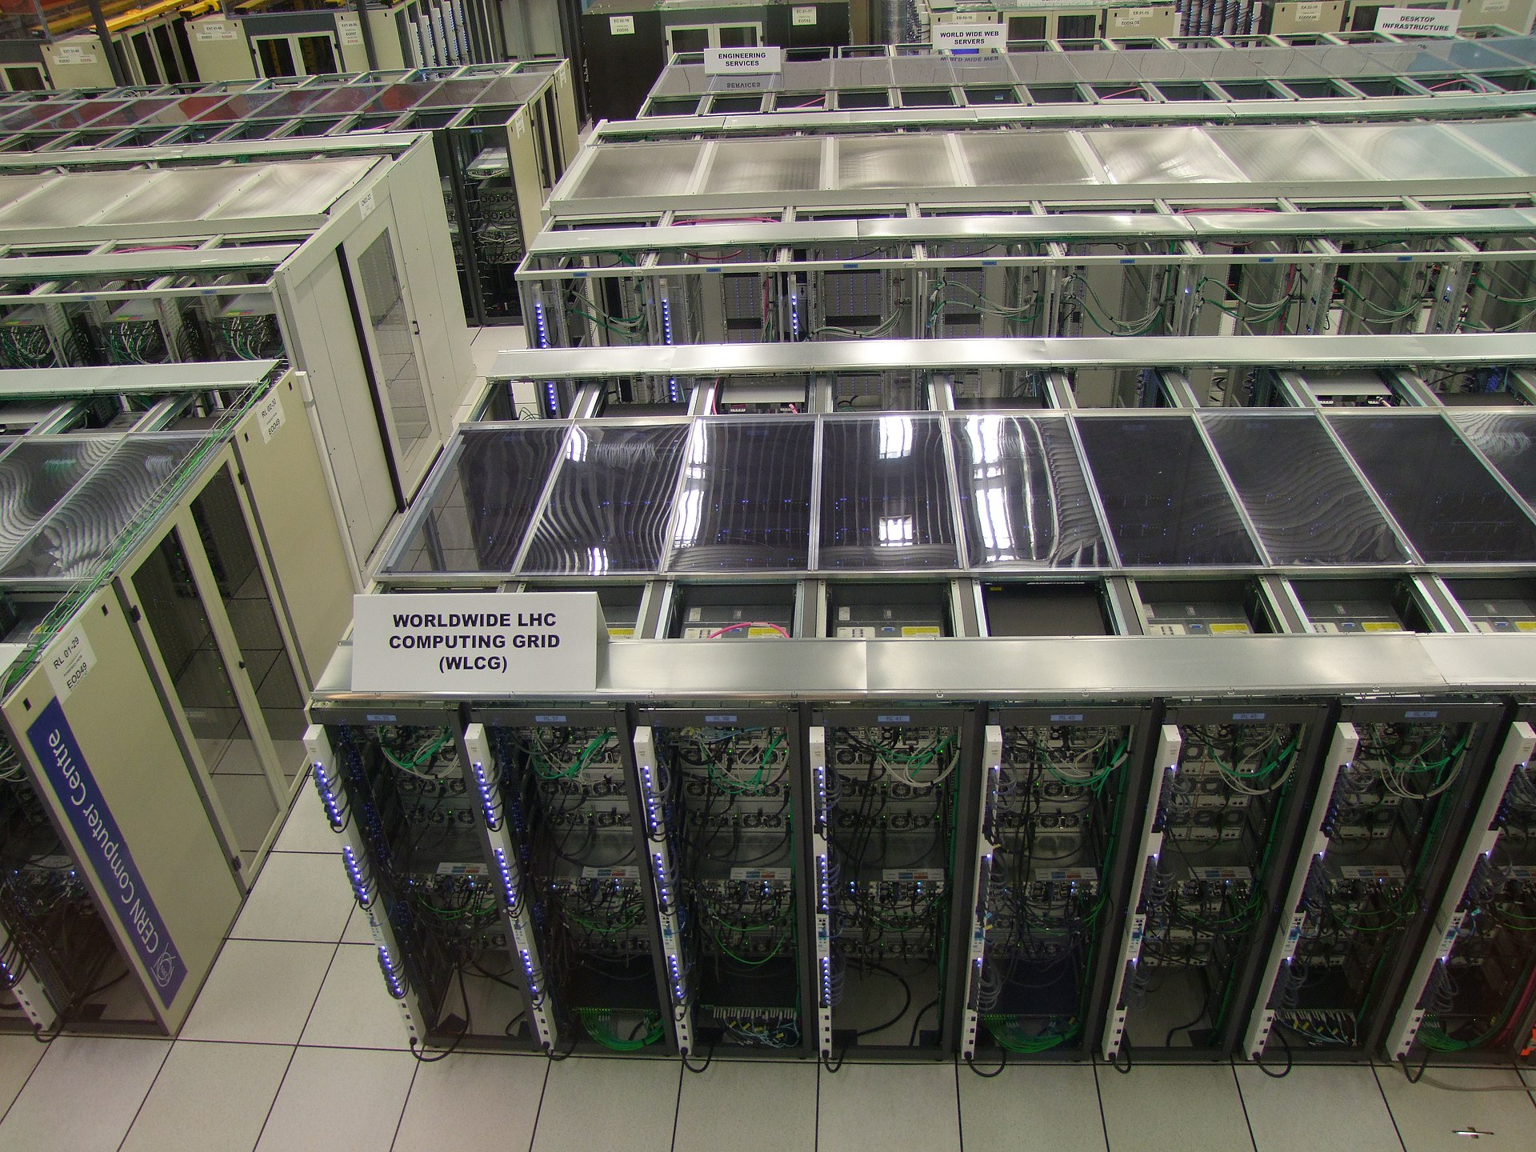
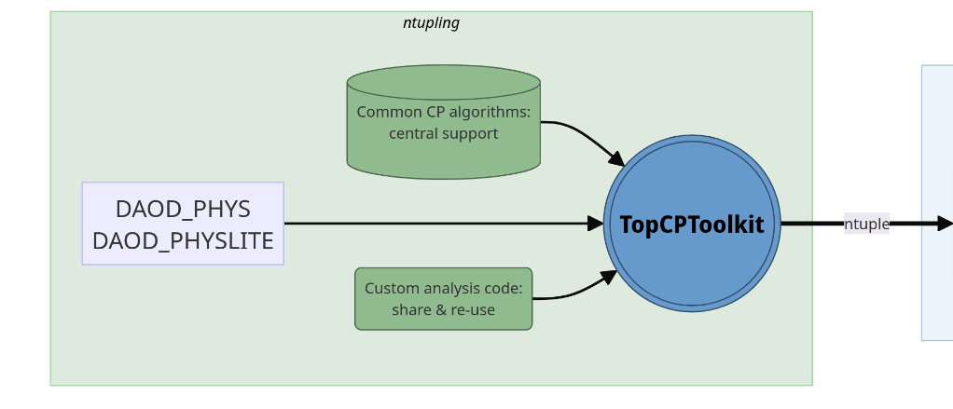
N-tuple Production
TopCPToolkit is n-tuple production framework written for all top quark related analyses
Practice submitting jobs to the Grid
Notes:
The Grid is CERN’s computer network

Slide 29
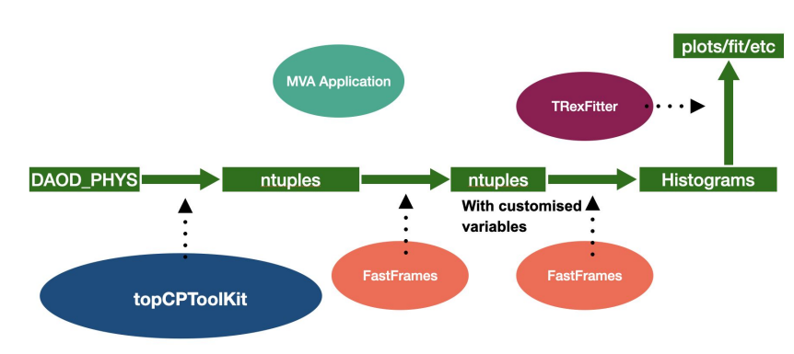
Recap: Analysis Framework
Data analysis pipeline has multiple stages
FastFrames code computes custom kinematic variables

Slide 30
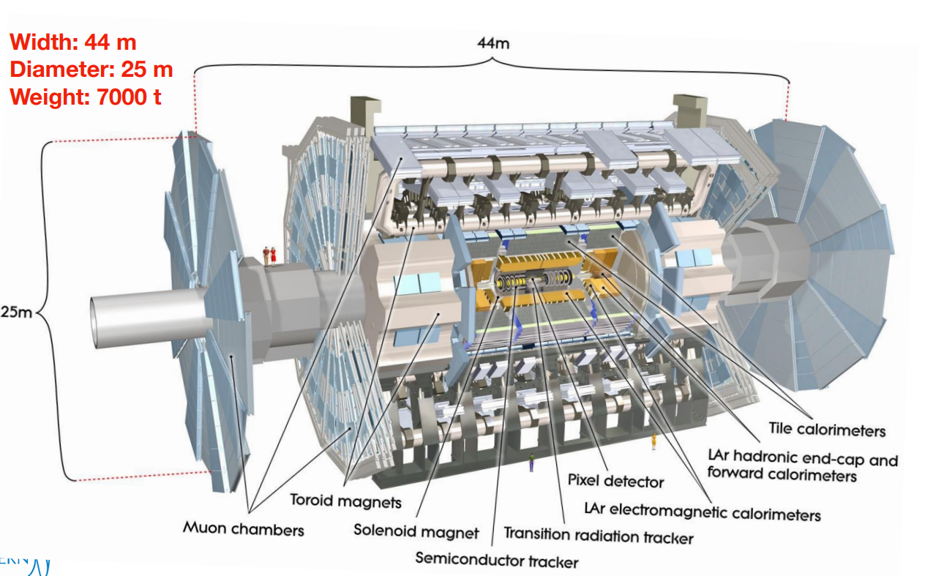
ATLAS Detector

Slide 31
Recap: Top Quark Reconstruction
You can reconstruct a top quark by finding its decay products
Gives us more kinematic information to separate signal from background
  More input for multivariate analysis algorithm
Need to study whether this is feasible, effective

Slide 32
Recap: Top Quark Decay
Top quark decay is hadronic or leptonic
Hadronic
  3 jets (at least 1 b-jet)
Leptonic
  1 b-jet
  1 lepton (electron, muon, tau)
  1 neutrino

Slide 33
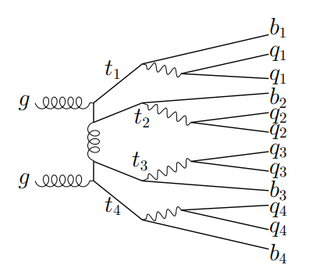
Recap: Four Tops
Much more complex topologies
Most 4 tops decay into all hadrons
2 and 3 lepton channels (3L, 2LSS) are cleanest
Ex: All hadronic (0L) channel

Slide 34
“Set Assignment Problem”
p_{T}^{miss}
Ex: 3-lepton (3L) channel

Slide 35
What are our final states?
2-Lepton Same Sign (2LSS)
3-Lepton (3L)
2 hadronic tops
2 leptonic tops
Final State
  2 Leptons (same charge)
  8 Jets
      At least 4 b-jets
  Missing energy
      2 neutrinos
1 hadronic top
3 leptonic tops
Final State
  3 Leptons
  6 Jets
      At least 4 b-jets
  Missing energy
      3 neutrinos

Slide 36
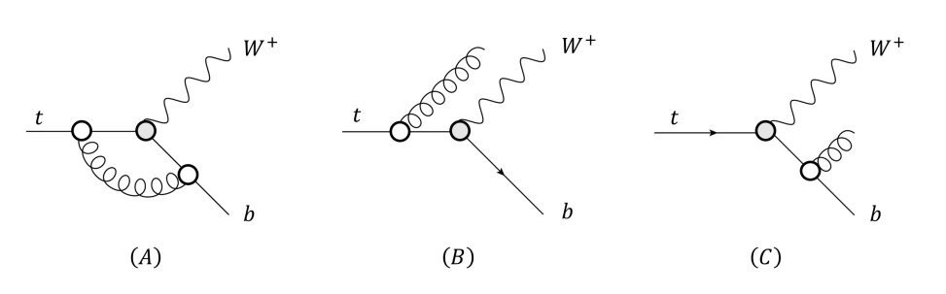
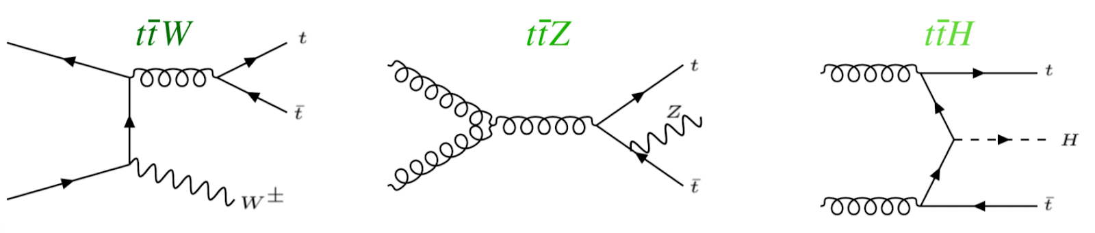
What are our backgrounds?
Largest backgrounds are ttW, ttZ, ttH
Can look like four tops signal
  Possibility of gluon splitting

Slide 37
Hadronic Top Reconstruction, cont.
Kinematic Fitting
  KLFitter: https://doi.org/10.1016/j.nima.2014.02.029 (semi-leptonic tt)
Boosted Decision Trees
Deep Neural Networks
  https://arxiv.org/abs/1907.11181 (semi-leptonic tt)
Graph Neural Networks
  Briefly investigated in 2023 ATLAS four tops observation study
  Did not manage to increase sensitivity over background
  https://cds.cern.ch/record/2765538/files/ATL-COM-PHYS-2021-195.pdf
Other: SPA-NET
  Attention based network which preserves physical symmetries
  20% improved efficiency over chi-squared method
  Was able to reconstruct 0L tttt events
  https://arxiv.org/abs/2106.03898

Slide 38
Leptonic Top Reconstruction
Mass reconstruction is non-trivial
  System is kinematically unconstrained
  Missing transverse momentum is the sum from 2+ neutrinos
  Cannot determine momenta of individual neutrinos
Possible solutions (constraining m_{t} and m_{W})
      https://pdg.lbl.gov/2019/reviews/rpp2019-rev-top-quark.pdf
  Analytic solutions
  Neutrino weighting methods
      https://arxiv.org/abs/hep-ex/9808029
  Neutrino reconstruction with deep neural networks (2023)
      https://arxiv.org/abs/2307.02405
      Can recover full neutrino momenta in multi-neutrino final states

Slide 39
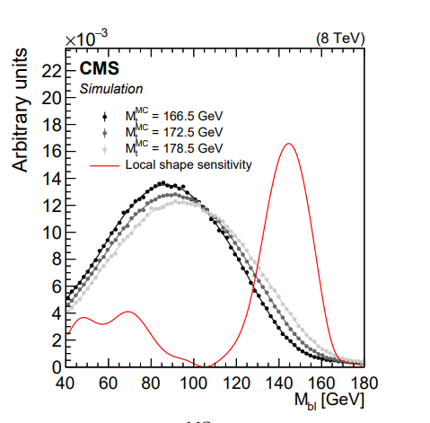
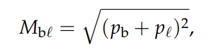
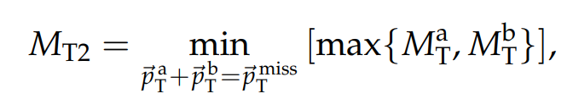
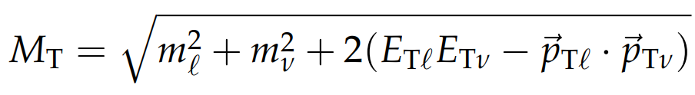
Leptonic Top Reconstruction, cont.
Other observables sensitive to top quark mass
  Invariant mass of bottom jet and lepton system is theoretically limited by top quark mass
  Other transverse-mass-like variables
  Maybe can be fitted to known distributions to reconstruct leptonic tops? Maybe can be used as discriminating variables
https://arxiv.org/abs/1704.06142

