Slide 1


ᑐ ᑌ ᑎ ᕮ
Supernova Pointing
Harry Akins 14/05/2024

Slide 2

Recap
Background Calibration
  Shape of distribution needs further investigation
ADC cut for Main Track identification model optimization

Slide 3
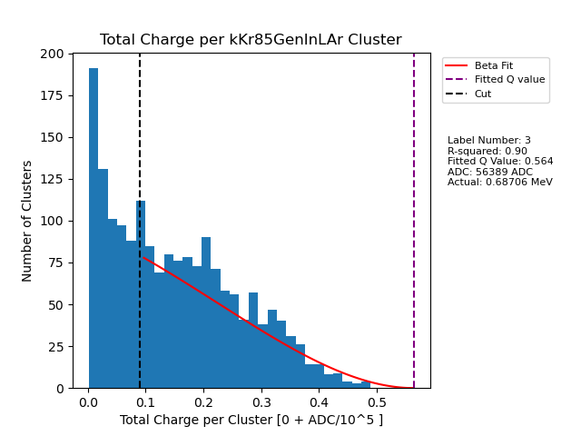
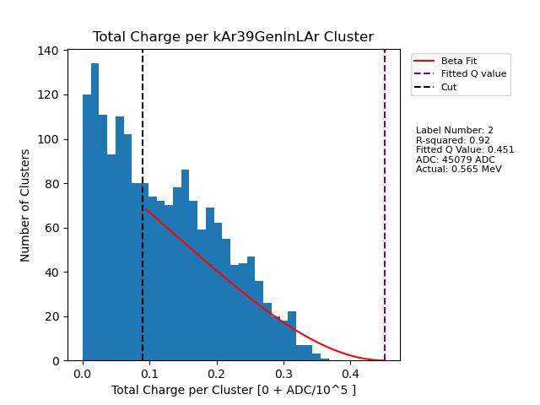
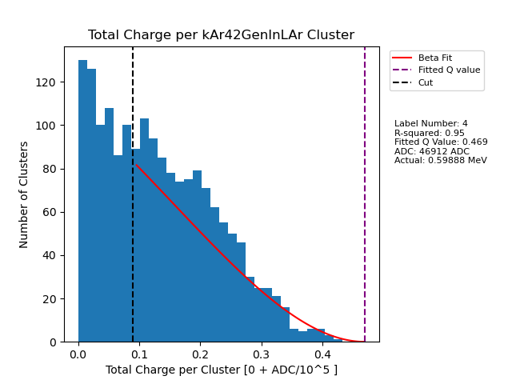
Why is there spike at low energy?

Slide 4
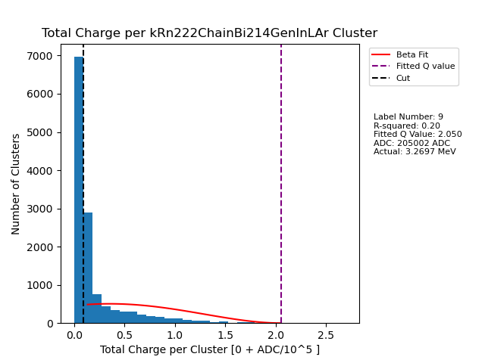
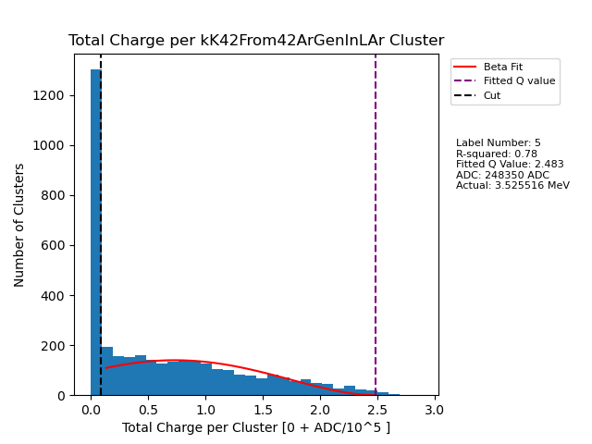
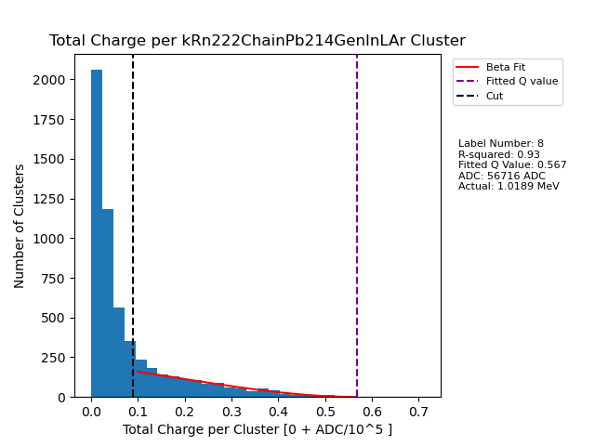
Why is there spike at low energy?

Slide 5
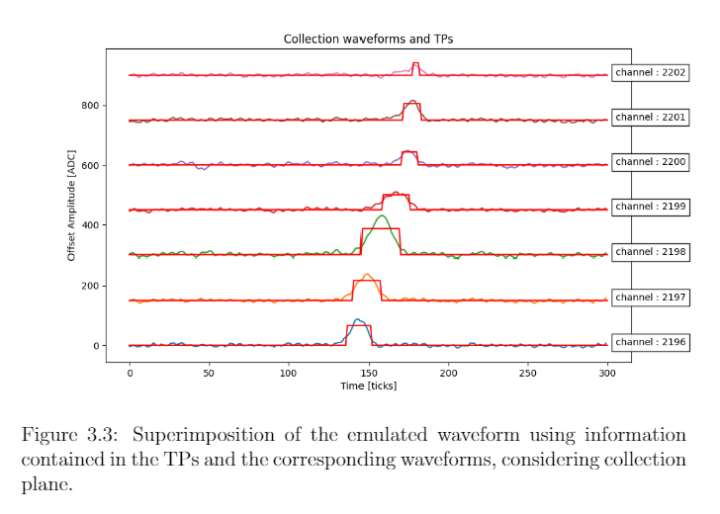
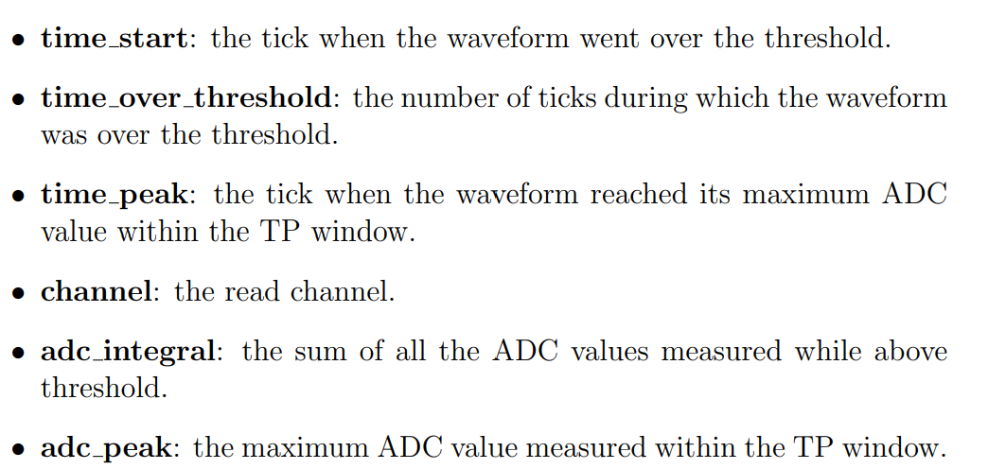
Real Reason
Electron attenuation would just squeeze the distribution, not “pile up”
For smaller signals, more of the waveform area is “lost”
End up with many small signal electrons ending up with even less ADC integral value —> spike at near zero

Slide 6
Solution
Need to recover area
  Important for lower energy events
  This could be extremely relevant depending on where energy cut is placed
Lower Threshold
Secondary Threshold
Fit Gaussian

Slide 7
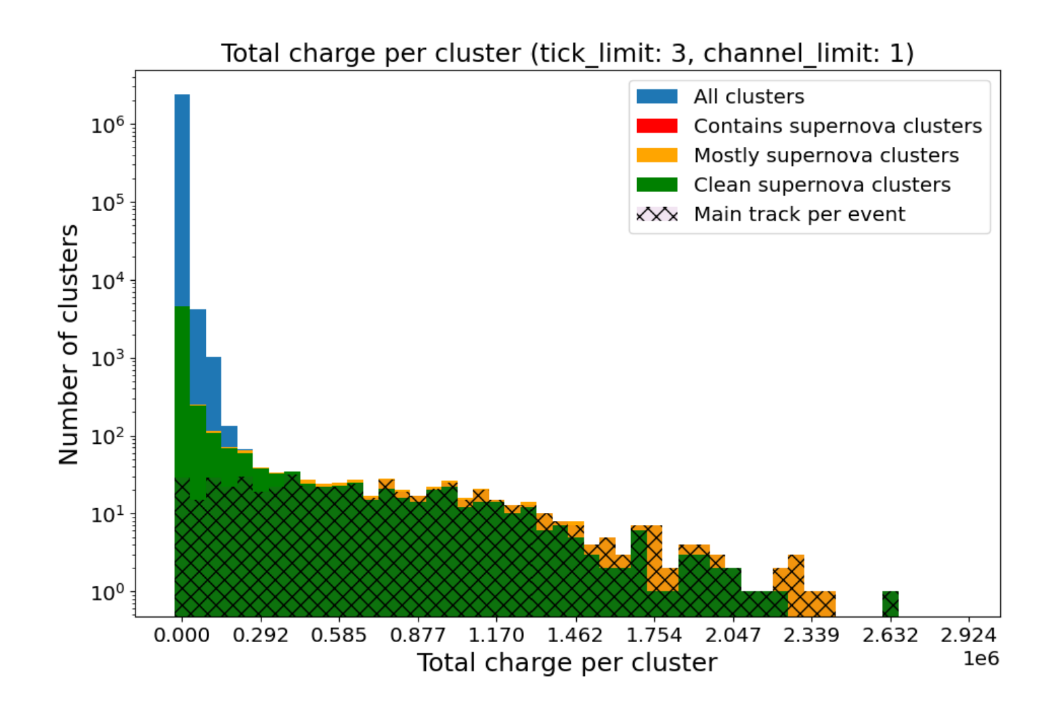
Main Track Identifier
Testing SN Main track identifier using different total charge cuts
  Goal: Classify events as Main Track or other with speed and accuracy ---> Must significantly reduce number of events to analyse so a more complex algorithm can be applied to remaining events for identification (ML)

Slide 8
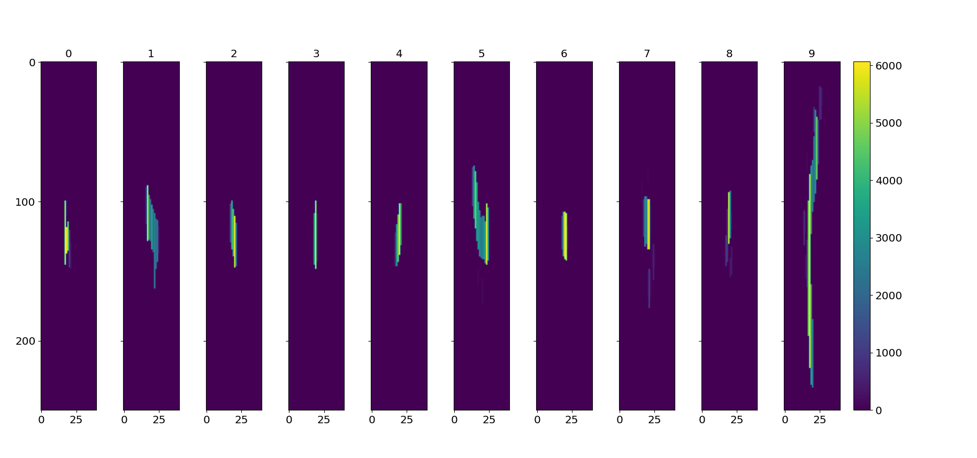
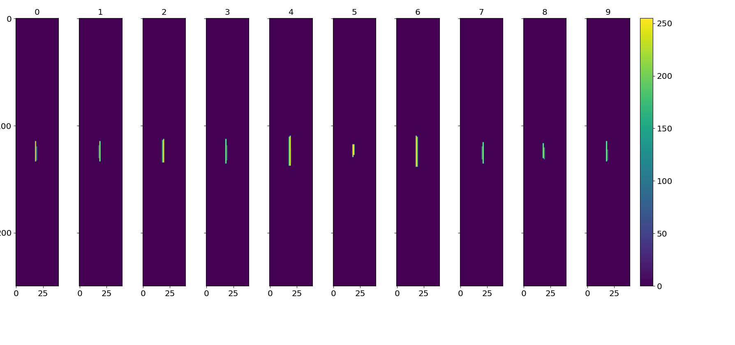
The Model
Main Track Samples
Images created from TPs, model is trained on them
Using 2D CNN
  Good for images, picks up different patterns across different convolution layers
Background Samples

Slide 9
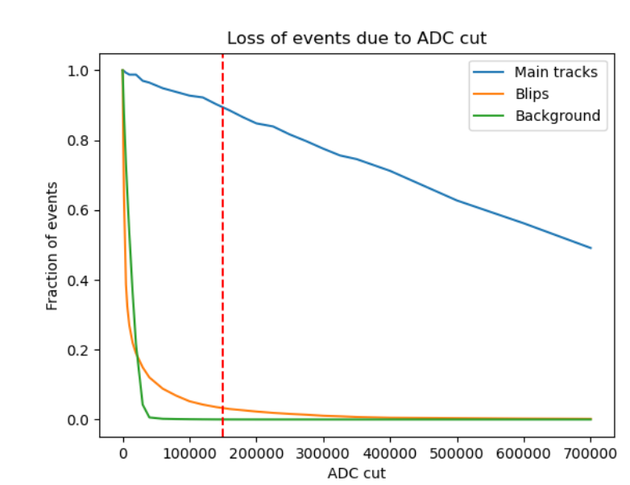
Where to Cut?
We can cut at very high ADC and eliminate most backgrounds, but we are not sure how many MTs we need for pointing yet
Accepting only higher energy main tracks may also affect performance of ES-CC neural net as well
My task:
  Generate new models at different cuts and test performance. Find best cut
  Test ES-CC classifier with this cut as well

Slide 10
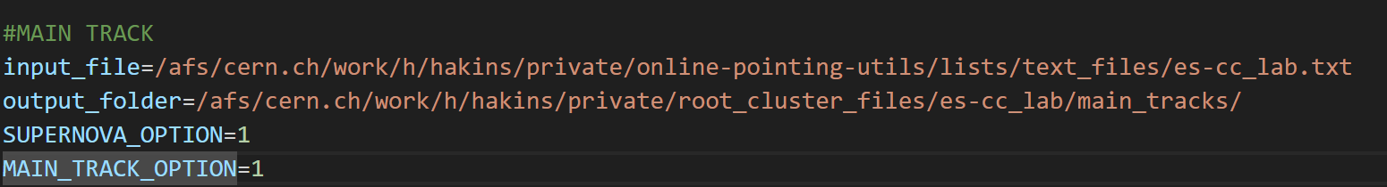
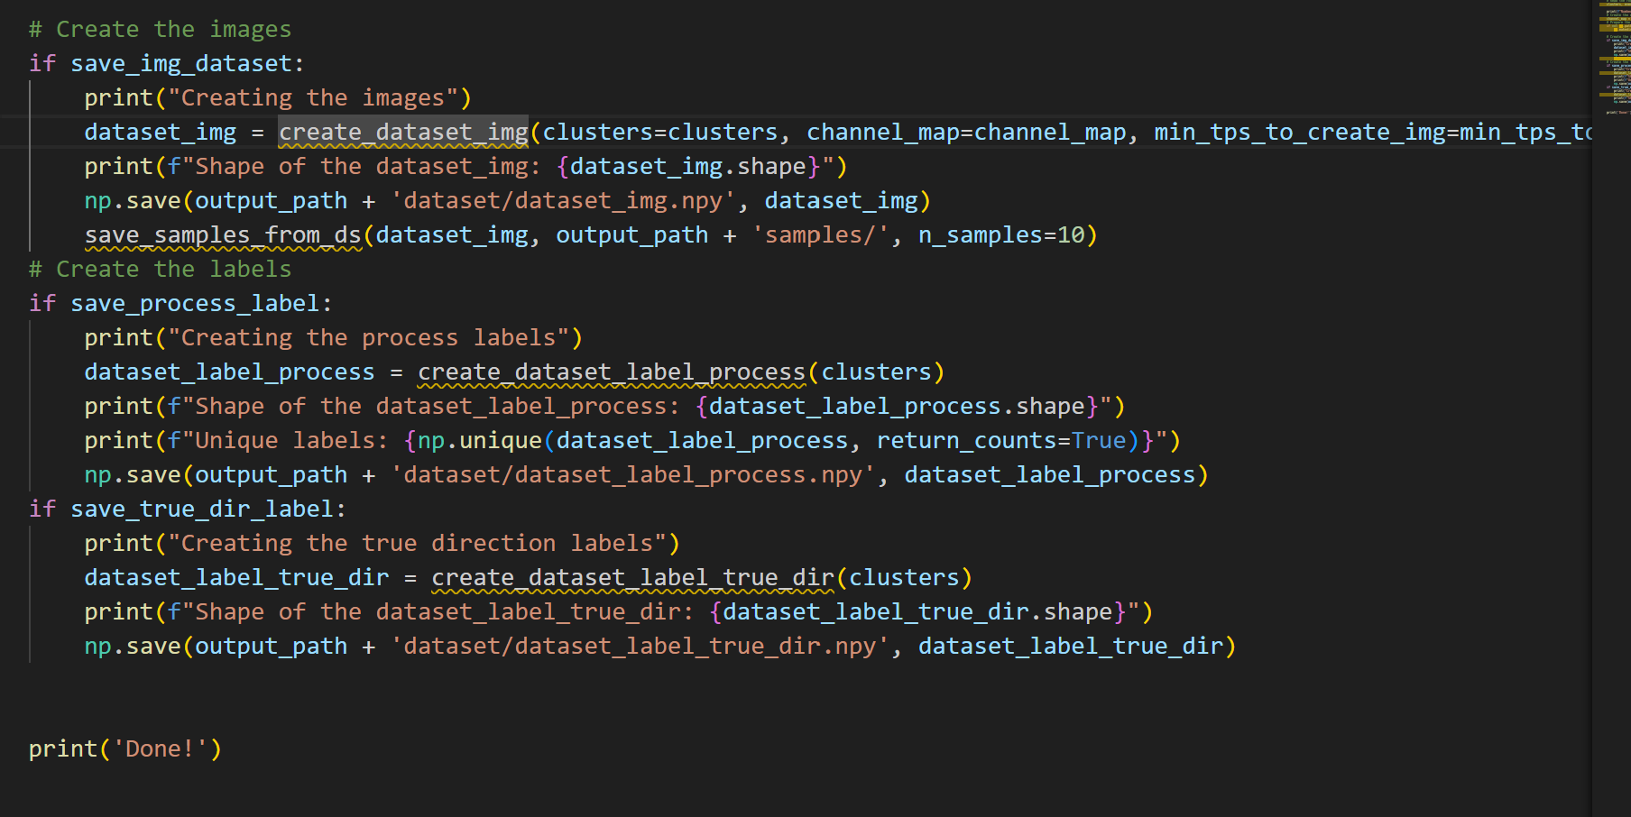
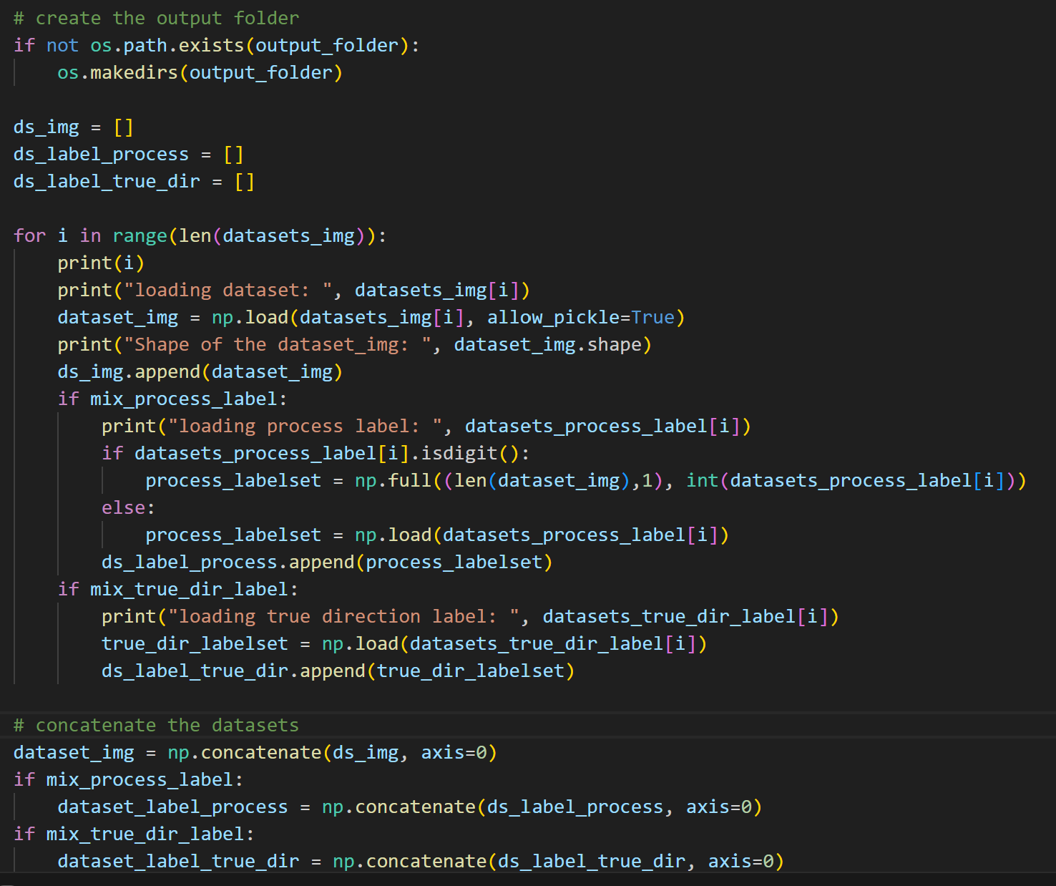
Step 1: Create Training Data
Create Cut Clusters
2. Clusters to numpy datasets
3. Mix Datasets

Slide 11
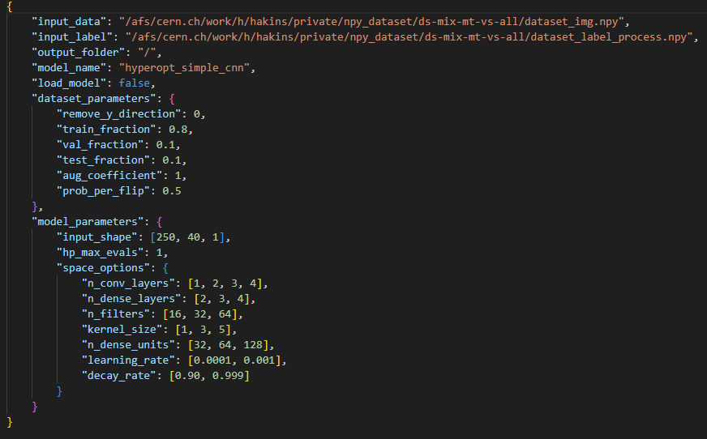
Step 2: Train Model

Slide 12
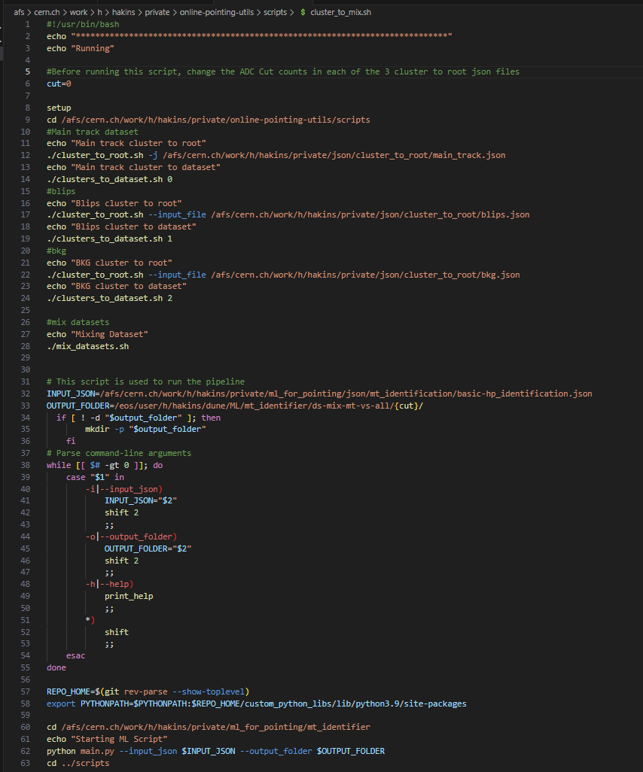
Optimizing Process
Creating structure that requires least amount of file editing to change data creation settings

Slide 13
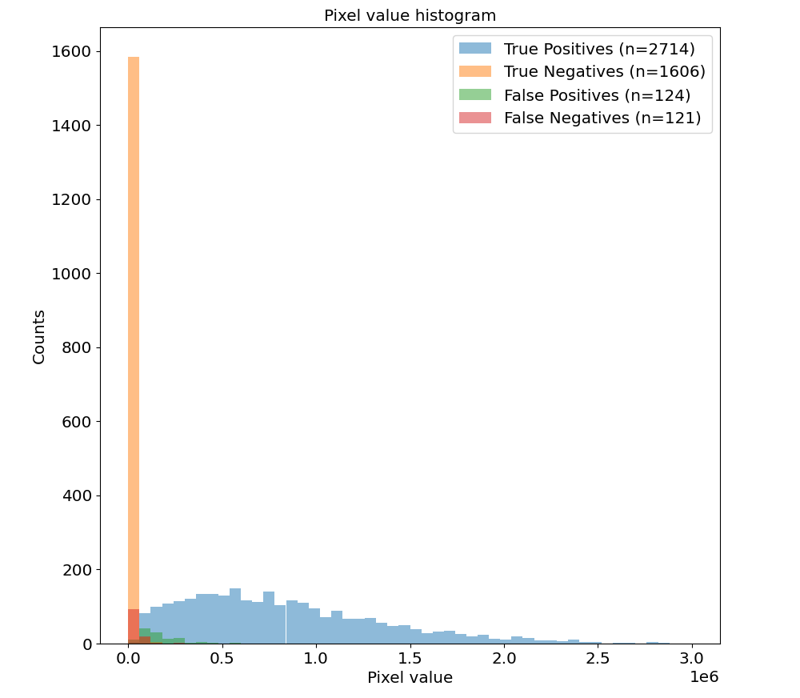
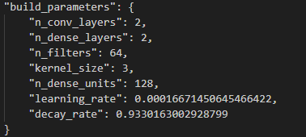
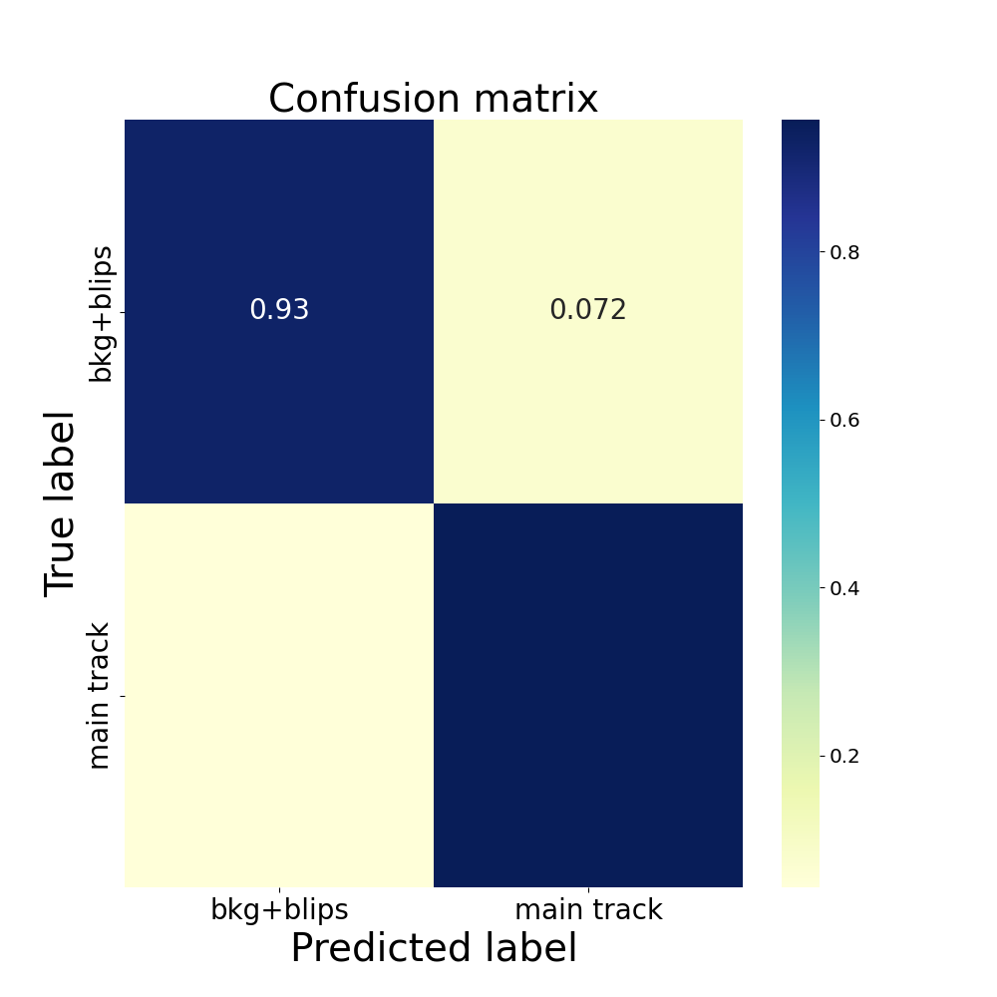
No ADC Cut
Hyperparameters:
0.04
0.96

Slide 14
Next Steps
Learn how to use Condor
  Train and test around 8-10 more models with different ADC cuts
  Analyse and compare performance of models

Slide 15
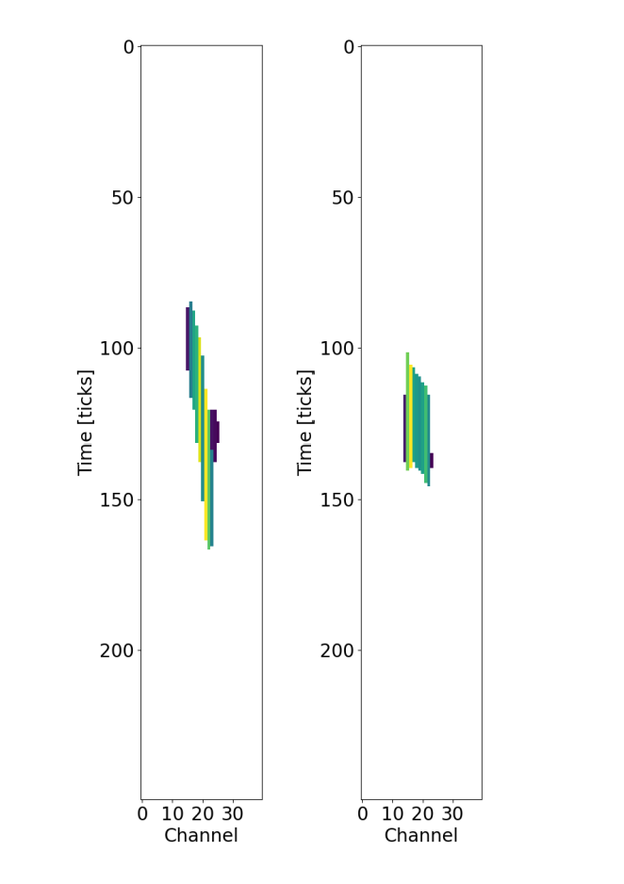
Ideas for Better Performance:
Create more sophisticated images
  Pixel value(color) is ADC Integral/TOT
  Create triangle instead of rectangle using start and end time
  Include peak value
Use a transformer instead of CNN
  Better for more sparse images (mostly 0s)

