Slide 1
L1T Upgrade Update #7
Brock Ewing
5.14.2024

Slide 2
Project Recap
Upgrade the L1T system to look for new Higgs signatures in background HL-LHC data
Analyze and select events from simulated data to train an NN for implementation onto the HL-LHC hardware
Create NN and generate accuracy and efficiency graphs, ROC graphs to show the ability of our NN.
Use Qkeras and hls4ml to reduce the size of our NN and transfer it onto FPGA hardware.

Slide 3
Progress
Trained and tested the network on different datasets to see what performed the best.

Slide 4
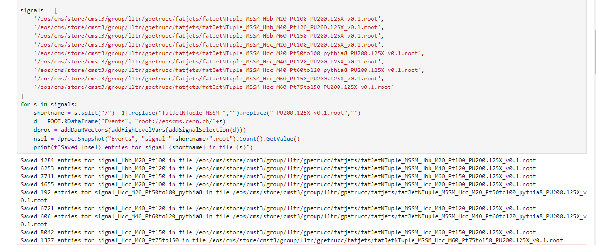
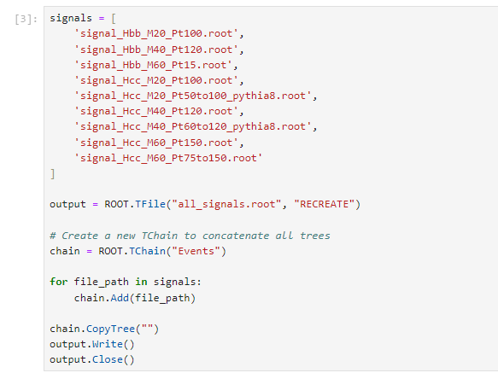
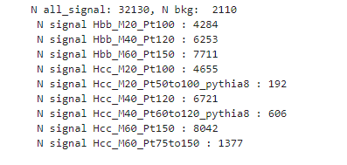
Combining signal files

Slide 5
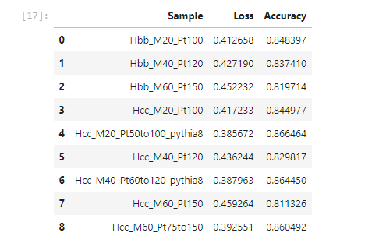
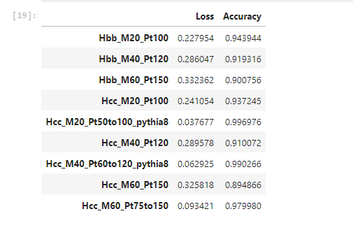
Total vs Individual Signal Comparison
QCD Background: 69,250 hits
Trained on all signals
Tested on individual signals
Trained on Individual signals
Tested on individual signals

Slide 6
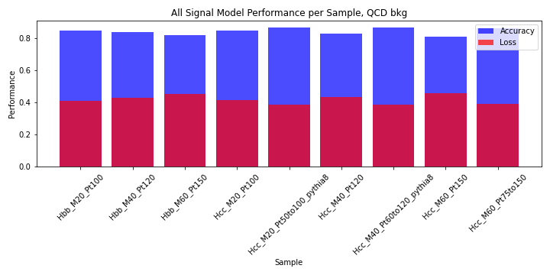
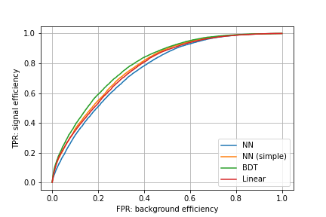
Total vs Individual Signal Comparison
QCD Background: 69,250 hits
Trained on all signals
Tested on individual signals

Slide 7
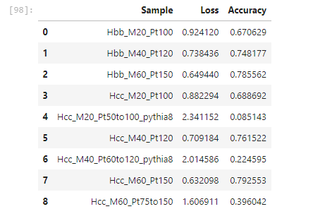
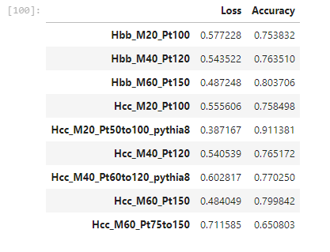
Total vs Individual Signal Comparison
Neutrino Pileup Background: 2,110 hits
Trained on all signals
Tested on individual signals
Trained on Individual signals
Tested on individual signals

Slide 8
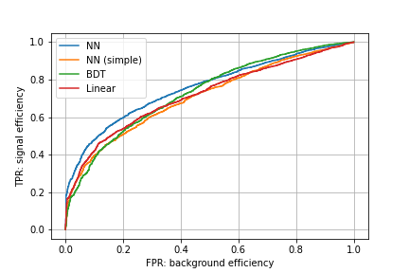
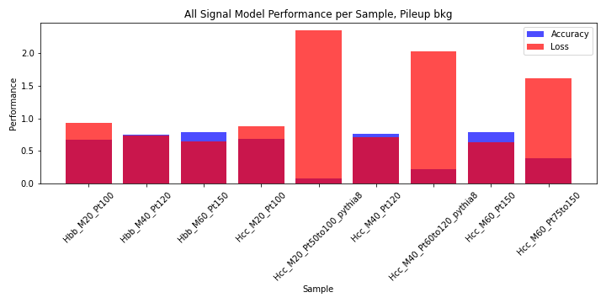
Total vs Individual Signal Comparison
Neutrino Pileup Background: 2,110 hits
Trained on all signals
Tested on individual signals

Slide 9
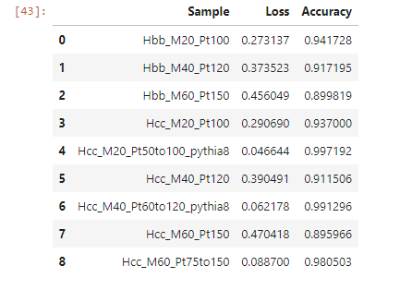
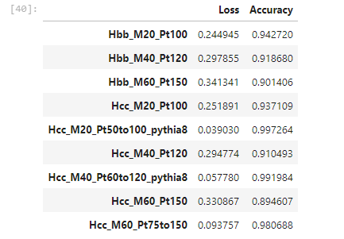
Total vs Individual Signal Comparison – Outlier Run
QCD Background: 69,250 hits
Trained on all signals
Tested on individual signals
Trained on Individual signals
Tested on individual signals

Slide 10
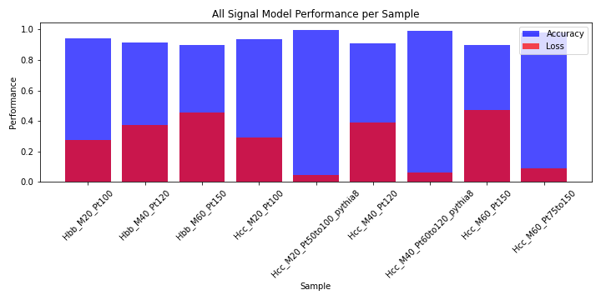
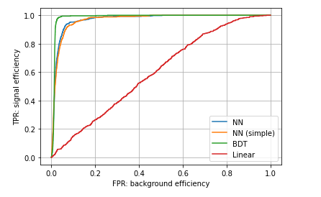
Total vs Individual Signal Comparison – Outlier Run
QCD Background: 69,250 hits
Trained on all signals
Tested on individual signals

Slide 11
Next Steps
Try Deep Sets architecture
Try to replicate outlier run
Add TTBar background to comparisons

