Slide 1
Project Report 7
Investigating Four-Top Production with ATLAS
Dean A. Reiter
Advisor: Nedaa-Alexandra Asbah
May 28, 2024

Slide 2
Status Update
Did more work on hadronic top reconstruction algorithm
Gave presentation to four tops group meeting
Starting to make framework validation plots

Slide 3
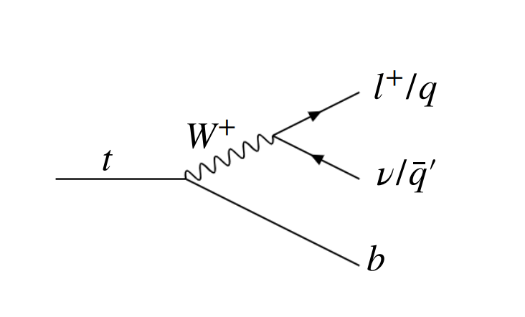
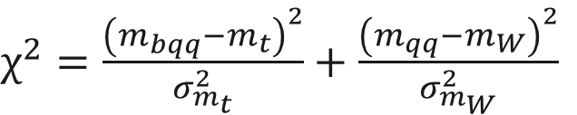
Recap: Hadronic Top Reconstruction
Chi-Squared Method
  Step 1: Find every possible permutation of jets
      Matchings of 1 b-jet and 2 other jets
  Step 2: Compare reconstructed mass of jet triplets to known masses of W boson and top quark
  Step 3: Cut matchings with chi-squared above threshold, select two matchings with the lowest scores
$χ^{2}=\frac{{\left(m_{bqq}−m_{t}\right)}^{2}}{σ_{m_{t}}^{2}}+\frac{{\left(m_{qq}−m_{W}\right)}^{2}}{σ_{m_{W}}^{2}}$
Notes:
The algorithm I am testing to reconstruct hadronic tops is based on a chi-squared method, which I drew from previous ATLAS and CMS papers
There are other more advanced algorithms that use machine learning, such as SPAN-NET, but this is the simplest and most commonly used algorithm I found in my research
This is how the algorithm works
First, we goes through all jets in a final state and lists all possible combinations or matchings of at least 1 b-jet and two other jets
Second, we compute a chi-squared value for every matching. This chi-squared value acts as a score which compares the reconstructed masses of a set of jets to the known masses of the top and W. A set of jets with a lower score is more likely to come from a top
Third, we cut out all combinations above a predefined threshold, and then select the lowest two scoring combinations and assume that they reconstruct a top

Slide 4
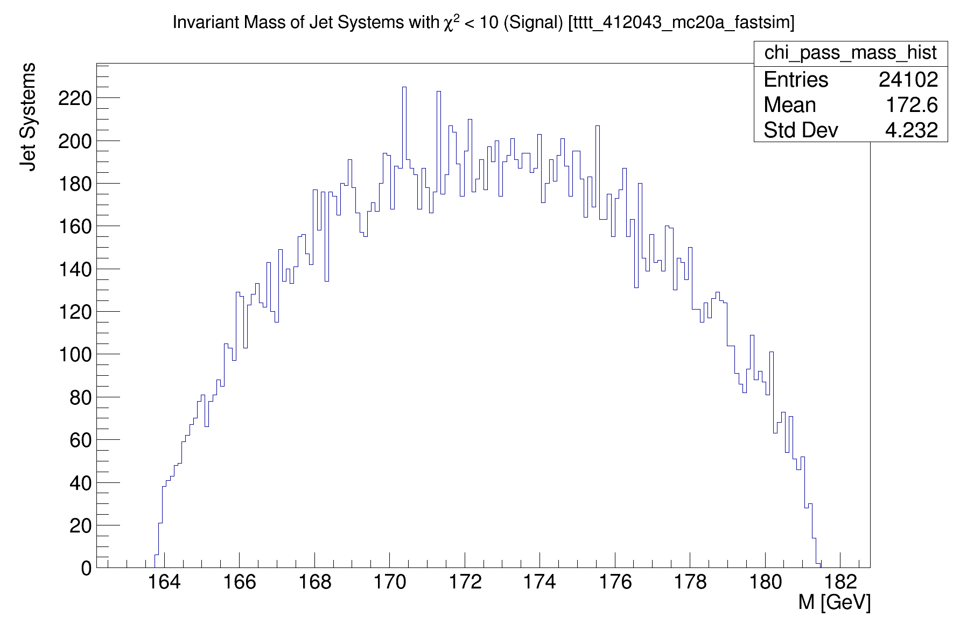
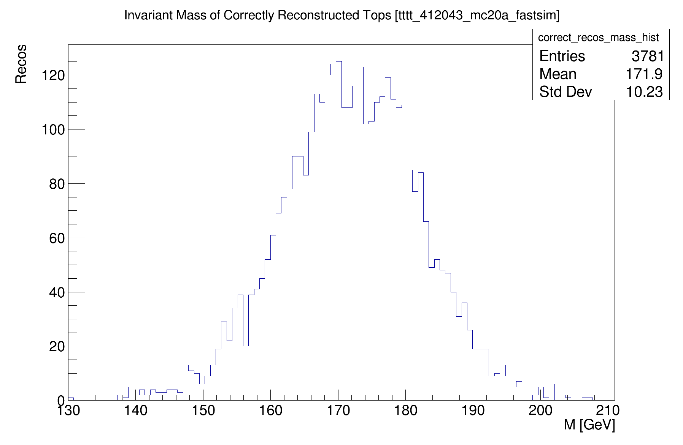
Inaccuracy of Reconstruction Algorithm
Jet Matchings with χ² < 10
Correct Reconstructions
Algorithm produces many false reconstructions and misses tops with outlying masses
Notes:
Another thing I looked at is trying to reconstruct the top quark mass
On the right, I have plotted the mass distribution of the correct, truth-matched reconstructions
And on the left, I have plotted the mass distribution of the reconstructions selected by the algorithm with a chi-squared value less than 10
Because the known top quark mass is used as an input to the chi-squared algorithm and how it makes selections, it is obviously able to reconstruct the correct mass very well
However, as you can see by the number of entries in these histograms, the algorithm produces many potentially false reconstructions which happen to have a combined mass within the top quark range
This just again shows how the algorithm needs to be improved to be more accurate

Slide 5
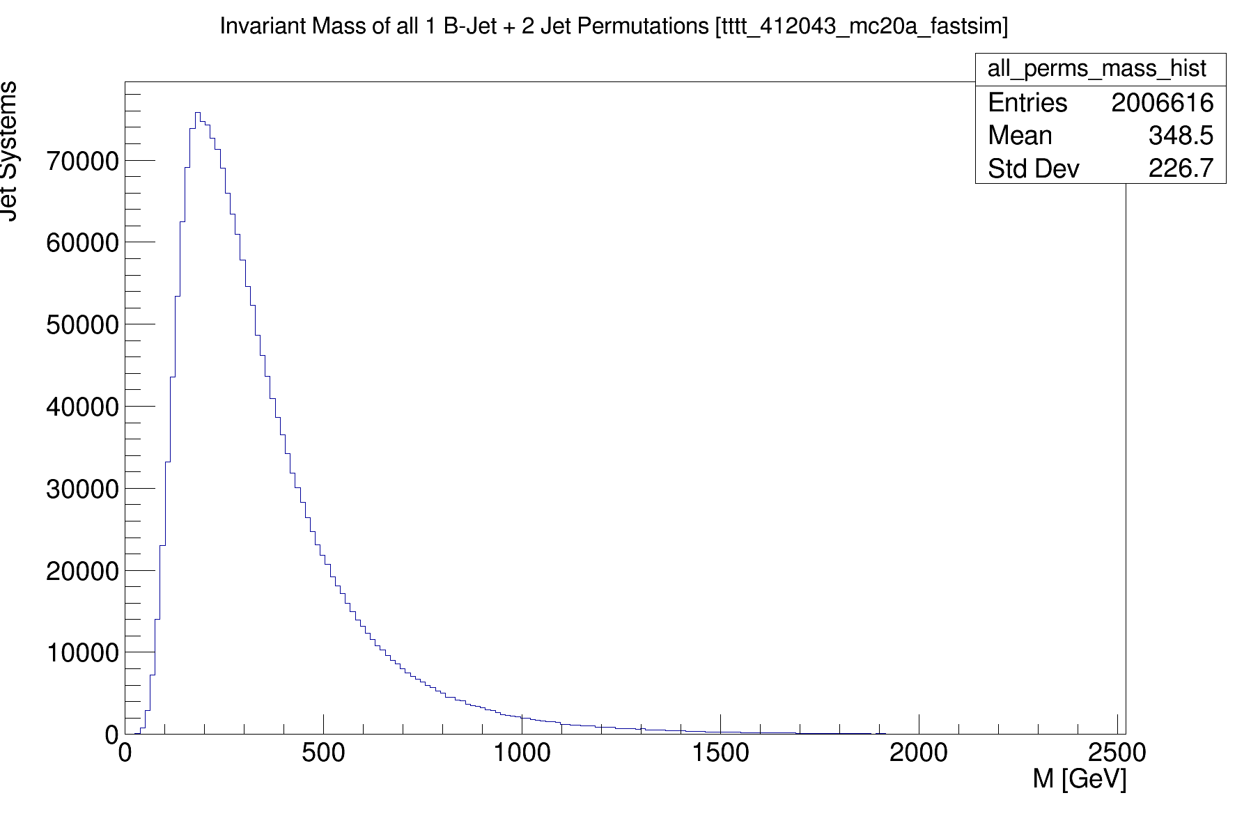
Why?
Mass distribution of all matchings of 1 b-jet and 2 other jets
  (Before chi-squared selection)
Happens to peak around 250 GeV, within the top quark mass range
→ We can expect some incorrect matchings to pass the algorithm
Notes:
Another way of highlighting this issue is by looking at the mass distribution generated by all possible combinations of jets, both the correct and incorrect matchings
As you can see, this distribution happens to peak right within the top quark mass range, so it is unfortunately very likely that a random combination of jets in a final state will happen to have a mass close to that of the top quark

Slide 6
Truth Matching
Since data comes from Monte Carlo, it contains information about the original particles and their decays
This particular dataset was made with a matching efficiency of ~ 10%
  Most jets are not matched, so it is difficult to truly determine accuracy of algorithm

Slide 7
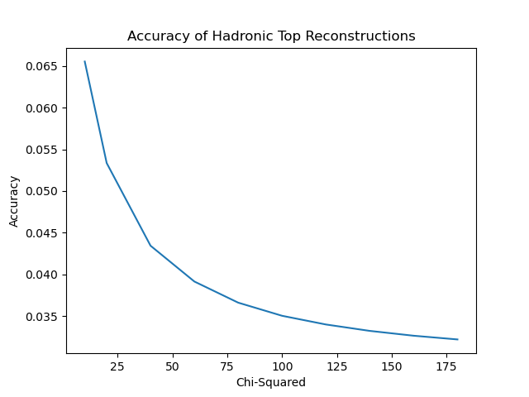
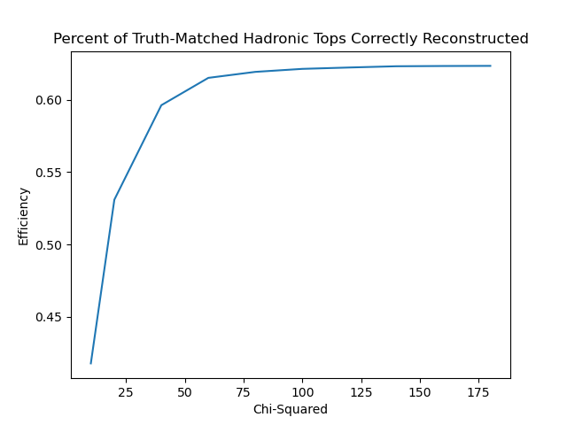
Effectiveness of Chi-Squared Algorithm
Fraction of algorithm recos which can be truth matched
Fraction of truth matched decays correctly reconstructed
Notes:
Today I ran the algorithm with a range of chi-squared selection thresholds (from 10 to 180), and I am trying to determine the optimal cut-off
The algorithm’s reconstructions are most accurate when the chi-squared cut-off is lowest
At best, when we only select jet matchings with a score less than 10, about 6.5 percent of the reconstructions are correct, but it only finds about 40 percent of the truth-matched hadronic top quarks that it could find
When we raise the chi-squared threshold, the algorithm selects more incorrect matchings and so its accuracy decreases, but it is able to find more (up to about 65 percent) of the top quarks that it can find
My analysis here is unfortunately limited by our matching efficiency, however
I do not have the exact number, but based on a back of the notebook calculation I think only about 10 percent of hadronic top decays have truth-matching information
Regardless, the chi-squared algorithm can certainly be improved to reconstruct more tops and more accurately

Slide 8
Improving the Chi-Squared Method
Can the angle (ΔR) between decay products enhance the chi-squared method?
  Add terms for ΔR between two W-boson jets, and between reconstructed W-boson and b-jet
$$χ^{2}=\frac{{\left(m_{bqq}−m_{t}\right)}^{2}}{σ_{m_{t}}^{2}}+\frac{{\left(m_{qq}−m_{W}\right)}^{2}}{σ_{m_{W}}^{2}}+\frac{{\left({{ΔR}_{qq}}^{reco}−{ΔR}_{qq}\right)}^{2}}{σ_{{ΔR}_{qq}}^{2}}+\frac{{\left({{ΔR}_{bW}}^{reco}−{ΔR}_{bW}\right)}^{2}}{σ_{{ΔR}_{bW}}^{2}}$$
Work in progress: Need to modify these terms to score the closeness of ΔR values to skewed distributions
Notes:
One way I might be able to improve this algorithm is by adding additional terms to the chi-squared formula to take into account the angle between the jets in a particular matching
Assuming that there is a clear unimodal distribution in the angle between the top quark decay’s W boson and b-jet, and in the angle between the two jets which decay from the W, then I should be able to score how closely the angles between jets in any particular matching compare to a known mean or median
So far what I have done, is I plotted these delta R distributions using the truth matched data in my sample, just to see if clear modal distributions exist

Slide 9
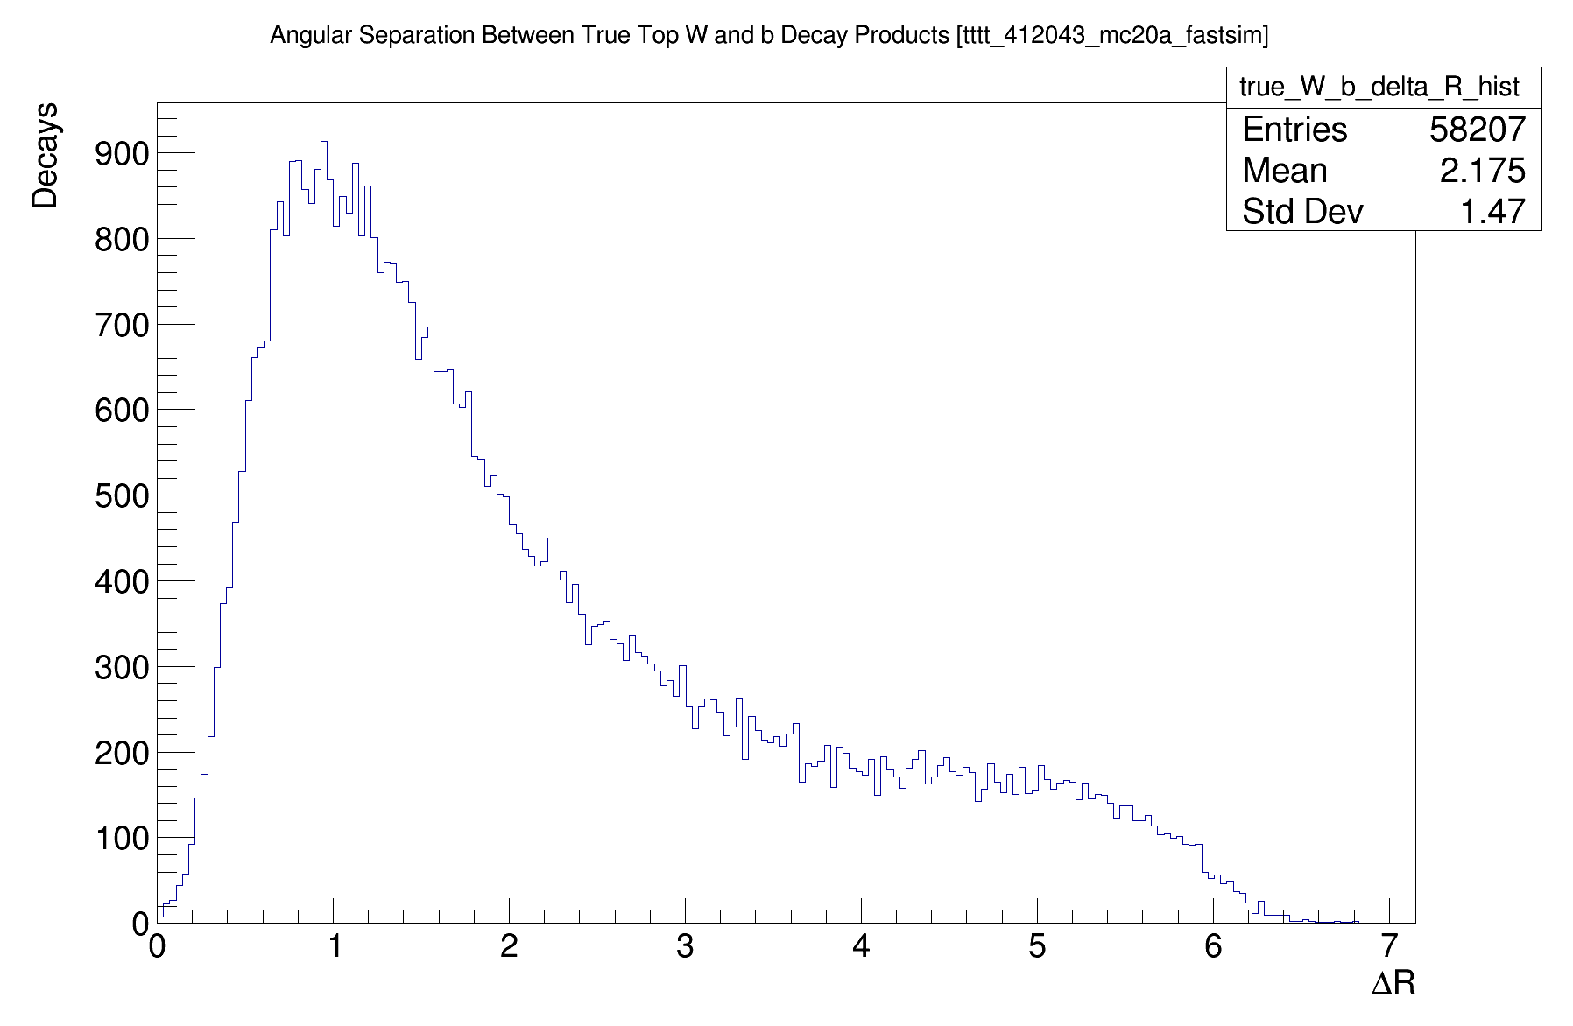
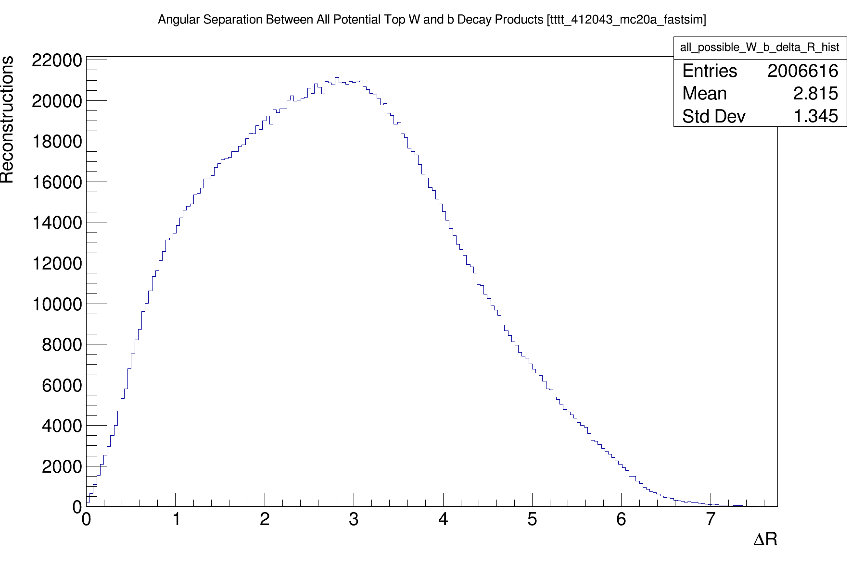
ΔR Between W and b
Truth Kinematics
All Tested Jet Matchings
Notes:
Here on the left is the distribution of delta R between a top quark’s W boson and b jet, and you can see a clear peak around 1
The distribution is skewed rather than normal, however, (so I will need to modify the terms in the chi-squared formula to compare against the mode rather than the mean)
On the right is the distribution of delta R’s which is generated from all possible jet matchings, both the correct and incorrect matchings
As you can see, these distributions are quite different, so this delta R will definitely be useful to help discriminate correct form incorrect matchings

Slide 10
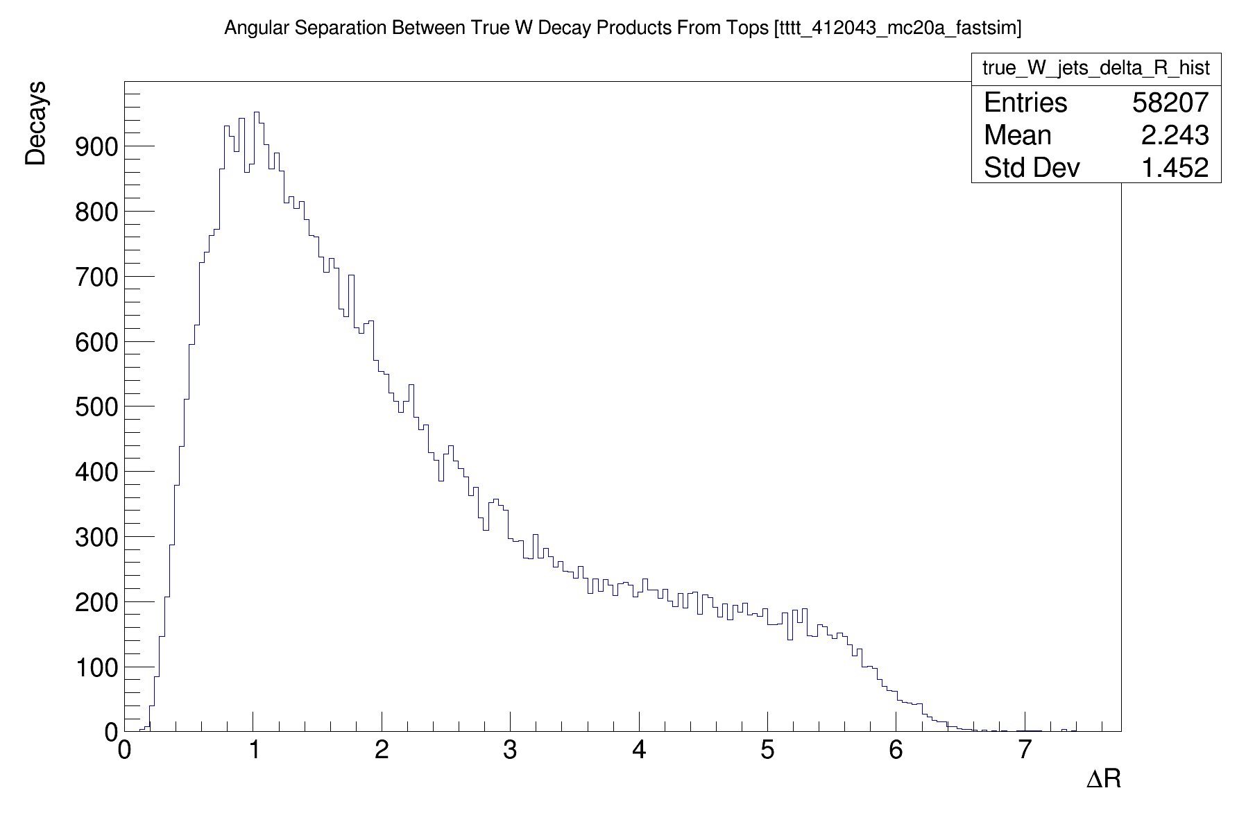
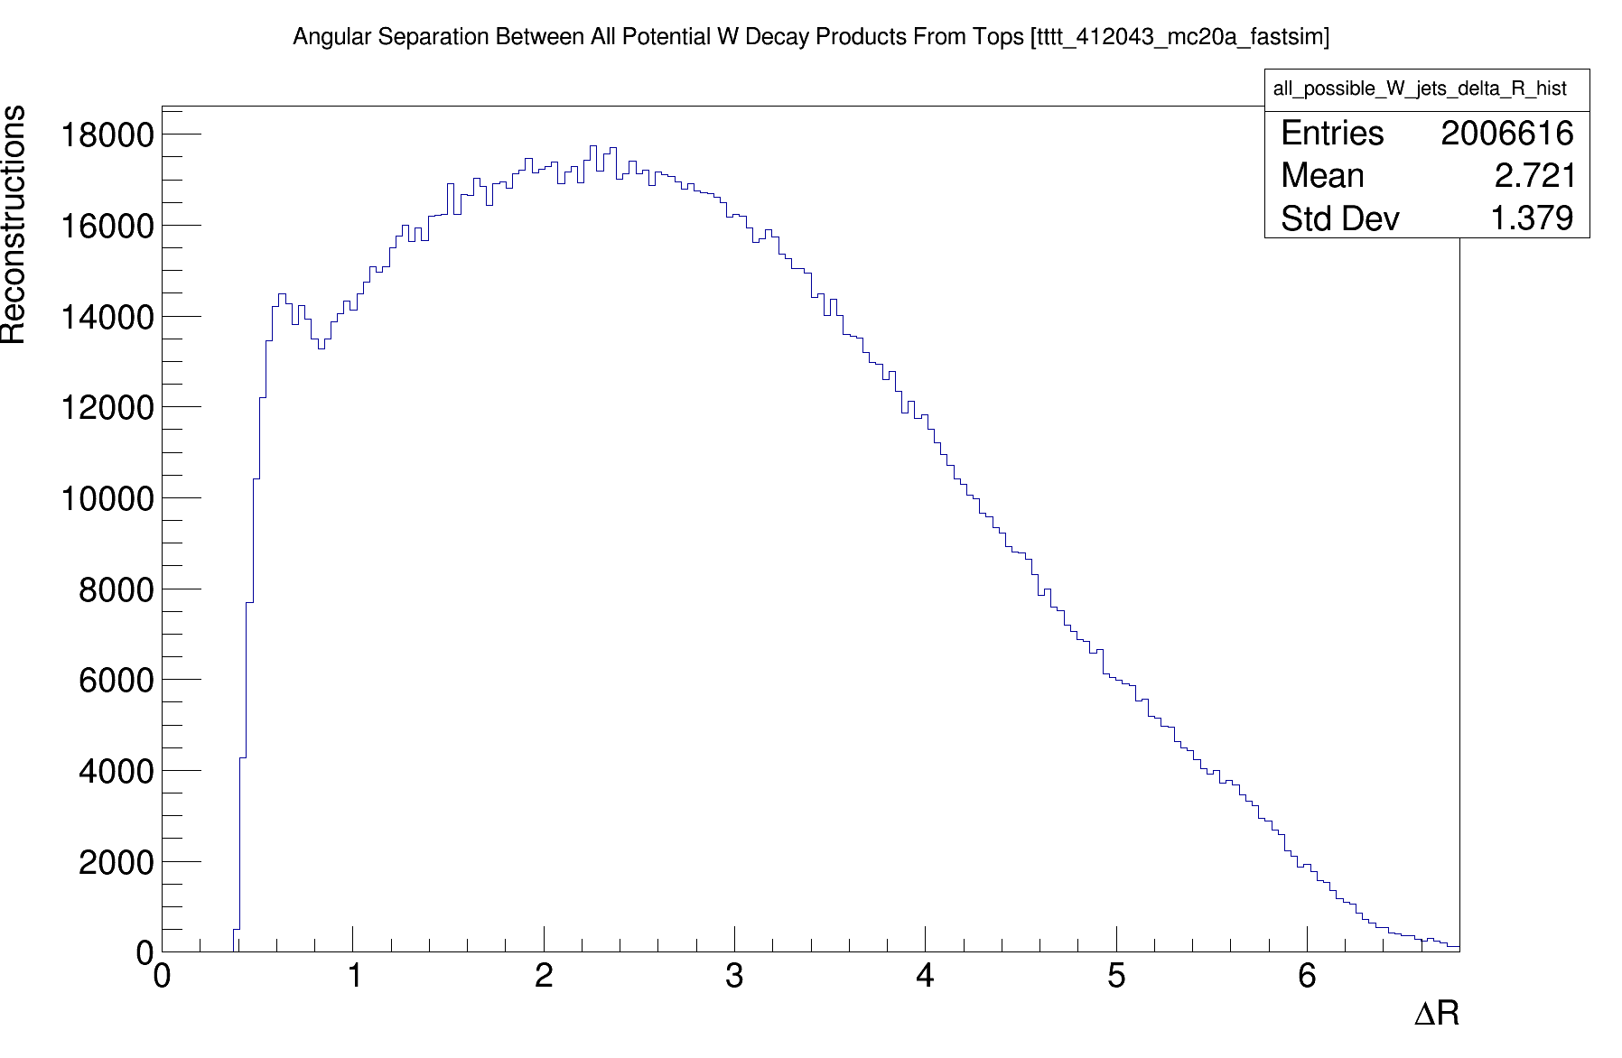
ΔR Between W jets
Truth Kinematics
All Tested Jet Matchings
Notes:
And the story is very similar for the delta R between the two jets which decay from the W

Slide 11
Next Steps
Hadronic top reconstruction algorithm
  Try adding ΔR terms to chi-squared calculation
  Optimize chi-squared cut-off for best accuracy
  Look at computational efficiency
  Compare results to ML algorithms (e.g. SPAN-NET)
  Test on realistic dataset
Research leptonic top reconstruction
Speak with others working on four top reconstruction
Notes:
My next steps are
First to incorporate the angle between jets into the chi-squared scoring method
Then optimize the algorithm to make it as accurate and reconstruct as many tops as possible
Then I would like to quantify the computation time of running this algorithm and reduce it if I can
After optimizing this algorithm to the best of my ability, I would like to also experiment with using machine learning algorithms such as SPAN-NET, which has been previously tested on reconstructing the four tops all jets channel
I would like to compare these algorithms against each other, test them on more realistic datasets which include backgrounds
And then I will start looking into leptonic tops, which will be much more difficult
Thank you!
I know that there are some other people working on four tops reconstruction, so if anyone would like to share ideas or feedback, please let me know!

Slide 12
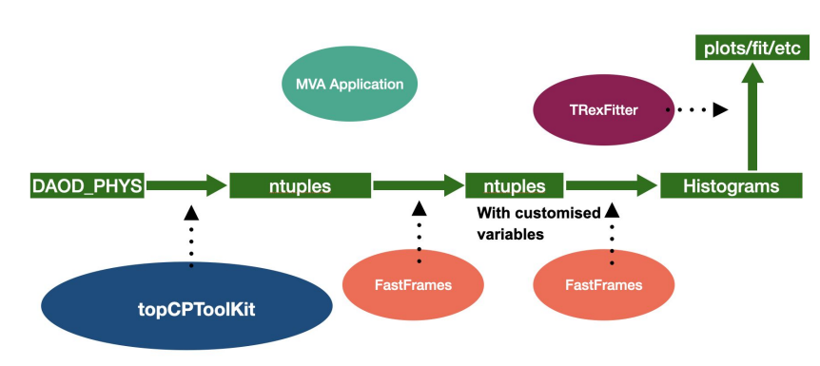
Recap: Analysis Framework
Data analysis pipeline has multiple stages
FastFrames code computes custom kinematic variables

Slide 13
Framework Validation
New n-tuple processing framework (TopCPToolkit) must be compared to old framework (AnalysisTop)
Validated by comparing with processed MC data, real data, and data to MC plots
  The variables we are looking at are nJets and hT
Data is separated into different regions: Signal, control, validation
MC data is separated by physical processes (tt, ttW, tttt, etc)

Slide 14
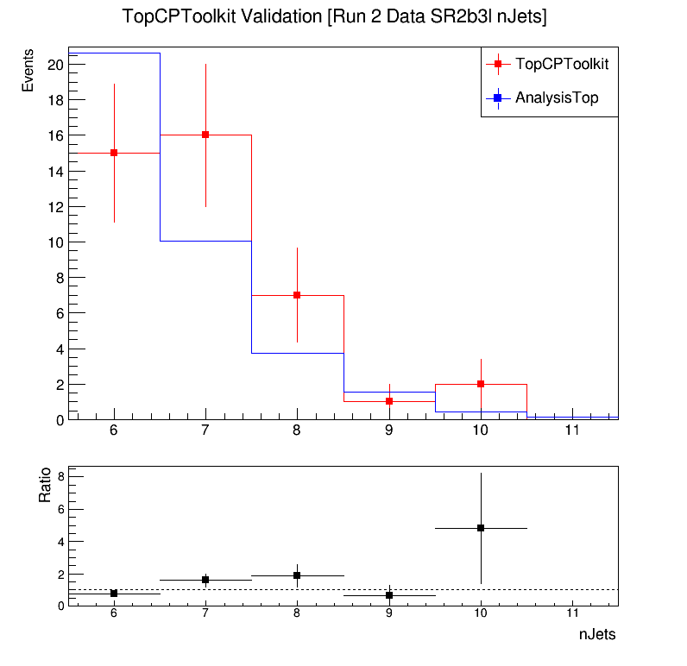
Data validation plots
Lower pad shows ratio between two histograms
Need to use ATLAS formatting
Challenges figuring out how data files are structured
  The AnalysisTop data here is from incorrect file
  Also Rongqian made updates

Slide 15
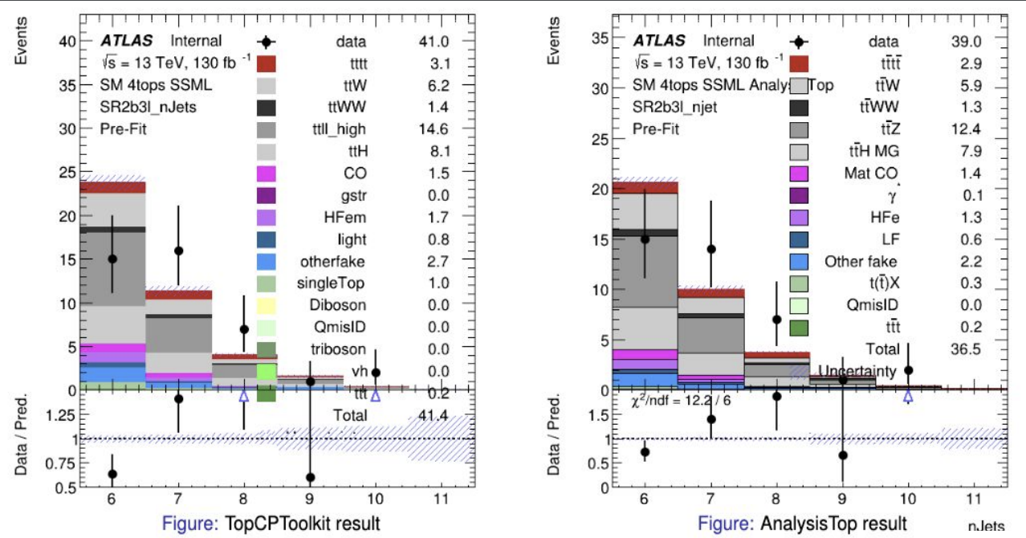
Monte Carlo Validation Plots
Source: Rongqian Qian

Slide 16
Next Steps
Make data-to-data plots for signal and validation regions
  Make plots for control region once bug is fixed
Help Make data to MC comparison plots (maybe)
  Learn TRexFitter

Slide 17
Questions?

Slide 18
Backup Slides

Slide 19
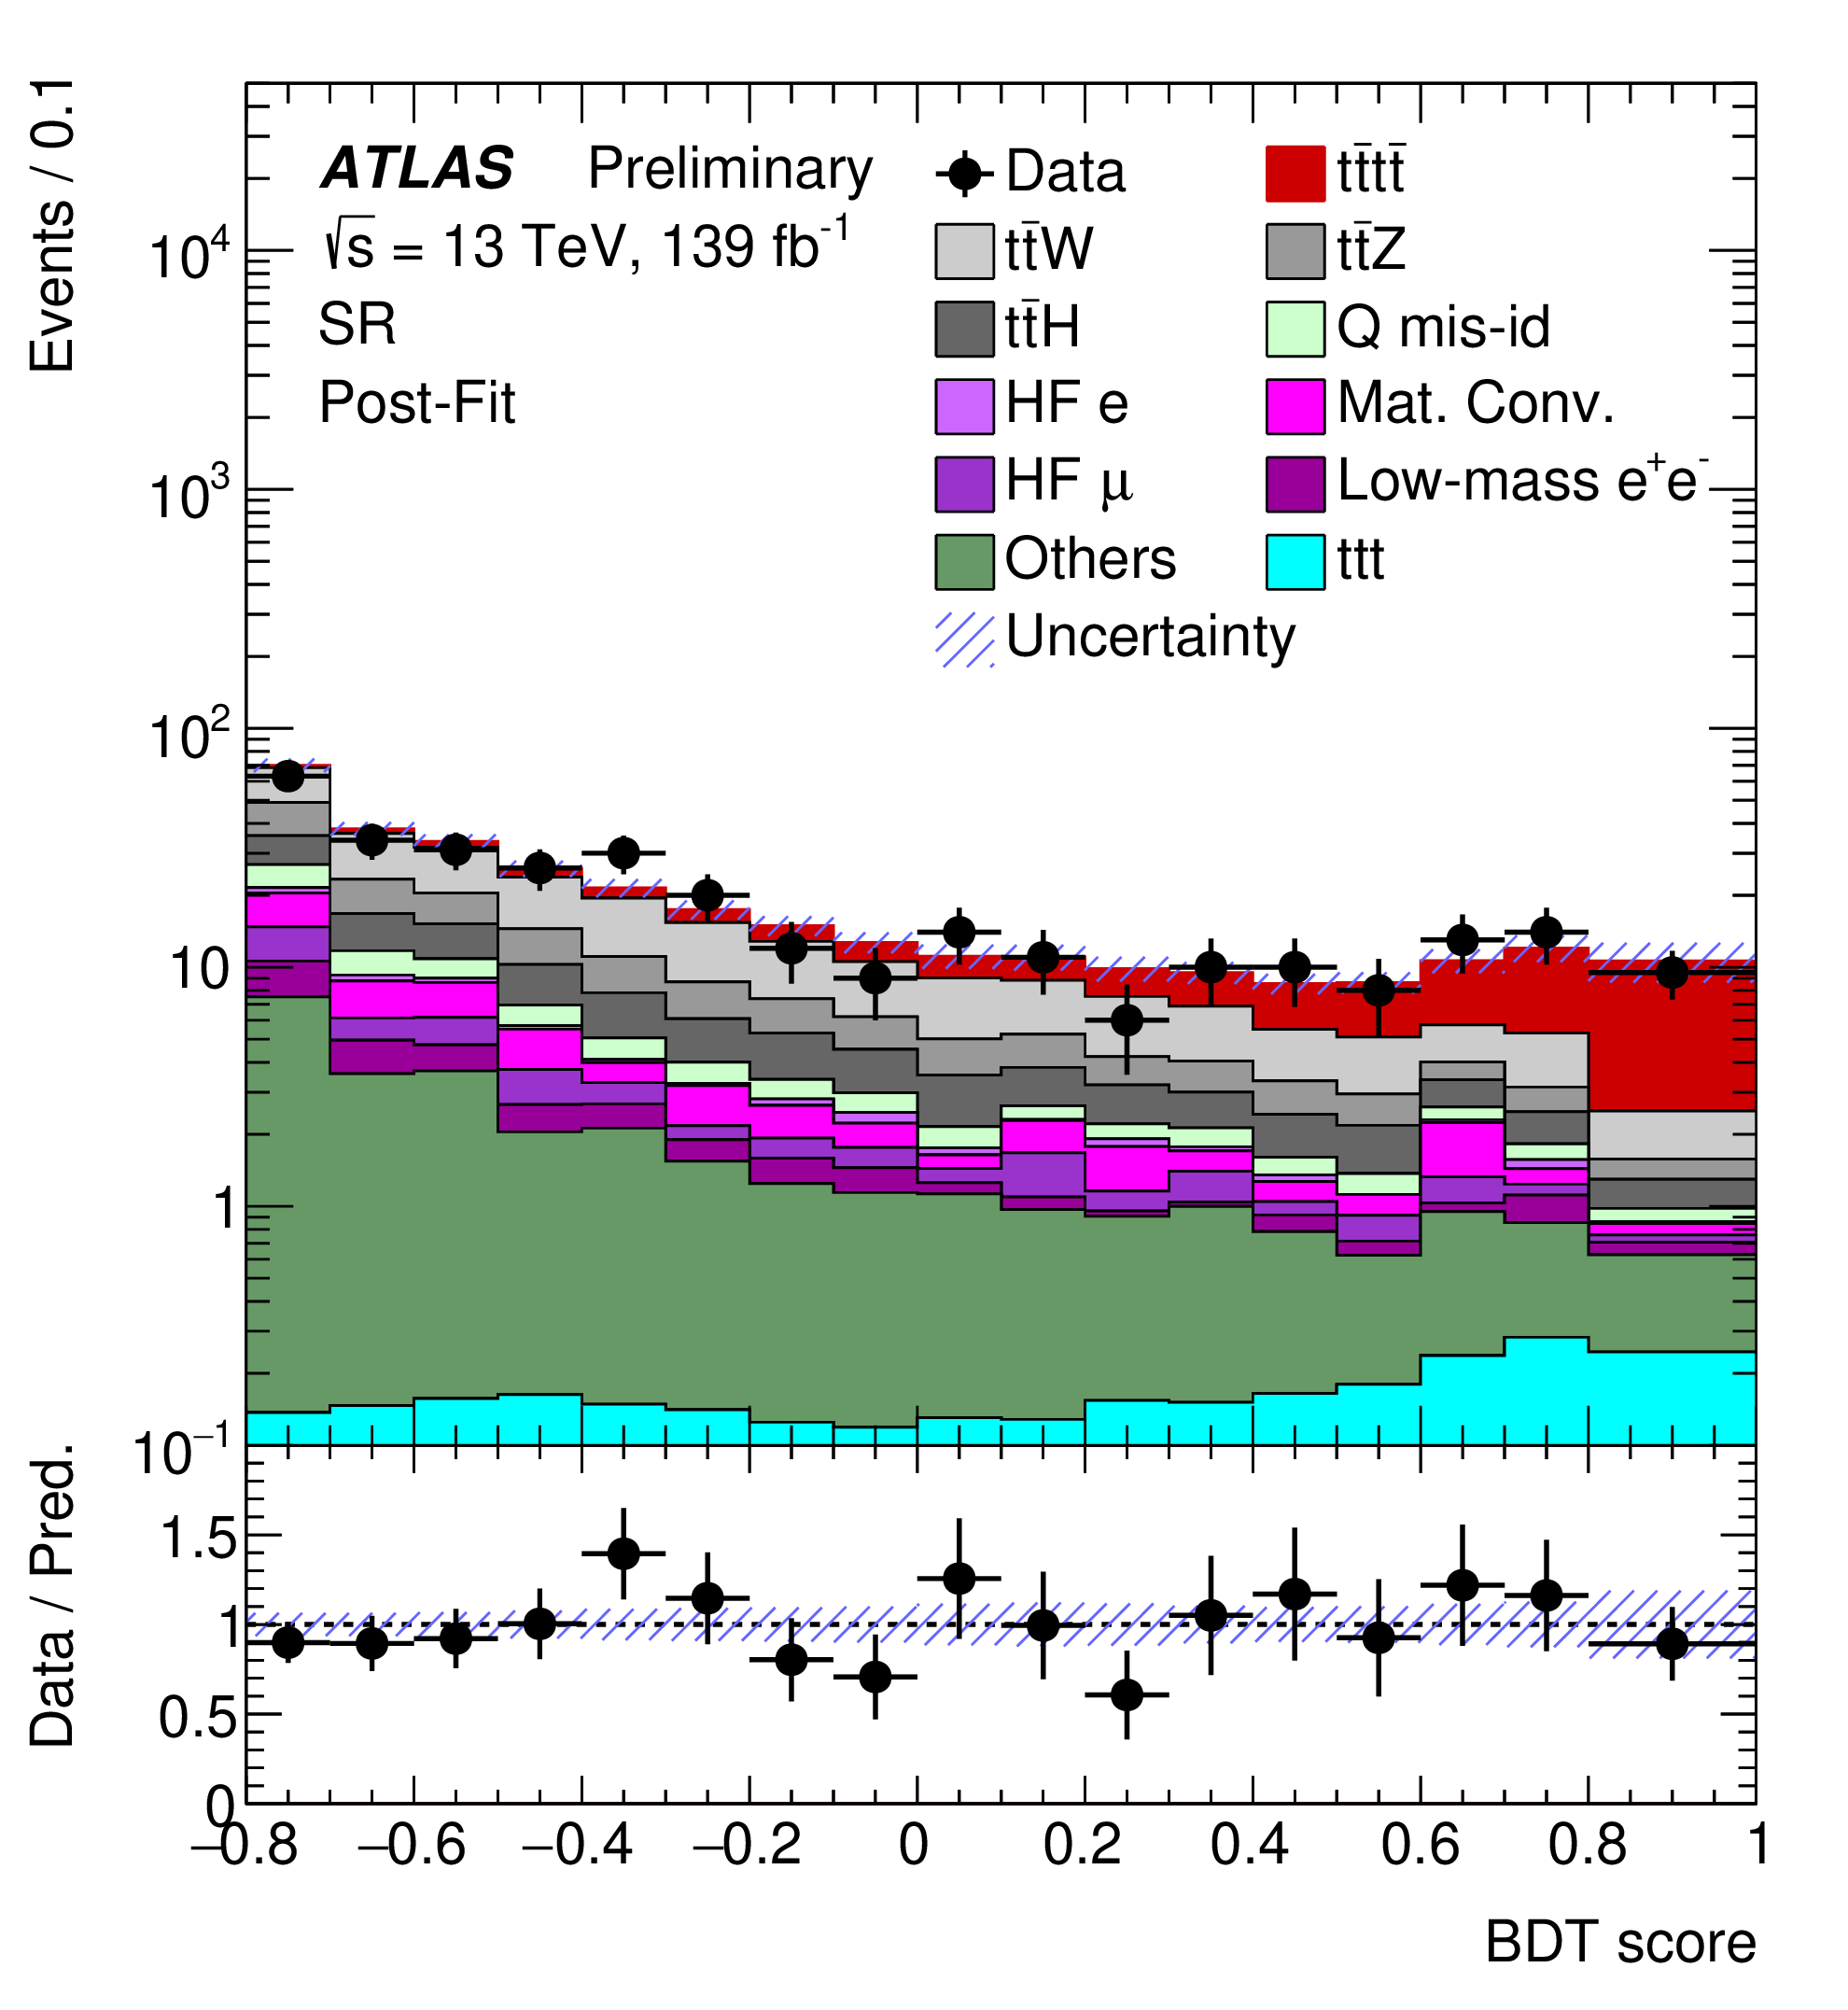
Past Observation of 4 Tops
2020/2023 Papers
Used Run 2 Data @13 TeV
Observed 4 Tops with ~ 6 sigma
Now looking at Run 3 Data @13.6 TeV
Need to update analysis framework and code
  Also helps prepare for HL-LHC

Slide 20
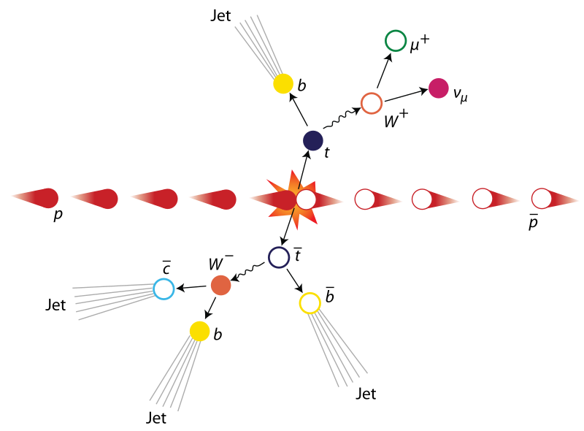

Example: $t\overline{t}$ Production

Slide 21
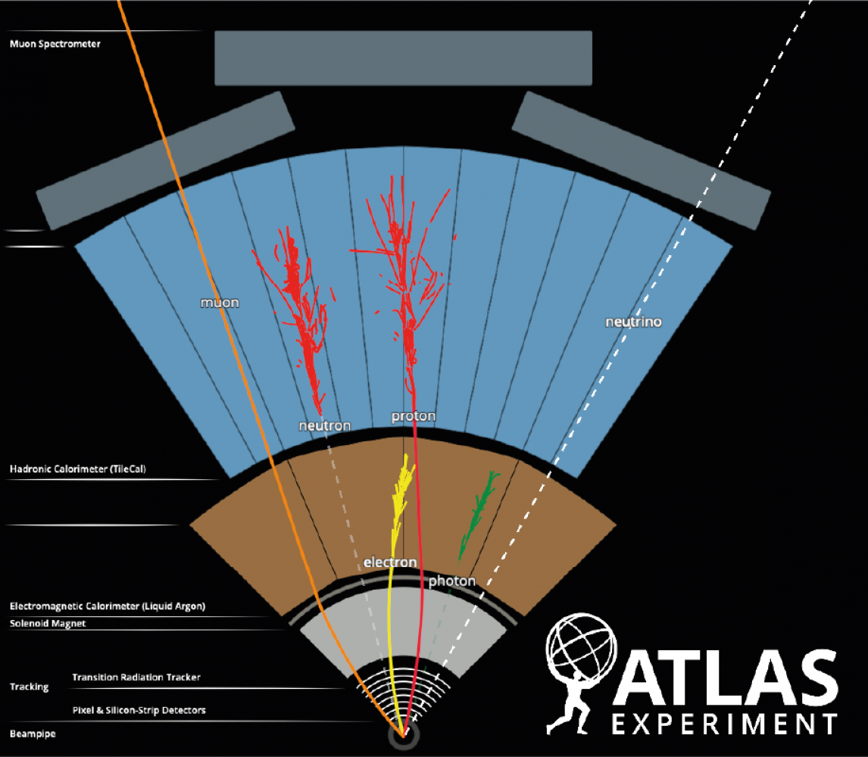
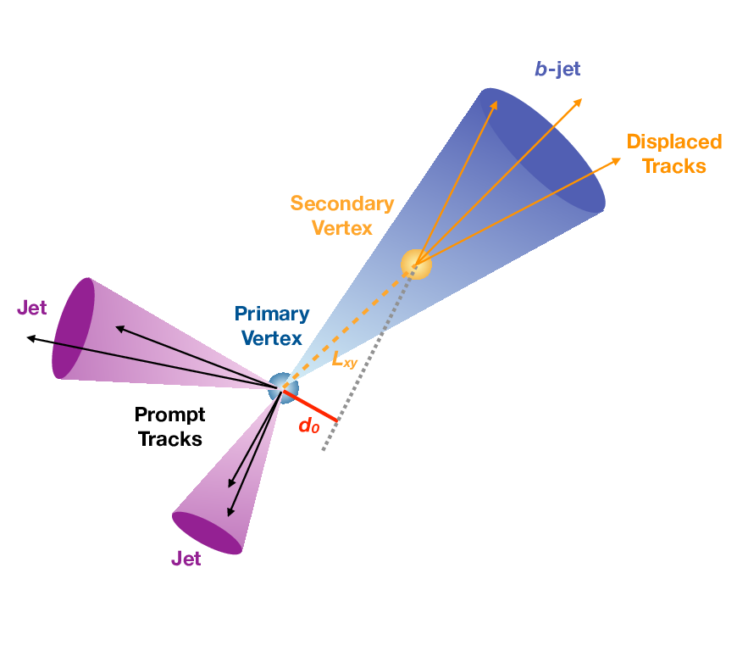
B-Jet Tagging vs Leptons

Slide 22
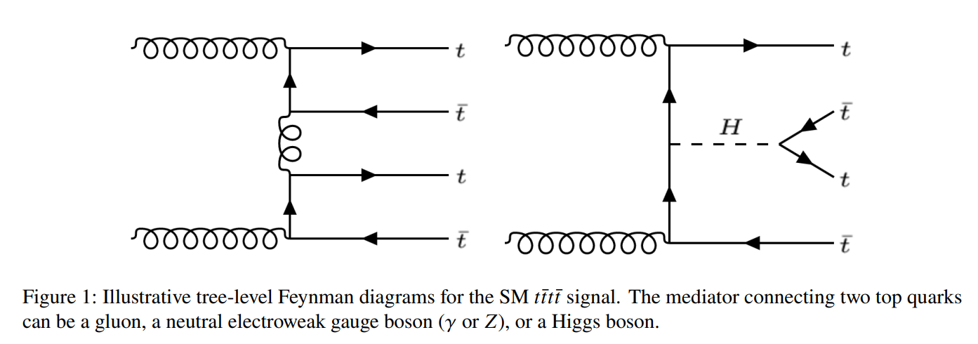
Four Tops

Slide 23
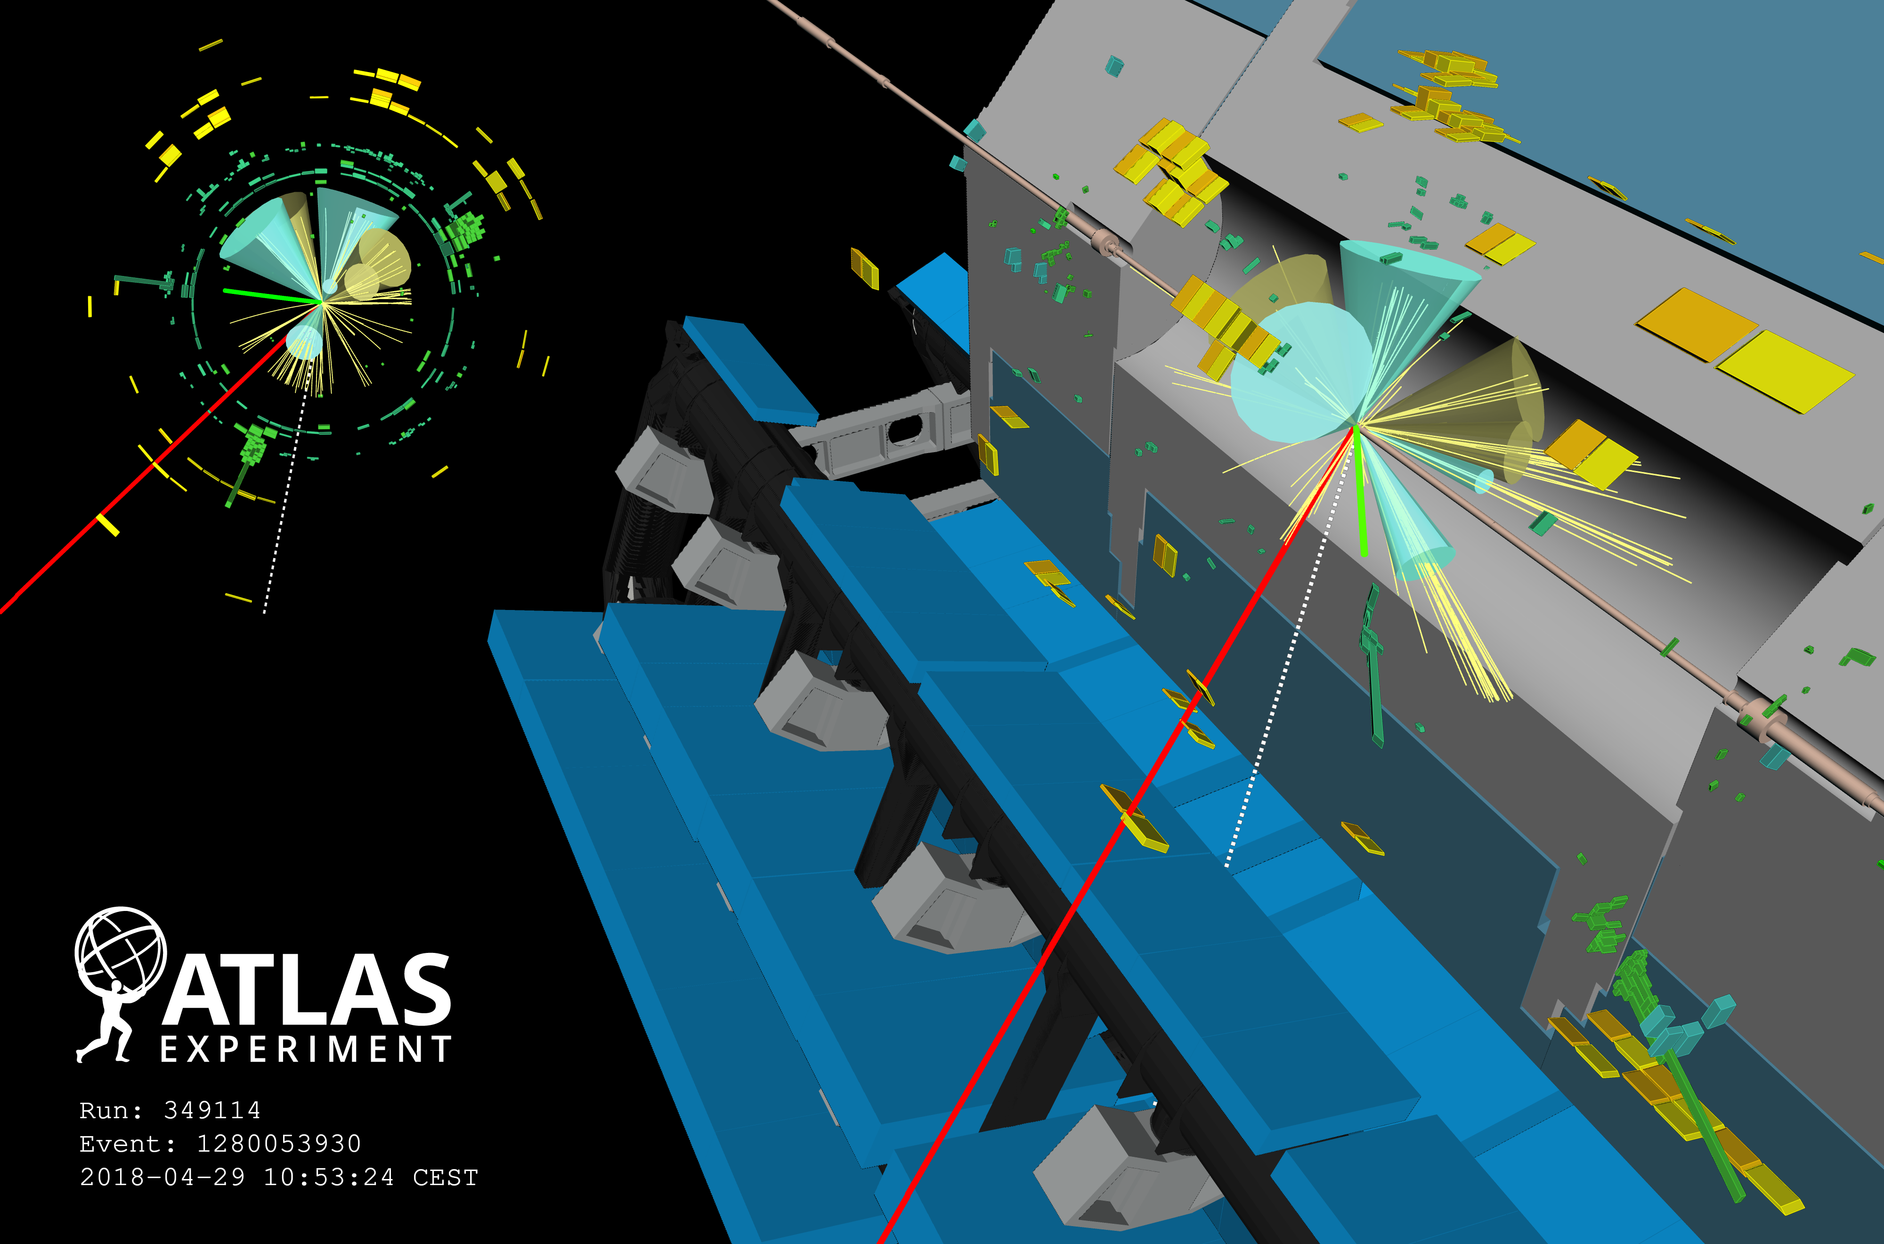
Notes:
Four-top candidate from 2018. Event display of a candidate four-top-quark event (Run 349114, Event 1280053930) with seven jets (four of them are b-tagged); two of the top quarks decay leptonically (one with a resulting muon, shown in red, and one with an electron, shown in green), and two top quarks decay hadronically. Green rectangles correspond to energy deposits in cells of the electromagnetic calorimeter, while yellow rectangles correspond to energy deposits in cells of the hadron calorimeter. The jets (b-tagged jets) are shown as yellow (blue) cones. The direction of the missing transverse momentum is indicated by a dotted line.

Slide 24
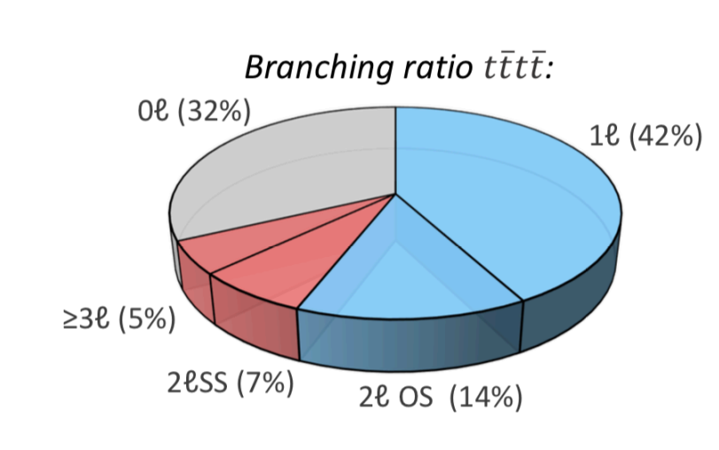
Branching ratios
Most 4 Tops decay into all hadrons
2 and 3 lepton channels (3l, 2lss) are cleanest

Slide 25
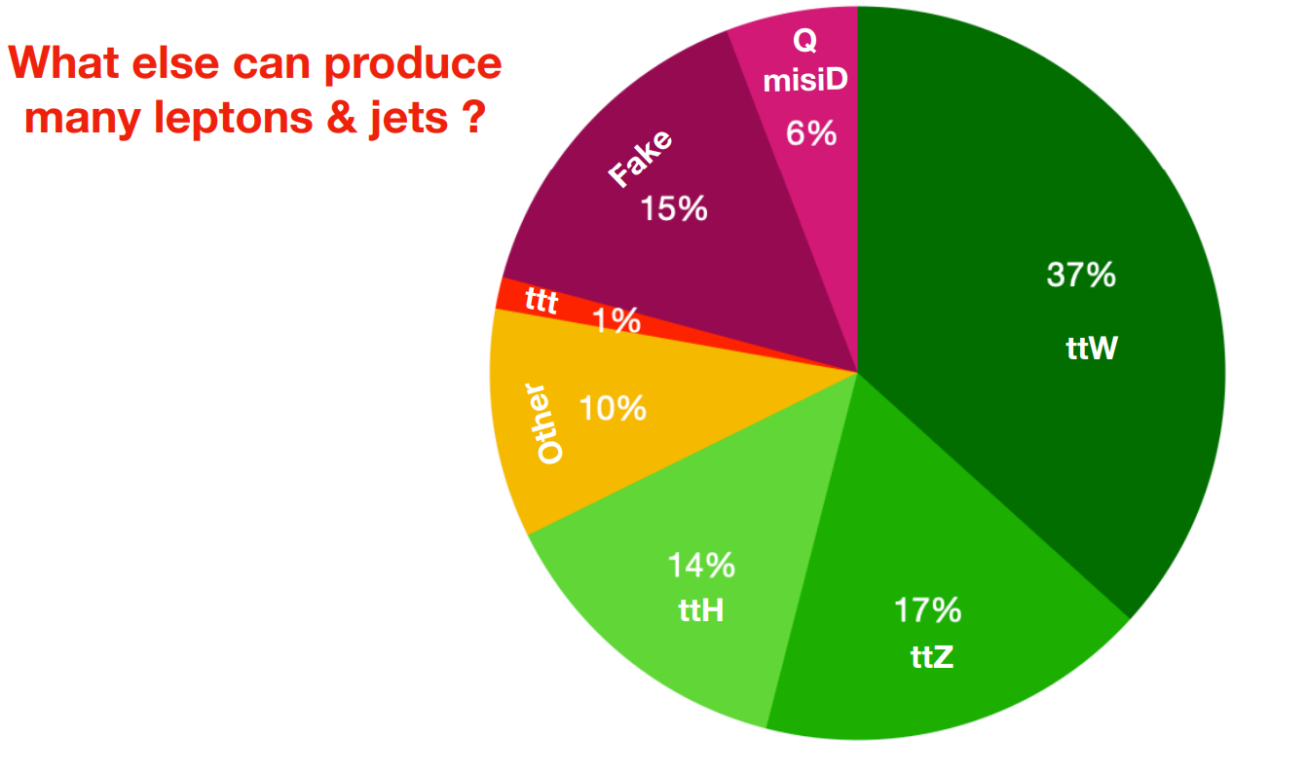
Backgrounds

Slide 26
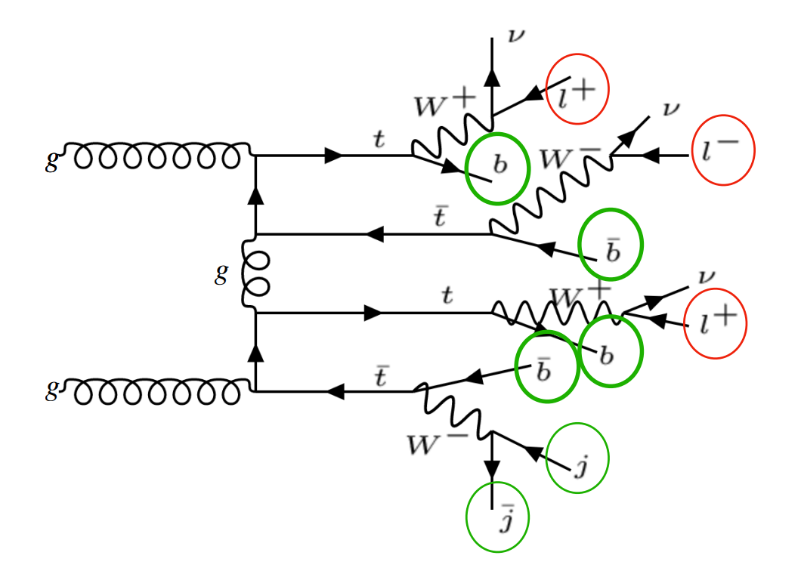
Example of 3L Channel Signal

Slide 27
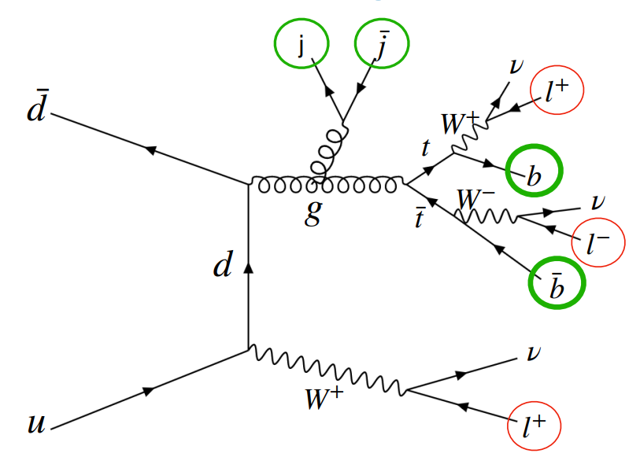
Example of 3L Background

Slide 28
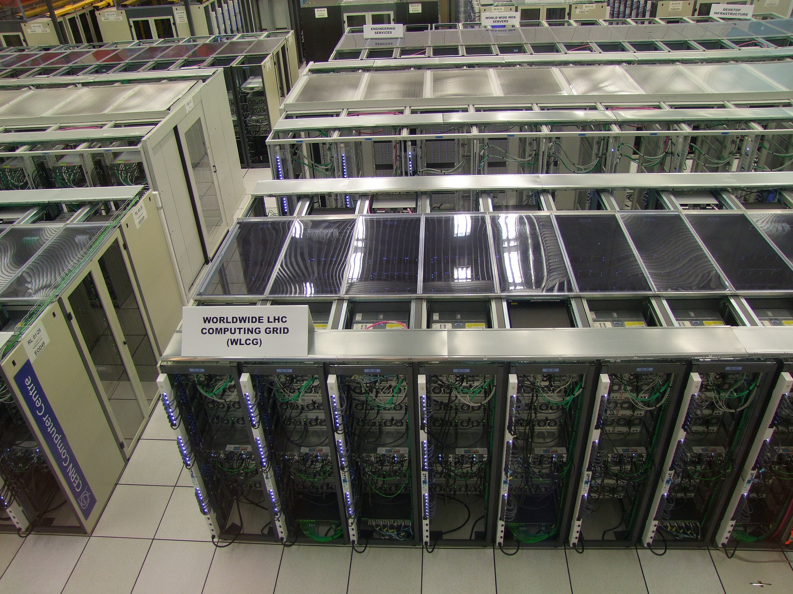
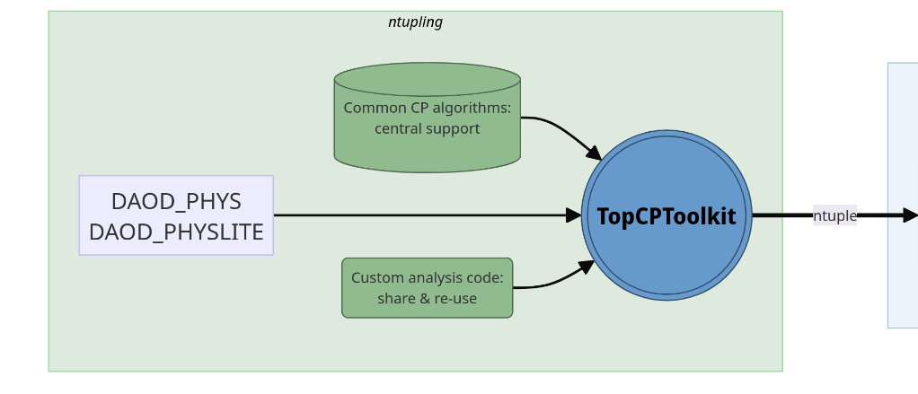
N-tuple Production
TopCPToolkit is n-tuple production framework written for all top quark related analyses
Practice submitting jobs to the Grid
Notes:
The Grid is CERN’s computer network

Slide 29
Recap: Analysis Framework
Data analysis pipeline has multiple stages
FastFrames code computes custom kinematic variables

Slide 30
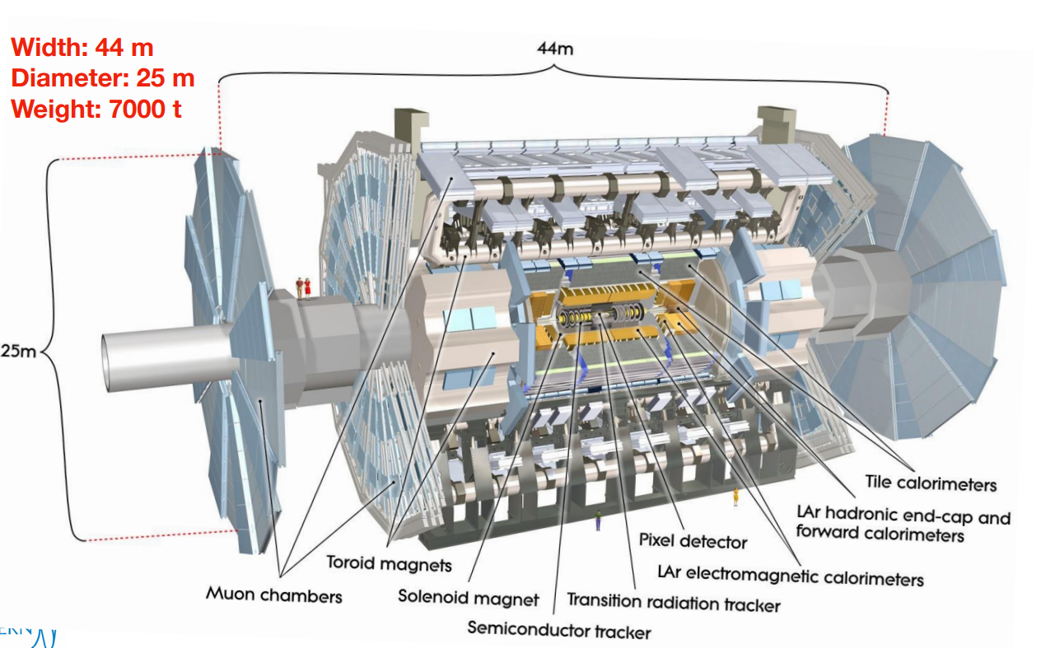
ATLAS Detector

Slide 31
Recap: Top Quark Reconstruction
You can reconstruct a top quark by finding its decay products
Gives us more kinematic information to separate signal from background
  More input for multivariate analysis algorithm
Need to study whether this is feasible, effective

Slide 32
Recap: Top Quark Decay
Top quark decay is hadronic or leptonic
Hadronic
  3 jets (at least 1 b-jet)
Leptonic
  1 b-jet
  1 lepton (electron, muon, tau)
  1 neutrino

Slide 33
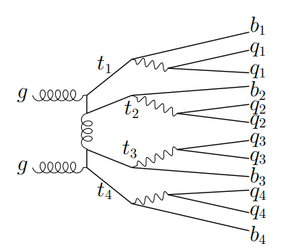
Recap: Four Tops
Much more complex topologies
Most 4 tops decay into all hadrons
2 and 3 lepton channels (3L, 2LSS) are cleanest
Ex: All hadronic (0L) channel

Slide 34

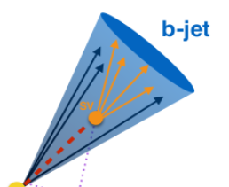
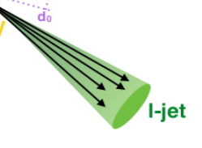



“Set Assignment Problem”
p_{T}^{miss}
Ex: 3-lepton (3L) channel

Slide 35
What are our final states?
2-Lepton Same Sign (2LSS)
3-Lepton (3L)
2 hadronic tops
2 leptonic tops
Final State
  2 Leptons (same charge)
  8 Jets
      At least 4 b-jets
  Missing energy
      2 neutrinos
1 hadronic top
3 leptonic tops
Final State
  3 Leptons
  6 Jets
      At least 4 b-jets
  Missing energy
      3 neutrinos

Slide 36
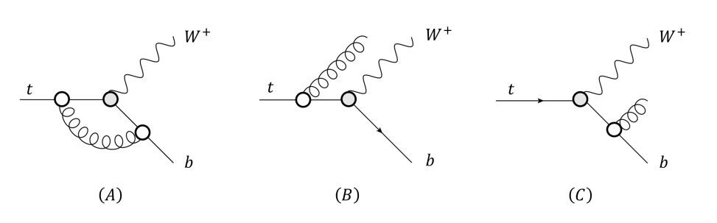
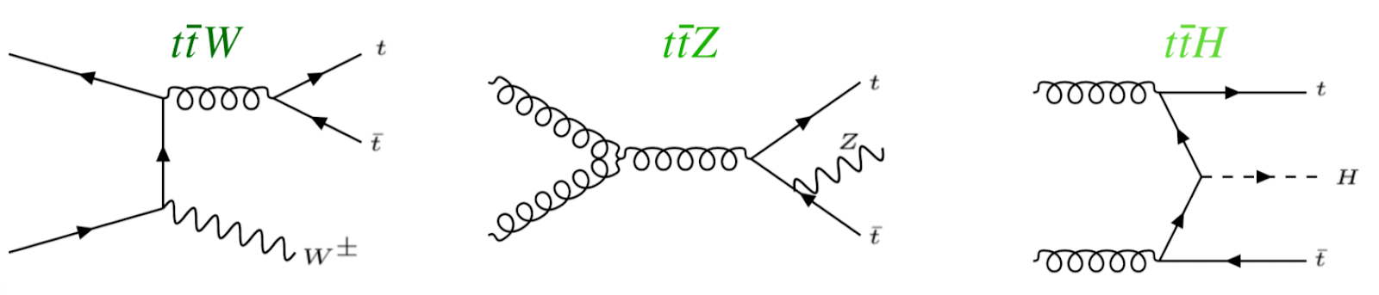
What are our backgrounds?
Largest backgrounds are ttW, ttZ, ttH
Can look like four tops signal
  Possibility of gluon splitting

Slide 37
Hadronic Top Reconstruction, cont.
Kinematic Fitting
  KLFitter: https://doi.org/10.1016/j.nima.2014.02.029 (semi-leptonic tt)
Boosted Decision Trees
Deep Neural Networks
  https://arxiv.org/abs/1907.11181 (semi-leptonic tt)
Graph Neural Networks
  Briefly investigated in 2023 ATLAS four tops observation study
  Did not manage to increase sensitivity over background
  https://cds.cern.ch/record/2765538/files/ATL-COM-PHYS-2021-195.pdf
Other: SPA-NET
  Attention based network which preserves physical symmetries
  20% improved efficiency over chi-squared method
  Was able to reconstruct 0L tttt events
  https://arxiv.org/abs/2106.03898

Slide 38
Leptonic Top Reconstruction
Mass reconstruction is non-trivial
  System is kinematically unconstrained
  Missing transverse momentum is the sum from 2+ neutrinos
  Cannot determine momenta of individual neutrinos
Possible solutions (constraining m_{t} and m_{W})
      https://pdg.lbl.gov/2019/reviews/rpp2019-rev-top-quark.pdf
  Analytic solutions
  Neutrino weighting methods
      https://arxiv.org/abs/hep-ex/9808029
  Neutrino reconstruction with deep neural networks (2023)
      https://arxiv.org/abs/2307.02405
      Can recover full neutrino momenta in multi-neutrino final states

Slide 39
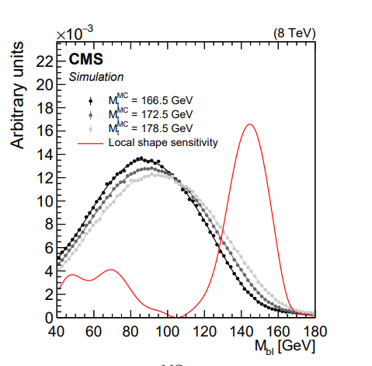
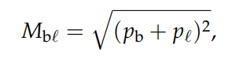
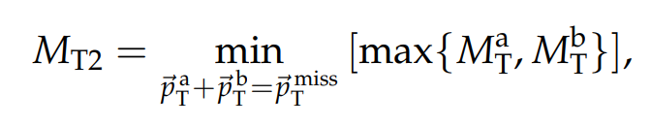
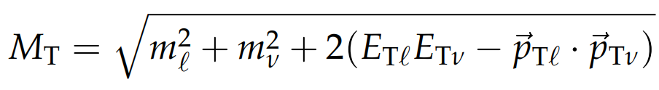
Leptonic Top Reconstruction, cont.
Other observables sensitive to top quark mass
  Invariant mass of bottom jet and lepton system is theoretically limited by top quark mass
  Other transverse-mass-like variables
  Maybe can be fitted to known distributions to reconstruct leptonic tops? Maybe can be used as discriminating variables
https://arxiv.org/abs/1704.06142

Slide 40
Recap: Initial Tests
Writing scripts with Python and pyROOT
Using simulated sample (tttt_412043_mc20a_fastsim)
  Every event contains the decay of four top quarks
  Data is from Monte Carlo and contains truth data
Goals
  Proof of concept – how does algorithm work
  Determine accuracy and efficiency
Notes:
For my initial tests of this chi-squared algorithm, I am testing on a simulated four tops dataset, where every event in the ntuple contains the decay of four tops
The goals of my initial tests are firstly to see how it works, and secondly to determine how accurate and efficient this algorithm is and how it can optimized

Slide 41
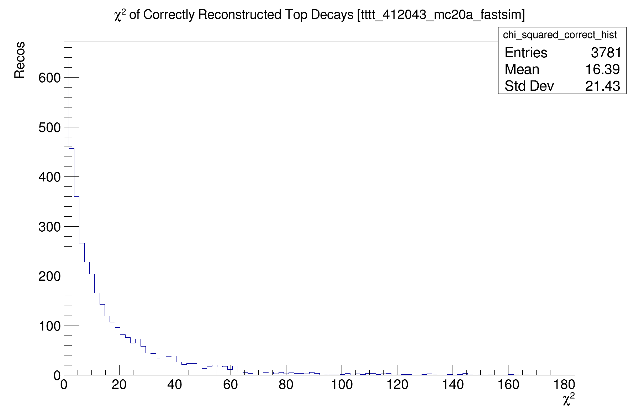
What is a good chi-squared?
Chi-squared values of jet triplets that correctly reconstruct top quarks
  Using b and W parton truth kinematics
Most top quark decay products have chi-squared < 40
Work in progress: Finding optimal cut-off between 0 and 200
Notes:
The first thing I wanted to determine was what might be a good chi-squared value for a particular matching of jets
Here I have plotted the computed chi-squared values for all correctly reconstructed and truth-matched top decays
As you can see, most correct matchings should have a chi-squared value under 40, but some score as high as 180

Slide 42
“Set Assignment Problem”
Leptonic Tops
p_{T}^{miss}
Hadronic Tops
Ex: 3-lepton (3L) channel
Neutrinos
Notes:
The basic challenge of reconstructing four top quarks is this so called “set assignment problem”
Where we have a large number of jets, leptons, etc in our final state, and we have to match them to individual decay products
There are many possible combinations or matchings of jets and leptons, but only one is correct
Note that for my purposes, I am assuming that only the simplest decay modes are taking place – no gluon fusion, or any other higher order effects

Slide 43
Trying to Reconstructing the Top Quark Mass
Jet Matchings with χ² < 10
Correct Reconstructions
Algorithm produces many false reconstructions and misses tops with outlying masses
Notes:
Another thing I looked at is trying to reconstruct the top quark mass
On the right, I have plotted the mass distribution of the correct, truth-matched reconstructions
And on the left, I have plotted the mass distribution of the reconstructions selected by the algorithm with a chi-squared value less than 10
Because the known top quark mass is used as an input to the chi-squared algorithm and how it makes selections, it is obviously able to reconstruct the correct mass very well
However, as you can see by the number of entries in these histograms, the algorithm produces many potentially false reconstructions which happen to have a combined mass within the top quark range
This just again shows how the algorithm needs to be improved to be more accurate

Slide 44
Reconstructed Masses of all Tested Jet Combinations
Mass distribution of all matchings of 1 b-jet and 2 other jets
  (Before chi-squared selection)
Happens to peak around 250 GeV, within the top quark mass range
→ We can expect some incorrect matchings to pass the algorithm
Notes:
Another way of highlighting this issue is by looking at the mass distribution generated by all possible combinations of jets, both the correct and incorrect matchings
As you can see, this distribution happens to peak right within the top quark mass range, so it is unfortunately very likely that a random combination of jets in a final state will happen to have a mass close to that of the top quark

Slide 45
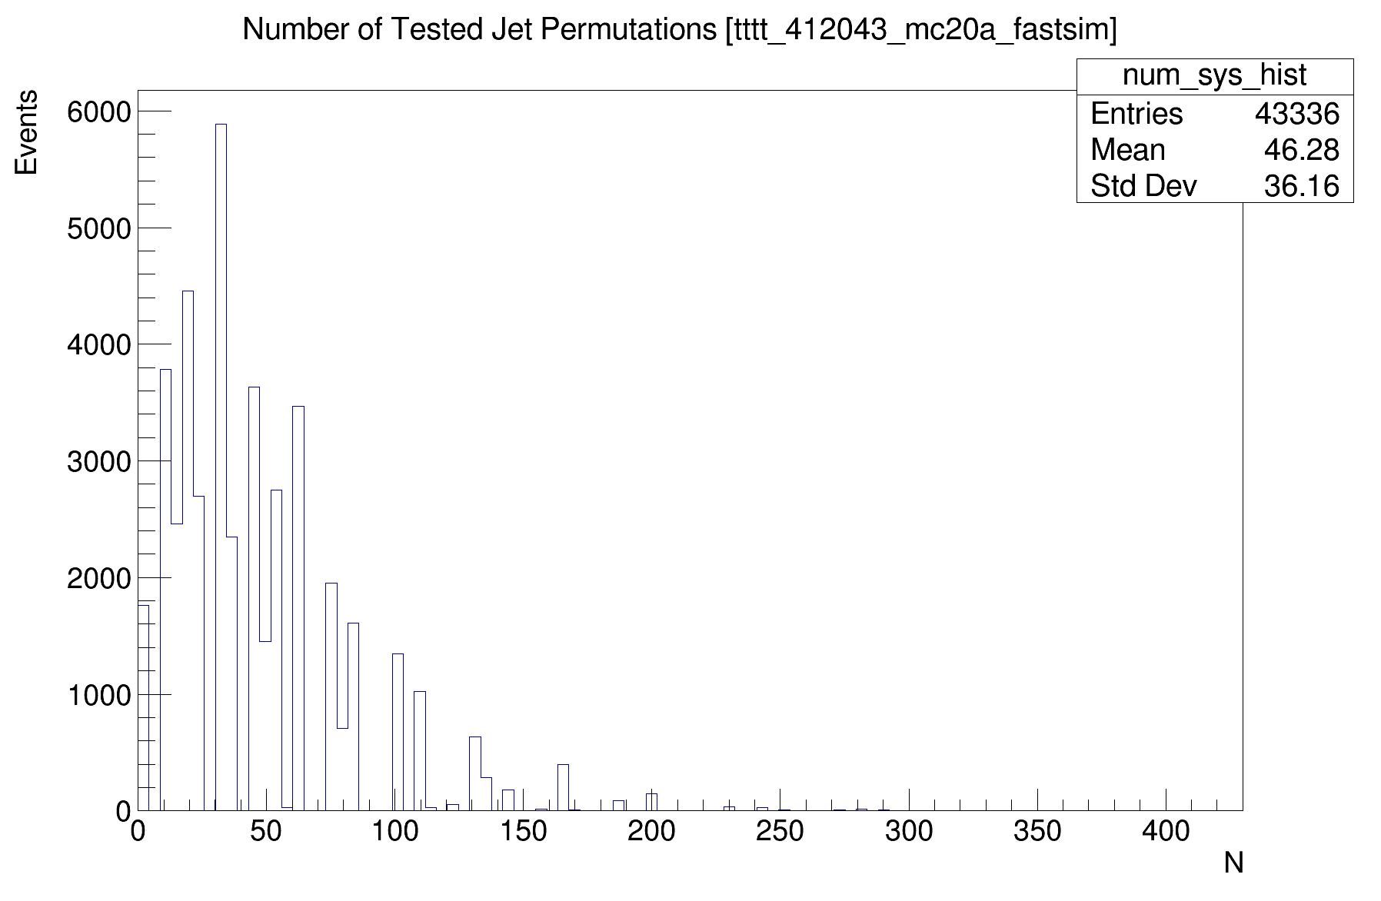
Combinatorial explosion
47,757 events
2,006,616 total combinations
On average 46 combinations checked per event
Reducing computation time is a priority for this algorithm to be useful
Notes:
One last thing I started to look at, but need to work more on, is the computational efficiency of the algorithm
The sample I tested contained data for about 50,000 events, and the algorithm had to search through over 2 million combinations of jets
On average, the algorithm had to check 46 combinations in every final state

