Slide 1
L1T Upgrade Progress
Brock Ewing
5.28.2024

Slide 2
Project Goals
Upgrade the L1T system to look for new Higgs signatures in background HL-LHC data
Analyze and select events from simulated data to train an NN for implementation onto the HL-LHC hardware
Create NN and generate accuracy and efficiency graphs, ROC graphs to show the ability of our NN.
Use Qkeras and hls4ml to reduce the size of our NN and transfer it onto FPGA hardware.

Slide 3
Data Set
Data sets consist of simulated Higgs decays for BBbar and CCbar varying in mass ranging from 20-60 GeV and Pt ranging from 100 to 150 GeV, along with 3 background samples for QCD, Neutrino Pileup and TTbar decays.
Signal and Background Counts after processing
B_M20_Pt100: 4,284
B_M40_Pt120: 6,263
B_M60_Pt150: 7,711
C_M20_Pt50-100: 192
C_M20_Pt100: 4,655
C_M40_Pt60-120: 606
C_M40_Pt120: 6,721
C_M60_Pt75-150: 1,377
C_M60_Pt150: 8,042
QCD: 69,250
Neutrino Pileup: 2,110
TTbar: 171,913

Slide 4
Initial Data Analysis
- Took simulated Higgs decay data and did feature analysis initially, looking at various qualities for comparison like pt and eta distributions for daughter particles along with DeltaR separations and jet matching.

Slide 5
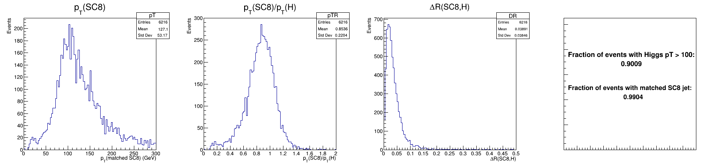
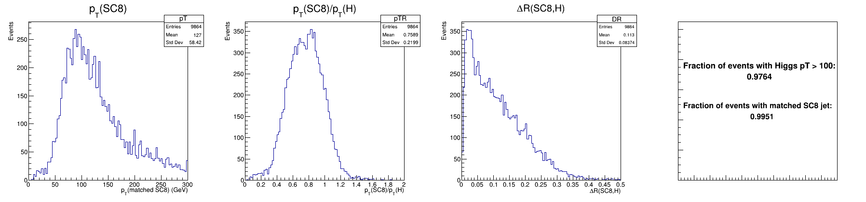
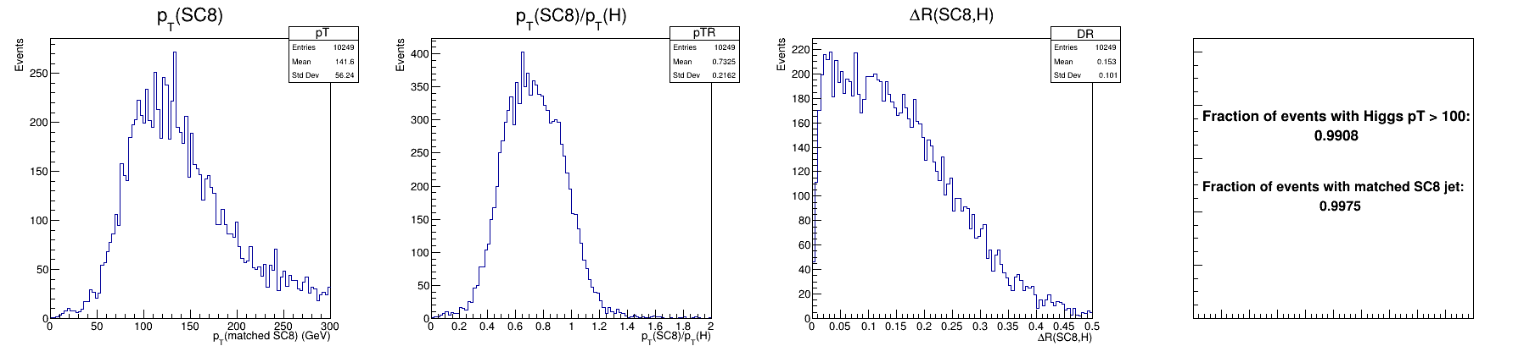
Higgs Jet Analysis Comparison
Mass:
20 GeV
Mass:
40 GeV
Mass:
60 GeV

Slide 6
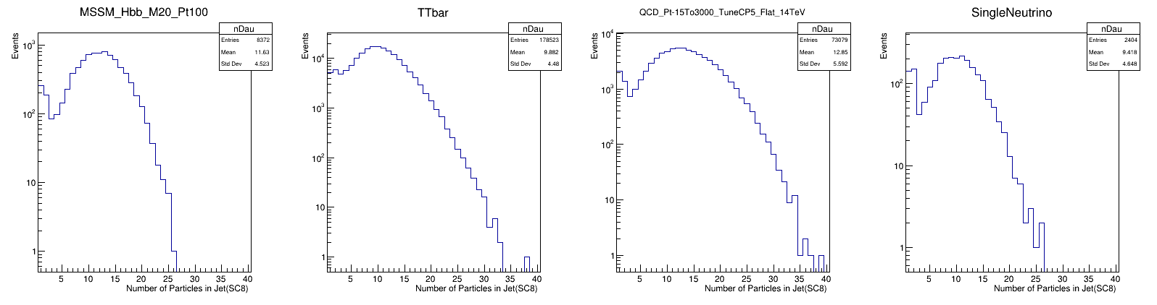
Particle Count Comparison

Slide 7
Data Processing
- Applied filters and cuts to the dataset. We set cuts for:
DeltaR < .03
Jet Pt > 100 GeV
- Filter on all 32 daughter Jets by:
Pt
Particle constituent type
Charge
Eta
Theta
Phi
dxy

Slide 8
NN Training and performance
Trained 4 models for comparison:
Simple sequential network with 3 dense layers
More complex sequential network with 4 dense layers
Linear model
Boosted Decision Tree
- Currently working on testing DeepSet architecture

Slide 9
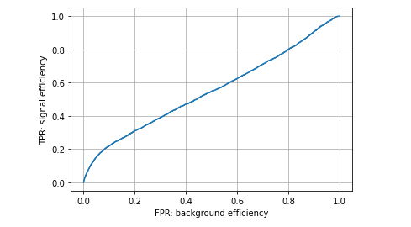
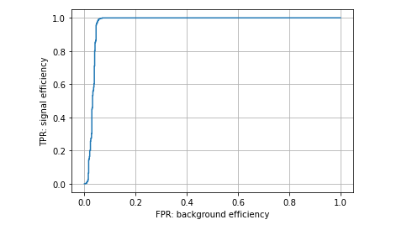
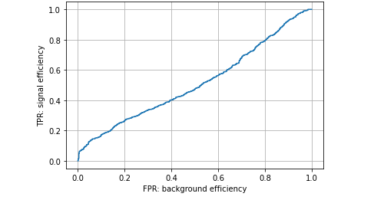
Initial ROCs
No cuts
DeltaR < .03 no cuts
DeltaR < .03 & cuts

Slide 10
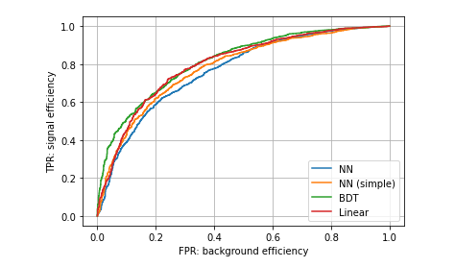
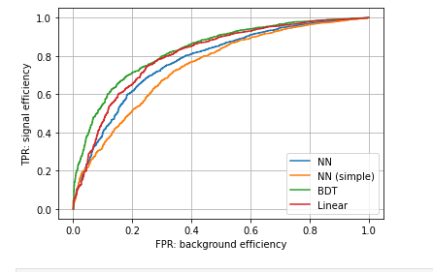
ROCs
Hbb M20 & QCD Background
PdgID
One hot encoding

Slide 11
Comparisons
Decided to compare performance between a network trained on all signals vs individual signals and training on different #s of daughters.

Slide 12
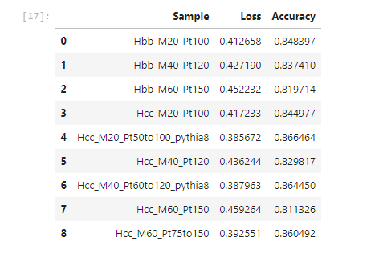
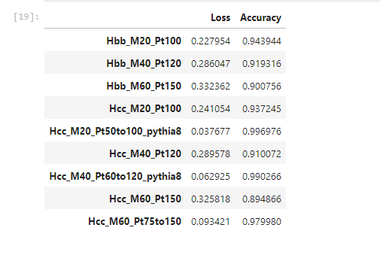
Total vs Individual Signal Comparison
QCD Background: 69,250 hits
Trained on all signals
Tested on individual signals
Trained on Individual signals
Tested on individual signals

Slide 13
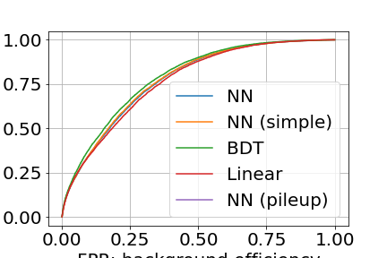
Total vs Individual Signal Comparison
QCD Background: 69,250 hits

Slide 14
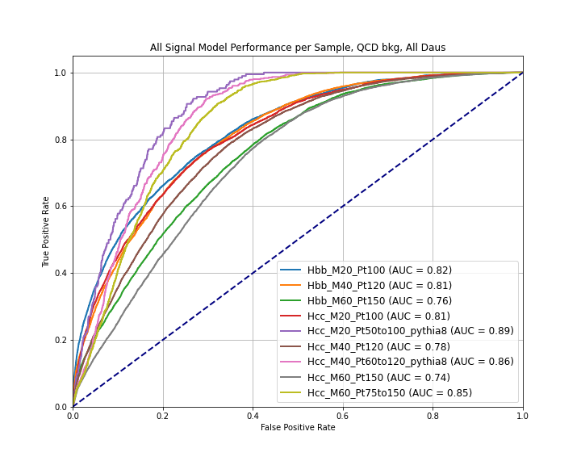
Total vs Individual Signal Comparison
QCD Background: 69,250 hits

Slide 15
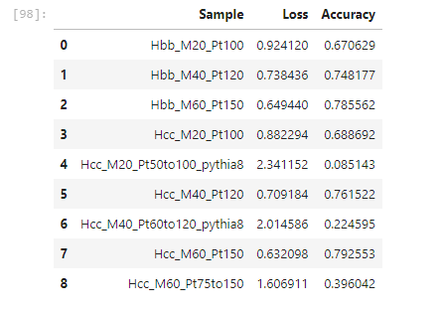
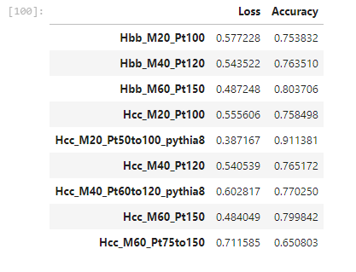
Total vs Individual Signal Comparison
Neutrino Pileup Background: 2,110 hits
Trained on all signals
Tested on individual signals
Trained on Individual signals
Tested on individual signals

Slide 16
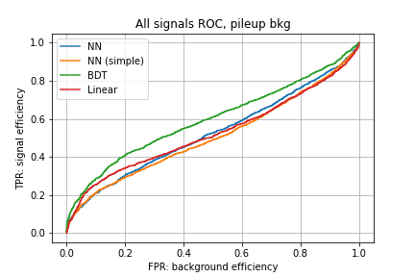
Total vs Individual Signal Comparison
Pileup Background: 2,110 hits

Slide 17
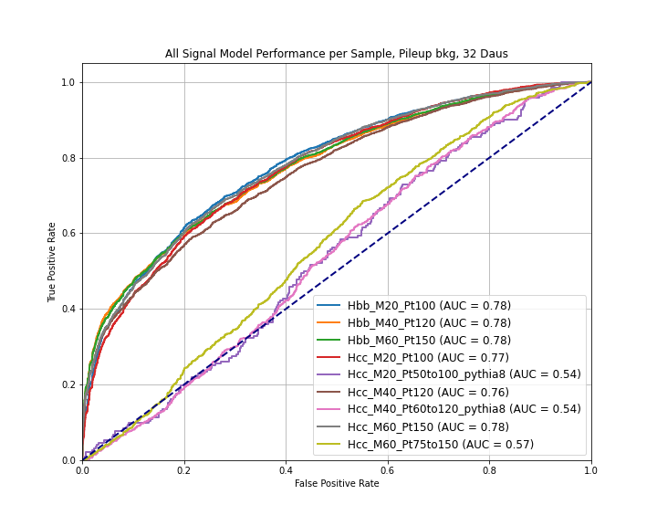
Total vs Individual Signal Comparison
Pileup Background: 2,110 hits

Slide 18
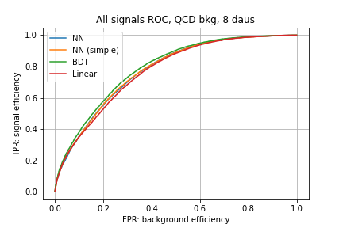
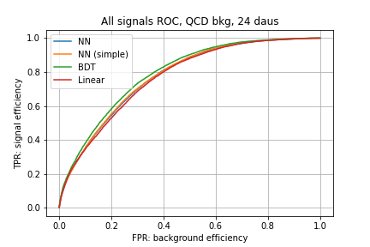

Daughter # Comparison
QCD Background: 69,250 hits

Slide 19
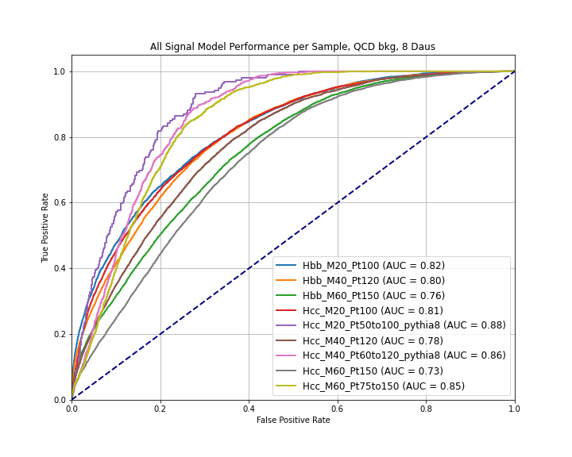
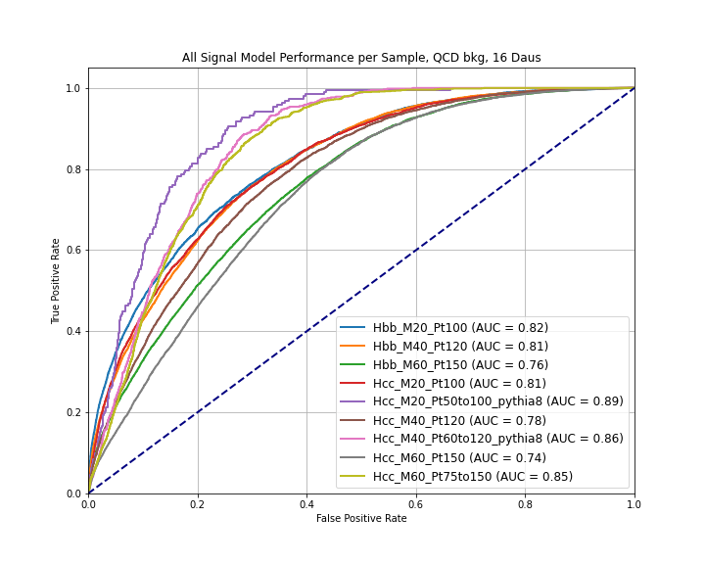
Daughter # Comparison
QCD Background: 69,250 hits

Slide 20
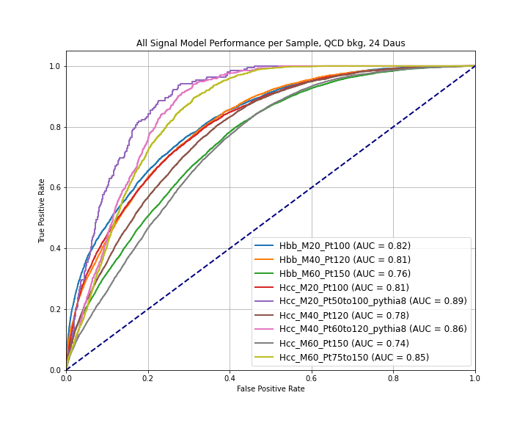
Daughter # Comparison
QCD Background: 69,250 hits

Slide 21
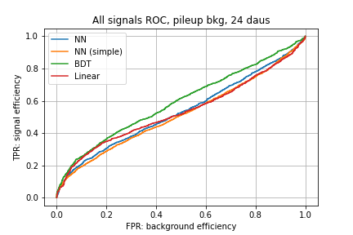
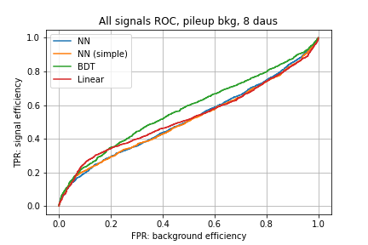
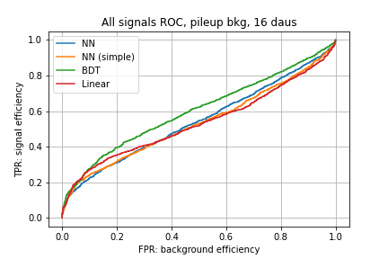
Daughter # Comparison
Neutrino Pileup Background: 2,110 hits

Slide 22
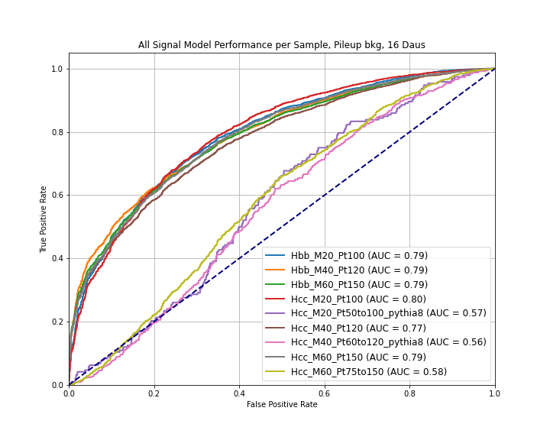

Daughter # Comparison
Neutrino Pileup Background: 2,110 hits

Slide 23
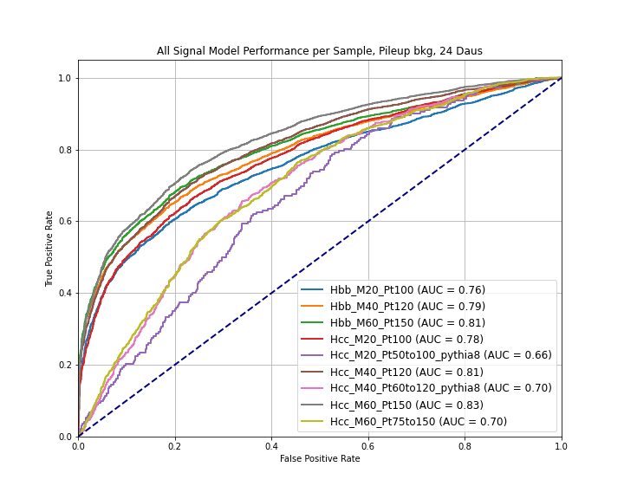
Daughter # Comparison
Neutrino Pileup Background: 2,110 hits

Slide 24
Next Steps
Pass Exams
Try out recommendations from other group members, i.e. try training unweighted vs weighted, try out a network parameterized on masses and jet Pts, switch fpr to log scale.
Implement Deepset architecture
Ssh into CERN cpu to process TTbar background samples

