Slide 1
Perturbation Theory Presentation
By Preston

Slide 2

Perturbation Theory in the 2-level Atom
Perturbed solutions of a perturbed potential using known solutions of an unperturbed potential.
$HΨ=EΨ=iℏ\frac{δΨ}{δt}$
$U\left(x\right)=U_{0}\left(x\right)+U_{perturbed}\left(x\right)$
The solution of the known potential: $H_{0}φ_{n}=E_{n}φ_{n}=iℏ\frac{δφ_{n}}{δt}$
Solution of the total potential:$Ψ=\sum_{n}{C_{n}\left(t\right)φ_{n}(x,t)}$
$\left.|n\right\rangle \left(x,t\right)=\left.|n_{0}\right\rangle (x)e^{−iωt}$
So our full equation for the Hamiltonian of the total wave is:
$iℏ\frac{δΨ}{δt}=\left(H_{0}+H_{perturbed}\right)\sum_{n}{C_{n}\left(t\right)|\left.n\right\rangle }$ and for some state m applied
$$\left\langle m\right.|iℏ\frac{δΨ}{δt}=\left\langle m\right.|\left(H_{0}+H_{p}\right)\sum_{n}{C_{n}\left(t\right)|\left.n\right\rangle }$$

Slide 3

Perturbation Theory Continued
RHS: $\left\langle m\right.|\left(H_{0}+H_{p}\right)\sum_{n}{C_{n}\left(t\right)|\left.n\right\rangle }=\sum_{n}{C_{n}\left(t\right)\left\langle m | H_{0} | n\right\rangle }+\sum_{n}{C_{n}\left(t\right)\left\langle m | H_{p} | n\right\rangle }$
$$=C_{n}\left(t\right)E_{n}δ_{nm}+\sum_{n}{C_{n}\left(t\right)\left\langle m | H_{p} | n\right\rangle }$$
LHS: $\left\langle m\right.|iℏ\frac{δ}{δt}(\sum_{n}{C_{n}\left(t\right)\left|\left.n\right\rangle \right)=\left\langle m\right.|iℏ \sum_{n}{\frac{δ}{δt}(C_{n}\left(t\right)\left|\left.n\right\rangle \right)}}$
$$=\left\langle m\right.|iℏ \sum_{n}{ (C_{n}\left(t\right)\frac{δ|\left.n\right\rangle }{δt}+|\left.n\right\rangle \frac{δC_{n}\left(t\right)}{δt})}$$
Recall that since we know $|\left.n\right\rangle$, $\frac{δ|\left.n\right\rangle }{δt}=−iw|\left.n\right\rangle$. =>
$$\left\langle m\right.|iℏ \sum_{n}{ |\left.n\right\rangle \frac{δC_{n}\left(t\right)}{δt}}=\sum_{n}{C_{n}\left(t\right)\left\langle m | H_{p} | n\right\rangle }$$

Slide 4

Perturbation Theory Continued
We know: $iℏ \sum_{n}{\left\langle m | n\right\rangle \frac{δC_{n}\left(t\right)}{δt}}=\sum_{n}{C_{n}\left(t\right)\left\langle m | H_{p} | n\right\rangle }$
$$=iℏ\frac{δC_{m}\left(t\right)}{δt}=\sum_{n}{C_{n}\left(t\right)\left\langle m | H_{p} | n\right\rangle }$$
Where $H_{p}\left(t\right)=−e\overset{⃑}{E}∗\overset{⃑}{r}$. For a plane wave, $\overset{⃑}{E}=E_{0}\hat{ξ}\cos{(kz−w_{l}t)}$
So $iℏ\frac{δC_{m}\left(t\right)}{δt}=C_{n}\left(t\right)H_{mn}(t)e^{iω_{mn}t}$
For a two state system, we only have state $m=g(ground)$ and state $m=e\left(excited\right)$. This gives us a system of two differential equations

Slide 5

System of 2 Differential Equations
Plugging in, we get:
$$iℏ\frac{δC_{g}\left(t\right)}{δt}=C_{e}\left(t\right)H_{ge}\left(t\right)e^{iω_{ge}t}$$
$$iℏ\frac{δC_{e}\left(t\right)}{δt}=C_{g}\left(t\right)H_{eg}\left(t\right)e^{−iω_{ge}t}$$
With initial conditions $t=0$, $C_{e}\left(0\right)=0$, $C_{g}\left(0\right)=0$
Giving us the solution $C_{e}=−i\frac{Ω}{Ω_{′}}\sin\left(\frac{Ω_{′}t}{2}\right)e^{−iΔt/2}$
Where $Δ=ω_{l}−ω_{eg}$, $Ω=\frac{−eE_{0}}{ℏ}\left\langle e | r | g\right\rangle$ and $Ω_{′}={(Ω^{2}+Δ^{2})}^{{−1}/2}$

Slide 6
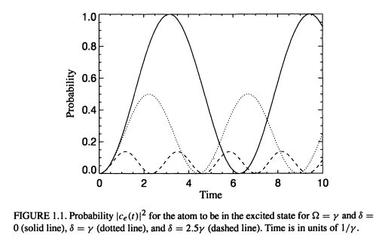
Transition probability over time

