Slide 1
Status of the Accelerator
Matteo Solfaroli BE/OP
158th LHCC OPEN Session
May 29th, 2024

Slide 2
Outline
2024 run so far
“Limitations”
Outlook for the rest of the year

Slide 3
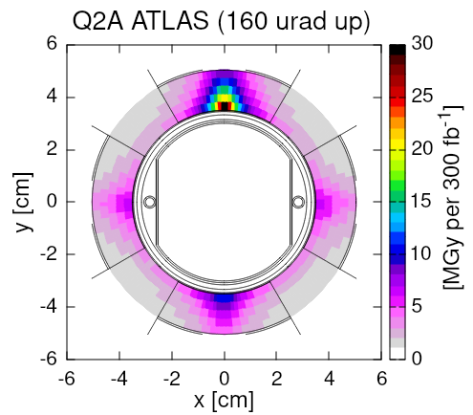
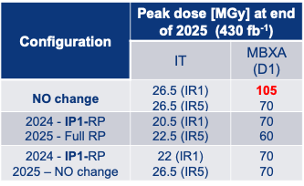
Reversed Polarity (RP) optics
Excessive dose deposition on magnets of Inner Triplet region (close to interaction point) can lead to damage and failure
Solutions to redistribute the radiation, allowing for longer lifetime of the equipment:
Local optics change (implemented in P1, as most critical)
Example for IP1
Estimated damage limit:
30 MGy for IT
90 MGy for D1

Slide 4
2024 LHC schedule v.2.0 - Q1+Q2
Hardware commissioning completed in time
First injection on 8th March (3 days ahead of schedule)
First STABLE BEAMS at 6.8 TeV on 5th April (3 days ahead)
Scrubbing succesful
Intensity ramp-up completed in advance (1215b fill on 14.04)
MD#1 & VdM successfully performed
today

Slide 5
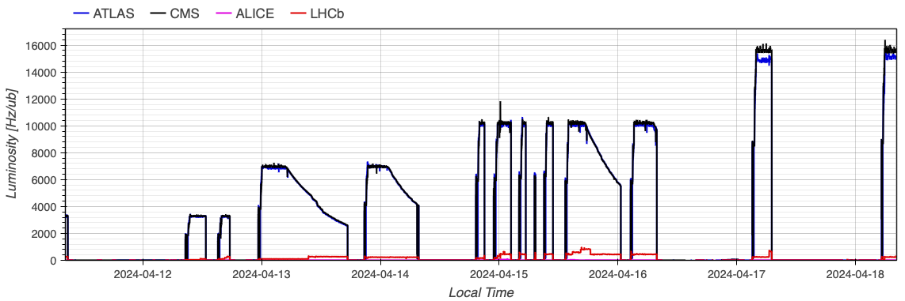
Establishing physics production
Beam commissioning completed in the 4 weeks allocated:
  Well established baseline, effective knowledge and control: early start (3 days) -> early stable beams (3 days)
  Optics change accounted for ~1 week (as expected)
Step-wise approach for intensity ramp-up:
  Monitor behavior during >15h in stable beams
  Validate progressively correct functionality of machine-protection system and operational tools
  Bunch intensity (in collisions) ~1.55e¹¹ p/b
Early start
1st SB

Slide 6
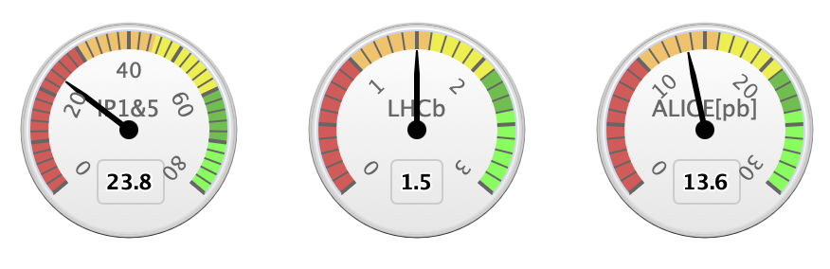
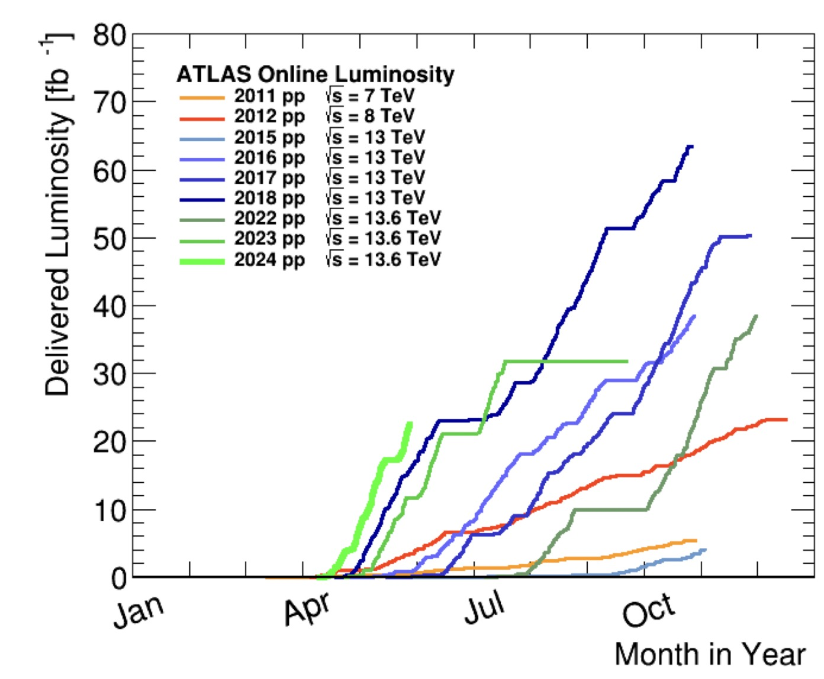
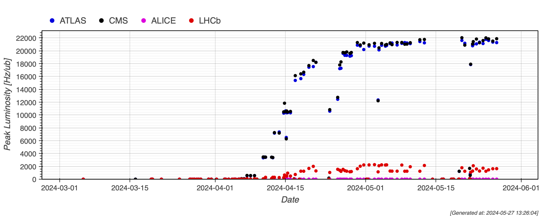
Physics production
Good availability through the first part of the year
~24 fb⁻¹ in ATLAS/CMS
Achieved nominal rate (as 2023)
Peak luminosity at ~2.1e³⁴ cm⁻¹ s⁻¹ (limited by cryogenic)
Pile-up at 65

Slide 7
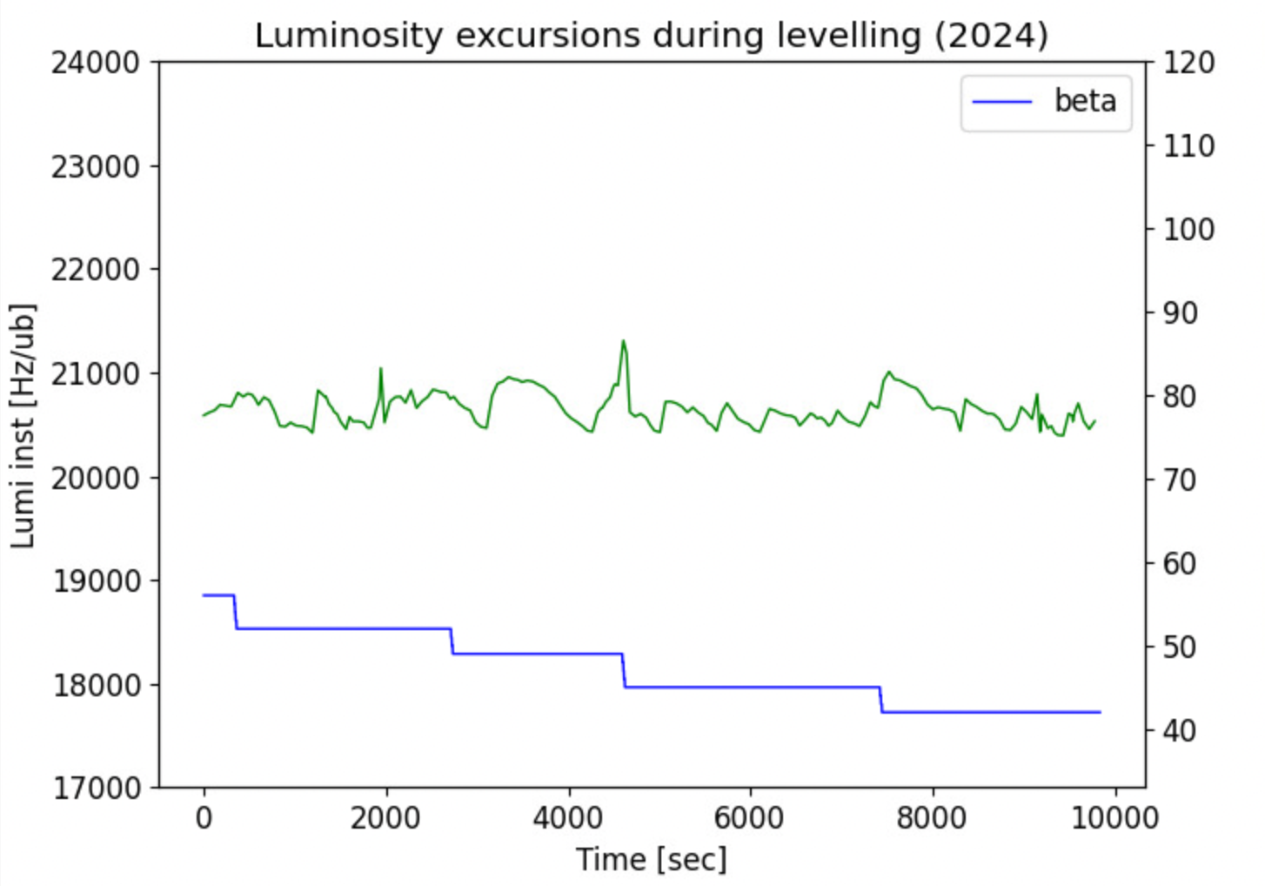
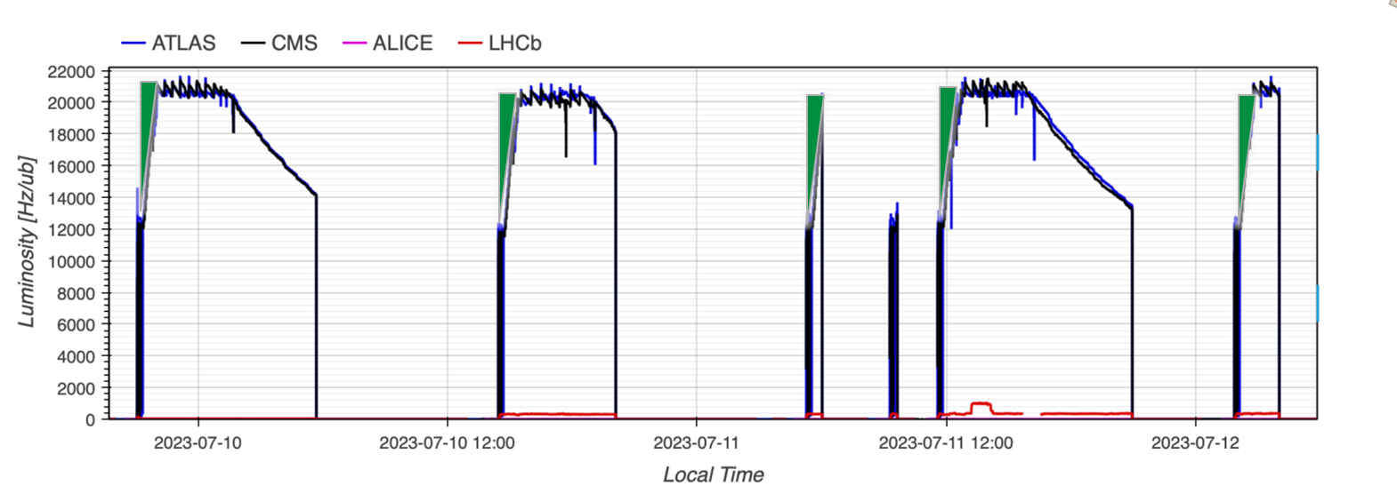
2024 operational improvements
“virtual lumi”: based on machine and beam parameters gives theoretical luminosity
Used for β* levelling
  2024 improvement: Luminosity oscillations in 2.5% range (Run3 request was 5%)
~2.5%
Fast(er) reach of desired β*
LHC cycle (i.e. β* at collision) optimised for 1.8x10¹¹ p/b ➔ ~45 min to reach target levelling luminosity
Few % gain (depending on fill length)

Slide 8
Outline
2024 run so far
“Limitations”
Outlook for the rest of the year

Slide 9
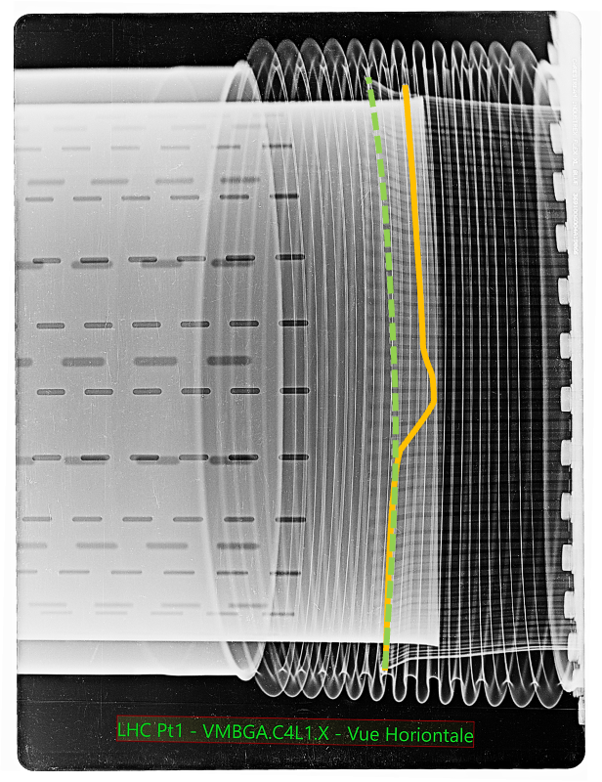
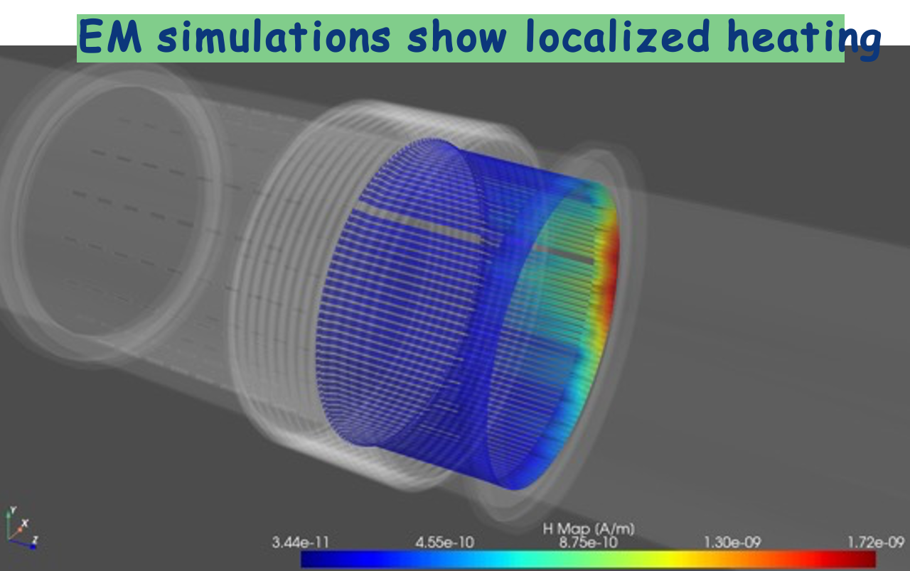
Vacuum module
VISUAL INSPECTION
annealed/plasticised spring on the 212 mm vacuum module due to localized temperature increase to more than 500°C
IMPACT in 2023
~5 days lost
Bunch intensity limited to 1.6e¹¹ p/b
Difficult to identify intensity limitation (strong dependence on contact quality)
2024 LHC operation presently limited to 1.6e¹¹ p/b
Simulations ongoing to assess impact of beam parameters on power deposition
Consolidation plan:
47 replaced during 23/24 EYETS
24 foreseen in 24/25
  No failure expected with ideal contact
LMC 479: limit bunch intensity at 1.6e¹¹ p/b, while maximizing the bunch length throughout the cycle
Improved control of bunch length provides a safety factor of ~2 or more in power deposition

Slide 10
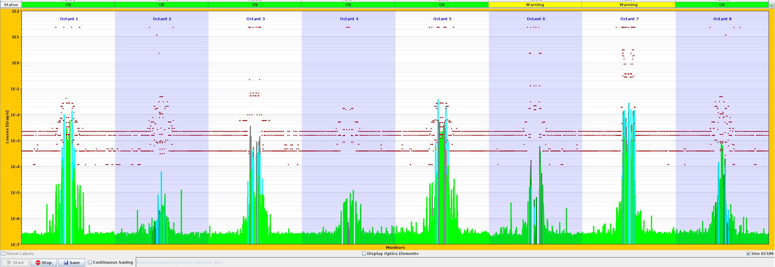
Beta* limitation (36 cm)
First observation: significant losses on secondary collimator (TCSPM.B4R7.B2) in fill 9530 (17th April)
300-400 um orbit shift needed to induce observed hierarchy breakage
Highest losses in the
middle of insertion, instead of extremities, where primary collimators are located!
Signature of broken collimation hierarchy (protection at risk)
No issue observed during machine validation (low intensity):
  Quite some differences between validations fills (single bunches) and physics fill with long trains (non-linearities, beam-beam effect, BPM response,…)

Slide 11
Beta* limitation (36 cm)
Studies, tests and simulations to identify the origin of the problem
Various contributions, no clear “smoking gun” identified:
  Centres of suspected collimators within 0.1-0.2 sigma from nominal settings (<20 um)
  No significant orbit change at collimators as function of filling scheme
  Optics stable within <5% (45-30 cm)
  Observed dependency on bunch intensity
  Impact from non-linearities (octupoles, chromaticity)
  Two-beams effect
Physics production limited to 36 cm (about 1-2% loss), until the origin of the problem and possible mitigations are identified
  Produced by halo (not primary beam), hitting only one collimator jaw
  could match off-momentum halo, due to non-linearities (beam-beam), combined with a somehow large dispersion
Test planned for this week

Slide 12
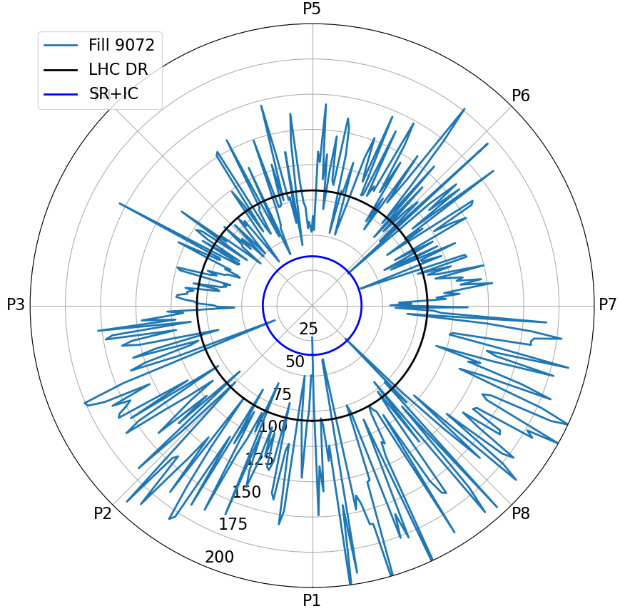
Heat load
Geographical HL distribution
Heat load (HL) deposited by the beams can become a limitation when not enough cryo capacity is available (presently well beyond the Design Report value)
Degradation observed when sectors are vented to air (LS)
Non-homogeneous distribution across the machine
  Sector 78 is the highest sector in Run3
Gradual conditioning helps to increase the beam intensity
2015
Normalised HL at top energy
2022
2023
2017
2016
2018

Slide 13
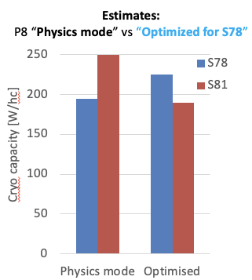
Heat load in Run3
2023: HL kept under control thanks to hybrid filling scheme (8b4e and 36 bunch trains) – e-cloud suppressed at price of total number of bunches
2024
Test with modified cryogenic configuration (capacity rebalanced between S78 and S81) hinted at possibility to operate LHC without hybrid scheme at 1.6e¹¹ p/b, allowing for:
  Larger number of bunches
  Better beam quality
Beam generated HL, higher than expected, limits further the number of bunches (~100b less than in 2023)
Design Report
85 W/hc

Slide 14
Hybrid vs 48b vs 36b (today)
Beam type | Max number of bunches
Hybrid | 2464
48b trains | 2355 (HL limited)
36b trains | 2352 (HL limited)
Hybrid vs pure 25 ns beam
  PROS: e-cloud free beam, NO heat load
    Higher number of bunches (~100b)
  CONS: mixed beam type (8b4e + 36b)
    Continuous setup in the injectors (2 beam types to be maintained), with increased risk of availability limitations
    Lower beam quality with less homogeneous bunch distribution
    More difficult control, increased losses across LHC cycle
48b vs 36b trains
  No (significant) difference in number of bunches
  36b means more injections (longer LHC flat-bottom), but allows to exploit BCMS (next slide) -> potential gain up to 10% in brightness
  36b generates less HL, allowing for larger cryogenic operational margin

Slide 15
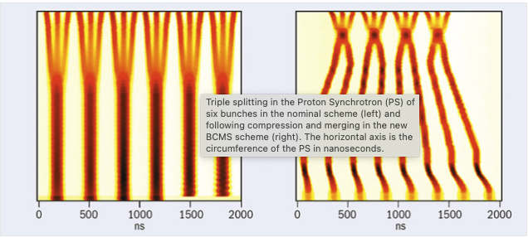
BCMS vs 25 ns beam
With a filling scheme based on 3x36b patterns, the standard 25 ns and Batch Compression and (bunch) Merging and (bunch) Splitting (BCMS) beams are interchangeable transparently
Test with optimized BCMS beams in the LHC is ongoing (brightness theoretical 10% higher):
  Smaller emittance is beneficial for losses reduction, especially at injection
  If smaller emittance preserved through the LHC cycle, better equivalent cross-section

Slide 16
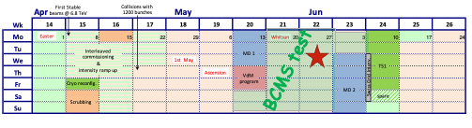
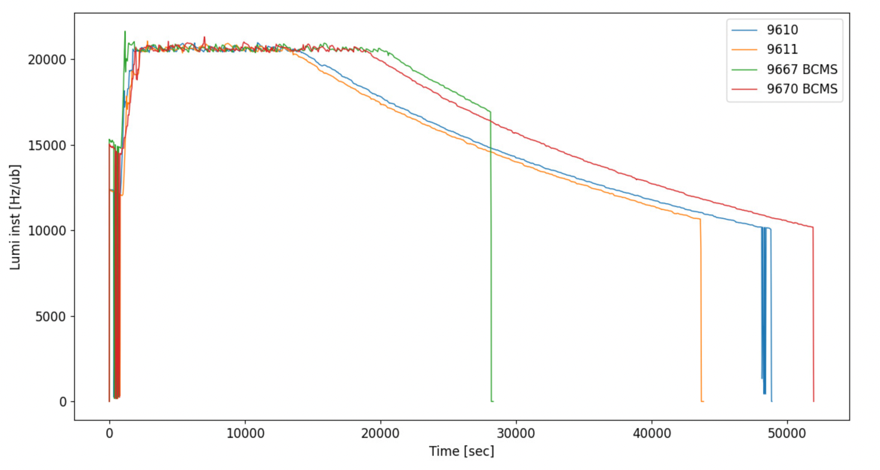
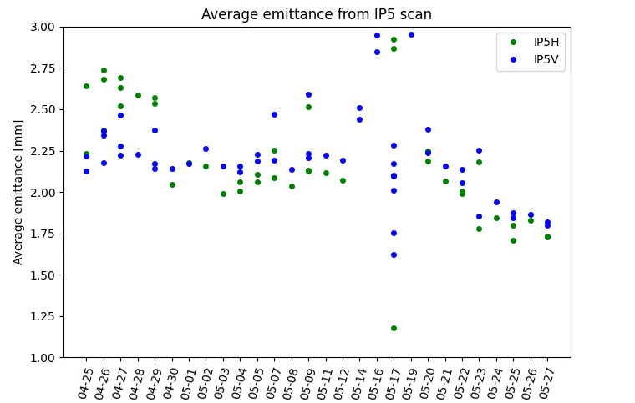
BCMS vs 25 ns beam
Increased levelling time
Test operation with BCMS beam until TS#1 (unless major problems come out) to establish performance difference
Few fills needed to adjust the working point (fight emittance growth at injection)
Once set, clear increase of 25-30% in levelling time
Potential gain of 6-8% in integrated luminosity
MD & VdM
BCMS
Preliminar observations

Slide 17
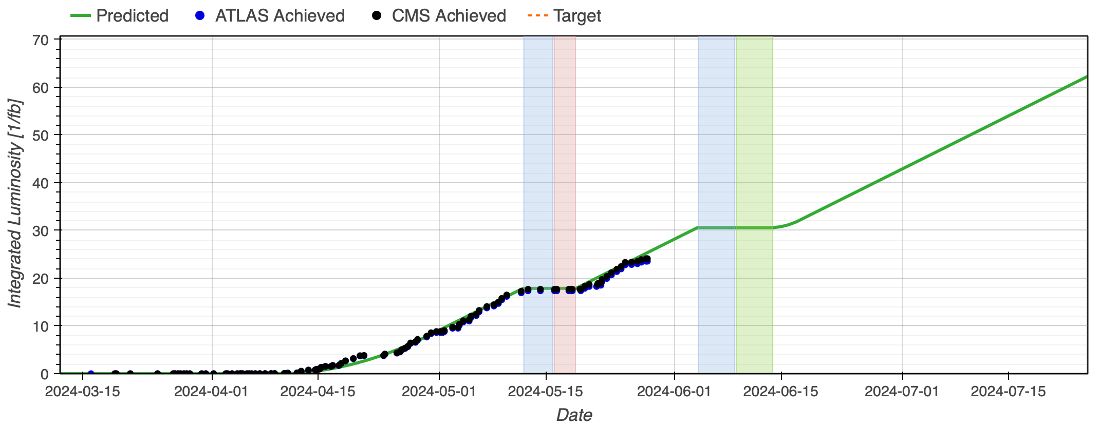
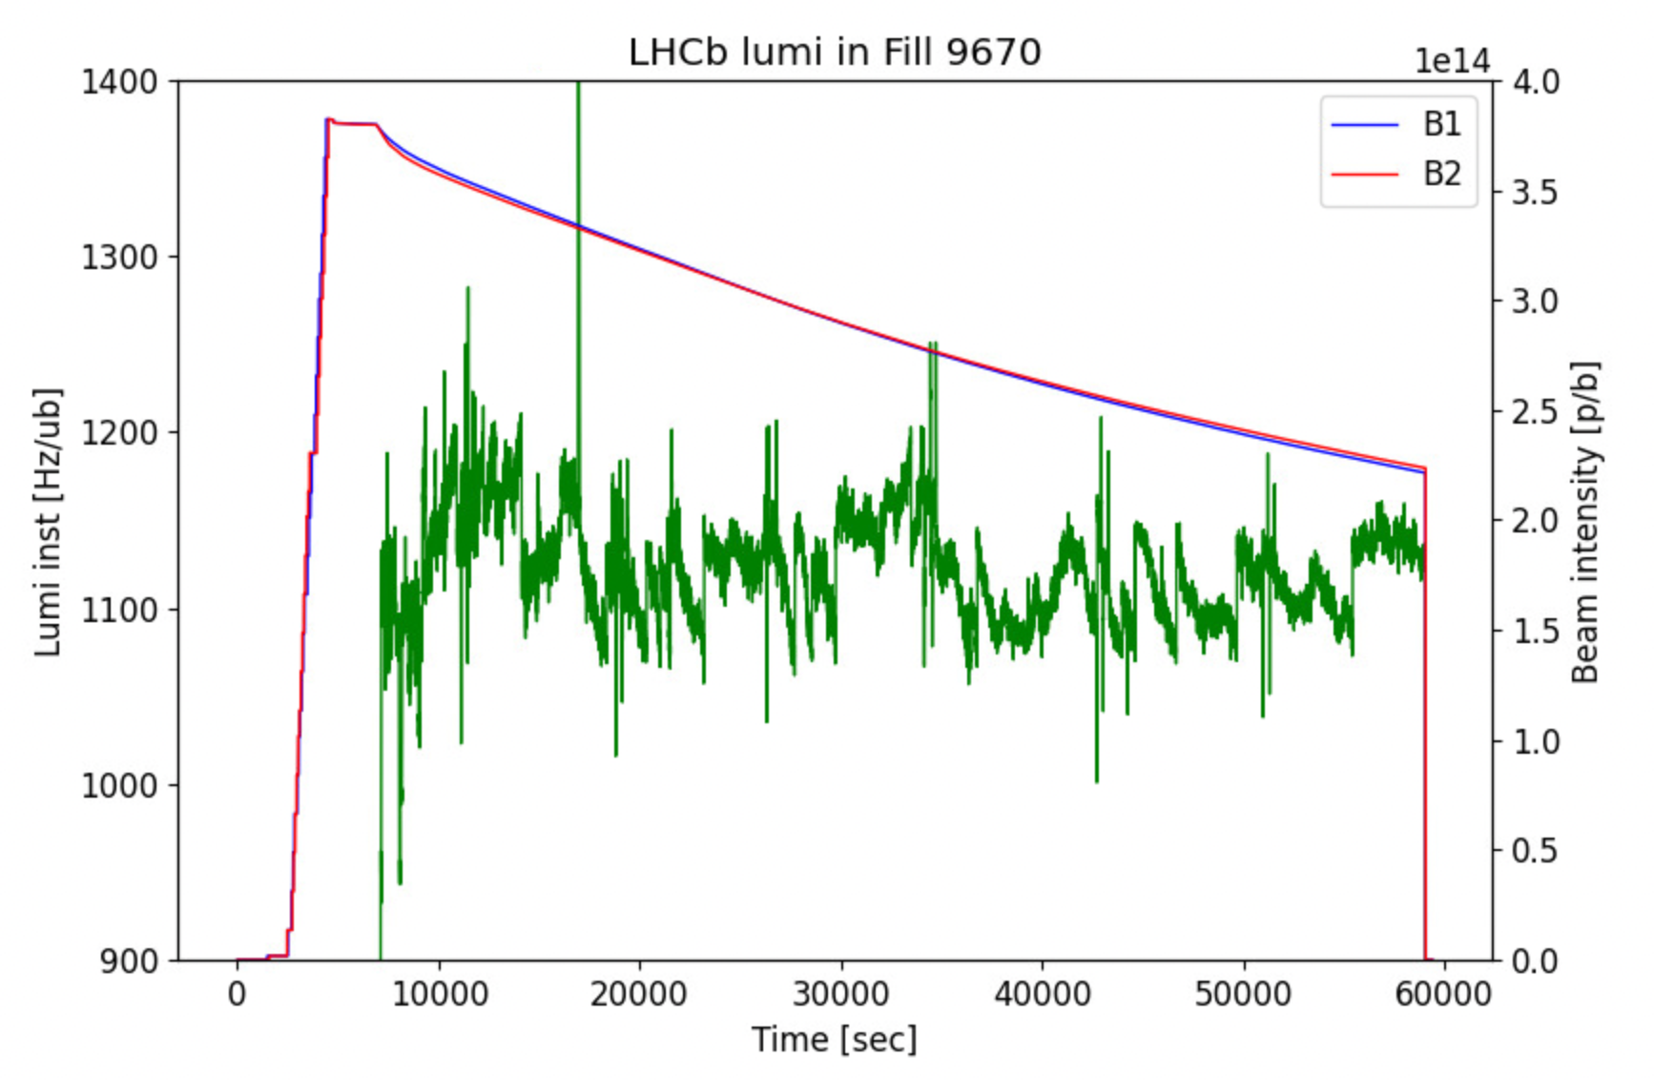
Performance reach
Despite the above-mentioned “limitations” (beta*, number of bunches and bunch intensity), physics production is nicely following expectations and target is in reach
  LHCb levelling >=15h
2024 operational configuration allows performance similar to 2023 with more homogeneous beam and better operational control
Some improvements still possible

Slide 18
FASER/SND background
FASER and SND background rates significantly higher (~double) wrt 2023 (non-RP optics)
  Implies more frequent emulsion exchanges (if available!)
Background tests for FASER demonstrated little impact of collimation system on background:
  increase driven by TeV-scale muons, originating from IP

Slide 19
Outline
2024 run so far
“Limitations”
Outlook for the rest of the year

Slide 20
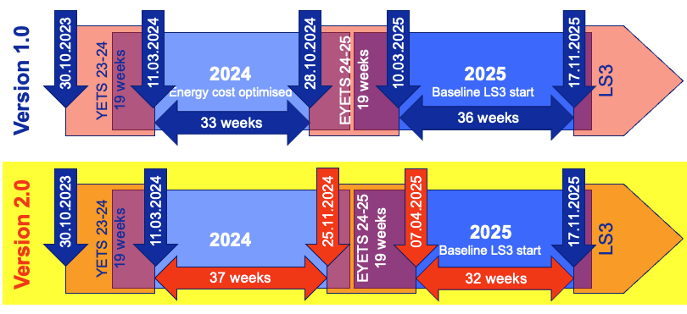
LHC schedule - changes
Injectors YETS shifted by 5-weeks
  3-weeks reduction, more physics
LHC YETS shifted by 4-weeks (Start date 28.10 -> 25.11)
  19 weeks length (beam-to-beam) maintained
  Extended time used for proton physics
2025 run shortened by 4 weeks -> one Technical Stop removed
NO additional technical stop for 2024 run
Activity | 2024+2025 v1.0 [days] | 2024+2025 v2.0 [days] | Diff [days]
Proton physics | 269 | 274.5 | +5.5
Ion physics & p-p ref. run (Oxygen included) | 44.5 | 45 | +0.5
Scheduled stops & recovery | 28.5 | 22.5 | -6

Slide 21
2024 LHC schedule
Activity | Duration [days] | Ratio [%]
Beam Commissioning & Intensity ramp-up | 41 | 15.8
Scrubbing | 3 | 1.2
25 ns physics (>1200 bunches) | 147.5 | 56.9
Special physics runs (incl. setting-up) | 2 | 0.8
Pb-Pb ions & p-p ref. setting-up | 6 | 2.3
Pb-Pb ions physics & p-p ref. run | 23 | 8.9
Technical stop | 9 | 3.5
Technical stop recovery | 2 | 0.8
Other scheduled stops | 2.5 | 1.0
Machine Development | 23 | 8.9
Total: | 259 | 100

Slide 22
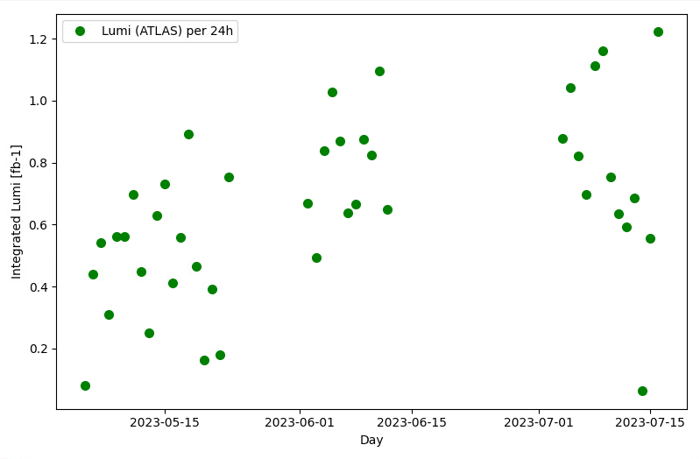
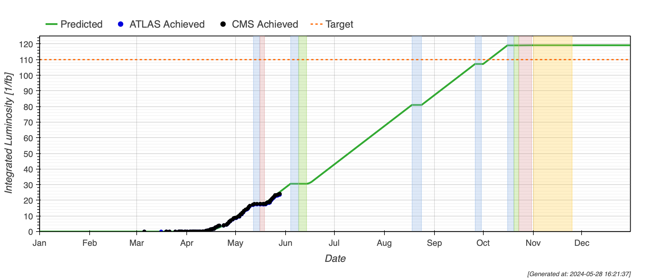
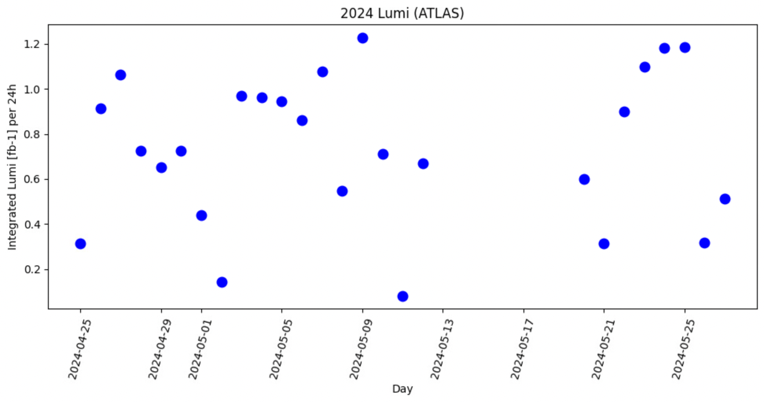
Performance
Record
1.2 fb⁻¹/24h
2023 integrated Lumi (ATLAS) per 24h
2024 production rate reached 2023 values (~0.8 fb⁻¹/24h)
  Peak record of 1.2 fb⁻¹/24h
Scaling the target by the increased number of pp physics days, 110 fb⁻¹ should be in reach
AVG =
0.78 fb⁻¹/24h
2024 integrated Lumi (ATLAS) per 24h
MD#1
VdM
AVG =
0.76 fb⁻¹/24h

Slide 23
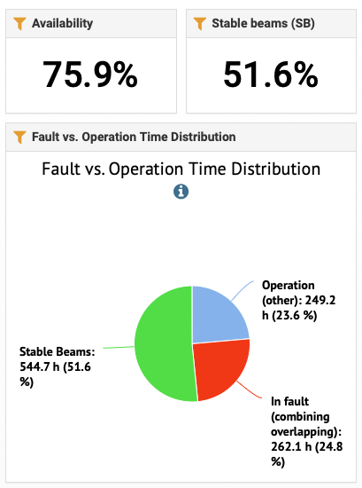
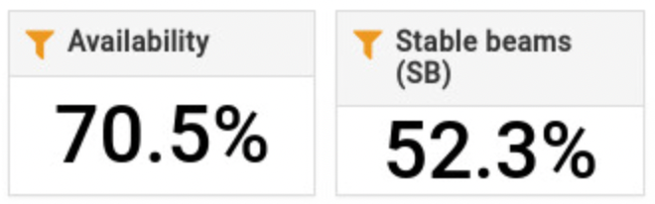
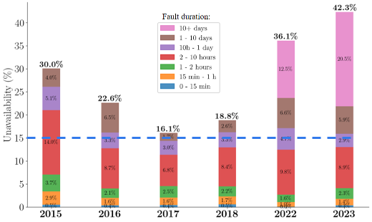
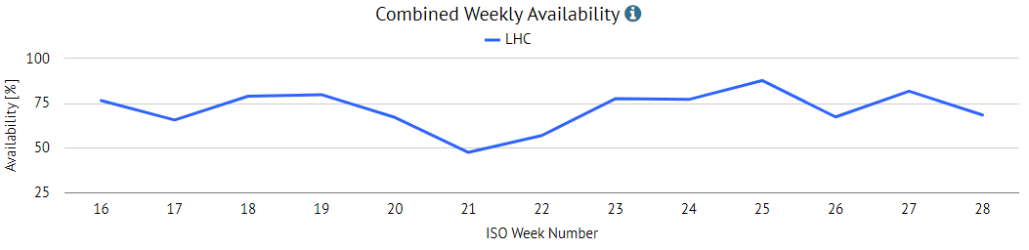
Availability is key
2023 availability during production period
Availability is THE key factor for accelerator performance
Accelerator Fault Tracking (AFT) systems allows for analysis and cataloguing of down time
Availability factor was constant through Run2 and Run3 for small (<24h) faults
“Long faults” have been so far dominant for Run 3
2024 availability during production period

Slide 24
Conclusions
2024 Run is progressing well
  Some improvements still possible (BCMS optimised, lower beta*)
Despite of a few “limitations”, production rate is in line with expectations
  Bunch intensity limited to 1.6e¹¹ p/b for risk mitigation
  Beta* (temporarily) limited to 36 cm, until problem identified
  Heat load limits number of bunches
2024 LHC schedule v2.0 allocates 23.5 additional days to pp physics
  110 fb⁻¹ should be in reach (provided good availability)
Thanks for your attention

Slide 25
SPARE

Slide 26
2024 LHC schedule
 | Version 2.0 |  | Version 1.0 |  | Gains & Losses
Activity | Duration [days] | Ratio [%] | Duration [days] | Ratio [%]
Beam Commissioning & Intensity ramp-up | 41 | 15.8 | 42 | 18.2 | =
Scrubbing | 3 | 1.2 | 3 | 1.3 | =
25 ns physics (>1200 bunches) | 147.5 | 56.9 | 124 | 53.7 | + 23.5
Special physics runs (incl. setting-up) | 2 | 0.8 | 2 | 0.9 | =
Pb-Pb ions & p-p ref. setting-up | 6 | 2.3 | 6 | 2.6 | =
Pb-Pb ions physics & p-p ref. run | 23 | 8.9 | 22.5 | 9.7 | + 0.5
Technical stop | 9 | 3.5 | 9 | 3.9 | =
Technical stop recovery | 2 | 0.8 | 2 | 0.9 | =
Other scheduled stops | 2.5 | 1.0 | 0.5 | 0.5 | =
Machine Development blocks (incl. floating MDs) | 23 | 8.9 | 20 | 8.7 | + 3
Total: | 259 | 100% | 231 | 100% | +28

Slide 27
2025 LHC schedule
 | Version 0.6 |  | Version 0.4 |  | Gains & Losses
Activity | Duration [days] | Ratio [%] | Duration [days] | Ratio [%]
Beam Commissioning & Intensity ramp-up | 36 | 16.1 | 37 | 14.7 | =
Scrubbing | 2 | 0.9 | 2 | 0.8 | =
25 ns physics (>1200 bunches) | 123 | 54.9 | 141 | 56 | -18
Special physics runs (incl. setting-up) | 2 | 0.9 | 2 | 0.8 | =
Oxygen ion setting-up | 4 | 1.8 | 4 | 1.6 | =
Oxygen ion physics | 4 | 1.8 | 4 | 1.6 | =
Oxygen ion recovery | 0.5 | 0.2 | 0.5 | 0.2 | =
Pb-Pb ions & p-p ref. setting-up | 6 | 2.7 | 6 | 2.4 | =
Pb-Pb ions physics & p-p ref. run | 18 | 8.0 | 18 | 7.1 | =
Technical stop | 8 | 3.6 | 13 | 5.2 | - 5
Technical stop recovery | 2 | 0.9 | 4 | 1.6 | - 2
Other scheduled stops | 1.5 | 0.7 | 0.5 | 0.2 | +1
Machine Development blocks (incl. floating MDs) | 17 | 7.6 | 20 | 7.9 | - 3
Total: | 224 | 100% | 252 | 100 | - 28

Slide 28
P. Chiggiato @ LMC #479

Slide 29
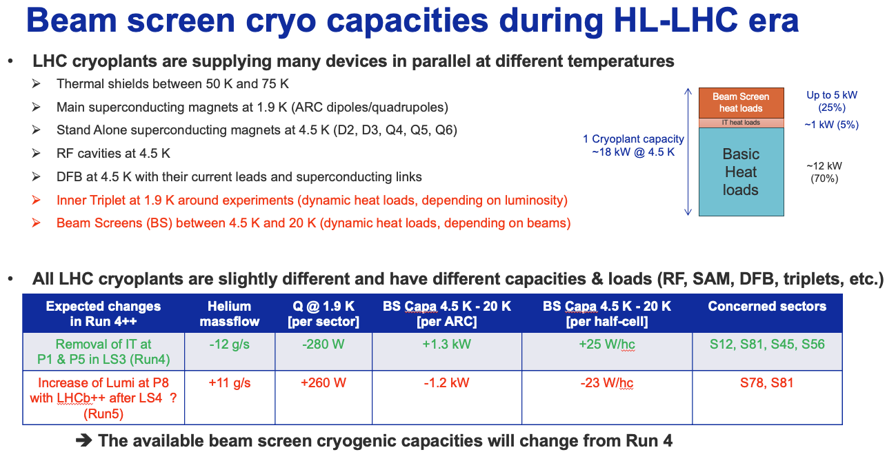
Heat load expectations

Slide 30
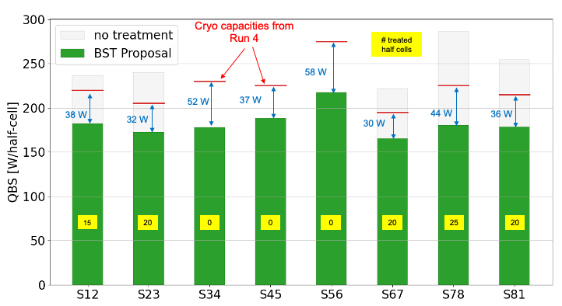
Beam screen treatment
OBJECTIVES
Remove CuO and/or increase surface carbon concentration on selected BS
Beam Screen (BS) surface passivation (robustness against re-oxidation)
Risks:
Degradation of un-treated half-cells during future LS
  Extremely difficult to quantity and impossible to localize
Higher than expecter heat loads of treated half-cells
Low(er) number of treated half-cells in LS3
Possible mitigations?
Treat larger number of half-cells (more margins)
Produce less e-cloud
  Filling scheme (36b/48b (2022), hybrid (2023))
  Continue the beam screen treatment in future LS
A scenario treating 100 half-cells looks realistic

Slide 31
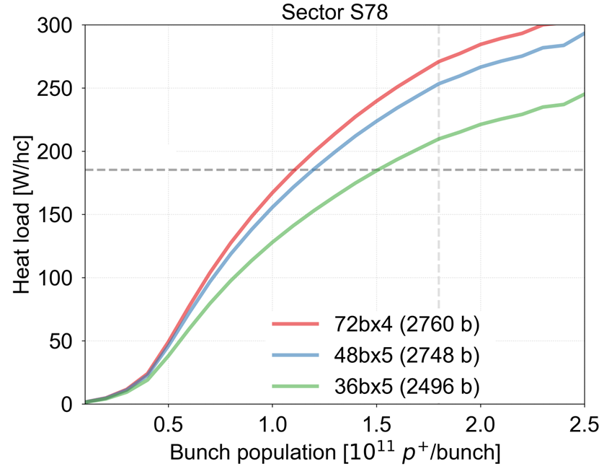
Heat load expectations
HL-LHC prediction in S78
for 5x48b @ 2.3x10¹¹ ppb & 7 TeV
➔ 280 W/hc > Cryo limit [225 W/hc]
Cryo Limit expected for Run4
Objective after BS treatment
Fill #8471 in 2022
(measured 5x36b)
Simulations performed for main beam injection schemes without any Beam Screen treatment
4x72b, 5x48b and 5x36b
2.3

