Slide 1
CaR Board v1.5
Eric Buschmann
MAY 14, 2024

Slide 2
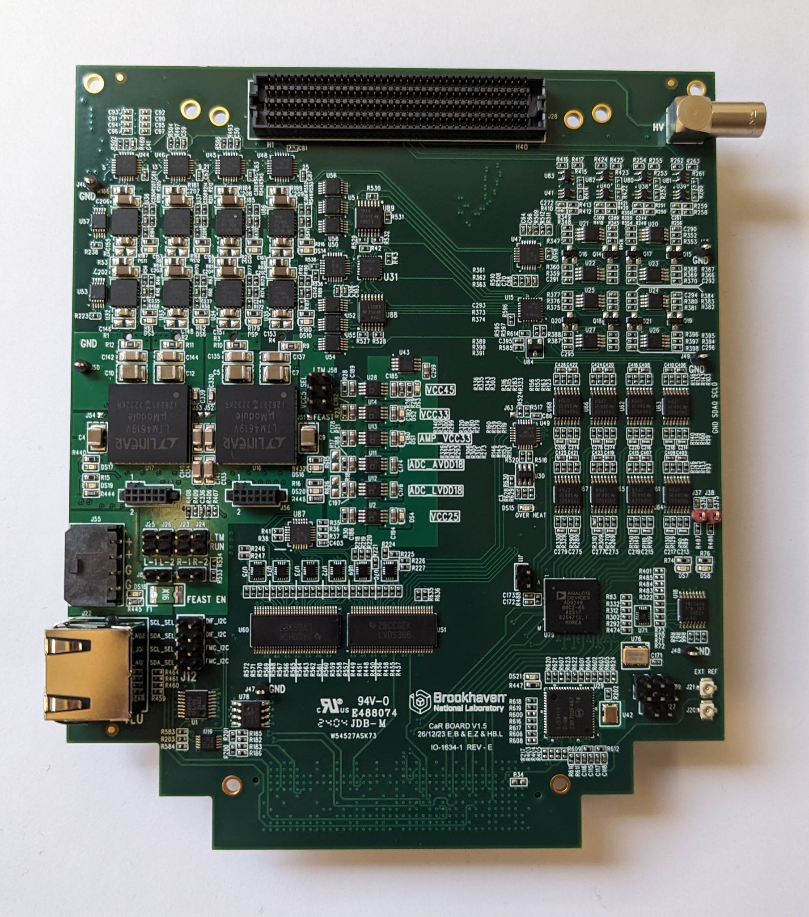
Carboard V1.5
Slightly updated version of V1.4 to replace obsolete parts and fix a few minor issues
Interim solution before V2 is ready
Have 5 boards assembled
1 shipped to CERN and 1 to Fermilab

Slide 3
Changes from V1.4
Replaced obsolete I2C to SPI bridge
Replaced level shifters for CMOS I/O
Changed 2 resistors to set identical gain on all ADC channels
Reconnected power rails on U89 which got disconnected in V1.4
Reconnected enable pin on U51
Inverted polarity of overheat LED
Misc cleanup of layout and schematic

Slide 4
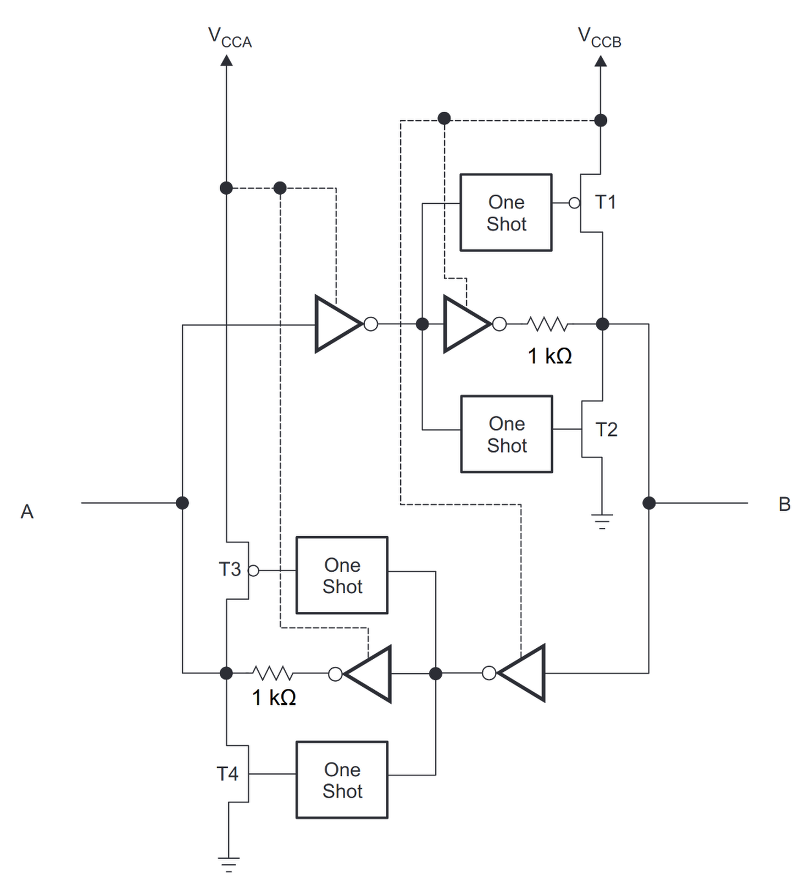
Level Shifters
Bidirectional level shifters for CMOS signals on V1.4 cause distortions and ringing, especially when driving long cables
Replaced bidirectional TXB0304 with unidirectional 74AVCT245GU and added series termination
Not yet tested with long FMC cable

Slide 5
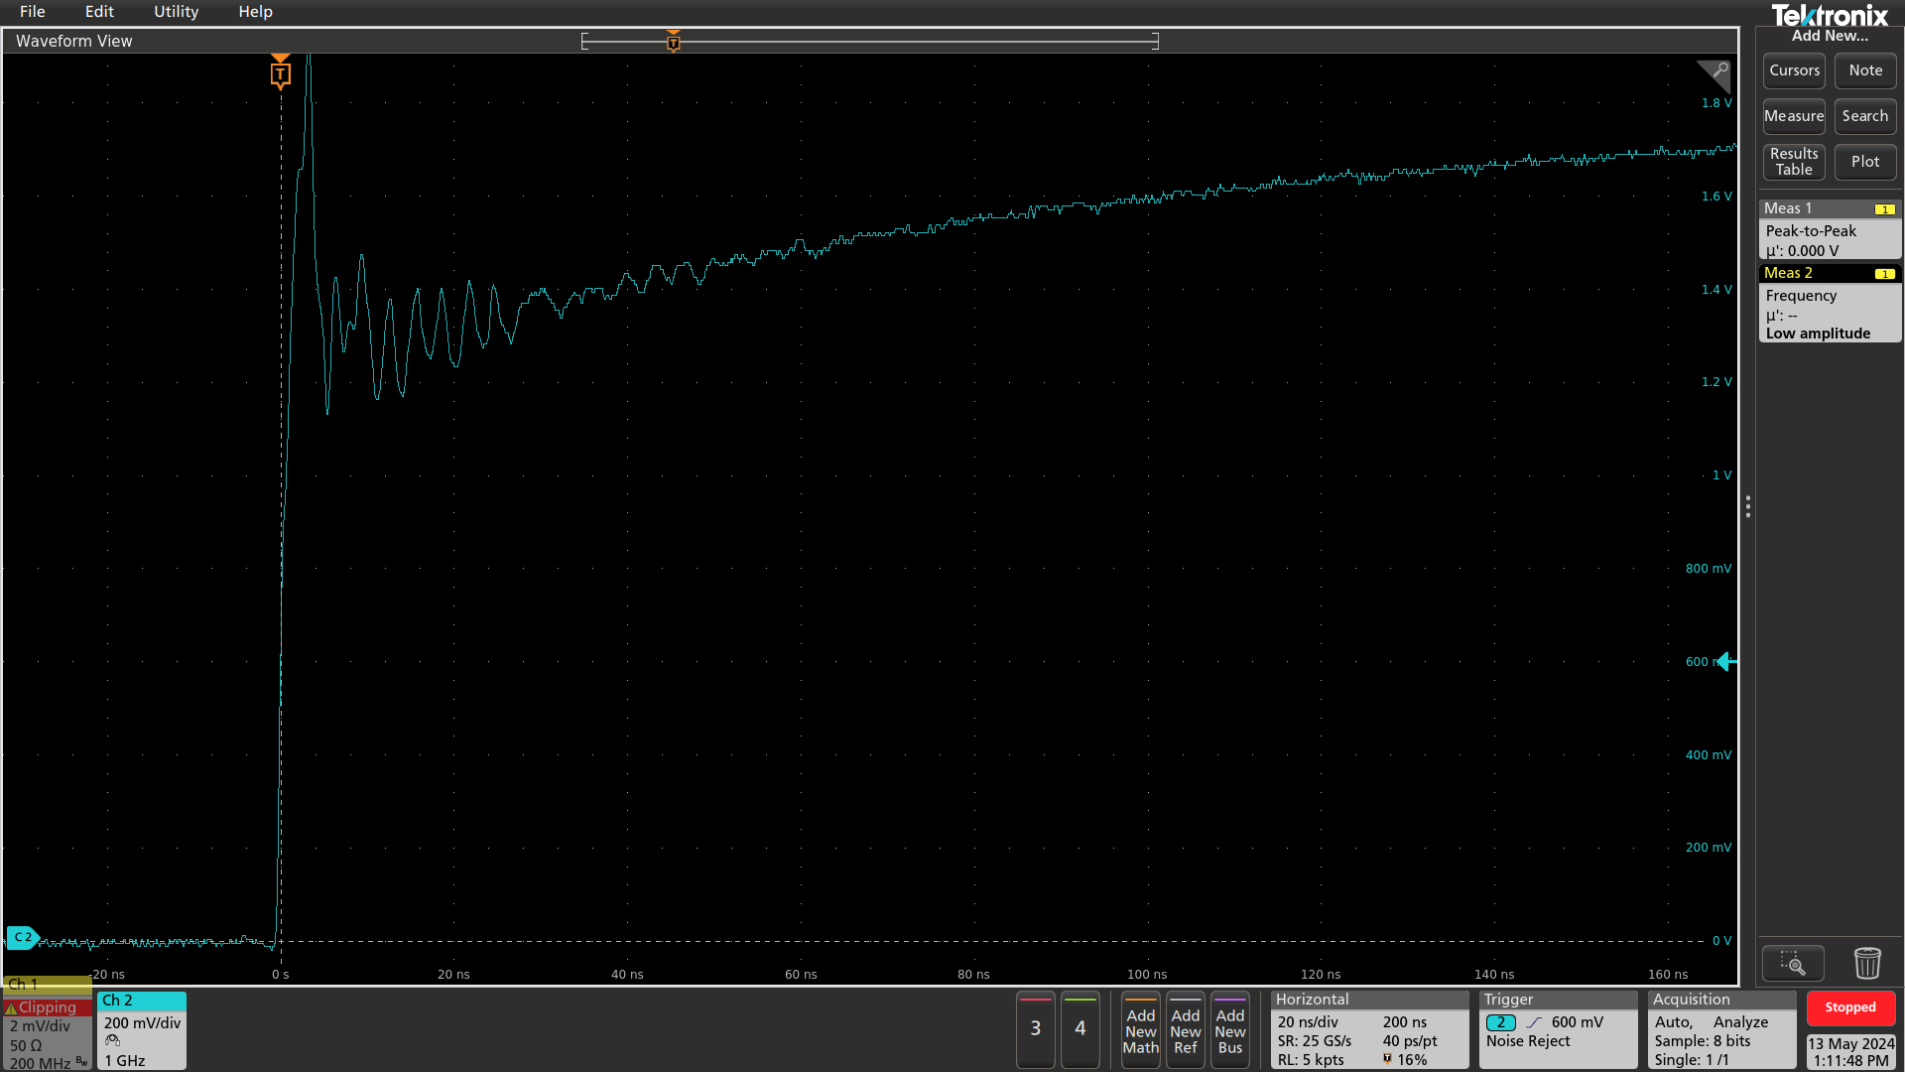

Testing: Level Shifters
Rising edge, breakout board without cable:
V1.3
V1.5

Slide 6
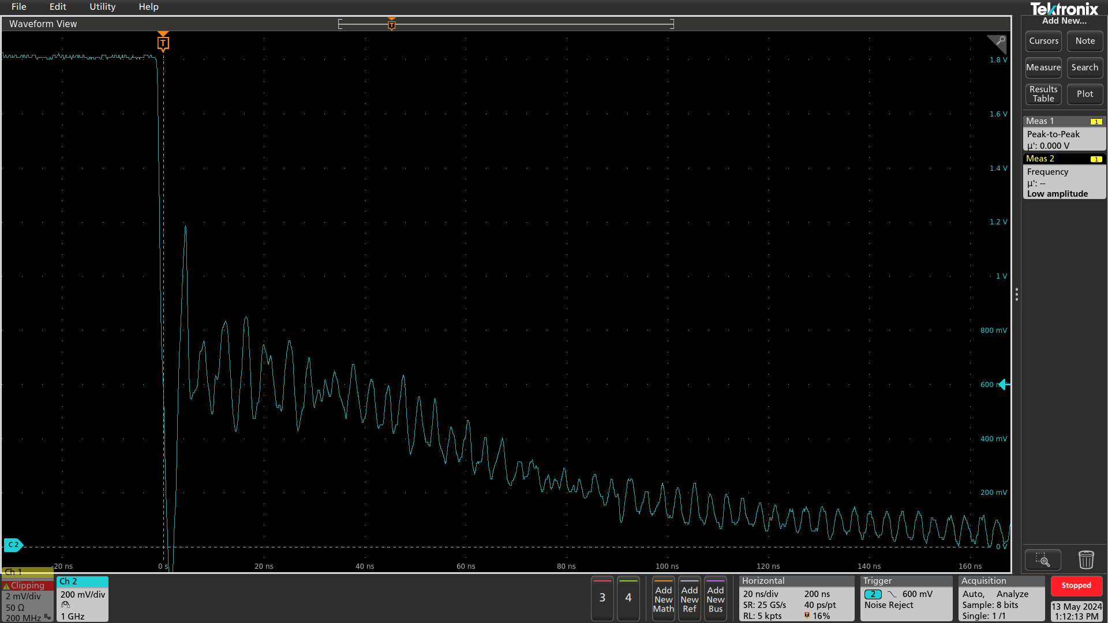
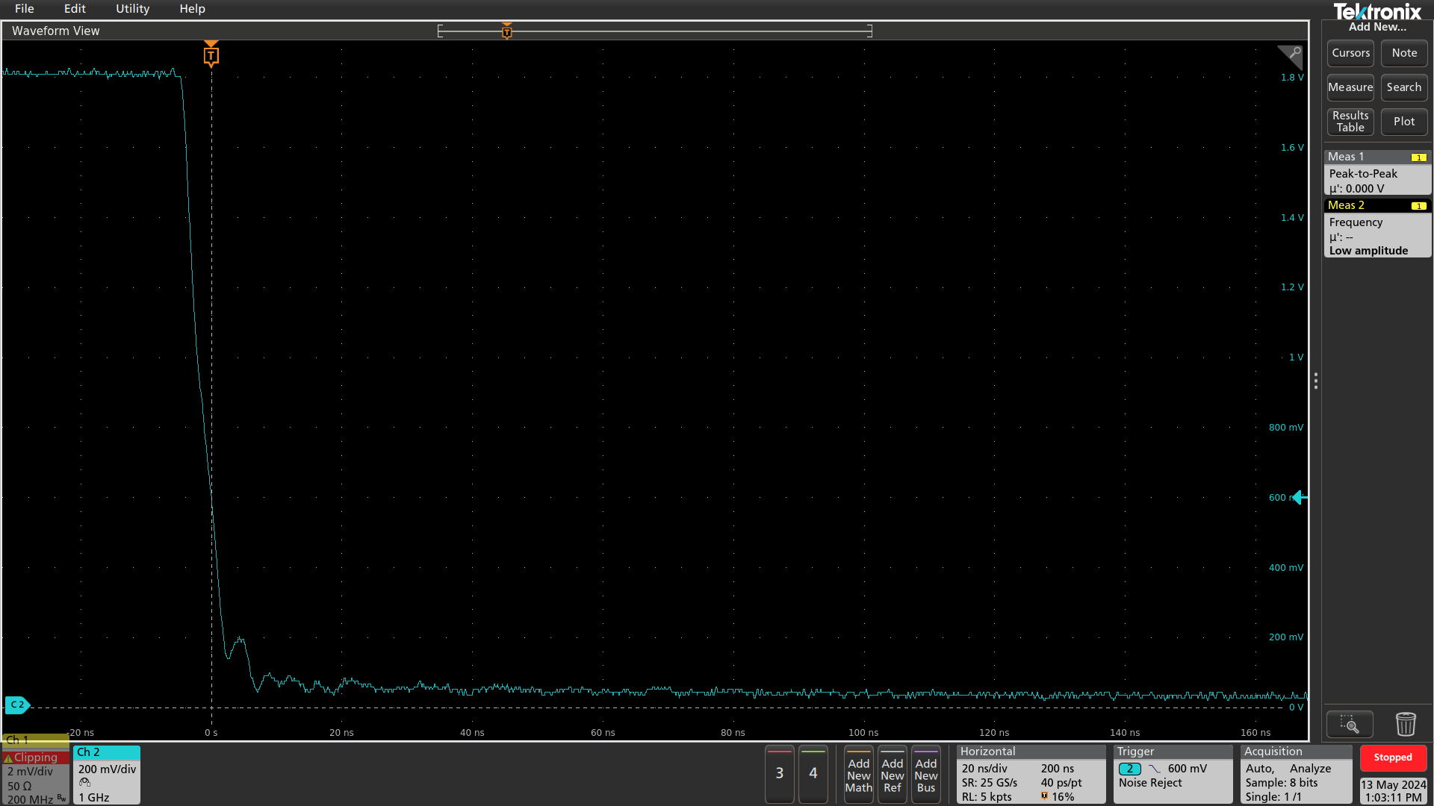
Testing: Level Shifters
Falling edge, breakout board without cable:
V1.3
V1.5

Slide 7
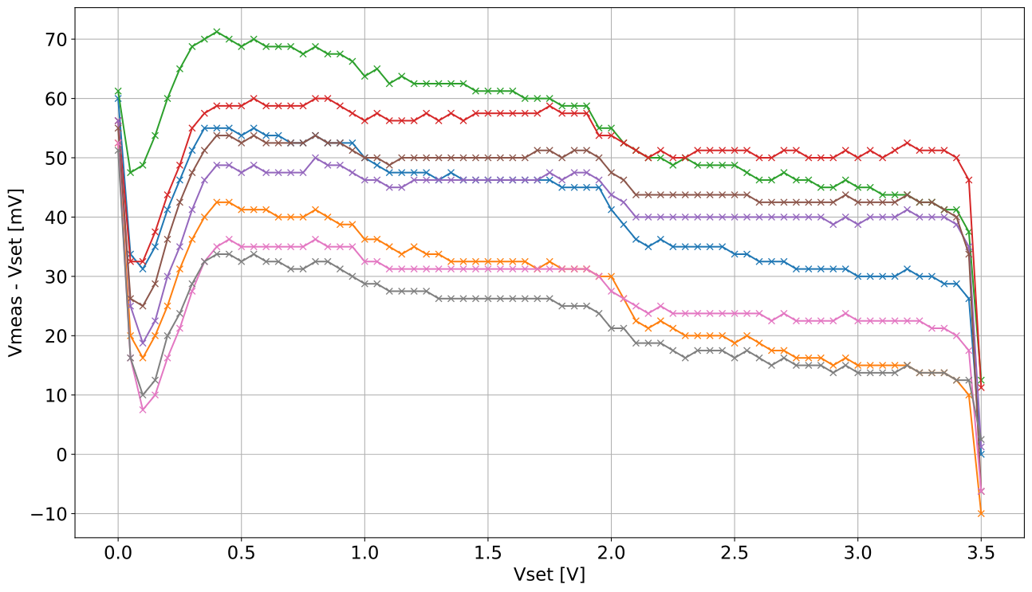
Testing: Power Supplies
Testing the 8 adjustable power supply channels
Measured voltage is 30mV - 60mV above set voltage
Mostly linear between 0.5V and 3.4V
Found error in current monitoring for negative values
no load

Slide 8
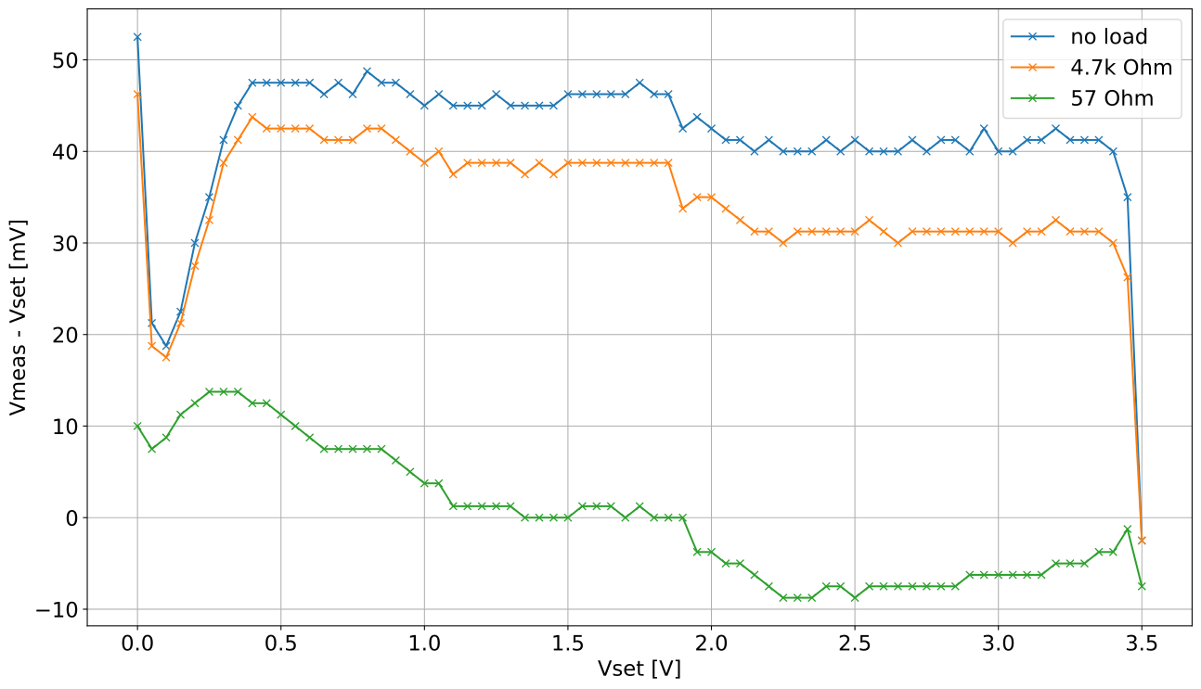
Testing: Power Supplies
Deviation seems to be caused by load regulation of TPS74401 at low currents
Improves with higher load
Board 2 channel 1

Slide 9
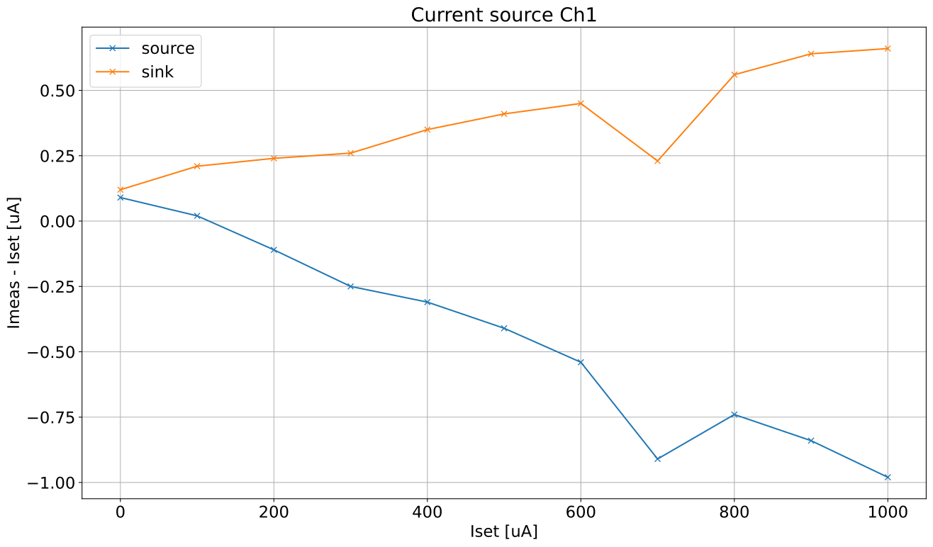
Testing: Current Sources
Found error in calculation: currents were off by a factor of 1.024
Mostly linear with a dip at 700uA
Gain error of about 0.5uA/mA (sink) and 1uA/mA (source)
Not tested more channels yet, resistors in current source are only 1%

Slide 10
Testing: 16 Ch ADC AD9249
0 ????+??*+++++++?
1 ++??++?*+++++++?
2 +++++++*++++++++
3 +++++++*++++++++
4 +++++++*++++++++
5 +++++++*+?++++++
6 +++++++???+????+
7 +++++++????????+
8 +++++++????????+
9 +++++++?00??000+
10 ++++?+++0000000+
11 ++++???+0000000+
12 ???+???+0000000+
13 ???????+0000000?
14 ???????+0000000?
15 00??0??+0000000?
16 000000?+00000000
17 0000000+00000000
18 0000000+00000000
19 0000000?00000000
20 0000000???00???0
21 0000000????????0
22 0000000??????-?0
23 0000000??-??---0
24 00000000-------0
25 0000?000-------0
26 0?00???0-------0
27 ???0???0-------?
28 ?-?????0-------?
29 ---?-??0-------?
30 -------0--------
31 -------0--------
Replaced obsolete I2C to SPI bridge SC18IS602B with SC18IS606
Used for SPI interface on AD9249 ADC
Software compatible but has different pinout
Testing SPI communication and receivers on FPGA by doing a phase scan:
  ADC is configured to send test pattern, received data is checked for different phase settings
  Works as expected, very similar results to V1.4

Slide 11
Conclusions
Updated V1.4 to fix (most of the) known issues
Tested the first 3 boards and verified the changes
A few peculiarities (i.e. power supplies) remain, which will be addressed in the development of the V2 CaR board

