Slide 1
WP4 – Target Complex
Kick-off meeting
BDF @ HI-ECN3 Project
Jean-Louis Grenard (SY-STI-TCD), Matthew Fraser – PL, et al.
16/04/2024

Slide 2
TODAY’S OBJECTIVE
Welcome and get all WP4 team onboard
Highlight key priorities & timeline during the TDR
Go through some admin/managerial aspects

Slide 3
WP4 Coordination meetings
Every 3 weeks (time slot still to be confirmed)
Objective:
  Streamline coordination efforts (by having everyone together)
  Define priorities
  Track changes
  Follow up on actions
  Present / review / discuss technical aspects
Will cover specific agenda
Sub-work package and technical meetings to be arranged with smaller groups

Slide 4
Content
HI-ECN3 Project & WP4 structure
Target complex for HI-ECN3
Why we need a TDR for the Target Complex?
WP4 Planning, activities, responsibilities, deliverables and resources
Admin
PLAN
E-groups
Indico, web & data-storage

Slide 5
HI-ECN3 Project & WP4 structure

Slide 6
Project Team
Matt’s slides at 345th IEFC
HI-ECN3 Study Project Team
Project Leader (PL):
Matthew FRASER
Deputy Project Leader (DPL):
Claudia AHDIDA
Project Safety Officer (PSO):
Melenia AVERNA
Project Radiation Safety Officer (PRSO):
TBC
Project Budget Officer:
Sylvie PRODON
Project Planning Officer (PPO):
Fernando PEDROSA
Configuration & Quality Assurance Manager:
Giulia ROMAGNOLI
Integration Support via ICEA:
Michael LAZZARONI
North Area Operation & Experiment Liason:
Dipanwita BANERJEE
SHiP Experiment Contact Person:
Richard JACOBSSON
SHiP Experiment Safety Correspondant:
Letizia DI GIULIO
Project & Experiment Safety Support (PESS) Correspondant :
James CURRIE
Admin Support:
Katarina SIGERUD & Ane-Mona BRANZA
+ WPLs
WP8 – Radiation field and R2E & R2M effects
Luigi ESPOSITO
WP1 – Project Management
Matthew FRASER
WP2 – Beam Extraction, Transfer and Delivery
Francesco VELOTTI
Deputy Laurie NEVAY
WP3 – Target & Beam Intercepting Devices
Rui XIMENES
WP4 – Target Complex
Jean-Louis GRENARD
WP5 – Exp. Area, Interface & Integration
Francois BUTIN
WP6 – Radiation Protection & Safety
Claudia AHDIDA
WP7 – Infrastructure, Services & Civil Eng.
Fernando PEDROSA

Slide 7
Project Work Breakdown Structure
WP8 – Radiation field and R2E & R2M effects
Luigi ESPOSITO
WP1 – Project Management
Matthew FRASER
Deputy: Claudia AHDIDA
WP2 – Beam Extraction, Transfer and Delivery
Francesco VELOTTI
Deputy: Laurie NEVAY
WP3 – Target & Beam Intercepting Devices
Rui XIMENES
WP4 – Target Complex (TC)
Jean-Louis GRENARD
WP5 – Experimental Area & Expt. Interface
Francois BUTIN
WP6 – Radiation Protection & Safety
Claudia AHDIDA
WP7 – Infrastructure, Services & Civil Eng.
Fernando PEDROSA
Planning, Scheduling & Coord.
Fernando PEDROSA
TDR Project Study Team
BE-CEM Jerome LENDARO, Luca BUONOCORE
BE-ABP Hannes BARTOSIK, Tirsi PREBIBAJ (PBC GRAF)
BE-CSS TBC
BE-EA Francois BUTIN, Michael LAZZARONI + Beatriz SUTIL MARTINEZ (ORIGIN), Johannes BERNHARD, Miguel SANTOS + Angelo PETRELLESE (ORIGIN), Laurie NEVAY + Fabian METZGER & Luke DYKES (GRAF), Dipanwita BANERJEE, David JAILLET
BE-GM Camille VENDEUVE
BE-OP Kevin LI, James RIDEWOOD
EN-AA Anna SUWALSKA, Tomasz LADZINSKI
EN-ACE Fernando PEDROSA, Ixone VAQUERO (ORIGIN) + Xavier PALLE (ORIGIN)
EN-CV Roberto BOZZI, Francesca DRAGONI + Nikola ZARIC (ORIGIN)
EN-EL Eva CANO GONZALEZ + Ming LIU (QUEST)
EN-MME Stefano SGOBBA, Ana Teresa PEREZ FONTENIA​, Luca GENTINI
EN-HE Roberto RINALDESI, Cristina DURÁN GUTIÉRREZ (ORIGIN)
SY-ABT Pablo ARRUTIA, Yann DUTHEIL, Matthew FRASER + Aleksandr GORN (PBC GRAF), Francesco VELOTTI, Bruno BALHAN, Friedrich LACKNER
SY-BI Federico RONCAROLO, Christos ZAMANTZAS + ORIGIN + TECH
SY-EPC Ivan JOSIFOVIC, Yves GAILLARD
SY-RF Giulia PAPOTTI
SY-STI Jean-Louis GRENARD, Rui Franqueira XIMENES + Mike PARKIN (QUEST), Luigi ESPOSITO + Guiseppe MAZZOLA (GRAF), Damien GRENIER,
Ruben ALIA, Nicolas QUINQUIS, Melania AVERNA, Michal MACHA
TE-MSC Philipp SCHWARTZ
TE-VSC Anthony HARRISON
TE-MPE Antoine COLLINET
HSE-RP Claudia AHDIDA+ Olin PINTO (QUEST) + Francesca LUONI (PBC QUEST), Renaud CHAROUSSET
HSE-OHS Simon MARSH + James CURRY (ORIGIN), Oriol RIOS + QUEST
SCE-SAM-FS John OSBORNE + Tamara BUDD (PBC QUEST) → Natacha LOPEZ, David Rodriguez GOMEZ + QUEST
EP Richard JACOBSSON, Letizia DI GIULIO & NA62 Technical Coordinator
Budget & Resources
Sylvie PRODON
Procurement
Project Office
Matthew FRASER
Technical Coordination
Matthew FRASER
Configuration & Quality Management
Giulia ROMAGNOLI
Installation
Commissioning

Slide 8
Project Work Breakdown Structure
WP8 – Radiation field and R2E & R2M effects
Luigi ESPOSITO
WP1 – Project Management
Matthew FRASER
Deputy: Claudia AHDIDA
WP2 – Beam Extraction, Transfer and Delivery
Francesco VELOTTI
Deputy: Laurie NEVAY
WP3 – Target & Beam Intercepting Devices
Rui XIMENES
WP4 – Target Complex
Jean-Louis GRENARD
WP5 – Exp. Area, Interface & Integration
Francois BUTIN
WP6 – Radiation Protection & Safety
Claudia AHDIDA
WP7 – Infrastructure, Services & Civil Eng.
Fernando PEDROSA
Planning, Scheduling & Coord.
Fernando PEDROSA
Extraction
Pablo ARRUTIA
Target Design & Engineering
Rui XIMENES
Target Complex Design & Engineering
Jean-Louis GRENARD
Expt Area Design & Engineering
Francois BUTIN
Safety Files
Melania AVERNA
NA-CONS Synergism
Fernando PEDROSA
Budget & Resources
Sylvie PRODON
Primary Beam Line
Laurie NEVAY / Francesco VELOTTI
BIDs Design & Engineering
Rui XIMENES
TC & Surface Building Integration
Jean-Louis GRENARD
Global Integration (inc. Exp. Area Integration)
Francois BUTIN
Radiation Protection
Claudia AHDIDA
Civil Engineering
John OSBORNE
Procurement
Magnets
Philip SCHWARTZ
XTAX Upgrade
Miguel SANTOS
Containment Systems
Jean-Louis GRENARD
TCC8/ECN3 Dismantling
Nicolas QUINQUIS / Francois BUTIN
Radioactive Waste Management
Renaud CHAROUSSET
Gas Distribution
Davide JAILLET
Project Office
Matthew FRASER
Power Converters
Ivan JOSIFOVIC
Experiment Requirements
Richard JACOBSSON
Service Cell Systems
Jean-Louis GRENARD
Shielding Proecurement & Recovery
Michael LAZZARONI
Fire Safety
Oriol RIOS
Cooling & Ventilation
Roberto BOZZI
Technical Coordination
Matthew FRASER
Vacuum Upgrade
Miguel SANTOS
Energy Deposition & Radiation Effects
Luigi ESPOSITO
Robotic Systems
Luca BUONOCORE
Experiment Interfaces
Richard JACOBSSON
Access & Safety Systems
Tomaz LADZINSKI / Anna SUWALSKA
Electrical & Fiber Infrastucture
Eva CANO GONZALEZ
Configuration & Quality Management
Giulia ROMAGNOLI
Instrumentation
Detailled Design & Production
Luca GENTINI
Remote Handling Systems
Roberto RINALDESI
Accelerator Interfaces
Francois BUTIN
Occupational Safety
Simon MARSH
Cryogenics
Installation
Machine Protection
Antoine COLINET
Target Instrumentation
Jerome LENDARO
Radioactive Components Storage & Disposal
Jean-Louis GRENARD
Experiment Installation
Francois BUTIN /
Richard JACOBSSON
Survey & Alignment
Camille VENDEUVRE
Operational Controls & Tools
Kevin LI
Material R&D
Stefano SGOBBA
Radiation to Electronics
Ruben ALIA
Experiment Requirements
Richard JACOBSSON
Handling Systems & Operational Support
Roberto RINALDESI
Commissioning
Beamline Shielding Improvements
Laurie NEVAY
Prototype Target Beam Test
Rui XIMENES
Accelerator Interfaces
Jean-Louis GRENARD
Telecom & Network
Experiment Requirements
Richard JACOBSSON
Magnetised Hadron Stopper
TE-MSC

Slide 9
Target Complex
HI-ECN3
Brief overview!

Slide 10
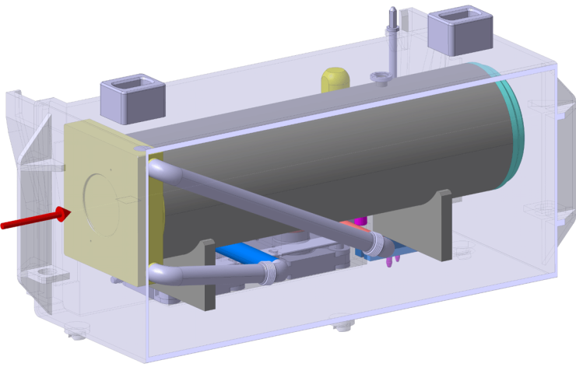
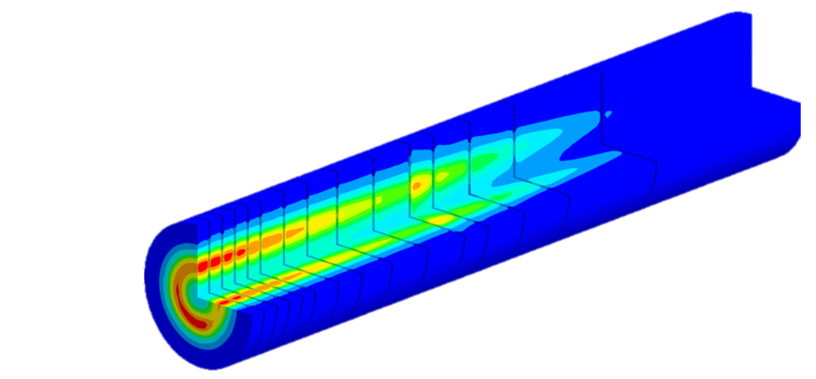
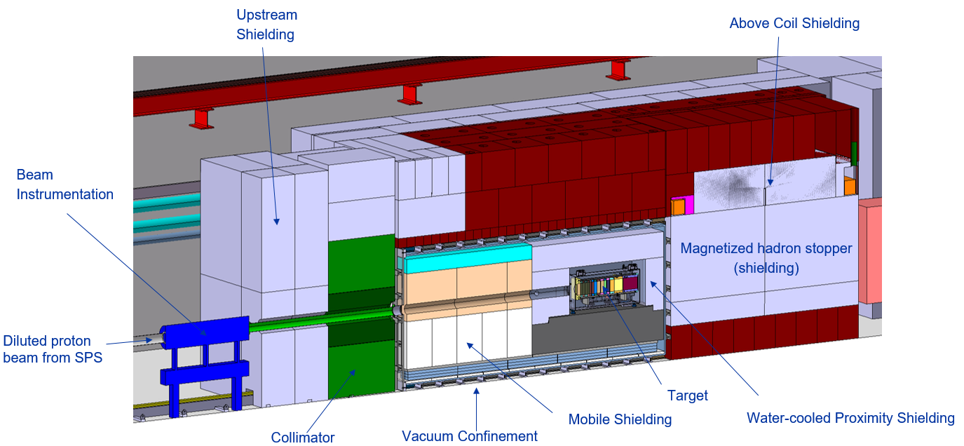
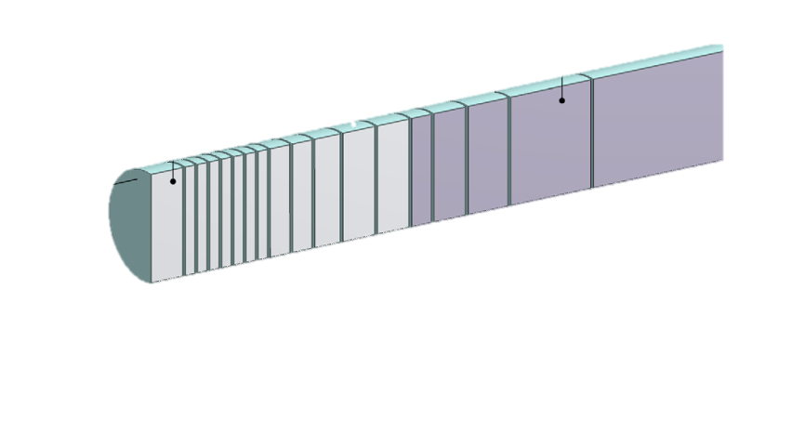
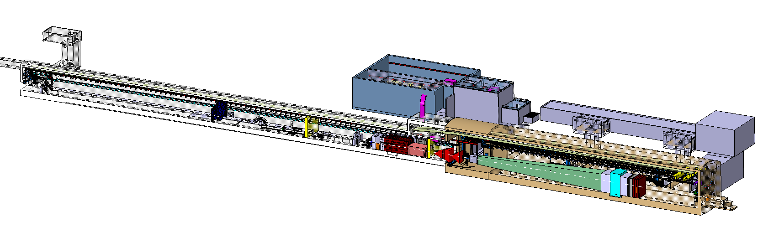
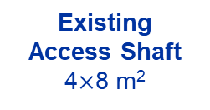
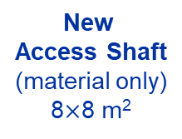
BDF/SHiP Target
Baseline Design → To be improved during TDR
WP4
WP3
13 x TZM blocks (580 mm)
5x W blocks (780 mm)
New
Service Building
~ 500 – 700 m²
New
Access Shaft
(material only)
8$×$8 m²
Existing
Access Shaft
4$×$8 m²
WP4
B911
B918
Beam Dilution System
TCC8
WP2
WP4
ECN3
WP6,WP7 +al.
New Target Complex
containing the Beam Dump Target
WP5+SHiP

Slide 11
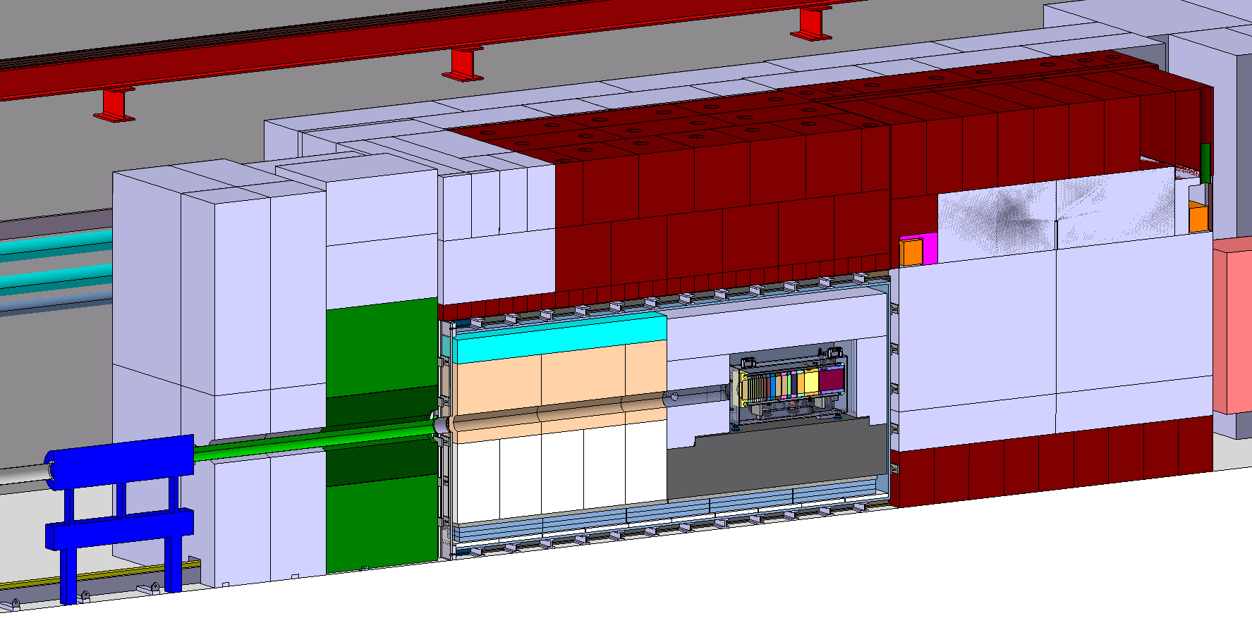
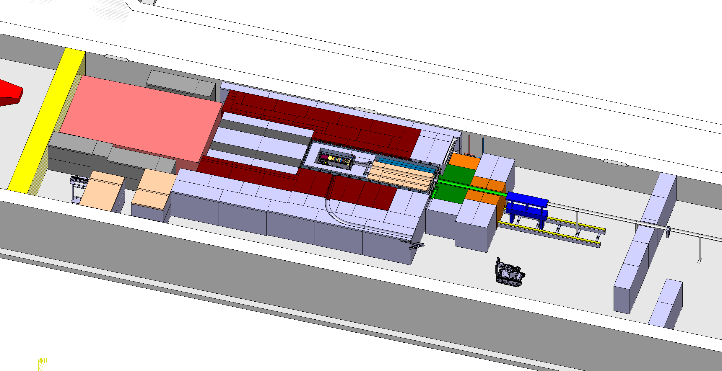
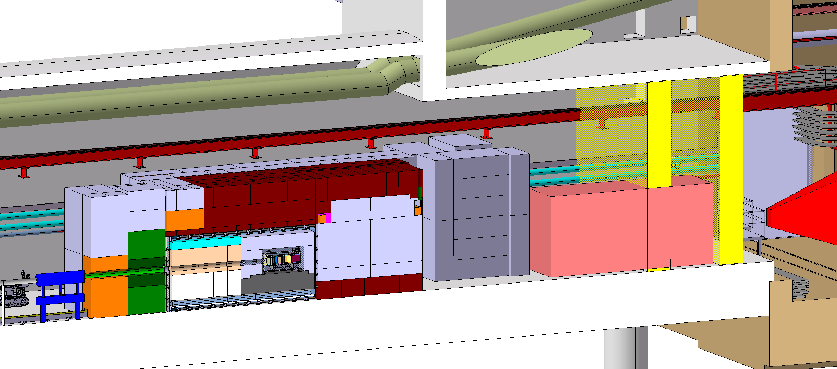
BDF Target complex integration
Upstream Shielding
Above Coil Shielding
Target area
Confinement wall
Magnetized
shielding
Beam instrumentation
Diluted Proton beam from SPS
Water cooled proximity shielding
Mobile Shielding
Vacuum confinement
Target
Collimator
Target station
SHIP experiment
Access chicane
Space for shielding temporary storage

Slide 12
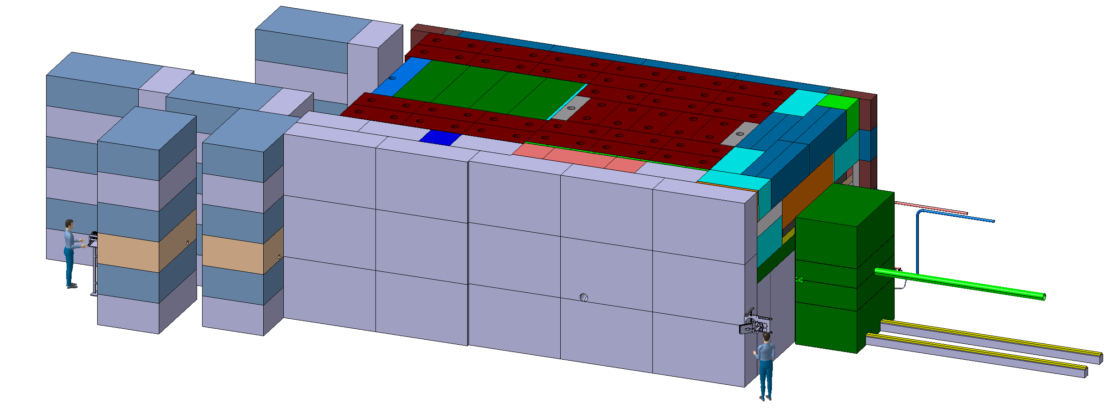
BDF Target complex integration - shielding
~4,8m
~8m
~ 180 m³ (~1400t) of cast iron + US1010
~ 360 m³ (~800t) of concrete / marble
~12m

Slide 13
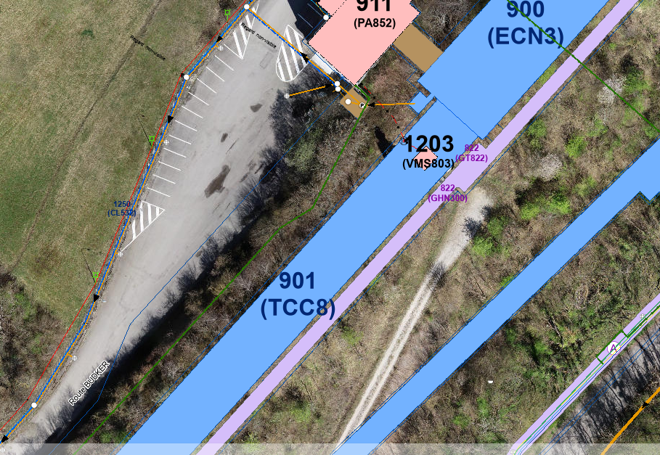
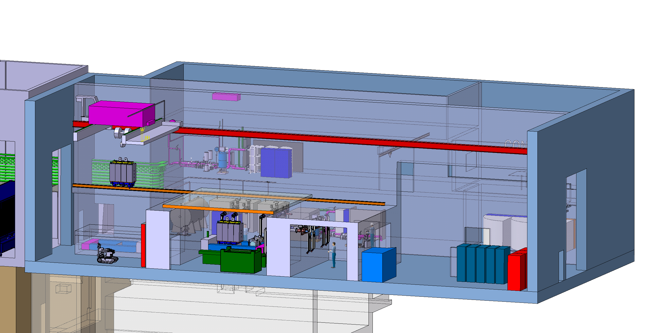
The target service building
Nuclear ventilation system of the target complex
  Air handling units, filters, dehumidifiers (outside)
Target cooling systems
  Pumps, Filters, Heat exchanger, Cooling instrumentation, He circulation system (target primary confinement)
Target controls systems
  Target monitoring (sensors), Target control valves, vacuum vessel confinement
  Service cell
Evaporator
Electrical distribution system
~700m²
* BDF/SHiP PCs: Investigation ongoing for finding am existing place, reusing existing PCs

Slide 14
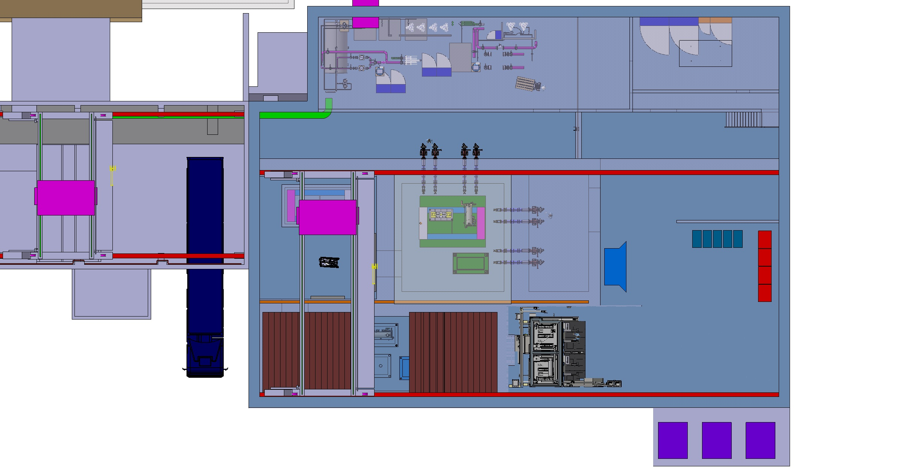
Service building
Cooling equipment
Material access
Control racks
New lorry access
Hotcell
Shielded buffer zone
Overhead travelling crane
Service cell
with a movable roof

Slide 15
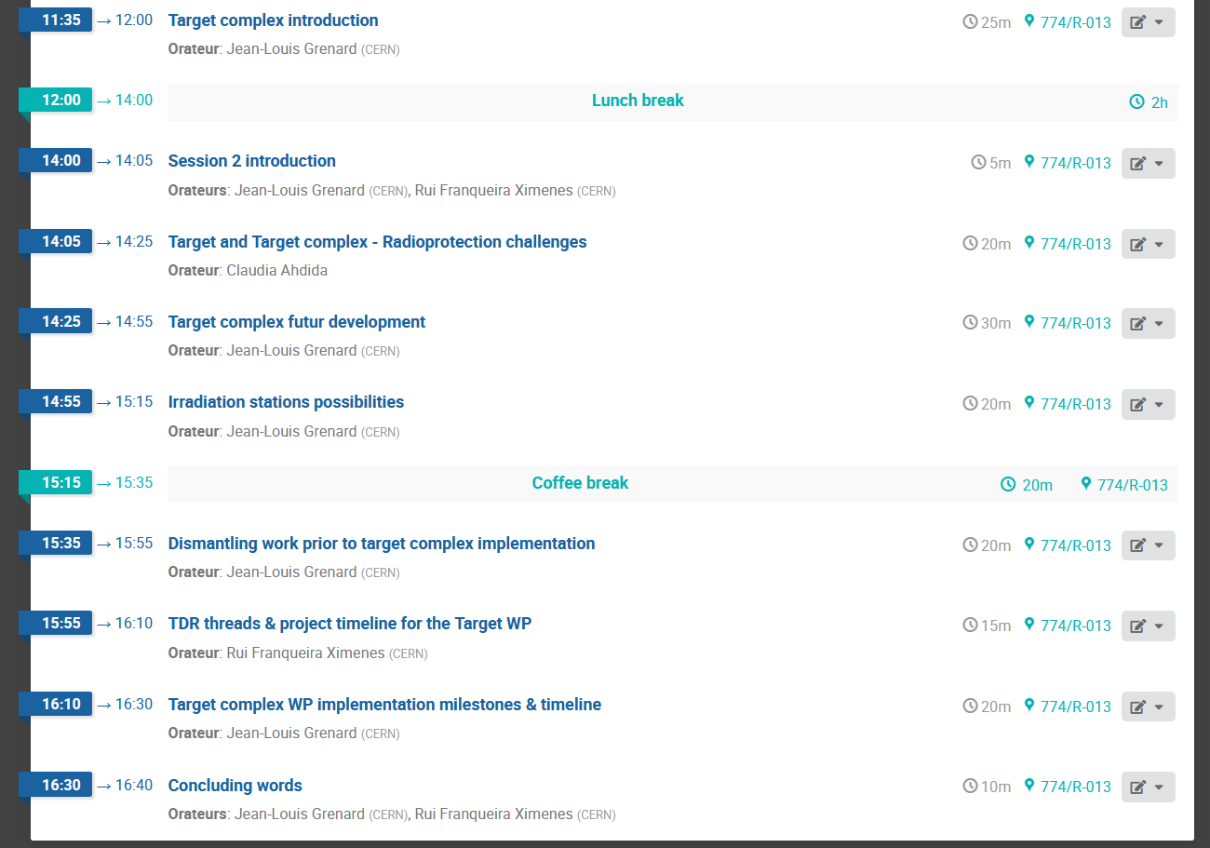
Target Complex - Initial concept review
29th April 2024
https://indico.cern.ch/event/1395903/

Slide 16
Why we need a TDR for the Target Complex?

Slide 17
Target station design
Move toward a detail mechanical design
  Vacuum confinement → design supported by external partners
  Extraction system → design supported by external partners
  Shielding design → to update based on shielding recovery possibilities
  Target supporting interface → need to develop a model
  Utilities routing → need to build mock-ups to test handling and shearing
Design to be made compliant (and flexible) with target, beam line and experiment requirements

Slide 18
Target service building
CE on the critical path
  Need the envelops defined by end of 2024
  Constrains with existing CE structure (911 shaft and TCC8 soil retaining wall)
  Design of the building mainly driven by Cooling and Ventilation equipment
  Building confinement to be defined (fire assessment)
  Shielding assessment to define building superstructure
Equipment part of the building → staged implementation
  Service cell and associated tools
  Hot Cell
  → Utilities made available but installation system staged

Slide 19
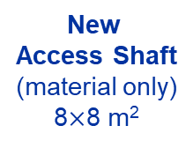
Interfaces
New
Service Building
~ 500 – 700 m²
New
Access Shaft
(material only)
8$×$8 m²
Existing
Access Shaft
4$×$8 m²
B911
B918
TCC8
New Target Complex
containing the Beam Dump Target
ECN3
Physical interface in between all the different systems

Slide 20
WP key Interfaces
Beam delivery WP2
  Position and definition of beam instrumentation
  Beam pipe
  Dilution system definition and position
Target WP3
  Cooling circuit design
  Supporting scheme
  Utilities routing
  Handling
Experiment WP5 + SHiP
  Magnetized hadron stopper
  Utilities routing in TCC8 and ECN3
  Shielding to minimize background
  Installation and maintenance tasks
  Experiment position
Internal interfaces WP4
CE structure
Cooling systems
Ventilation systems
Confinements
Survey network and alignment
Safety systems
Handling and remote handling tools
Shielding
Control systems (including protection systems)
Irradiation stations
We need to work on establishing clear interfaces definitions

Slide 21
WP key Interfaces
Interfaces will evolve following other WPs development
Be prepared on major changes
Certain choices on the target and experiment may have major consequence on target station design
We need to work with systems ‘’bricks’’ to adapt to changes
→ Some parameters must be frozen by end of 2024
→ Once the target station will be built and installed some elements can’t be changed: ie vacuum vessel, target station position, target size (increase)

Slide 22
Definition and assessment of failure scenarios
Failure scenarios will trigger design choice and exclude certain technologies
  Defined redundancy level
  Material selection (especially radiation tolerance)
  Back up plans
  Should contain all the different phases of the lifecycle of the complex
  Including unlikely events (ie earthquake)
  Preliminary risk of failure modes been established and need to work with stakeholders
  Establishment and execution of tests for systems validations

Slide 23
Target and target ancillary lifecycle
How to replace a target?
What is the process to move from an operational broken target to final repository?
Target size reduction
Target material separation
Imposed final repository casks by the authorities
Same apply for all target complex highly activated objects
  Probably more complex to handle
  Lot of destructive work to be performed

Slide 24
WP4 planning, activities, responsibilities, deliverables, resources

Slide 25
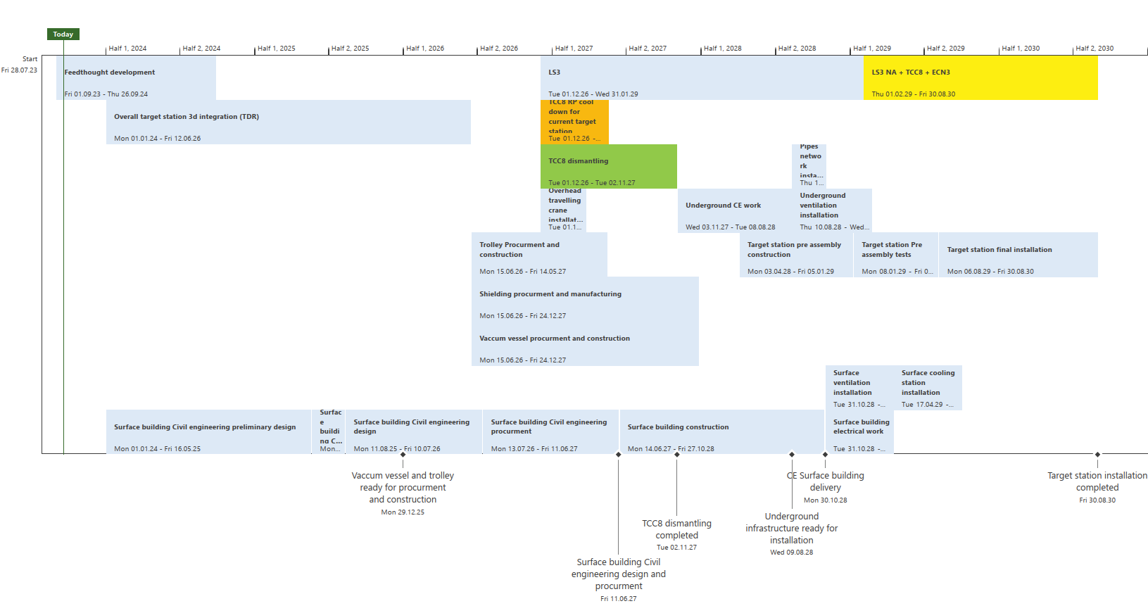
HI ECN3: WP4 – Target Complex Planning (key dates)
Draft : to be developed during TDR phase
TDR phase
Production, implementation phase
Commissioning & operation

Slide 26
HI ECN3: WP4 – Target Complex
Main activities & responsibilities
TDR phase
1) Target complex conceptual design followed by detailed design
  Radio protection studies (for design handling considerations) → HSE-RP/AS, C. Ahdida
  Definition of robotic tasks and design of associated tooling → BE-CEM, L. Buonocore
  Design/interfaces integration studies with beam delivery WP → SY-STI, BE-EA, SY-ABT
  Design/interfaces integration studies for the hadron stopper → TE-MSC
  Design/interfaces integration studies with experiment complex WP → SY-STI, BE-EA, EP
  Design and integration of CE modifications → SCE
  Design integration of vacuum components (primary vacuum confinement) → SY-STI
  Design integration of irradiation station(s) → SY-STI
  Definition of the handling procedures and design handling equipment → EN-HE, R. Rinaldesi
  Definition of air and cooling handling circuit routing → EN-CV, F. Dragoni
  Definition and design of the fire safety systems → HSE, EN-AA
  Definition and design of the access safety systems → HSE, EN-AA, BE (DSO), PSO
  Definition and assessment of failure scenarios → HSE, PSO

Slide 27
HI ECN3: WP4 – Target Complex
Main activities & responsibilities
TDR phase
2) Service building design followed by detailed design
  Definition of building integration to define building design → SCE, HSE-RP, EN-CV, SY-STI, EN-HE
  Radio protection studies (for design handling considerations) → HSE-RP/AS, C. Ahdida
  Definition of robotic tasks & accessibility and design of associated tooling → SY-STI, BE-CEM
  Design/interfaces/processes and integration studies with utilities and existing infrastructure → EN-CV, EN-EL, SY-STI, BE-EA, SCE
  Definition of the handling procedures and design handling equipment → EN-HE, R. Rinaldesi
  Definition and design of the fire safety systems HSE, EN-AA
  Definition and design of the access safety systems HSE, EN-AA, BE (DSO)

Slide 28
PLANs
Activity Description | WP | Coordinator | Plan Number(s) | Timeline | Comments
HI-ECN3 Target Station | 4 | Jean-Louis | 13710 | LS3+ | OK
HI-ECN3 Service Building | 4 | Jean-Louis | 13718 | LS3+ | OK
Upgrade of TCC8 Crane | 4 | Roberto | 13716 | LS3 | OK
HI-ECN3 BDF/SHIPs Power converters installation | 4 | Jean-Louis | 14015 | LS3 | OK
More to be created once we will move closer the implementation phase

Slide 29
Resources
GRADs supporting WP4
SY-STI, EN-CV, EN-EL, EN-HE, SCE, BE-EA, HSE-RP
Budget
2024:
110kCHF design work
200kCHF TT7 shielding recovery (managed by WP5)
2025:
130kCHF design work
700kCHF TT7 shielding recovery (managed by WP5)
500kCHF TCC8 handling systems upgrade

Slide 30
3d Integration methodology
Target complex centralized integration via BE-EA integration team
CATIA model
New service building
Once we agree on volumes in CATIA design will be performed with REVIT mainly managed by SCE and EN-CV to take full benefit of BIM system (I will propose a methodology to implement other utilities)
Will be migrated regularly to CATIA to check and validate interfaces and keep general TCC8/ECN3 integration manged by BE-EA integration team UpToDate
ICEA role
Validation of integration
Defined: https://edms.cern.ch/ui/file/3018359/1.0/SPS-XPM-MEMO-0001-1.0.pdf

Slide 31
e-groups
HI-ECN3 project
Hi-ecn3-project-team (It will gather the project team members)
cernbox-project-hi-ecn3-readers
cernbox-project-hi-ecn3-writers
Work package 4
hi-ecn3-wp4-core-team (Sub WP4.x leaders + core-team (ad-hoc))
hi-ecn3-wp4-members (all members of WP + contact people from other WPs)
hi-ecn3-wp4-info (Enlarged “for your information” e-group)
Let me know if you need a dedicated sub-WP e-group (hi-ecn3-wp4.x...)

Slide 32
Indico, web & data-storage
Indico - https://indico.cern.ch/category/17794/
Please create an indico event with notes/actions for your meetings
Let me know if you need your own category inside managed by you
EOS/Cernbox – https://cernbox.cern.ch/s/nlK7CKjNdyeahv7
Use cernbox to store all project related documentation
EDMS – https://edms.cern.ch/project/CERN-0000248960
Same directory structure as EOS. Use if for reports, documents requiring a release procedure etc. Remember to attach your documentation there.
JIRA – https://its.cern.ch/jira/secure/RapidBoard.jspa?rapidView=9206&projectKey=TARGCWG&view=detail&selectedIssue=TARGCWG-17
Follow-up of actions. (although recommended, is up to you to use it within your activities)
DFS - No! unless internal to your dep/group
If something else needed let me know

Slide 33
Thank you!
Welcome on board and all your contributions will key for the success of the project

Slide 34
Questions?

