Slide 1



Overview of European Accelerator R&D
European Laboratory Directors Group Meeting
06/06/2024 Brookhaven National Lab. USA.
Peter Williams
Accelerator Science & Technology Centre,
STFC Daresbury Laboratory & Cockcroft Institute, UK

Slide 2

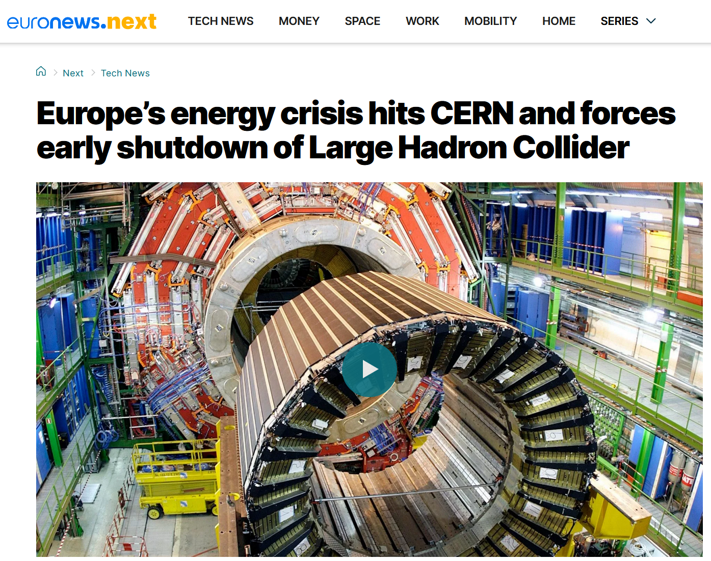
Landscape of European Accelerator R&D
What are the priorities for European accelerator R&D? …
A dauntingly large topic! Is there even such a thing?
Yes! And they follow from the dominant challenge to existing and future accelerator-based facilities in Europe = how to do more science using less energy, and less carbon
This talk:
Part 1:
What are the major supported facilities and their shortcomings?
What does society expect of us in future?
How will new accelerator facilities be approved?
Some comparisons to US approach…
Part 2:
LDG identified 5 accelerator R&D key topics specifically for particle physics in 2022 roadmap requested by the 2020 ESPP – I’ll summarise the state of play for these, and add a couple more personal choices

Slide 3

Priorities for Accelerator R&D – US Facility Construction / Preparation
Contemporary accelerator facility construction activity in the US from DOE Science Programmes:
Basic Energy Sciences Advisory Committee – 2023 Facilities Charge:
Linac Coherent Light Source II – High Energy Upgrade: $710M CD3B
Spallation Neutron Source – Second Target Station: $1800M CD1
National Synchrotron Light Source II – Experimental Tools III: $350M CD0
Linac Coherent Light Source II – Low Emittance Injector: $210M
National Synchrotron Light Source II – Upgrade: $1000M
Linac Coherent Light Source X: $1500M
High Energy Physics Advisory Panel – 2023 Facilities Charge:
LBNF/DUNE: $350M CD3A (furthest advanced sub-project)
Fermilab Accelerator Complex Enhancement – Main Injector & Target: $?
Advanced Accelerator Test Facilities (LWFA / PWFA): $?
Future Energy Frontier Colliders (FCC / ILC / ?): $?
Fermilab Accelerator Complex Enhancement – Booster Replacement: $?
Nuclear Science Advisory Committee – 2023 Facilities Charge:
Electron-Ion Collider: $2000M CD1
Facility for Radioactive Ion Beams – Energy Upgrade: $?
There is no such common framework or “guiding mind” for Europe!
Why? History & Politics…
National programmes +
Pan-European facility coordination +
EU research funding +
Treaty Governed European facilities e.g. CERN, ESRF, ESS
= A complex landscape!

Slide 4
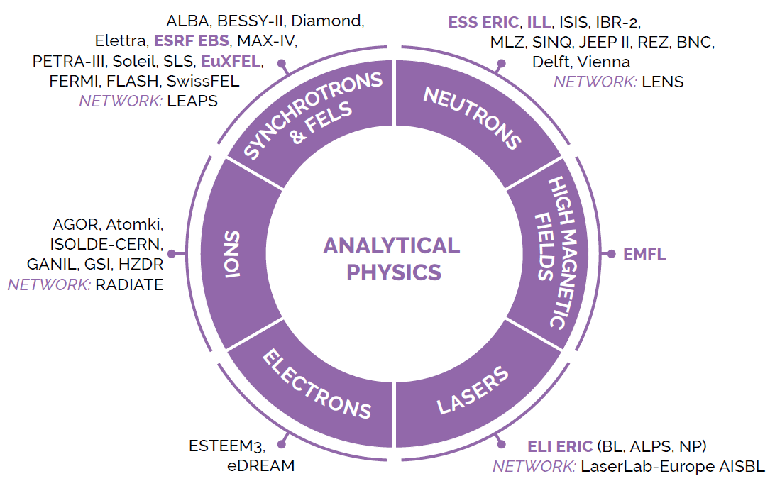

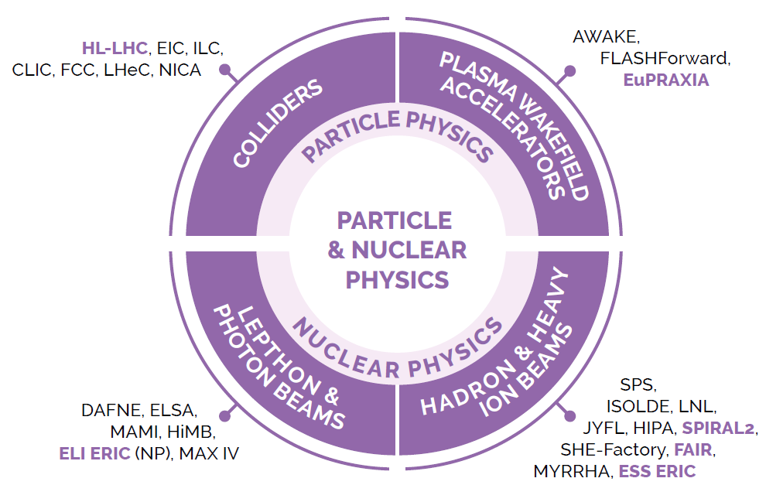
Priorities for Accelerator R&D – European Facility Construction / Preparation
Main body for pan-European research coordination = ESFRI – representation from: European Commission, Each of the 27 EU Member States, Each Associated Country (= a further 15 States e.g. UK)
ESFRI Projects (Early stage, construction start expected within 5 years):
EuPRAXIA – Plasma & novel acceleration R&D facility (569 M€)
ESFRI Landmarks (Finalising construction or operational):
ESRF-EBS – Upgrade of 8 GeV synchrotron light source to near-diffraction limit (128 M€)
ELI – Extreme Light Infrastructure = high power laser multi-site facility (850 M€)
European Spallation Source – SC linac driven neutron source (3009 M€)
European XFEL – SC linac driven free-electron laser (1540 M€)
FAIR – Heavy ion synchrotron, storage rings & antiproton production (? M€)
High-Luminosity LHC (1408 M€)
SPIRAL-2 - light ion SC linac upgrade of cyclotron based ion facility (307 M€)
Funding models are bespoke to each. The list matters as it guides EU research funding – notably “Framework programmes” – current one is Horizon Europe (2021 – 2027) = 95 Bn€
The latest strategy report on Research Infrastructures (2021) enumerates the live priority projects and their “investment costs”. Accelerators fall under “Analytical Physics” (light & neutron sources) and “Particle & Nuclear Physics” categories:

Slide 5
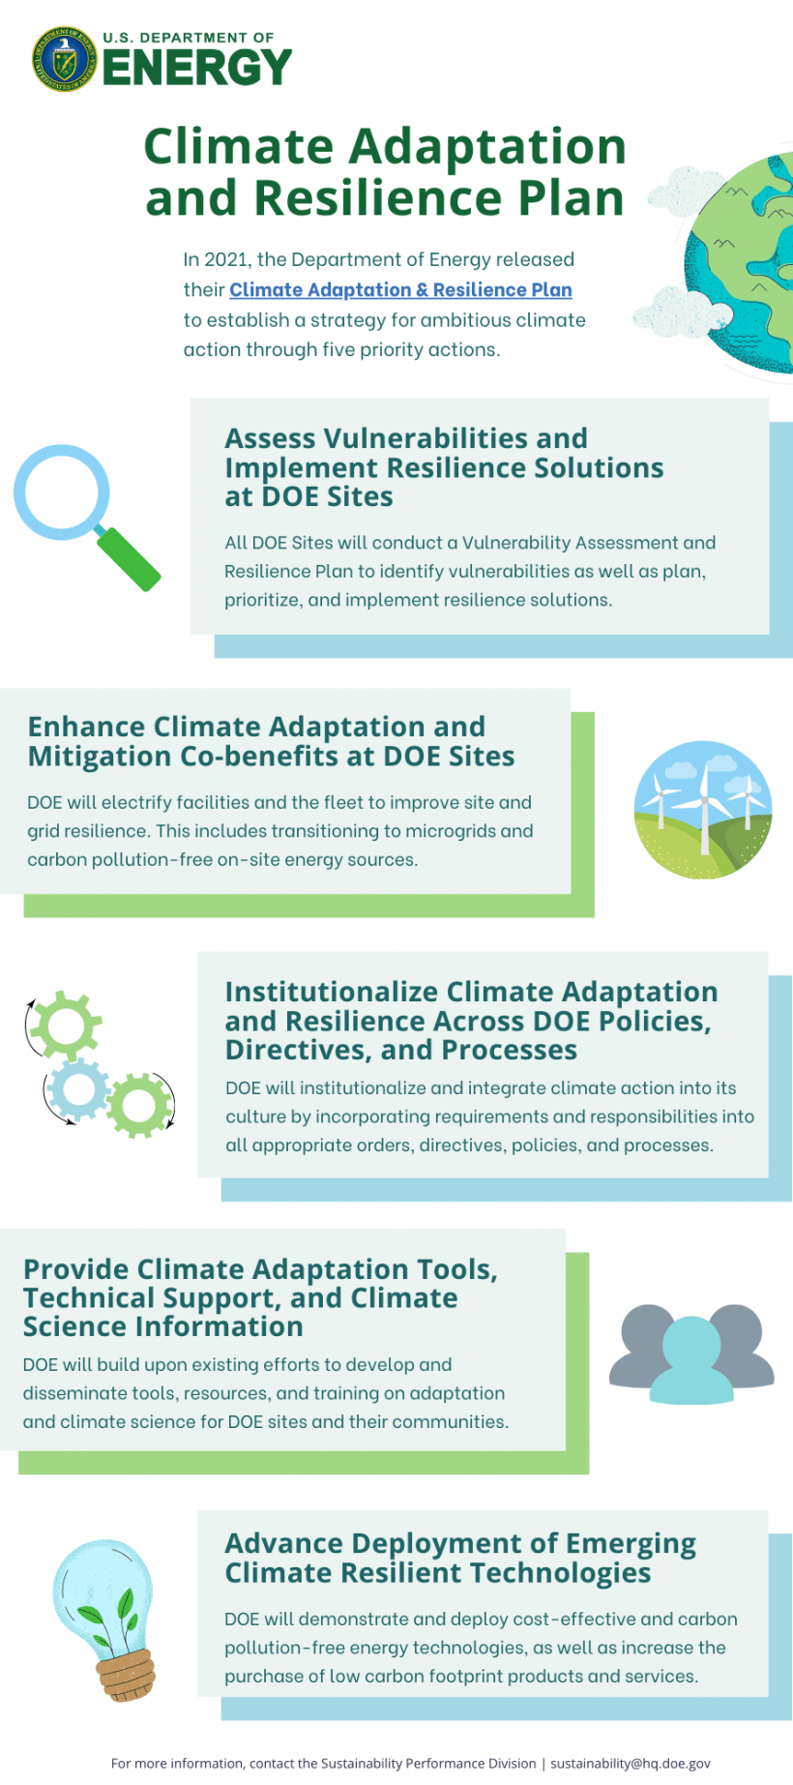
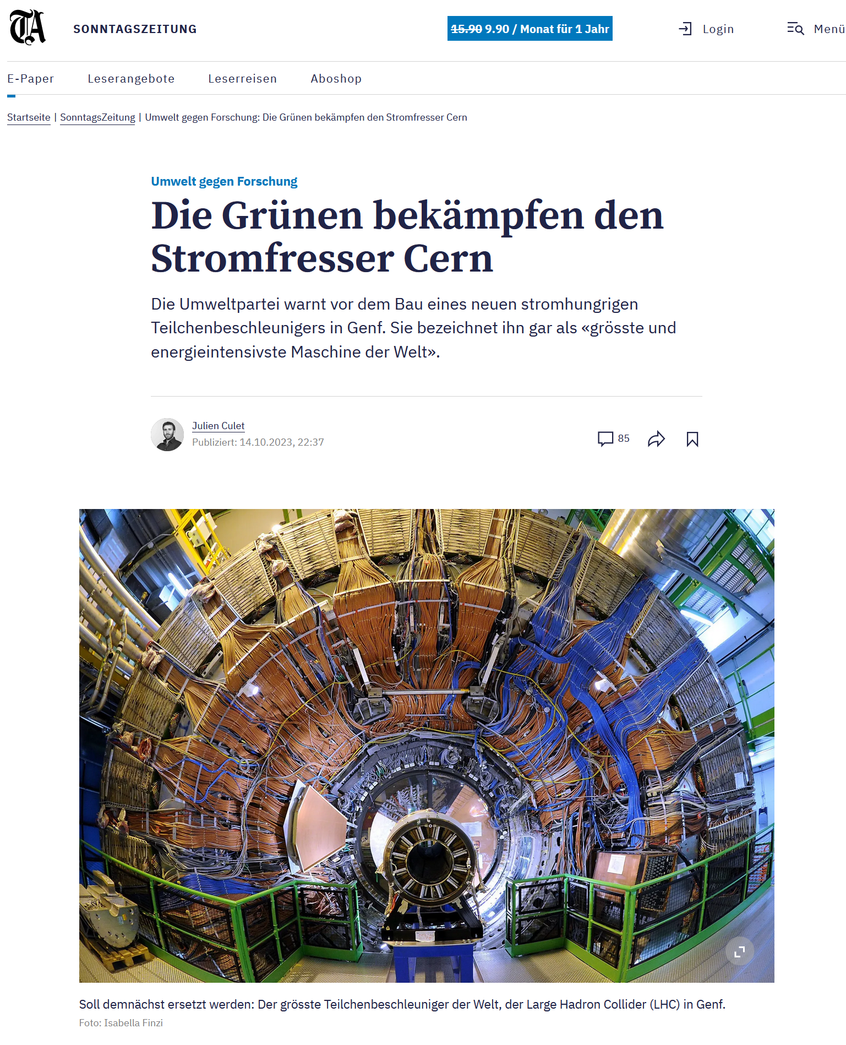
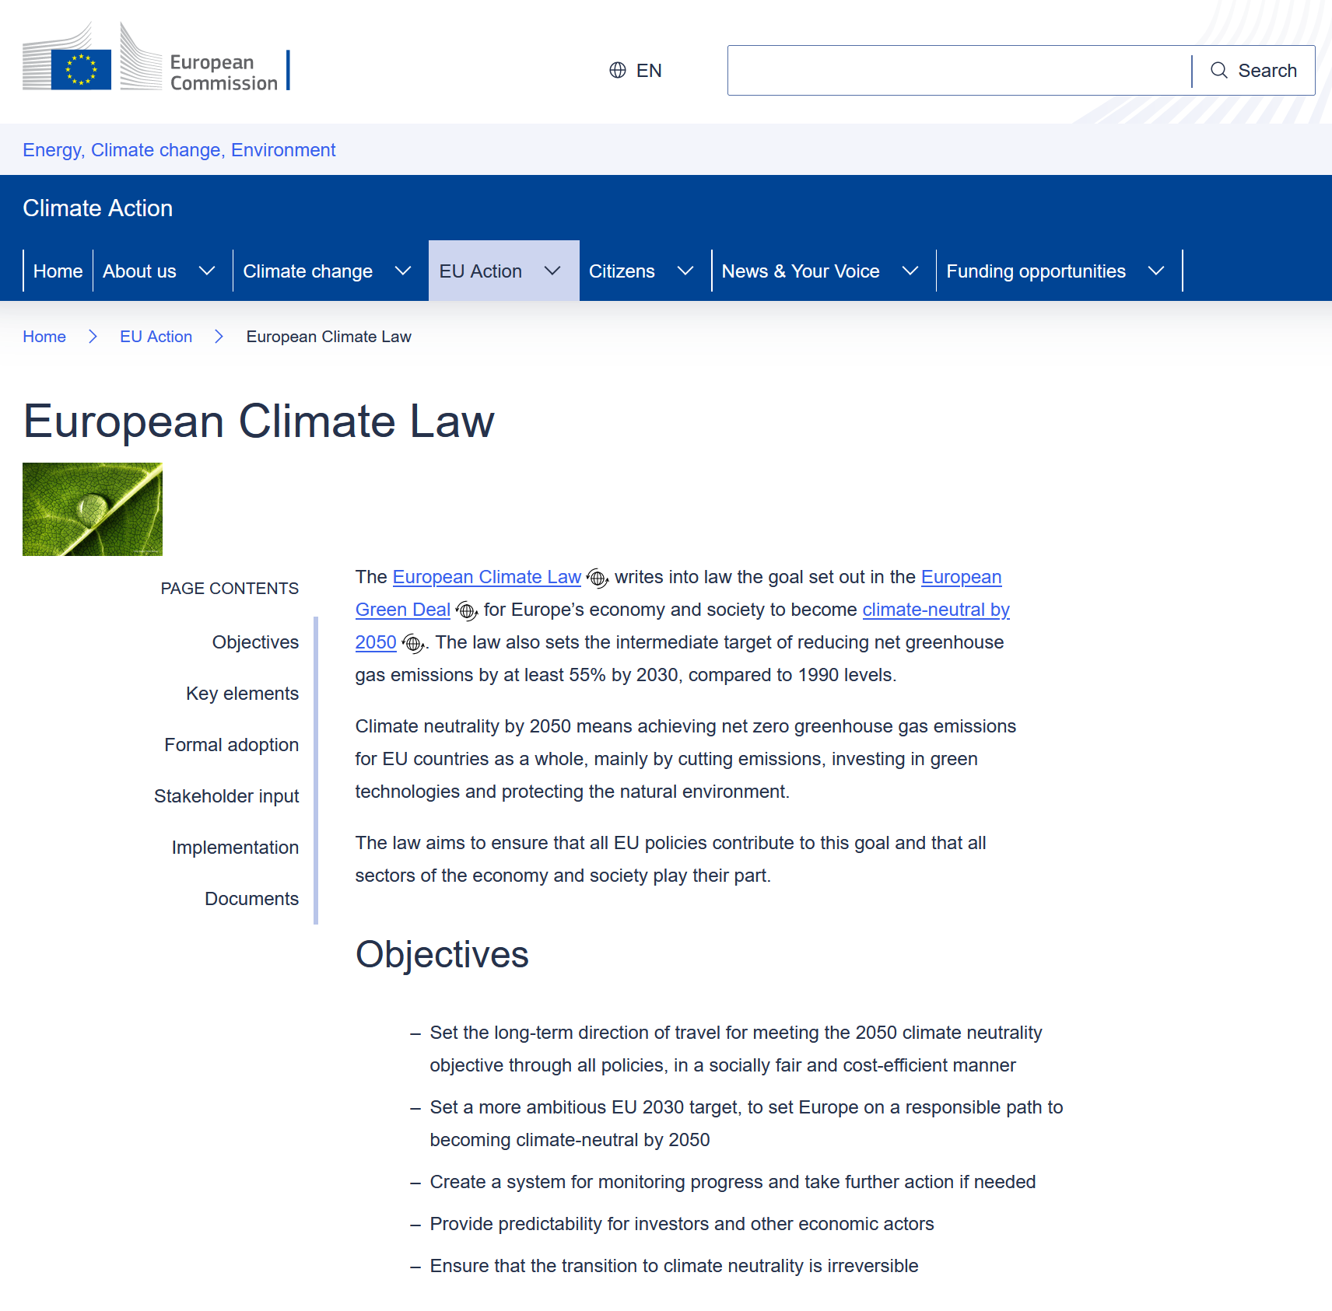
Priorities for Accelerator R&D – Facility Approval Processes – Climate Impact
In the US …
2022 DOE Sustainability Plan:
“Council on Environmental Quality requirement of net zero emissions from buildings, campuses and installations by 2045” …
…“DOE announced the new NZL Pilot initiative that lays the foundation for one of the first-ever models for addressing hard-to-decarbonize industries. Four DOE National Laboratories are taking proactive steps to produce and harness technology at their facilities to drive down carbon emissions. DOE expects the pilot to demonstrate solutions that can be replicated at facilities across DOE, state and local governments, and the federal government”…
In Europe …
“The Greens are fighting CERN, the energy guzzler.
The environmental party is warning against the construction of a new energy-hungry particle accelerator in Geneva. It describes it as the largest and most energy-intensive machine in the world”

Slide 6
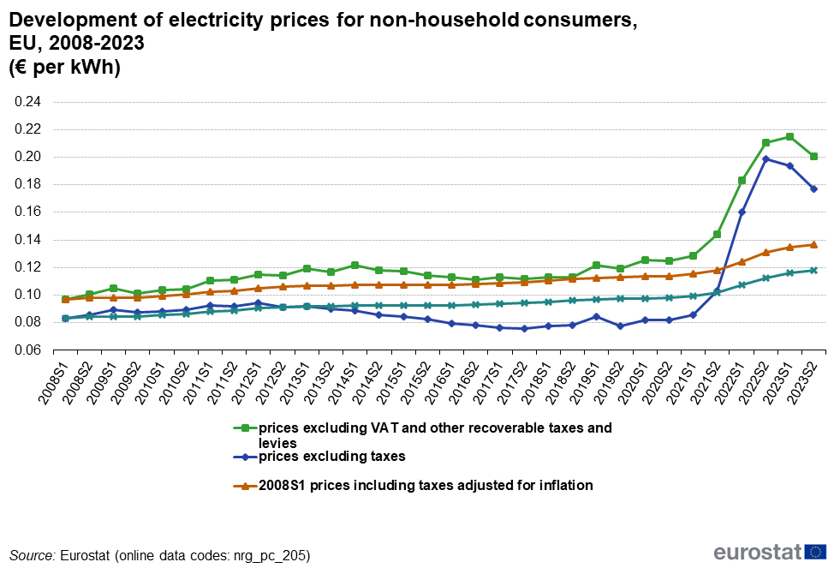
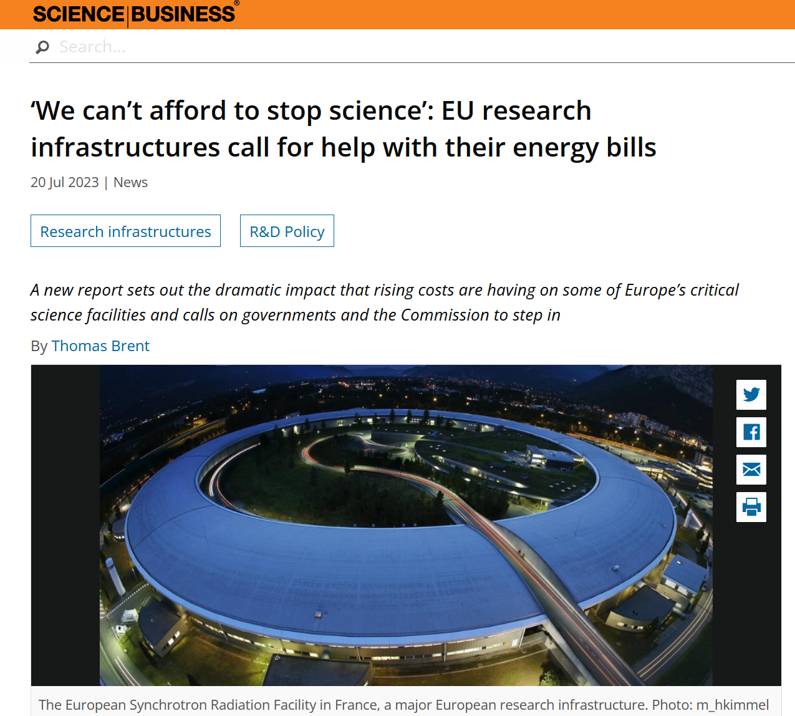
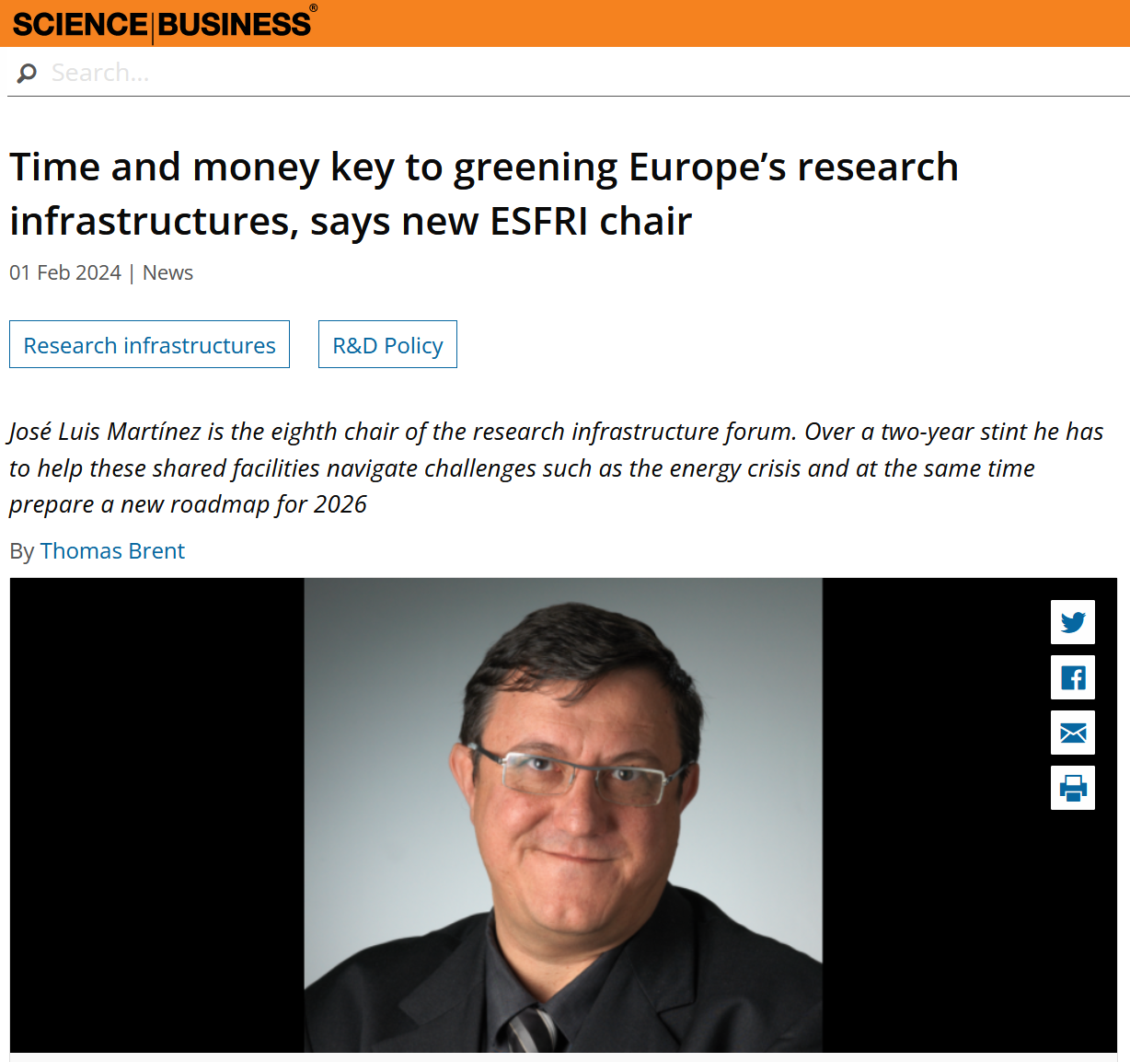
European Accelerator Facility Approval Processes – Energy Crisis Impact
In Europe … 2022 war in Ukraine produces electricity price spike … many research infrastructures forced to pause operations … 2024 spike has passed, but electricity costs elevated for the long term … European RI’s must adapt
July 2023
Feb 2024
⇒ The focus of European Accelerator R&D has shifted to “new scientific capability + less energy usage / climate impact”

Slide 7
Accelerator Facilities Use Energy During Operation
Quite some diversity! But this accounting fairly cursory. E.g. Doesn’t include large items like “people travelling to use it”
CLIC conceptual design report
LHC
Diamond Light Source - UK
ISIS Neutron Source - UK
RF 50%
magnets 21%
CV 16%
other 13%
magnets, RF 11%
cryogenics 38%
CV 12%
experiments 20%
other 19%
RF 12%
magnets 27%
CV 31%
beamlines 22%
other 8%
RF 11%
magnets 15%
water 13%
other 61%
CV = Cooling & Ventilation
ISIS “other” – mainly target cooling, beamlines and detectors

Slide 8
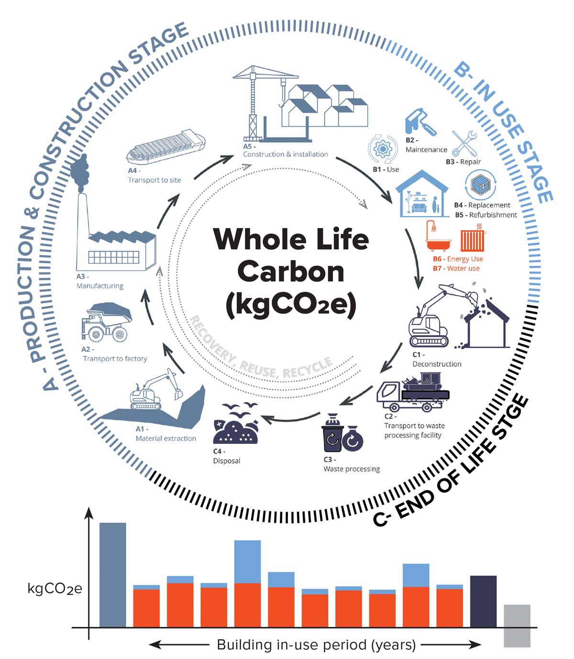
Accelerator Facilities Use Energy During Construction
Building an accelerator uses a lot of materials
  Steel, aluminium, copper, concrete
  Cabling, racks, servers, power supplies, …
All of this has a carbon footprint:
  mine raw material from the ground (e.g. iron ore)
  process it to refined material (e.g. magnetic grade steel)
  transport it to a factory
  make components (e.g. magnets)
  transport finished goods
Lifecycle analysis can capture this – complex to do
Emissions can vary a lot by country
  for instance, steel manufacture:
  1.1 kgCO₂e / kg (Mexico) up to 2.1 kgCO₂e / kg (China) …
In fact there is not (yet) a globally agreed definition of kgCO2e! …

Slide 9
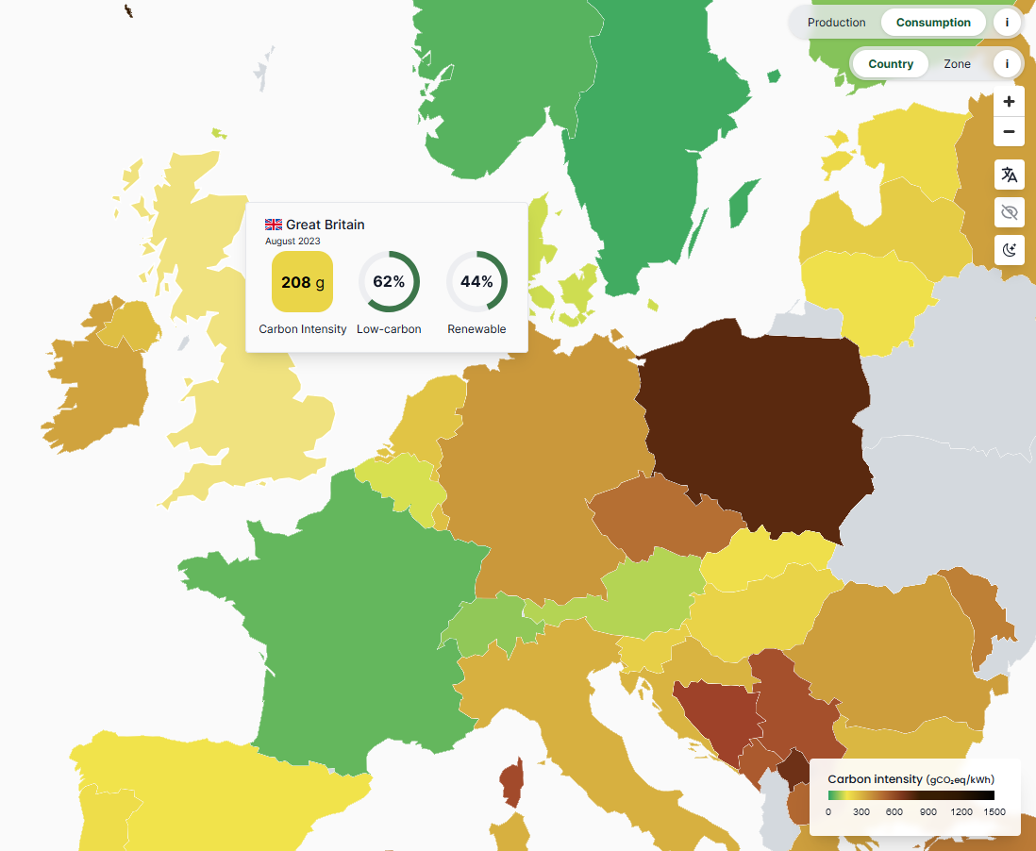
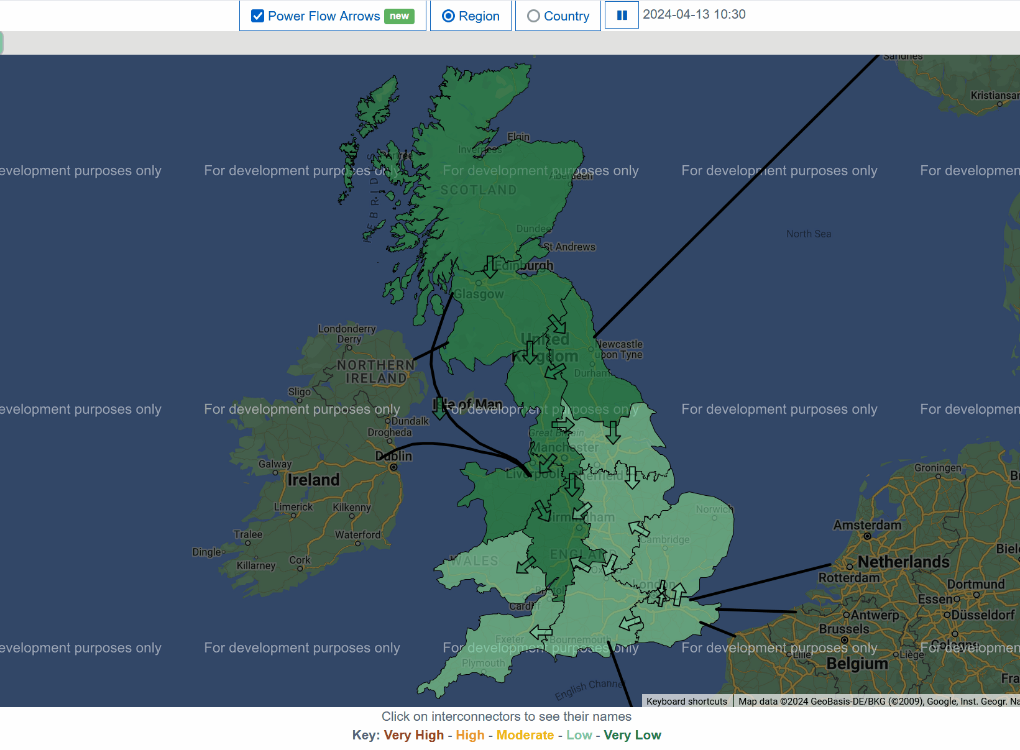
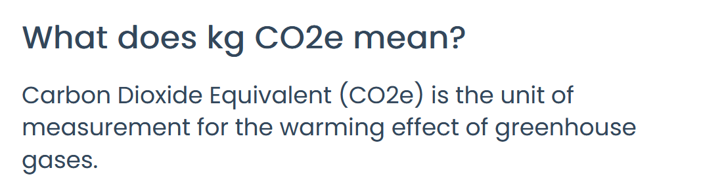
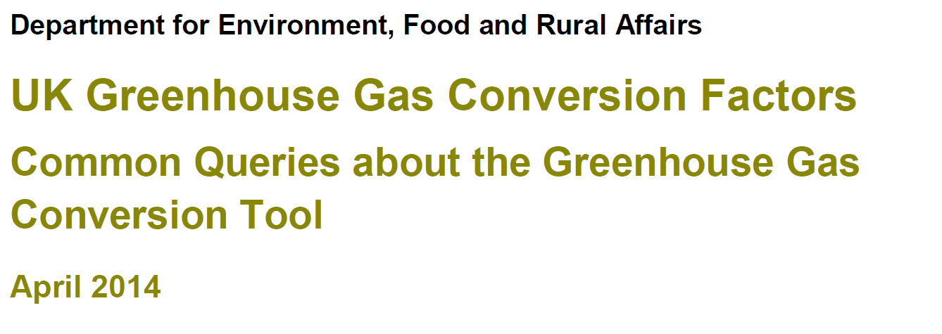
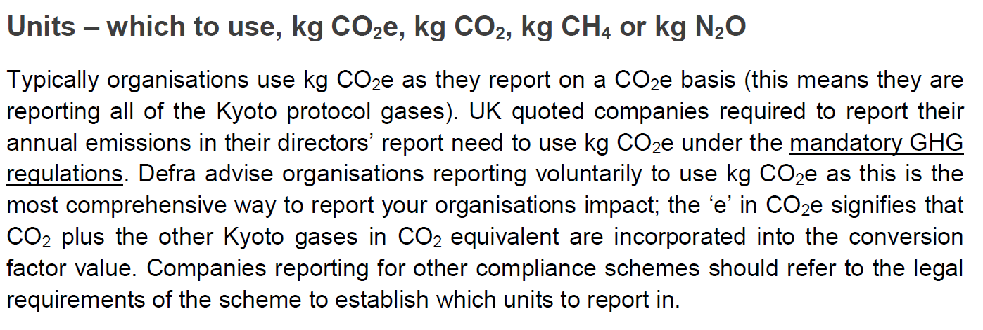
Where and When do Accelerator Facilities Use Energy?
← mostly fossil
One area of ambiguity is what assumptions do you make for future electricity grid carbon intensities? e.g. the UK is fairly green…
… but some areas are greener than others! It depends when the wind blows! … and where the nuclear power stations are!
Expect future facilities to need to justify their location, and timings of energy intensive operation to match with a fluctuating supply
you are here
mostly renewable →
  app.electricitymaps.com
  carbonintensity.org.uk

Slide 10

Sustainability In Project Approval – UK Infrastructure Fund - RUEDI
Funding route from UK Government for new national research infrastructures now requires mandatory sustainability lifecycle analysis by independent consultants
The electron diffraction facility RUEDI, to be sited at Daresbury Laboratory, recently successfully negotiated this process, being awarded £124M http://www.ruedi.uk/
Detailed review of the climate impact of the facility activities
Where are the Big Sources of emissions?
  Manufacturing? Steel / Copper / Aluminium / Concrete
  Operations? Running RF and magnet systems. Cooling & AC
  Disposal? End of life of components – not considered (yet)
How can we reduce these for the biggest impact?
  Using different materials
  Improved efficiency
  Smart powering schemes
Figure of merit is kgCO₂e per “delivered unit”
  Other environmental impact indicators are available
  (land use change, ocean acidification, eutrophication etc)
  so this isn’t really the same as a full LCA
  Aim - a database listing carbon emissions for components in every area
Laser systems
Pump conversion
Electron Source
CONDENSOR LENS
Imaging/Microscopy
OBJECTIVE LENS
PROJECTOR LENS
CONDENSOR LENS
INTERMEDIATE LENS
DECHIRPER CAVITY
SAMPLE STAGES
DETECTOR
QUAD
QUAD
YAG/DIAG
F-CUP
QUAD
YAG/DIAG
Ultrafast Diffraction
QUAD
LOAD-LOCK
QUAD
QUAD
Laser systems
Diffraction Station
YAG/DIAG
TW
GUN
BAM
ICT
SOL
IINTERMEDIATE LENS
PROJECTOR LENS
DETECTOR
Laser Systems
QUAD
PI conversion
QUAD
QUAD
QUAD
SAMPLE CHAMBER
QUAD
QUAD
F-CUP
DEFLECTOR
YAG/DIAG
YAG/DIAG
Laser delay
Pump conversion
INTERCHANGABLE SAMPLE CHAMBERS
Laser oscillator
F-CUP
-1m
0m
1m
2m
3m
4m
5m
6m
7m
8m
9m
10m
11m
12m
13m
14m

Slide 11
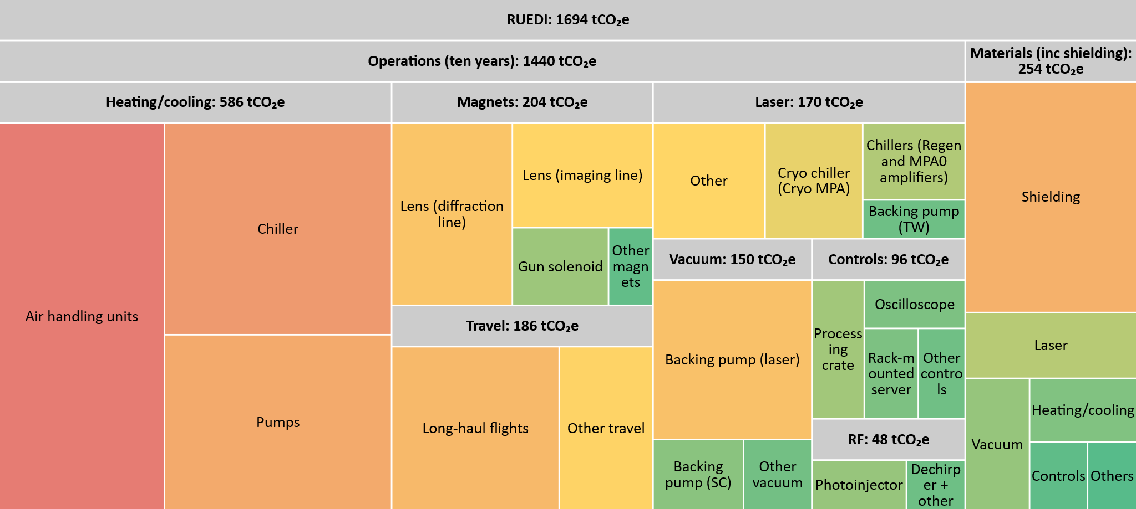
RUEDI Electron Diffraction Facility Lifecycle Carbon Footprint
Further iterations: more than 10 years operation will be favoured for future analyses (50 years for UK-XFEL) ⇒ component obsolescence models needed

Slide 12
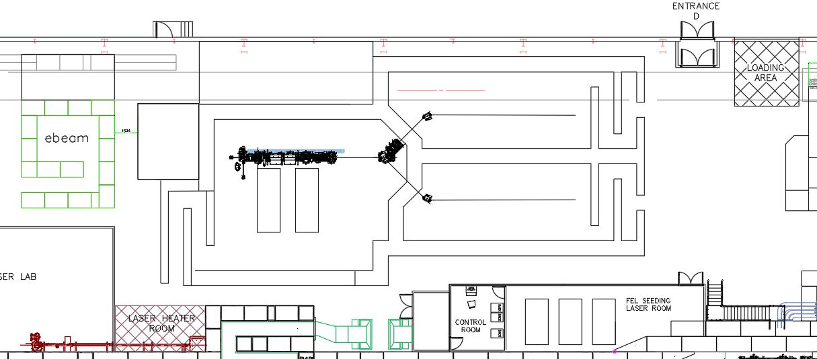
RUEDI Electron Diffraction Facility Lifecycle Carbon Footprint
Pick one component = shielding:
Structural materials (‘the building’) and radiation shielding is a major component of nearly all particle accelerator infrastructure; these use large quantities of concrete
Cement only represents 15% of the mass of concrete, but most of the CO₂ emissions
Today’s cement production accounts for 8% of global CO₂ emissions: 900 kgCO₂e/ton
CO₂ production during cement manufacture is mainly due to clinker intermediary
34m
13m
Rack room
11m x 4m
5m
Sync room
6m x 4m
12.6m
User Area 1
User Area 2
Laser tables 4.2m x 1.5m
Shielding 1m thick
Possible mitigation strategies:
  Modular / standardized shielding (blocks and beams), e.g. v-blocks, can be re-used / reconfigured
  Frame and infill construction using (local) aggregates, earth, sand etc.
  Replacement of clinker with recycled materials (fly ash, GGBS) – used in STFC EPAC project
  Alternative shielding materials and combinations, e.g. for neutron shielding

Slide 13

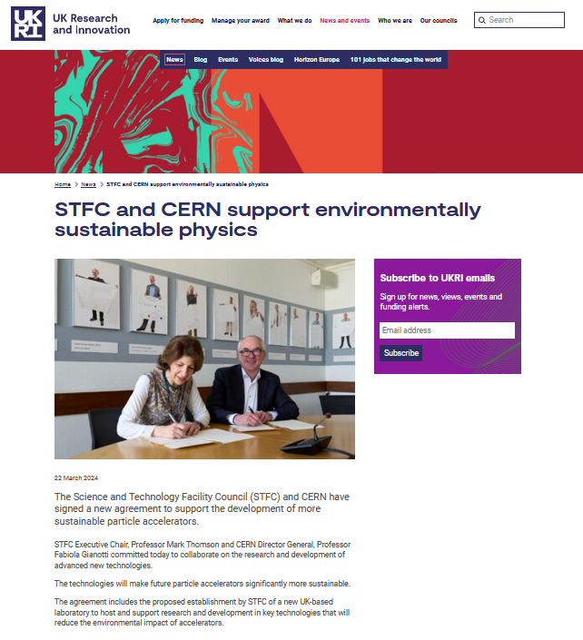
Centre of Excellence in Sustainable Accelerators @ Daresbury, UK
The RUEDI carbon lifecycle analysis is the first attempt to do a proper accounting in a UK research infrastructure
We are now conducting a similar exercise for the larger UK-XFEL project (> £1Bn). This will include comparison of options such as:
  build a new UK machine OR … build a new machine with other countries OR …
  invest in an existing machine OR … do nothing
Separately, but related, March 2024 agreement between STFC and CERN to establish CESA at Daresbury (~£50M) to specifically support R&D in key technologies to reduce environmental impact of accelerators:
  Thin-film superconducting RF
  Fast reactive tuners
  High efficiency klystrons
  Permanent magnets for accelerators and klystrons
  High efficiency wakefield accelerators
  Machine learning and AI
  ERLs and FFAs
  Cooling & Ventilation
https://www.ukri.org/news/stfc-and-cern-support-environmentally-sustainable-physics/

Slide 14


Priorities for Accelerator R&D – Europe - ESPP
The 2020 European Strategy for Particle Physics recommended: “the particle physics community should ramp up its R&D effort focused on advanced accelerator technologies… a roadmap should prioritize the technology…”
Five areas identified as priority for PP: High-Field Magnets, Plasma Acceleration, High-Gradient RF, Muon Beams, and Energy Recovery Linacs. Report published March 2022 https://doi.org/10.23731/CYRM-2022-001
Findings summarised at INFN Frascati, July 2023 https://agenda.infn.it/event/35579/timetable/#all.detailed – I’ll summarise these, but more info in talks tomorrow …
The energy efficiency of present and future
accelerators […] is and should remain an area
requiring constant attention.
A detailed plan for the […] saving and re-use of
energy should be part of the approval process
for any major project.

Slide 15
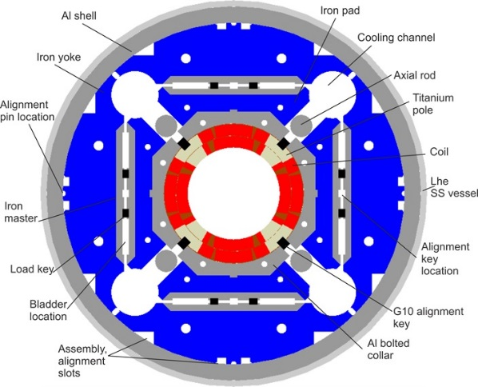
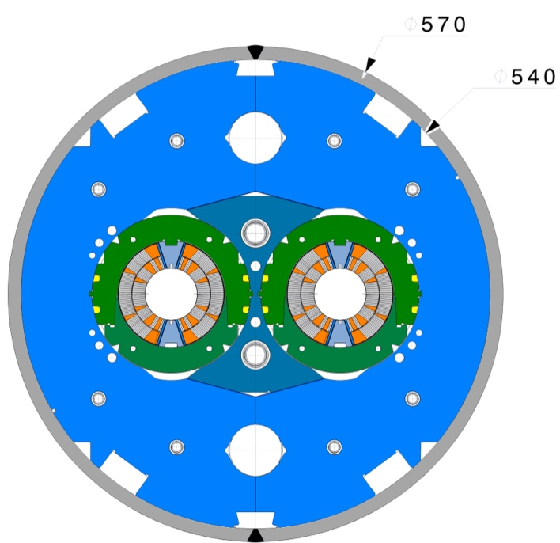
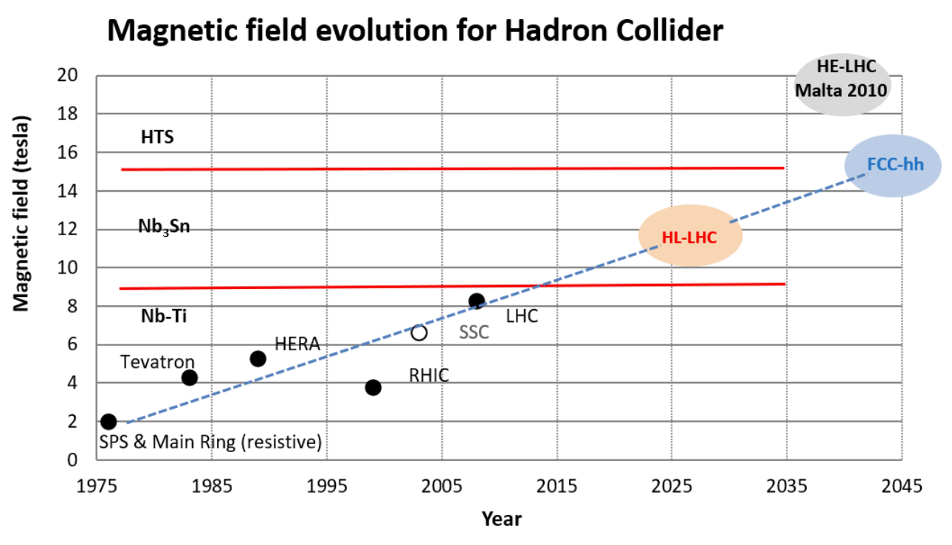
ESPP-LDG Topic 1 – High Field Magnets
HL-LHC will see the first large-scale application of MgB₂ superconducting links and Nb₃Sn accelerator magnets
Nb₃Sn is a viable and robust technology for fusion and accelerator magnet applications, thanks to ITER and HL-LHC; no inherent issues with the technology, but it requires good engineering practices, it is the only reliable option:
  For long magnets >10 m in the range of 12-14 T by 2030.
  Together with NbTi, for the hybrid HTS/LTS outserts for magnets in the range of 14-20 T by 2030.
HTS technology is still (36 years after its discovery) in its infancy; it is well worth exploring its potentials, but it is not, and will not be matured for large applications for several decades
Speakers: Jose Miguel Jiminez, Andrzej Siemko (CERN), Anna Kario (U. Twente)
11 T Dipole Magnet X-Section
MQXF Quadrupole Magnet X-Section
Courtesy of F. Savary (CERN TE-MSC)
Courtesy of E. Todesco (CERN TE-MSC)
L. Rossi, C. Senatore, https://doi.org/10.3390/ instruments5010008

Slide 16
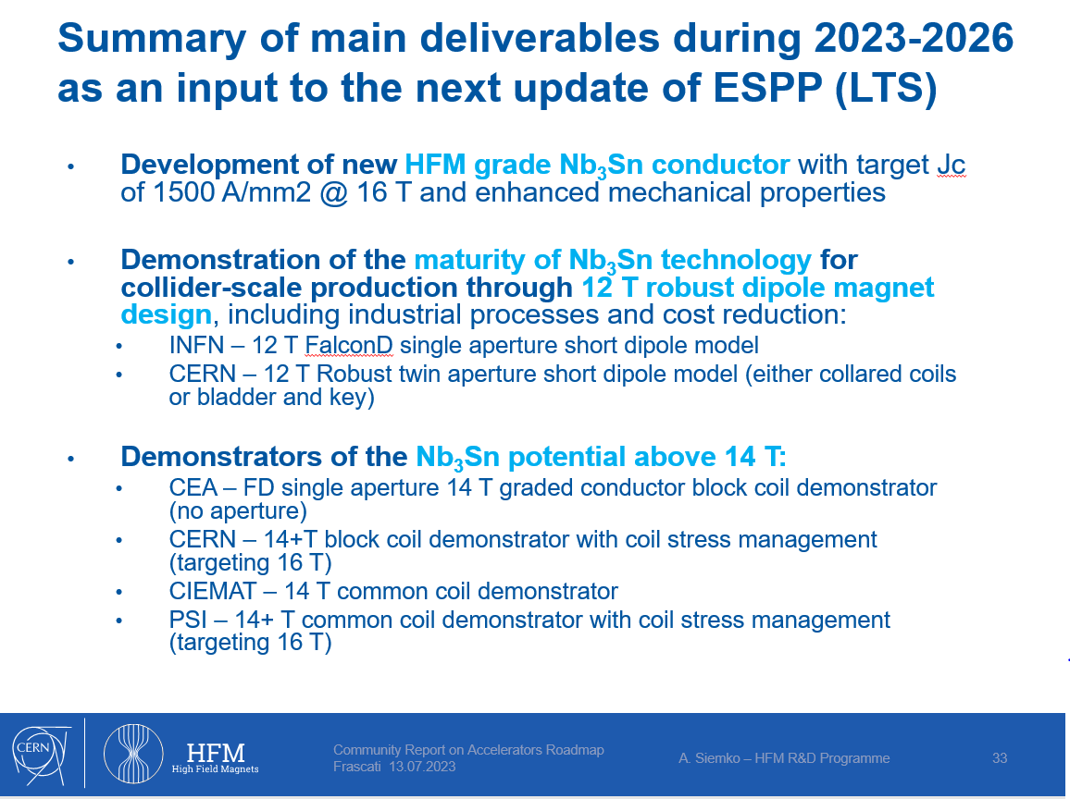
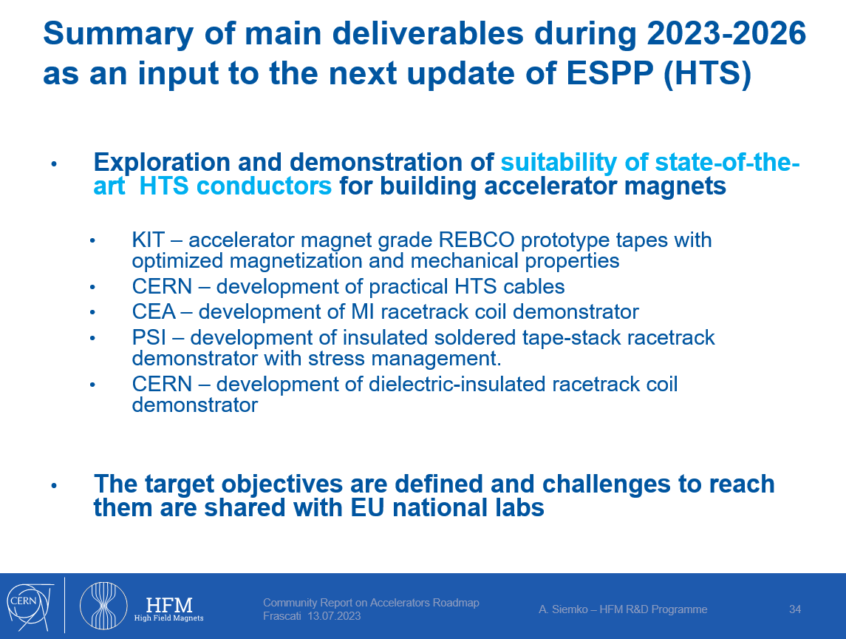
ESPP-LDG Topic 1 – High Field Magnets

Slide 17

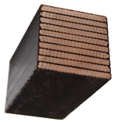


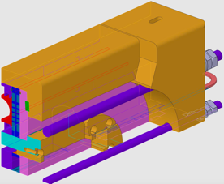
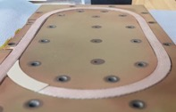

ESPP-LDG Topic 1 – High Field Magnets
HFM R&D has suffered from slow turnaround and late feedback on technology
“We propose […] a succession of meaningful fast-turnaround demonstrations […]. In this way, new technologies can be tested under realistic conditions at the earliest possible stage, the smallest relevant scale and cost, and the fastest pace.“
First deliverable
#Deliverables / year
2019
Materials and Composite Samples (not powered)
100s
2020
Powered Samples and Mechanical Models
10
2023
Sub-scale Magnets (5 T)
2-3
2025/26
Short Magnets
Ultimate Field (14…16T)
0.5-1
Courtesy M. Daly
2PoM01-01,
D. Araujo
Long Magnets Ultimate Field Magnets
(14…16 T)
Courtesy D. Araujo
Courtesy D. Araujo

Slide 18
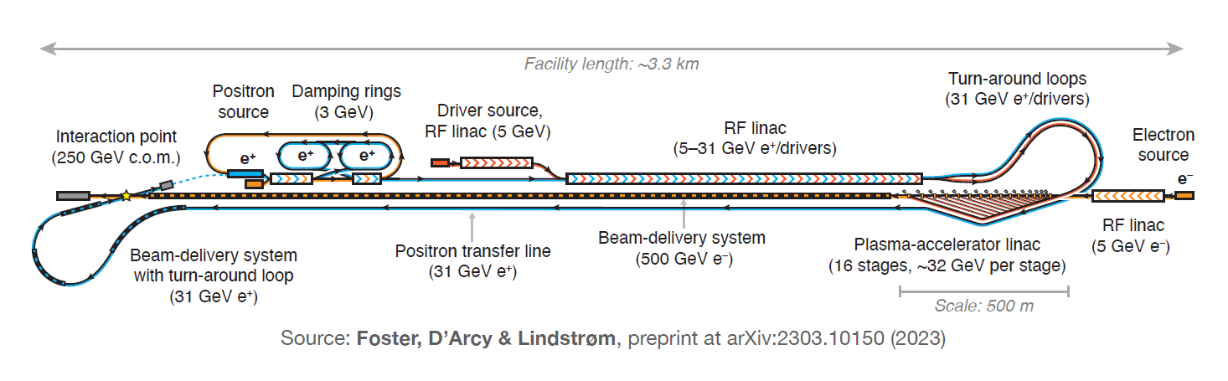
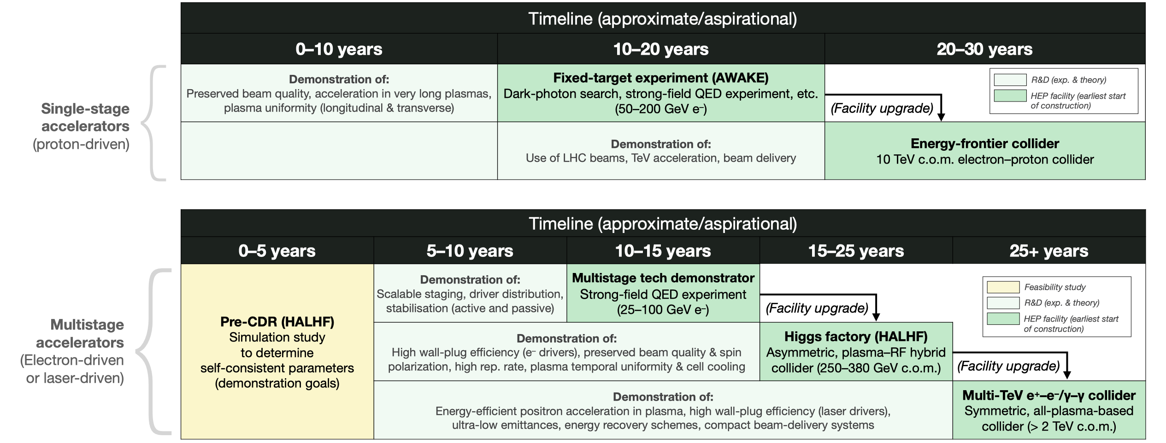
ESPP-LDG Topic 2 – Plasma Acceleration
The HALHF concept of multi-stage plasma acceleration married to conventional positron linac and asymmetric IP – guiding thinking around a credible facility proposal

Slide 19
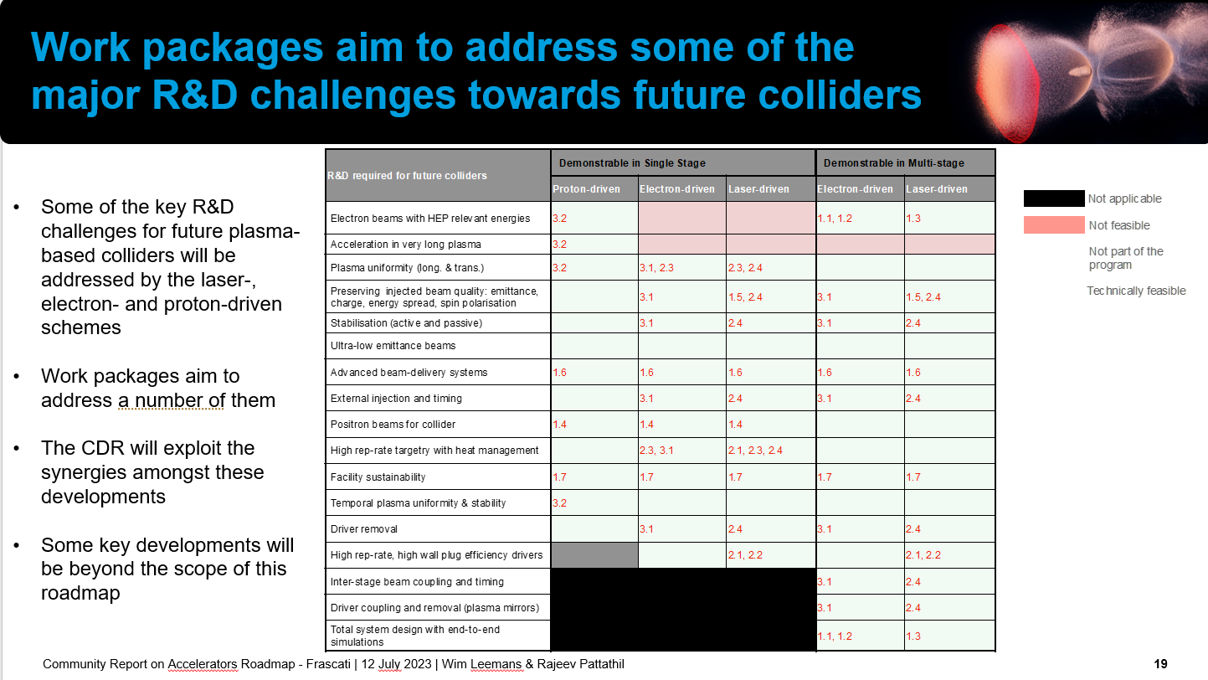
ESPP-LDG Topic 2 – Plasma Acceleration
Demonstrations on light sources based on single stage LPA and e-PFWA will de-risk plasma-based collider concepts
Speakers: Rajeev Pattathil (STFC), Wim Leemans (DESY) Carl Lindstrøm (Oslo), Brian Foster (Oxford/DESY/Hamburg)

Slide 20
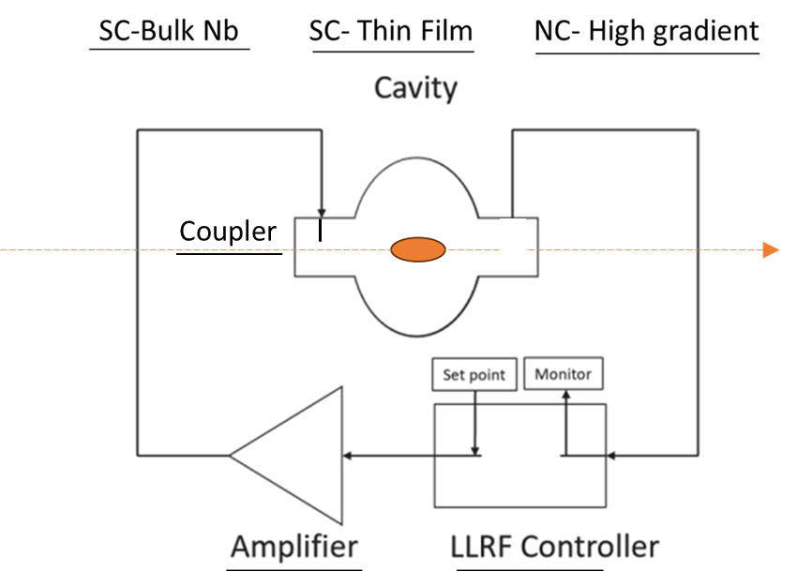
ESPP-LDG Topic 3 – High Gradient RF
Goal – Improve RF efficiency & reliability – many big wins possible
Speakers: Giovanni Bisoffi (INFN), Peter McIntosh (STFC), Nuria Catalan-Lasheras (CERN), Nadia Pastrone (INFN)
WG1
WG2
WG4
WG3
WG5
WG6

Slide 21
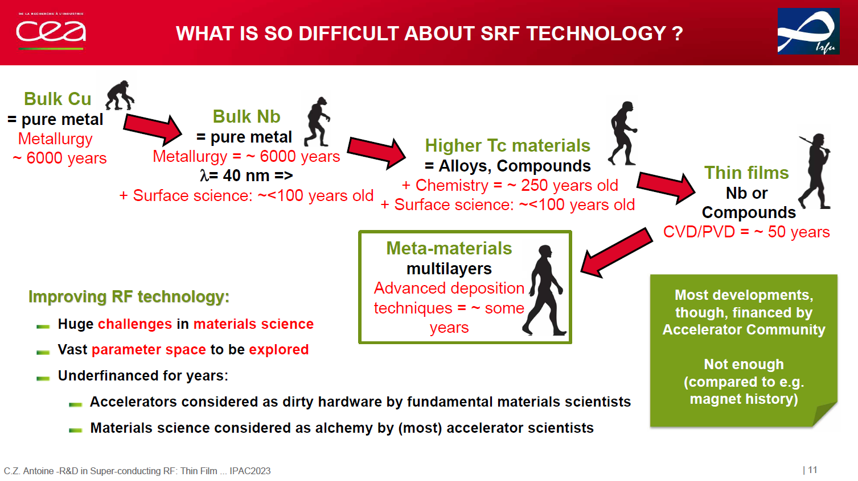
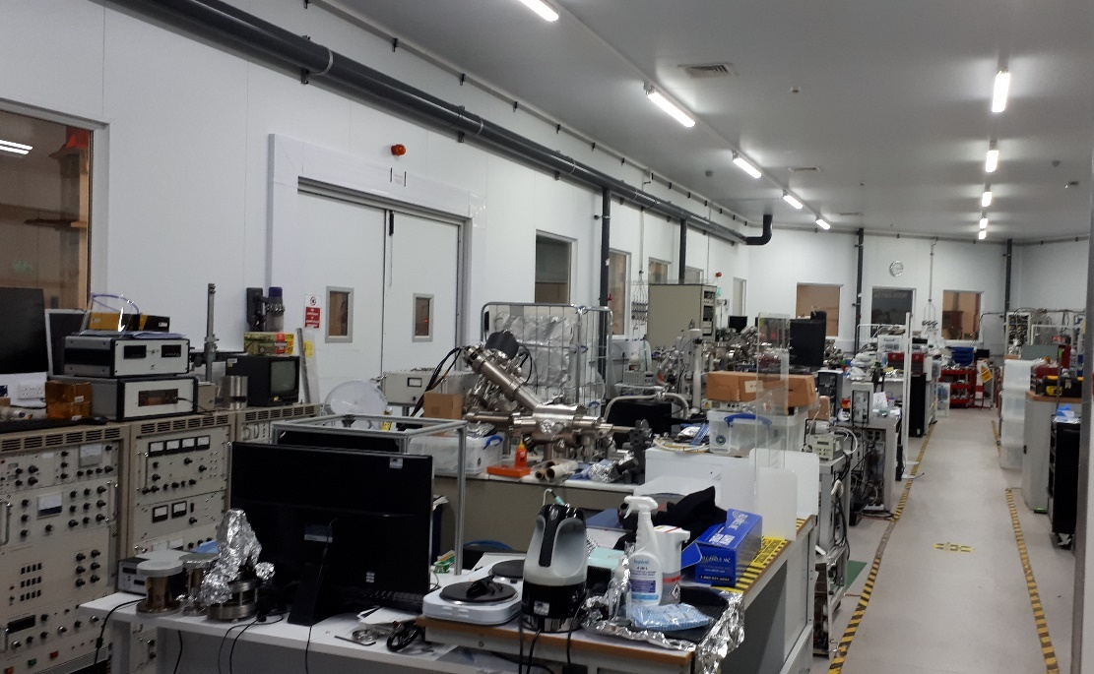
ESPP-LDG Topic 3 – High Gradient RF – e.g. Thin Films
Bulk niobium cavities have been the choice for SRF for 50 years
Use a considerable amount of natural material
Performance limit of niobium has been reached
Costly to produce
Run at a temperature of 2 K
  A considerable cryogenic demand and energy load
Benefits of thin films
Use a copper supporting cavity
  Better thermal properties, cheaper material and production
Use different SC materials (e.g. Nb₃Sn, NbN and MgB₂)
  Better performance than Nb that can’t be formed into solid cavities
Higher operation temperature of new alloys
Reach higher accelerating gradients
Example: TF-SRF Research Programme at STFC :
Deposition of Nb, Nb₃Sn, NbTiN, Mg₂B, … and SIS structures , Thin film characterisation, AC/DC superconductivity evaluation
Developing cavity deposition expertise - Copper cavity production, Polishing and cleaning, Building deposition facilities, Optimising deposition parameters
SRF testing - 1.3 GHz cavity testing as 1st step, scaling up to a routine cavity coating and testing
VISTA laboratory: deposition facility @ STFC Daresbury

Slide 22
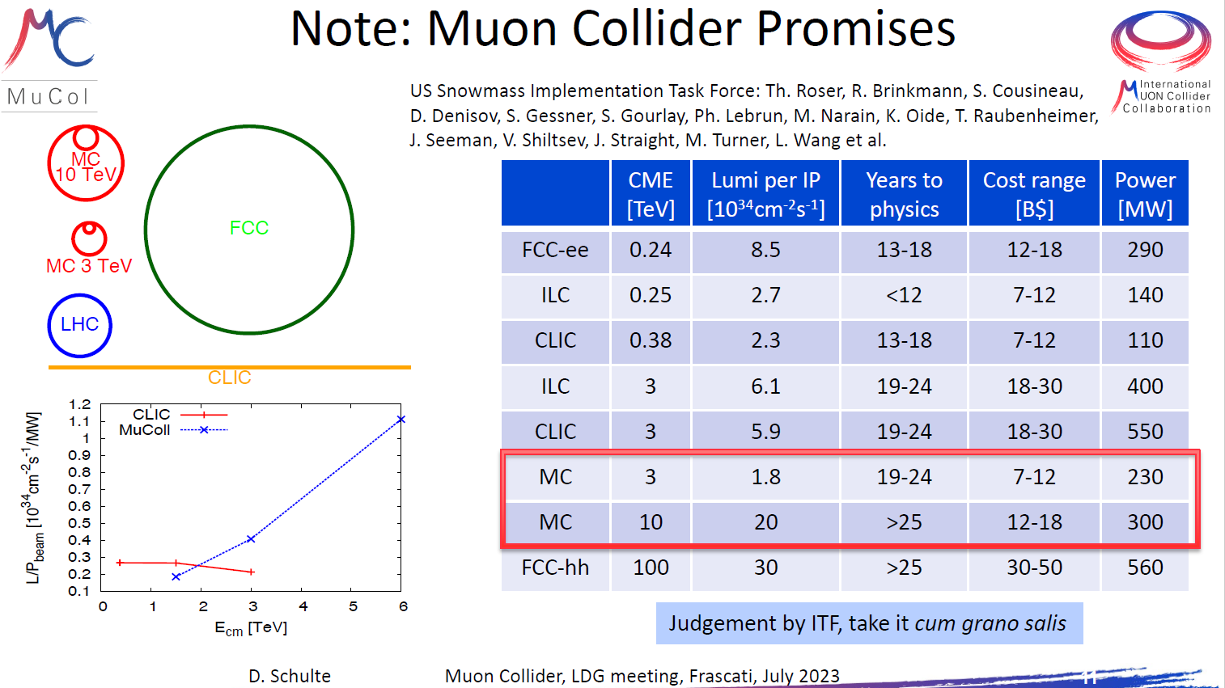
ESPP-LDG Topic 4 – Muons
For high CoM, muon collider very attractive
Key challenges under demonstration, particularly target + ionization cooling
Technically limited timeline presented to establish if it could follow directly from HL-LHC
Speakers: Daniel Schulte (CERN), Chris Rogers (STFC), Luca Bottura (CERN), Andrea Wulzer (ICREA)

Slide 23
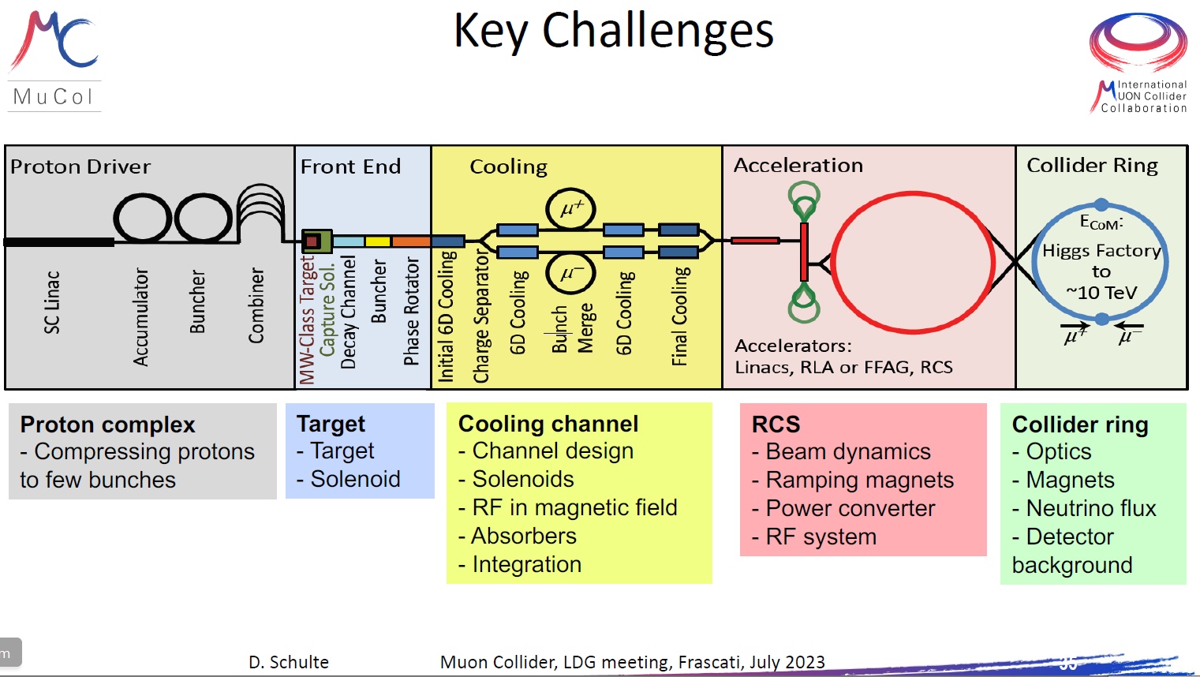
ESPP-LDG Topic 4 – Muons
For high CoM, muon collider very attractive
Key challenges under demonstration, particularly target + ionization cooling
Technically limited timeline presented to establish if it could follow directly from HL-LHC
Speakers: Daniel Schulte (CERN), Chris Rogers (STFC), Luca Bottura (CERN), Andrea Wulzer (ICREA)

Slide 24
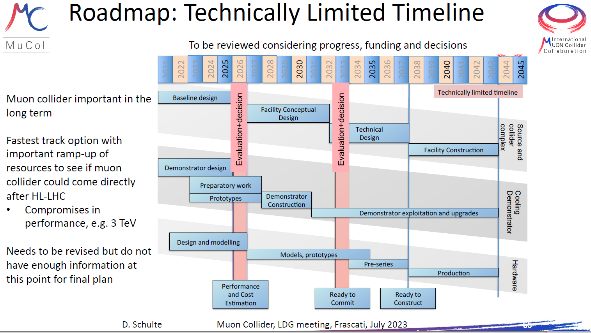
ESPP-LDG Topic 4 – Muons
For high CoM, muon collider very attractive
Key challenges under demonstration, particularly target + ionization cooling
Technically limited timeline presented to establish if it could follow directly from HL-LHC
Speakers: Daniel Schulte (CERN), Chris Rogers (STFC), Luca Bottura (CERN), Andrea Wulzer (ICREA)

Slide 25
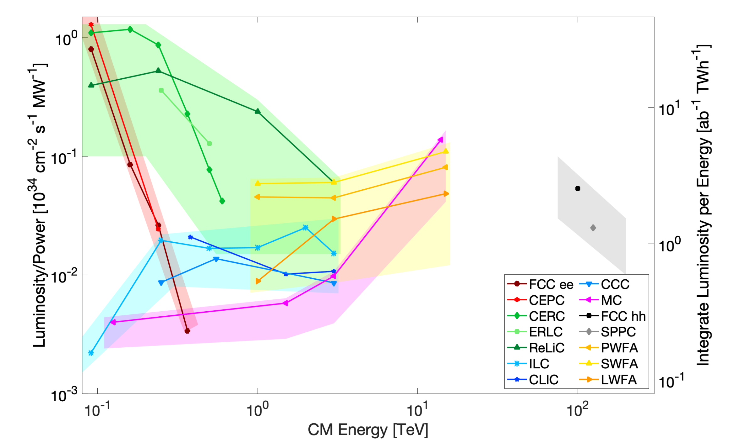
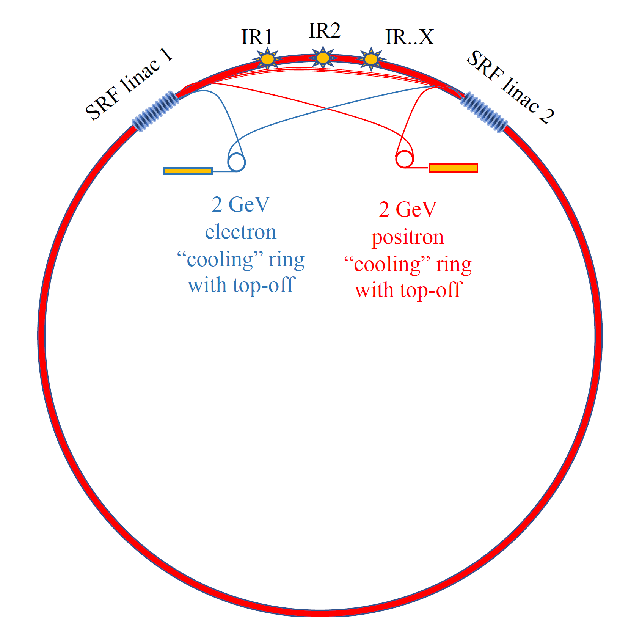
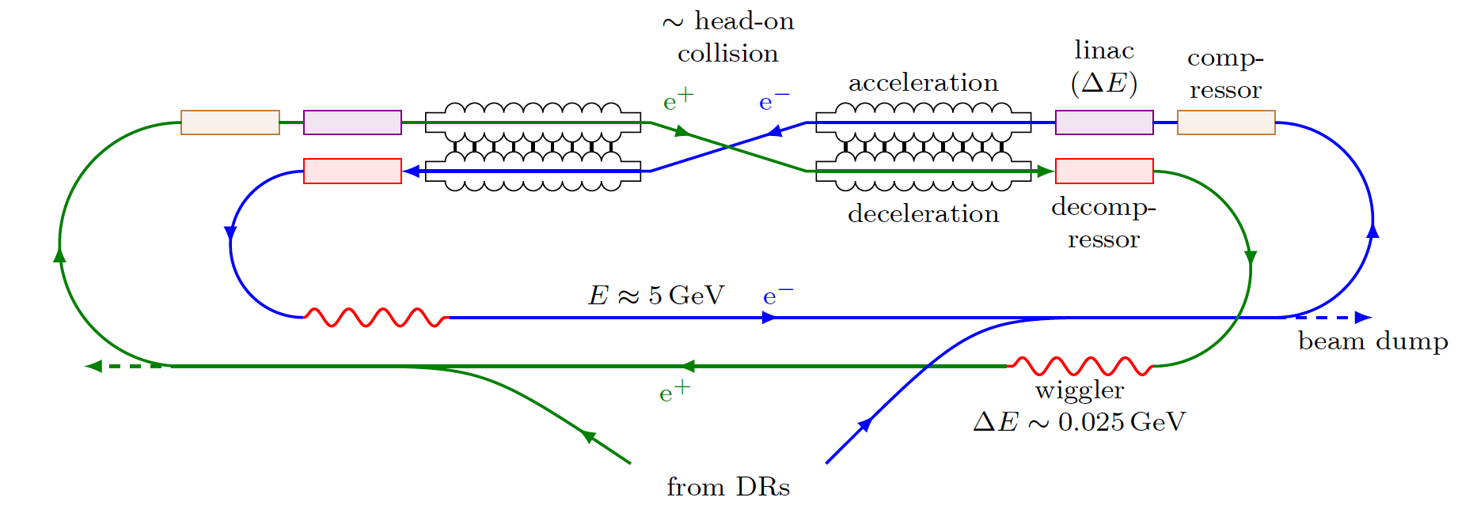
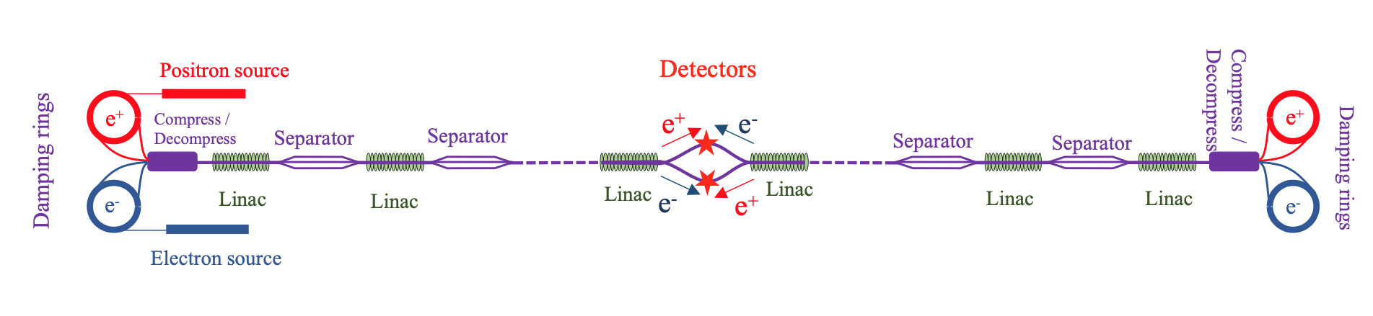
ESPP-LDG Topic 5 – Energy Recovery Linacs
Speakers: Jorgen d’Hondt (VUB), Walid Kaabi (IJCLab), Axel Neumann (HZB), Andrew Hutton (JLab)
Snowmass ITF Luminosity / Facility power plot – more from Thomas Roser later today.
A very seductive plot – why? Essentially the physics is “we keep a linac quality beam whilst allowing storage ring current”
Plot normalizes out the absolute facility cost, which is also important. These ERL proposals typically 100-1000 times luminosity, but for 10 times the cost… not necessarily what is needed!
What drives the cost of the ERL proposals? What sets the size of the error bars?
ReLiC Proposal by Litvinenko, Llatas & Roser, BNL – energy recycling LC
  ERLC Proposal by Telnov, BINP – re-imagining ILC as an ERL
CERC Proposal by Litvinenko, Llatas & Roser, BNL – re-imagining FCC-ee as an ERL

Slide 26
ESPP-LDG Topic 5 - Energy Recovery Linacs
Main challenges - CERC:
Beamstrahlung (high-energy photons from collisions) and disruption – studies indicate only 4-fold ε_{y} increase – beam still energy-recoverable
Energy acceptance of damping rings to cope with low energy tail at high CoM → damping ring energies updated to increase with CoM – to 8 GeV for Htt
Microphonics require additional RF power to keep cavities tuned. CERC with 182 GeV beams would require additional 46 MW (!). Development of ferro-electric tuners would reduce to about 200W and so are an essential R&D requirement
Main challenges - ERLC:
Build cost: with ILC-like cavities, DF = 1/3 and HOMs extracted to > 100 K likely to be 224% more to construct. As both luminosity per unit cost, AND absolute cost are relevant, this points to necessity of modified cavity design = geometry, number and location of HOM absorbers to be optimized
Running cost: with ILC-like cavities. Case A = DF of 1/3, and Case B = CW. ERLC is favoured in terms of luminosity per unit cost, but NOT absolute cost! This can be recovered with 4.5K SRF operation at high Q₀
Summary: ILC-like cavities are not suitable. Need new cavity / cryomodule technologies to realise these luminosity gains with simultaneous power / cost reduction
Personal note: These proposals are just a start – better ones are gestating…
Peter Williams | European LDG Meeting, BNL | 06/06/2024

Slide 27
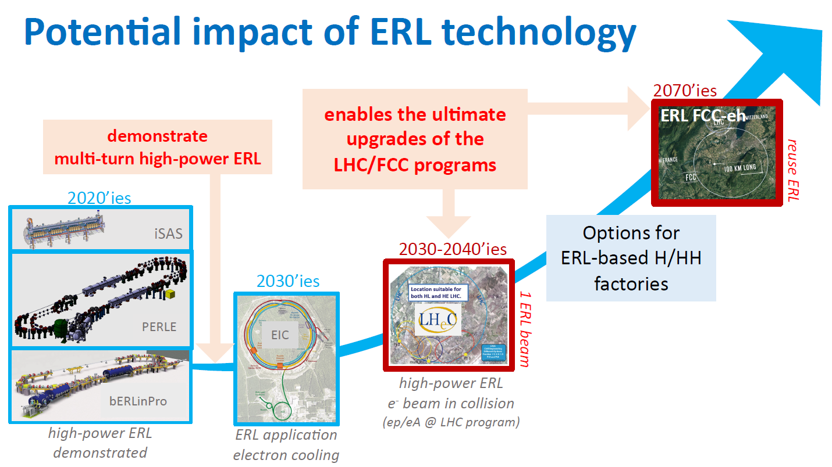
ESPP-LDG – Topic 5 – Path To An ERL Higgs Factory Passes Through Potential LHC Upgrades

Slide 28
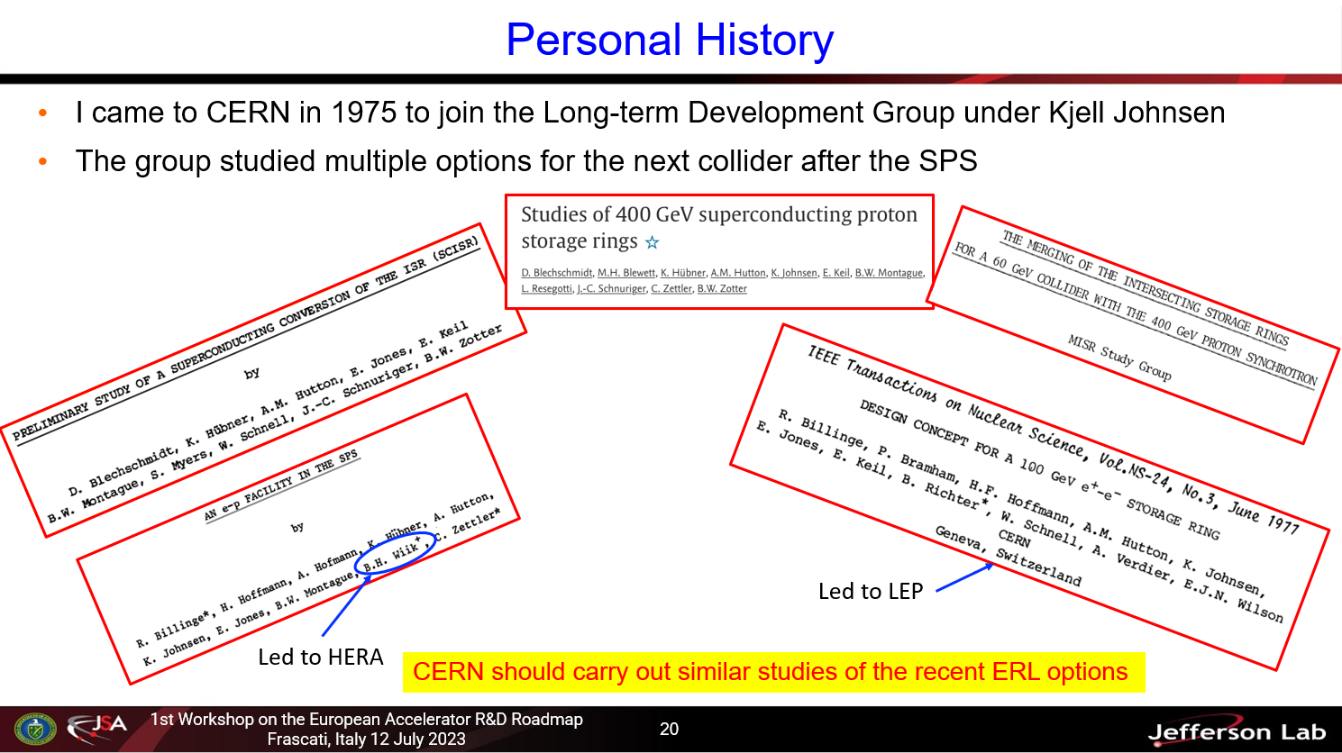
ESPP-LDG – Topic 5 – ERLs - Andrew Hutton Suggests The Next Step…

Slide 29
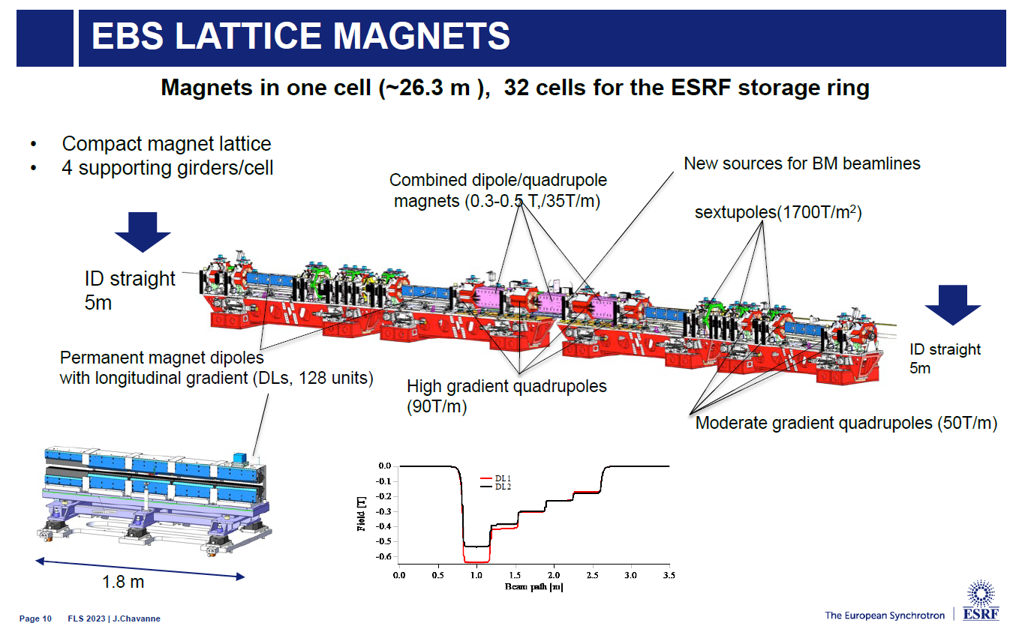
Additional Topic 1: Permanent Magnets: E.G. Dipoles at ESRF
Permanent magnets
No electricity
No cooling water
No vibration
Less infrastructure
but…
Can’t easily adjust
Large forces
Sensitive to temperature
Susceptible to radiation damage
… however operational experience is positive!

Slide 30

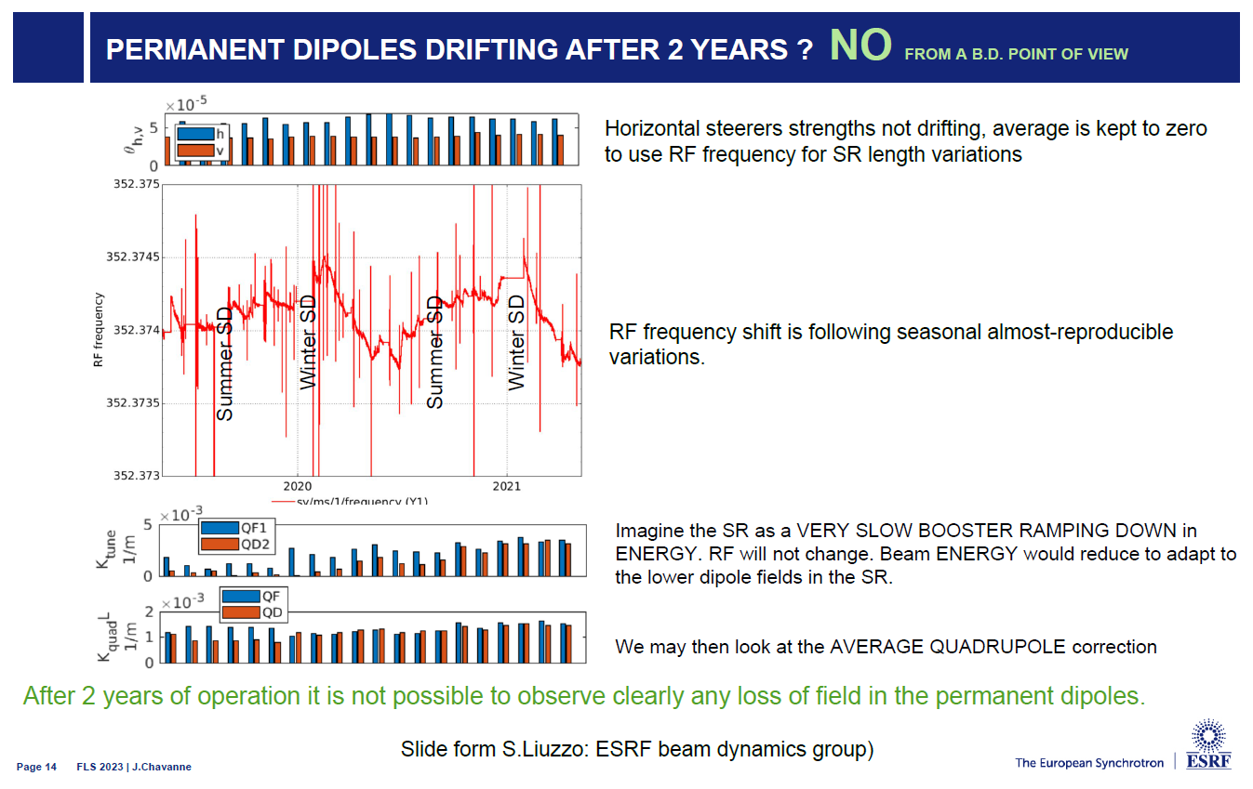
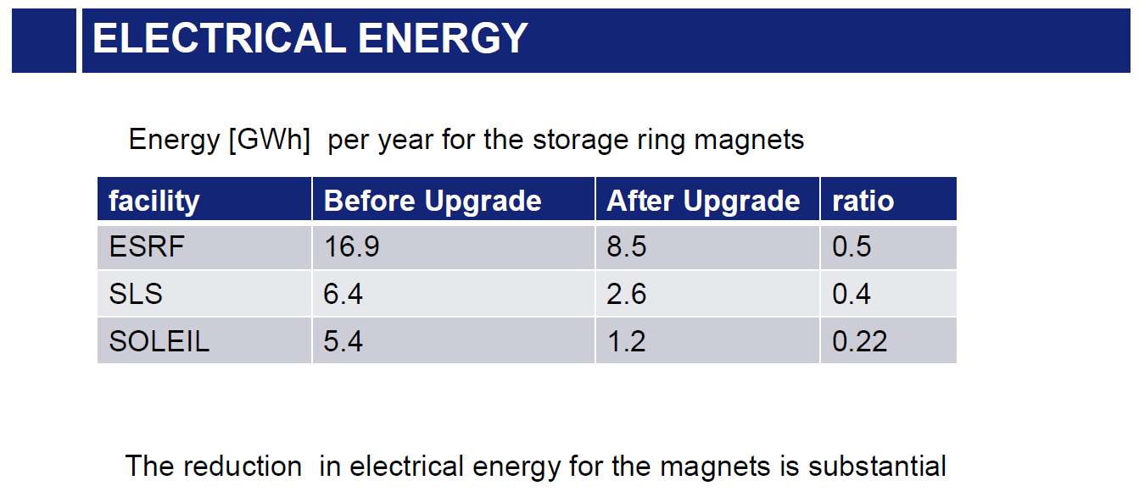
Additional Topic 1: Permanent Magnets: E. G. Dipoles at ESRF

Slide 31

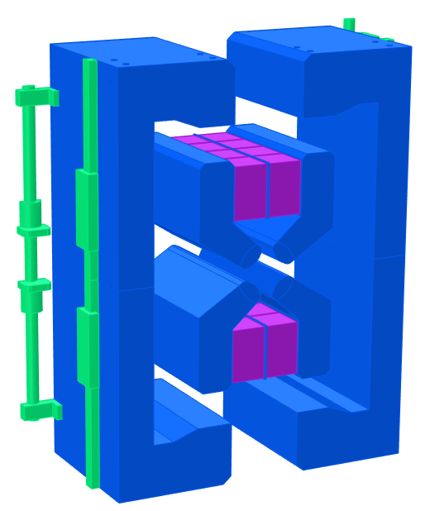
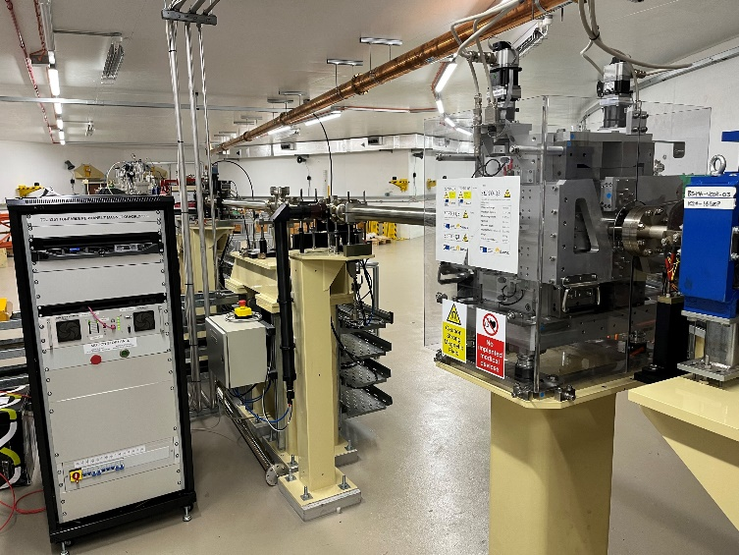
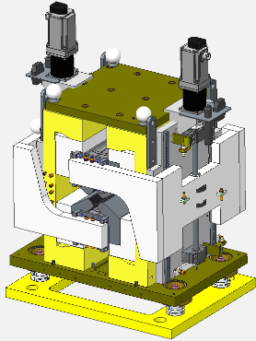
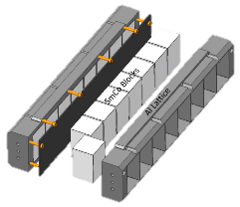
Additional Topic 1: Permanent Magnets: E. G. Tuneable Quads
Daresbury developed ZEPTO tuneable PM quadrupole drop-in replacement for electromagnet on Diamond
Step towards commercialisation of ZEPTO technology
Installed August 2022, now in operation
  Gradient range 0.5-19 T/m
  Movement range 90 mm
  Aperture diameter 32 mm
  Improvements to design:
    SmCo blocks
      improved temperature stability
      better radiation resistance
    Splittable to allow installation around vacuum chamber
    Two independent motors for magnetic centre correction
    Ice cube tray concept for easy installation of PM blocks

Slide 32

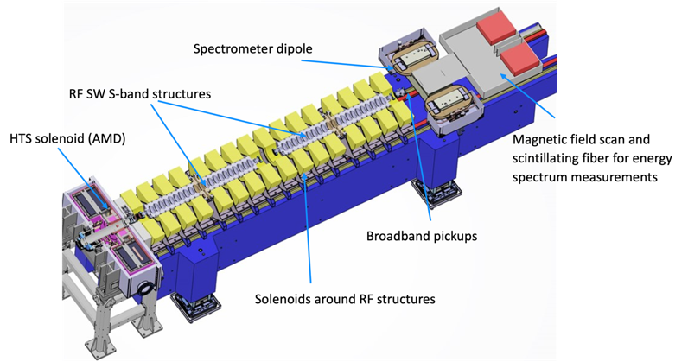
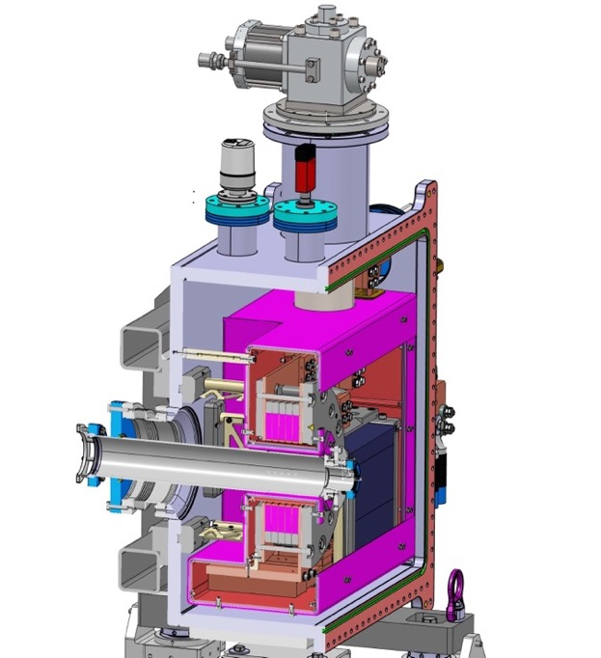

Additional Topic 2: Positron Production
If the priority for particle physics is an e+e- Higgs Factory, then more positrons are needed! … Common challenge to all proposed Higgs factory facilities
FCC-ee Injector Study: PSI Positron Production Experiment (P³)
HTS
15 K conduction-cooling
HTS no-insulation target solenoid,
Demonstrate positron source concept with 6x increased yield e⁺/e⁻
Manufacturing/commissioning Q1-Q2’24
Experiment at SwissFEL 2025/26
5 coils from 12 mm ReBCO, 110 mm ID
21 T peak field
target
Solid-state (Pb)
thermal buffer
15 T in 72 mm warm bore

Slide 33


Summary: Landscape of European Accelerator R&D
Our facilities do world-leading science, including science that benefits the climate, society will continue to value this
Can’t do that without energy use & a carbon footprint…
…But we can do much better than today and society is demanding that we do so – explicitly through governmental facility approval processes …
Implies investment in low TRL technologies for future facilities, our job to accept this risk so we may realise the reward
I have shown examples of such technologies that have been prioritised by the European accelerator community
Thanks to: Maud Baylac, Oliver Bruning, Jim Clarke, Jorgen d’Hondt, Peter McIntosh, Hywel Owen, Mike Seidel, Ben Shepherd, Andrew Vick
North Sea between UK, Belgium, Netherlands, Germany, Denmark now contains ~2600 wind turbines producing 100 GWe, plan is for 450 GWe by 2050

