Slide 1

RF priorities for FCC
Frank Gerigk, CERN
With material from JP. Burnet (ATS-DO), S. Gorgi Zadeh, F. Peauger, V. Parma, O. Brunner, E. Montesinos, W. Venturini, D. Smekens, M. Therasse, A. Macpherson, I. Syratchev (SY-RF), M. Garlasche, S. Barrière (EN-MME), T. Koettig (TE-CRG), G. Rosaz (TE-VSC), T. Raubenheimer (SLAC), and many more
European Lab Directors Group Meeting and Accelerator R&D Workshop, 6 - 7 June 2024

Slide 2
Content
RF baseline
SRF R&D
Efficient RF power sources
RF R&D roadmap

Slide 3
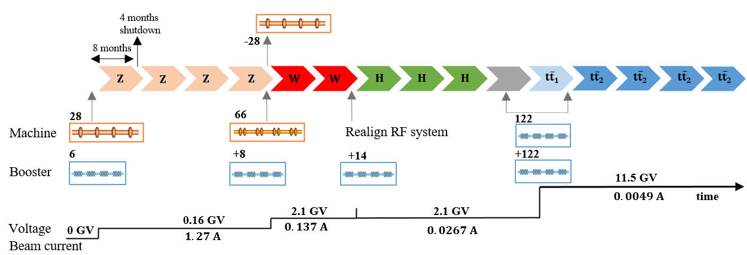
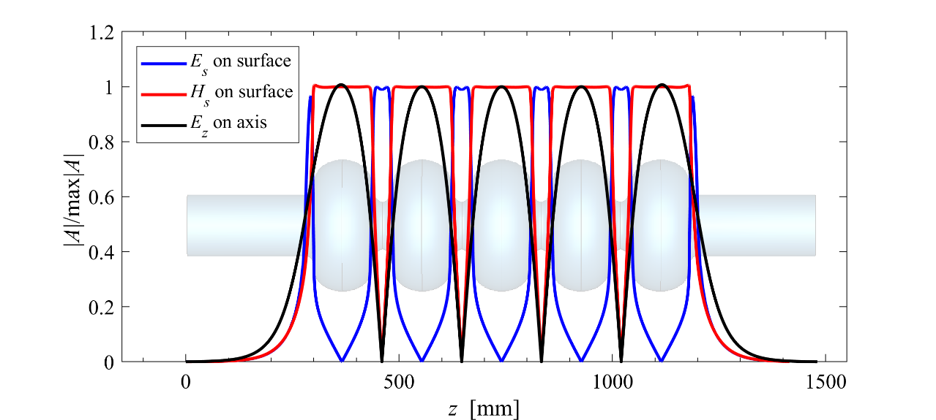
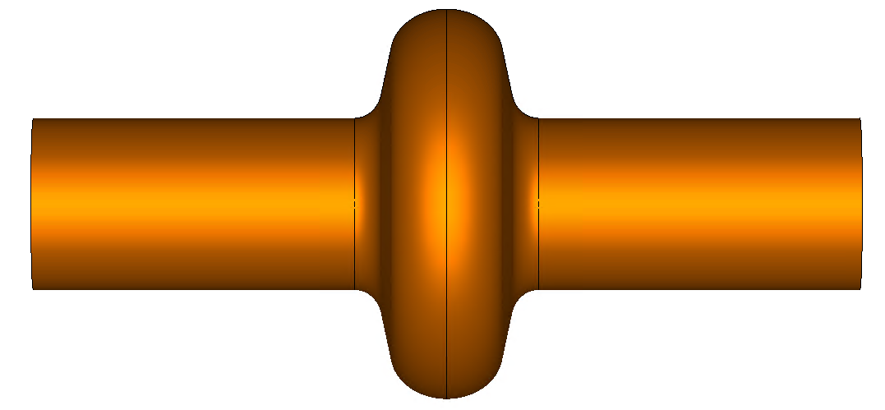
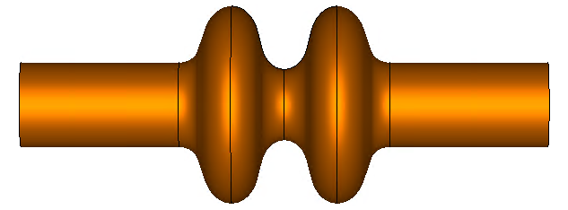

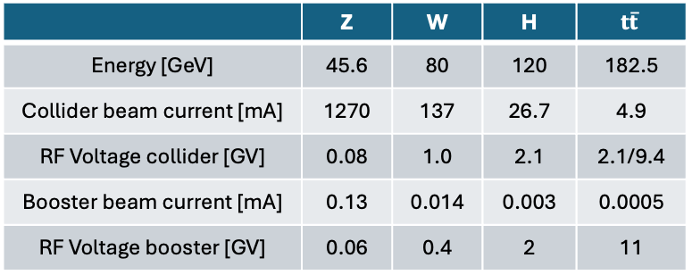
FCC-ee SRF system baseline
  Baseline: Starting with 1-cell for Z to reduce HOM power load: but 1-cell modules need to be removed for W and replaced by 2-cell modules.
  Under study: starting with 2-cell using increased HOM damping & transverse feedback.
Z: 112 cavities
+ 24x800 MHz
W, H: 264 cavities
+ 88x800 MHz
$t\overline{t}$ and booster: 1088 cavities
 | Z | W | H | $$t\overline{t}$$
Energy [GeV] | 45.6 | 80 | 120 | 182.5
Collider beam current [mA] | 1270 | 137 | 26.7 | 4.9
RF Voltage collider [GV] | 0.08 | 1.0 | 2.1 | 2.1/9.4
Booster beam current [mA] | 0.13 | 0.014 | 0.003 | 0.0005
RF Voltage booster [GV] | 0.06 | 0.4 | 2 | 11
400 MHz 1-cell
Nb/Cu, 4.5 K
400 MHz 2-cell
Nb/Cu, 4.5 K
800 MHz 5-cell
Bulk Nb, 2 K

Slide 4
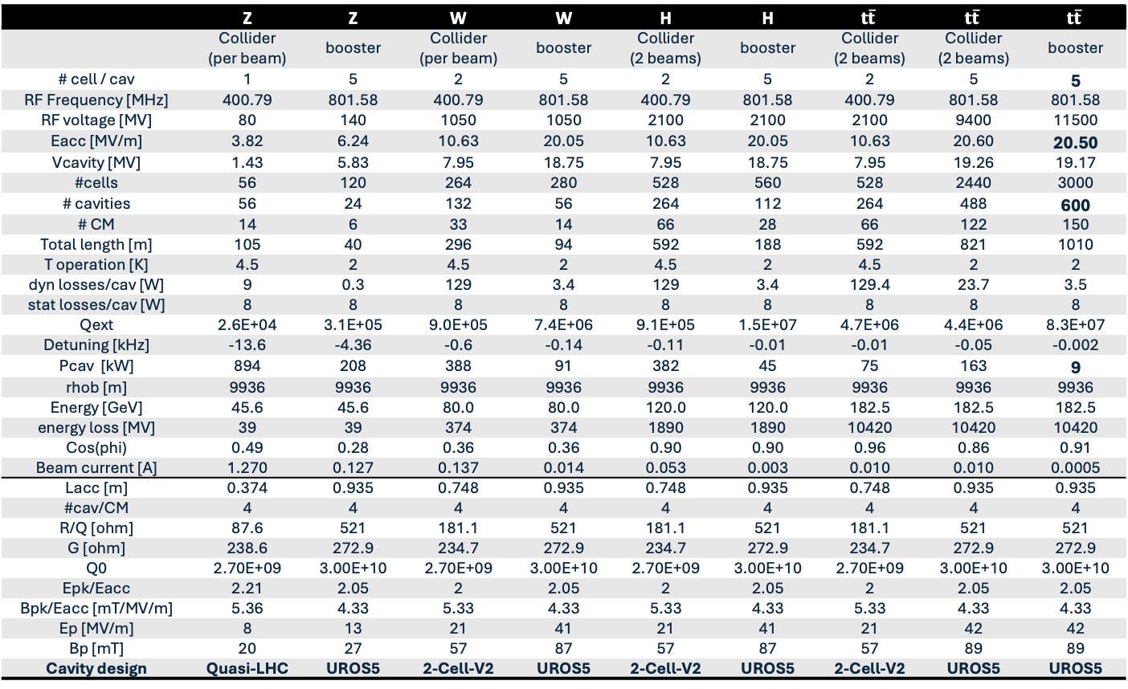
RF parameter table
RF parameter table
 | Z | Z | W | W | H | H | $$t\overline{t}$$ | $$t\overline{t}$$ | $$t\overline{t}$$
 | Collider (per beam) | booster | Collider (per beam) | booster | Collider (2 beams) | booster | Collider (2 beams) | Collider (2 beams) | booster
# cell / cav | 1 | 5 | 2 | 5 | 2 | 5 | 2 | 5 | 5
RF Frequency [MHz] | 400.79 | 801.58 | 400.79 | 801.58 | 400.79 | 801.58 | 400.79 | 801.58 | 801.58
RF voltage [MV] | 80 | 140 | 1050 | 1050 | 2100 | 2100 | 2100 | 9400 | 11500
Eacc [MV/m] | 3.82 | 6.24 | 10.63 | 20.05 | 10.63 | 20.05 | 10.63 | 20.60 | 20.50
Vcavity [MV] | 1.43 | 5.83 | 7.95 | 18.75 | 7.95 | 18.75 | 7.95 | 19.26 | 19.17
#cells | 56 | 120 | 264 | 280 | 528 | 560 | 528 | 2440 | 3000
# cavities | 56 | 24 | 132 | 56 | 264 | 112 | 264 | 488 | 600
# CM | 14 | 6 | 33 | 14 | 66 | 28 | 66 | 122 | 150
Total length [m] | 105 | 40 | 296 | 94 | 592 | 188 | 592 | 821 | 1010
T operation [K] | 4.5 | 2 | 4.5 | 2 | 4.5 | 2 | 4.5 | 2 | 2
dyn losses/cav [W] | 9 | 0.3 | 129 | 3.4 | 129 | 3.4 | 129.4 | 23.7 | 3.5
stat losses/cav [W] | 8 | 8 | 8 | 8 | 8 | 8 | 8 | 8 | 8
Qext | 2.6E+04 | 3.1E+05 | 9.0E+05 | 7.4E+06 | 9.1E+05 | 1.5E+07 | 4.7E+06 | 4.4E+06 | 8.3E+07
Detuning [kHz] | -13.6 | -4.36 | -0.6 | -0.14 | -0.11 | -0.01 | -0.01 | -0.05 | -0.002
Pcav [kW] | 894 | 208 | 388 | 91 | 382 | 45 | 75 | 163 | 9
rhob [m] | 9936 | 9936 | 9936 | 9936 | 9936 | 9936 | 9936 | 9936 | 9936
Energy [GeV] | 45.6 | 45.6 | 80.0 | 80.0 | 120.0 | 120.0 | 182.5 | 182.5 | 182.5
energy loss [MV] | 39 | 39 | 374 | 374 | 1890 | 1890 | 10420 | 10420 | 10420
Cos(phi) | 0.49 | 0.28 | 0.36 | 0.36 | 0.90 | 0.90 | 0.96 | 0.86 | 0.91
Beam current [A] | 1.270 | 0.127 | 0.137 | 0.014 | 0.053 | 0.003 | 0.010 | 0.010 | 0.0005
Lacc [m] | 0.374 | 0.935 | 0.748 | 0.935 | 0.748 | 0.935 | 0.748 | 0.935 | 0.935
#cav/CM | 4 | 4 | 4 | 4 | 4 | 4 | 4 | 4 | 4
R/Q [ohm] | 87.6 | 521 | 181.1 | 521 | 181.1 | 521 | 181.1 | 521 | 521
G [ohm] | 238.6 | 272.9 | 234.7 | 272.9 | 234.7 | 272.9 | 234.7 | 272.9 | 272.9
Q0 | 2.70E+09 | 3.00E+10 | 2.70E+09 | 3.00E+10 | 2.70E+09 | 3.00E+10 | 2.70E+09 | 3.00E+10 | 3.00E+10
Epk/Eacc | 2.21 | 2.05 | 2 | 2.05 | 2 | 2.05 | 2 | 2.05 | 2.05
Bpk/Eacc [mT/MV/m] | 5.36 | 4.33 | 5.33 | 4.33 | 5.33 | 4.33 | 5.33 | 4.33 | 4.33
Ep [MV/m] | 8 | 13 | 21 | 41 | 21 | 41 | 21 | 42 | 42
Bp [mT] | 20 | 27 | 57 | 87 | 57 | 87 | 57 | 89 | 89
Cavity design | Quasi-LHC | UROS5 | 2-Cell-V2 | UROS5 | 2-Cell-V2 | UROS5 | 2-Cell-V2 | UROS5 | UROS5
6
30
6-cell cavities instead of 5-cell:
significant potential for cost savings at 800 MHz, especially in booster cavities
Duty cycles:
collider: CW
Booster: ~15%

Slide 5
SRF R&D

Slide 6
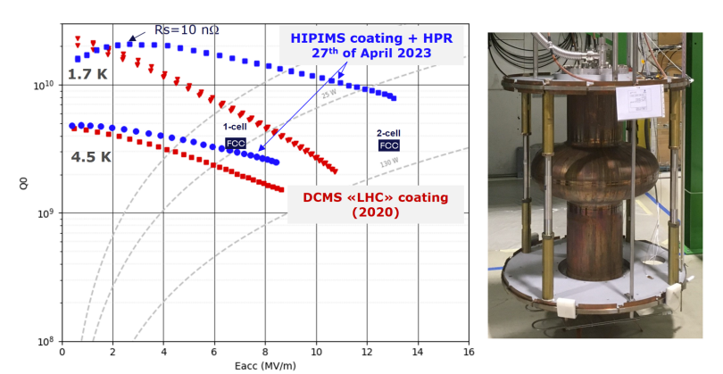
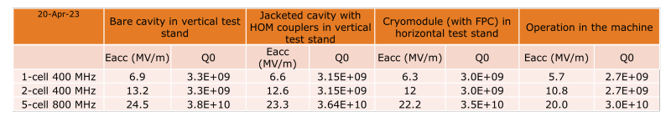
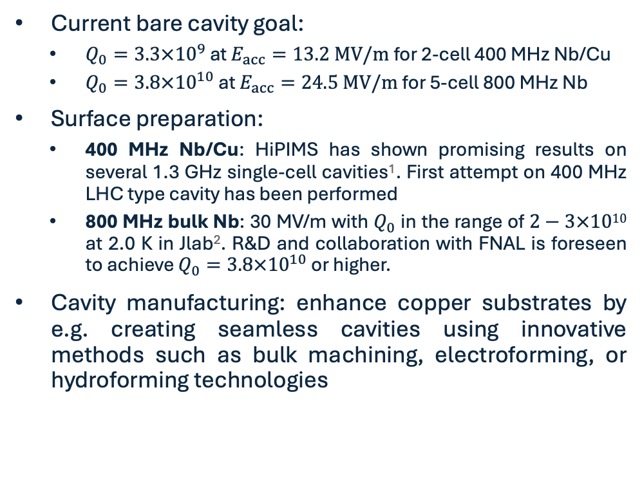
R&D on SRF cavity performance
Current bare cavity goal:
  $Q_{0}=3.3×{10}^{9}$ at $E_{acc}=13.2 MV/m$for 2-cell 400 MHz Nb/Cu
  $Q_{0}=3.8×{10}^{10}$ at $E_{acc}=24.5 MV/m$for 5-cell 800 MHz Nb
Surface preparation:
  400 MHz Nb/Cu: HiPIMS has shown promising results on several 1.3 GHz single-cell cavities¹. First attempt on 400 MHz LHC type cavity has been performed
  800 MHz bulk Nb: 30 MV/m with $Q_{0}$ in the range of $2−3×1010$ at 2.0 K in Jlab². R&D and collaboration with FNAL is foreseen to achieve $Q_{0}=3.8×{10}^{10}$ or higher.
Cavity manufacturing: enhance copper substrates by e.g. creating seamless cavities using innovative methods such as bulk machining, electroforming, or hydroforming technologies
W,H
Z
1. L. Vega Cid, R&D on superconducting thin films for SRF cavities, RF seminar, 2024, CERN
2. S. Posen, ”R&D towards an 800 MHz cryomodule”, FCC Week 2023, London, UK

Slide 7
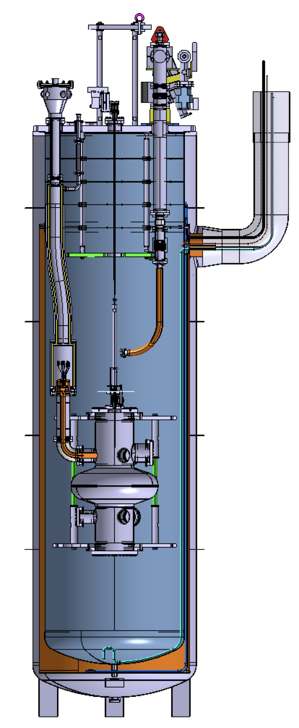
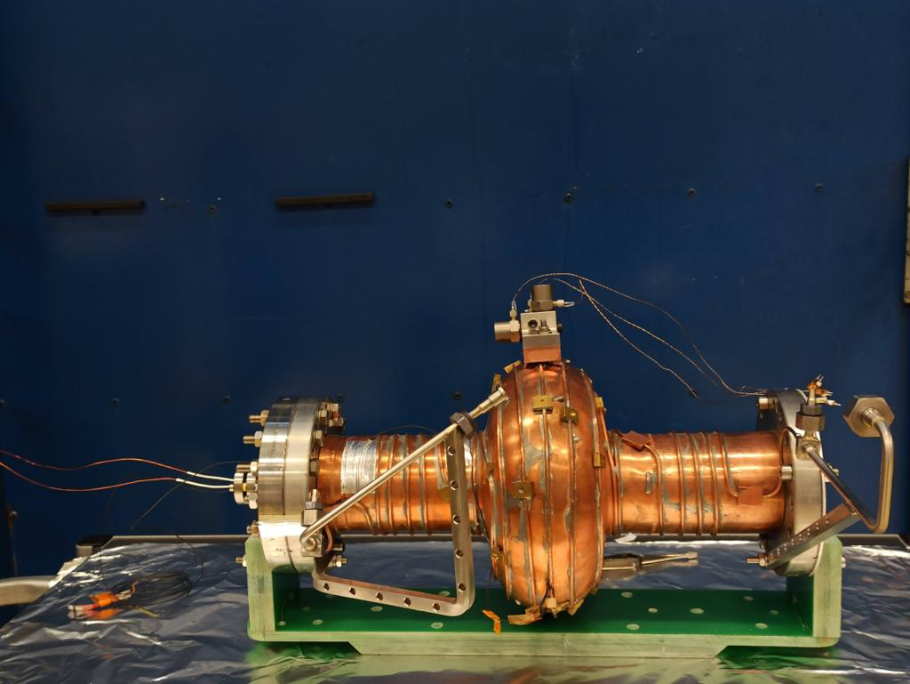
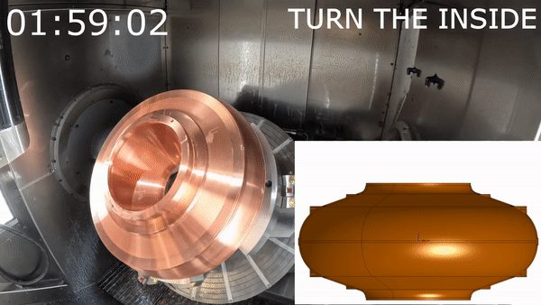
Key SRF objectives until 2030: R&D
Further SRF R&D topics
  SRF cavity manufacturing (seamless cavities), thin film coating techniques, novel cooling methods (to reduce He-inventory).
  Sample tests and magnetic flux trapping studies on coatings, multi-layers.
  Routine optical inspection of all cavities.
  Non-mechanical tuning with ferroelectric fast reactive tuner (Fe-FRT) with Euclid Techlabs, HZB & JLAB.
  To be established: dedicated Nb₃Sn roadmap until 2040 (see Annex).
Quasi-dry cooling
Validate transient detuning compensation for LHC with Fast Reactive Tuner
Seamless cavities via bulk machining as reference cavities

Slide 8
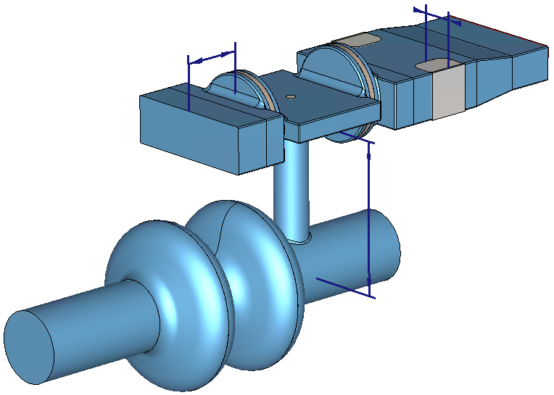
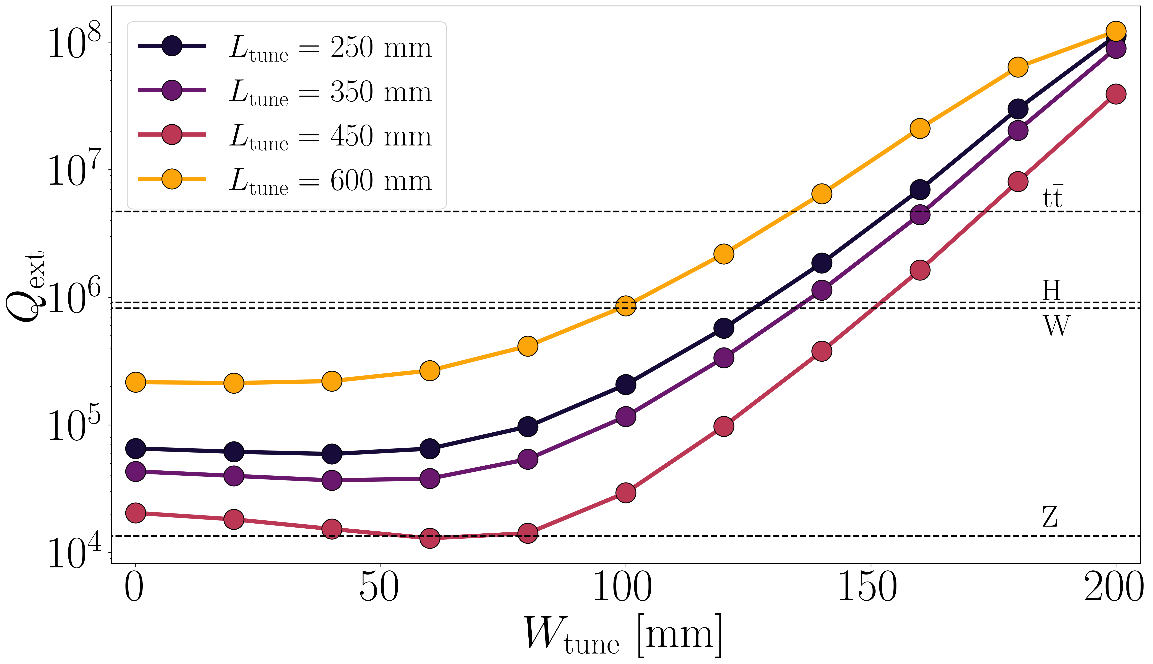

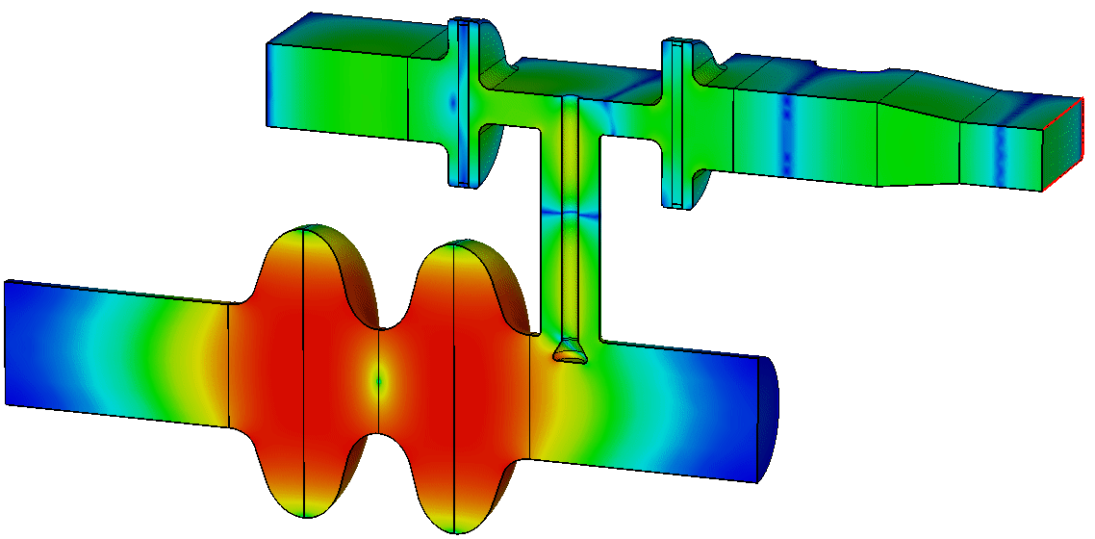
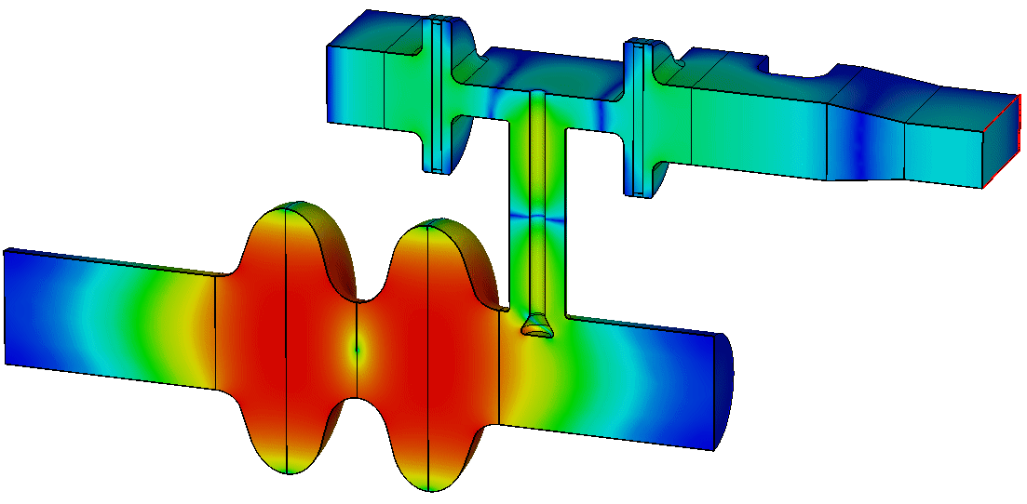
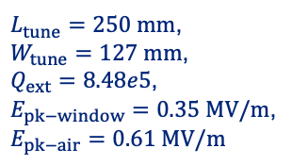

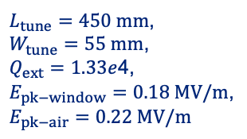


New adjustable power coupler concept
$$W_{tune}$$
$$L_{tune}$$
  Two windows (LINAC4-like) are placed outside the cryomodule → challenging to integrate after cryostating (similar to LHC cavity)
  A more robust and easier-to-cool down window design → easier to cover all four working points
  Providing ~1 MW in CW operation with variable coupling for Z, W, H, ttbar.
  Prototyping starting.
t
W
This length can be increased by λ/2 (374 mm) and get similar results
Z
Z
W
$L_{tune}=450 mm$,
$W_{tune}=55 mm$,
$Q_{ext}=1.33e$4,
$E_{pk−window}=0.18 MV/m$,
$$E_{pk−air}=0.22 MV/m$$
$L_{tune}=250 mm$,
$W_{tune}=127 mm$,
$Q_{ext}=8.48e5$,
$E_{pk−window}=0.35 MV/m$,
$$E_{pk−air}=0.61 MV/m$$
$E$ normalized to 1J stored energy

Slide 9
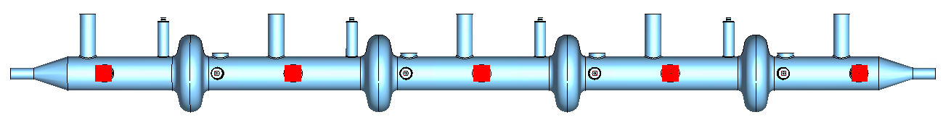
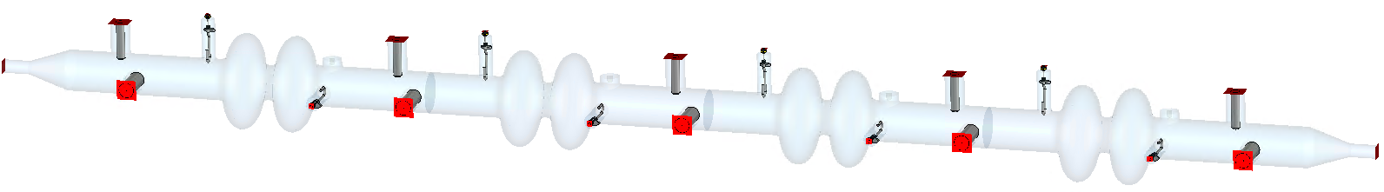


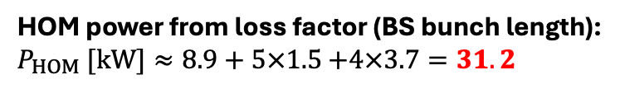


HOM power in 400 MHz cavities at Z working point
~12 kW increase in HOM power with 2-cell cavity and potentially additional ~10 kW in case of resonant excitation.
kWs of HOM power extracted by two rigid coaxial lines → need experimental demonstration.
HOM power from loss factor (BS bunch length):
$P_{HOM} [kW]≈8.9+5×1.5$ $+4×3.7=31.2$
Tapers
2-coax couplers
Cavities
HOM power from loss factor (BS bunch length):
$P_{HOM} [kW]≈8.9+5×1.5$ $+4×6.7=43.2$
Z: $P_{HOM}≈47.9 kW$
3.8 kW
0.06 kW
Total length$≈10.6 m$
2.7 kW
3.4 kW
0.1 kW
3.1 kW
0.08 kW
2.7 kW
0.06 kW
3.2 kW
Z Beam
6.0 kW
0.06 kW
4.5 kW
0.04 kW
4.2 kW
0.07 kW
4.1 kW
0.05 kW
3.8 kW
5.8 kW

Slide 10
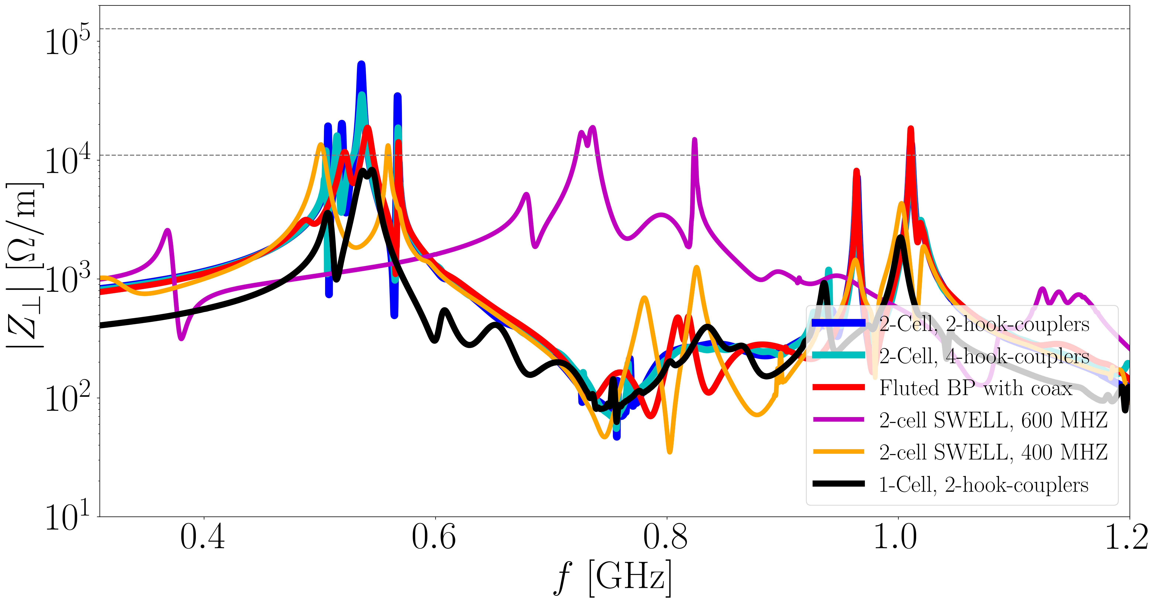
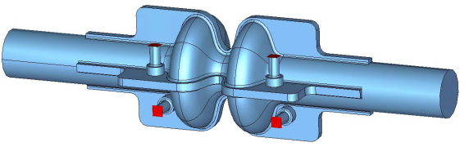
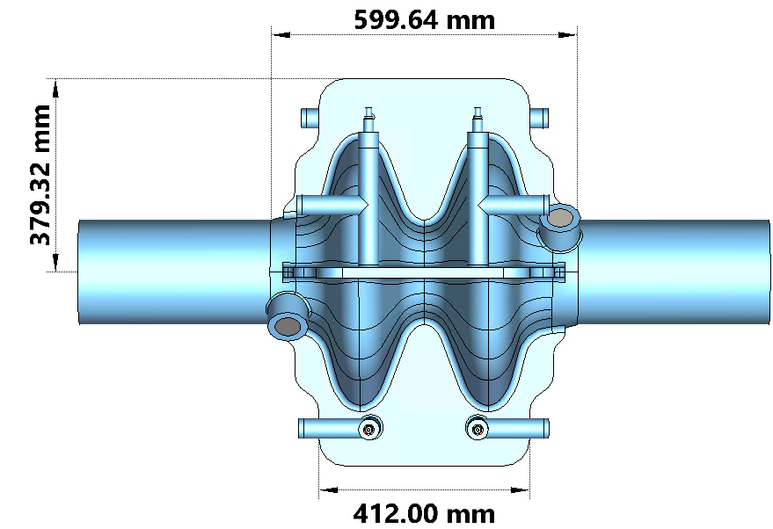
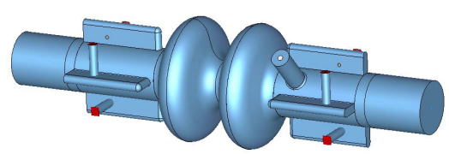
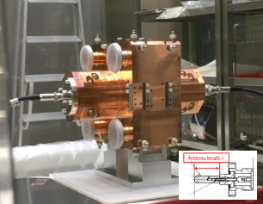
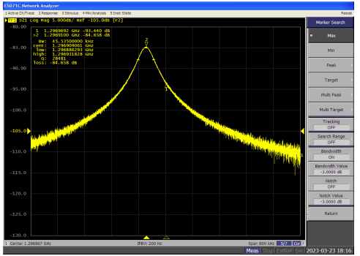
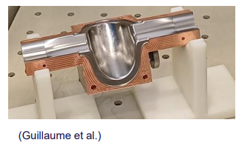

Alternative cavity designs
Alternative 2-cell cavity design aimed at reducing transverse impedance peak
Z: 1.28 A, 100 turn FB
SWELL 400 MHz
Z: 1.28 A, SR
SWELL 600 MHz
F. Peauger
Fluted beam pipe
SWELL 1.3 GHz cavity prototype
F. Peauger
M. Therasse
Warm RF measurements of SWELL cavity 1.3 GHz before Nb coating. 0.006% error in $f$ (-78kHz ) and 0.1% error in $Q_{0}$
Niobium thin film coating of the four quadrants and surface treatment in progress

Slide 11
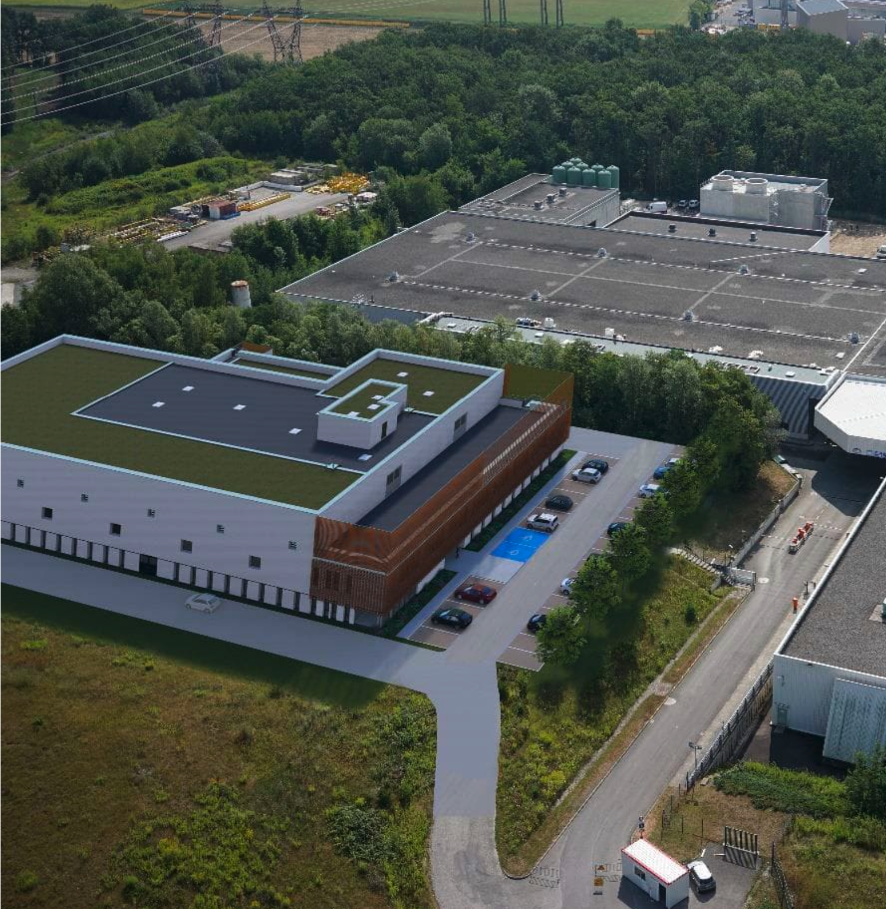
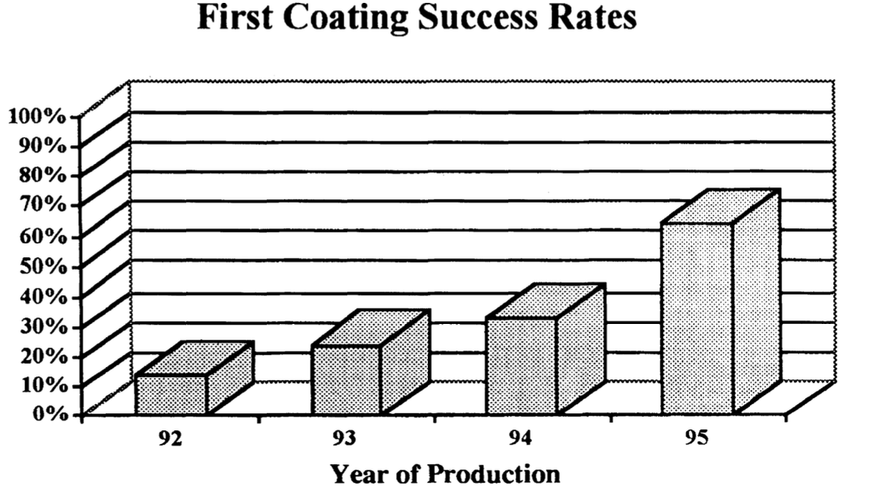
New SRF infrastructure at CERN: SA18
Unique facility for thin film (and bulk) SRF R&D
Chemistry, high-pressure water rinsing, cavity coating, clean room assembly, cryo-module assembly in one building.
Better environmental and process control.
Maximum throughput for rapid improvement (possible throughput at max staffing: ~ 1 cavity/w , 6-9 CM/y).
Delivery foreseen for end of end of 2028 to start installing SRF process infrastructure (1 – 1.5 years).
Increasing coating success rate. Today with LHC spares: 25%.
LEP first coating success rate

Slide 12
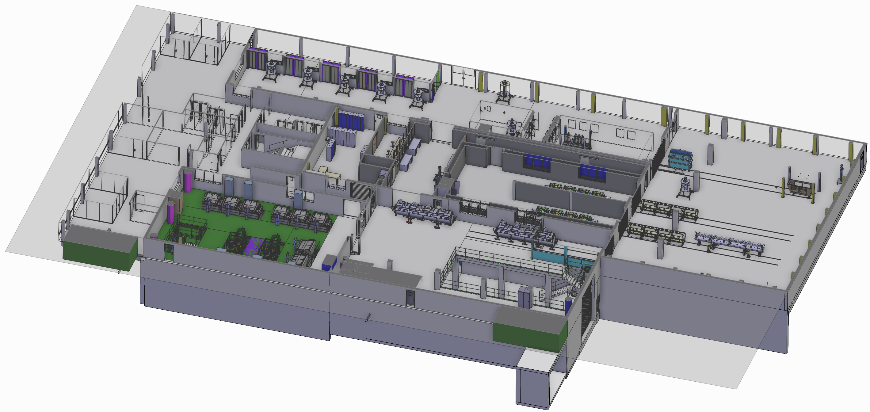
Ground Floor Process Layout
Technical Gallery
Bulk Nb Cavity assembly
ISO 4 Cleanroom
Vertical airflow
General Area
Personnel & Visitor Entrance
Open space workstations
meeting room,...
Sputtering Lab
LPR / HPR & Cathode Assy ISO 4 Cleanroom
Horizontal airflow
Cavity string assembly lines 1&2
ISO 4 Cleanroom
Horizontal airflow
HIE Isolde CM assembly
ISO 4 Cleanrooms
Horizontal airflow
Gowning Area
Personnel access
to cleanrooms
Main Hall
Cryomodule Cryostating
ISO 8 Cleanroom
Preparation area
For small components
Prior to entering cleanrooms
+ component washer
Cleanroom ISO 7
Surface Treatment Workshop
Electropolishing and Chemical polishing
for Nb and Cu cavities
QA/QC Room
+ HPR
Reception Hall
Loading Bay
(access to basement)
Access
from/to SM18

Slide 13
Efficient RF power sources

Slide 14
Energy savings: RF power generation
Radiofrequency systems are the biggest loads
Power demand for RF Storage ring Z, W, H
P_{RF} = 100MW
P_{EL} = 100 / ηklystron / ηmodulator / ηdistribution
P_{EL}= 100 / 0.8 / 0.9 / 0.95 = 146MW
Booster: P_{ELav} = P_{EL} * booster duty cycle = 1.7MW
With 55% efficiency, the RF power demand would be 212MW,
66MW reduction expected: 300GWh/y of energy saving
Storage ring | Z | W | H | TT
Beam Energy (GeV) | 45.6 | 80 | 120 | 182.5
PRF (MW) | 100 | 100 | 100 | 100
Klystron efficiency | 0.8 | 0.8 | 0.8 | 0.8
PRF EL (MW) | 146 | 146 | 146 | 146
Booster | Z | W | H | TT
Beam Energy (GeV) | 45.6 | 80 | 120 | 182.5
PRFb (MW) | 7.5 | 7.5 | 7.5 | 7.5
Klystron efficiency | 0.7 | 0.7 | 0.7 | 0.7
Booster duty cycle | 0.15 | 0.15 | 0.15 | 0.15
PRFb EL (MW) | 2 | 2 | 2 | 2
Assumption of 80% efficiency, not existing today!
LDG Meeting and Accelerator R&D Workshop, 6-7 June 2024
14

Slide 15

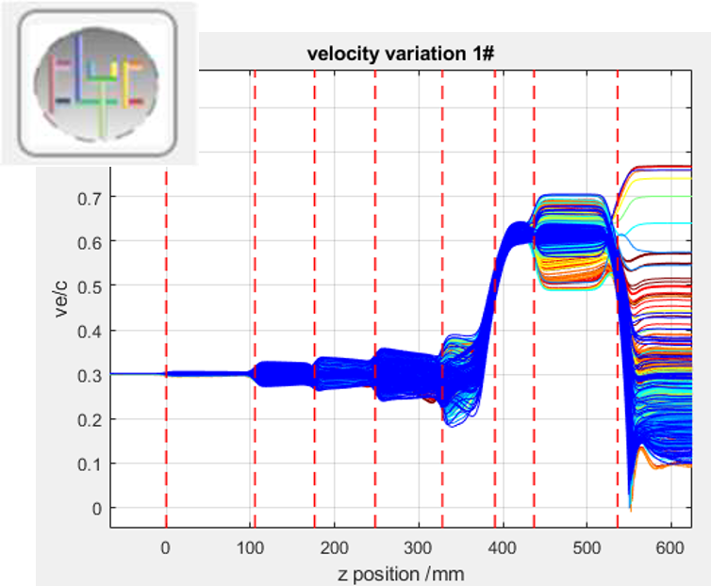
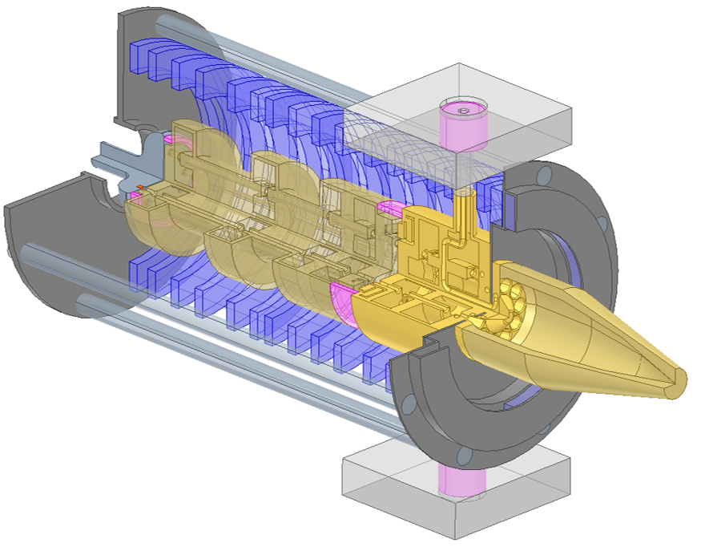
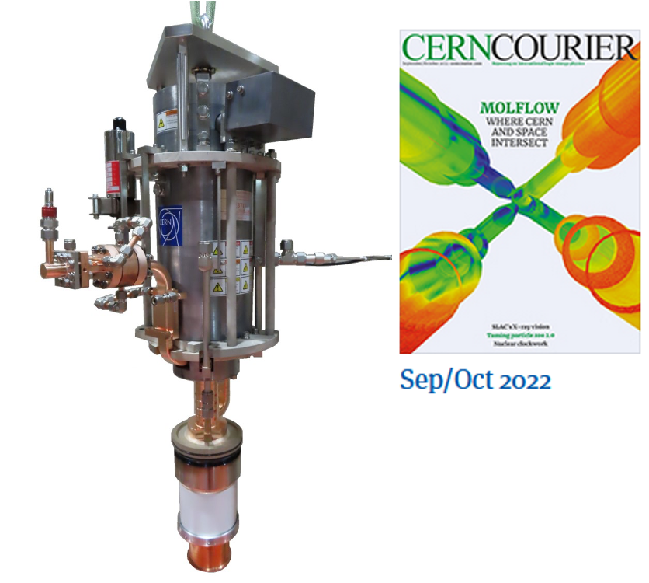
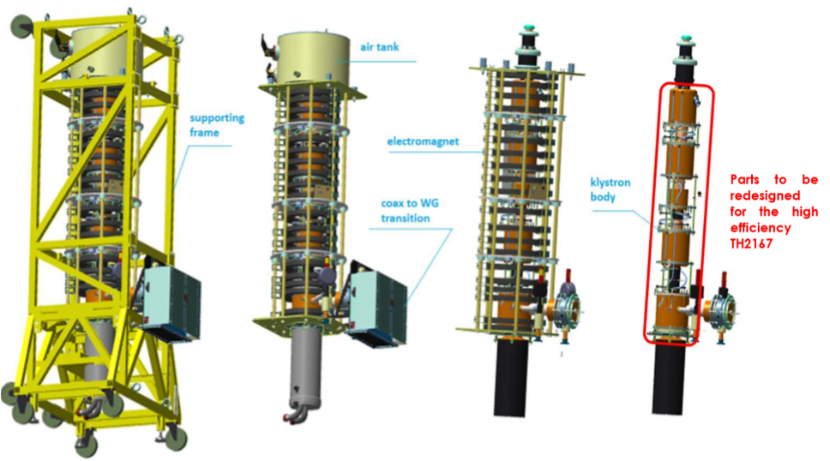
High Efficiency Klystron Project
Collaboration with Lancaster University & Industry (Thales, Canon)
FCC scope: increase klystron efficiency from ~55% today to >80%. 400 MHz 2-stage: design ready, 800 MHz: probably IOT solution.
Design & simulation
HE LHC klystron
2-stage klystrons with
>80% efficiency
HE X-band klystrons:
10-50 MW
CERN made klystron code: KlyC.
Under construction, prototype expected summer 24.
400 MHz 1MW CW klystron for FCC.
Electrical design ready, discussion with industry starting. Prototype ~2027
First CERN-designed & industry produced prototype successfully tested in 2022
LDG Meeting and Accelerator R&D Workshop, 6-7 June 2024
15

Slide 16
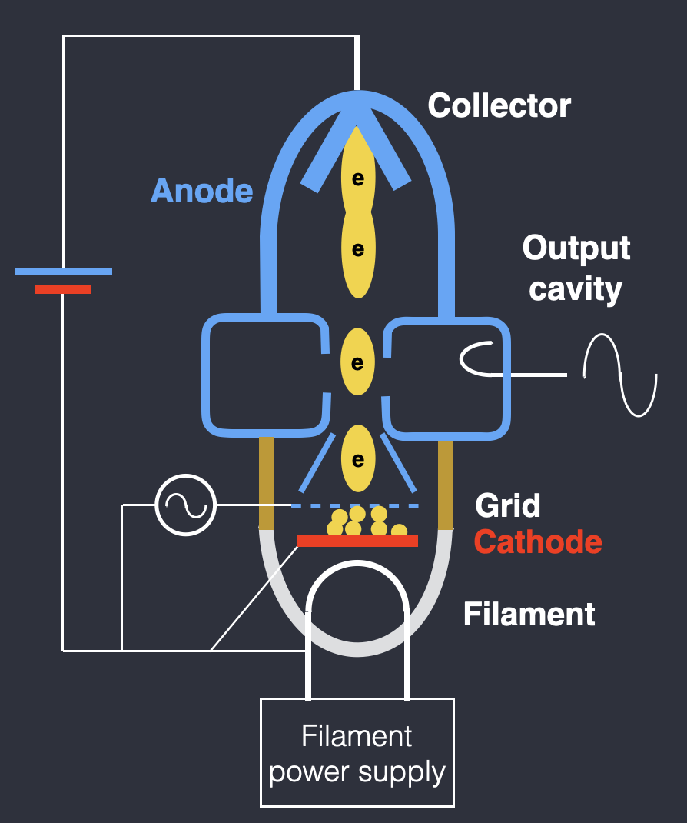
800 MHz Inductive Output Tubes (IOT) for the booster
Z, W, H: Low average power consumption in the booster (~2 MW vs. 150 MW in storage ring) and high efficiency of existing IOTs (~70%): focus on lowering capital investment rather than increase of efficiency.
Development of a cost-efficient IOT based RF system combining several tubes to cover the 800 MHz power needs (60 - 250 kW) for Z, H, W. (Thales collaboration)
ttbar (with 800 MHz in the storage ring) merits the development of a new high-efficiency system (MB-2-stage IOT, klystron, or solid state).

Slide 17
RF R&D roadmap

Slide 18
400 MHz high power system test
Z technology
baseline
W,H technology
baseline
ttbar technology
baseline
FCC-ee timeline:
operation: 2044 - 2059
1.3 GHz R&D
400 MHz R&D
800 MHz R&D
400 MHz industrialisation
& pre-series
Bulk Nb baseline
Z
W, H
800 MHz industrialisation
& pre-series
Z
W, H
ttbar
400 MHz production
& testing
SRF building operational
112
168
800 MHz production & testing
24
88
976
Operation
Z
W, H
ttbar
800 MHz high power system test
2025
2030
2035
2040
2045
2050
2055
2060
R&D, prototyping & testing
Industrialisation & pre-series
Production & testing
Installation & HW commissioning
Operation

Slide 19
Planned prototyping effort to prepare for FCC (or other future accelerators), Council vote in June

Slide 20
FCC feasibility study Project decision
SRF building operational
Start of industrialisation
Roadmap towards
construction
Existing FCC
Workpackages
Resourced
feasibility
New SRF
building
Resourced
SRF building: Dedicated process infrastructure
New SRF prototyping package
June council vote
Development: Technological readiness (Z)
Final prototypes, prepare for construction (Z)
Start of industrial production
Tbd: Pre-industrialisation,
Design iterations,
Resources to be defined
SRF R&D project
Resourced today
Research: Performance & efficiency improvement, cost reduction (Z, W, H, ttbar)
2025
2030
2035
2040

Slide 21
Key technologies and technological readiness
RF technology exists to build this machine today though not at the desired specifications.
Research is needed to reach nominal specs, to keep capital cost under control and to potentially increase energy efficiency.
Development (prototyping) of cavities, couplers, cryomodules is a time-consuming process and needs to start now.
400 MHz largely at CERN, 800 MHz so far planned in the US.
CERN is making a strategic investment in a dedicated new SRF facility, is setting up a significant SRF R&D effort, and is developing high-efficiency RF sources.
The ttbar starting date (2055) justifies a long-term research program for Nb3Sn cavities. Any progress until 2040 – 2045 will significantly impact cost & efficiency of the ttbar run. This is the time for a major technological step forward.

Slide 22
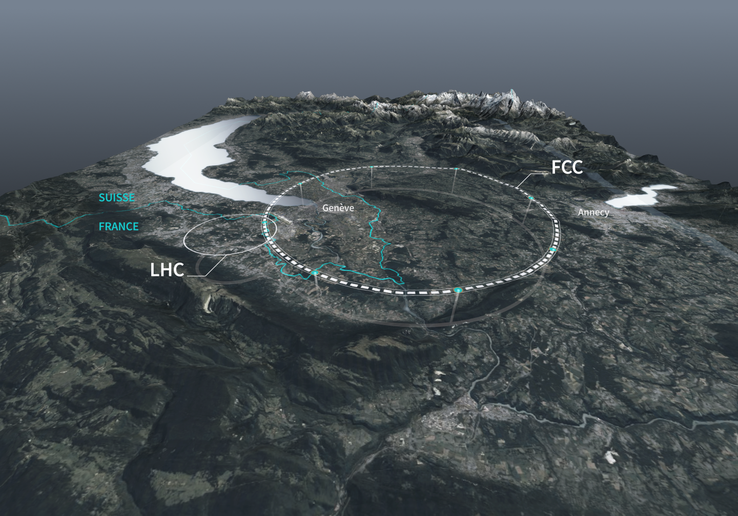
Thank you

Slide 23



Nb₃Sn/Cu for SRF, rationale and first steps
Nb3Sn on bulk Nb (thermal diffusion of tin in Nb cavity, mostly at US-labs) state of the art:
  1.3 GHz cavities reaching high Q at 4.5 K (comparable with Nb at 2 K)
  Accelerating field limited so far <25 MV/m (potential of 100 MV/m): may come from insufficient thermal stabilization of weaker superconducting spots
Using copper substrates promises to overcome the field limit, but comes with several challenges:
  Process temperatures limited by substrate
  Differential thermal expansion, stress , disorder
  Copper interdiffusion, need of buffer layers
1st phase of CERN study , based on DC magneton sputtering on small samples is documented in (1)
2nd phase with High Power Impulse Magnetron Sputtering (HIPIMS) is starting.
(1) Development of sputtered Nb₃Sn films on copper substrates for superconducting radiofrequency applications (E A Ilyina et al, Superconductor Science and Technology, Volume 32, Number 3

Slide 24
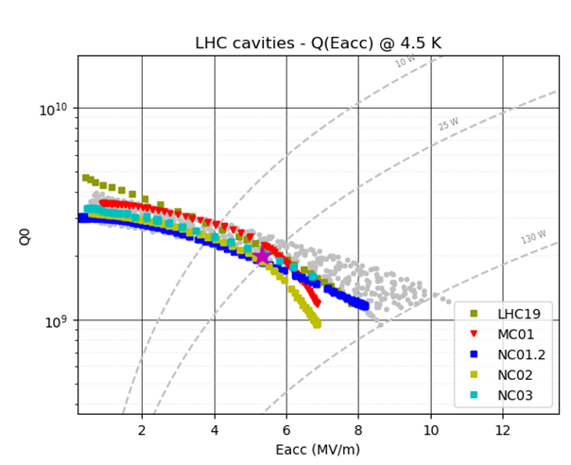
From samples to cavities
In 2023, QPR sample reached surface resistance at 400,800 and 1200 MHz and 4.2 K better than Nb/Cu but not as good as Nb₃Sn/Nb
Next step: scaling to cavity size
Challenges:
Cavity mechanical design (support of annealed copper, tunability)
Coating system design (cavity support and turning system, heating, multiple cathodes, target cooling, etc.)
A working group has been set up to create a long-term (10 – 20 year) roadmap to develop Nb3Sn for SRF cavities.
Collaborations on thin films & Nb₃Sn with: INFN, CEA, FNAL, JLAB, Cornell, University Hamburg, Wien Technical University, Geneva University, ..
400MHz
QPR Q4

