Slide 1

Stability study of GEM detector
and
Performance study of a new RPC prototype
Saikat Biswas
Department of Physical Sciences
Bose Institute, India
2nd DRD1 Collaboration Meeting & Topical Workshop on Electronics for Gaseous Detectors
June 17 – 21, 2024, CERN

Slide 2
Outline
Stability study of GEM detector
Development of Bakelite RPC
  Study of I-V characteristics
  Efficiency measurement
  Time resolution measurement
  Stability
  Radiation hardness
  Charge sharing measurement
Summary

Slide 3
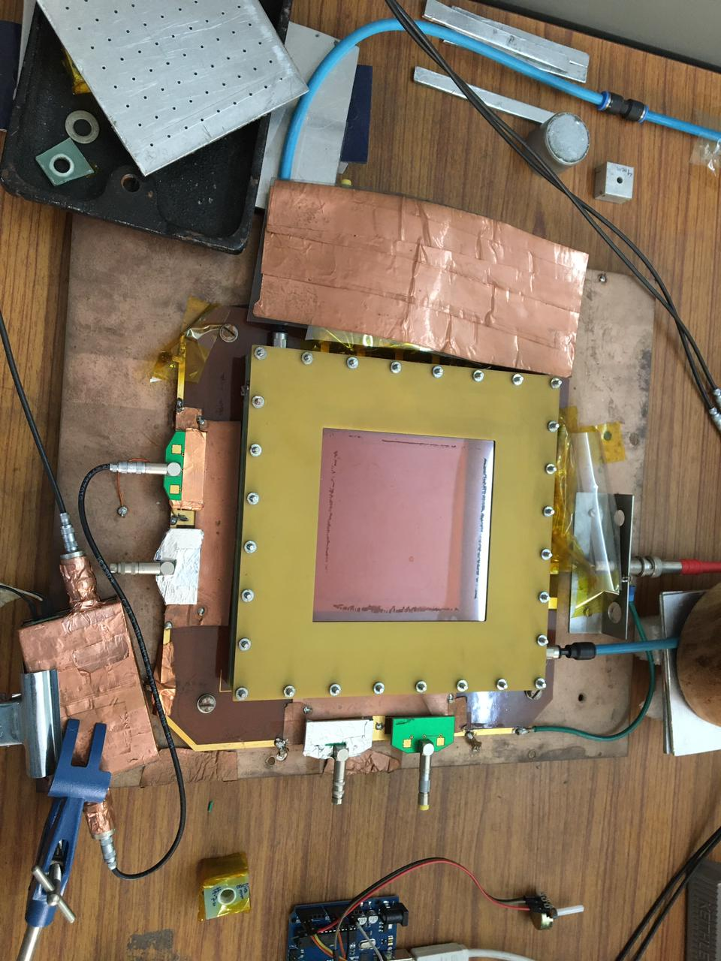
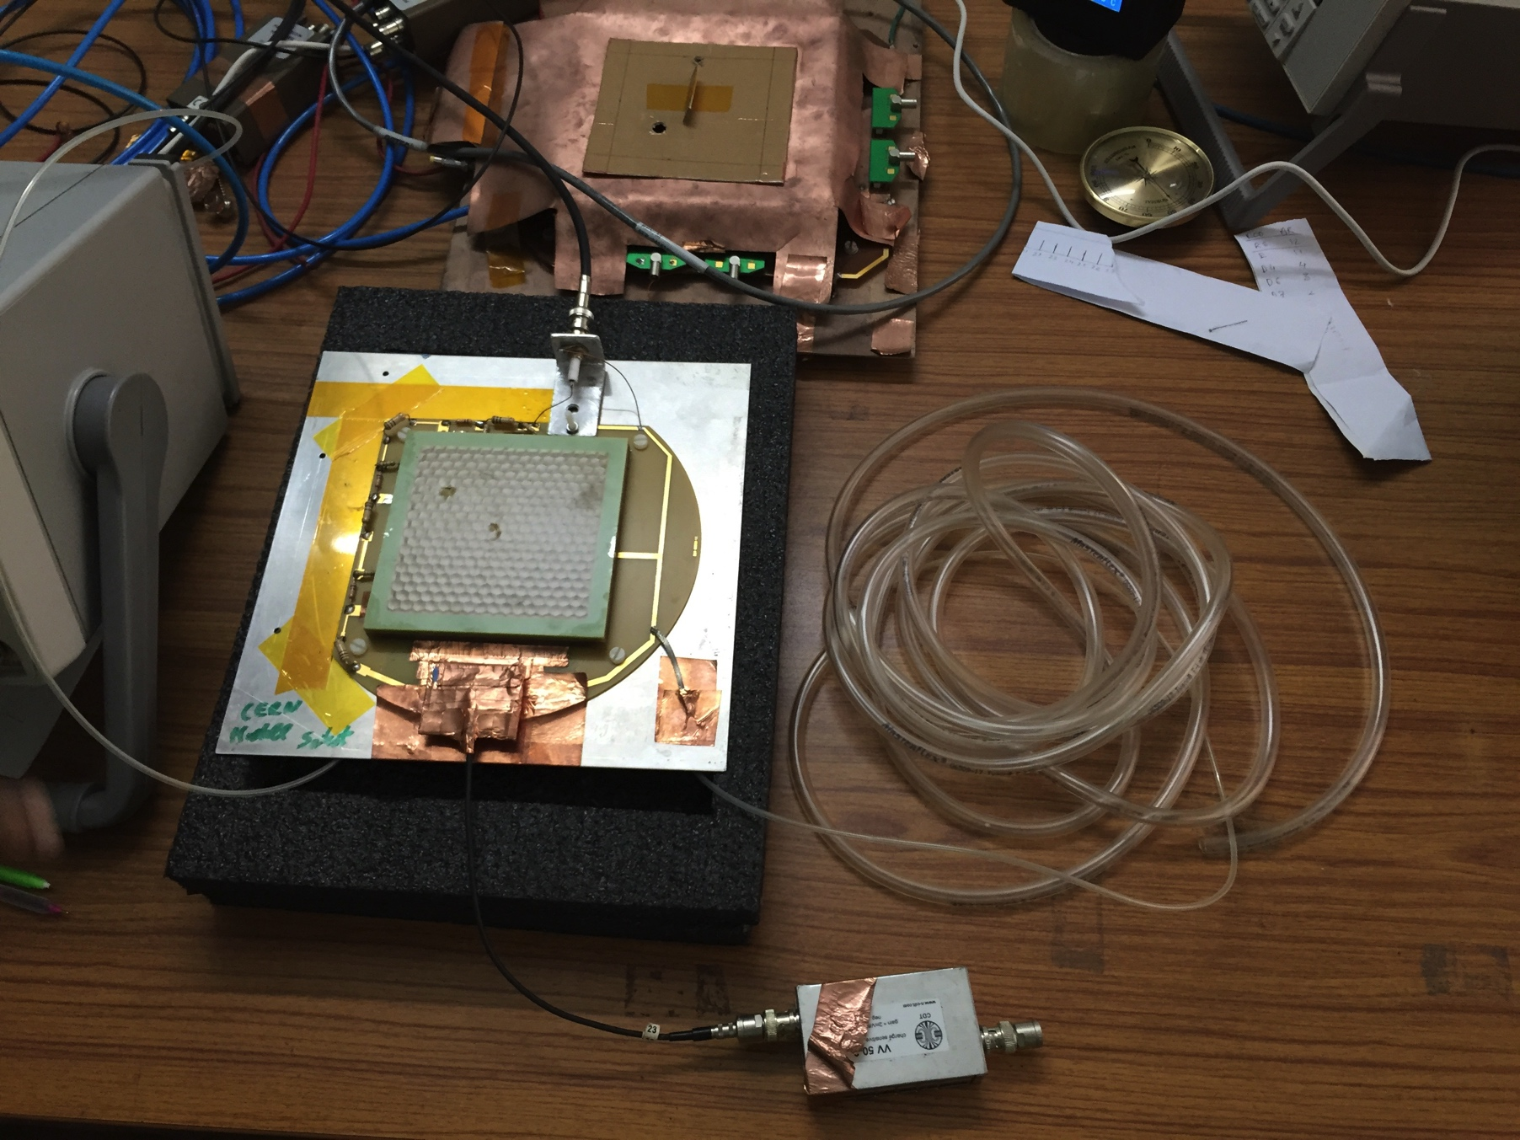
Triple GEM chambers prototype under testing
Double Mask (DM) triple GEM chamber
Single Mask (SM) triple GEM chamber

Slide 4
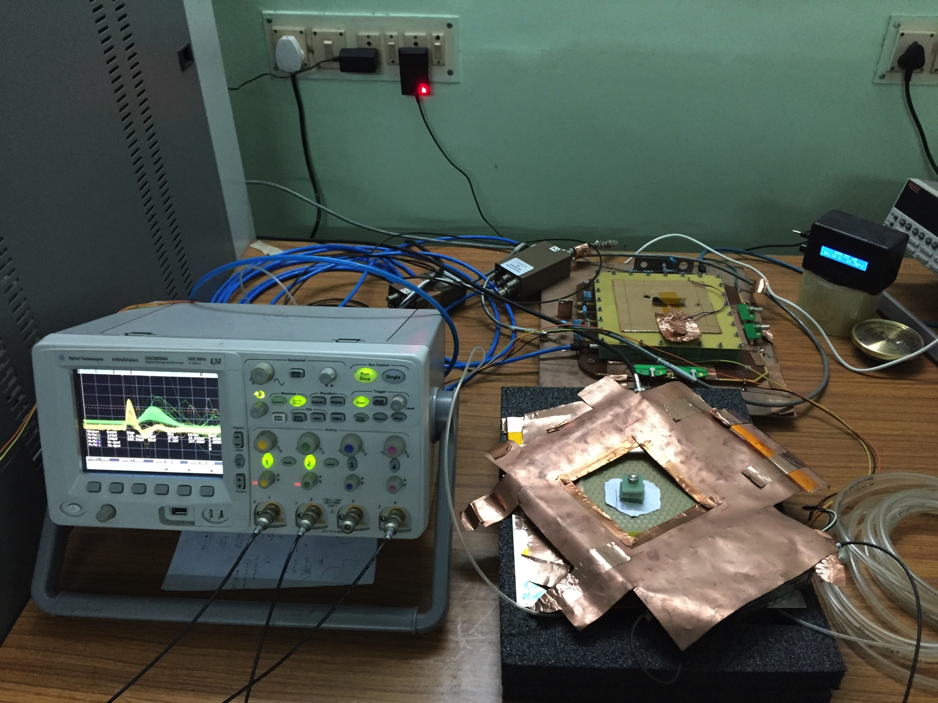
Triple GEM chamber prototype under testing

Slide 5
Characteristics studies of triple GEM prototypes

Slide 6
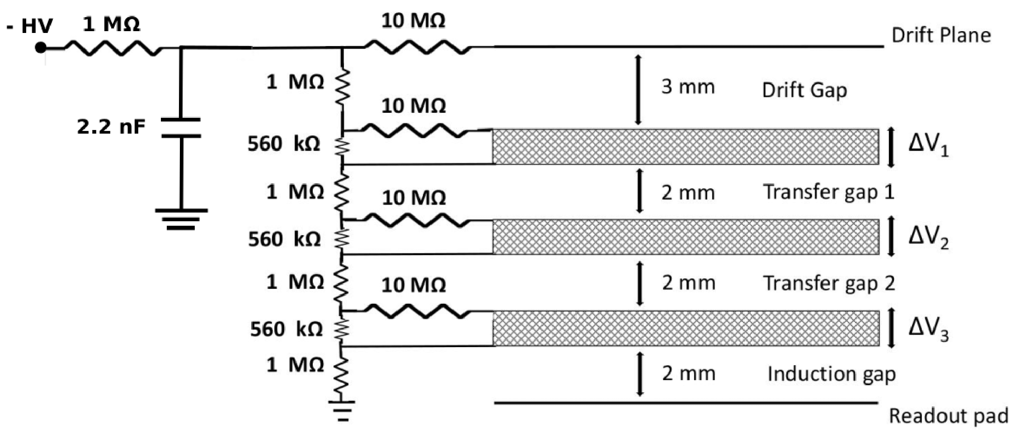
Characteristics studies
Schematic of the High Voltage distribution of the DM mask triple GEM chamber of dimension 10×10 cm²
Dimension of the chamber: 10×10 cm²
GEM: SM & DM triple GEM chamber
Source: Same Fe⁵⁵ X-ray (5.9 keV) source is used for irradiation and monitoring the spectrum
Gas mixture: Ar/CO₂ (Continuous flow mode)
Preamplifier gain: 2 mV/fC (charge sensitive)

Slide 7
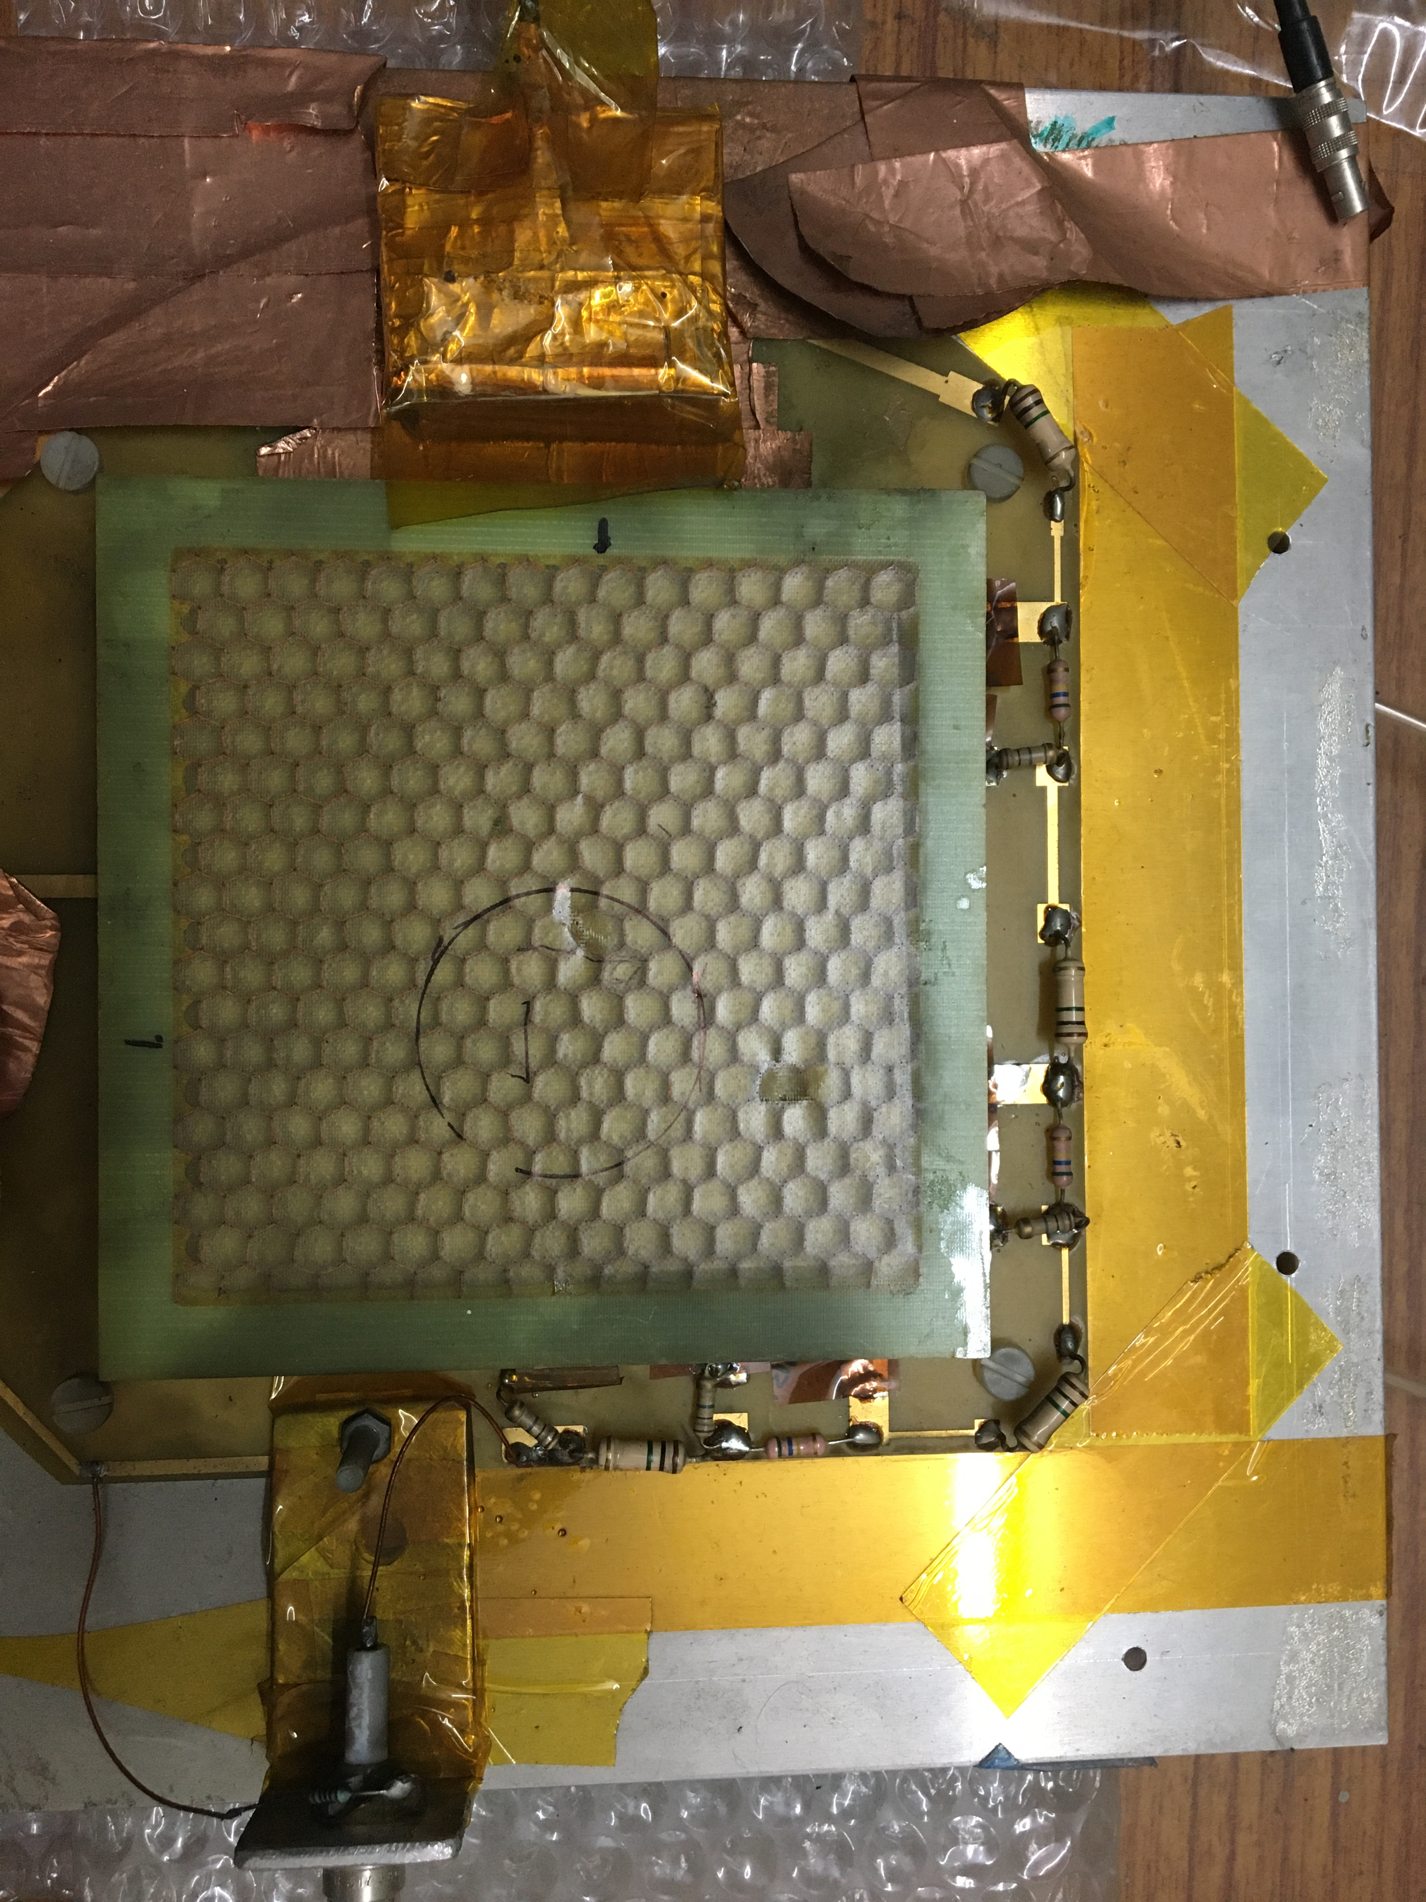
Characteristics studies
Schematic of the High Voltage distribution of the DM mask triple GEM chamber of dimension 10×10 cm²
Dimension of the chamber: 10×10 cm²
GEM: SM & DM triple GEM chamber
Source: Same Fe⁵⁵ X-ray (5.9 keV) source is used for irradiation and monitoring the spectrum
Gas mixture: Ar/CO₂ (Continuous flow mode)
Preamplifier gain: 2 mV/fC (charge sensitive)

Slide 8
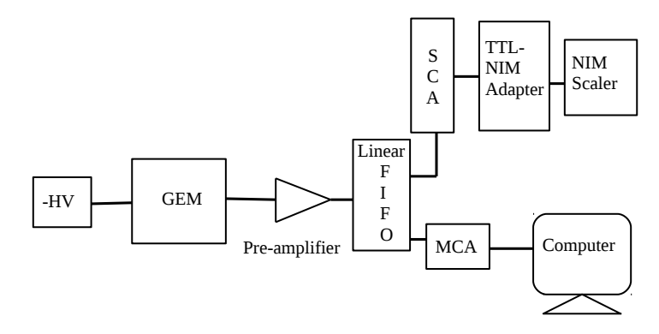
Characteristics studies
Schematic representation of the electronics setup
Schematic of the High Voltage distribution of the SM mask triple GEM chamber of dimension 10×10 cm²
Dimension of the chamber: 10×10 cm²
GEM: SM & DM triple GEM chamber
Source: Same Fe⁵⁵ X-ray (5.9 keV) source is used for irradiation and monitoring the spectrum
Gas mixture: Ar/CO₂ (Continuous flow mode)
Preamplifier gain: 2 mV/fC (charge sensitive)

Slide 9
Characteristics studies
Schematic representation of the electronics setup
Schematic of the High Voltage distribution of the SM mask triple GEM chamber of dimension 10×10 cm²
Dimension of the chamber: 10×10 cm²
GEM: SM & DM triple GEM chamber
Source: Same Fe⁵⁵ X-ray (5.9 keV) source is used for irradiation and monitoring the spectrum
Gas mixture: Ar/CO₂ (Continuous flow mode)
Preamplifier gain: 2 mV/fC (charge sensitive)
Fe⁵⁵ spectra at ΔV ~ 396 V and with Ar/CO₂ gas mixture at 70/30 volume ratio

Slide 10
Stability study of SM triple GEM prototypes

Slide 11
Variation of different parameters with time
Variation of the measured gain, energy resolution, divider current and T/p as a function of the time

Slide 12
Variation of current with time
Applied voltage and divider current as a function of time. The current as a function of time for the first 5 hours after applying high voltage is shown in the inset

Slide 13
Variation of gain and energy resolution with T/p
Variation of the gain as a function of T/p
Variation of the energy resolution as a function of T/p
Gain of the chamber can be expressed as e^{α}, where α is the first Townsend coefficient
Townsend coefficient α ∝ 1/ρ ∝ T/p; ρ = mass density, T = temperature, p = pressure
Gain of the chamber depends on the variation of T/p
Gain is normalised using a parameterisation of the form Ae^{(BT/p)}

Slide 14

Normalised gain & energy resolution vs accumulated charge
Gain and energy resolution is normalised by T/p ratio to nullify the effects of temperature and pressure variations
Degradation in the normalised gain and energy resolution is observed due to the change of the biased current
Typical accumulated charge for 10 CBM years is ~ 0.8 mC/mm² at the gain of 10³
r = rate, n = no of primary electrons, dt = time
e = electronic charge, G = gain, dA = irradiated are
Reference : S. Mandal et al., NIM, A 1064 (2024) 169389

Slide 15
Normalised gain & energy resolution vs bias current
Variation of normalised gain and normalised energy resolution as a function of bias current
Reference : S. Mandal et al., NIM, A 1064 (2024) 169389

Slide 16
Bias current corrected norm. gain and norm. energy reso.
No significant degradation is observed

Slide 17
Abnormality in the initial spectra
The shape of ⁵⁵Fe X-ray spectra at different times after the application of HV.

Slide 18
Abnormality in the initial spectra
Variation of the shape of ⁵⁵Fe X-ray spectra after different time from the application of HV. Appearance of an abnormal double peak at the beginning

Slide 19
Summary
Stability studies of a SM triple GEM chamber
  The T/p normalised gain decreases with time after initial charging up phase
  The probable reason: The bias current started decreasing gradually. As a result, the 𝛥V across the GEM foils decrease which in turn reduce the gain of the detector
  The decrease in the normalised gain is directly proportional to the decrease in the bias current
  Long term stability study doesn’t show any significant degradation in the performance in terms of gain and energy resolution of the chamber after correction for the bias current

Slide 20
Bakelite based RPCs have been developed using indigenous material
and
characterized in the Avalanche mode
A. Sen et al., Nucl. Instrum. Methods. A 1045 (2023) 167572
A. Sen et al., Nucl. Instrum. Methods. A 1024 (2022) 166095
A. Sen et al., 2020 JINST 15 C06055
A. Sen et al., CBM Progress report 2021, 106
A. Sen et al., Proc. of the DAE-BRNS Symp. on Nucl. Phys. Vol. 64 (2019), 996

Slide 21
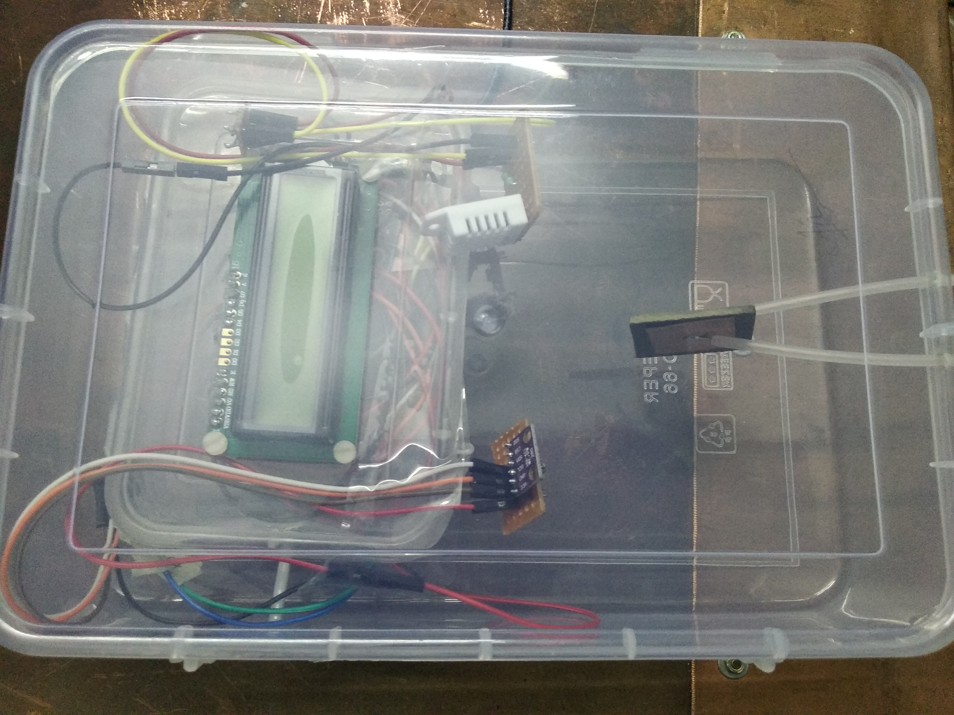
Measurement of bulk resistivity
Humidity & temperature sensor
Material
Display
Pressure sensor
Bakelite Sample 1: Bulk resistivity 2 × 10¹¹ Ω cm
Bakelite Sample 2: Bulk resistivity 3 × 10¹⁰ Ω cm
@ Temp: 22 ℃ and RH: 60 %

Slide 22
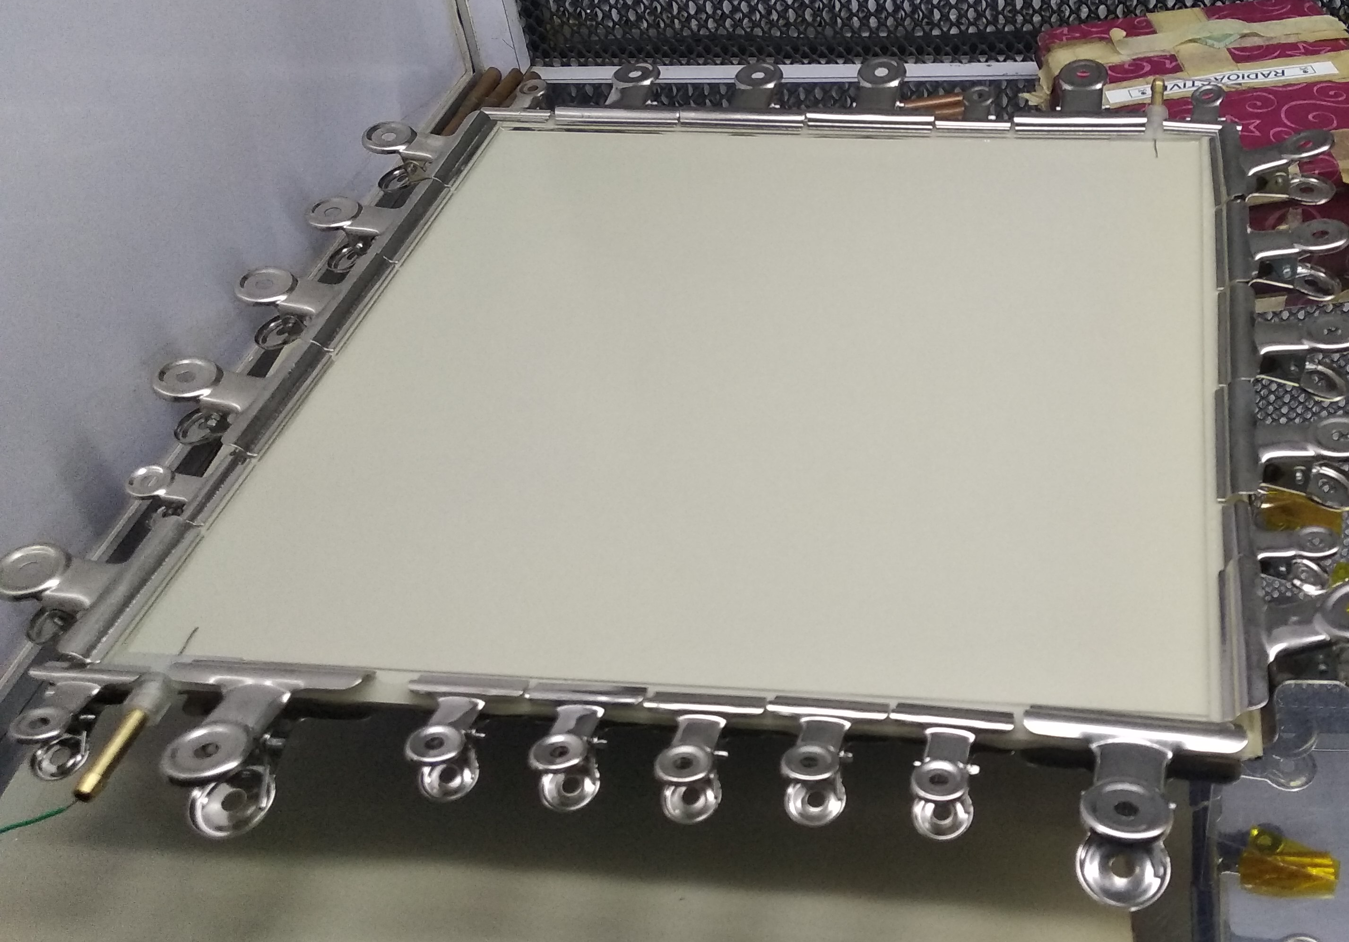
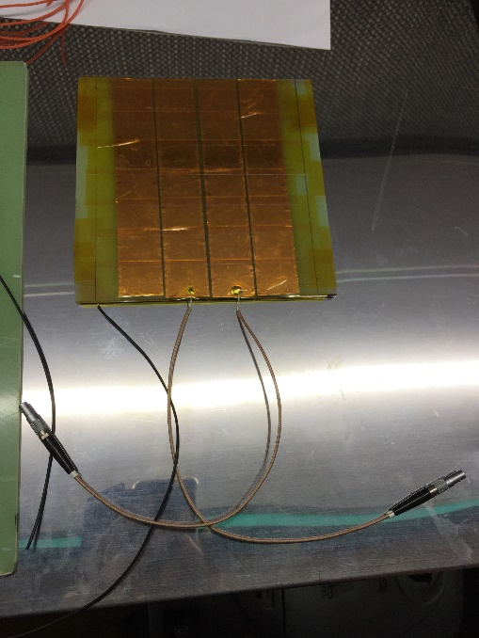
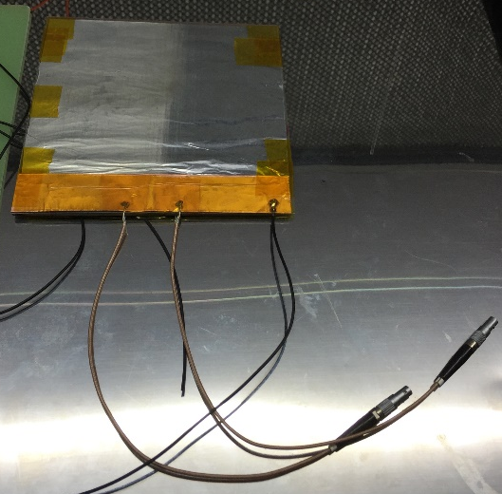
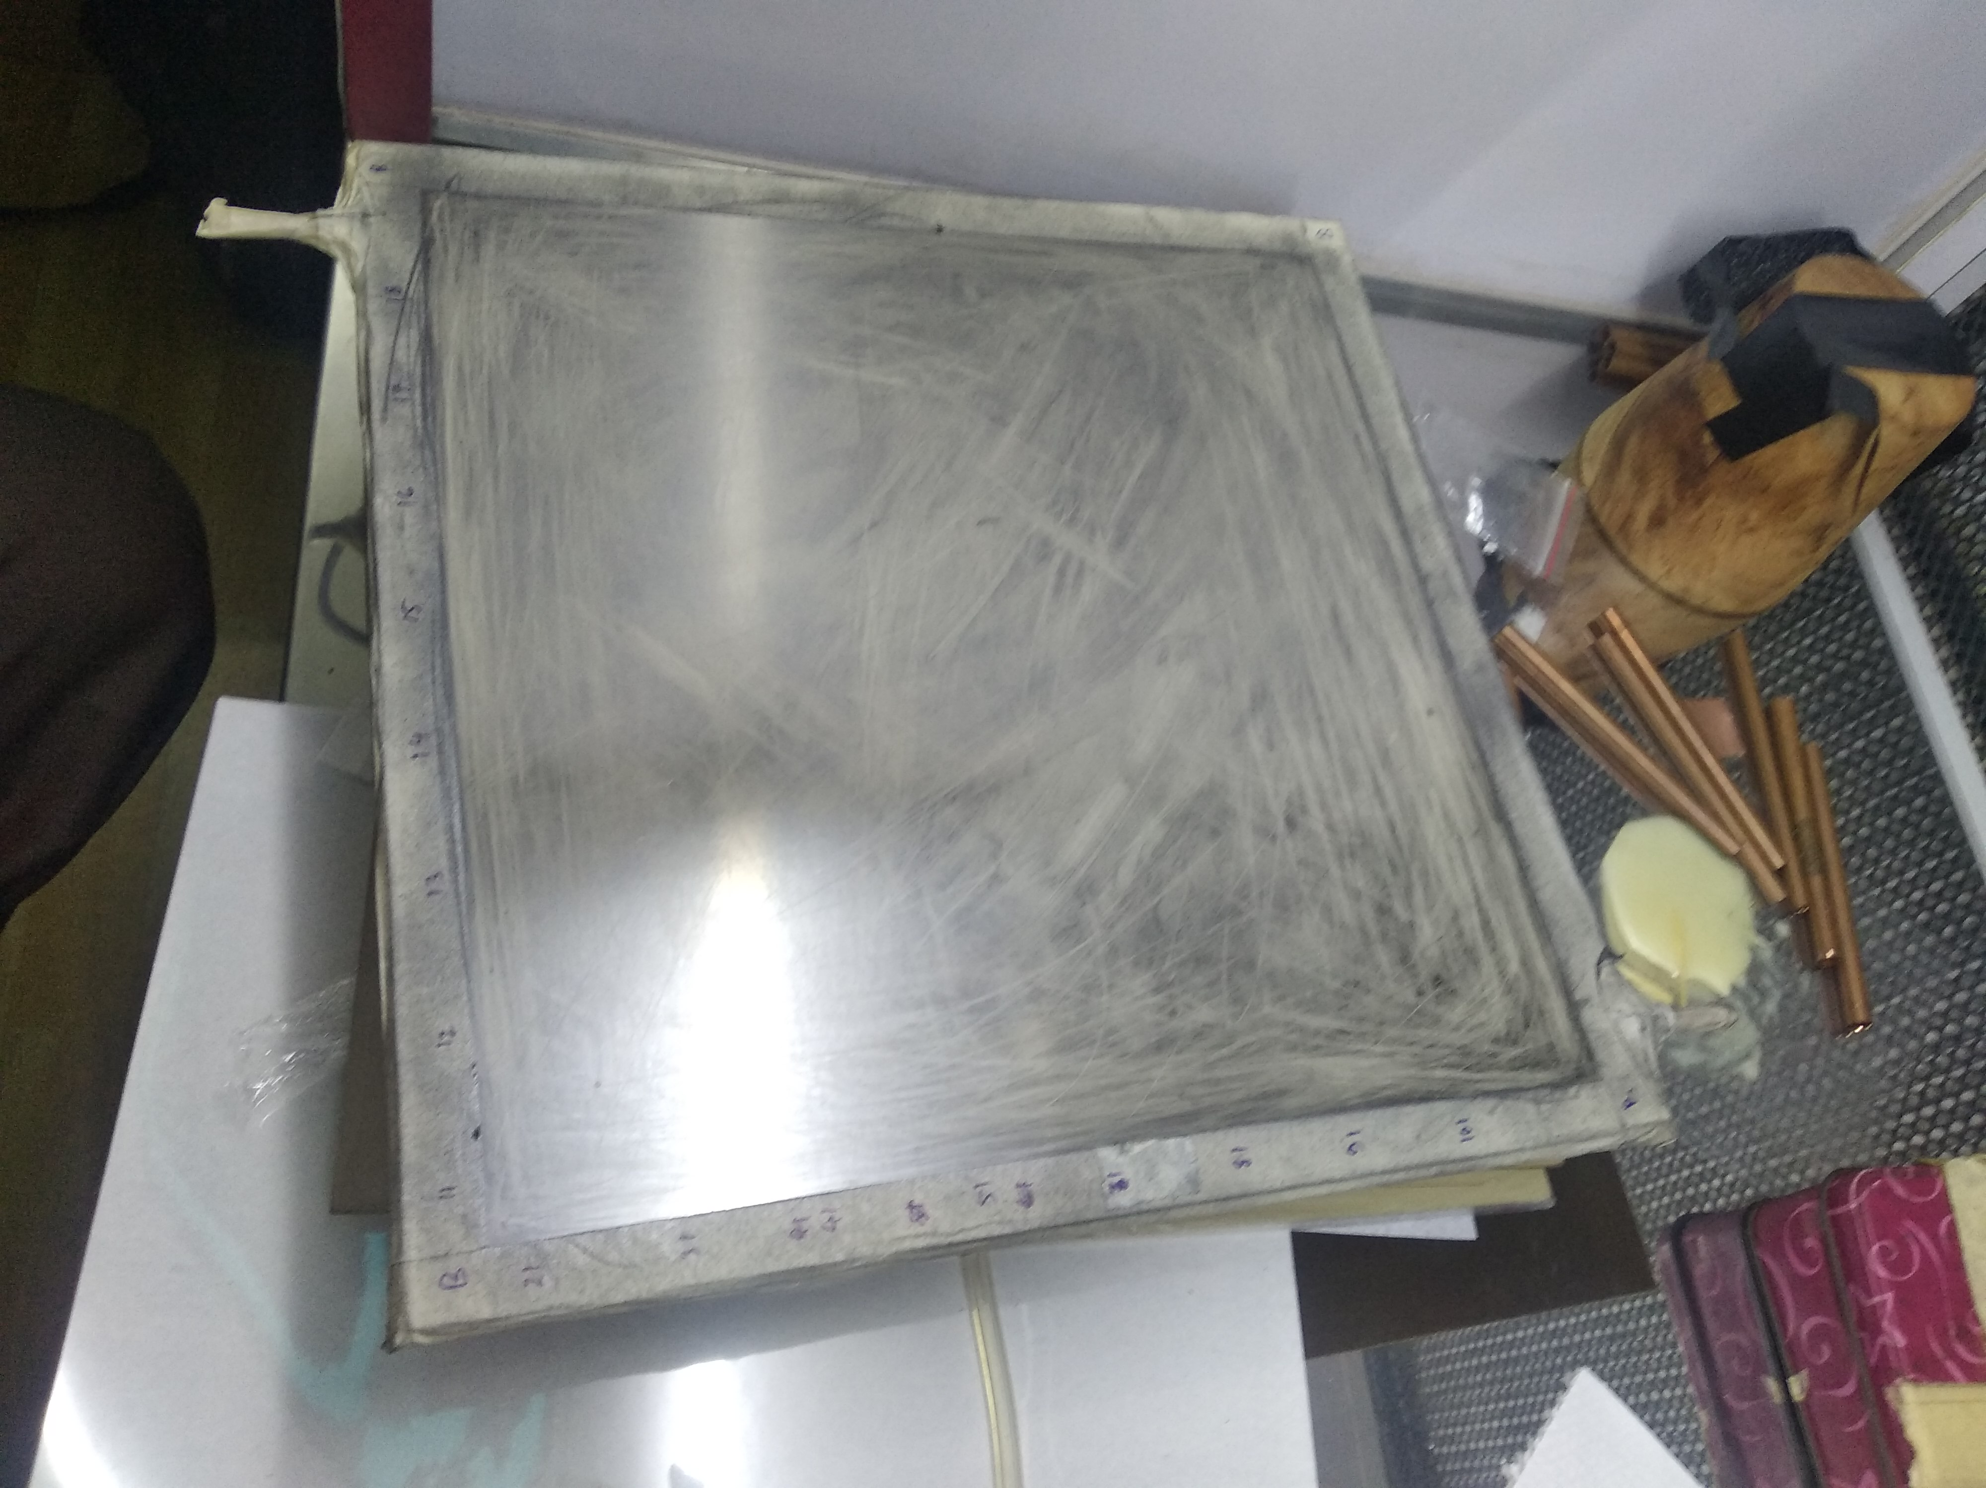
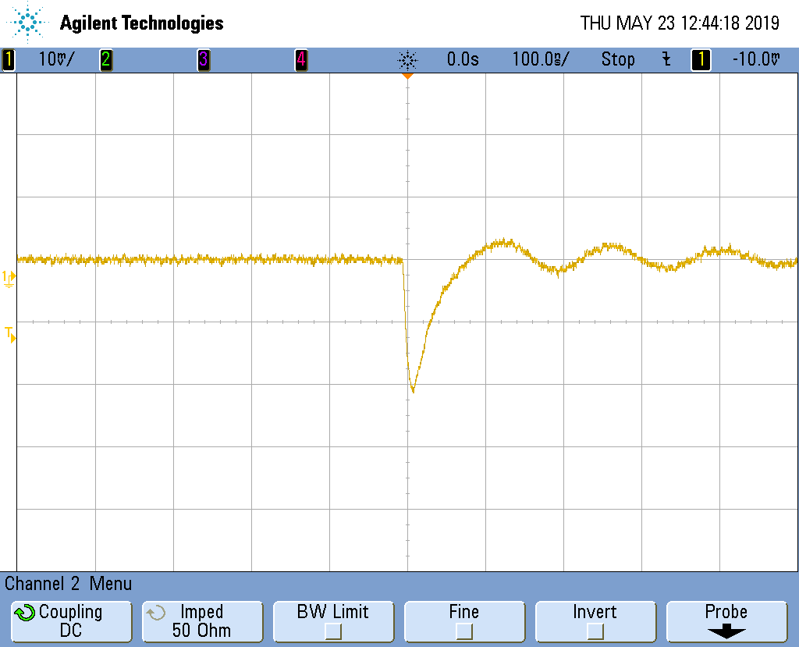
Fabrication of the first prototype
Resistivity
3 × 10¹⁰ Ω cm
Assembling of Components
Typical induced pulse on a pick-up strip observed in oscilloscope with 10 mV/div, 100 ns/div and 50 Ω termination
Pick-up strips
Complete RPC
22

Slide 23
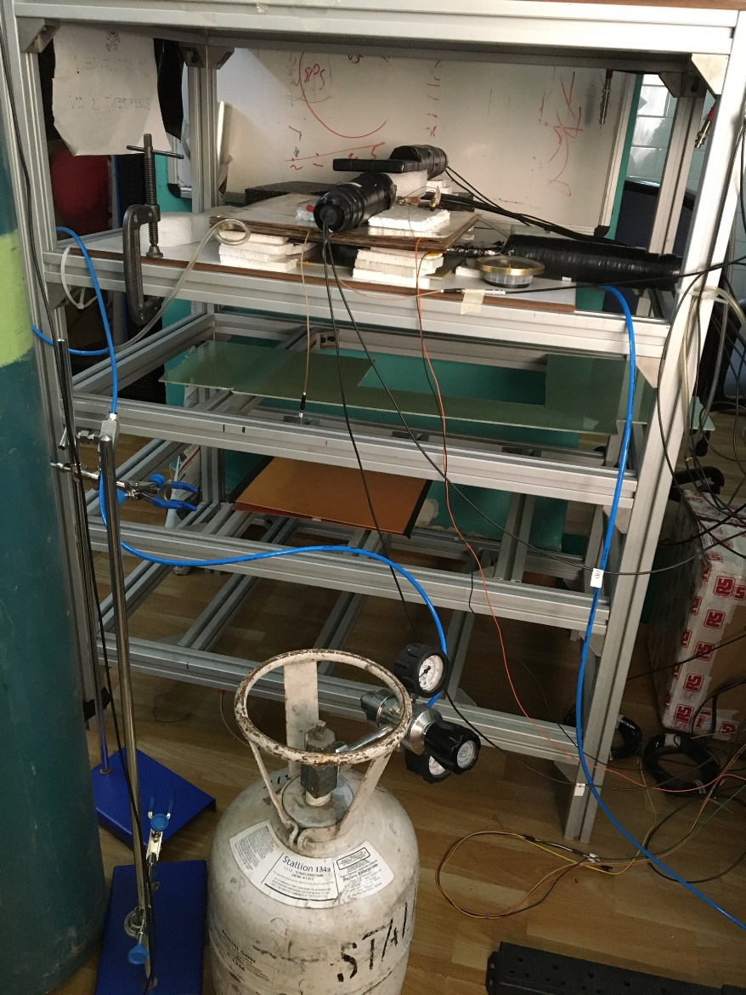
Efficiency measurement
Trigger window = 20 cm²
Trigger = SC1 .AND. SC2 .AND. SC3
Efficiency =
RPC signal in coincidence with trigger (4F)
Trigger (3F)
Threshold to the Sc: - 15 mV
Threshold to RPC: - 15 mV
Reference : A. Sen et al., 2020 JINST 15 C06055

Slide 24
Efficiency vs voltage
Gas: 100 % Tetrafluroethane
Efficiency ∼70±3%
24
Reference : A. Sen et al., 2020 JINST 15 C06055

Slide 25
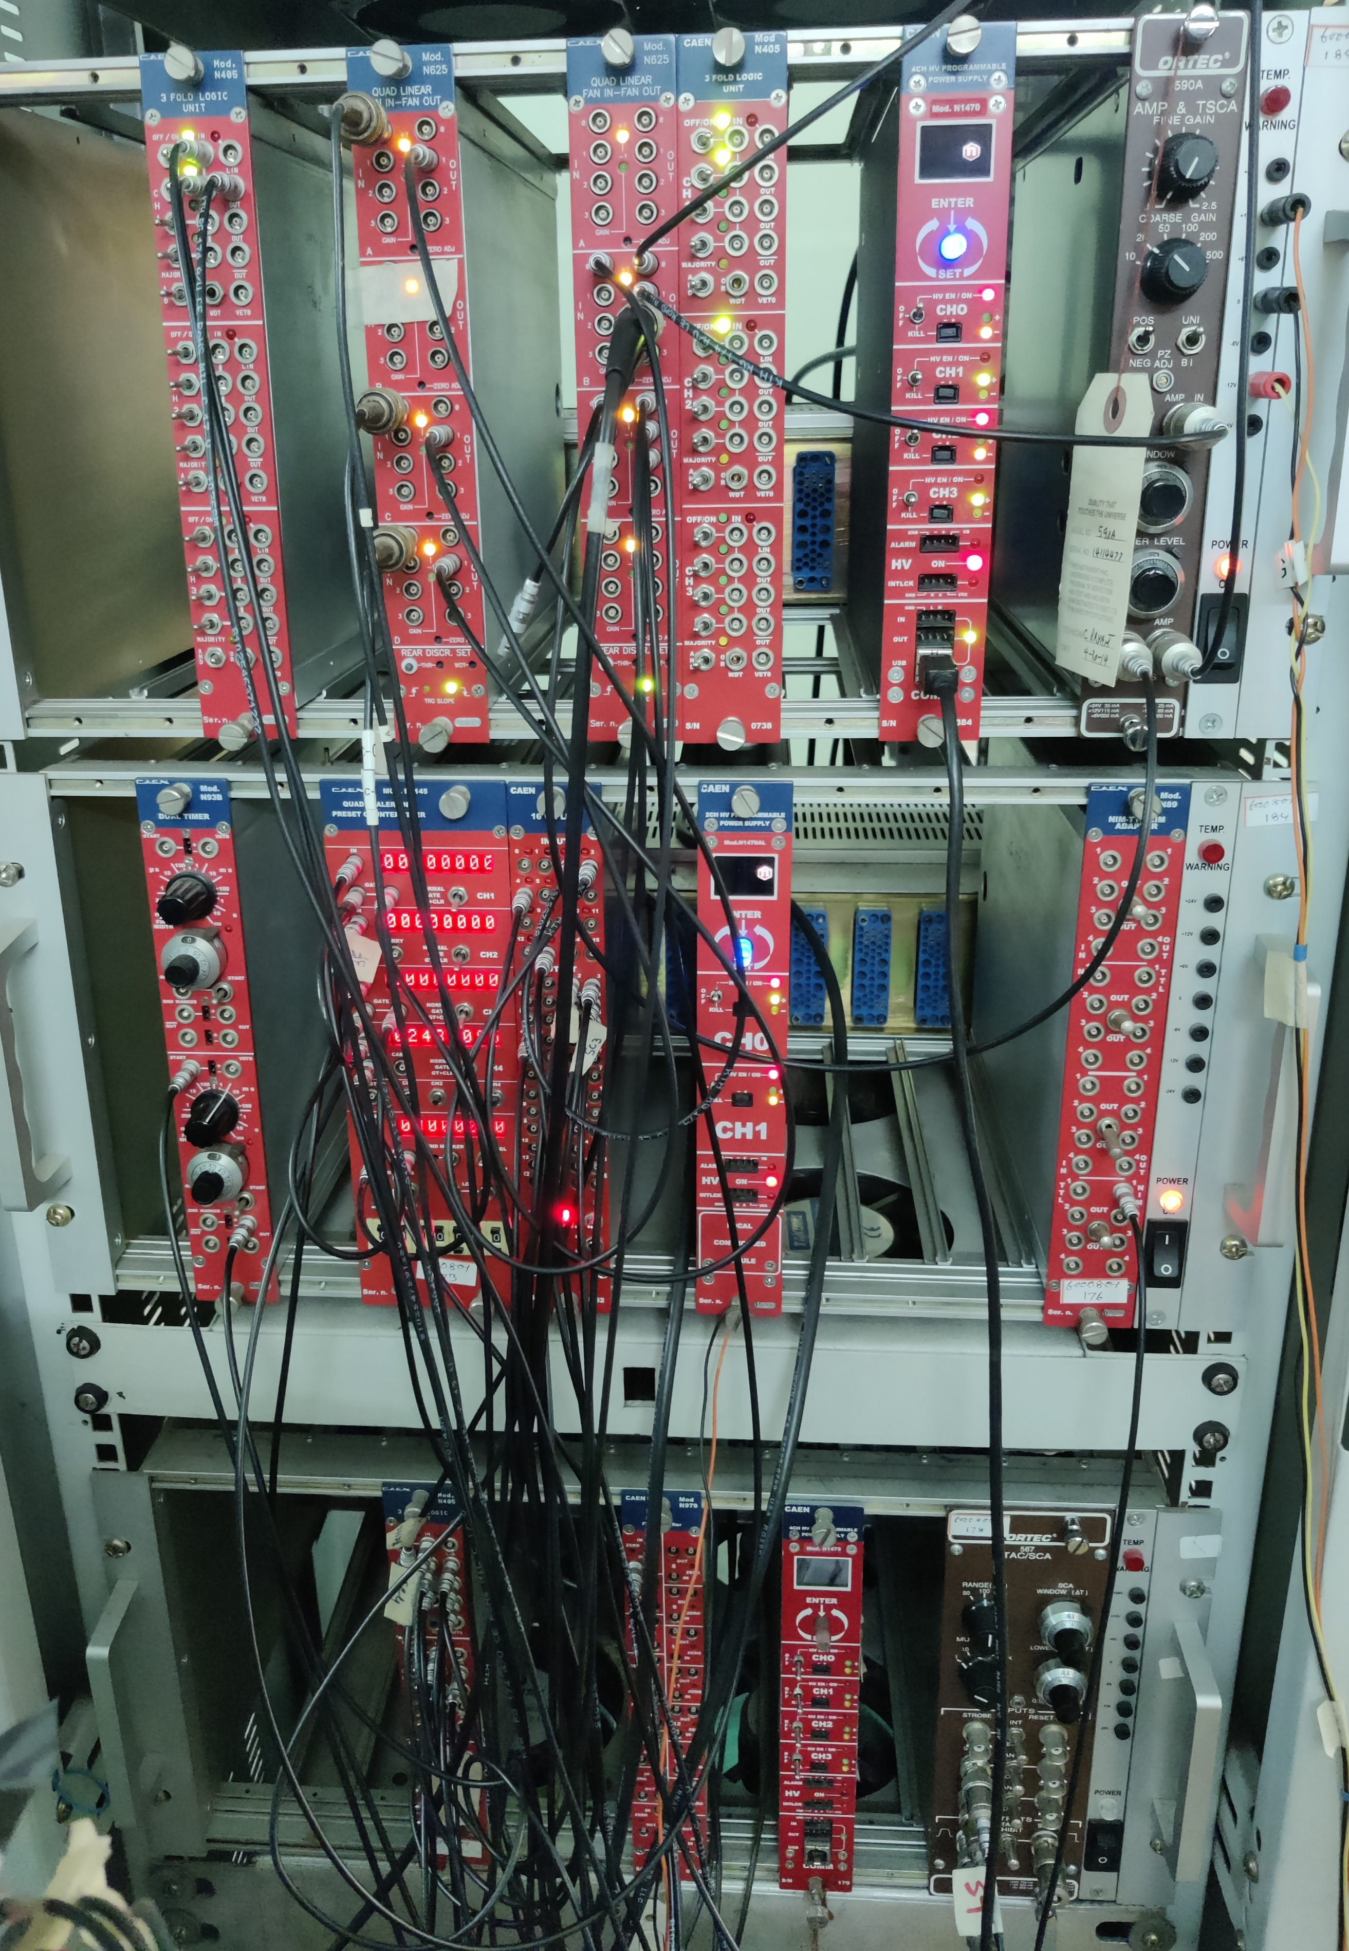
Time resolution measurement
Reference : A. Sen et al., 2020 JINST 15 C06055

Slide 26
Time resolution vs voltage
Gas: 100 % Tetrafluroethane
Timing Spectrum
Time resolution ∼1.2±0.03 ns (𝝈)
26
Reference : A. Sen et al., 2020 JINST 15 C06055

Slide 27
New technique of linseed oil coating
In the present work the linseed oil coating is done on bakelite plate before making the gas gap.
We take about 2g of linseed oil is applied over the 27 cm × 27 cm area of each plate.
The linseed oil is distributed over the surfaces and both the plates are left for 15 days in a sealed box for curing.
The advantage of this procedure is that after linseed oil coating it can be checked visually whether the curing is properly done or any uncured droplet of linseed oil is present.

Slide 28
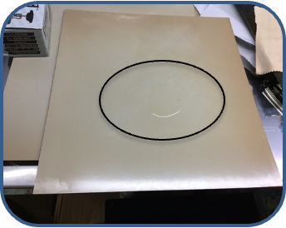
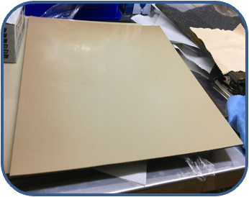
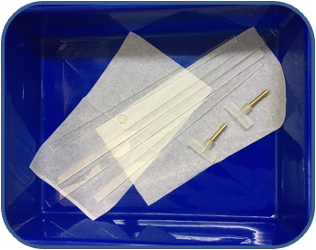
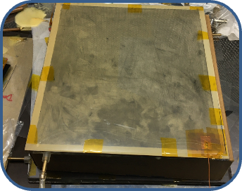
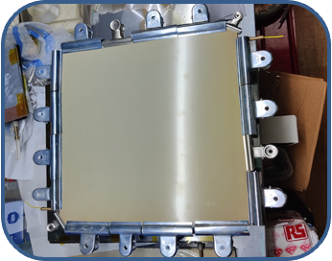
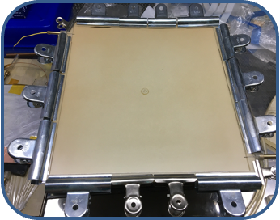
Fabrication steps
Resistivity= 3 × 10¹⁰ Ω cm
Oil
Application of linseed oil on the bakelite surface
Cured linseed oil coated bakelite surface
Gas nozzles and spacers
Complete RPC module after graphite coating
Making of gas gap
Gluing of spacers and nozzles

Slide 29
Results
100% C₂H₂F₄
Leakage current as a function of the applied voltage
@ -15 mV threshold
Efficiency: ∼ 95±1% from 9.4 kV onwards
Noise rate ∼ 500 Hz/cm²
@-20 mV threshold
Efficiency: ∼ 85±5% from 10.1 kV onwards
Noise rate ∼ 200 Hz/cm²
(a) The efficiency vs the applied voltage
(b) Noise rate as a function of the applied voltage
Reference : A. Sen et al., NIM A 1024 (2022) 166095

Slide 30
Results
@ -20 mV threshold
Efficiency: ∼ 95±2% from 10 kV onwards
Noise rate ∼ 120 Hz/cm²
@-25 mV threshold
Efficiency: ∼ 95±2% from 10 kV onwards
Noise rate ∼ 80 Hz/cm²
C₂H₂F₄ / i-C₄H₁₀ : 90/10
(a) The efficiency vs the applied voltage
(b) Noise rate as a function of the applied voltage
Reference : A. Sen et al., NIM A 1045 (2023) 167572

Slide 31
Stability test result
@ 10.2 kV applied voltage
Efficiency: 88±6% from Noise rate ∼ 189 Hz/cm² for C₂H₂F₄ / i-C₄H₁₀ : 90/10
Efficiency: 93±6% from Noise rate ∼ 207 Hz/cm² for C₂H₂F₄ : 100%

Slide 32
Time resolution measurement
Gas: 100 % Tetrafluroethane
START
Time resolution
∼0.8±0.06 ns (𝝈)
DISC
STOP
Timing Spectrum

Slide 33
Charge sharing measurement
Gas: 90 % C₂H₂F₄ + 10 % i-C₄H₁₀
Shared charge between strips ∼ 30%

Slide 34
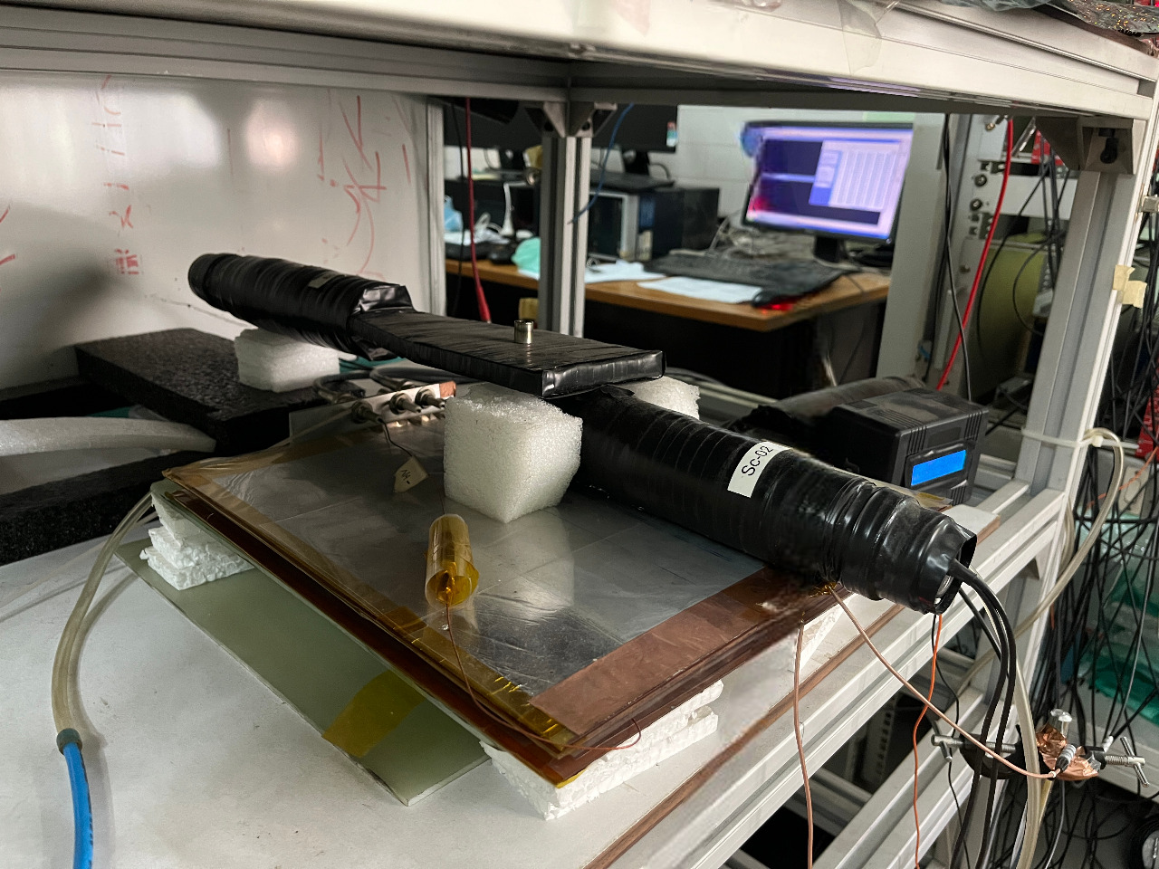
Efficiency measurement in Gamma ray background
source
Gas: 90 % C₂H₂F₄ + 10 % i-C₄H₁₀
Source: Cs¹³⁷
Activity: 0.6 GBq
High efficiency even with ∼46 kHz/cm² gamma flux

Slide 35
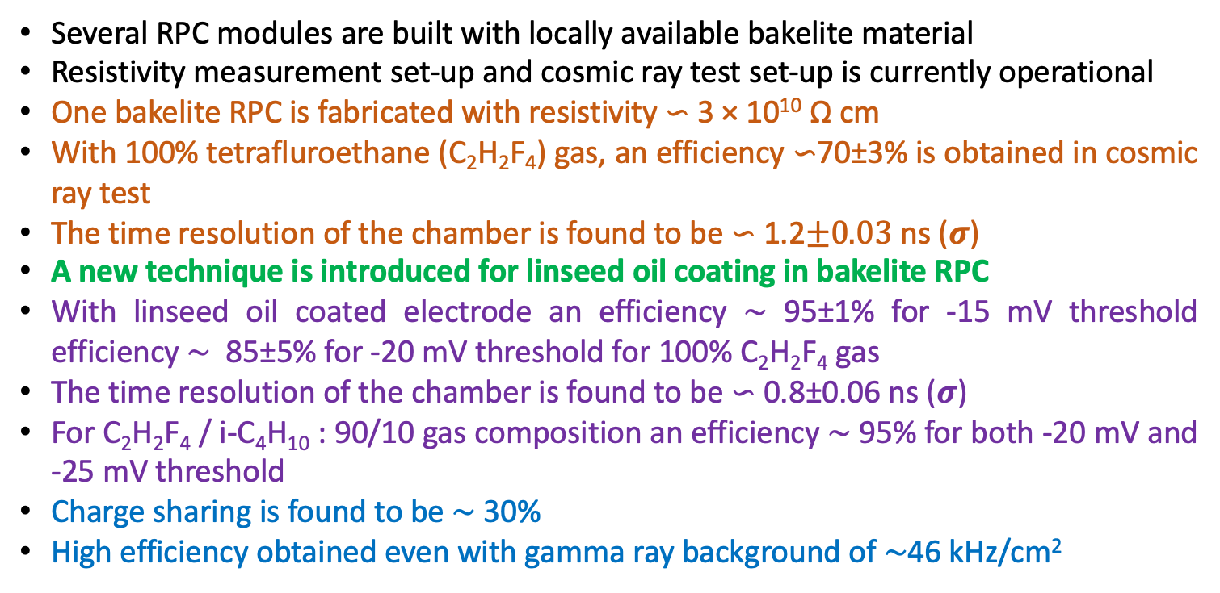
Summary
Several RPC modules are built with locally available bakelite material
Resistivity measurement set-up and cosmic ray test set-up is currently operational
One bakelite RPC is fabricated with resistivity ∽ 3 × 10¹⁰ Ω cm
With 100% tetrafluroethane (C₂H₂F₄) gas, an efficiency ∽70±3% is obtained in cosmic ray test
The time resolution of the chamber is found to be ∽ 1.2$±0.03$ ns (𝝈)
A new technique is introduced for linseed oil coating in bakelite RPC
With linseed oil coated electrode an efficiency ∼ 95±1% for -15 mV threshold efficiency ∼ 85±5% for -20 mV threshold for 100% C₂H₂F₄ gas
The time resolution of the chamber is found to be ∽ 0.8±0.06 ns (𝝈)
For C₂H₂F₄ / i-C₄H₁₀ : 90/10 gas composition an efficiency ∼ 95% for both -20 mV and -25 mV threshold
Charge sharing is found to be ∼ 30%
High efficiency obtained even with gamma ray background of ∼46 kHz/cm²

Slide 36
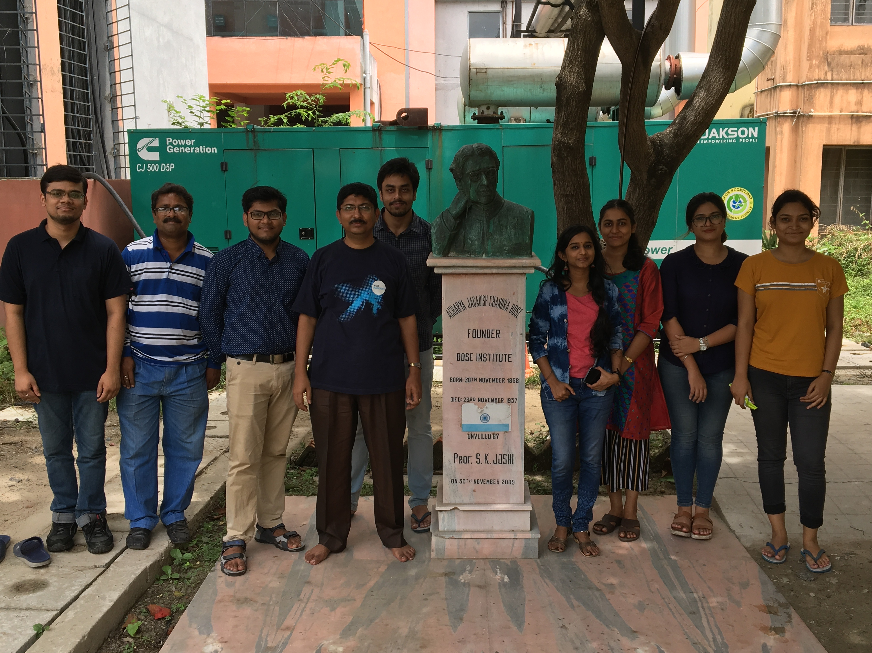

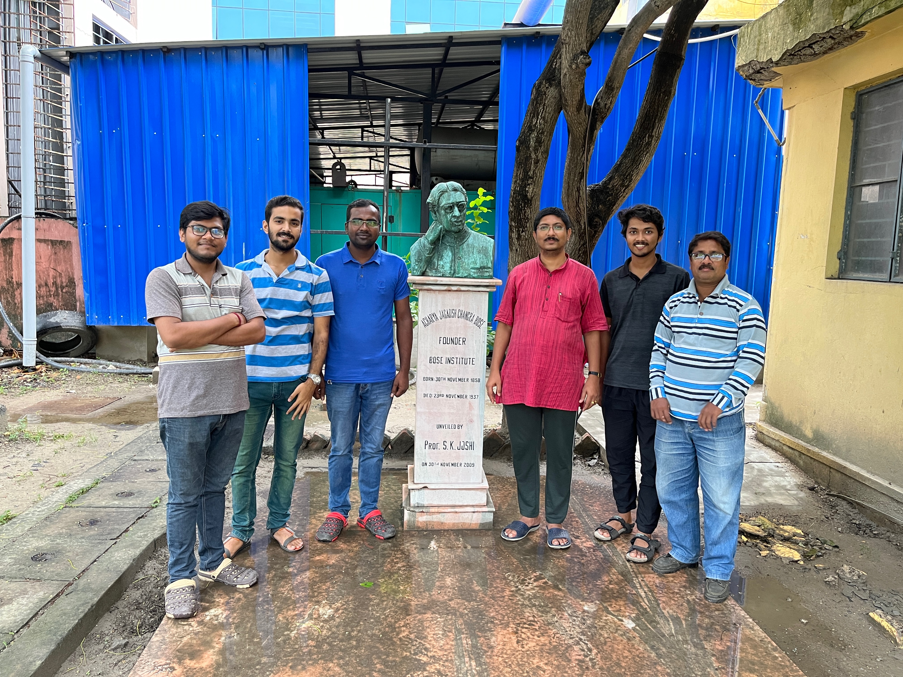
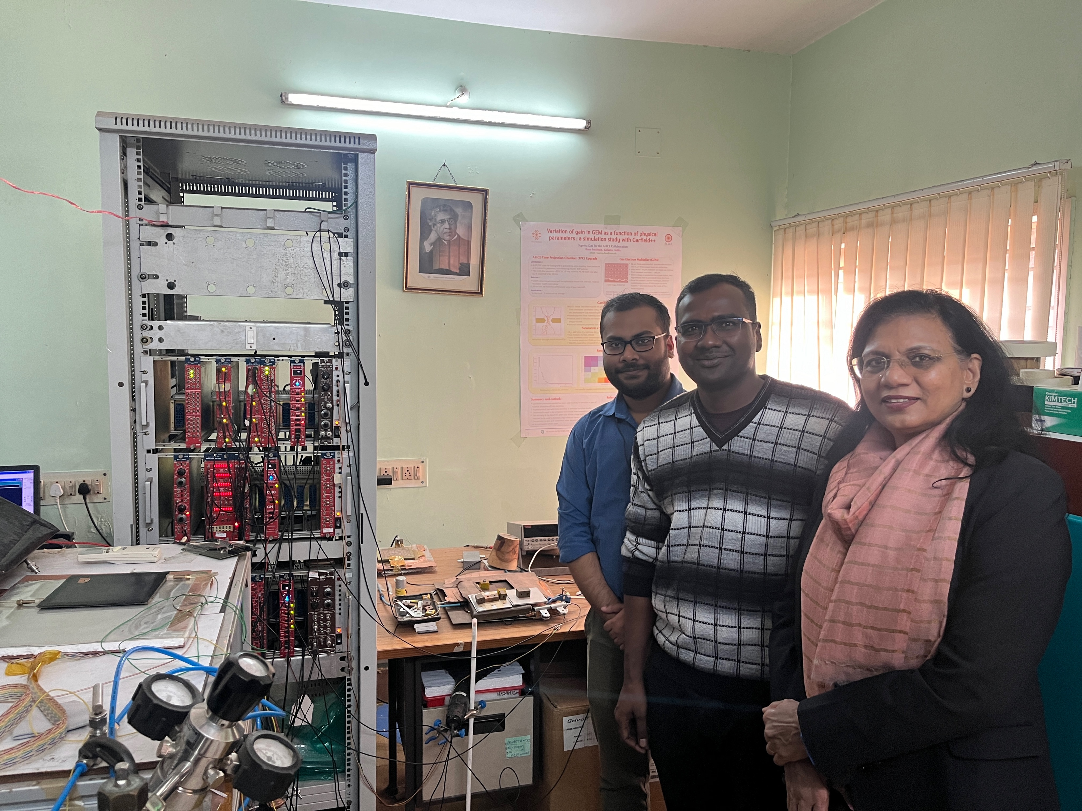
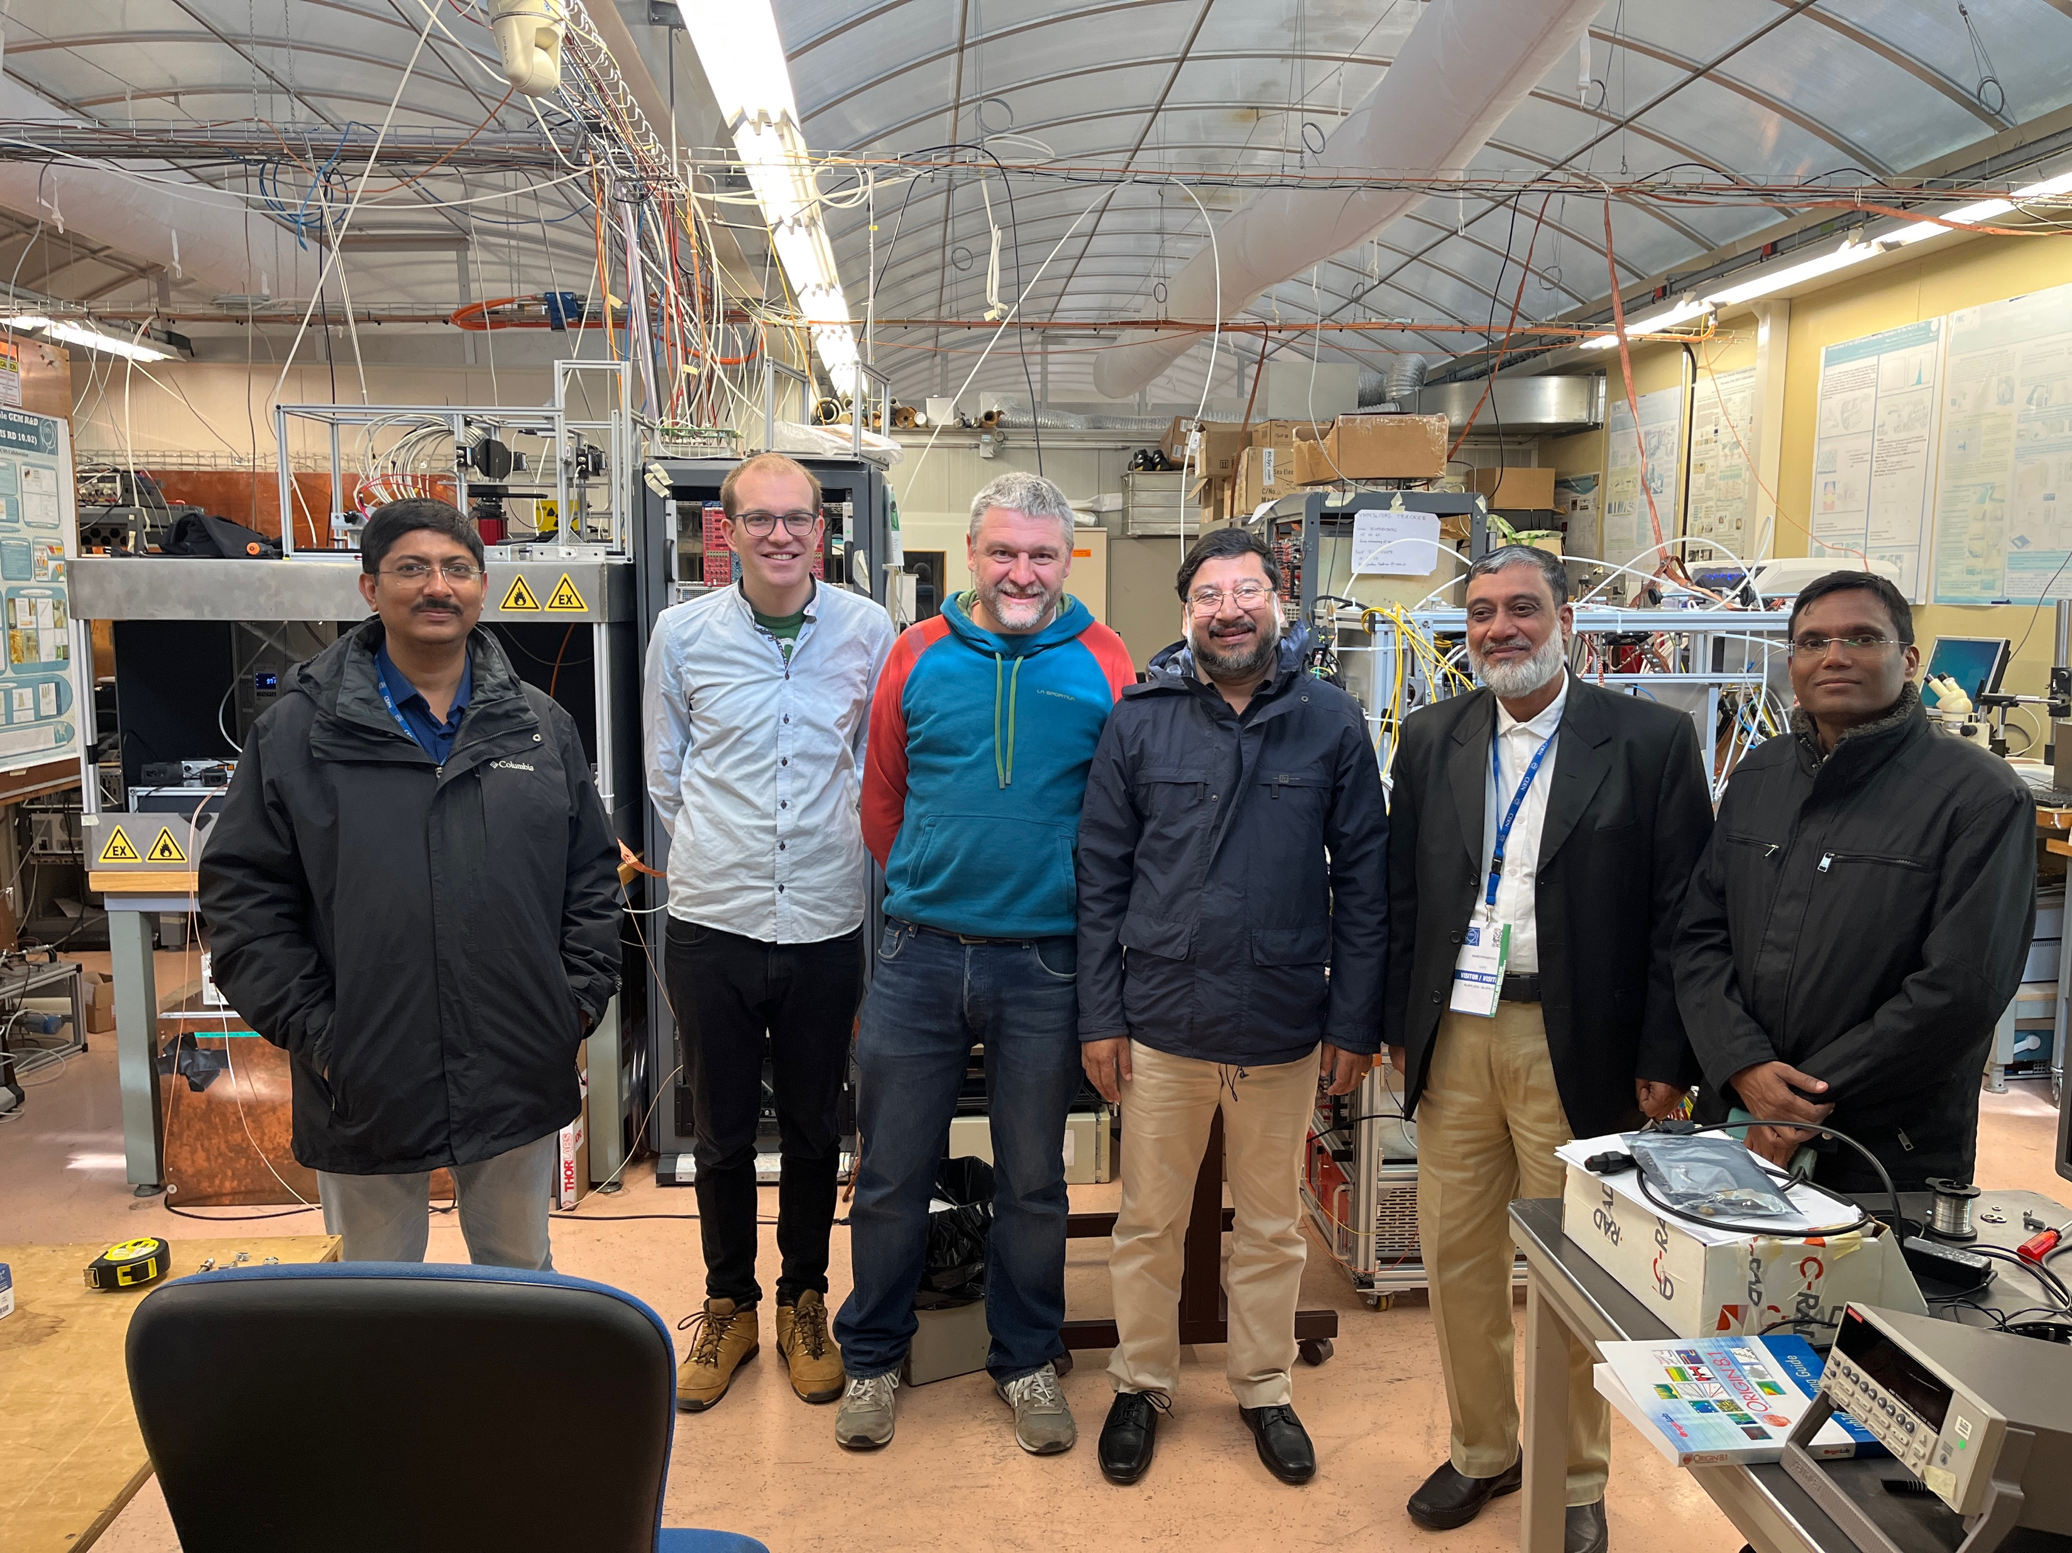
Collaborators
Sayak Chatterjee
Arindam Sen
Subir Mandal
Somen Gope
Supriya Das
Sayan Dhani (IITB)
Thank You

