Slide 1
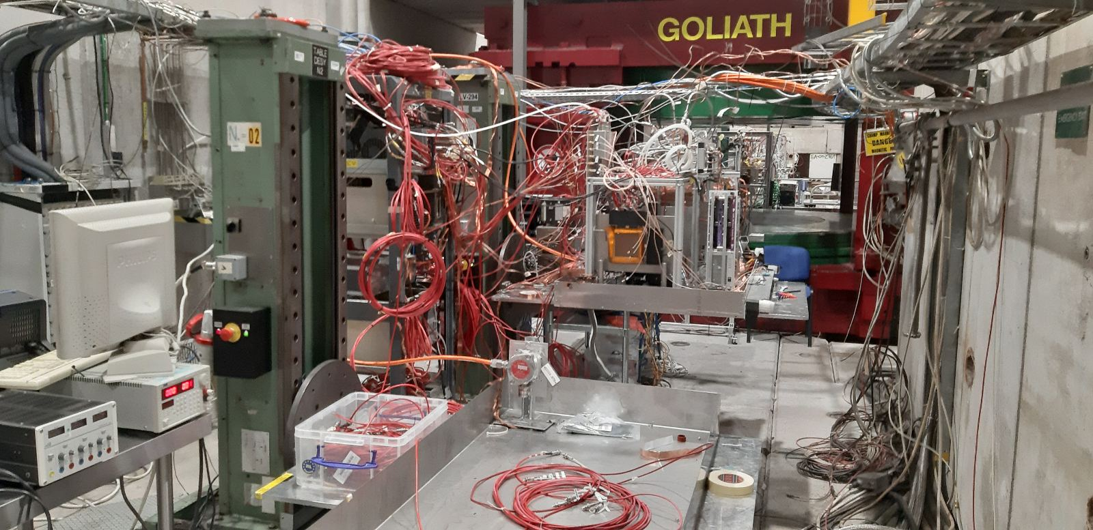
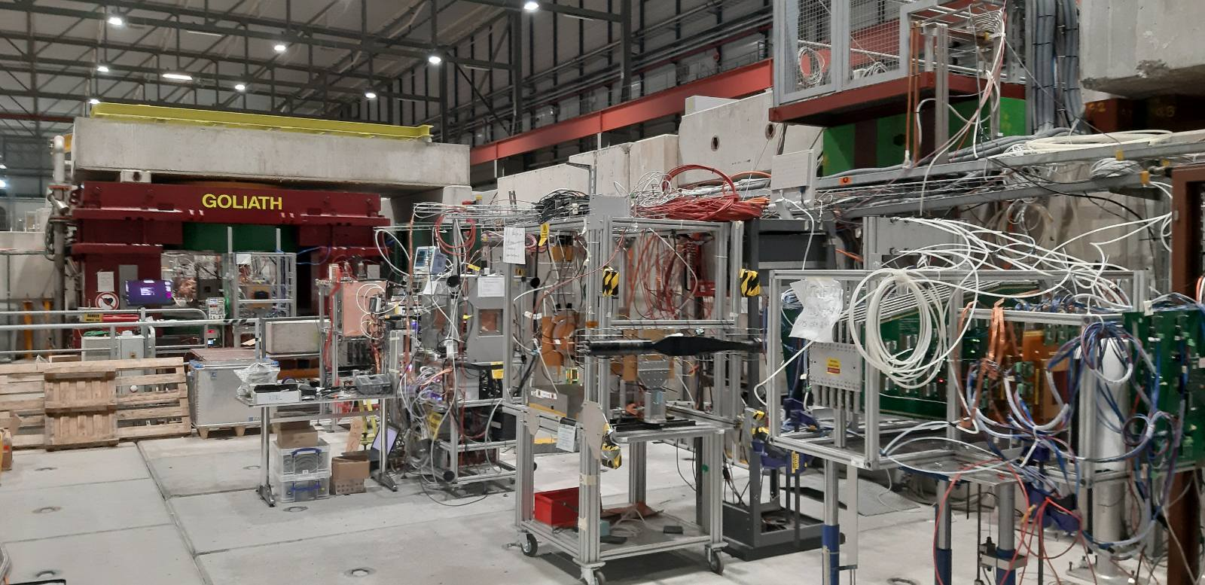
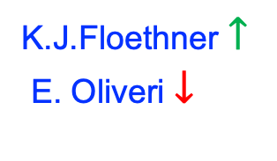
DRD1-WG7: Common Test Facilities
Status Report of the SPS/H4 “playground”
(runs in parallel with EURO 2024)
Y.Tsipolitis
TB1: 10 – 24 April 2024
TB2: 26 June – 10 july 2024
TB3: 18 Sept. – 2 Oct. 2024
K.J.Floethner​ $↑$
E. Oliveri $↓$
DOWNSTREAM GOLIATH
UPSTREAM GOLIATH

Slide 2
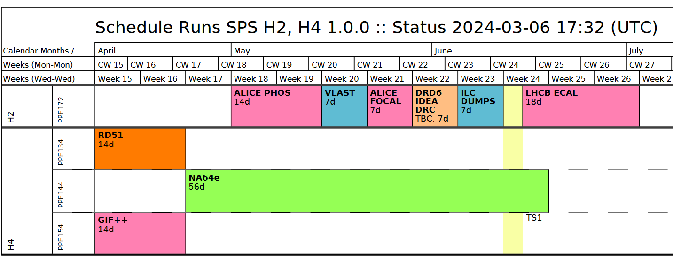
DRD1 H4(PPE134) 2024 Test Beam​
Generic and Application driven R&D
  Technologies: Micromegas, uRWELL, uRGroove, GEM
  Application: High Rate, Timing
  Readout: Capacitive Coupling, Resistive Sharing
Project driven R&D
  CMS ME0
Detector Commissioning
  Twin TPC for MIXE
FE electronics and DAQ
  Straw, VMM3a and TPC
Wed. 10/04/2024 – Wed. 24/04/2024

Slide 3
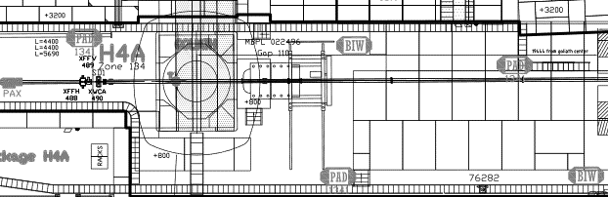
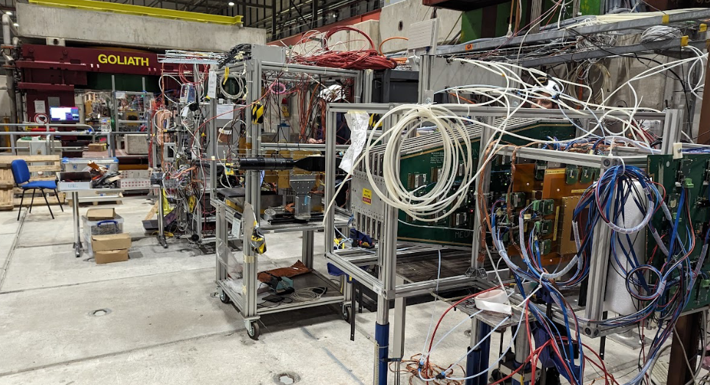
Setups (8)
SETUP
A
SETUP
B
SETUP
C
SETUP
D
SETUP
E
SETUP
F
SETUP
G
SETUP
H
PICOSEC
PICOSEC
STRAW
RHUM
TWIN TPC
GDD/
DRD1
Tracker
USTC
CMS
SETUP A, B: PICOSEC (F. Brunbauer, M. Lisowska)
SETUP C: STRAW (T. Enik, K. Kuznetsova)
SETUP D: RHUM (M. Iodice, G. Sekhniaidze)
SETUP E: TWIN TPC (F. Garcia Fuentes)
SETUP F: GDD/RD51 Tracker (K. Floethner)
SETUP G: USTC (Y. Zhou)
SETUP H: CMS ME0 (A. Pellecchia, P. Everaerts)

Slide 4
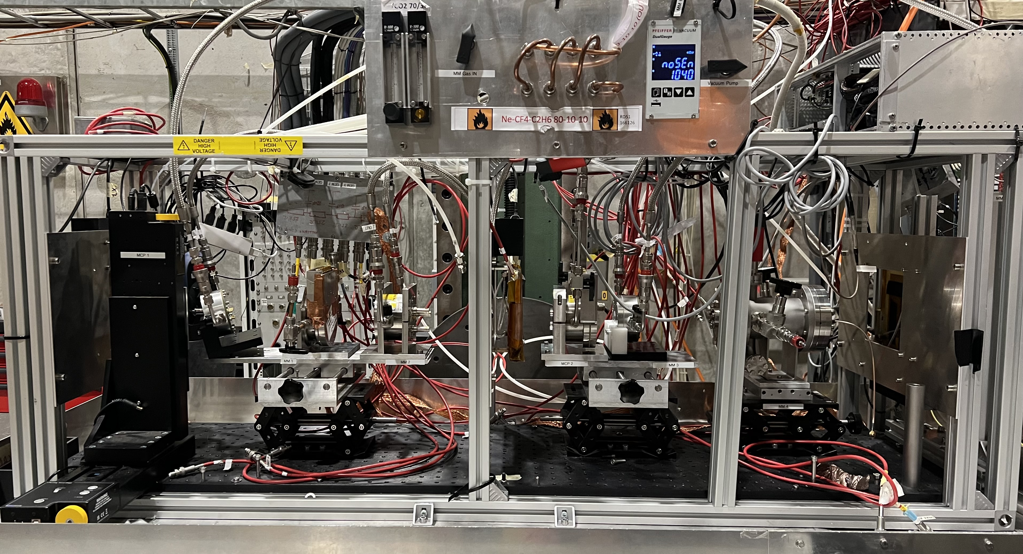
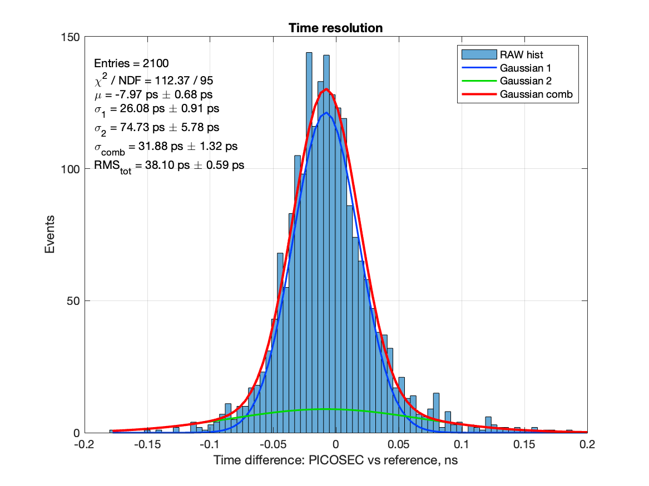
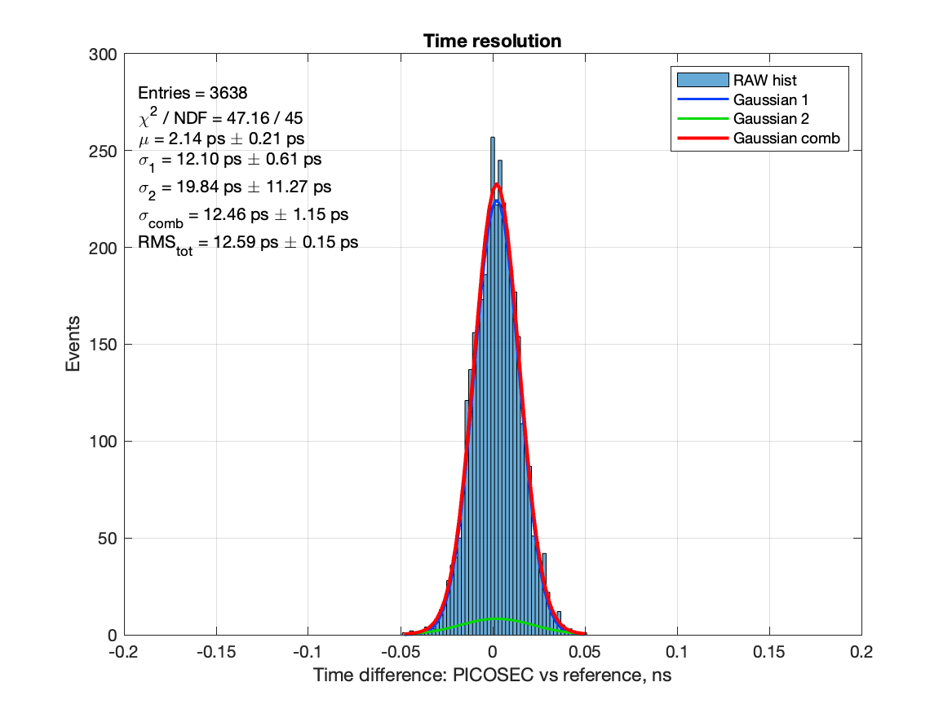
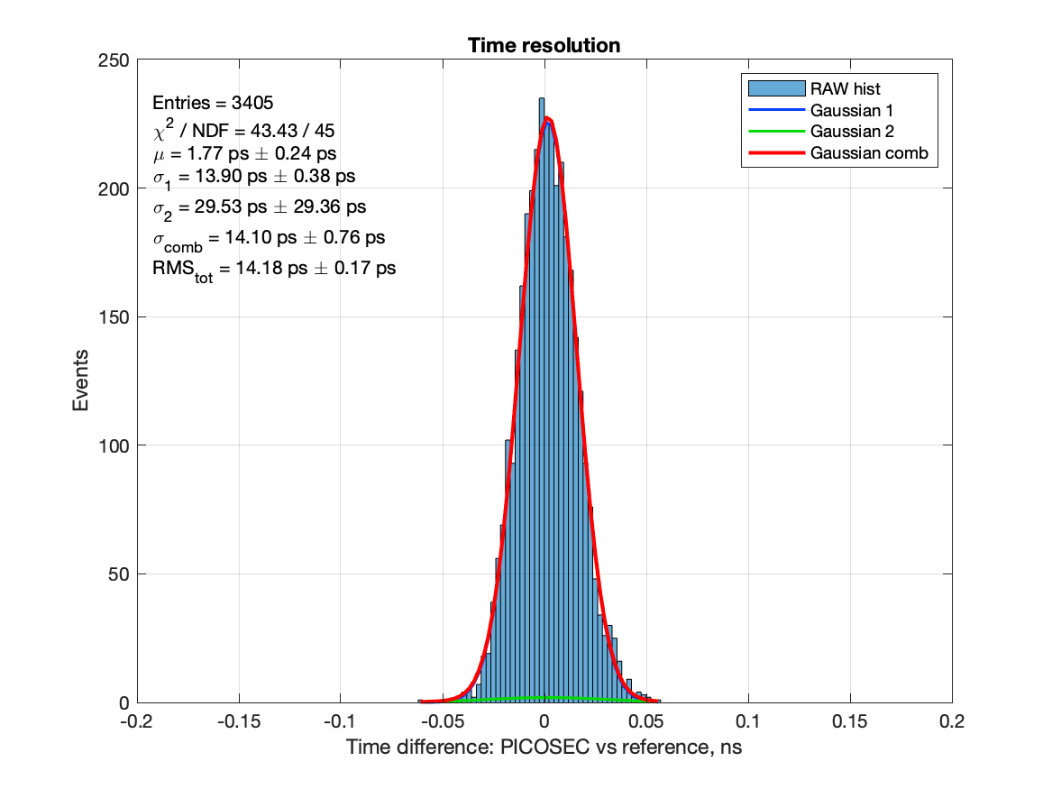
PICOSEC Micromegas – April 2024
  PICOSEC Micromegas – a gaseous detector that aims at reaching a time resolution of tens of picoseconds
  Objective: Robust multi-channel detector modules for large-area detection systems requiring good time resolution
  Experimental setup: tracking/timing/triggering telescope: GEMs + MCP PMT + PICOSEC MM detectors
  Test beam campaign April 2024 measurements:
  → Single-pad photocathodes studies (CERN,CEA,Bari): CsI with Cr/Ti, DLC, nanodiamonds → DLC σ ~ 31 ps
  → Single-pad resistive MM (CERN,RB): 20 MΩ/◻︎, 10 + 15 mm dia. → 10 mm MM + CsI time resolution σ ~ 12 ps
  → Single-pad uRWELL (JLAB): 7 different prototype geometries tested with CsI photocathodes → σ ~ 23 ps
  → Large area detector (USTC): 20x20 cm² MM with different photocathodes: DLC, B₄C, CsI → with CsI σ ~ 25 ps
  → Gas studies: Ne/Iso mixture at different ratios as an alternative to the std gas Ne:CF₄:C₂H₆ (80:10:10) → σ ~ 17 ps
  → New readout electronics(CERN,RB,SBU): integrated preamp on the outer PCB → σ ~ 14 ps, DRS4 v5 12bit, 5GS/s
Clean (wireless) setup (after disconnecting the cables ☺ )
Single-pad + DLC photocathode σ ~ 31 ps
Single-pad resistive MM 20 MΩ + CsI σ ~ 12 ps
Single-pad + CsI + integrated preamp σ ~ 14 ps
  PRELIMINARY
  PRELIMINARY
  PRELIMINARY

Slide 5
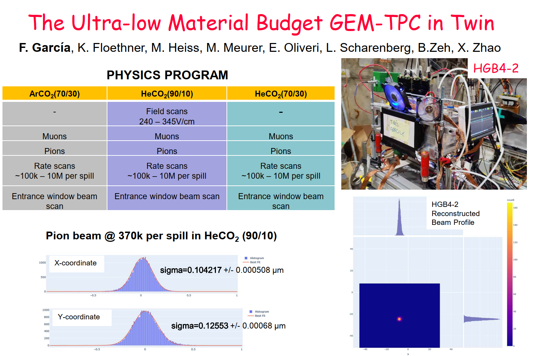

Slide 6
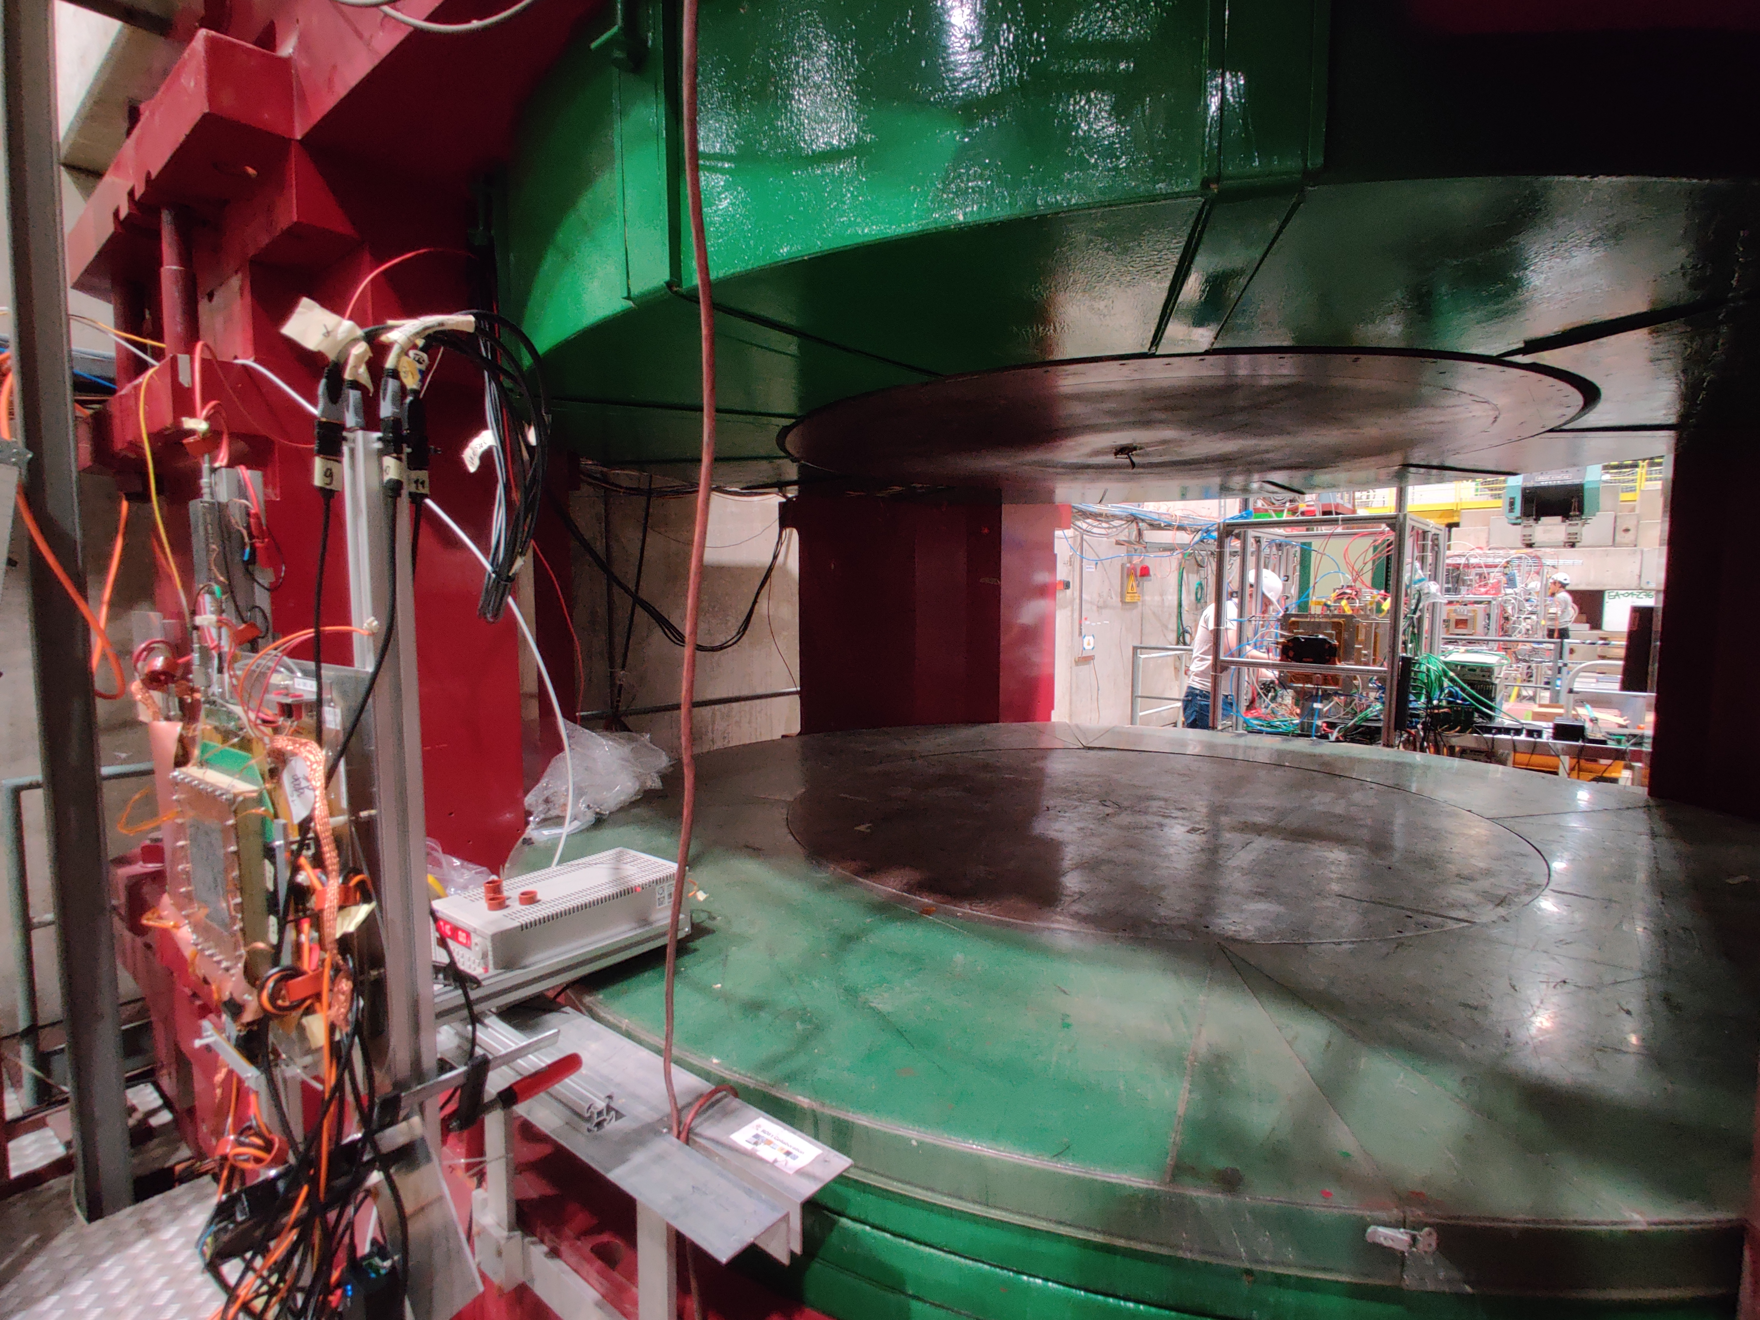
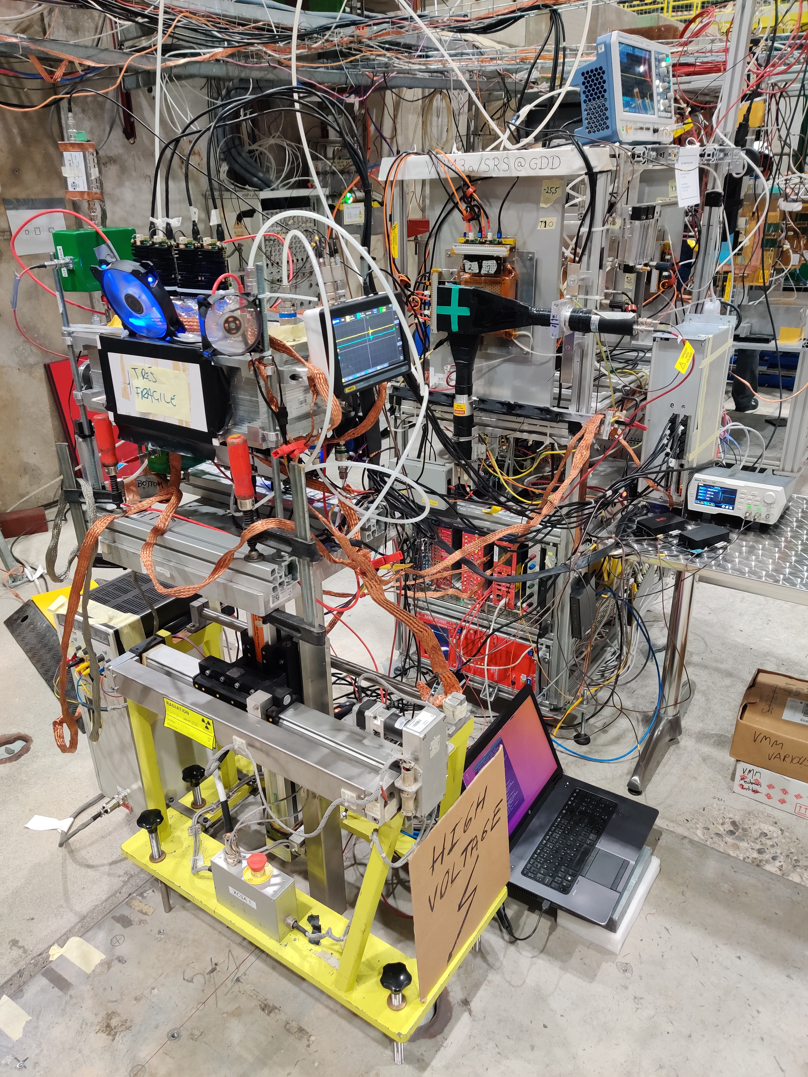
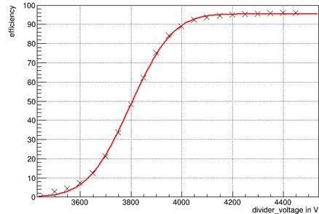
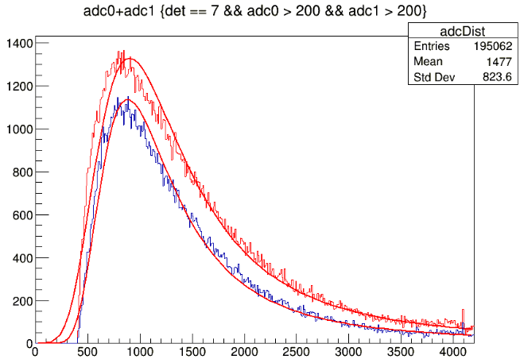
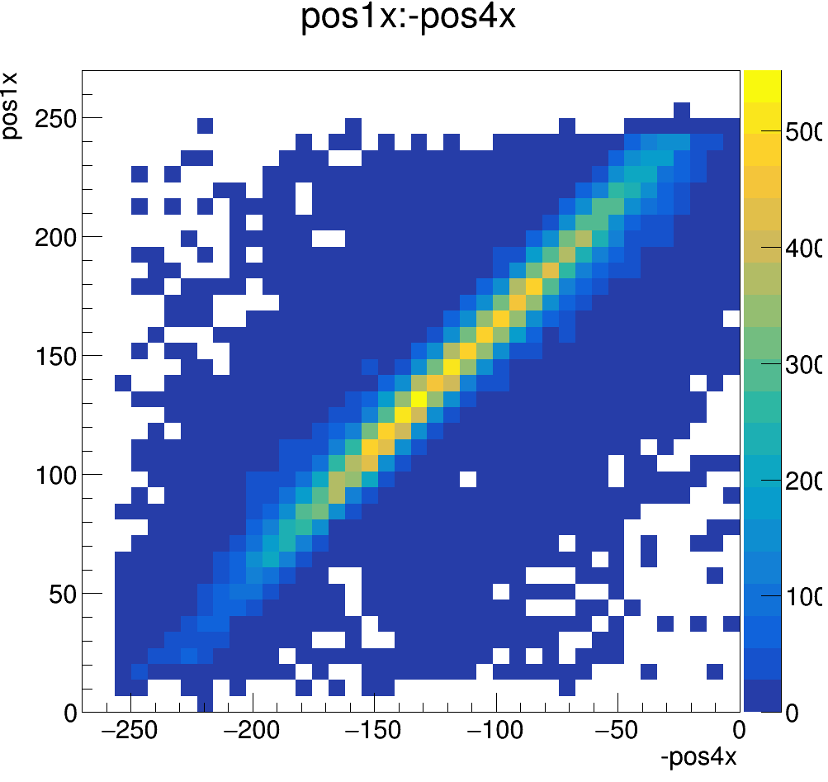
RD51/DRD1 VMM3a/SRS beam telescope:
April 2024
Distributed readout system
GEM twin-TPC
GEM prototype for AMBER
14 m detector distance
20 m HDMI cable
20 000 gain
2 fC THL
Due to new external powering scheme for VMM3a/SRS
Characterisation of low material budget TPC for MIXE@PSI with He/CO2 (90/10 %) gas mixture
Characterisation of tracking detector in terms of efficiency and gain behaviour

Slide 7
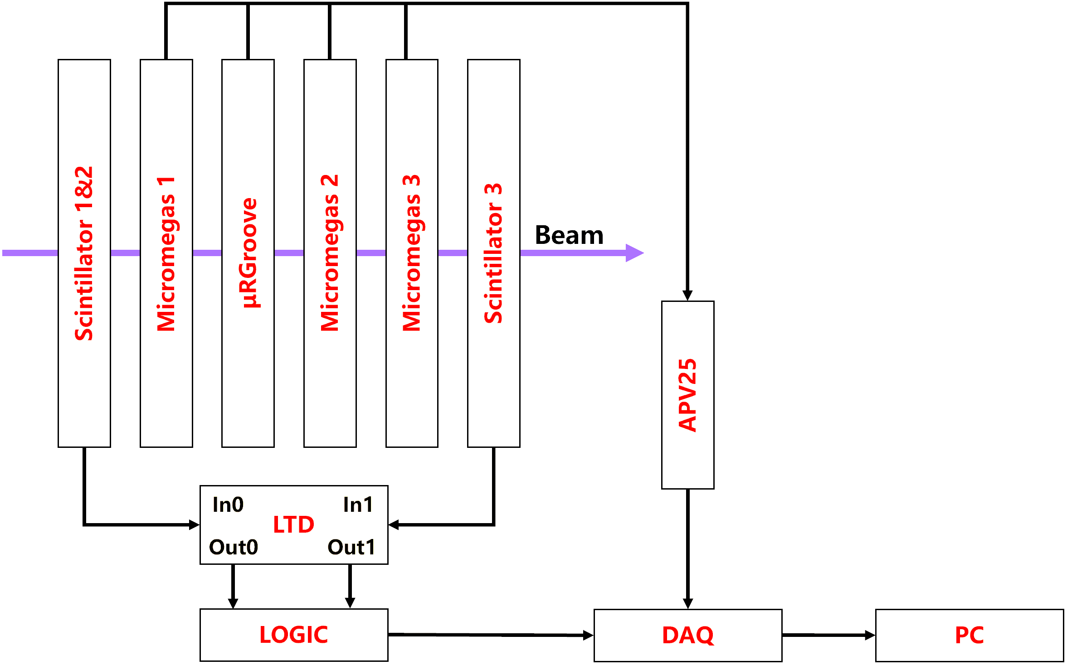
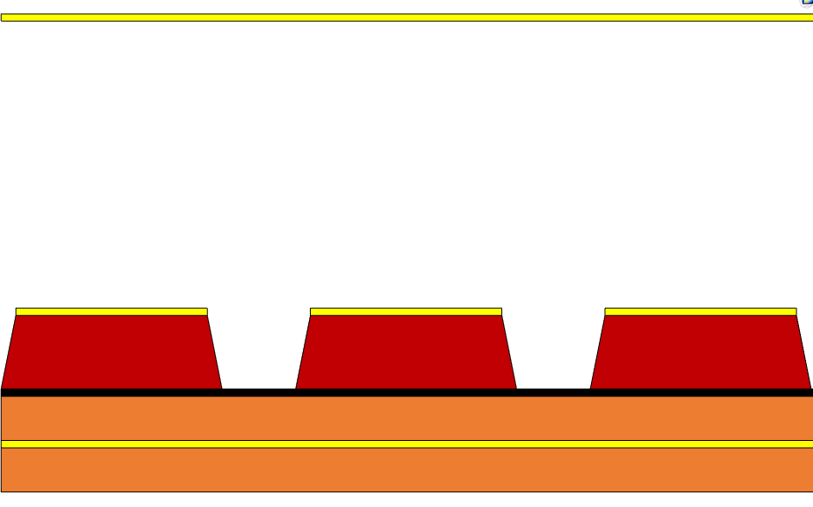
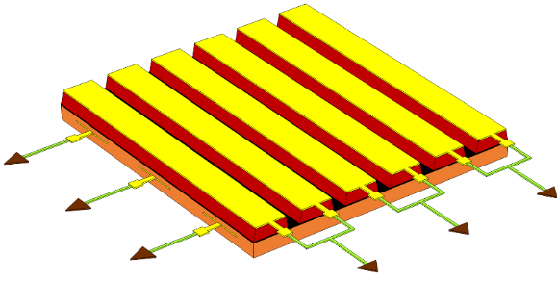
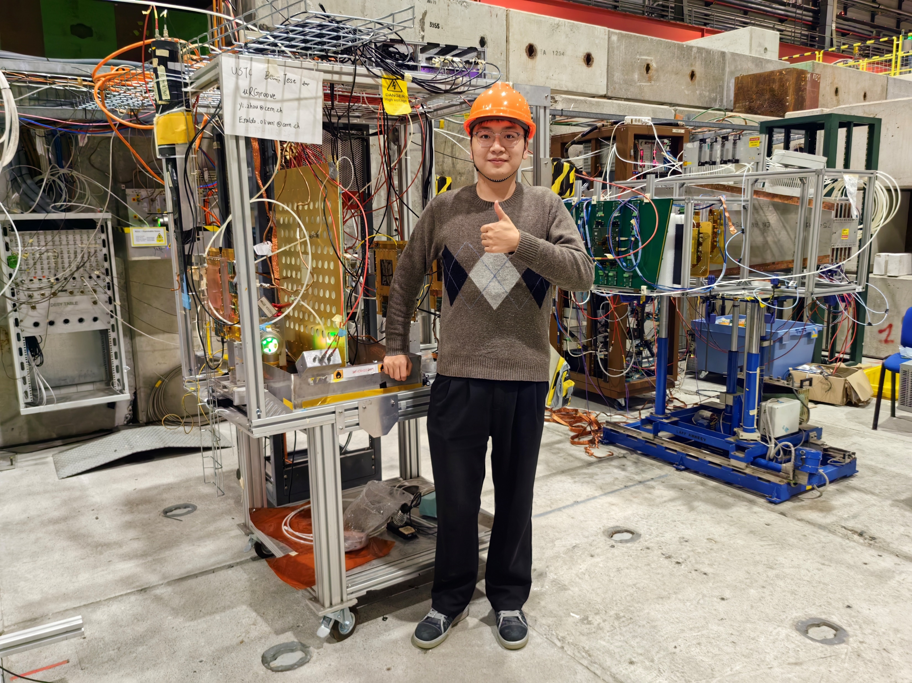
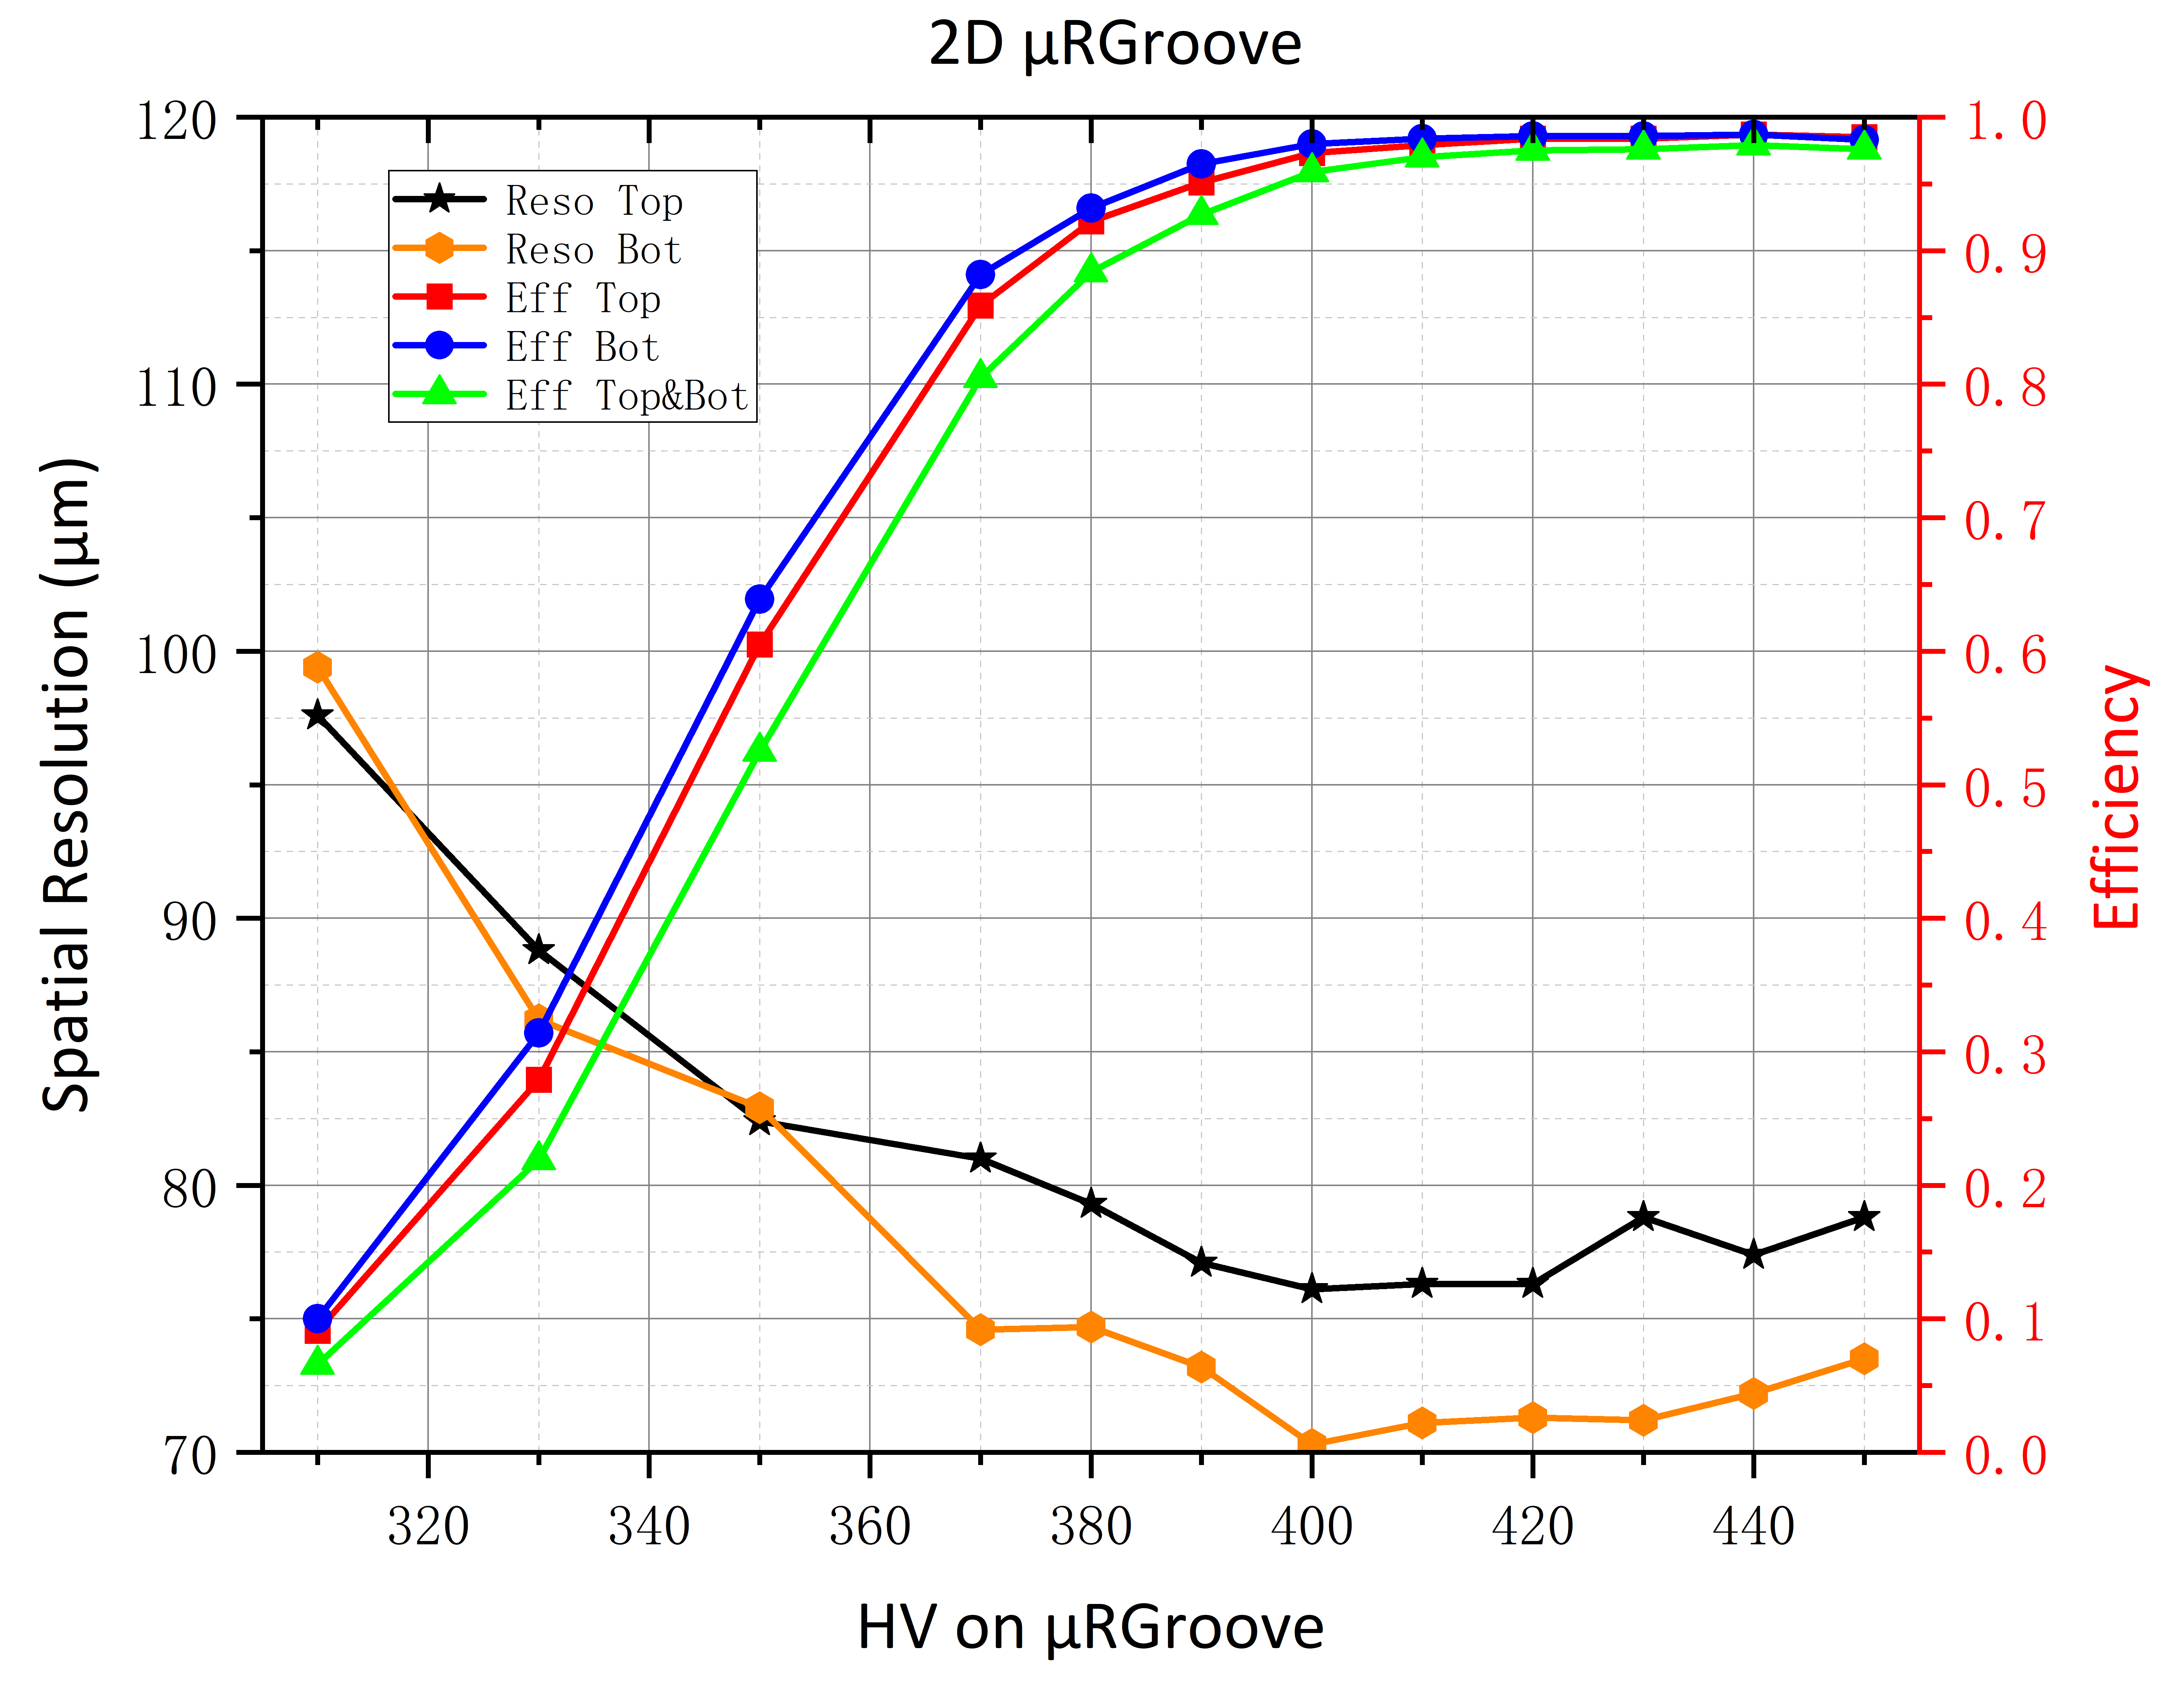
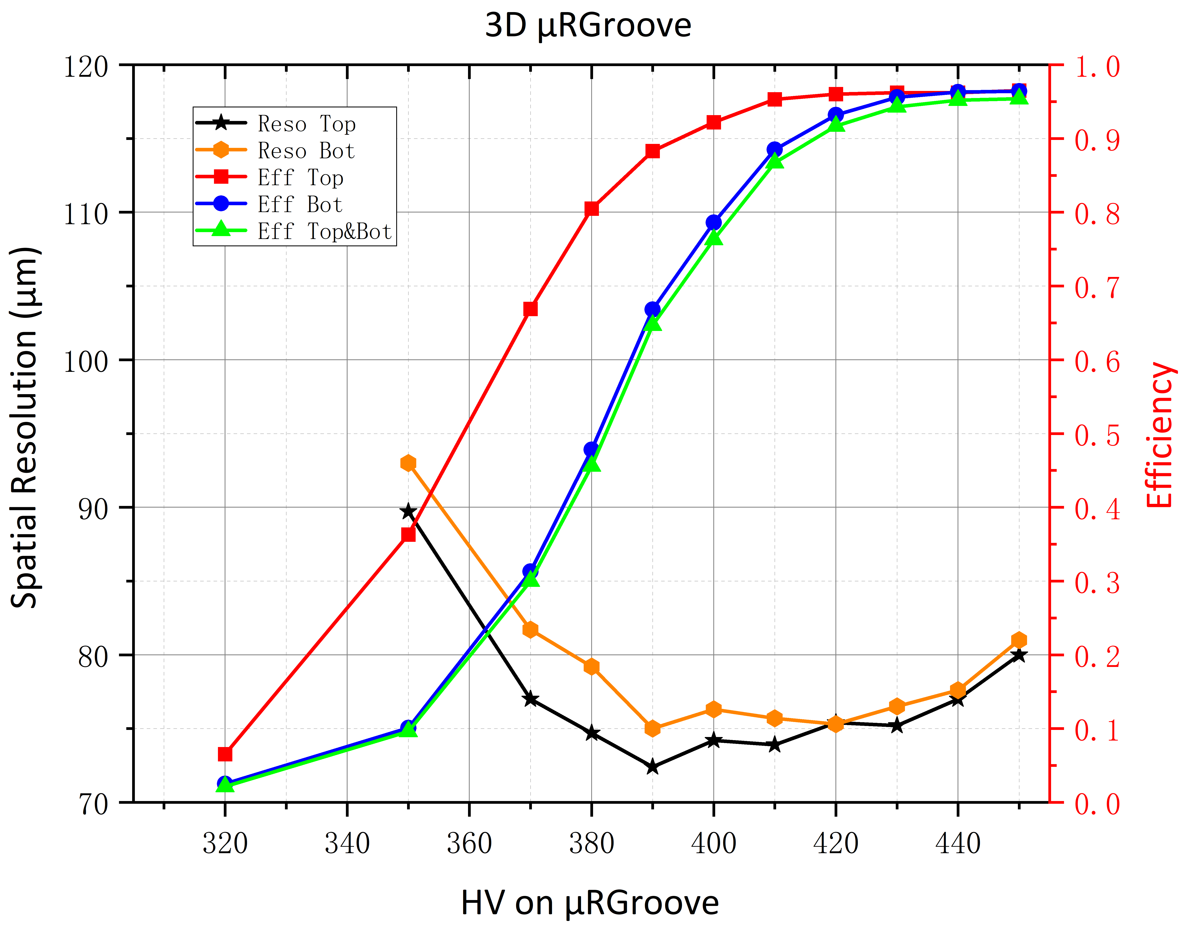
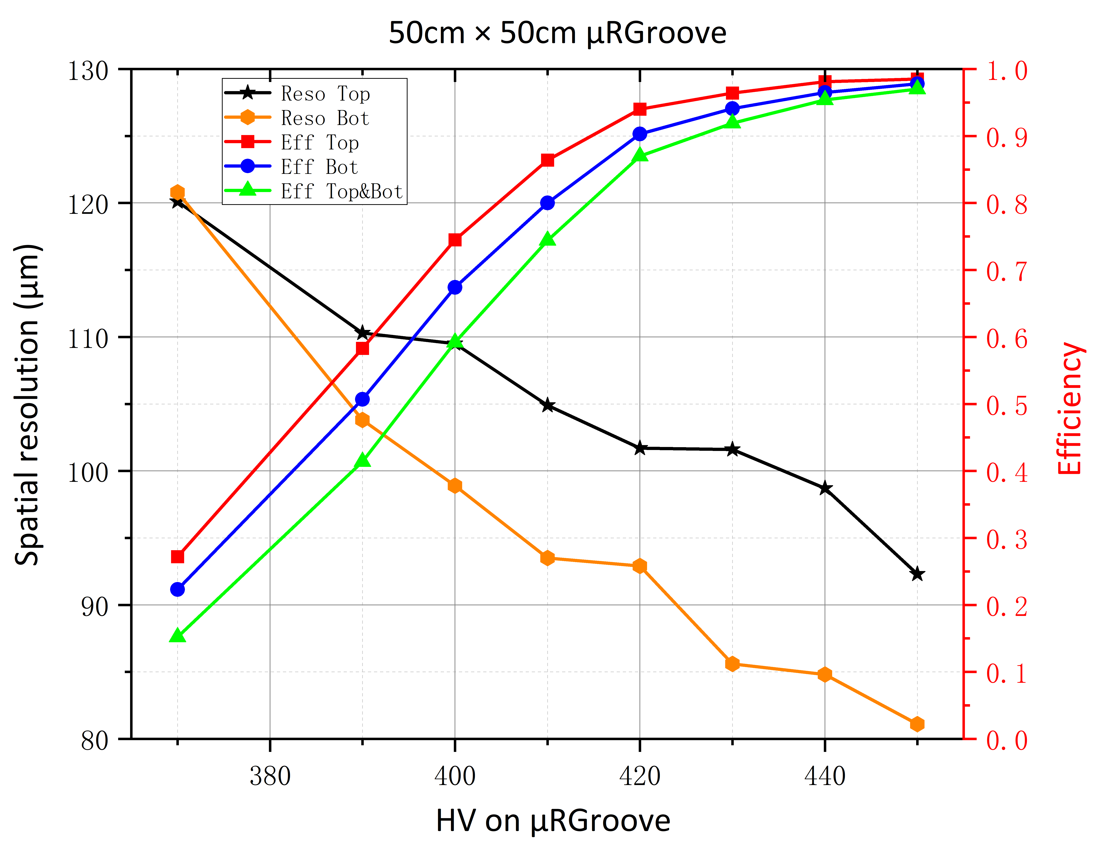
μRGroove test results from April
μRGroove
Gap=3mm
Pitch=200μm
Thickness=50μm
Width=70/50μm
DLC ~50MΩ/□
Siqi He, RD51 Mini-Week, 02/27/2023
10cm ×10cm 2D
10cm ×10cm 3D
50cm ×50cm 2D
Gas: Ar:ISO/90:10
Efficiency ∼97.9%
Spatial resolution ≤76μm
Efficiency ∼95.6%
Spatial resolution ~80μm
Efficiency: ∼96.9%
Spatial resolution: ≤93μm

Slide 8
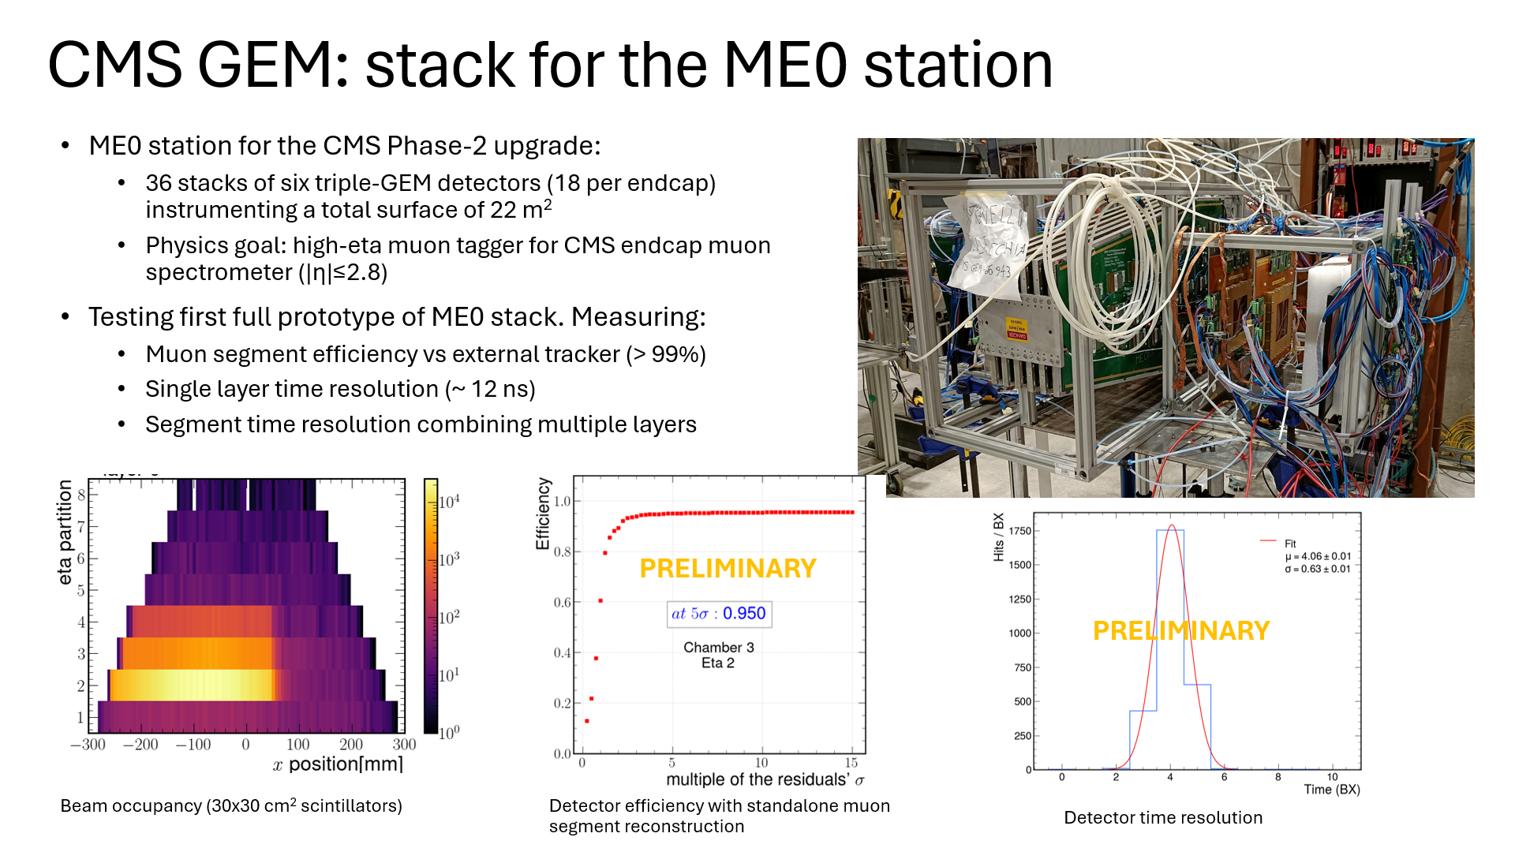

Slide 9
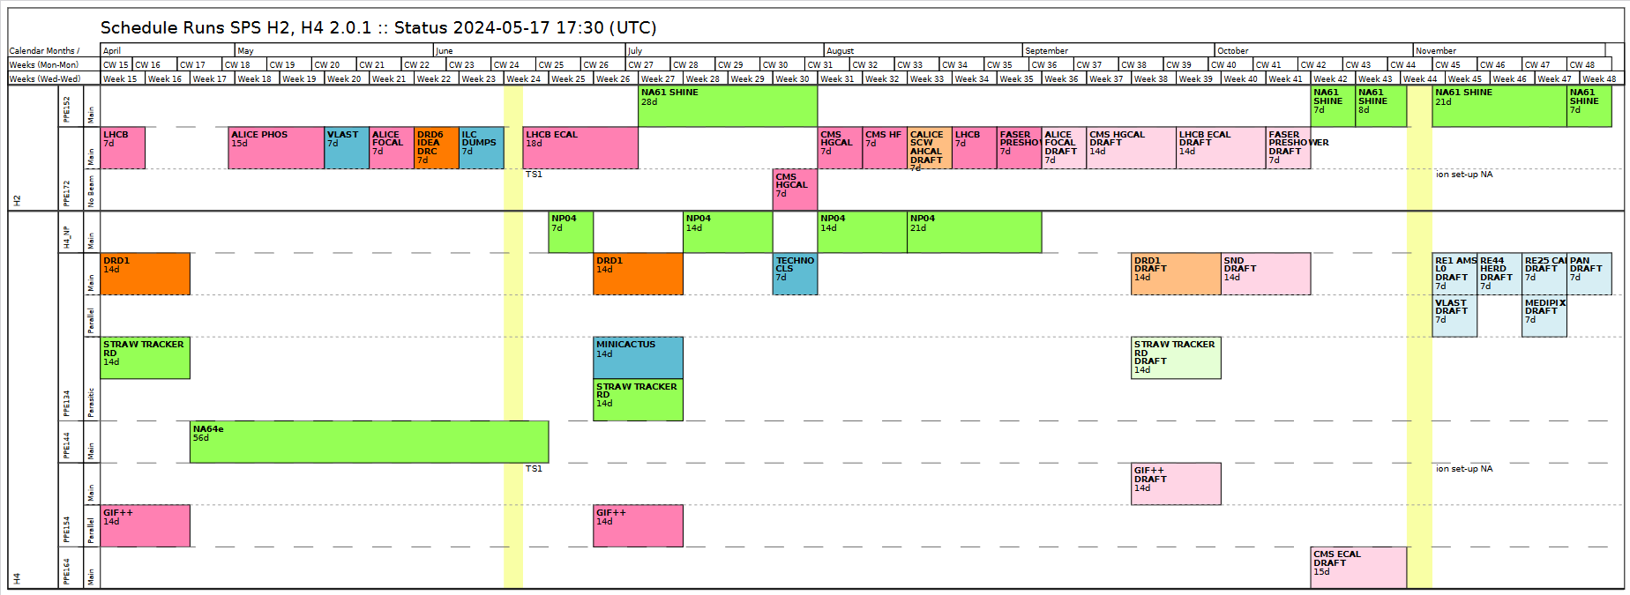
DRD1 H4(PPE134) 2024 Test Beam​
Generic and Application driven R&D
  Technologies: Micromegas, uRWELL, uRGroove, GEM
  Application: High Rate, Timing, Calorimetry
  Readout: Capacitive Coupling, Resistive Sharing
Project driven R&D
FCC-muons uRWELL/TIGER
Detector Commissioning
  Twin TPC for MIXE
FE electronics and DAQ
  Straw, VMM3a and TPC
Wed. 26/06/2024 – Wed. 10/07/2024

Slide 10
BEAM H4, PPE134 – INSTALLATION (DRD1, June 26 – July 10)
SETUP
A
SETUP
B
SETUP
C
SETUP
D
SETUP
E
SETUP
F
SETUP
G
SETUP
H
PICOSEC
PICOSEC
MINICACTUS
STRAW
GDD/
DRD1
Tracker
USTC
MPGD HCAL
FCC-muons
SETUP A, B: PICOSEC (F. Brunbauer, M. Lisowska)
SETUP C: MINNICACTUS (P. Schwemling)
SETUP D: STRAW (T. Enik, K. Kuznetsova)
SETUP E: GDD/RD51 Tracker (K. Floethner)
SETUP F: USTC (Y. Zhou)
SETUP G: MPGD HCAL (L. Longo, A. Pellecchia)
SETUP H: FCC-muons (G. Cibinetto)

Slide 11
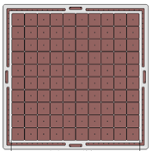
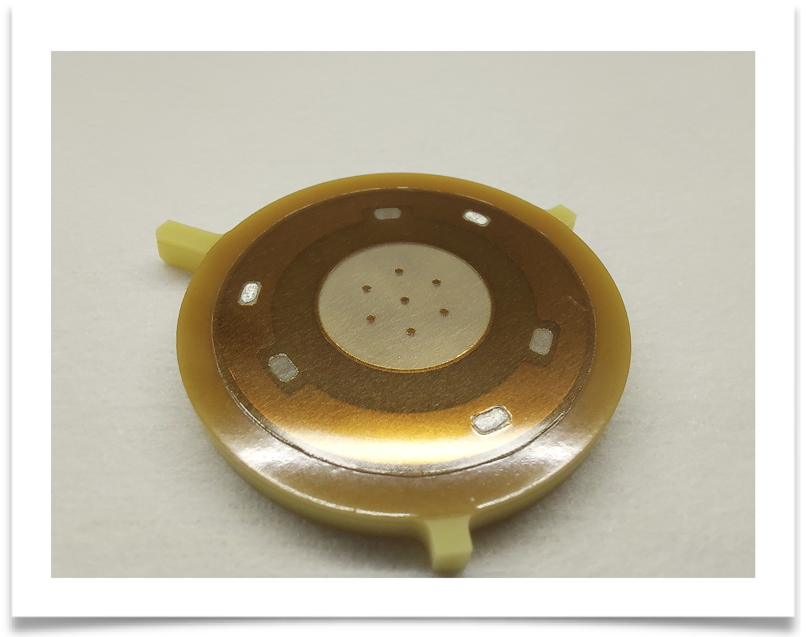
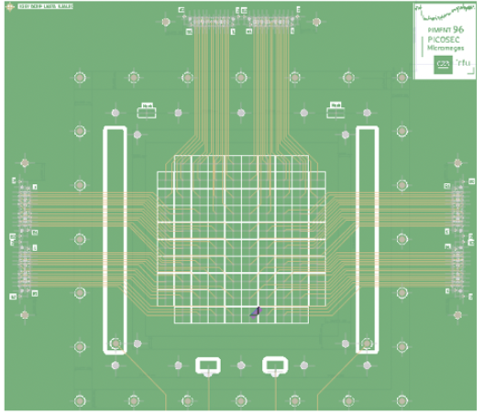


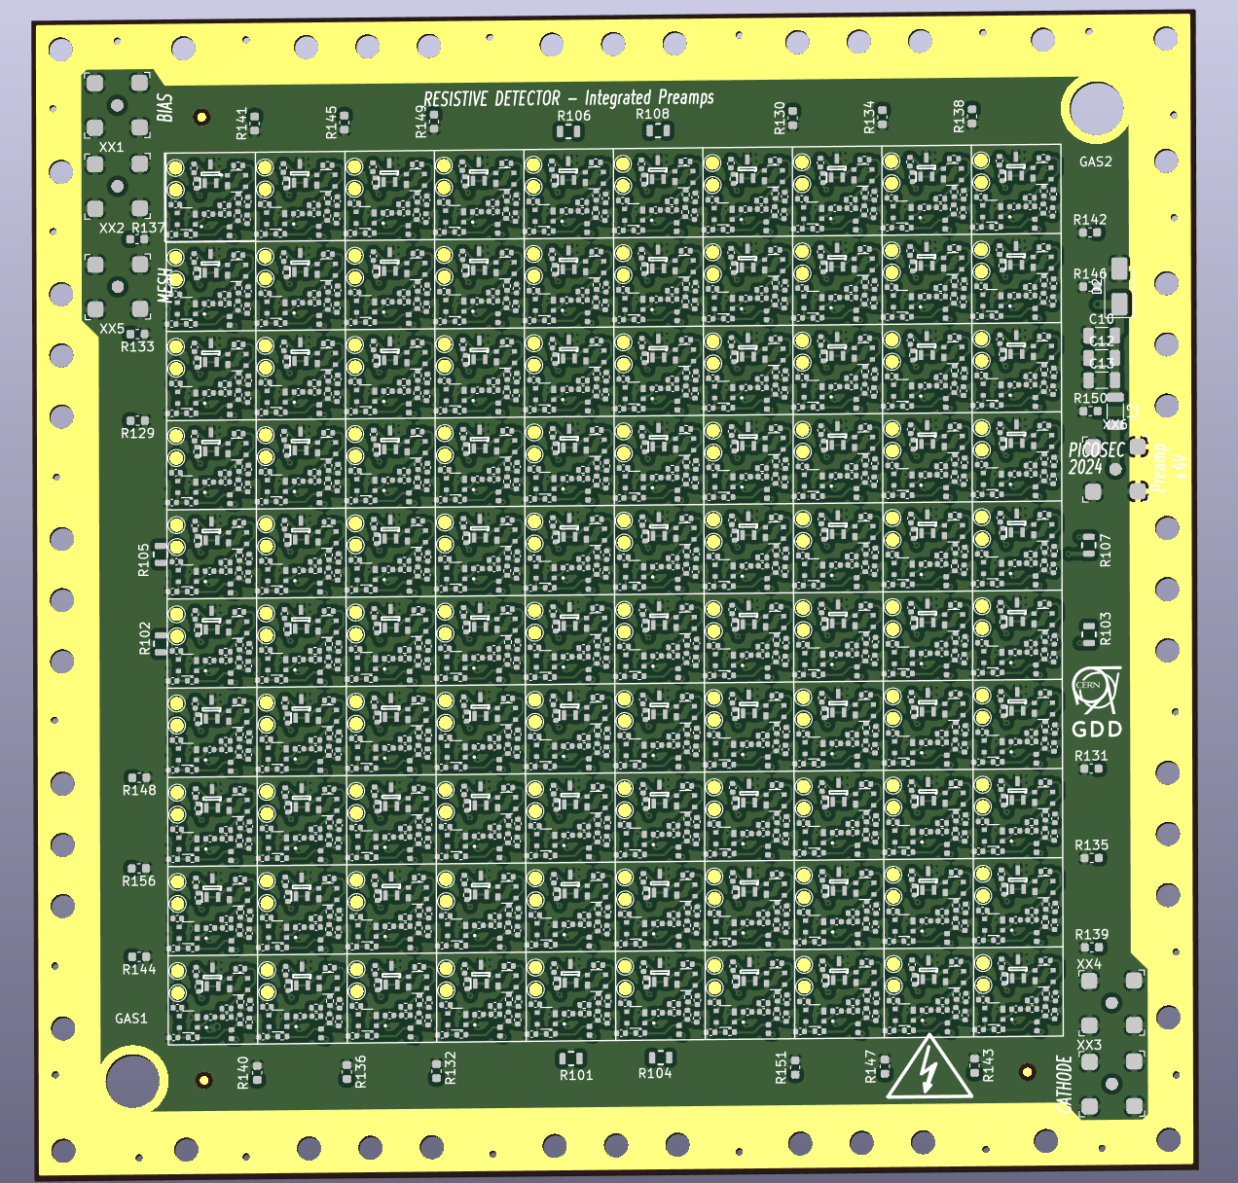
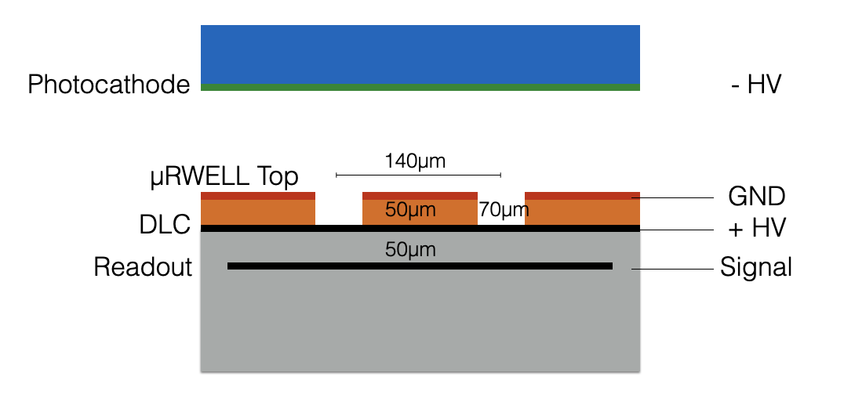
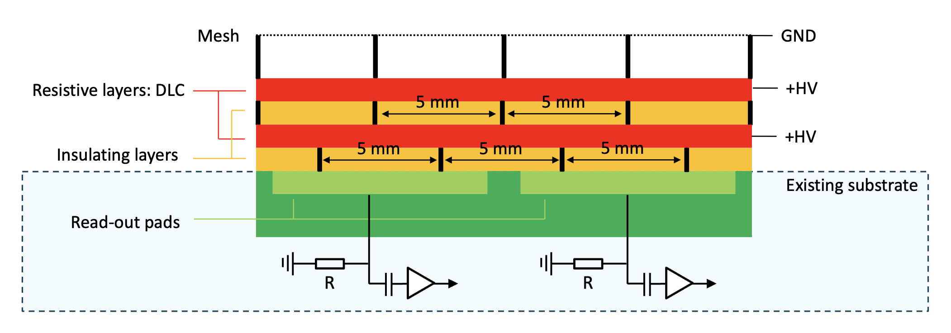
PICOSEC Micromegas – June 2024 plans
  Setup with two telescopes: PICOSEC Micromegas telescope and JLAB telescope dedicated to µRWELL studies
  Plans for June 2024 test beam period include the following developmens:
  Single pad prototypes
  Studies of stability with different meshes (standard woven, fine woven, electroformed mesh)
  Spatial resolution studies with medium/high granularity Picosec
  Test of TIA preamplifier
  Low material budget detectors
  96 readout pad prototype on thin substrate fixed to rigid, flat support structure
  Custom preamp card with connection to SAMPIC WTDC
  Multipad Micromegas
  Possible time resolution measurement with vertical charge evacuation (double-DLC layers) 10x10 prototype
  Repeated multi-pad measurement with FastIC readout chip
  Possible evaluation of integrated preamplifiers on outer board of 10x10 prototype
  µRWELL Picosec
  Operation of 10x10 µRWELL multi-pad preamp with SAMPIC readout
  Continued performance studies and optimization of single pad prototypes

Slide 12
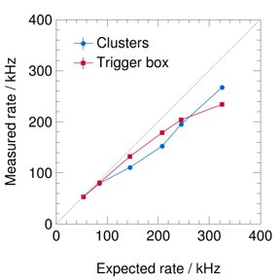

RD51/DRD1 VMM3a/SRS beam telescope:
June/July 2024 plans
Test VMM3a/SRS triggered mode (developed by the colleagues from FRIB @ MSU) with MIPs and not only with X-rays
Studies on using the Corryvreckan tracking software with VMM3a/SRS: Corryvreckan / Corryvreckan · GitLab (cern.ch)
Further measurements with the distributed system (test also with the triggered mode) and possible re-measurements of existing detectors (AMBER prototype, XYU ambiguity free detector, finer-pitch GEM detector, etc.)

Slide 13
μRGroove test plans for June
Detectors to be tested：
Two Cylindrical μRGroove detectors
A new 50cm×50cm planar μRGroove detector(not 100% sure)
Request to DRD1：
The MM tracker
SRS+APV25+mmDAQ
Flammable gas: Ar:ISO/95:5
A table is needed for operating during the setup and access

Slide 14
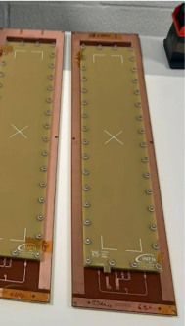
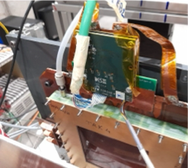
FCC-Muon: μRWELL detector TIGER readout
8 TIGER electronics
2 GEMROC FPGA
1 FANOUT
TIGER: 110 nm CMOS fabrication technology
Analog input - digital output S/H or ToT for energy measurement Simultaneous time and charge measurement ; Triggerless operation capability; Suitable for capacitances up to 100 pF and charges up to 50 fC
GEMROC :Distribute digital and analogue voltage levels; Configure the TIGERs; Monitor currents and temperatures during operation; Collect and organize output data from the TIGERs; Receive trigger signal for trigger-matched operation
Tracking system:
  2 x triple-GEM XY strips
Detector under test:
  4 x μRWELL 1D strip
DUT setting:
  active area: 400x50 mm2 prepreg thickness: 50 μm resistivity range: 10-80 MΩ/❐ strip pitch: 400 μm
  strip width: 150 μm
Gas mixtures:
  Ar:CO2 (70/30) Ar:CO2:CF4 (45:15:40)

