Slide 1
What EU Funding programmes would I regularly scan if I wanted to submit proposals on Electronics for Gaseous Detectors?
2nd DRD1 Collaboration Meeting
June 21st, 2024
Pablo Garcia Tello

Slide 2
EIC Pathfinder Work Programme
What for?
Deep tech projects. Taking forward breakthrough deep tech projects with a high degree of scientific and technological ambition and risk (TRL 1-4).
Who can apply?
Consortia of different independent legal entities established in different countries of EU Member States or Horizon Europe Associated Countries.
What you get?
Grants of up to EUR 3 million (Pathfinder open) or EUR 4 million (Pathfinder Challenges), coaching & mentoring, networking.
More Information HERE

Slide 3
Research Infrastructures Work Programme
What for?
Especially calls under the label HORIZON-INFRA-TECH; Next generation of scientific instrumentation, tools, methods, and advanced digital solutions for Research Infrastructures.
Who can apply?
Consortia of different independent legal entities established in different countries of EU Member States or Horizon Europe Associated Countries.
What you get?
Grants of average EUR 5 million.
More Information HERE

Slide 4
ERC Synergy GRants
What for?
The ERC's grants operate on a 'bottom-up' basis without predetermined priorities. Applications can be made in any field of research.
Who can apply?
A group of two to maximum four Principal Investigators (PIs) working together and bringing different skills and resources to tackle ambitious research problems. One will be designated as the corresponding PI (cPI).
What you get?
Synergy Grants can be up to a maximum of € 10 million for a period of 6 years (pro rata for projects of shorter duration).
However, an additional € 4 million can be requested in the proposal in total to cover eligible 'start-up' costs for Principal Investigators moving to the EU or an Associated Country from elsewhere as a consequence of receiving an ERC grant and/or the purchase of major equipment and/or access to large facilities.
More Information HERE

Slide 5
Marie Skłodowska-Curie Doctoral Networks
What for?
Implementing doctoral programmes by partnerships of organisations from different sectors across Europe and beyond to train highly skilled doctoral candidates.
Who can apply?
Doctoral Networks are open to international consortia of universities, research institutions, businesses, SMEs and other non-academic organisations.
What you get?
Paid recruited researchers that will do a PhD in the scientific programme described in the submitted proposal. The duration of each fellowship is between 3 and 36 months. The EU provides support for each recruited researcher in the form of
    a living allowance; a mobility allowance; if applicable, family, long-term leave and special needs allowances.
In addition, funding is provided for
    research, training and networking activities; management and indirect costs.
More Information HERE

Slide 6
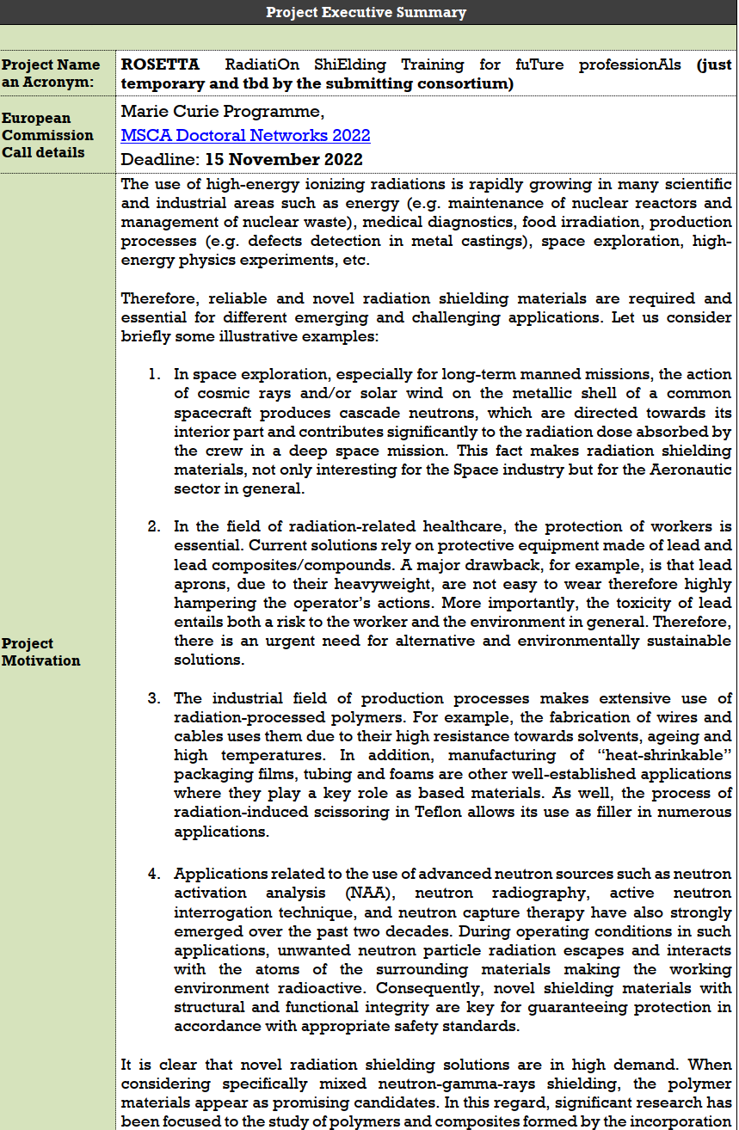
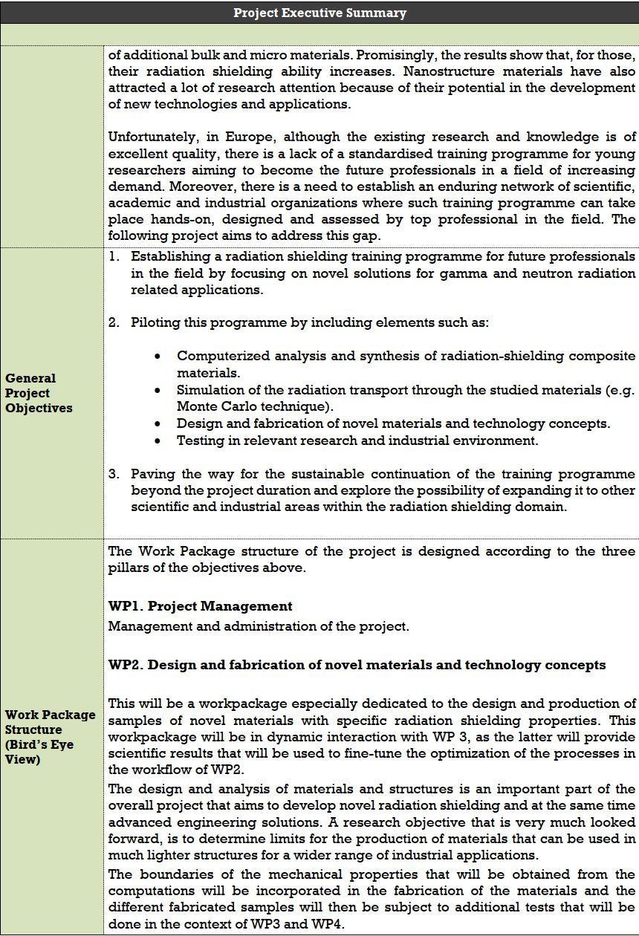
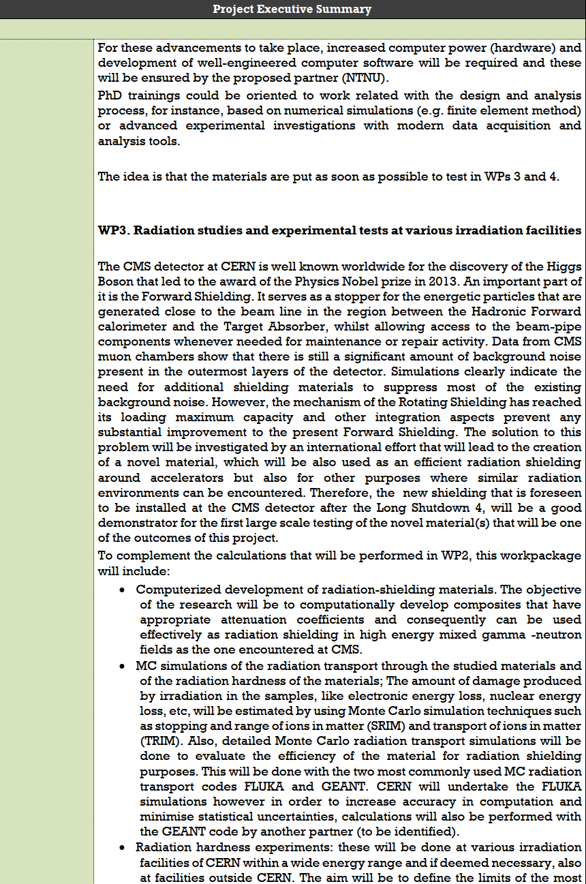
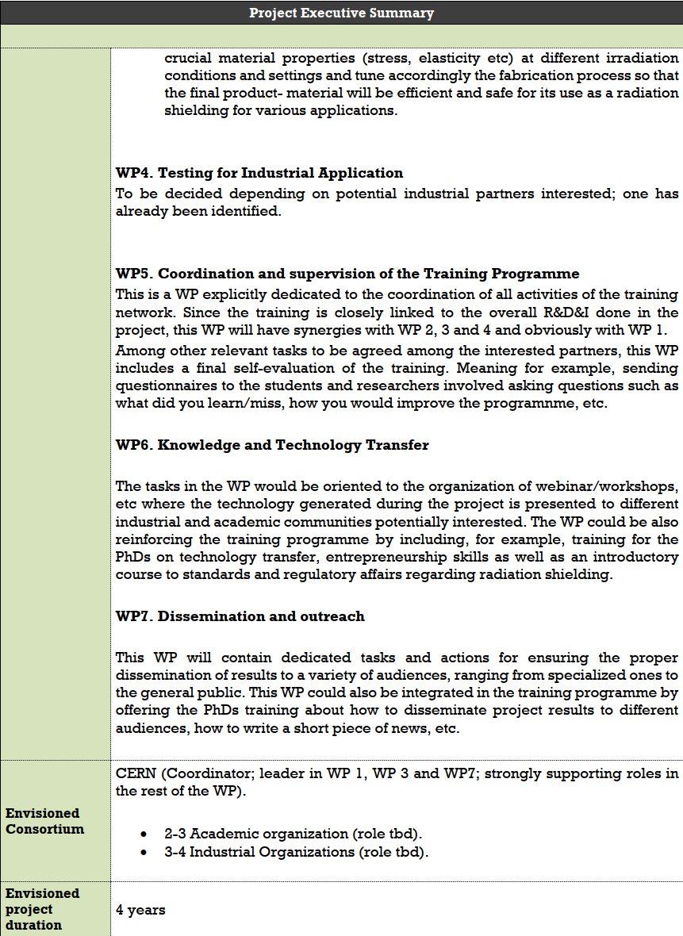
Some tips (1)
If/When you have a concrete idea for a project, please fill in a template like this example
Send it to me and I will be more than happy to provide further advise.

Slide 7
Some tips (2)
It is extremely difficult for an EU project proposal nowadays to be funded without any industrial organization in the consortium taking an active role in it.
So please, partner with industry.
The competition is very hard. Therefore, if you decide to go for a proposal, think that for it being competitive, it requires 3 months of intensive work.
Thus, don’t waste your time in calls with a deadline nearby.
Make sure that:
    You have the time required to write a competitive proposal before the deadline.
    You want to go for it.
    You are committed to spend the necessary time and work.
Stay tuned because many of the Work Programmes I mentioned will be launched again by September/October.

Slide 8
Thanks and Questions

