Slide 1
IdeaSquare
Strategy: Setting the Scene
Pablo Garcia Tello (CERN)
ISAB Meeting, June 27th 2024

Slide 2
What are we presenting today?
A more detailed strategy with reference to the previously sent strategy draft document.
Focusing on present and mid-term future.
Reflecting where we want to go and what we want to achieve in the future.
Mentioning some concerns we have for IdeaSquare’s future development.

Slide 3
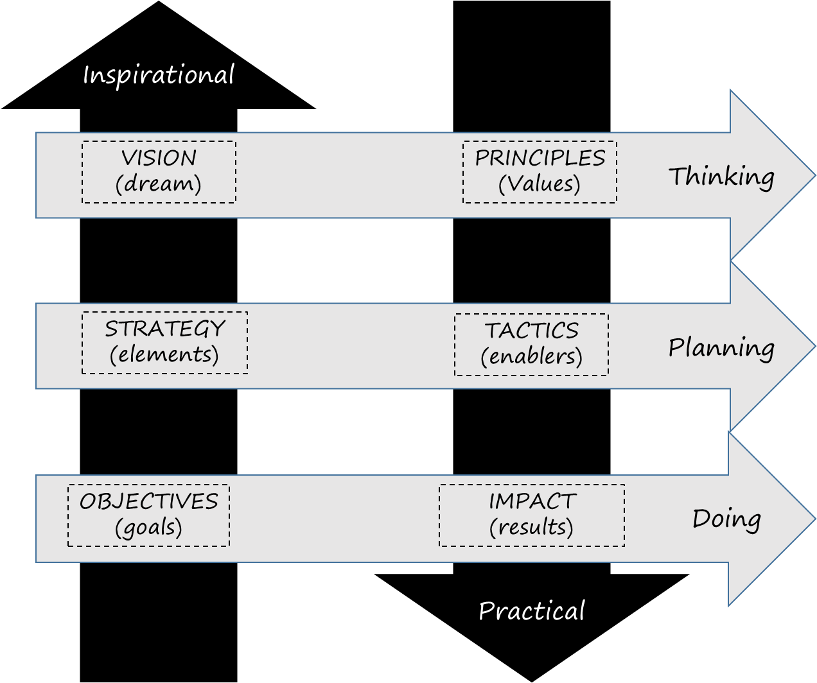
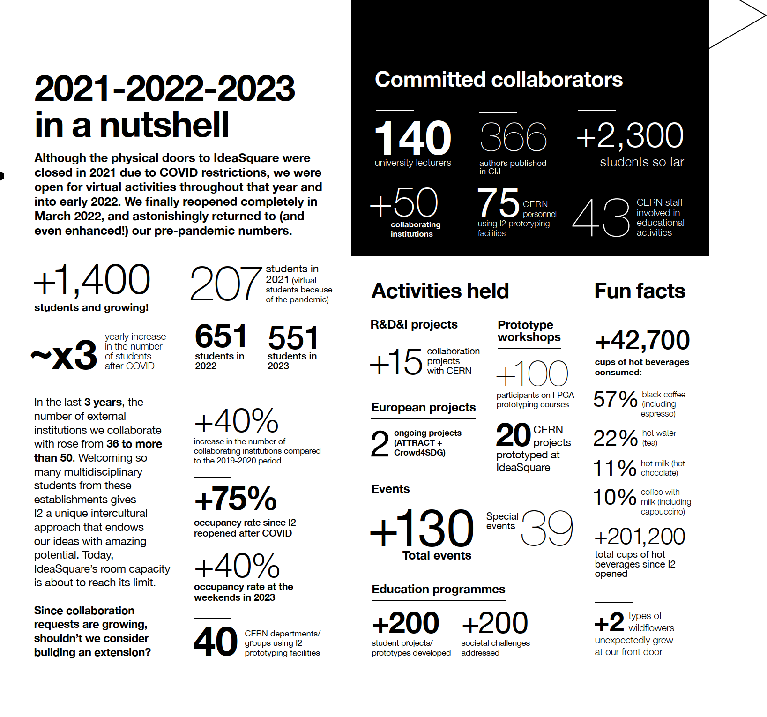
IdeaSquare Strategy in a Nutshell
IdeaSquare’s wants to become a global reference facility dedicated to the development and implementation of transformative educational and training programs to address complex social problems in a sustainable and inclusive way.
Spirit of openness and collaboration
Embracing diversity
Integrating different cultures
Passion for generating transformative innovation
Commitment to excellence
Active Participation in European Funded Projects
Competitive Space for Ideation and Prototyping
Co-developing Executive Education Workshops
Hosting Innovative R&D&I Projects
Establishing Open and Pro-active Communication and Outreach Channels
IdeaSquare’s Team
IdeaSquare Physical Space
Contributing to CERN’s Mission and Values
Enhancing CERN’s Role in European R&D&I Strategy
Educating and Training Future Generations
Supporting CERN’s Research Community at Large

Slide 4
What IdeaSquare’s team will be presenting?
IdeaSquare’s wants to become a global reference facility dedicated to the development and implementation of transformative educational and training programs to address complex social problems in a sustainable and inclusive way.
Spirit of openness and collaboration
Embracing diversity
Integrating different cultures
Passion for generating transformative innovation
Commitment to excellence
Active Participation in European Funded Projects
Competitive Space for Ideation and Prototyping
Co-developing Executive Education Workshops
Hosting Innovative R&D&I Projects
Establishing Open and Pro-active Communication and Outreach Channels
IdeaSquare’s Team
IdeaSquare Physical Space
Contributing to CERN’s Mission and Values
Enhancing CERN’s Role in European R&D&I Strategy
Educating and Training Future Generations
Supporting CERN’s Research Community at Large

Slide 5
IdeaSquare faces difficulties
Despite our best efforts, it is not the best moment for IdeaSquare.
Some latest developments have altered the previous plans.
We are implementing mitigation measures as much as we can.
We seek the ISAB advice and supporting action.

Slide 6


Slide 7
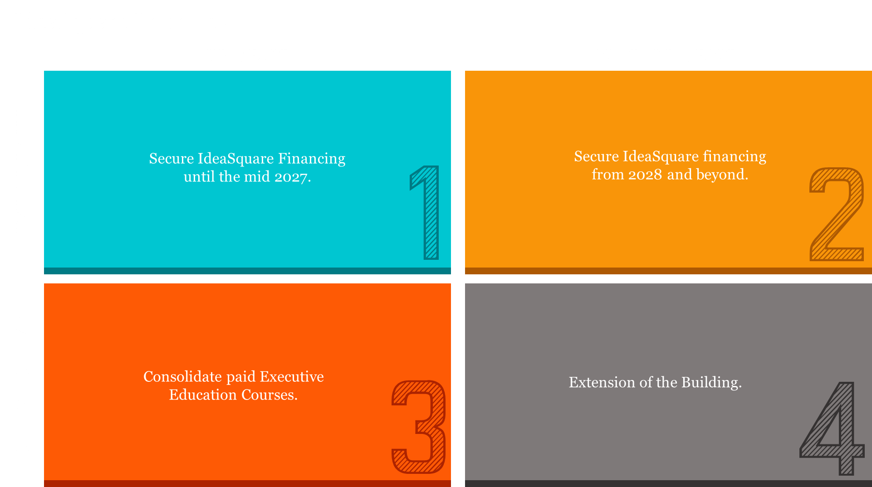

Slide 8
Please ask questions

