Slide 1
Generic pre-R&D at IdeaSquare
Pablo Garcia Tello (CERN)
ISAB Meeting
June 27th, 2024

Slide 2
Developments in 2023-2024
Activities (I)
Continue hosting the development of high-performance electronics and detectors
  Development of a new generations of detectors and related electronics for the LHC-phase 2 upgrade, the dark matter particle searches and for the next generation colliders
  Detector prototype design and test
  Chip design and bench-test
  Development of a new type of low power neuromorphic analog electronics, capable to support ns-level inference and correlation on large and sparse data sets, for a new approach to green computing.
Applications: large area fast tracking systems
  ATLAS HL-LHC upgrade
  New dark matter experiment searches, based on enclosing large monitored volumes to search for rare events
  New applications based on the cosmic rays background exploitation:
  Muon tomography for home land security, large infrastructures integrity, geological prospections, cultural heritage searches
  Future colliders….

Slide 3
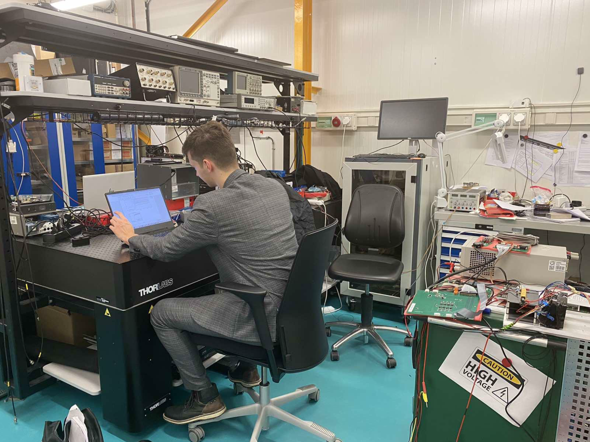
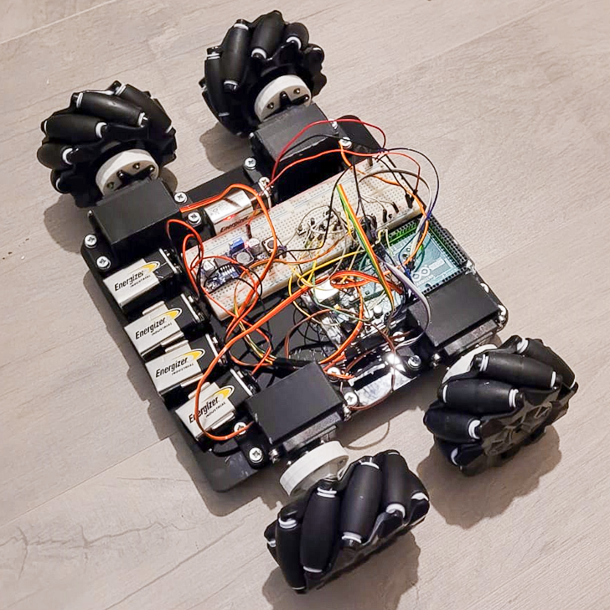
Developments in 2023-2024
Activities (II)
Continuing hosting developments for:
  WA105-ICARUS Cosmic Ray Tagger System
  Feasibility study of power-over-fiber technology
  T2K SuperFGD
  Testing photosensors for Neutrino project
  Testing 3D printed plastic scintillators
  Testing Hyper Kamiokande electronics
Continuing hosting developments for CMS Inspection Robot
  WA105-ICARUS Cosmic Ray Tagger System
  Feasibility study of power-over-fiber technology
  T2K SuperFGD
  Testing photosensors for Neutrino project
  Testing 3D printed plastic scintillators
  Testing Hyper Kamiokande electronics

Slide 4
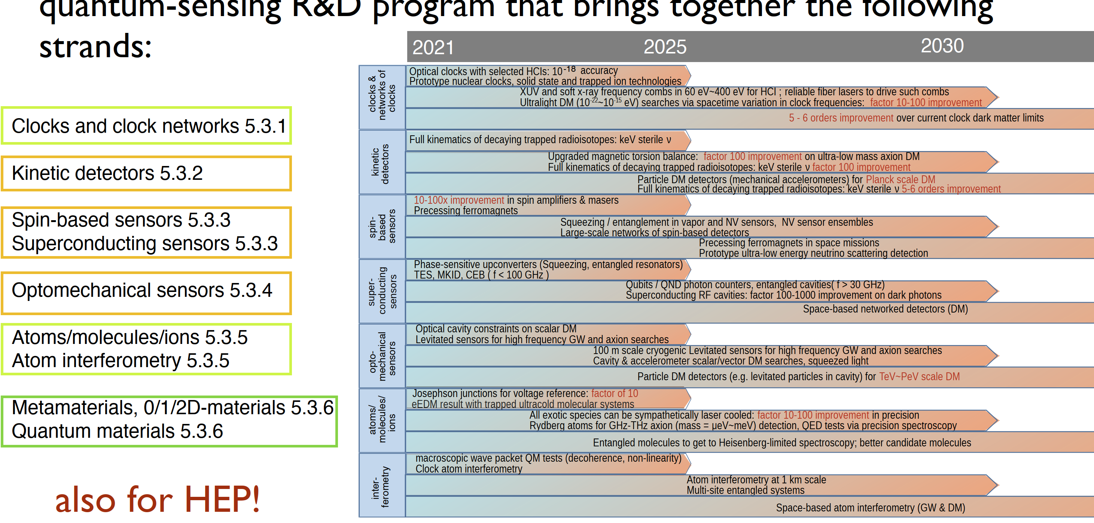
Future Developments Pipeline
Part of the Quantum Technology Initiative at CERN.
Hosting summer school on Quantum Sensing at CERN (Michael Dose, https://doser.web.cern.ch/ , 2-6 September).
The six quantum sensing families that form part of the ECFA detector R&D roadmap are:
  clocks and clock networks
  kinetic detectors
  superconducting and spin-based sensors
  optomechanical sensors
  atoms, ions, molecules and atom interferometry
  metamaterials, 0-,1-,2-dimensional materials
IdeaSquare at the disposal of the Quantum Sensing community for becoming a hosting facility (ongoing discussions).

Slide 5
Thank You

