Slide 1
CERN IdeaSquare Journal of Experimental Innovation
27.6.2024
Matteo Vignoli – Editor-in-Chief
Valeria Brancolini – Managing editor

Slide 2
CERN IdeaSquare Journal of Experimental Innovation
Editor-in-Chief
  Matteo Vignoli, University of Bologna, Department of Management, Bologna, Italy
Emeritus, Founding Editor-in-Chief
  Saku Juhani Mäkinen, University of Turku, Finland and CERN, Switzerland
Co-Editor
  Jonathan Wareham, ESADE Business School, Ramon Llull University, Barcelona, Spain
Managing Editor
  Valeria Brancolini, Italy
Co-managing Editor
  Lauri Valtonen, CERN IdeaSquare, Switzerland

Slide 3
Why are we here?
Promote the culture of CERN as an experimental organization into innovation with concrete actions
To become the central outlet for academic research in experimental innovation including the design factory network
To involve and support future scientists, PhDs and students, in experimental innovation research
Notes:
Three bullet points max.
What does it mean that we do/What does our role mean? I2 strategy and in general.
• Uniting people from all over the world to push the frontiers of science and technology, for the benefit of all.
• Training new generations of physicists, engineers, and technicians, and engaging citizens in research and in the values of science.
IdeaSquare’s wants to become a global reference facility dedicated to the development and implementation of transformative educational and training programs to address complex social problems in a sustainable and inclusive way.
The first value is a spirit of openness and collaboration. IdeaSquare fosters an environment where transparency and teamwork are paramount, encouraging the free exchange of ideas and collective problem solving.
Embracing diversity is another cornerstone value of IdeaSquare strategy. By welcoming individuals from all social, cultural, and geographic backgrounds, as well as from all educational disciplines and levels of experience
Questioning the status quo.
The physical space of IdeaSquare is designed to be an open and collaborative environment. This openness is essential in fostering a culture of transparency and mutual respect, where ideas can be freely exchanged and tested. --- Unique opportunity for open and collaborative research and subsequent discussion.
open and proactive communication and outreach activities.

Slide 4
Now and then: 2023-2024
Activity | Objective
Increased to three issues per year | Foster expanded open and global discussion around innovation knowledge
“How-to” methodological notes on experimentational research methods | Embracing and enabling people from different disciplinary backgrounds to join and bring their expertise to research innovation
ATTRACT Socio-economic studies’ findings publications | Knowledge exchange from the international collaboration on EU projects to a larger audience, give room to the biggest experiment in innovation
Notes:
Three bullet points max.
What does it mean that we do/What does our role mean? I2 strategy and in general.
• Uniting people from all over the world to push the frontiers of science and technology, for the benefit of all.
• Training new generations of physicists, engineers, and technicians, and engaging citizens in research and in the values of science.
IdeaSquare’s wants to become a global reference facility dedicated to the development and implementation of transformative educational and training programs to address complex social problems in a sustainable and inclusive way.
The first value is a spirit of openness and collaboration. IdeaSquare fosters an environment where transparency and teamwork are paramount, encouraging the free exchange of ideas and collective problem solving.
Embracing diversity is another cornerstone value of IdeaSquare strategy. By welcoming individuals from all social, cultural, and geographic backgrounds, as well as from all educational disciplines and levels of experience
Questioning the status quo.
The physical space of IdeaSquare is designed to be an open and collaborative environment. This openness is essential in fostering a culture of transparency and mutual respect, where ideas can be freely exchanged and tested. --- Unique opportunity for open and collaborative research and subsequent discussion.
open and proactive communication and outreach activities.
international collaboration and knowledge exchange and positions it
as a central hub for delivering cutting-edge and innovative education knowledge

Slide 5
Now and then: 2023-2024
Activity | Objective
Fostering a scientific view in the innovation community, i.e. Coffee papers from scientists | Bring the perspective of scientists, like a message in a bottle, to the innovation community
Presence in relevant academic conferences | Connect with researchers that are presenting papers using experimental methodologies and offer CIJ as a potential outlet
Spring & Summer: Normal issues, Winter: Innovation in Career and Life Design | Present the strategy between normal and special issues as a way to nurture community
Communications of CIJ activity, 41 social media posts and 2 website news articles | Communication as a strategic value creation asset for CIJ authors that can see their research promoted in the IdeaSquare channels
Notes:
Three bullet points max.
What does it mean that we do/What does our role mean? I2 strategy and in general.
• Uniting people from all over the world to push the frontiers of science and technology, for the benefit of all.
• Training new generations of physicists, engineers, and technicians, and engaging citizens in research and in the values of science.
IdeaSquare’s wants to become a global reference facility dedicated to the development and implementation of transformative educational and training programs to address complex social problems in a sustainable and inclusive way.
The first value is a spirit of openness and collaboration. IdeaSquare fosters an environment where transparency and teamwork are paramount, encouraging the free exchange of ideas and collective problem solving.
Embracing diversity is another cornerstone value of IdeaSquare strategy. By welcoming individuals from all social, cultural, and geographic backgrounds, as well as from all educational disciplines and levels of experience
Questioning the status quo.
The physical space of IdeaSquare is designed to be an open and collaborative environment. This openness is essential in fostering a culture of transparency and mutual respect, where ideas can be freely exchanged and tested. --- Unique opportunity for open and collaborative research and subsequent discussion.
open and proactive communication and outreach activities.
international collaboration and knowledge exchange and positions it
as a central hub for delivering cutting-edge and innovative education knowledge

Slide 6
Impacts of activities now and then: Data
3 issues per year: Two normal issues and one special issue at the end of the year
Two new sections: Methodological notes: 3 done, 2 in pipeline and ATTRACT Socio-economic studies: 2 done, 6 in the pipeline
Monthly clinics for students: 10 since August with varying participation.
Notes:
Three bullet points max.
What does it mean that we do/What does our role mean? I2 strategy and in general.
• Uniting people from all over the world to push the frontiers of science and technology, for the benefit of all.
• Training new generations of physicists, engineers, and technicians, and engaging citizens in research and in the values of science.
IdeaSquare’s wants to become a global reference facility dedicated to the development and implementation of transformative educational and training programs to address complex social problems in a sustainable and inclusive way.
The first value is a spirit of openness and collaboration. IdeaSquare fosters an environment where transparency and teamwork are paramount, encouraging the free exchange of ideas and collective problem solving.
Embracing diversity is another cornerstone value of IdeaSquare strategy. By welcoming individuals from all social, cultural, and geographic backgrounds, as well as from all educational disciplines and levels of experience
Questioning the status quo.
The physical space of IdeaSquare is designed to be an open and collaborative environment. This openness is essential in fostering a culture of transparency and mutual respect, where ideas can be freely exchanged and tested. --- Unique opportunity for open and collaborative research and subsequent discussion.
open and proactive communication and outreach activities.

Slide 7
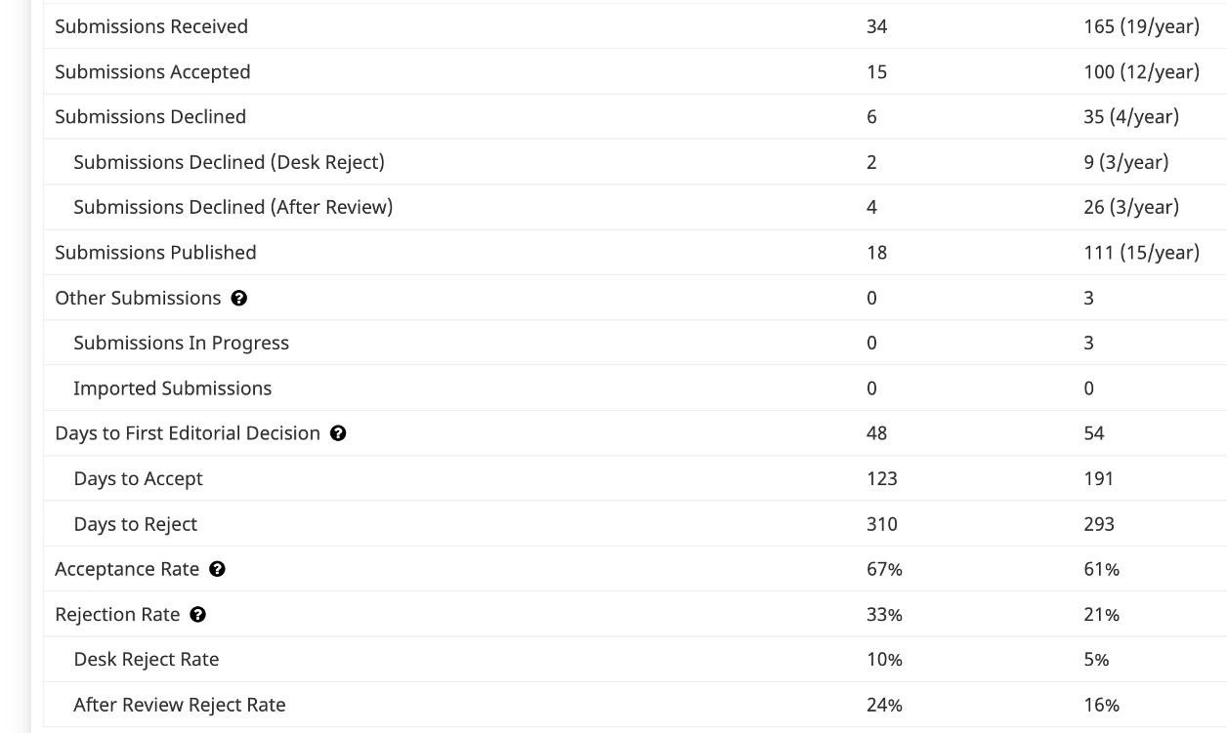
Editorial activity 2023

Slide 8
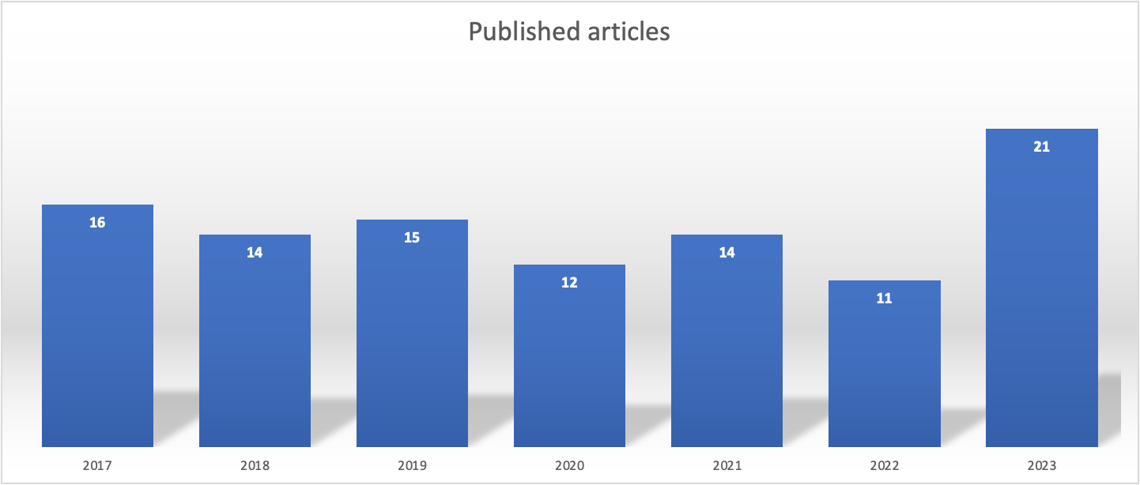
Editorial workflow

Slide 9
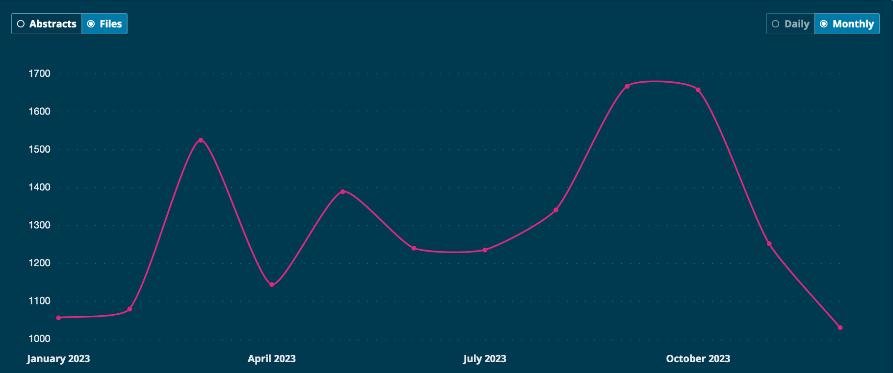
Articles’ downloads/month in 2023 (all articles)

Slide 10
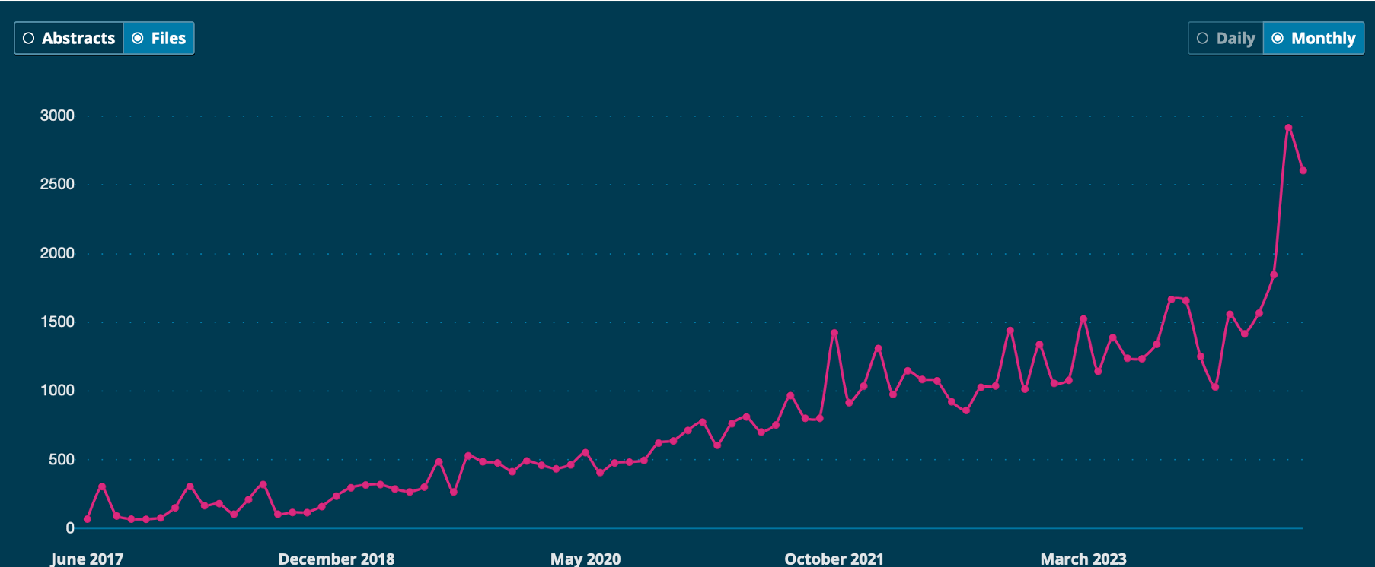
Articles’ downloads/month over the years (all articles)

Slide 11
10 MOST DOWNLOADED ARTICLES OF ALL TIMES
Article ID | Article Title | Date Published | Abstract Views | Total Gallery Views
1054 | Cultural tourism development and the impact on local communities: a case study from the South of Italy | 2020-12-28 | 1761 | 12685
799 | Designing and building a 3D printed low cost modular Raman spectrometer | 2018-12-21 | 3713 | 6648
746 | Smart work centers as “creative workspaces” for remote employees | 2018-07-02 | 2394 | 2150
920 | Closing the gap: reinventing organizations for innovation and the disruptors who drive it | 2019-12-24 | 2085 | 1866
544 | Organizational experiments and the change of meaning | 2017-12-22 | 892 | 1841
459 | Experimentation and innovation: purpose, possibilities and preferred solutions | 2017-06-30 | 857 | 1614
1287 | Can challenge-based learning be effective online? A case study using experiential learning theory | 2021-06-30 | 2218 | 1428
997 | Designing services for employees' wellbeing: principles for an improved employee experience | 2021-12-21 | 1715 | 1185
882 | Improving plastic management by means of people awareness | 2024-06-25 | 1337 | 950
873 | Customized servitization as an innovative approach for renting service in the fashion industry | 2024-06-25 | 901 | 939

Slide 12
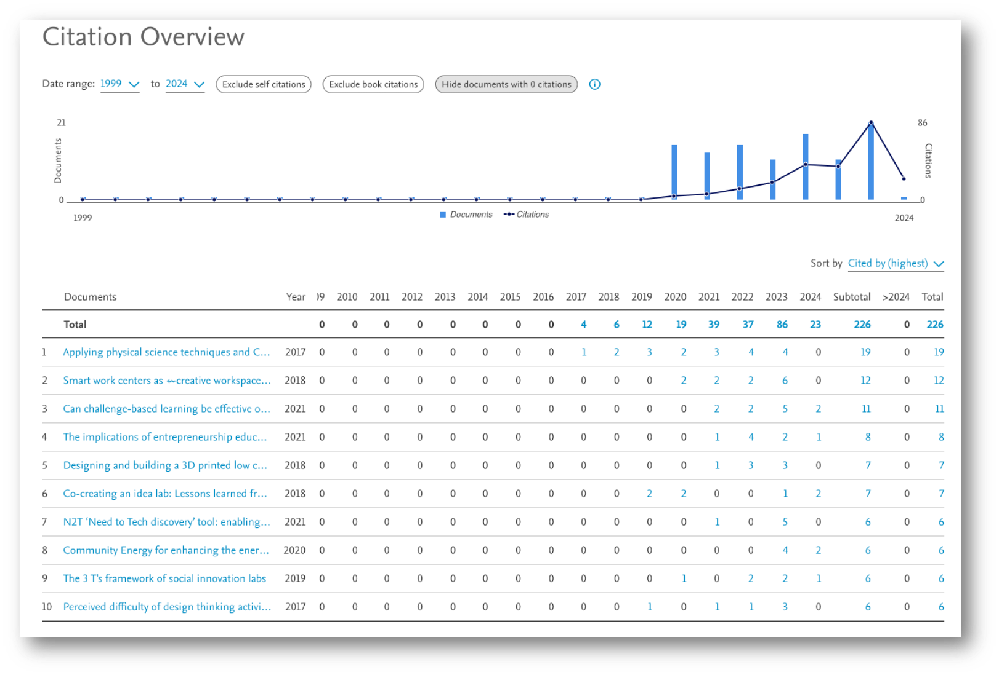
10 MOST CITED ARTICLES OF ALL TIMES

Slide 13
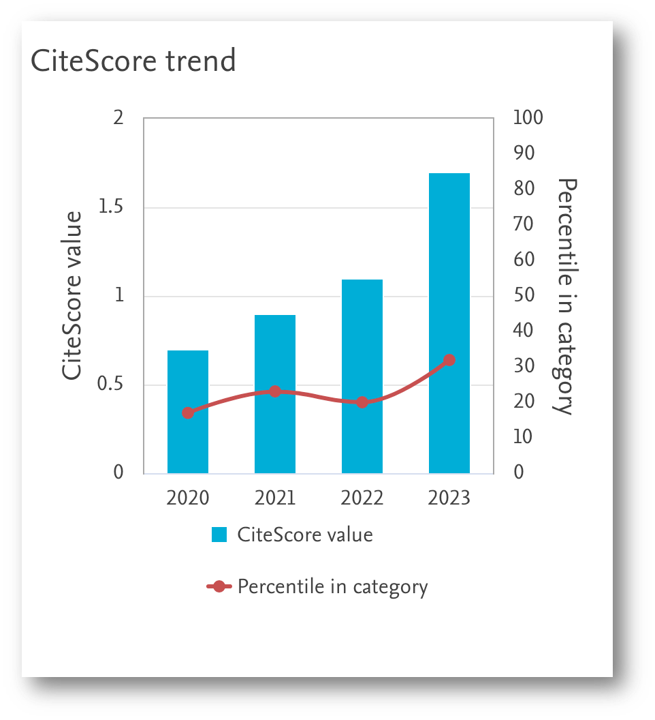
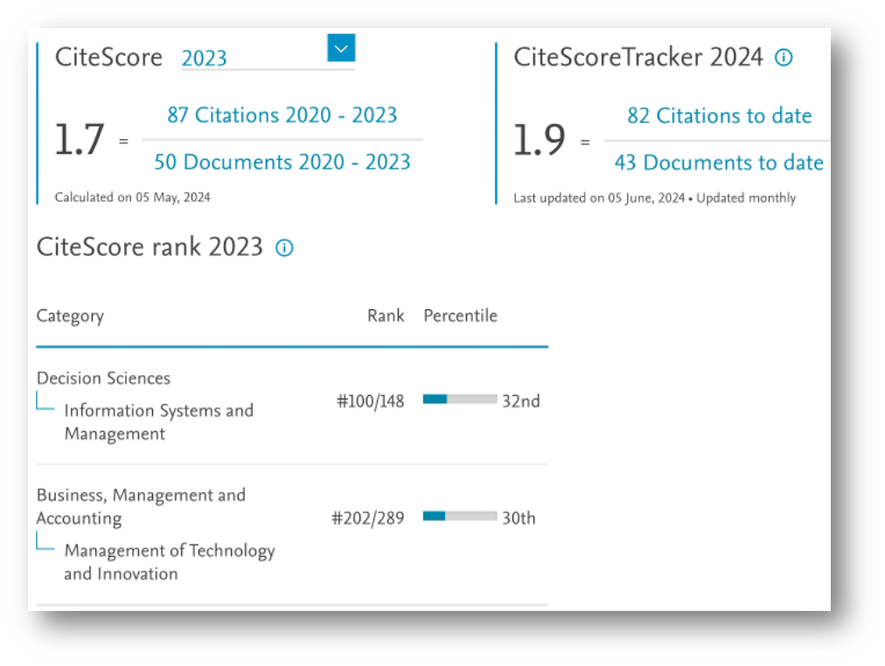
Cite Score and ranking

Slide 14
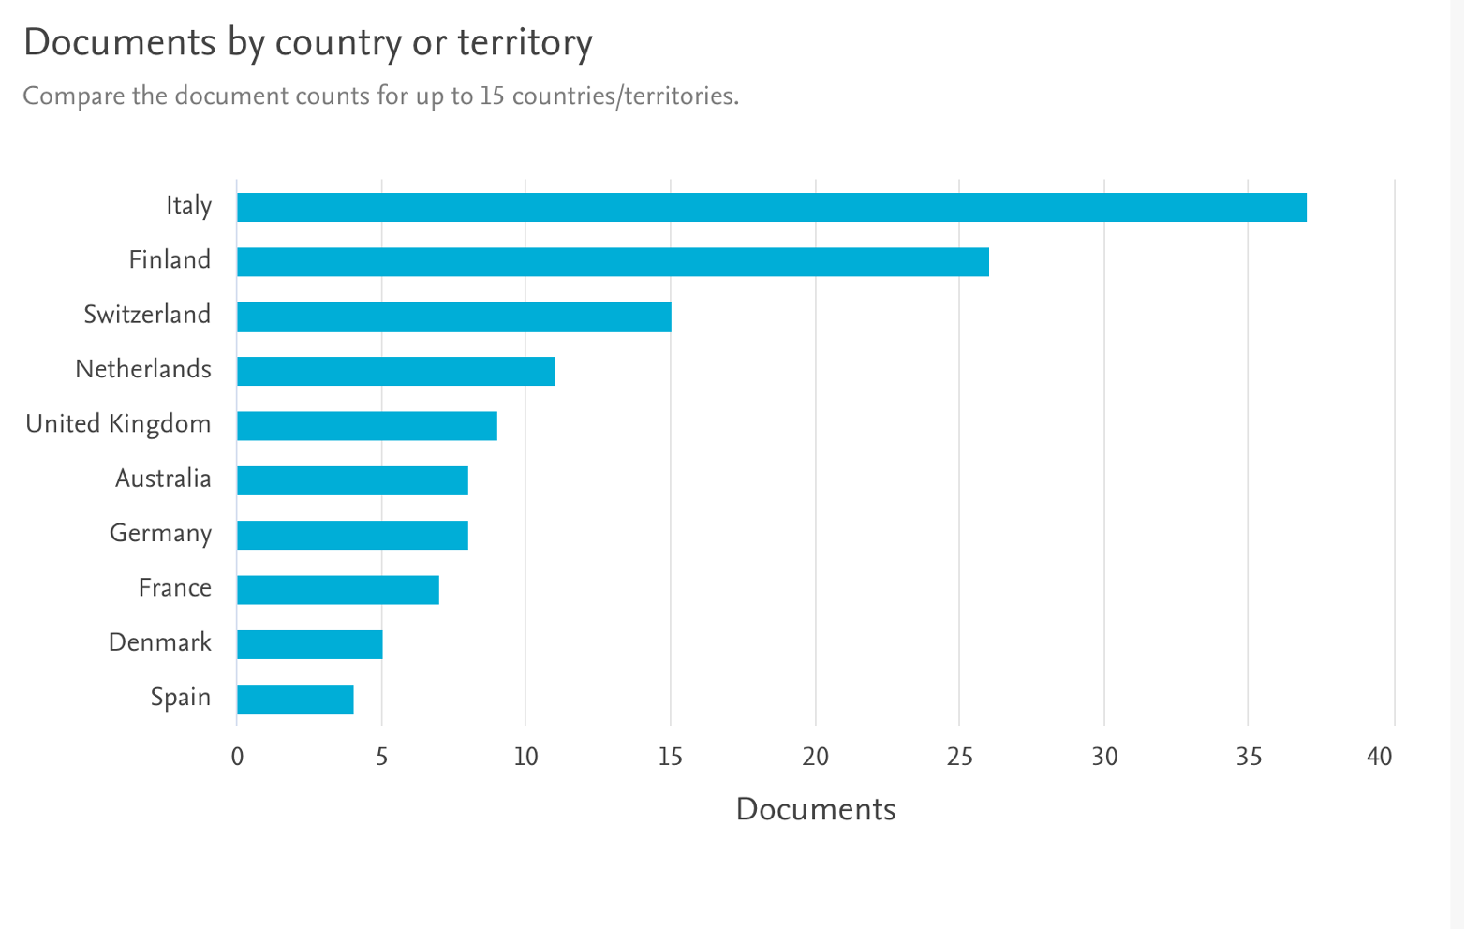

Slide 15
Pipeline: 2025-2026
Activity | Objective
PhD summer school on methodological notes | Training future scientists in experimental methodologies to study innovation and its relation to societal good and sustainability.
Reapply to Web of Science | Impact factor: Legitimacy in the academic community and reach of journal
Data sharing and data publications | Openness and collaboration, collect value generated by student projects in form of raw data as an alternative to usual publications
Special issue 2025: PhD Summer school follow-up | A way to close the loop with the training of PhD summer school, so they learn the process also including publishing the work
Meeting and restructuring the editorial board of the journal | Be ready to support the growth of the number of submissions
Notes:
Activities planned for the near future. Their link to strategy objective.
What does it mean that we do/What does our role mean? I2 strategy and in general.
• Uniting people from all over the world to push the frontiers of science and technology, for the benefit of all.
• Training new generations of physicists, engineers, and technicians, and engaging citizens in research and in the values of science.
IdeaSquare’s wants to become a global reference facility dedicated to the development and implementation of transformative educational and training programs to address complex social problems in a sustainable and inclusive way.
The first value is a spirit of openness and collaboration. IdeaSquare fosters an environment where transparency and teamwork are paramount, encouraging the free exchange of ideas and collective problem solving.
Embracing diversity is another cornerstone value of IdeaSquare strategy. By welcoming individuals from all social, cultural, and geographic backgrounds, as well as from all educational disciplines and levels of experience
Questioning the status quo.
The physical space of IdeaSquare is designed to be an open and collaborative environment. This openness is essential in fostering a culture of transparency and mutual respect, where ideas can be freely exchanged and tested. --- Unique opportunity for open and collaborative research and subsequent discussion.
open and proactive communication and outreach activities.

Slide 16
2025 PhD School
Professors | Affiliations
Georges Romme | Eindhoven University of Technology
Massimo Florio | University of Milan
Matthias Guertler | University of Technology Sydney
Jan Auernhammer | Stanford University
Leona Chandra Kruse | University of Agder
Research development workshops for PhD students with lectures on experimental methodologies and CERN visits for 5 days
Authors of methodological notes and CIJ editors as professors
Participants offered the possibility to submit research they work on in an upcoming CIJ special issue
Coinciding with an editorial in-person/hybrid meeting
Tentative dates: 23.6-27.6. or 30.6.-4.7.2025

Slide 17
Web of Science
We applied in 2019 and were stopped at the triage step, because we were not publishing enough articles (minimum of 20) compared to other journals in the same categories
We are planning to apply to be included again in early 2025, as we have since increased the number of issues (3 vs 2) and articles.

Slide 18
Sought impact
Increase quality of papers, 60 submissions but maintain number of publications at 20-30
PhD School: 5 authors, 35 students, 3 years
WOS: Get impact factor as a KPI for CIJ
Data publications: One publication per issue in 2026
Special issues 2025-2027: 7-10 papers per issue from PhD School
Editorial board: 3 associate editors committed to working on the journal
Notes:
Three bullet points max.
What does it mean that we do/What does our role mean? I2 strategy and in general.
• Uniting people from all over the world to push the frontiers of science and technology, for the benefit of all.
• Training new generations of physicists, engineers, and technicians, and engaging citizens in research and in the values of science.
IdeaSquare’s wants to become a global reference facility dedicated to the development and implementation of transformative educational and training programs to address complex social problems in a sustainable and inclusive way.
The first value is a spirit of openness and collaboration. IdeaSquare fosters an environment where transparency and teamwork are paramount, encouraging the free exchange of ideas and collective problem solving.
Embracing diversity is another cornerstone value of IdeaSquare strategy. By welcoming individuals from all social, cultural, and geographic backgrounds, as well as from all educational disciplines and levels of experience
Questioning the status quo.
The physical space of IdeaSquare is designed to be an open and collaborative environment. This openness is essential in fostering a culture of transparency and mutual respect, where ideas can be freely exchanged and tested. --- Unique opportunity for open and collaborative research and subsequent discussion.
open and proactive communication and outreach activities.

Slide 19
Learnings and developments beyond 2026
Post-impact factor
  Develop CIJ identity and presence as an established journal
  Focus on sustainability of the journal

