Slide 1
IdeaSquare Educational Programmes
ISAB-G June 2024
Ole Werner, Catarina Batista, Laura Wirtavuori

Slide 2
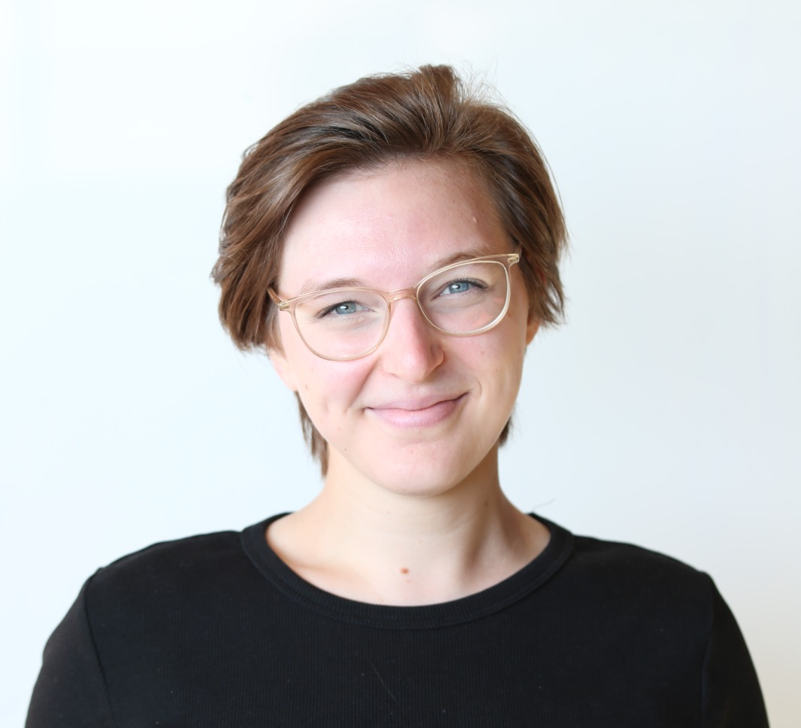
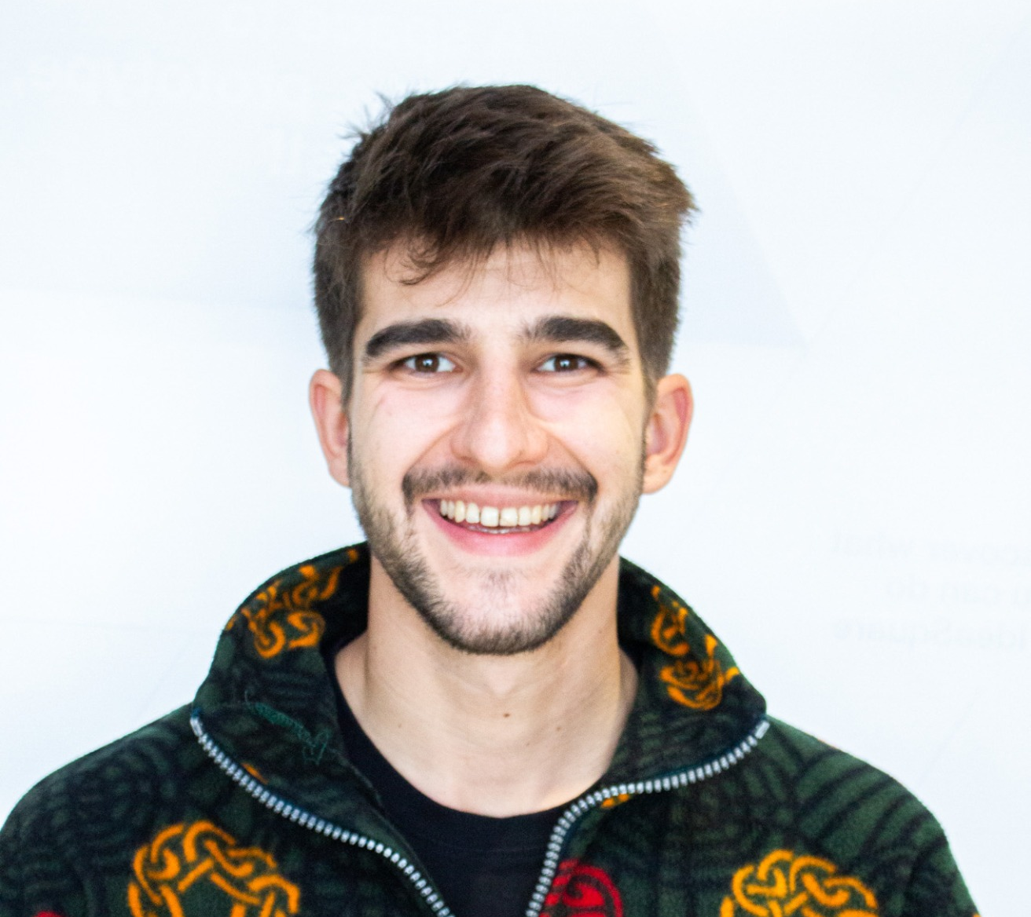
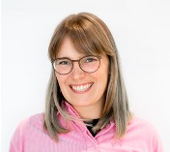
Catarina Batista
Mindset Accelerator at CERN IdeaSquare
BA Communication, Post-grad Product and Service Innovation, MSc Psychology.
Passionate about education and humanitarian challenges.
Ole Werner
Galactic Firefighter at CERN IdeaSquare
BSc Psychology, MSc Behavior Change
Passionate about understanding individual cognitions and behaviors in teams.
Laura Wirtavuori
Activity manager at CERN IdeaSquare
MSc Industrial Engineering and Management
Passionate about sustainability and systemic change.

Slide 3
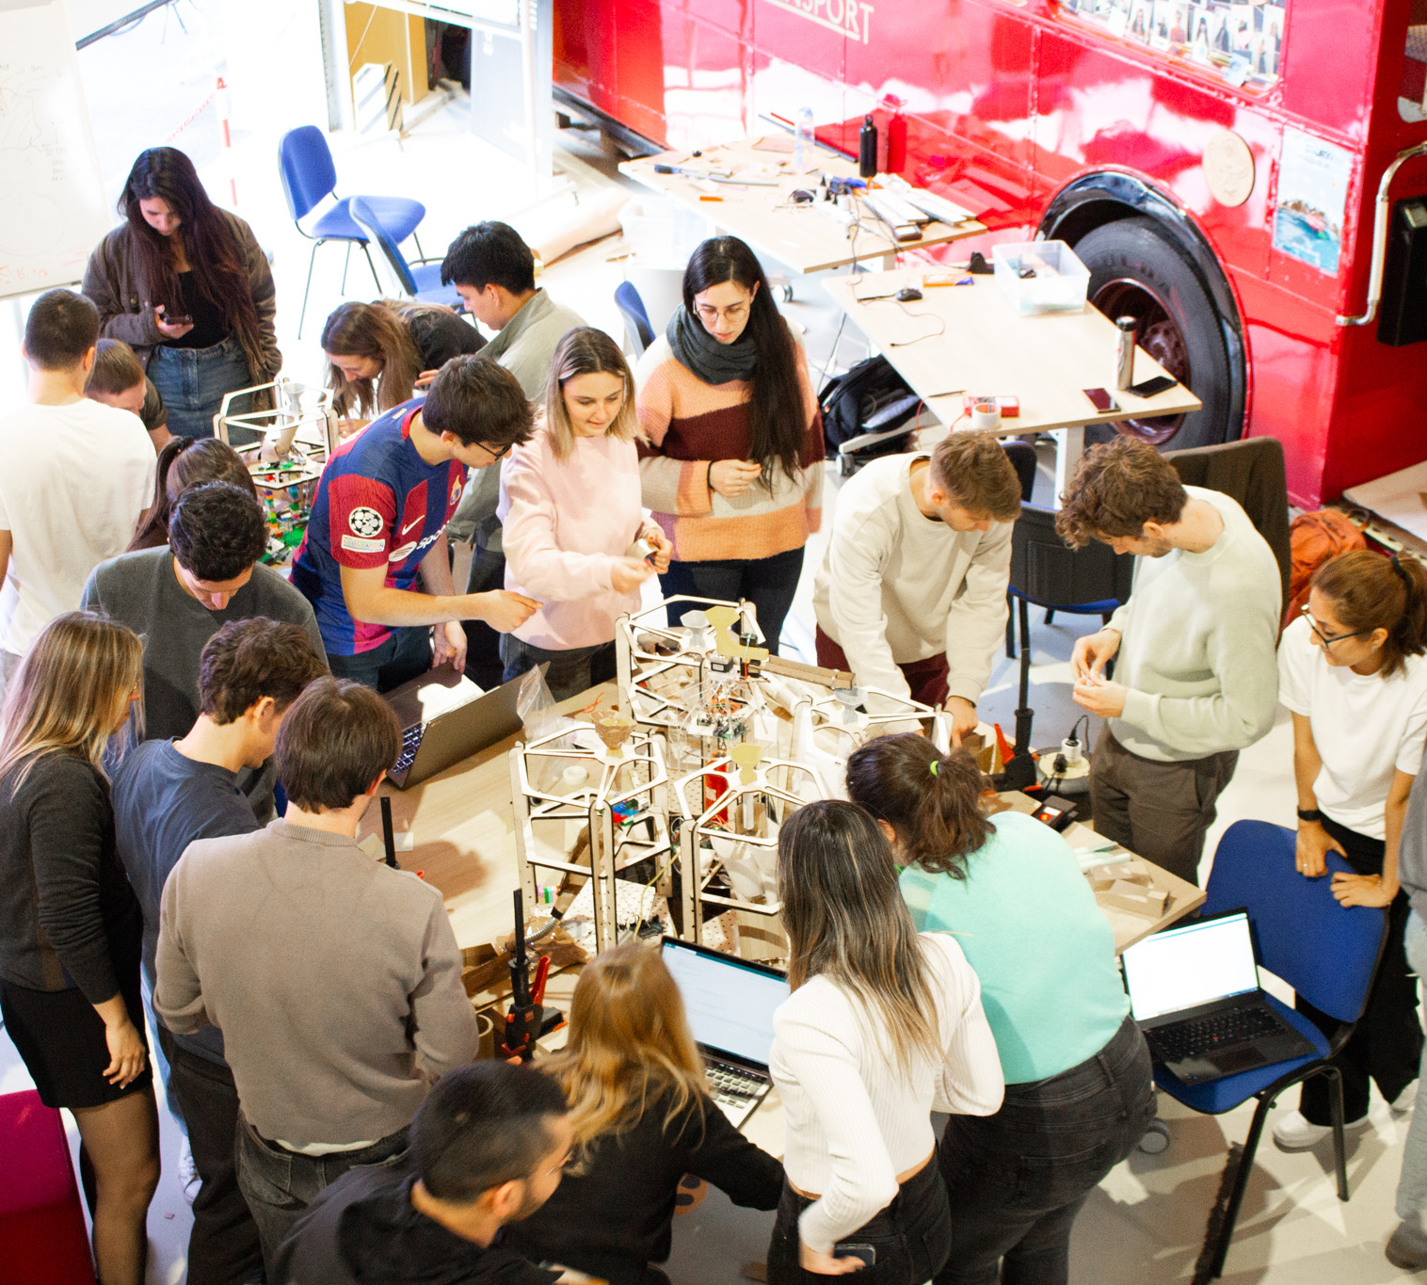
Why are we here?
Educating and Training Future Generations
Training of young minds to become thought leaders.
Delivering experiential learning fostering analytical and creative thinking, curiosity, self-awareness, resilience and flexibility.
Co-designing the programs embedded in the curricula in several universities worldwide, with the following building blocks:
  Systemic societal problems as a lens in the process
  Increasingly multidisciplinary teams of students
  CERN as an inspirational and immersive space.
  Duration from 1 week to 8 months, 10-50 students per course;
  Final deliverables from inspirational videos to functioning prototypes to concept papers.
Make-a-thon at IdeaSquare
Notes:
CERN as an inspirational and immersive space, to take lessons on collaboration and breakthrough thinking.

Slide 4
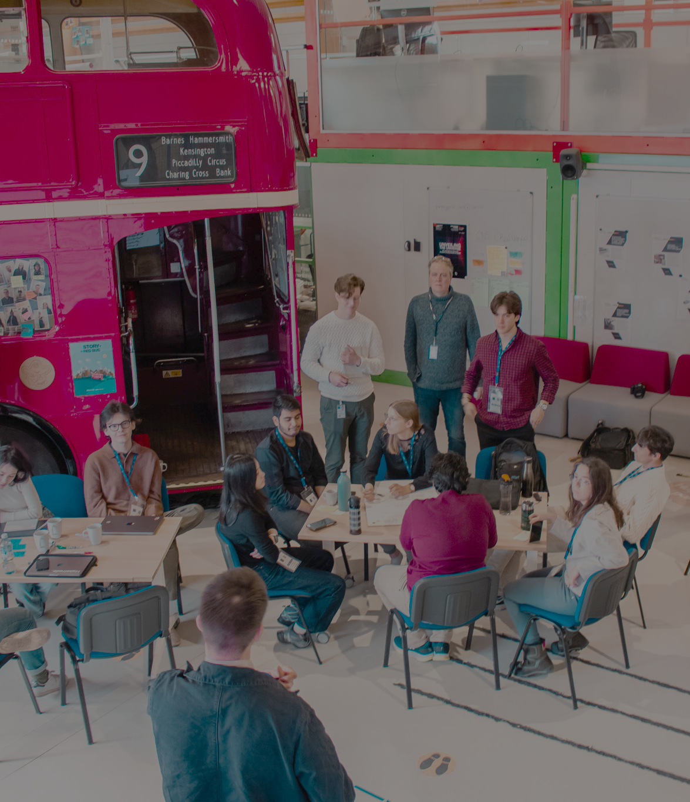
What is happening?
In 2023:
551 students
+30 different institutions
16% Design, 33% Business, 30% Engineering, 17% Other
47% female students (x2 of CERN’s goal for 2025)
45/52 weeks booked in the space
Until end of June 2024:
234 students
19% Design, 20% Business, 38% Engineering, 24% Other
43% female students (x2 of CERN’s goal for 2025)
+15 different institutions
10 different programs done
4 new IdeaSquare Planet Pilots
45/52 weeks booked in the space already
N° coffees divided by trialogue
14,233/3 = 4,744
conversations in the kitchen
Notes:
Gender balance
9 ATTRACT programs
{Number of conversation = n° Coffee/3}

Slide 5
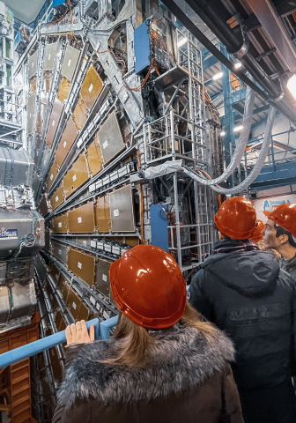
What’s changing?
New partners across CERN member states and beyond with Educational Institutes in Norway, the USA, Thailand, Singapore, Estonia, and Germany.
Interactions with Students are a great opportunity for young users at CERN to diversify their experience and build science communication/education skills.
Alumni of IdeaSquare collaborations end up taking student working positions at CERN (currently 3 employed).
Continuous research on student programmes (2 master thesis, 2 abstracts published at OIS conference 2023+2024, 1 paper in writing, 1 paper on i2Planet methodology by IdeaSquare team also ongoing)
Notes:
How has this benefited CERN – new partners, new collaborations (St. John’s, HVL, NorCC, Ruth’s school, continuously engaging with younger community of CERN – increased perception of I2 as an important space inside CERN, be perceived as an expert for people at CERN to shine and interact with society, improve scicne communication/interdisciplinary skills.
Our Alumni that end up working at CERN

Slide 6
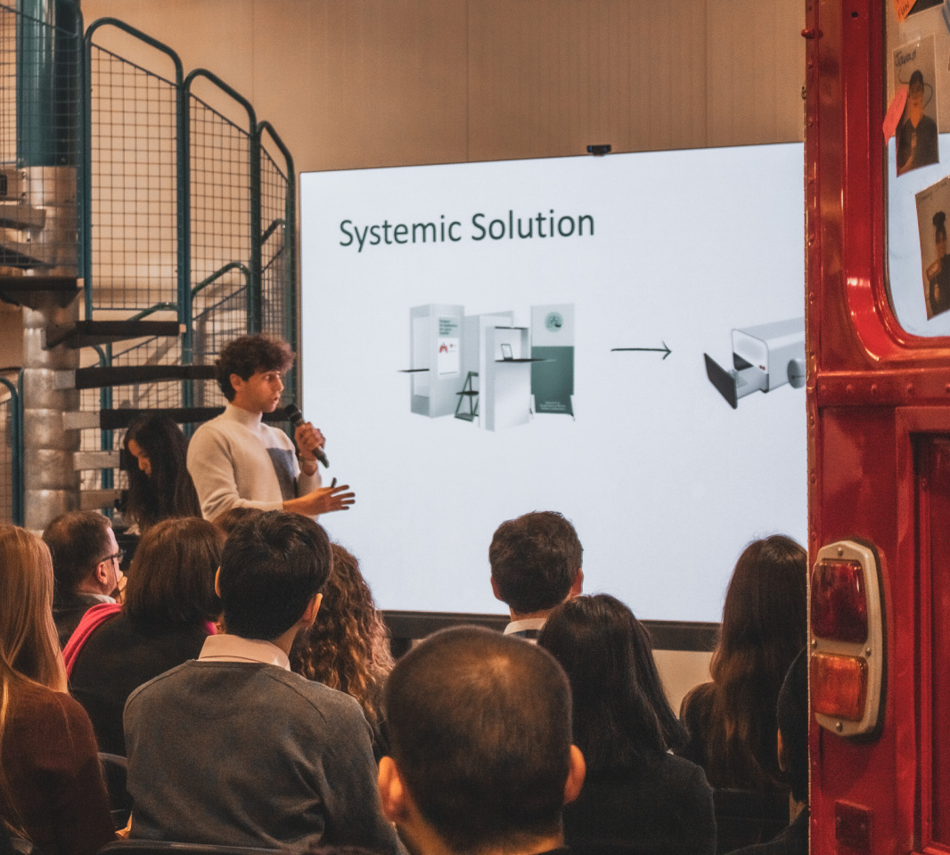
What is in the pipeline for 2025/26?
I2Planet Workshops planned with
LAB-University (Finland), Püha Johannese Kool (Estonia), Chulalongkorn University (Thailand), EPFL (Switzerland)
Industry Collaboration with Klang Games to further develop immersive educational materials for i2-Planet
Frequent interactions with CERN scientists as part of the IdeaSquare experience
Workshops and networking sessions for/with different CERN departments (FAP-BC, HR-PXE)
Notes:
Klang, more collbas outside of EU

Slide 7
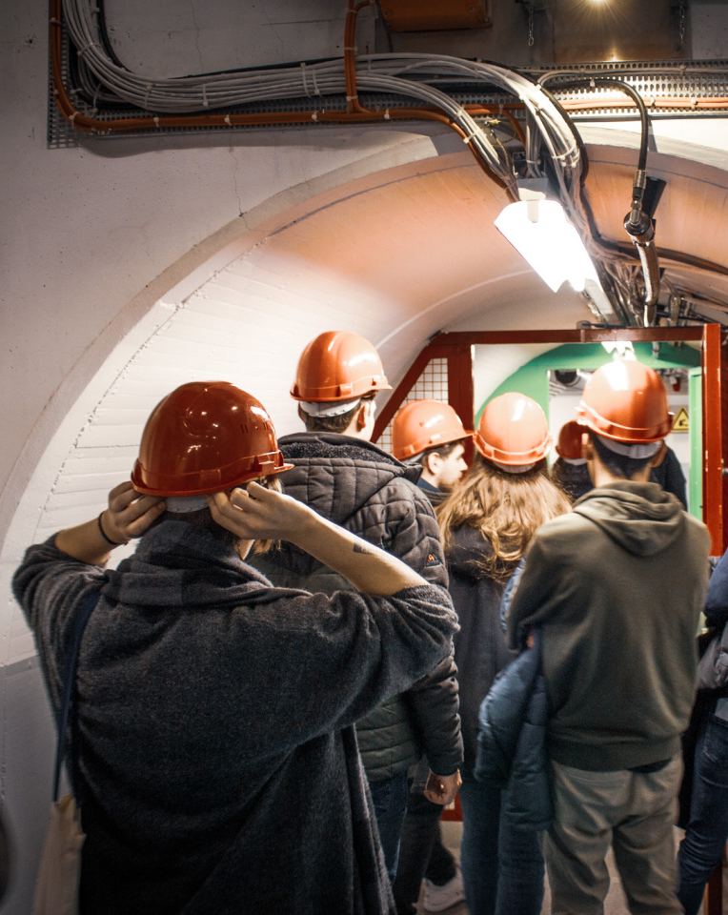
What do want to get out of it?
IdeaSquare's new methodological concept in line with the Strategy Plan, working towards a new, full-fledged Program by 2025.
Teach systems thinking and adopting a long-term perspective, as well as helping students to challenge societal constructs that might limit their thinking.
New developments in curriculum integrating systems thinking, behaviour change and regenerative design.
Be trailblazers in new experimental learning methodologies.

Slide 8
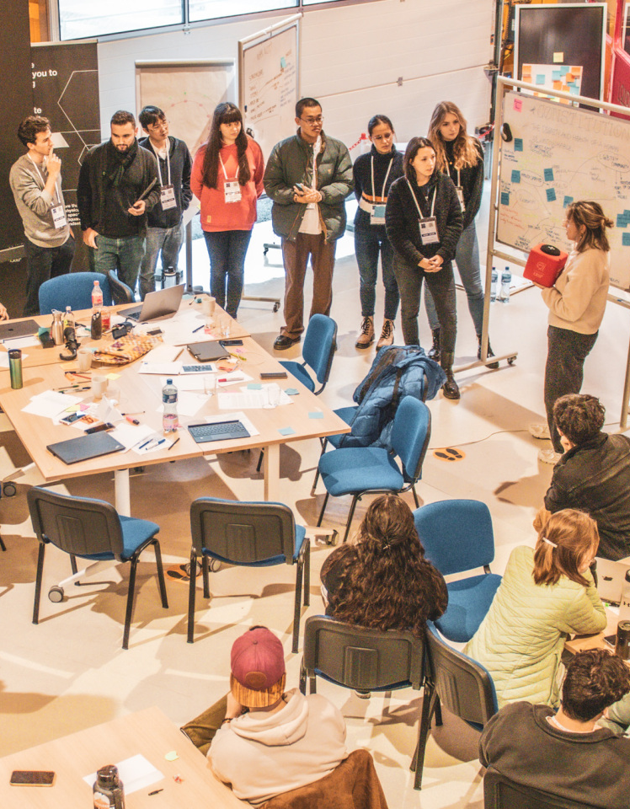
What have we learned? What’s on the horizon?
I2Planet is proving to be an interesting and captivating offer to many established and new partners.
Lots of effort in planning these first rounds of I2Planet will compensate long term since the materials can be reused and improved upon.
Continuing the exploration around the immersive elements of I2Planet through game and storytelling elements.

Slide 9
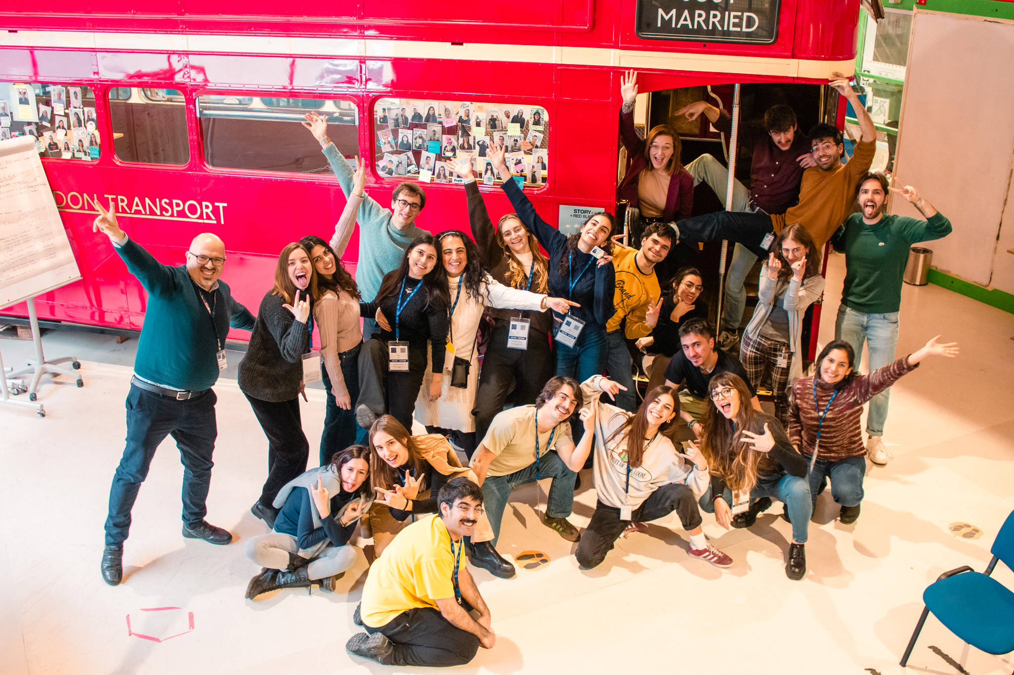
Thank you!

