Slide 1
Prototyping at IdeaSquare
ISAB Meeting 27. June 2024
Dina Zimmermann

Slide 2
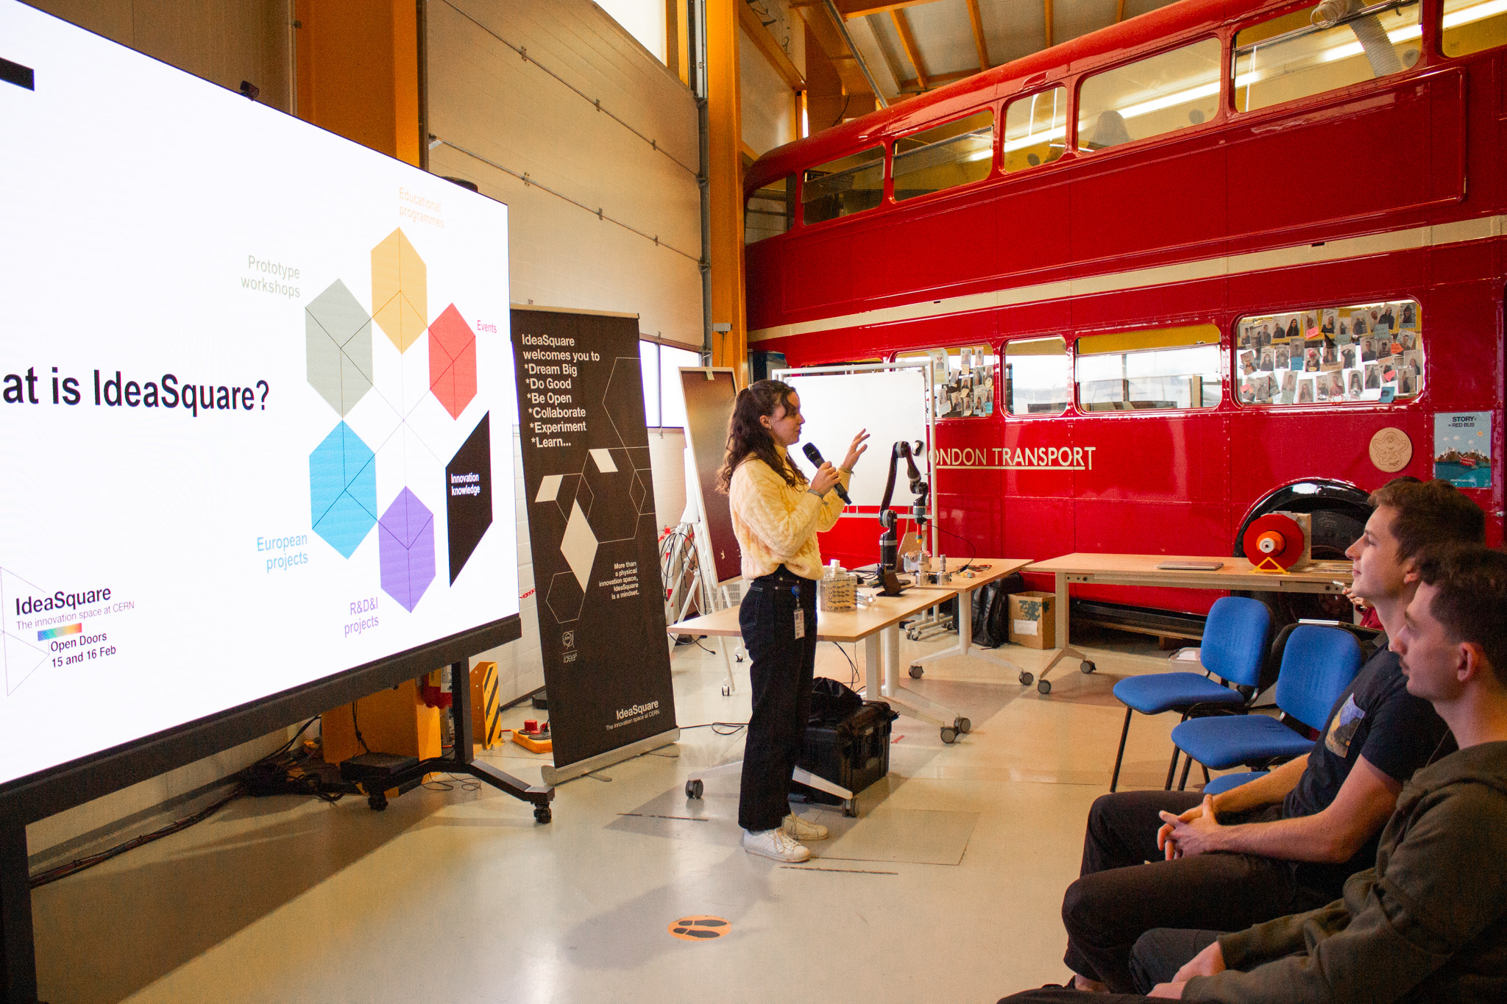
Notes:
Who am I?
Dina
Structural Engineer from Norway
1.5 years at IdeaSquare

Slide 3
The purpose of prototyping
Teaching the students a tangible methodology for problem-solving and exploration
Providing CERN personnel with a rapid prototyping facility
Hands-on workshops to share knowledge inside CERN
Notes:
Hands-on workshops for externals and CERN employees

Slide 4

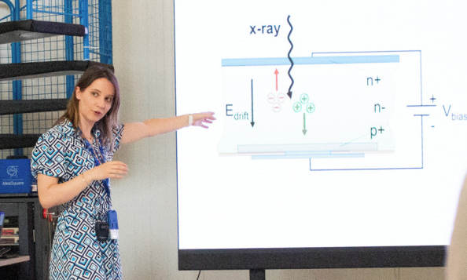
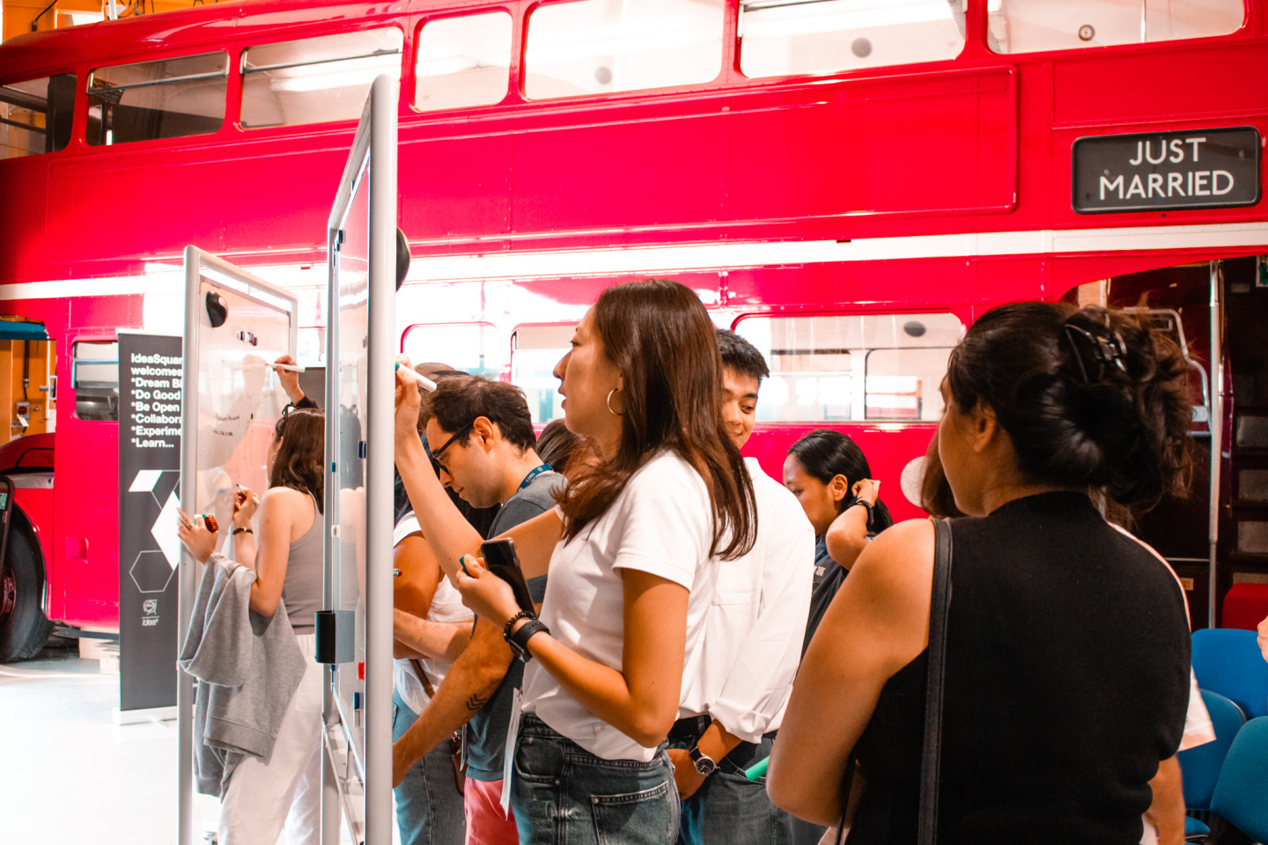
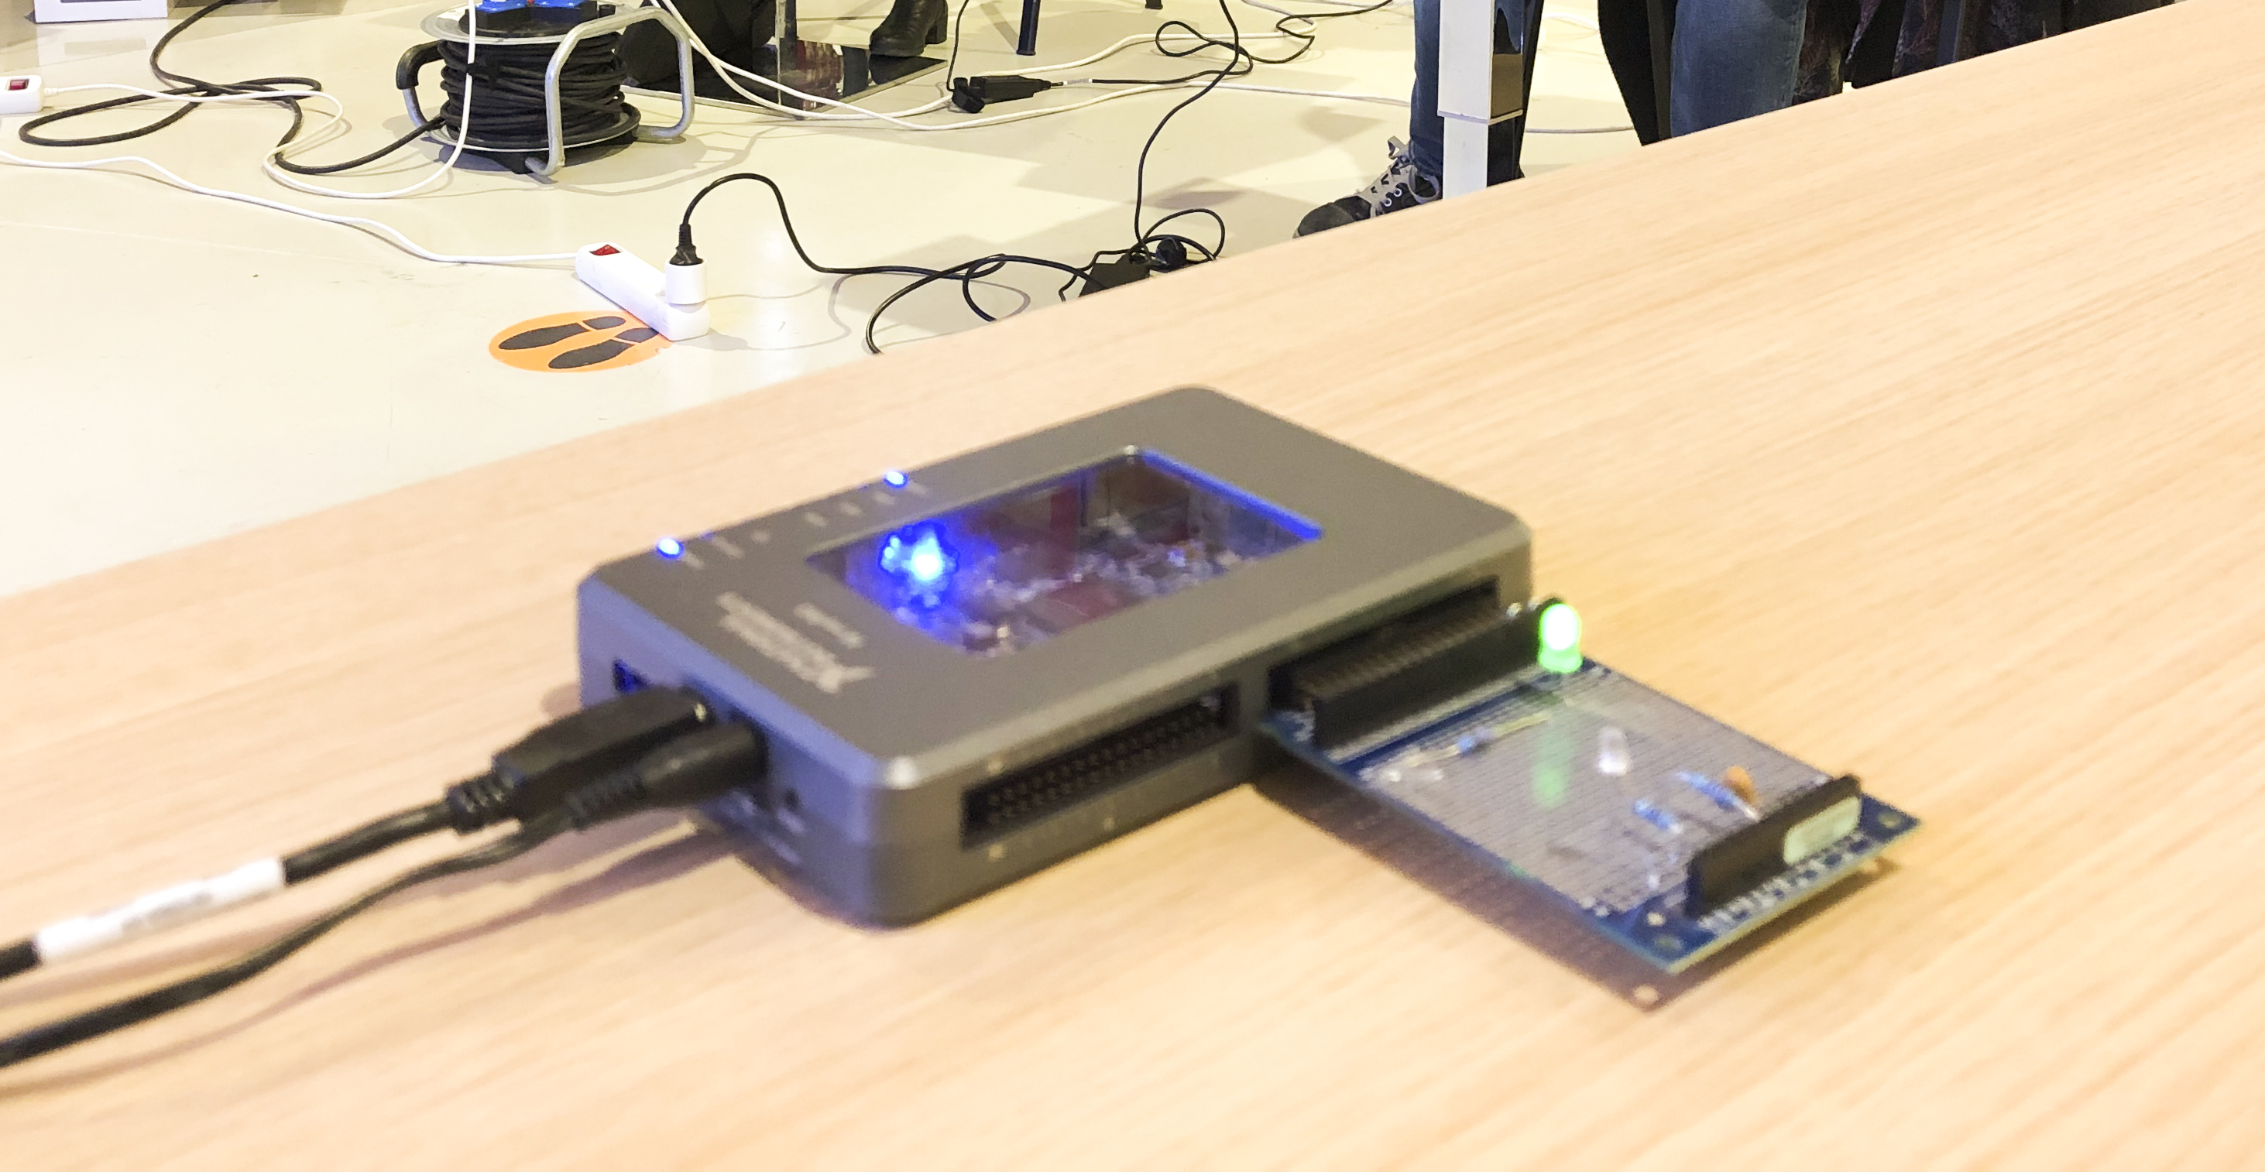
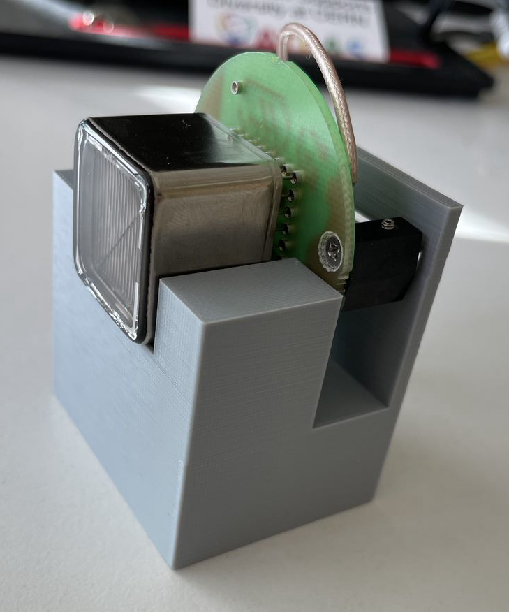
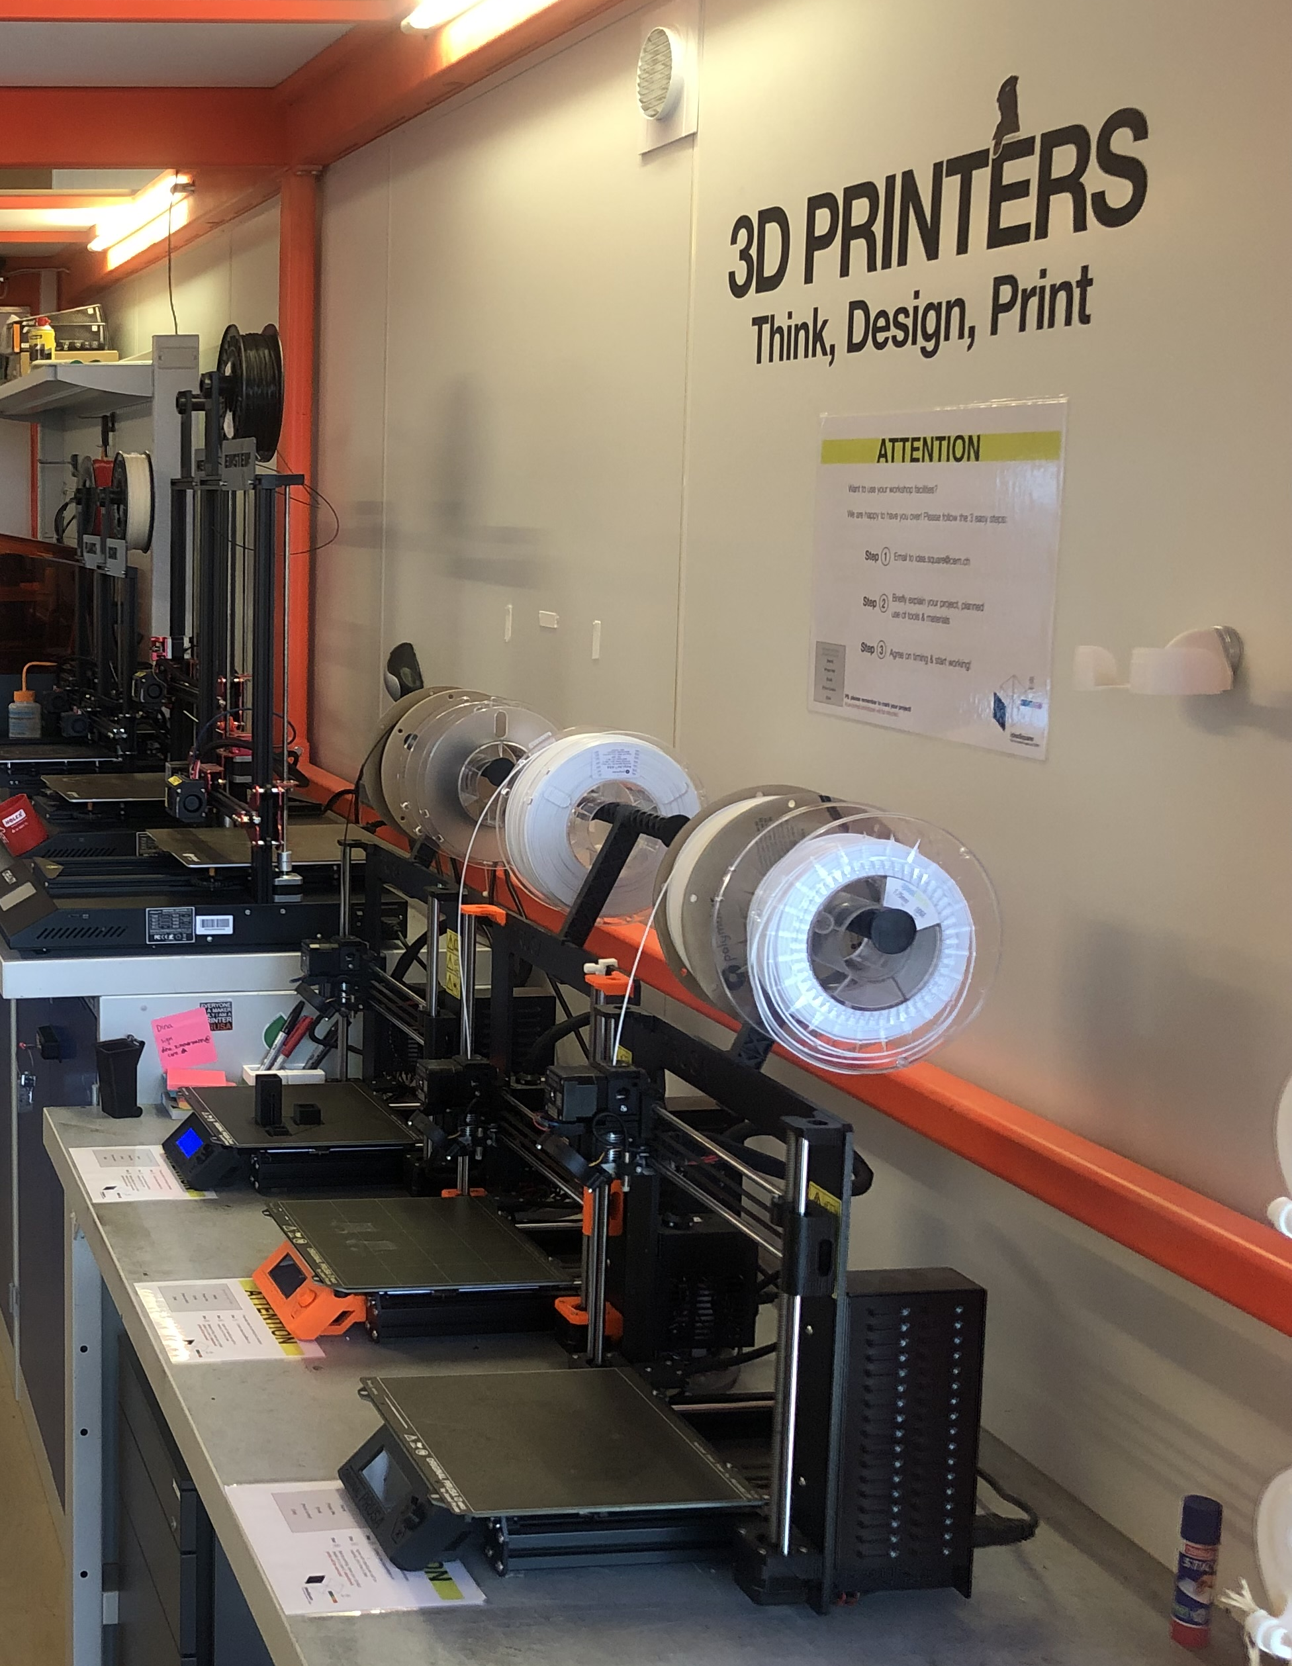
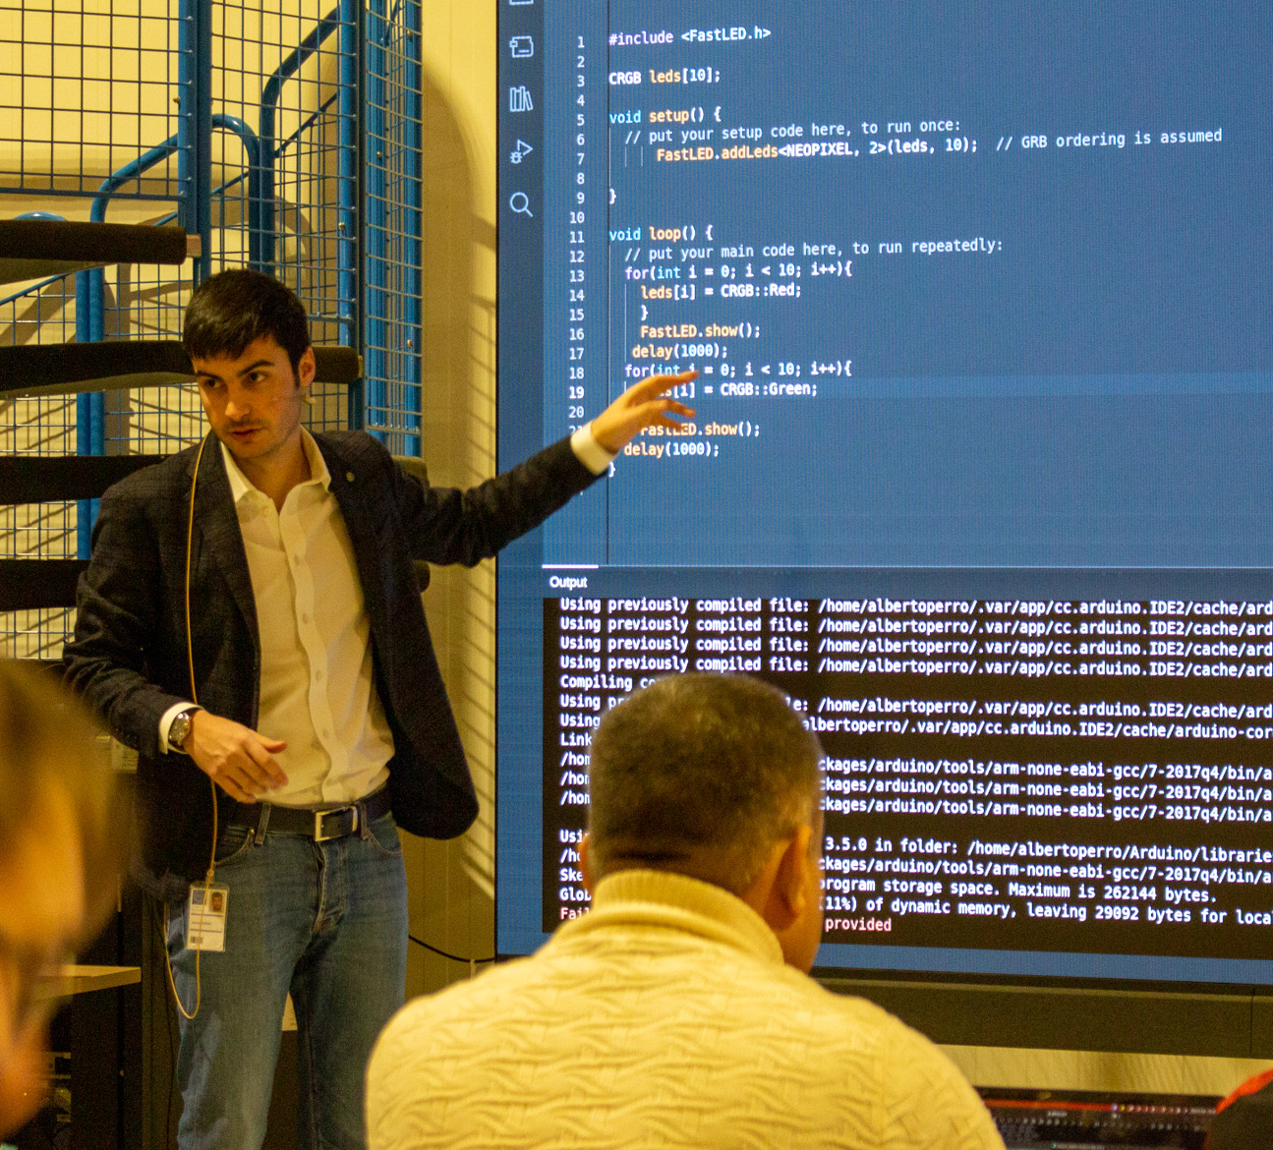
The last year
Student Program Prototyping
MediPix
workshop
FPGA courses with Adriaan Rijllart
18 participants
6 courses - 71 participants
CERN
Collaboration Projects
10 different programs with over 350 students
Machine Trainings for CERN Personnel
Arduino courses with Alberto Perro
More than 20 projects across departments
5 courses – 51 participants
30 trainings for over 70 participants
Notes:
Numbers:
6 FPGA courses
March 2024: 10
January 2024: 10
December 2023: 11
October 2023: 11
September 2023: 10
April 2023: 19
= 71
4 Arduino courses
March 2023: 14
April 2023: 9
May 2023: 15
November 2023: 15
= 53 participants
CERN Collaboration projects: with ALPHA, ATLAS
Photo of: Holder for photomultiplier tube for the ATLAS Detector. A photomultiplier tube is a device in which the absorbtion of a photon results in the emisison of an electron.
354 students

Slide 5

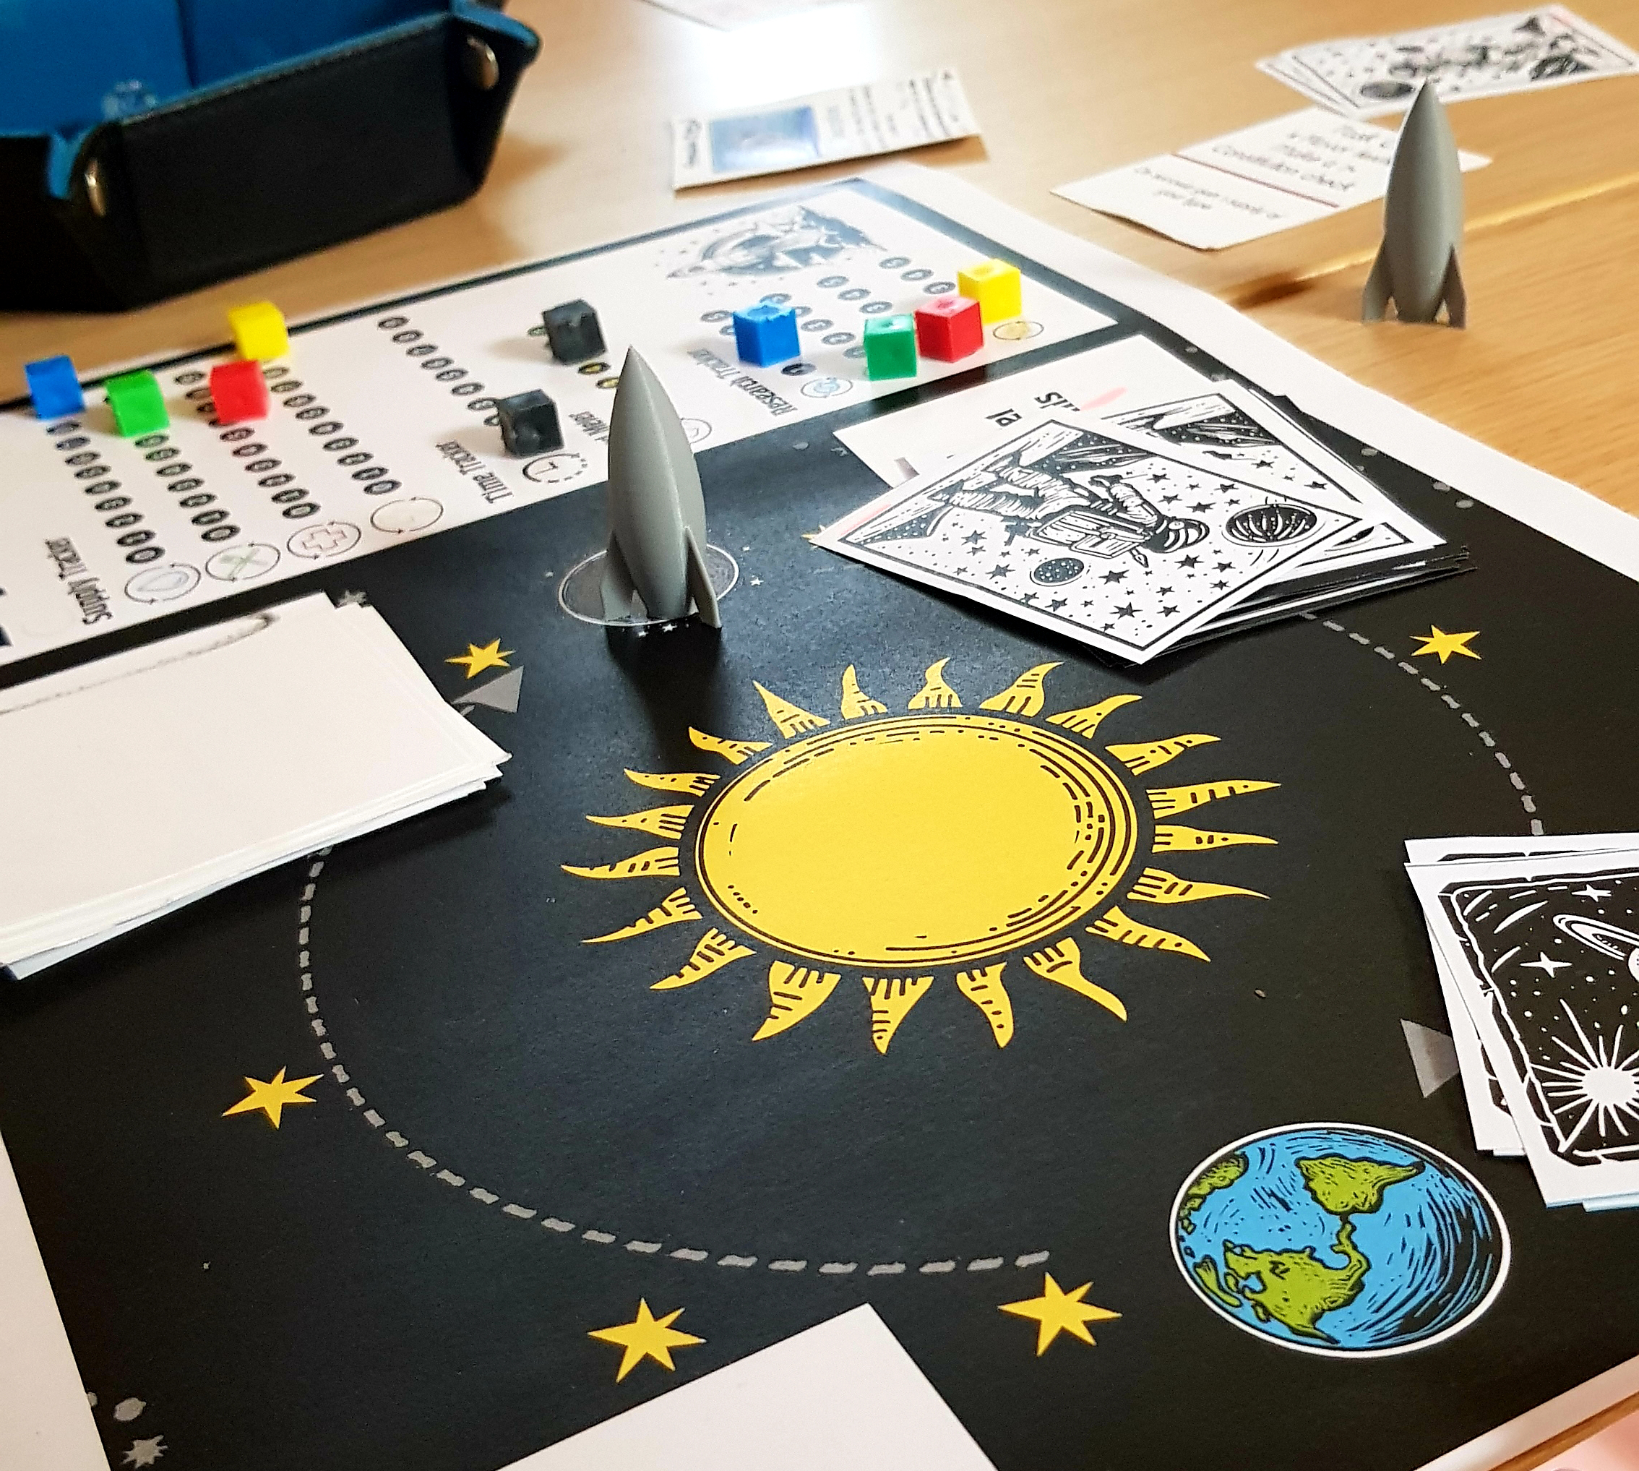
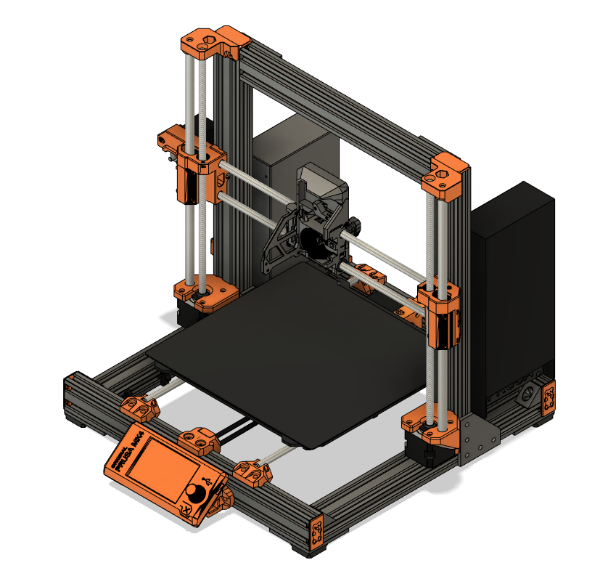
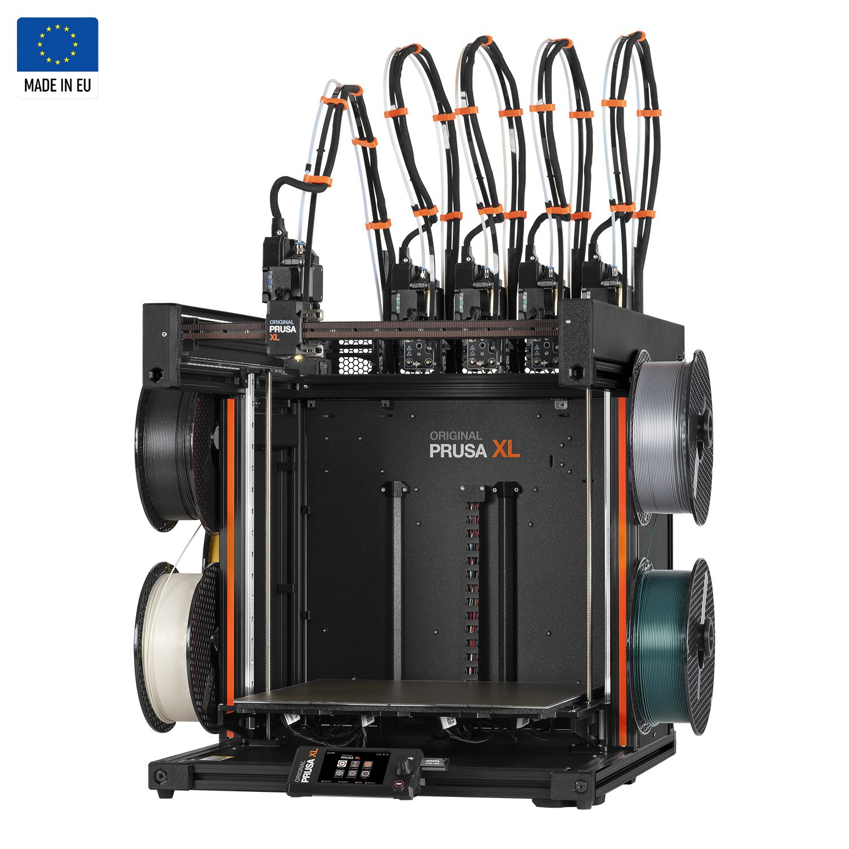
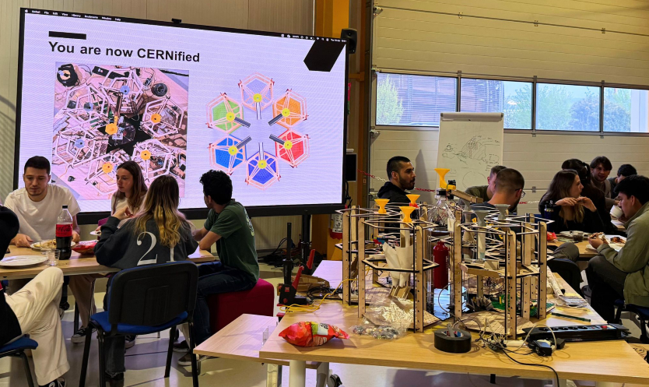
In the pipelines
I2Planet Prototyping
Upgrades of existing printers
Prusa XL printer
Make-A-Thon
Notes:
Explain Make-A-Thon
Bring the skeleton

Slide 6
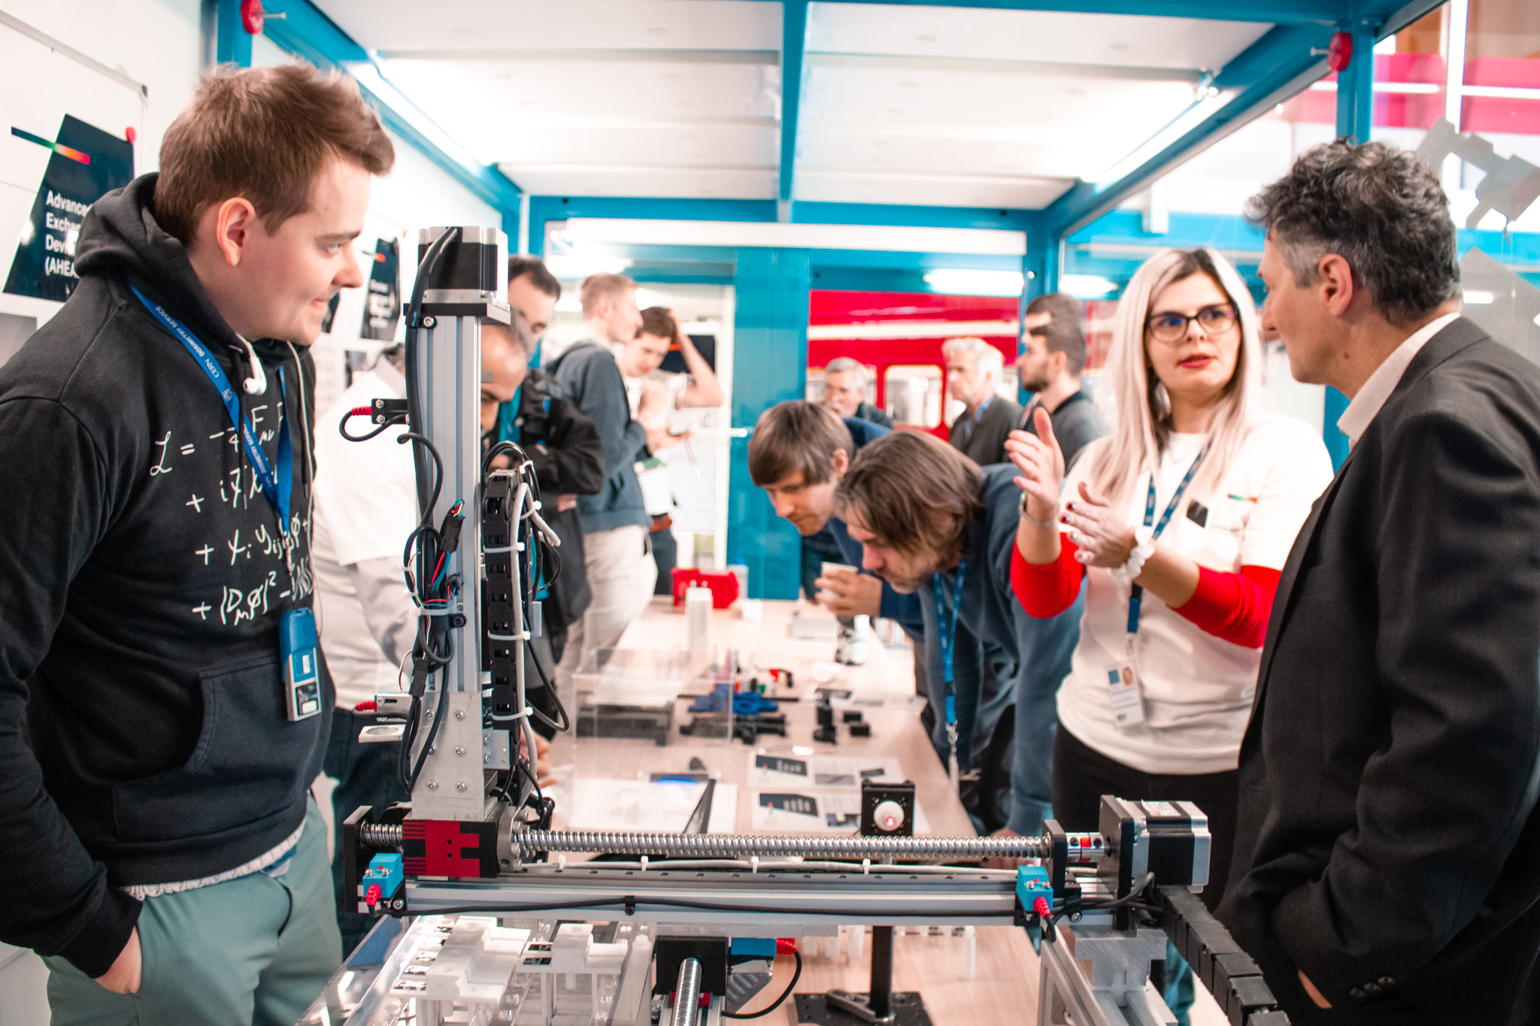
The Future of Prototyping at IdeaSquare
Rapid Prototyping Facility for CERN that can offer unique machines and expertise
At the forefront of Prototyping Methologies in collaboration with Design Factory Global Network
Connecting CERN through workshops and collaboration

Slide 7
Thank you!

