Slide 1
IdeaSquare
Finance, projects & outlook
27/06/2024

Slide 2
IdeaSquare finance & projects
ID2 resource manager (ad-interim)
  Roy Pennings (for Markus Nordberg)
EU-projects driver
  Roy Pennings
Finance & EU project implementation support
  Laetitia Pedroso
Project development collaborators
  Lauri Valtonen (concepts - science)
  Catarina Batista (concepts - training)
  Ole Werner (concepts - SSH)
  Dina Zimmermann (concepts)
  Jimmy Pouillon (dissemination)
  Pablo Garcia Tello (Call identification, general brainstorming)
EU project capacity building

Slide 3
Why are we here?
Finance: monitoring & maintaining financial stability of ID2!
  building internal capacity (project management)
  support in expanding service & training portfolio.
Projects: main instrument to maintain financial stability for ID2!
  show relevance to CERN (training & workshops via ID2 + direct science support).
Notes:
Three bullet points max.
What does it mean that we do/What does our role mean? I2 strategy and in general.
• Uniting people from all over the world to push the frontiers of science and technology, for the benefit of all.
• Training new generations of physicists, engineers, and technicians, and engaging citizens in research and in the values of science.
IdeaSquare’s wants to become a global reference facility dedicated to the development and implementation of transformative educational and training programs to address complex social problems in a sustainable and inclusive way.
The first value is a spirit of openness and collaboration. IdeaSquare fosters an environment where transparency and teamwork are paramount, encouraging the free exchange of ideas and collective problem solving.
Embracing diversity is another cornerstone value of IdeaSquare strategy. By welcoming individuals from all social, cultural, and geographic backgrounds, as well as from all educational disciplines and levels of experience
Questioning the status quo.
The physical space of IdeaSquare is designed to be an open and collaborative environment. This openness is essential in fostering a culture of transparency and mutual respect, where ideas can be freely exchanged and tested. --- Unique opportunity for open and collaborative research and subsequent discussion.
open and proactive communication and outreach activities.

Slide 4
Now and then: 2023-2024
Status 2023 | Status 2024
Expenditure: CHF 815K in salaries and remunerations + CHF 336K operational cost of running ID2. Most salaries (CHF 715K) booked on ATTRACT. | Expenditure remains roughly the same, however: 10-year anniversary costs (CHF 20k-30k). Need to increase useable space + improve inside air quality. General wear&tear (3d printers, toilets, outside area, etc.).
Contribution from CERN budget: CHF 200k. | Contribution from CERN budget: CHF 0. Available budget (June): CHF 610k (incl. carry-forward + received MISK-part 1). Total expenditure status to-date: CHF 106k spent + CHF 125k committed. Reserves: CHF 604K from MISK (302K already included in budget; 302K to 2025 budget).
Staffing increased by 3 persons (Lauri, Giulia, Roy). Markus went on holiday. | Staffing unchanged (current end-of-term contracts were extended). We cannot claim Markus’ retirement as ‘savings’ from IPT. ID2 salaries in process of being fully booked on ATTRACT2.
Finances = ‘in control’ | Finances = ‘in control’, but CERN budget refusal is hurting us. Also: uncertainty about ATTRACT 1b, and failure to secure EU funding thus far.
GV proposal failed, due to inaccurate evaluation. Re-evaluation resulted in apology from EC, but no money. ‘ATTRACT-type’ proposal failed due to EC-internal miscommunication. 1 direct collaboration (ongoing) | Many GV proposals submitted; most as partner. GV proposals with non-CERN coordinator all failed thus far. 2 proposals submitted as coordinator. 1 failed. 1 in evaluation (Sept.) 2 new proposals (coordination) in preparation (1 of which with KT). 2 direct collaborations (ongoing)

Slide 5
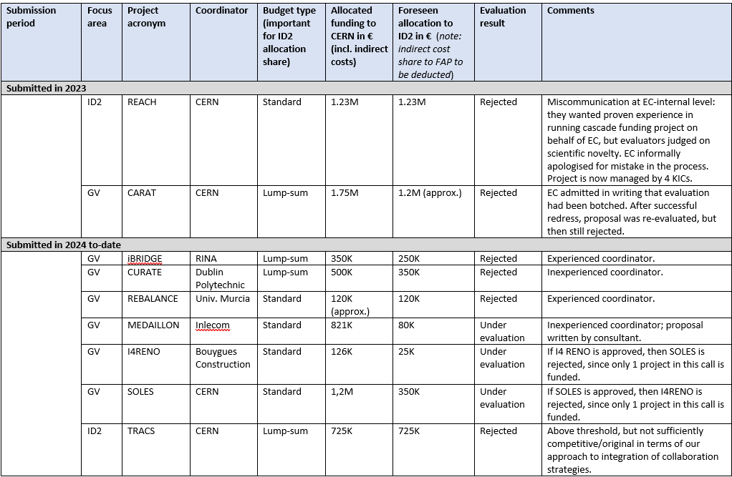
2023-2024 proposals (1)
Considerations for selection:
ID2 proposals:
Strengthen financial position in ‘most direct manner’ possible.
GV proposals:
Build momentum and references.
Create visibility inside CERN.
Support CERN policy w.r.t. member states or network (examples: CURATE, IN4RENO, AirInMotion).

Slide 6
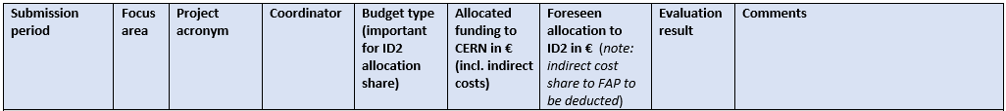
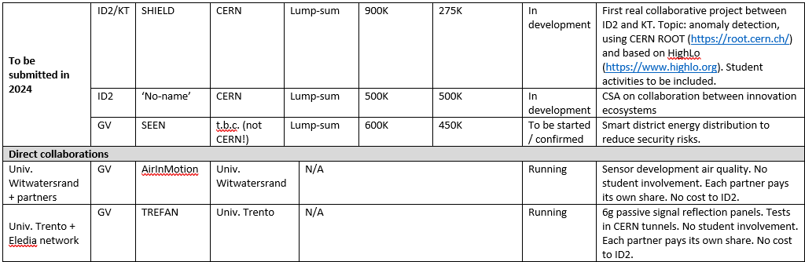
2023-2024 proposals (2)

Slide 7
The playing field has changed!
CERN annual contribution: We received 0.
ATTRACT 2: this is the cork that floats ID2. Project is coming to an end. We will submit extension request to June 2025, but not yet confirmed.
ATTRACT 1b: this is the ‘new cork’ until we win EU-projects. We are waiting to hear if the project can start or is cancelled.
EU projects: Initial batch of proposals failed for various reasons (see previous slides). Currently the number of Calls is limited until new Work Programmes are released.
GV projects: Strategy 2023-2024 does not work; modification to be implemented (see other slide for details).
Notes:
Three bullet points max.
What does it mean that we do/What does our role mean? I2 strategy and in general.
• Uniting people from all over the world to push the frontiers of science and technology, for the benefit of all.
• Training new generations of physicists, engineers, and technicians, and engaging citizens in research and in the values of science.
IdeaSquare’s wants to become a global reference facility dedicated to the development and implementation of transformative educational and training programs to address complex social problems in a sustainable and inclusive way.
The first value is a spirit of openness and collaboration. IdeaSquare fosters an environment where transparency and teamwork are paramount, encouraging the free exchange of ideas and collective problem solving.
Embracing diversity is another cornerstone value of IdeaSquare strategy. By welcoming individuals from all social, cultural, and geographic backgrounds, as well as from all educational disciplines and levels of experience
Questioning the status quo.
The physical space of IdeaSquare is designed to be an open and collaborative environment. This openness is essential in fostering a culture of transparency and mutual respect, where ideas can be freely exchanged and tested. --- Unique opportunity for open and collaborative research and subsequent discussion.
open and proactive communication and outreach activities.

Slide 8
The playing field has changed!
‘Worst case’ scenario end-2025:
If ATTRACT1b cancelled.
If no new EU funding.
If running costs ‘as-is’.
But assuming that ATTRACT2 can be extended.
Mitigation:
CERN Dynamic Fund (being investigated).
CERN central funding.
HEU projects!
Reduction of running cost + trim to core-activities.
ATTRACT successor (FP10).
Notes:
Three bullet points max.
What does it mean that we do/What does our role mean? I2 strategy and in general.
• Uniting people from all over the world to push the frontiers of science and technology, for the benefit of all.
• Training new generations of physicists, engineers, and technicians, and engaging citizens in research and in the values of science.
IdeaSquare’s wants to become a global reference facility dedicated to the development and implementation of transformative educational and training programs to address complex social problems in a sustainable and inclusive way.
The first value is a spirit of openness and collaboration. IdeaSquare fosters an environment where transparency and teamwork are paramount, encouraging the free exchange of ideas and collective problem solving.
Embracing diversity is another cornerstone value of IdeaSquare strategy. By welcoming individuals from all social, cultural, and geographic backgrounds, as well as from all educational disciplines and levels of experience
Questioning the status quo.
The physical space of IdeaSquare is designed to be an open and collaborative environment. This openness is essential in fostering a culture of transparency and mutual respect, where ideas can be freely exchanged and tested. --- Unique opportunity for open and collaborative research and subsequent discussion.
open and proactive communication and outreach activities.

Slide 9
Financial status 2024-2026
Observations:
ATTRACT 2 MUST be extended by 6 months to June 2025, so salaries can kept away from ID2-internal budget.
ATTRACT 1b MUST become operational. Otherwise, we cannot cover costs from Q3-2025^{(*)}. If operational, then risk is limited to running costs.
If GV SOLES is funded but ATTRACT 1b is lost, then we can remain afloat until mid/end 2026 (assuming transfer of funding from SCE). Other GV EU projects (in evaluation) cannot compensate for loss of ATTRACT1b.
Despite clear demand and need, ID2 building extension has moved out of view!
Operational costs must be trimmed in any case! But we need CERN contribution to help pay for operational costs. We cannot keep doing it alone! Funding (>200K) should restart in 2025 to provide some form of financial stability.
EU project participation must be (further) ramped up, but strategy must include non-GV (anything that supports student training!). Comfort is ‘in the number of high-quality applications’.
(*) IPT would still cover contractual obligations, but many current employment contracts end in 2025. This scenario would canibalise core aims and activities of ID2.
Notes:
Three bullet points max.
What does it mean that we do/What does our role mean? I2 strategy and in general.
• Uniting people from all over the world to push the frontiers of science and technology, for the benefit of all.
• Training new generations of physicists, engineers, and technicians, and engaging citizens in research and in the values of science.
IdeaSquare’s wants to become a global reference facility dedicated to the development and implementation of transformative educational and training programs to address complex social problems in a sustainable and inclusive way.
The first value is a spirit of openness and collaboration. IdeaSquare fosters an environment where transparency and teamwork are paramount, encouraging the free exchange of ideas and collective problem solving.
Embracing diversity is another cornerstone value of IdeaSquare strategy. By welcoming individuals from all social, cultural, and geographic backgrounds, as well as from all educational disciplines and levels of experience
Questioning the status quo.
The physical space of IdeaSquare is designed to be an open and collaborative environment. This openness is essential in fostering a culture of transparency and mutual respect, where ideas can be freely exchanged and tested. --- Unique opportunity for open and collaborative research and subsequent discussion.
open and proactive communication and outreach activities.

Slide 10
Financial survival strategy (1)
EU project coordination
Main source of income
2. Executive Training programmes
Supportive income
3. Reduction of running costs
Ad 1: training-related projects
Project coordination (7% of funding)
Direct costs (18%-20% of funding)
Indirect costs (25% of direct costs * 25%)
Actions:
Keep ATTRACT 2 running (extension by 6 months).
Keep ATTRACT 1b alive.
Submit at least 2 more proposals in 2024 and 4 in 2025, but dependent on Call availability. We are scouting new draft programmes across all HEU Pillars.
Any programme, any Call!
Notes:
Three bullet points max.
What does it mean that we do/What does our role mean? I2 strategy and in general.
• Uniting people from all over the world to push the frontiers of science and technology, for the benefit of all.
• Training new generations of physicists, engineers, and technicians, and engaging citizens in research and in the values of science.
IdeaSquare’s wants to become a global reference facility dedicated to the development and implementation of transformative educational and training programs to address complex social problems in a sustainable and inclusive way.
The first value is a spirit of openness and collaboration. IdeaSquare fosters an environment where transparency and teamwork are paramount, encouraging the free exchange of ideas and collective problem solving.
Embracing diversity is another cornerstone value of IdeaSquare strategy. By welcoming individuals from all social, cultural, and geographic backgrounds, as well as from all educational disciplines and levels of experience
Questioning the status quo.
The physical space of IdeaSquare is designed to be an open and collaborative environment. This openness is essential in fostering a culture of transparency and mutual respect, where ideas can be freely exchanged and tested. --- Unique opportunity for open and collaborative research and subsequent discussion.
open and proactive communication and outreach activities.

Slide 11
Financial survival strategy (2)
Ad 2: Green Village projects
Project coordination
7% for PM + direct costs (18%-20% of funding) + indirect costs (25% of direct costs * 25%)
Always include student training (=direct costs)
Project participations
Original strategy does not work: if funded, too little money into ID2 for project management.
Sole focus on lump-sum:
  Projects are pre-approved by SCE and focus on activities that SCE already has budget for.
  SCE transfers their ‘direct project costs’ (effort) as contribution to ID2. SCE keeps (part of) materials budget.
  Where possible, we include student training element to emphasize ‘content link’ to ID2, but this is not always possible since projects come from external consortia.
Drawback: we are dependent on quality of external consortium to write winning proposals.
  Our time investment = limited. We just provide service.
  Visibility problem to CERN: people may not understand that that the strategy accepts many proposal rejections.

Slide 12
Financial survival strategy (3)
Ad 3: Reduction of ID2 running costs
Reduce representation (hosting of CERN workshops, CERN prototyping, building EU projects etc.) CHF 97K ^{(*)}
Reduce networking (Brussels lobby, SB contracts, consulting etc.) CHF 110K
No refurbishments in 2024/2025, except for updates/upgrades of 3d printers.
Assess if/what universities are willing to contribute to educational programmes.
Re-assess activities of ID2?
Reduction by at least 70% to CHF 30K
Reduction by at least 70% to CHF 33K
…
=> Immediate trimming from CHF 360K - 400K to CHF 200K annual costs (as baseline/minimum).
^{(*)} Actual expenditure 2023
Notes:
• Uniting people from all over the world to push the frontiers of science and technology, for the benefit of all.
• Training new generations of physicists, engineers, and technicians, and engaging citizens in research and in the values of science.
IdeaSquare’s wants to become a global reference facility dedicated to the development and implementation of transformative educational and training programs to address complex social problems in a sustainable and inclusive way.
The first value is a spirit of openness and collaboration. IdeaSquare fosters an environment where transparency and teamwork are paramount, encouraging the free exchange of ideas and collective problem solving.
Embracing diversity is another cornerstone value of IdeaSquare strategy. By welcoming individuals from all social, cultural, and geographic backgrounds, as well as from all educational disciplines and levels of experience
Questioning the status quo.
The physical space of IdeaSquare is designed to be an open and collaborative environment. This openness is essential in fostering a culture of transparency and mutual respect, where ideas can be freely exchanged and tested. --- Unique opportunity for open and collaborative research and subsequent discussion.
open and proactive communication and outreach activities.

Slide 13
Pipeline: 2025-2026
Activity | Objective/task
Build pressure inside CERN for CERN funding. | Record and highlight costs that should be covered by IPT/management. Highlight ID2 public visibility.
Start of SOLES, MEDAILLON. | If funded: operationalise costs. Build delivery capacity.
Expand direct project collaborations (non- funded). | Find new collaboration partners.
Submit SHIELD, project X. in 2024 | Build pipeline of new funding opportunities, using revised strategy (for GV + other programmes).
Reorient target Calls for EU funding. | Emphasis on any Calls with strong student focus. Scout new draft Work Programmes.
Build more visibility for GV. | More exposure in ECTP. Only Lump-sum calls + student training.
Financially support ‘face-lift’ of ID2. | Interaction with SCE, Nagoya Univ.; build budgets/reserves.
Notes:
Activities planned for the near future. Their link to strategy objective.
What does it mean that we do/What does our role mean? I2 strategy and in general.
• Uniting people from all over the world to push the frontiers of science and technology, for the benefit of all.
• Training new generations of physicists, engineers, and technicians, and engaging citizens in research and in the values of science.
IdeaSquare’s wants to become a global reference facility dedicated to the development and implementation of transformative educational and training programs to address complex social problems in a sustainable and inclusive way.
The first value is a spirit of openness and collaboration. IdeaSquare fosters an environment where transparency and teamwork are paramount, encouraging the free exchange of ideas and collective problem solving.
Embracing diversity is another cornerstone value of IdeaSquare strategy. By welcoming individuals from all social, cultural, and geographic backgrounds, as well as from all educational disciplines and levels of experience
Questioning the status quo.
The physical space of IdeaSquare is designed to be an open and collaborative environment. This openness is essential in fostering a culture of transparency and mutual respect, where ideas can be freely exchanged and tested. --- Unique opportunity for open and collaborative research and subsequent discussion.
open and proactive communication and outreach activities.

Slide 14
Financial challenges beyond 2026
Creating more training space (inside/outside) for students.
Ramping up I2P (pilots, events, materials, features).
More students = more training costs (materials, wear&tear)
Expansion of 3-d printing/laser cutting.
Re-stocking of mechanical shop and electrical shop.
Improving inside air quality.
Reserving money for replacement of standard equipment (kitchen, AV, tables, chairs, floors, …).
General wear & tear (to be discussed with SCE).
Notes:
Three bullet points max.
What does it mean that we do/What does our role mean? I2 strategy and in general.
• Uniting people from all over the world to push the frontiers of science and technology, for the benefit of all.
• Training new generations of physicists, engineers, and technicians, and engaging citizens in research and in the values of science.
IdeaSquare’s wants to become a global reference facility dedicated to the development and implementation of transformative educational and training programs to address complex social problems in a sustainable and inclusive way.
The first value is a spirit of openness and collaboration. IdeaSquare fosters an environment where transparency and teamwork are paramount, encouraging the free exchange of ideas and collective problem solving.
Embracing diversity is another cornerstone value of IdeaSquare strategy. By welcoming individuals from all social, cultural, and geographic backgrounds, as well as from all educational disciplines and levels of experience
Questioning the status quo.
The physical space of IdeaSquare is designed to be an open and collaborative environment. This openness is essential in fostering a culture of transparency and mutual respect, where ideas can be freely exchanged and tested. --- Unique opportunity for open and collaborative research and subsequent discussion.
open and proactive communication and outreach activities.

Slide 15
Please ask questions
Notes:
Three bullet points max.
What does it mean that we do/What does our role mean? I2 strategy and in general.
• Uniting people from all over the world to push the frontiers of science and technology, for the benefit of all.
• Training new generations of physicists, engineers, and technicians, and engaging citizens in research and in the values of science.
IdeaSquare’s wants to become a global reference facility dedicated to the development and implementation of transformative educational and training programs to address complex social problems in a sustainable and inclusive way.
The first value is a spirit of openness and collaboration. IdeaSquare fosters an environment where transparency and teamwork are paramount, encouraging the free exchange of ideas and collective problem solving.
Embracing diversity is another cornerstone value of IdeaSquare strategy. By welcoming individuals from all social, cultural, and geographic backgrounds, as well as from all educational disciplines and levels of experience
Questioning the status quo.
The physical space of IdeaSquare is designed to be an open and collaborative environment. This openness is essential in fostering a culture of transparency and mutual respect, where ideas can be freely exchanged and tested. --- Unique opportunity for open and collaborative research and subsequent discussion.
open and proactive communication and outreach activities.

