Slide 1
World-Wide Fundamental Power Coupler meeting #6
eric.montesinos@cern.ch
Welcome & Introduction
WWFPC #6 meeting Indico

Slide 2


















Thank you very much for coming !
 | CERN | Eric Montesinos
 | DESY | Denis Kostin
 | KEK | Yasuchika Yamamoto
 | FNAL | Sergey Kazakov
 | RIKEN | Kazutaka Ozeki
 | IHEP | Tong ming Huang
 | BNL | Wencan Xu
 | IBS | Junyoung Yoon
 | CEA | Guillaume Devanz
 | JLAB | Mircea Stirbet
 | HZB | Emmy Sharples
 | IMP | Guochang Liu
 | PKU | Fang Wang
 | F4E | Fabio Cismondi
 | QST | Andrea De Franco
 | BARC | Rajesh Kumar
 | ORNL | John Mamosser
 | INFN | Luca Bellan
 | IARC | Joshua Helsper
 | INFN | Francesco Grespan

Slide 3
Why this WWFPC meeting and its goals
Why?
To share information on FPC during a dedicated event with people focused on this topic
Goal ?
To setup a worldwide community in order to exchange information
To setup collaborations if though useful

Slide 4
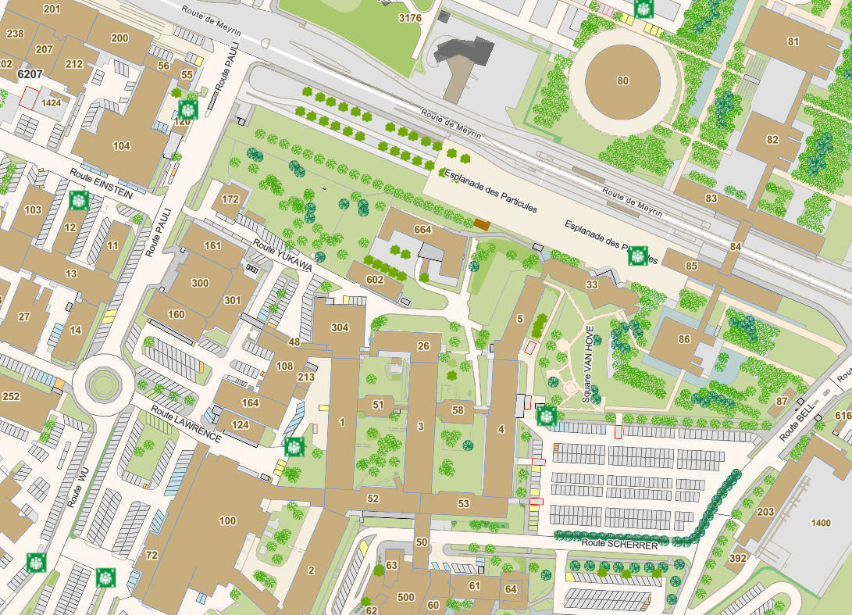
General information
Day 1
  09:00 Place des Particules + CERN access cards
  Join meeting room 1/1-025
  09:30 to 12:00 presentations
  12:00 to 13:30 Lunch at the CERN Main Restaurant
  14:00 to 17:00 presentations
  Tram to Geneva
  Restaurant de l’Hôtel-de-ville (Fondue Suisse)
  Bar en terrasse La Clémence

Slide 5
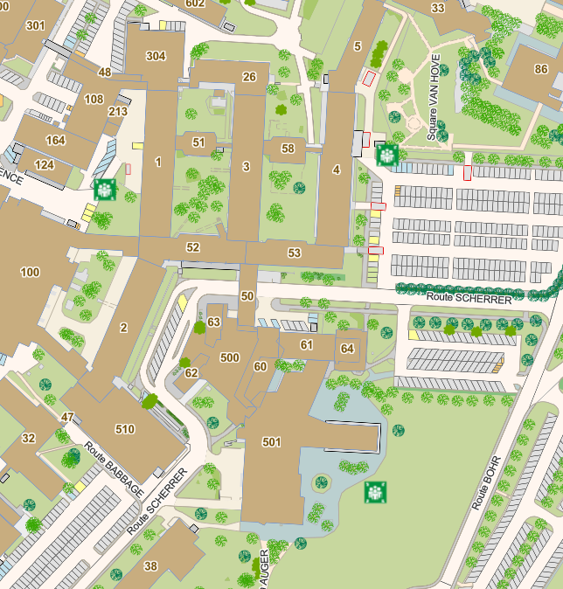
General information
Day 1
  09:00 Place des Particules + CERN access cards
  Join meeting room 1/1-025
  09:30 to 12:00 presentations
  12:00 to 13:30 Lunch at the CERN Main Restaurant
  14:00 to 17:00 presentations
  Tram to Geneva
  Restaurant de l’Hôtel-de-ville (Fondue Suisse)
  Bar en terrasse La Clémence

Slide 6
General information
Day 1
  09:00 Place des Particules + CERN access cards
  Join meeting room 1/1-025
  09:30 to 12:00 presentations
  12:00 to 13:30 Lunch at the CERN Main Restaurant
  14:00 to 17:00 presentations
  Tram to Geneva
  Restaurant de l’Hôtel-de-ville (Fondue Suisse)
  Bar en terrasse La Clémence

Slide 7
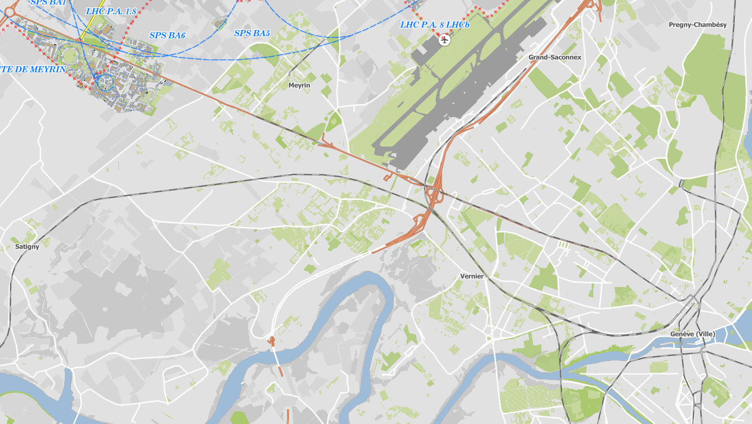
General information
Day 1
  09:00 Place des Particules + CERN access cards
  Join meeting room 1/1-025
  09:30 to 12:00 presentations
  12:00 to 13:30 Lunch at the CERN Main Restaurant
  14:00 to 17:00 presentations
  Tram to Geneva
  Restaurant de l’Hôtel-de-ville (Fondue Suisse)
  Bar en terrasse La Clémence

Slide 8
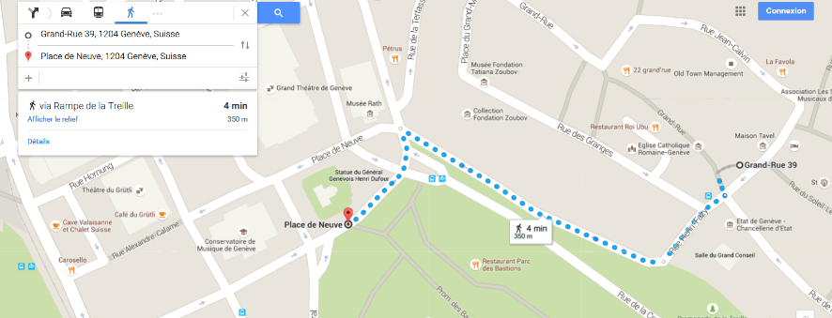
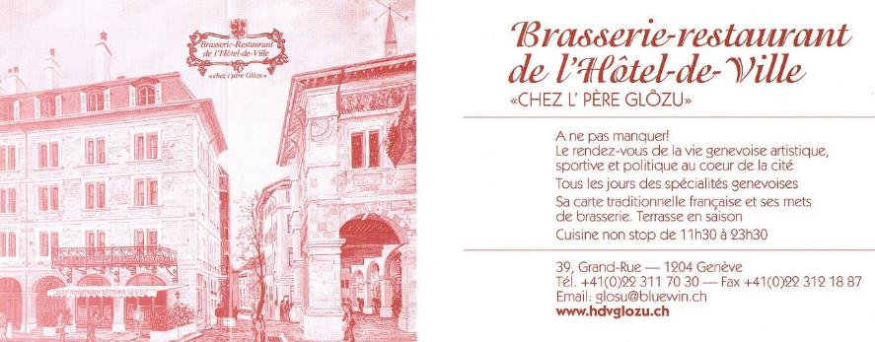
General information
Day 1
  09:00 Place des Particules + CERN access cards
  Join meeting room 1/1-025
  09:30 to 12:00 presentations
  12:00 to 13:30 Lunch at the CERN Main Restaurant
  14:00 to 17:00 presentations
  Tram to Geneva
  Restaurant de l’Hôtel-de-ville (Fondue Suisse)
  Bar en terrasse La Clémence

Slide 9
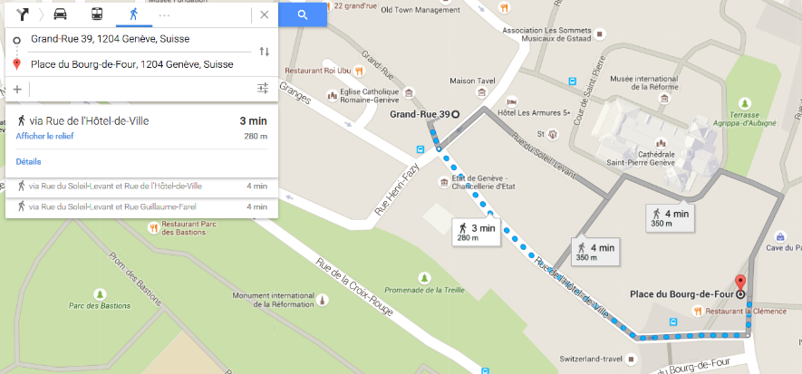
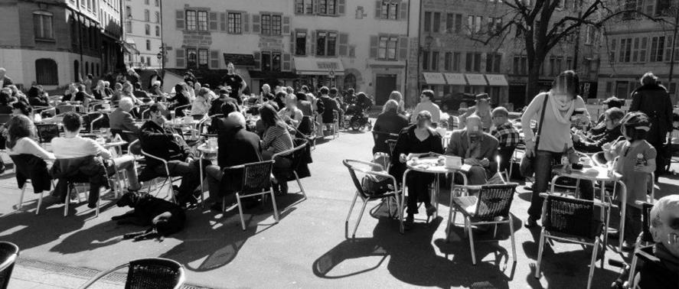
General information
Day 1
  09:00 Place des Particules + CERN access cards
  Join meeting room 1/1-025
  09:30 to 12:00 presentations
  12:00 to 13:30 Lunch at the CERN Main Restaurant
  14:00 to 17:00 presentations
  Tram to Geneva
  Restaurant de l’Hôtel-de-ville (Fondue Suisse)
  Bar en terrasse La Clémence

Slide 10
General information
Day 2
  09:00 Place des Particules
  Join meeting room 4/S-035
  09:00 to 12:30 presentations
  12:30 to 14:00 Lunch at the CERN Main restaurant
  14:00 to 16:00 presentations
  16:30 to 17:30 Visit of CERN’s Main workshop (100)

Slide 11
General information
Day 2
  09:00 Place des Particules
  Join meeting room 4/S-035
  09:00 to 12:30 presentations
  12:30 to 14:00 Lunch at the CERN Main restaurant
  14:00 to 16:00 presentations
  16:30 to 17:30 Visit of CERN’s Main workshop (100)

Slide 12
General information
Day 2
  09:00 Place des Particules
  Join meeting room 4/S-035
  09:00 to 12:30 presentations
  12:30 to 14:00 Lunch at the CERN Main restaurant
  14:00 to 16:00 presentations
  16:30 to 17:30 Visit of CERN’s Main workshop (100)

Slide 13
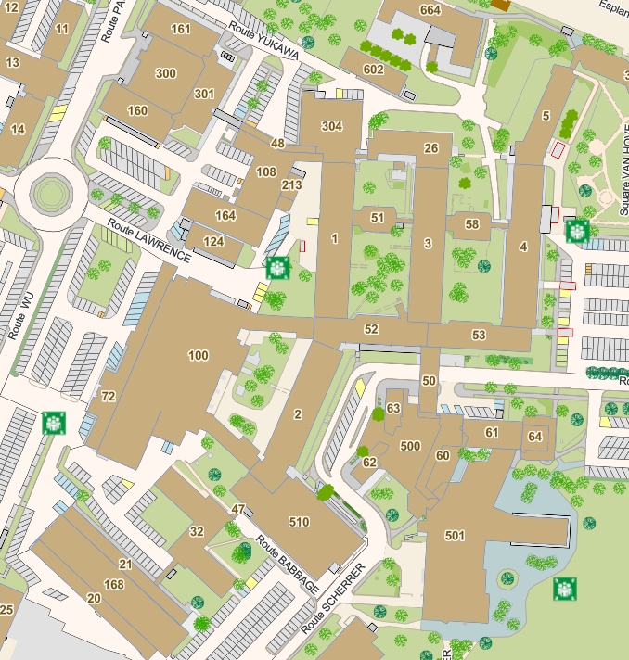
General information
Day 2
  09:00 Place des Particules
  Join meeting room 4/S-035
  09:00 to 12:30 presentations
  12:30 to 14:00 Lunch at the CERN Main restaurant
  14:00 to 16:00 presentations
  16:30 to 17:30 Visit of CERN’s Main workshop (100)

Slide 14
Thank you again for being here today !

