Slide 1
CERN FPC status and perspectives
eric.montesinos@cern.ch
On behalf of all colleagues involved in the topic
Thanks to all of them for the tremendous amount of work and for all the invaluable competencies provided!

Slide 2










Overview of the couplers built up to 2019 at CERN
2000
2005
2010
2015
2020
LHC
16
SPS 2
16
SPL 1
4
2
4
PERLE
LHC
SPL
SPL 2
Linac4
26
4
Crab DQW
2
ESRF
2
APS 1
2
Crab RFD
SOLEIL
4
ADAM
4
SPS LIU
24
APS 2
16
16
Operation
Crab 2
Design to spares (3-8 years)
LHC 2
FCC

Slide 3
Overview of the couplers built up to 2024 at CERN
2000
2005
2010
2015
2020
2025
LHC
16
SPS 2
16
SPL 1
4
4
4
PERLE
ISAS
LHC
SPL
SPL 2
Linac4
26
4
Crab DQW
2
ESRF
2
APS 1
2
Crab RFD
SOLEIL
4
ADAM
4
SPS LIU
24
APS 2
18
Crab 2
16
Operation
4
Design to spares (3-8 years)
LHC 2
FCC

Slide 4
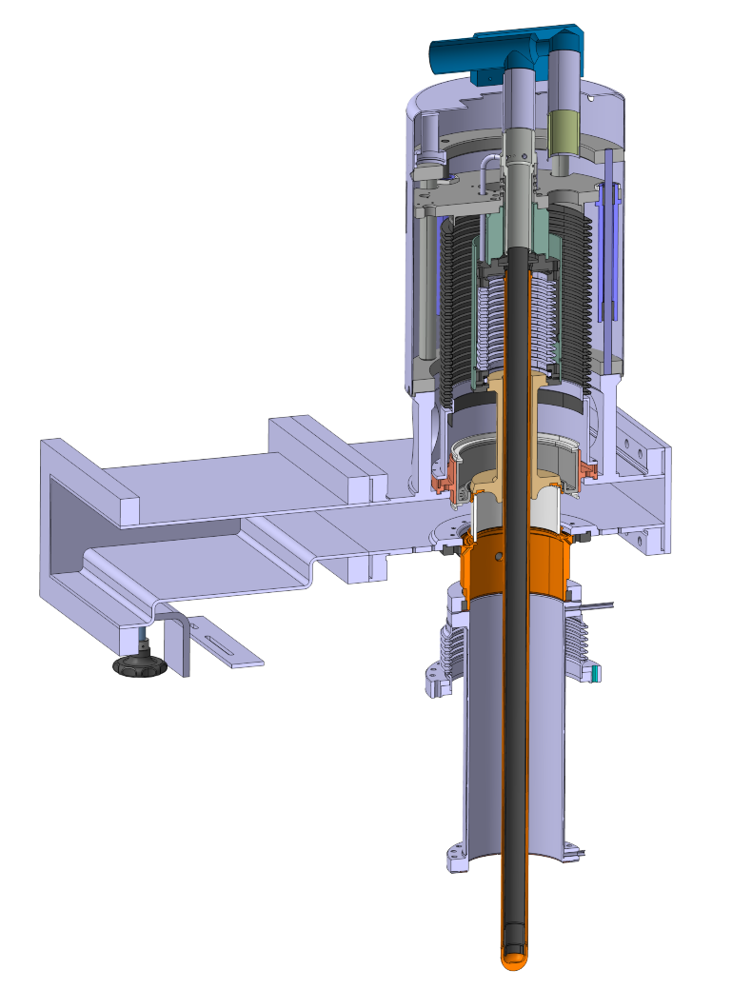
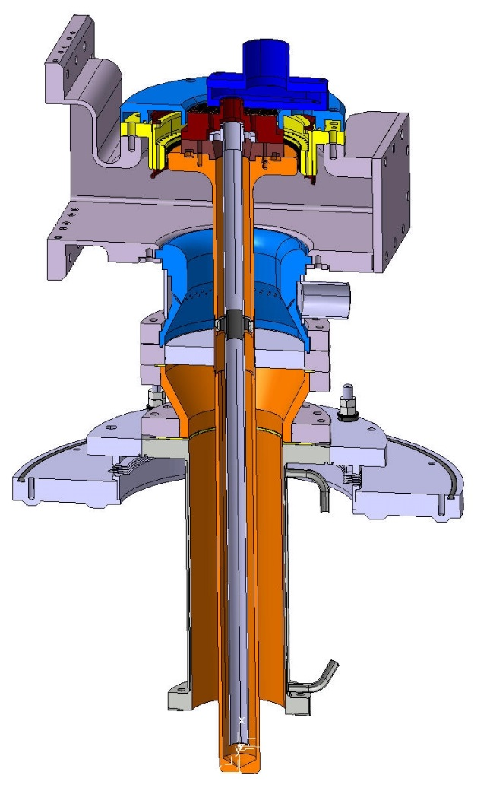
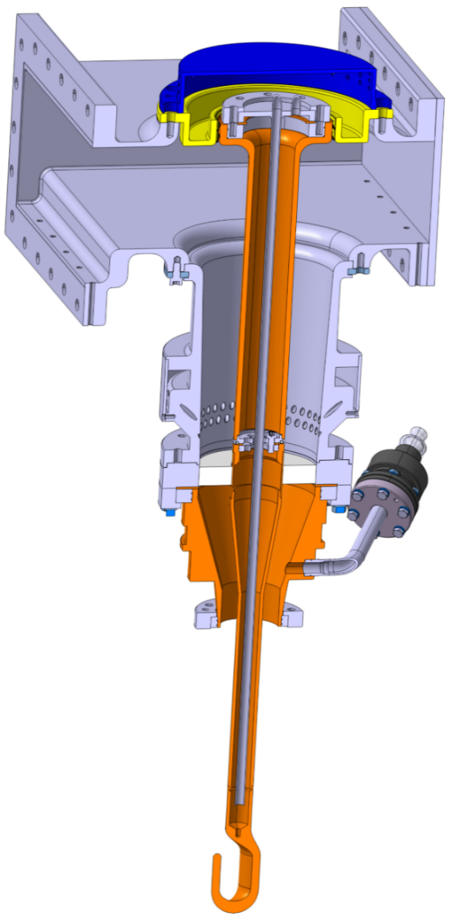
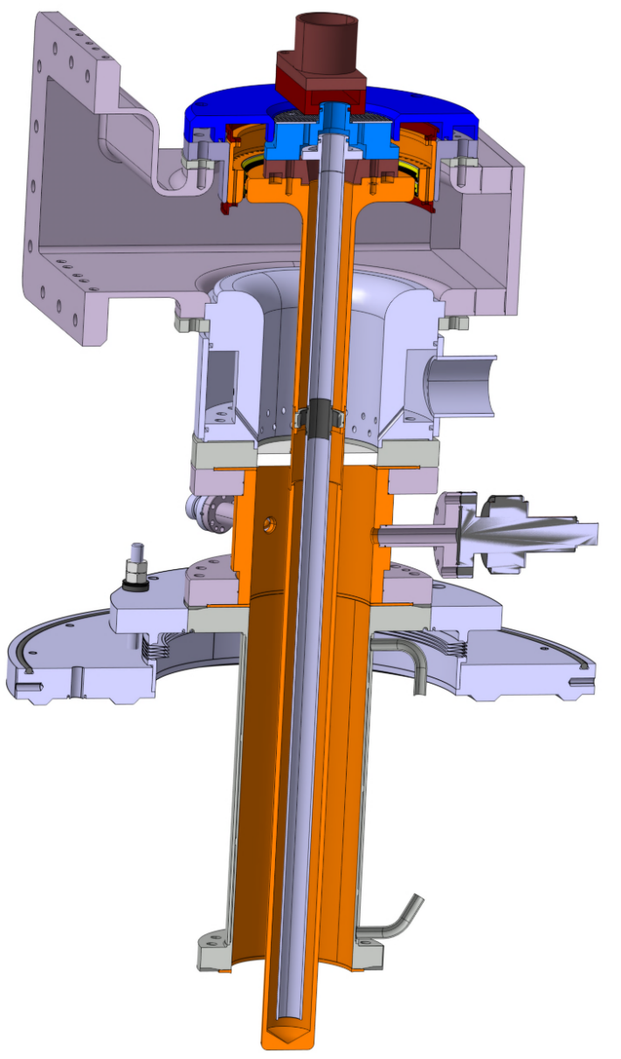
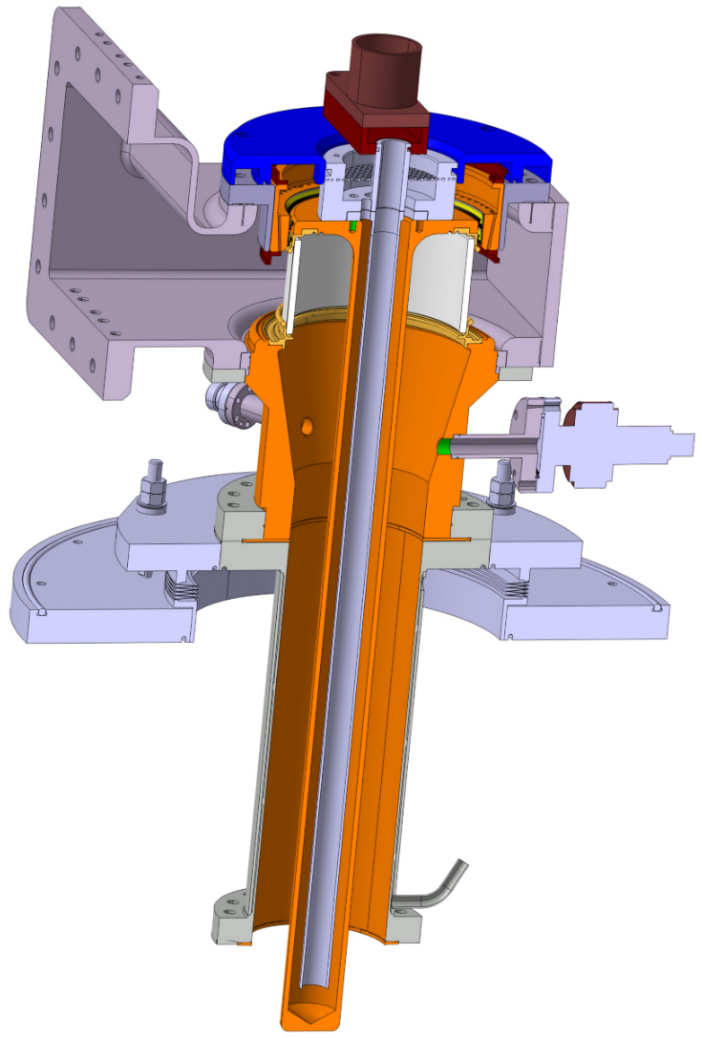
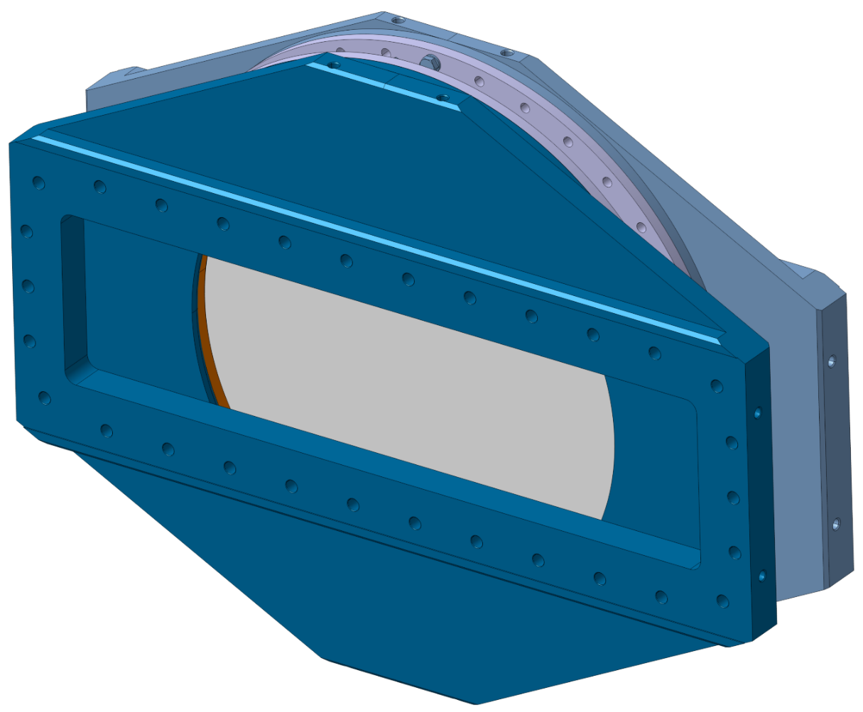


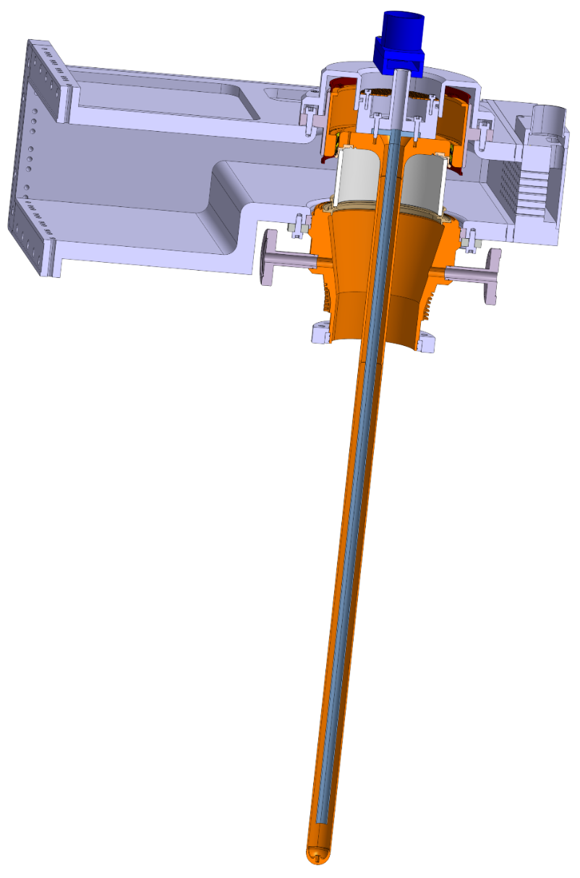
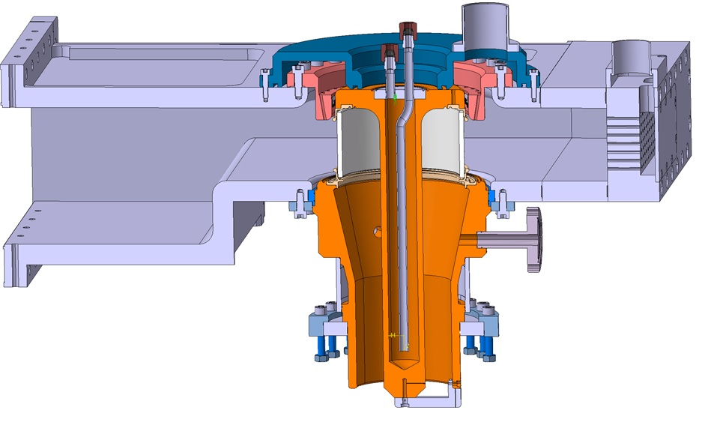




Overview of the CERN power couplers
LHC 400 MHz, 500 kW CW SW
SPS 2.0 200 MHz, 750 kW CW TW
SPL 2.0 704 MHz, 900 kWp 10 % SW
SPL 3.0 704 MHZ, 1000 kWp 10 % SW
Linac4 352 MHz, 1000 kWp 10 % SW
Crab DQW 400 MHz, 100 kW CW SW
Crab RFD 400 MHz, 100 kW CW SW
ESRF 352 MHz, 200 kW CW SW
SOLEIL 352 MHz, 200 kW CW SW
APS 1.0 352 MHz, 200 kW CW SW
SPS LIU 200 MHz, 800 kW CW TW
LHC 2.0 400 MHz, 500 kW CW SW
APS 2.0 352 MHz, 250 kW CW SW
FCC 400 MHz, 1 MW CW SW
FCC 800 MHz, 250 kW CW SW
LHC
SPL

Slide 5
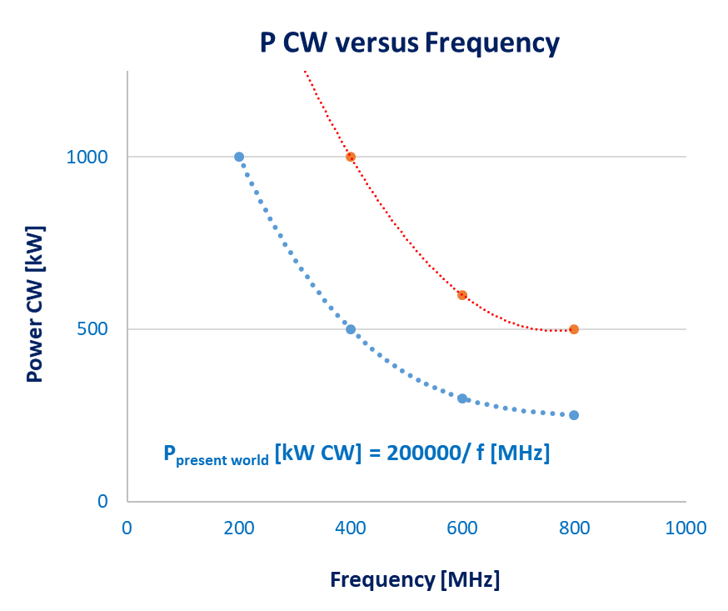
Overview of the CERN power couplers
LHC 400 MHz, 500 kW CW SW
SPS 2.0 200 MHz, 750 kW CW TW
SPL 2.0 704 MHz, 900 kWp 10 % SW
SPL 3.0 704 MHZ, 1000 kWp 10 % SW
Linac4 352 MHz, 1000 kWp 10 % SW
Crab DQW 400 MHz, 100 kW CW SW
Crab RFD 400 MHz, 100 kW CW SW
ESRF 352 MHz, 200 kW CW SW
SOLEIL 352 MHz, 200 kW CW SW
APS 1.0 352 MHz, 200 kW CW SW
SPS LIU 200 MHz, 800 kW CW TW
LHC 2.0 400 MHz, 500 kW CW SW
APS 2.0 352 MHz, 250 kW CW SW
FCC 400 MHz, 1 MW CW SW
FCC 800 MHz, 250 kW CW SW
P_{FCC} = 2 x P_{present world}

Slide 6
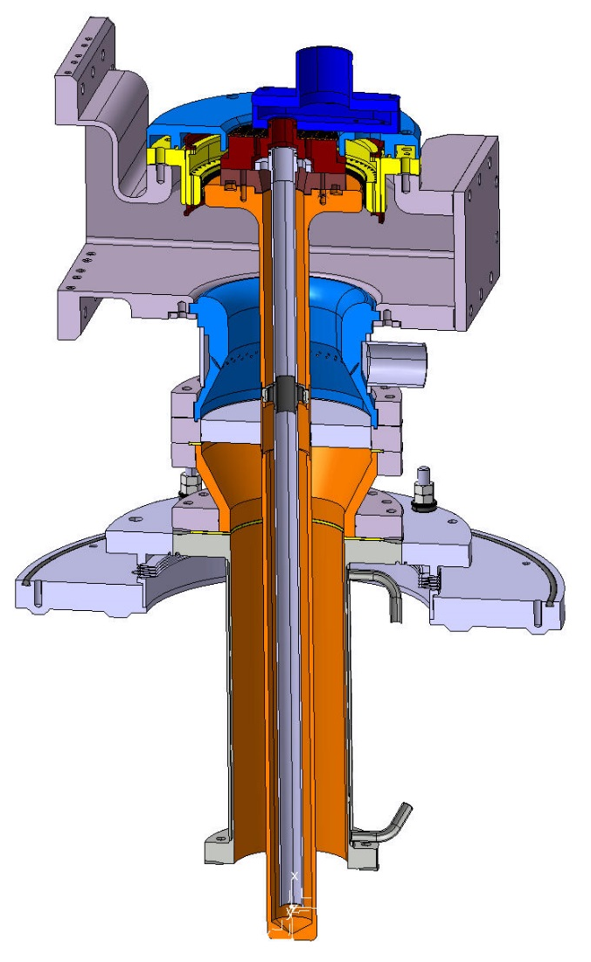
FPC design input parameters
Ceramics
  Ceramic material
  Metallization
  Window families
    Disk
    Cylindrical
    Coaxial disk
  Two windows
  Single window
  Solutions proposed
Antenna
  Adjustable coupler
  Antenna shape
Outer Antenna line
  Copper for RF
  Stainless steel
  Bad coating
  RF & vacuum seal
Protection of the FPC
Cryomodule integration
Orientation of the FPC
Inner antenna cooling
WG to coax
Multipacting
  Ti sputtering
  DC polarisation
Simulation and proposed solution
  Cylindrical Design
  Coaxial disk
  Disk
Construction
Clean room
  Clean process study
  Mock-ups
  Preparation for assembly
  Assembly in ISO 5
  Assembly in ISO 4
FPC test boxes
FPC test benches
  In clean room
  Resonant ring
RF conditioning
  Ceramic cracks
  Conditioning process
  VCA
  Pulses
  Ramping
  Repetition rate
  TW and SW mode
  Automated process
  Processing time
  Summary
First test results
  Arcing

Slide 7
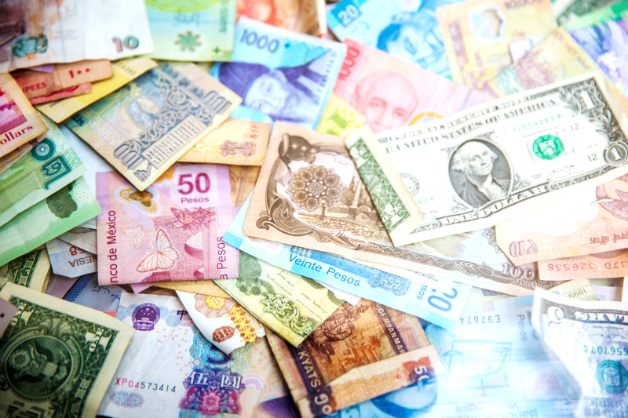
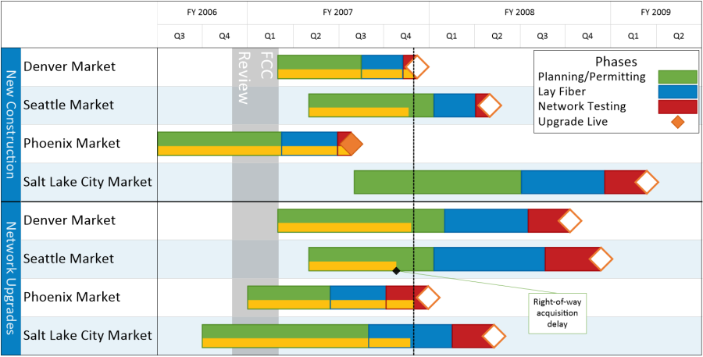
FPC design input parameters
Ceramics
  Ceramic material
  Metallization
  Window families
    Disk
    Cylindrical
    Coaxial disk
  Two windows
  Single window
Antenna
  Adjustable coupler
  Antenna shape
  Inner antenna cooling
RF conditioning
  Test boxes
  Conditioning process
  VCA
  Pulses
  Ramping
  Repetition rate
  TW and SW mode
  Automated process
  Processing time
Simulation and proposed solution
  Cylindrical Design
  Coaxial disk
  Disk
All parameters linked together and often conflicting
Cost
WG to coax
Protection of the FPC
Orientation of the FPC
Schedule
Construction
Multipacting
  Ti sputtering
  DC polarisation
Outer Antenna line
  Copper for RF
  Stainless steel
  Bad coating
  RF & vacuum seal
Cryomodule integration
Clean room
  Clean process study
  Mock-ups
  Preparation for assembly
  Assembly in ISO 5
  Assembly in ISO 4
FPC test benches
  In clean room
  Resonant ring

Slide 8
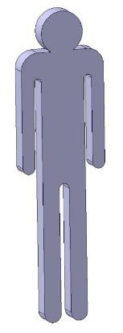
FTE (Full Time Equivalent)
Activities | FTE year
RF Design | 0.2
Mechanical Design | 1.8
Raw material | 0.05
External machining pilot | 0.5
Internal machining | 1.0
Surface treatments | 0.1
Brazing | 0.2
Titanium sputtering | 0.1
BE welding | 0.1
Metrology | 0.05
Assembly | 0.5
Vacuum tests | 0.1
RF Conditioning | 0.5
Clean room assembly | 0.8
Total | 6.0
With Respect to FPC, at CERN, since 2000’s,
almost everything, is done in-house

Slide 9
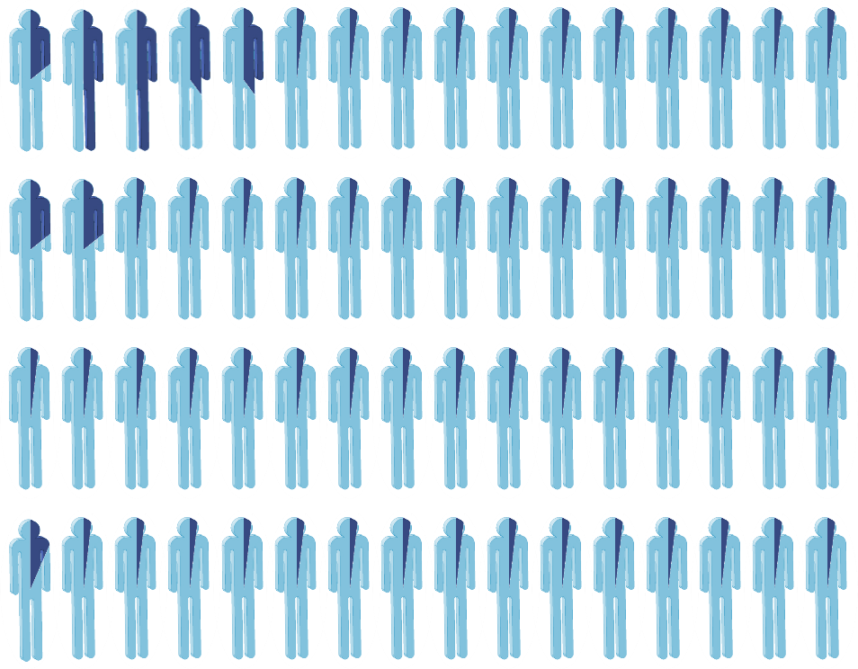
FTE (Full Time Equivalent)
Activities | FTE year
RF Design | 0.2
Mechanical Design | 1.8
Raw material | 0.05
External machining pilot | 0.5
Internal machining | 1.0
Surface treatments | 0.1
Brazing | 0.2
Titanium sputtering | 0.1
BE welding | 0.1
Metrology | 0.05
Assembly | 0.5
Vacuum tests | 0.1
RF Conditioning | 0.5
Clean room assembly | 0.8
Total | 6.0
At CERN, more than 60 experts working (very) part time on the topic

Slide 10
LIU-SPS
LHC Injector Upgrade program of the CERN’ Super Proton Synchrotron
Warm Travelling Wave Cavity
200 MHz
750 kW CW TW
1 MW pulsed 12 µs at 43 kHz (23.2 µs), i.e. 51.6 % average, 516 kW average
5 MHz bandwidth minimum
Two couplers per side (two input couplers and two output couplers)
  375 kW CW, 500 kWp per window

Slide 11
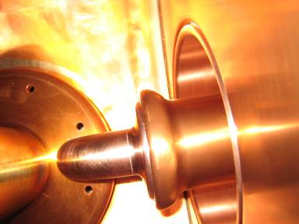
LIU-SPS
For high power RF, the identified weak point of the previous two versions was the connection to the cavity
  V1 designed for 375 kW CW / 2 = 200 kW CW
  V2 designed for 600 kW CW / 2 = 300 KW CW + 800 kWp / 2 = 400 kWp
Indeed, it was using a spiral contact that would have not been able to allow higher average power

Slide 12
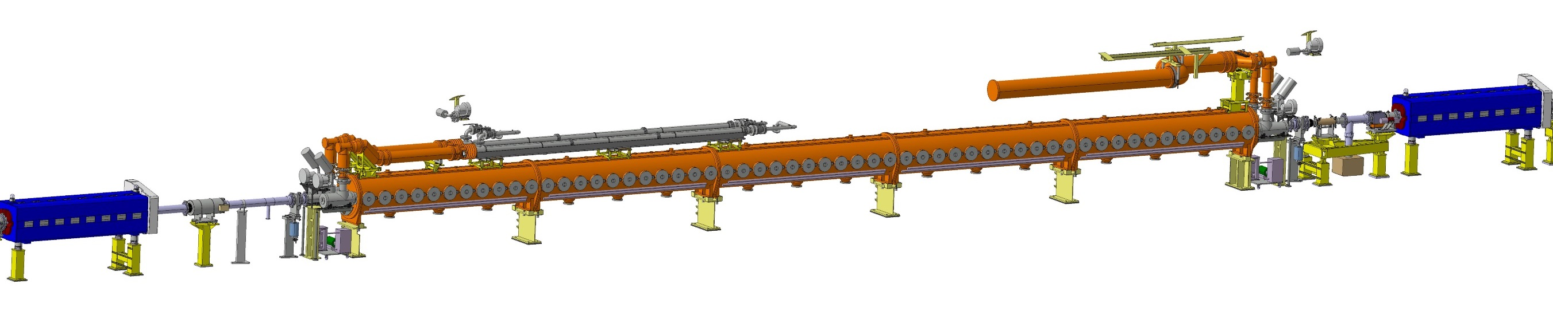
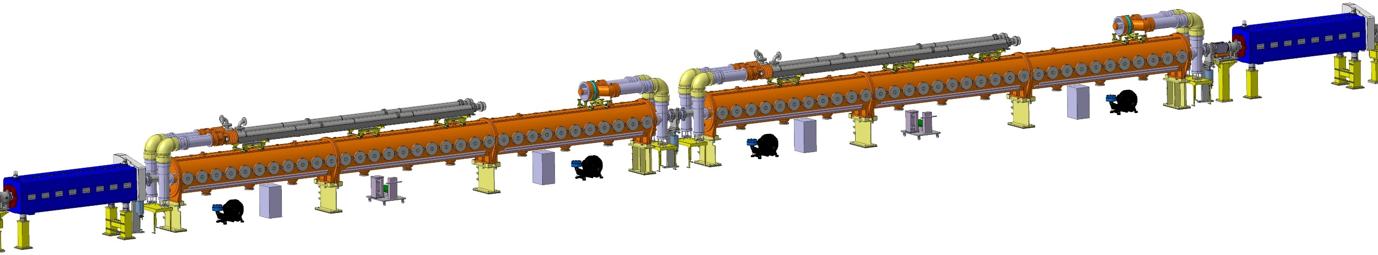
SPS to LIU-SPS
2x 300 kW
(2x 400 kWp)
2x 300 kW
(2x 400 kWp)
2x 400 kW
(2x 500 kWp)
2x 400 kW
(2x 500 kWp)
2x 400 kW
(2x 500 kWp)
2x 400 kW
(2x 500 kWp)
As more cavities, from 16 to 24 FPCs

Slide 13
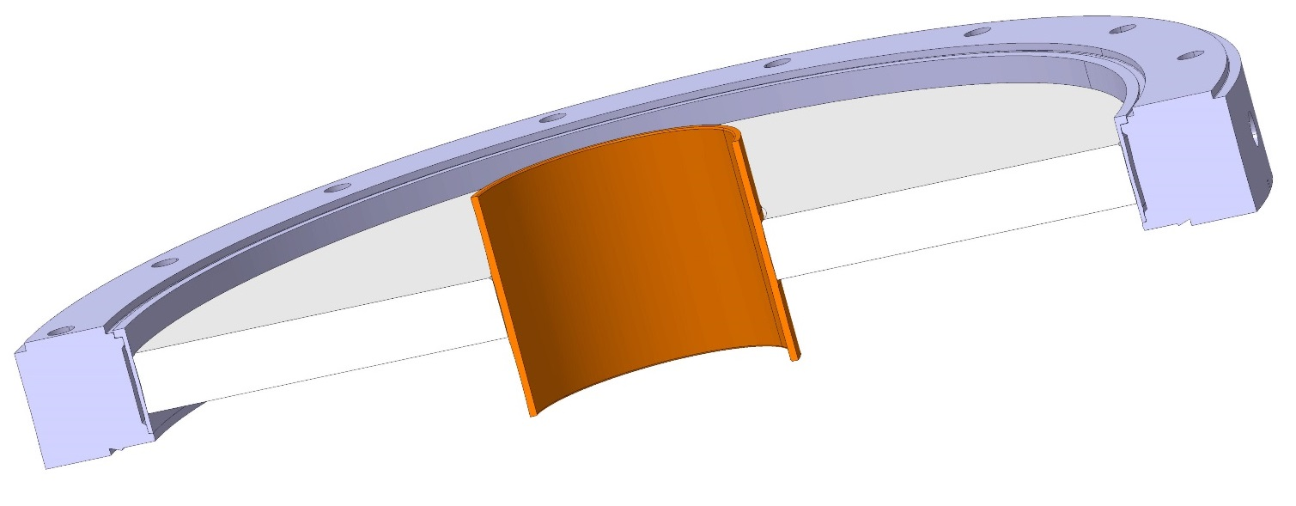
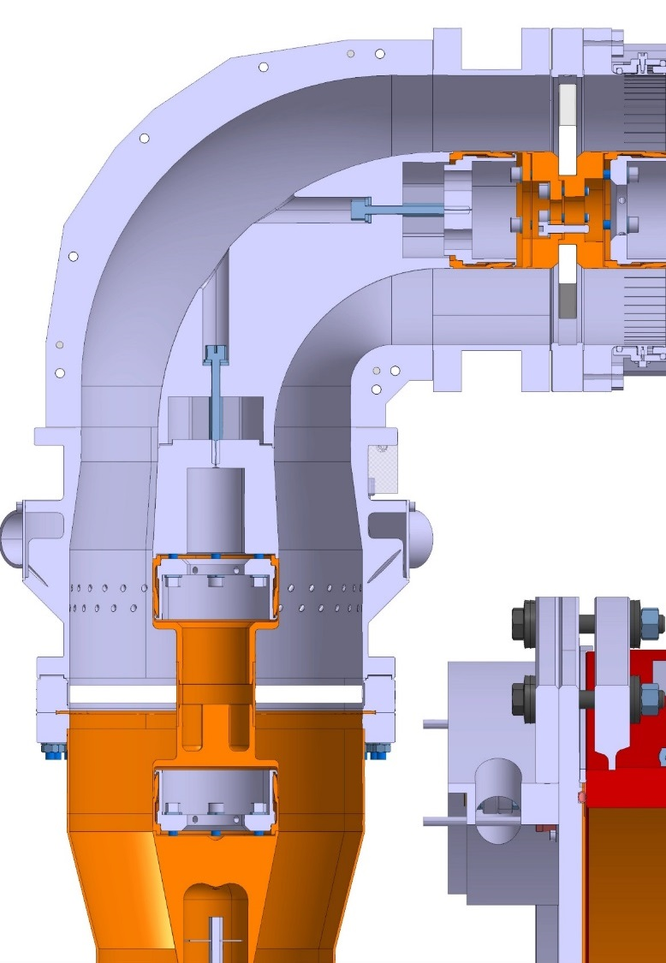
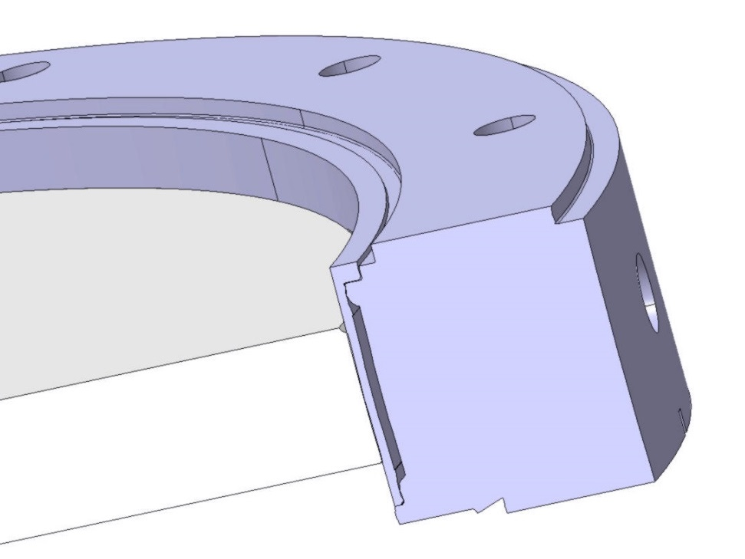
LIU-SPS
Al2O3 99.7 %
15 mm thickness
D250 mm
Ti grade 4

Slide 14
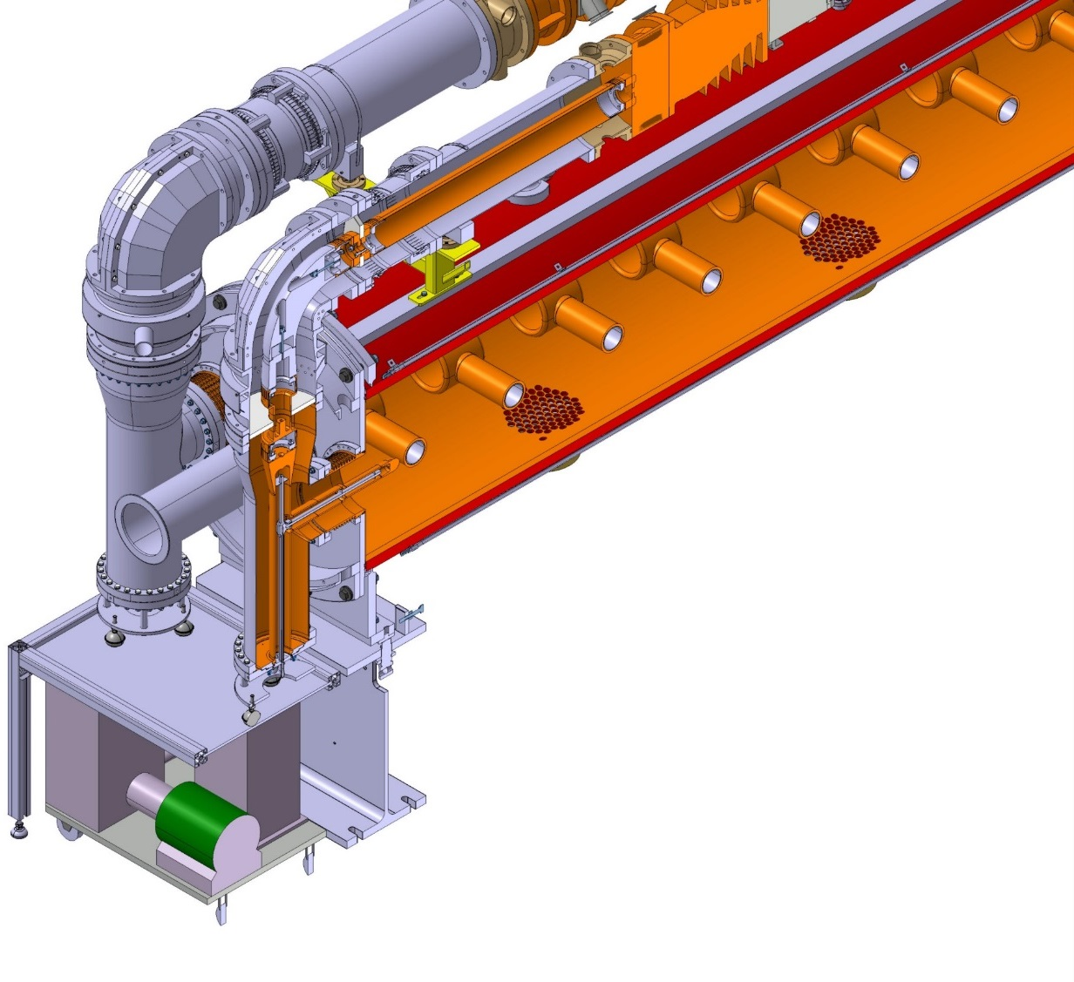
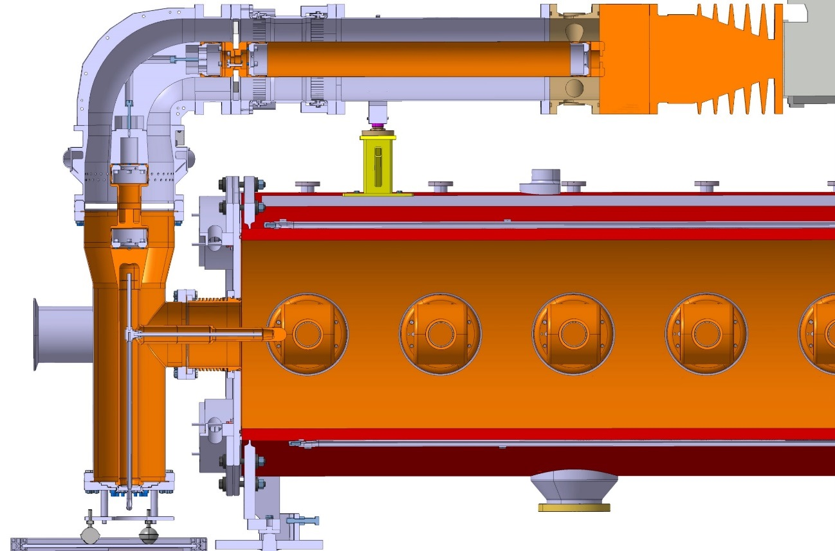
LIU-SPS

Slide 15
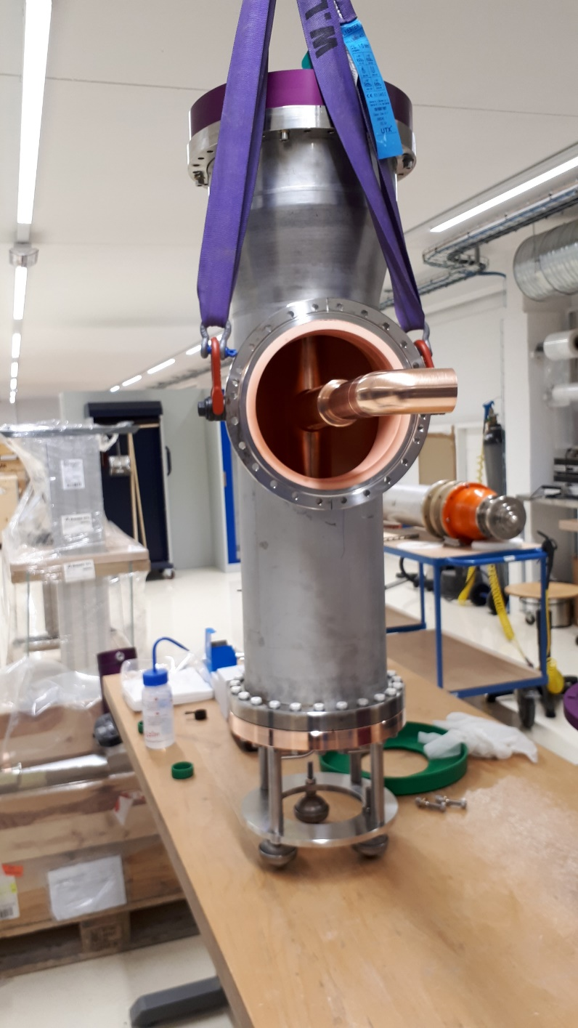
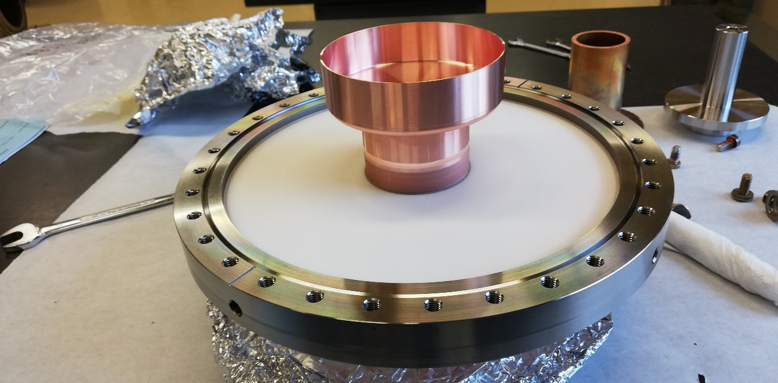
LIU-SPS

Slide 16
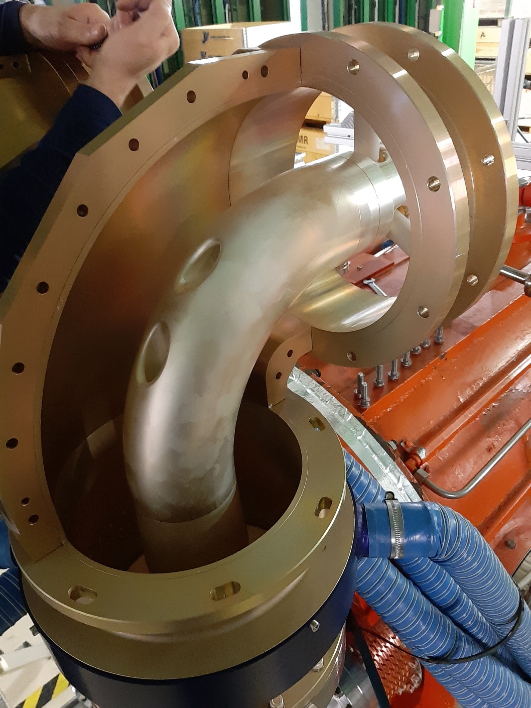
LIU-SPS
A special elbow with two halves outer lines to connect the window to the 14’’ coaxial lines (345 mm)

Slide 17
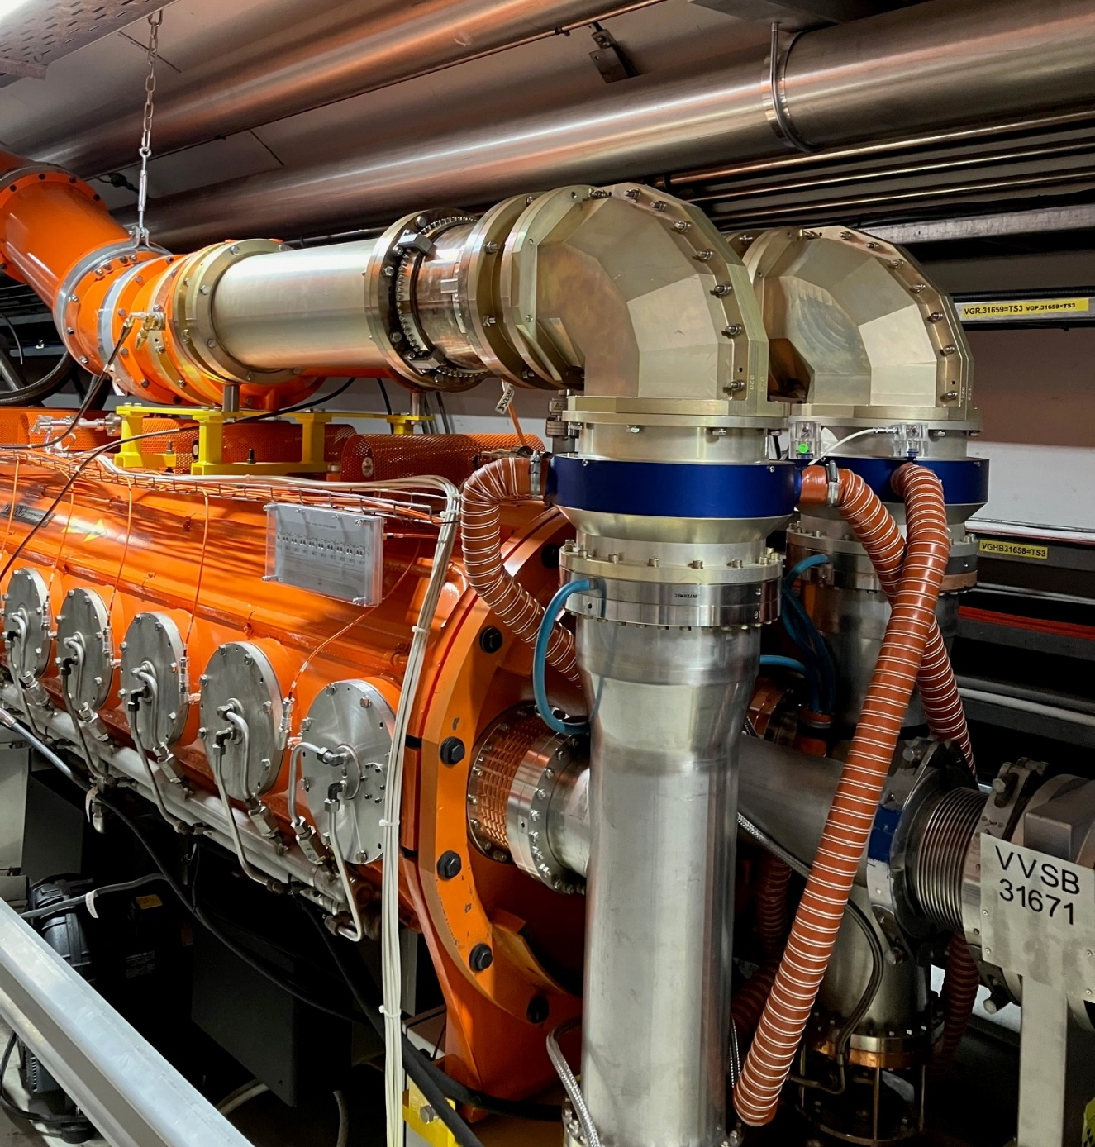
LIU-SPS
24 couplers in operation since 2021
It took almost all 2021 to 2023 to have a stable vacuum under all beam conditions
Looks normal given that the cavities are 800 mm diameter and 16 meters long of 10 mm copper thickness
As they have been vented for days twice (removal and réinstallation, vacuum in between), getting a good static vacuum was difficult (no possibility to do a bake out)

Slide 18
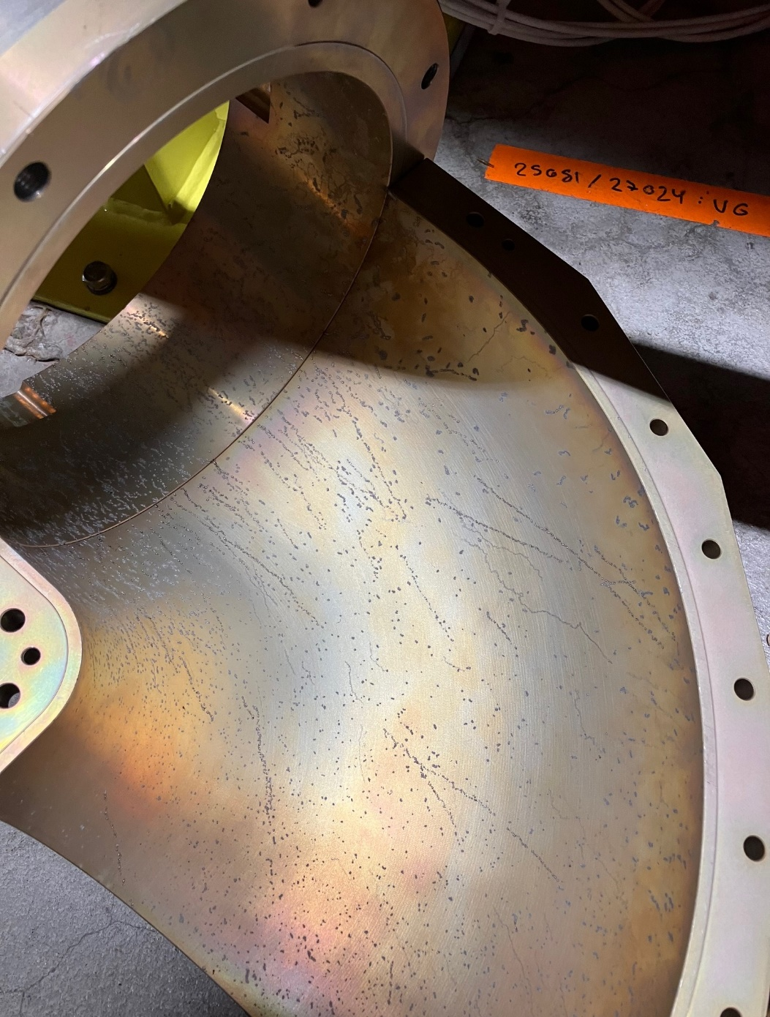
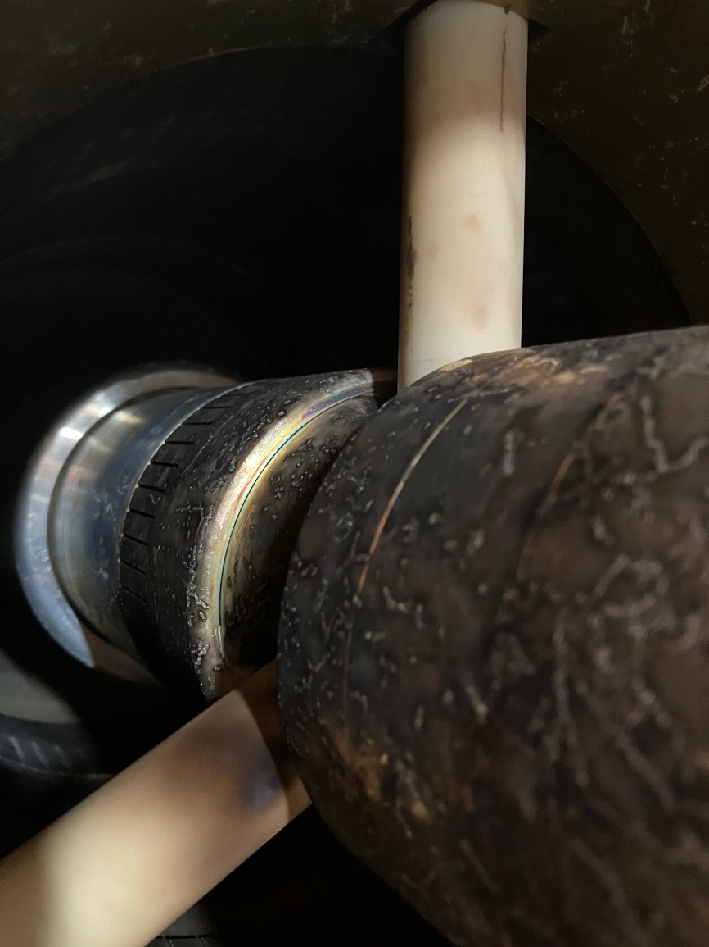
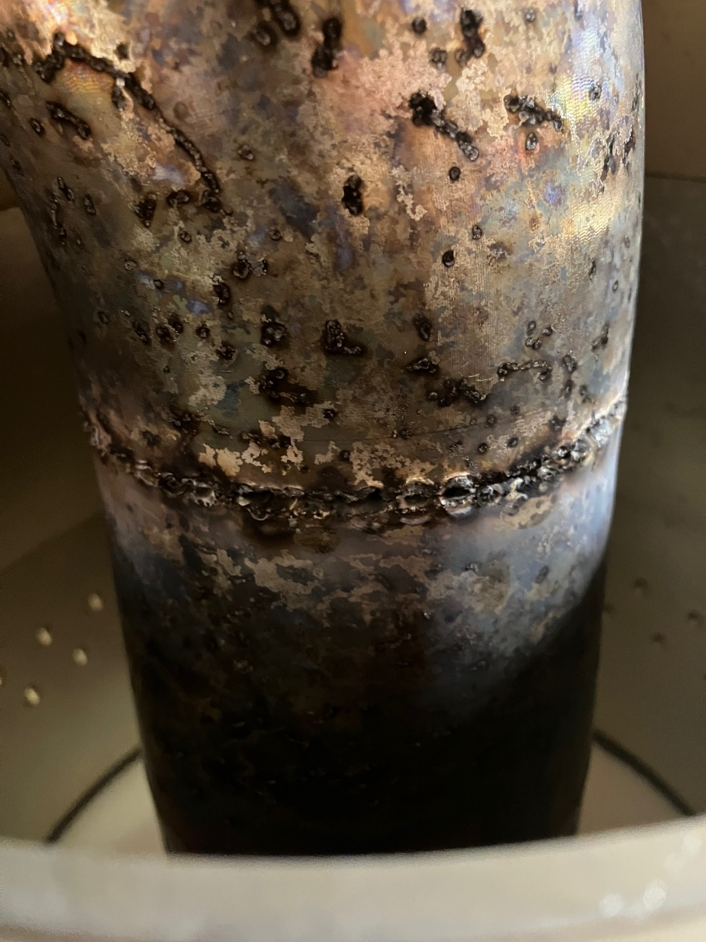
LIU-SPS true life

Slide 19
LIU-SPS
In total, we produced, and RF processed 32 FPC
Since 2021, we have 24 FPCs operating in the SPS
Despite the troubles with the input and output RF lines, to date, not a single failure with the windows…

Slide 20
PIXE & ELISA
Proton Induced X-ray Emission at INFN
Experimental Linac for Surface Analysis at CERN’ Science Gateway
Warm compact RFQ
750 MHz
100 kW pulsed 200 µs at 250 Hz (4 ms), i.e. 5 % average, 5 kW average
0.5 MHz bandwidth minimum

Slide 21
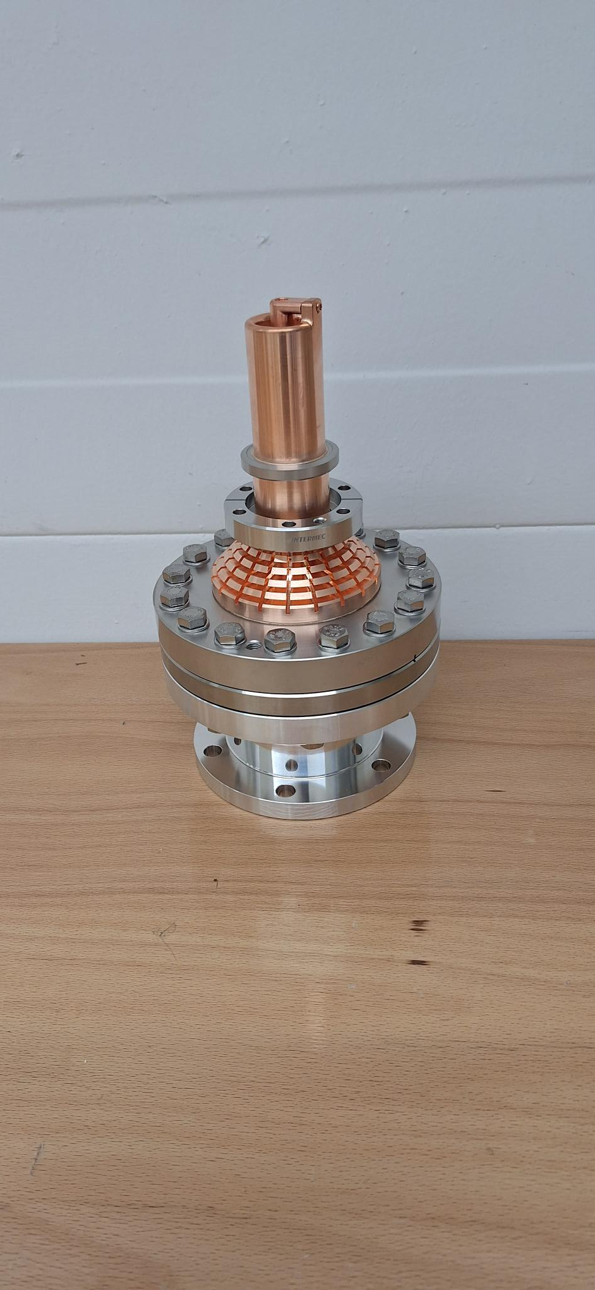
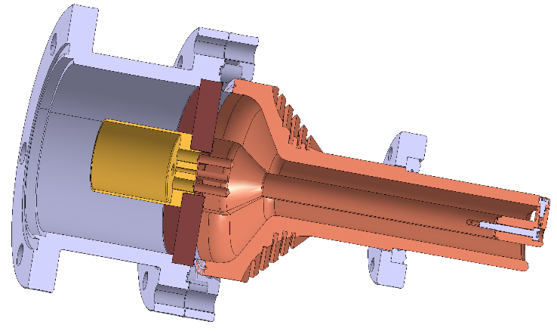
PIXE & ELISA
The window is a disk of PEEK and it is only air cooled
(We also designed, and produced, two ceramic window couplers, but they are not used for the time being)
To date we only produced three of these PEEK couplers
  One is operated at INFN Firenze, Italy
  One is operated at CERN Science Gateway
  One is a spare

Slide 22
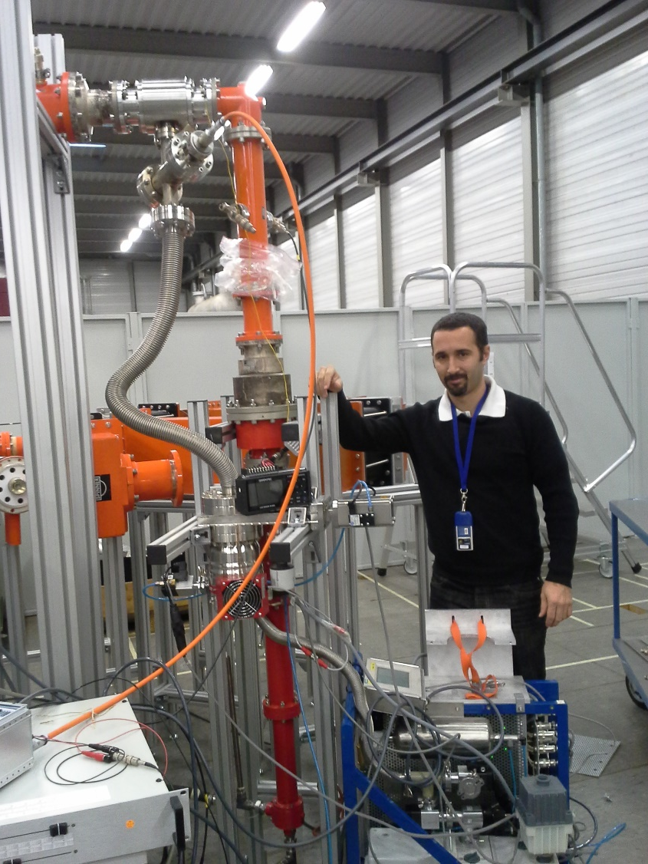
PIXE & ELISA
We tested two PEEK window couplers face to face up to
  10 kW CW TW
  100 kWp 500 µs at 50.3 Hz
The two windows were perfectly ok

Slide 23
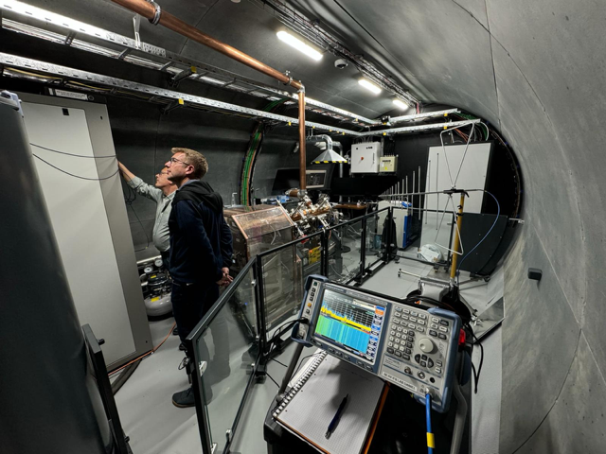
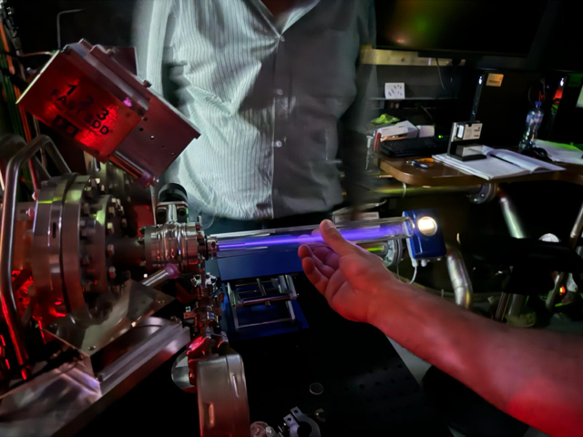
ELISA

Slide 24
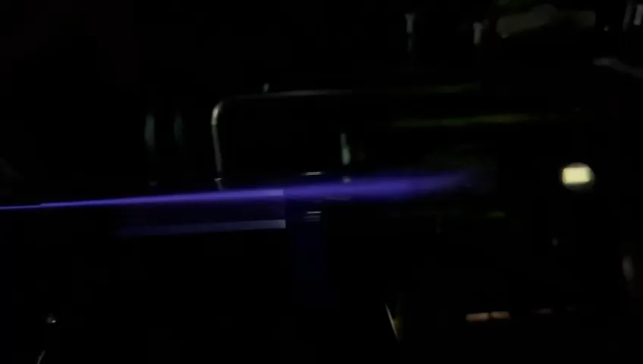

Slide 25

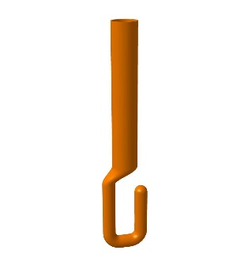
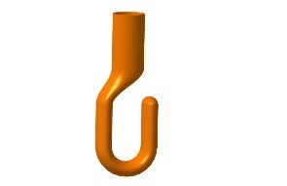
HL-LHC crab
Design started in 2012
Three cavities, down selected to two cavities in 2015
2 K cavities
400 MHz
100 kW CW
reduced to 50 kW CW & 100 kWp for 1 ms maximum
1 MHz bandwidth minimum requested by LLRF
Single coaxial disk window
No doorknob, WG to coaxial transition instead
Water cooled antenna
Vacuum gauge for coupler protection

Slide 26
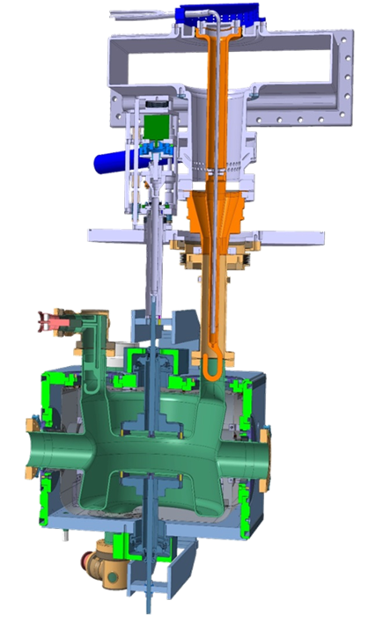
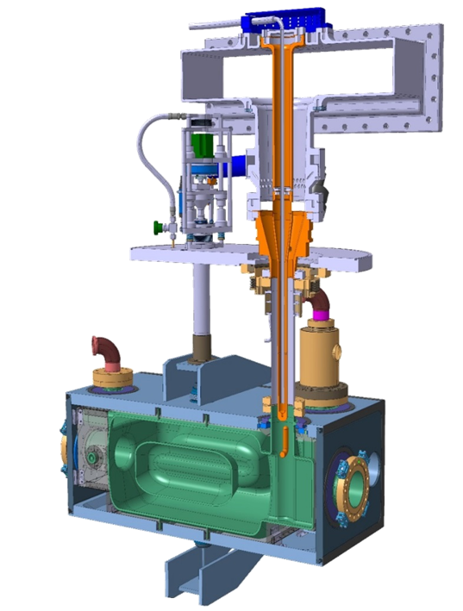
HL-LHC crab
DQW FPC
RFD FPC
Regarding FPC
the difference is only the length of the antenna and the shape of the hook

Slide 27
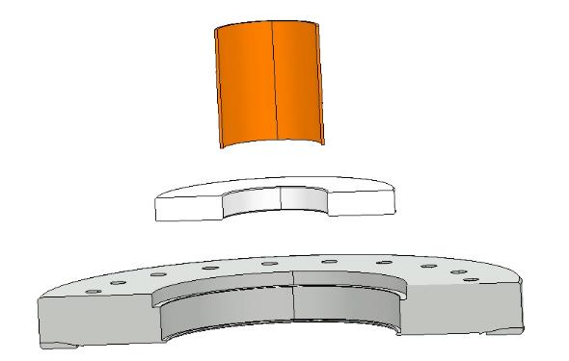
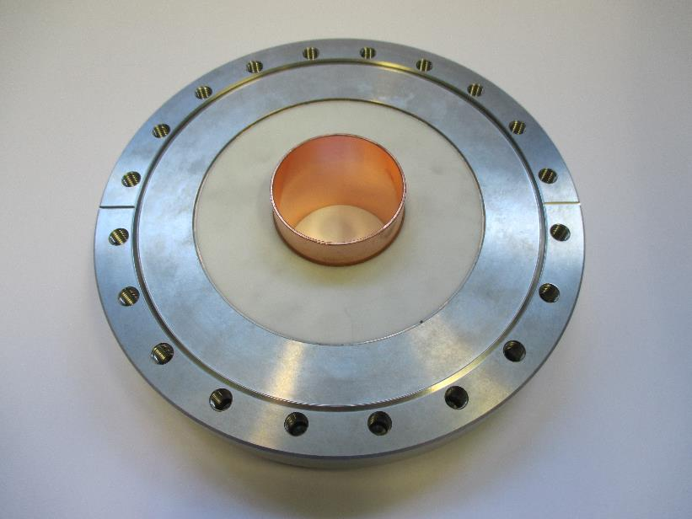
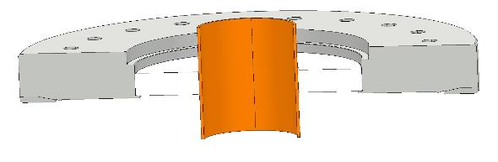
HL-LHC crab

Slide 28
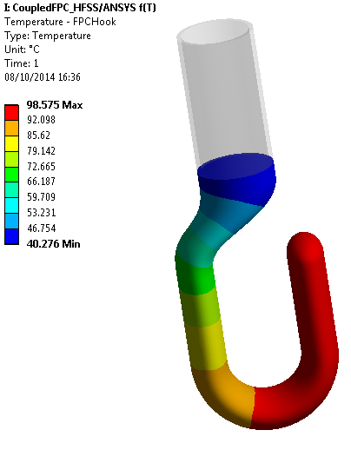
Hook cooling
Simulations shown that with an air-cooled system, the hook would heat up to over 400 C
A water-cooled system was designed in order to keep the hook temperature to 100 C maximum
At CERN, we do not like it, the hook will be EBW
In addition, to guaranty there will be no water overpressure, we will have a FPC dedicated water-cooling plant with a heat exchanger and a little FPC water pump

Slide 29

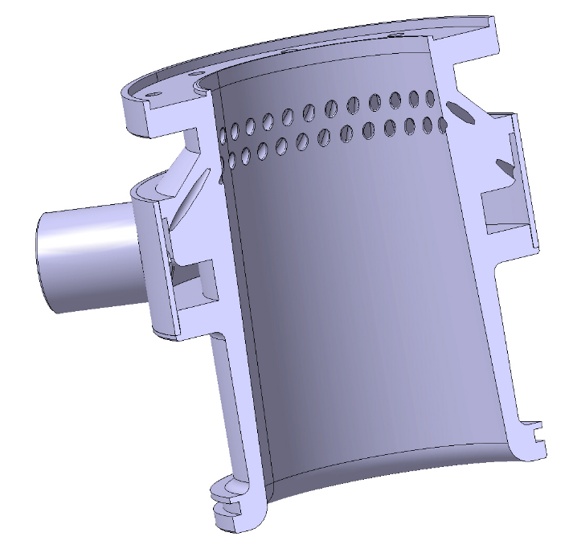
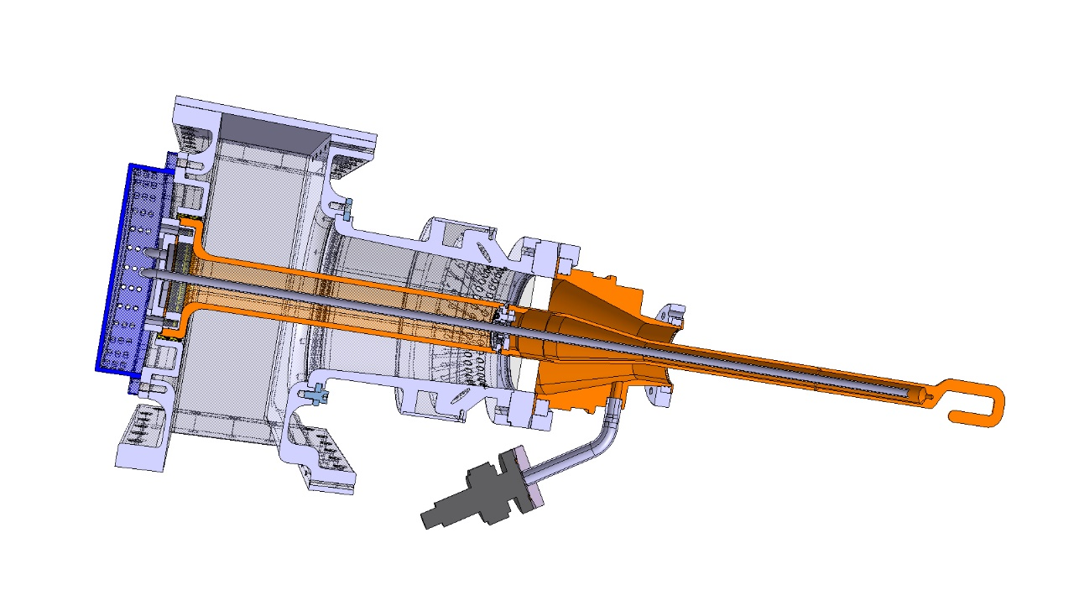
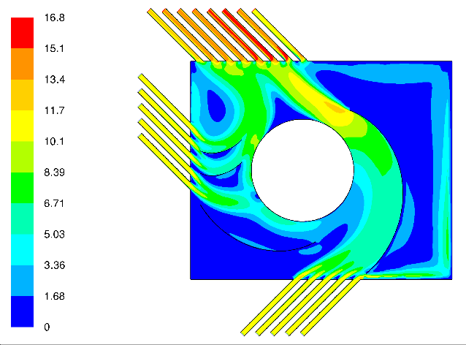
Cyclotronic© air cooling
In order to cool down the ceramic from the air side, we invented the cyclotronic air cooling system
The goal is to avoid any ‘no air flow area’ that would generate a hot spot
To do so, the air is directed down to the ceramic and with a tangential angle
This was proven very efficient with the SPL couplers
Air inlet directed to the ceramic and with a tangential angle to avoid ‘no air flow areas’
Cyclotronic © air cooling

Slide 30
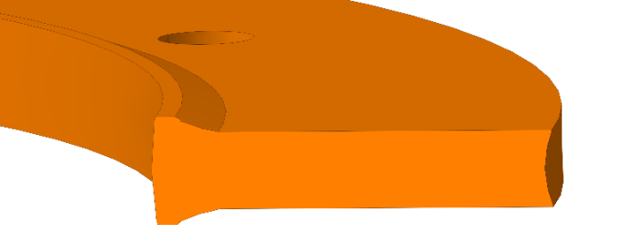
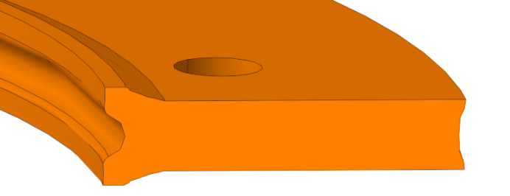
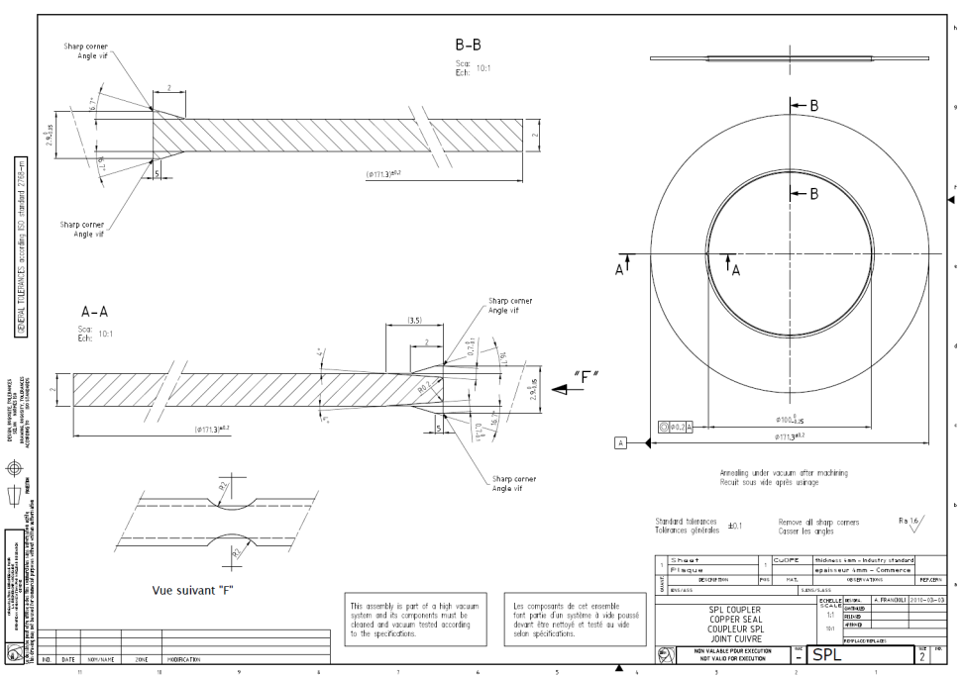
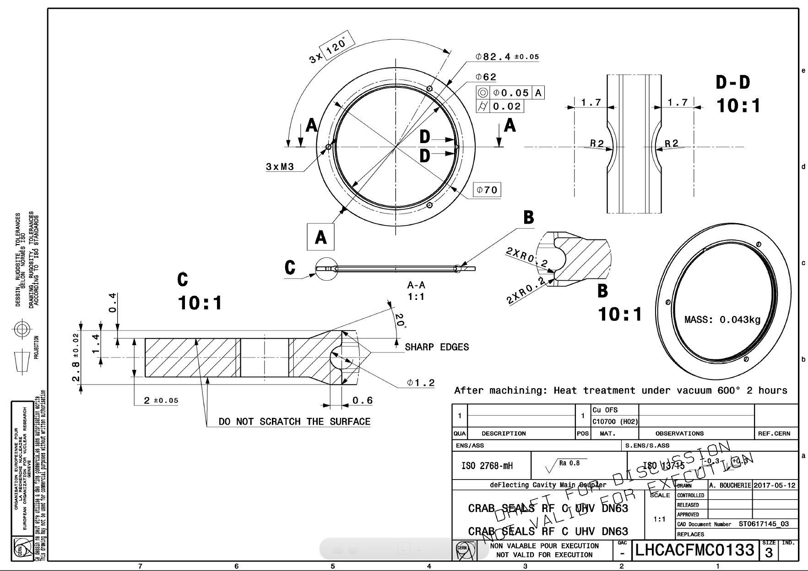
Specific Outer line “RF and vacuum” seal
Specific shape designed for RF perfect continuity and vacuum sealing
It has been designed for LEP couplers, then re-used with LHC and HL-LHC crab couplers
Following Sergey Belomestnykh idea, we implemented an improved version for easier mounting at cold
For bake out compatibility
  MATERIAL : Cu OFE for low temperature operation
  SURFACE STATE : Rolled bright, free of scratches and burrs

Slide 31

HL-LHC crab
All copper parts are 3D forged copper machined for massive raw copper

Slide 32

HL-LHC crab test box
A first test box in Stainless Steel 304 L (vacuum usage) was constructed all in one machined
An exact same design in Aluminium EN AW-6082, all in one machined as well, with 0.1 to 0.3 µm Alodine 1200 was tested and has proven to be re-usable
We then constructed several Aluminium test boxes

Slide 33





HL-LHC crab test box

Slide 34























HL-LHC crab test box
As Crab is with high gradient, we needed to take care of the FPC in clean room from the first day, including assembly on the test box
We first prepared all actions on a flip book, we trained ourselves on mock-ups outside clean room

Slide 35

HL-LHC crab test box
During the assembly in clean room, we learnt a lot on many details, and we improved our processes and tooling
We 3D printed several tools in Acura 25 that allows to avoid polluting the items

Slide 36


HL-LHC crab test box

Slide 37


HL-LHC crab test box

Slide 38


HL-LHC crab test box

Slide 39

HL-LHC crab test box
Following the experience with all the couplers we built over the last decades; we learnt that a well done bake out process considerably help to speed up the RF processing time
With the aluminium test box, we had to define a safe cycle, so we bake out the two couplers with the following programme
  Up to 150 °C with 30 °C/h
  18 hours at 150 °C
  Down to room temp with 30 °C/h

Slide 40

HL-LHC crab test box
Couplers are processed face to face first in TW
  75 kW pulsed 10 ms @ 52.6 Hz
  50 kW CW
We also processed them at the same values in SW, full reflection all phases
To date, we processed
  6 x DQW
  4 x RFD
Next couplers (12+12 total) are due until end of 2025

Slide 41


HL-LHC crab Assembly in clean room
Once the FPC have been RF processed, they are stored under vacuum until we assemble them in clean room ISO4
Here the process as done at CERN

Slide 42


HL-LHC crab Assembly in clean room
Preparation in the UK at STFC clean room facilities

Slide 43


HL-LHC crab Assembly in clean room

Slide 44



Cleanroom requirements
ISO5 preparation of FPC and test boxes
In summary, cleanliness aspects must also be though from the very beginning such that cavities are not polluted
This covers design of the couplers themselves, and also tooling and processes
Specific cleaning process
ISO4 FPC on cavities

Slide 45

APS
352 MHz
300 kW CW
LHC type cylindrical single window
No doorknob, WG to coaxial transition instead
Water cooled antenna
Vacuum gauge for coupler protection

Slide 46



APS
Despite we were very careful, we broke two windows during high power tests

Slide 47

APS
In order to deliver from Europe to the USA, we developped a two metalic frame with springs in all axes to reduce any stress to the window that can occur at any time
This has proven to be very effective, and we also use it for the Crab project.

Slide 48
FCC
Room for R&D
SRF
High gradient
400 MHz
1 MW CW
Waveguide disk window
No doorknob, WG to coaxial transition instead
Water cooled antenna
SRF
High gradient
800 MHz
500 kW CW
Coaxial disk window
No doorknob, WG to coaxial transition instead
Water cooled antenna

Slide 49


FCC
Courtesy Shahnam Gorgi Zadeh

Slide 50
Ceramic material
CERN published a reference document in 1996 (10 pages) explaining all the parameters that a ceramic for RF window shall fulfil
http://cds.cern.ch/record/91419?ln=fr
It is still in use, and all our ceramics are the Al2O3 - 97.6 % purity ones
 | Purity | RF losses | Brazing
Al₂O₃ | 99.9 % | Very Low | Very difficult
Al₂O₃ | 97.6 % | Medium | Medium
Al₂O₃ | 95 % | Higher | Easier
This is one of our first topic for R&D with respect to FCC high power requirements, we launched a program to master how to braze 99.9 % purity ceramics with the sizes we need (thickness and diameter)

Slide 51



Water cooled from the inside ceramics
With the help of or mechanical experts, we launched a prototyping of a 3D printed ceramic with water channels cooling down the ceramic from the inside
This should help getting to higher power handling
The construction is ongoing, but not easy at all, several prototypes failed

Slide 52
FCC
Over the last 3 years, power level requirements and frequencies have often changed
We now have a robust plan to develop LHC compatible FPC and to test them after Long Shutdown 3 (2026-2029) to validate the concept for FCC
For the 400 MHz version, this will be a disk window(s) in the waveguide with a target at 1 MW CW SW, with an assembly in a dedicated clean room (ISO5?)
For the 800 MHz version, this will be a coaxial window close to the beam axis with a target at 500 kW CW SW, with an assembly before cryostating in ISO4 clean room

Slide 53

Conditioning processes
Dedicated talk at the 6th Open Collaboration Meeting on Superconducting Linacs for High Power Proton Beams (SLHiPP-6)

Slide 54


Conditioning processes
It In order to be safe, we first ramp RF power with very short pulses from zero to full power
We then restart with longer pulses, again from zero to full power
We repeat the process until maximum pulse duration, that could be CW
What we also noticed is that making a ‘straight ramping’ could be dangerous
Indeed, a higher power level can ‘de-condition’ a lower power level previously processed
So inside one envelope, we ramp up and we ramp down to guaranty that ALL power levels have been processed with the shorter pulses
This process ensures that the lowest energy is deposited into an arc if it should occur

Slide 55

Conditioning processes
It is important to keep the repetition rate low enough to allow enough time to the vacuum gauge to detect the pressure rise
This allows not to stop the system, only few pulses are missed

Slide 56
Conditioning processes
TW
Prototype
SW
Operation

Slide 57
RF processing
We need to define the best RF processing strategy in order to guaranty mass production delivery schedule
Total duration 2 windows + 2 windows = 64 days
Exchange
Windows
2 days
Processing 2 windows
30 days
Exchange
Windows
2 days
Processing 2 windows
30 days
Preparation next 2 windows, 5 days
Bake out
5 days
Preparation next 2 windows, 5 days
Bake out
5 days
With Linac 4 windows, we did some tests with four windows in series, and we were much faster than two plus two windows
Total duration 4 windows = 37 days
Exchange
Windows
2 days
Processing 4 windows
35 days
Preparation next 4 windows,
6 days
Bake out
5 days

Slide 58



Resonant rings
No progress
Resonant ring are one of the most important way to make huge savings with test benches, we still have it in our plans

Slide 59


CERN FPC R&D Centre, done, and operational
Robots
Metrology
Vacuum
Test boxes
Deepest thanks to the CERN management that agreed to invest in a new FPC R&D Centre
RF components
200 m² First Floor
600 m² Ground floor
LLRF measurement
RF power for
FPC processing
Assembly
Transport
Heavy components
Machining

Slide 60
CERN FPC R&D Centre & WWFPC meetings topics for discussion
Design
Maximum power per coupler ?
Multi couplers per cavity ?
Ceramic
Sputtering: TiOx – TiN ?
Control of the process ? Qualification (*** Sergio/Fritz)
New ceramic without treatment ? (KEK/CERN – Thales/CERN)
Gray deposit ?
How to qualify ? (*** Sergio/Fritz – Wolf-Dietrich – Walid)
Coating
Copper plating (launch a program)
how to make it correct ?
Common classification of defects
acceptance criteria ?
Discoloration of ceramic
Is superficial oxidation or discoloration a problem ?
(*** identification Walid)
Before/after RF processing
To gray after RF conditioning at XFEL
To yellow due to multipacting ?
To brown after X-ray
Specific constraints for operation reasons
No brazing-welding-soldering between liquid coolant and vacuum (proven EBW should not be on the list)
No liquid cooled couplers
Do you have the same constraints ?
Do you have statistics linked to these constraints ?
Tests
TW? SW? TW & SW ?
Test boxes in 3D printing copper plated ? Acceptable or incompatible with cleanliness requirements ?
Arcing and air cooling
Is lower pressure creates arc ?
Is N2 worse than air ?
Do we need vacuum gauge for series production FPC ?
BNL, SNS, DESY do not use DC bias, prefer a good conditioning, afraid of gas accumulation (use multipacting simulation tool in order to make a multipacting free coupler)
Amplifiers for tests
Prototype processes versus series processes
What margin do we need between pre-series and series ?
Diagnostics
R&D and prototyping
Operation in accelerators
Statistics
How to list all couplers operated in accelerators ?
Degradation of characteristic over time of operation
How to share these information ? This meeting ? Mandatory in talks ?
Make pictures of work environments !
World Wide Program ?
How to organise it ?
Who can do what ?
Who want to do what ?

Slide 61
Statistics
Quite poor statistics of couplers over the world
May I ask you to provide me with relevant numbers

Slide 62


Miscellaneous

Slide 63

Miscellaneous

Slide 64

Miscellaneous

Slide 65


Miscellaneous

Slide 66

Miscellaneous

Slide 67


Miscellaneous

Slide 68


Miscellaneous

Slide 69


Miscellaneous
Despite we do all our couplers the same way, copper coating is always a challenge
HL-LHC crab was as always, complex before being successful

Slide 70
Final comment
Message that I deliver to my management as often as I can
We are passionate to work on this fantastic topic
CERN is very active with respect to FPC activities
(thanks to the management for supporting the team since decades!)
Thanks to all the FPC colleagues over the world for the so open-minded constructive contributions
International collaborations between FPC experts is always very fruitful

Slide 71

Thank you again for being here today !

