Slide 1
High power FPCs development for EIC
Wencan Xu
Brookhaven National Lab
WWFPC workshop July 2-3 2024

Slide 2
Outline
Brief introduction of EIC RF systems and FPC counts
High power FPC design for ESR SRF cavity
  Requirements
  Components design
    Window assembly
    Vacuum side
    Air side
Prototype FPC manufacture progress
  RF window brazing recipe development
  TiN coating sample measurement
  Brazing and EB welding
Summary and Future Plan

Slide 3
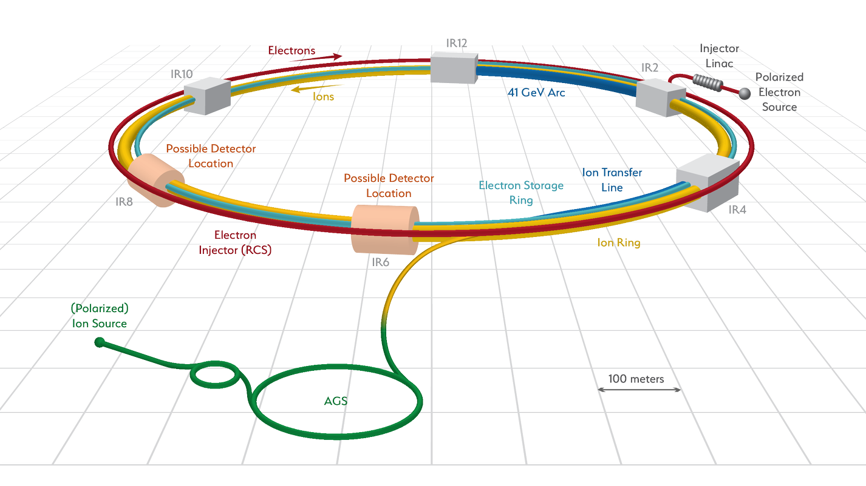
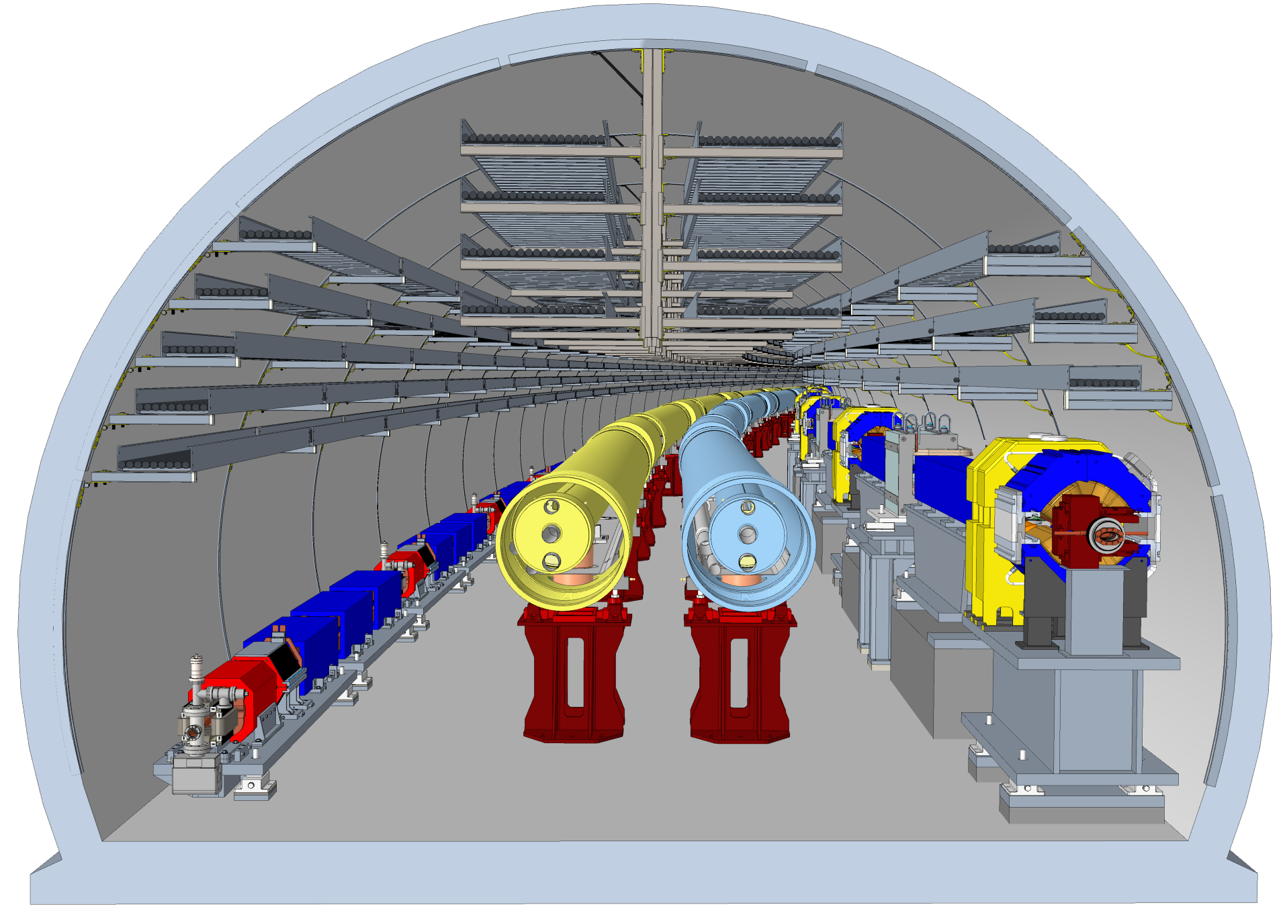
EIC
The EIC is a unique high-energy, high-luminosity, polarized electron-proton/ion collider.
  High luminosity: L = 1E33 to 1E34 cm-2sec-1
  Large range of center-of-mass energies Ecm= 29 to 140 GeV
  High flexible polarization: > 60 %
EIC is based on the RHIC complex
  Same RHIC tunnel (space limit)
  HSR ring: upgraded RHIC ring.
  New electron facility
    ESR in RHIC tunnel
    RCS in RHIC tunnel
    Electron injection
Jlab is the EIC partner lab

Slide 4
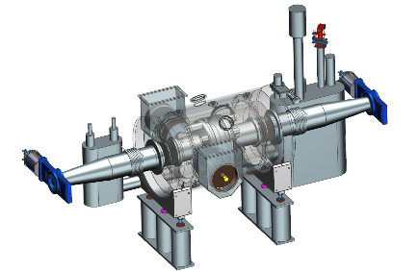
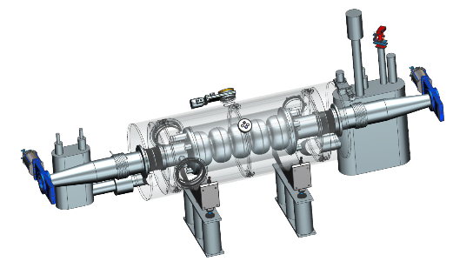
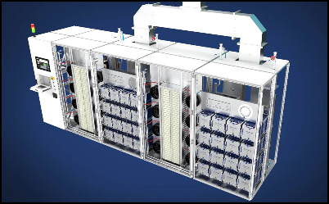
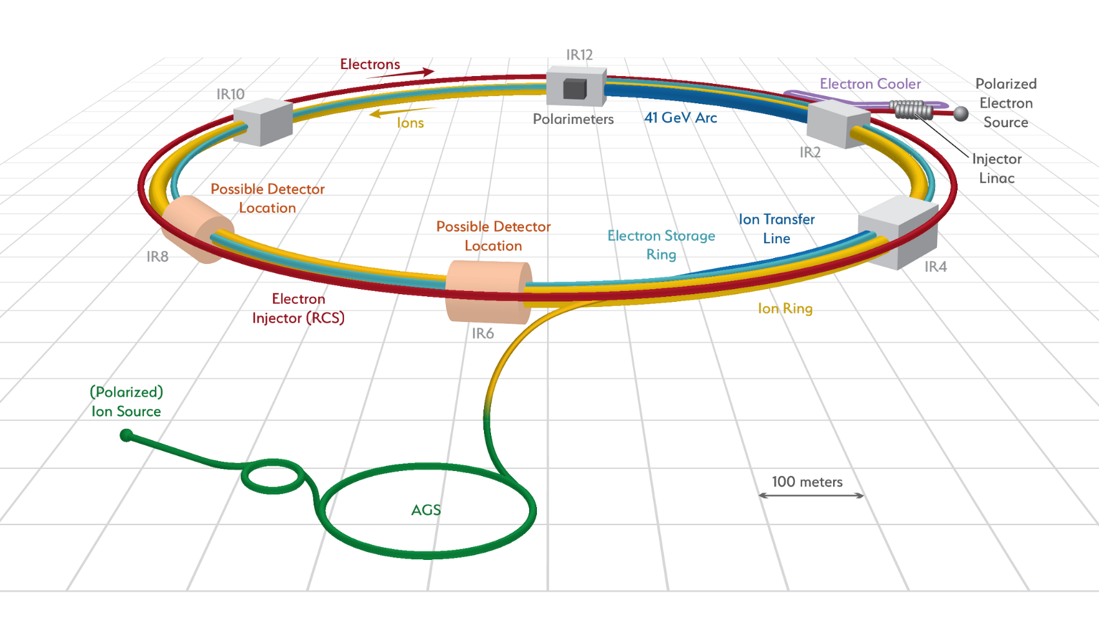
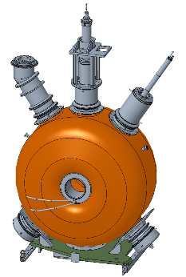
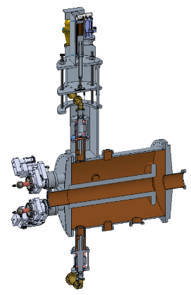
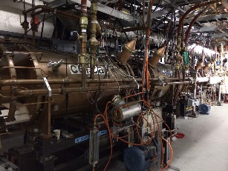
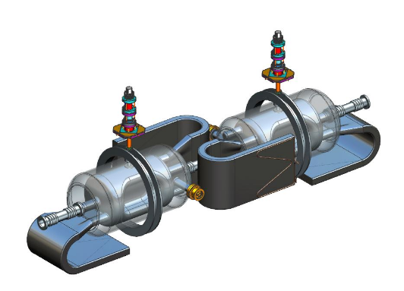
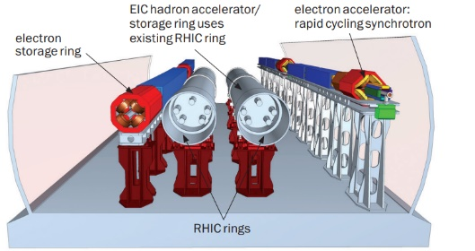
EIC RF Systems
1773 MHz 3rd Harmonic (4) Cavities (Not shown)
1 CM, Electron Cooler
Hadron - 591 MHz bunch compression cavity
5 CMs, IR10
Hadron Cooling - 591 MHz acceleration cavity
10 CMs, Electron Cooler
Electron - 591 MHz electron storage cavity
17 CMs, IR10
RF power and distribution
400kW×34 new SSAs for ESR 591MHz cavities, various power level for other cavities
Hadron - 197 MHz bunch compression cavity
Rapid Cycling Synchrotron - 591 MHz acceleration cavity
3 CMs, IR10
Hadron – 24.5 MHz acceleration cavity
Crab Cavities (per IR) | HSR (Cavities/CMs) | ESR (Cavities/CMs)
197 MHz | 8/4 | –
394 MHz | 4/4 | 2/2
Hadron – 49.2 MHz and 98.5 MHz bunch splitter cavity
Both rings –
Crab cavities

Slide 5
FPC list for ERIC RF/SRF cavities
RF System | Sub System | Freq [MHz] | Type | Location | # Cavities | # FPC/cavity | FPC power (kW)
Electron Storage Ring | Accel / Store | 591 | SRF, 1-cell | IR-10 | 17 | 2 | 380
Rapid Cycling Synchrotron (RCS) | Accel / Store | 591 | SRF, 5-cell | IR-10 | 3 | 1 | 70
 | Harmonic Kickers | 591 | NCRF, QWR, 1-mode NCRF, QWR, 2-mode | IR-2 or IR-12 | 1 1 | 1
 | Bunch Merge Type 1 | 295 | NCRF, Reentrant | IR-4 | 2 | 1 | 70
 | Bunch Merge Type 2 | 148 | NCRF, Reentrant | IR-4 | 1 | 1 | 70
Hadron Storage Ring | Capture / Accel | 24.6 | NCRF, QWR | IR-4 | 4 | 1 | 100
 | Bunch Split 1 | 49.2 | NCRF, QWR | IR-4 | 2 | 1 | 200
 | Bunch Split 2 | 98.5 | NCRF, QWR | IR-4 | 2 | 1 | 200
 | Store 1 | 197 | NCRF, Reentrant | IR-4 | 7 | 1 | 100
 | Store 2 | 591 | SRF, 1-cell | IR-10 | 5 | 1 | 60
Strong Hadron Cooling | ERL Injector | 197 591 | SRF, QWR SRF, 1-cell | IR-2 | 2 1 | 2 1 | 200 10
 | ERL Low Energy Linac | 197 591 | SRF, QWR SRF, 1-cell | IR-2 | 4 2 | 2 1 | 200 10
 | ERL Fundamental | 591 | SRF, 5-cell | IR-2 | 10 | 1 | 60
 | ERL Third Harmonic | 1773 | SRF, 5-cell | IR-2 | 4 (1 CM) | 1 | 5
Crab Cavities | Hadron | 197 | SRF, RFD | IR-6 | 8 (4 CM) | 1 | 70
 | Hadron/Electron | 394 | SRF, RFD | IR-6 | 6 | 1 | 50

Slide 6
FPC list for ERIC RF/SRF cavities
RF System | Sub System | Freq [MHz] | Type | Location | # Cavities | # FPC/cavity | FPC power (kW)
Electron Storage Ring | Accel / Store | 591 | SRF, 1-cell | IR-10 | 17 | 2 | 370
Rapid Cycling Synchrotron (RCS) | Accel / Store | 591 | SRF, 5-cell | IR-10 | 3 | 1 | 70
 | Harmonic Kickers | 591 | NCRF, QWR, 1-mode NCRF, QWR, 2-mode | IR-2 or IR-12 | 1 1 | 1
 | Bunch Merge Type 1 | 295 | NCRF, Reentrant | IR-4 | 2 | 1 | 70
 | Bunch Merge Type 2 | 148 | NCRF, Reentrant | IR-4 | 1 | 1 | 70
Hadron Storage Ring | Capture / Accel | 24.6 | NCRF, QWR | IR-4 | 4 | 1 | 100
 | Bunch Split 1 | 49.2 | NCRF, QWR | IR-4 | 2 | 1 | 200
 | Bunch Split 2 | 98.5 | NCRF, QWR | IR-4 | 2 | 1 | 200
 | Store 1 | 197 | NCRF, Reentrant | IR-4 | 7 | 1 | 100
 | Store 2 | 591 | SRF, 1-cell | IR-10 | 5 | 1 | 60
Strong Hadron Cooling | ERL Injector | 197 591 | SRF, QWR SRF, 1-cell | IR-2 | 2 1 | 2 1 | 200 10
 | ERL Low Energy Linac | 197 591 | SRF, QWR SRF, 1-cell | IR-2 | 4 2 | 2 1 | 200 10
 | ERL Fundamental | 591 | SRF, 5-cell | IR-2 | 10 | 1 | 60
 | ERL Third Harmonic | 1773 | SRF, 5-cell | IR-2 | 4 (1 CM) | 1 | 5
Crab Cavities | Hadron | 197 | SRF, RFD | IR-6 | 8 (4 CM) | 1 | 70
 | Hadron/Electron | 394 | SRF, RFD | IR-6 | 6 | 1 | 50
EIC FPC summary:
  About 100 new FPCs are required for EIC RF/SRF systems.
  Most EIC cavities’ frequencies are below ESR SRF cavity’s frequency, i.e., 591 MHz.
  The only cavities with frequency above ESR cavity’s frequency are the third harmonic cavity for ERL SHC, i.e., 1773 MHz.
  The most challenging FPC is for ESR SRF cavity: CW 400 kW.
EIC FPC strategy:
  One type of window (new design) for SRF cavities with frequency < 591 MHz
  One type of window for 1773 MHz: using CEBAF FPC window
  One type of window for NCRF cavities (loop coupling)

Slide 7
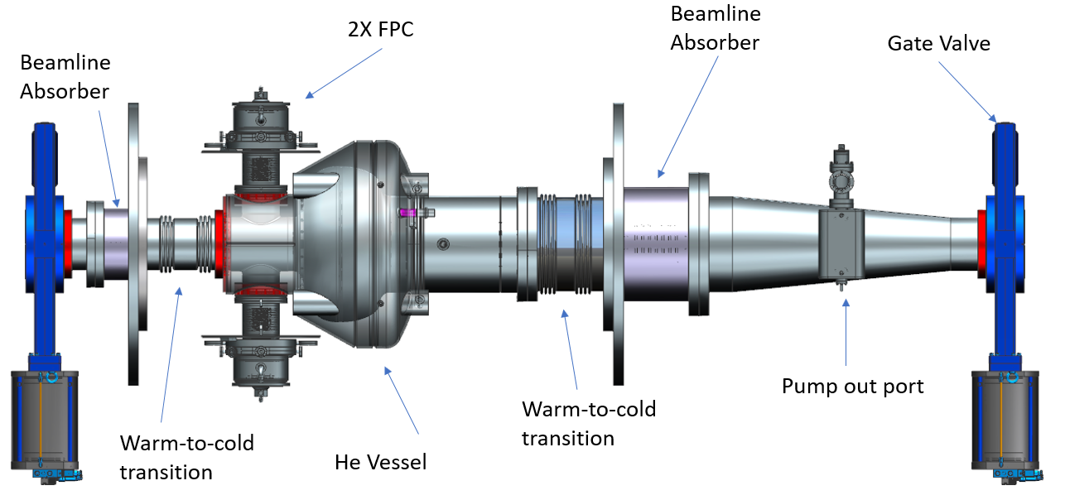
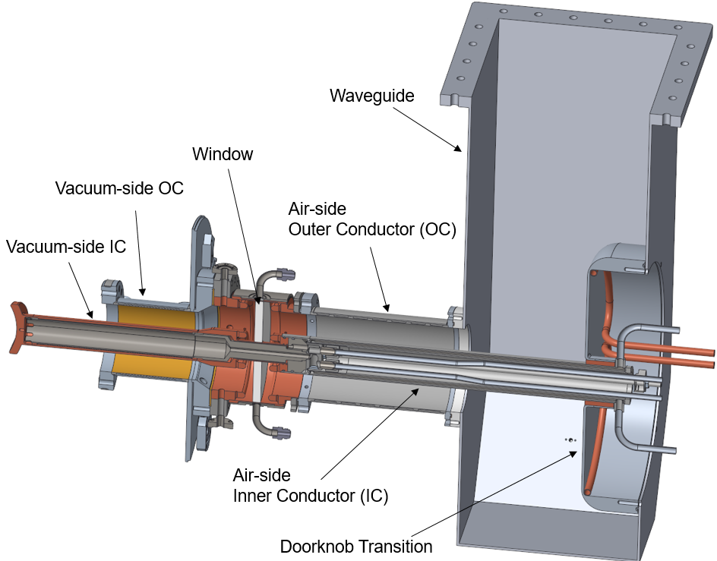
FPC design requirement for ESR SRF cavity
Parameters | Nominal maximum* | Ultimate maximum #
Frequency | 591 MHz | 591 MHz
Synchrotron radiation | 8.8 MW | 10 MW
HOM power per cavity | 56.2 kW | 72.7 kW
Total power requirement per cavity | 574 kW | 661 kW
Operational Overhead | 15% | 15%
Max. RF power per cavity | 660 kW | 760 kW
Couplers per cavity | 2 | 2
Max. RF power per coupler | 330 kW | 380 kW
* Nominal operation parameters: Table 6.63 in CDR (https://www.bnl.gov/ec/files/eic_cdr_final.pdf)
# Machine design parameters

Slide 8
FPC design achieve vs criteria
 | Requirement | FPC Design Criteria
Average RF power | 380 kW * | 1 MW, traveling wave 500 kW, full reflection
Peak Power (during full reflection) | 1.5 MW, equivalent | 2 MW, equivalent
Frequency | 591 MHz | Broadband window design, good for EIC cavities below 591 MHz
Acceleration load | 5g, In any orientation | 5g, In any orientation
Mechanical Modal frequency | > 60 Hz | > 100 Hz
Q_{ext} of each coupler | 2.5E5 | Fixed coupler#, Tuning Q_{ext} with waveguide junction, a factor of 20
*The beam abort gap is RHIC is 8% of 12.8 us.
# Fixed coupling is set at 4E5, and a waveguide junction was tested up to 500 kW CW standing wave(@704 MHz). However, recent evolution of EIC design demonstrated a fixed coupling is feasible for EIC operation, with RF FODO operation mode.

Slide 9
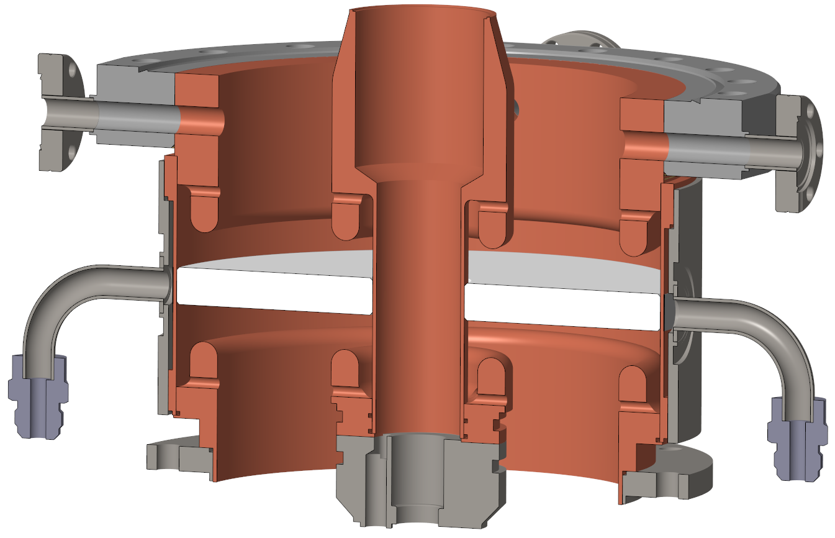
FPC for EIC ESR SRF Cavity
EIC eSR FPC design is a variation of KEKB/ Tristan/SNS/BNL BeO high power window.
Particularly, this Al2O3 window FPC improved various aspects based on lesson and learn from design and operating experiences of BNL BeO window, so that it can satisfy the EIC requirements.
  Replace BeO window with 99.5% Al2O3 for safety and maintenance considerations.
  Increase choke to window distance for better TiN coating and inspection.
  Optimized coaxial line to increase power handling and coupling with cavity.
  Larger ceramic ID to survive 5 g acceleration load in any direction.
  Improve cooling channel design.
  Improve instrumentations on FPC.
  4.5 kV bias will be ready to apply.
This is common RF window for EIC SRF/RF cavities.

Slide 10
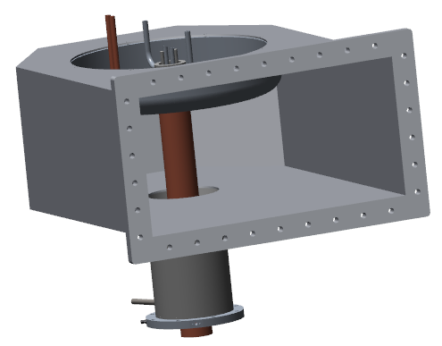
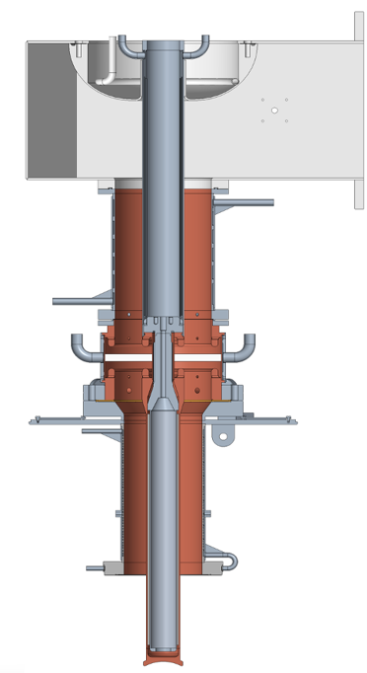
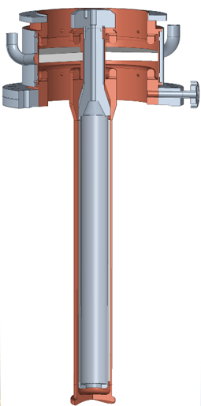
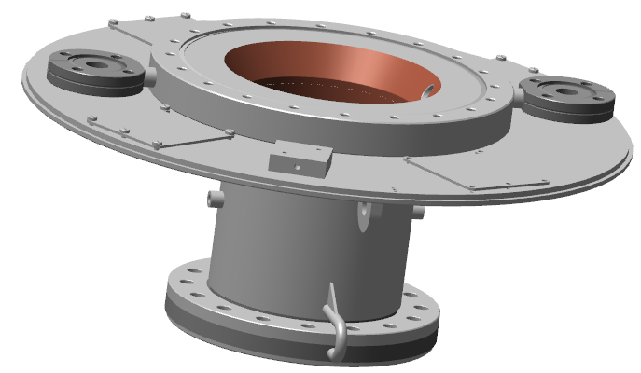
EIC ESR FPC design
FPC window assembly
FPC vacuum side outer conductor
FPC airside components
The pre-project plan for window development
  Fabricate 8 RF window assembly, and 4 full FPCs.
  High power RF condition up to 500 kW standing wave, all phases.
  Deliver two FPCs for First Article Cryomodule.
Airside components
Vacuum side outer conductor
RF window assembly

Slide 11
RF window assembly

Slide 12
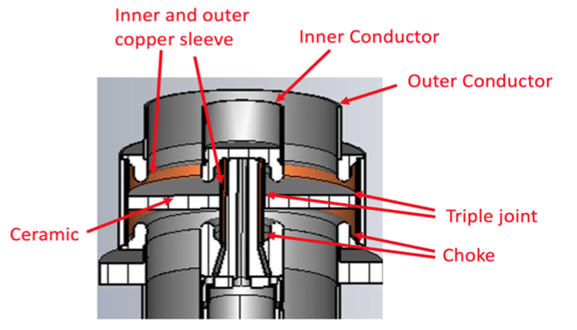
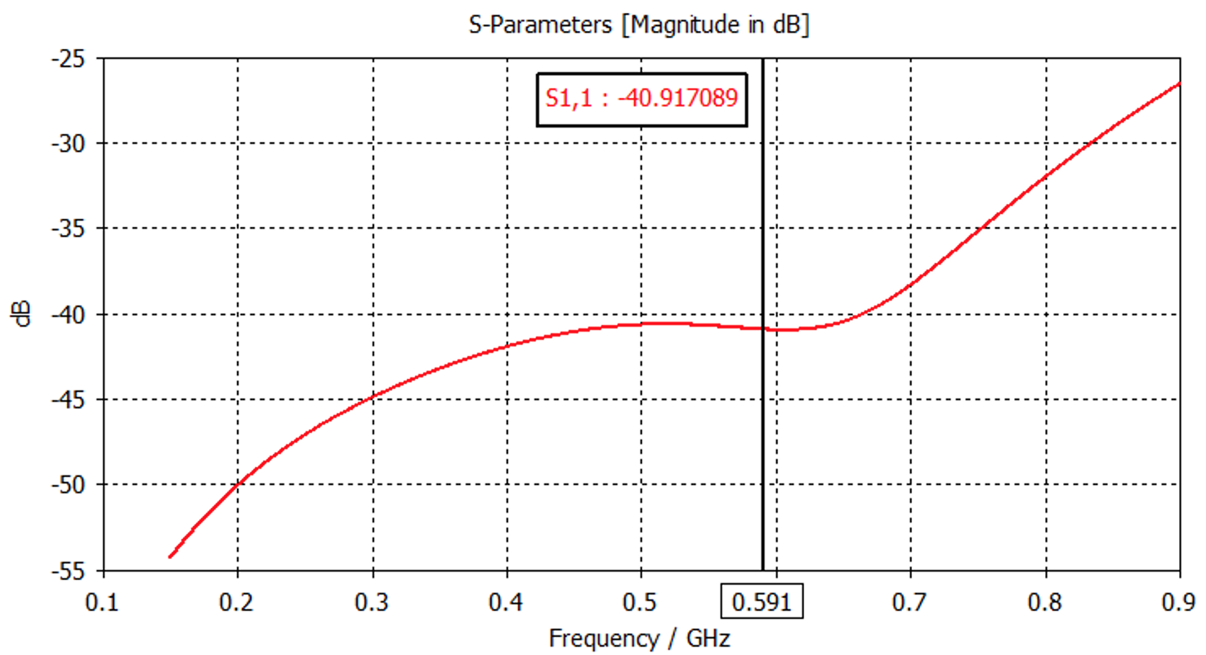
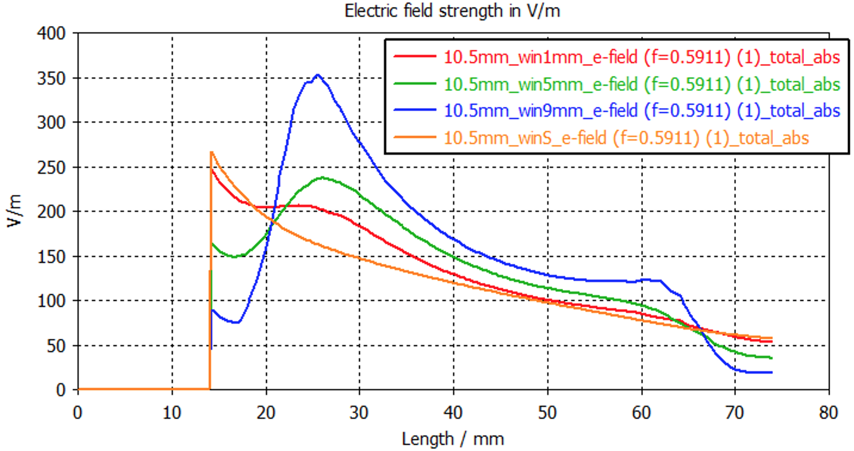
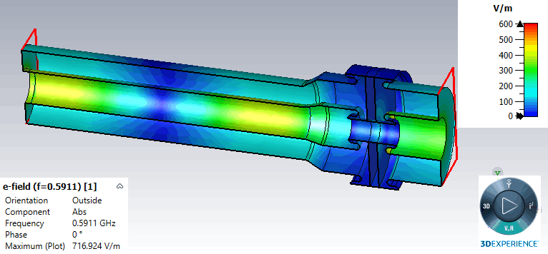
High power broadband window for EIC Cavities
A high power, broadband window has been designed for EIC RF/SRF cavities.
  Broadband: < -40 dB for frequency below 591 MHz.
  The peak field at the braze-joint is 367 kV/m.
Braze joint field
Peak field in window area

Slide 13
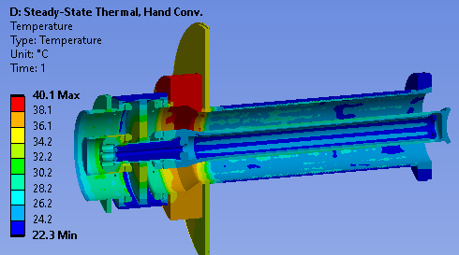
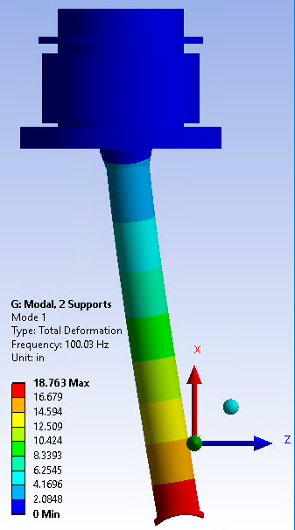
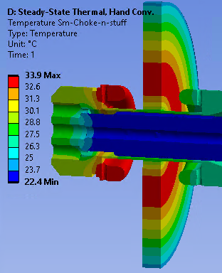
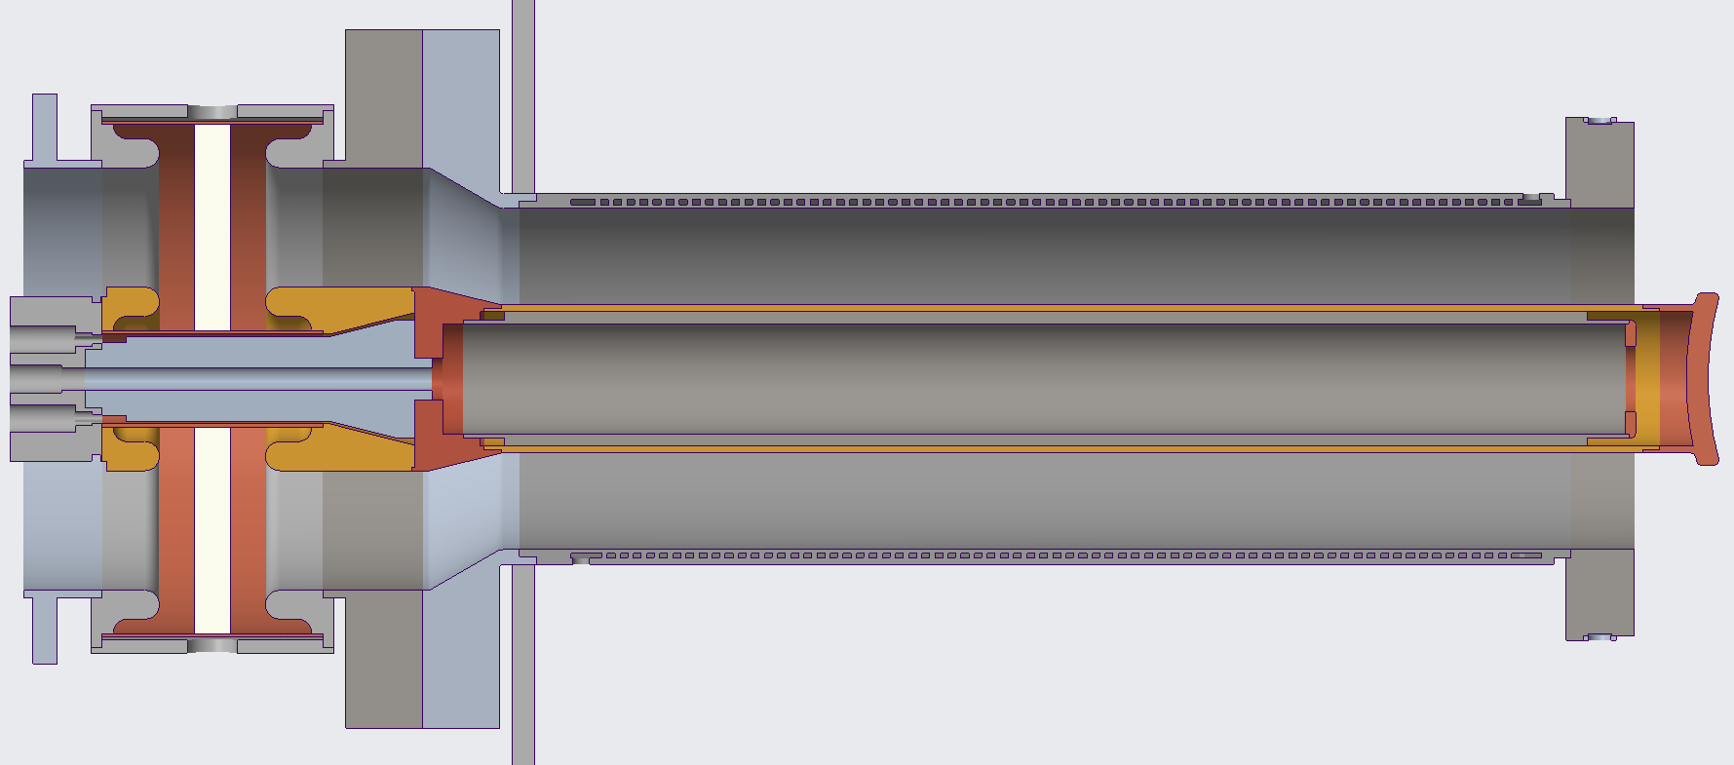
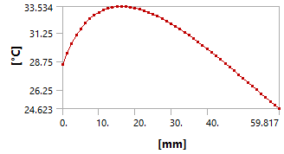
Thermal and mechanical design
Water cooling for inner conductor and window.
RF thermal simulation
  1 MW power input
  Conservative thermal film coefficient
Temperature difference in the ceramic is 10 degree.
Highest temperature of 40 C is at uncooled flanges.
Choke tip highest temperature is 34 C.
Al₂O₃ temperature ranges from 24 C to 34 C
1st mechanical modal frequency is 100 Hz
Water cooling loop
Centerline temp of Al2O3
Inner Conductor Cooling Path
1st
ID
OD

Slide 14
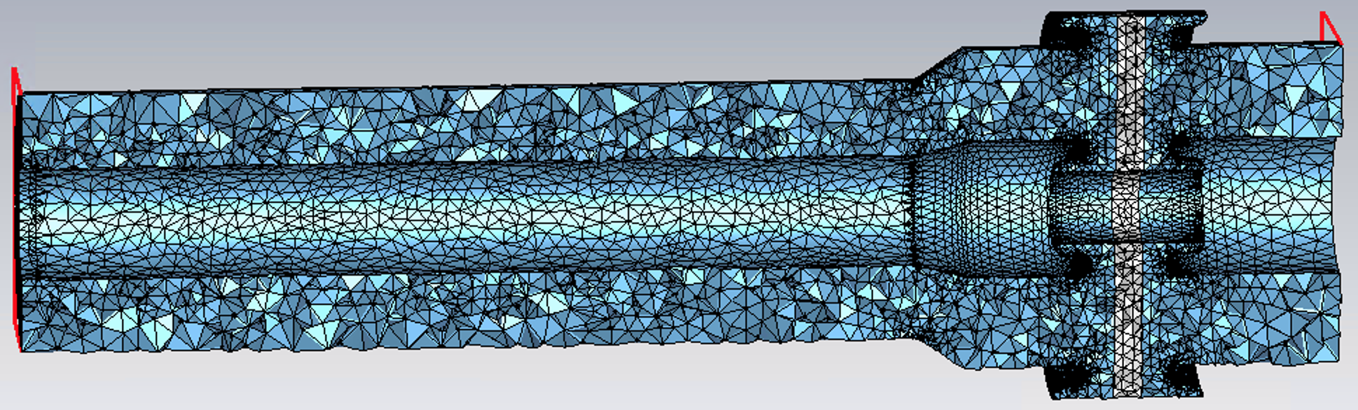
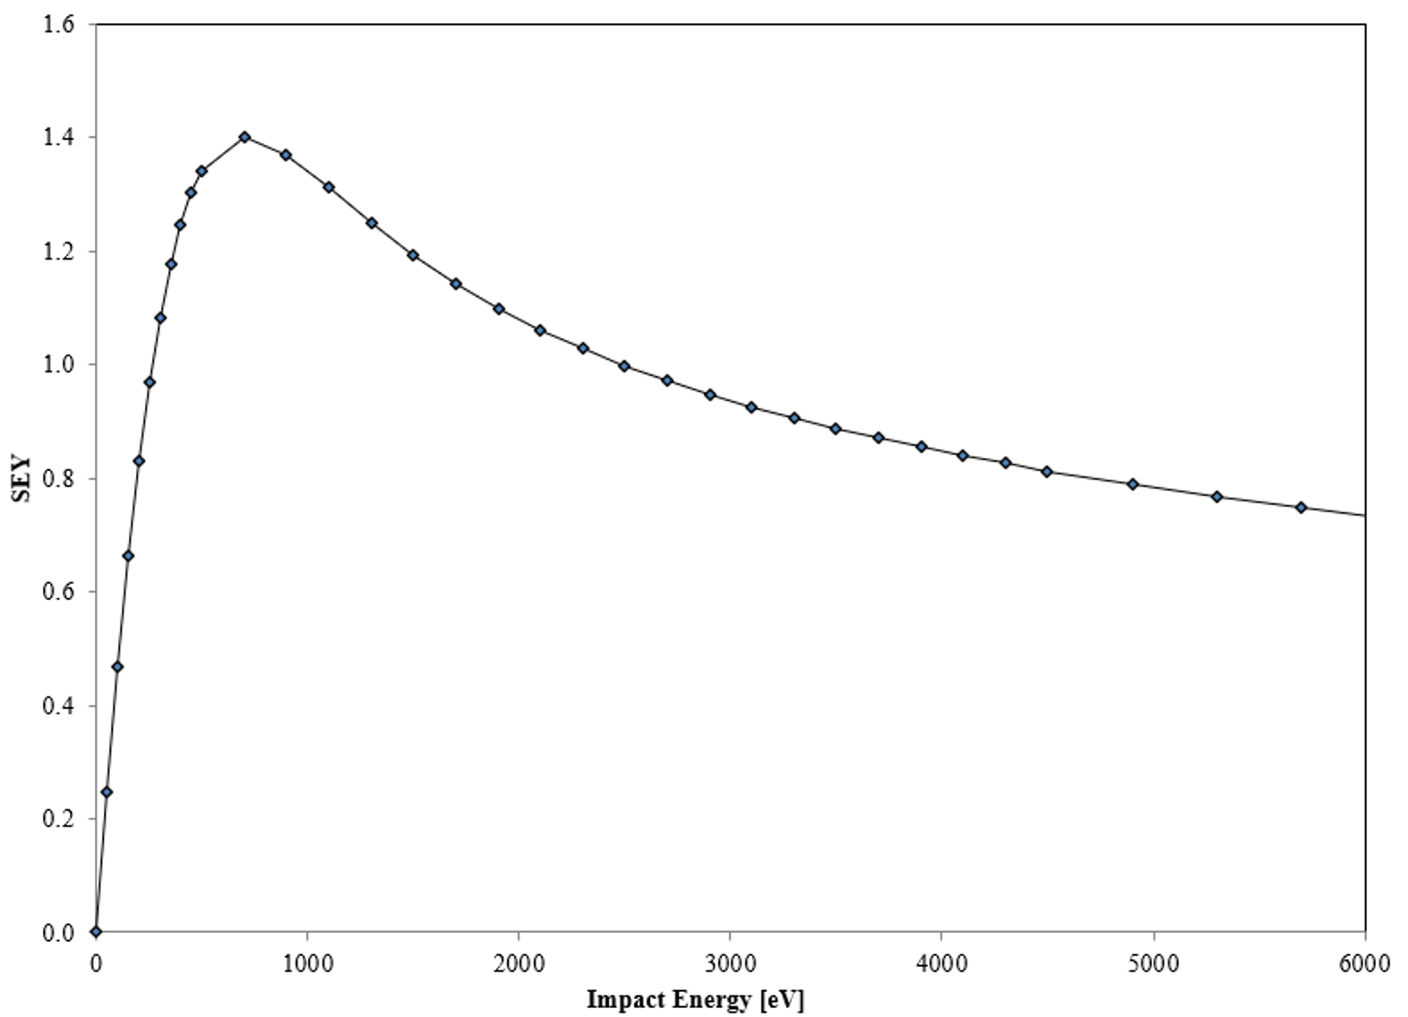
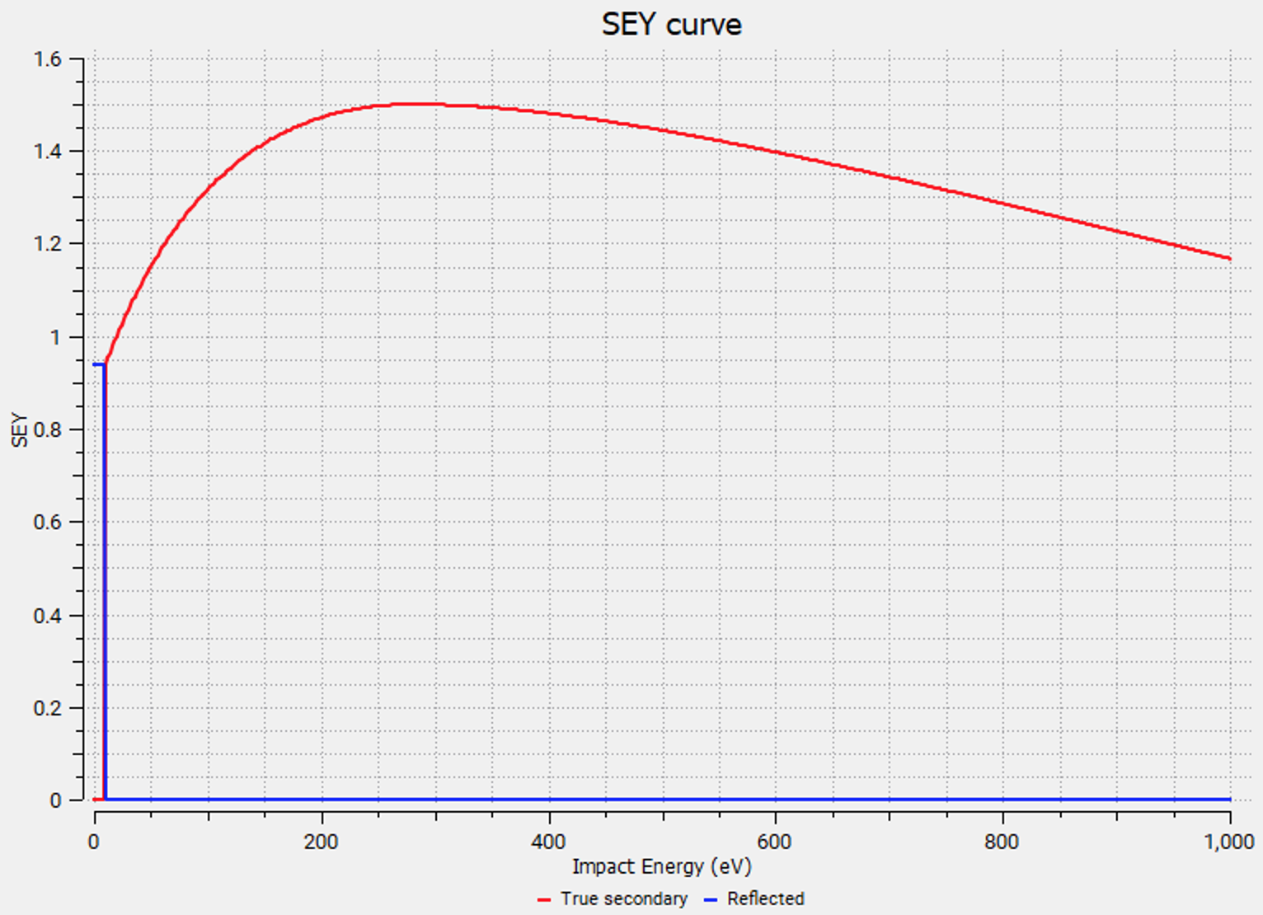
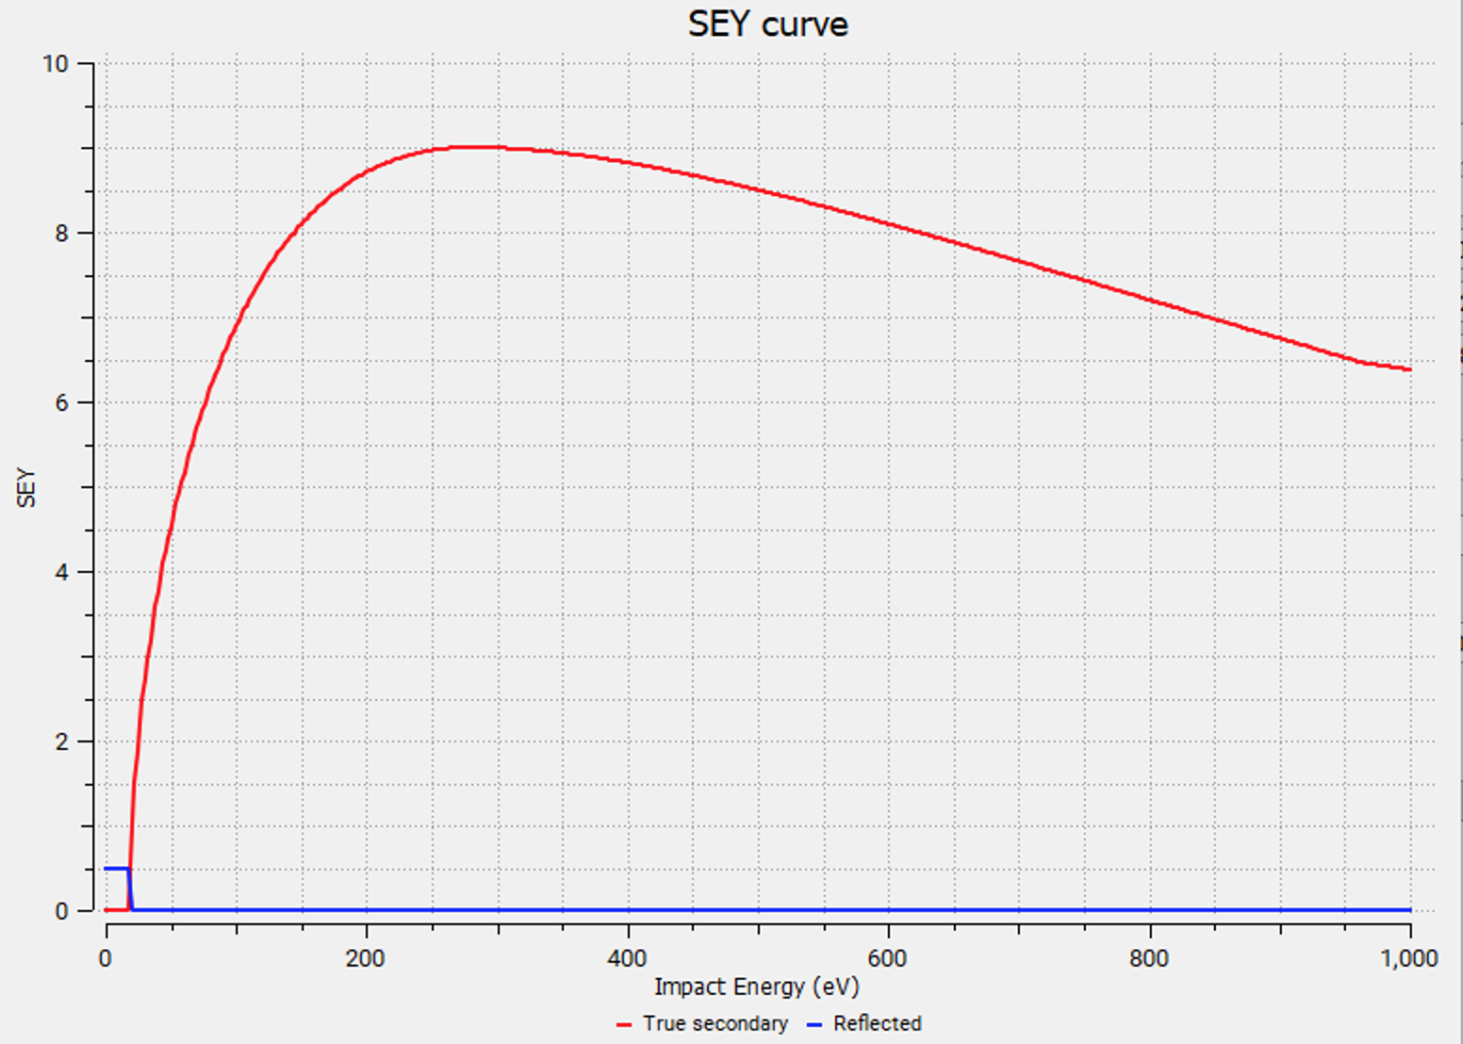
Multipacting Simulation with SPARK3D
Mulitpacting simulation in two regions: vacuum side
Multipacting simulation was carried out with and w/o DC bias.
In reality, a DC bias will provision for application if we need.
Typical TiN’s SEY is with SEY_max=1.2~1.5
Extreme case: SEY curve of Alumina w/o TiN.
Note: SEY >1 for impact energy from 20 eV-1000 eV
SEY curve of cleaned and baked Cu
There will be SEY measurement results on the samples in the later slide

Slide 15
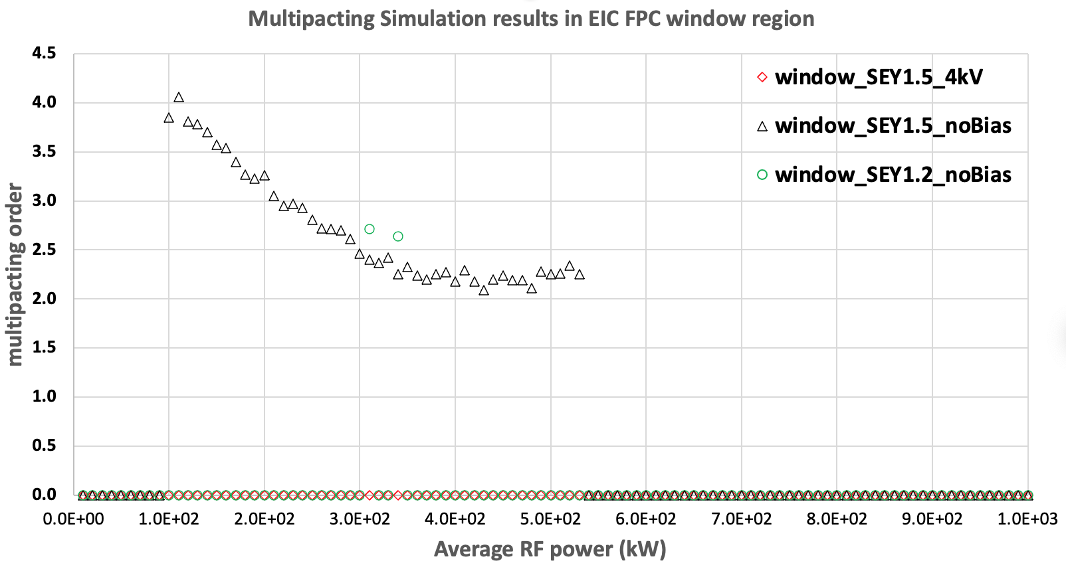
Multipacting in Window Region: Typical TiN SEY
Only one narrow MP zone for good TiN coating quality
No MP for SEY 1.5 with 4 KV bias
With SEY_max=1.2, only one narrow MP zone at 310, 330 kW, no bias is needed.
With SEY_max=1.5, a wide MP zone spans from 100-520 kW. However, when 4 kV bias is applied, there is not MP.

Slide 16
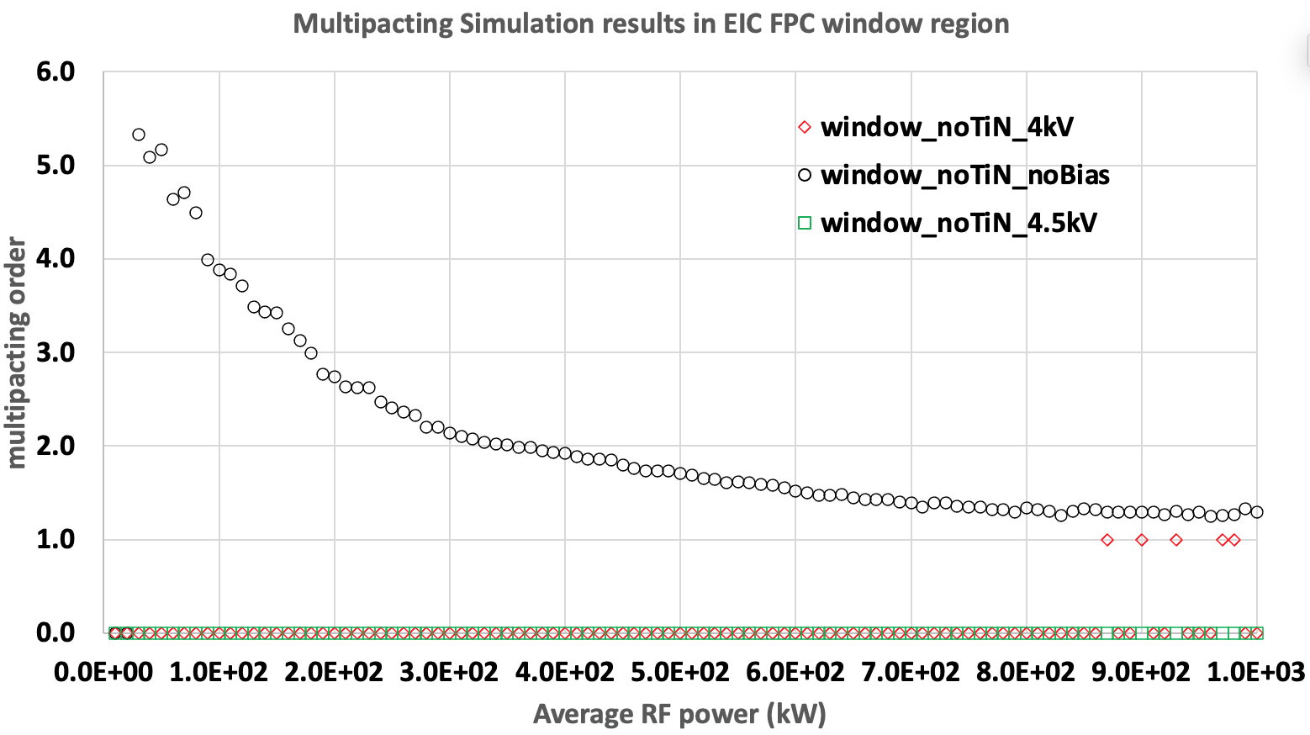
Multipacting in Window Region: No TiN Coating (SEY_max=9)
w/o TiN coating, MP happens at everywhere
4 KV DC bias suppresses most of MP
No MP on alumina with 4.5 KV
Without TiN coating, multipacting happens everywhere, due to broad SEY>1 for all impact energy.
With 4.5 kV DC bias, MP in the window area will be suppressed.

Slide 17
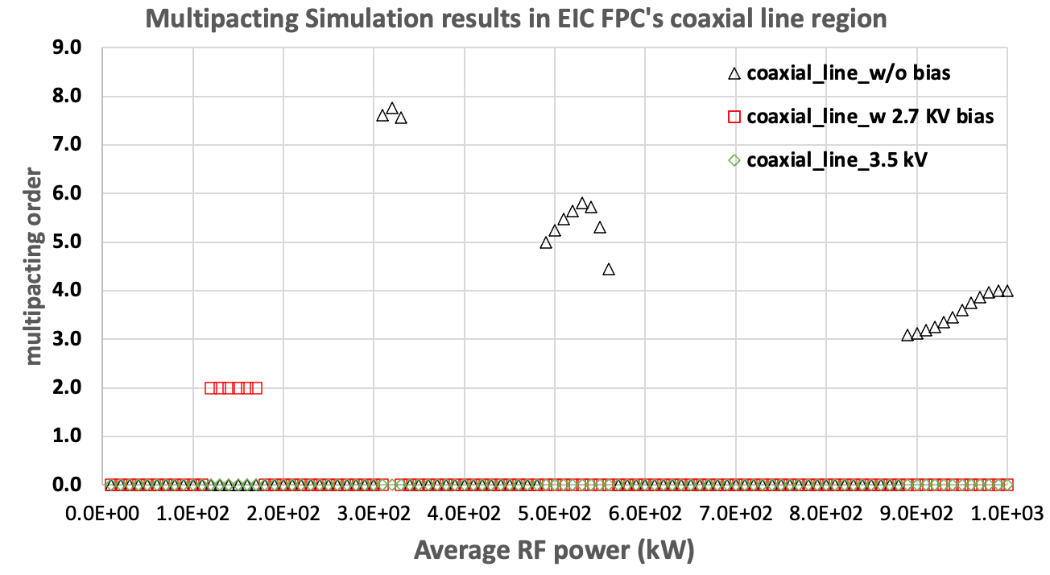
Multipacting in Coaxial Line Region
2.7 kV bias suppressed MP zones but generates new MP zone
No MP with 3.5 KV, 4.5 KV (not shown)
When above 3.5 ~4.5 kV DC bias is applied, there is no MP in coaxial line region.
So a 4.5 kV DC bias will be ready to be applied, if needed, to suppress all multipacting.

Slide 18
Vacuum side outer conductor

Slide 19
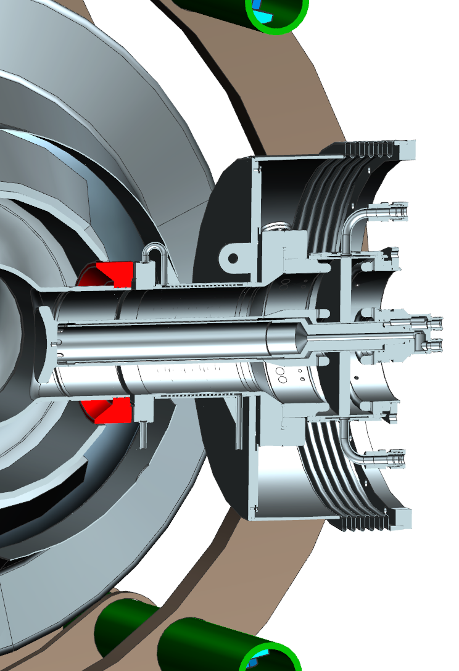
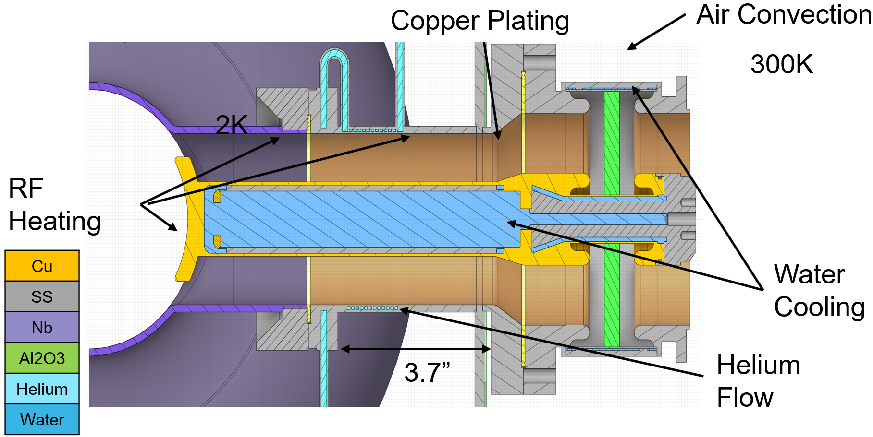
Vacuum side outer conductor
Challenge:
  Compact space: Short distance between 2 K to 300 K
  Large RF heating (especially in some operation scenarios)
  FPC flange is the LHe boundary, i.e, the FPC tube on the cavity is immersed in the LHe.
Helium bath flange

Slide 20
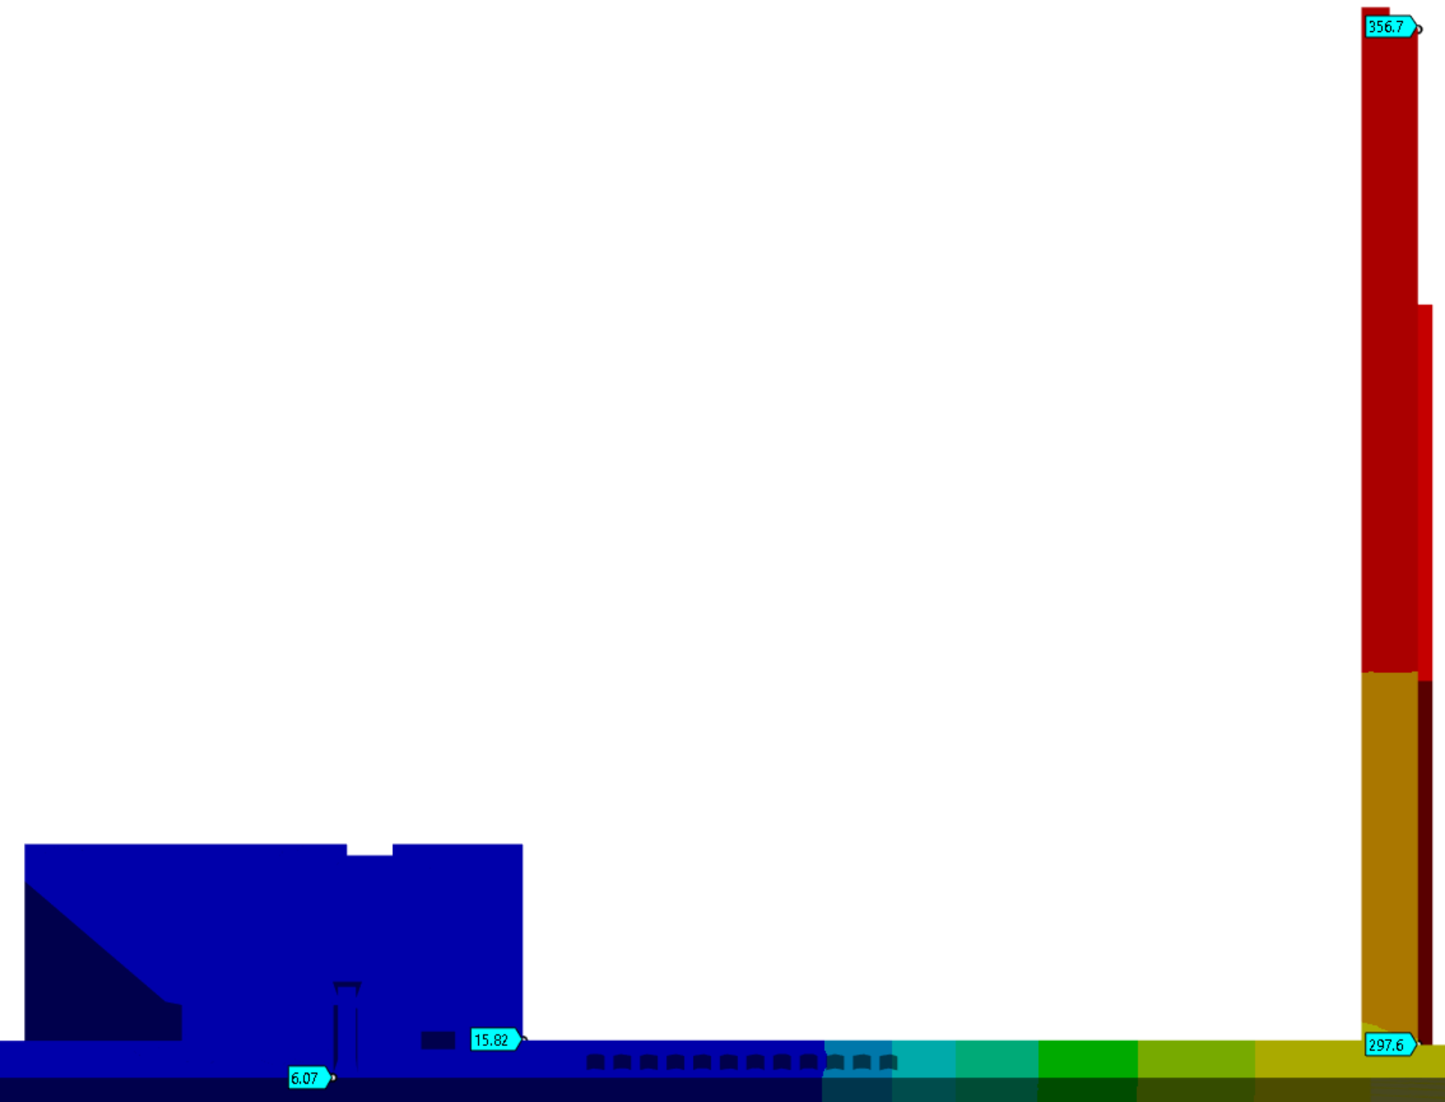
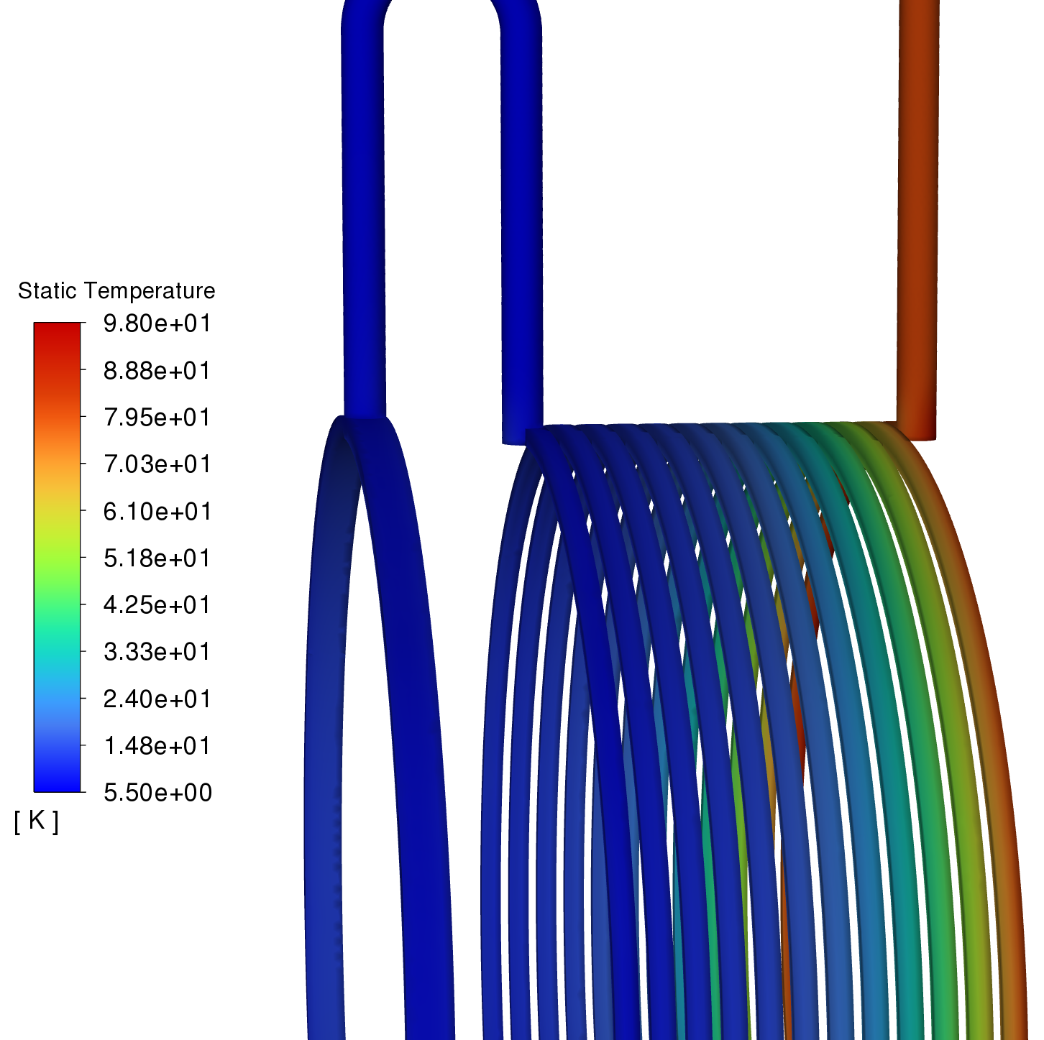
Thermal design results
5.5K helium, 3.3atm, 300mg/s inlet flow
400kW RF power (10GeV operation voltage and 2.5A average beam current)
4W radiation load, 20W heaters
Shielded seal provides direct path between warmer flange and niobium
Assuming perfect contact for both knife edge and RF shield. No contact between flanges
All results meet the requirements
6.1K niobium temperature @300mg/s trace flow
Lowest temperature at bellows flange: 298 K
8.2W heat flow to 2K
80K outlet temperature, 287kPa pressure
61m/s max velocity in the channel

Slide 21
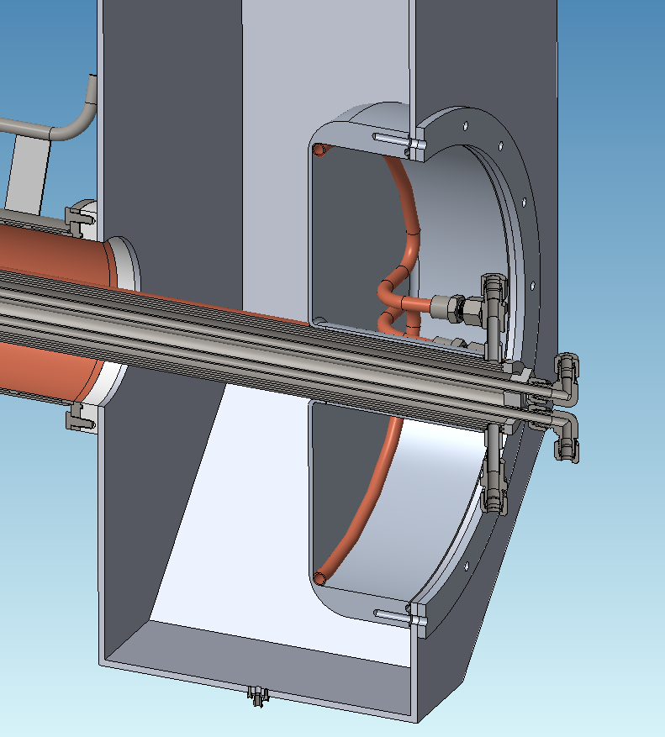
Airside components

Slide 22
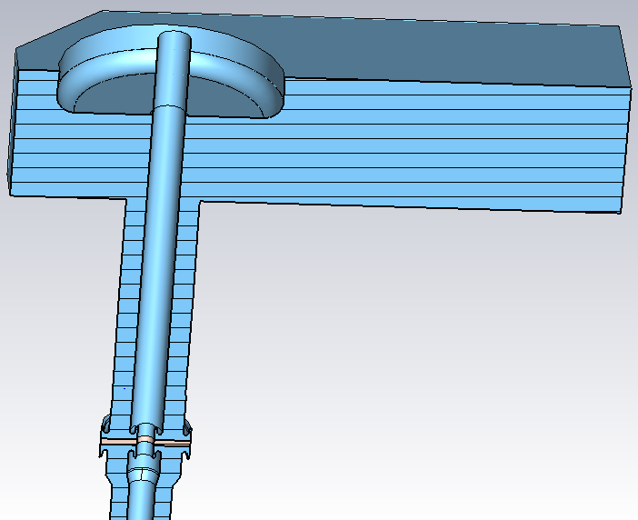
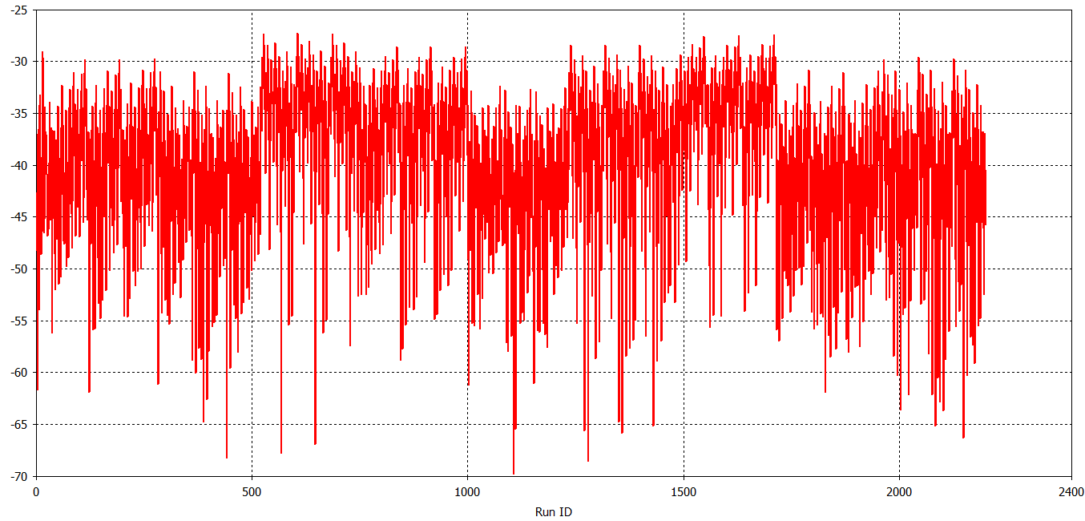
FPC air side components
FPC Airside Components:
  FPC airside length needs to cooperate the limit space in the tunnel
  Doorknob is optimized for RF transmission, and we are working on engineering design based on error analysis results.
Doorknob error analysis

Slide 23
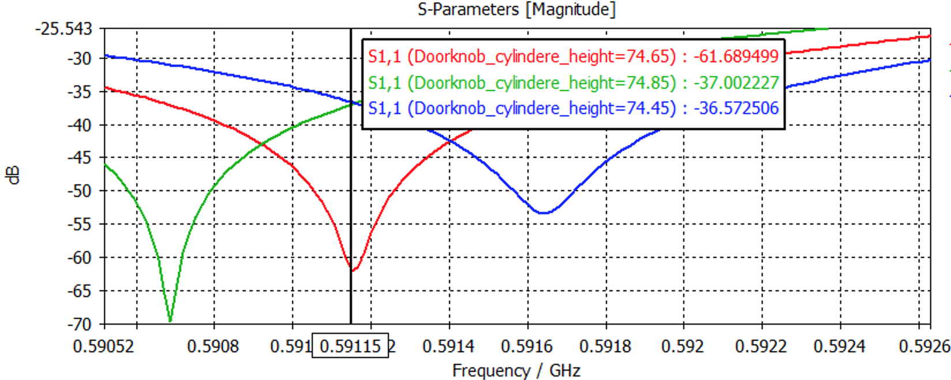
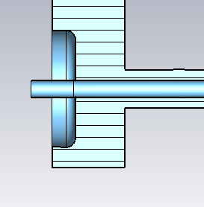
Doorknob tuning mechanism
Doorknob cylinder height
  Red: 74.65
  Green 74.65+ 0.2 (mm)
  Blue: 74.65-0.2

Slide 24
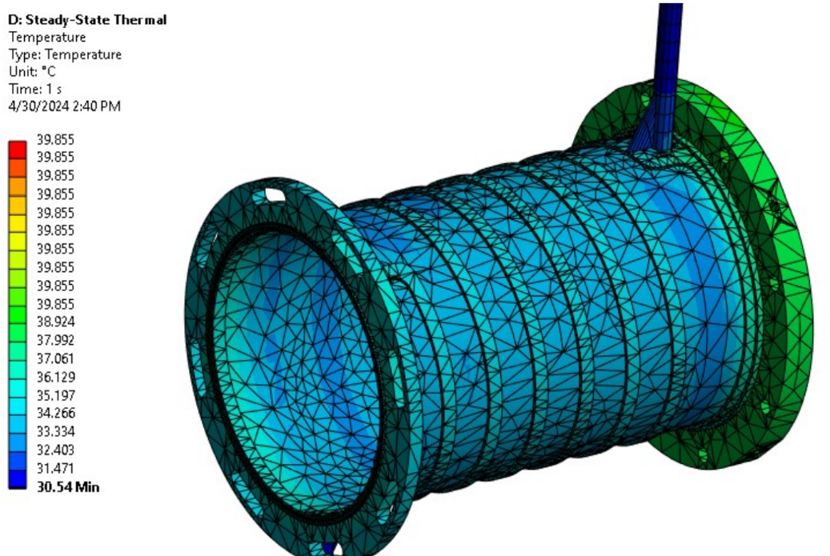
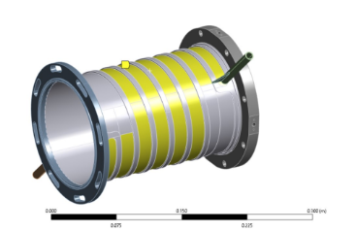
Airside outer conductor
Water cooling.
150 W RF power dissipation

Slide 25
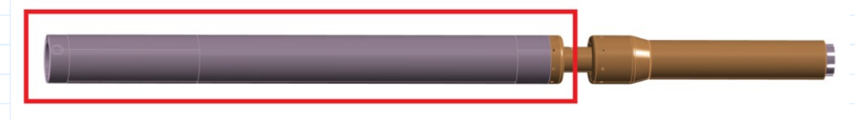
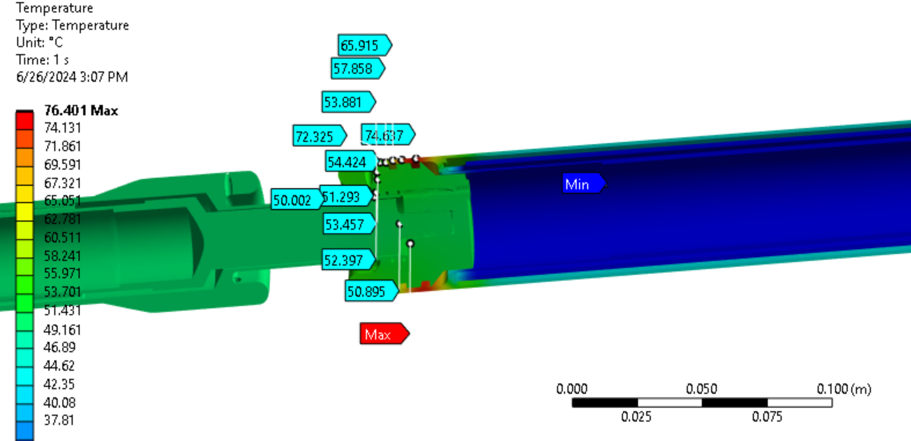
Airside inner conductor
Challenge to bring water to the end of the airside inner conductor.
1500 W of RF dissipation (With RF FODO operating scenarios, RF dissipation is ~10 times smaller ).

Slide 26
Water cooling for doorknob and waveguide
Water cooling design is capable of up to 5.4 kW RF dissipation.
RF dissipation will be only ~500 W, with recent determination of the operation mode (focus-defocus).

Slide 27
Prototype FPC manufacture progress
  RF window brazing recipe development
  TiN coating sample measurement
  Brazing and EB welding

Slide 28
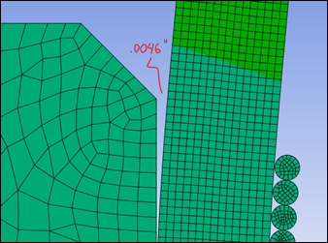
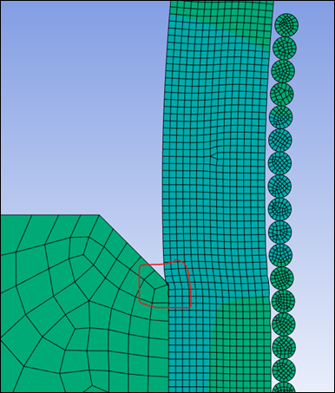
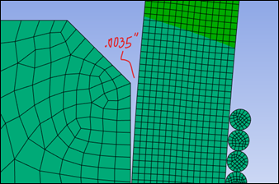
RF window brazing recipe development

Slide 29
Successfully brazed RF window
Question: which side is preferred for the vacuum side?

Slide 30




TiN coating study (1)
Vendor 2
TiN coating will be coated on ceramic vacuum side.
TiN coating study
  TiN coating on a window mockup structure.
  Coated by two vendors
  Measure SEY
  Measure species on the TiN coating
  Measure TiN coating thickness
Si and Ceramic stripe
Vendor 1
Window mockup

Slide 31
TEM analysis on TiN coating
Vendor #1
Thickness: 5 -6 nm
Local crystal
TiN layer
Native silicon oxide layer
Si substrate
Thickness: 7 -8 nm
Vendor #2
TiN coating analysis by BNL Center for Functional Nanomaterials (CFN) with transmission electron microscopy (TEM)
Similar TiN coating thickness from two vendors
Both vendor got TixNiyOz, but with different composition.

Slide 32



TiN coating SEY measurement
Three samples sent to KEK (Kirk Yamamoto, Thank you!) for SEY measurement
  BNL#1 and BNL#2 were coated by vendors
  BNL #3 was bare Al2O3
Both vendors’ SEY results are close to each other.

Slide 33

Multipacting simulation
Conservative (worse than the measurement results) SEY curve was used for multipacting simulation.
Multipacting simulation shows that multipacting will be fully suppressed (even no TiN coating on ceramic) with 4.5 kV DC bias applied.
However, TiN will be coated on the ceramic.
FPC test will start without bias.
SEY curve used in simulation.

Slide 34









Window Manufacturing - Status
Vacuum-side Flange sub-assembly
Air-side Flange sub-assembly
Water adapters
Water supply/returns
Air-side Choke/Hub sub-assembly
Antenna “Pringles”
Small Sleeve / Tapered Choke

Slide 35


EB welding test

Slide 36


FPC conditioning box and cart
Finalized FPC conditioning box drawing package.
Started to refurbish FPC conditioning cart.
Hopefully, we can start high power conditioning by the end of summer 2025

Slide 37
Summary and plan
EIC RF needs about 100 new FPCs, which most of them will use the same RF window design.
The most demanding FPC is the FPC for ESR SRF cavities. And a CW 500 kW high power FPC has been designed for ESR SRF cavity.
Prototype Manufacture
  Will make 8 window assembly and 4 full FPCs.
  Completed sample tests (brazing, EB welding, coating).
  Most of parts have been made for 5 full FPCs.
  Ready to proceed full FPC manufacture.
  Completed FPC conditioning box design and working on drawing package.
  FPC conditioning setup is under preparation.

Slide 38
Acknowledge
BNL: Jesse Fite, Doug Holmes, Eric Link, Eric Polanco, Donald Landwehrle, Alex Zatsman, Kevin Smith, and more…
Jlab: Bob Rimmer, Zack Conway, Eduard Drachuk, Jim Henry, and more…
CERN: Eric Montesinos
SNS: John Mammosser
KEK: Eiji Kako, Kirk Yamamoto
IHEP: Tongming Huang
FNAL: Sergey Belomestnykh
Everyone in this meeting !!

