Slide 1
Fundamental Power Couplers of PIP-II project
Sergey Kazakov
World Wide Fundamental Power Coupler meeting #6
2-3 July 2024

Slide 2
Outline:
PIP-II project
Couplers requirements
RFQ coupler
325 MHz, Single Spoke Resonator (SSR) coupler
DC block
650 MHz coupler
650 MHz, Low cryogenic loading coupler.
1.3 GHz, Lowe cryogenic loading coupler.
Testing new conductive ceramics.
325 MHz coupler test stand
650 MHz coupler test stand
Measurements of loss tangent of ceramics

Slide 3
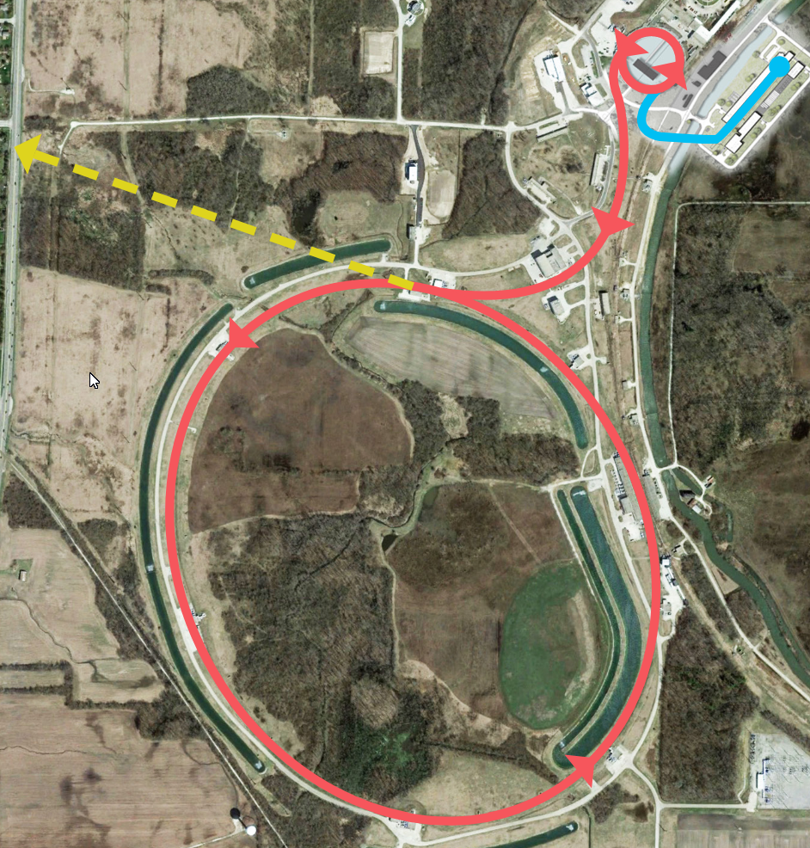
PIP-II project:
PIP-II (Proton Improvement Plan) – superconducting 800 MV linac, which will serve as proton injector for Fermilab Accelerator complex.
Main PIP-II parameters
Parameter | Value | Units
Beam energy | 800 | MeV
Beam particles | H-
Beam power | 1.2 | MW
Average current | 2 | mA
Frequency | 162.5 harmonics | MHz
PIP-II
Buster and
Main Injector
Neutrino beam

Slide 4
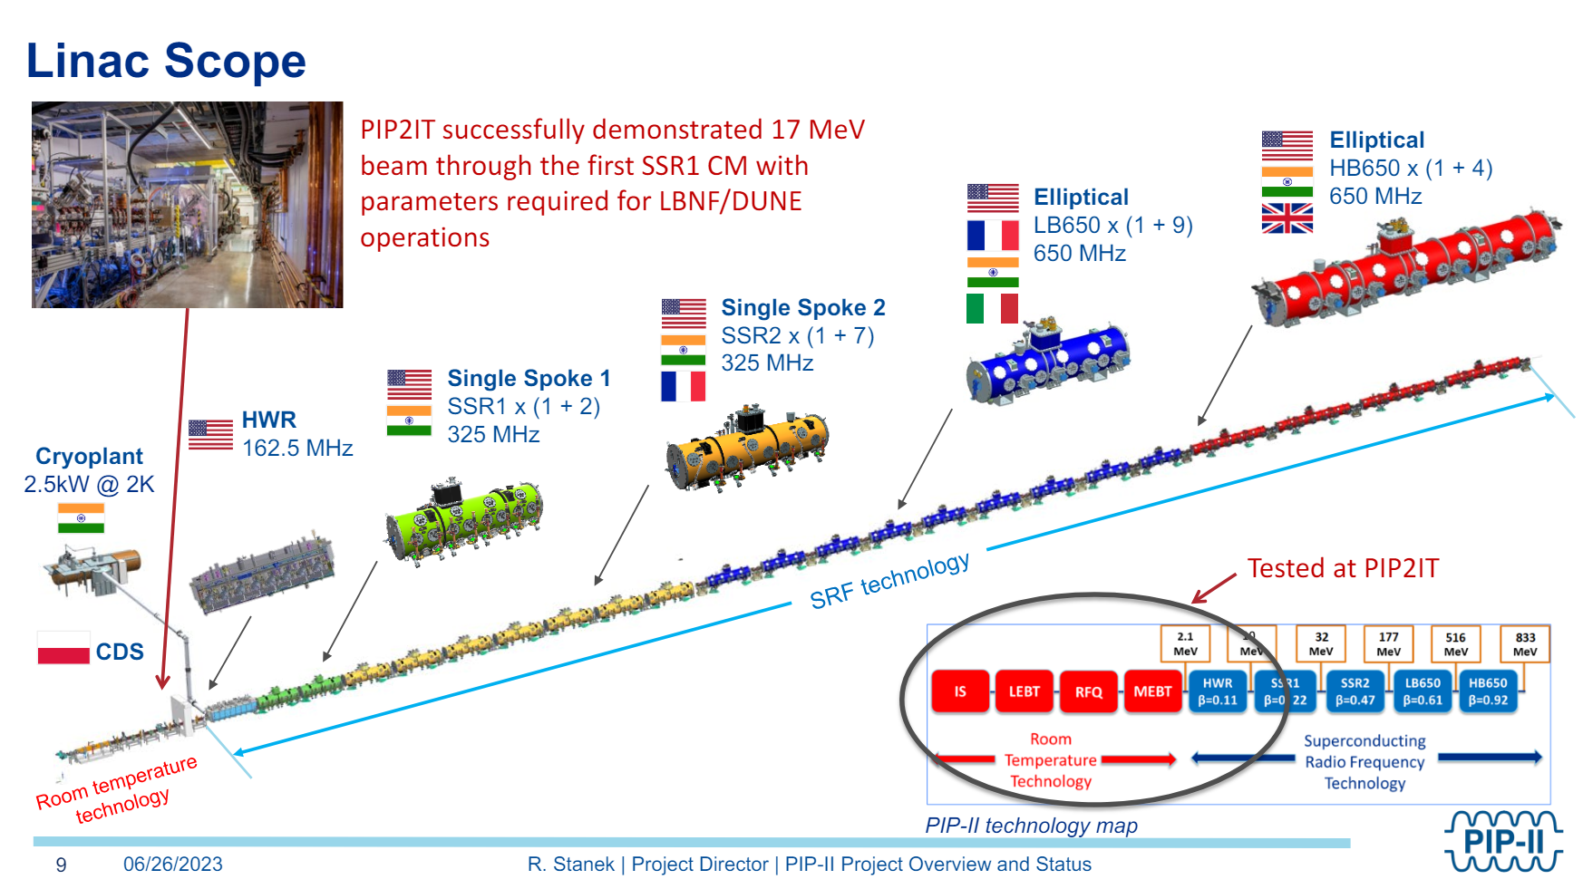
PIP-II is international project:

Slide 5
Couplers of PIP-II project, types and number.
Cavity Type | Coupler type | Number of couplers | Max. power to beam, kW | Max. Power in coupler, kW
RFQ | RFQ | 2 | =<20 | 70
HWR | HWR | 8 | 4.5 | 5.5
SSR1 | SSR | 16 | 4.4 | 4.9
SSR2 | SSR | 35 | 12.4 | 15
LB650 | “650MHz” | 36 | 29.3 | 35.8
HB650 | “650MHz” | 24 | 44.4 | 56
Total number of types of couplers 4
Total number couplers 121

Slide 6
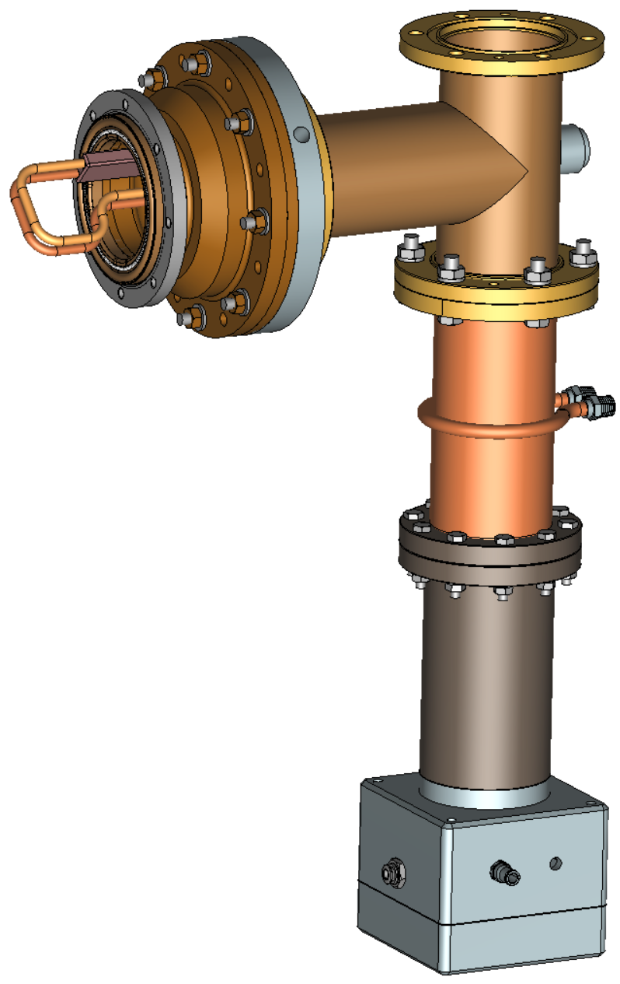
RFQ coupler
Parameters:
Frequency: 162.5 MHz
Operating power: 75 kW
Ceramic sizes: OD 152 mm x ID 33 mm x 4mm
Antenna type: Loop, air cooled, rotatable
HV bias: ~ up to 5 kV
Input: Standard 3-inch 50 Ohm coaxial
Number of couplers: 2

Slide 7
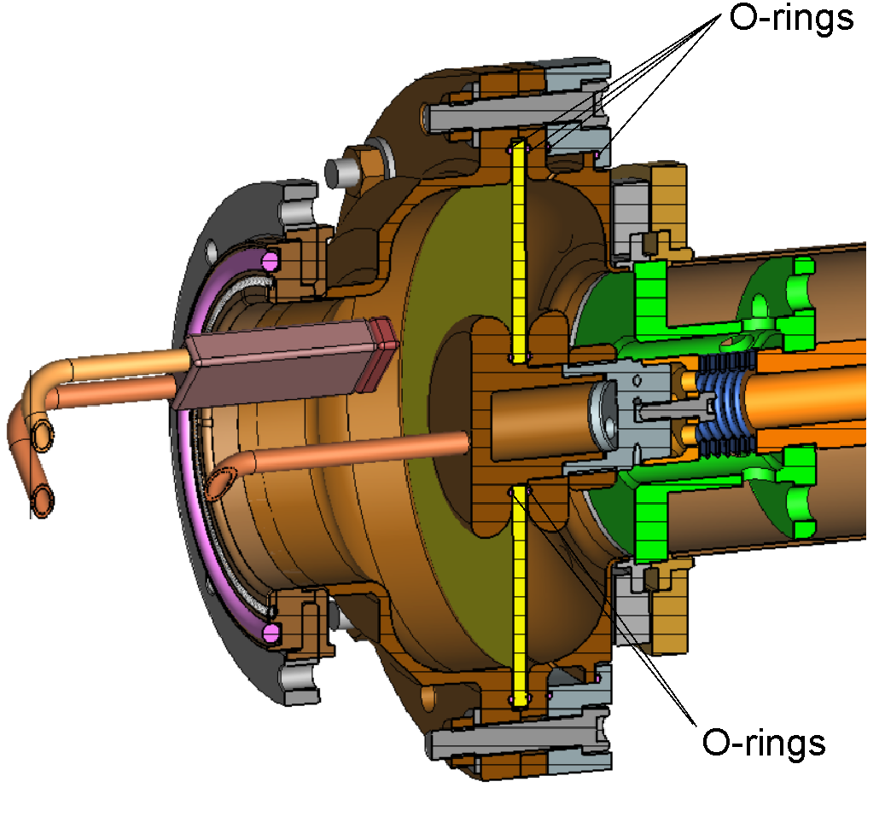
Dismountable window of RFQ coupler
Vacuum requirements of RFQ allow to use Viton O-rings.
Couplers are made dismountable. Ceramics disks can be replaced if necessary.

Slide 8
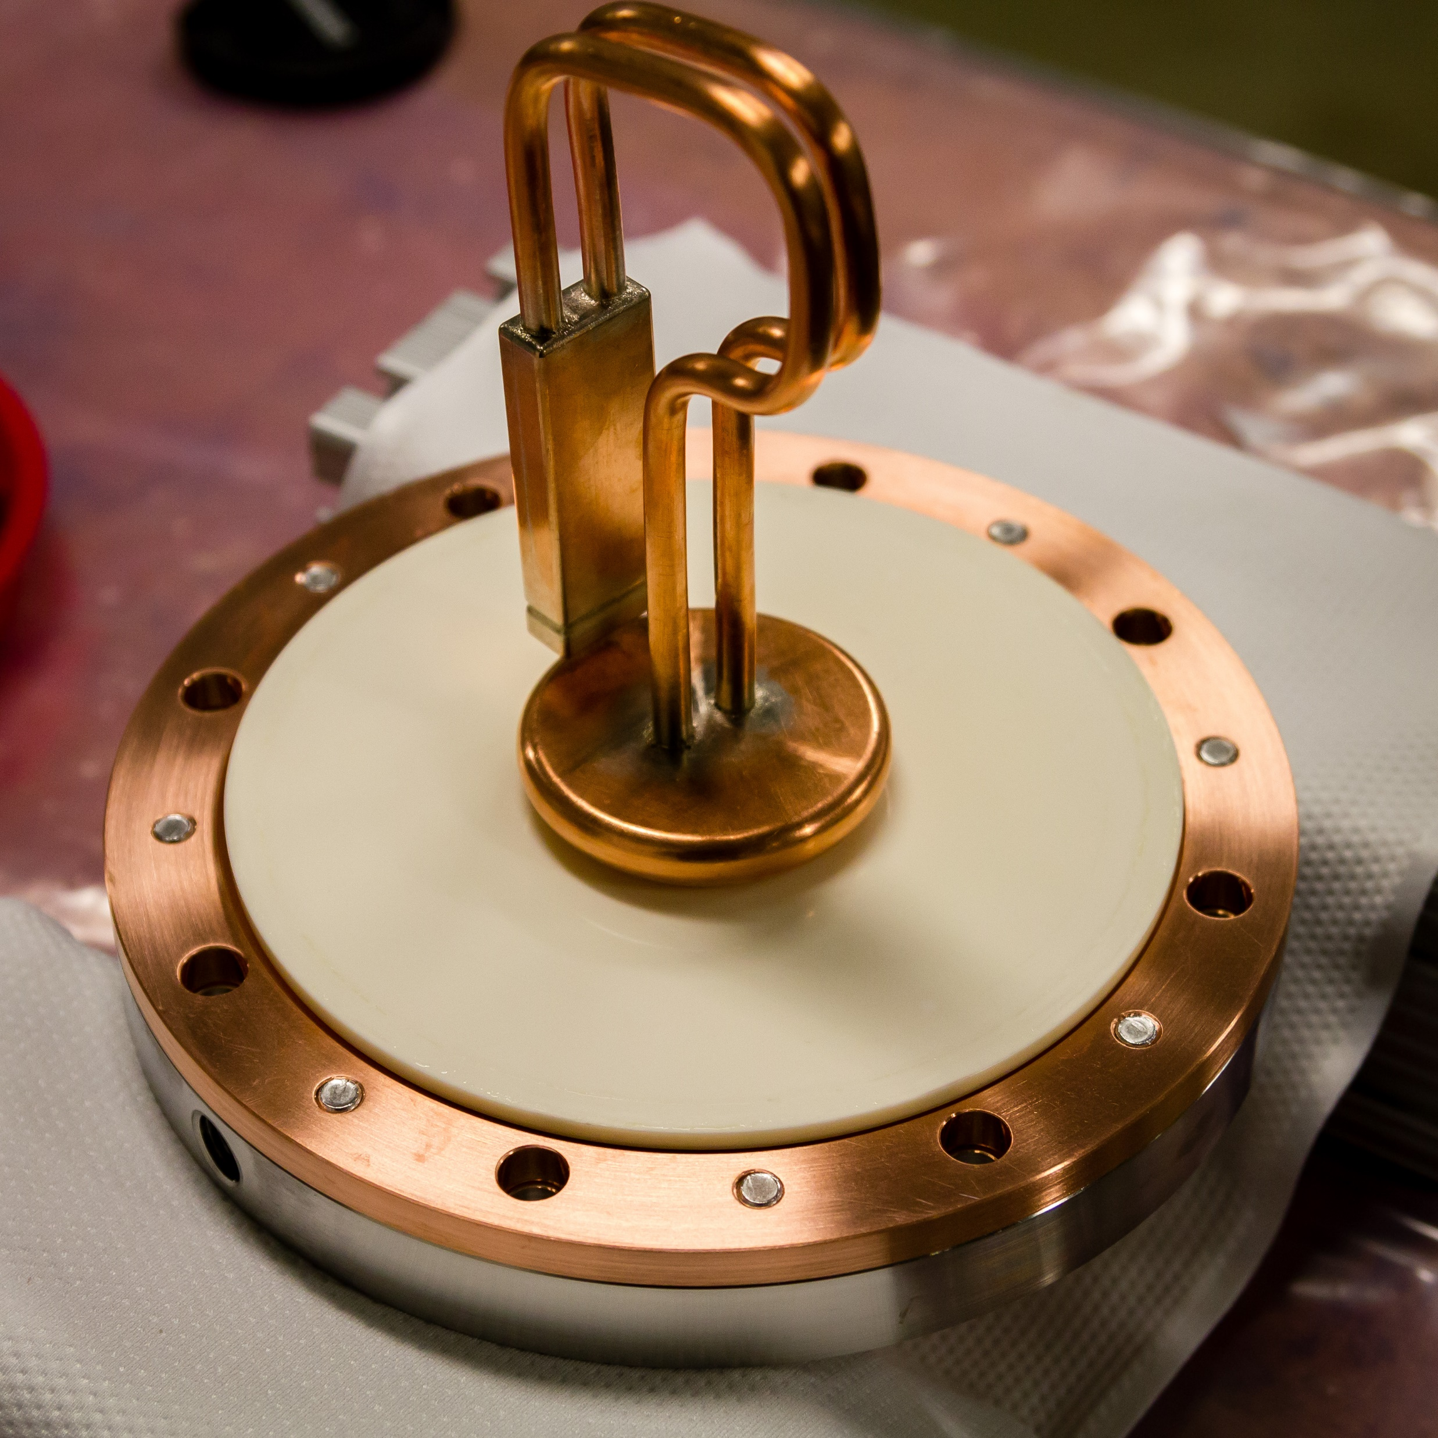
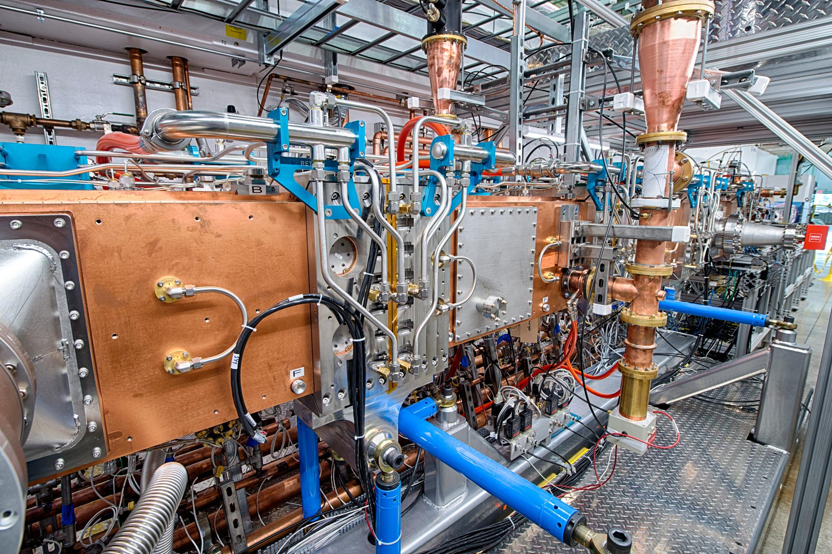
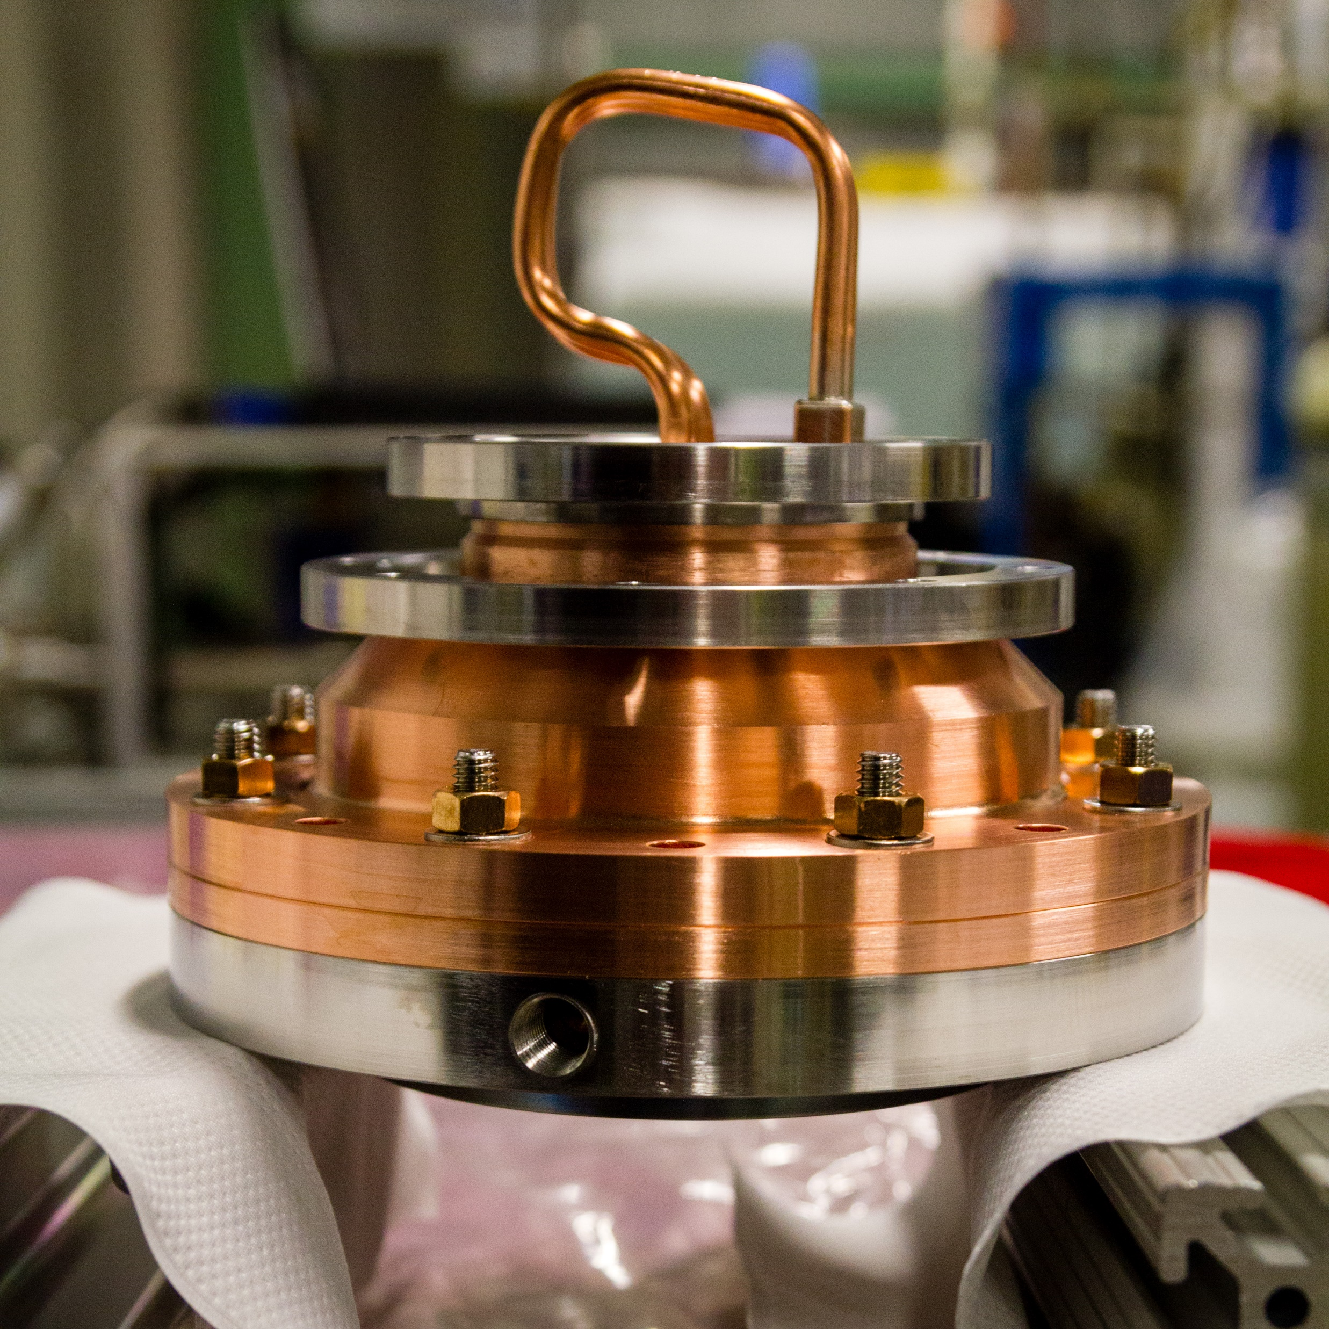

Slide 9
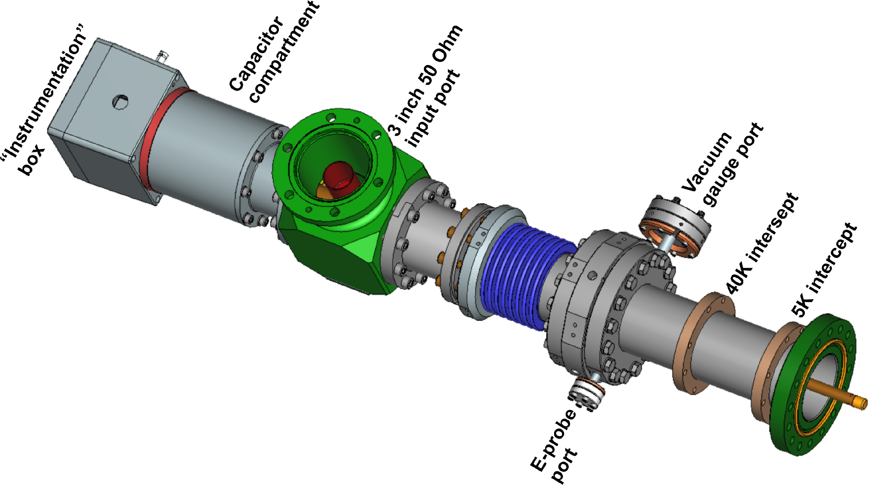
Single Spoke Resonator(SSR) coupler
Parameters:
Frequency: 325 MHz
Operating power: 12 kW
Ceramic sizes: OD 101 mm x ID 25.4 mm x 7mm
Antenna type: copper OD 12.7mm, air cooled
HV bias: ~ up to 5 kV
Input: Standard 3-inch 50 Ohm coaxial
Number of couplers: XX

Slide 10
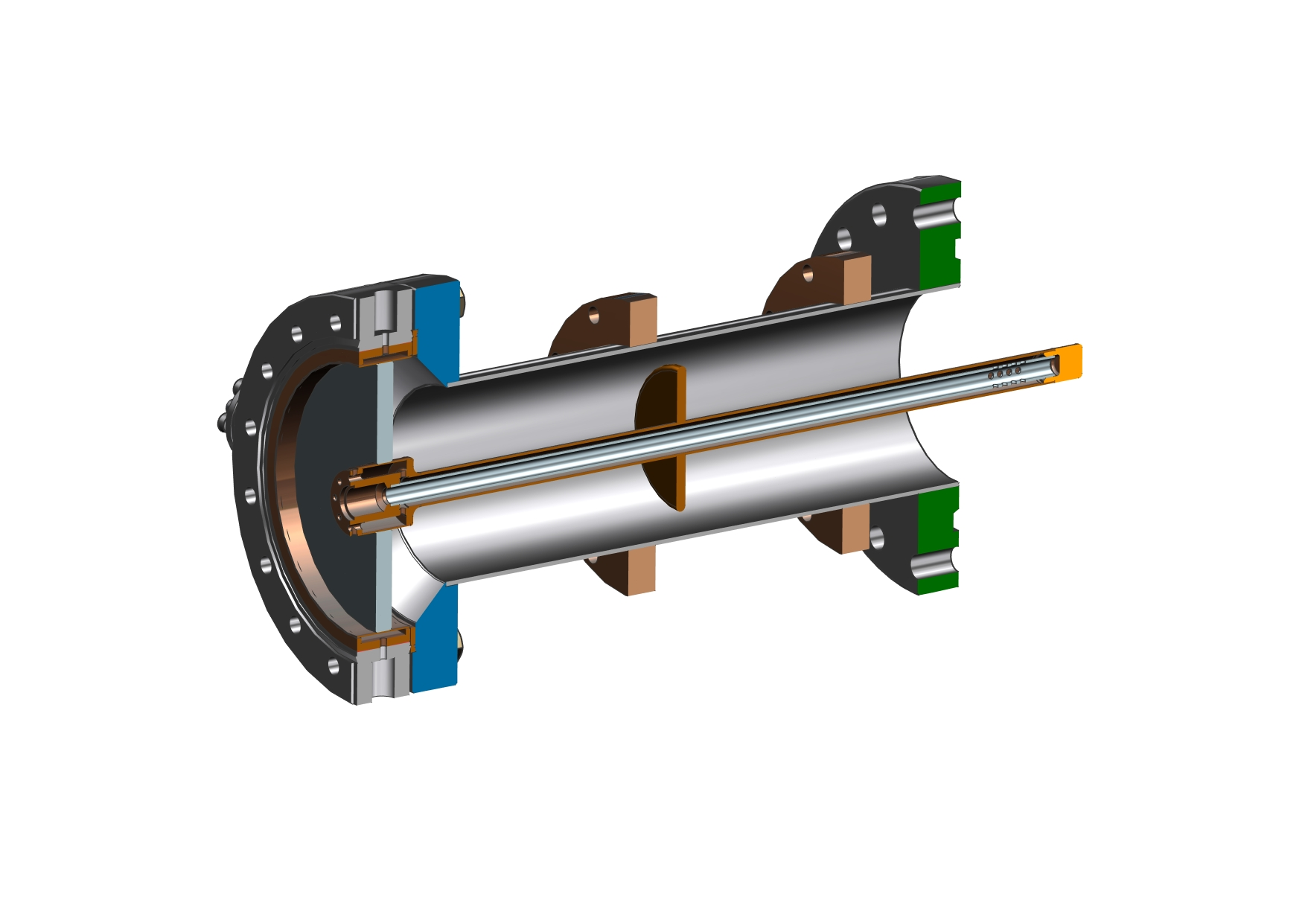
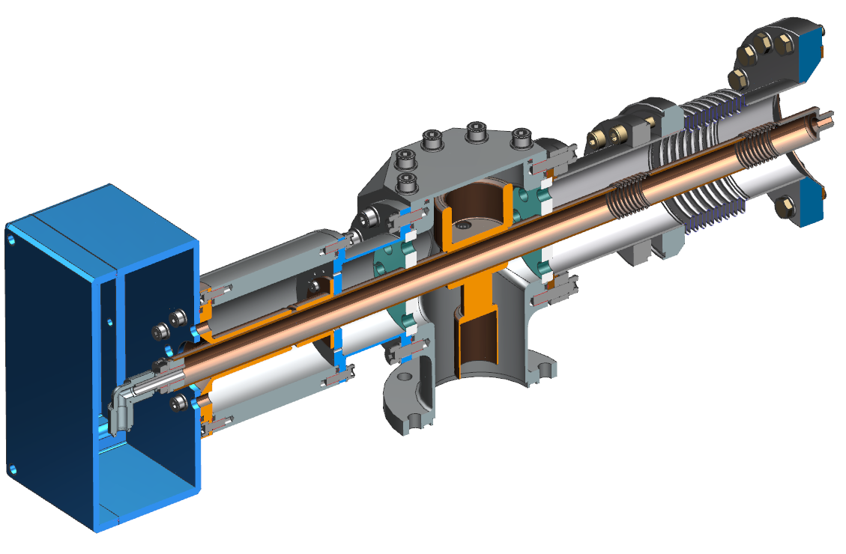
Matching, protecting
copper disk
Air part of 325 MHz coupler
Matching
element
Teflon
supports
Air cooling tube
Capacitor
assembly
Instrumentation
box
Vacuum part of
325 MHz coupler
Copper coated outer
conductor with bellows
Copper coated inner
conductor with bellows
Kapton film
T-junction
Standard 3’’ coaxial
waveguide
Air inlet

Slide 11
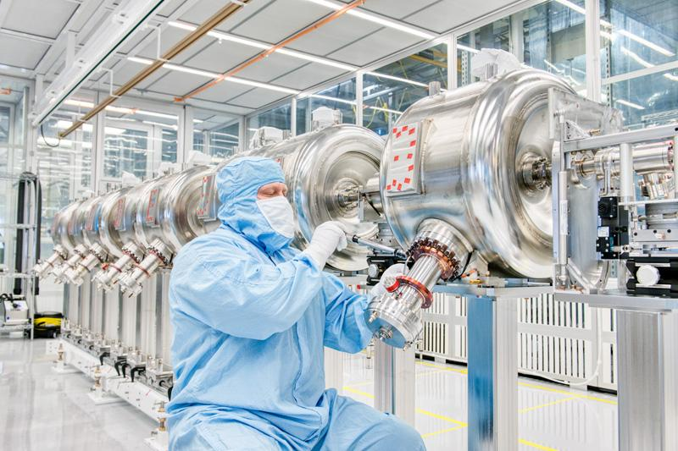
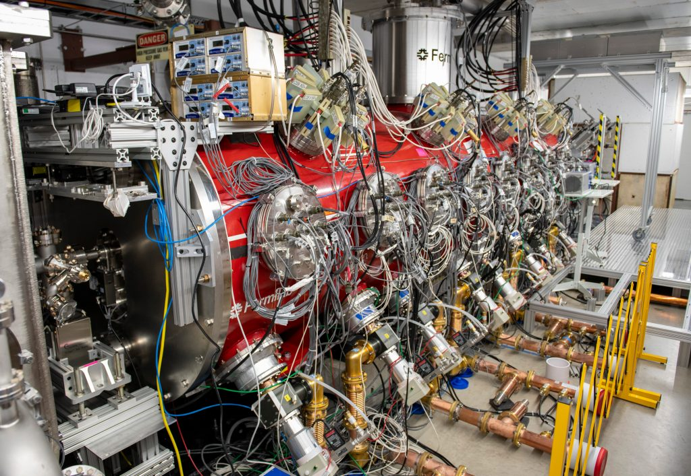
Installing vacuum parts of SSR couplers
Couplers at SSR-I cryomodule

Slide 12
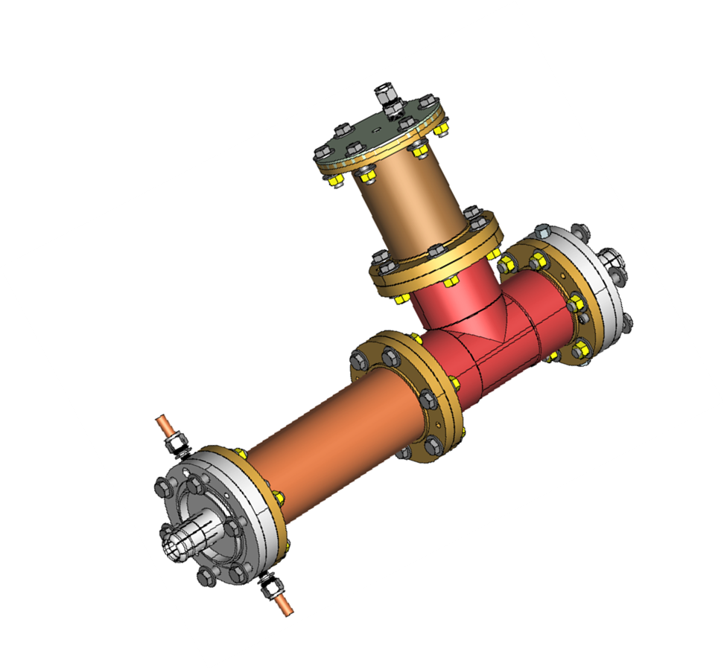
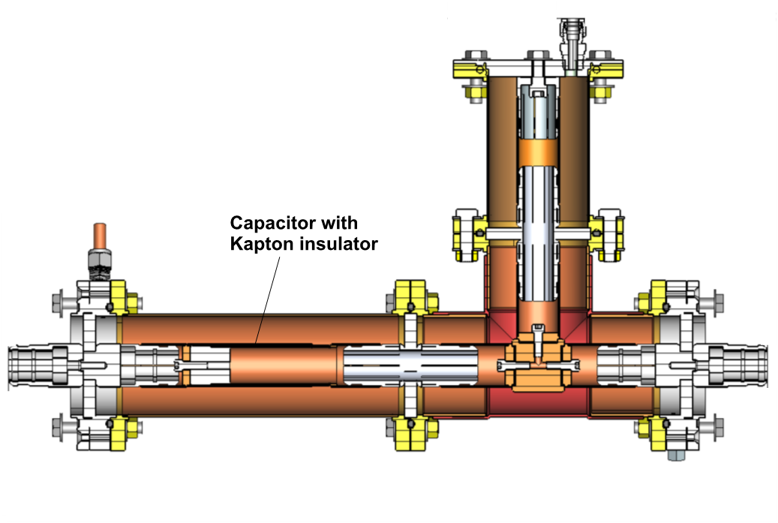
DC block
SSR couplers are connected to RF power amplifier through “ DC-block” (it blocks DC current and transmits RF). The purpose of the DC-block is to protect the amplifier from high voltage of coupler bias.

Slide 13
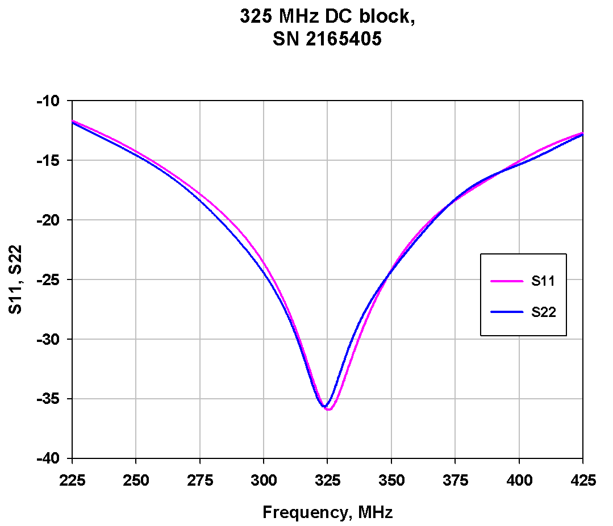
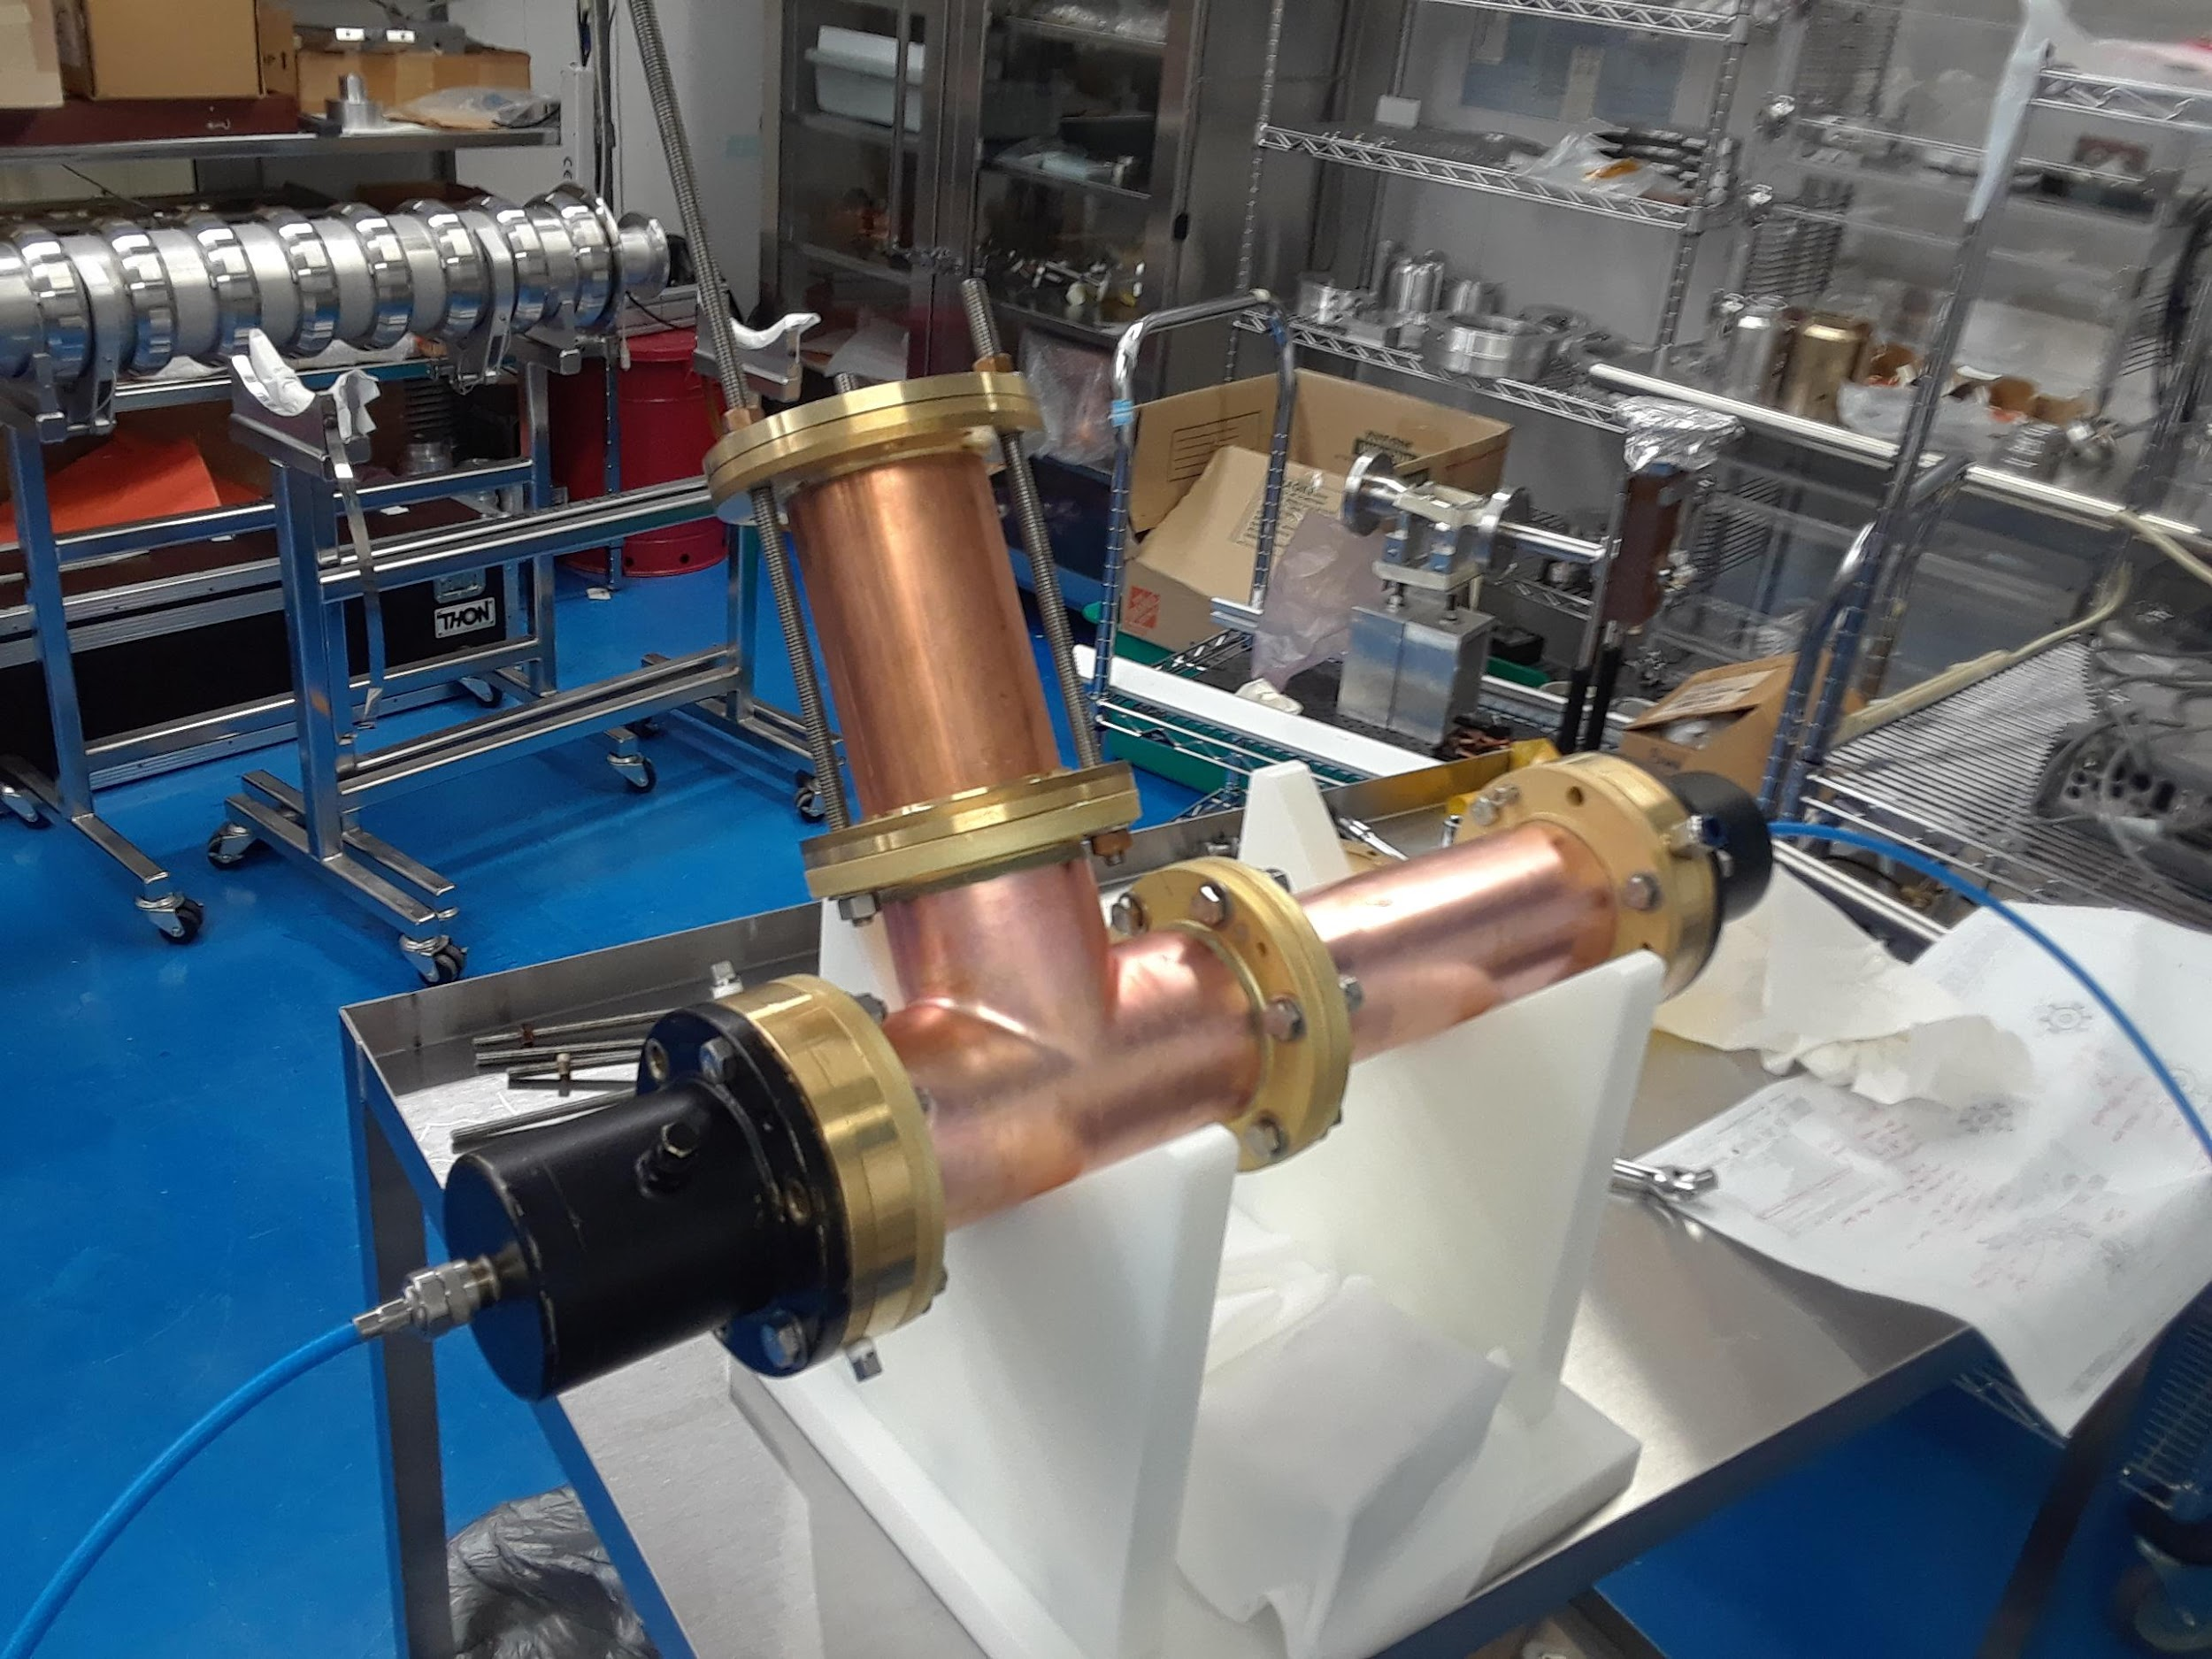
Adjusting the length of short of DC block

Slide 14
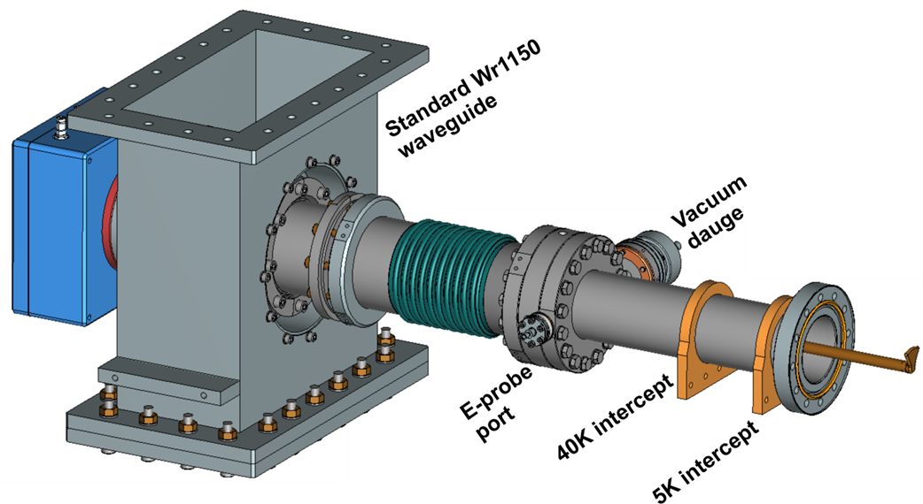
650 MHz coupler
Parameters:
Frequency: 650 MHz
Operating power: 47 kW
Ceramic sizes: OD 101 mm x ID 25.4 mm x 7mm
Antenna type: copper OD 12.7mm, air cooled
HV bias: ~ up to 5 kV
Input: Standard WR1150 waveguide
Number of couplers: XX

Slide 15
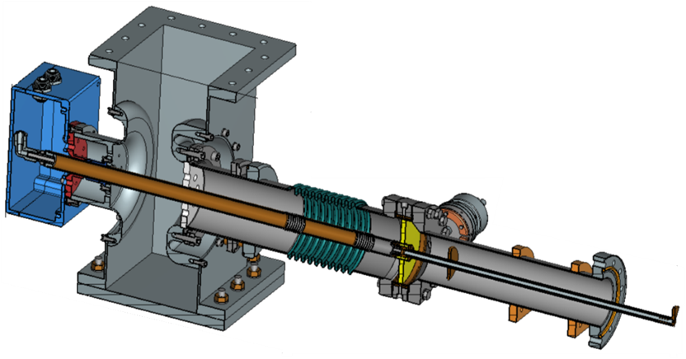
Cut view of 650 MHz coupler

Slide 16
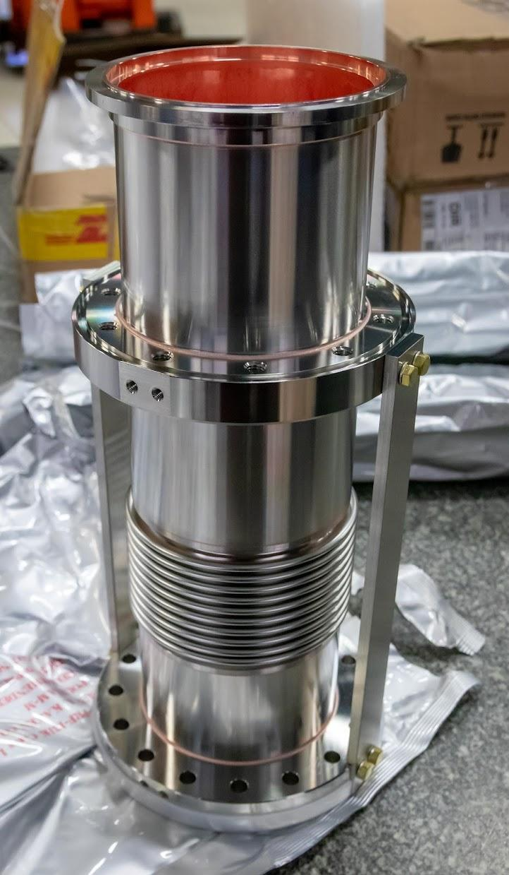
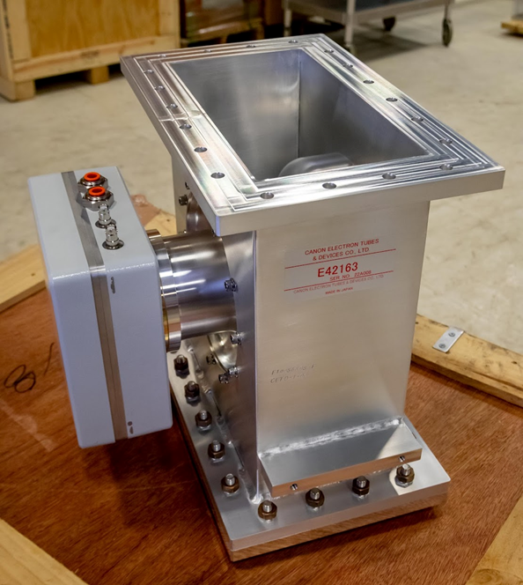
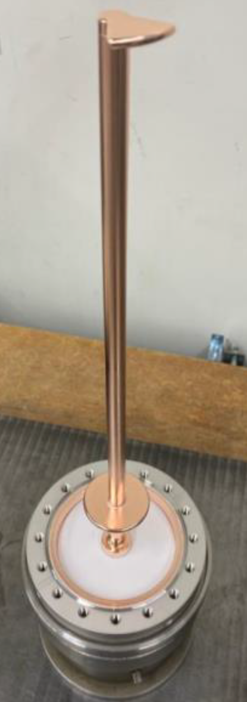
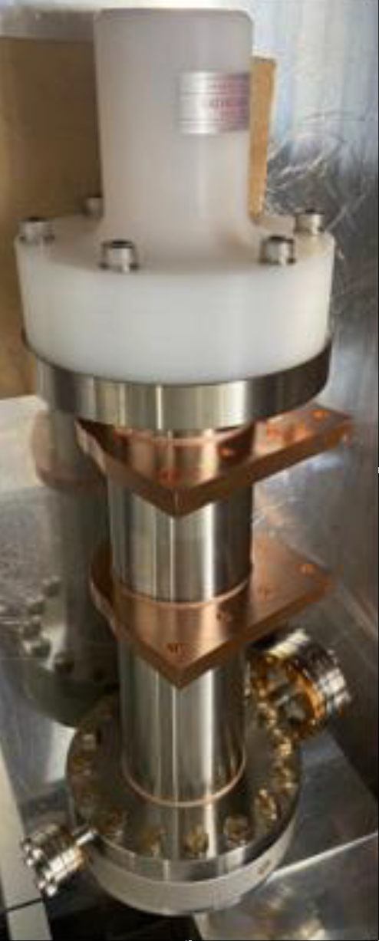
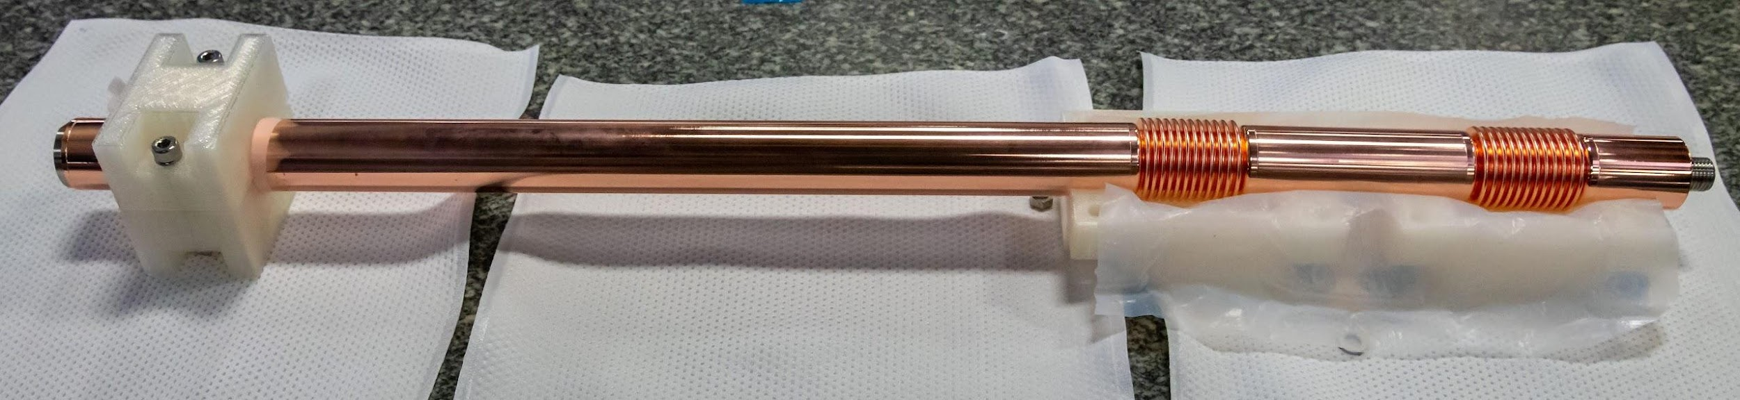
Parts of 650 MHz coupler

Slide 17
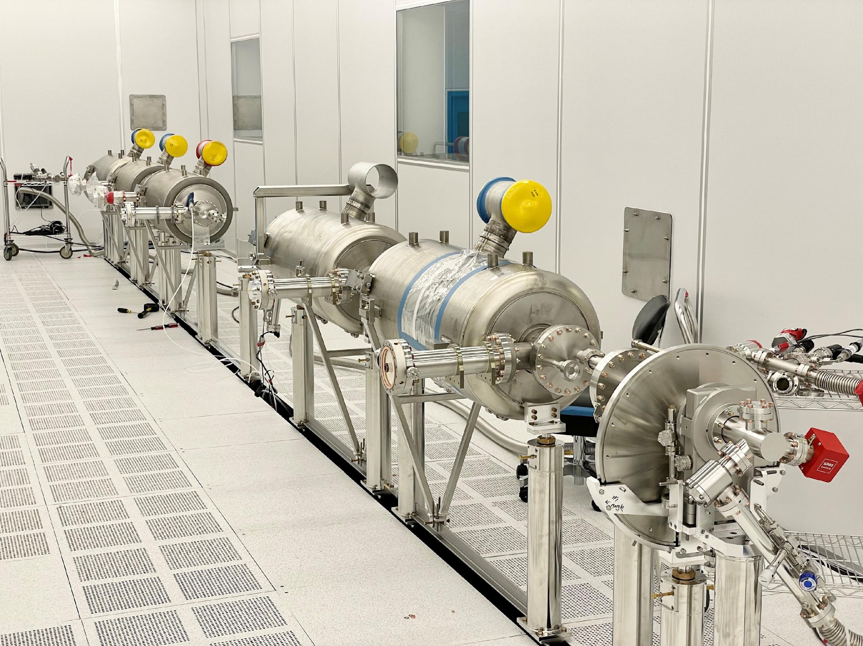
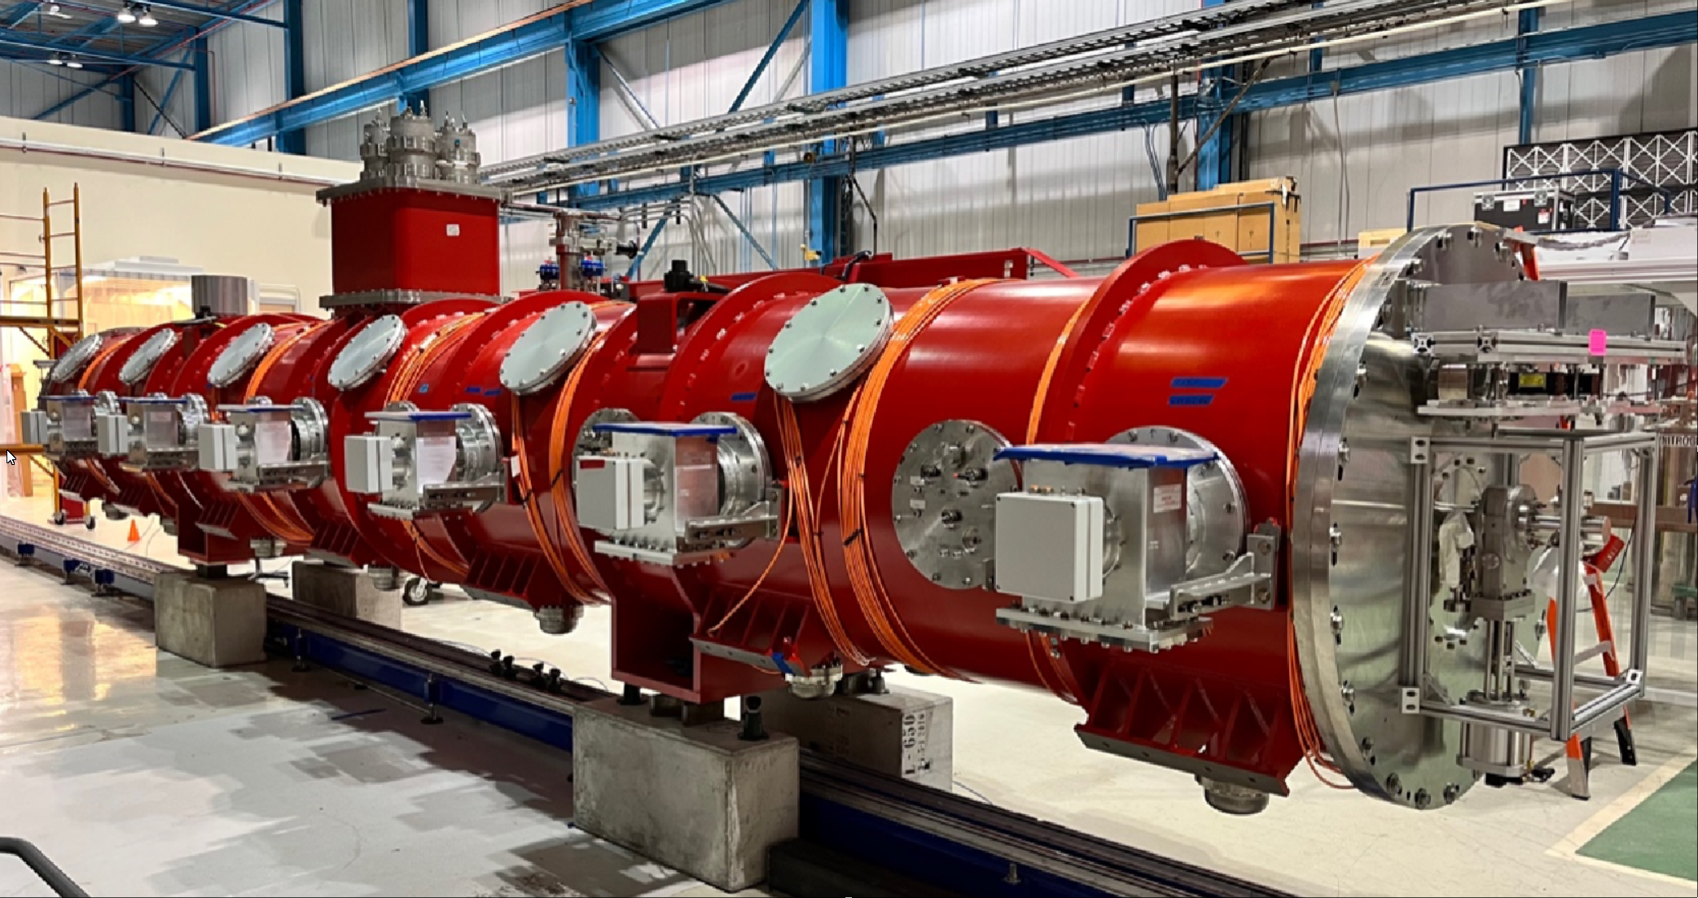
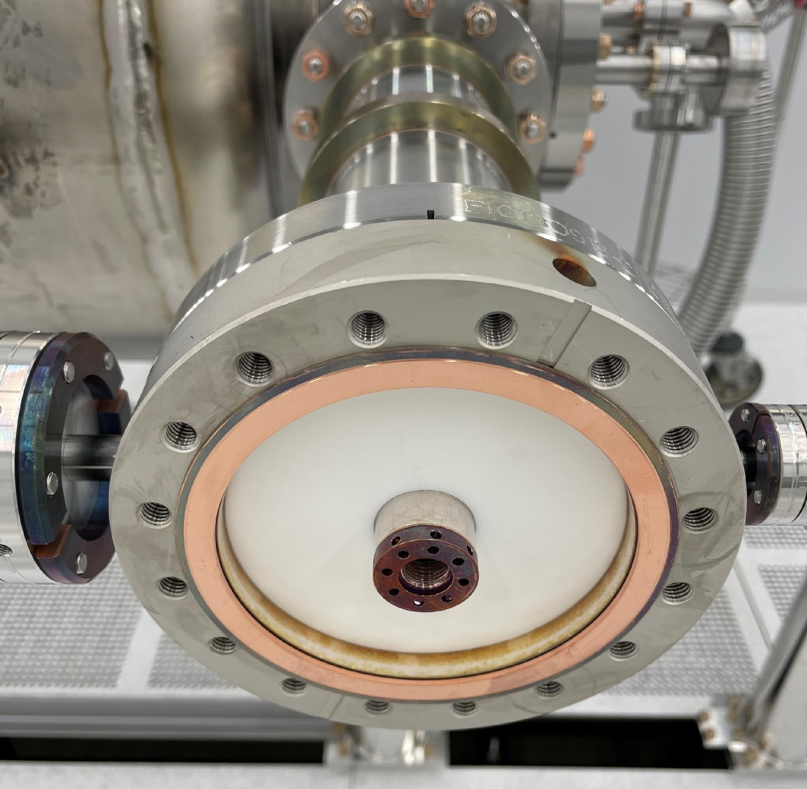
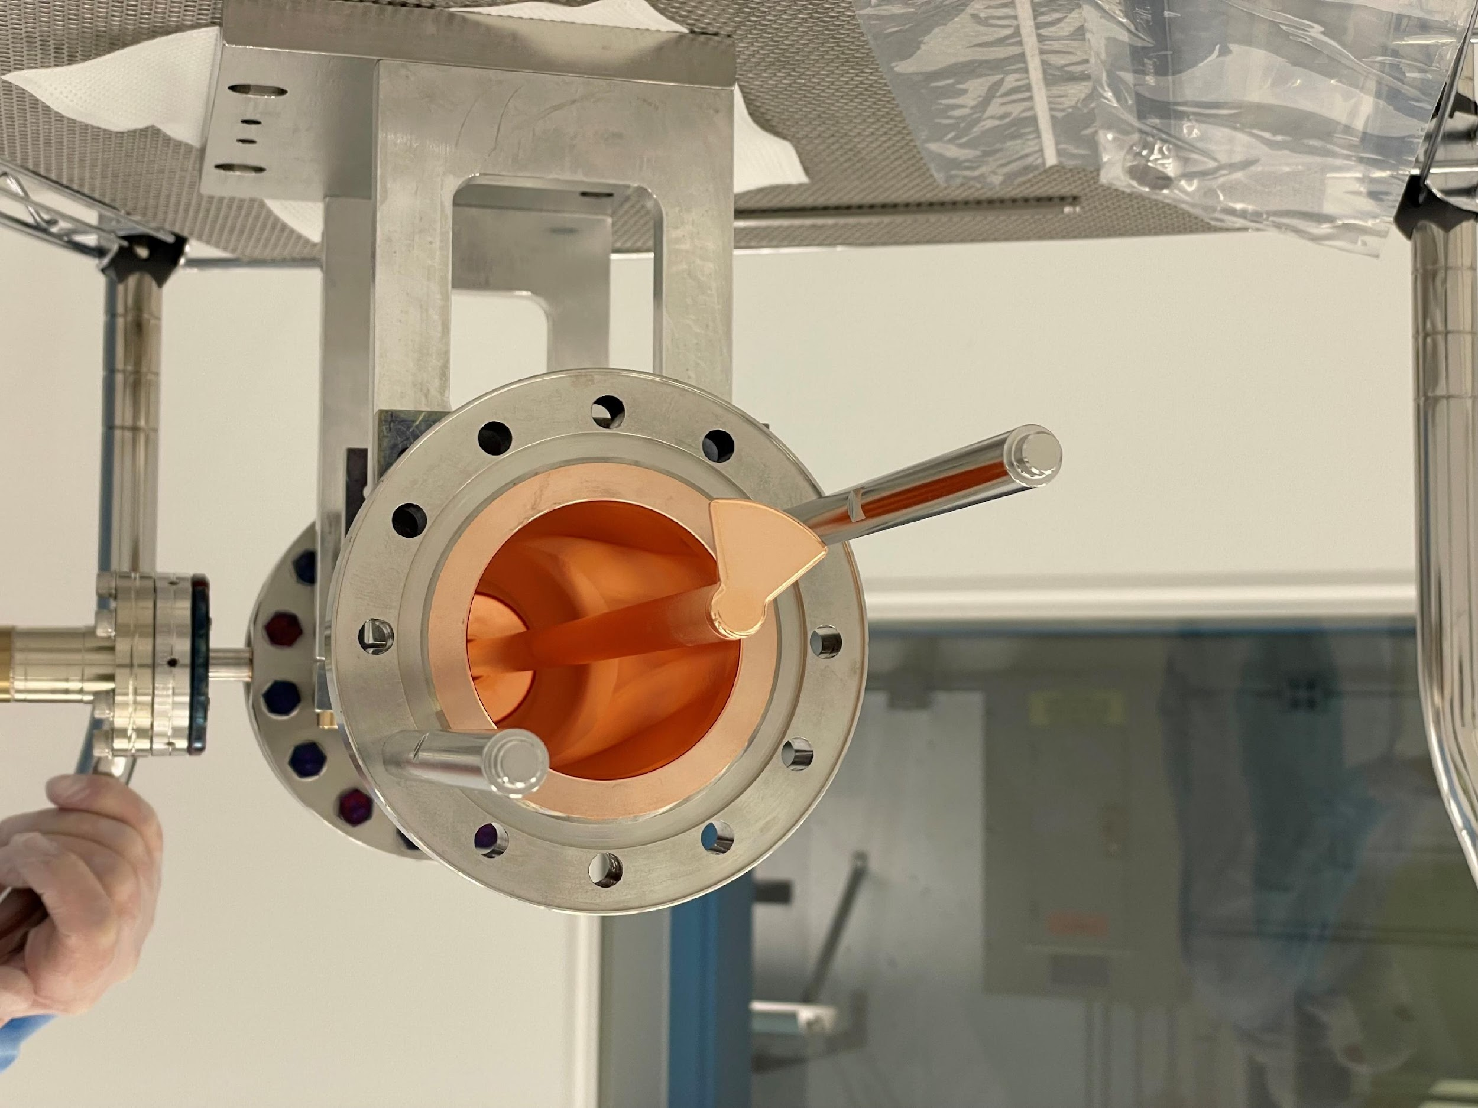

Slide 18
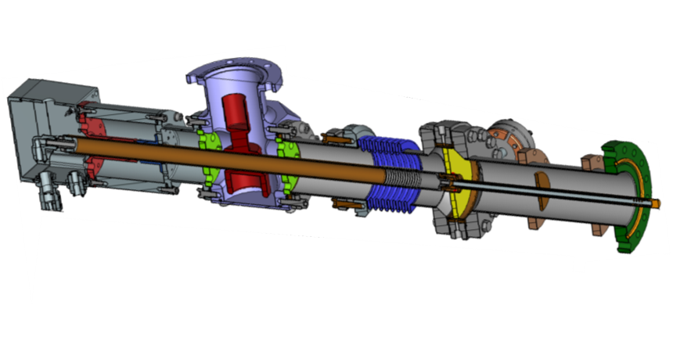

Configurations of 325 MHz and 650 MHz couplers are very similar
650 MHz couplers were successfully tested up to 50 kW, full reflection, any phase.
Therefore, the operating power of 325 MHz coupler can be > 50 kW.

Slide 19
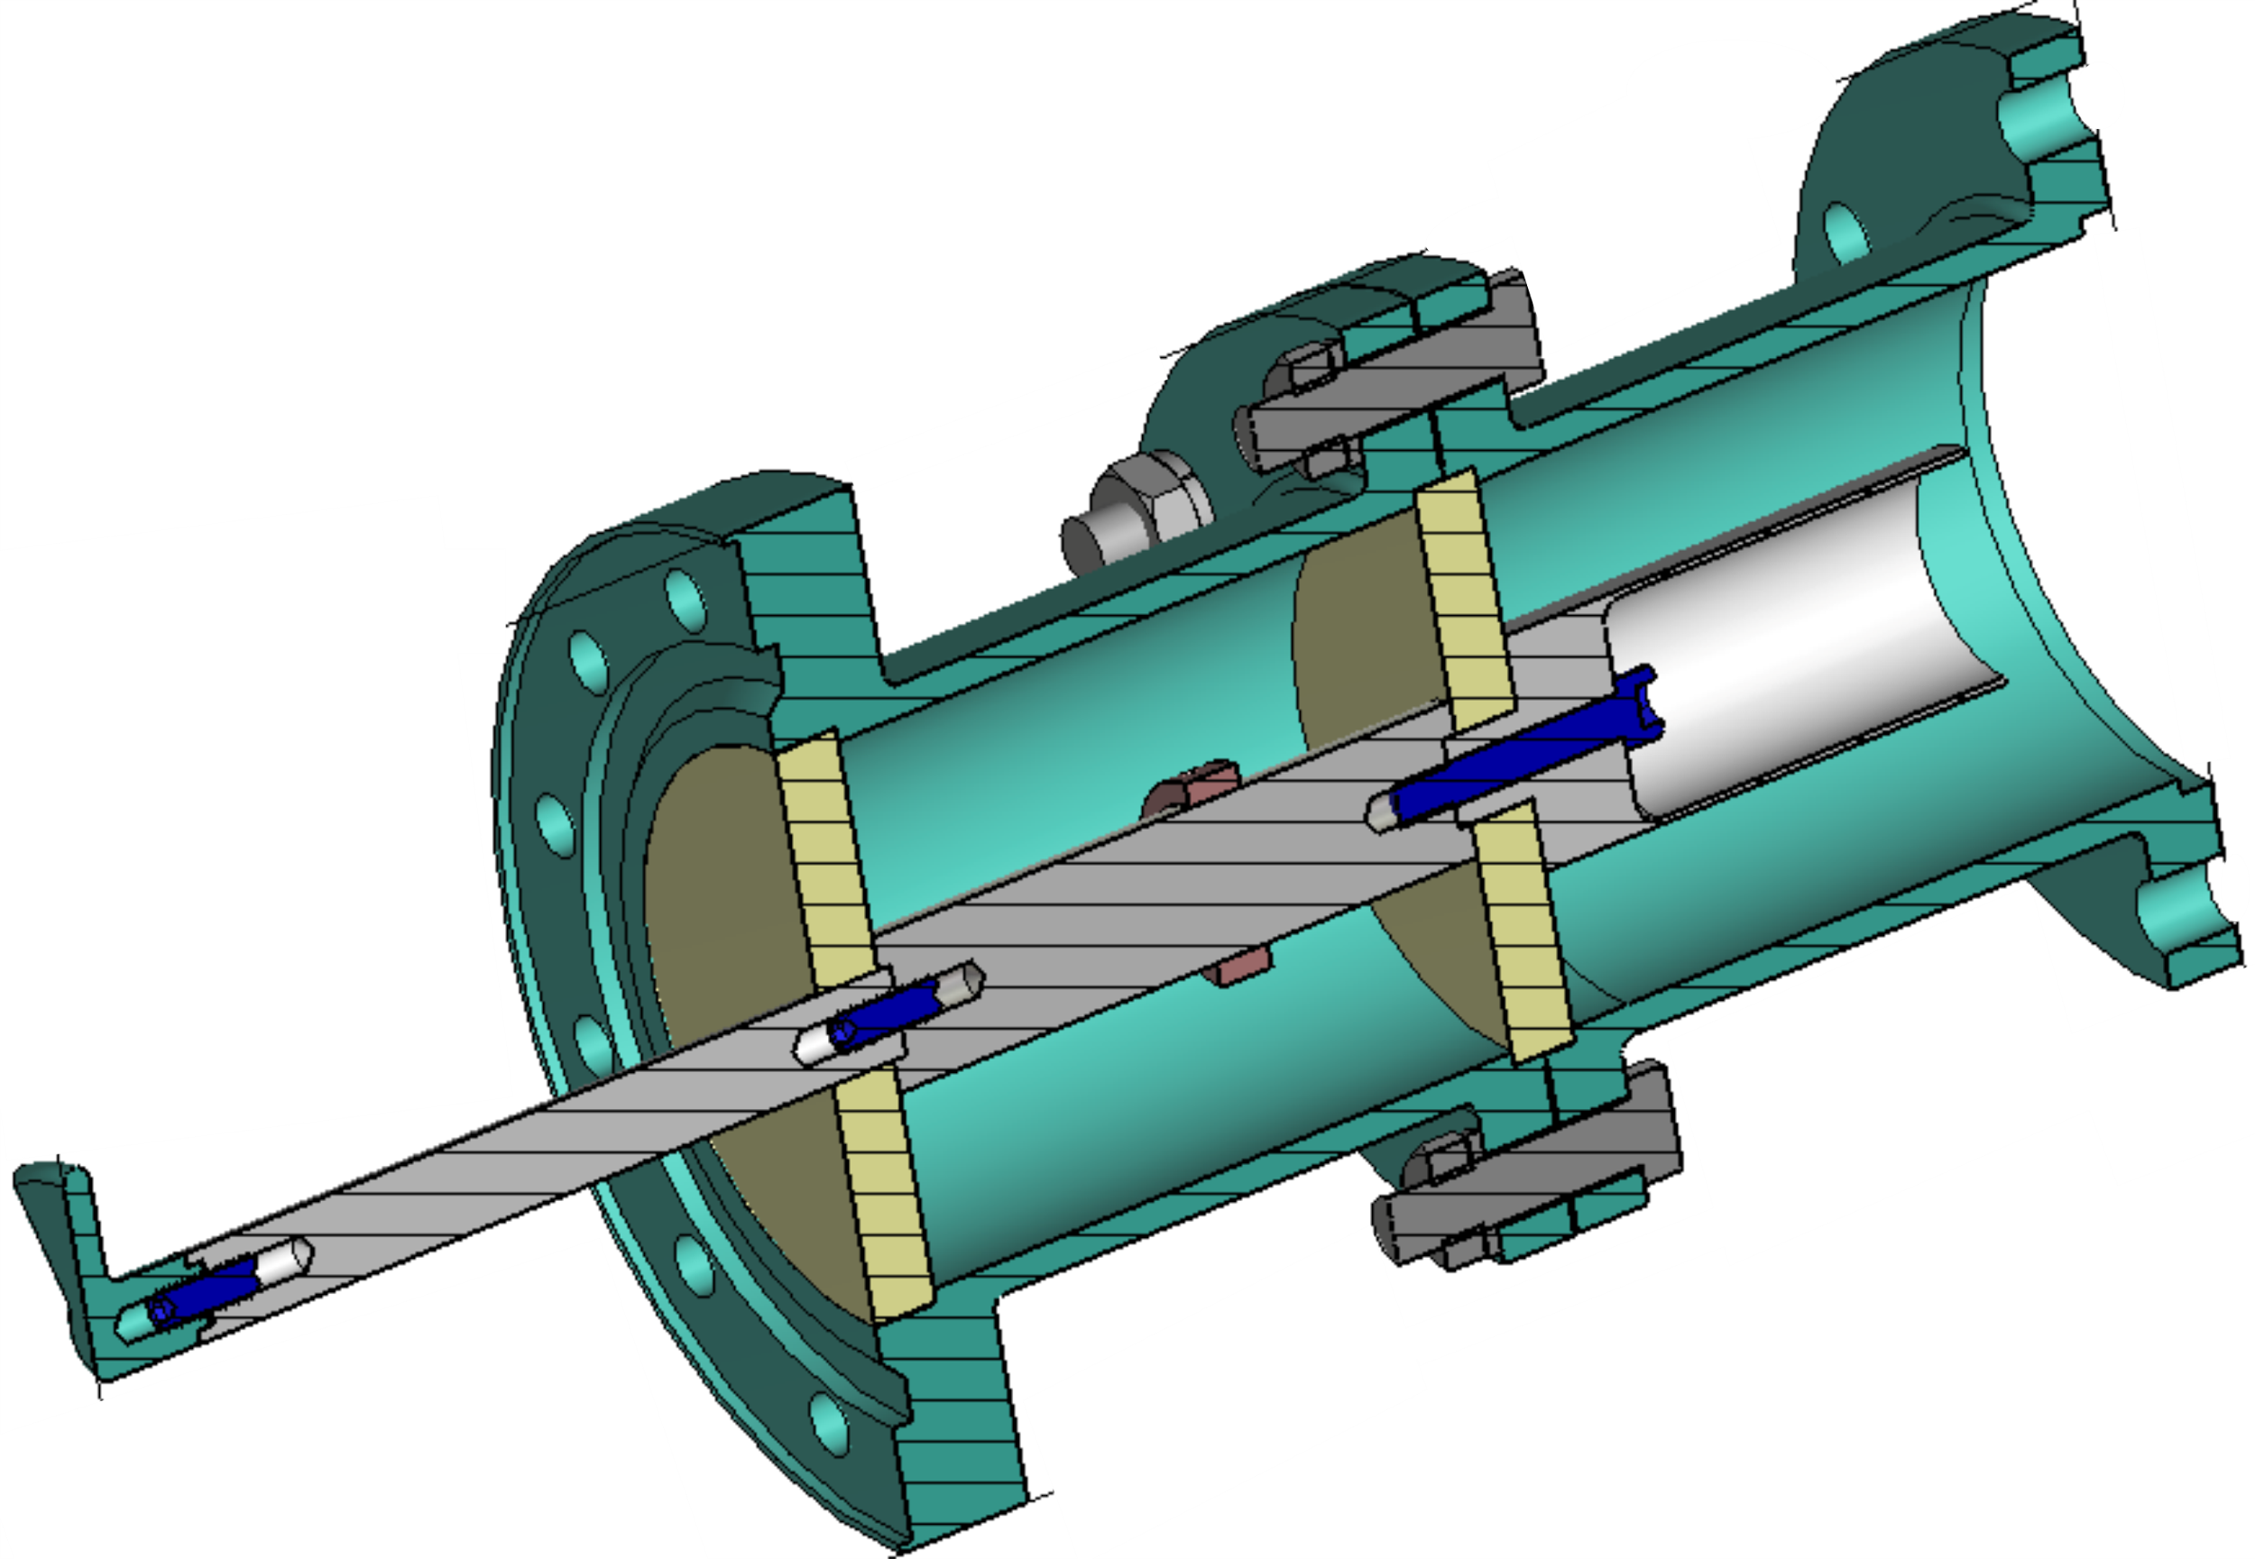
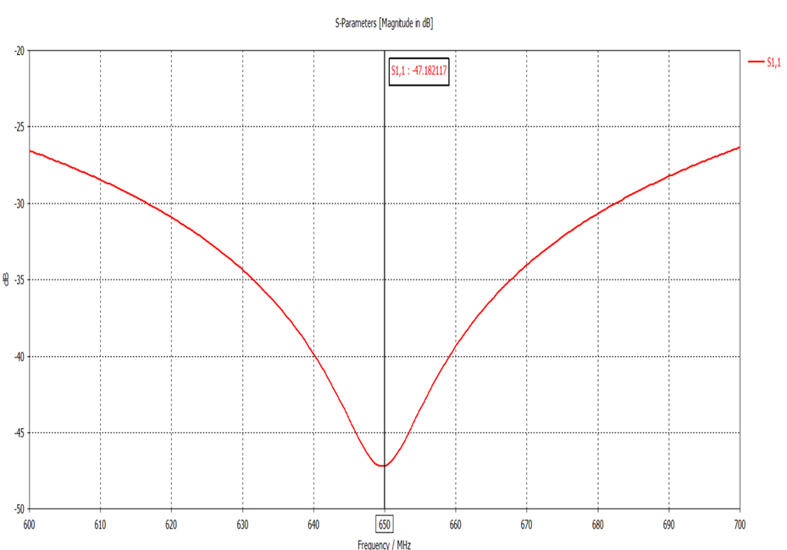
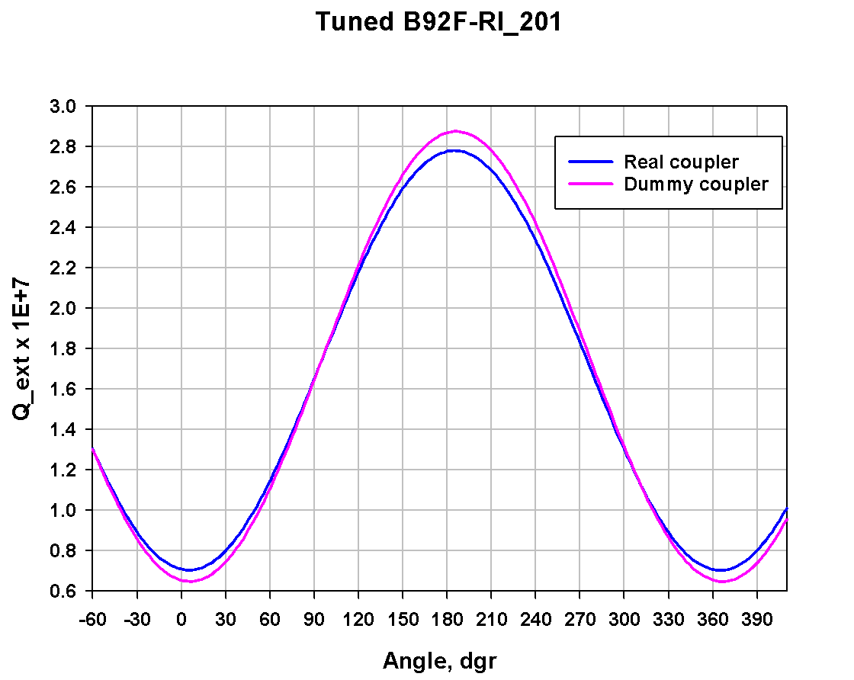
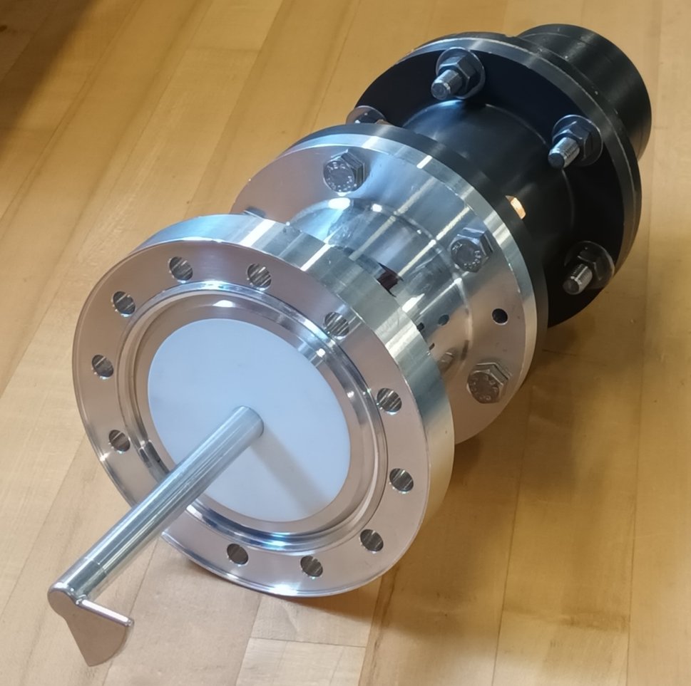
650 MHz dummy coupler
Tip of antenna of 650 MHz coupler is not axial symmetrical and has a “goose foot” shape. It allows to change coupling by rotating antenna. We use dummy coupler to find a right antenna angle for particular cavity.

Slide 20
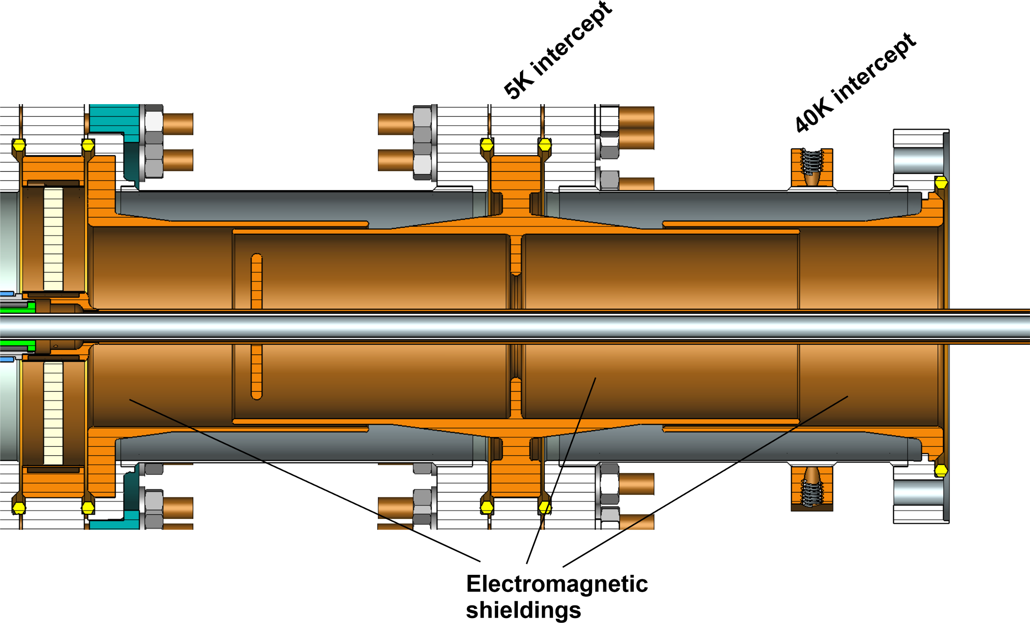
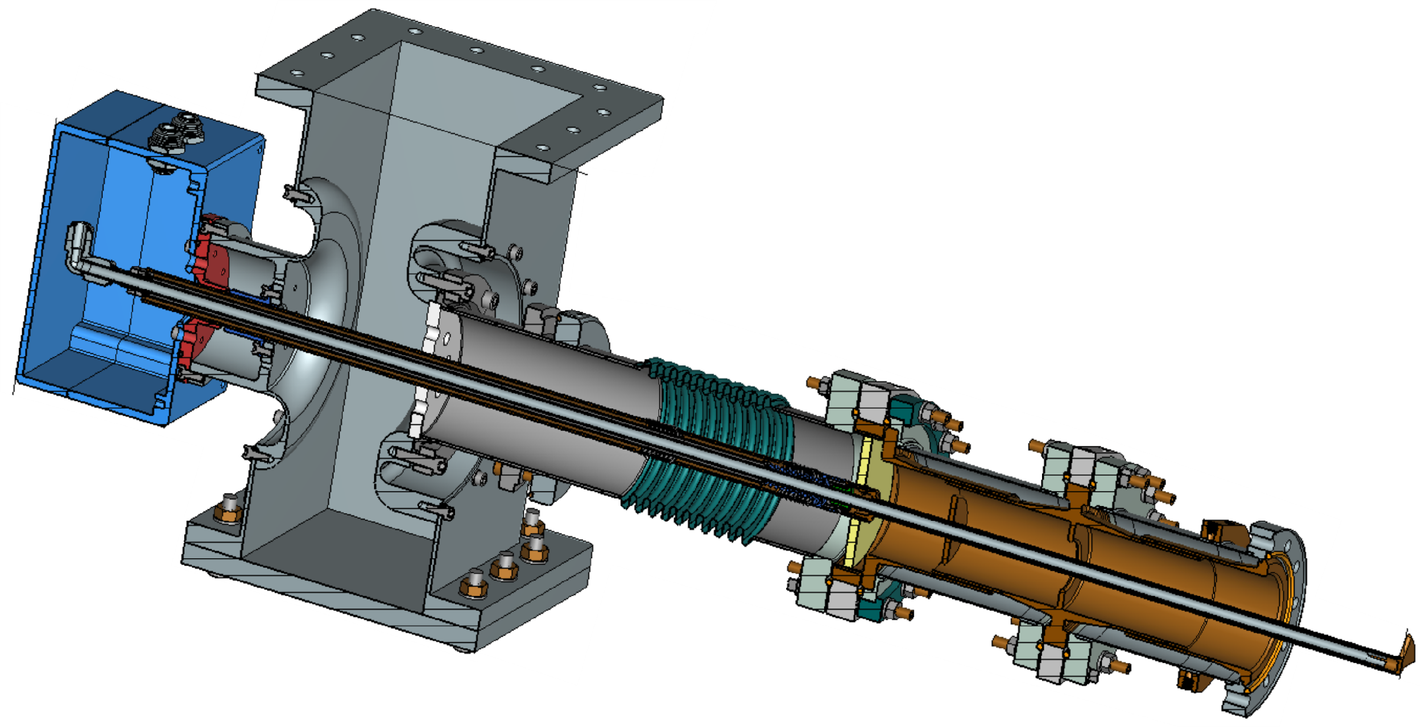
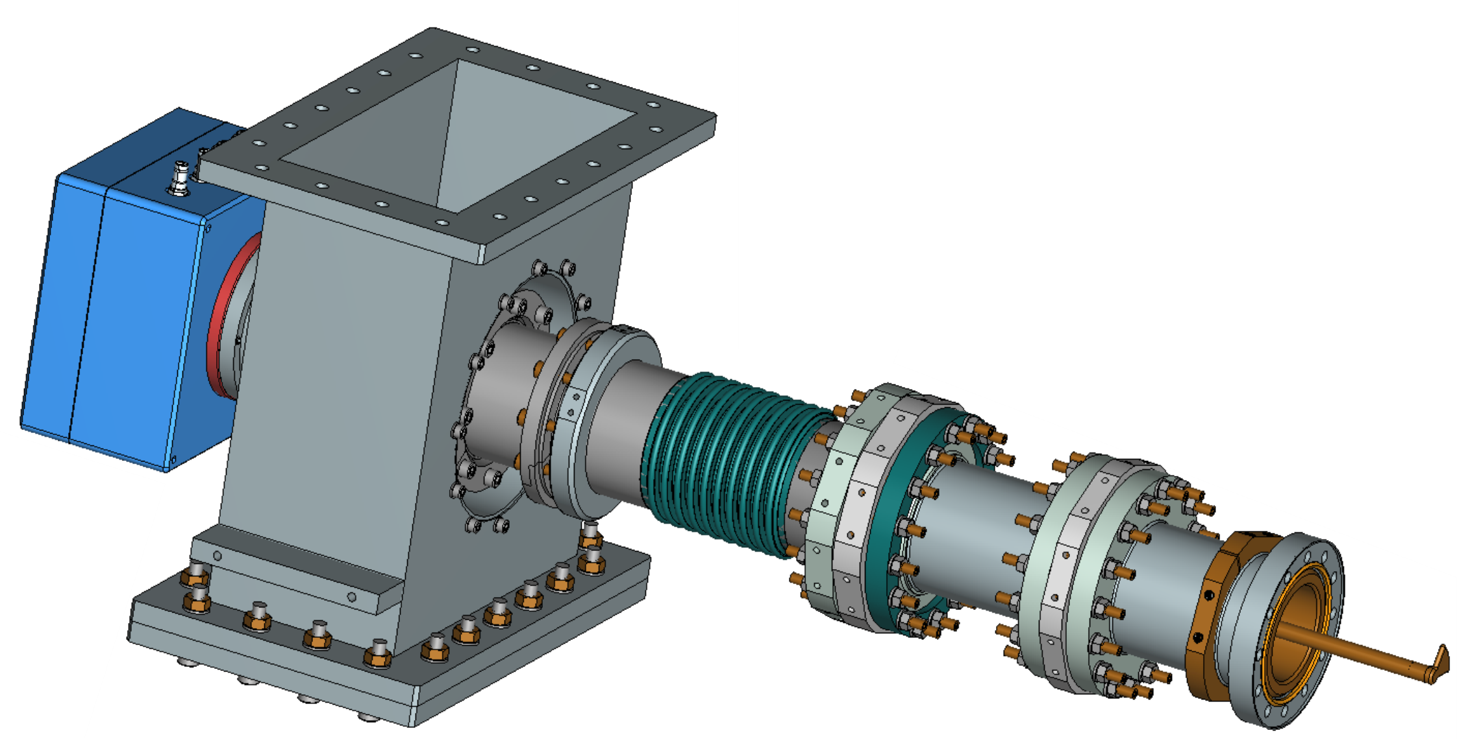
650 MHz coupler with electromagnetic shields
(low cryogenic loading)
No copper coatings, reduced cryogenic loading.
Will be used for accelerators with conducting cooling.
Tested up to 50 kW, CW, full reflection.

Slide 21
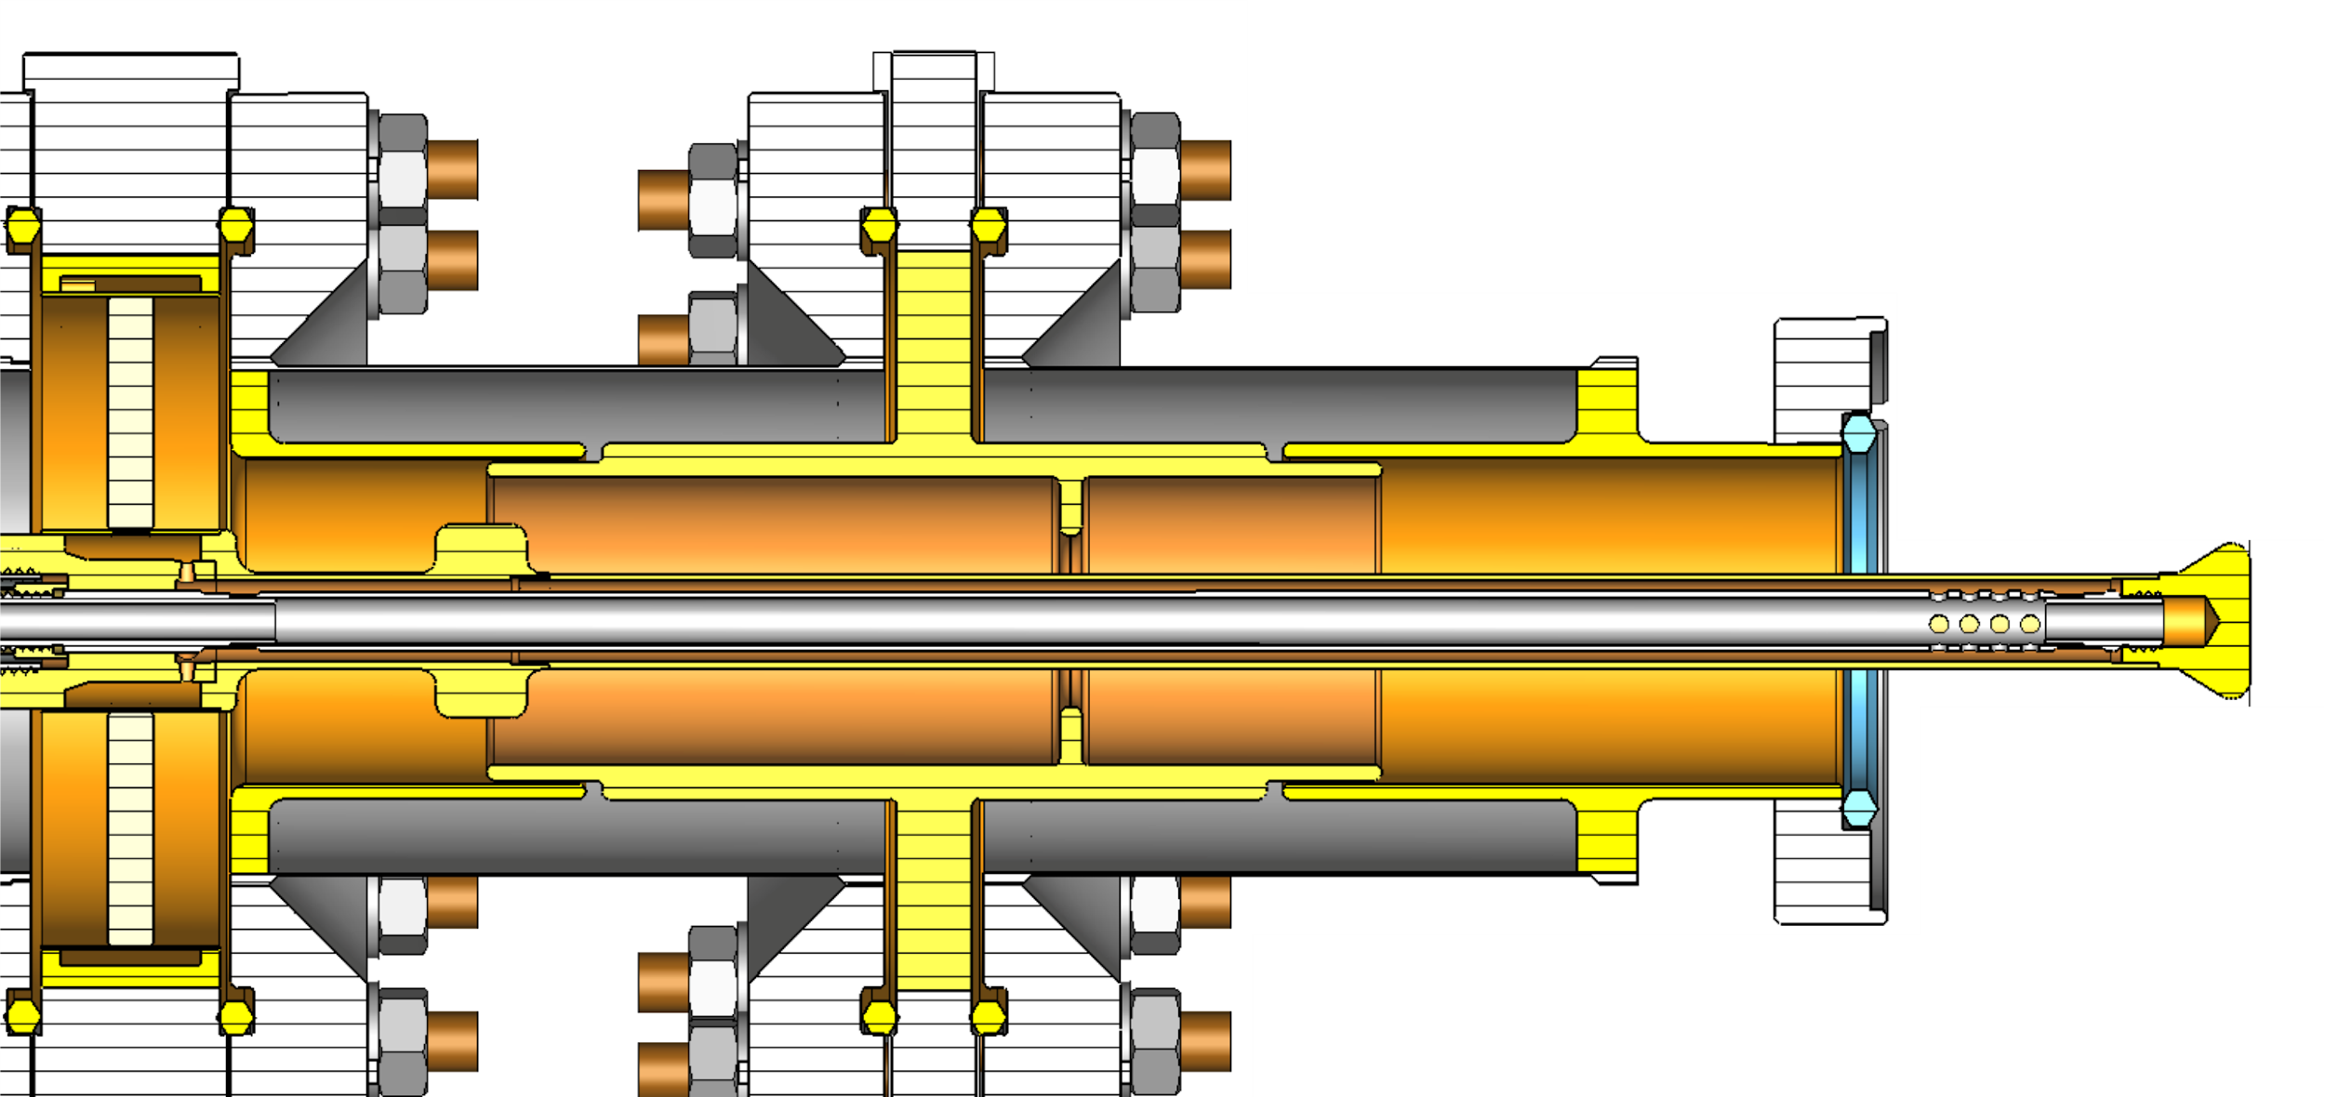
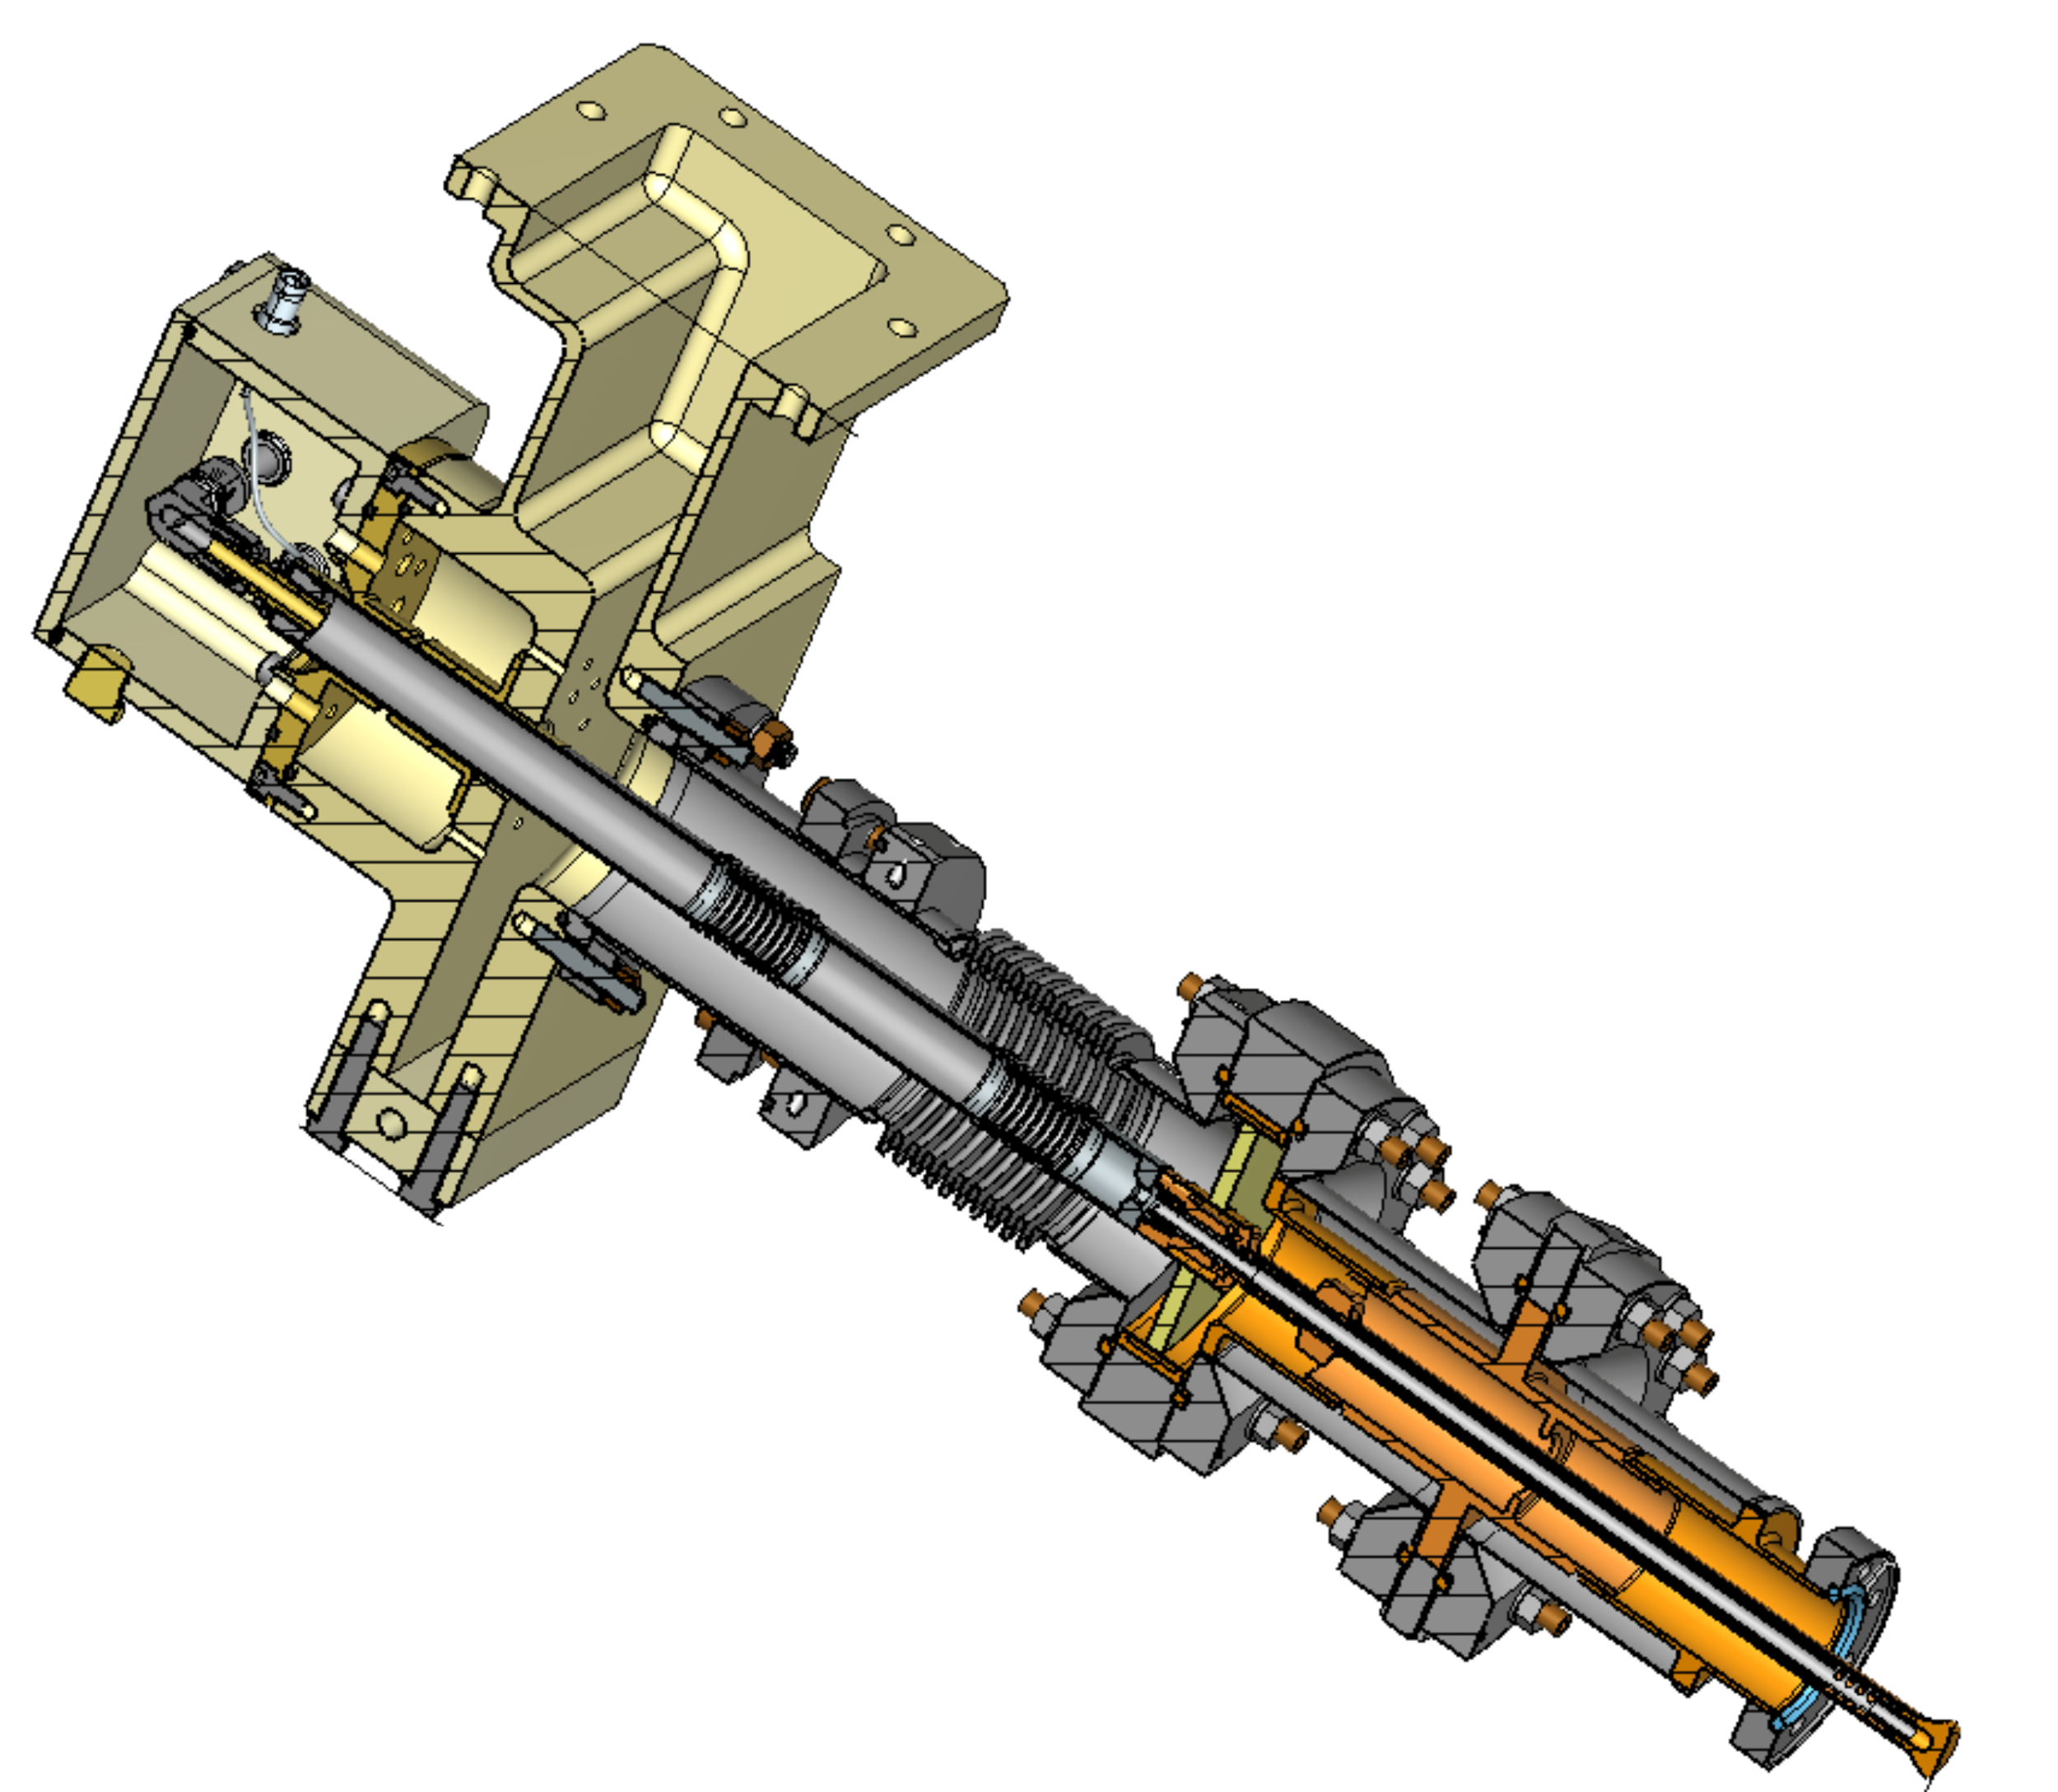
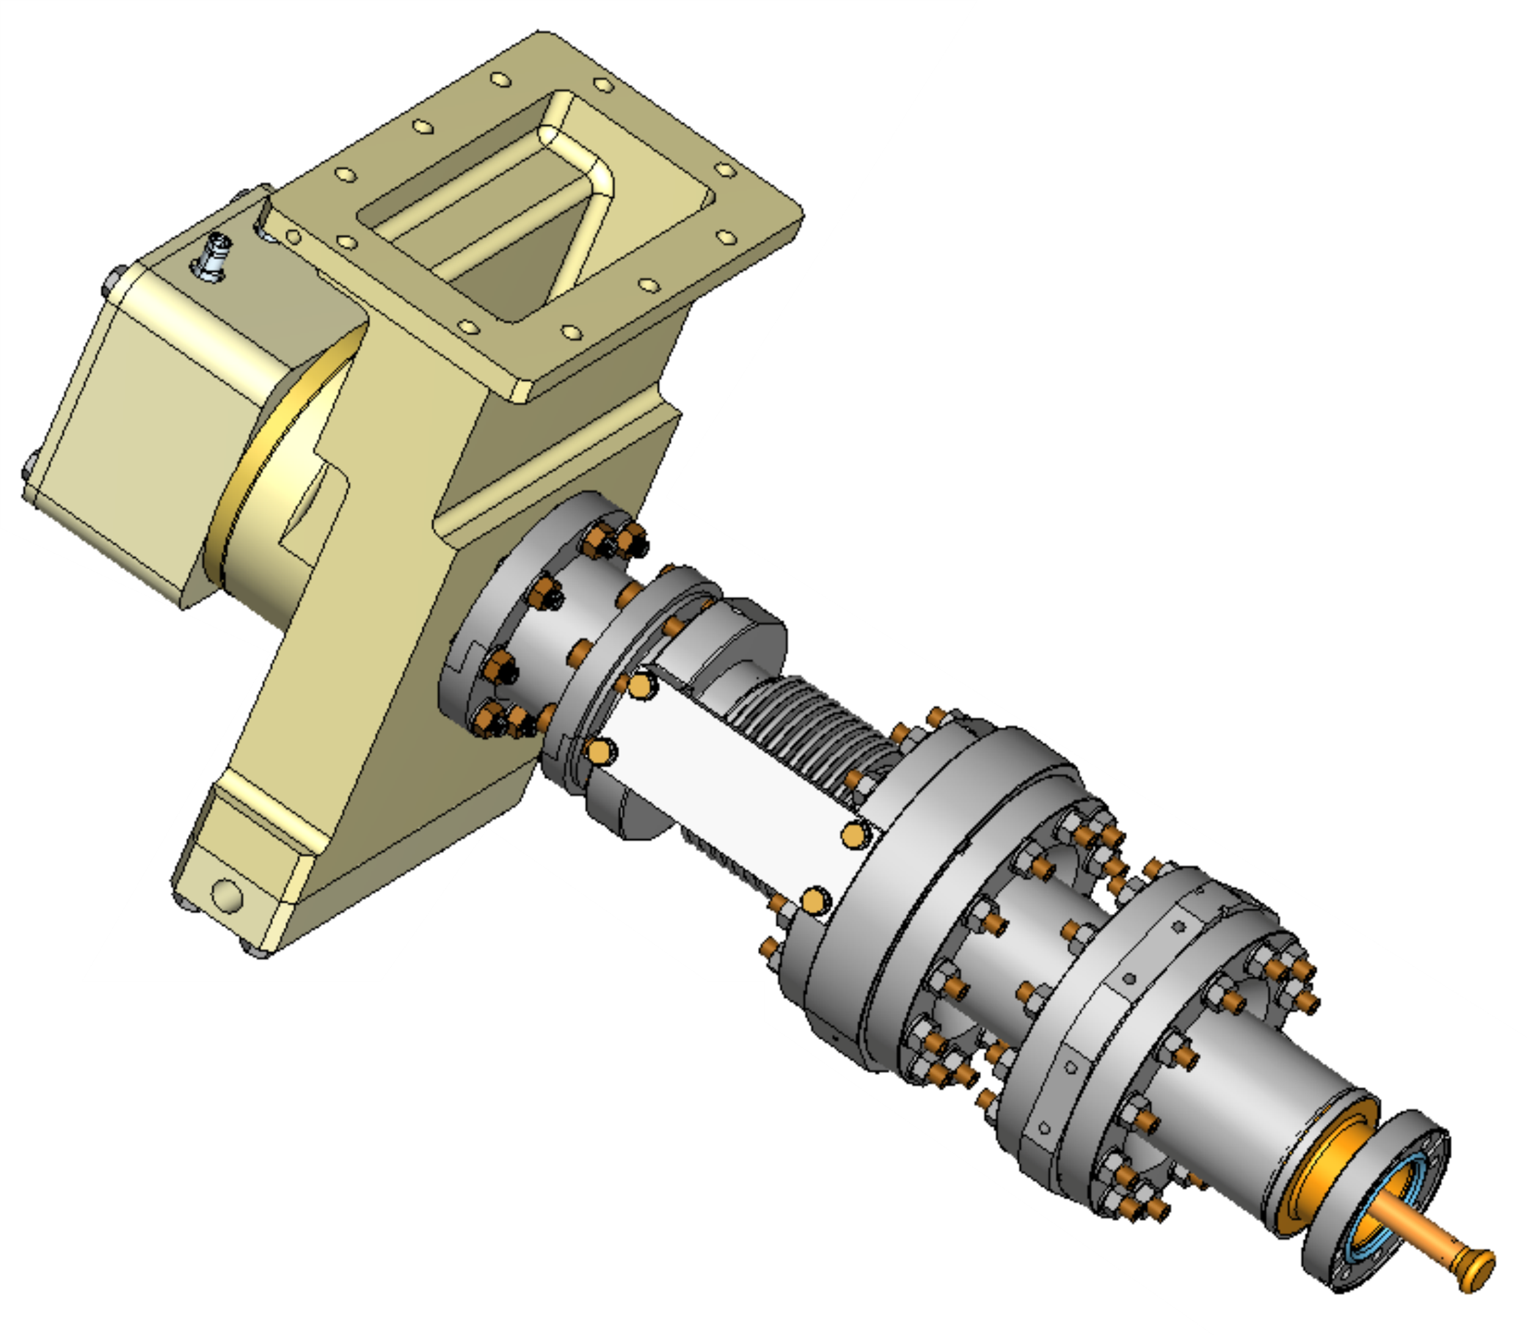
1.3 GHz coupler with electromagnetic shields
(low cryogenic loading)
No copper coatings, reduced cryogenic loading.
Will be used for accelerators with conducting cooling.
Prototype was tested up to 27 kW, CW, TW.

Slide 22
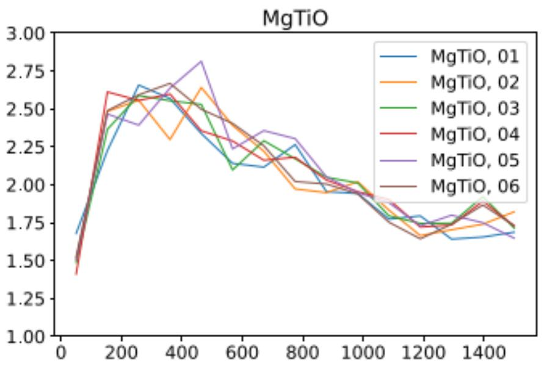
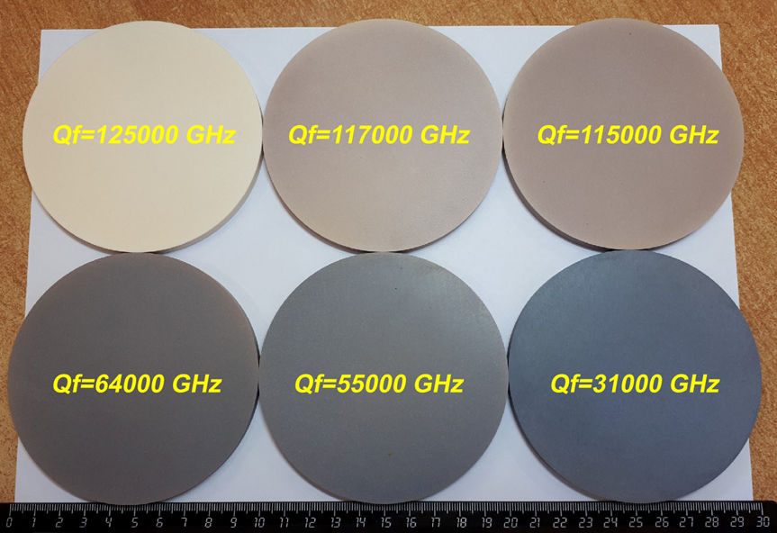
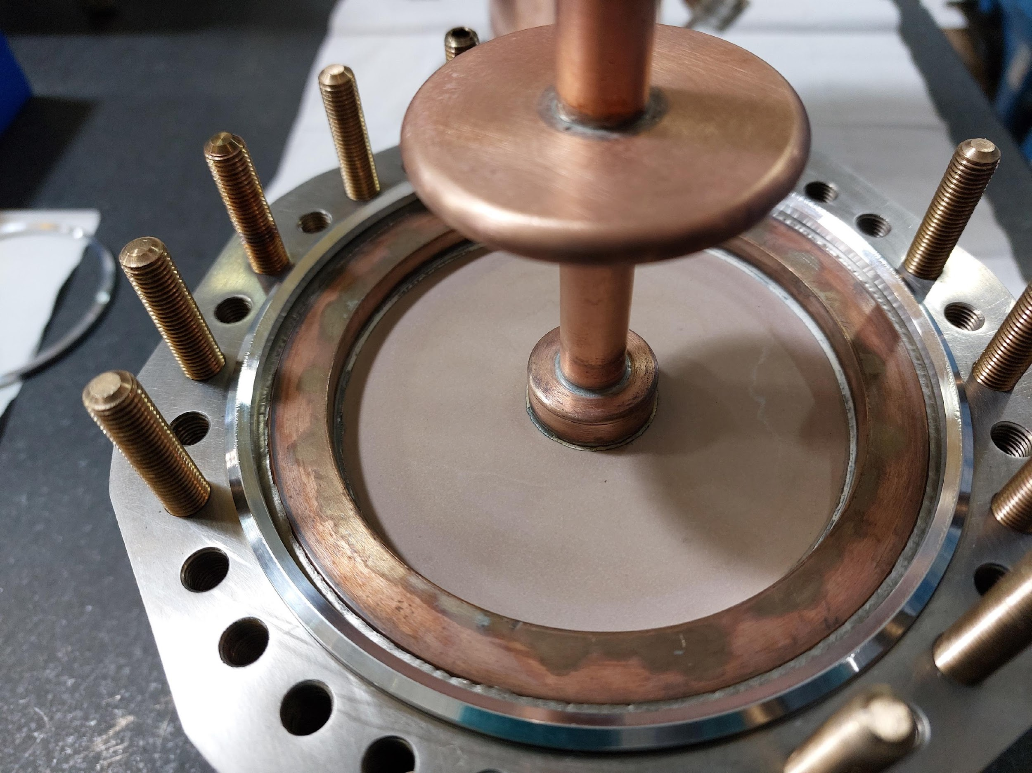
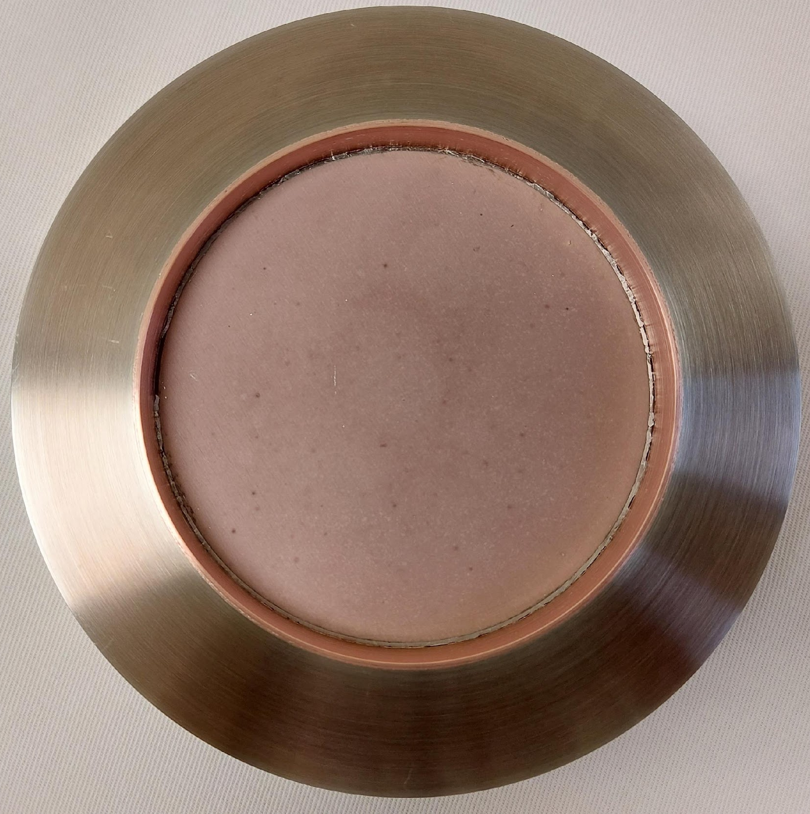
Magnesium Titanate Conductive Ceramic
Low loss, mildly conductive ceramic prevents charge buildup
  Controllable conductivity from 10⁻¹² to 10⁻⁸ S/m
  Relative dielectric constant ε_{r}=15
  Figures of merit, Q×f, in the range 30,000–125,000 GHz, providing tan δ ~ 10⁻⁵ @ 650 MHz
SEY measured, peak < 2.75
Waveguide and coaxial window designs fabricated & tested
A. Grudiev, et al, CLIC Note 1175, CERN-ACC-2022-006
SEY
Energy [eV]
Supported by DOE Office of Nuclear Physics SBIR DE-SC0017150

Slide 23
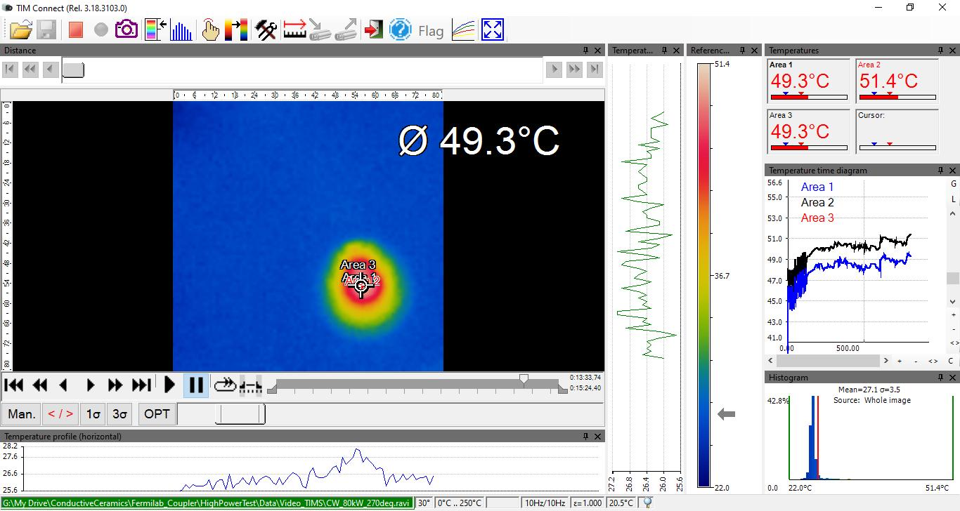
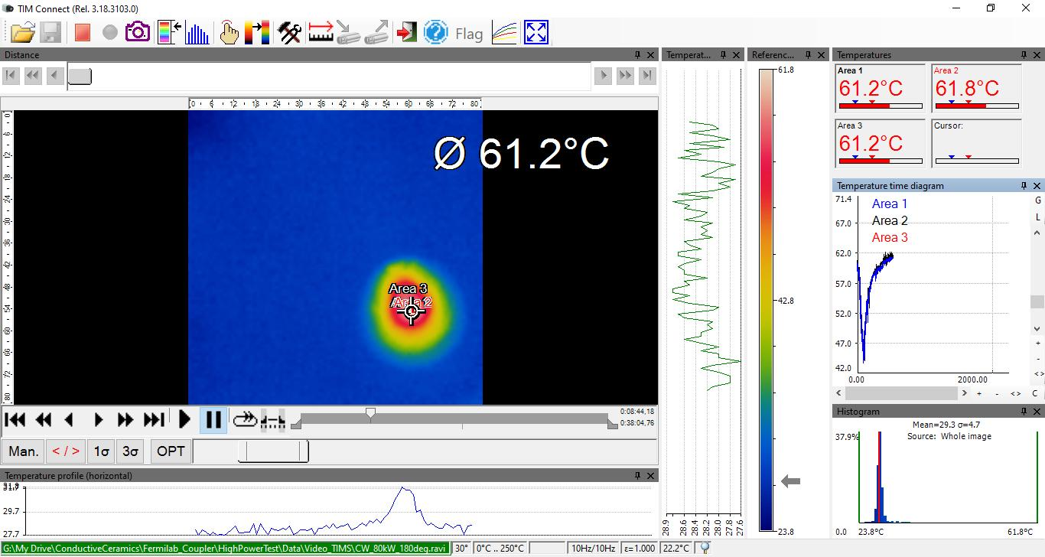
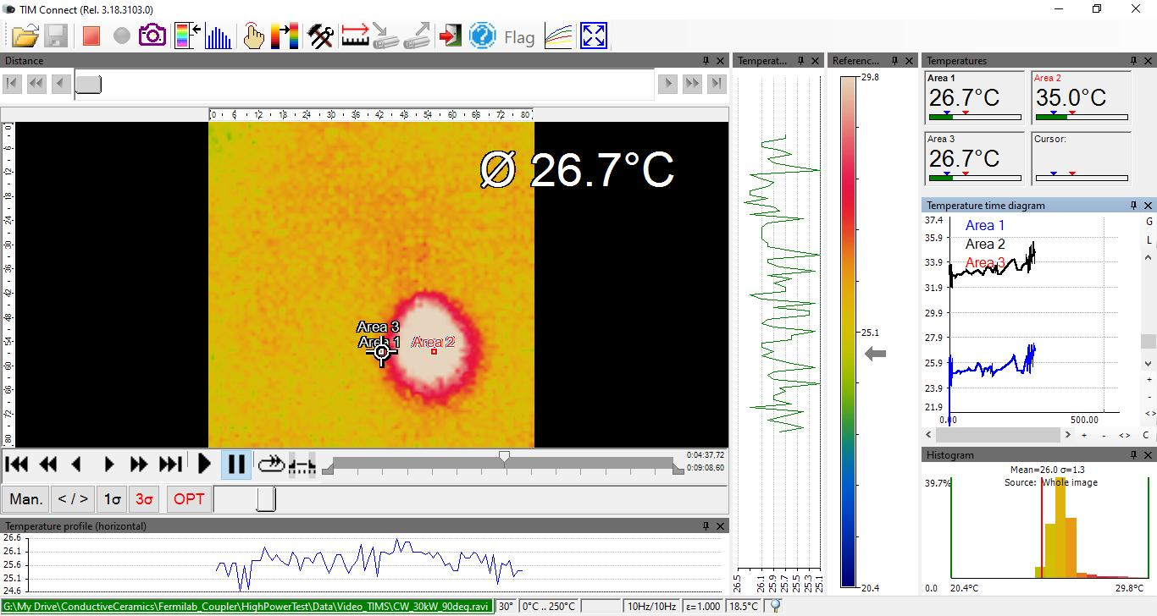
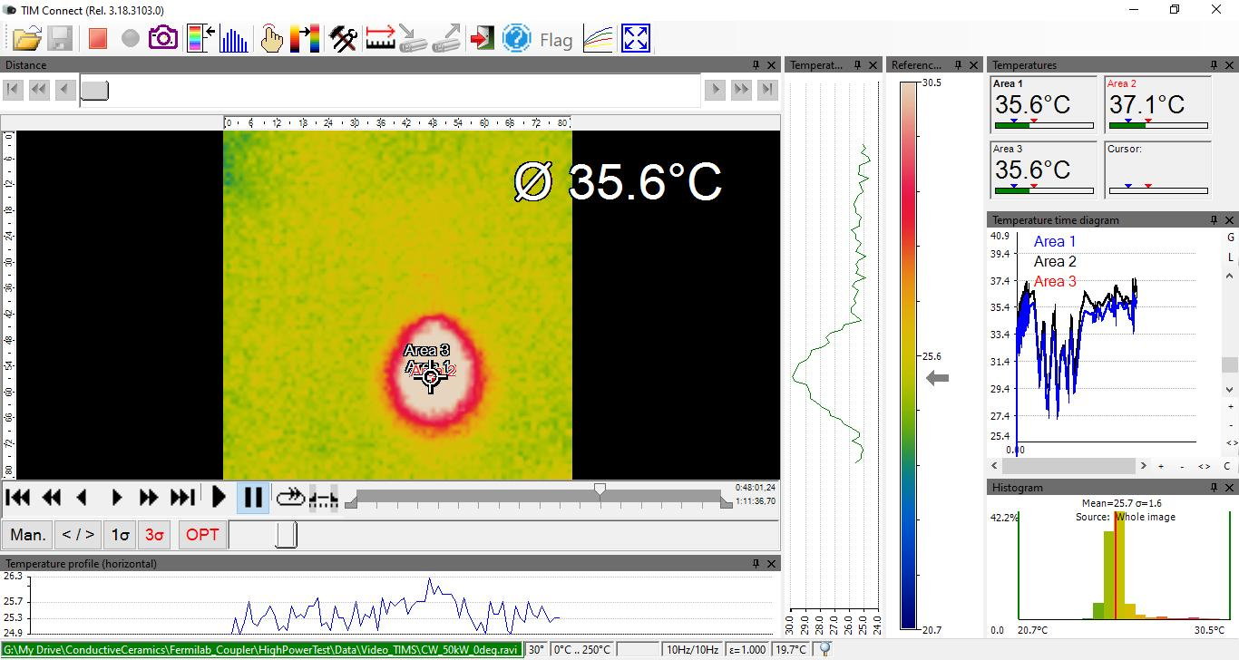
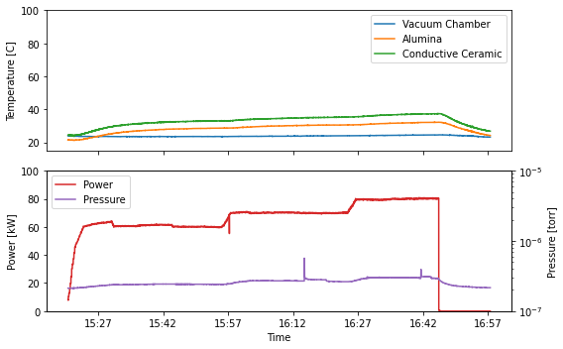
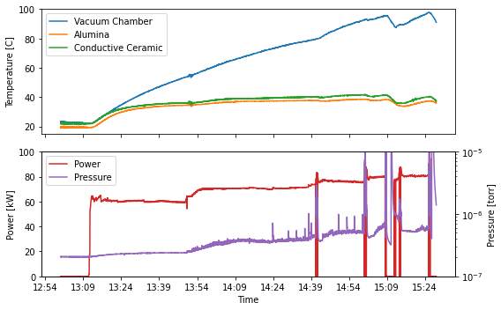
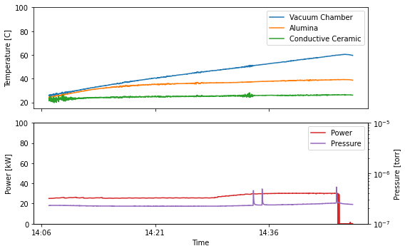
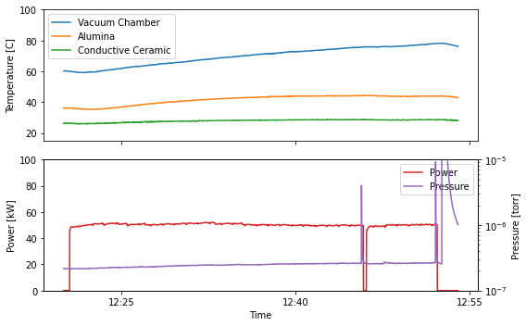
High-Power Test Results
Field configuration 1:
  80 kW
  51.4°C CC window
  41.8°C CC flange
  38.7°C Al₂O₃ flange
  No vacuum activity
Field configuration 2:
  80 kW
  61.8°C CC window
  37.5°C CC flange
  32.3°C Al₂O₃ flange
  Some vacuum activity
Field configuration 3:
  30 kW
  35.0°C CC window
  28.3°C CC flange
  39.3°C Al₂O₃ flange
  Limited by vacuum interlock (data not shown)
Field configuration 4:
  50 kW
  37.1°C CC window
  28.8°C CC flange
  44.4°C Al₂O₃ flange
  Limited by vacuum interlock (data not shown)
B. Freemire, et al, IPAC’24, WEPS17
C1
C2
C3
C4

Slide 24



Inspection & Conclusion
Pickups showed significant electron activity near alumina window, minimal activity near conductive ceramic window
After high power test:
  No change in conductive ceramic window appearance
  Significant discoloration of alumina window
Before – Conductive Ceramic
Before – Alumina
Multipacting on alumina window limited achievable power in two field configurations
Power in other two configurations administratively limited to 80 kW
  No indication conductive ceramic window could not achieve higher power
After – Conductive Ceramic
After – Alumina

Slide 25






Coupler test stand, 325 MHz
Power amplification ~ 5:
Movable reflector:

Slide 26


Coupler test stand, 650 MHz
Power amplification ~ 5:

Slide 27
Procedure of testing
Test preparation:
Couplers and coupling cavity are assembled/disassembled in clean room, class 10.
Couplers with coupling cavity is baked at temperature 120C x 48 hours.
Stage 1: Testing with bias.
Goals:
325 MHz couplers – 12 kW, CW, full reflection, 4 phase pints.
650 MHz couplers – 47 kW, CW, full reflection, 8 phase pints.
Testing protocol for each phase points
Pls. length, ms | 10 | 100 | 300 | 600 | CW
Max. power, 325 MHz, kW | 25 | 25 | 25 | 20 | 12
Max. power, 650 MHz, kW | 100 | 100 | 100 | 70 | 47
Stage 2: Cleaning without bias

Slide 28



Measuring the loss tangent of ceramics
Frequency of measurements ~ 2.4 GHz

