Slide 1
World-Wide Fundamental Power Coupler meeting #6
eric.montesinos@cern.ch
Conclusion

Slide 2

WWFPC #6 meeting date
Still hosted at CERN
Still yearly
Still June/July
Experts only
One representative only per lab
Mandatory to be present the entire two days
No remote participation
Discussion oriented, no time limitation
On invitation only (please provide me with names to be added to the list)

Slide 3
Topics for discussion
Statistics
List all couplers operated in your accelerators
  Can you please send me the list of FPC (past, present, future) including Fc, Pmax, duty cyle, quantity
Degradation of characteristic over time of operation
  Can you please provide a short comment in case of identified trouble
Vendors
List all vendors you trust
  Can you please send me the list of Vendors you would like to be known

Slide 4
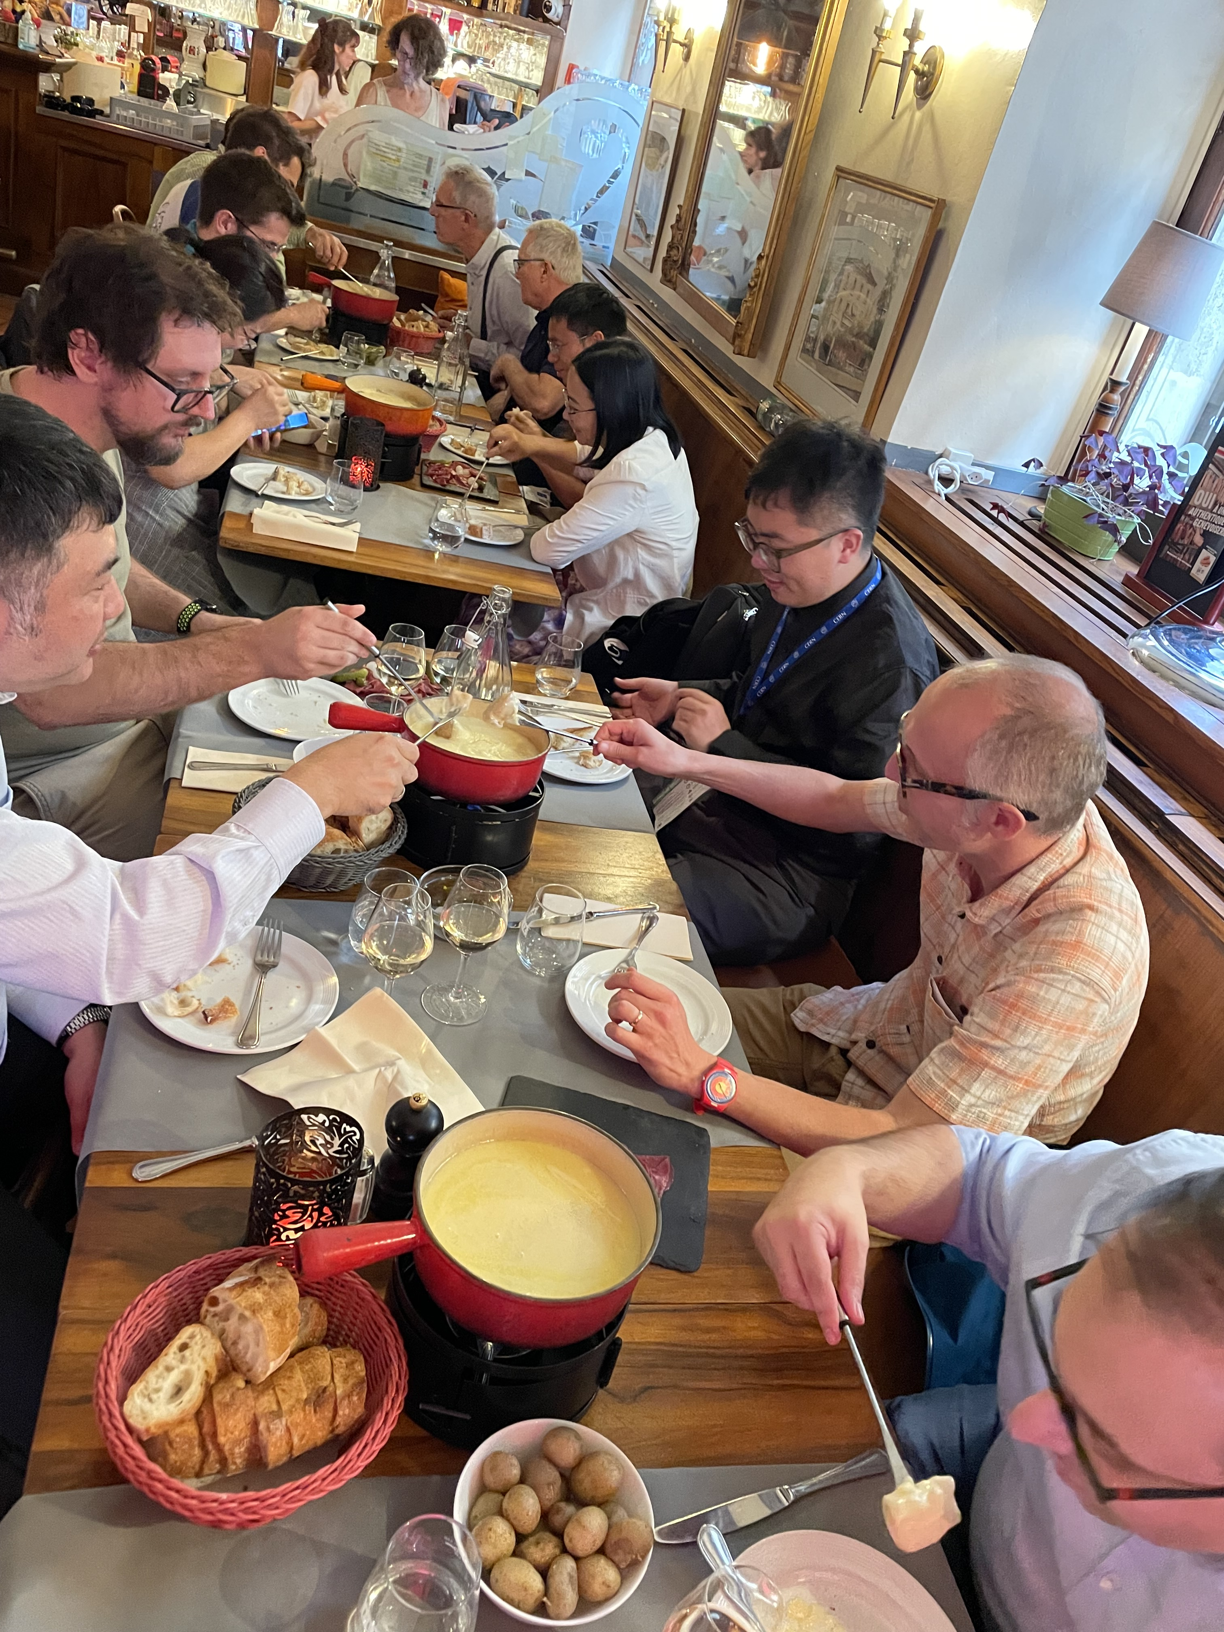
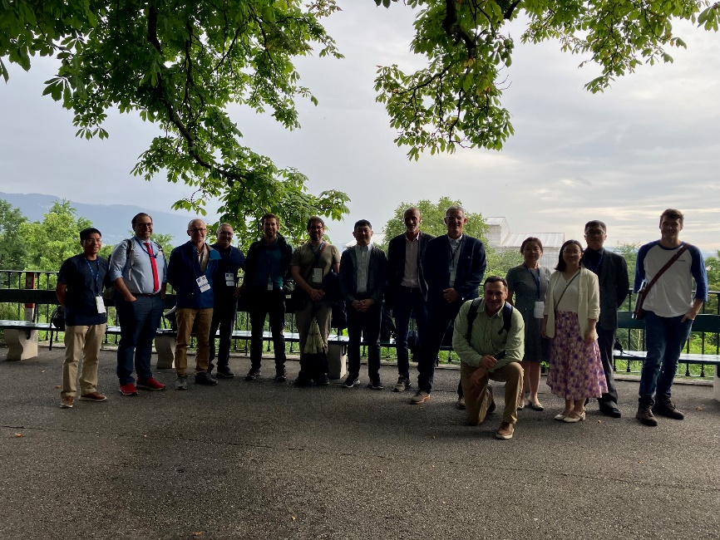
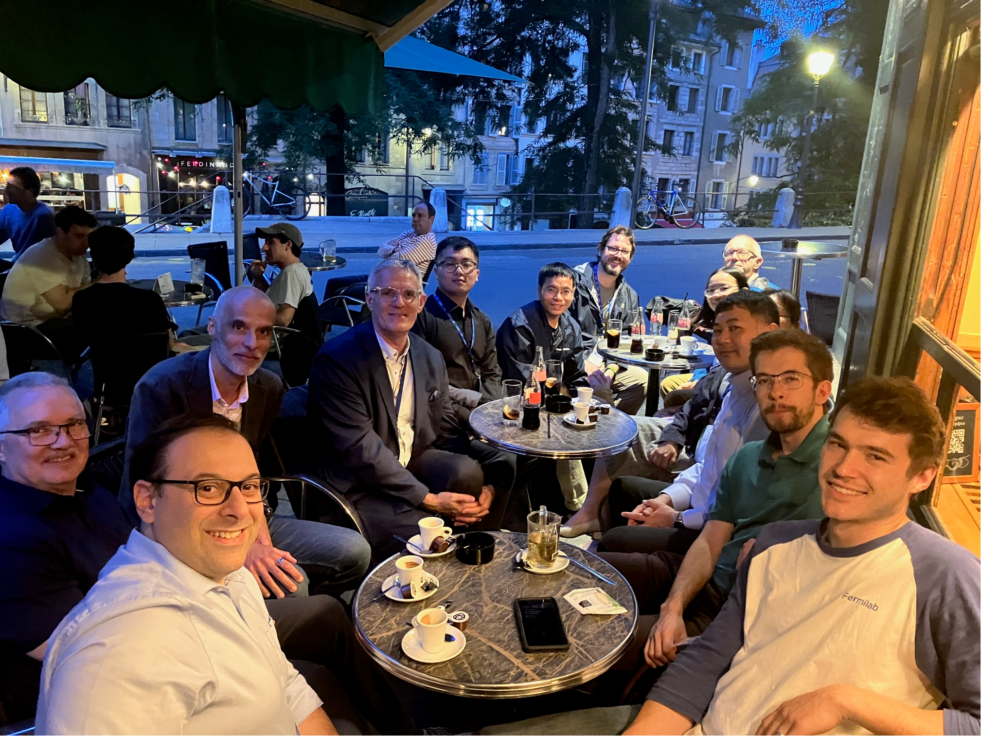
Thank you again for being here these two days !
The team at Les Bastions
The team at La Clémence
Fondue at The Brasserie de l’hotel de ville

