Slide 1
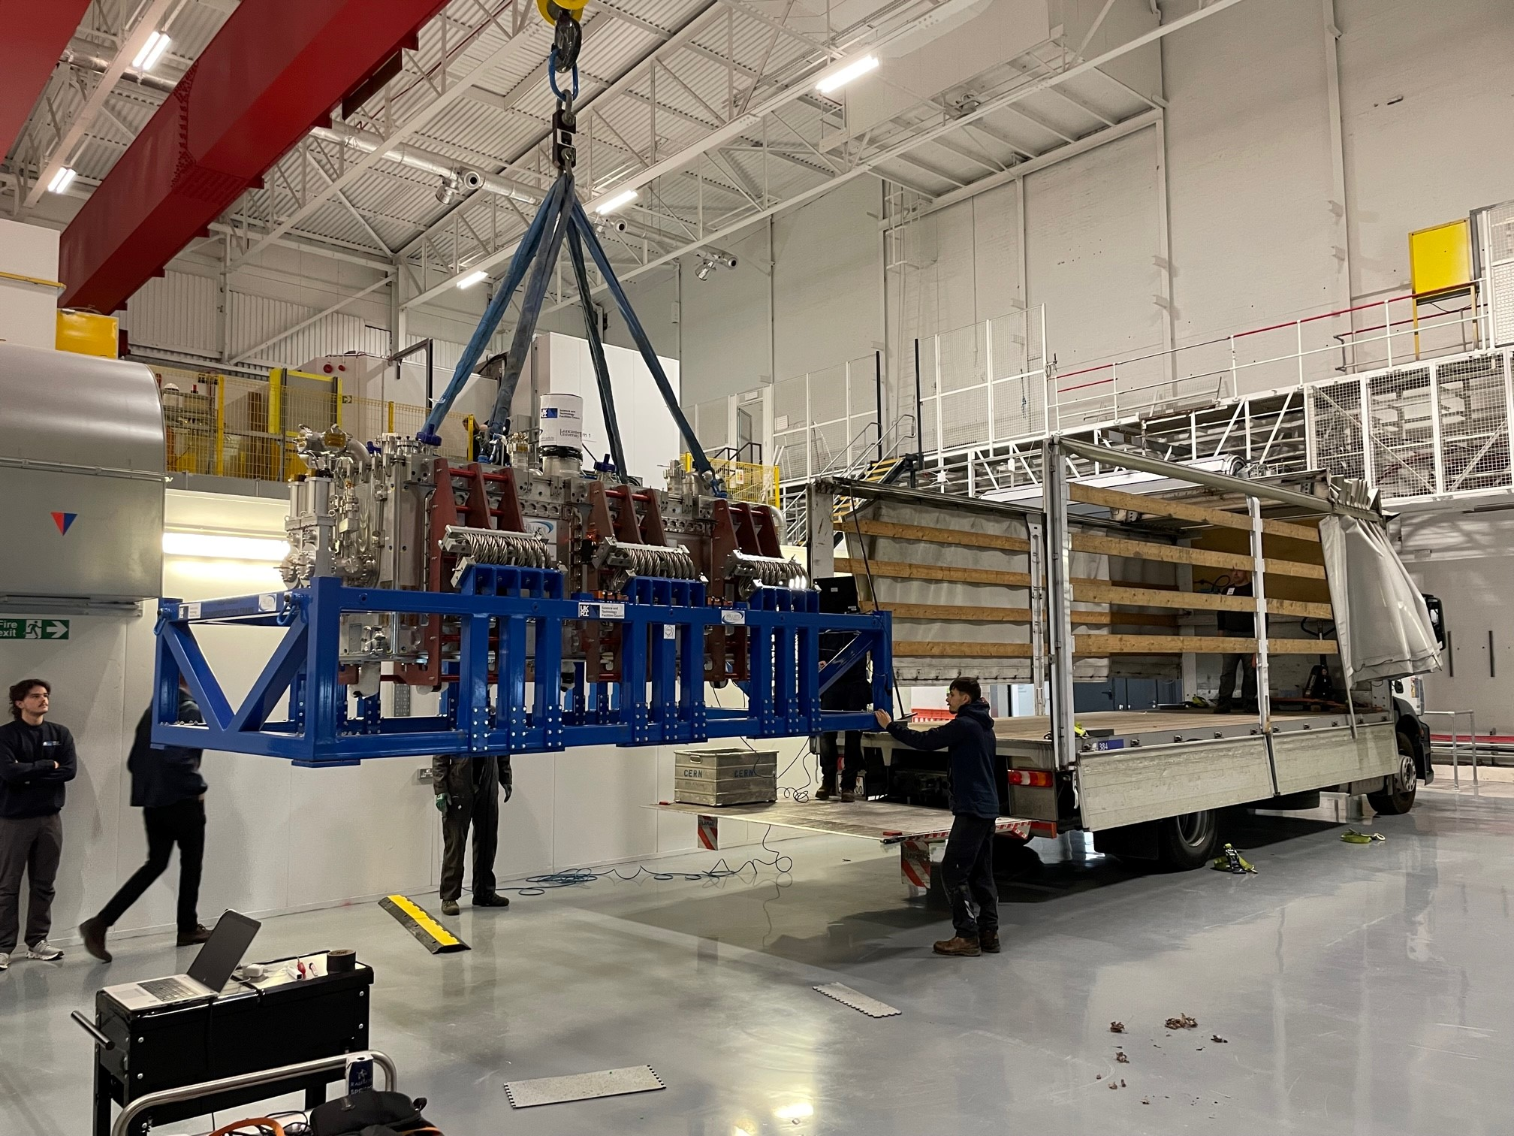
RFD Cryomodule transport
STFC to CERN
EN/MME Mechanical Measurement Lab
M. Guinchard, D. Thuliez

Slide 2
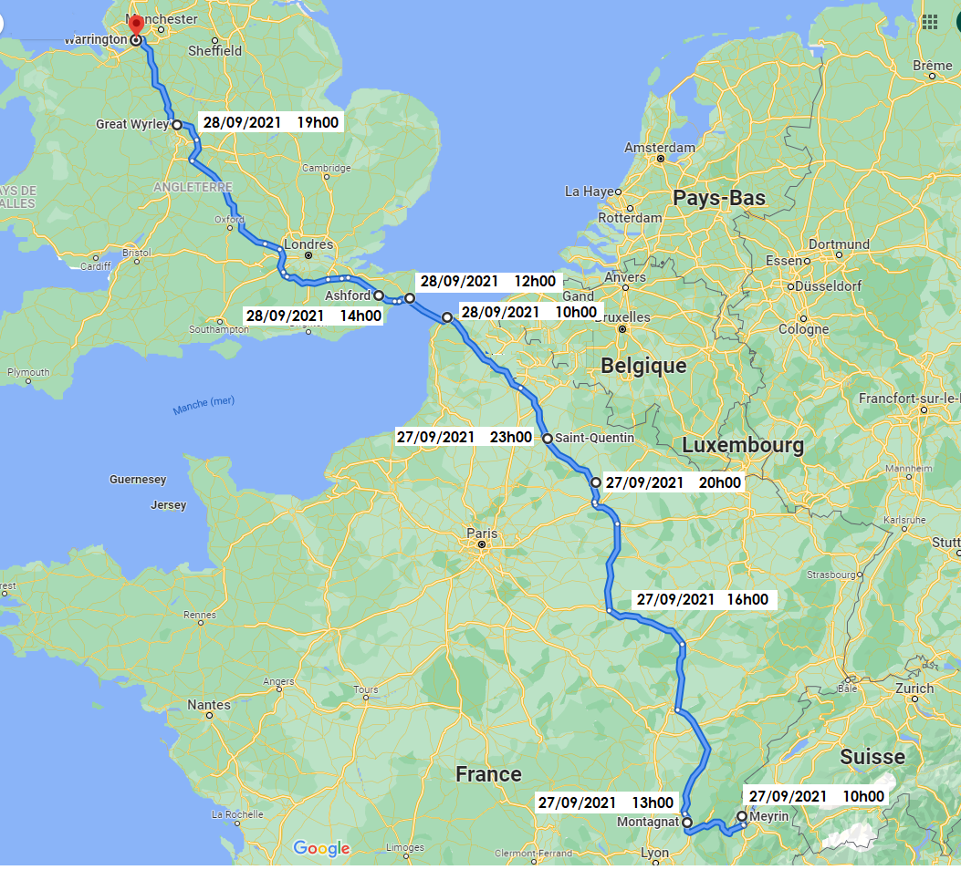
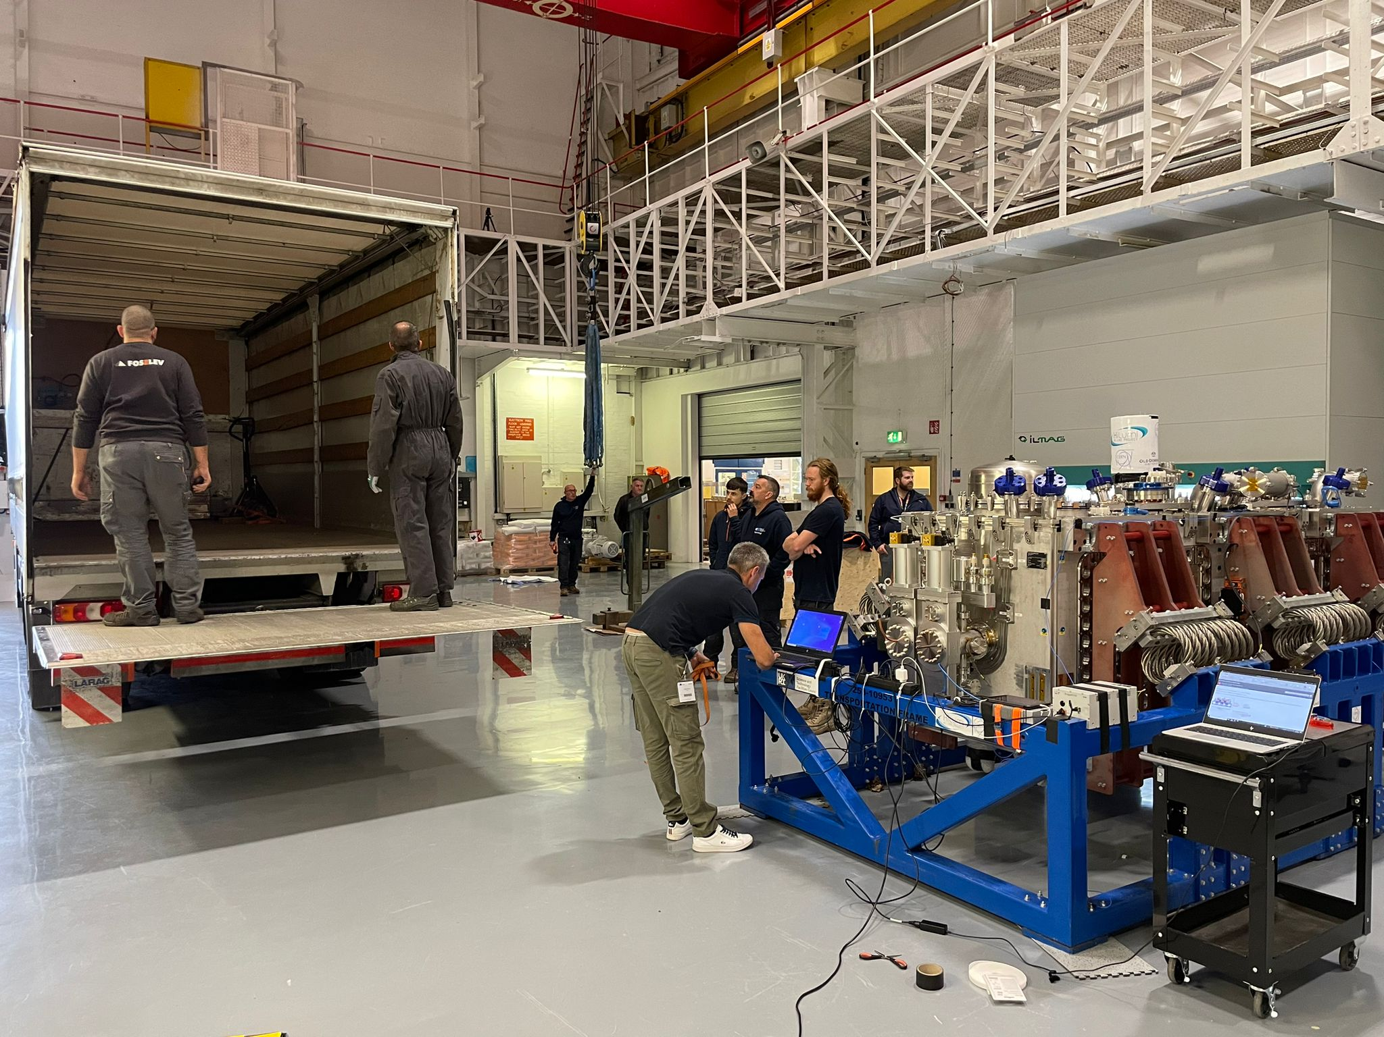
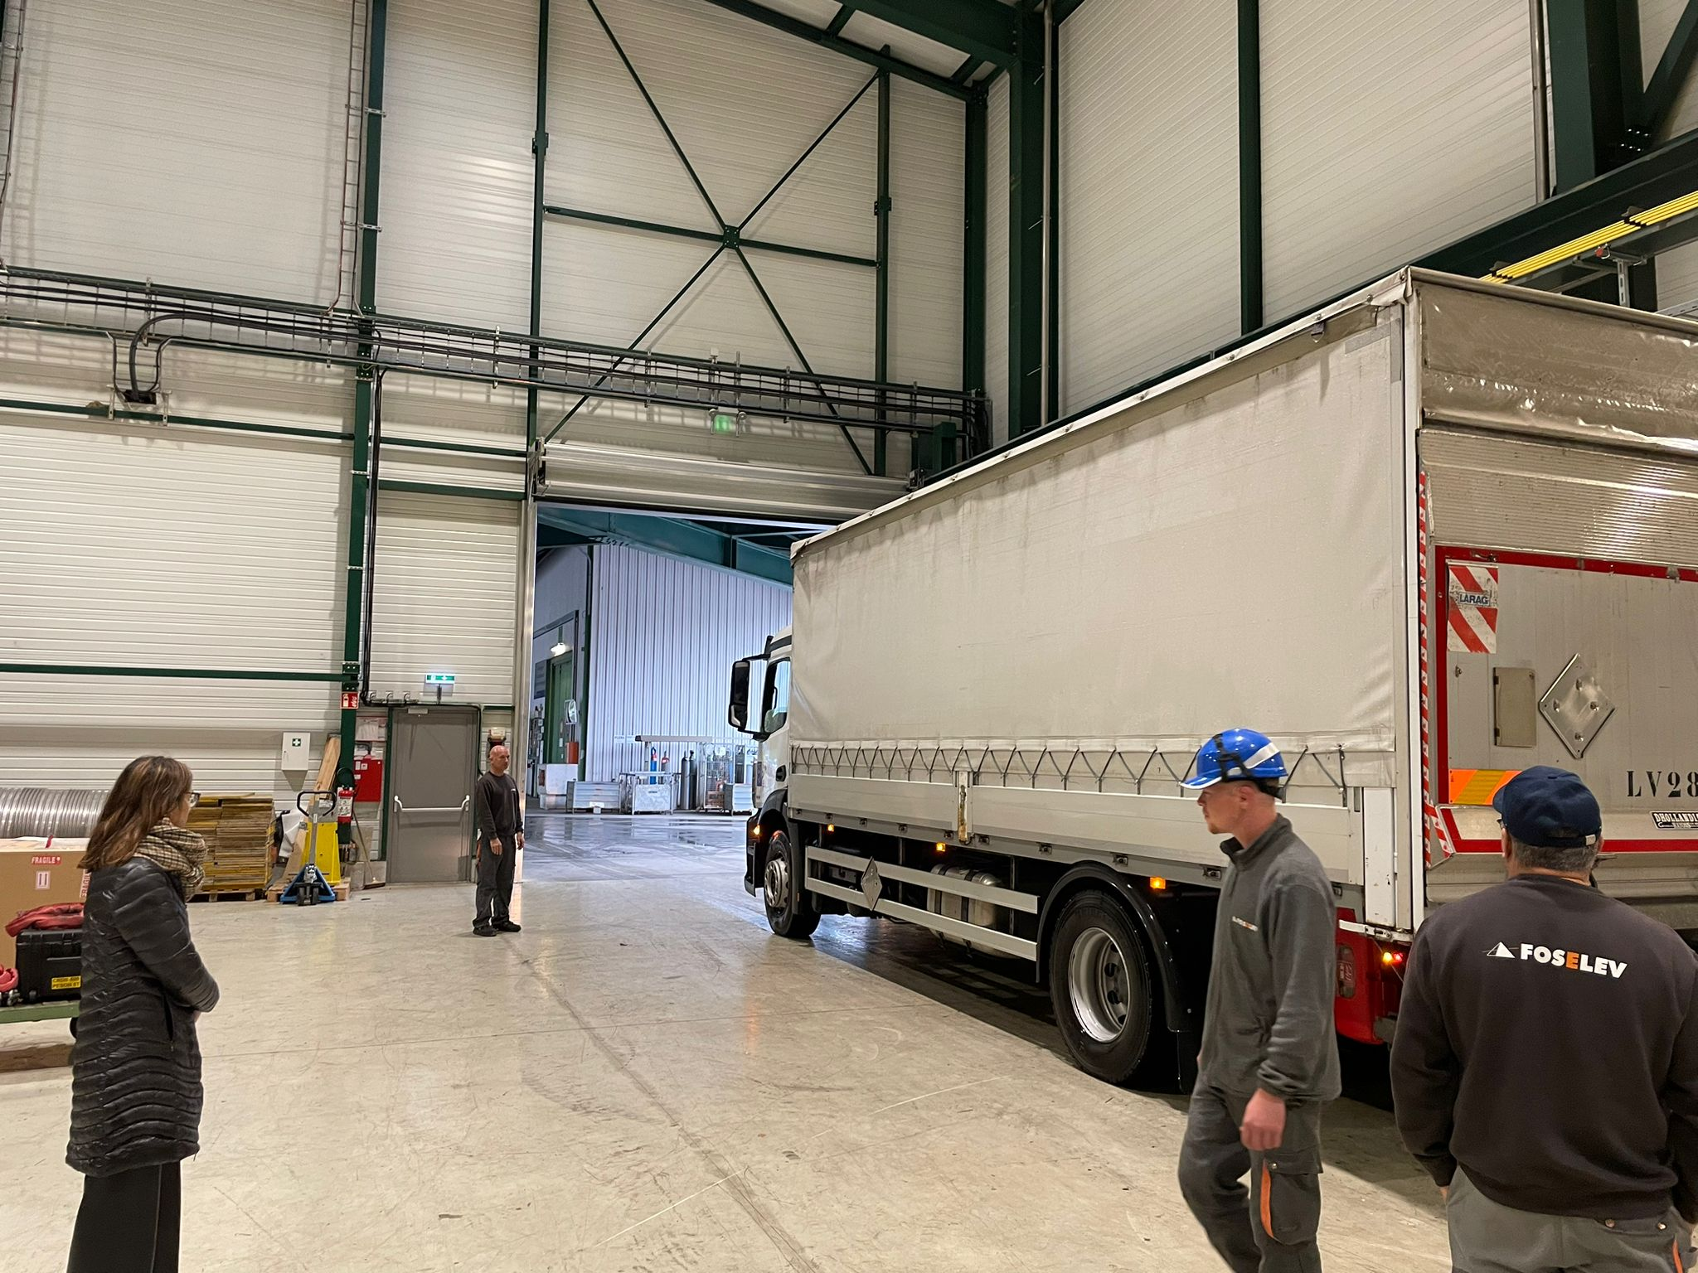
Timeline
18th October 2023@ 9h30 : Loading
18th October 2023@ 11h20 : Departure
18th October 2023@ 11h20 : Departure
18th October 2023@ 19h30 :
Ashford customs
18th October 2023@ 21h00 :
Departure Ashford customs
18th October 2023@ 22h00 : Tunnel
19th October 2023@ 01h00 : Hotel
19th October 2023@ 10h00 : Departure
Huge thanks to Pierre-Loic (driver), Christophe (driver) and David (instrumentation) for the efforts !
19th October 2023@ 12h00
19th October 2023@ 14h00
19th October 2023@ 17h00
19th October 2023@ 19h00 : Dole Hotel
20th October 2023@ 12h00 : CERN

Slide 3
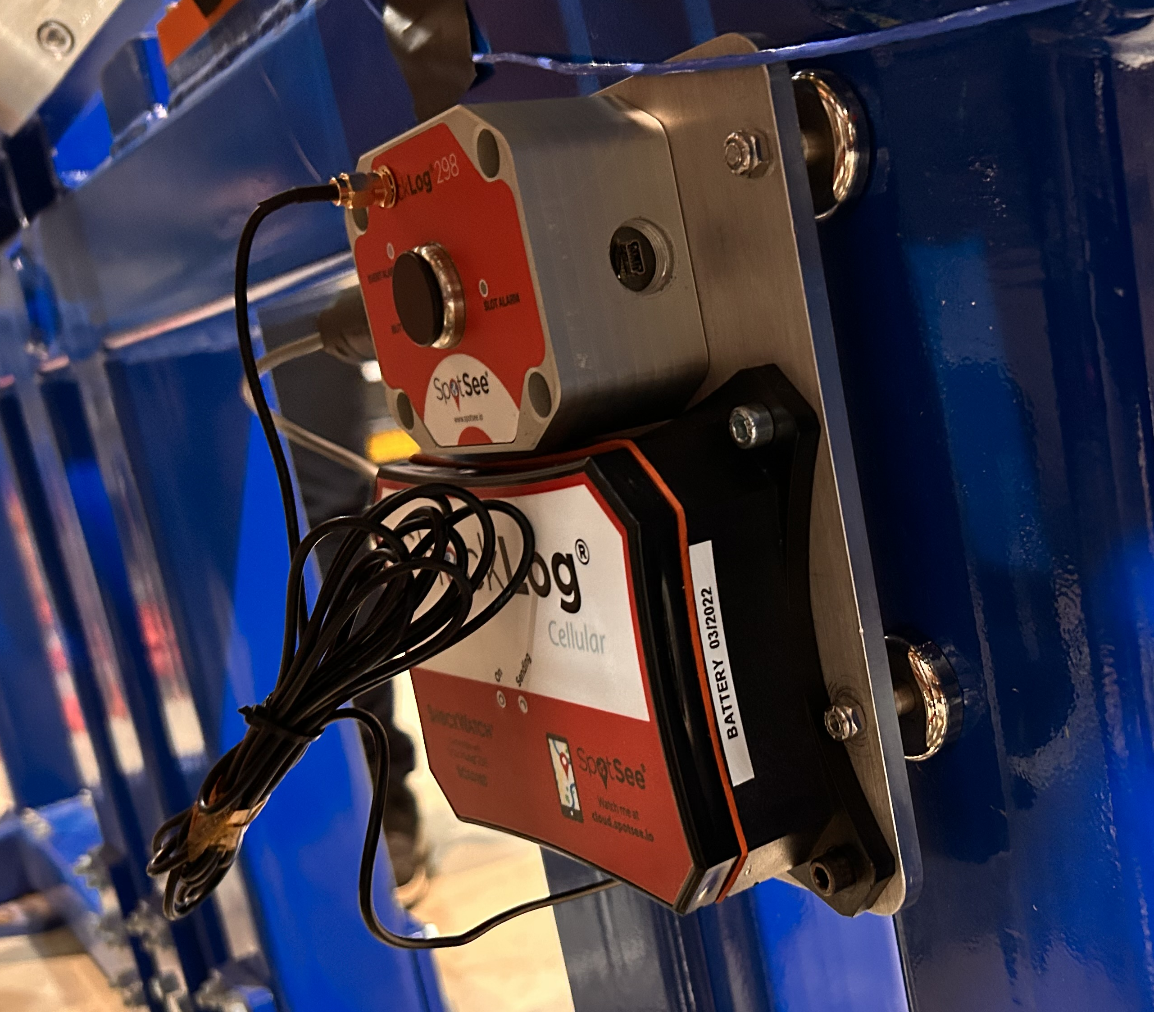
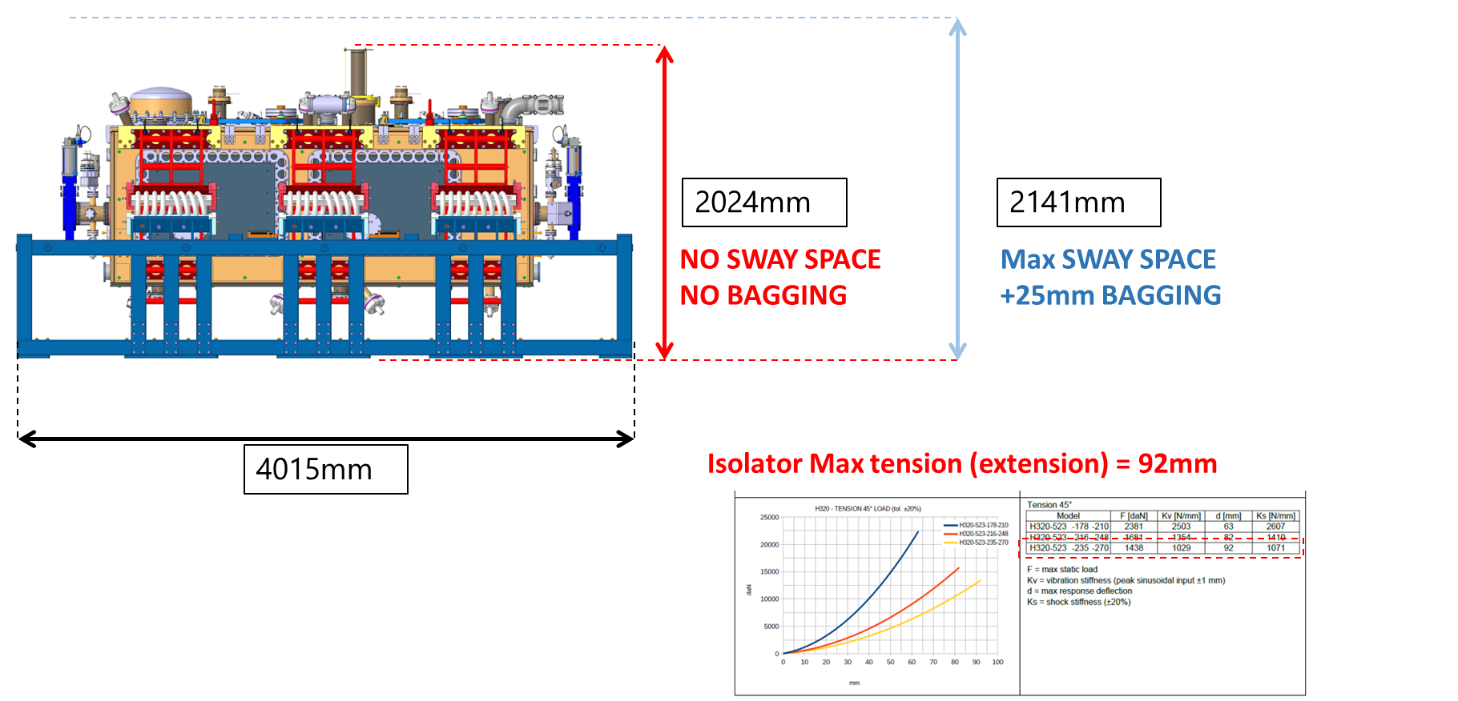
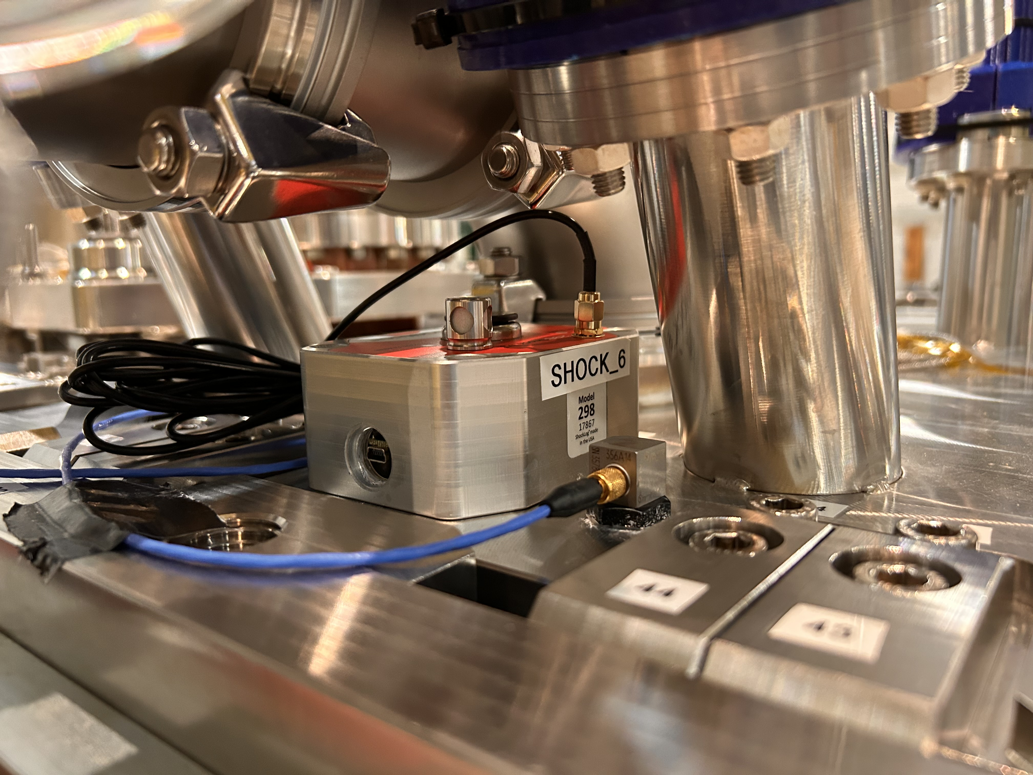
CERN Instrumentation – Baseline for future transport
2 Shocklog® Systems with GPS and GSM connections worldwide to collect shocks, Temp, HR :
- Cryomodule (3 directions)
- Transport frame (3 directions)
Z=Transverse
X= Longitudinal
Y= Vertical
Z=Vertical
X= Lateral
Y= Longitudinal

Slide 4
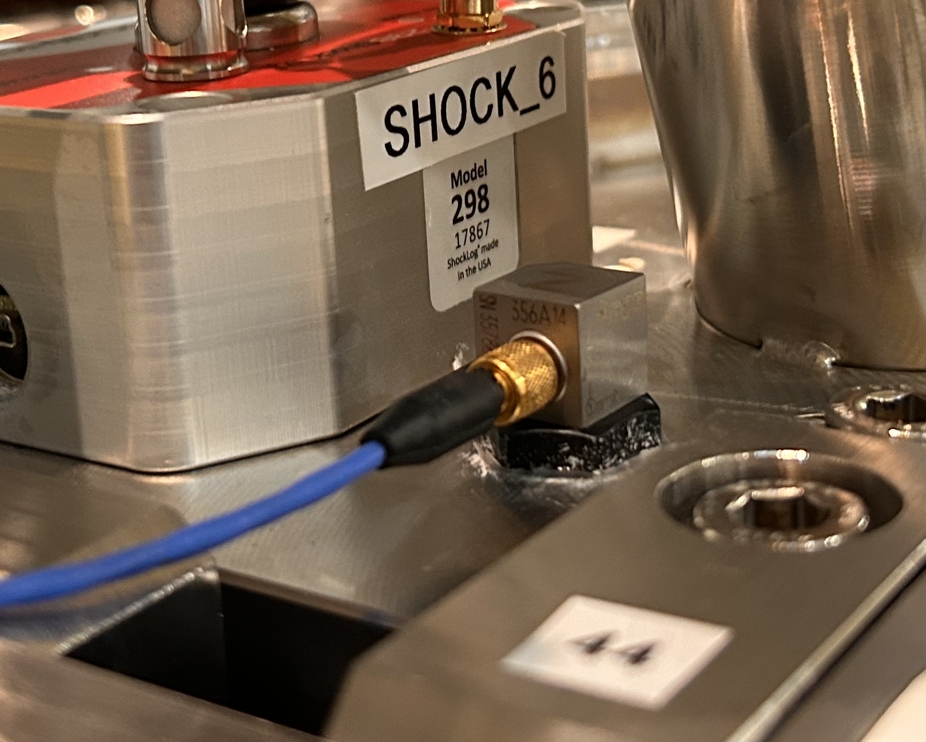
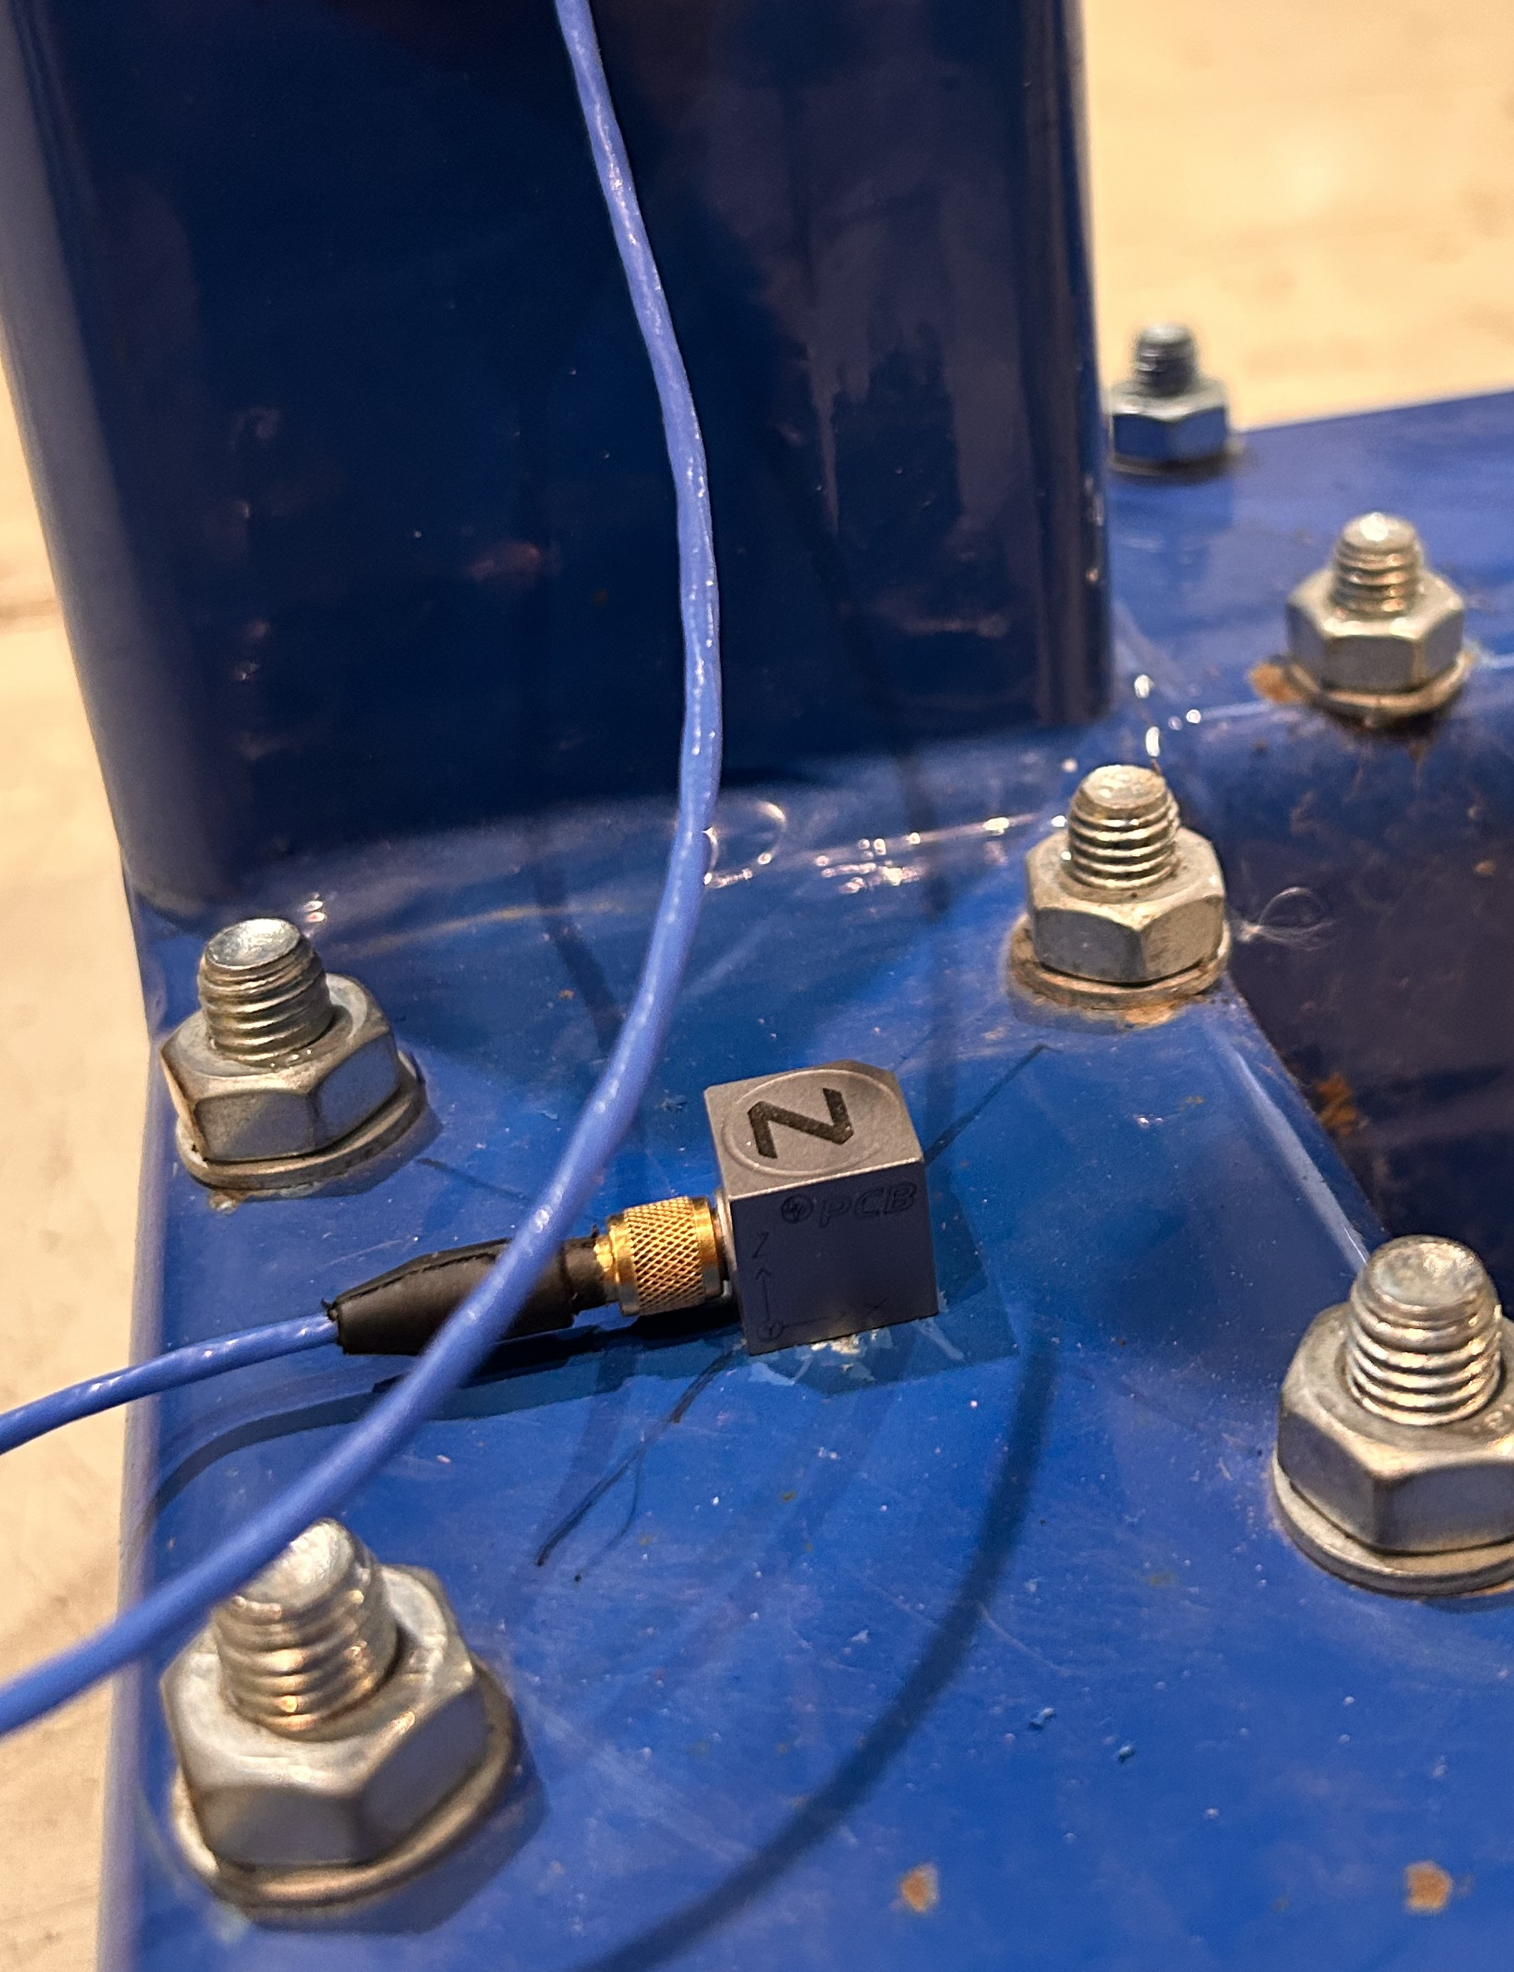
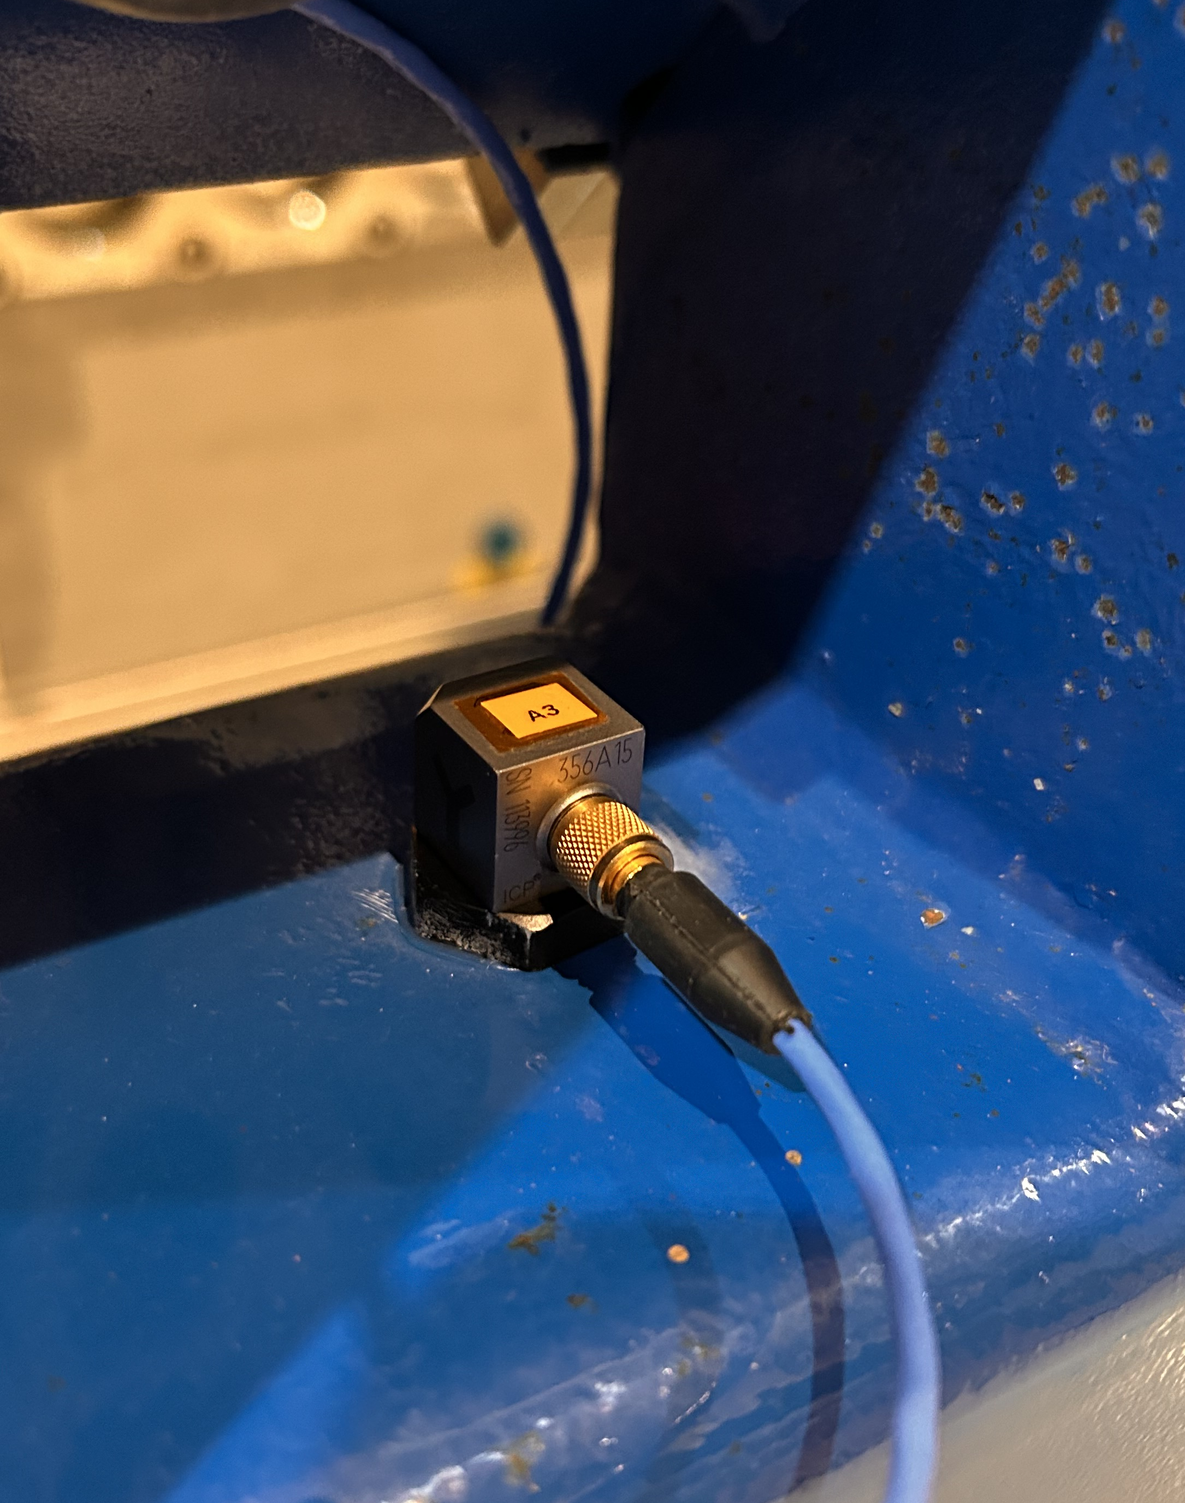
CERN Instrumentation – Extra
Continuous vibration monitoring system based on :
- 3 ICP triaxial accelerometers PCB-356A14
- Spectrum Analyzer with real time FFT analysis MicroQuantus®
    Online visualization
    Storage in an SSD hard drive
    Fs : 1024 Hz
Z=Vertical
X= Lateral
Y= Longitudinal

Slide 5
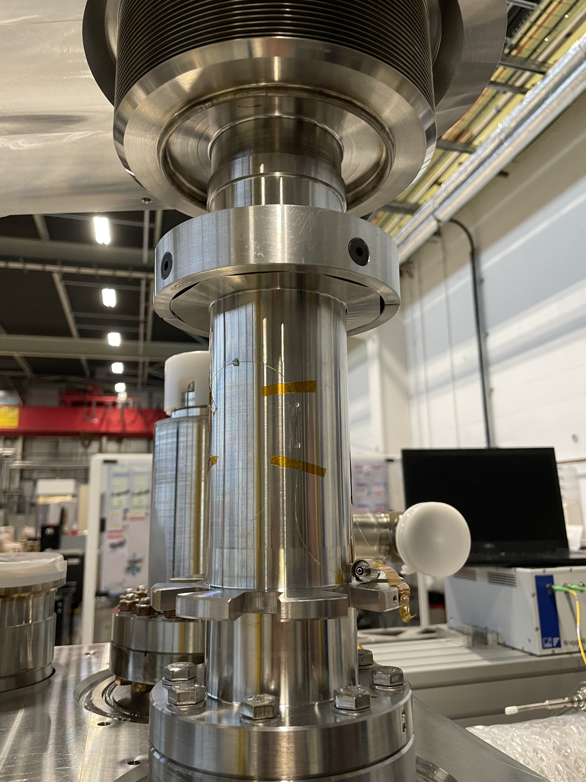
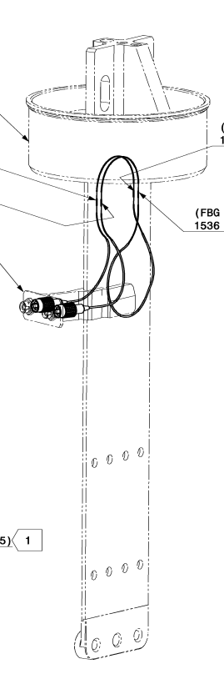
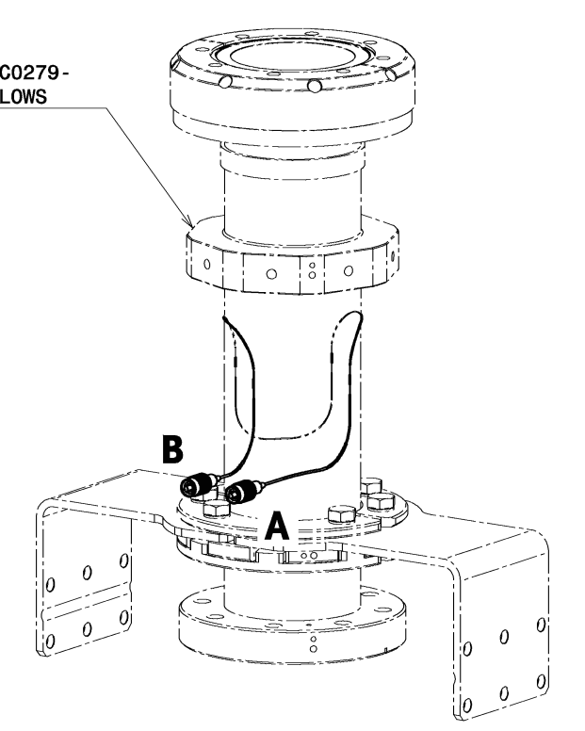
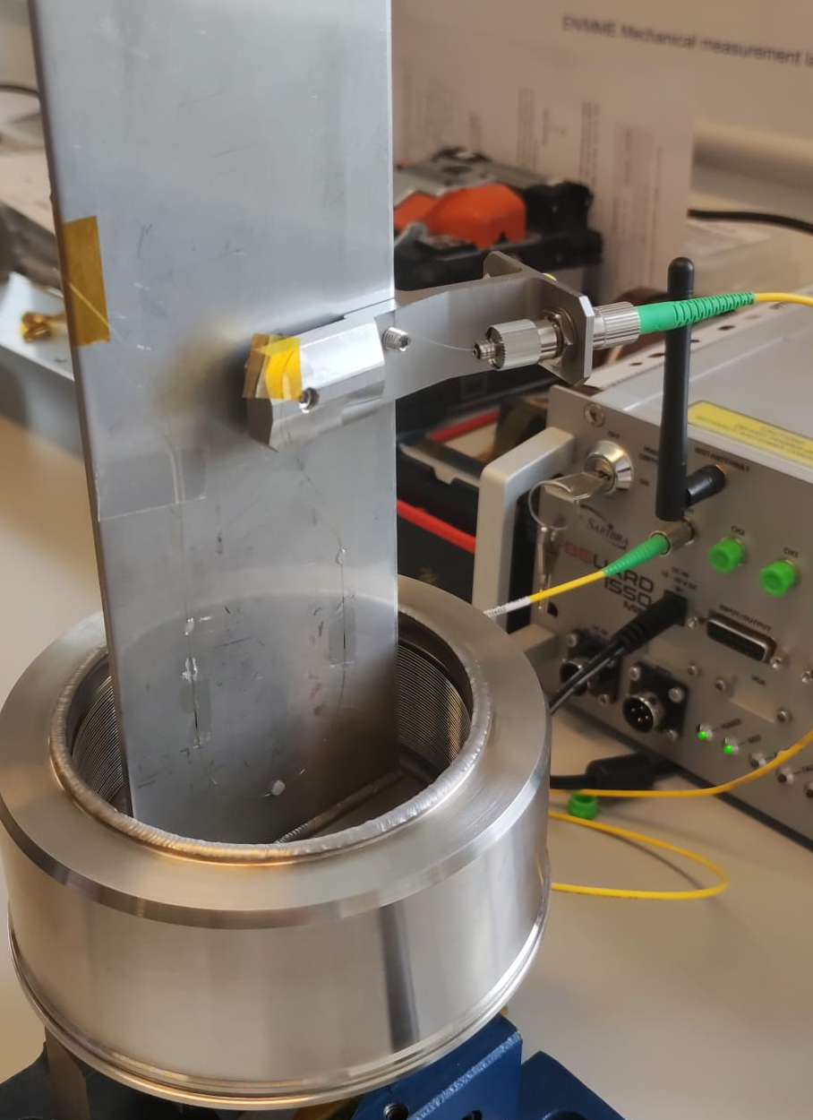
CERN Instrumentation – Cryomodule
Continuous strain measurements installed on blades and FPC tubes :
- Optical strain measurements based on FBG
- Online visualization with recording at 1000 Hz
Z=Vertical
X= Lateral
Y= Longitudinal

Slide 6
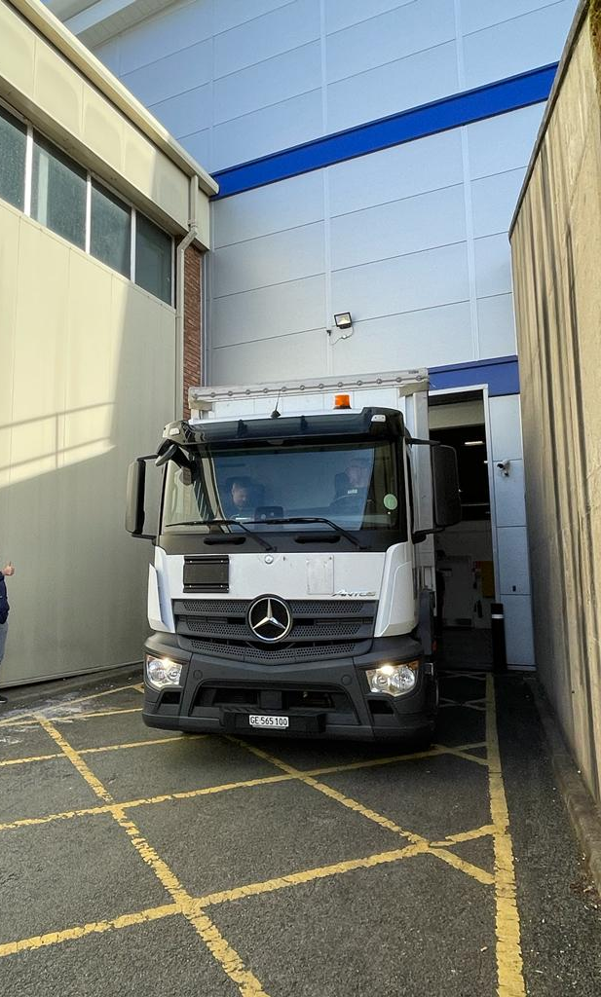
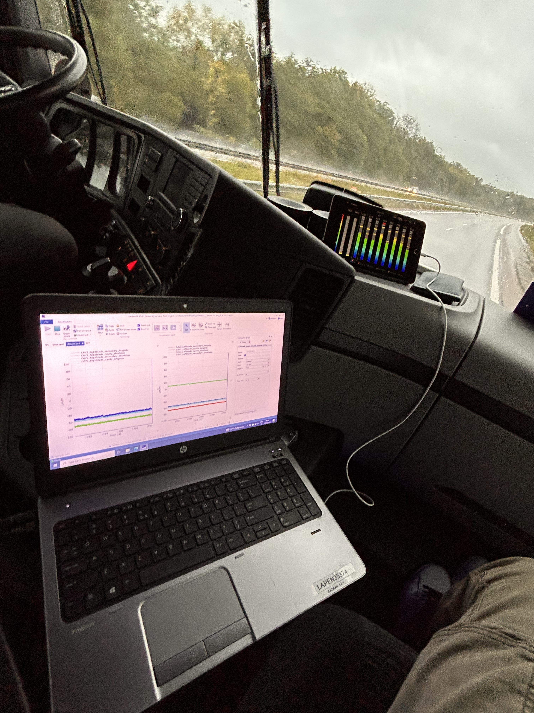
Results

Slide 7
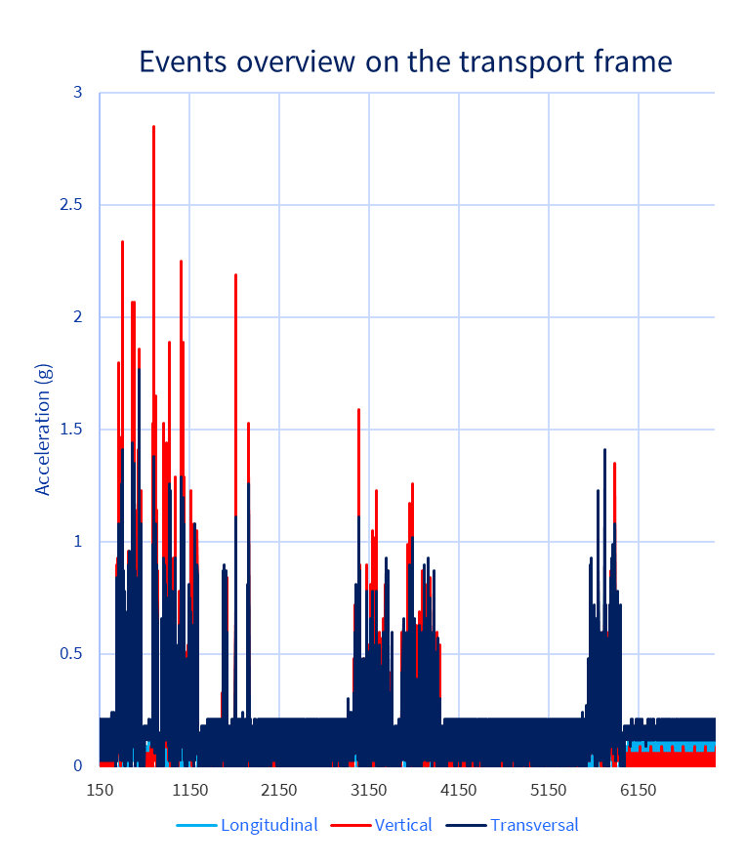
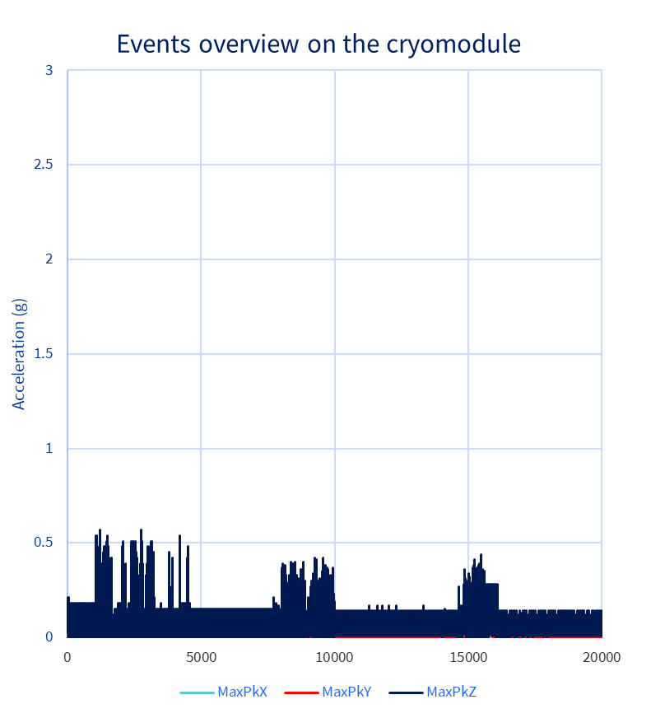
Results – Shocklog units

Slide 8
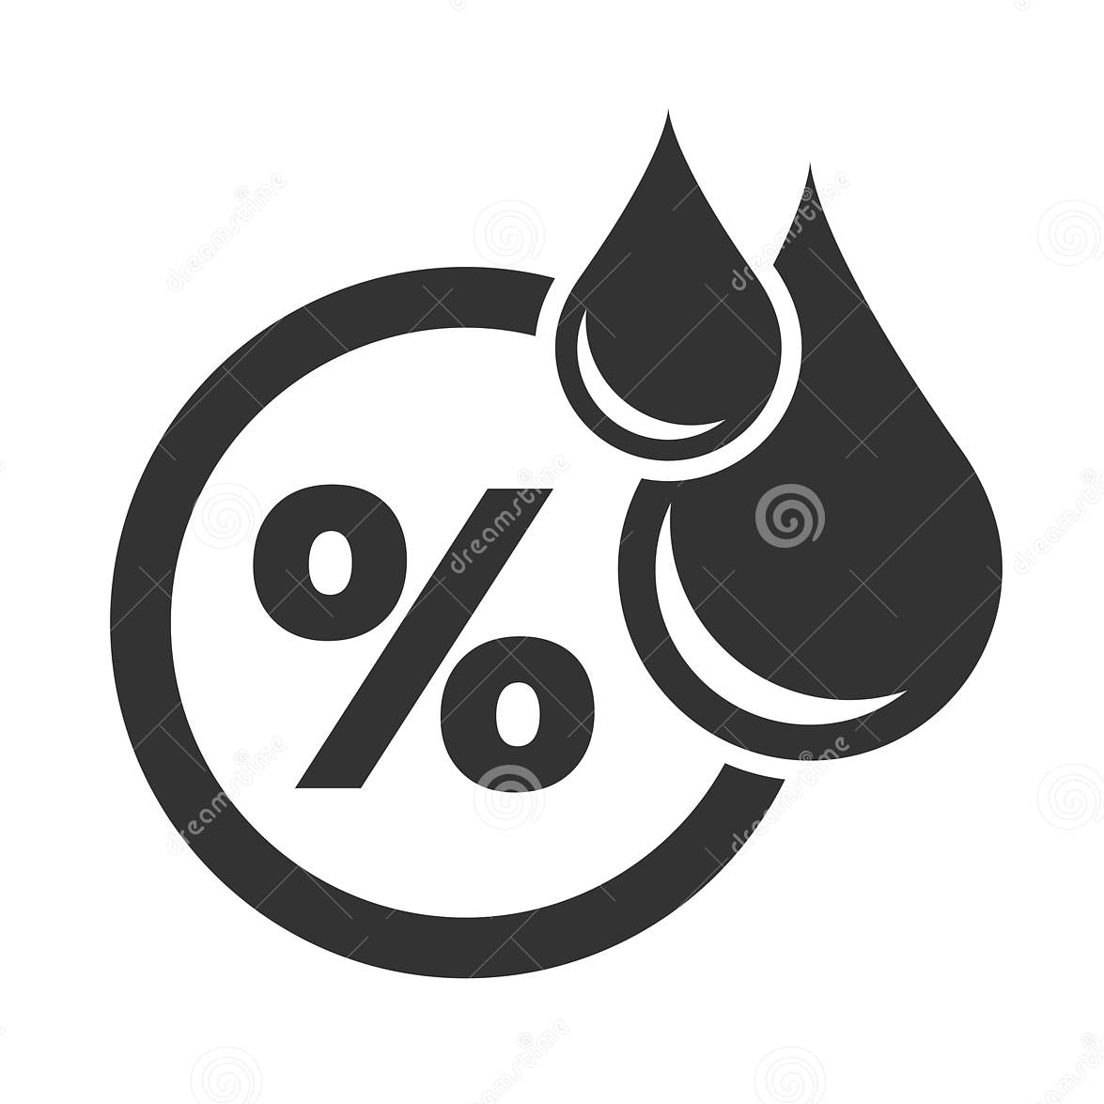
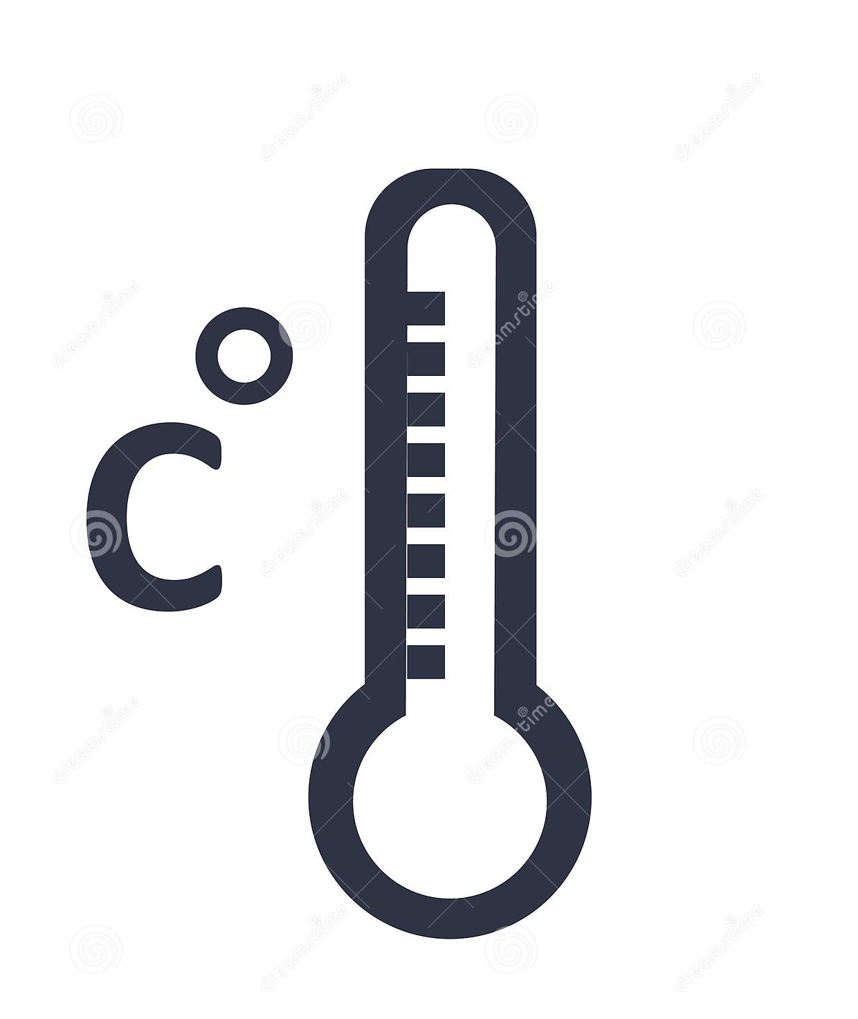


Results – Shocklog units

Slide 9
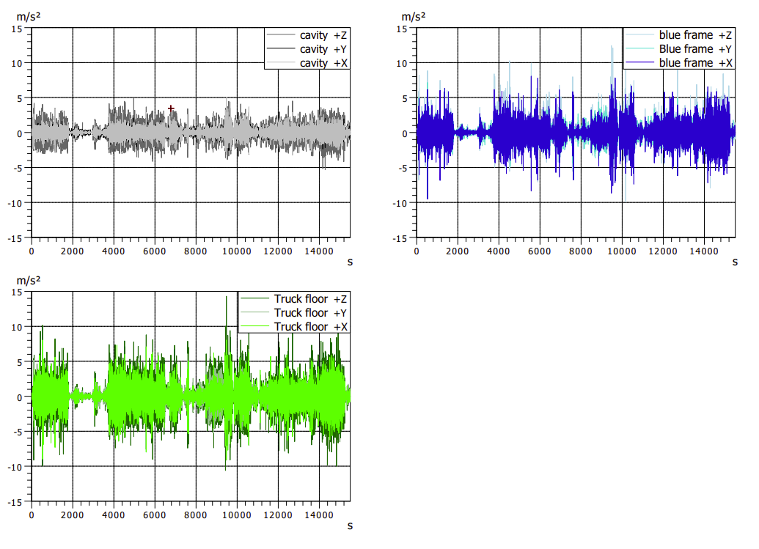
Results – Vibration monitoring system
Set of data from Warwick to Ashford Customs
Z=Vertical
X= Lateral
Y= Longitudinal

Slide 10
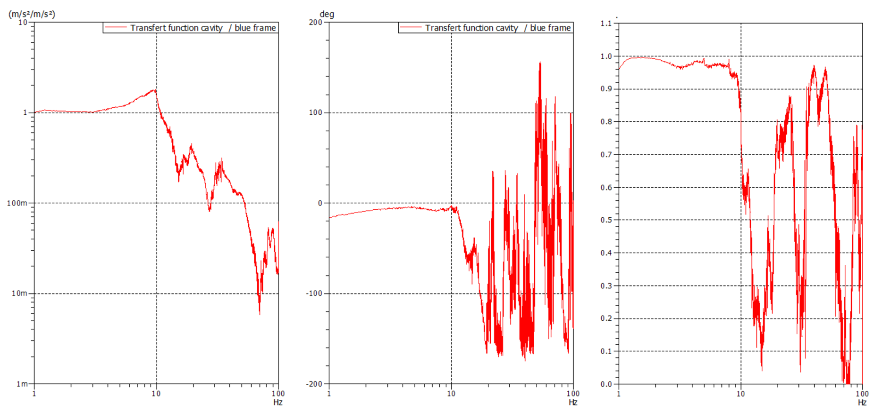
Results – Vibration monitoring system – Transfer function
Cut-off frequency ≅ 13 Hz

Slide 11
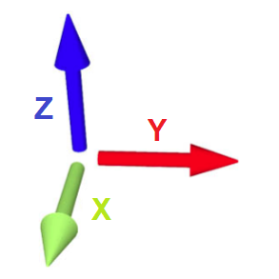
Results – Vibration monitoring system

Slide 12
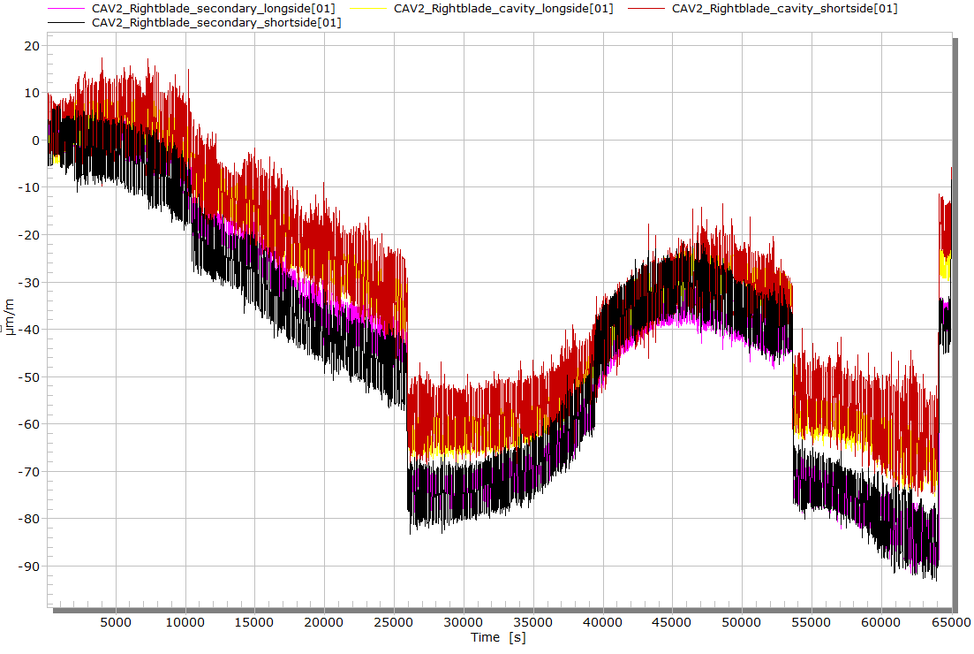
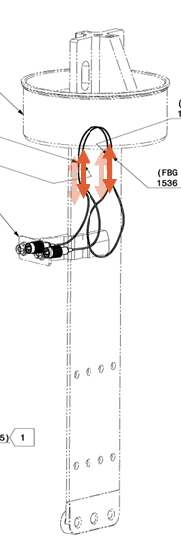
Results – Optical strain measurement system
Stop Measurement during the night
Transport effects
Low frequency effects are related to temperature
Full transport data

Slide 13
Results – Optical strain measurement system
Typical response of the blade instrumentation during transport event
Strain (μm/m)

Slide 14
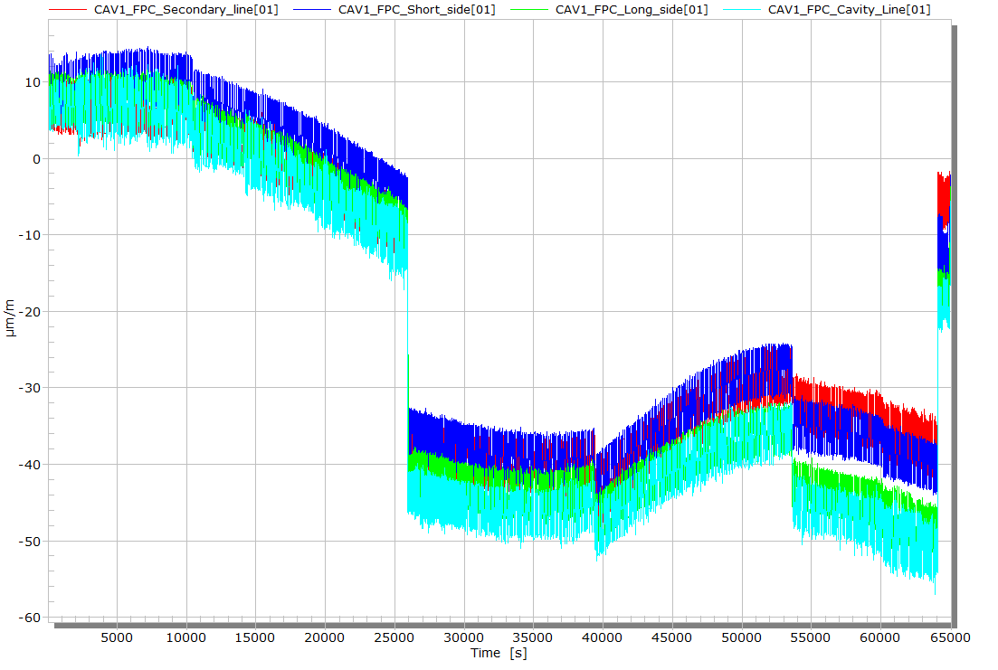
Results – Optical strain measurement system
Stop Measurement during the night
Full transport data

Slide 15
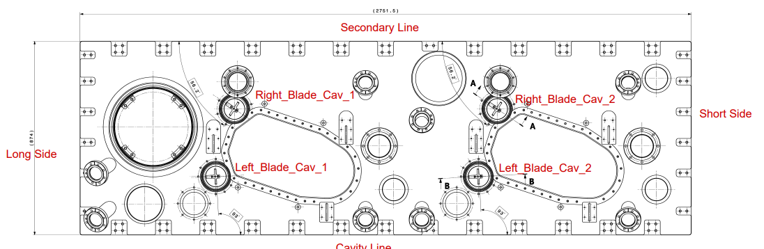
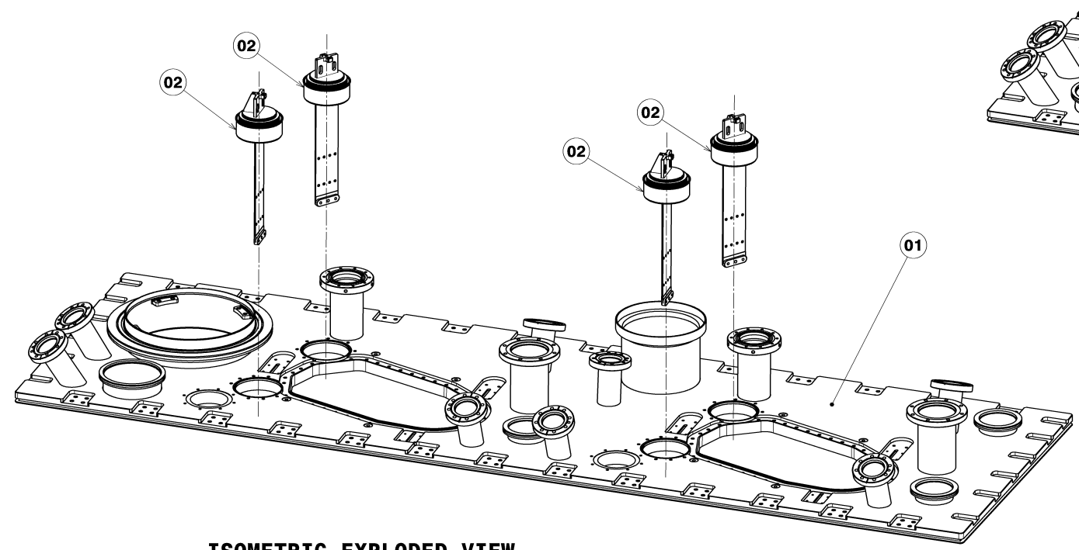
Results – Optical strain measurement system
 | 18th August 2023 | 17th October 2023 | 23th October 2023 | variation due to transport
 | Strain (µm/m) | Strain (µm/m) | Strain (µm/m) | Strain (µm/m)
CAV1_FPC_Secondary_Line | 29.12 | -13.4 | -23.8 | -10.4
CAV1_FPC_Short_Side | -29.91 | -43.41 | -59.47 | -16.06
CAV1_FPC_Long_Side | 17.97 | -76.33 | -99.1 | -22.77
CAV1_FPC_Cavity_Line | 104.7 | -24.16 | -46.58 | -22.42
CAV1_RightBlade_Cavity_Long Side | 299.1 | 281.62 | 262.4 | -19.22
CAV1_RightBlade_Secondary_Long Side | 22.24 | -43.96 | -52.49 | -8.53
CAV1_RightBlade_Secondary_Short Side | -268.3 | -418.47 | -447.9 | -29.43
CAV1_RightBlade_Cavity_Short Side | -388.7 | -489.43 | -519.1 | -29.67
CAV1_LeftBlade_Secondary_Long Side | 90.7 | 59.36 | 26.7 | -32.66
CAV1_LeftBlade_Cavity_Long Side | 6.579 | -47.39 | -41.57 | 5.82
CAV1_LeftBlade_Cavity_Short Side | -147.3 | -242.3 | -267.74 | -25.44
CAV1_LeftBlade_Secondary_Short Side | -103.3 | -146.14 | -161.43 | -15.29
CAV2_FPC_Secondary_Line | -73.02 | -129.23 | -141.69 | -12.46
CAV2_FPC_Short_Side | 41.06 | -19.99 | -29.3 | -9.31
CAV2_FPC_Long_Side | 168.6 | 64.92 | 53.54 | -11.38
CAV2_FPC_Cavity_Line | 48.74 | -44.96 | -58.38 | -13.42
CAV2_LeftBlade_Secondary_Long Side | -182.9 | -139.04 | -170.8 | -31.76
CAV2_LeftBlade_Cavity_Long Side | -34.94 | -153.79 | -169.67 | -15.88
CAV2_LeftBlade_Cavity_Short Side | -360.1 | -411.13 | -387.81 | 23.32
CAV2_LefttBlade_Secondary_Short Side | 48.44 | -23.51 | -42.46 | -18.95
CAV2_RightBlade_Cavity_Short Side | -44.86 | -97.98 | -118.8 | -20.82
CAV2_RightBlade_Secondary_Short Side | -184.1 | -321.01 | -354.98 | -33.97
CAV2_RigthBlade_Secondary_Long Side | 150.6 | 98.07 | 64.25 | -33.82
CAV2_RightBlade_Cavity_Long Side | 26.02 | -5.79 | -31.13 | -25.34

Slide 16
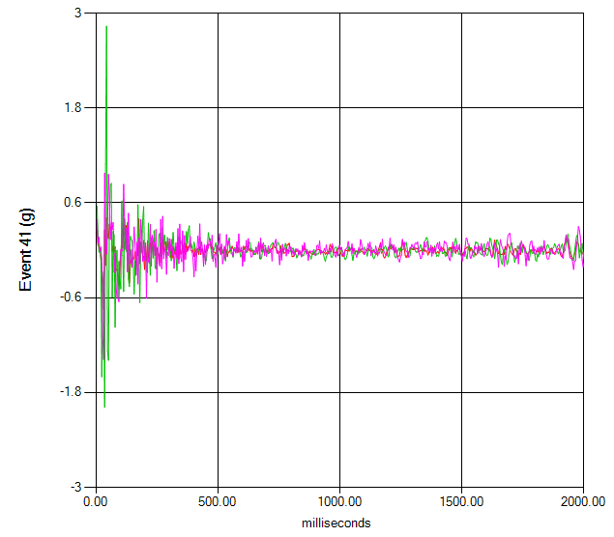
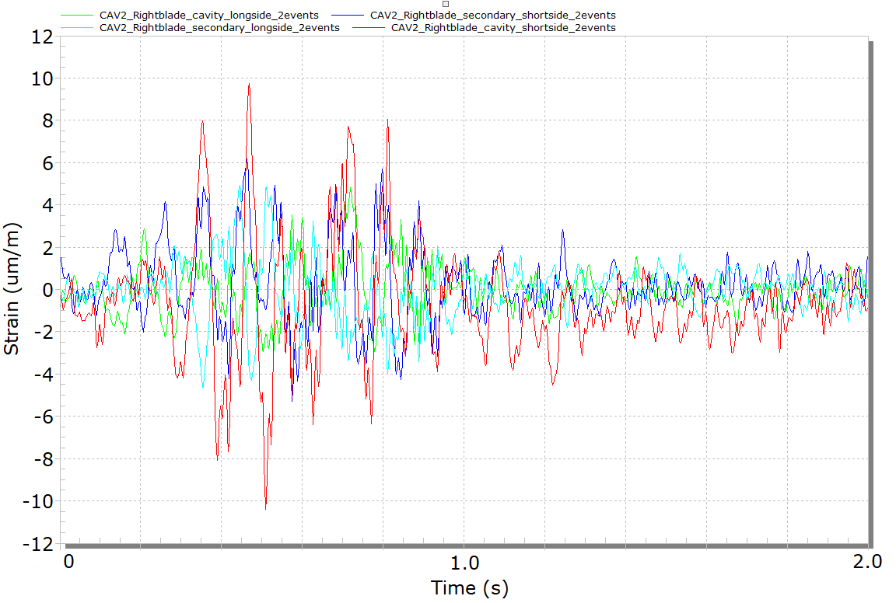
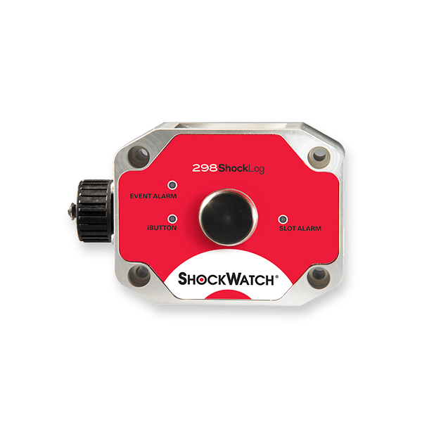

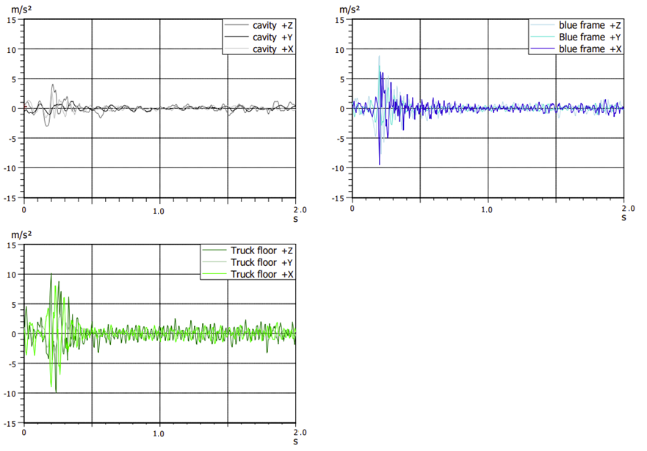
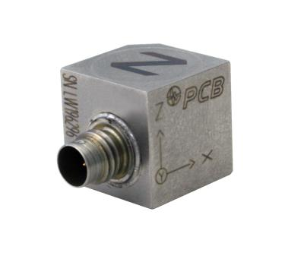
Results – Worst case event
Blue frame
Sample rate = 1000 Hz
Sample rate = 4096 Hz
18/10/23 11h30 19/10/23_10h00 20/10/23 8h30
Sample rate = 1024 Hz
Sample rate = 1024 Hz
Sample rate = 1024 Hz

Slide 17
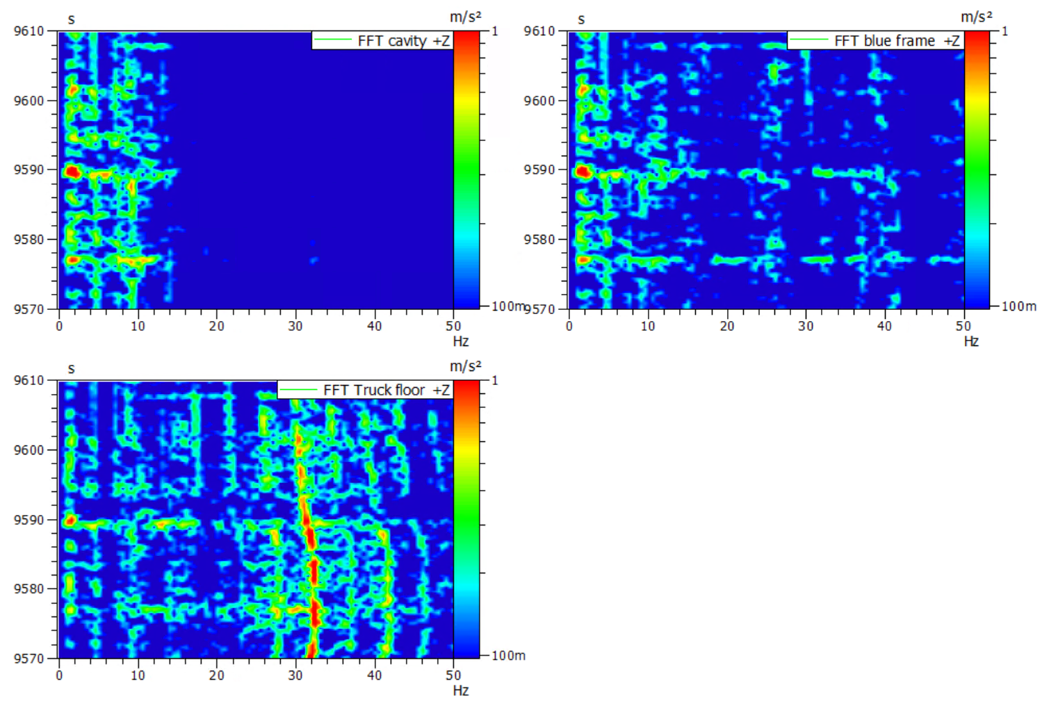
Results – Worst case event
Blue frame
Sample rate = 1000 Hz
Sample rate = 4096 Hz
18/10/23 11h30 19/10/23_10h00 20/10/23 8h30
0.2 g @ 2 Hz

Slide 18
Results – Transport Summary
 |  | Min value | Max Value
Shocklog Data | Temperature | 14 °C | 20 °C
 | Humidity | 55 % | 100 %
 | Tilt | - 7 ° | +15 °
 | Roll | -10 ° | +5 °
 | Vertical RFD acceleration (@4096 Hz) | / | < 0.6 g
 | Longitudinal RFD acceleration (@4096 Hz) | / | < 0.6 g
 | Lateral RFD acceleration (@4096 Hz) | / | < 0.6 g
Monitoring system | Vertical RFD acceleration (@1024 Hz) | / | < 0.5 g
 | Longitudinal RFD acceleration (@1024 Hz) | / | < 0.5 g
 | Lateral RFD acceleration (@1024 Hz) | / | < 0.5 g
 | Strains on blade components | / | +/- 20 μm/m
 | Strains on FPC components | / | +/- 20 μm/m

Slide 19
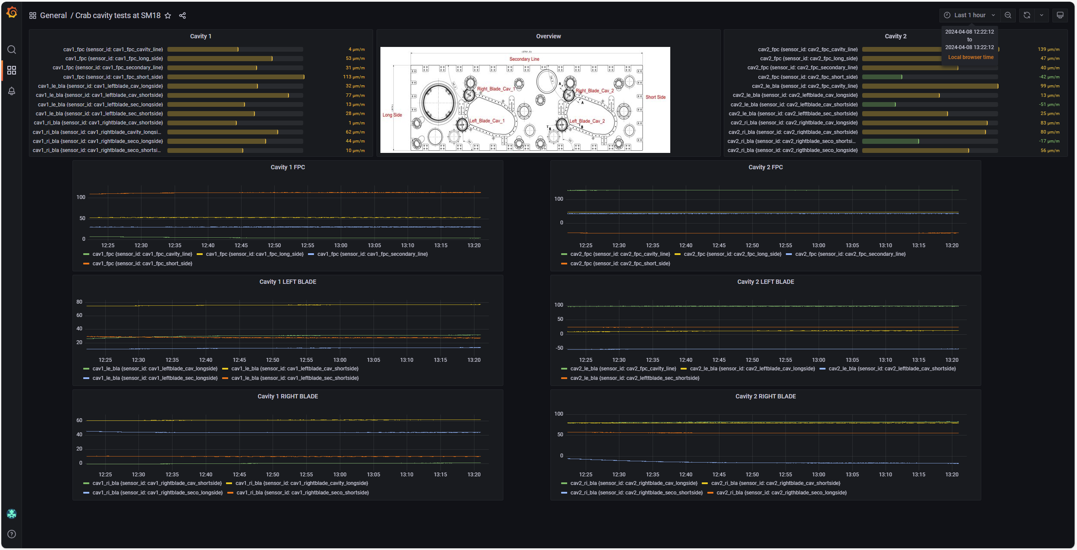
Since the transport…
Continuous optical strain monitoring : (https://mml.web.cern.ch/)

Slide 20
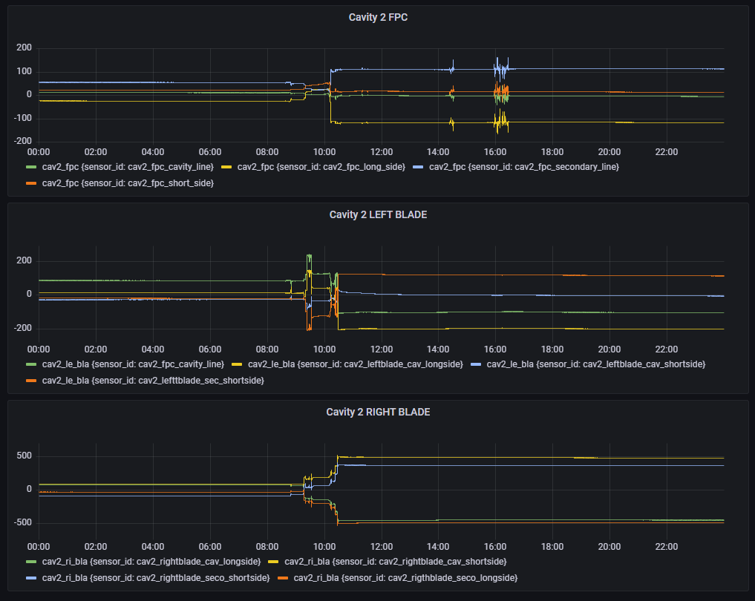
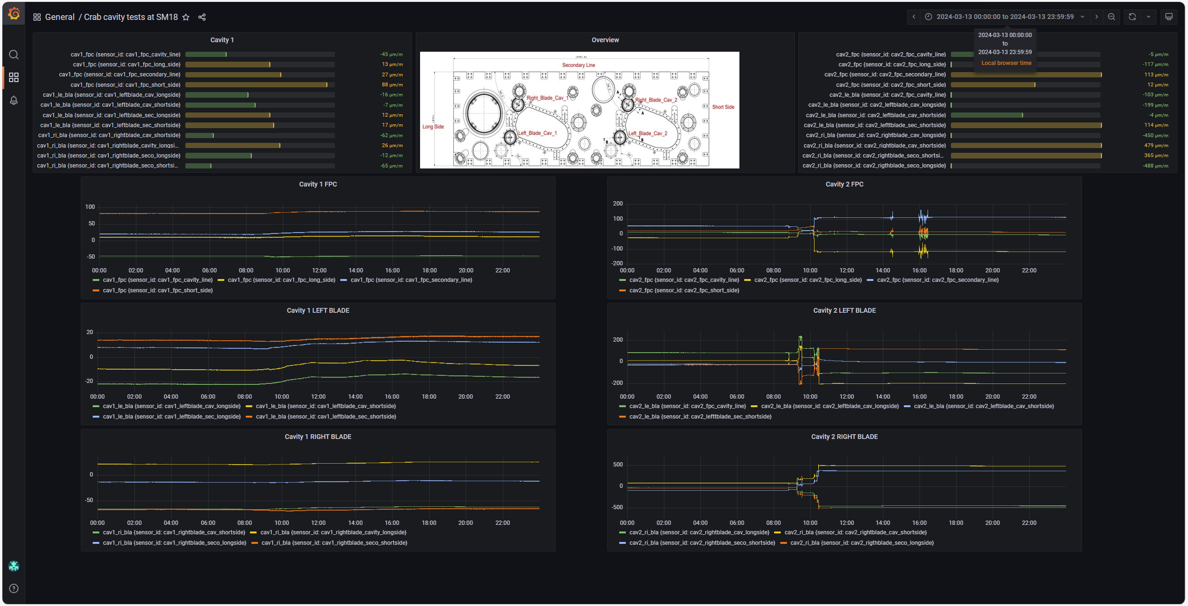
Since the transport…
Mechanical operation on cavity 2 the 13th March 2024

Slide 21
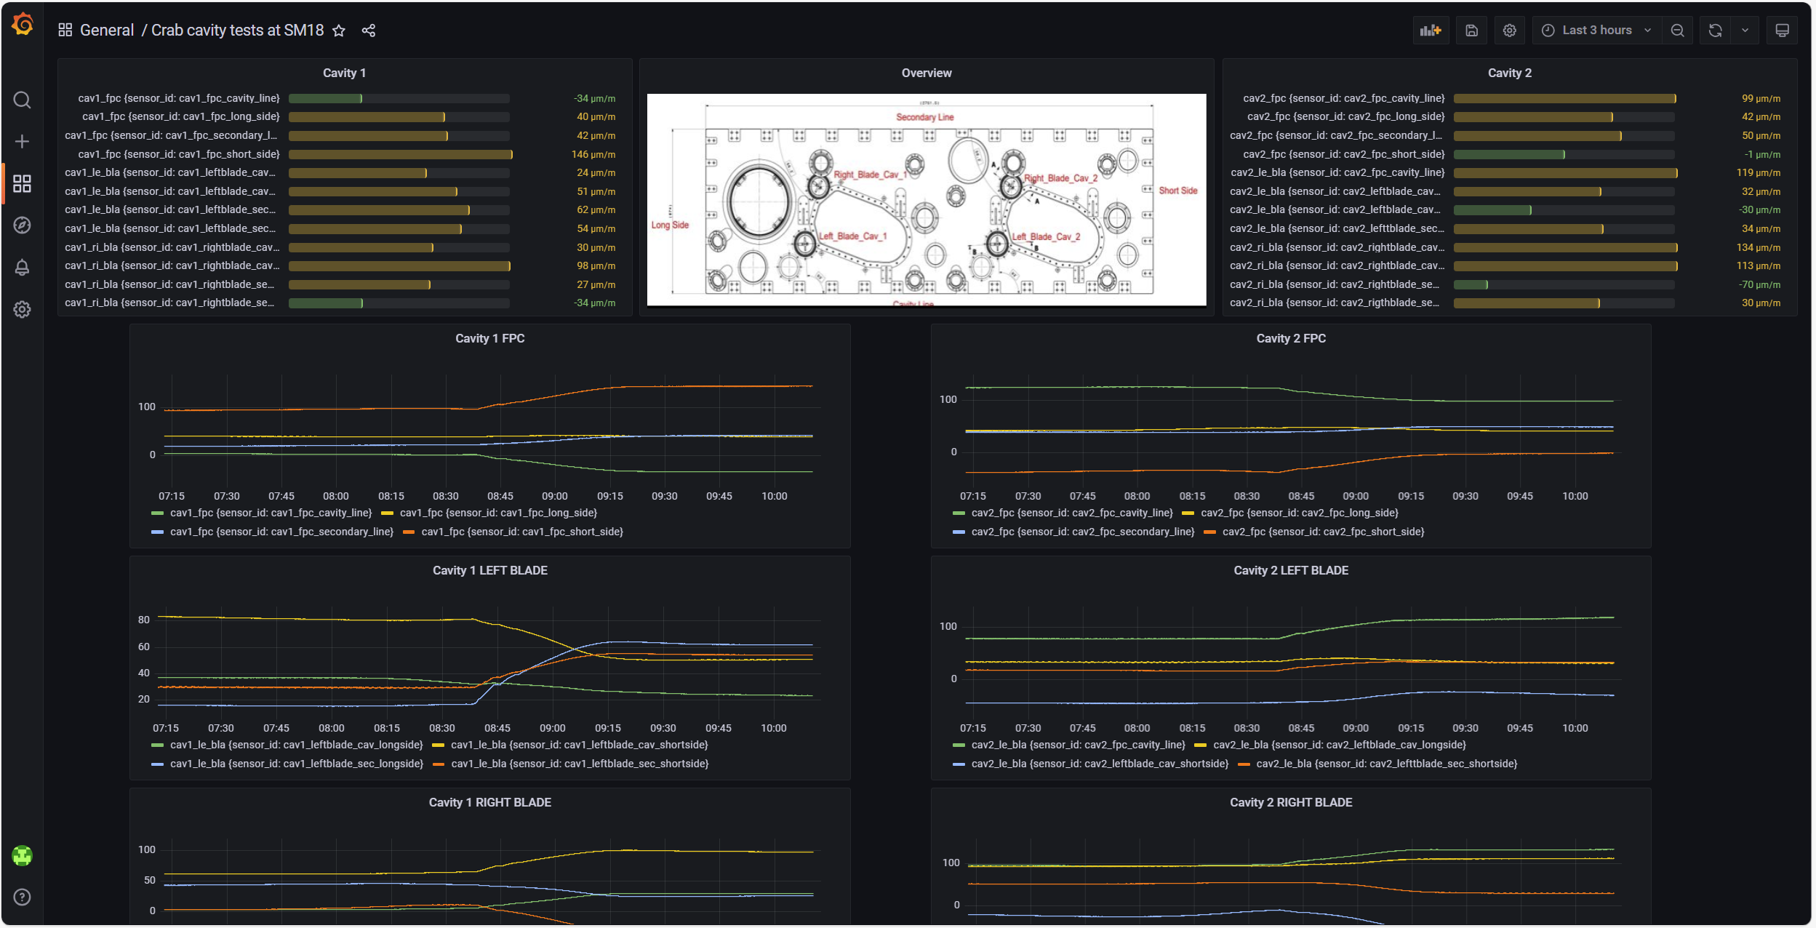
Since the transport…
This morning…

Slide 22
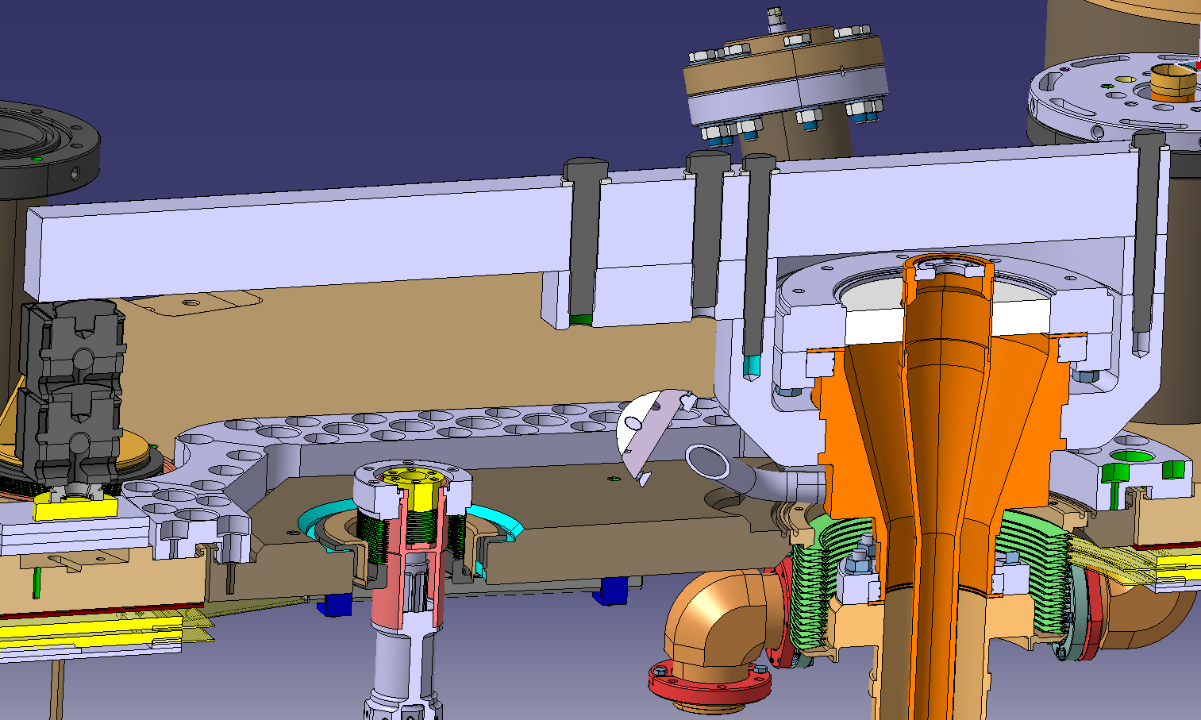
Future activities
Support during the mechanical reparation of cavity 1 thanks to the optical instrumentation + additional instrumentation.
Displacement monitoring
Force monitoring
FPC tube strain monitoring

Slide 23
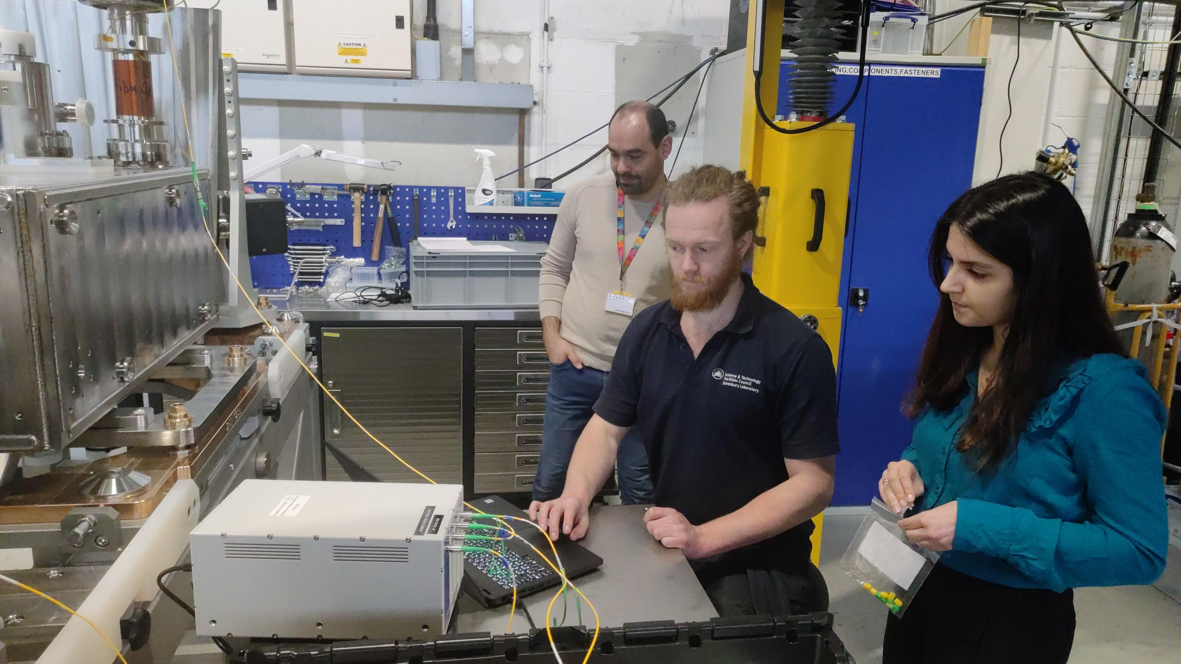
Conclusion / Lessons learnt
Lot of data collected during the cryomodule transport from UK to assess the dynamic simulations and validate the transport frame efficiency;
For future transports from UK ⇔ CERN, a limited instrumentation should be used (based on shocklogs with GPS and GSM connections to collect shocks, Temp, HR);
Internal instrumentation based on optical fibers is useful during assembly operations and after transports !
Local experts (STFC, TRIUMF in the future) must be identified and/or trained to support our activities remotely.

