Slide 1
Qualification and NCRs from UK during Cryomodule Assembly
Julien DEBEUX (EN-MME)
Experience from RFD CM tests at CERN I – Indico 1414262 – 18/06/2024

Slide 2

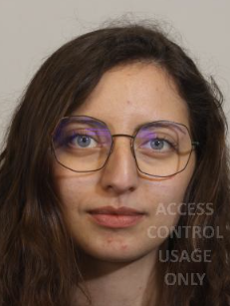
Introduction
Welding and Manufacturing Quality activities
  3 years working at Main Workshop as Welding Engineer for various projects
  Working for WP4 since November 2022
  Since April 2024: Myriam Benahmed has joined the WP4 team as Welding Engineer
Topics
  Qualifications passed by UKRI during RFD-SPS CM Assembly
  NCRs spotted during RFD-SPS components fabrication and assembly in UK
  NCRs spotted during RFD-SPS assembly and reception at CERN

Slide 3
Qualification passed by UKRI during CM Assembly

Slide 4
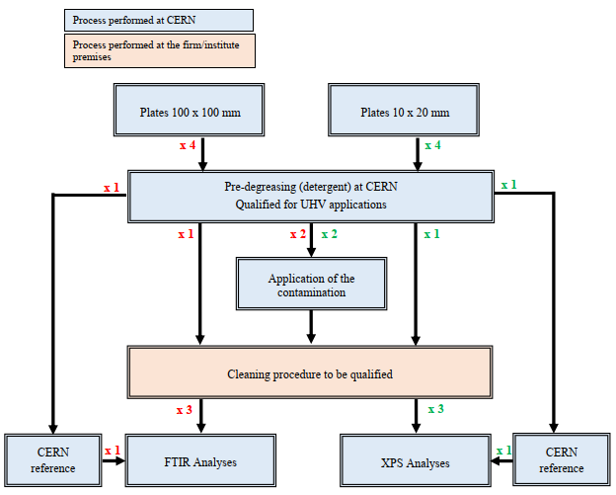
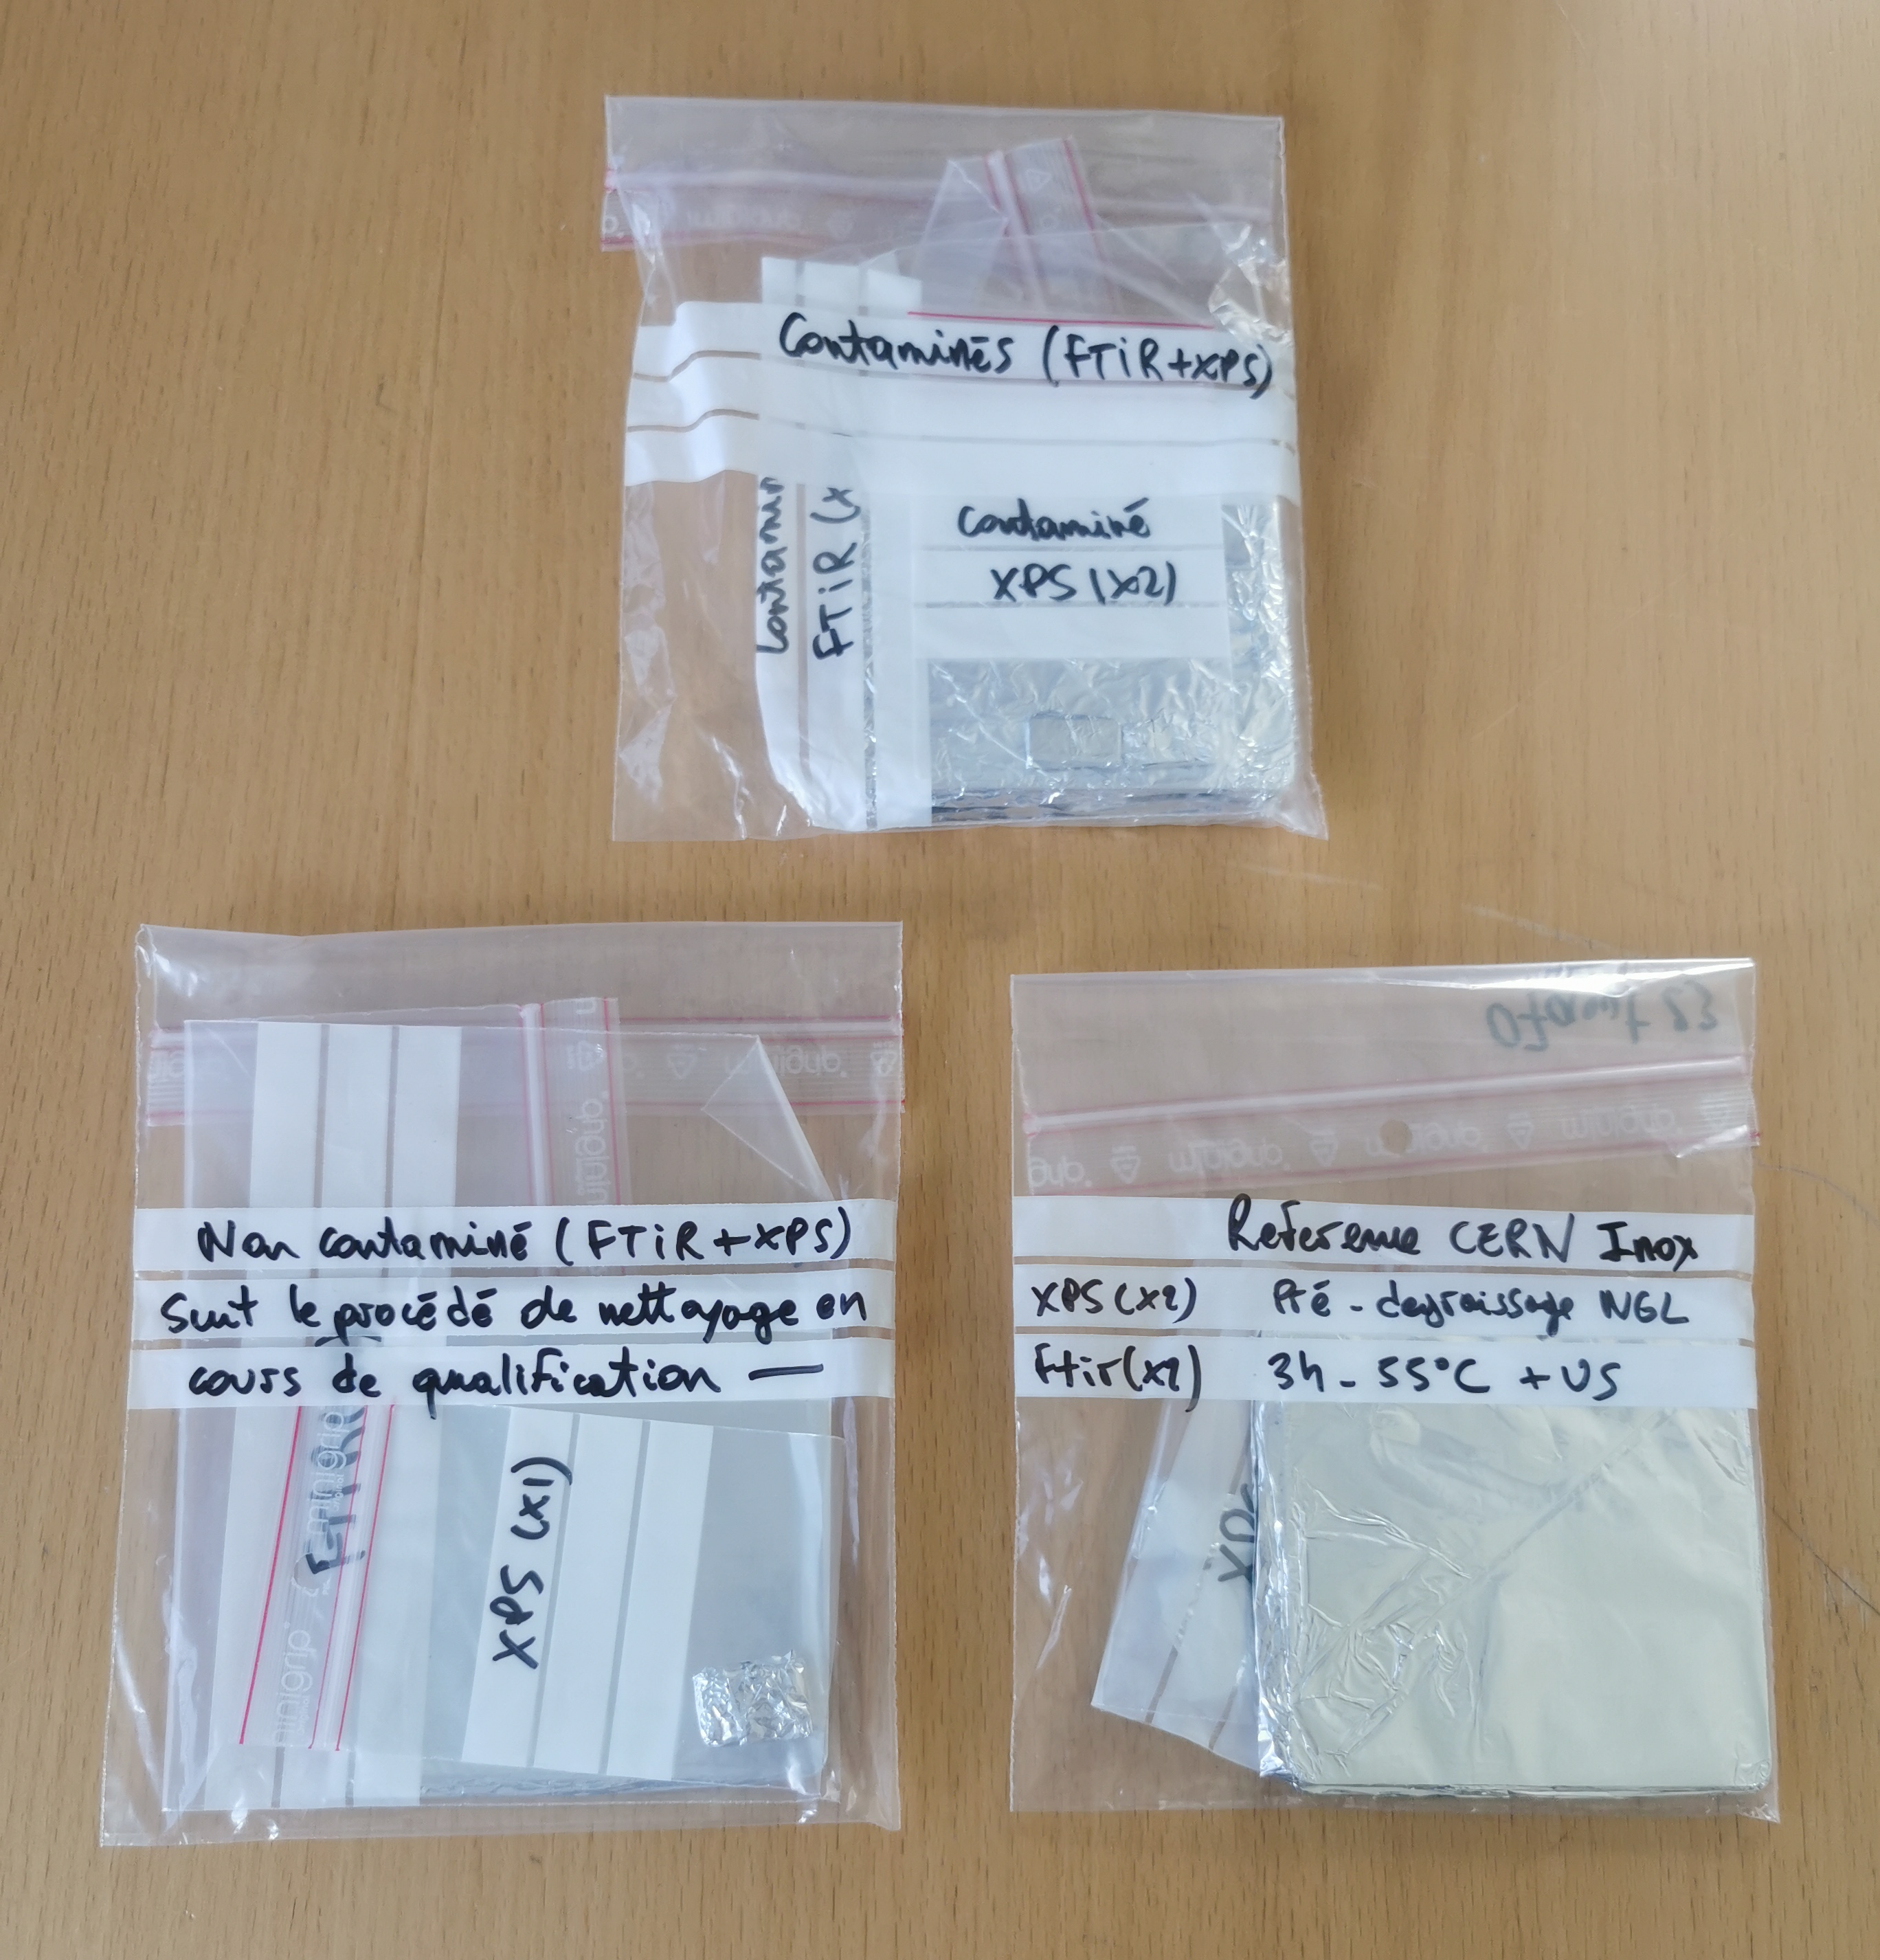
Qualification passed by UKRI during CM Assembly
UHV Cleaning procedure qualification
  Procedure for qualification: EDMS 1726970
  First attempt: NOK, see NCR LHC-ACF_A-QN-0004
    Qualification process not respected
    Cleanliness requirements not shared with technicians
    6 months between cleaning and CERN analysis
  Second attempt: OK, see EDMS 2888023

Slide 5
Qualification passed by UKRI during CM Assembly
UHV Cleaning procedure qualification
  Procedure for qualification: EDMS 1726970
  First attempt: NOK, see NCR LHC-ACF_A-QN-0004
    Qualification process not respected
    Cleanliness requirements not shared with technicians
    6 months between cleaning and CERN analysis
  Second attempt: OK, see EDMS 2888023

Slide 6
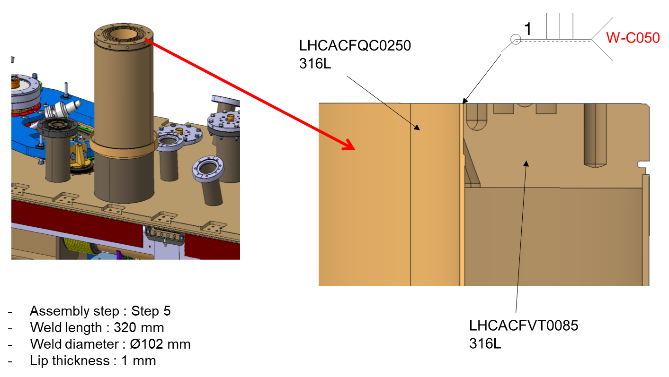
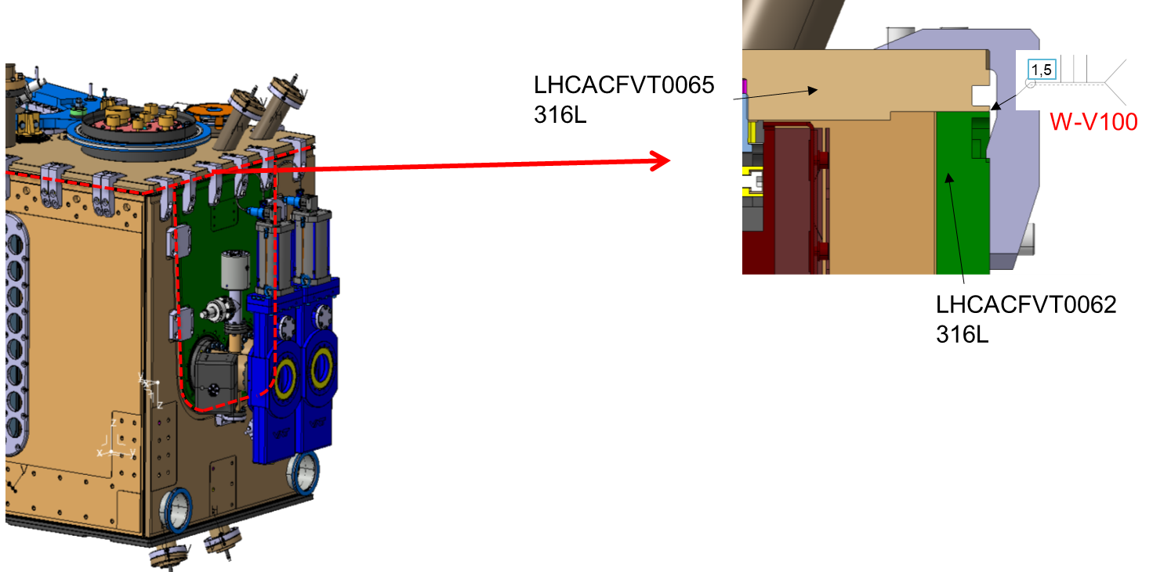
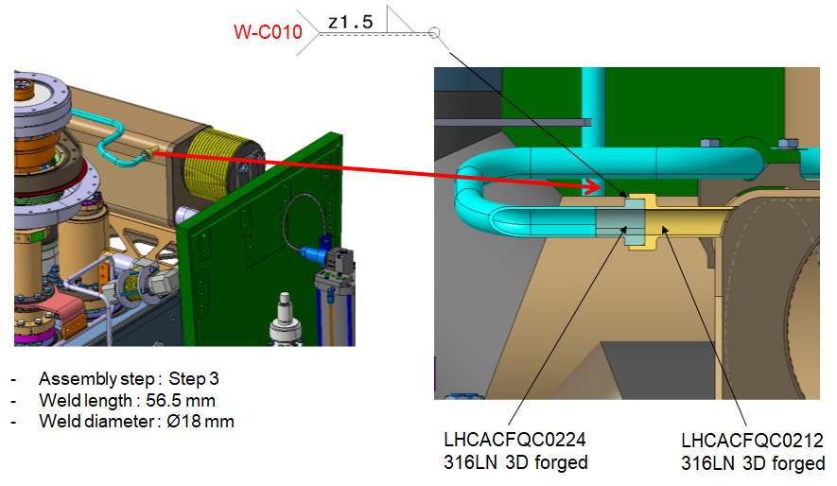
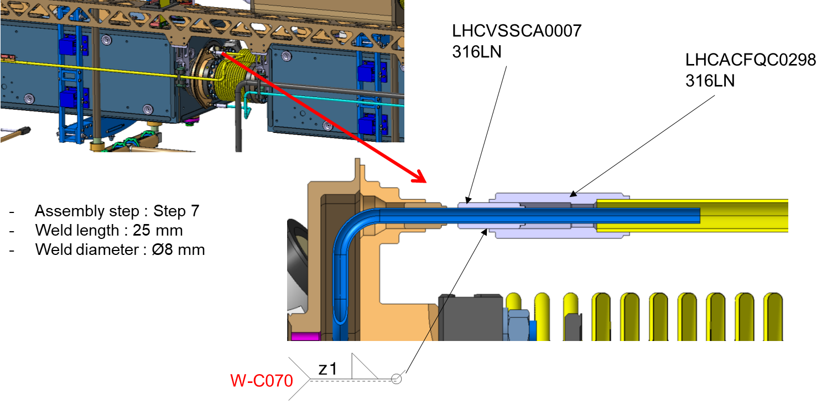
Qualification passed by UKRI during CM Assembly
Welding activity during CM Assembly
  List of weld to be performed during CM Assembly: EDMS 2678641
  4 main configurations:

Slide 7
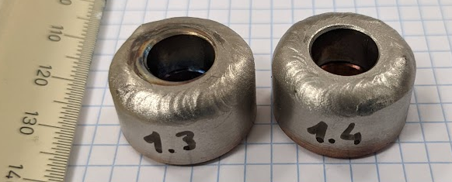
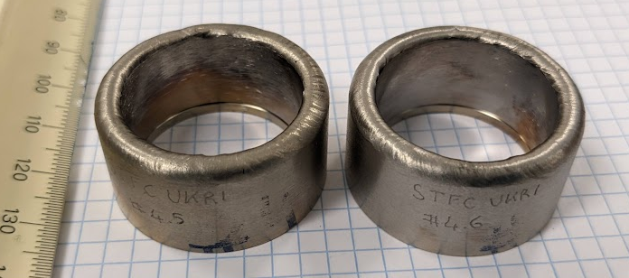
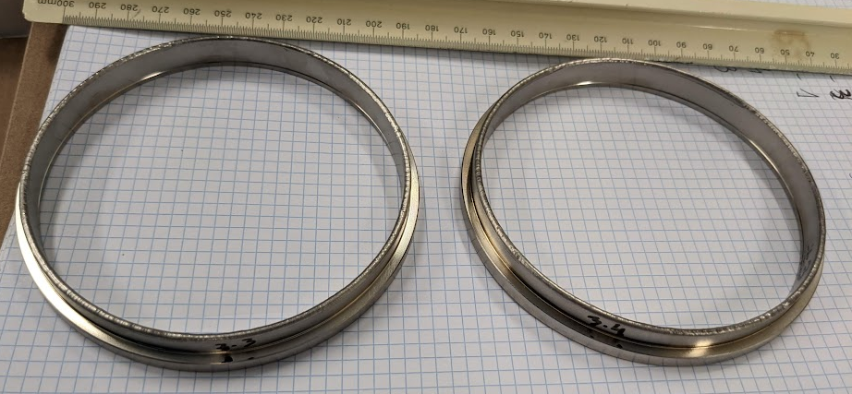
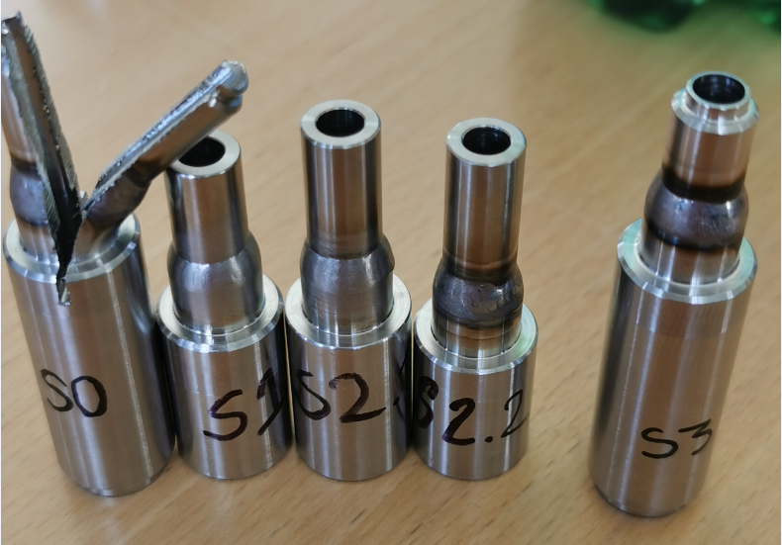
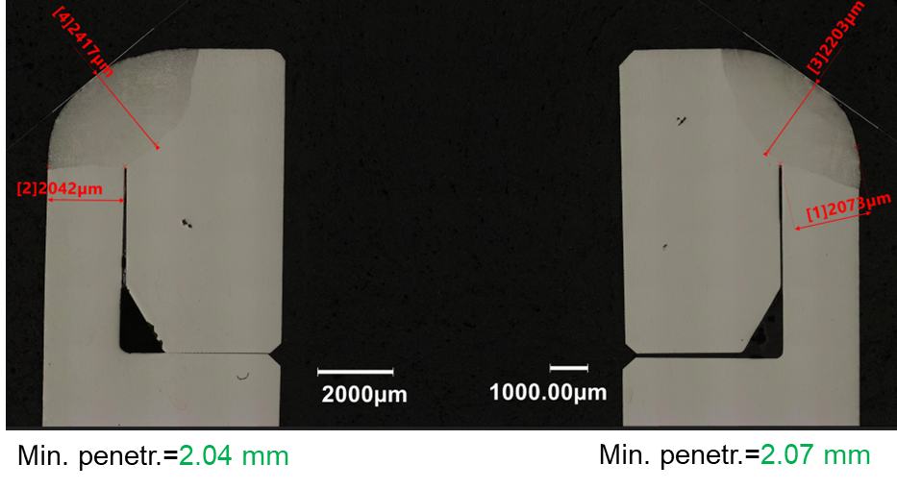
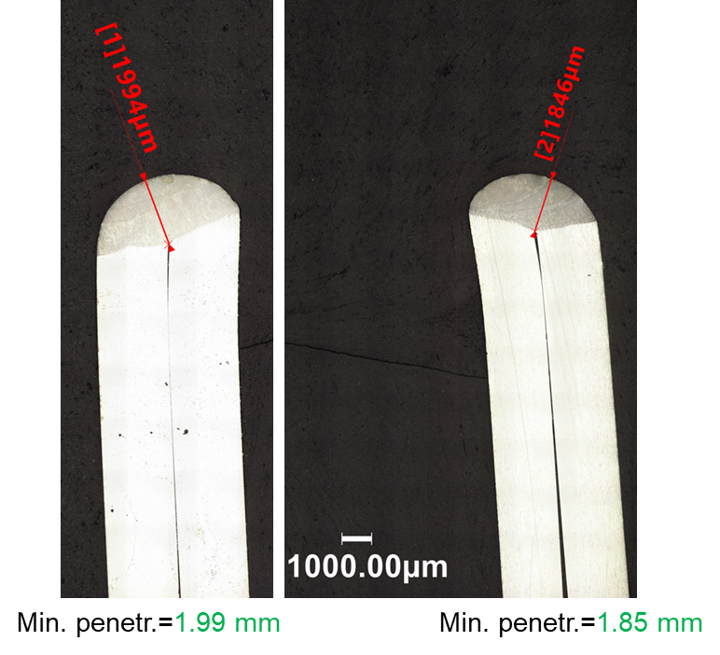
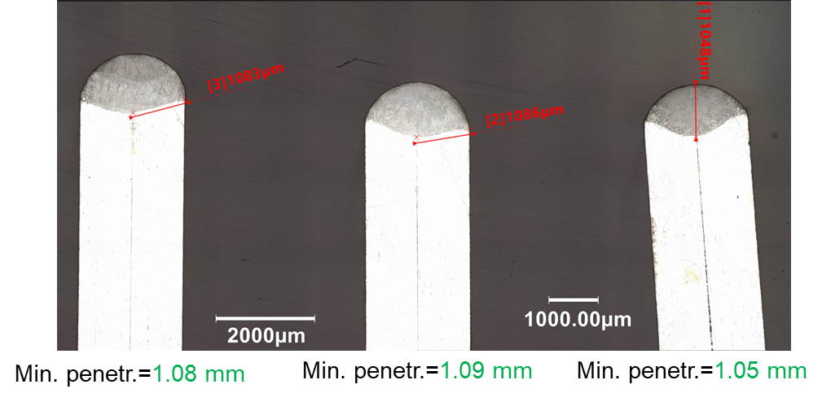
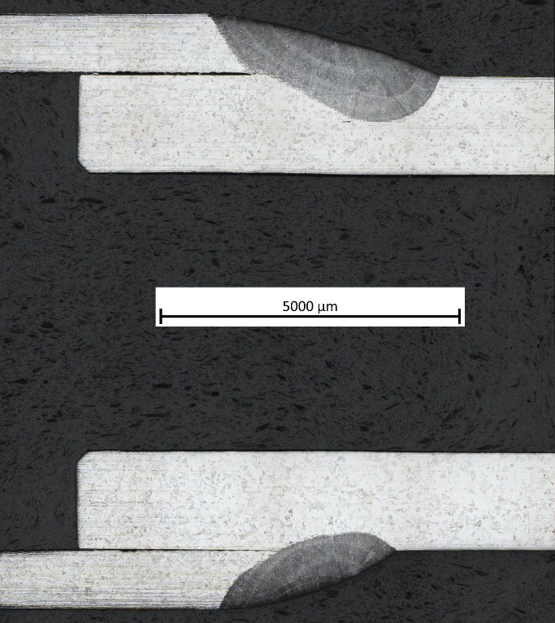
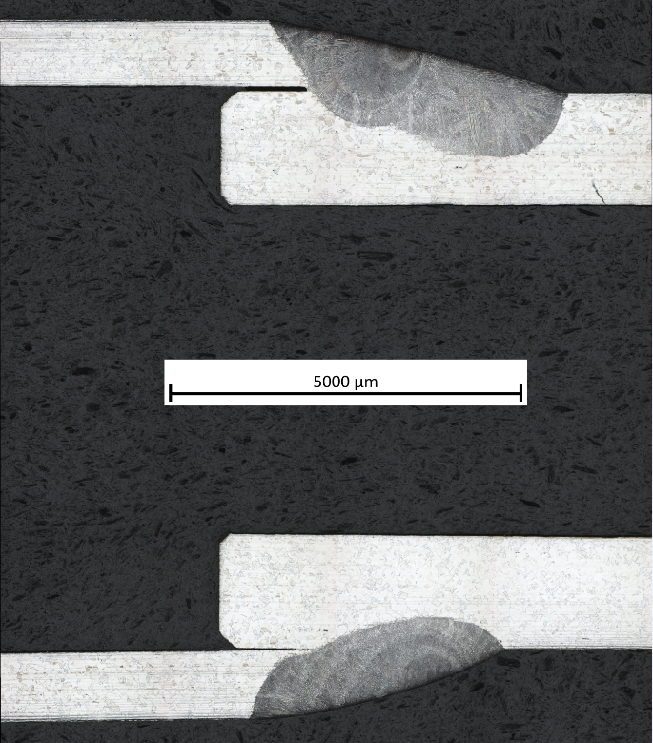
Qualification passed by UKRI during CM Assembly
Welding activity during CM Assembly
  Dedicated specification edited for qualification, fabrication, inspection and acceptance criteria: EDMS 2706475
    WPQR required for the 4 configurations
    Welder and Welding Operators Qualifications required
    Witness samples sent to CERN for examination (VT + PT + Metallography)

Slide 8
NCRs during RFD-SPS CM fabrication, assembly and reception

Slide 9
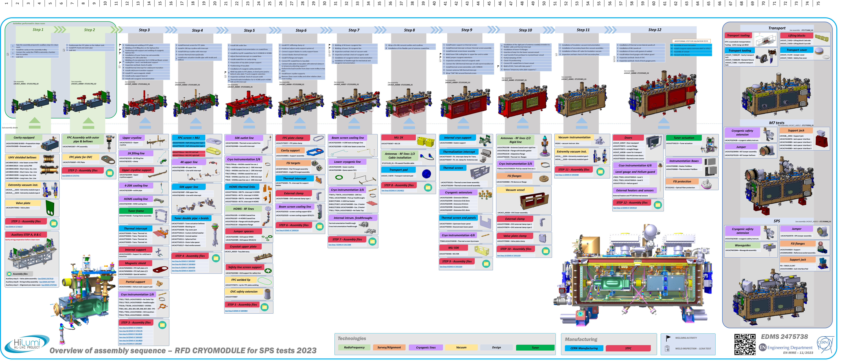
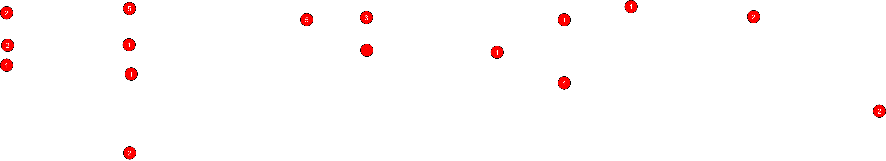
Overview of NCRs for RFD SPS
2
Between 30 to 35 NCRs Difficult to count due to approximative metadata / EDMS Context / Release Procedure / Assets / etc.

Slide 10
NCRs during RFD-SPS CM fabrication, assembly and reception
Bellows and base materials

Slide 11
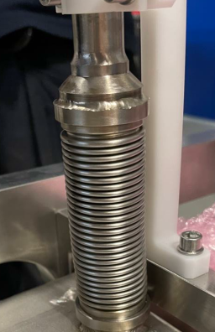
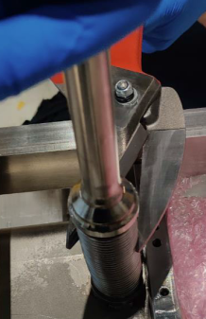
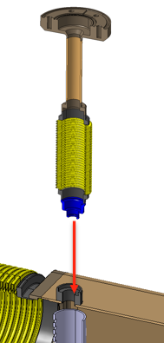
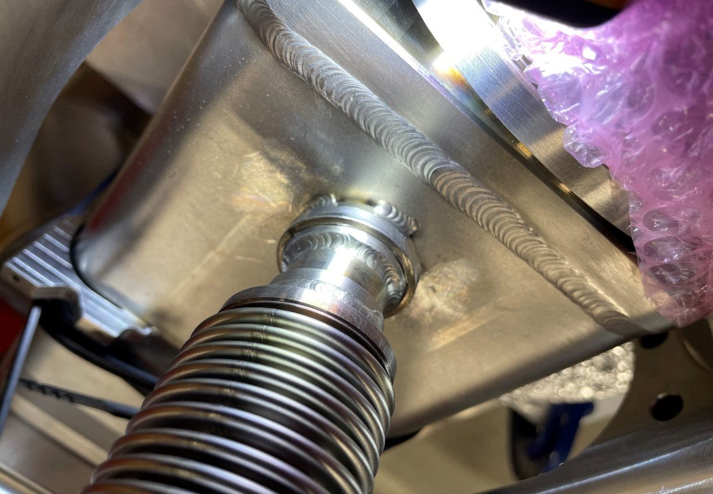
NCRs spotted during RFD-SPS CM Components fabrication
Bellows
The NCR are linked to:
  2-ply bellows
  Design and Test Pressure
  Dents
  Base material
  Dimensional aspect
Biphase boxes – Level Port Bellows
Difficulties to source bellows as per CERN drawings, so stock bellows were proposed.
No NCR / Deviation request prepared in time with full review
Info on «2-ply» missed during discussions
➔ Replacement with an adapted CERN LOWER CRYOLINE BELLOWS
1 NCR

Slide 12
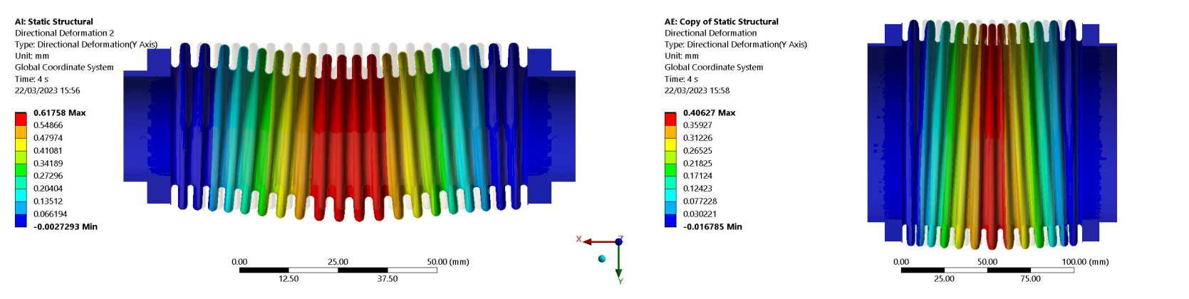
NCRs spotted during RFD-SPS CM Components fabrication
Bellows
The NCR are linked to:
  2-ply bellows
  Design and Test Pressure
  Dents
  Base material
  Dimensional aspect
Bellows for cryogenic lines
Design pressure is 2.1 barg and test pressure is 2.7 barg.
The supplier used a design pressure of 1.8 barg based on test pressure 2.7 barg + coefficient of 1.5 ; while the actual coefficient in CERN Specification is 1.25.
The bellows were welded before acceptance of the documentation.
New calculations and simulations were performed
Pressure test passed
Clarification done in Engineering Specification
2 NCRs

Slide 13
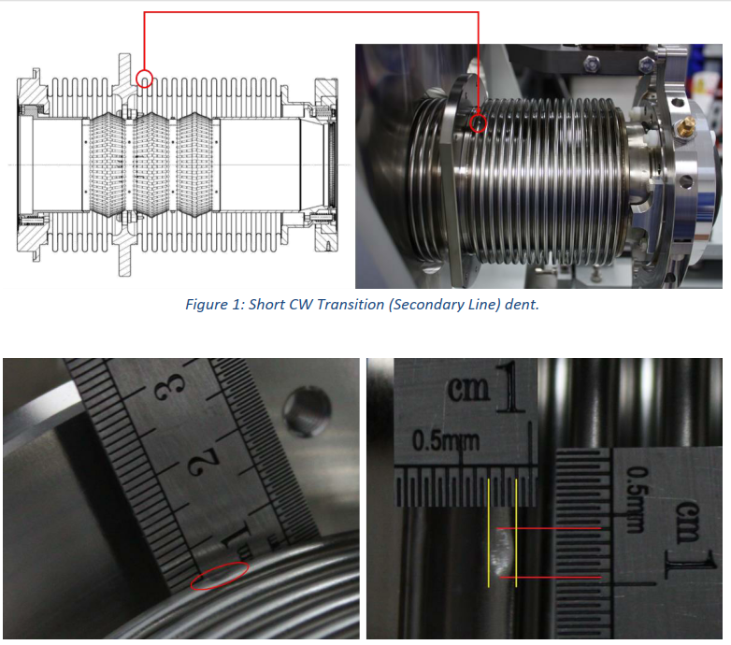
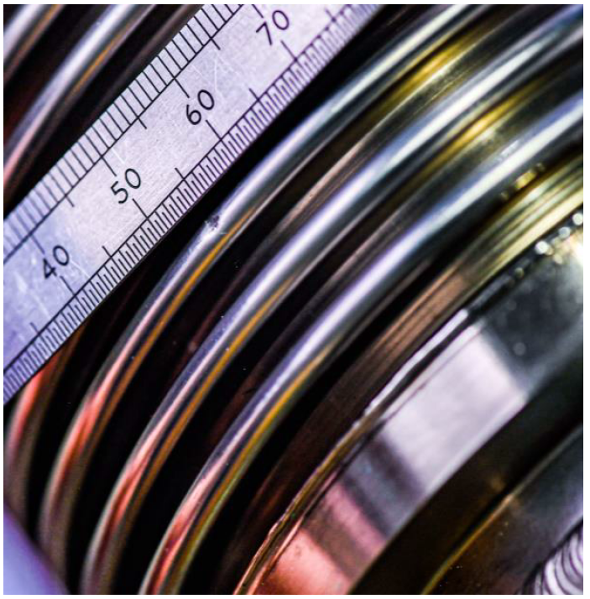
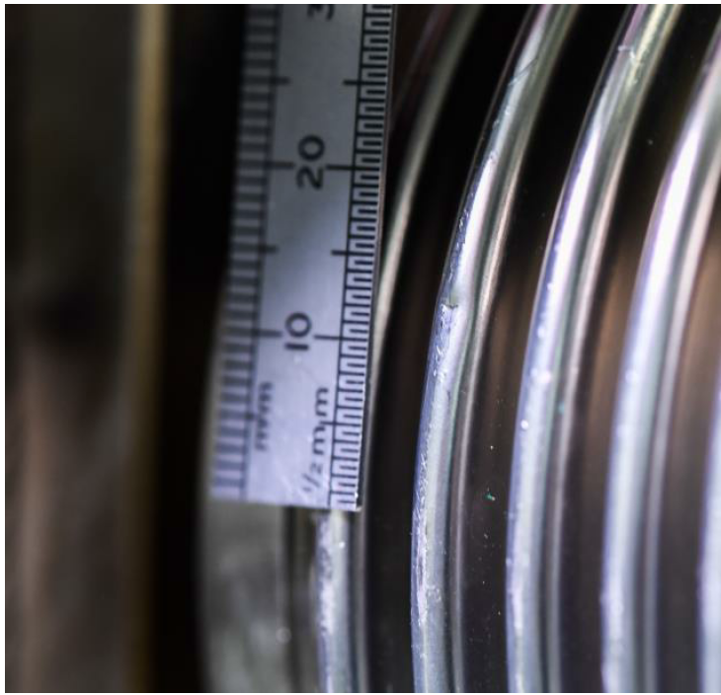
NCRs spotted during RFD-SPS CM Components fabrication
Bellows
The NCR are linked to:
  2-ply bellows
  Design and Test Pressure
  Dents
  Base material
  Dimensional aspect
Bellows for cryogenic lines and CWT
Protection during transport or manufacturing
Deviation during assembly procedure
Bellows must be always protected
Dedicated leak tests and pressure tests of the components with evaluation of the geometries before, during and after.
2 NCRs

Slide 14
NCRs spotted during RFD-SPS CM Components fabrication
Bellows
The NCR are linked to:
  2-ply bellows
  Design and Test Pressure
  Dents
  Base material
  Dimensional aspect
Cryogenic lines bellows, blade support and tuner bellows
Collars in EN 1.4429 2D Forged instead of 3D Forged
Convolutions in EN 1.4404 (EN 10088-2) instead of EN 1.4435 (EN 10028-7)
Missing Cobalt assessment or Cobalt content >0.3%
No magnetic permeability values given
No inclusion content reported
PMA (Particular Material Appraisal) prepared
Additional tests performed on spare bellows (metallography, 3D Computed microtomography, Helium leak test)
Cobalt content assessment (EN-MME-MM)
Update of Engineering Specification and drawings to be more precise and relevant in the requirements
3-4 NCRs

Slide 15
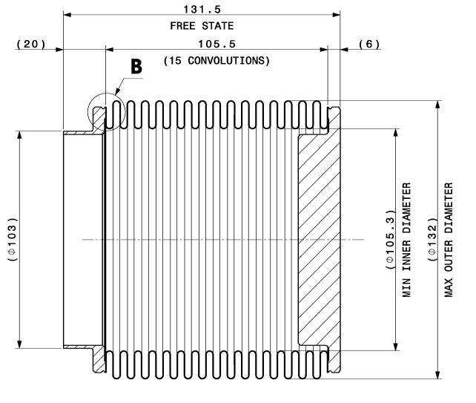
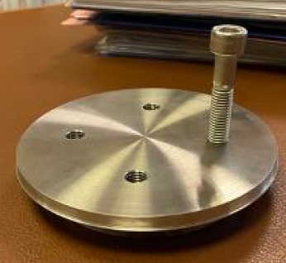
NCRs spotted during RFD-SPS CM Components fabrication
Bellows
The NCR are linked to:
  2-ply bellows
  Design and Test Pressure
  Dents
  Base material
  Dimensional aspect
Cryogenic line bellows (extremity bellows)
The total length of the bellows is shorter than required (118.6mm instead of 131.5mm)
The number of convolutions is lower than mentioned on drawing
Holes of blank extremity collar not perpendicular
Spacers installed to compensate
Second pattern of holes machined
Quality controls requirements increased
2 NCRs

Slide 16
NCRs spotted during RFD-SPS CM Components fabrication
Bellows
The NCR are linked to:
  2-ply bellows
  Design and Test Pressure
  Dents
  Base material
  Dimensional aspect
Main preventive actions for LHC Series:
The Engineering specification have been reworked
CERN is providing the bellows (vacuum and cryogenic) to the collaborations
  Cryogenic bellows: KOMPAFLEX AG
  Tuner and blade support bellows: MEWASA AG
~10 NCRs in total

Slide 17
NCRs spotted during RFD-SPS CM Components fabrication
8 NCRs
Base materials
The NCR are linked to:
  Material standard
    ASME / ASTM vs EN standards
    EN standards for pressure applications (PED harmonized)
  Material grades or properties
    Grade of austenitic stainless steels (EN 1.4429)
    Welding filler material (W Z 18 16 5 NL)
    Magnetic permeability
  Cobalt content
    Cobalt content not mentioned in the certificates
    Values are above the limit
Evaluation thanks to PMA
Evaluation by experts
Evaluation with destructive testing
Non-destructive measurements
Measurements at CERN
Tracking in EDMS 2798791
For LHC Series: Update of specs and drawings, free-issued parts, improvement of QA/QC

Slide 18
NCRs during RFD-SPS CM fabrication, assembly and reception
Welding

Slide 19
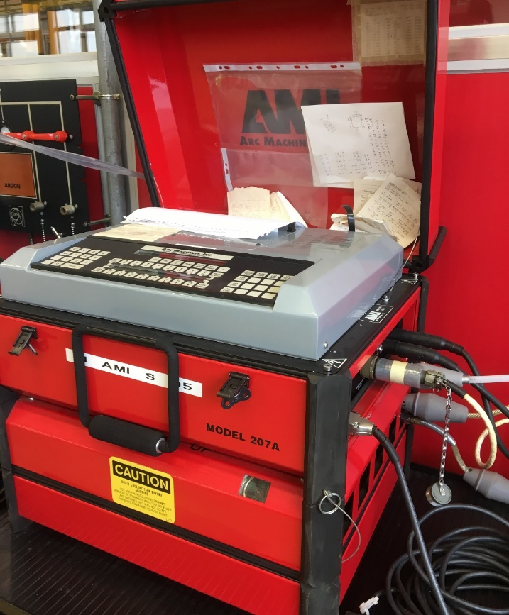
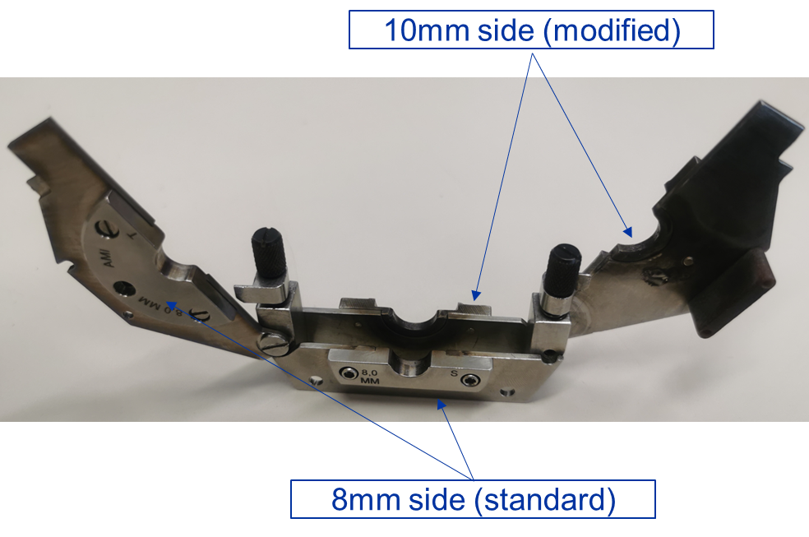
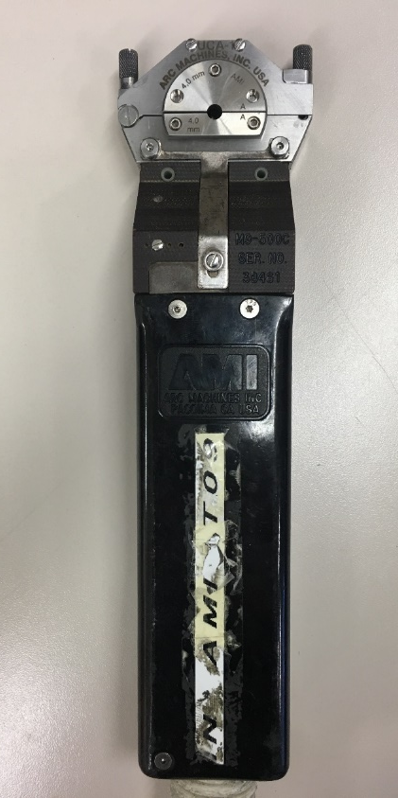
NCRs spotted during RFD-SPS CM Components assembly
Orbital welds of beam screens
See EDMS 2758225

Slide 20
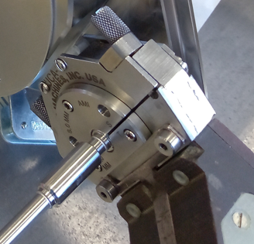
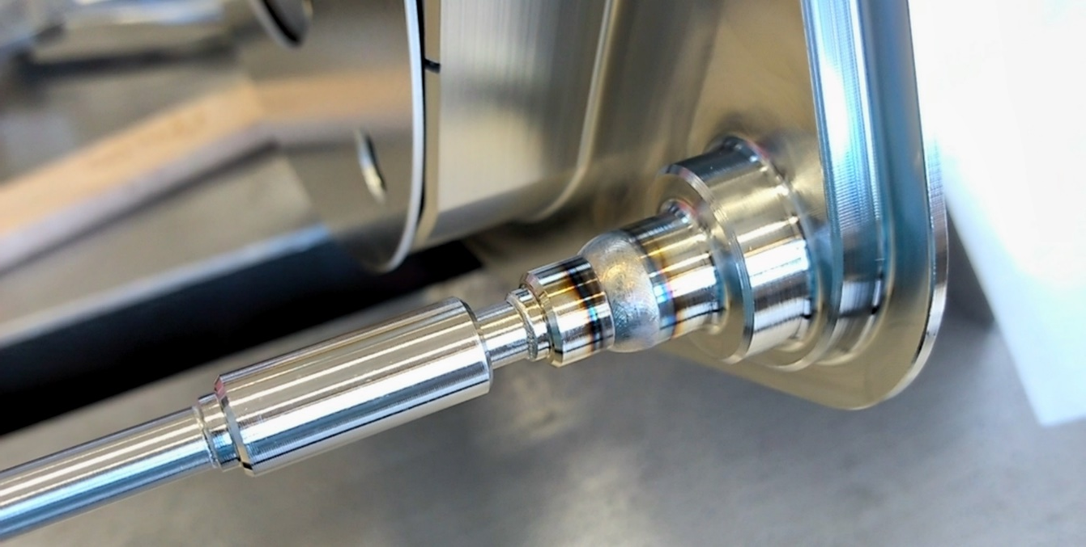
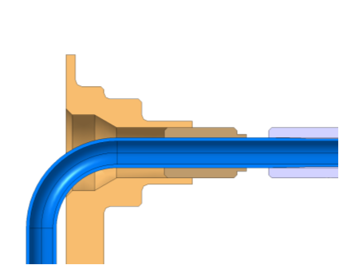
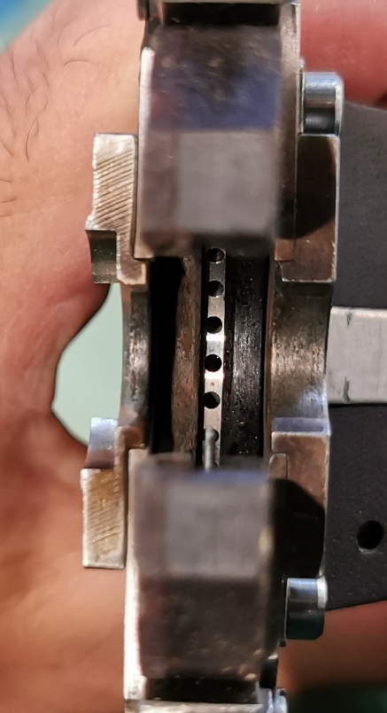
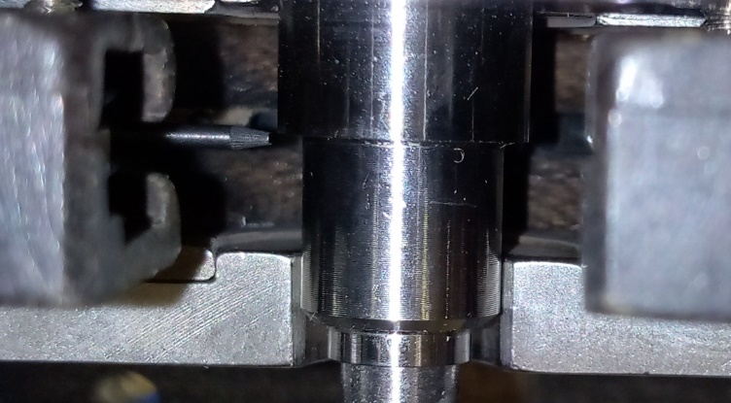


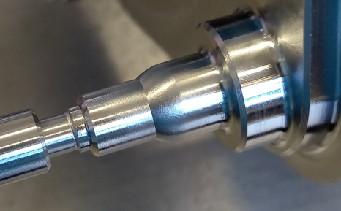
NCRs spotted during RFD-SPS CM Components assembly
Orbital welds of beam screens
See EDMS 2758225

Slide 21
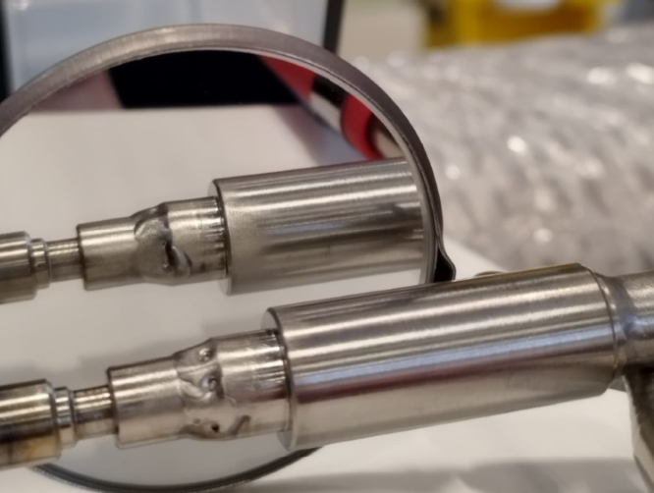
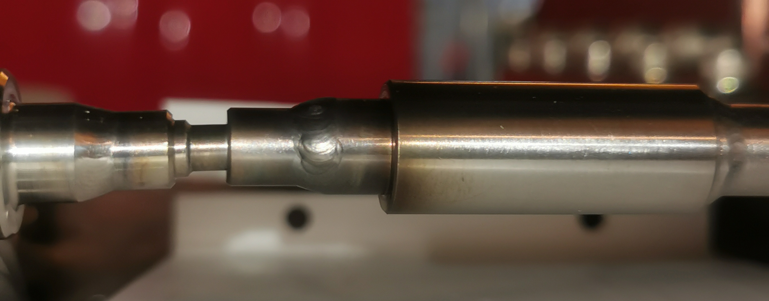
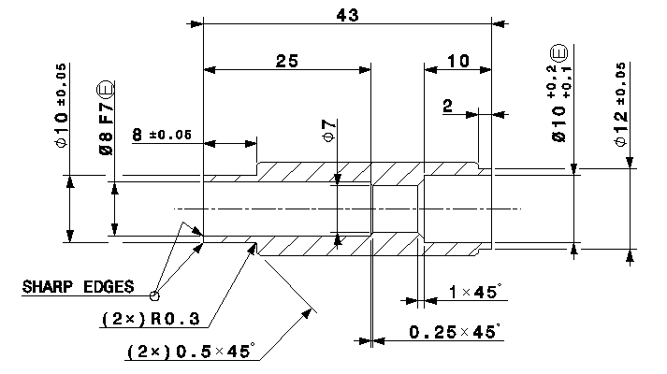
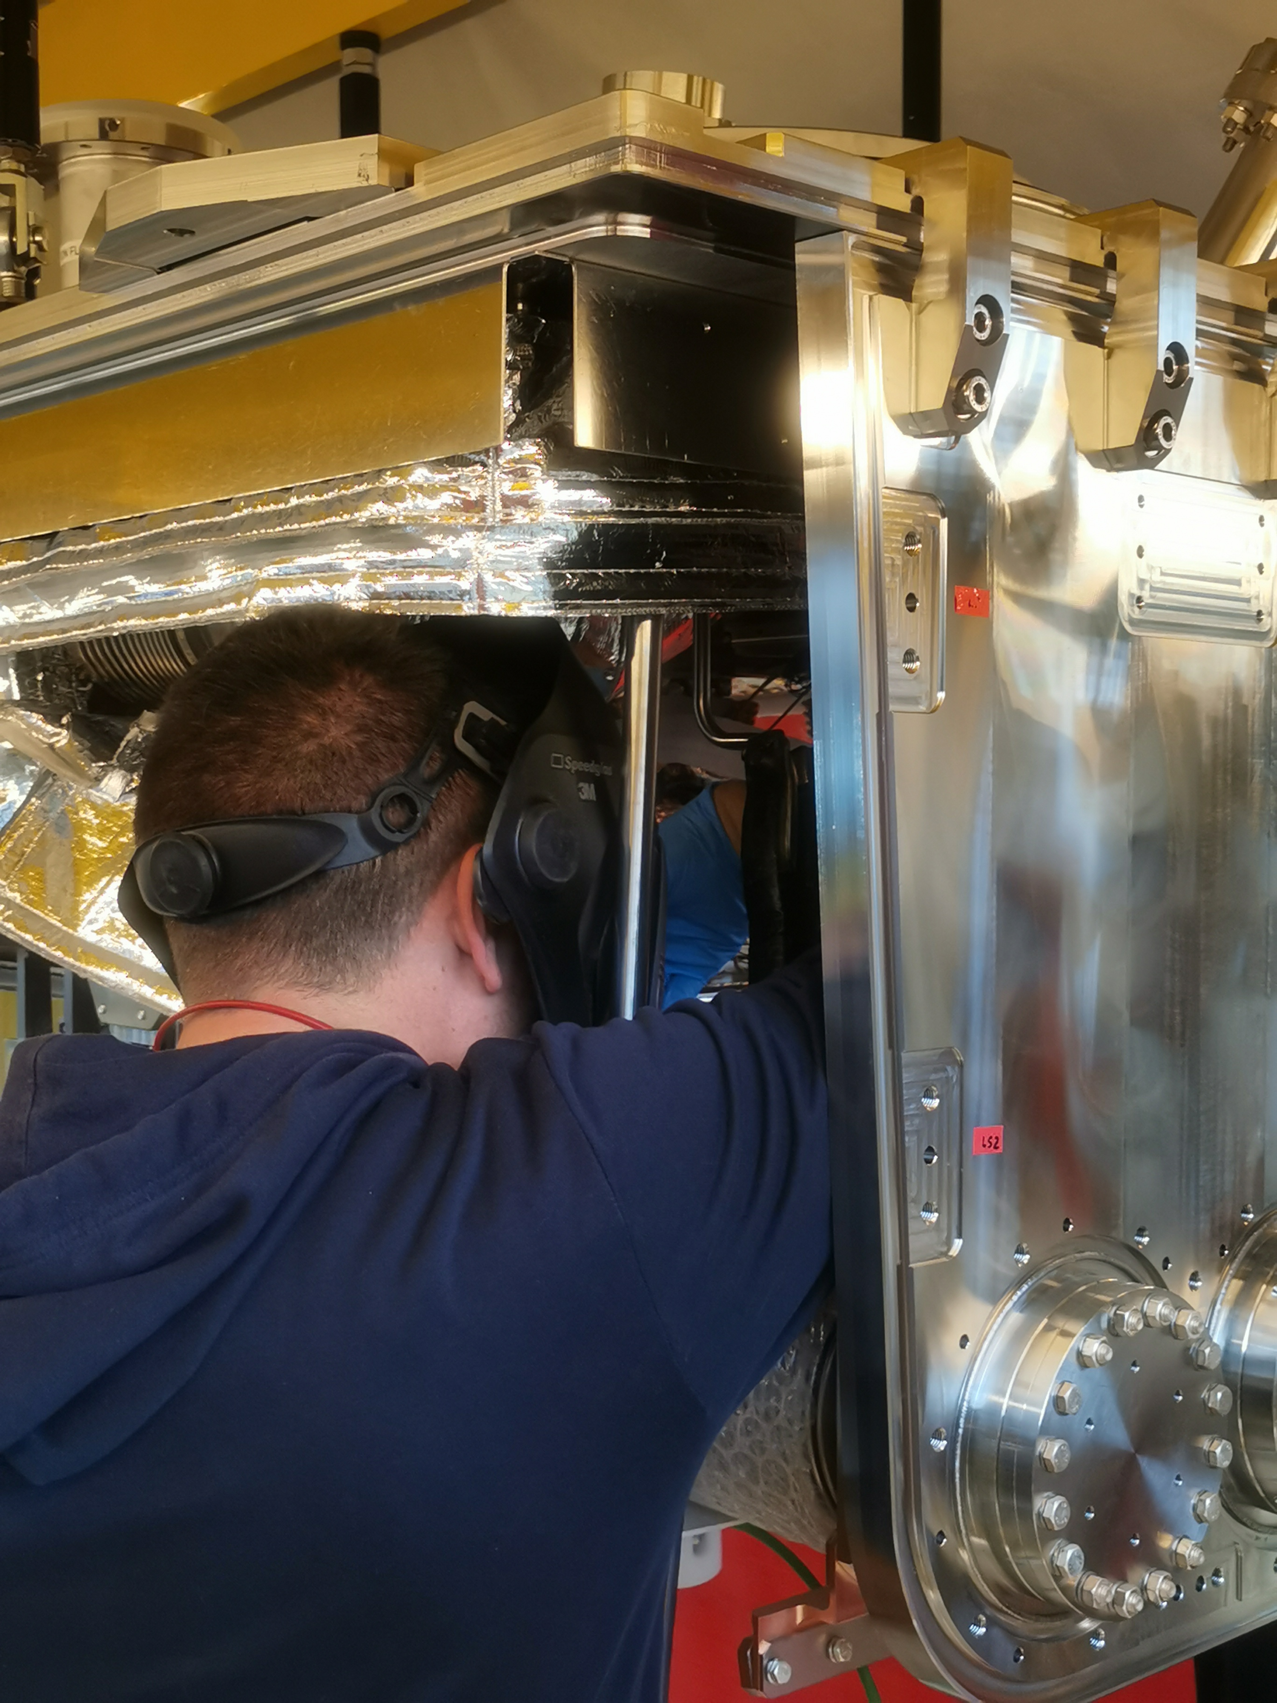
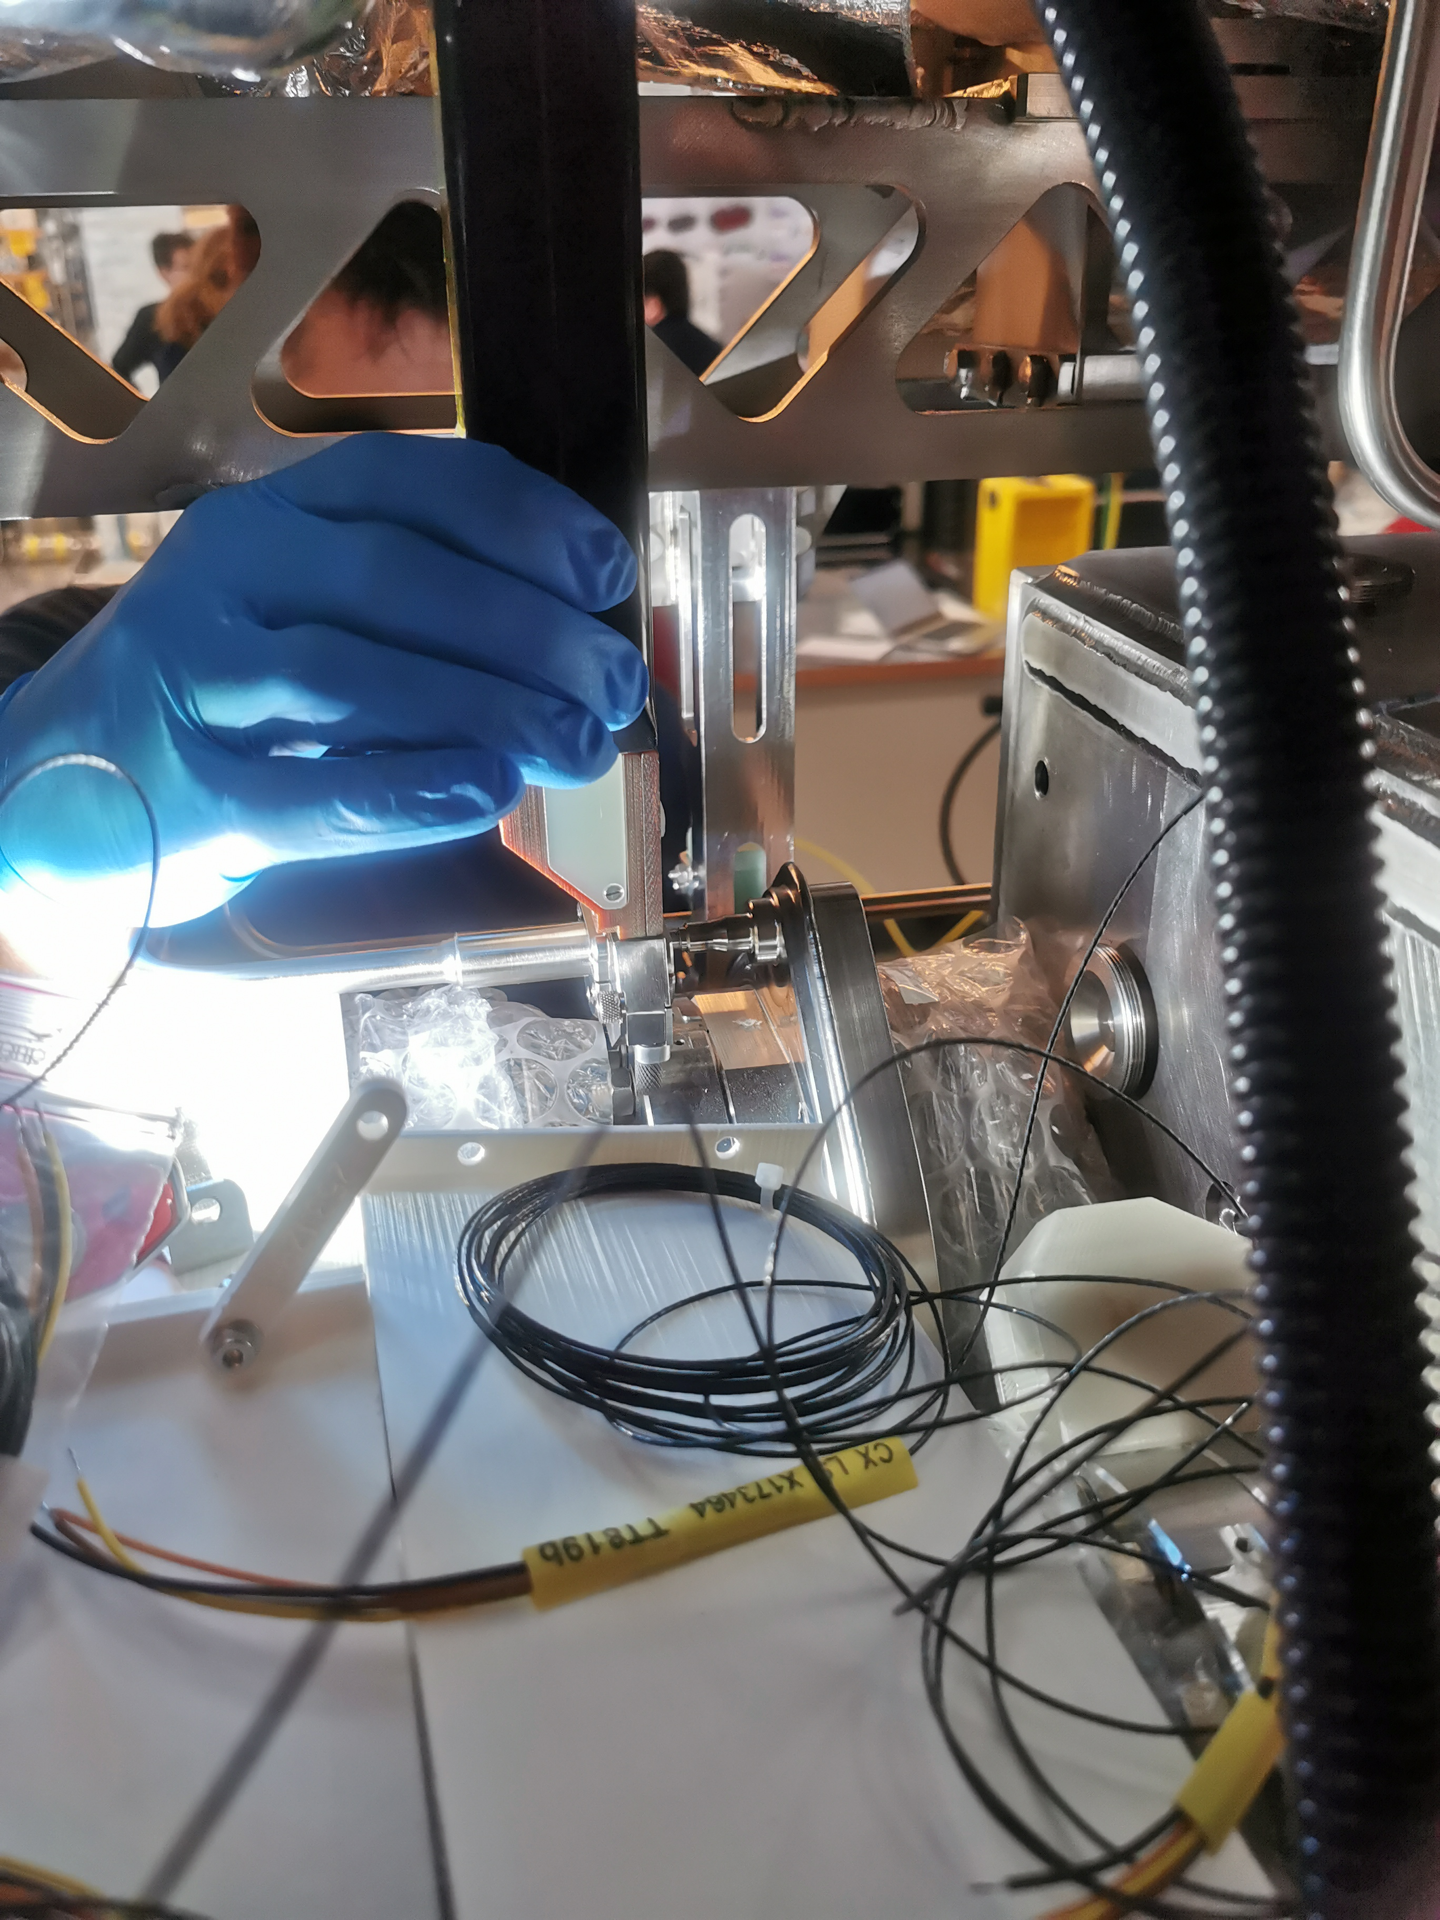
NCRs spotted during RFD-SPS CM Components assembly
Orbital welds of beam screens
The NCR is linked to:
  Tolerances of the parts
  Experience of the welder
  Limited access
  Difficulty of execution
  Difference between sample work and in-situ assembly
  Actions:
  CERN performed the repair
  Knowledge transfer between welders
  Modifications of the design drawings

Slide 22
NCRs spotted during RFD-SPS CM Components assembly
Orbital welds of beam screens
The NCR is linked to:
  Tolerances of the parts
  Experience of the welder
  Limited access
  Difficulty of execution
  Difference between sample work and in-situ assembly
  Actions:
  CERN performed the repair
  Knowledge transfer between welders
  Modifications of the design drawings

Slide 23
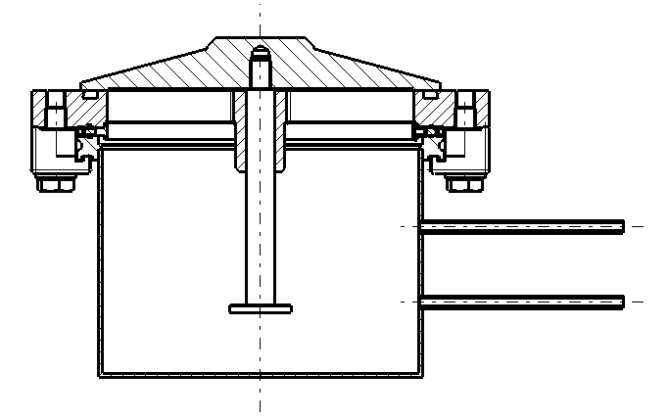
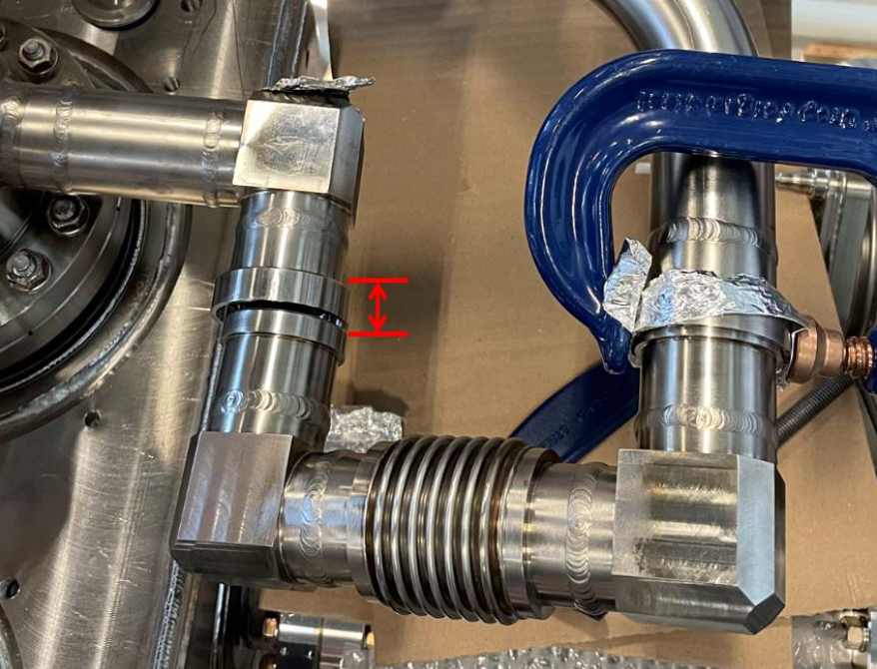
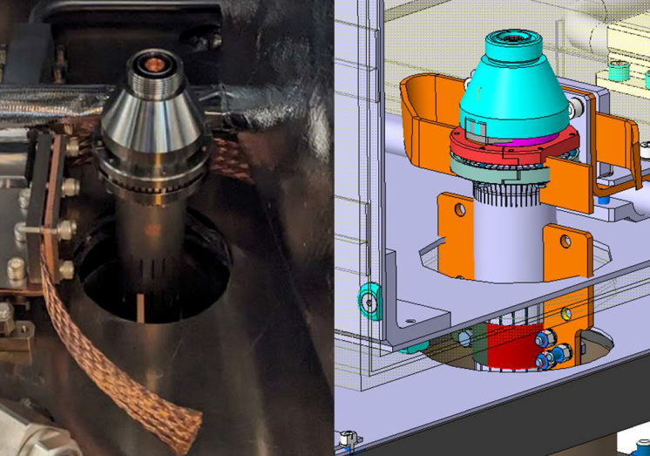
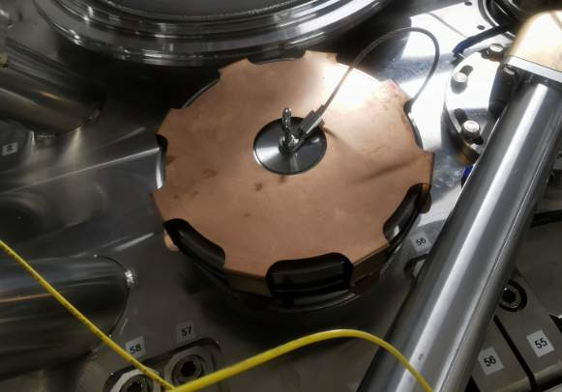
NCRs spotted during RFD-SPS CM Components assembly
Other NCRs
Dimensional control (Blade support assy, OVV, WMS, biphase line, etc.)
Clash / Mating during assembly (HOM Cooling line, RF Coax line, etc.)
Blow-off valve (insulation vacuum)
➔ Evolution of assembly procedure, Engineering Specs, safety components, etc.

Slide 24
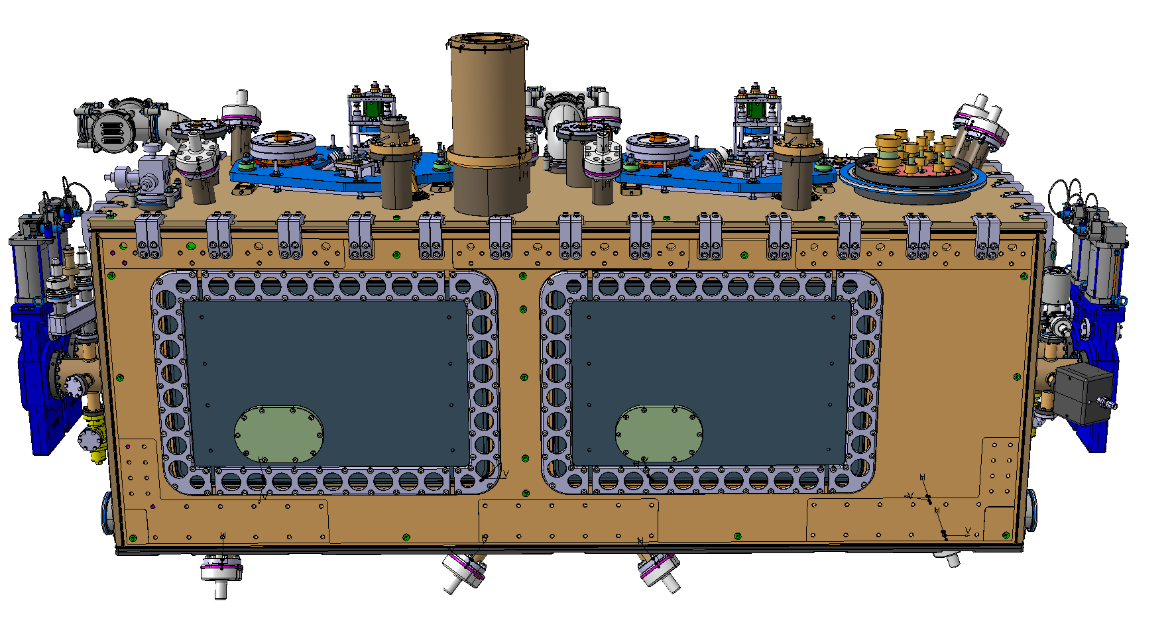
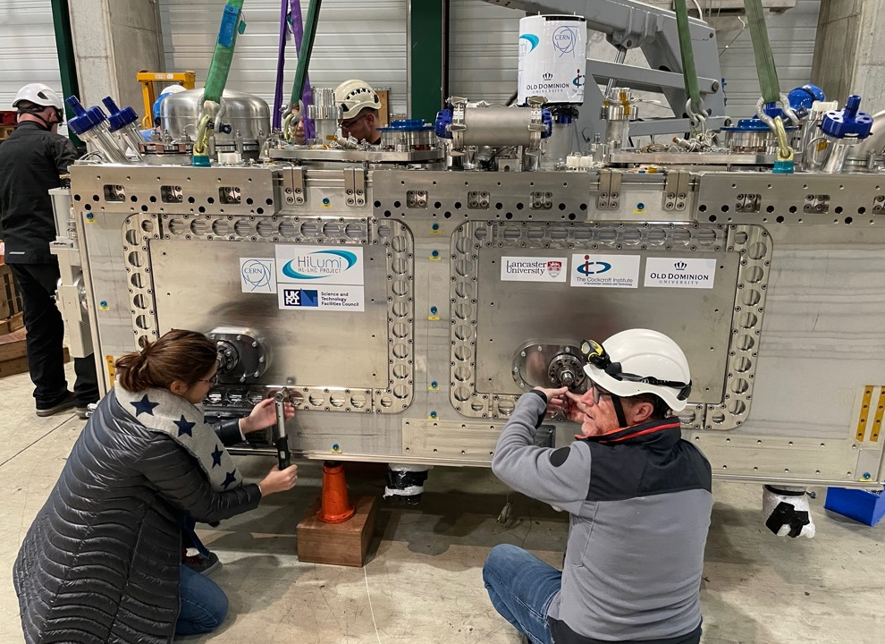
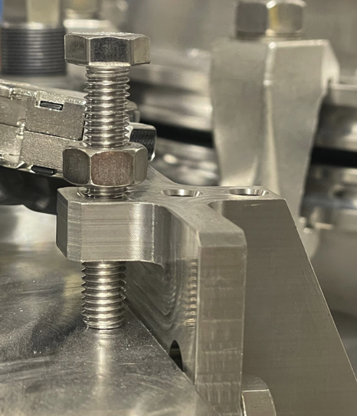
NCRs spotted during RFD-SPS CM Reception and Testing
These NCRs are not always documented on EDMS
Tightening checks:
  Lateral doors: 1 door not OK (1/4 of a turn missing)
  Cavity support system:
    1 FPC connection partially OK
    Top blade connection: locking screws not OK
Courtesy of T. CAPELLI

Slide 25
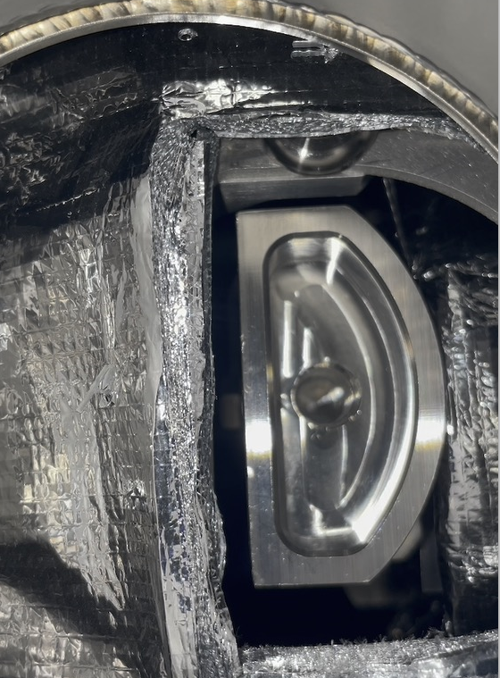


NCRs spotted during RFD-SPS CM Reception and Testing
These NCRs are not always documented on EDMS
Tightening checks:
  Cryogenic transport lock: Completely loose
  Tuner Thermal Intercept: Connexion to double pipes or braids partially OK
FSI checks:
  4 lower FSI were obstructed by MLI
Cryo instrumentation:
  Labels removed / replaced
  Heaters not installed / checked
  Etc.
MLI
Reflector
Courtesy of T. CAPELLI

Slide 26
Conclusions

Slide 27



Importance of NCR Evaluation, Decision and Actions
Non-exhaustive list of guidelines
In case of NCR:
  Stop the work and contact ALL the WP4 experts concerned: EDMS 3014549
  In parallel, prepare and launch the NCR according to the HL Procedure: EDMS 1499015
  It is important to mind about preventive and corrective actions
  Root cause analysis and implications shall be evaluated too, especially when integration is concerned
Example of (potential) link between NCRs / Critical Components / Steps:
  RFD-SPS Biphase line: NCRs on bellows > New Pressure Test > NCR due to Plastic deformation of bellows
  Cavity Support Plate Integration: Is this issue linked to the critical NCR on FPC1 ?
    LHC-ACFAH-QN-0005
    LHC-ACF-QN-0005
➔ Hector GARCIA GAVELA and Gorana PRICA can help you in the process
➔ See talk of T. CAPELLI (NCR and Repair actions : Leak cav2 and FPC cav1)

Slide 28
Importance of NCR Evaluation, Decision and Actions
LHC Series
CERN:
  Following RFD-SPS, a huge work done on Eng. Spec. and drawings
  A new welding and quality engineer hired early 2024
  A close-knit, transparent and responsive team
STFC / UKRI:
  The RFD-SPS Prototype phase was highly instructive
  The team seems now OK with HL Procedure and WP4 Eng. Spec. requirements
TRIUMF:
  Relevant questions and discussions on WP4 components requirements
  HL Quality trainings seems to have a good impact
  Some of the critical components (e.g.: cryogenic lines) are manufactured at CERN
  During manufacturing steps, probable discussions or NCR linked to standards (ASTM /ASME vs EN ISO)
  At that time, Cleaning and Welding qualifications have not yet begun…

Slide 29
Thank you !

Slide 30
Qualification passed by UKRI during CM Assembly
Welding activity during CM Assembly
  List of weld to be performed during CM Assembly: EDMS 2678641
  4 main configurations:

Slide 31
Qualification passed by UKRI during CM Assembly
Welding activity during CM Assembly
  List of weld to be performed during CM Assembly: EDMS 2678641
  4 main configurations:

Slide 32
Qualification passed by UKRI during CM Assembly
Welding activity during CM Assembly
  List of weld to be performed during CM Assembly: EDMS 2678641
  4 main configurations:

Slide 33
Qualification passed by UKRI during CM Assembly
Welding activity during CM Assembly
  List of weld to be performed during CM Assembly: EDMS 2678641
  4 main configurations:

Slide 34
NCRs spotted during RFD-SPS CM Components fabrication
Bellows
The NCR are linked to:
  2-ply bellows
  Design and Test Pressure
  Dents
  Base material
  Dimensional aspect
Bellows for cryogenic lines and CWT
Protection during transport or manufacturing
Deviation during assembly procedure
Bellows must be protected at all times
Dedicated leak tests and pressure tests of the components with evaluation of the geometries before, during and after.
2 NCRs

Slide 35
NCRs spotted during RFD-SPS CM Components fabrication
Bellows
The NCR are linked to:
  2-ply bellows
  Design and Test Pressure
  Dents
  Base material
  Dimensional aspect
Bellows for cryogenic lines and CWT
Protection during transport or manufacturing
Deviation during assembly procedure
Bellows must be protected at all times
Dedicated leak tests and pressure tests of the components with evaluation of the geometries before, during and after.
2 NCRs

Slide 36
NCRs spotted during RFD-SPS CM Components fabrication
Bellows
The NCR are linked to:
  2-ply bellows
  Design and Test Pressure
  Dents
  Base material
  Dimensional aspect
Bellows for cryogenic lines and CWT
Protection during transport or manufacturing
Deviation during assembly procedure
Bellows must be protected at all times
Dedicated leak tests and pressure tests of the components with evaluation of the geometries before, during and after.
2 NCRs

