Slide 1

RFD SPS TUNER
SM18 tests CD1 + CD2
K. Artoos, A. Edwards, D. Glenat, N. Stapley, K. Turaj, N. Valverde
18.06.2024 Experience from RFD CM tests

Slide 2
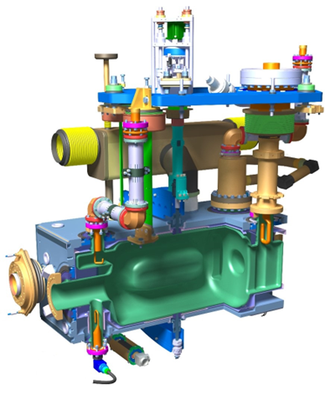
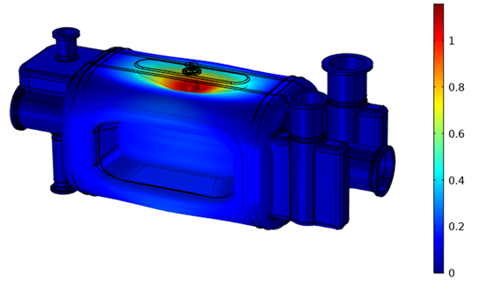
Reminder: Tuning principle HL LHC RFD
RFD
RFD
Tuning Sensitivity:
512 kHz/mm*
Cavity tuning stiffness:
2.8 kN/mm*
Specified tuning range at 2 K:
± 150 kHz
Elastic limit range at 2 K:
± 1.22 MHz
± 2.38 mm*
± 6.7 kN
Requested precision ~ 80 Hz

Slide 3
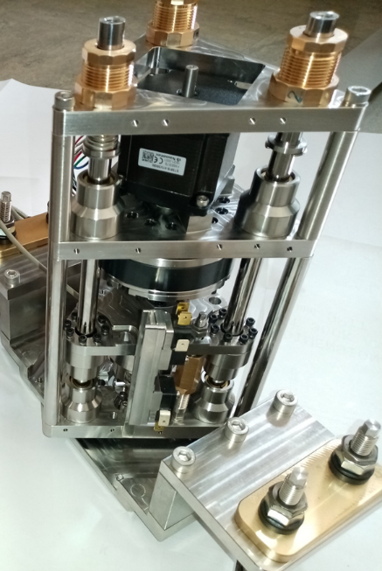
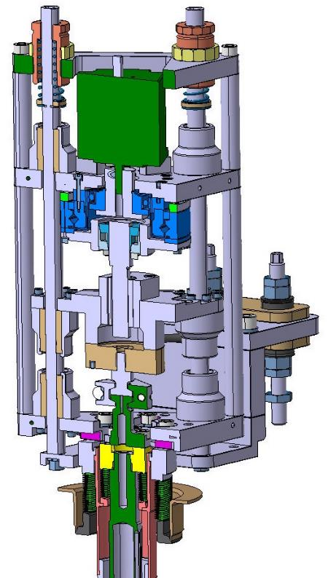
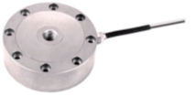
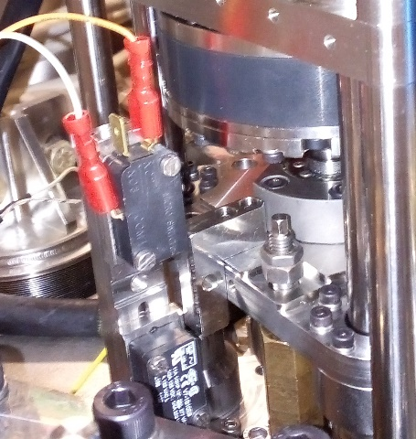
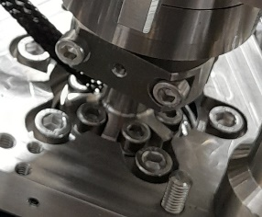
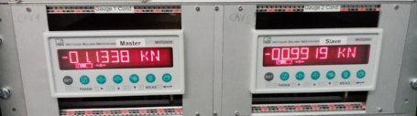
Overview components
ACTUATOR SPS proto
Vertical Spring pre-load from alignment plate
Stepper motor
1.3 Nm bipolar, motor step 1.8 deg, micro stepping 8000/360 , not ramped open loop, limited to 2000 steps/sec
Harmonic drive HFUS-20-100-2SO
Ratio 100, Accuracy < 1 arcmin, precision <0.1 arcmin (5 nm)
Fa Dyn 7.7 kN
Radhard grease SYNRAD 1252
Roller screw
Rollvis RV 12 x 1 static load capacity 17 kN
coupling
Sferax Compact GBL 1219 bearings XA +A (all metal) and guides
Loadcell
So far: Kistler 10 kN 4576A55C1 class 0.1
Limit switches
Difficult to set, not so reliable
Mechanical end stops with max load interlock on load cell conditioner
Actuator coupling
Allows quick change of actuator + connection without frequency change
Incorporates heater

Slide 4
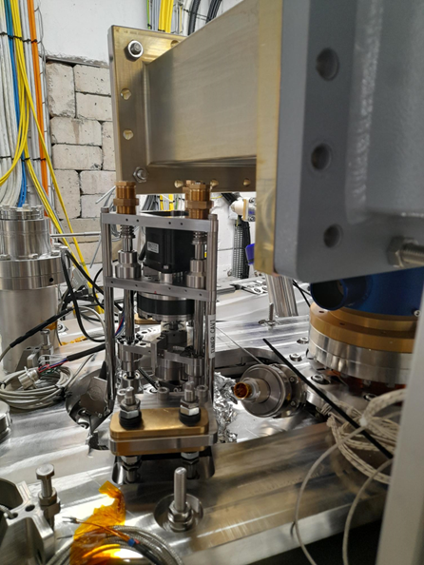
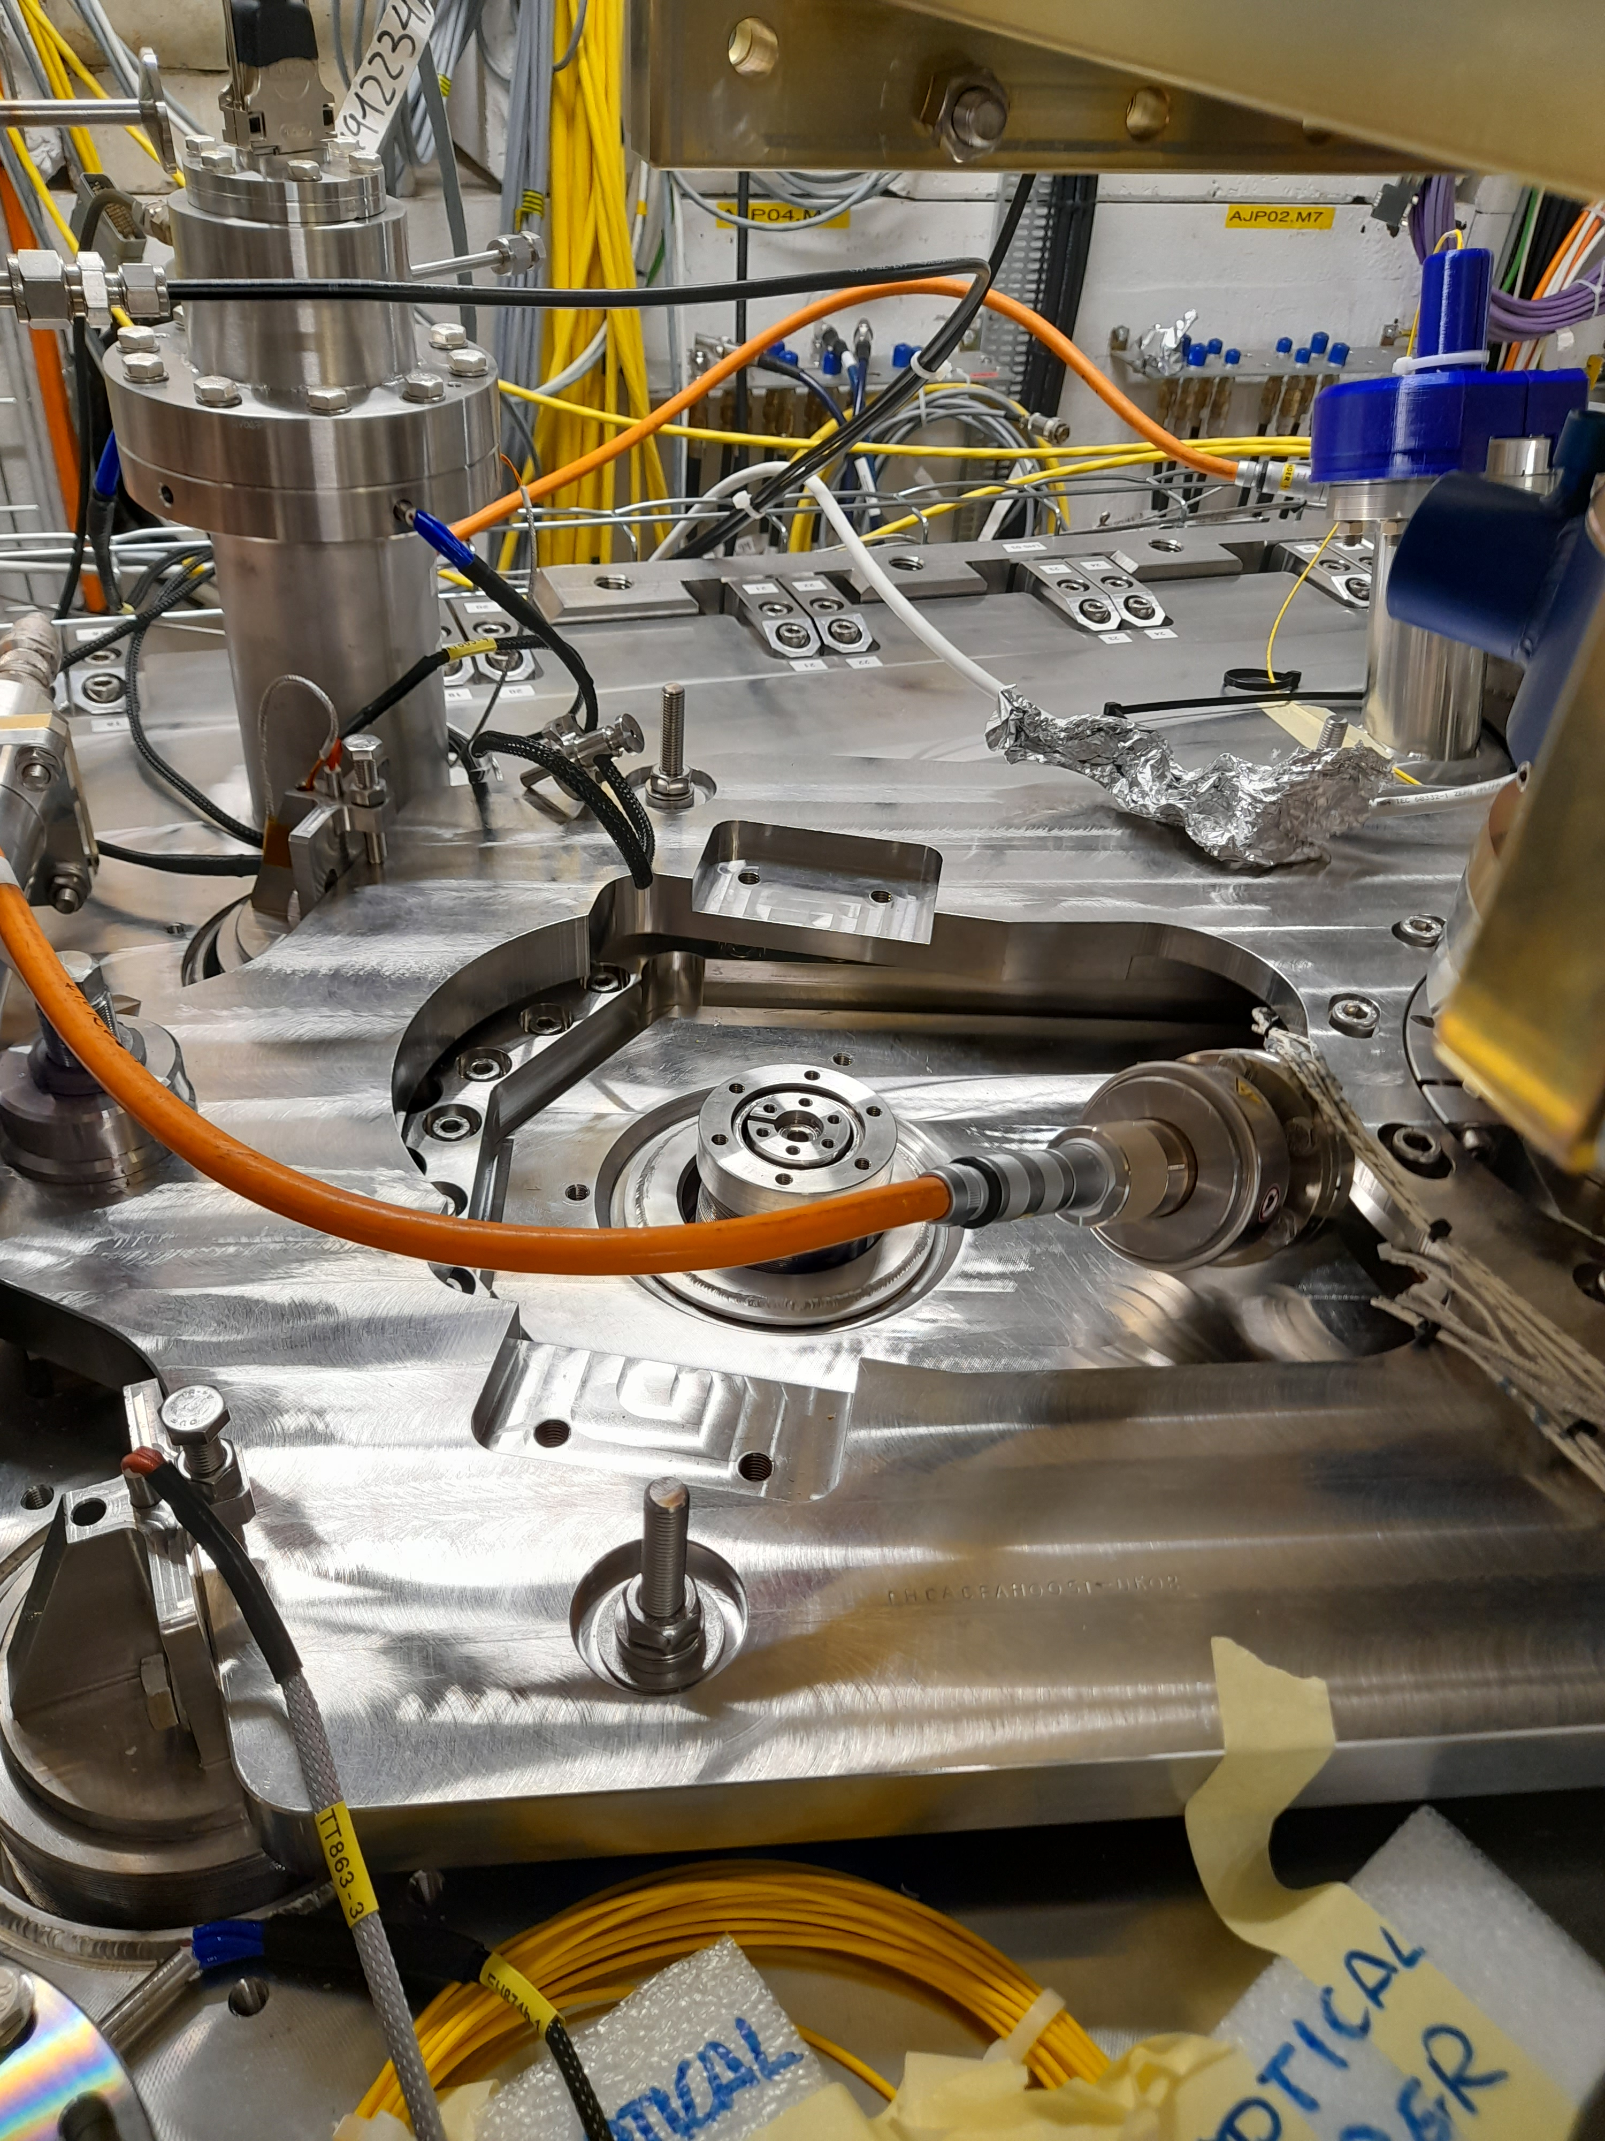
Installation Actuators + RT test
Interference actuator springs with turned and tilted waveguide
Interference between cable gauge FPC with actuator support

Slide 5
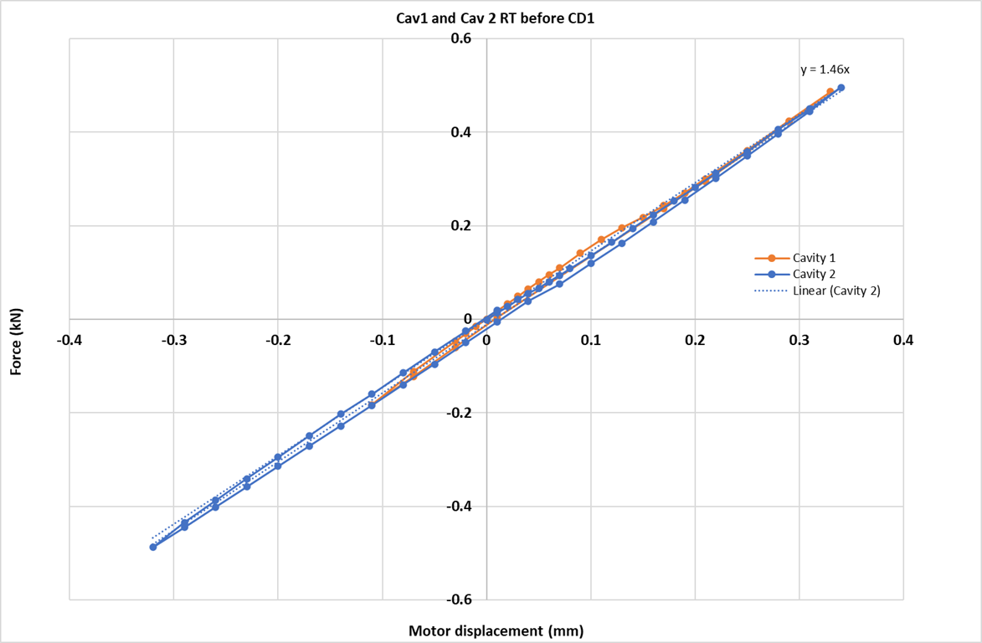
RT cycle before CD 1, OVC open
*Cycle on Cav1 shortened due to x-rays in evening

Slide 6
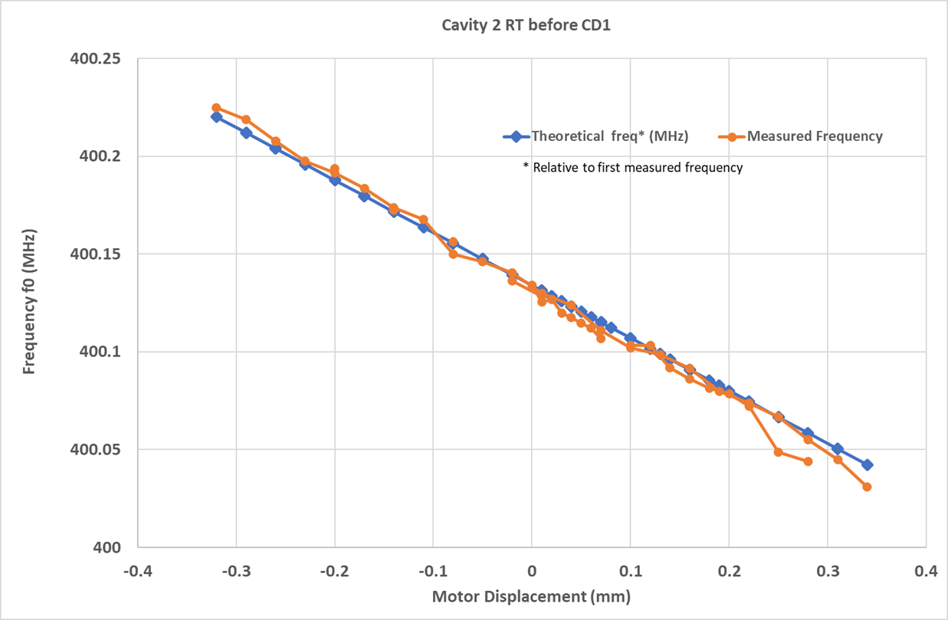
RT before CD 1, OVC open
Additional: 14/11/23 Tuner and HOM measurements at RT

Slide 7
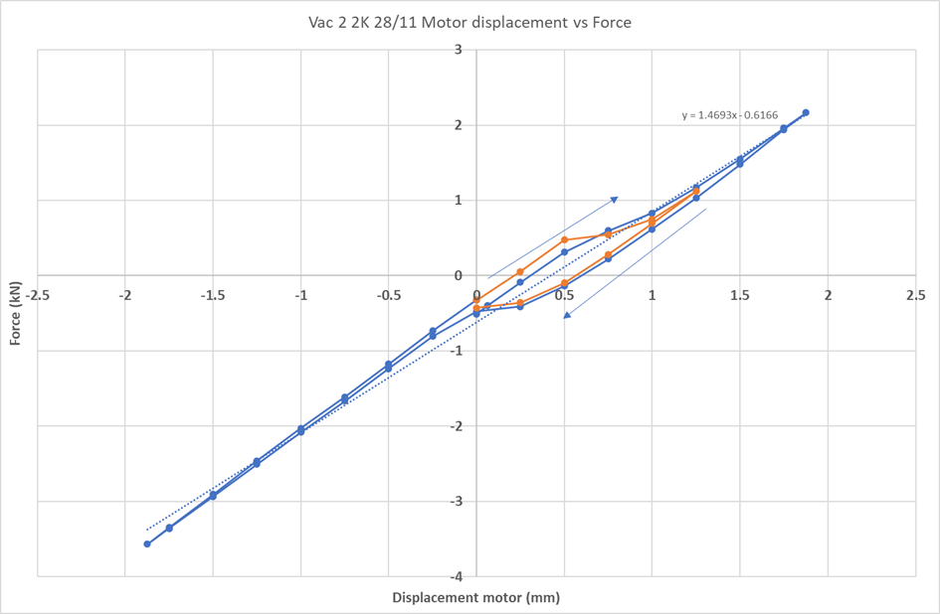
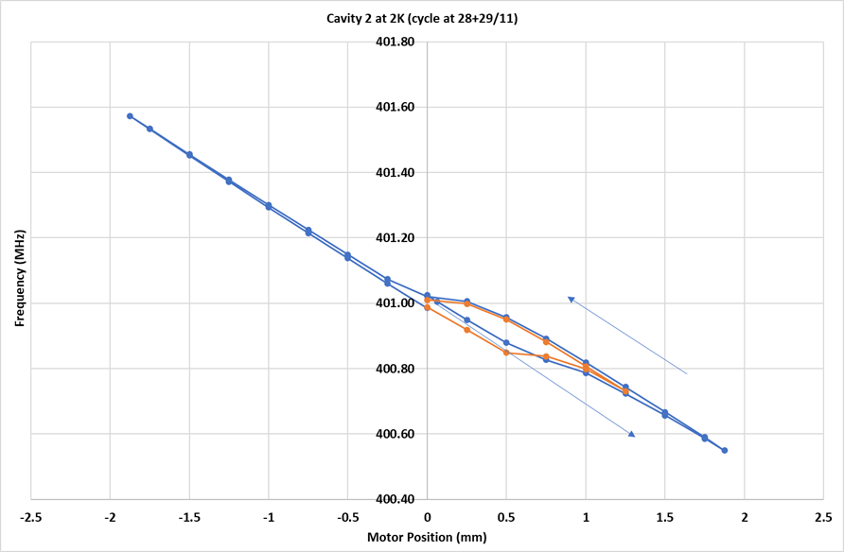
Cool Down 1 to 2 K
No tuner force measurements during cool down
Non-linearity measured on cavity 2 and cavity 1 (backlash with a twist)

Slide 8
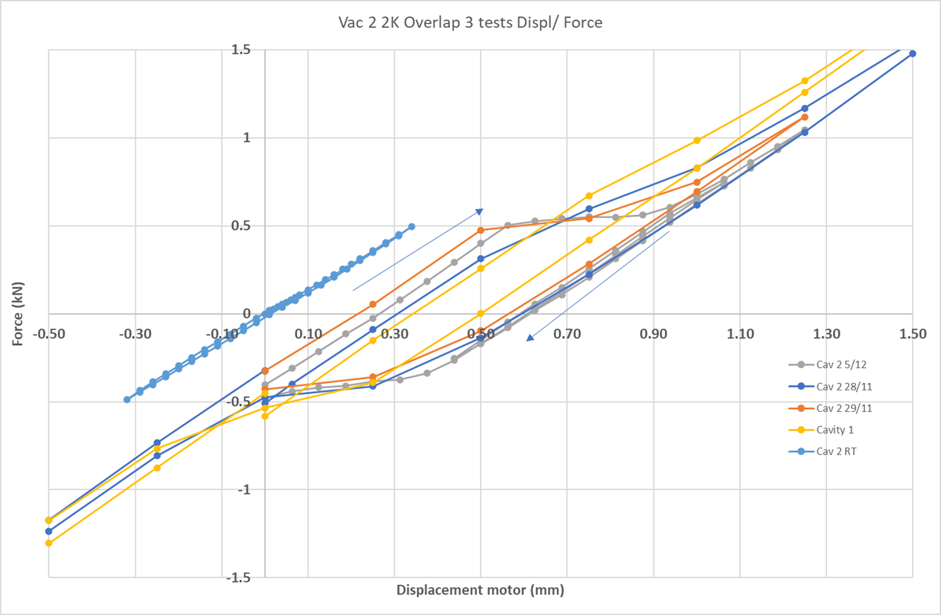
Cav 1 + 2, CD1 several cycles

Slide 9
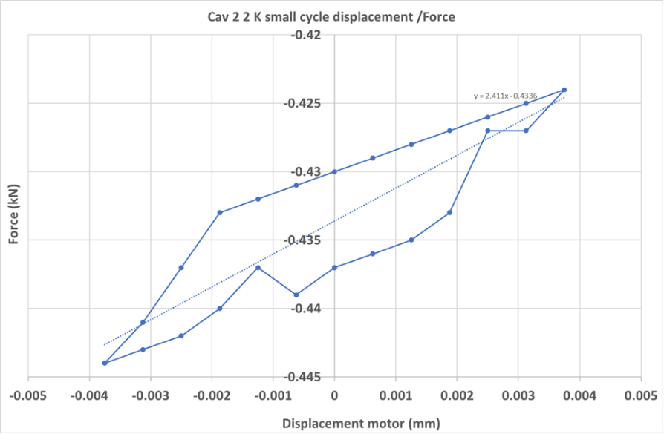
Small precision cycle CD1
Stick slip

Slide 10
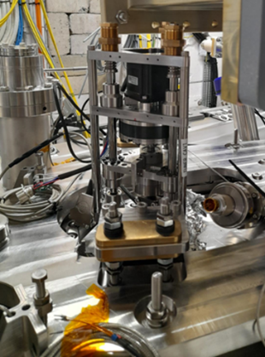
CD1 Other observations tuner
Tuner laterally blocked on sliding pads support
During assembly tuner, bearings very hard to align, some “hard points” in guidance
No ice nor condensation observed during CD1 run on tuner feed through

Slide 11

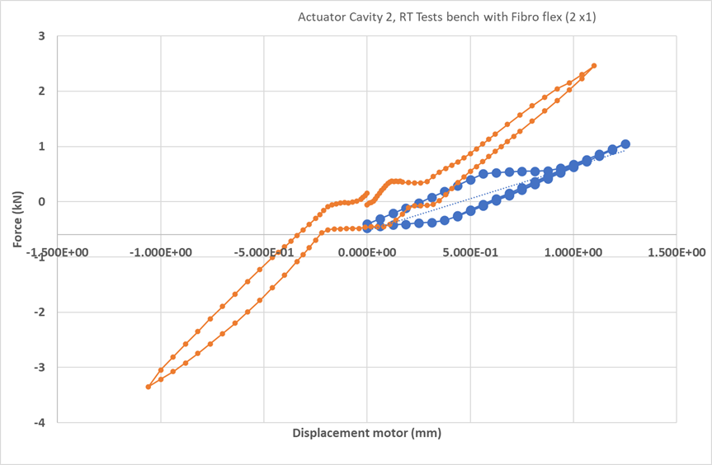
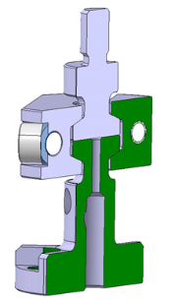
Adjustments actuator before CD2
Reason for the backlash: play in actuator clamp reproduced on actuator test bench, part out of tolerance
Solution:
spacer added
We will improve design
Removed the actuator support + springs. The actuator now “sits” completely on cavity. This to reduce the restraints on bearings + bonus: no more interference with waveguide or cable FPC

Slide 12
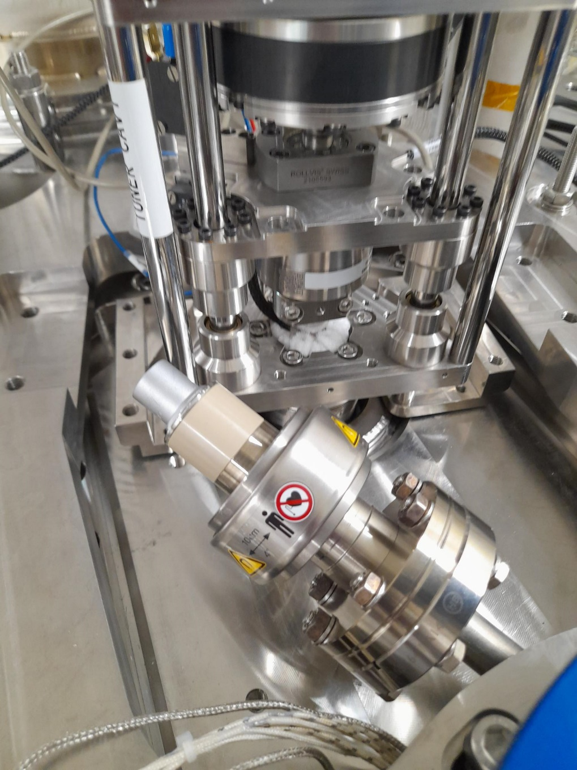
?

Slide 13
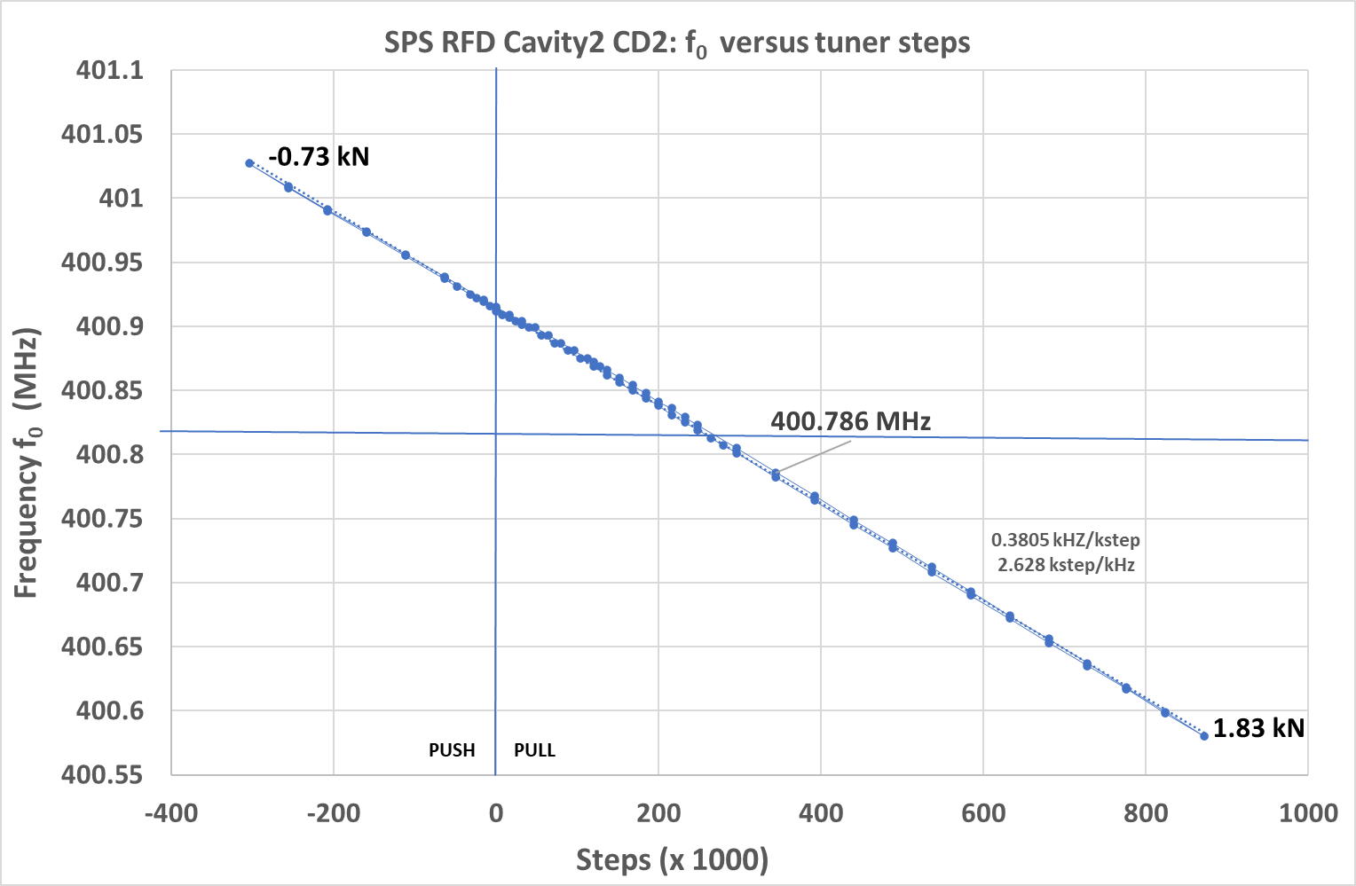
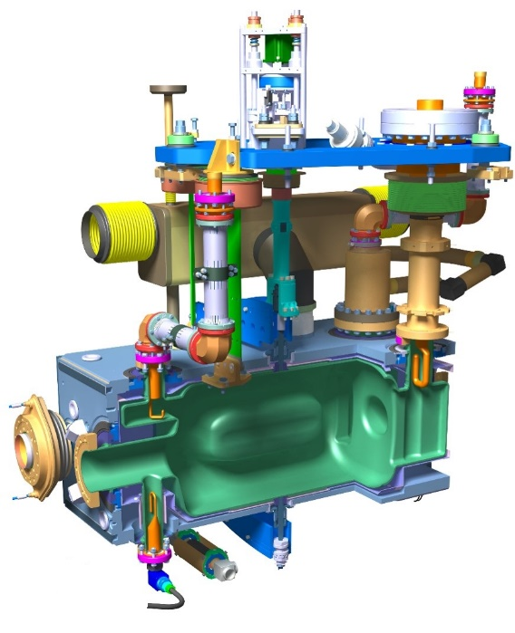
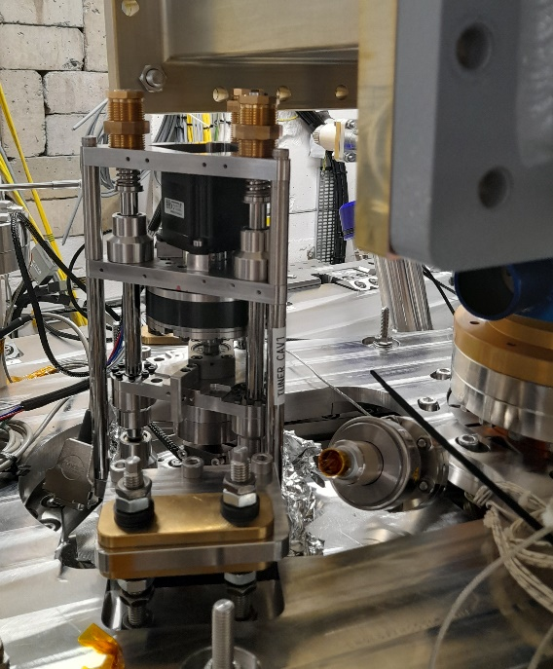
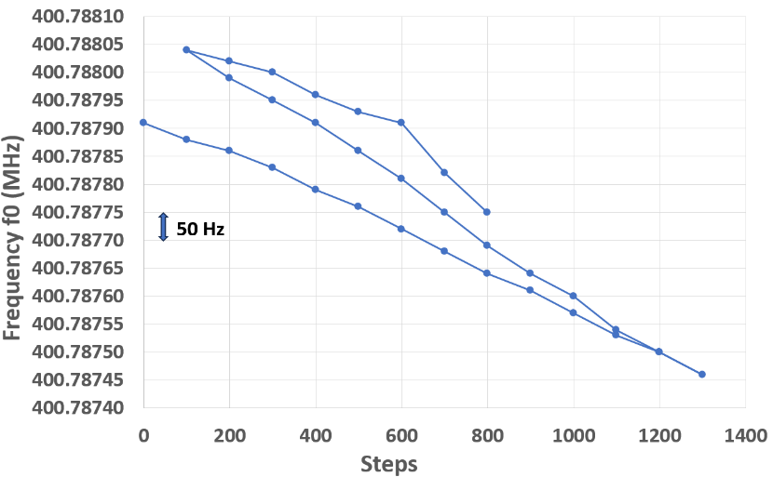
Tuning SPS-RFD SM18 Cavity 2 CD2
Small cycle
(Frequency is drifting during test)

Slide 14
Acceptance testing tuner
Remark: The 80 Hz precision steps (uni directional + bidirectional) are difficult to measure: the frequency measured is drifting slowly + superimposed noise.
Up to LLRF to say if tuner precision is sufficient.

Slide 15
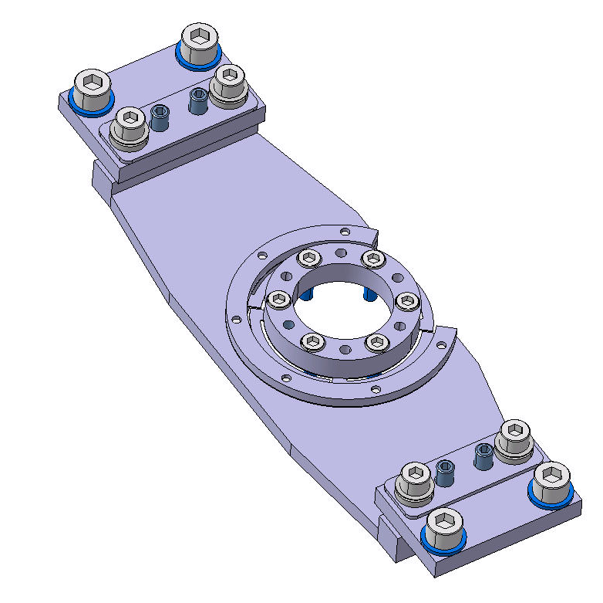
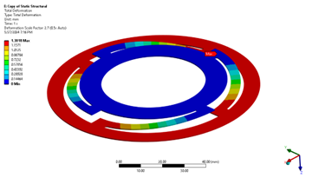
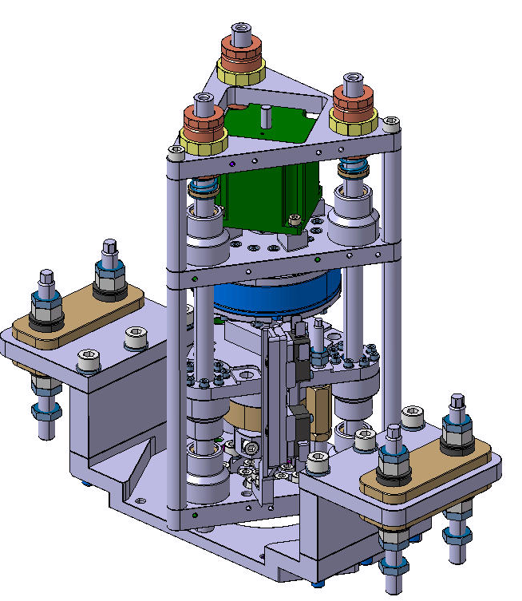
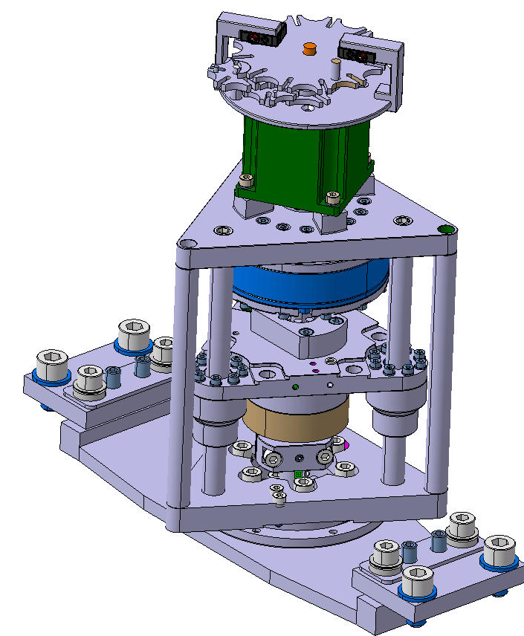
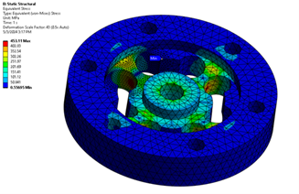

Ongoing upgrade design actuator:
Actuator support with flexural guide
3 times less ball bearings
Limit switches + mechanical stops: improved reliability + better access: on going
Rad-hardness components+ dismountability in situ: ongoing
Improving the load cell + rad –hardness
Need to improve reliability + easier access heater: idea to include in clamp to be verified
Reintroduce a pre-load spring (AUP RFD)
Preparing purchase components

